Slide 1
Design and Implementation of Pilot of a TVET Renewable Energy Course
DELIVERABLE #5 - TRAINING COURSES & PROFESSIONAL DEVELOPMENT
Session 17 (10 June 2022) - Course C 02: Applied Math !

Slide 2
For Today:
Math Courses in 2 year RE EE Program
What does “success” look like at course completion?
Content within context of other ITVET Belize Courses
Description of Course 2 in Term 1 of Year 1
Development of Course 2

Slide 3
1. Communications Courses in 2 Year Program
2 Year (32 Course) RE EE Program Overview
1st Year | Term 1 | Communi- cations 1 (“Comms”) | Applied Math 1 | Intro to Energy Science | PV Applications |  |  |  |  | Electricity and Circuits 1 | Integrated Lab 1
 | Term 2 | Customer Relations and Audits 1 | Energy, Buildings and Equipment | Electricity and Circuits 2 |  |  | PV System Installation |  |  |  | Integrated Lab 2
 | Term 3 | English Comms 2 | Applied Math 2 | Solar Hot Water Systems |  |  | Energy Efficiency Measurement and Verification |  |  |  | Integrated Lab 3
2nd Year | Term 4 | English Comms 3 | Small Wind Design and Operation | Energy Use Modeling & Analysis |  | Advanced Energy System Design |  |  | Battery Based PV Installation |  | Integrated Lab 4
 | Term 5 | Projects and Comms 1 | Technical Drawing | Economic Analysis of Energy Systems |  |  | Solar PV System Design | Solar PV System Design |  |  | Integrated Lab 5
 | Term 6 | Projects and Comm 2 | Electricity Codes and Regulations | Business Operations and Entrepreneurship |  |  | PV System Maintenance & Operation | PV System Maintenance & Operation |  |  | Integrated Lab 6

Slide 4
Course 02: Applied Math 1
12 Week Term 1, Year 1 40 Classroom hours 0 New Lab hours 12 weeks x 5 periods/wk 3 periods Wed am 2 periods Thur pm
Marking Breakdown 35% Individual Tests 35% Individual Projects 25% Group Projects 05% Employability Skills

Slide 5
Course 13: Applied Math 2
10 Week Term 3, Year 1 40 Classroom hours 0 New Lab hours 10 weeks x 6 periods/wk 3 periods Tue & Thurs am Same Marking Breakdown
Marking Breakdown 35% Individual Tests 35% Individual Projects 25% Group Projects 05% Employability Skills

Slide 6
2. What does “success” look like?
Students completing Year 1 (Installer) or 2 Year (Designer) RE EE Program Requirements at their own time and pace
Students and Industry Qualifications NABCEP, CVQ, etc.
Instructors with resources, achieving their desired results
ITVET with resources for scalable, sustainable program
Skills competently applied to a changing Green Economy
Belize Employers – competent, adaptable team members

Slide 7
2. What does “success” look like?
For Employers and the “Applied Math” part of Program:
Belize High School Form 4 Math and much more
Estimating, Calculations, Unit Conversions, and Geometry
Use of calculators and spreadsheets as tools of the trade
Prepare for technical calculations in other RE EE Courses
Verbal, written, & digital math skills – (e.g. estimating and ordering project materials, supplies, business math)

Slide 8
2. What does “success” look like?
Successful use of skill sets with applied math skills:
Technical – calculating energy use, losses, production
Field Activities – construction and installation materials, supplies, tools, equipment for projects
Business – financial quotes, invoices, financial summaries

Slide 9
2. What does “success” look like?
For “applied math” skill sets, what does program completion or work place “success” look like:
For an experienced electrical technician in the field?
For a project manager, or regulator representative?
For an ITVET Belize Instructor?
For someone completing the new RE EE Program?
For potential new students to the RE EE Program?

Slide 10
3. Content within context of ITVET
Vision of “applied math” skill sets, experiences, and potential of people completing the new RE EE Program
Uncertainty of skill sets for those starting New Program
Introductory math courses may be similar in theory for multiple ITVET Belize technical programs but differ with
Applications presented through assignments and projects
Scenarios based on expected potential work place conditions

Slide 11
3. Content within context of ITVET
Belize High School Form 4 Math Skills
The two applied math courses (40 hours for Course 02 in Term 1 and 40 hours for Course 13 in Term 3) review and build on Belize High School Form 4 Math Skills.
Not enough time to teach Form 4 math, but intended to review and soon build on High School Form 4 math.
Investigate skill sets of new RE EE Program students

Slide 12
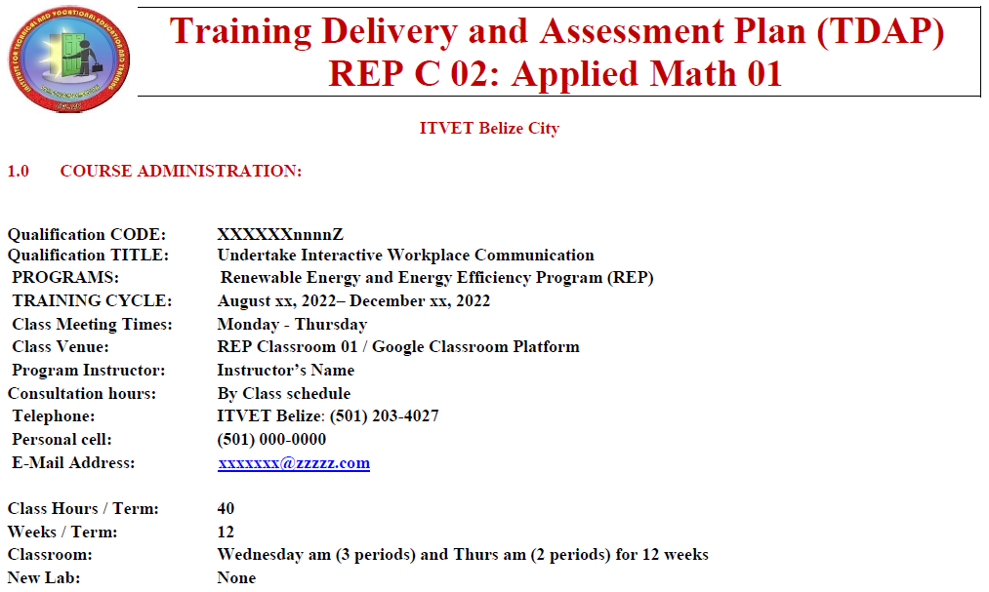
3. Content within context of ITVET
Typical at ITVET
New REP C 01 – 32
Partially complete
Course Instructors
to complete TDAP
Training Delivery and Assessment Plan
Profile of the Trainee / Portfolio of the Trainee
Program Policies & Regulations / Technology Requirements
Instructional Methods / Modes (Face to Face and Online)
Resources (Technical; Underpinning Knowledge and Skills)
Delivery Schedule (week / Instructional Methods (IM)
Practical Grading Criteria and Theoretical Grading Criteria

Slide 13
3. Content within context of ITVET
Typical at ITVET
New REP C 01 – 32
Partially complete
Course Instructors
to complete TDAP
Delivery Schedule (Is it equivalent to a Lesson Plan?)
For each Week or 2 week period, the Course Outline Topic (e.g. Parts of Speech) and Tasks (e.g. Define, Identify, Use)
Instructional Methods (IM) (e.g. Collaborative Discussions)
Promotional Action (PA) (e.g. Practice work sheets, games)
Assessment Method (e.g. Test 1, Assignment 1, Project 1)
Resources (e.g. Textbook, Videos, Worksheet, Powerpoint)

Slide 14
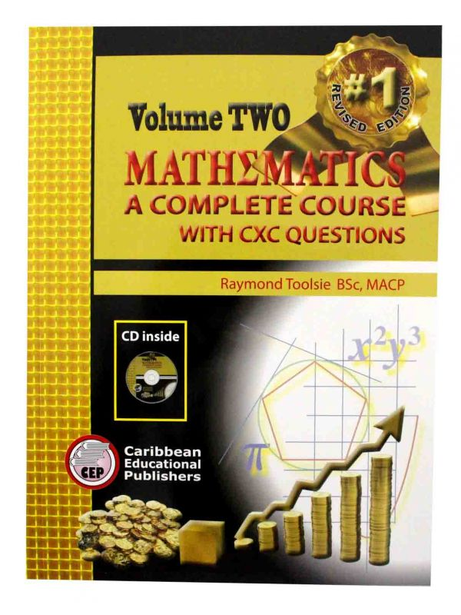
3. Content within context of ITVET
Math at High School Form 4
(before?) ITVET Belize
Vol 1 and 2 from 1990’s
Revised and updated
Source for some review material
Used at a Belize High School
Mathematics A complete Course with CXC Questions
CXC = Caribbean Examinations Council
Exit Assessment
RE EE Program assumes Form 4 Math already completed

Slide 15
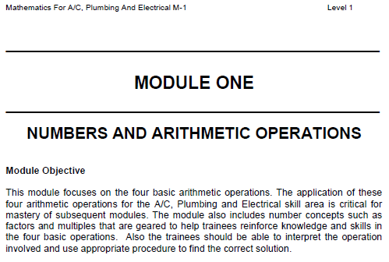
3. Content within context of ITVET
Math Modules M1 to M10
ITVET Belize for
A/C, Plumbing, Elec.
240 pages
10 Modules (1 – 10)
Form 4 Math Content
Modules 11 + ?
Math (M1 – M10) skills when starting at ITVET Belize
For those who did not complete High School Form 4 Math?
Not required if High School Form 4 Math completed?
RE EE Program assumes Form 4 Math already completed

Slide 16
3. Content within context of ITVET
Math Modules M1 to M10 (132 hours in total)
M - 1 (6 hours) Numbers and Arithmetic Operations
M - 2 (15) Calculations and Fractions and Decimals
M - 3 (15) Computing with Scientific Notation: Powers, Symbols / Terms and Signed Numbers
M - 4 (10) Estimations and Measurements
M - 5 (20) Percentages
M - 6 (12) Ratio and Proportion
M - 7 (15) Basic Statistics
M - 8 (12) Exploring Algebra
M - 9 (12) Calculating Perimeters and Areas
M - 10 (15) Geometry

Slide 17
3. Content within context of ITVET
Math Modules M1 to M10
Attitudinal Requirement
Assessment Statement
Prerequisites and Hours
Workplace Safety
Instruction Methods
Media and Methods
Information Sheet (Topics for Each Module and Calculation Examples)
Assignment Sheet (Multiple Tasks for Students)
Checklist Sheet (Assessment Rating by Instructor)
References

Slide 18
3. Content within context of ITVET
New RE EE Program and Applied Math Skills
Belize High School Form 4 Math Skills before starting
Course 02 Applied Math (40 hours) reviews and builds on some existing Form 4 Math skills and topics
With 132 hours as Modules M – 1 to M – 10, Course 02 (40 hours) builds on Modules M - 1 to M - 10
Course 02 Math reviews, not teaches M 1– 10 content

Slide 19
3. Content within context of ITVET
ITVET Belize Math Skills Diagnostic Assessment?
Form 4 High School Math Skills
Complete ITVET Belize Modules M-1 to M – 10 (132 hours) before starting the New RE EE Program
Transfer with ITVET Belize Math from other programs

Slide 20
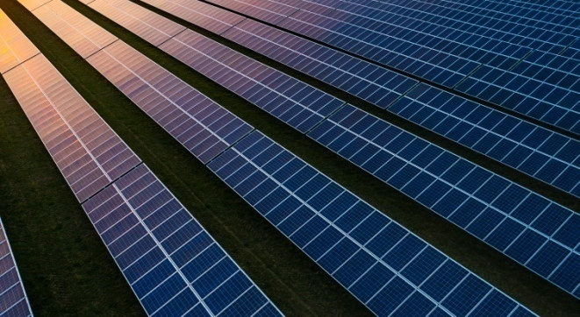
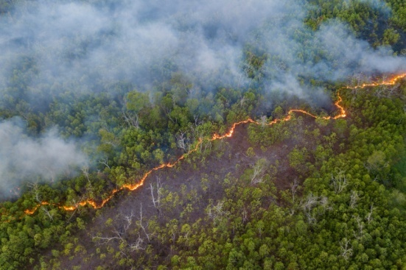
4. Description of Course 02
Applied Math 1 (Term 1, Year 1)
40 Classroom Hours as 12 weeks x 5 periods / week
3 periods Wed. am and 2 Periods Thurs. pm
Marking Breakdown
35% Individual Tests 35% Individual Projects
25% Group Projects 05% Employability Skills

Slide 21
4. Description of Course 02
Learning Outcomes and Tasks
(from Course 02 Description Outline and Work Plan)
Review basic operations of addition, subtraction, multiplication and division
Negative Numbers
Orders of Operations (BEMDAS)
Exponential and engineering notation

Slide 22
4. Description of Course 02
Learning Outcomes and Tasks
(from Course 02 Description Outline and Work Plan)
Percentages
Unit Conversions
Geometry of Areas
Geometry of Volumes
Algebraic use of formulas to solve for unknown measurements

Slide 23
4. Description of Course 02
From Learning Outcomes and Tasks
Task 01
Review basic operations of addition, subtraction, multiplication and division
Review Trade Related Examples provided
What “success” looks like to different people
Applicable elements from ITVET Belize courses

Slide 24
4. Description of Course 02
From Learning Outcomes and Tasks
Task 01
Review basic operations of addition, subtraction, multiplication and division

Slide 25
4. Description of Course 02
From Learning Outcomes and Tasks
Task 02
Negative Numbers
Review Trade Related Examples provided
What “success” looks like to different people
Applicable elements from ITVET Belize courses

Slide 26
4. Description of Course 02

Slide 27
4. Description of Course 02
From Learning Outcomes and Tasks
Task 03
Orders of Operations (BEDMAS)
Review Trade Related Examples provided
What “success” looks like to different people
Applicable elements from ITVET Belize courses

Slide 28
4. Description of Course 02

Slide 29
4. Description of Course 02
From Learning Outcomes and Tasks
Task 04
Exponential and engineering notation
Review Trade Related Examples provided
What “success” looks like to different people
Applicable elements from ITVET Belize courses

Slide 30
4. Description of Course 02

Slide 31
4. Description of Course 02
From Learning Outcomes and Tasks
Task 05
Percentages
Review Trade Related Examples provided
What “success” looks like to different people
Applicable elements from ITVET Belize courses

Slide 32
4. Description of Course 02

Slide 33
4. Description of Course 02
From Learning Outcomes and Tasks
Task 06
Unit Conversions
Review Trade Related Examples provided
Technical, Material, Financial
What “success” looks like to different people
Applicable elements from ITVET Belize courses

Slide 34
4. Description of Course 02

Slide 35
4. Description of Course 02
From Learning Outcomes and Tasks
Task 07
Geometry of Areas
Review Trade Related Examples provided
(e.g. Solar panel area on sloped roof)
What “success” looks like to different people
Applicable elements from ITVET Belize courses

Slide 36
4. Description of Course 02

Slide 37
4. Description of Course 02
From Learning Outcomes and Tasks
Task 08
Geometry of Volumes
Review Trade Related Examples provided
(e.g. Water heated in Solar Hot Water system)
What “success” looks like to different people
Applicable elements from ITVET Belize courses

Slide 38
4. Description of Course 02

Slide 39
4. Description of Course 02
From Learning Outcomes and Tasks
Task 09
Algebraic use of formulas to solve unknown measurements
Review Trade Related Examples provided
(e.g. Variables in calculations of energy production)
What “success” looks like to different people
Applicable elements from ITVET Belize courses

Slide 40
4. Description of Course 02

Slide 41
4. Description of Course 02
Marking Breakdown
35% Individual Tests
35% Individual Projects
25% Group Projects
05% Employability Skills

Slide 42
4. Description of Course 02
Marking Breakdown
35% Individual Tests (Examples)
4 x 5% - Individual Tests
Tasks 1, 2, and 3 (Operations)
Tasks 4, 5, and 6 (Notation, Percentages, Conversions)
Task 7 and 8 (Geometry)
Task 9 (Algebra)
15% “Exam” – Individual Test

Slide 43
4. Description of Course 02
Marking Breakdown
35% Individual Projects (Examples)
4 x 5% - Small Individual Projects or Assignments
Tasks 1, 2, and 3 (Completing Project Materials List)
Tasks 4, 5, and 6 (Focus on Unit Conversions)
Task 7 and 8 (Focus on Geometry)
Task 9 (Focus on Algebra style problem solving)
15% Major Project – Technical estimate of Power

Slide 44
4. Description of Course 02
Marking Breakdown
20% Group Projects (Examples)
2 x 10% - Group Projects or Assignments
Material – Material Estimate for a Solar Panel Project
Financial - Cost Estimate for a Solar Panel Project

Slide 45
4. Description of Course 02
Marking Breakdown
5% Employability Skills (Examples)
Those used in ITVET Belize communications courses
Attendance
Timeliness
Attention to detail

Slide 46
5. Development of Course 02
Development of Course
From Theory to Practical Application
Build on 2022 ITVET Belize communications courses
Provide “Trade” content to fill the theoretical gaps
Provide Course 02 Instructor with “Trade” related examples for assignments, projects, and tests
June 2022 “small group” session on Course 02
Share “Trade” related examples

Slide 47
5. Development of Course 02
Providing Instructor with “Trade”
related Course Material Examples
Technical, Material, and Financial
Energy Losses (Equipment, Wiring, Transitions)
Equipment sizing sheet
Technical Specification and Drawings
Project financial estimates, quotes, invoices

Slide 48
Summary
Course 02: Applied Math 1
40 Classroom hours
12 Week Term 1, Year 1
Review / Build on Form 4 Math
Add “Trade” related examples
Applied Math Courses in 2 year RE EE Program
What does “success” look like at course completion?
Content within context of other ITVET Belize Courses
Description of Course 02 in Term 1 of Year 1
Development of Course 02
Share “Trade” related examples
00,000,000,000,000 kg
100,000 kg per person
38 m x 38 m x 38 m
Also a very small part of the
atmosphere
Belize is a “net carbon sink” due to FOLU
Sink = drain, removal; FOLU = Forestry and Other Land Use
Energy is your dominant emission
Forests absorb and sequester much larger amounts of carbon
They always did, so the emissions remain a problem
Look after forests!
http://www.grisanik.com/blog/how-much-carbon-is-in-the-atmosphere/#:~:text=Furthermore%2C%20multiplying%20Earth's%20atmosphere%205.137,atmosphere%20is%20~3%2C208%20Gt%20CO2.

Slide 49
Prelude to Course 13: Math 2
Course 13: Applied Math 2
40 Classroom hours
10 Week Term 3, Year 1
Build on Course 02: Math 1
Add “Trade” related examples
Basic Algebra and Geometry
Functional Notation, Linear and Quadratic Equations
Trigonometric Functions and Exponents
Problem Solving renewable energy / energy efficiency
Spreadsheets (Computer Lab – Excel)
Journal of Mathematical Tools and Spreadsheets

Slide 50
Questions?
Comments?
Suggestions?
Thank you

