Slide 1
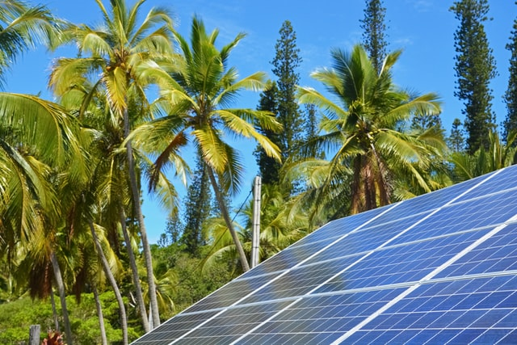
Design and Implementation of Pilot of a TVET Renewable Energy Course
DELIVERABLE #5 - TRAINING COURSES & PROFESSIONAL DEVELOPMENT
Session 07 (March 18) for Course 03 Introduction to Energy Science

Slide 2
Energy + Efficiency
Introduce concepts,
What is energy?
What do we mean by efficiency?
What types of energy are there?
Key energy concepts
dREP goals
Energy use in Belize.

Slide 3
Energy + Efficiency
New ITVET Course
16 first year classes over three terms
16 second year classes over three terms
Spring 2022 Friday Sessions for instructor preparation
4 of 19 sessions are on energy efficiency topics
4 of 16 Year 1 Courses are on energy efficiency topics

Slide 4
Energy + Efficiency
Provide context for all instructors
Electrical
Science
Mathematics
English (communications)
Business
Learn the lingo:
Jargon, acronyms, measurement units
For later: getting technical!
Conversion of measurement units
Worked examples
Resources

Slide 5
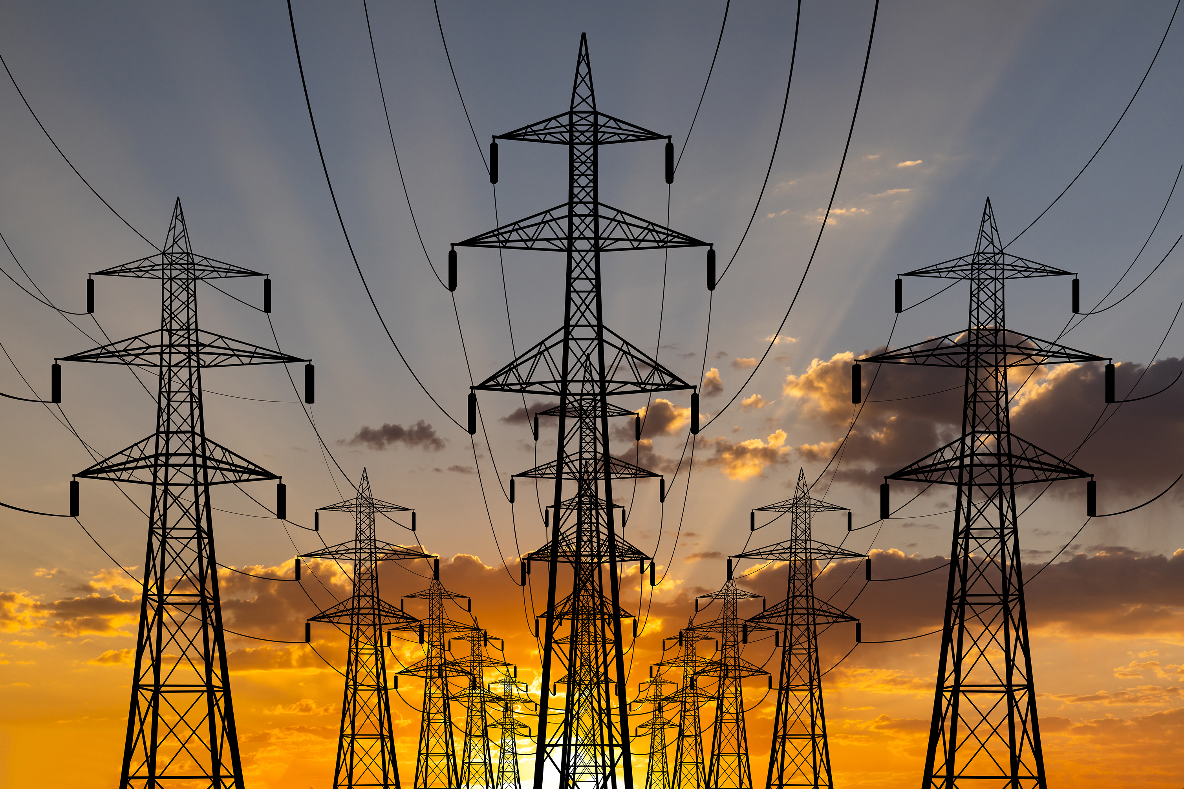
Energy Efficiency is a Science
Science: the intellectual and practical activity encompassing the systematic study of the structure and behavior of the physical and natural world through observation, measurement, and experiment.
Mathematics, Algebra, Geometry
Physics of electricity, motion, heat and energy
Communication
for collaboration, clarity, precision and understanding
Notes:
We are all scientists

Slide 6
What is Energy?
What comes to mind when you think about energy?
Speak up or type in chat!
Notes:
Things like active, strength, endurance, capacity
Or work, power, heat, fuel, electricity, oil?

Slide 7
What is Energy
What comes to mind when you think about energy?
Things like:
active, strength, endurance, capacity
Or:
work, power, heat, fuel, electricity, oil?
The word energy has a general use:
capacity or tendency to act with force or vigor
expressed with force or vigor
abilities directed to some use
Notes:
Things like active, strength, endurance, capacity
Or work, power, heat, fuel, electricity, oil?

Slide 8
What is Energy?
Energy science uses a narrow technical definition from physics:
a quantity of work that a physical system can do.
capacity to do work in a useful form
physical resources that can be used to do work
Have you ever been “out of steam”?
The two uses lean on each other

Slide 9
What is Energy?
an amount or quantity that can be accumulated, held and released.
Like WATER in a BUCKET or MONEY in the BANK.
Examples:
Fuel in a tank
A charged battery
A raised weight
A pile of firewood
Notes:
Energy is a quantity, an amount, that can be accumulated, held and released, like water in a bucket or money in the bank.

Slide 10
What is Energy?
an amount or quantity that can be accumulated, held and released.
Metric measurement unit for energy = Joule
Kilojoule, kJ, Megajoule, MJ
Imperial: British Thermal Units – BTU, calorie
Electricity: kilowatt hour, kW-hour, kWh
Approximate conversion: 1 kWh = 3.6 MJ = 3412 BTU
Conversion tables and programs widely available
 | MJ per US Gallon | Electricity (kW-hours) | Sugar (kg) | Wood (kg) | Cheese Burgers
LPG (Butane) | 105 | 29.2 | 6.19 | 1.32 | 46
Gasoline | 131 | 36.4 | 7.70 | 1.65 | 36
Notes:
Energy is a quantity, an amount, that can be accumulated, held and released, like water in a bucket or money in the bank.

Slide 11
What is Power?
Energy science uses a narrower technical definition from physics for power:
A flow of energy that can be used to do work
Sustained capacity to do work in a useful form over time
a rate of energy flow that a physical system can produce.
Power = Energy amount ÷ time period
Energy = Power x time ; kWhr = kW x hours

Slide 12
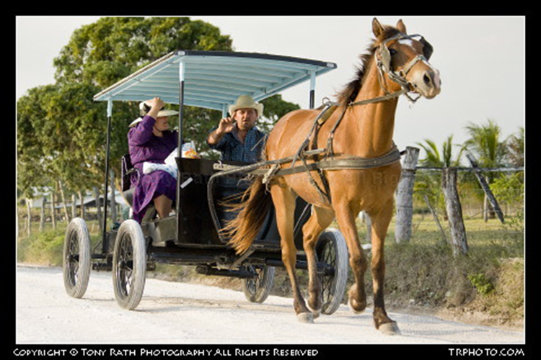
What is Power?
A flow of energy sustained for a time period.
Like WATER from a HYDRANT or SALARY from a JOB.
An engine driving a car;
A battery powering a lamp
An elevator lifting
people
A boiler providing
heat
A horse pulling a loaded
cart….horsepower
Notes:
Energy is a quantity, an amount, that can be accumulated, held and released, like water in a bucket or money in the bank.

Slide 13
What is Power?
Metric measurement unit is the Watt (W)
kilowatt, kW, Megawatt, MW
1 Watt = 1 Joule x 1 second
1 Watt = 1 Volt x 1 Ampere
Other units, horsepower (HP), BTU per hour (BTU/hr)
1 HP = 745 Watts = 0.745 kW
1 HP = 2544 BTU/hr
Notes:
Energy is a quantity, an amount, that can be accumulated, held and released, like water in a bucket or money in the bank.

Slide 14
Types of Energy
ELECTRIC
magnetic
CHEMICAL
nuclear
THERMAL
radiant
gravitational
POTENTIAL ?
KINETIC ?
MECHANICAL ?
Notes:
Many types of energy that all arise from the forces between molecules, atoms and sub-atomic particles. In Energy Science we are concerned with the basic types in use in our daily lives. We will look at these types in detail later.

Slide 15
Sources of Energy
Questions: Speak up or type in chat!
How do you get your energy?
How much do you pay for it, what units?

Slide 16
Efficiency
Often an economic concept:
"There ain't no such thing as a free lunch."
A popular phrase to explain the consequences of free lunches offered with a beverage purchase in 19th century American saloons
Free food was frequently extra salty…..
Notes:
The free lunch was often salty to encourage further beverage purchases!

Slide 17
Efficiency
Pop culture:
“You can’t always get what you want, but if you try, sometimes, you find, you get what you need.”
Mick Jagger and Keith Richards

Slide 18
Efficiency
Get the most bang for your buck.
More for less
Common concepts in economics and productivity management
Can you think of other ways of expressing this idea?

Slide 19
Efficiency
What other ways of expressing this idea can you think of?
Kill two birds with one stone?
Greater return for the same effort (improved yield)

Slide 20
Efficiency
Energy science puts these ideas together
a mathematic expression
describes energy transformation processes
Efficiency = What you get ÷ What you start with
Efficiency = $\frac{What you get}{What you start with}$
What you get is less than What you start with
What you get < What you start with
Efficiency is a fraction normally less than 1
Often expressed as a percentage

Slide 21
Efficiency
Mary is filling a 200 liter tub with water.
She makes 24 trips using a full 10-liter pail to fill the tub
Efficiency = $\frac{What you get}{What you start with}$ = $\frac{200}{24 x 10}$ = $\frac{200}{240}$ = 0.83 = 83 %

Slide 22
Efficiency
Example: A solar panel receives 1000 Watts of incoming sunlight and produces 180 Watts of electricity.
Efficiency = $\frac{What you get}{What you start with}$ = $\frac{180}{1000}$ = 0.18 = 18 %
World record for solar cell efficiency is 47.1%
multi-junction concentrator solar cells
2019, US National Renewable Energy Laboratory
Only used in spacecraft – research not a product

Slide 23
Efficiency
Inefficiency is often a result of physical limits or processes
Friction
Gas laws, Thermodynamic laws
Efficiencies of individual components combine when assembled into a larger systems:
Combustion engines
Power plants and boilers
Refrigeration and heating equipment
Electrical systems
…… a death of a thousand cuts!

Slide 24
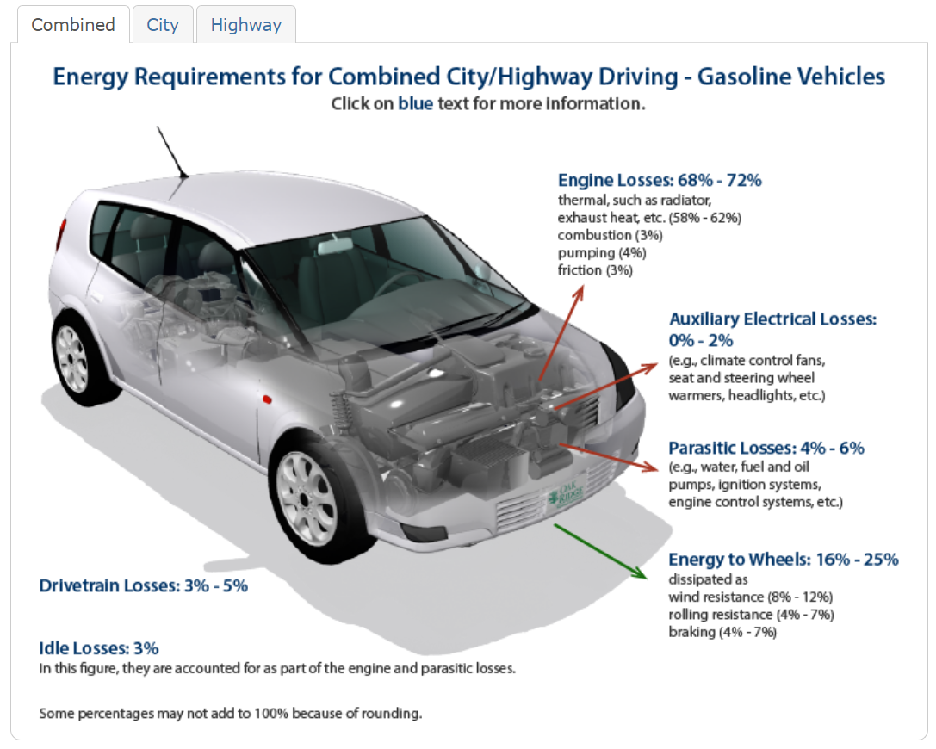
Efficiency
https://www.fueleconomy.gov/feg/atv.shtml

Slide 25
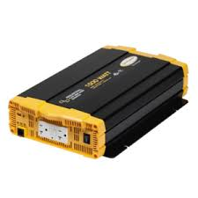
Efficiency
John is operating his 300 Watt cooling fan using an inverter he salvaged from an old boat. He measures 40 amps of current flowing to the inverter from his 12 volt battery. Knowing that voltage multiplied by current in amps give power in Watts, how efficient is the inverter?
Efficiency = $\frac{What you get}{What you start with}$ = $\frac{300}{12 x 40}$ = $\frac{300}{480}$ = 0.625 = 62.5 %
Is this good or bad?
Where does the “lost”
energy go?

Slide 26
Why a Renewable Energy Program?
Implement climate change mitigation measures and improve the economic and social status of its population.
Reduce Belize’s dependence on fossil fuels.
Increasing access to and availability of renewable energy;
Reduce energy consumption by implementing energy efficiency measures

Slide 27
What is a Renewable Energy Program?
Stakeholders recommended four general subject areas:
General Knowledge
Present energy sources and sustainability and the future of renewable energy in Belize
Renewable Energy Technologies
PV & electricity basics; and the applications and efficiency of wind energy, water energy, solar energy
Notes:
Discuss Belize energy sources, electrification,. Roles as communicators between team members. Practical awareness and a systems perspective.

Slide 28
What is the Renewable Energy Program?
Stakeholders recommendations continued:
Energy use and efficiency
Introduction on renewable energy and energy efficiency
The advantages of renewable energy and energy efficiency
Practical Skills
Tools and their use;
How to diagnose and rectify faults in renewable energy control systems
Notes:
Discuss Belize energy sources, electrification,. Roles as communicators between team members. Practical awareness and a systems perspective.

Slide 29
Stretch Break
Stand and stretch!
Take a 5-minute break
Exercise:
What sources of energy do you see or use on your break?

Slide 30
ENERGY SOURCES

Slide 31
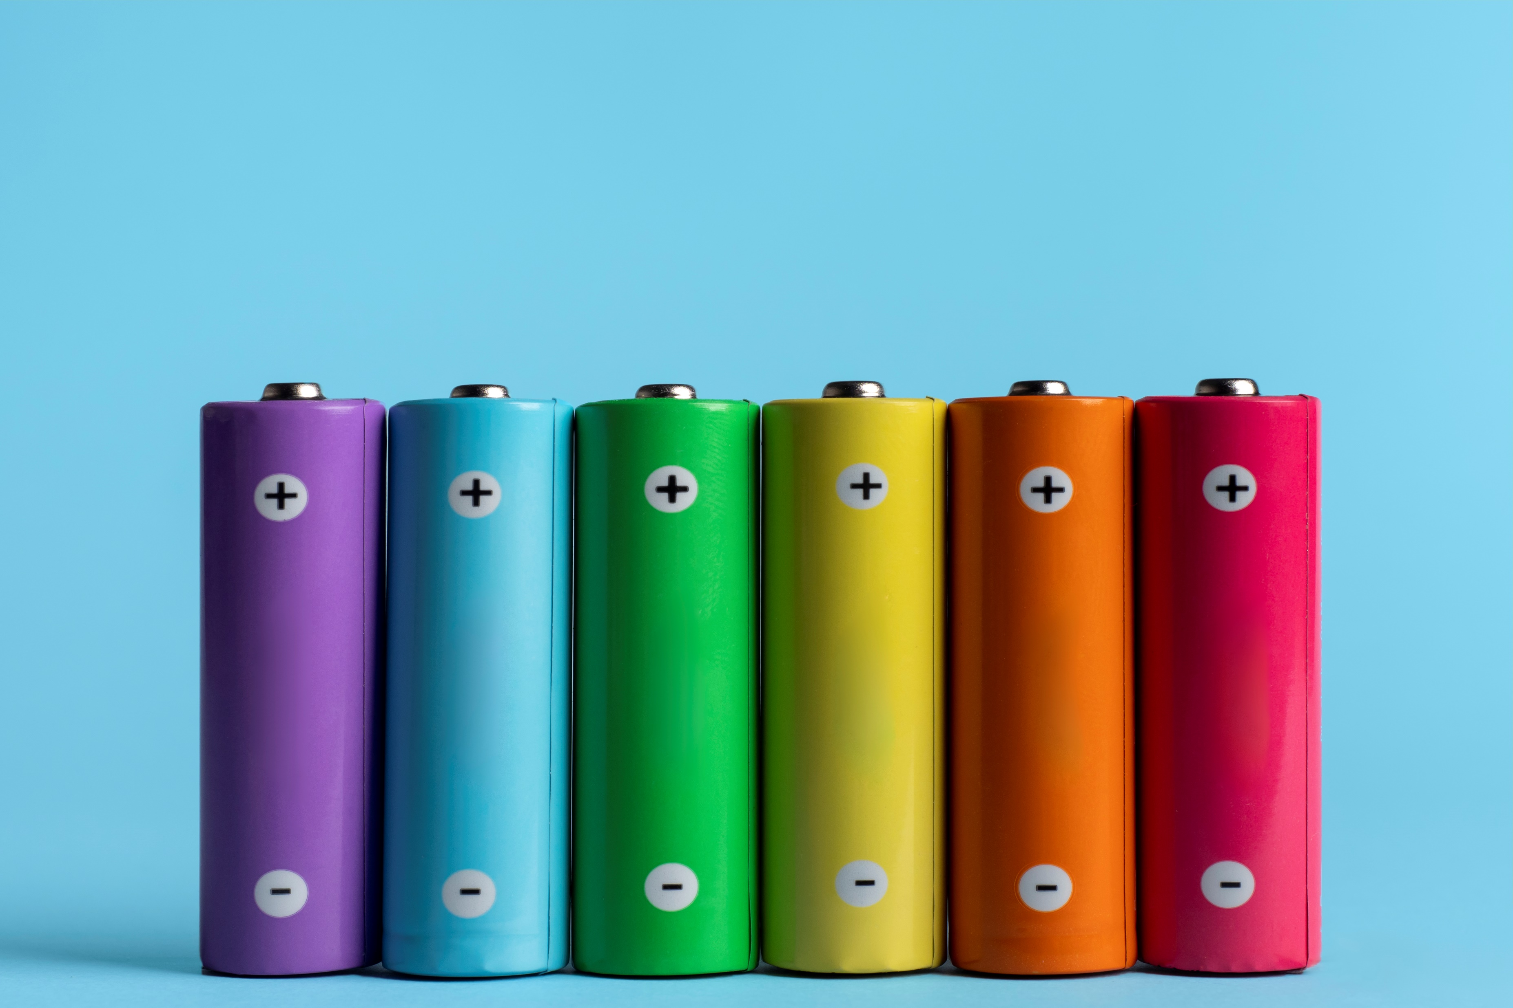
Types of Energy?

Slide 32
Electric Energy
A source of electric energy
Electrons separated from atoms
accumulated as energy
static electricity on a balloon
allowed to flow as power
Electric CURRENT flowing from a source
generator driven by another source of power
Electricity utilities
Solar panels
Windmill
Battery

Slide 33
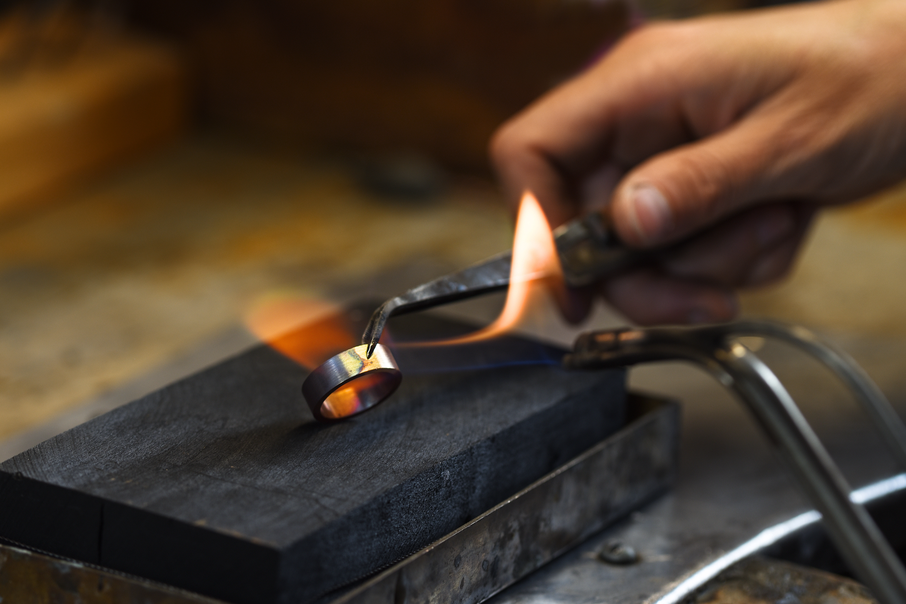
Types of Energy?

Slide 34
Chemical Energy
Chemical energy
Molecules reacting with other molecules
Fire; combustion, oxidization
Fuels combine with oxygen in the air, burn and produce heat
Coal, oil, kerosene, LPG, Butane, gasoline, diesel
Wood, bagasse
Energy stored in chemical bonds
Batteries, fuel cells

Slide 35
Types of Energy?

Slide 36
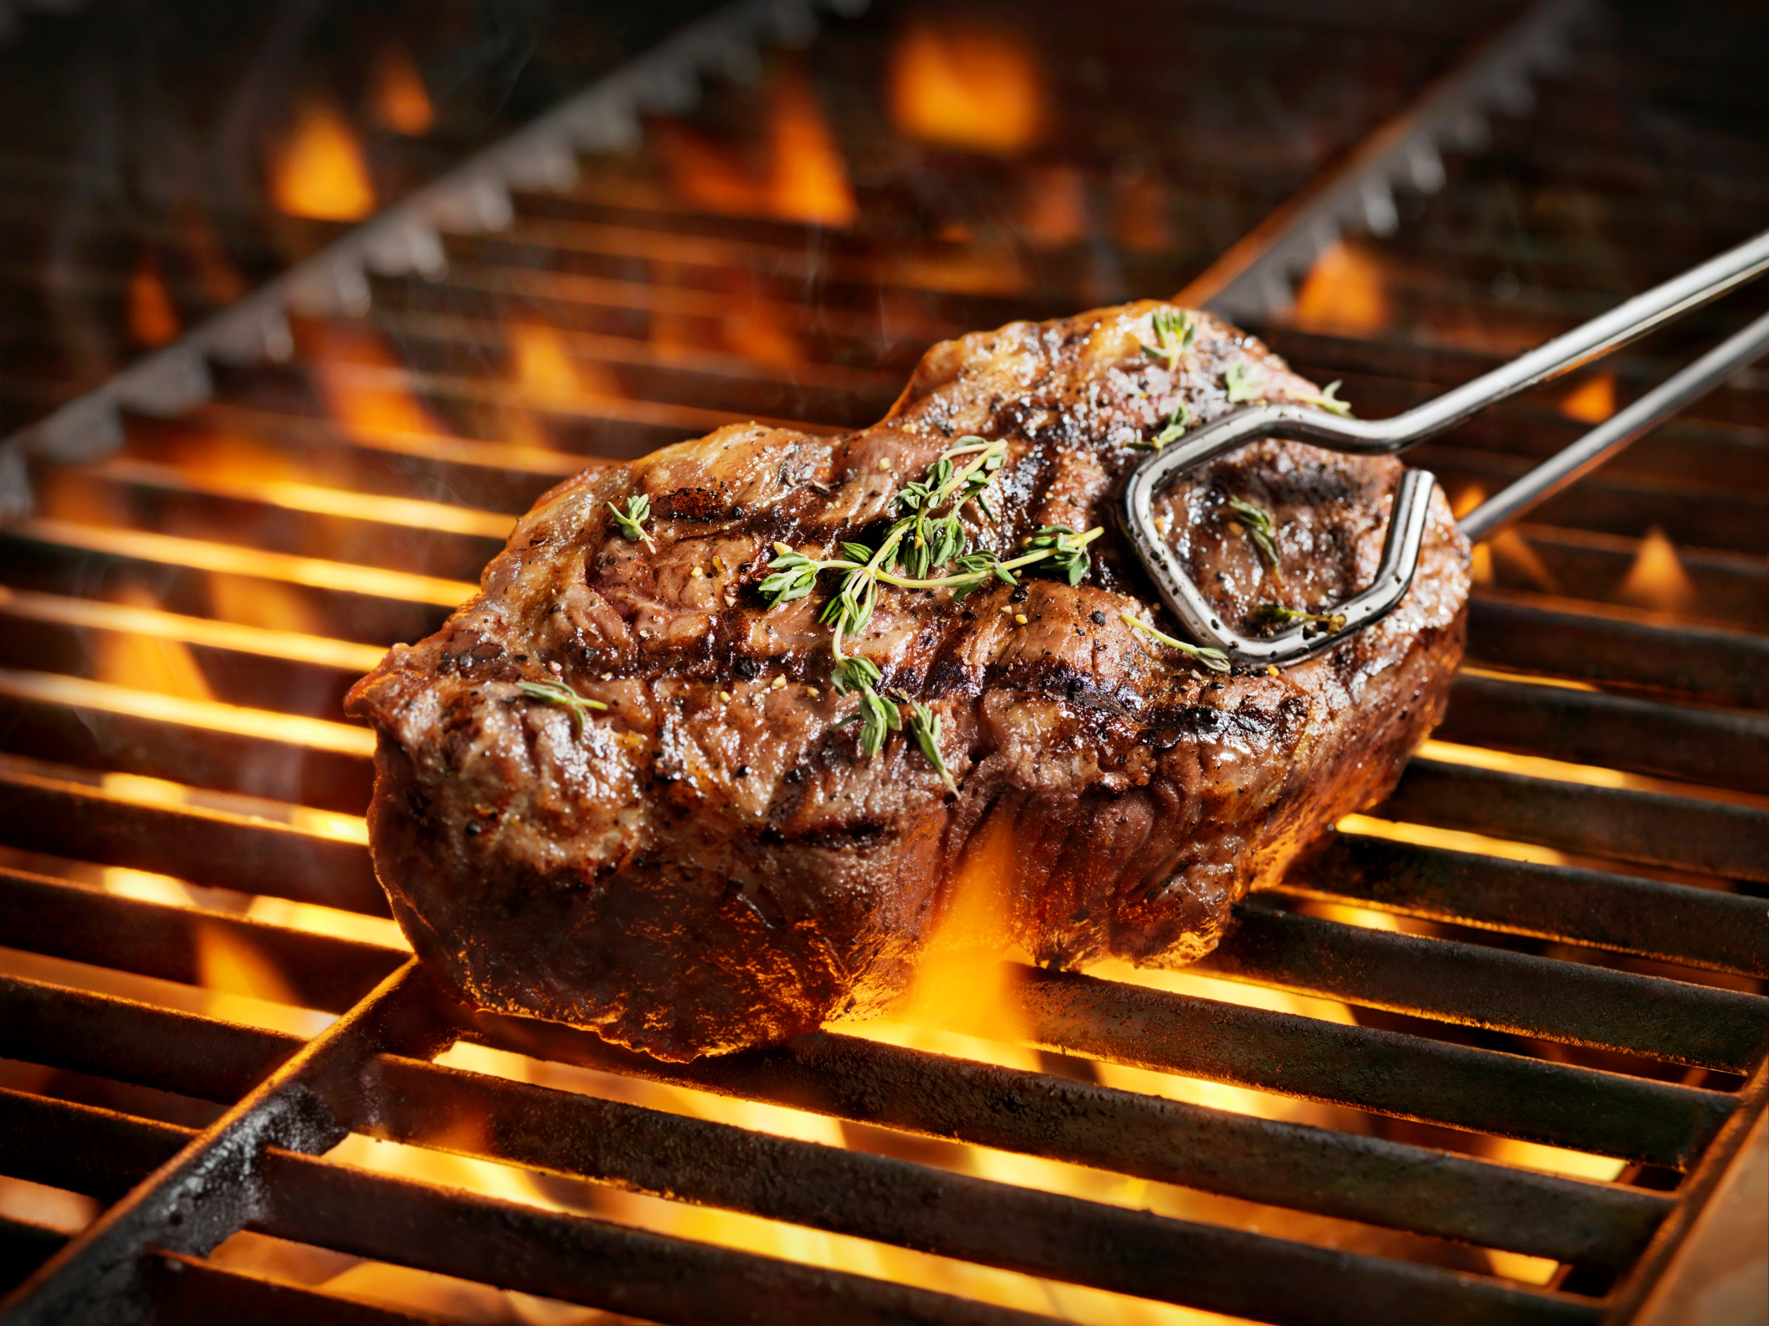
Thermal Energy
Thermal energy, heat:
matter separated by temperature
Heat flow from HOT to COLD
boiling water
hot water in a tank
heat from a stovetop
ice in a freezer
heat from an engine radiator
Lowest grade of energy
Hard to contain or transform
Central to our sense of
comfort

Slide 37
Types of Energy?

Slide 38
Potential Energy
Potential energy (PE)
a mass moved against a force
a weight raised; steps climbed
water stored in a reservoir
pressure in a steam boiler
PE = weight x height
PE = mass x gravity acceleration x height
Water pumped to an elevated tank is stored potential energy
Hydropower is flowing potential energy
Hydropower
= density x volume flow rate x gravity x height
= pressure x volume flow rate

Slide 39
Types of Energy?

Slide 40
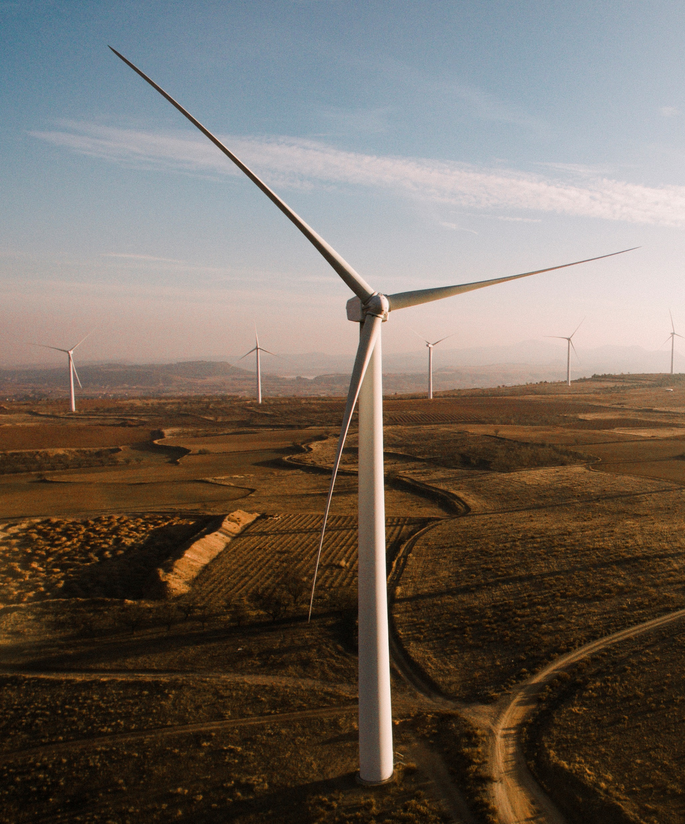
Kinetic Energy
Kinetic energy
a mass in motion
a thrown baseball
a car moving along a road
KE = ½ x mass x velocity²
Wind energy harnesses
kinetic energy

Slide 41
Mechanical Energy
Mechanical energy
combined potential energy and kinetic energy
a swinging pendulum
a car moving uphill
11,000 kg School Bus at 80 km/hr = 2.7 MJ
11,000 kg raised to Doyle’s Delight = 122 MJ
No velocity, all height
H
All velocity, no height

Slide 42
Key Concepts
Several concepts affect energy systems:
Time, duration
Temperature
Distance, area, volume
Motion, speed, velocity, acceleration
Mass (solid, liquid, gas)
Force, (Newton’s first, second and third laws)
Is weight a force or a mass?
Is 2.2 pounds the same as 1 kilogram?
What is a Newton?
it is the unit for force in SI
Pound unit conceived before the concepts of mass and acceleration were related

Slide 43
Key Concepts
Different measurement systems
Imperial, US, Metric (SI)
mixtures
Multiple units of measurement
Standard measurement units have been established to permit common understanding of recorded phenomena
Important to master the math
required to convert into different units.
All the math is simpler if you work in metric units.
We will return to these concepts in later sessions

Slide 44
Energy Concepts
Advanced scientific concepts used to understand and analyze energy interactions:
System boundary
Conservation of mass
Conservation of energy
First Law of Thermodynamics, efficiency
Conservation:
means that the quantity remains the same: it is conserved
mass or energy
Entropy:
Second Law of Thermodynamics
Harder to break than time travel or faster than light travel!
“No free lunch” means no perpetual motion machines!
More in later sessions

Slide 45
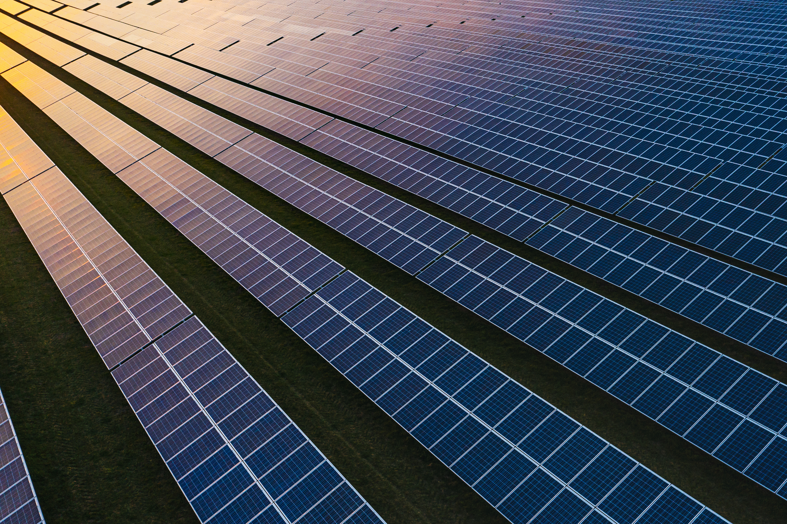
Questions?
Questions?
Other energy sources?

Slide 46
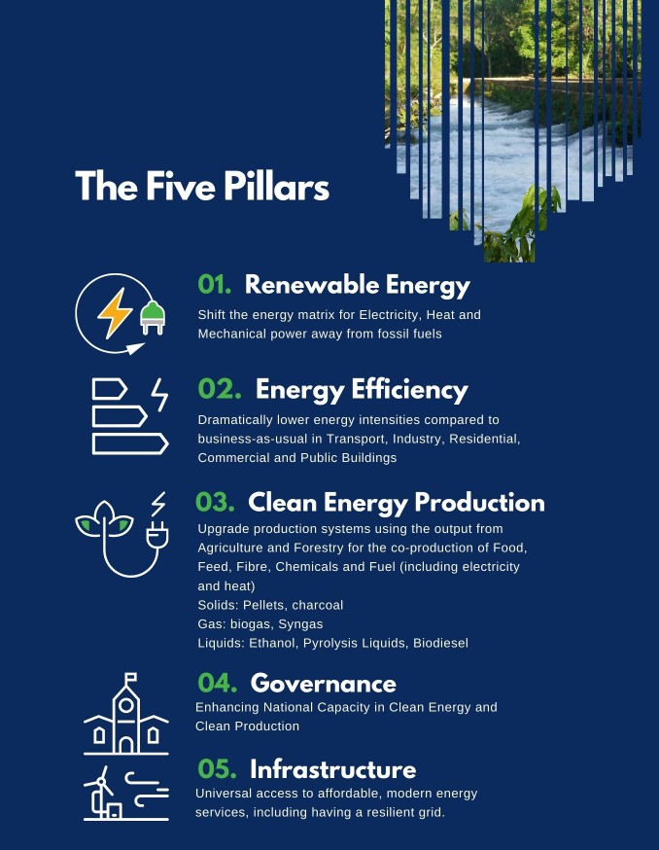
Energy + Efficiency
2020 Annual Energy Report, December 21, 2021, Belize Energy Unit
https://energy.gov.bz/2020-annual-energy-report/.”

Slide 47
Energy + Efficiency
2020 Annual Energy Report:
“The capacity to do work (Energy) is one of the most influential factors as an input for economic development.
Given a tangible perspective, it can be said that energy use is the main driver of economic productivity and industrial growth; thus, is considered central to the operation of any modern economy (Asghar, 2008). From a physical viewpoint, energy should be seen beyond dollars and cents with respect placed on socio-economic, political, and environmental factors as well.”

Slide 48
Primary Energy Supply
Notes:
The energy supply represented by Belize’s consumption of fuelwood or firewood, for 2020 as well as earlier annual energy reports, is not quantified by direct measurement or monitoring,

Slide 49
Energy Supply - Notes
High Carbon Fossil Fuel
Low carbon renewable
Carbon emitting renewable
Crude oil
some export, some industrial use, declining
Natural gas
small amount used in oilfield
Hydro
Several sources, requires regular rainfall
Solar PV
small grid array, off grid not counted
Wind
no grid wind, off grid wind not counted
Firewood
estimated, used in industry, residential use
Bagasse: used in industry for heat and electricity generation

Slide 50
Energy Supply Notes
Imported Electricity
grid electricity from CFE in Mexico, fossil dominated
LPG
Liquid Petroleum Gas, Butane
Gasoline
Transport fuel
Kerosene
various use, some lighting
Diesel
transport, generation, heat
Fuel Oil
generation, heat

Slide 51
Energy Use
Primary Energy
ultimate source of an energy input
Secondary Energy
energy converted or transformed for practical use
Transforming processes are often inefficient
You get less than what you started with

Slide 52
Energy Use
Transforming processes are often inefficient
Combustion
Best case ~ 45% (advanced gas turbines)
Worst case ~ 20% or less (wet biomass)
Internal combustion engines ~ 25%
Stationary electricity generation ~ 33%
Electric motors and systems ~ 99 - 75%
Combined Heat and Power
makes use of the waste heat; bagasse
Transportation (mobile fuel use) is the major use for diesel and gasoline

Slide 53
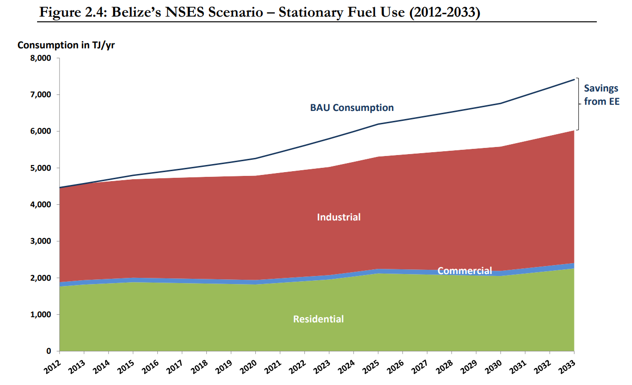
Fuel Use
BAU = Business as usual

Slide 54
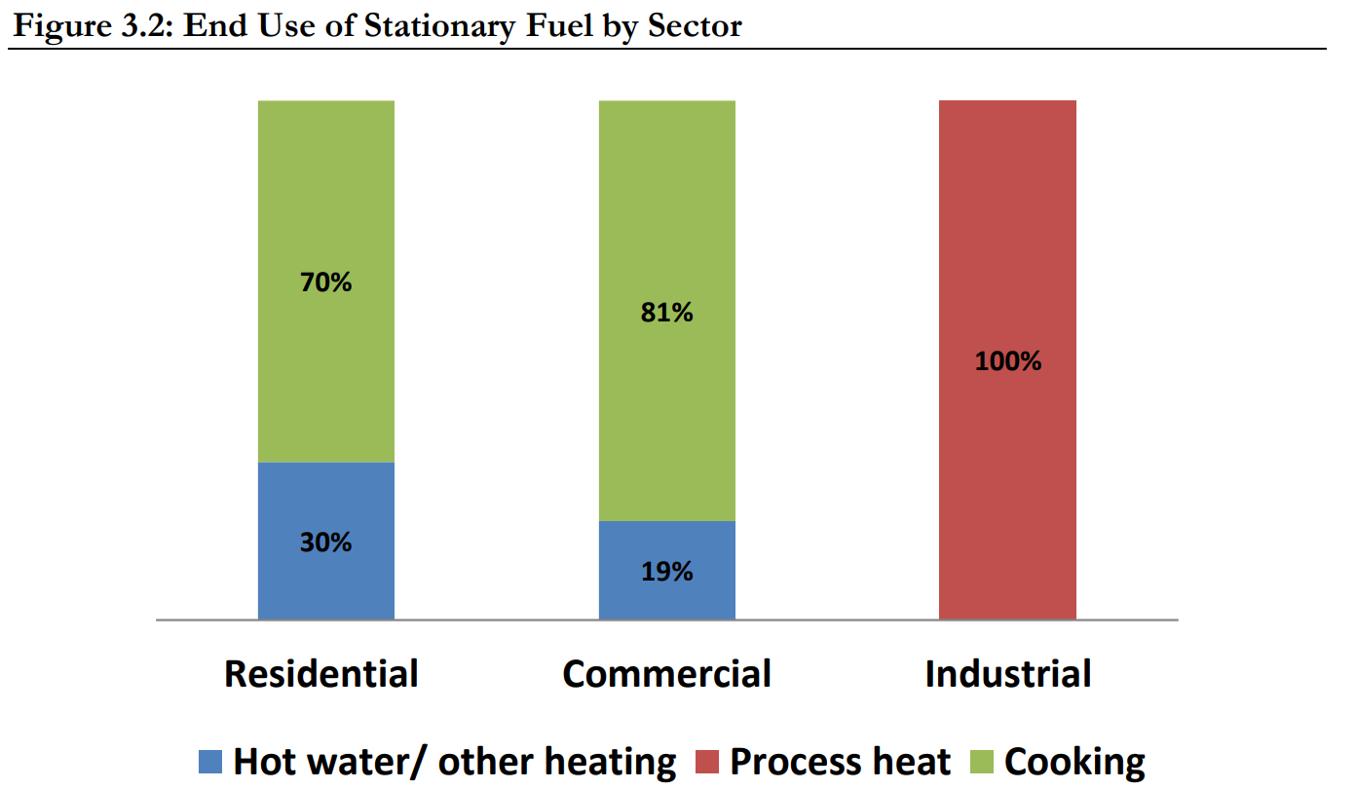
Fuel Use
End Use = what you want to achieve; the final energy use

Slide 55
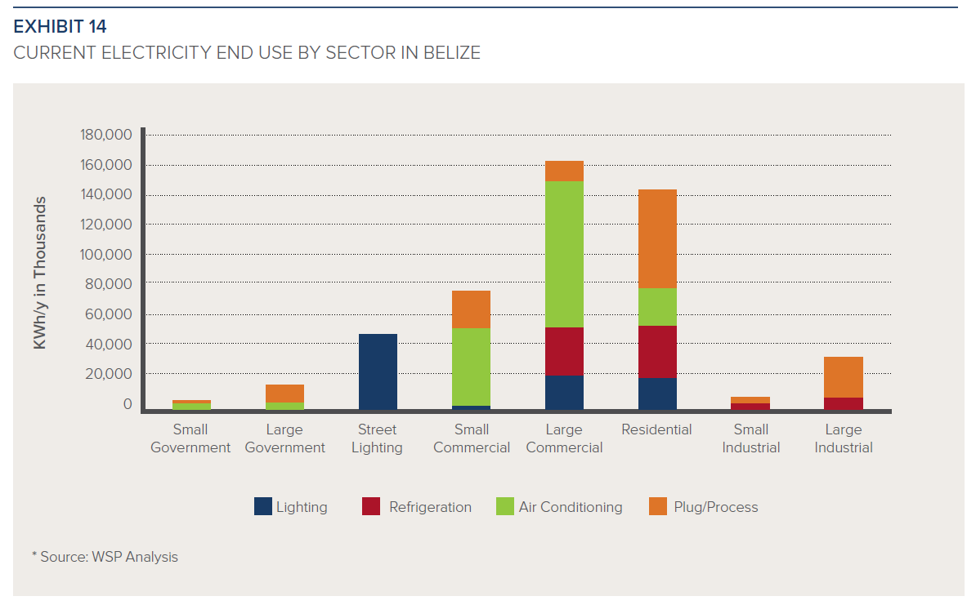
Electricity Use
Based on limited energy audits
energy data on final consumption by sectors in Belize is currently not available.

Slide 56
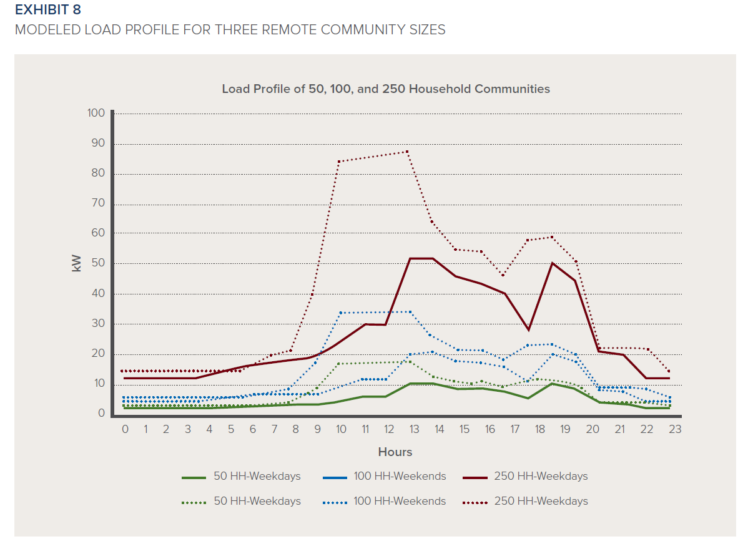
Energy + Efficiency

Slide 57
Renewable Energy and Efficiency Measures
A marathon, not a sprint
Provide basic services
Expand grid, grid-tied solar, small scale solar, water pumping
Reduce grid electricity use
Equipment upgrades (esp. refrigeration), Insulation and weatherization, windows, passive design
Reduce Greenhouse Gas (GHG) emitting fuel use
Fuel switching….electrification
Solar thermal hot water

Slide 58
Renewable Energy and Efficiency Measures
Measure present use
Starts with auditing current energy use
“follow the money”
Baseline
Plan and cost improvements, access finance, available programs
Relies upon:
Knowledge (PV, Energy, Efficiency)
communications
planning
transparent analysis
Successful dREP will include all these skills

Slide 59
Spanish Lookout Expo Assignment!
Business Expo Assignment:
Provide a list of renewable energy equipment or service businesses that you visit at the 2022 Spanish Lookout Business Expo. Include a brief description of the products or services that the business offers.
Describe in a brief professionally written report (1 page or less) your experience at the expo.
What product did you see that you think would provide the most benefit to customers trying to reduce their energy costs or carbon emissions?
What products or services did you see that might increase customers energy costs or carbon emissions?
Submit your response in an email to james.thomson@nscc.ca

Slide 60
Questions and Feedback
Any questions?
Comments, requests and feedback?

