Slide 1
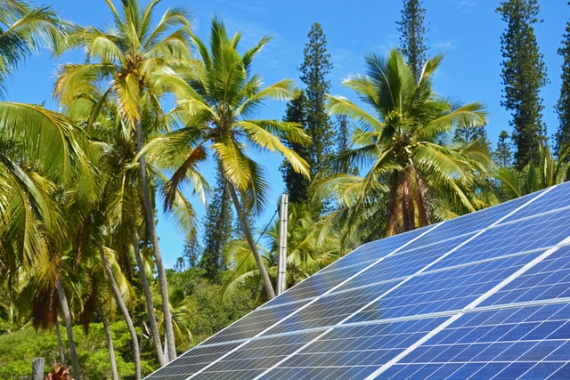



Design and Implementation of Pilot of a TVET Renewable Energy Course
DELIVERABLE #5 - TRAINING COURSES & PROFESSIONAL DEVELOPMENT
Session 07 (01 April 2022) for Course 04 Introduction to Energy Science

Slide 2

For Today:
Introduce course classes
  PV, other renewables
  Efficiency
  Communications
  Electricity basics
  Mathematics
  Business and projects
  Practical Laboratory
System thinking
Electricity Use
Biogas

Slide 3
Renewable Energy and Energy Efficiency Course
Content Overview
1st Year | Term 1 | English Comm 1 | Applied Math 1 | Electricity and Circuits | Intro to Energy Science |  |  | PV Applications | Integrated Lab 1
 | Term 2 | Customer Relations and Audits 1 | Energy, Buildings and Equipment | Electricity and Circuits 2 |  | PV System Installation |  |  | Integrated Lab 2
 | Term 3 | English Comm 2 | Applied Math 2 | Photovoltaic System Installation |  | Solar Hot Water Systems |  |  | Integrated Lab 3
2nd Year | Term 4 | English Comm 3 | Energy Efficiency Measurement and Verification | Energy Use Modeling & Analysis | Advanced Energy System Design |  |  | Small Wind Design and Operation | Integrated Lab 4
 | Term 5 | Projects and Comms 1 | Technical Drawing | Economic Analysis of Energy Systems |  | Solar PV System Design | Solar PV System Design |  | Integrated Lab 5
 | Term 6 | Projects and Comm 2 | Electricity Codes and Regulations | Business Operations and Entrepreneurship |  | PV System Maintenance & Operation | PV System Maintenance & Operation |  | Integrated Lab 6

Slide 4

Term 1: English Communication 1
Introduce technical writing
  Write about things; descriptive, objective
  Business correspondence (email, invoices, estimates…)
  Break informal social media habits
Introduce oral presentations and critical thinking
  The RE and EE industry has to explain a lot of new things
  Practitioners need to be clear and persuasive
Develop interpersonal communications skills required of technical professionals in the workplace
  Practitioners need to be trusted

Slide 5
Term 1: English Communication 1
Identify personal characteristics which impact academic and career success
  Industry wants self aware employees
Identify the elements of English grammar
  Capitalization, punctuation, grammar
  More bad habits from social media
Describe technical terms clearly and concisely in grammatically correct sentences
  Explain acronyms
Comprehend written technical content
  New equipment, changes frequently, interconnected

Slide 6
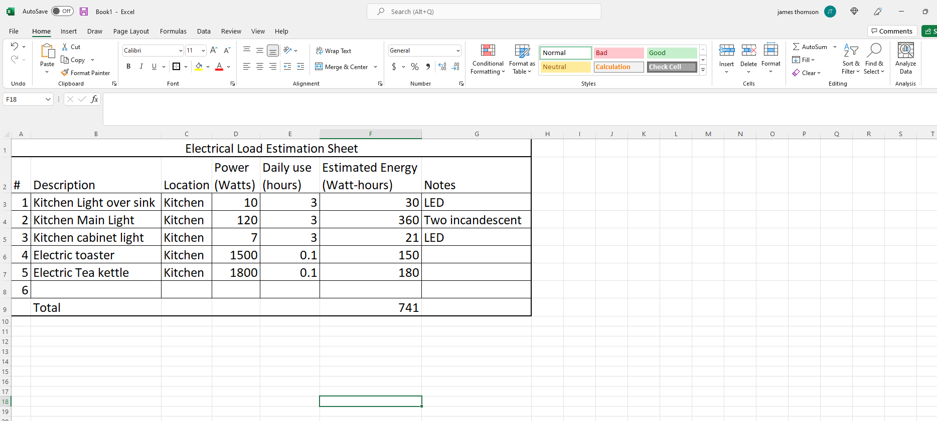
Term 1 Applied Mathematics
Review basic operations of addition, subtraction, multiplication and division
Order of Operations (PEDMAS)
  Parenthesis, Exponents, Division, Multiplication. addition, subtraction
  Negative Numbers
  Scientific and engineering notation
  Percentages
  Unit Conversions
  Geometry of Areas, Volumes
Algebraic use of formulas to solve for unknown measurements
Learn to use spreadsheets efficiently

Slide 7
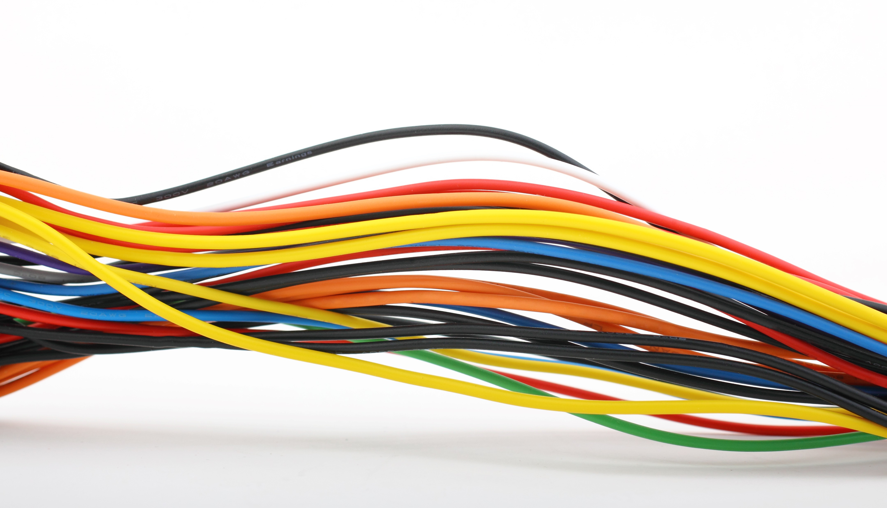
Term 1 Electricity and Circuits
Introduce electric charge, insulators and conductors
Introduce electrical current flow through materials
Introduce the concept of voltage
Introduce resistance and resistivity, Ohm’s law
Identify power and energy in a circuit
Understand basic units of electricity and measurement tools
Relate these concepts to the world around us
  AC power in homes
  DC power in vehicles, phones. etc.

Slide 8

Term 1: Intro to Energy Science
Reenforce secondary school science learning
  May be gaps – especially around electricity
  May be gaps – work and energy
Connect to personal experience
  Science is in the world we live in, not in a lab
Identify sources of energy
  their final uses
Identify the causes and consequences of climate change
Identify sources of renewable energy

Slide 9
Term 1: Intro to Energy Science
Learn a new language:
  Identify basic units and measurement
  Review force, mass, velocity and flow
Introduce important physical properties
  pressure temperature and density
Introduce
  concept of heat and temperature
  energy and work, kinetic energy and potential energy
  conservation of energy
Introduce physical limits to energy systems
  the Second Law of Thermodynamics

Slide 10
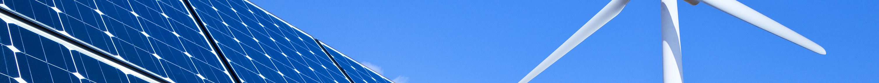
Term 1: Photovoltaic Applications
Identify common solar PV applications and their purpose.
Understand the solar resource.
Perform basic site assessments.
Interpret PV panel data sheet information.
Measure PV panel data sheet values.
Understand how the PV panel operates.

Slide 11
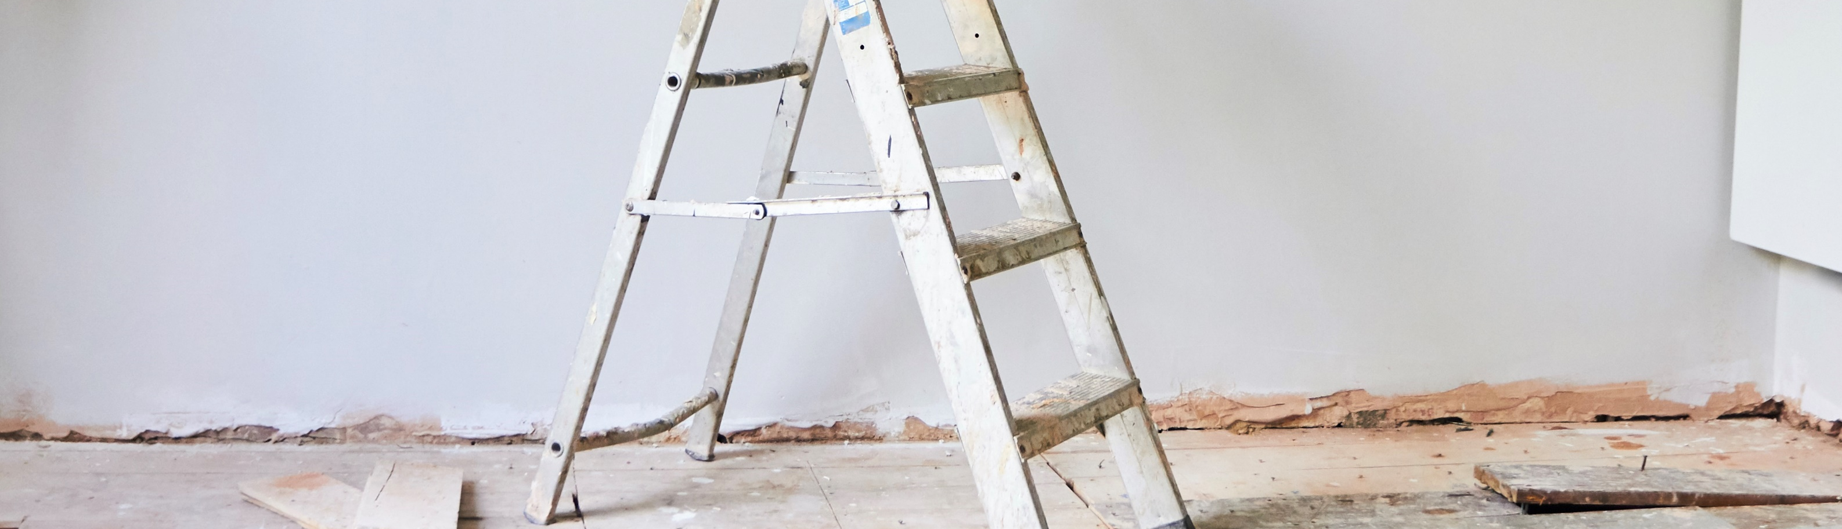
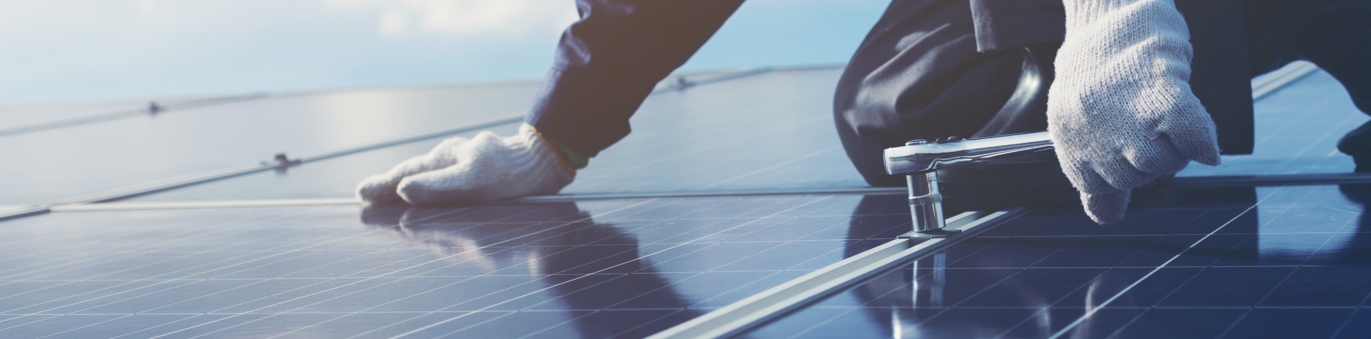
Term 1: Integrated Laboratory 1
Provide hands on access to renewable energy equipment
Safety:
  Identify hand tools and their safe use
  Understand and identify workplace hazards and prevention
  Identify appropriate personal protective equipment (PPE) and correct use
  Identify common power tools and their safe use
Assemble and operate specific components PV systems
Measure, record and analyze results from laboratory assignments

Slide 12
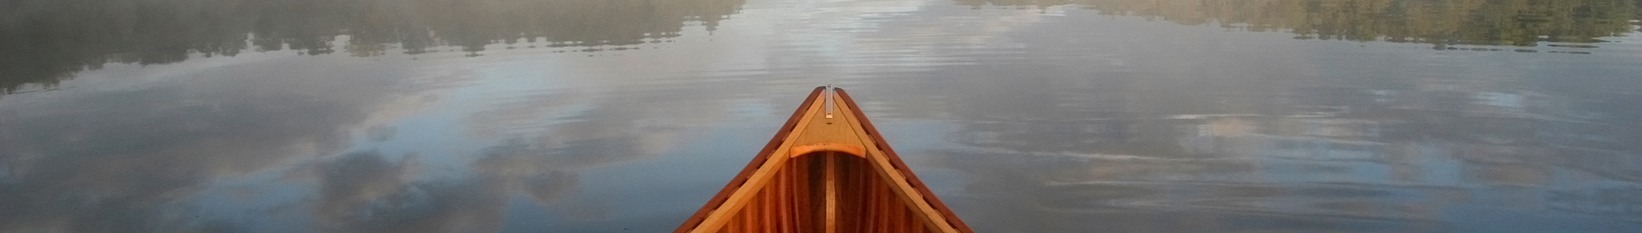
Year 1: Beyond Term 1
Continued electricity, mathematics and communications fundamentals
Reading drawings
Buildings and equipment
Solar thermal water heating
Auditing energy use, planning and measuring improvements
Installation and maintenance of systems

Slide 13
Year 2
Progress to small wind; limits, challenges
Progress beyond installation to design
Understand advanced applications
  grid connected / large battery systems
Planning and measuring efficiency improvements
Progress to customer and project communications
  Technical drafting
Planning and executing projects
Calculating economic benefits
  Replacing fuel payments with loan payments

Slide 14
Questions?
Speak up or type in the chat!
Is anything missing?
What content will be challenging?

Slide 15
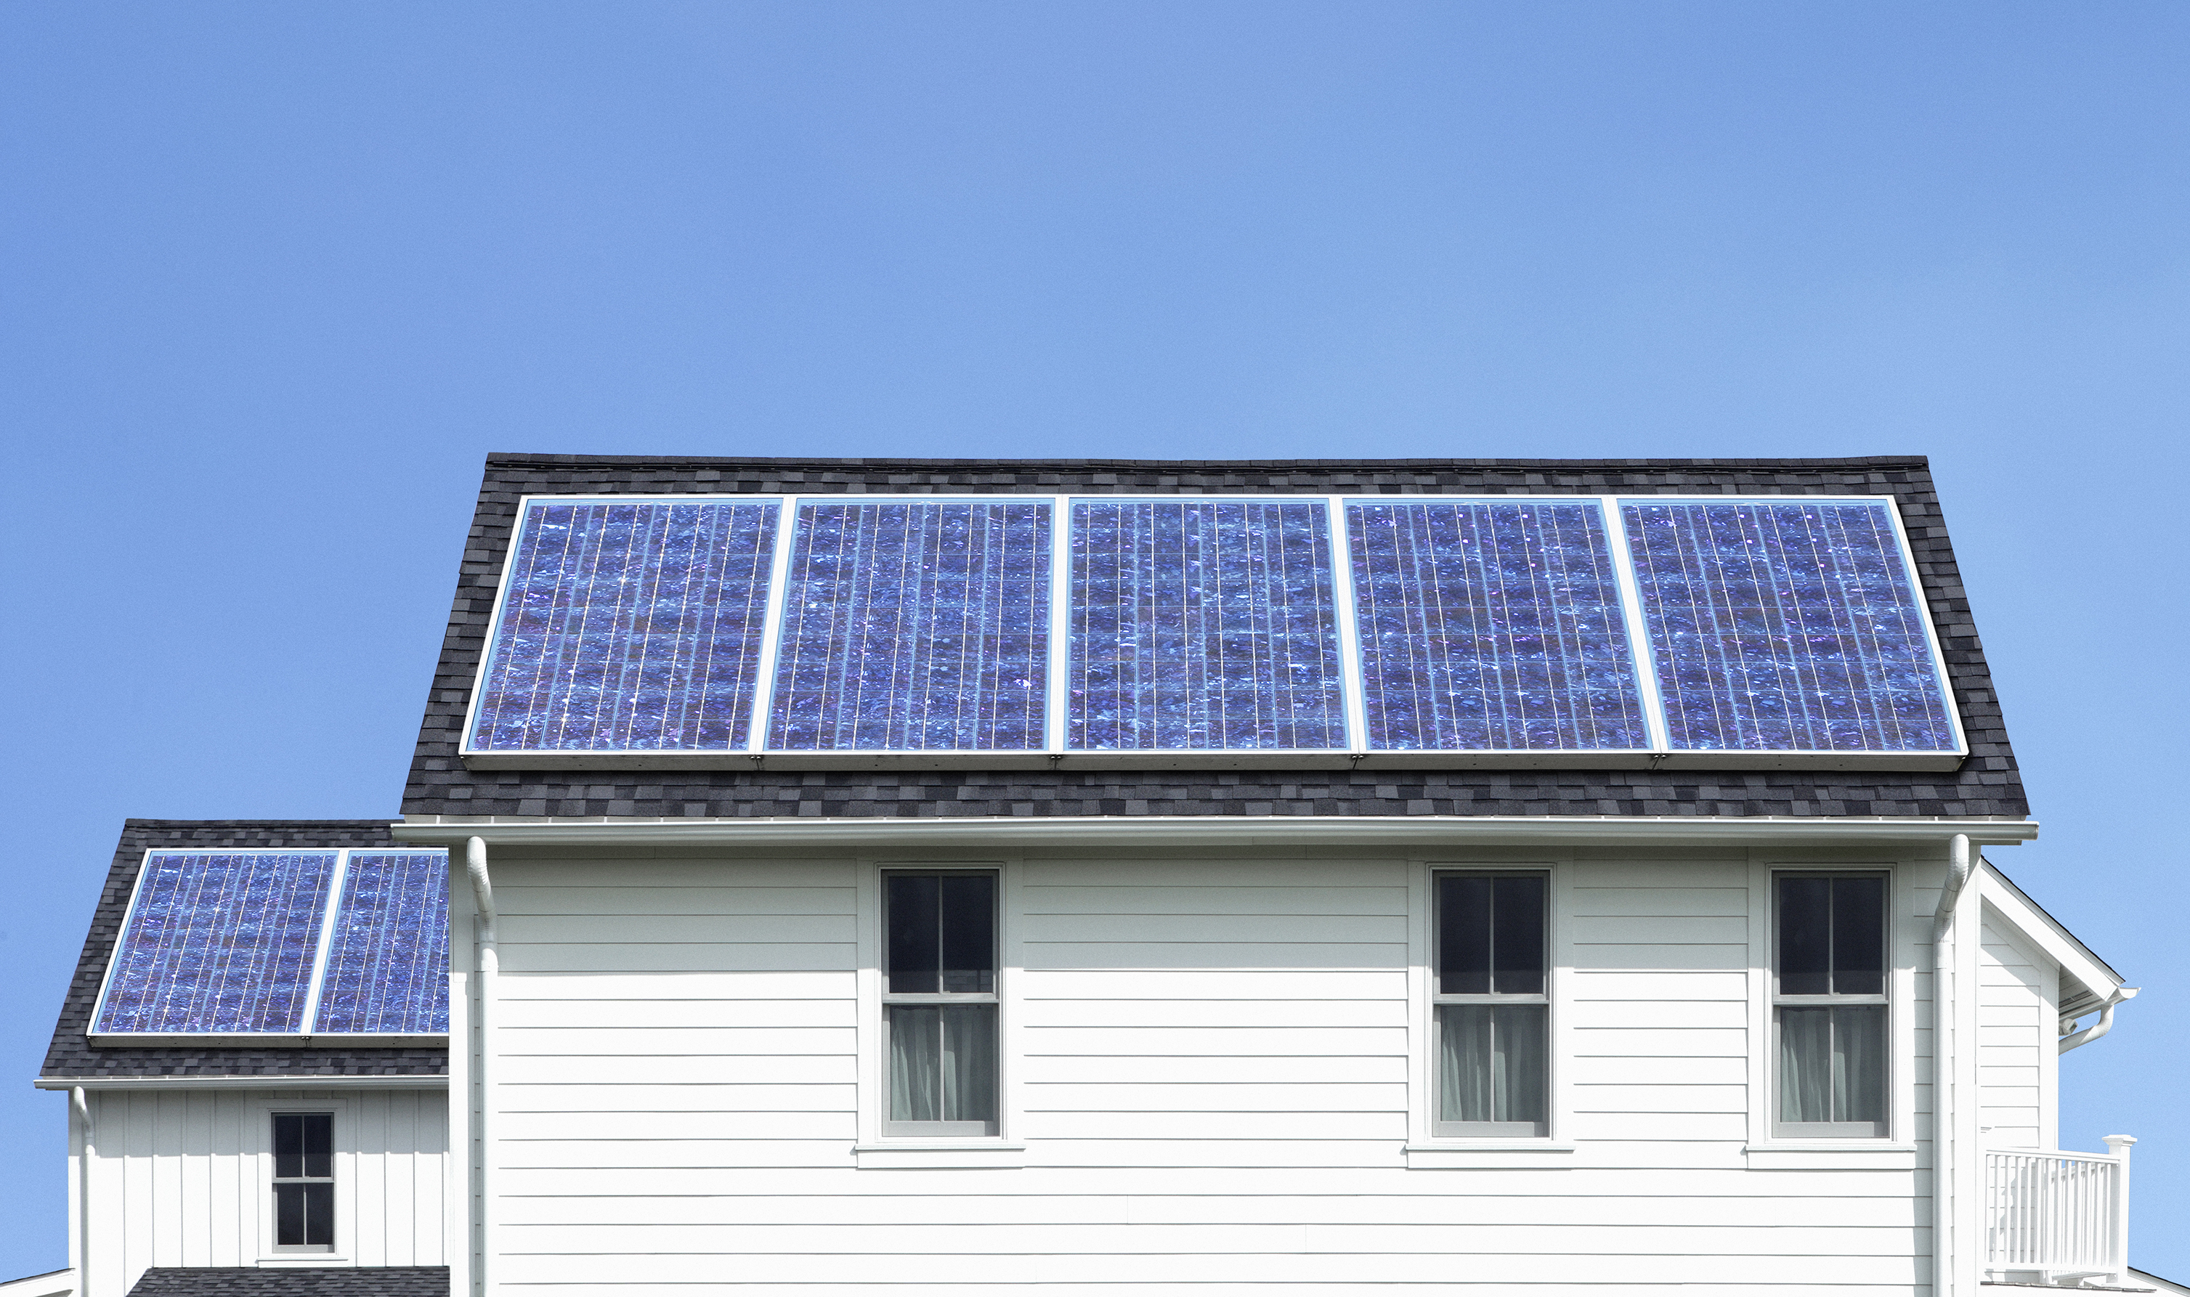
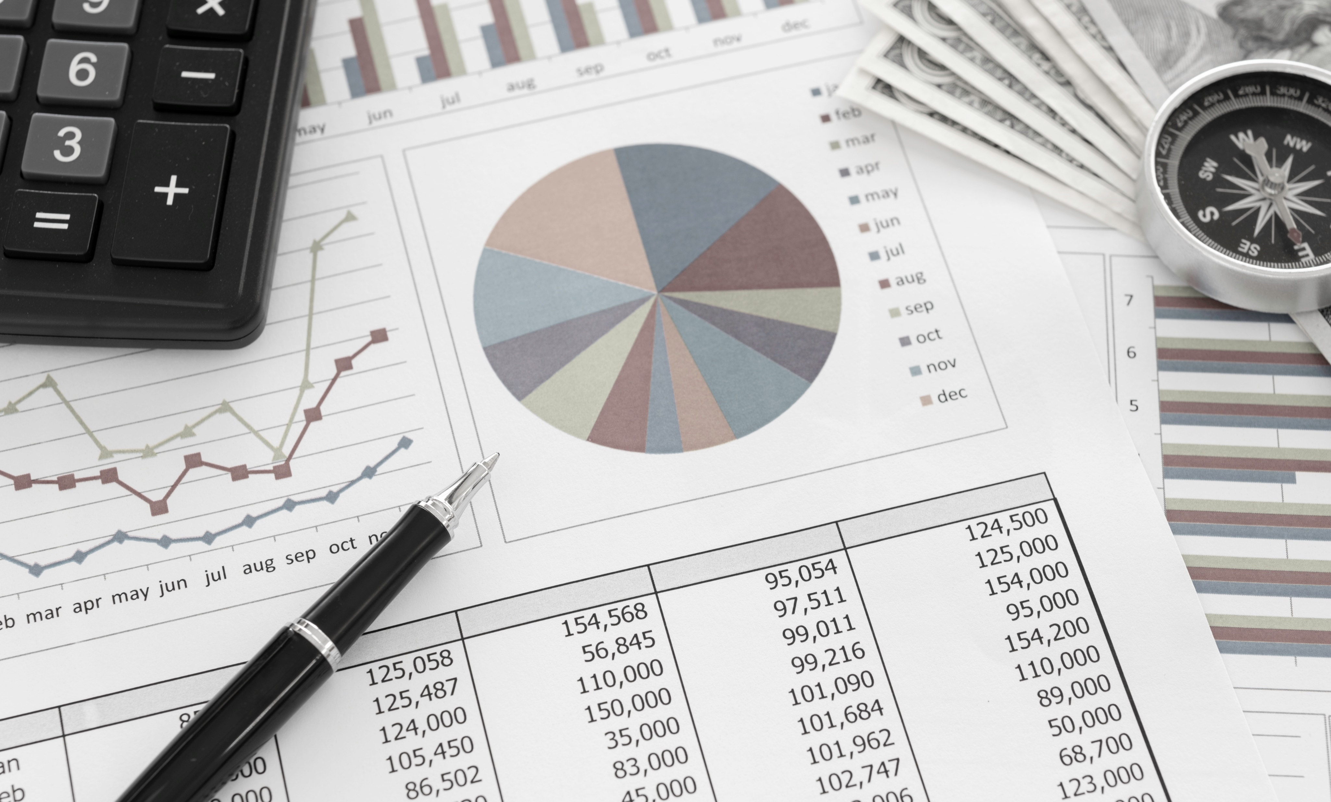
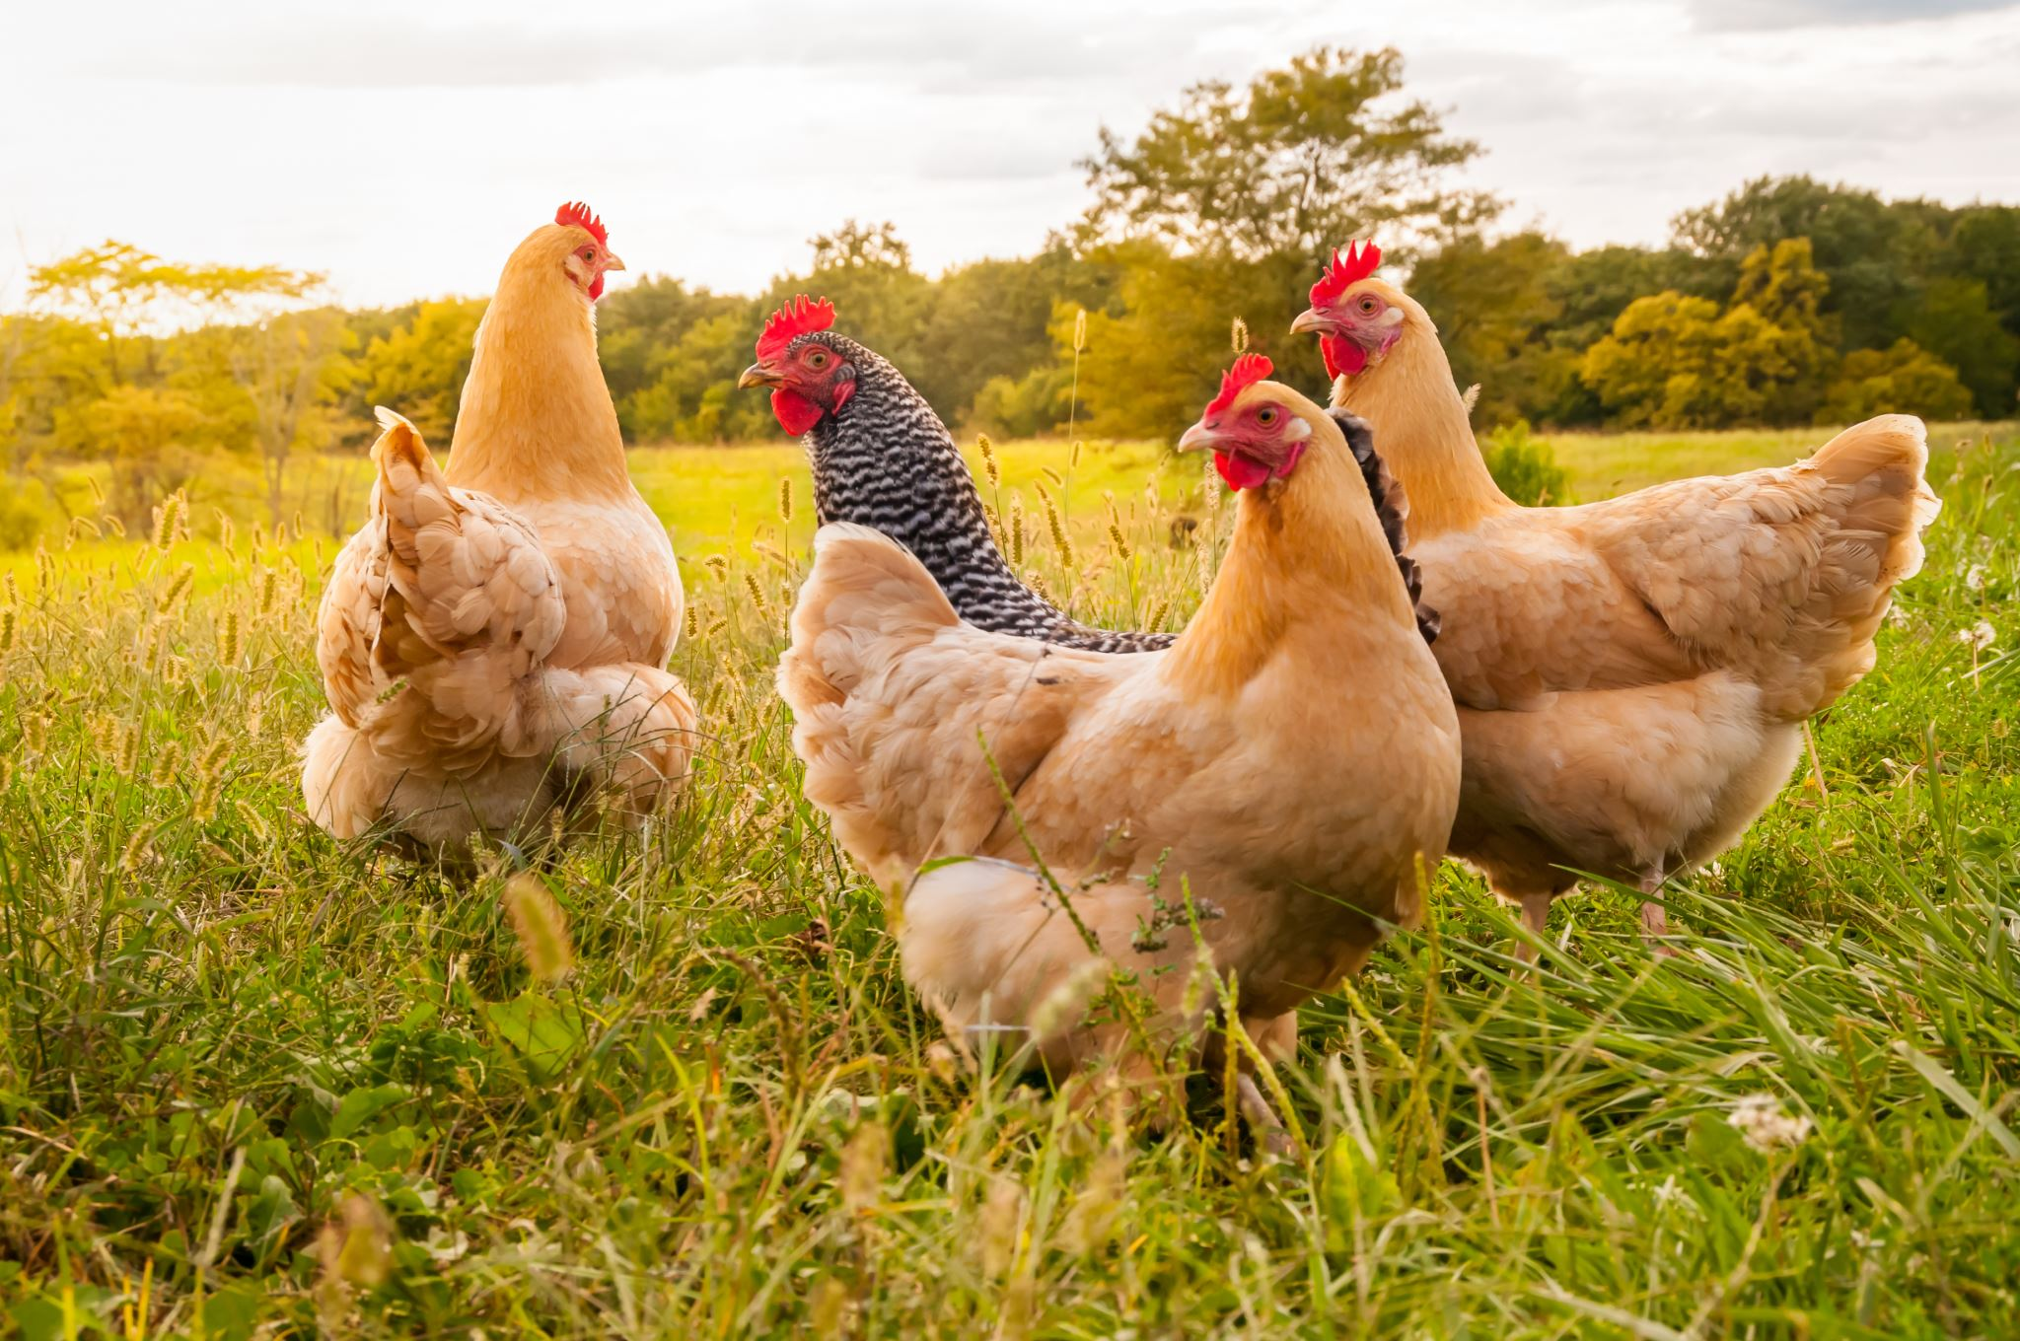
Energy + Efficiency
Residential Energy Auditing
  The residence as an energy system
  collecting a baseline
  Electricity
Biogas
  Big biogas
  DIY

Slide 16


Advanced Concept: System Thinking
IN
OUT
What inputs and outputs?

Slide 17
Advanced Concept: System Thinking
Inputs:
Fuel
Electricity
Sunshine
Food
Water
Air
Outputs:
Combustion products
Reflected Sunshine
Heat
Waste
Air
What goes IN = what goes OUT
What crosses the SYSTEM BOUNDARY ?
Mass in = mass out : Conservation of mass
Energy in = energy out : Conservation of energy
These concepts are key to tracking energy use

Slide 18
Advanced Concept: System Thinking
Inputs:
Fuel
Electricity
Sunshine
Food
Water
Air
Outputs:
Combustion products
Reflected Sunshine
Heat
Waste
Air
No magic, basic accounting
Tracking all energy use is important
Need to identify best economic opportunity
  Compare across all energy forms
Where can you use renewable energy most effectively
Keep your bills and invoices
  Build an annual energy use record

Slide 19

Energy Audits
Where are you starting?
Collect basic data
  Location
  Customer or client name and contact information
  Building type and dimensions
  Windows and doors
  Number of residents
Record on paper or electronically
Take photos
Stay organized and be efficient
  Limit trips, quickly assess
  Accurately report

Slide 20
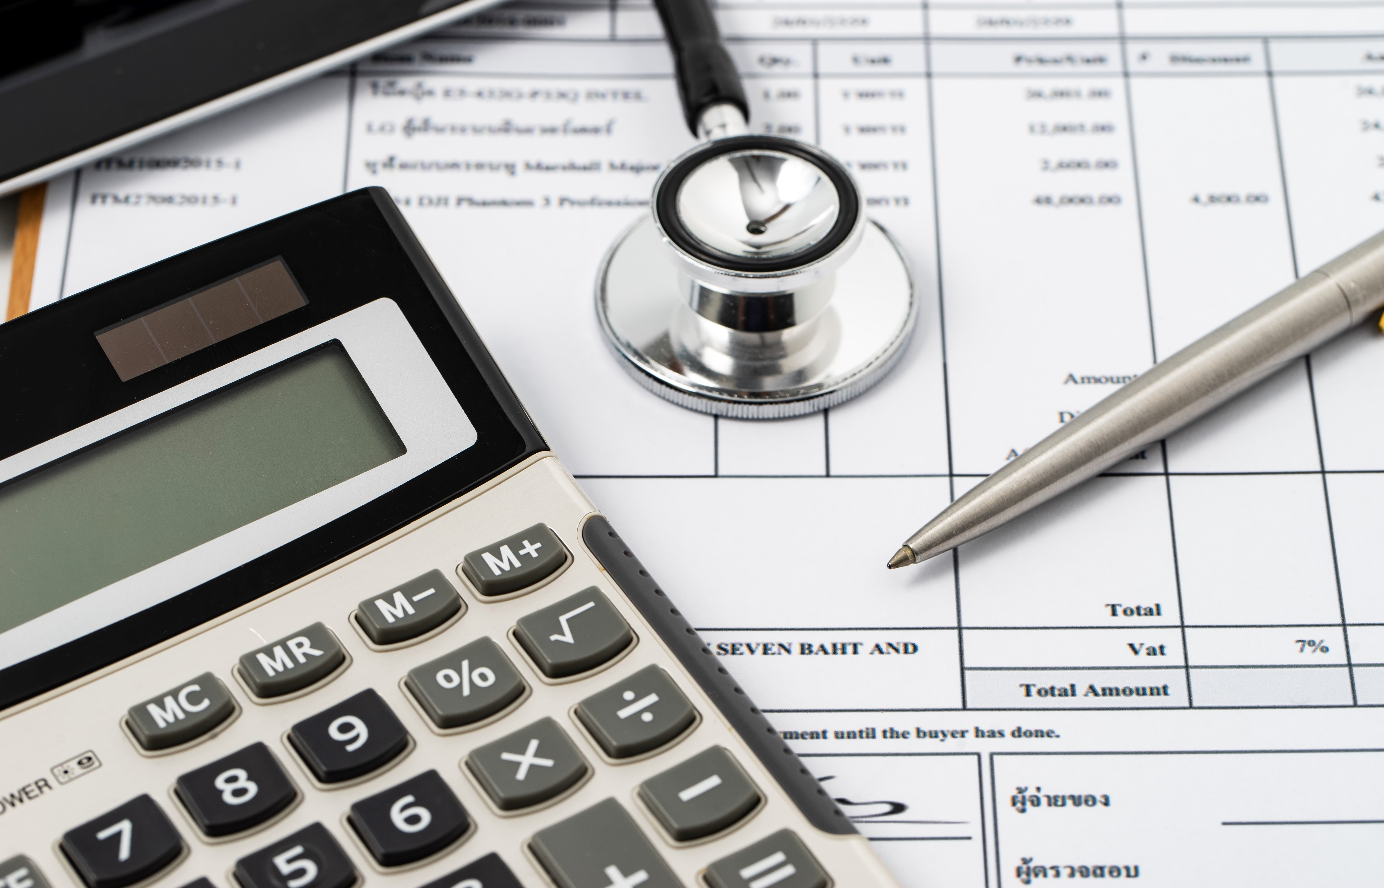
Energy Use
Where are you starting?
Collect energy use data
  Regular electricity bills
  Periodic bills for fuels, wood
  Capture quantities and dollar amounts, taxes
  Water and sewer for reference
Cover a full year as a minimum
Better to have several years
  All years not the same
  Relate load with annual weather
May help to read meters manually more frequently

Slide 21
Fuel Energy Use
Periodic deliveries or purchases
  Note dates, amounts and dollars
  Calculate per day consumption
  Some room for error, judgement will be required
Wood can be tricky
  May need to rely on estimates (quantity, type…)
  Challenging to measure
  Initial steps may be to weigh during use
  Logbook, fish scale
We will discuss these in the future

Slide 22
Stretch Break: 5 minutes
Would you have the records and bills to audit your personal energy use?
What is easy to find?
What is hard to find?
Next up electrical loads labels and energy use

Slide 23
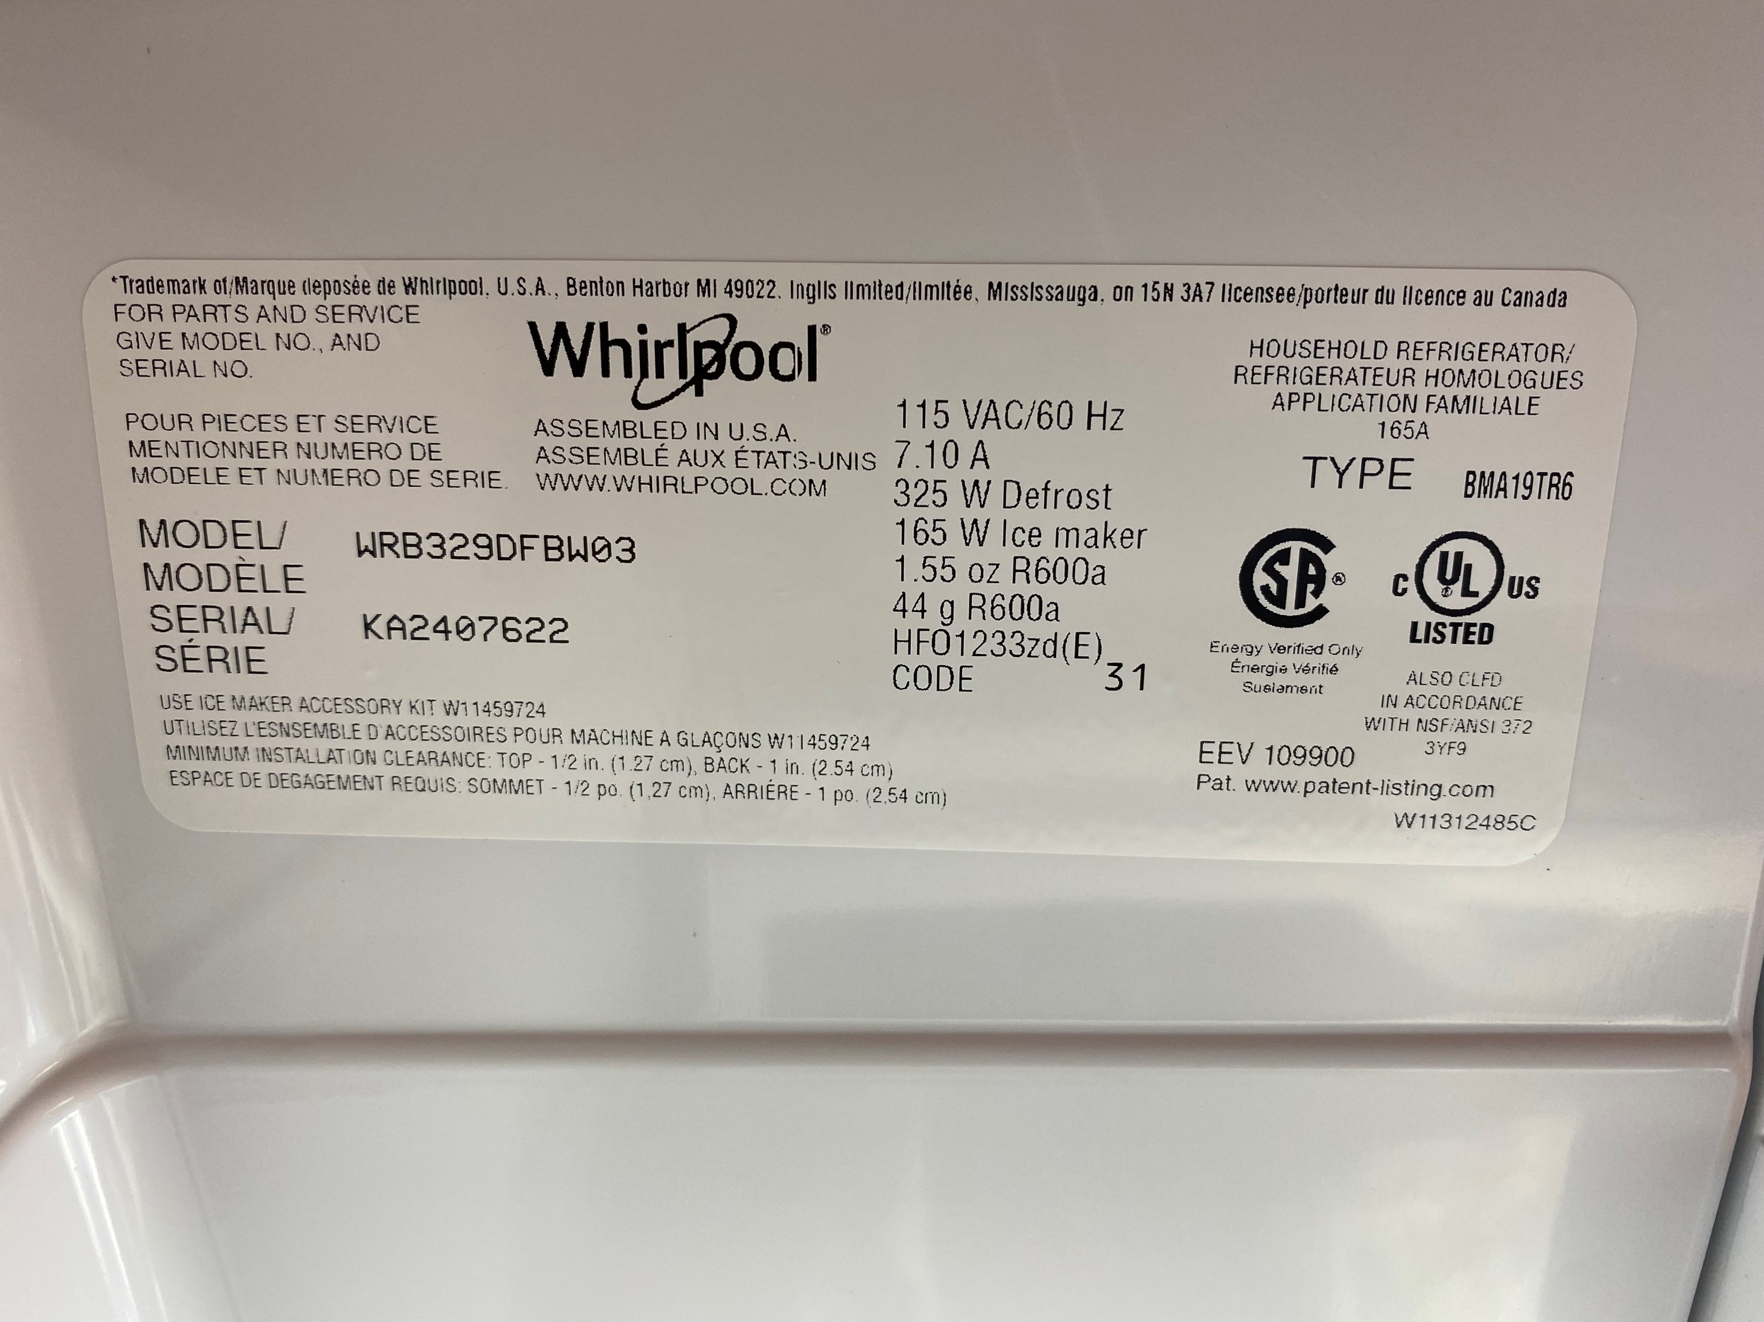
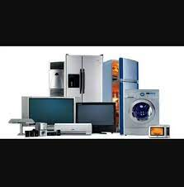

Audit: Record all significant Loads
What’s significant?
  Anything that gets HOT
  Anything that is always on
  Possibly other things…be suspicious
Note type and size of large appliances
Photograph nameplates, where possible
  Refrigerator and freezer
  Clothes washers and dryers
  Cooker / stove
  Take measurements if no labels

Slide 24
Audit: Record all significant Loads
Water heating
  Energy source
  Capacity
  Operation, timers, etc.
Lighting
  Room by room location and wattage of all lamps and lights
  Don’t forget exterior lights
  Discuss frequency of use with the residents
Pumps (more in future sessions)

Slide 25
Focus on Electricity: Nameplates
Typically indicate rated voltage and peak current
  Energy does not equal rated voltage x peak current
  7.1 Amps x 115 Volts x 24 hours = 19.6 kW!
Peak power is not average power
  Peaks from starting current at highest temperature
  Power use may vary with cycle, operation (defrost, spin cycle, heat settings) – depends on the appliance

Slide 26
Focus on Electricity: Nameplates
Frequently hard to interpret
Peak power is not average power
  Important for sizing energy sources (like inverters)
  Energy use important for audits, battery capacity calculations
Appliance ratings can help

Slide 27
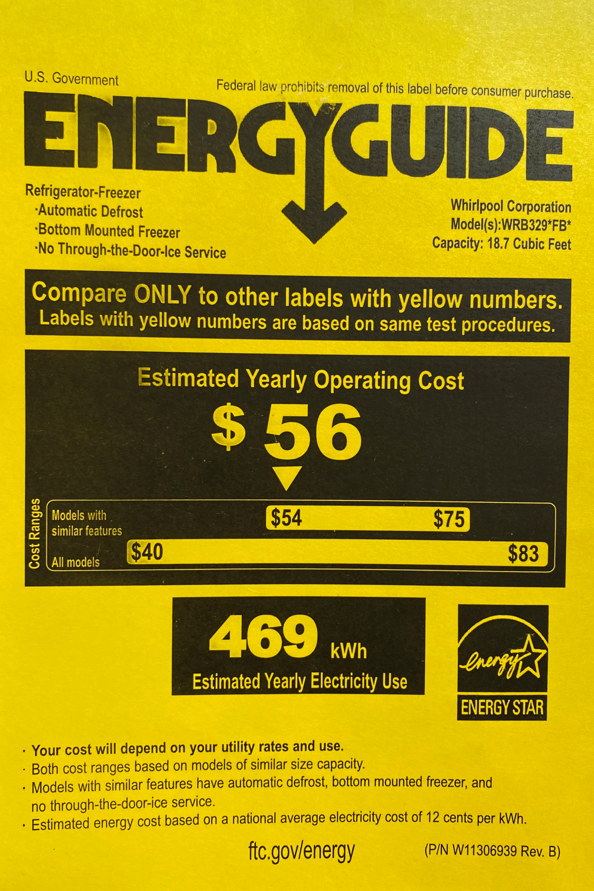
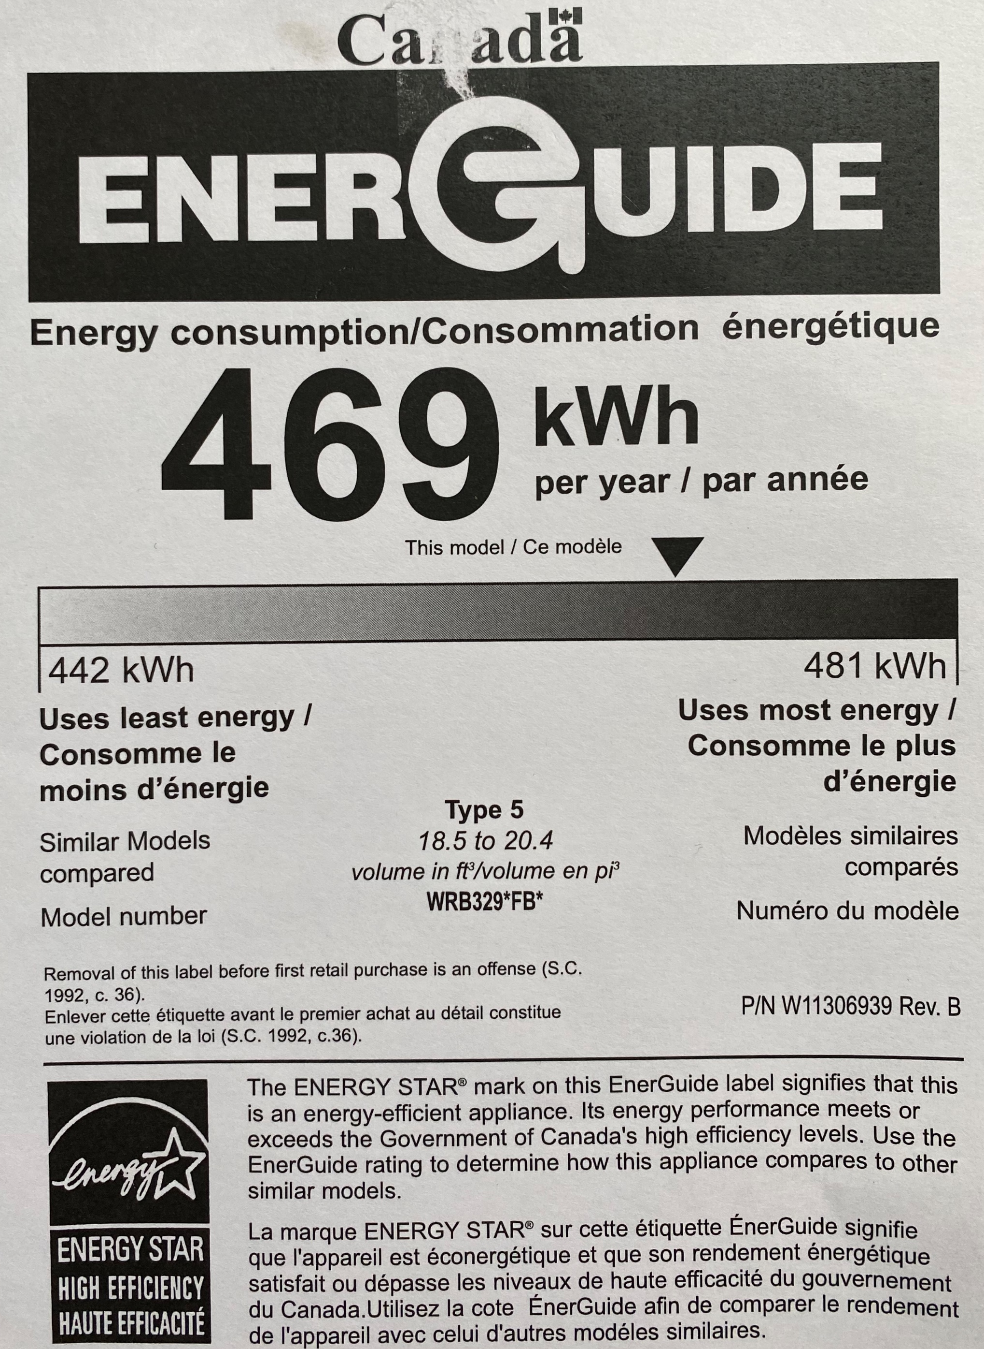
Energy Labels

Slide 28
Discussion
Have you seen energy labels on new appliances?
Is there a market for used appliances?
Notes:
Asking questions to suppliers and explaining benefits to residents is hard work

Slide 29
Regulations and Energy Labels
Most manufacturing nations have MEPS
  Minimum Energy Performance Standard – a regulation
  Mexico/USA/Brazil/China/EU
Purchase a model with a published energy label
Or Measure it!
China Energy Label (CEL) Testing
EnergyGuide Label (US)
ENERGY STAR® Program Testing (US)
California Energy Commission (CEC) (US)
Natural Resources Canada (NRCan) (Canada)
Eco Label (Europe)
European Energy Label (Europe)
Green Mark (Taiwan)
Australian Energy Rating Label (Australia)

Slide 30
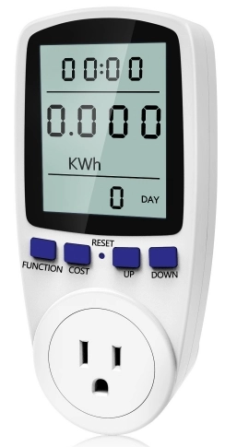
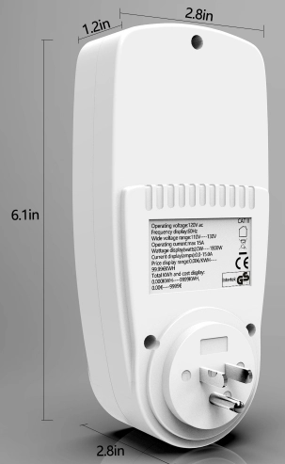
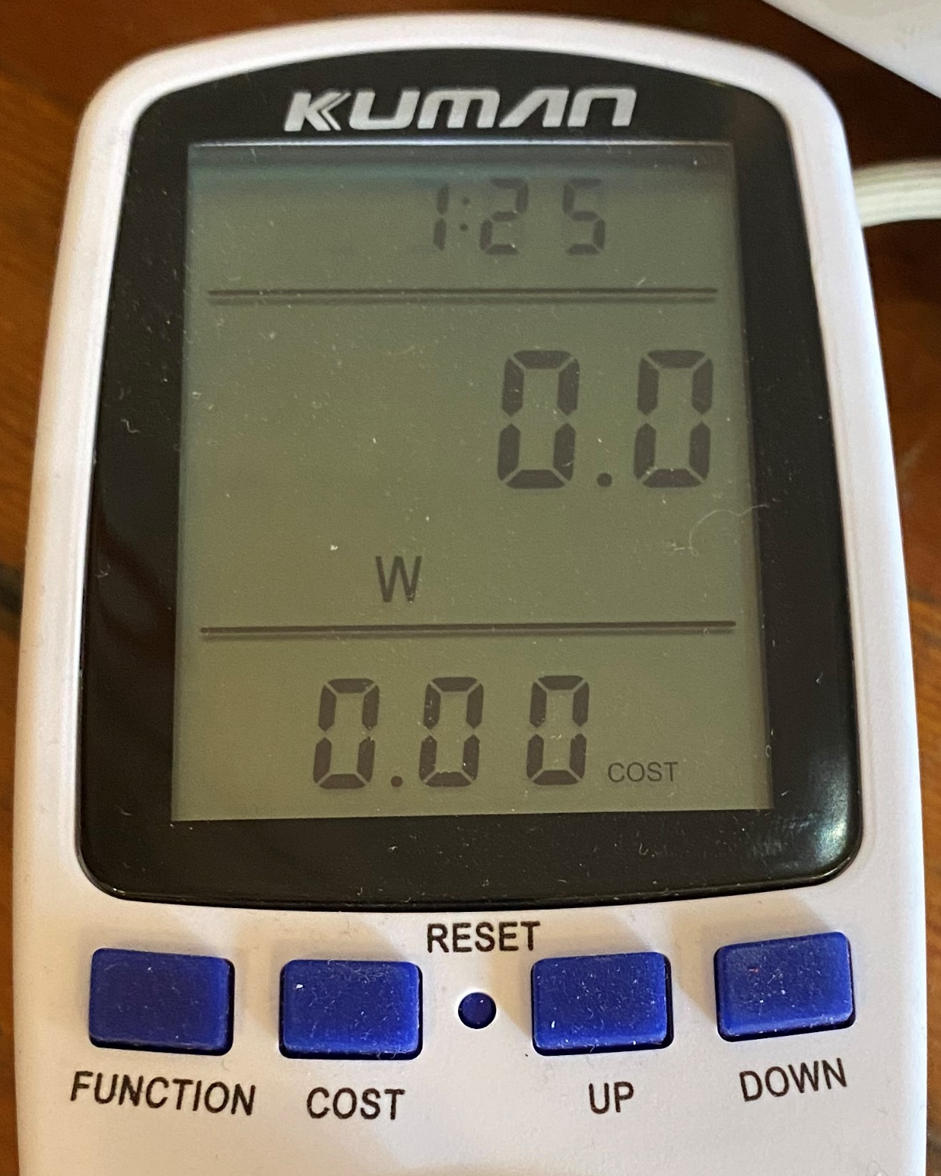
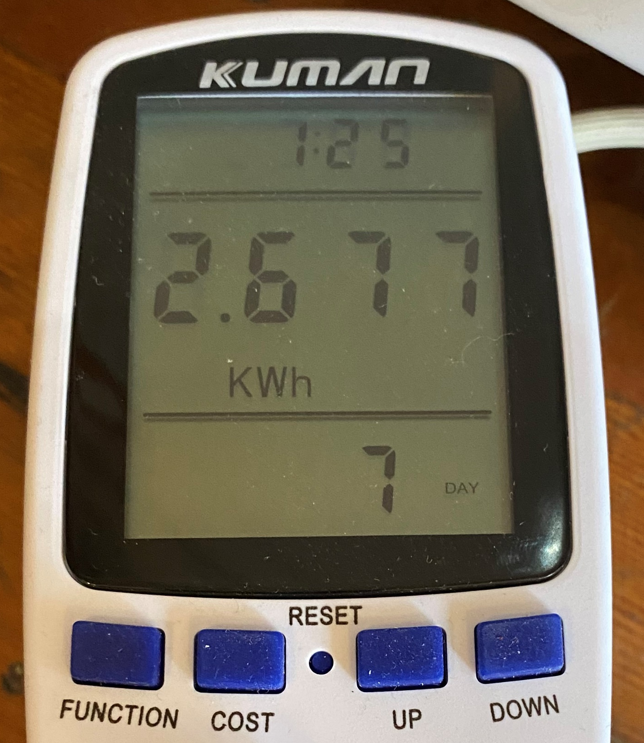
Plug meter: Measure when unsure
Measure voltage, frequency, current and power factor
Calculates power and total energy
Resettable
Inexpensive, unspecified accuracy
Good tool, planned for lab

Slide 31
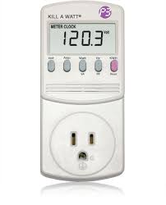
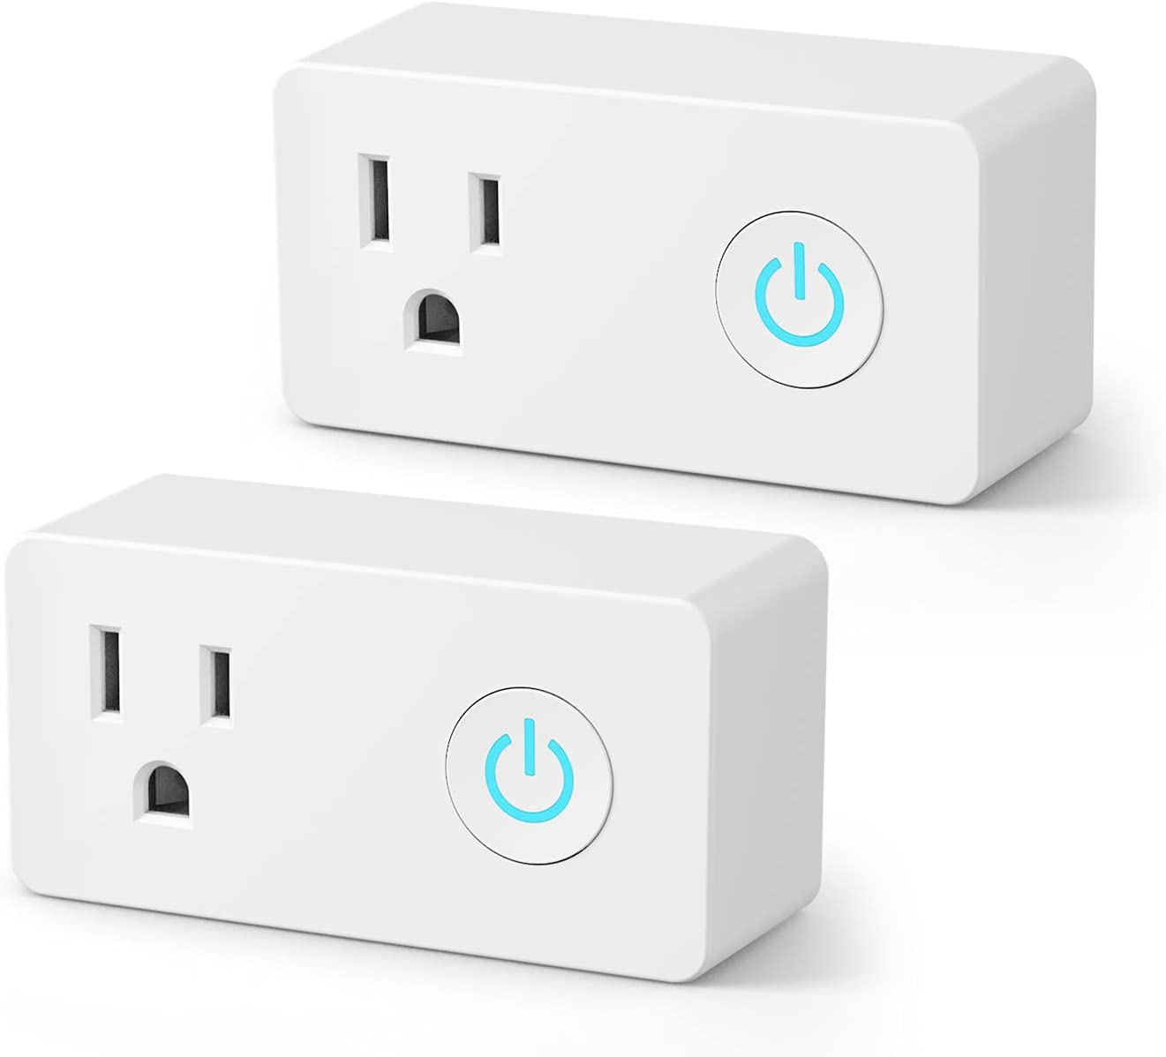
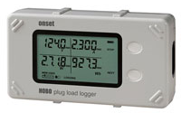
Plug meter and measurement
Other names:
  Energy meter
  Energy logger
  Kill-a-watt
Some public libraries loan them
Limited to the outlet
Some with Wi-Fi
Some take batteries (avoid)
Lots of online resources discussing everyday appliances

Slide 32
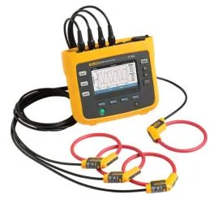
Large load measurement
More expensive equipment needed for higher voltage, multiple phases
Datalogging required for large equipment with variable loads
Power quality analyzers measure higher frequency content, distortion
Expensive
Some utilities will loan or rent
  For larger customers
  Troubleshooting local grid
Work with specialists

Slide 33
Load estimation
Many appliances have a variable power use
Energy consumption estimated based on average power and daily use
Tabulate values and calculate in a form or spreadsheet
Common procedure for lighting, small electric appliances
Prepare estimate and compare to actual usage
Electrical Load Estimation Sheet
# | Description | Location | Power (Watts) | Daily use (hours) | Estimated Energy (Watt-hours) | Notes
1 | Kitchen Light over sink | Kitchen | 10 | 3 | 30 | LED
2 | Kitchen Main Light | Kitchen | 120 | 3 | 360 | Two incandescent
3 | Kitchen cabinet light | Kitchen | 7 | 3 | 21 | LED
4 | Electric toaster | Kitchen | 1500 | 0.1 | 150
5 | Electric Tea kettle | Kitchen | 1800 | 0.1 | 180
6
 | Total |  |  |  | 741

Slide 34
Load estimation
Estimated Energy = Power (W) x Daily Use (hours)
Estimate hours based on interview with residents
  Consider number and age of occupants, occupancy patterns - Judgment may be required
Simple daily table shown, weekly, monthly may be required for some
Electrical Load Estimation Sheet
# | Description | Location | Power (Watts) | Daily use (hours) | Estimated Energy (Watt-hours) | Notes
1 | Kitchen Light over sink | Kitchen | 10 | 3 | 30 | LED
2 | Kitchen Main Light | Kitchen | 120 | 3 | 360 | Two incandescent
3 | Kitchen cabinet light | Kitchen | 7 | 3 | 21 | LED
4 | Electric toaster | Kitchen | 1500 | 0.1 | 150
5 | Electric Tea kettle | Kitchen | 1800 | 0.1 | 180
6
 | Total |  |  |  | 741
Calculated
Power x Daily Use
From Appliance
Estimated

Slide 35
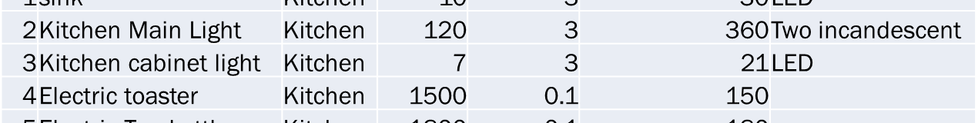
Load estimation tools
Paper Forms, calculator
Spreadsheet – Excel, Google sheets, others
  Highly recommended: Allows reuse, accurate calculation
  Also probably requires a computer
Modeling tools
  RETScreen, a Canadian tool. Free version, legacy version
  Models solar, wind, building heating and cooling, global locations, electrical loads
  Will demonstrate in future sessions

Slide 36
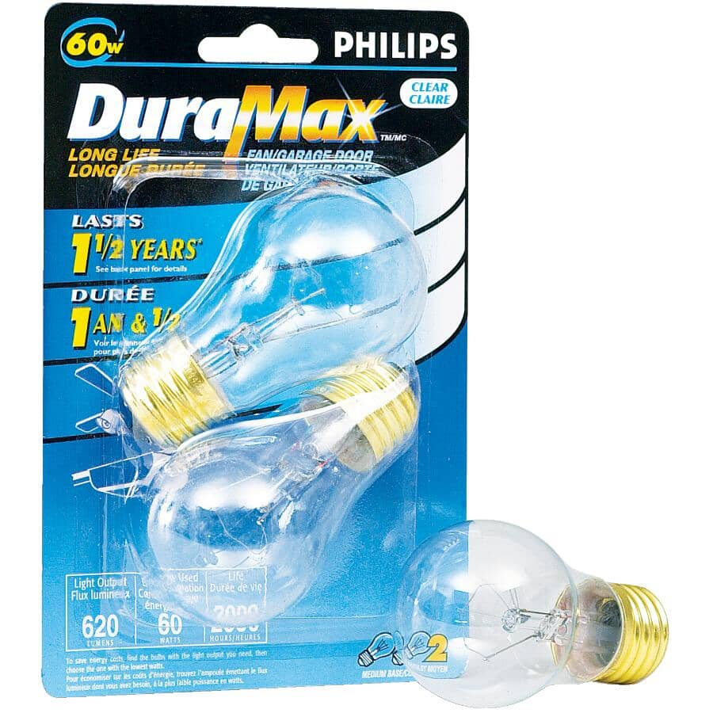
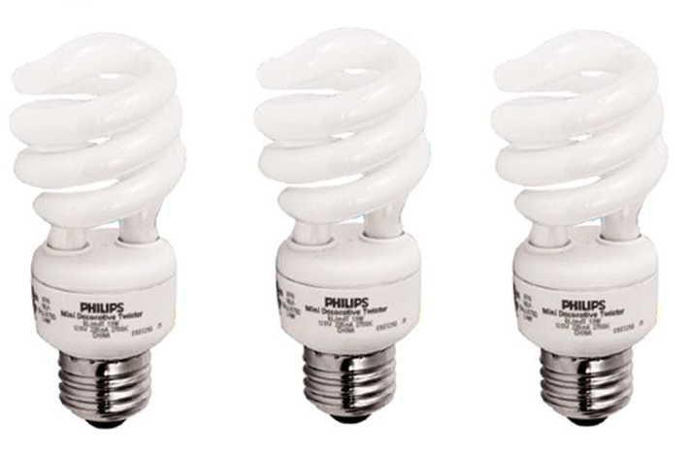
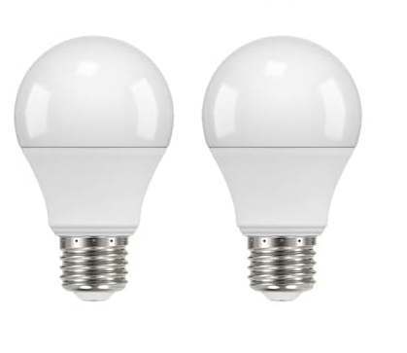
Efficiency Example: Light bulbs
Old school incandescent
  60 W, 620 lumens, 2000 hrs
Compact Florescent Lamp (CFL)
  13W, 900 lumens, 10,000 hrs
Light Emitting Diode (LED)
  8.5 W, 800 lumens, 10,000 hrs
Compare vs the same lifetime period
  10,000 hours
  9 years at 3 hours a day

Slide 37
Example: Lightbulb
Lightbulb Comparison
 | Unit | Incandescent | CFL | LED
Price (estimated) | $ | 1 | 3 | 6
Power | W | 60 | 13 | 8.5
Life | Hours | 2000 | 10000 | 10000
Study period | Hours | 10000 | 10000 | 10000
Daily Use | Hours | 3 | 3 | 3
Number of bulbs | # | 5 | 1 | 1
Cost of electricity | $/kW | $0.38 | $0.38 | $0.38
Energy Use per period | kW | 600 | 130 | 85
Cost of energy used | $ | $228.00 | $49.40 | $32.30
Cost of bulbs | $ | $5.00 | $3.00 | $6.00
Total Cost | $ | $233.00 | $52.40 | $38.30
Cost per year | $ | $25.51 | $5.74 | $4.19

Slide 38

Lightbulbs
All bulbs cost more to operate than to purchase
Upgrades save money over only a few months of use
Some efficiency programs provide new bulbs for free!

Slide 39
Electrical Utility: Discussion:
How do you feel about the electrical utility?
What would you like to see from the electrical utility?

Slide 40
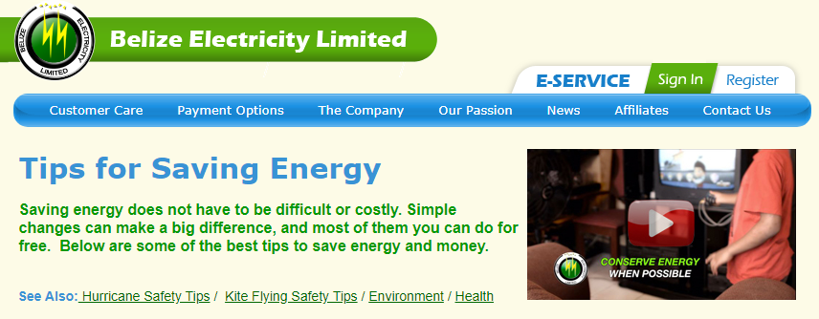
Electric Utility
Majority owned by the government of Belize
  Minority ownership: Fortis Inc. (Canada)
  Regulated by specific legislation
  Regulated by the Public Utility Commission
These arrangements are similar around the world

Slide 41
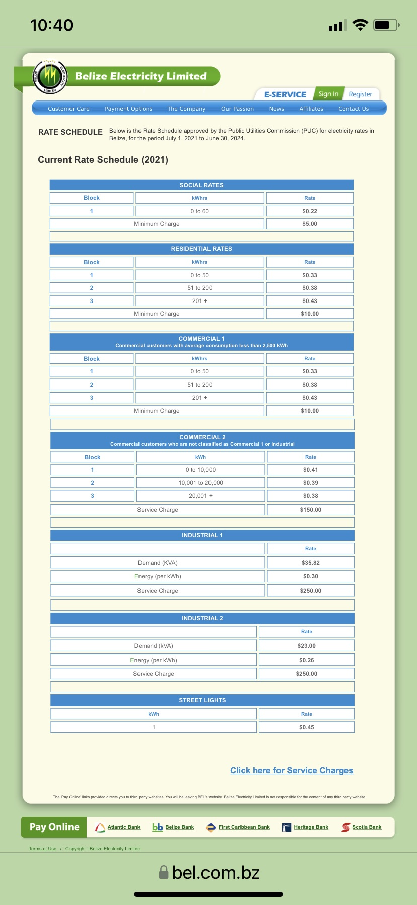
Electrical Utility
Electricity Utilities
  Government oversight
  Contentious, consumers lack choice
  We all like to complain about our utilities
  Utilities are useful
Rates may vary by customer type
  Residential
  Commercial…, others

Slide 42
Electrical Utility
Rates based on usage
  Quantity used (kWhr)
  Limits may trigger increase or decrease
  Peak demand (kW)
  Service charges, surcharges, taxes
  Billing period?
https://www.bel.com.bz/Rate_Schedule.aspx

Slide 43
Current listed rates / tariffs:

Slide 45
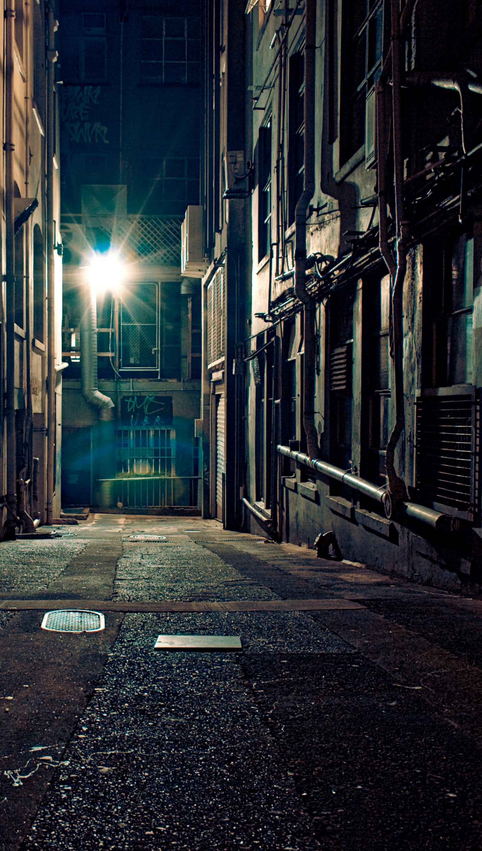
Streetlighting
Often un-metered
  counted and power consumption estimated
  Costs typically carried by the local community government
Incandescent, mercury vapour and sodium vapour are high energy users
  require frequent replacement
LED lights use less energy and last longer
  Savings in energy and service labour
  expect 60% less energy, 2 X life
Work with local suppliers to establish specific details

Slide 46
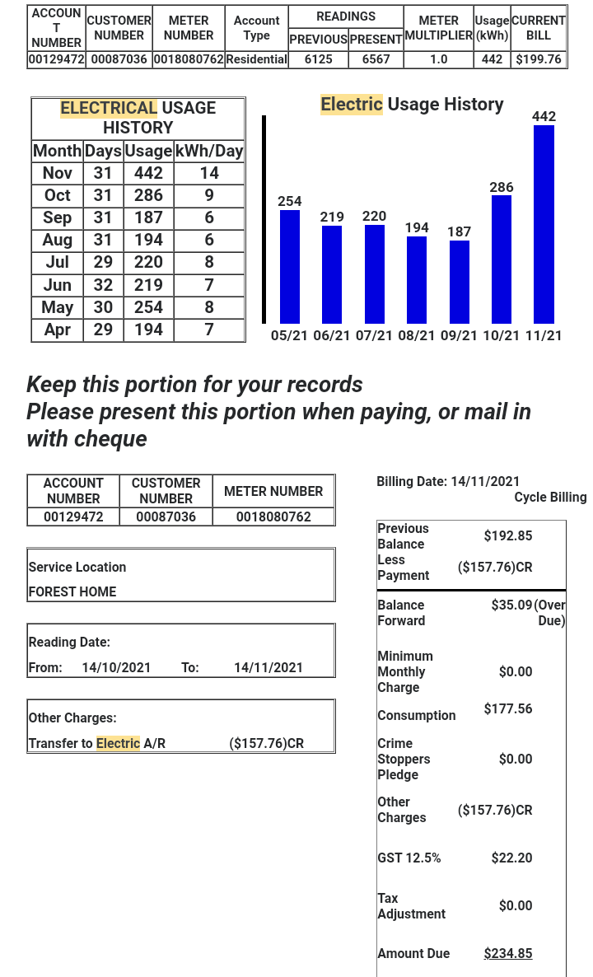
BEL bill
Customer info
  Number, account, etc.
  Account type (rate)
Meter information
  Previous and present reading
  Units and factors
  History
Dollars and cents
  Energy consumption charge
  Other charges and adjustments
  Tax
Different for different account types

Slide 47
Stretch Break: 5 minutes
If you can, post a picture of an appliance label in the chat

Slide 48
Electric Utility Efficiency Programs
Electricity Utilities often have efficiency programs
  Good practice not to waste electricity
  Reduces costs but also sales
  Called DSM
    Demand Side Management

Slide 49
BEL: Lighting Advice
Turn off any lights you don’t need, but make sure you have enough lighting on stairs and hallways.
Use Compact Fluorescent bulbs. They burn 75% less electricity than regular incandescent light bulbs (yellow light)
Consider how much light you need and see if you can take out one or two bulbs from a multiple light fitting.

Slide 50
BEL: Lighting Advice
Spotlights can be more expensive to run than other lighting, so avoid leaving them on for a long time.
Fluorescent tubes give out more light and are good for kitchens.
Good advice! Consider also:
Switch to LED’s
  Light Emitting Diodes, available in most types (bulbs, tubes, colour, dimmable)
  More efficient than CFLs (compact fluorescent lamps)
  Do not contain mercury
  Longer life
Motion sensing
Timers
Photocell activation

Slide 51
Lighting Links
Identify local suppliers
https://www.petersglassshop.bz/?p=336
  10 hours a day for lights may be high
Watch for local programs and incentives
  Utility, government, others
  Some LED upgrade programs in the news
https://energy.gov.bz/bulb-exchange-program-in-stann-creek/
https://www.publicservice.gov.bz/index.php/medias/news-and-events/item/130-energy-conservation-measures-by-installing-led-lights-in-public-buildings

Slide 52
BEL: Refrigerator Advice
Good advice!
Don’t put your fridge or freezer next to a cooker or in the sun.
Make sure air can circulate around the back of your fridge or freezer and keep the back (or vents) dust free.
Load and unload the fridge as quickly as possible. Don’t leave the fridge door open for longer than you need to.
Never put hot food in a fridge or freezer. Let it cool first.
Defrost your fridge or freezer regularly. Ice should never be more than a quarter of an inch (6mm) thick around the ice box

Slide 53
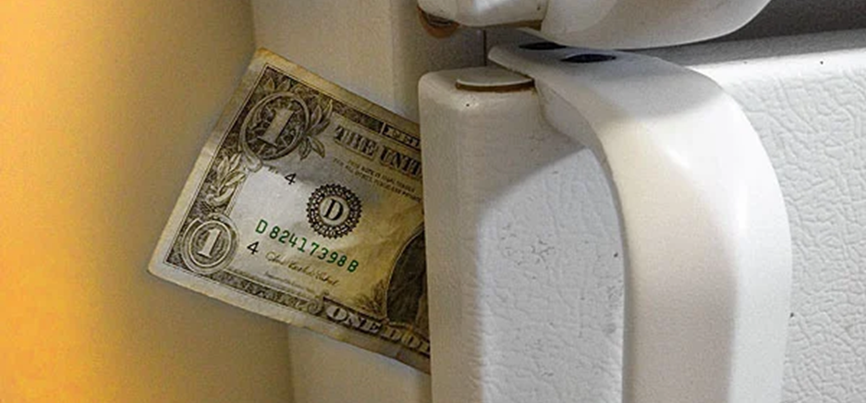
BEL: Refrigerator Advice
Good advice!
Upright freezers are less efficient than chest freezers as cool air drops out of an upright freezer when you open the door.
Use a thermometer to make sure you have set the thermostat in your fridge or freezer to the correct temperature. If it’s too low your appliance will use more energy and will not keep your food as effectively.
Check for gaps in door seals that could let warm air in. Place a piece of paper in the door, if you can easily remove the paper with the door closed, then the door is letting warm air into the fridge.

Slide 54
BEL Appliances Advice
Parasitic loads:
  When you’re not using them, switch appliances off. This may seem obvious, but it’s easy to leave a TV on when we leave the room and forget about it!
  Try not to leave phones or other items charging overnight. A few hours are usually all that’s needed.
  Appliances like your TV, DVD player and games console use energy even when you’re not using them. Some appliances can use up to 90% in standby mode which, in some homes, is the equivalent to leaving a 100W light bulb on all year!
Use a plug load meter to track these down!

Slide 55
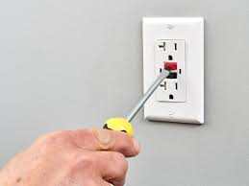
BEL Appliances Advice
Towel dry your hair so you don’t have to use your hairdryer as much.
  True, tough sell, not for everyone
Good advice!
In addition:
Timers
Power bars with timers or switches
Look for labels, MEPS standard or mark
Changing behavior is hard – not worth it for small savings
Standby losses can be very high
Parasitic loads – as discussed, also safety plugs (GFCI)

Slide 56
BEL Laundry Advice
Washing machine or tumble dryer.
Use economy settings on your washing machine for small loads or laundry which is not very dirty.
If the weather is fine, dry your laundry outside.
Make sure the filters in your tumble dryer are fluff free.
You won’t have to iron everything if you don’t turn up the tumble dryer thermostat too high or dry your clothes for too long.
Hang up or fold clothes straight after drying to cut down on ironing time.
Plan your ironing so you don’t have to keep changing the temperature setting on your iron. Iron the clothes that need a cooler setting first, and finish with clothes that need the hottest setting.

Slide 57
Restricted Supply!
Caulker Caye Generator repair electricity tips:
  Reduce use of air conditioners and turn off when leaving the room.
  Place the refrigerator thermostat on medium.
  Turn off lights when not in the room.
  Unplug phone charges and similar devices when charging is complete.
  Do not leave hot water running unnecessarily in the shower.
These actions have a significant effect on loads

Slide 58

Appliance Example: Fans
Many different types
Measure of efficiency is how much air is moved for the power used (cfm/Watt)
Cubic feet per minute per Watt
  rarely indicated by the seller
Efficiency = $\frac{What you get}{What you start with}$ = $\frac{Air flow (CFM)}{Power Consumption (W)}$
Freestanding fans
  Pedestal, Oscillating, Box, Tower
Power consumption varies widely with type, quality & size
  Rarely greater than 100W
  50 W or less on average

Slide 59
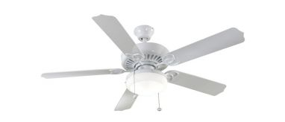
Appliance Example: Fans
Ceiling Fans
Typically more efficient (more cfm per Watt)
Power consumption lower, air flow higher
  Best models can be below 30 W
  Not great for cross flow ventilation
US Energy star data is a good reference
  https://www.energystar.gov/productfinder/product/certified-ceiling-fans/
Lots of online discussion
For example:
  https://ecocostsavings.com/fan-power-compared/

Slide 60
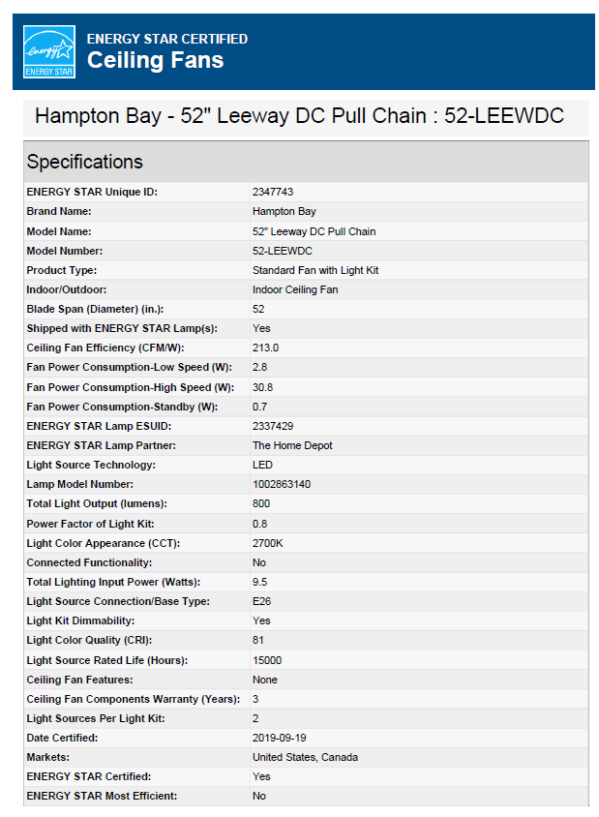
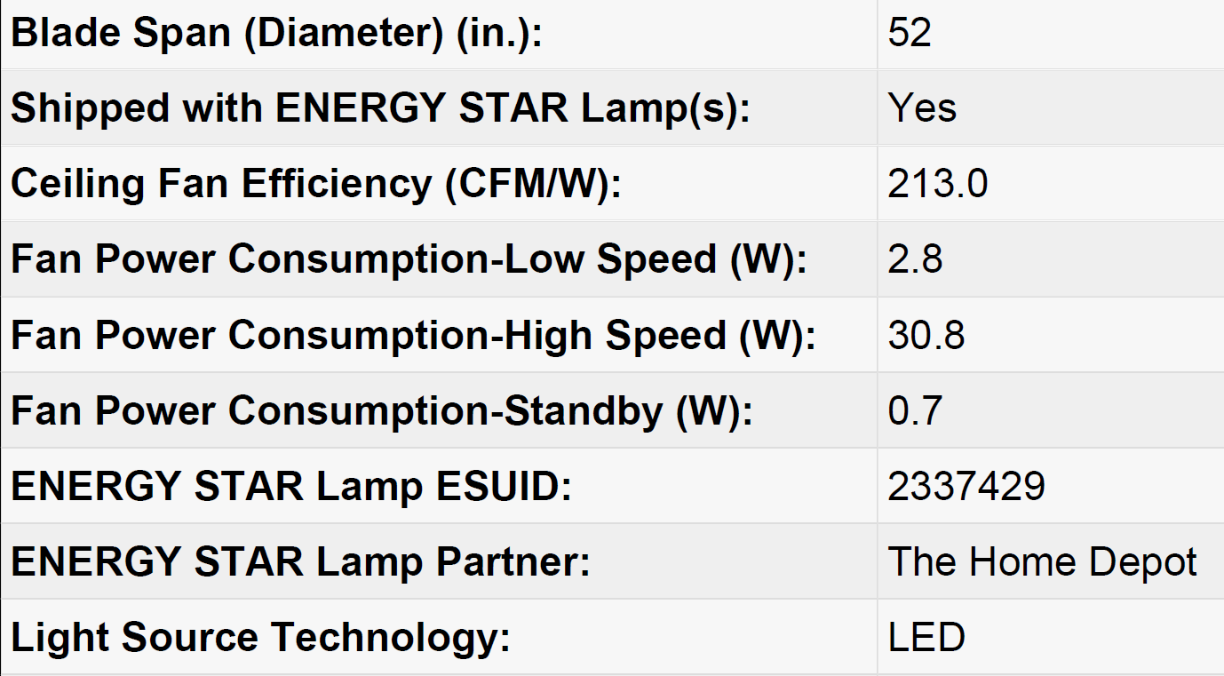
Energy Star Ceiling Fan
Local product research is required
Look at the label
  Power numbers may be indicated

Slide 61
Energy Star
USA / Canada
https://www.energystar.gov/
A reference for what is available
Identify energy saving features
Appliances
  Air Purifiers (Cleaners)
  Clothes Dryers
  Clothes Washers
  Dehumidifiers
  Dishwashers
  Freezers
  Refrigerators
Many others
  Air Conditioners
  Water Heaters
  Lighting
  Office equipment
  Electronics
  Water coolers

Slide 62
Window Air Conditioners?
Potential to be a growing electrical load
Best used in a closed room
  Better if well sealed AND insulated
Old units can be very inefficient
  Wear and tear
  Recent improvements in technology
  changes in refrigerants
Do you see these used in homes or businesses?
  Will discuss in future session
Assignment: Send photos of old air conditioners to
James.thomson@nscc.ca

Slide 63


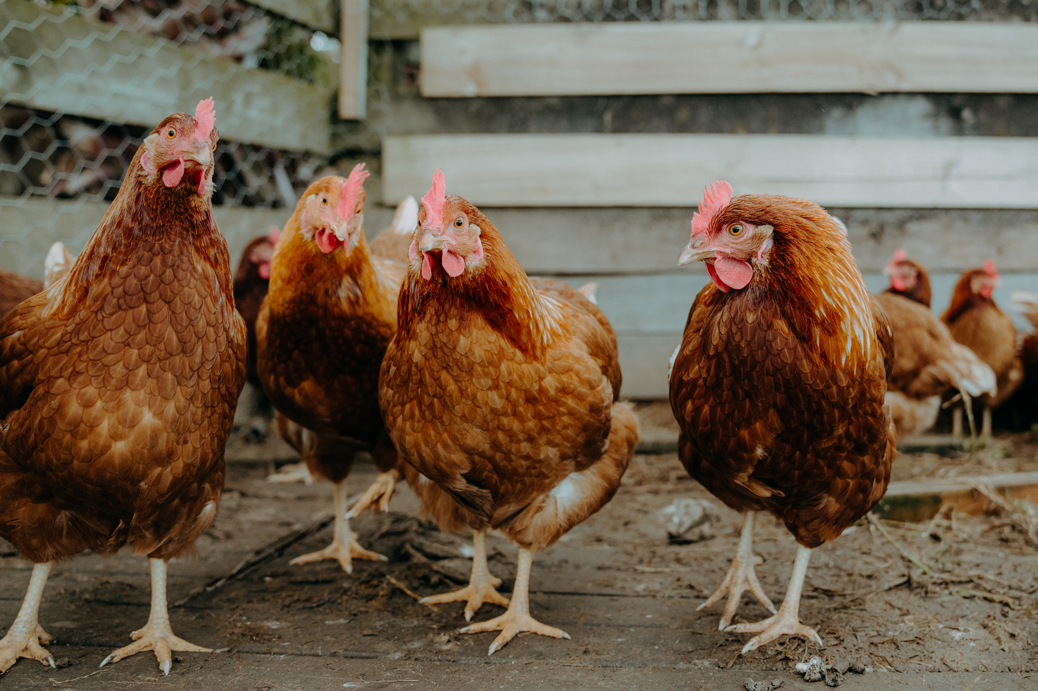
Basic Biogas
Biogas is a mix of methane and carbon dioxide
Produced when micro-organisms digest organic waste
  Anerobic – without air
A living process that requires management care and attention
Can be produced at a number of scales

Slide 64
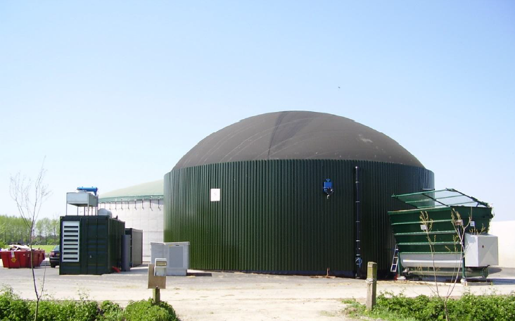
Big Biogas
Industrial scale
  Produce heat and electricity
Research lab at UB
Report: Potential Study on producible Biogas and Renewable Energy from Biomass and Organic Waste in Belize, The Caribbean Community Climate Change Centre (CCCCC), 2016
https://www.bb.undp.org/content/barbados/en/home/presscenter/articles/2017/02/06/jcccp-supports-study-on-biogas-and-renewable-energy-from-biomass-and-organic-waste-in-belize.html
Great potential:
  Municipal waste (sewer effluent & municipal solid waste)
  Banana waste is easily digestible
  Shrimp and chicken manure however has high ammonia
  Citrus waste but most already recycled

Slide 65
Community Biogas
Community scale
  RedBioLAC: Regional support organization
  http://redbiolac.org/en/
  Exchange information
  Identify and overcome technical, environmental, social and economic barriers.
  Propose projects to spread biodigester technology in LAC

Slide 66
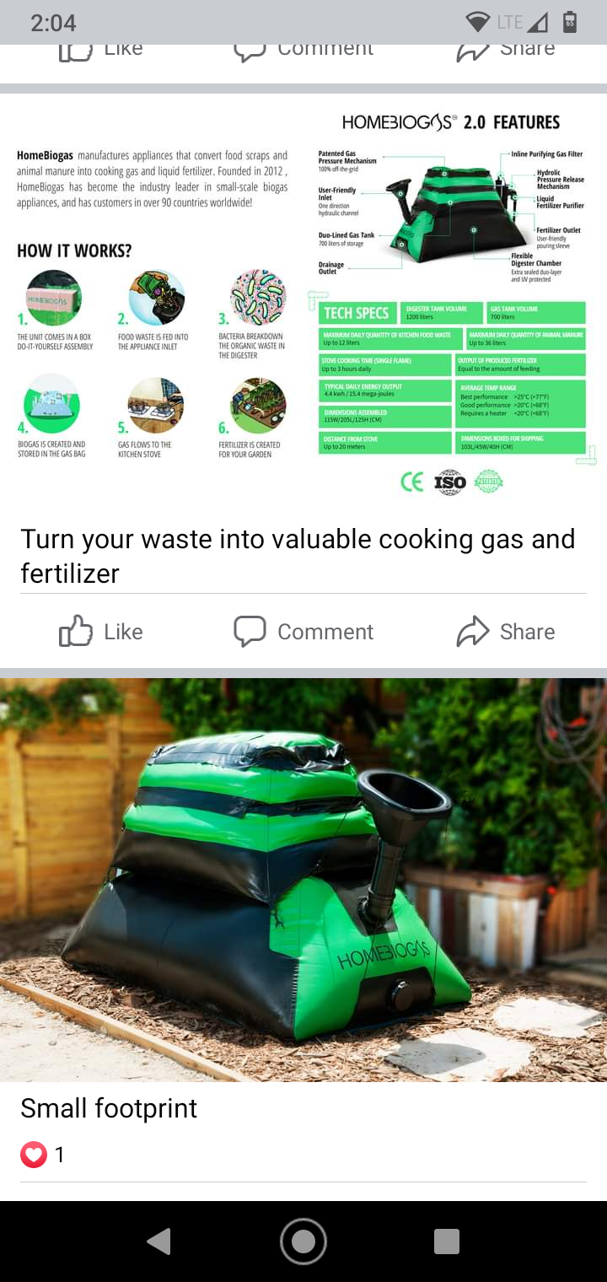
Residential Biogas
Residential scale
Commercial units
  https://www.homebiogas.com/explore/how-it-works/
DIY – Do it Yourself
Extensive online accounts and videos

Slide 67
Residential Biogas
Recap: Biogas is a mix of methane and carbon dioxide
Produced when micro-organisms digest organic waste
  Anerobic – without air
Can be used for cooking with modified burners
A living process that requires management care and attention – many tiny pets!
  Good fit with agriculture
  Gardeners, hobbyists, experimenters
May be limited opportunity in urban environments
  Odor potential
Good online resources, support

Slide 68
Questions and Feedback
Any questions?
Comments, requests and feedback?
What was your apple/mango?
What was your onion/noni?
Next up – Gord to discuss PV materials and assignments

