Slide 1




Design and Implementation of Pilot of a TVET Renewable Energy Course
DELIVERABLE #5 - TRAINING COURSES & PROFESSIONAL DEVELOPMENT
Session 09 (22 April 2022) for Introduction to Energy Science and Customer Audits

Slide 2

For Today:
Review: System thinking
Energy Content and Costs of Fuels
Algebra! Units!
Comparing Fuel and Electricity use

Slide 3
Renewable Energy and Energy Efficiency
Content Overview
1st Year | Term 1 | English Comm 1 | Applied Math 1 | Electricity and Circuits | Intro to Energy Science |  |  | PV Applications | Integrated Lab 1
 | Term 2 | Customer Relations and Audits 1 | Energy, Buildings and Equipment | Electricity and Circuits 2 |  | PV System Installation |  |  | Integrated Lab 2
 | Term 3 | English Comm 2 | Applied Math 2 | Photovoltaic System Installation |  | Solar Hot Water Systems |  |  | Integrated Lab 3
2nd Year | Term 4 | English Comm 3 | Energy Efficiency Measurement and Verification | Energy Use Modeling & Analysis | Advanced Energy System Design |  |  | Small Wind Design and Operation | Integrated Lab 4
 | Term 5 | Projects and Comms 1 | Technical Drawing | Economic Analysis of Energy Systems |  | Solar PV System Design | Solar PV System Design |  | Integrated Lab 5
 | Term 6 | Projects and Comm 2 | Electricity Codes and Regulations | Business Operations and Entrepreneurship |  | PV System Maintenance & Operation | PV System Maintenance & Operation |  | Integrated Lab 6

Slide 4


Advanced Concept: System Thinking
Inputs:
Outputs:
What inputs and outputs?

Slide 5
Advanced Concept: System Thinking
Inputs:
Fuel
Electricity
Sunshine
Food
Water
Air
Outputs:
Combustion products
Reflected Sunshine
Heat
Waste
Air
What goes IN = what goes OUT
What crosses the SYSTEM BOUNDARY ?
Mass in = mass out : Conservation of mass
Energy in = energy out : Conservation of energy
These concepts are key to tracking energy use

Slide 6
Advanced Concept: System Thinking
Inputs:
Fuel
Electricity
Sunshine
Food
Water
Air
Outputs:
Combustion products
Reflected Sunshine
Heat
Waste
Air
No magic, basic accounting
Tracking all energy use is important
Common comparisons are required
  Same energy units
  Dollars
Electricity in kWhrs, Joules
Fuel in? pounds, liters, barrels, cubic meters & feet etc.

Slide 7



Fossil Fuel Impacts
Plentiful resource
Energy dense
Transportable
Geographically distributed
Combustion on a large scale is altering our climate
Prices?
  Volatile

Slide 8

Climate Change
800 Gt of Extra CO2 and rising
800,000,000,000,000 kg
100,000 kg per person
38 m x 38 m x 38 m
  Also a very small part of the
  atmosphere
Belize is a “net carbon sink” due to FOLU
  Sink = drain, removal; FOLU = Forestry and Other Land Use
  Energy is your dominant emission
  Forests absorb and sequester much larger amounts of carbon
  They always did, so the emissions remain a problem
  Look after forests!
http://www.grisanik.com/blog/how-much-carbon-is-in-the-atmosphere/#:~:text=Furthermore%2C%20multiplying%20Earth's%20atmosphere%205.137,atmosphere%20is%20~3%2C208%20Gt%20CO2.

Slide 9
https://unfccc.int/documents/274001
Belize’s First Biennial Update Report To The United Nations Framework Convention On Climate Change
- Various methods, estimates

Slide 10

Notes
First report, Net carbon sink
Various methods and estimates
Historical variation due to weather, level of reporting and estimates – just like energy use reporting
General rise in almost all sectors
Sea level rise a concern
  Belize is counted as one of 44 Small Island Developing States (SIDS)

Slide 11


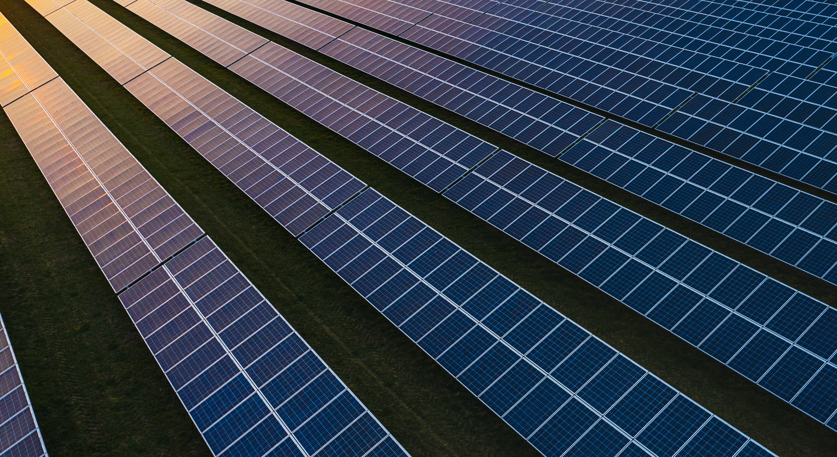

Notes
Energy up in transport, electricity and “other”
  a small increase in wood for cooking purposes was noted
Industrial emissions dominated by refrigerants
Agriculture emissions from manure, fermentation, biomass
Waste emissions from burning and sewage trending down
Transport and electricity high priorities
Deforestation, forest fire management as well

Slide 12
Questions and Discussion
What do people around you say about Climate Change?
What do people around you say about energy prices?

Slide 13
Fuel Energy Values & Emission Factors
Petroleum fuels are called hydrocarbons
Combinations of Carbon atoms bonded with Hydrogen atoms
Combustion releases energy in these bonds when they react with oxygen in the air
Oxidization (fire)
H
H
C
H
H
O
O
O
O

Slide 14
Fuel Energy Values & Emission Factors
Simplest HC: Methane
  One Carbon atom bonded with 4 Hydrogen atoms
  CH₄ - a gas (at atmospheric pressure)
Oxygen exists in air
  Bonded in pairs - O₂
Combustion Process
Ch₄ + 2 O₂ = CO₂ + 2 H₂O + Energy
H
H
C
H
H
O
O
O
O
H
H
H
O
C
O
O
H
O
ENERGY

Slide 15
Fuel Energy Values & Emission Factors
Hydrocarbons vary in length
  Each added Carbon atom bonds with 2 Hydrogen atoms
  C₂H₆ = Ethane, a gas
  C₃H₈ = Propane, a gas
  C₄H₁₀ = Butane (boils at ~ 0 C)
  C₅H₁₂ = Pentane (boils at ~ 36 C)
  And so on
Larger heavier molecules have more Carbon
  Greater carbon dioxide release
H
H
C
H
H
C
H
H
C
H
H
C
H
H

Slide 16
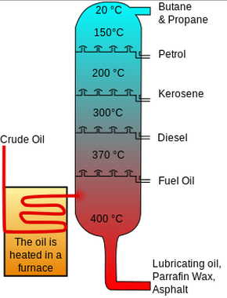
Fuel Energy Values & Emission Factors
Unrefined petroleum is a mixture of many hydrocarbons
Mix varies with the geology
Belize: Light Sweet Crude
Fractional Distillation separates component groups

Slide 17
Fuel Energy Values & Emission Factors
Refining process separates the mixture into fractions
  LP gas
  Petrol (gasoline)
  Kerosene
  Diesel
  Fuel oils
  Lubricants, heavier products

Slide 18
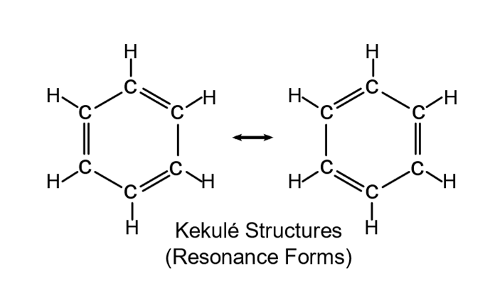
Chemistry of Fuels
Hydrocarbons vary in structure
  Chains, rings, branches
Fuels are mixtures of groups of hydrocarbons
LP gas – Liquid petroleum gas
  Belize – mostly butane (70% butane, 30% propane)
  Colder regions – mostly propane
Energy released measured for each fuel type
  Standards define the blend for various fuel types
  Definitions needed for commercial reasons
  Several Organizations: API, ASTM, BS, DIN, JIS
  Required for high precision calculations
Diagram By Vladsinger - Own vector drawing based on layout of en:File:Benzol trans.png., CC BY-SA 3.0, https://commons.wikimedia.org/w/index.php?curid=7536474

Slide 19
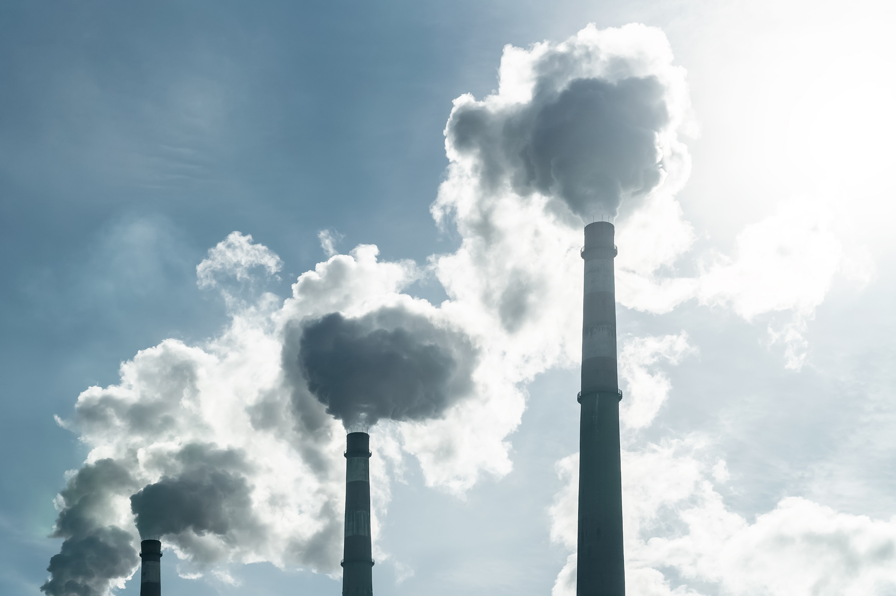
Fuel Energy Values & Emission Factors
Combustion gases contain water vapor, Carbon Dioxide and others
Energy released on combustion depends on the final condition of these gases
Steam has more energy than water

Slide 20
Fuel Energy Values & Emission Factors
HHV = Higher Heat Value
  Gross Heating Value
  Counts the energy in the water vapour
  Can be captured by condensing boiler designs
LHV Lower Heat Value
  Net Heating Value
  Does not count the energy in the combustion gases
  Carried away by the exhaust
Tables of energy content list one, the other or both
HHV represents the full available energy
H
H
O
O
H
C
O
H
O
ENERGY

Slide 21
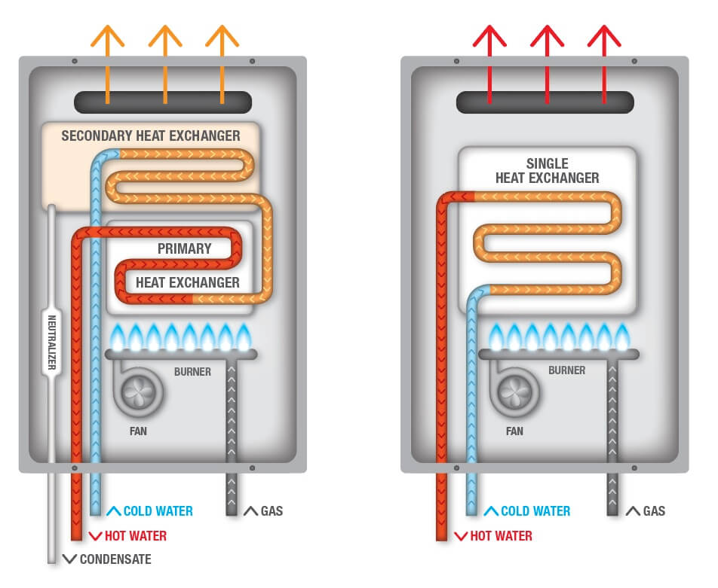
Condensing Hot Water Heater
Non-condensing
70 – 85% efficient
Condensing
90 – 95%
efficient

Slide 22


Heat of Combustion
Energy Released per unit of fuel mass
  MJ/kg (Megajoules per kilogram)
  BTU/lb (British Thermal Units per pound)
  Gravimetric energy density
Independent of temperature
  Directly related to the number of carbon atoms in the fuel
Proportional to Carbon dioxide emissions
Most common reference
Fuels not always sold by weight or mass
Added factors sometimes needed

Slide 23
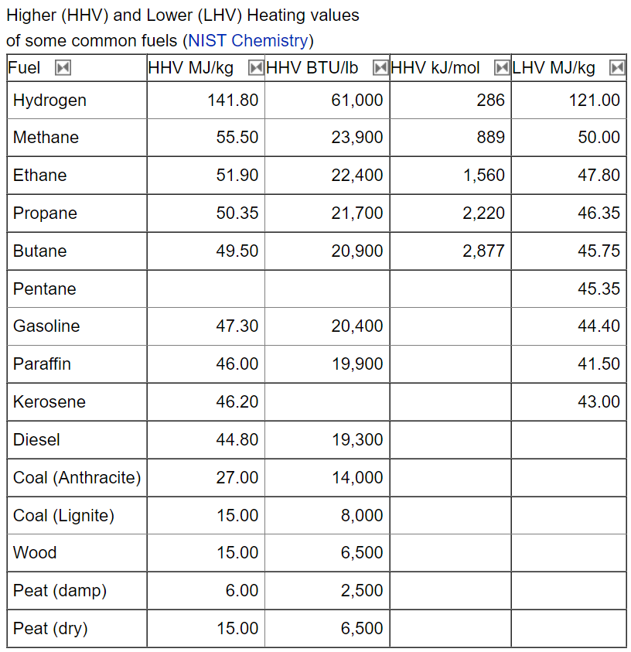
HHV vs LHV
Gravimetric values
Per unit weight
HHV vs LHV
  10%
http://www.thermalfluidscentral.org/encyclopedia/index.php/Heat_of_Combustion

Slide 24
Volumetric Heat of Combustion
Energy Released per unit of fuel volume
  MJ/l (Megajoules per liter)
  BTU/gal (British Thermal Units per gallon)
  Typically, US gallon unless specifically labeled Imperial gallon
Not independent of temperature
  Liquids expand and contract as the temperature varies
  Fuel standards set a reference temperature
Mostly proportional to Carbon dioxide emissions
Can calculate from gravimetric data and density data
  Density = mass per volume
  Consult tables
Government weights and measures regulations apply
https://www.ic.gc.ca/eic/site/mc-mc.nsf/eng/lm04920.html
https://bbs.gov.bz/wp-content/uploads/2016/11/Cap-294-National-Metrology-Act.pdf

Slide 25
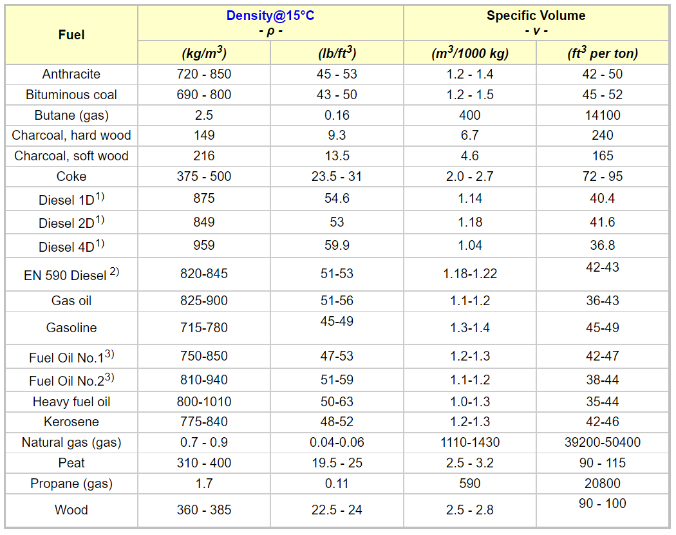
Fuel Density
Many products with many classes and specifications
Temperature and pressure affect the values
Generally stated at atmospheric pressure
LP gas delivered at pressures high enough to turn the gas into a liquid
https://www.engineeringtoolbox.com/fuels-densities-specific-volumes-d_166.html

Slide 26
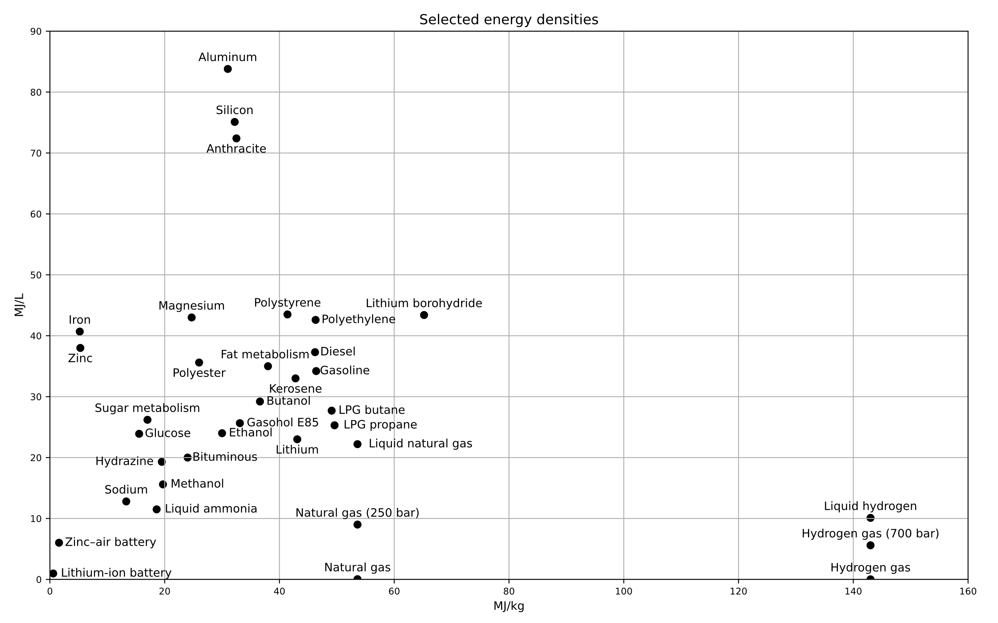
By Scott Dial - Own workData Source: Energy density, Lithium-ion battery, Public Domain, https://commons.wikimedia.org/w/index.php?curid=5551431
Selected Energy Densities

Slide 27
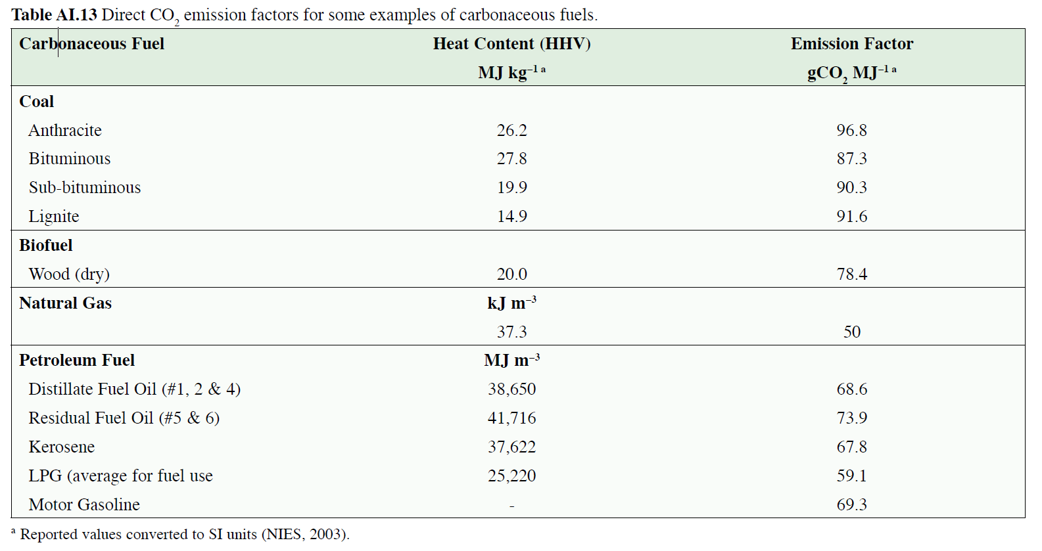
Emission factors
IPCC reports offer good sources, all online, large
Reported vs Energy (MJ) or other units (mass, volume…)
46.94 (2)
https://www.ipcc.ch/site/assets/uploads/2018/03/srccs_annex1-1.pdf
(2) https://www.claverton-energy.com/wordpress/wp-content/uploads/2012/08/the_energy_and_fuel_data_sheet1.pdf

Slide 28
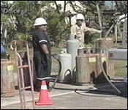
LPG in Belize
70% Butane
30% Propane
What is the energy in a 100 pound cylinder?
  Gather energy data
  Calculate energy in mix
  Apply to the quantity of LPG purchased
Need to compare across energy sources
  MJ per pound, kilowatt hours
  Fuel mixture
Some Algebra required…..

Slide 29
Stretch Break
5 minutes
Reflect on positive experiences with Algebra…..

Slide 30

Algebra and Unit Conversions
Why Algebra?
Accurate conversion from one unit of measurement to another
Make and check your own conversion factors
Allow comparison of energy use on equal terms
  Energy units
  Dollars

Slide 31

Why Algebra?
Find an answer to a question
Express your question, or problem, as an equation
Mathematically manipulate the equation to find your answer.
Algebra, like grammar, employs rules many of us have forgotten

Slide 32

Why Algebra?
Some Algebra Rules:
  Identities
  Rule of Symmetry
  Commutative Rule
  The inverse of adding
  Two rules for Equations
  Reciprocal Rule and Division
https://www.themathpage.com/Alg/rules-of-algebra.htm
https://www.euclideanspace.com/maths/algebra/equations/rules/index.htm

Slide 33
Identities
Identity of Multiplication
1 x a = a
Identity of Addition
a + 0 = a
Negative of a negative
- (- a) = a

Slide 34

Symmetry
Rule of Symmetry:
if a = b, then b = a
  a and b represent values for things we may be interested in
Example:
2 $US = 4 $BZ so….
4 $BZ = 2 $US
Both sides are equal
Side of the equation does not mater

Slide 35
Commutative Rule
Commutative Rule
  a x b = b x a
  ab = ba (abbreviated notation)
Order does not matter for multiplication
  The terms can be reversed
com·mu·tate, verb, /ˈkämyəˌtāt/
regulate or reverse the direction of (an alternating electric current), especially to make it a direct current.
"commutating coils"

Slide 36
Inverse of adding
The inverse of adding
a + (−a) = 0
5 + 4 = 9
5 + 4 + (-4) = 9 + (- 4) = 5
The opposite of an operation, the inverse, undoes that operation
Example: reversed charge at the bank
  A debit and credt for the same value cancels out, has zero effect

Slide 37
Two Rules for Equations
Rule 1:
  if a = b, then
  a + c = b + c
We may add the same number to both sides of an equation.
“If equals are added to equals, the sums are equal.”
  Little used in conversion math
  Used in temperatures, geometry

Slide 38
Two rules for Equations
Rule 2: if a = b, then
a x c = b x c
ac = bc
  We may multiply both sides of an equation by the same number.
Currency Example
1 $US = 2 $BZ so….
5 x 1 $US = 5 x 2 $BZ = 10 $BZ
We do this all of the time!

Slide 39

The definition of division
$\frac{a}{b}$ = a x $\frac{1}{b}$ = $\frac{1}{b}$ x a
a divided by b is equal to a times the reciprocal of b
  We may rewrite any fraction as the numerator times the reciprocal of the denominator.
$\frac{numerator}{denominator}$ represents division: ÷
Examples:
3 / 4 = 3 ÷ 4 = $\frac{3}{4}$ = 3 x $\frac{1}{4}$ $\frac{5}{1/3}$ = 5 x 3

Slide 40
Algebra and Conversions
Express your problem as an equation
Manipulate the equation by
  Apply the same operation to each side of the equation
  Multiply and divide anywhere by terms that have the value of 1 (unity conversion factor)
  https://www.themathpage.com/Alg/rules-of-algebra.htm

Slide 41
Algebra and Conversions
Basic Identities: a x 1 = a; a+0 = a; -(-a) = a
Rule of Symmetry : if a = b, then b = a
Commutative Rule: a x b = b x a; ab = ba
The inverse for adding: a + (−a) = (−a) + a = 0
Two rules for Equations:
  Rule 1 : if a = b, then a + c = b + c
  Rule 2: if a = b. Then a x c = b x c; ac = bc
Division: a / b is equal to a x reciprocal of b

Slide 42

Algebra and Conversions
Example:
We know that 1 kilogram is the same as 2.205 pounds
1 kg = 2.205 pounds
    Divide each side by 1 kg…..
$\frac{1 kg}{1 kg}=\frac{2.205 pounds}{1 kg}$
1 = 2.205 $\frac{pounds}{kg}$ , a unity conversion factor

Slide 43
LPG in Belize
https://en.wikipedia.org/wiki/Energy_density
  70% Butane: 49.1 MJ/kg
  30% Propane: 49.6 MJ/kg
Weighted average:
  70% x 49.1 = 34.37 (MJ in 0.7 kg)
  30% x 49.6 = 14.88 (MJ in 0.3 kg)
  Total = 49.25; rounded = 49.3 MJ/kg of mixture
Values are very close
Use Butane data as a close approximation
Sharpen your pencil when required
70% Butane
30% Propane

Slide 44
Detailed check from common reference
Marks Standard Handbook for Mechanical engineers, 3rd Edition
Table 4.1.6
  HHV Propane = 21670 BTU/lb
  HHV Butane = 21316 BTU/lb
  BTU x 1055.056 = B J
  1055.056 J/BTU
  lb x .4535924 = kg
  .4535924 kg/lb; 2.204622 lb/kg

Slide 45

Detailed check from common reference
Butane
21316 $\frac{BTU}{lb}$ x 1055.056 $\frac{J}{BTU}$ x 2.204622 $\frac{lb}{kg}$ = 49.58 $\frac{MJ}{kg}$
Propane
21670 $\frac{BTU}{lb}$ x 1055.056 $\frac{J}{BTU}$ x 2.204622 $\frac{lb}{kg}$ = 50.40 $\frac{MJ}{kg}$
70/30 blend = 49.83 MJ/kg ------- 1% difference
probably more to do with fuel standards and purity of the gases measured
Bottom line: don’t sweat a few percent
Use Butane values as a default

Slide 46

LPG in Belize
LPG Energy Density = 49.3 MJ/kg
Unity Conversion factor: 2.205 pounds/kg
100 pounds / 2.205 (pounds/kg) = 45.4 kg
100 lbs = $\frac{100 lbs}{2.205 lbs/kg}$ = 100 lbs x $\frac{1}{2.205}$ $\frac{kg}{lbs}$ = $\frac{100}{2.205}$ x $\frac{lbs x kg}{lbs}$
100 lbs = 45.4 kg
Energy Content = Mass x Energy density
E = 49.3 MJ/kg x 45.4 kg = 2238 MJ in a 100 lb. cylinder

Slide 47

LPG & Electricity
Compare between
  Electricity measured in kilowatt hours
  LPG measured in MJ
Need a conversion factor
  Online-Calculators
  Reference materials (printed and online)
  Physics and algebra
              VS

Slide 48

LPG & Electricity
Old school: a reference book
Online calculators
  No guarantee of accuracy
  Check one against another
  Many options with more or less capability
Why free ? Advertising, added functions with paid version….
  https://www.calculatorsoup.com/calculators/conversions/energy.php
  https://www.onlineconversion.com/
  https://www.unitconverters.net/
Better: use reputable reference sources
  https://www.nist.gov/pml/weights-and-measures/metric-si/unit-conversion
  https://www.nist.gov/pml/special-publication-811/nist-guide-si-appendix-b-conversion-factors

Slide 49
Or use Excel
Cross
Check!

Slide 50
LPG Example
Compare to Electricity
Conversion relation: 1 MJ = 0.277778 kWhr
  Unity Conversion factor = 0.277778 kWhr/MJ
Conversion relation: 1 kWhr = 3.6 MJ
  Unity Conversion factor = 3.6 MJ/kWHr
  1/3.6 = 0.277778

Slide 51
LPG Example
Remember:
  Energy is an amount, a quantity
  Power (watts and kilowatts) are delivery rates
  Power = Energy delivered over a period of time
  Power (Watts) = Energy (Joules) / time (seconds)
  1 Watt = 1 Joule per second

Slide 52

LPG Example
1 Watt = 1 Joule per second; 1 Watt = $\frac{1 Joule}{1 Second}$
Rearrange:
1 Joule = 1 Watt x 1 second = 1 Watt-second
1 MJ = 1 MW-second
1 MJ = 1 MW-second x $\frac{1 hour}{3600 seconds}$ x $\frac{1000 kilo}{1 Mega}$
1 MJ = 1 MW-second x $\frac{1 hour}{3600 seconds}$ x $\frac{1000 kilo}{1 Mega}$
1 MJ = $\frac{1000}{3600}$kilowatt-hour = .27778 kWhr
Kilowatt-hours and Joules are proportional to each other

Slide 53
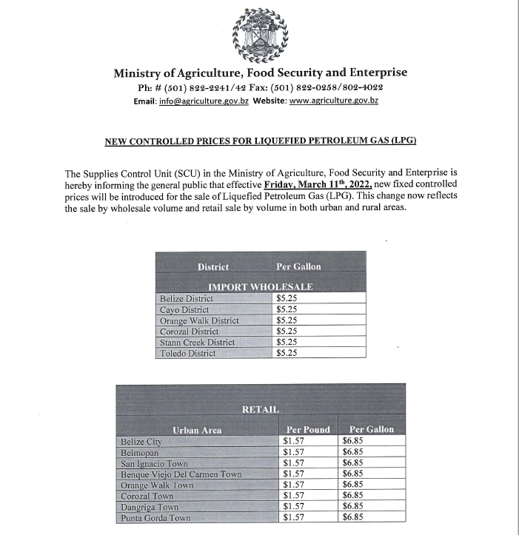
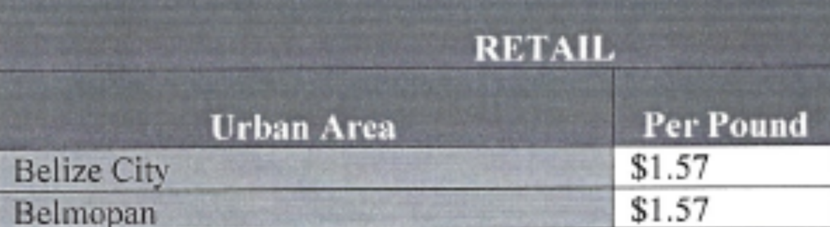
LPG Prices
Regulated by GoB?

Slide 54

LP Gas Comparison to Electricity
100 pound Cylinder, HHV = 2238 MJ
  Cost @ 1.57 / pound = $BZ 157
1 MJ = 0.277778 kWhr
2238 MJ x $\frac{0.277778 kWHr}{1 MJ}$ = 621.7 kWHr
  Cost @ $BZ 0.38 per kWHr = $BZ 236.23
Excluding any taxes!
Delivered electricity price can be as high as $BZ 0.41
Compares supplied energy to supplied energy
  Does not account for efficiency when used.
  That’s next

Slide 55
Efficiency and energy sources
Efficiency of use depends on the equipment used to provide an energy service
Most fuel sources provide heat
Or drive an engine
  Transport
  Electricity generation
For heating devices, it is important to track energy flows through your system
  Some heat will be directed at your target (food, water)
  Some will escape into the surroundings
  Some will exit with exhaust gases

Slide 56

Use System Thinking
Energy Lost to Surroundings
Efficiency = $\frac{\text{What} \text{you} \text{get}}{\text{What} \text{you} \text{start} \text{with}}$
Device Efficiency = $\frac{\text{Cooked} \text{Food}}{\text{Source} \text{Energy}}$
Efficiency = $\frac{\text{Energy} \text{to} \text{Food}}{\text{Energy} \text{to} \text{Device}}$
Rearranged:
  Energy to Device = $\frac{\text{Energy} \text{to} \text{Food}}{\text{Efficiency}}$
  Energy to Food = Efficiency x Energy to Device
  Similar to Kirchoff’s laws V = IR; I = V/R; R = V/I
Energy Delivered to Food
Cooking Device
Energy Delivered to Device

Slide 57
Condensing Hot Water Heater
Non-condensing
70 – 85% efficient
Condensing
90 – 95%
efficient

Slide 58
Water Heater
Comparison of On Demand Hot Water Heater by Efficiency and Type | Efficiency | Source Energy | Energy Yield | Cost
Older LPG Hot Water Heater | 70% | 2257 | 1580 | $157.00
Condensing LPG Hot Water Heater | 95% | 1663 | 1580 | $115.68
Electric On Demand Water Heater | 100% | 1580 | 1580 | $166.73
Best Standard LPG Hot Water Heater | 85% | 2257 | 1918 | $238.19
Worst Condensing LPG Hot Water Heater | 90% | 2131 | 1918 | $224.95
Electric On Demand Water heater | 100% | 1918 | 1918 | $202.46
We will review the calculations in another session

Slide 59
Cooking Efficiency
https://www.aceee.org/files/proceedings/2014/data/papers/9-702.pdf

Slide 60
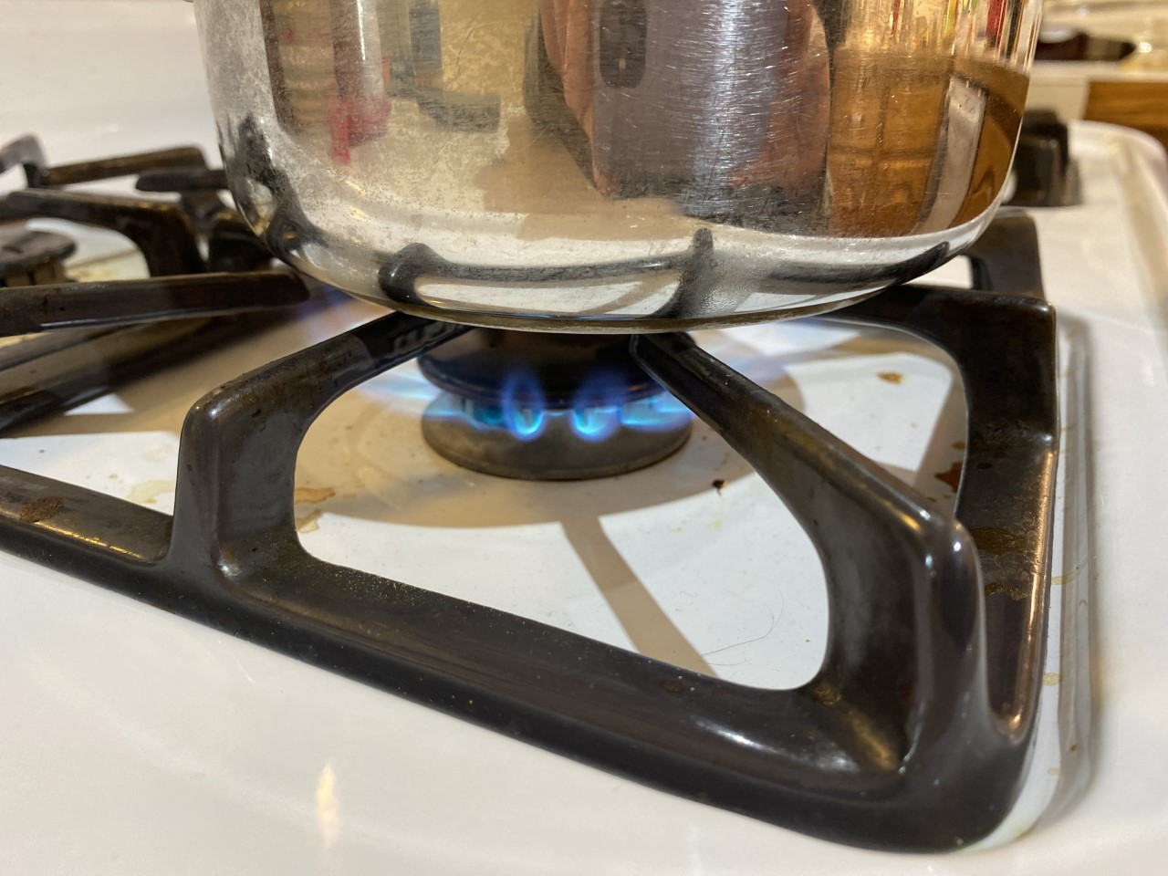
Cooking Fuel Comparison
LPG Cooking Efficiency
From earlier, 100 lbs of LPG
  2238 MJ
  $BZ 157
Gas Cooker efficiency = 30%
Energy to Food = Efficiency x Energy to Device
Energy to Food = 0.30 x 2238 MJ = 671.4 MJ

Slide 61
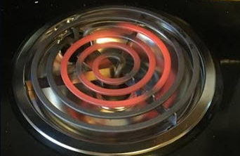

Electric Stove Comparison
Gas Cooker Energy to Food = 0.30 x 2238 MJ = 671.4 MJ
  Convert to kWhr:
  Energy to Food = 671.4 MJ x $\frac{1 kWhr}{3.6 MJ}$ = 186.5 kWhr
Energy to Food = Efficiency x Energy to Device
  Rearrange to determine input Energy:
  Energy to Device = $\frac{Energy to Food}{Efficiency}$
Energy to Device = $\frac{ Energy to Food}{Efficiency}$ = $\frac{186.5 kWhr}{0.42}$ = 440.0 kWHr
Cost = 440 kWHr x 0.38 $BZ/kWHr = $BZ 167.20
  Greater than $BZ 157.00

Slide 62
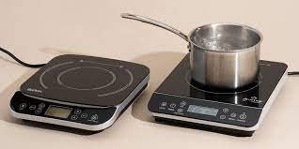

Electric Induction Comparison
Energy to Food = 0.30 x 2238 MJ = 671.4 MJ
  Convert to kWhr:
  Energy to Food = 671.4 MJ x $\frac{1 kWhr}{3.6 MJ}$ = 186.5 kWhr
Energy to Food = Efficiency x Energy to Device
  Rearrange to determine Energy to device:
  Energy to device = $\frac{Energy to Food}{Efficiency}$
Energy to device = $\frac{Energy to Food}{Efficiency}$ = $\frac{186.5 kWhr}{0.76}$ = 245.4 kWHr
Cost = 245.4 kWHr x 0.38 $BZ/kWHr = $BZ 93.25
  Less than $BZ 157.00

Slide 63
Summary
Different fuels have different energy content
  Electricity
  LPG
Different devices use energy differently
  Efficiencies vary
  Consider the final energy use
  Both affect cost of the activity
LPG Cooking: $BZ 157 for 671.4 MJ of food cooking.
Electric stove element: $BZ 167.20 for the same amount of cooked food energy (186.5 kWhr)
Induction Cooker: $BZ 93.25 for 671.4 MJ of food Cooking.

Slide 64
Renewables and Fuels
We did not consider carbon emissions from LPG vs Electricity
Process is the same but includes the emissions factors for the source energy. Stay tuned!
Electricity systems can increase their renewable content
  Not so for fuels
Solar Water Heating
  compare purchase cost vs purchase cost of water heating equipment AND energy costs
  Zero emissions
Solar PV for cooking, same

Slide 65

Questions and Feedback
Any questions?
Comments, requests and feedback?
Thanks for your time today!

