Slide 1
Design and Implementation of Pilot of a TVET Renewable Energy Course
DELIVERABLE #5 - TRAINING COURSES & PROFESSIONAL DEVELOPMENT
February 18/22 Training Session

Slide 2
Basic Solar System
Off-Grid

Slide 3
Basic 12 Volt Off-Grid Solar System
There are three basic components that make up the basic 12 volt off-grid system.
Solar PV panel
Charge Controller
Battery

Slide 4
Basic 12 Volt Off-Grid Solar System
The hands-on training will consist of the basic components as well as proper handling of the PV panel.
There will be two different panels for the training.
A 50 Watt 36 cell panel
A 120 Watt 36 cell panel
Panels come in standard cell configurations

Slide 5
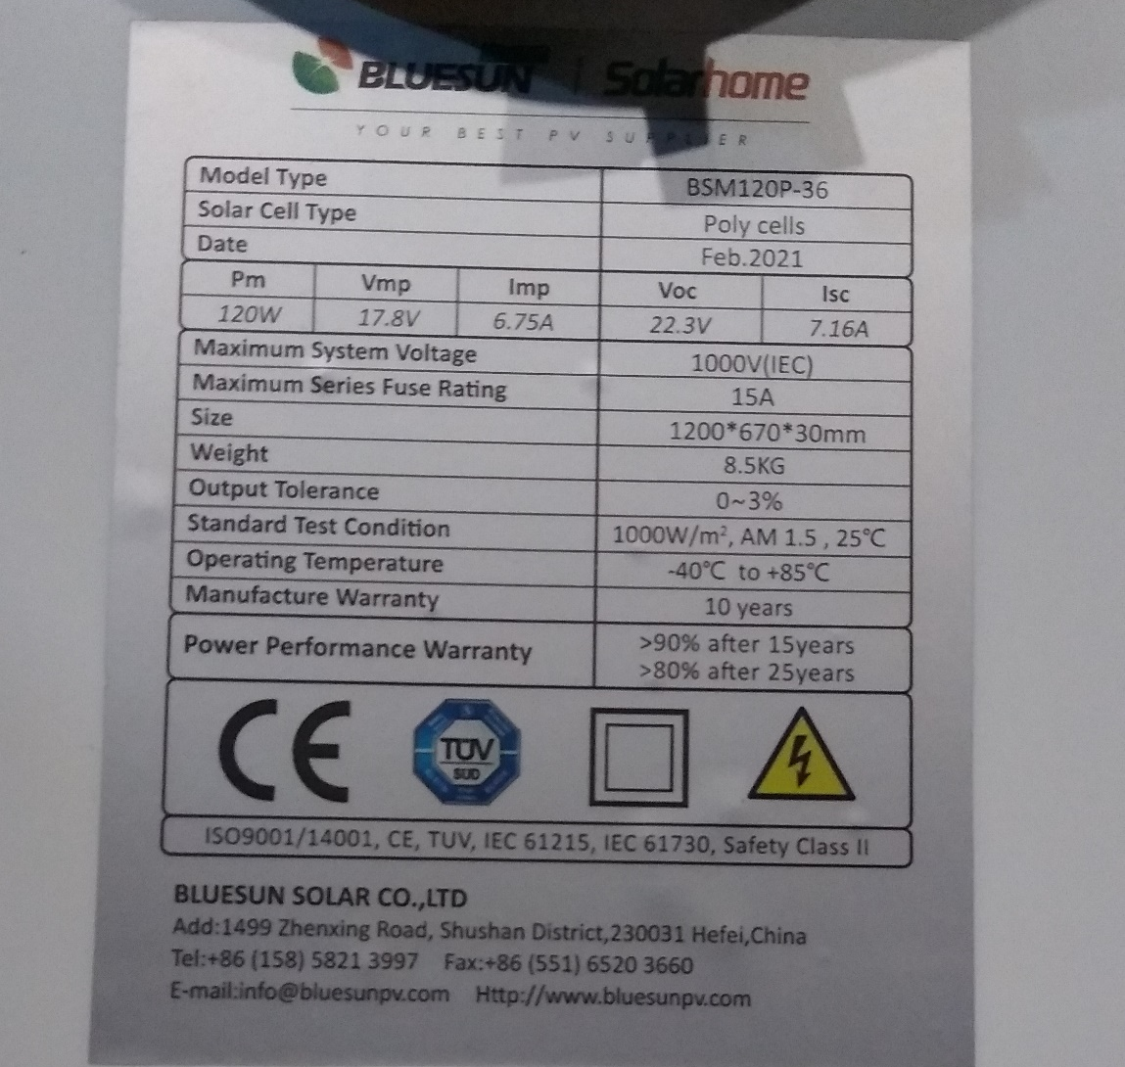
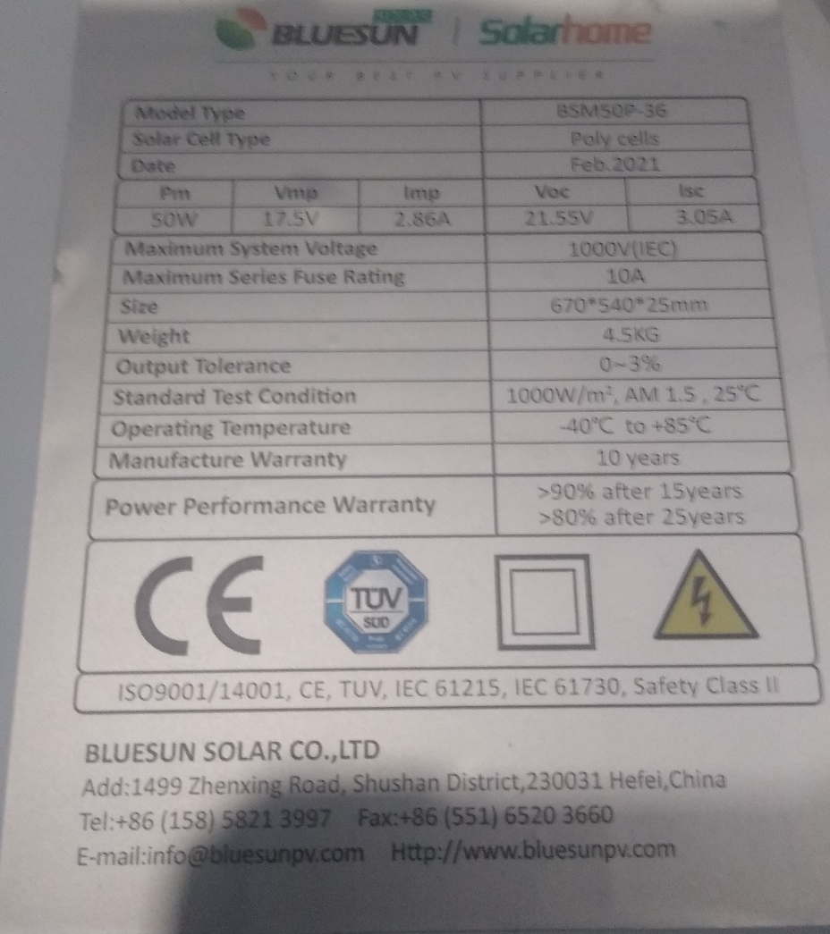
Basic 12 Volt Off-Grid Solar System
The two labels from the back of the panels. Look for Voc (Voltage Open Circuit) and Isc (Short Circuit Current).
Picture courtesy Southern Solar Solutions

Slide 6
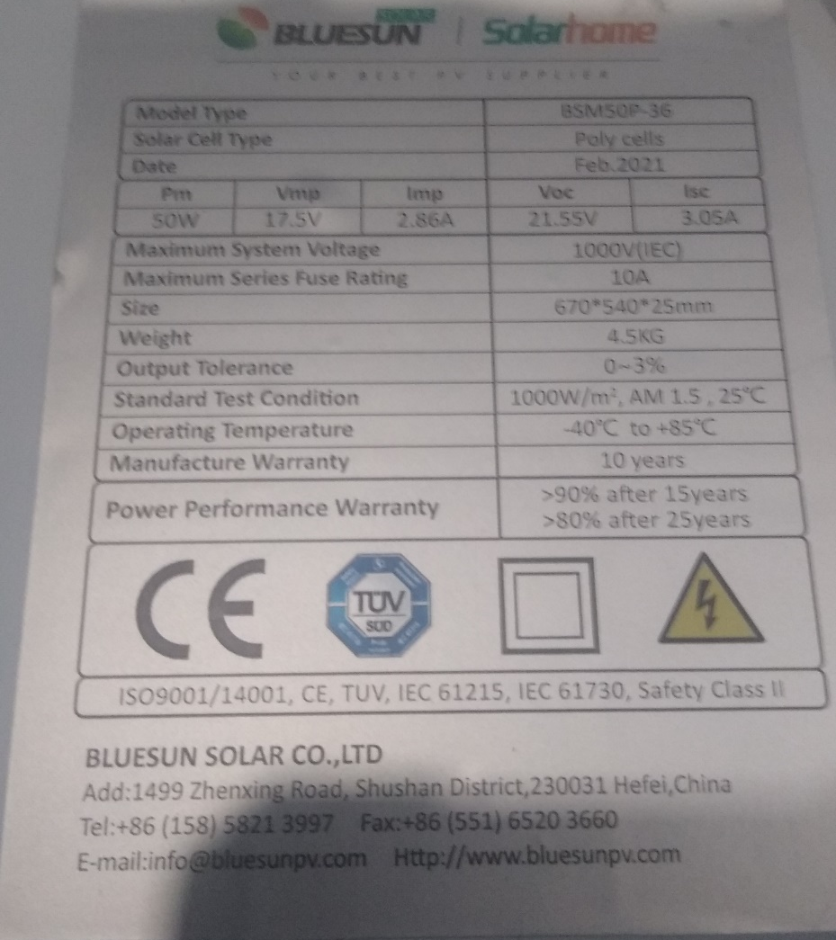
Basic 12 Volt Off-Grid Solar System
This one is the 50 Watt panel.
Voc = 21.55 volts
Isc = 3.05A
These are the STC ratings.
Picture courtesy Southern Solar Solutions

Slide 7
Basic 12 Volt Off-Grid Solar System
This one is the 120 Watt panel.
Voc = 22.3 volts
Isc = 7.16A
These are the STC ratings.
Picture courtesy Southern Solar Solutions

Slide 8
Basic 12 Volt Off-Grid Solar System
To measure the values of Voc and Isc requires a digital multimeter.
The multimeter must be able to read the range of values that the solar system can produce.
The multimeter must have an inline Ammeter capable of reading DC.
A clamp-on DC Ammeter can also be used if the multimeter can take the range of voltage that makes the readings accurate.

Slide 9
Basic 12 Volt Off-Grid Solar System
To measure the values in a solar PV system it is best to have a True RMS multimeter.
True RMS meters accurately measure non-sinusoidal waveforms.
Regular multimeters cannot accurately read the non-sinusoidal waveforms that are generated by certain solar related equipment.

Slide 10
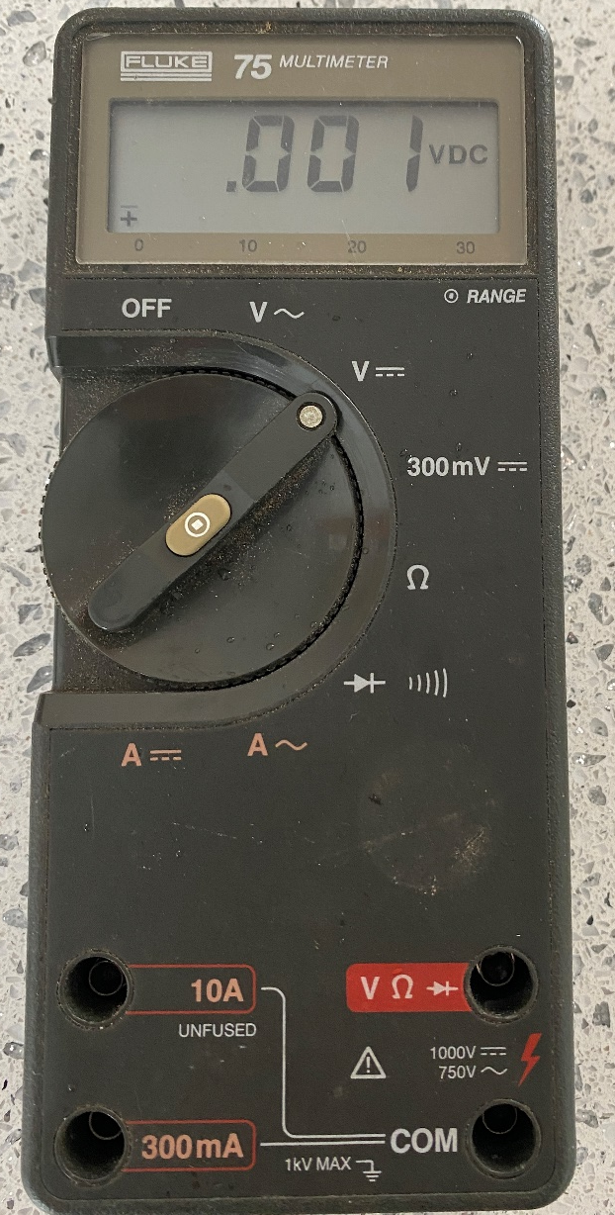
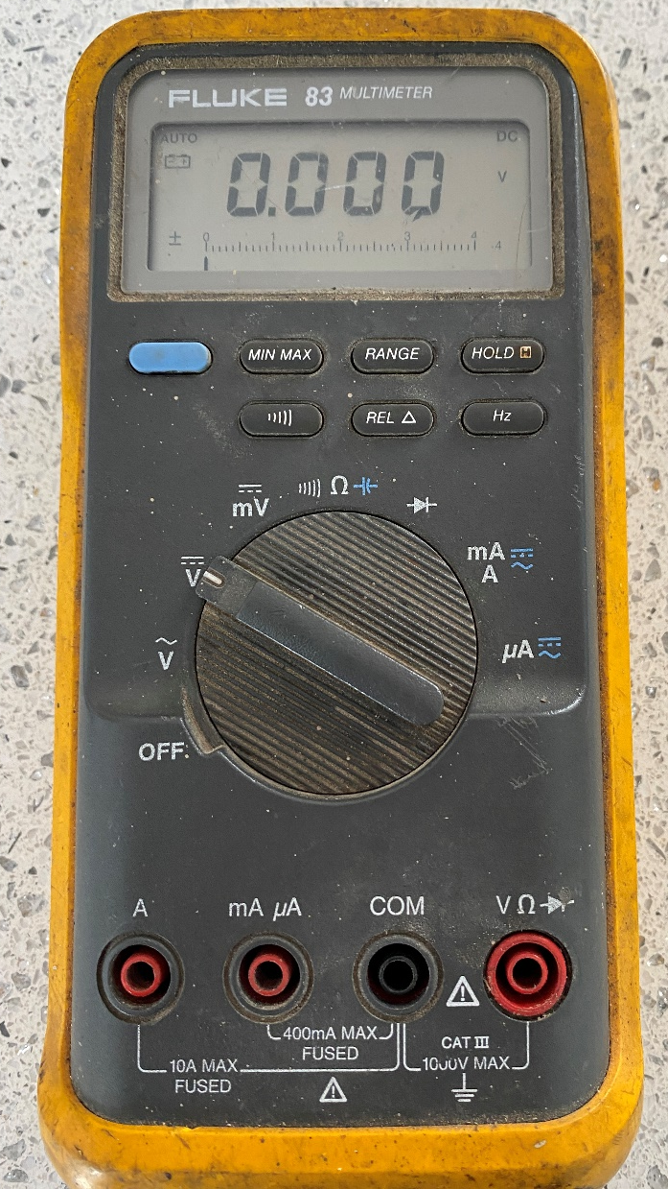
Basic 12 Volt Off-Grid Solar System
Some examples of the True RMS measuring meters.
Picture courtesy Author

Slide 11
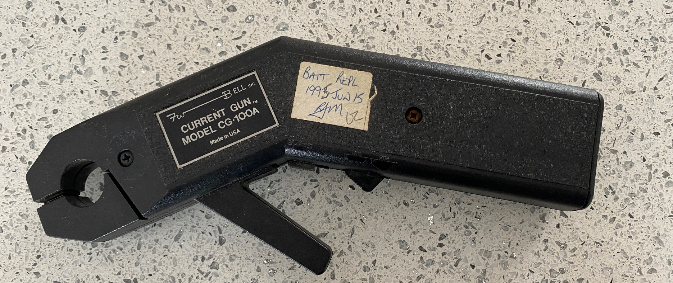
Basic 12 Volt Off-Grid Solar System
An example of a clamp-on, this one is an F.W.Bell model CG-100A.
100 Amp clamp-on.
Picture courtesy Author

Slide 12
Basic 12 Volt Off-Grid Solar System
Most DC clamp-on Ammeters require a zeroing to calibrate the reading.
This one has selectable range 10A or 100A.
1 volt output to multimeter.
Picture courtesy Author

Slide 13
Basic 12 Volt Off-Grid Solar System
Output to DC voltage input on multimeter.
Picture courtesy Author

Slide 14
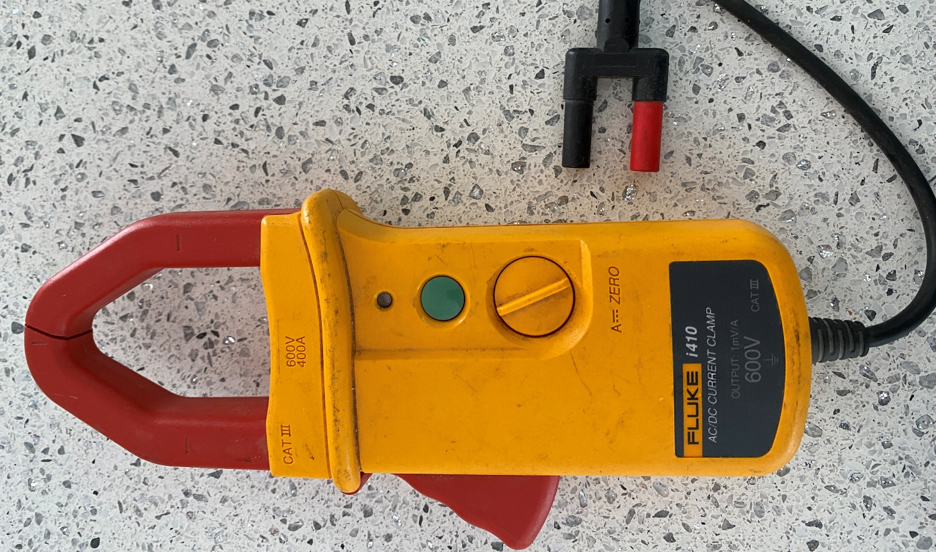
Basic 12 Volt Off-Grid Solar System
An example of a clamp-on, this one is an Fluke i410. It is both a DC and an AC Ammeter.
It also needs to be zeroed before use.
400 Amp clamp-on.
Picture courtesy Author

Slide 15
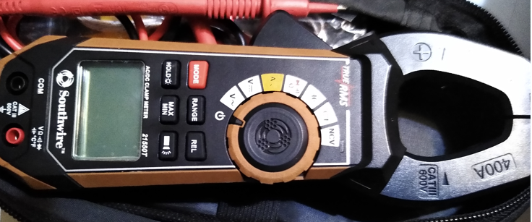
Basic 12 Volt Off-Grid Solar System
An example of a clamp-on, this one is a Southwire.
True RMS is stated on the meter.
400 Amp clamp-on.
Picture courtesy Southern Solar Solutions

Slide 16
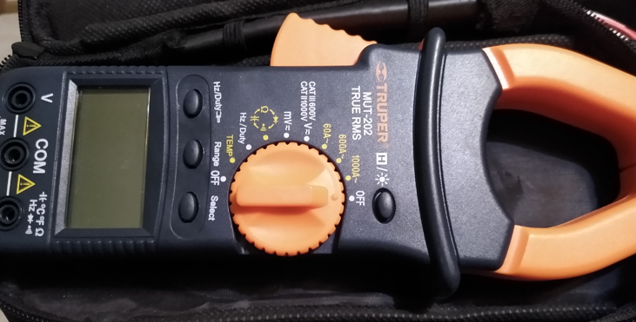
Basic 12 Volt Off-Grid Solar System
An example of a clamp-on, this one is a Truper.
True RMS is stated on the meter.
600 Amp clamp-on.
Picture courtesy Southern Solar Solutions

Slide 17
Questions?

Slide 18
Basic 12 Volt Off-Grid Solar System
The next major component is the charge controller.
The charge controller is an electronic interface between the PV panel and the battery.
It can also be able to control the DC loads as well.

Slide 19
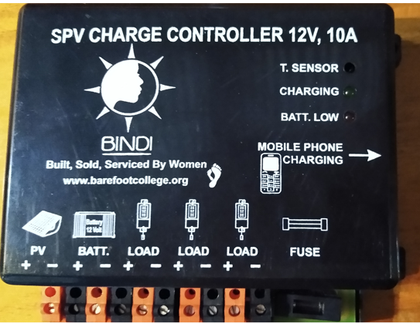
Basic 12 Volt Off-Grid Solar System
This particular charge controller is not mass produced.
It will be the one used for training.
Picture courtesy Southern Solar Solutions

Slide 20
Basic 12 Volt Off-Grid Solar System
Charge controllers take the energy from the PV panel and adjust the voltage going to the battery.
The voltage range the charge controller can accept will be in the specifications.
The current it can feed to the battery and or load is also in the specifications.

Slide 21
Basic 12 Volt Off-Grid Solar System
Today’s training will use this charge controller. It is designed for a 12 volt battery and it can charge at 10 Amps.
Mark will explain the
details of this model
during the training.
Picture courtesy Southern Solar Solutions

Slide 22
Basic 12 Volt Off-Grid Solar System
When selecting a charge controller there are a few options to consider.
Charge stages
Pulse Width Modulation (PWM)
MPPT (Maximum Power Point Tracking)
Display or indicators

Slide 23
Basic 12 Volt Off-Grid Solar System
The charge controller for today’s training is a PWM type with 3 stage charging and has indicator lights.
This charge controller is for Lead Acid batteries.
Lead Acid batteries require three stages of charging.

Slide 24
Basic 12 Volt Off-Grid Solar System
The three stages are:
Bulk, where the charge controller puts the maximum amount of current into the battery until a maximum voltage is reached or a defined period of time has elapsed.
Absorb, where the voltage is maintained for a defined period of time to allow the battery to not over heat.
Float, where the battery is held at a lesser voltage until the start of the next day Bulk charge.

Slide 25
Basic 12 Volt Off-Grid Solar System
This charge controls the current and voltage to the battery with PW.
The duty cycle of the controlling device (MOSFET usually) changes to satisfy the condition of each stage of charging.
MPPT will be discussed at a later session.

Slide 26
Questions?

Slide 27
Basic 12 Volt Off-Grid Solar System
The battery used in this training session is of the Lead Acid type.
There are three basic types of Lead Acid batteries.
Flooded
Gel
AGM

Slide 28
Basic 12 Volt Off-Grid Solar System
Flooded
The medium to hold the acid in suspension is distilled water.
Hydrogen gas is produced and needs to be vented.
The battery needs to be held in the upright position only.
An Equalization charging stage is required. (More on this in another session)

Slide 29
Basic 12 Volt Off-Grid Solar System
Gel
It is classified as a Valve regulated VRLA
In a gel cell battery, the electrolyte does not flow like a normal liquid. The electrolyte has the consistency and appearance of petroleum jelly.
Self discharge is less than a flooded type.
No Equalization Charge required

Slide 30
Basic 12 Volt Off-Grid Solar System
AGM (Absorbed Glass Mat)
It is classified as a Valve regulated.
The cell is encapsulated in fiberglass.
Shelf life of a VRLA battery is seven times higher than the shelf life of a deep cycle flooded battery.
Overcharging however is especially harmful to any VRLA battery because of the sealed design (No Equalization charge).

Slide 31
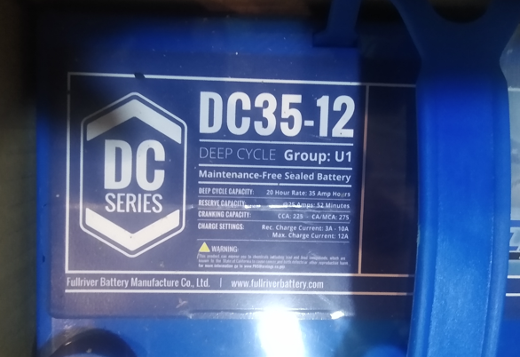
Basic 12 Volt Off-Grid Solar System
The AGM battery for the training is:
Picture courtesy Southern Solar Solutions

Slide 32
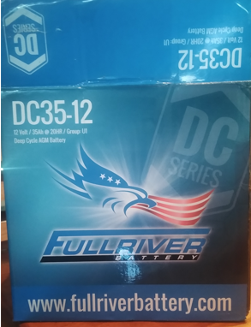
Basic 12 Volt Off-Grid Solar System
The AGM battery for the training is:
The DC25-12 is the model.
DC represents Deep Cycle.
It is of the AGM type.
35 is the Ah at the 20 hour rate.
12 is the nominal voltage of the
battery.
Picture courtesy Southern Solar Solutions

Slide 33
Basic 12 Volt Off-Grid Solar System
The nominal voltage for this battery is 12 volts.
This is a standard value.
Fully charged the terminal voltage at rest will be 12.65V.
Completely discharged the terminal volts will be 10.50V.
The voltage difference between fully charged and discharged is 2.15 volts.

Slide 34
Basic 12 Volt Off-Grid Solar System
The Ah rating is how many amps the battery can supply over a give time interval.
The 35Ah for this battery is at the 20 hour interval.
The battery when fully charged can deliver 1.75 Amps to a load for 20 hours before becoming completely discharged.
1.75A x 20h = 35 Ah
100 hour rating is 39Ah
20 hour rating is 35Ah
10 hour rating is 32Ah
5 hour rating is 29Ah
The faster the discharge the less efficient the battery.

Slide 35
Questions?

Slide 36
Basic 12 Volt Off-Grid Solar System
Balance of System (BOS) is the remaining equipment to connect the PV panel to the charge controller and the battery.
Wire
Overcurrent Protection
Disconnection Means

Slide 37
Basic 12 Volt Off-Grid Solar System
Wire needs to be rated for the following:
Maximum voltage it maybe subjected to.
125% of maximum current to be imposed on to it.
Insulation rated for the maximum temperature it will be exposed to.
Insulation rated for the environment it will be exposed to.

Slide 38
Basic 12 Volt Off-Grid Solar System
Overcurrent protection needs to be rated for the following:
Maximum voltage it maybe subjected to.
125% of maximum current to be imposed on to it.
Identify if overcurrent can be opened under load or not.
Breakers can be used as both overcurrent protection and a disconnection means.

Slide 39
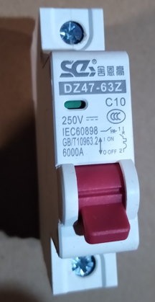
Basic 12 Volt Off-Grid Solar System
Today training will use a DC rated breaker:
This breaker is DC rated
Rated at 250 Vdc
6000A interrupting rated
10 Amp trip setting
It also can be opened unload, which makes it suitable as a disconnection means.
Picture courtesy Southern Solar Solutions

Slide 40
Questions?

Slide 41
Measurements:
Panel Wattage__________________________
Voc ___________Isc_________
Solar irradiance calculation from Isc______
Battery Voltage before connection_______
Initial Battery Amperage_________
Initial Battery Voltage__________

Slide 42
Measurements when system has started:
Panel Voltage__________Panel Amps_______
Panel Wattage ___________(VxA measured)
Battery Voltage charging_______
Battery Amperage charging_________
Battery Voltage charging_______
Battery Amperage charging_________
Battery Voltage charging_______
Battery Amperage charging_________

