Slide 1
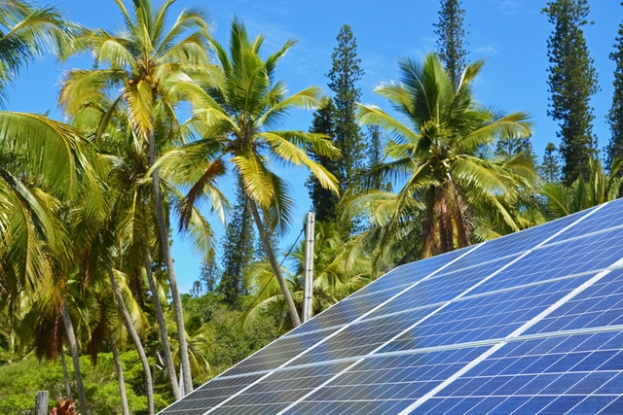



Design and Implementation of Pilot of a TVET Renewable Energy Course
DELIVERABLE #5 - TRAINING COURSES & PROFESSIONAL DEVELOPMENT
February 11/22 Training Session

Slide 2

Solar Basics

Slide 3

PHOTOVOLTAICS Solar Electricity

Slide 4
Following slide information
There are 4 applications in the next slide. One is at an IKEA parking lot that has solar providing electrical storage to batteries in an enclosure that at night time will power the LED parking lot light.
Below the light picture is an RV with a 300 Watt PV panel that provides energy to the storage deep cycle batteries to keep lights, water pump, radio and propane powered furnace on. The middle picture is of camels carrying solar PV powered refrigerators. Vaccines are being carried to remote villages in Africa. To the right is a sea going sailboat that uses solar to charge the DC electrical system used on the boat for navigation, lights, general 12 volt DC loads and powers a 2kWatt AC inverter.

Slide 5
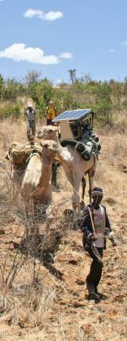
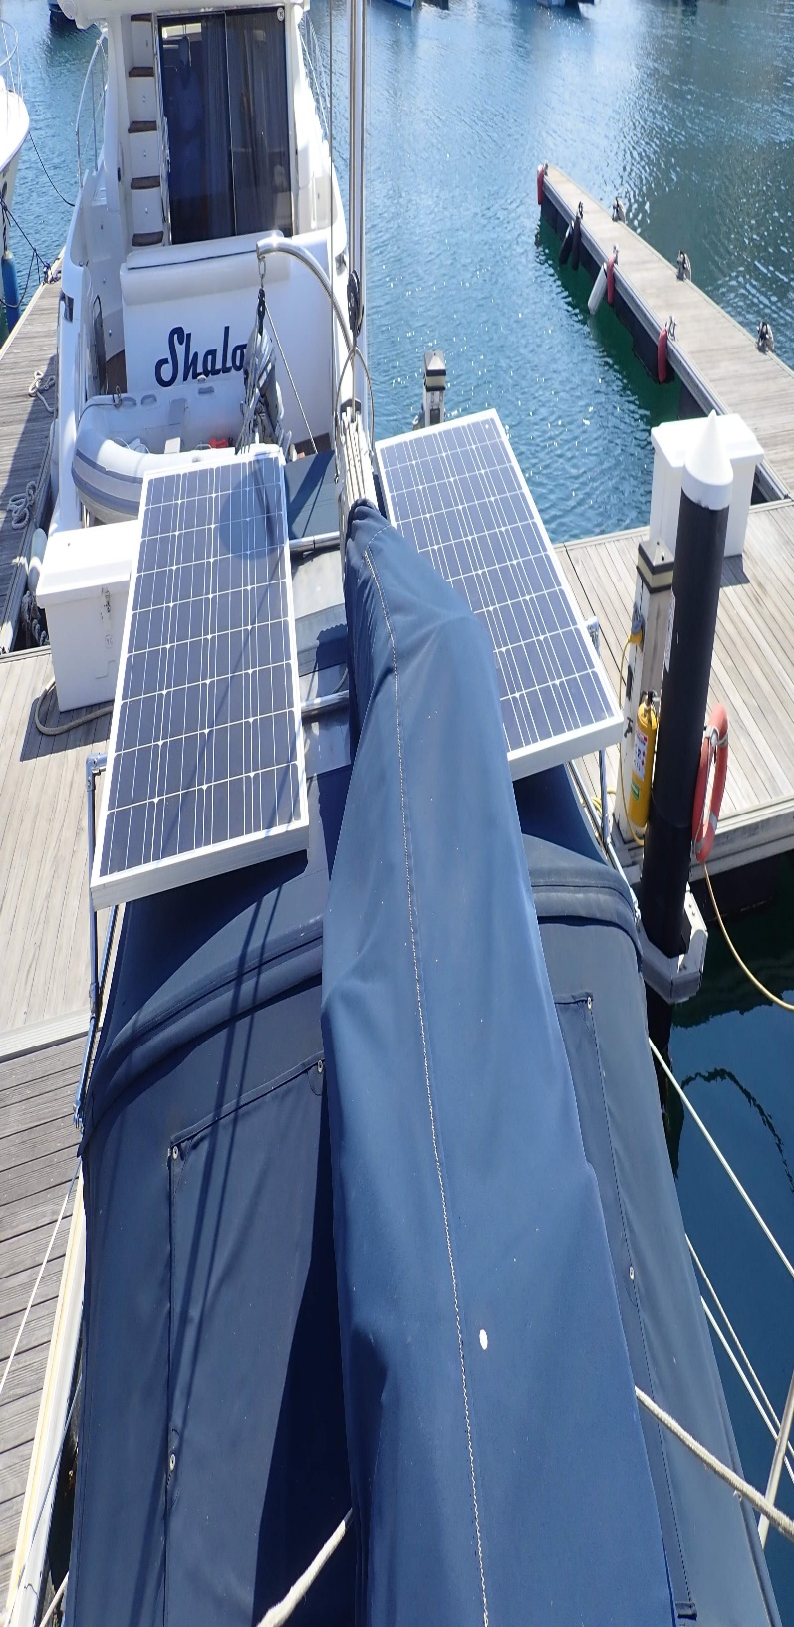
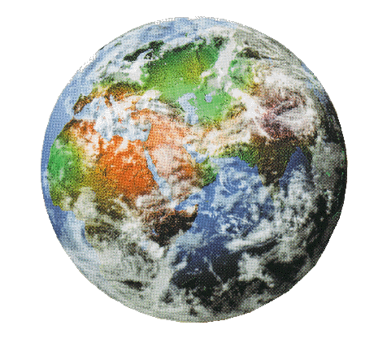
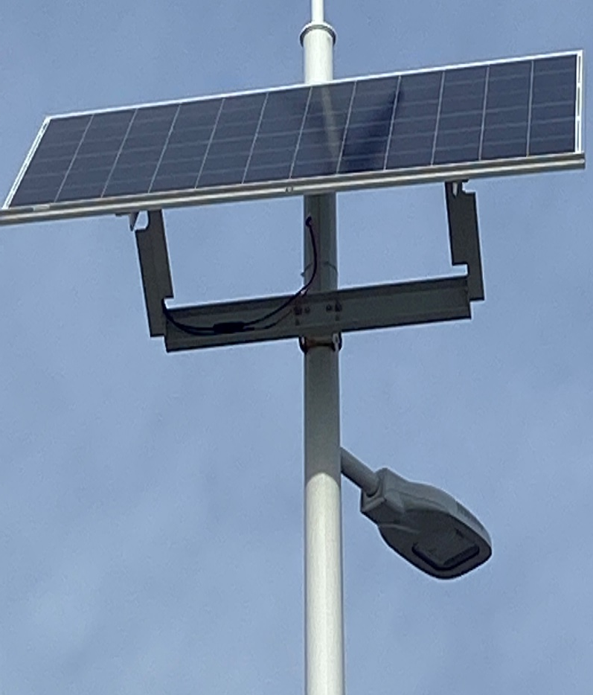
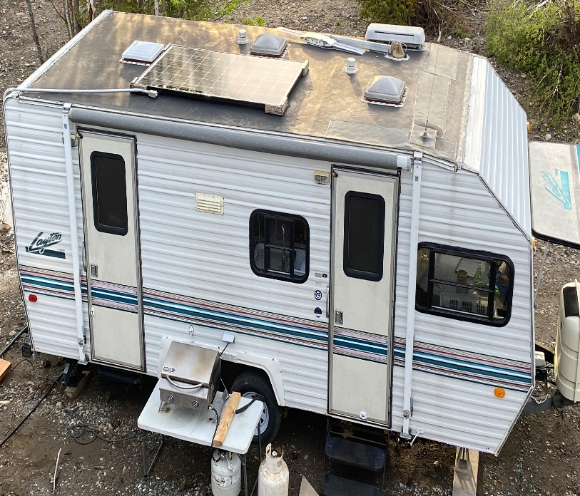
Solar Electricity...
is used around the world.

Slide 6
Questions

Slide 7
Following slide information
The energy leaving the surface of the sun that makes it to the earth surface has been calculated at 120,000,000,000,000,000 Watts per seconds. This is the combined energy across the entire surface that is exposed to the sun as it rotates.
The Watt is Joules / second. When we measure the Watts over time it becomes back to energy in Joules.
In other slide to come, we refer the energy available is measured in Watt/square meter.

Slide 8
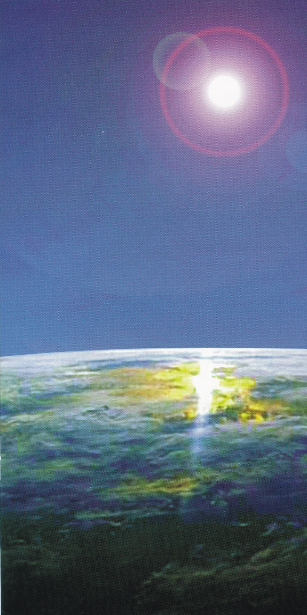
Solar Energy
120 000 000 000 000 000 Watts/second of solar energy strike the earth’s surface.

Slide 9
Following slide information
There are many resources that provide how much solar energy is available anywhere in the world. This is required when a solar design is to be completed. The amount of solar energy that is available everyday month or year is used for the design.
One of these resources is found on the Internet from a company called Solargis.
The next two slides are examples of their solar maps. First one is global the second is Belize.
The bar graph presented has two scales. Both use a colour that matched the mapped area.
The first (top) scale is how much energy hits the area per day when 1kW of PV is used.
The bottoms scale is a yearly average.

Slide 10
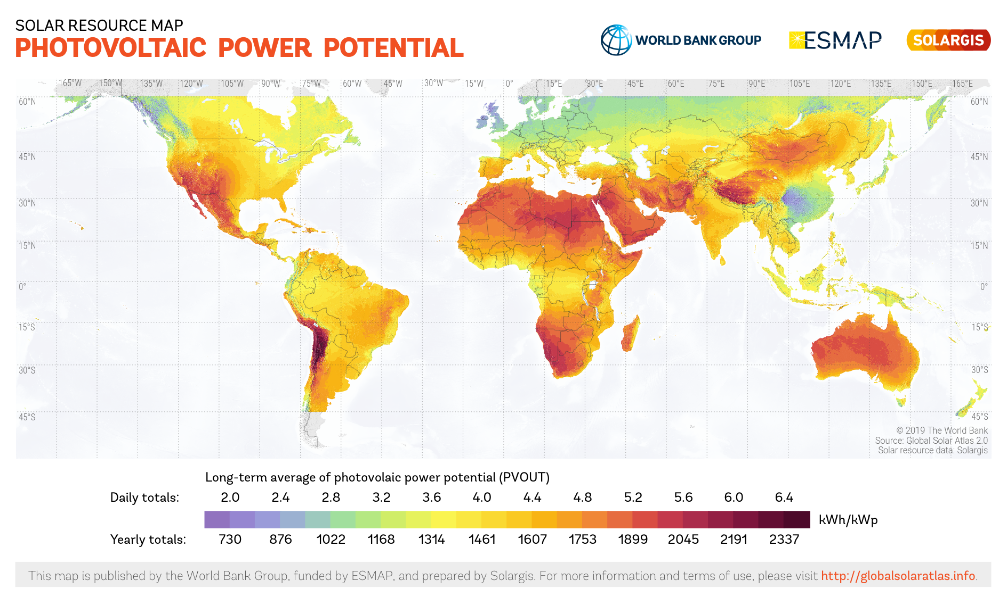
Solar Radiation
Picture courtesy Solargis.com
Solar Resource of Earth

Slide 11
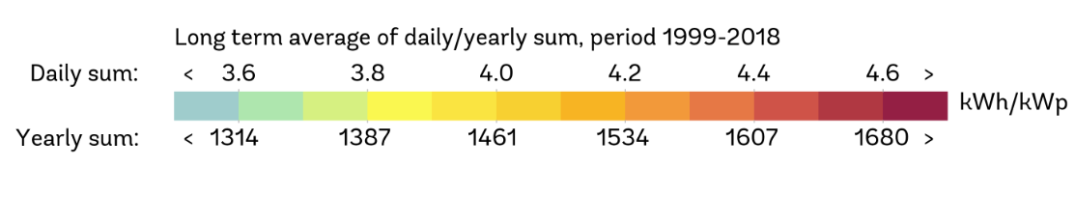
Following slide information
Taking a look at the scales for Belize you can see numbers for daily and yearly energy capture. Looking at the yearly graph, select 1534 kWh/kWp. On the map anywhere this colour at 1534 matches that is the energy at that location.
The 1534 represents the energy in kWh that strikes the surface when 1 kWatt of PV panels are installed.
This means that for example, if 4 250W PV panels are used they will produce 1534 kWh of energy over a year period. (kWp = 1 kW of PV)

Slide 12
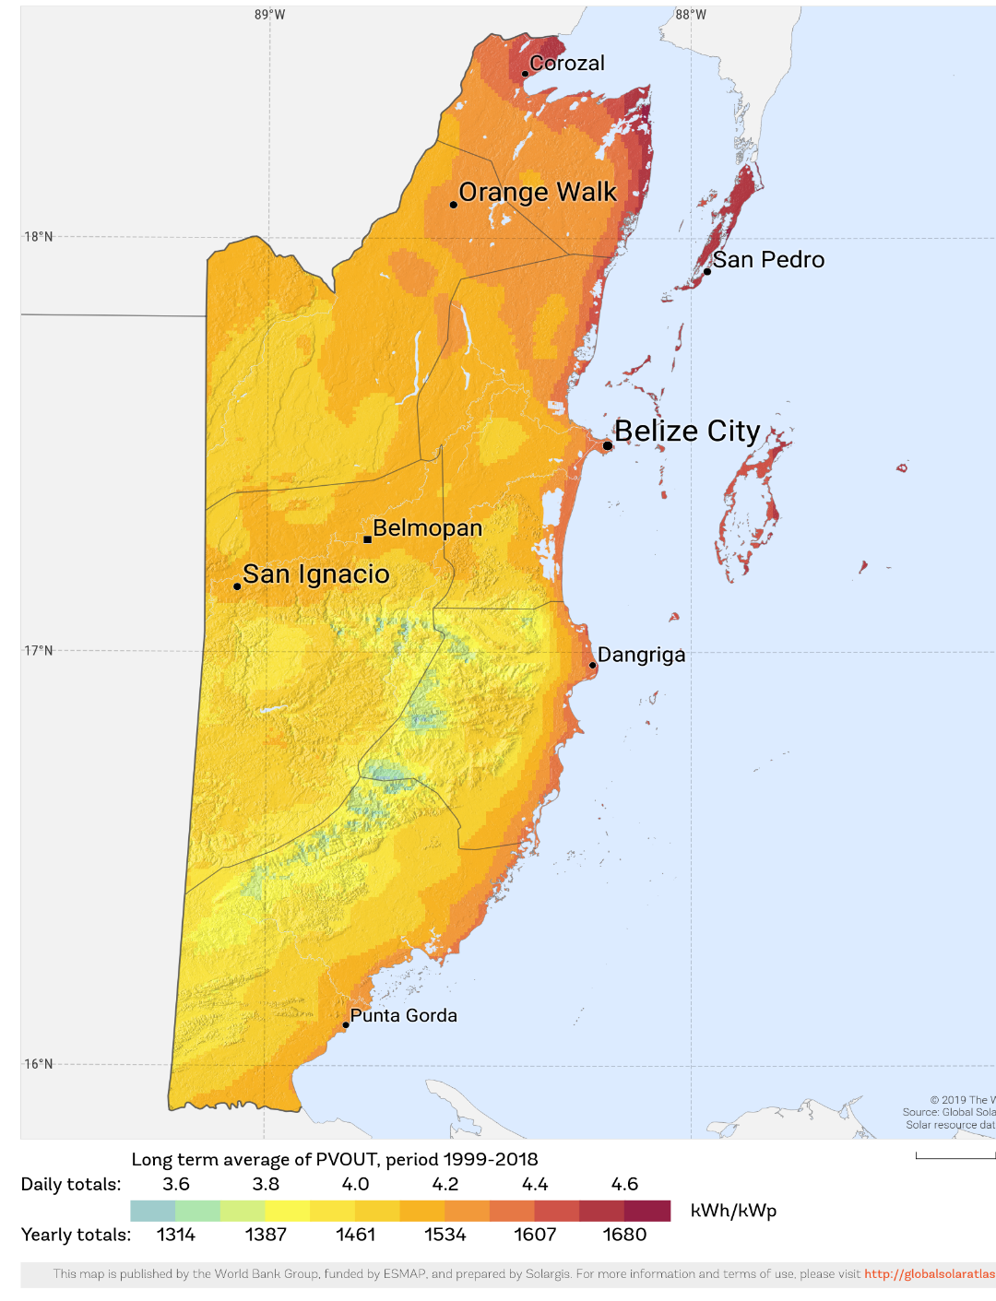
Solar Radiation
Solar Resource of Belize
Picture courtesy Solargis.com

Slide 13
Questions

Slide 14
Following slide information
The solar energy, call it sunlight that is used for solar energy conversion is in the form of electromagnetic radiation. (https://en.wikipedia.org/wiki/Electromagnetic_radiation)
The spectrum starts at the longest wavelength of the infrared then moves to the visual spectrum and finally to the ultraviolet range.
PV is only able to convert the visual spectrum to electrical energy. This represents about 49% of the solar energy.

Slide 15
Solar Radiation
The solar resource that the earth receives comes as sunlight.
This sunlight is in the form of electromagnetic radiation
It ranges in frequencies from infrared through the visual spectrum up to ultraviolet.

Slide 16
Following slide information
The solar constant is referred to the amount of solar energy that is outside of the earths atmosphere.
Because the earth wobbles seasonally this energy changes slightly. From approximately 1400W/m² to 1310W/m².
This is averaged to 1367W/m² yearly.

Slide 17
Solar Radiation
The amount of solar energy just outside of the atmosphere is measured at an average of 1367W/m².
Due to the earths seasonal wobble, the range is falls between 1400W/m² and 1310W/m².

Slide 18
Following slide information
The solar industry has adopted a standard value used to rate solar equipment. It comes from the amount of solar energy that actually strikes the earth in a useful manner.
After the solar radiation / energy passes through the atmosphere it is reduced to 1000 W/m².
Manufacturers rate the output of their solar PV panels in Watts.
For example a 250W panel will produce 250 Watts of electrical energy when 1000 W/m² strike the panel.
The angle at which the solar energy strikes the panel is called the angle of incidence.
Where normal is 90 degrees to the surface or straight above.
At 90 degrees the output is at the rated Wattage.

Slide 19
Solar Radiation
On the way through the atmosphere some of this energy gets absorbs.
The amount of this energy reaching the earth is reduced and is approximately 1000W/m².
1000W/m² has been defined as full sun power, or one sun, and is used as a universal reference.

Slide 20
Following slide information
The solar energy as it passes through the atmosphere does lose intensity as we see from the previous slides. The effect on the radiation can be explained in a few ways.
Direct radiation is that 1000 W/m² and we can feel it through the infrared radiation on our skin.
Reflected radiation is the radiation that goes away from the earth either as from reflection from the earth surface or from clouds.

Slide 21
Following slide information
Diffused radiation is what happens as the energy passes through moisture or clouds. The result is the energy is scattered just like a frosted glass.
Picture the sun at 4 o'clock it is not overhead. Pointing a diffused (directional selective) handheld pyranometer at the 4 o'clock sun location will detect less solar radiation than pointing the pyranometer straight up toward the 12 o'clock position. This is the result of diffused radiation from moisture and clouds.
“Cloud Burst” is when both direct radiation is present and partly cloudy conditions exist at the same time. Total radiation = direction + reflected side radiation (from clouds) add together.
An additional 25% energy can be realized.

Slide 22
Solar Radiation
As the solar energy passes the atmosphere it can be influenced.
Direct radiation comes straight down and can be felt on the skin.
Diffused radiation happens when clouds effect the sunlight from coming through directly. This diffused energy is bounced around and often best measured under the cloud and not directly where the sun is.

Slide 23
Solar Radiation
Some of the radiation is bounced back into the atmosphere from clouds or from the surface of the earth.
Cloud burst is the addition of direct radiation and the diffused radiation from clouds.

Slide 24
Solar Radiation
Extraterrestrial Solar Radiation
Reflected Radiation
Reflection from Clouds
Diffusion from Clouds
Direct Radiation
Atmospheric Absorption
Diffuse Radiation
Total Solar Radiation

Slide 25
Questions

Slide 26
Following slide information
The hand held diffused pyranometer is a very handy tool.
It provides the solar radiation in the direction that it is pointed to.
It displays W/m² which directly correlates to the amount of power the PV panel can produce.
Solar designers need to know the amount of solar energy over time. Measuring the ongoing radiation and recording it is called insolation.
This is where the kWh/m²/day is used.

Slide 27
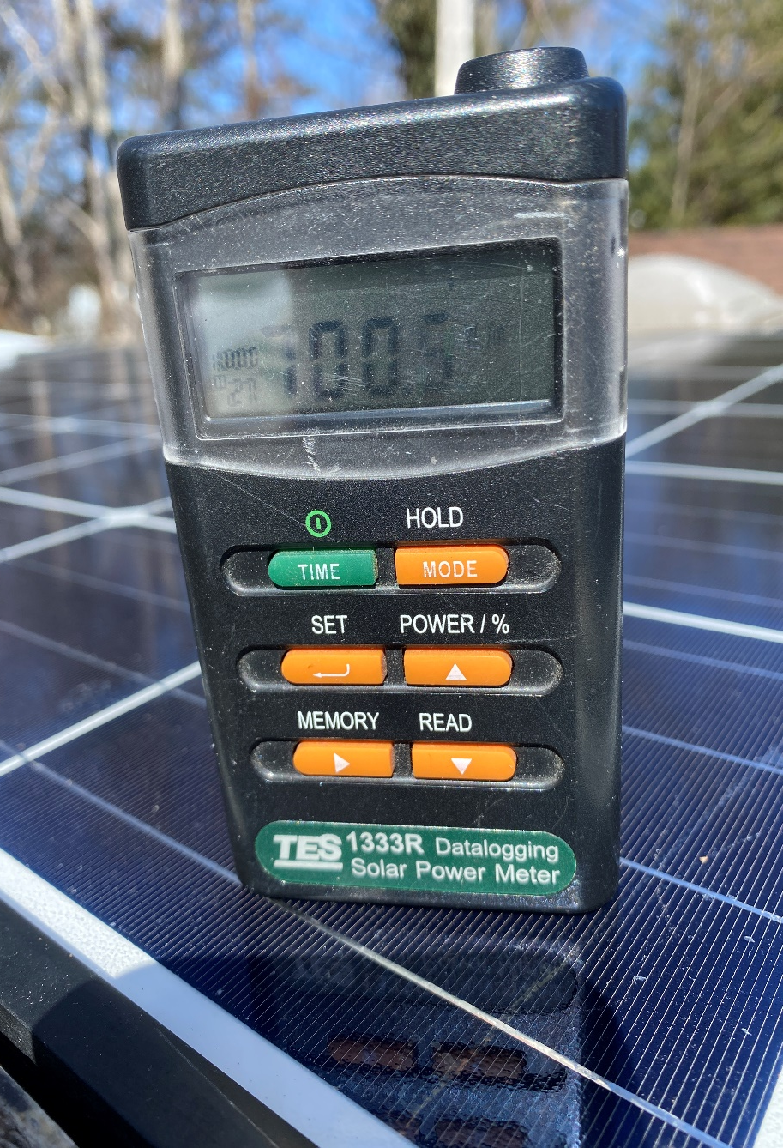
Measuring Solar Irradiance
Sun data is collected using an instrument called a pyranometer.
Solar radiation collected over time is called insolation.
In order to obtain statistically significant insolation data, the solar-radiation must be recorded continuously at a site for a long period of time.
Picture courtesy author

Slide 28

Measuring Solar Irradiance
Solar radiation is measured with a pyranometer.
This one is handheld and has a diffused lens.
The diffused lens allows for directional radiation readings.
Readings are in Watts per meter squared.
Picture courtesy author

Slide 29
Following slide information
Zenith is referred to the position of the sun during the daily position referenced to (the vertical) directly overhead.
Dawn and dusk have a zenith of almost 90 degrees to the vertical.
Azimuth is referred to the position of the sun referenced to the direction at which the PV panel is pointing.
In the northern hemisphere the sun is south, and the southern hemisphere the sun is north.
At the equinoxes, the sun rises directly east and sets in the west.
The azimuth if being calculated with a compass, requires the magnetic declination for the location.

Slide 30
Solar Radiation
The sun moves in a path everyday.
Seasonally the sun changes position between the equinoxes.
Depending where you are on earth the sun path can move up and down the horizon.
Near the equator the sun moves across the equator and moves the zenith north and south.
The next slide shows the sun path chart for Belize at latitude 16.5 and longitude -88.4

Slide 31
Following slide information
The sun path chart is a representative of where the sun appears in the sky every day of the year when it is above the horizon.
In the tropics below 23 degrees latitude the sun will move from the south to the north. Thus in May and June the sun will be behind you.
The sun path chart shows how the path moves from in front of you looking south to behind you.

Slide 32
Solar Radiation
Sun path chart courtesy Univ.of Oregon

Slide 33
Following slide information
The sun’s path changes during the day and seasonally.
When the sun comes up or sets the length of distance the energy travels is the longest which makes the energy striking the earth low.
Not until this distance gets short enough, that is provides the majority of it’s energy to a PV panel.

Slide 34
Solar Radiation
The sun path chart shows how the sun moves across the sky every day.
The important part of this is that the sun will not be at the same strength as it crosses the sky and the solar panel will not always be perpendicular to the sun.

Slide 35
Questions

Slide 36
Following slide information
The photonic energy from the sun penetrates the PV panel and transfers the energy to free electrons.
The free electrons contain enough of a charge to produce approximately 0.5V – 0.6V per cell.
This charge at this voltage can be moved in an electric circuit.
At today technology approximately 20% efficiency is realized.

Slide 37
Photovoltaic Panels
PV panels are able to convert some of the sunlight to electricity.
PV effect is when solar energy is transferred to the electrons in the panel.
These electrons are free to move in an electrical circuit.

Slide 38
Photovoltaic Panels
Approximately 50 percent of the frequencies are able to elevate these electrons.
Modern PV panels are getting close to the 20% efficiency of the total solar radiation.

Slide 39
Questions

Slide 40
Following slide information
The STC (Standard Test Condition) is used to provide a standard for all PV panels can rate their output in Watts.
All legal PV panels use this standard.
The conditions are:
Solar Radiation at 1000W/m²
Cell temperature at 25 degrees C.
Air Mass (AM) 1.5 (1 at equator 1.5 Europe level)
AM (Air Mass Index) represents the distance relative to the zenith of 0 or directly overhead. The AM at overhead is the shortest distance the sun energy travels through the atmosphere and is AM 1.
PV panels are rated from AM of 1.5.

Slide 41
Photovoltaic Panels
PV panels are rated in watts at a standard test condition (STC).
STC states the panel will be subject to 1000W/m² at a cell temperature of 25 degrees Celsius.
A solar panel rated at 450 Watts would be able to generate that power when 1000W/m² is striking the panel perpendicular to its surface.

Slide 42
Following slide information
The STC (Standard Test Condition) values from an LG 450 Watt PV panel.
The values stated are at the STC.
Maximum Power 450W
MPP Voltage VMPP (at maximum output) 41.1V
MPP Current IMPP 10.96A
Open Circuit Voltage Voc 49.0V (Nothing connected to the output leads)
Short Circuit Current Isc 11.47A (the maximum current that panel will produce at STC)
Module Efficiency 20.5% (panel)
Power Tolerance +3% (Manufacture stating could be up to 3% higher than rating of 450W)

Slide 43
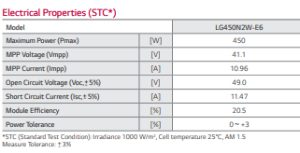
Photovoltaic Panels
The specification data from a LG450N2W-E6 solar PV panel rated at 450 Watts.
Courtesy HESPV.ca

Slide 44
Questions

Slide 45
Assignment
The assignment is worth X% of term mark.
Each student is to do the following questions.
Calculate the kWh production for 2kW of PV for the following locations located in the chart in the last slide.
Every student is to pick a different PV panel and find and present the STC Isc.

Slide 46
Assignment Example
Slides 5 and 6 show the solar resource for the assignment.
The website to search the cities is: https://globalsolaratlas.info/map?c=11.523088,8.4375,3
Use the colour chart to indicate the amount of solar energy is present.

Slide 47
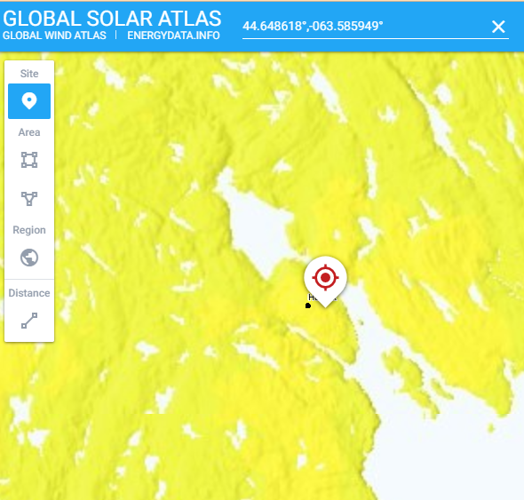
Assignment Example
The city of Halifax Nova Scotia Canada
Picture courtesy Solargis.com

Slide 48
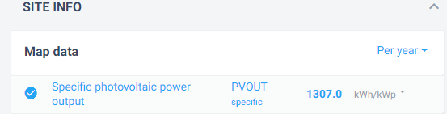
Assignment Example
The city of Halifax Nova Scotia Canada
The results per year is 1307.0 kWh/1kWp
Answer for assignment is 2614.0 kWh.
Picture courtesy Solargis.com

Slide 49
Assignment
Student Name | Country | City | kWh/year produced
 | USA | New York
 | Germany | Munich
 | Mexico | Mexico City
 | England | London
 | Japan | Tokyo
 | Canada | Saskatoon
 | Australia | Sydney

Slide 50
Assignment
Student Name | Country | City | kWh/year produced
 | Spain | Madrid
 | Italy | Rome
 | Russia | Moscow
 | Poland | Warsaw
 | Kenya | Nairobi
 | Jamaica | Kingston
 | Netherlands | Amsterdam

Slide 51
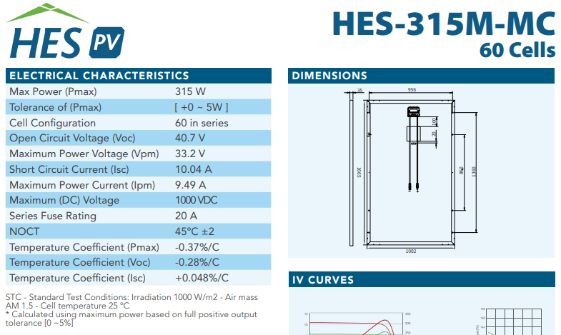
Assignment Example
PV Panel Data from Manufacturer.
Note the STC Isc is 10.04A
Picture courtesy HESPV.ca

Slide 52
Assignment
Student Name | Country | City | kWh/year produced
 | USA | New York | 2844.6
 | Germany | Munich | 2226.4
 | Mexico | Mexico City | 3647.8
 | England | London | 1750.8
 | Japan | Tokyo | 2682.6
 | Canada | Saskatoon | 3018.4
 | Australia | Sydney | 3040.2

Slide 53
Assignment
Student Name | Country | City | kWh/year produced
 | Spain | Madrid | 3304.4
 | Italy | Rome | 3046.4
 | Russia | Moscow | 2102.2
 | Poland | Warsaw | 2164.0
 | Kenya | Nairobi | 3081.8
 | Jamaica | Kingston | 3423.4
 | Netherlands | Amsterdam | 2086.2

