Slide 1
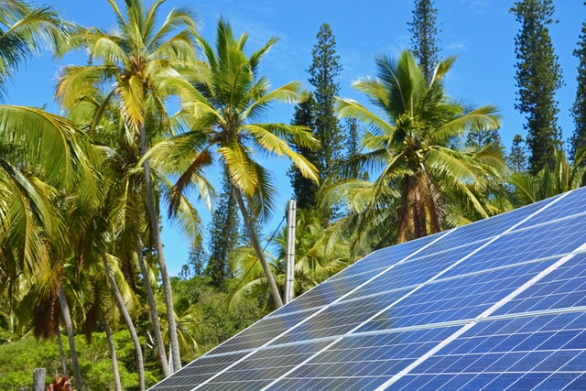



Design and Implementation of Pilot of a TVET Renewable Energy Course
DELIVERABLE #5 - TRAINING COURSES & PROFESSIONAL DEVELOPMENT

Slide 2
Solar Insolation

Slide 3
Solar Insolation
This module is about:
Amount of radiation.
Solar energy that is received by the earth.
What it looks like.
Types of radiation.
How the solar energy is measured.
Local effects.

Slide 4
Amount of Radiation
The earth's atmosphere receives energy from the sun in the form of light or solar radiation.
The solar resource that the earth receives comes as sunlight.
This sunlight is in the form of electromagnetic radiation.
It ranges in frequencies from infrared through the visual spectrum up to ultraviolet.

Slide 5
Amount of Radiation
The solar constant is referred to the amount of solar energy that is outside of the earths atmosphere.
Because the earth tilts seasonally this energy changes slightly.

Slide 6
Amount of Radiation
The amount of solar energy just outside of the atmosphere is measured at an average of 1367W/m².
Due to the earths seasonal tilt, the range is falls between 1400W/m² and 1310W/m².

Slide 7
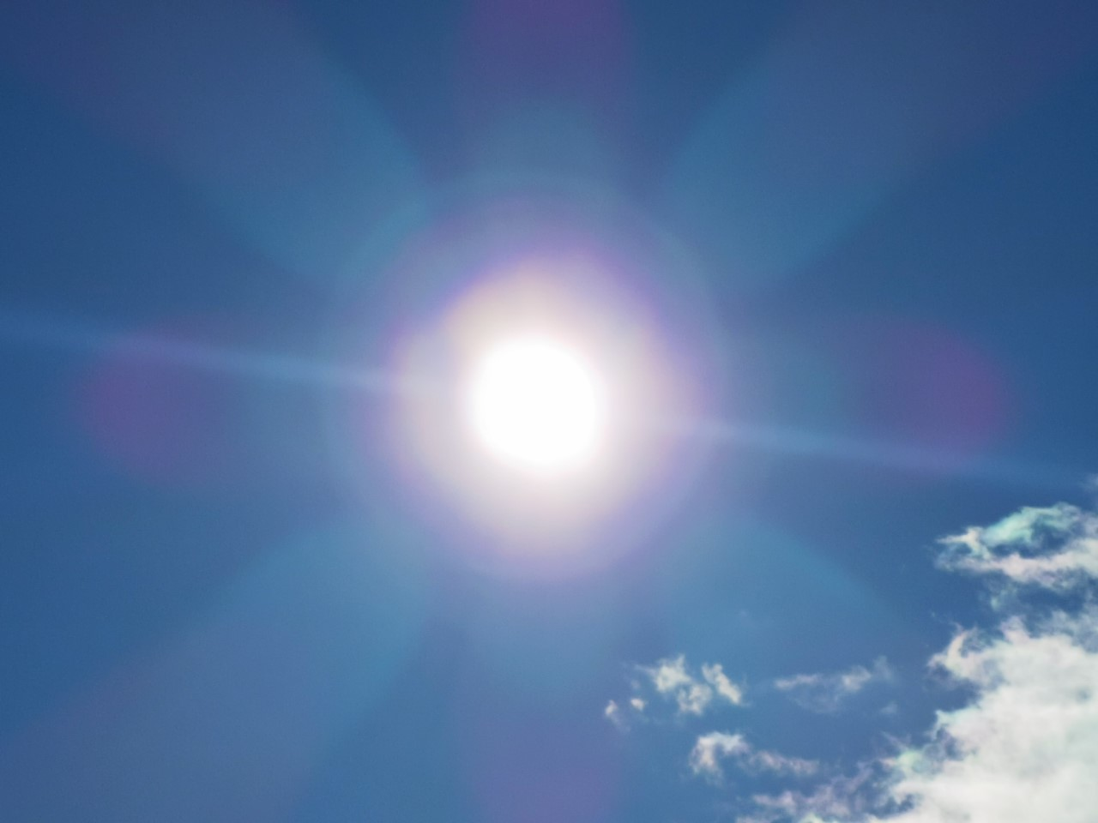
Solar energy that is received by the earth
120 000 000 000 000 000 Watts/second of solar energy strike the earth’s surface.

Slide 8
Solar energy that is received by the earth
The energy leaving the surface of the sun that makes it to the earth surface has been calculated at 120,000,000,000,000,000 Watts per seconds.
This is the combined energy across the entire surface that is exposed to the sun as it rotates.
The Watt is Joules / second. When we measure the Watts over time it comes back to energy in Joules.
In other slides to come, we refer the energy available is measured in Watt/square meter.

Slide 9
Solar energy that is received by the earth
On the way through the atmosphere some of this energy gets absorbs.
The amount of this energy reaching the earth is reduced and is approximately 1000W/m².
1000W/m² has been defined as full sun power, or one sun, and is used as a universal reference.

Slide 10
Solar energy that is received by the earth
The solar industry has adopted a standard value used to rate solar equipment.
It comes from the amount of solar energy that actually strikes the earth in a useful manner.
After the solar radiation / energy passes through the atmosphere it is reduced to 1000 W/m².
This is the amount at sea level and can vary depending on atmospheric conditions. These will be explained later.

Slide 11
Solar energy that is received by the earth
Manufacturers rate the output of their solar PV panels in Watts.
For example a 250W panel will produce 250 Watts of electrical energy when 1000 W/m² strike the panel.
The angle at which the solar energy strikes the panel is called the angle of incidence.
Where normal is 90 degrees to the surface or straight above.
At 90 degrees the output is at the rated Wattage.

Slide 12
What it looks like
The solar resource that the earth receives comes as sunlight.
This sunlight is in the form of electromagnetic radiation.
It ranges in frequencies from infrared through the visual spectrum up to ultraviolet.

Slide 13
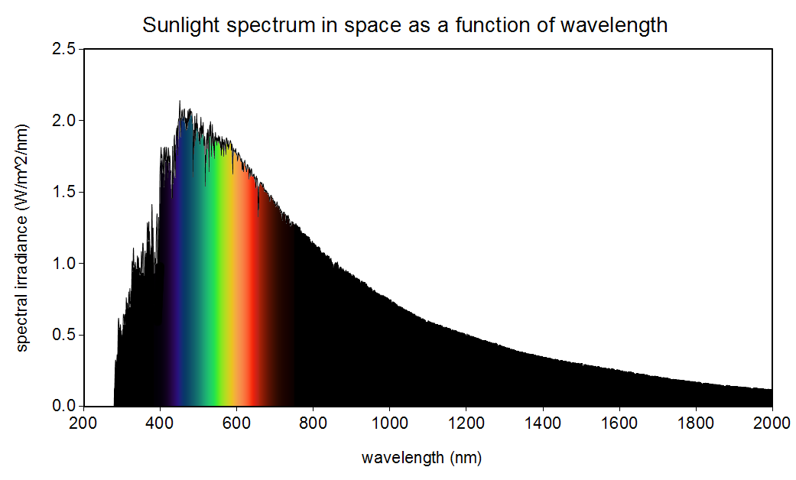
What it looks like
Sunlight spectrum in space as a function of wavelength. Public Domain Image, image source: Christopher S. Baird, data source: American Society for Testing and Materials Terrestrial Reference.

Slide 14
What it looks like
From the previous slide note that the visual spectrum is from the longest waveform of 700 nanometers down to the shortest at 380 nanometers.
Red is at 700 nanometers and
Violet is at 380 nanometers.
Red starts at 700 nm
Violet starts at 380 nm

Slide 15
What it looks like
Todays most common PV panels that are used for electric power generation are silicon based.
These panels produce this electric power when only the visual spectrum strikes them.
The infrared contributes to the heating of the cells as it cannot penetrate the cells but the backing of the panel absorbs it.
Ultraviolet wavelengths sit on the surface of the panel and adds heat to the cells.

Slide 16
What it looks like
Outside of this visual spectrum is infrared and ultraviolet.
Infrared has longer wavelengths up to ~2000 nanometers.
Ultraviolet has shorter wavelengths down to 100-400 nanometers.
Infrared ends at 700 nm
Ultraviolet starts at 400 nm

Slide 17
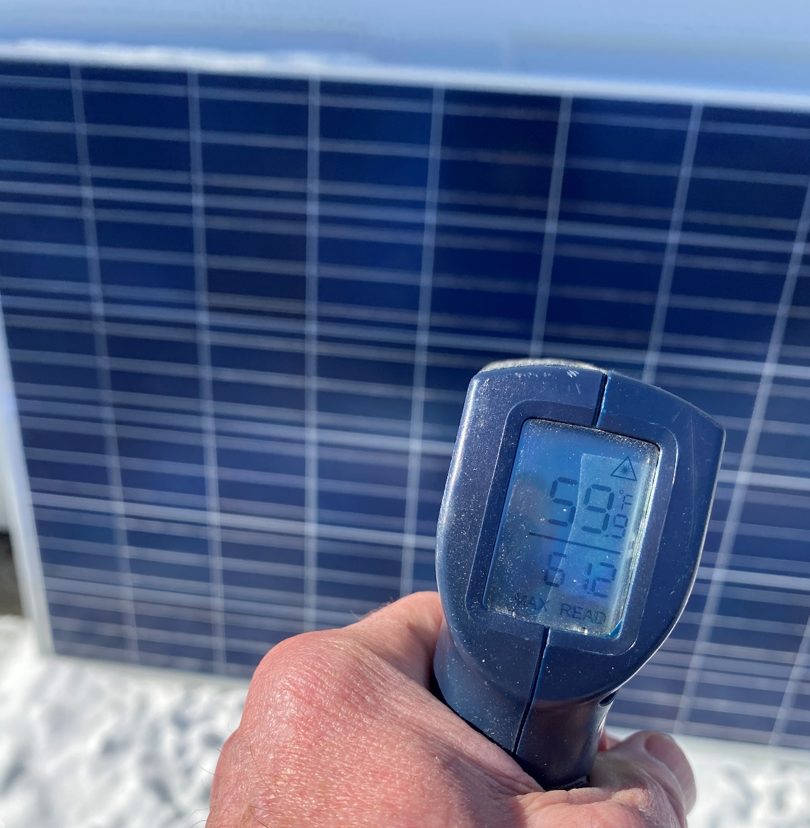
What it looks like
This panel is directly in the sun.
The outside temperature is 14F.
The surface of the panel is at 59.9F.
The panel is open circuited and is producing 0 power.
Picture courtesy author

Slide 18
Questions

Slide 19
Types of radiation
As this radiation comes through the atmosphere it can be manipulated in a few ways that effect the irradiance as it strikes a surface.
Solar irradiance is the solar radiation being measure in Watts per meter squared (W/m² )
A pyranometer is an instrument that measures the irradiance and provides the strength in W/m² .

Slide 20
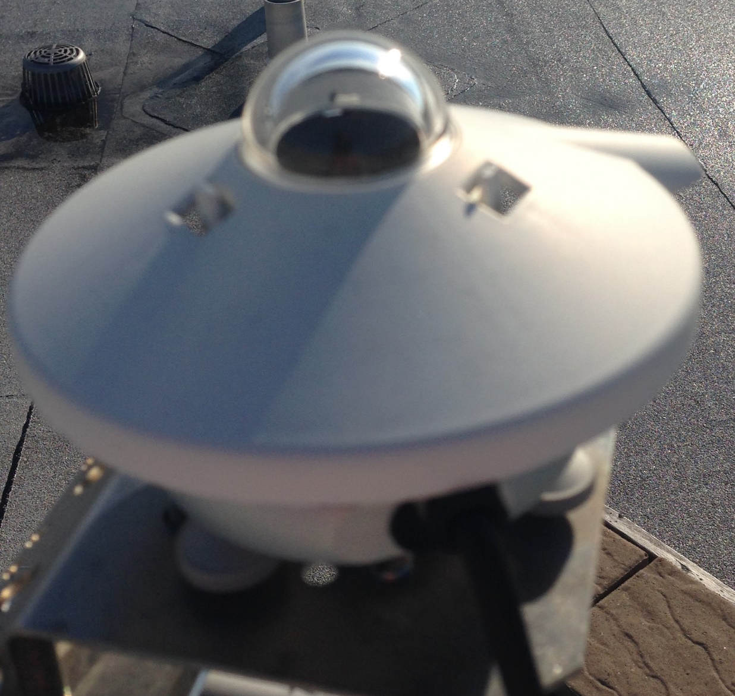
Types of radiation
There are two basic types of pyranometers.
One that measures irradiation globally for any angle the sun is in the sky.
Picture courtesy author

Slide 21
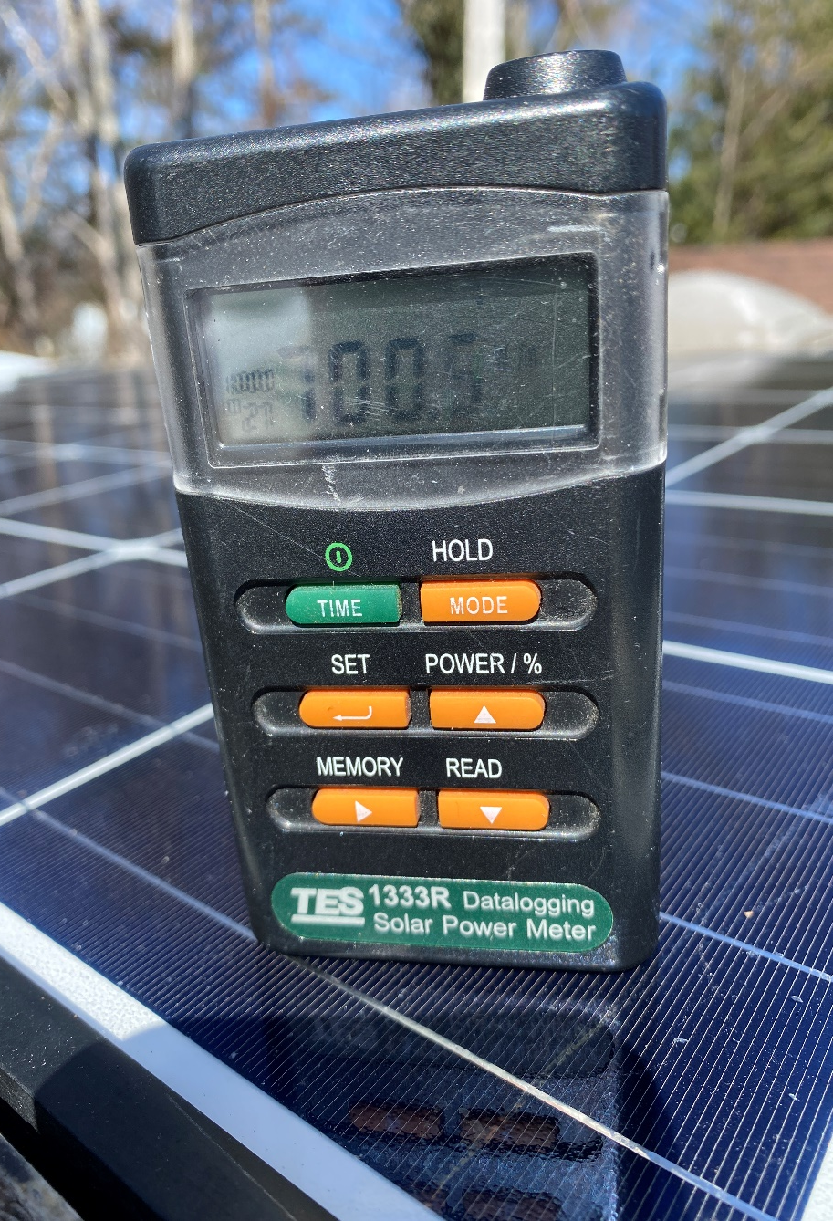
Types of radiation
The other has a diffused opening and only measures irradiance where it is pointed to.
Notice the small round opening at the top right side.
The diffused lens is there.
Picture courtesy author

Slide 22
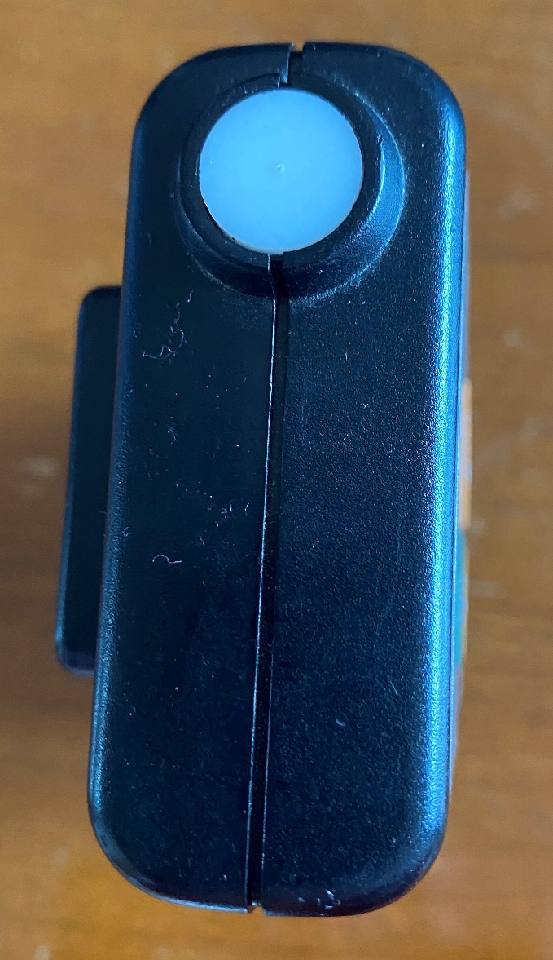
Types of radiation
Notice the diffused lens.
Picture courtesy author

Slide 23
Types of radiation
Direct radiation is that type of radiation we can feel directly. Much from the infrared radiation on our skin.
The sunshine comes through without any interference or obstruction.
Reflected radiation is the radiation that goes in the direction away from the earth.
Either as from reflection from the earth surface or from clouds.

Slide 24
Types of radiation
Diffused radiation is what happens as the energy passes through moisture or clouds.
The energy is scattered just like a frosted glass.
Picture the sun at 4 o'clock it is not overhead.
Pointing a diffused handheld pyranometer at the 4 o'clock sun location will detect less solar irradiance than pointing the pyranometer straight up toward the 12 o'clock position.
This is the result of diffused radiation from moisture and clouds.

Slide 25
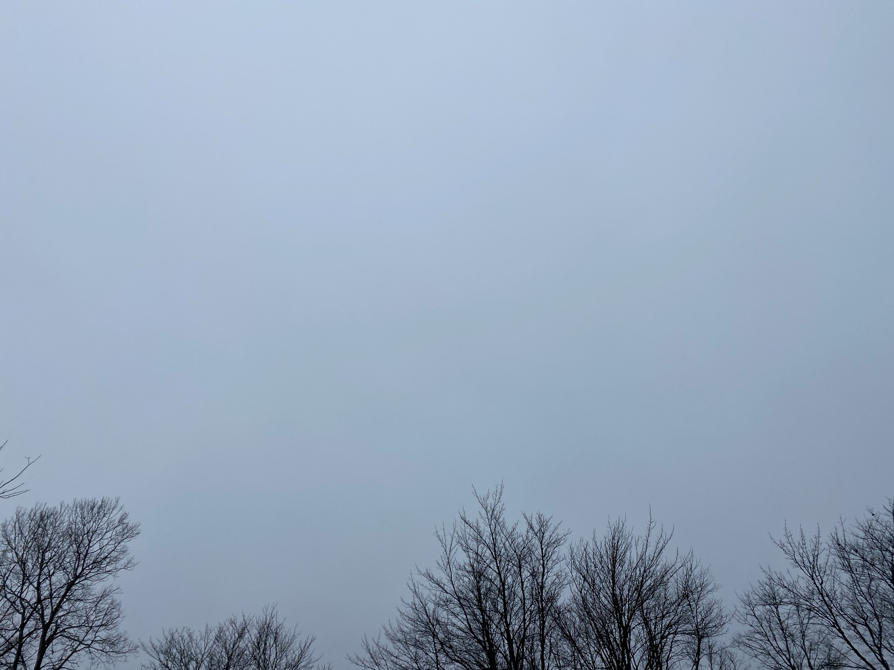
Types of radiation
Diffused radiation due to cloud cover.
This is a picture of an overcast day with broad cloud cover.
Picture courtesy author

Slide 26
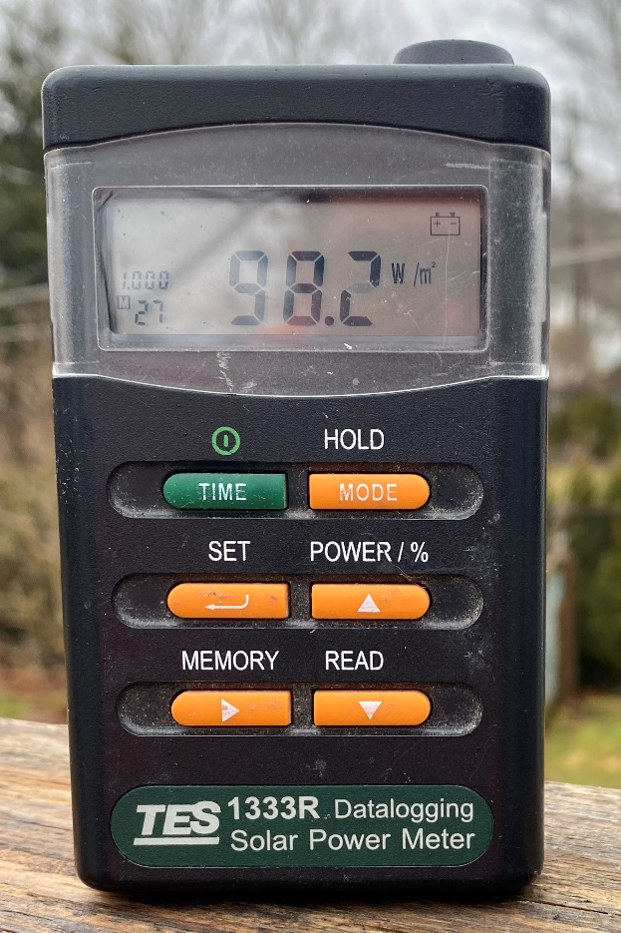
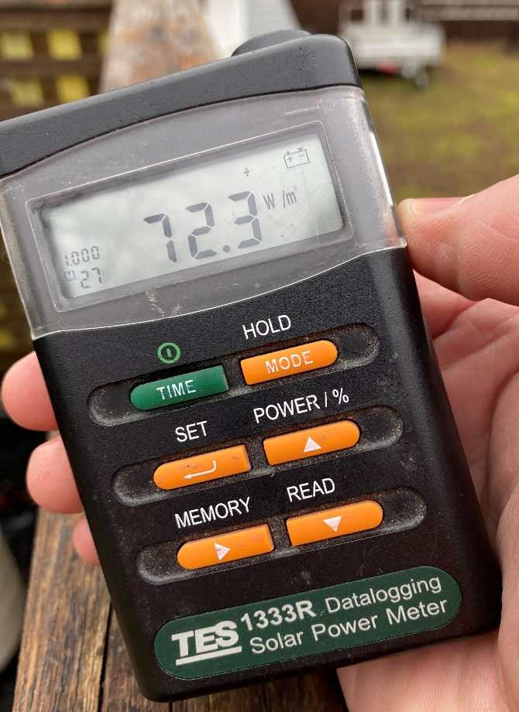
Types of radiation
Diffused radiation due to cloud cover.
The handheld pyranometer is pointing straight upwards and measuring 98 W/m².
Then pointing towards the sun measures 72 W/m².
Pictures courtesy author

Slide 27
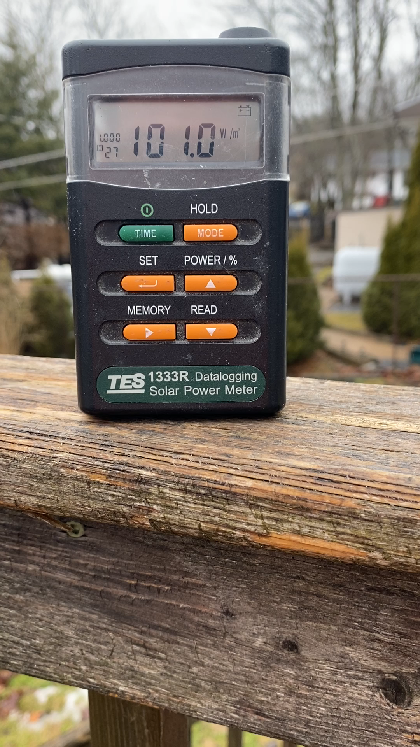
Types of radiation
A video showing the pyranometer readings due to diffusion.
Video courtesy author

Slide 28
Types of radiation
Extraterrestrial Solar Radiation
Reflected Radiation
Reflection from Clouds
Diffusion from Clouds
Direct Radiation
Atmospheric Absorption
Diffuse Radiation
Total Solar Radiation
Image courtesy author

Slide 29
Types of radiation
“Cloud Burst” is when both direct radiation is present and partly cloudy conditions exist at the same time.
Total radiation = direction + reflected side radiation (from clouds) add together.
An additional 25% energy can be realized.
What does this mean for the PV panel?
Irradiance is directly related to current production of the PV panel.
25% more current being produced.

Slide 30
Types of radiation
“Cloud Burst” is when both direct radiation is present and partly cloudy conditions exist at the same time.
Make video of this condition.

Slide 31
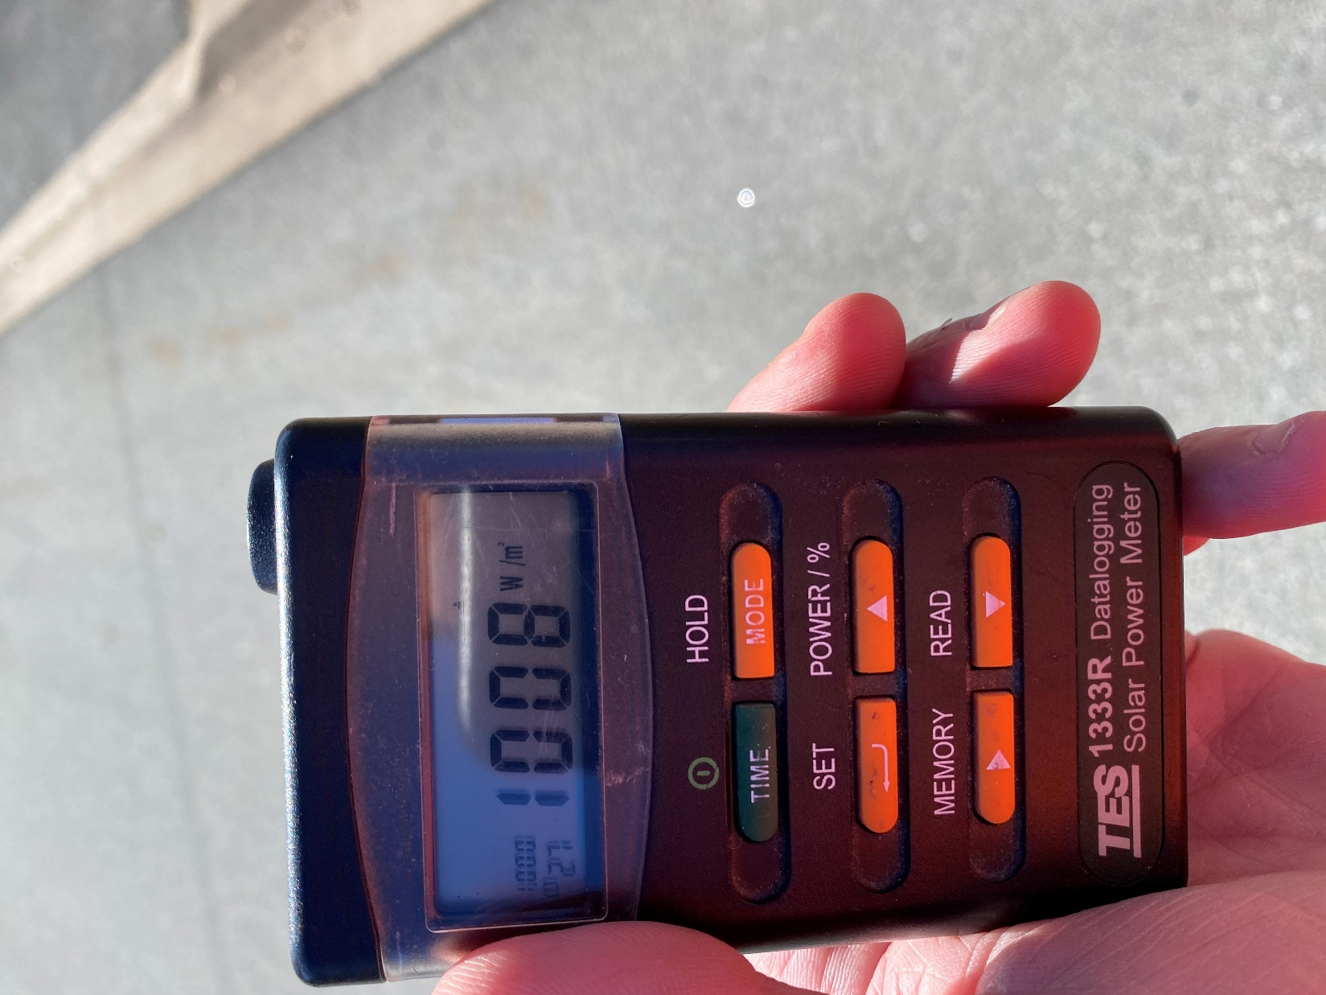
Types of radiation
Direct Radiation
Pointed directly at the sun.
Picture courtesy author

Slide 32
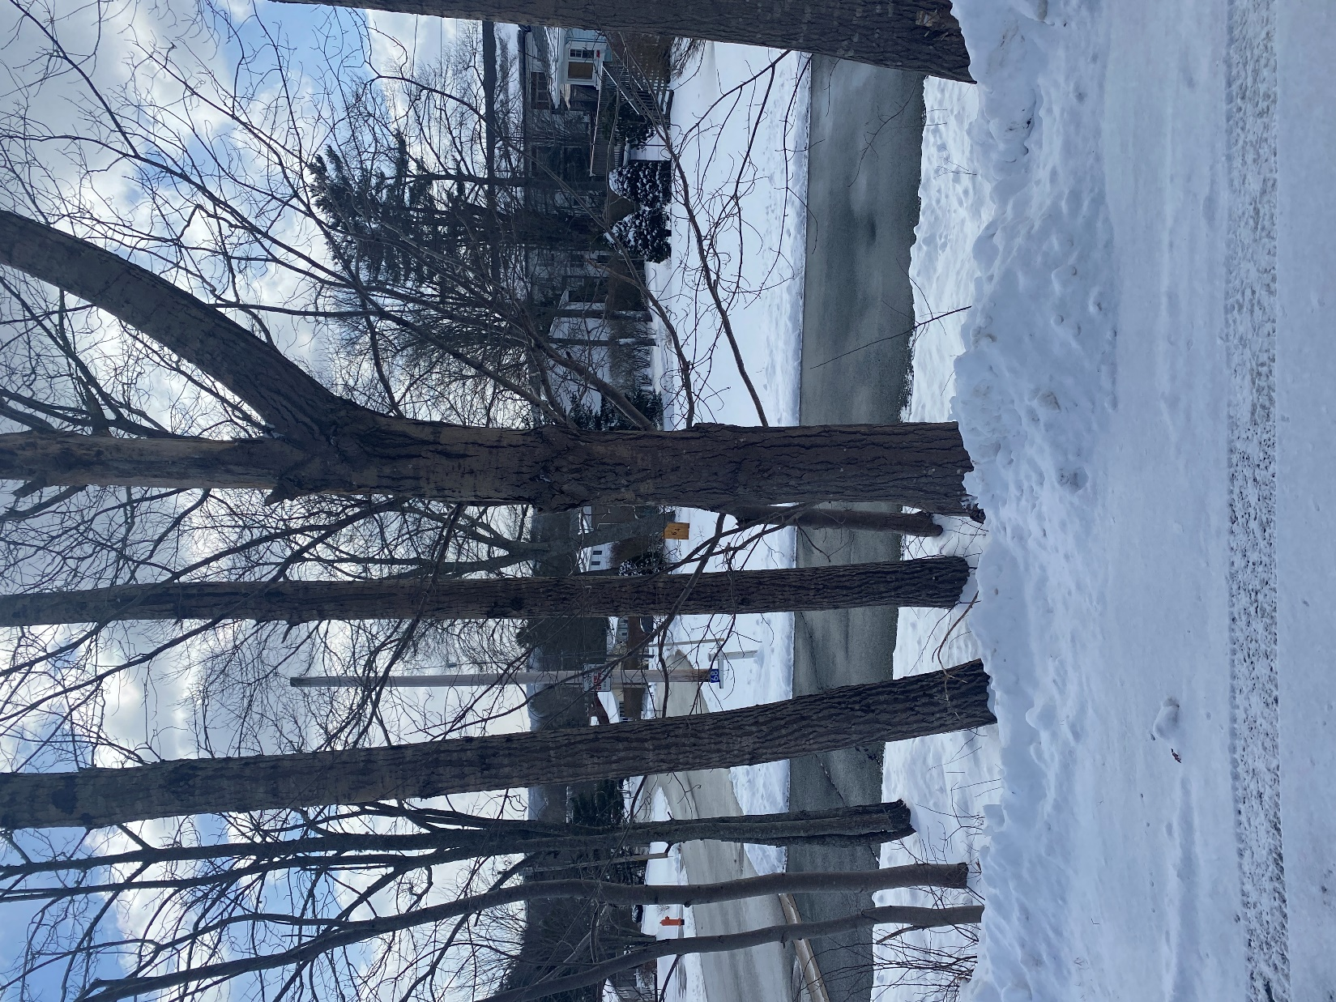
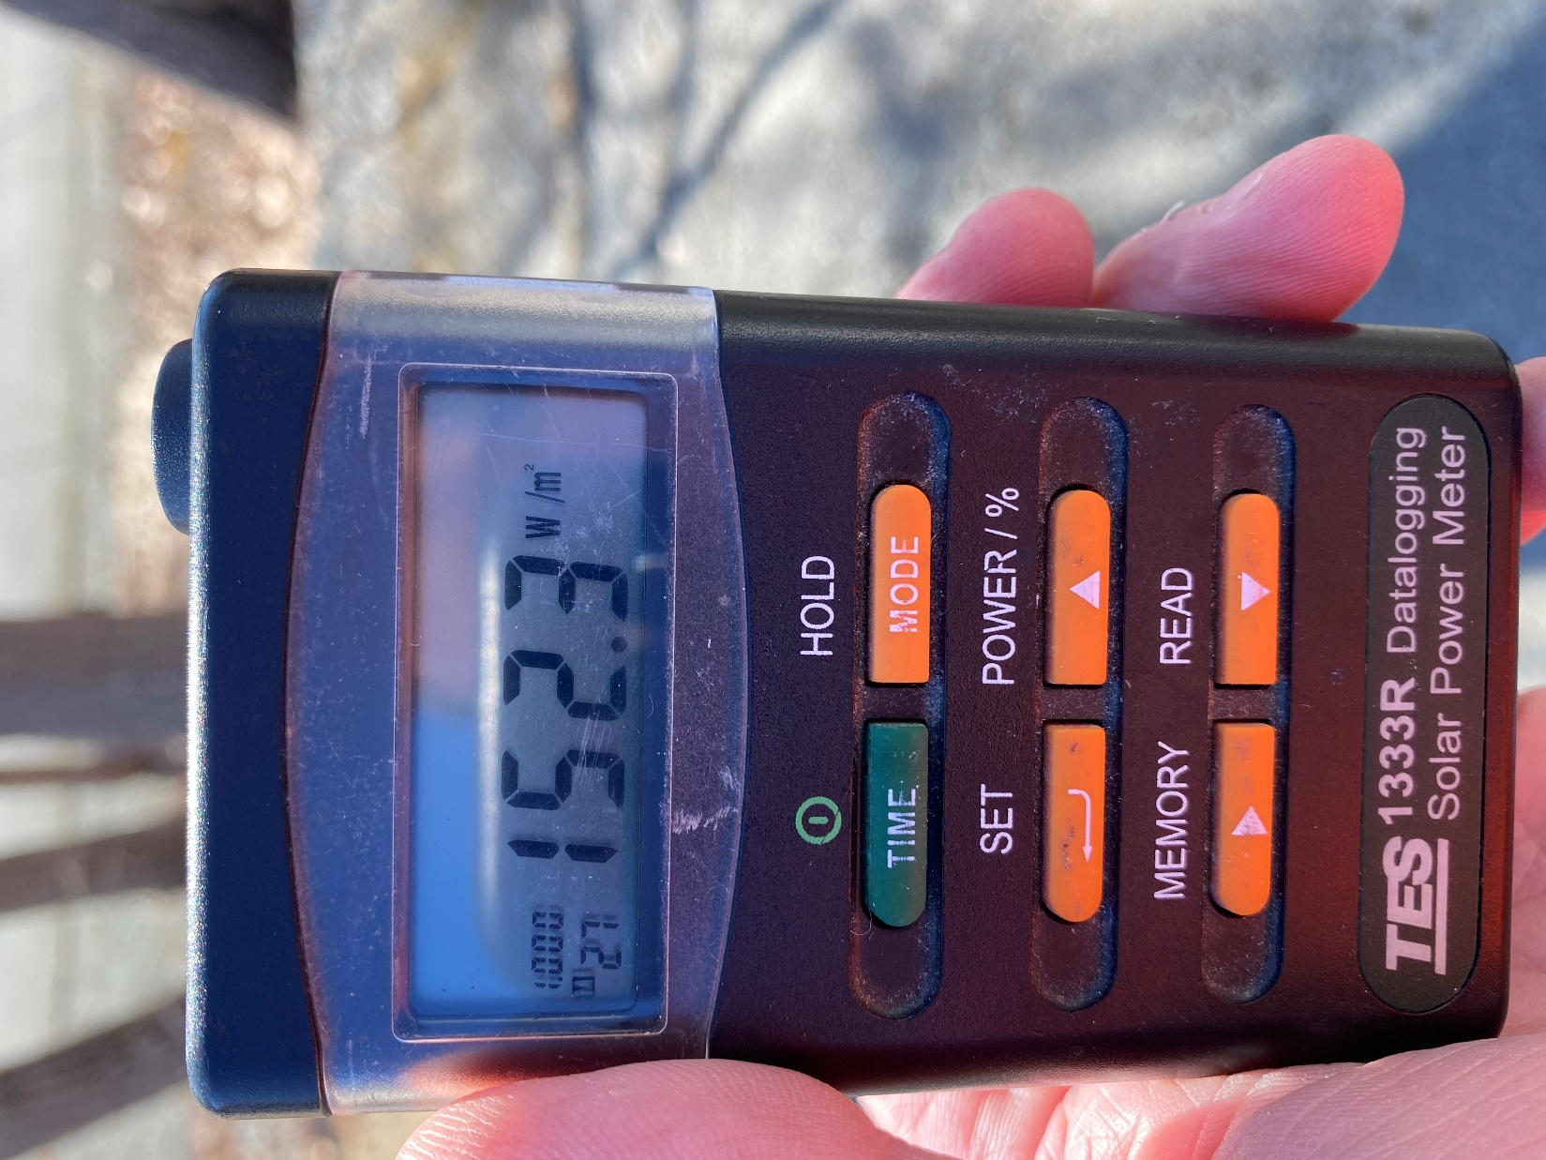
Types of radiation
Shaded radiation behind
tree approximately 6 feet away.
Measured irradiance dropped from
1000 W/m² to 152 W/m²
Pictures courtesy author

Slide 33
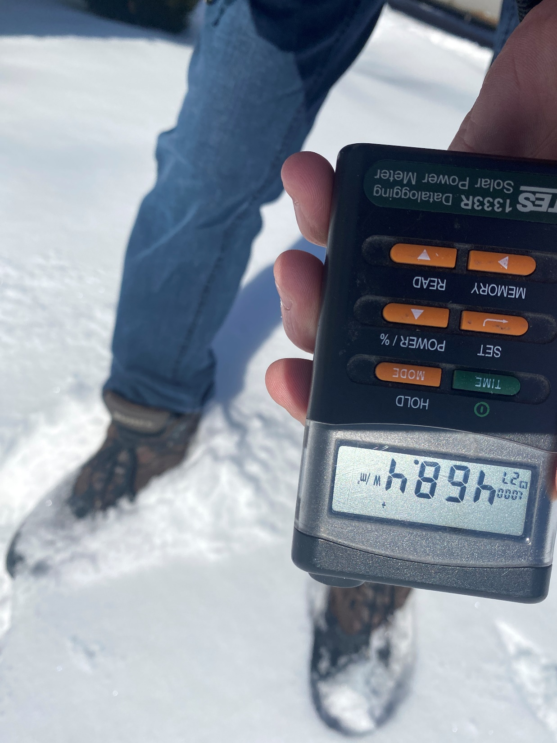
Types of radiation
Reflective irradiance from
a white surface.
Incoming irradiance is
750 W/m^{2.}
The reflected value is
468 W/m^{2.}
Picture courtesy author

Slide 34
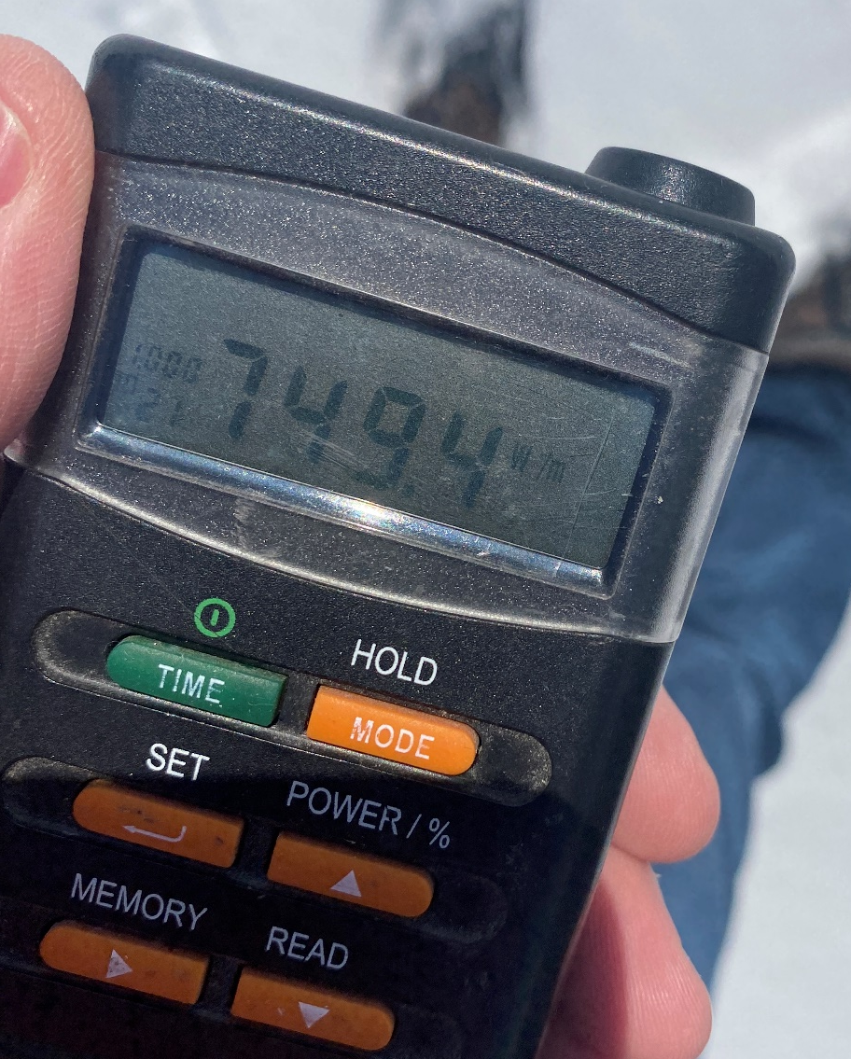
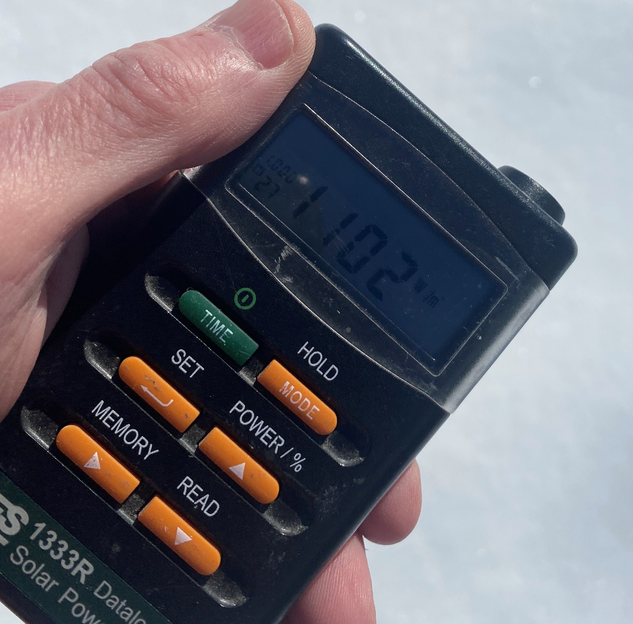
Types of radiation
Left side reading is direct radiation reading.
Right side is total from the reflected and the direct adding together.
Pictures courtesy author

Slide 35
Questions

Slide 36
How the solar energy is measured
The irradiance is measured in W/m²
PV manufacturers have agreed to rate the performance of the panels on a standard.
The standard is called STC (Standard Test Condition).
Only reputable manufactures use the standard.
The conditions for the standard are:
Solar irradiance at 1000W/m²
Cell temperature at 25 degrees C.
Air Mass (AM) 1.5 (1 at equator 1.5 Europe level)

Slide 37
How the solar energy is measured
The irradiance is affected by the types of radiation discussed in previous slides.
The irradiance that strikes the panel is also a function of angle.
The angle at which the sunlight strikes the panel is called the angle of incidence.

Slide 38
How the solar energy is measured
The irradiance is strongest when the angle of incidence is 90 degrees.
The output for the most part follows the Cosine.
Cos (90) = 1 = 100% output
Cos (45) = .70 = 70% output
The steeper the angle the more surface area is shared by the cells and less output is realized.
There are other factors but they play less of an effect.

Slide 39
How the solar energy is measured
The air mass ratio m is a measure of the amount of atmosphere the sun's rays must pass through to reach the earth's surface.
For the sun directly overhead, m = 1.
H1 is air mass length and H2 is length through atmosphere to ground.
Image courtesy author

Slide 40

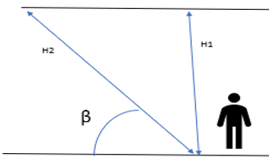
How the solar energy is measured
Showing the longer length the solar energy must travel and that relation to air mass.
M = air mass
= H2 / H1
= 1/ sinβ
Image courtesy author

Slide 41
How the solar energy is measured
Zenith is referred to the position of the sun during the daily position referenced to (the vertical) directly overhead.
Dawn and dusk have a zenith of almost 90 degrees to the vertical.

Slide 42
How the solar energy is measured
The sun moves in a path everyday.
Seasonally the sun changes position between the equinoxes.
Depending where you are on earth the sun path can move up and down the horizon.
Near the equator the sun moves across the equator and moves the zenith north and south.

Slide 43
How the solar energy is measured
The sun’s zenith angle for air mass calculations can be determined at any time.
By using a vertical stake or ruler of known height and measuring the length of the shadow cast.
The ruler, shadow and rays of the sun form a triangle. Using trigonometry, the zenith angle can be calculated.

Slide 44
How the solar energy is measured
Zenith angle
Image courtesy author

Slide 45
How the solar energy is measured
Azimuth is referred to the position of the sun referenced to the direction at which the PV panel is pointing.
In the northern hemisphere the sun is south.
In the southern hemisphere the sun is north.
East and West also play part in the azimuth angle.

Slide 46
How the solar energy is measured
At the equinoxes, the sun rises directly east and sets in the west.
The azimuth if being calculated with a compass, requires the magnetic declination for the location.

Slide 47
How the solar energy is measured
Zenith Angle
Image courtesy author

Slide 48
How the solar energy is measured
Azimuth Angle
Equator
Image courtesy author

Slide 49
Questions

Slide 50
How the solar energy is measured
Latitude
Climate
Altitude
Landscape
Obstructions
Image courtesy author

Slide 51
How the solar energy is measured
Latitude
Latitude effects the length the radiation travels to the earth.
The longer the length decreases the intensity / strength of the solar energy.

Slide 52
How the solar energy is measured
Latitude
Latitude also dictates the solar window during the year.
Being closer to the poles (North and South) changes the shape of the solar window.

Slide 53
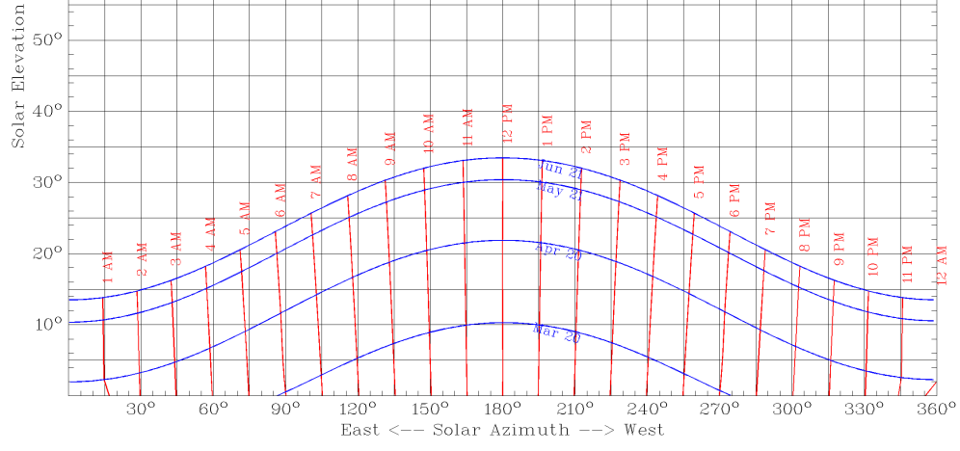
How the solar energy is measured
Latitude 80 Degrees North
Image courtesy Univ of Oregon

Slide 54
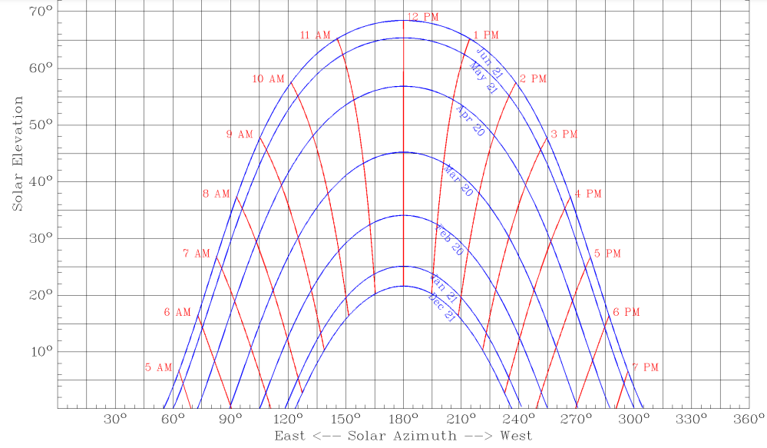
How the solar energy is measured
Latitude 45 Degrees Mid Way
Image courtesy
Univ of Oregon

Slide 55
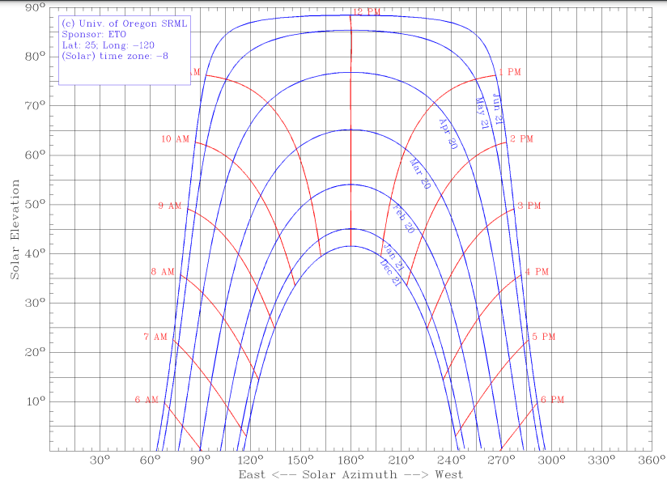
How the solar energy is measured
Latitude 25 Degrees Above Tropics
Image courtesy
Univ of Oregon

Slide 56
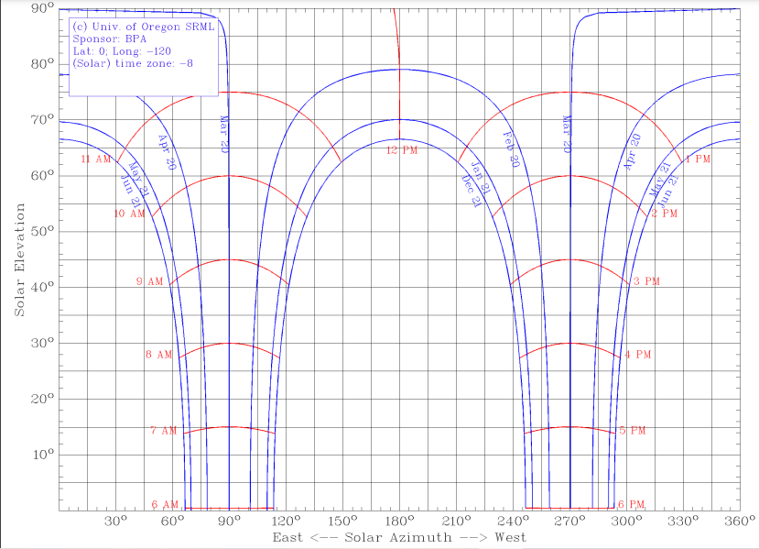
How the solar energy is measured
Latitude 0 Degrees Equator
Image courtesy
Univ of Oregon

Slide 57
How the solar energy is measured
Climate
Climate is the weather conditions in an area.
Both long term and short term weather conditions effect the solar radiation hitting a surface.
Moisture and clouds are biggest variables.

Slide 58
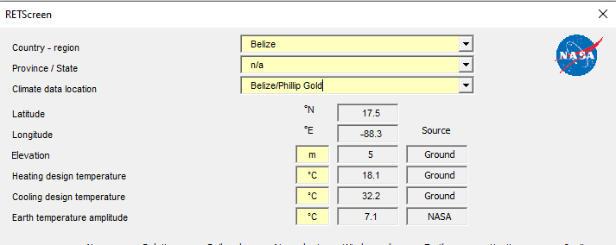
How the solar energy is measured
Climate Data
Climate data recorded for many years.
Image courtesy RETScreen

Slide 59
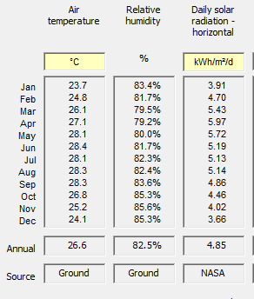
How the solar energy is measured
Climate Data
Daily solar radiation
Horizontal recorded.
Image courtesy RETScreen

Slide 60
How the solar energy is measured
Climate Data
Daily solar radiation represents the irradiance / insolation that strikes the surface on the horizontal plane.
The unit of kWh/m²/day is an energy measurement over an area. The kWh that can be harvested on a daily average for each month.
Then can be accumulated for a yearly value.

Slide 61
How the solar energy is measured
Altitude
Altitude effect is the increase in solar irradiance due to elevation in altitude.
The increase is small at Doyle’s Delight being at 1124m may see a 10% increase over sea level.
Micro climate conditions at altitudes above cloud cover is largest effect.

Slide 62
How the solar energy is measured
Landscape
The landscape is generally a local attribute that effects solar irradiance due to their reflective properties.
Examples include:
  Water sources (ponds/lakes/coves).
  Parking lots
  Ground cover

Slide 63
How the solar energy is measured
Obstruction
Obstruction is the reduction of irradiance that is site specific.
A site assessment is often required to account for obstructions.

Slide 64
How the solar energy is measured
Obstruction
There are two types of obstructions.
Hard shading is the most disruptive to the irradiance.
Partial shading allows a slight reduction of the solar irradiance.

Slide 65
How the solar energy is measured
Unshaded reading versus hard shade from a tree close to the pyranometer.
Pictures courtesy author

Slide 66
How the solar energy is measured
Obstruction
Shading can be measured with tools designed for site assessments.
One such tool is the “Solar Pathfinder”.
It provides a fish eye view of the sky the templates for various latitudes.

Slide 67
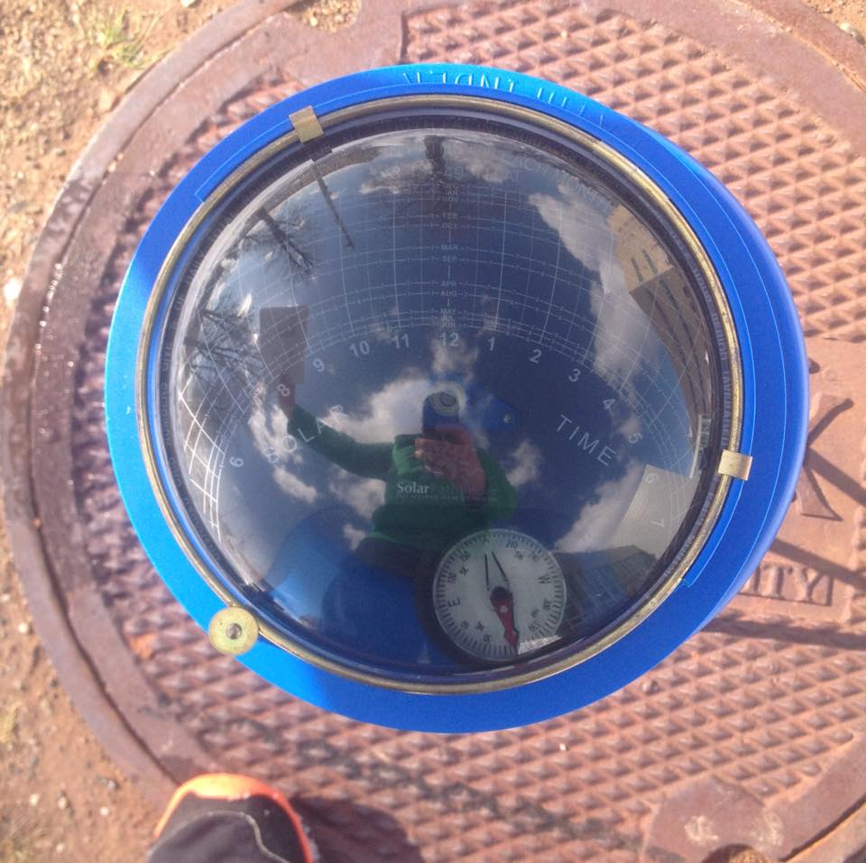
How the solar energy is measured
Obstruction
Shading can be seen
  looking down onto the
  reflective fish eye dome.
There is a template for
  latitudes placed under
  the dome.
Image courtesy Author

Slide 68
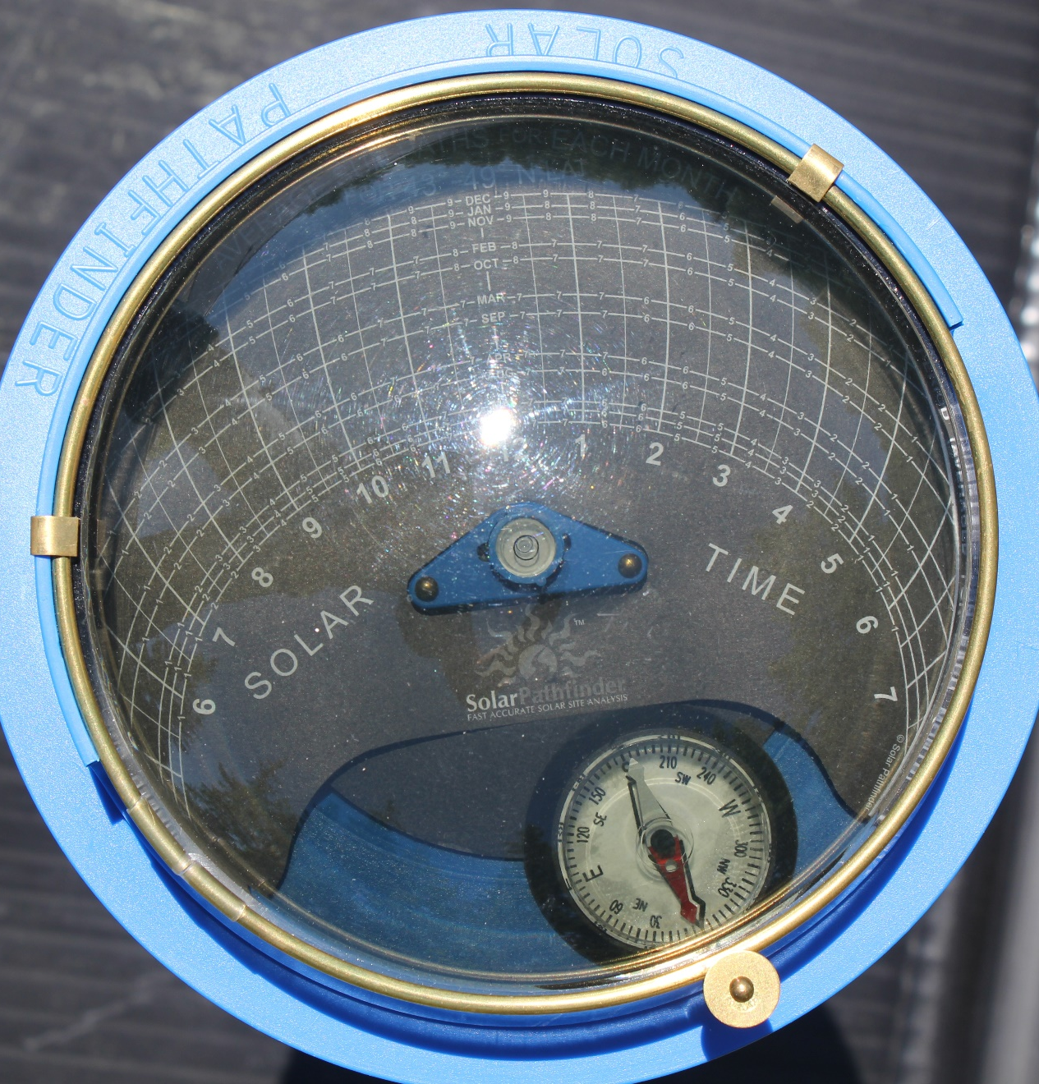
How the solar energy is measured
Notice the suns position. It is at noon in June. The highest point for the sun at latitude 45 degrees
Image courtesy Author

Slide 69
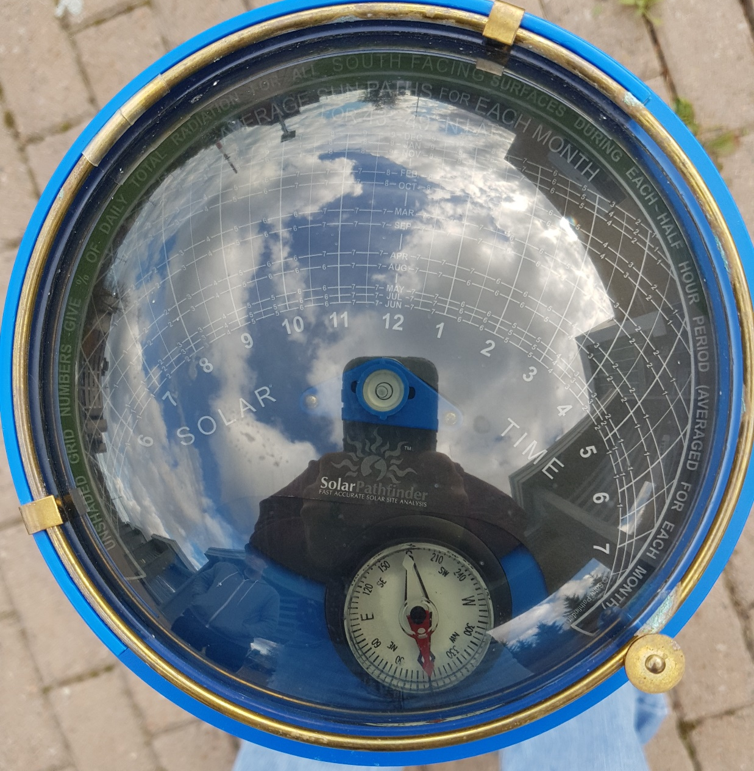
How the solar energy is measured
Lots of hard shading. The majority of the shading occurs during times of low intensity.
Early morning and mid to late afternoon.
Image courtesy Author

Slide 70
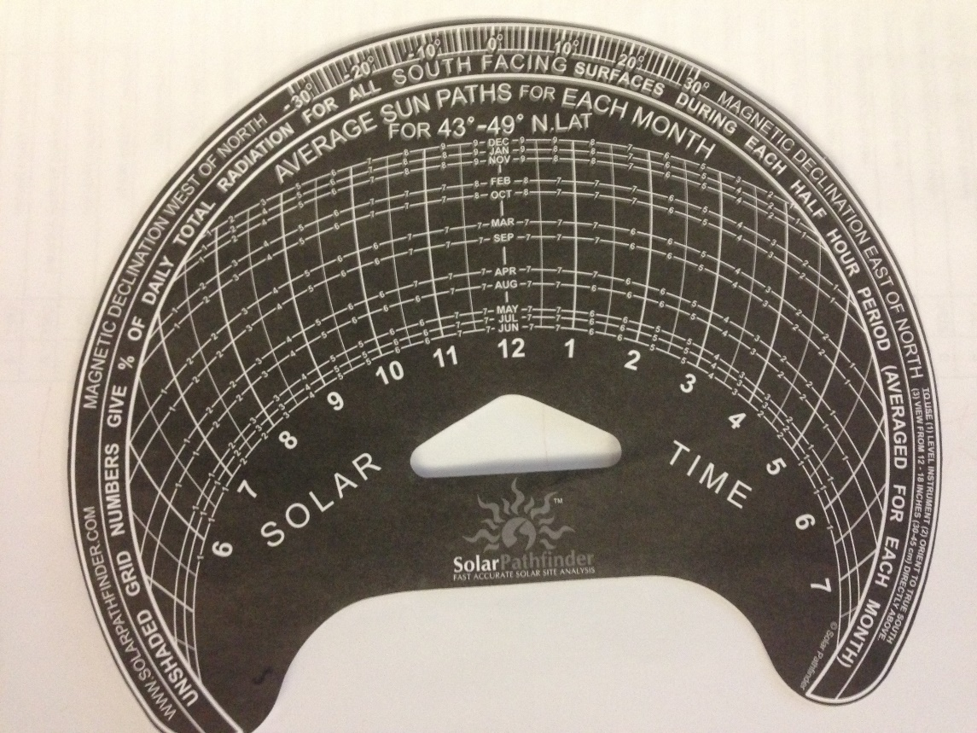
How the solar energy is measured
Obstruction
This is the template
  That represents the
  Solar path the sun
  Takes for each month
  Of the year.
Each line adds up to
  100 % of the daily
  Irradiance for each month.
Image courtesy Author

Slide 71
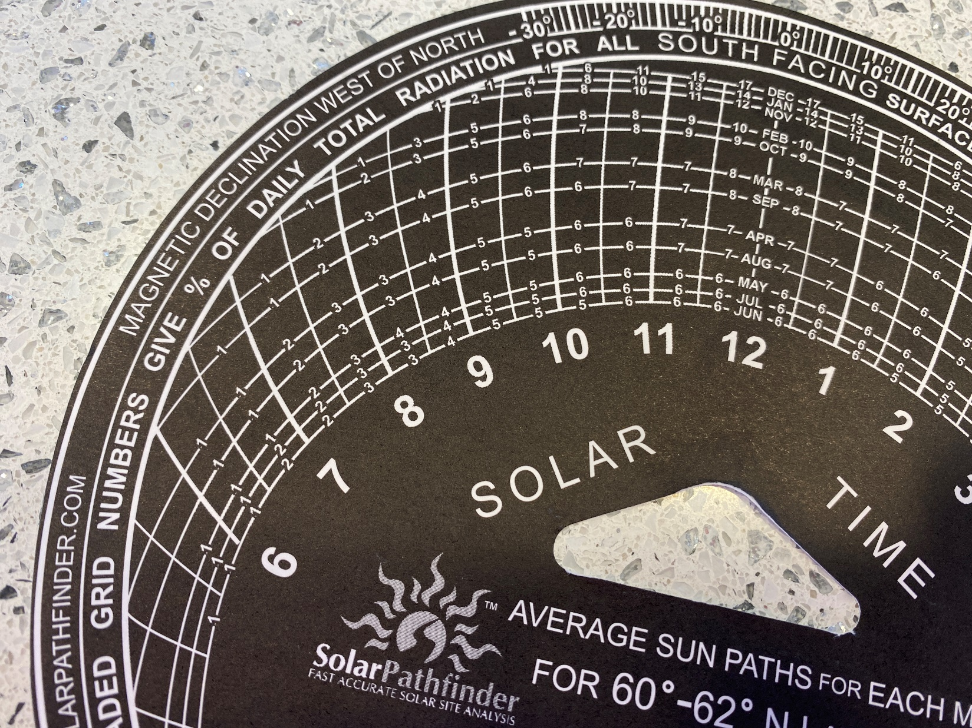
How the solar energy is measured
Each line until 12 adds to 50% of daily energy
Image courtesy Author

Slide 72
How the solar energy is measured
Obstruction
The user can trace around the template where shade from an obstruction is viewed.
The number that is under the shaded areas is added up for each line representing a month.
The total for each month is the daily percentage of shade.

Slide 73
How the solar energy is measured
Image courtesy Solar Pathfinder manual page 10

Slide 74
How the solar energy is measured
Obstruction
To find the site percent, add the numbers in the unshaded part of the sun-path arc. The
site tracing shown in previous slide has 64% solar available for December, found by adding 2 + 3 + 4 +
5 + 6 + 7 + 7 +8 + 8 + 8 + 6 = 64%. This shows that only 64% of the potential available
radiation is reaching this particular location during December. 36% of the potential available
radiation is blocked out.

Slide 75
How the solar energy is measured
Obstruction
The Solar Pathfinder manual has examples of this (page 10).

Slide 76
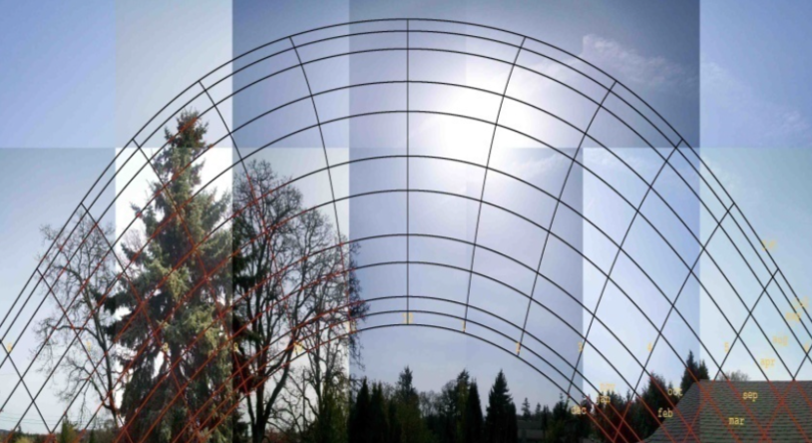
How the solar energy is measured
Obstruction
The tree takes up a large portion of the sky.
However it only blocks morning sky.

Slide 77
Questions

Slide 78
How the solar energy is measured
The next few slides will demonstrate the effect of slope (Zenith) and Azimuth have on irradiance and insolation.

Slide 79
How the solar energy is measured
Modelling software RETScreen will demonstrate how mounting angles change the insolation available.
The next slides are screen captures from RETScreen.
RETScreen is Excel based and charts can be made to demonstrate various conditions on a single chart.
RETScreen has a help file that explains every cell.

Slide 80
How the solar energy is measured
RETScreen is a clean energy management software package developed by the Government of Canada.
RETScreen is also used as a teaching and research tool by well-over 1,400 universities and colleges worldwide, and is frequently cited in academic literature.

Slide 81
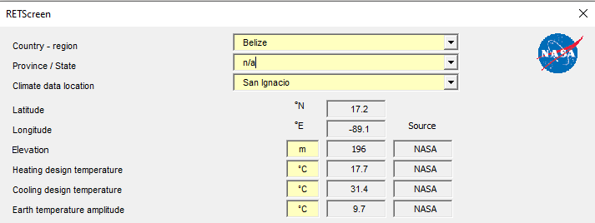
How the solar energy is measured
In RETScreen climatic data for many parts of the world are available in its database.
Data for San Ignacio is used for the following slides.

Slide 82
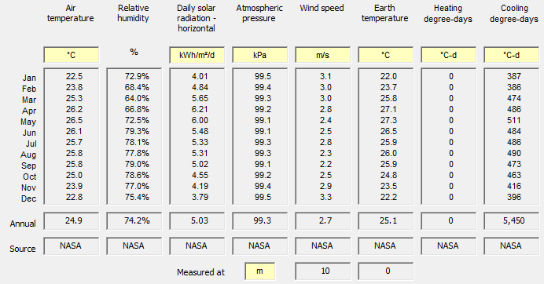
How the solar energy is measured
This is the complete climatical data for the site.

Slide 83
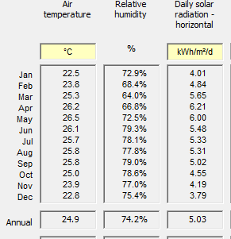
How the solar energy is measured
The Daily solar radiation
  horizontal.
This radiation will be
  readjusted to various
  Azimuths and tilt angles.
The next slides will
  demonstrate this.

Slide 84
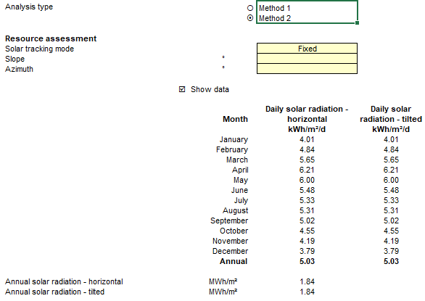
How the solar energy is measured
Method 2 allows for more options to adjust the angles of the tracking.

Slide 85
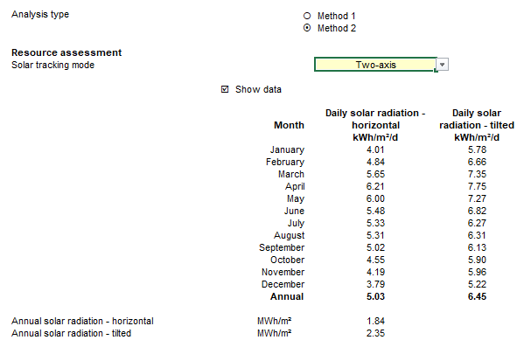

How the solar energy is measured
Tracking mode can be fixed or a few methods of active trackers. This is a Two-axis example.

Slide 86
How the solar energy is measured
This is a Two-axis tracker.

Slide 87
How the solar energy is measured
Slope is the angle from the horizontal the PV panel is tilted.

Slide 88
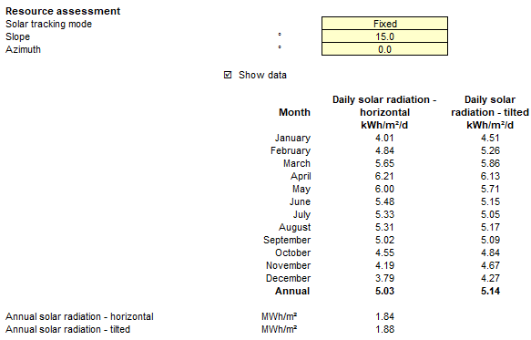
How the solar energy is measured
Slope is 15 degrees and the results are found in the column “Daily solar radiation – tilted. Annual value has increased to 1.84 to 1.88.

Slide 89
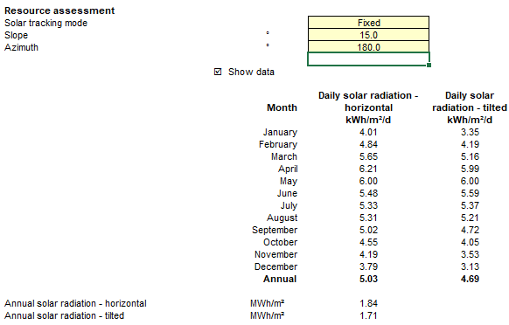
How the solar energy is measured
Azimuth changed to 180 degrees. Only June and July have increased. The sun was now to the north for those months.

