Slide 1
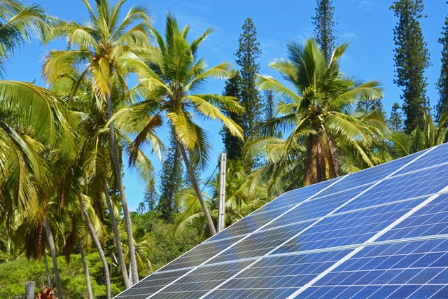



Design and Implementation of Pilot of a TVET Renewable Energy Course
DELIVERABLE #5 - TRAINING COURSES & PROFESSIONAL DEVELOPMENT

Slide 2

Irradiance Lab Results
These slides demonstrate the lab called Lab 5 PV Panel Angle of Incidence.
The pictures were taken under various irradiance values.
The set up was outside ambient temperature 12C.

Slide 3
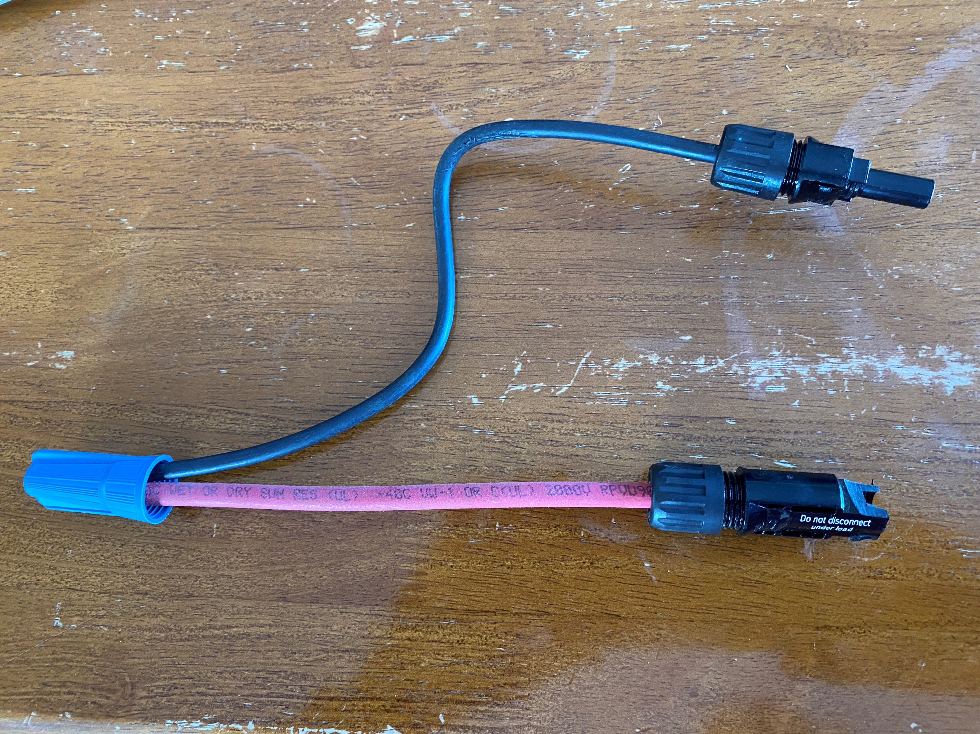
Irradiance Lab Results
The shorting wire was used to keep the MC-4 connectors from being opened under load.
The current was measured with a clamp on Ammeter attached to a multimeter.
Handheld pyranometer used to measure the irradiance.
Picture courtesy Author

Slide 4
Irradiance Lab Results
The conditions for doing this lab was perfect.
The measured irradiance was very close to 1000W/m²
Ambient temperature was 12C.

Slide 5
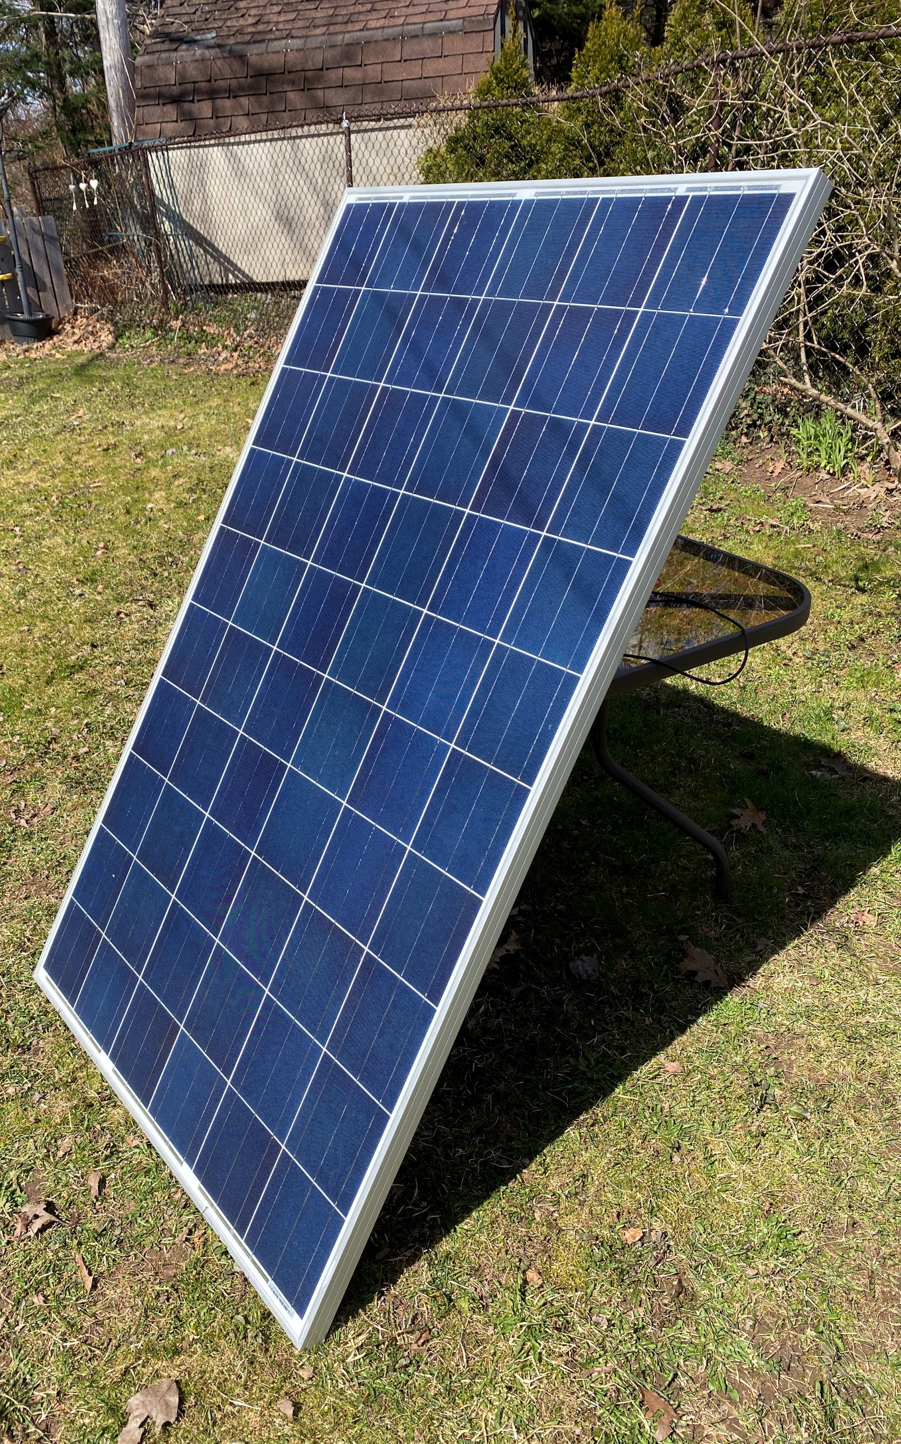
Irradiance Lab Results
The PV panel was
Hanwha Solar One
HSL60P6-PB-4-250
Voc = 37.7V
Isc = 8.79A
Picture courtesy Author

Slide 6
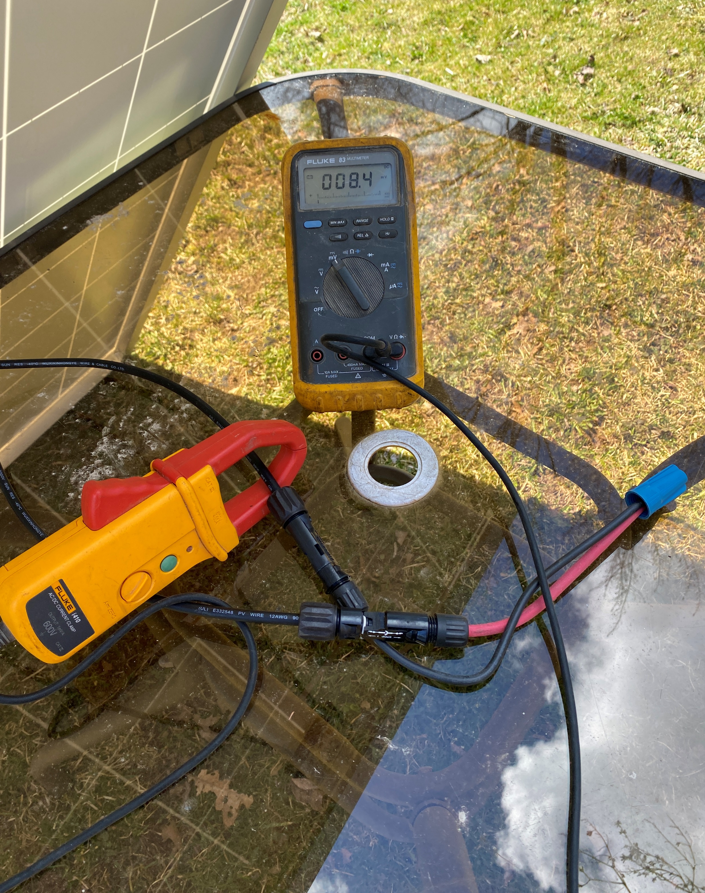
Irradiance Lab Results
Ammeter / multimeter.
The shorting wire is
Connected to the panel.
Picture courtesy Author

Slide 7
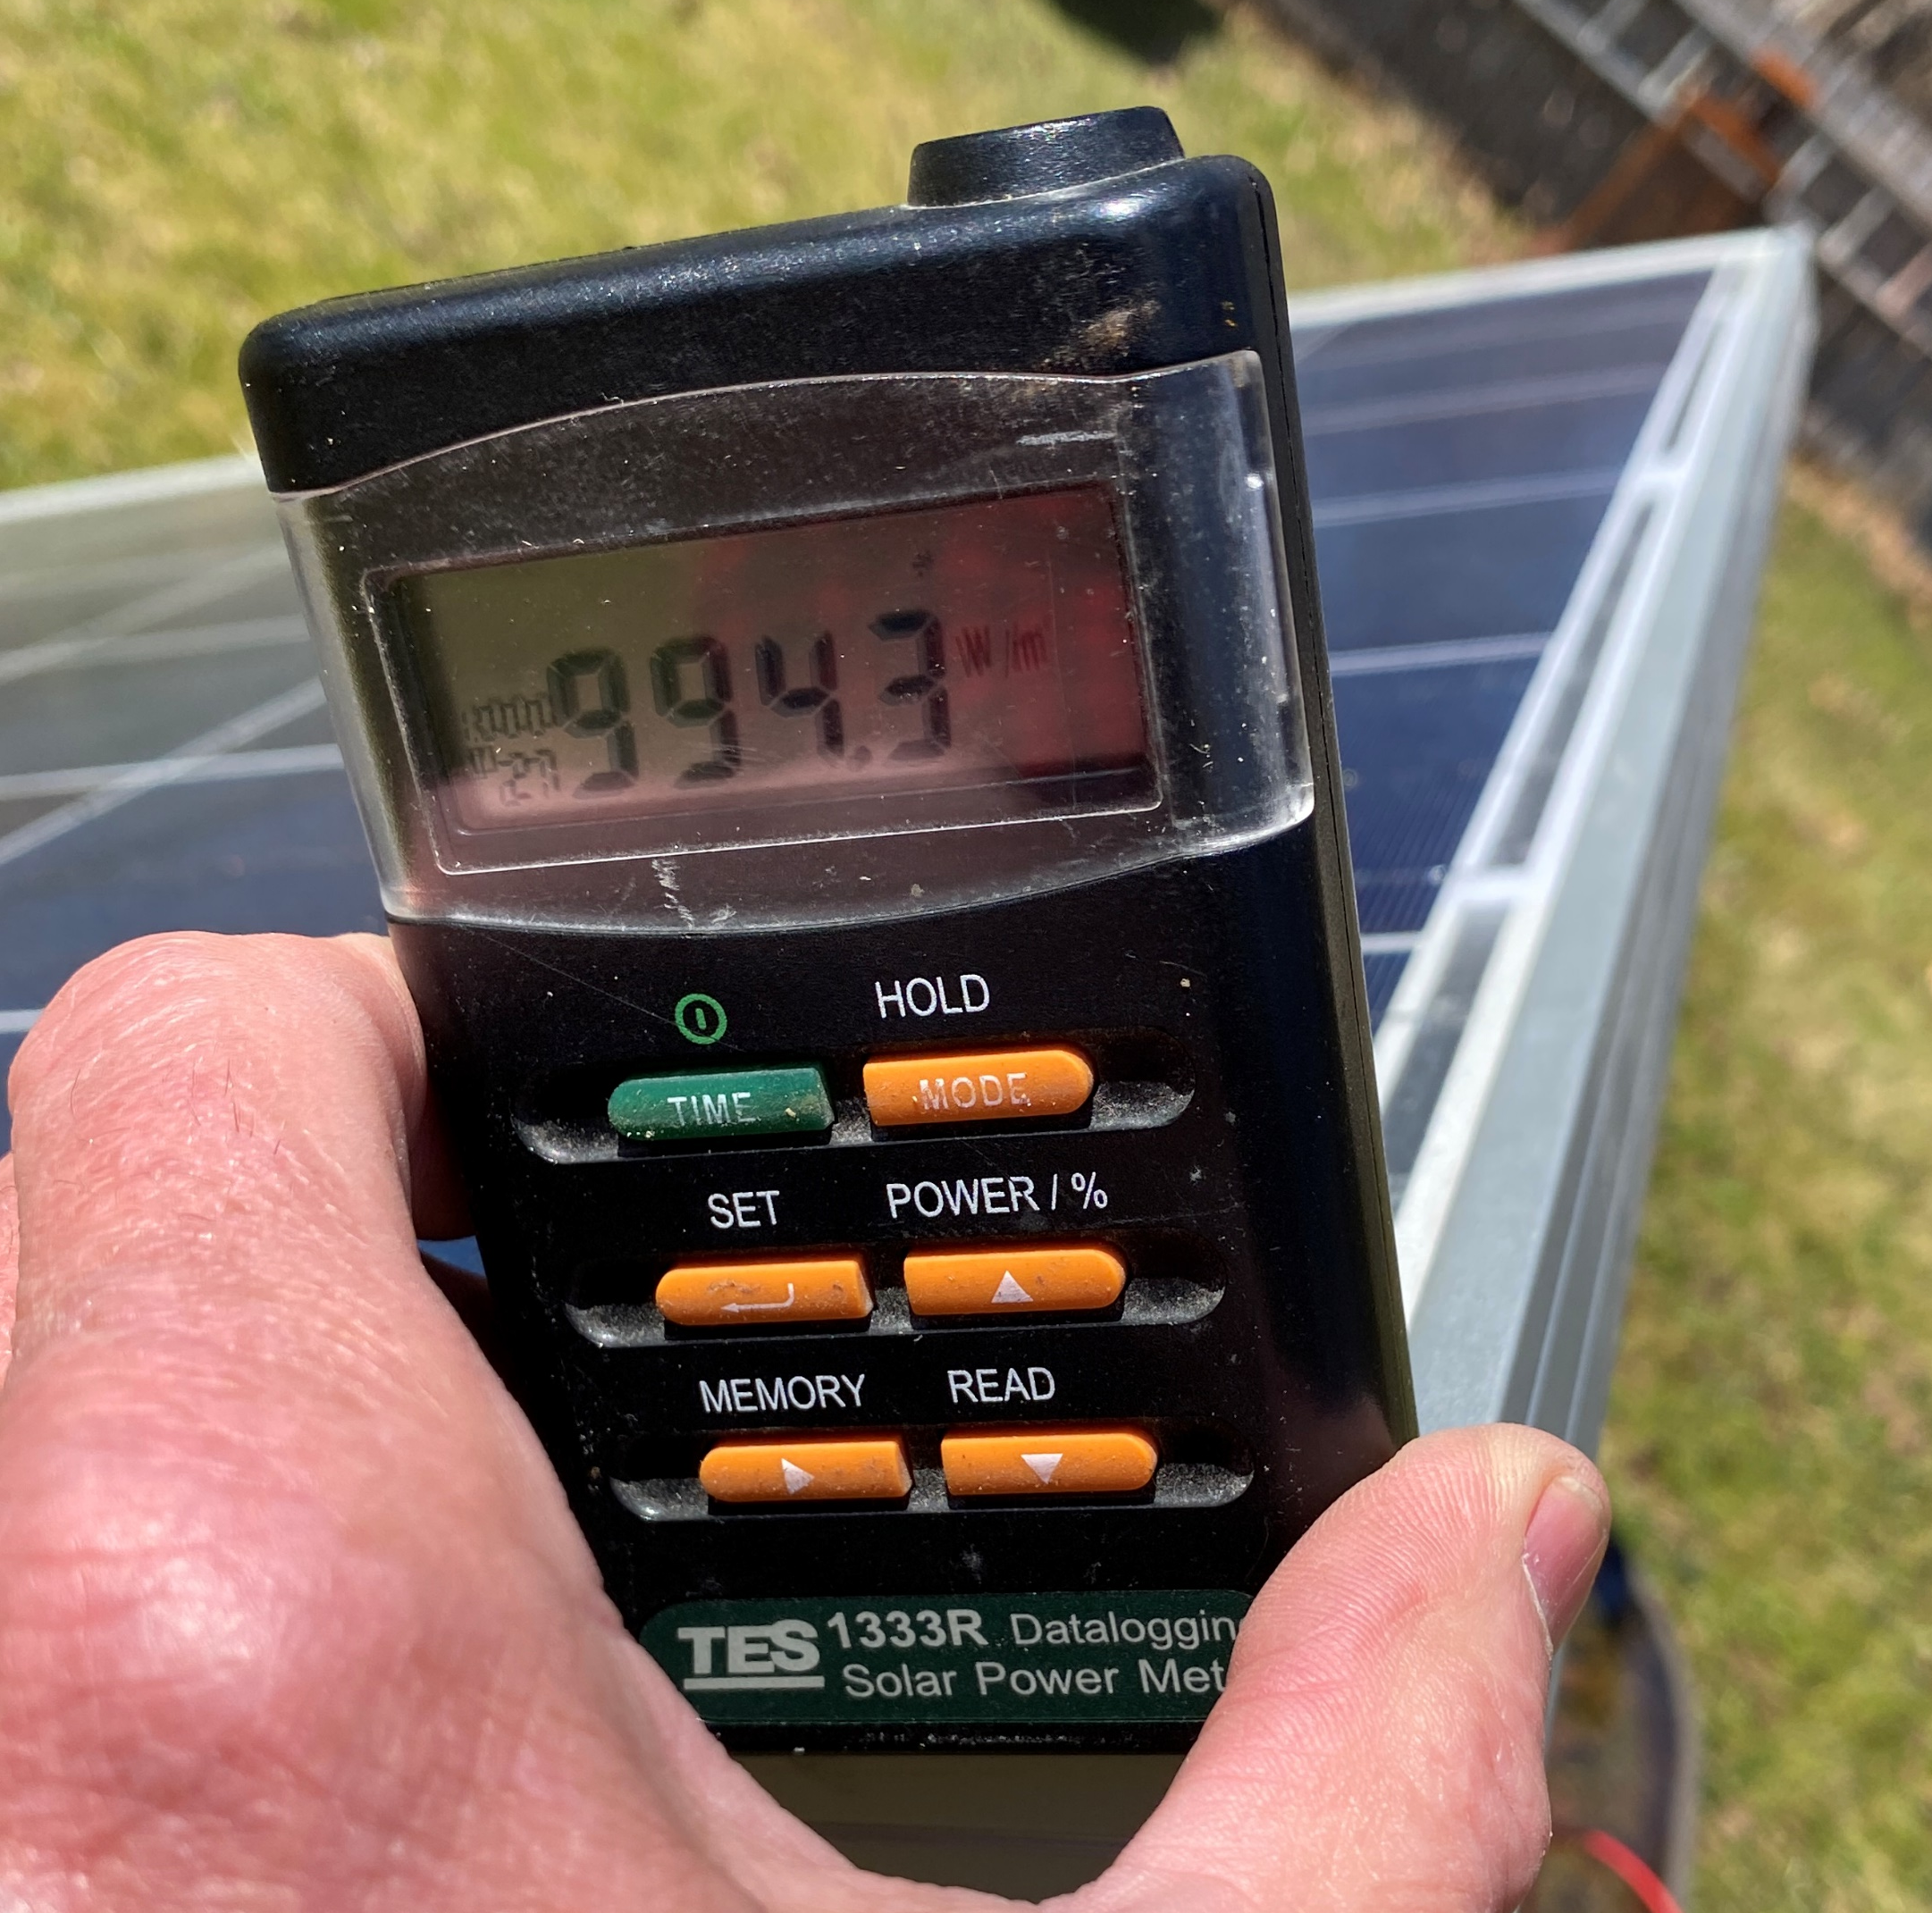
Irradiance Lab Results
The pyranometer reading 994 W/m²
Picture courtesy Author

Slide 8
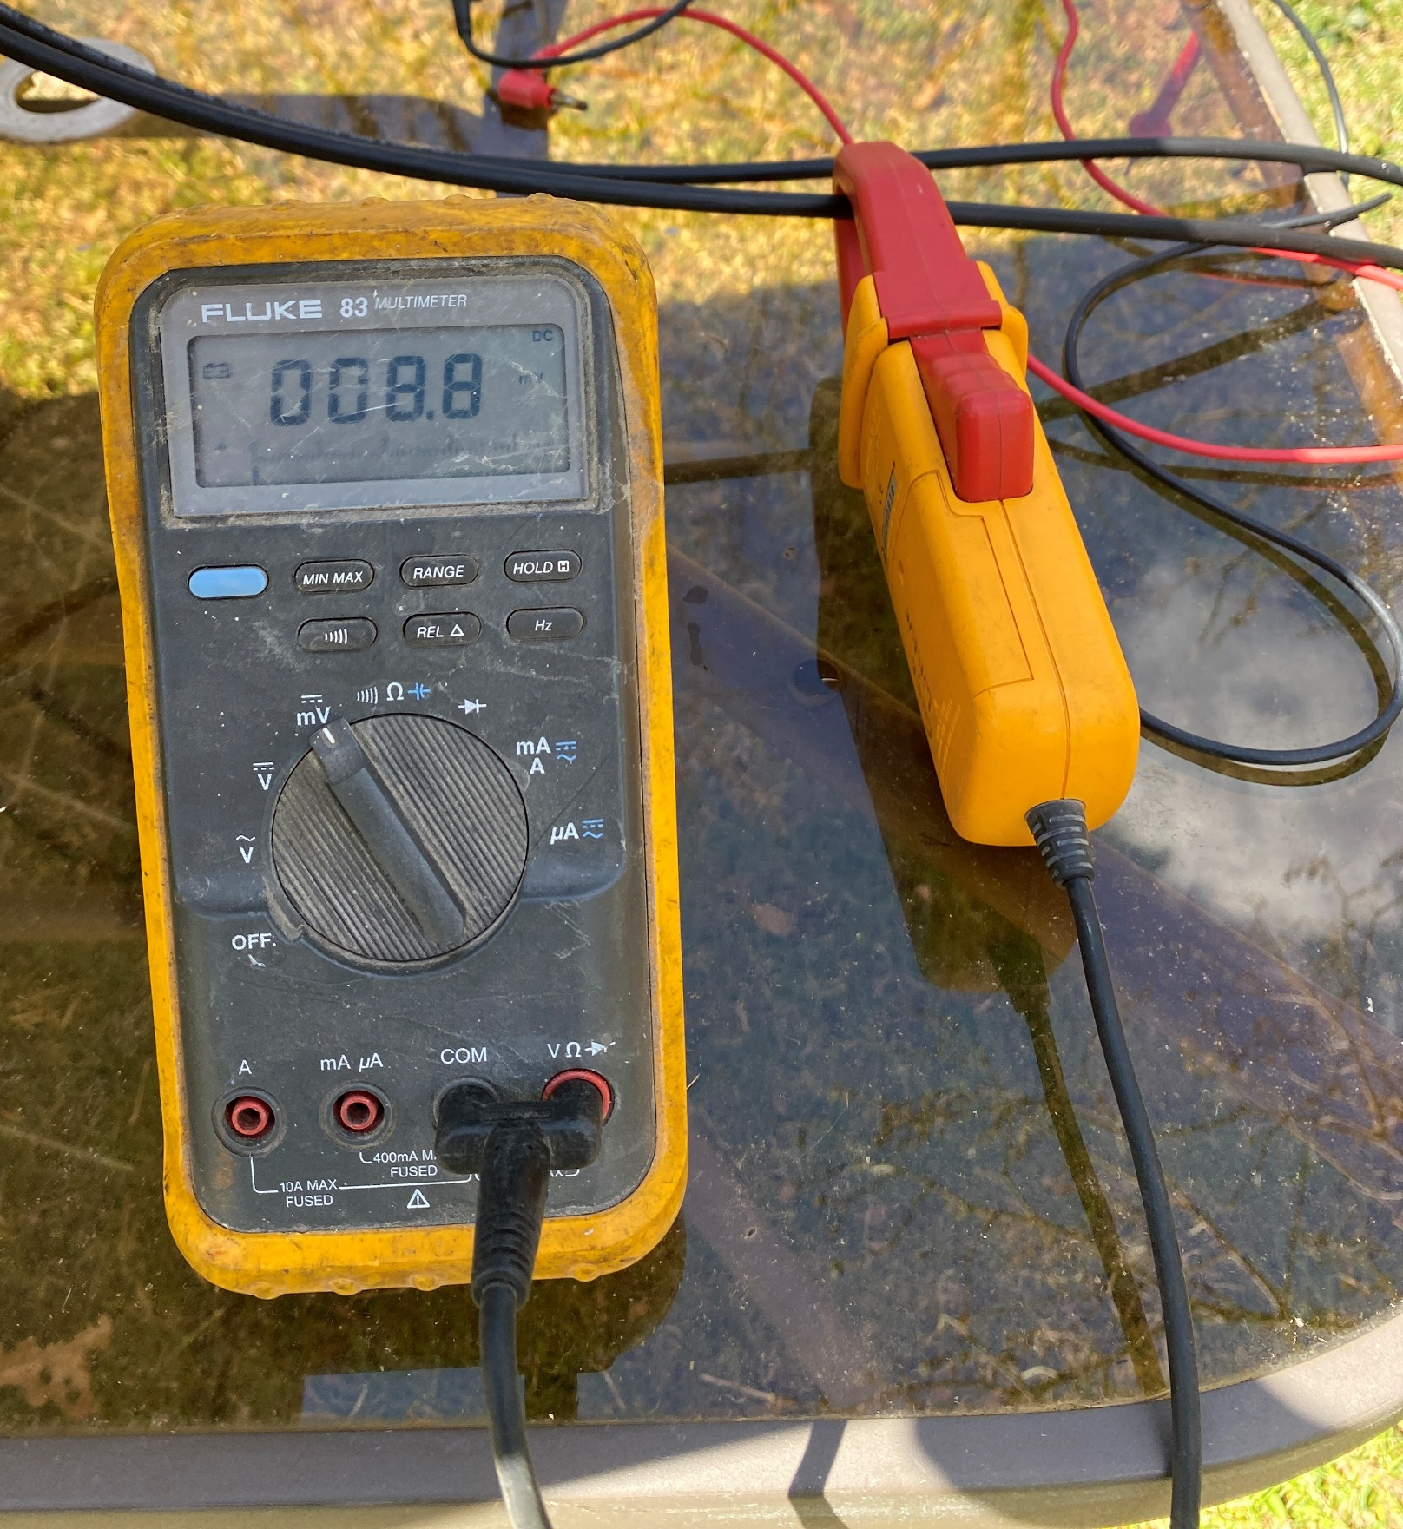
Irradiance Lab Results
The Ammeter showing 8.8A.
Isc is rated at 8.79A
Picture courtesy Author

Slide 9
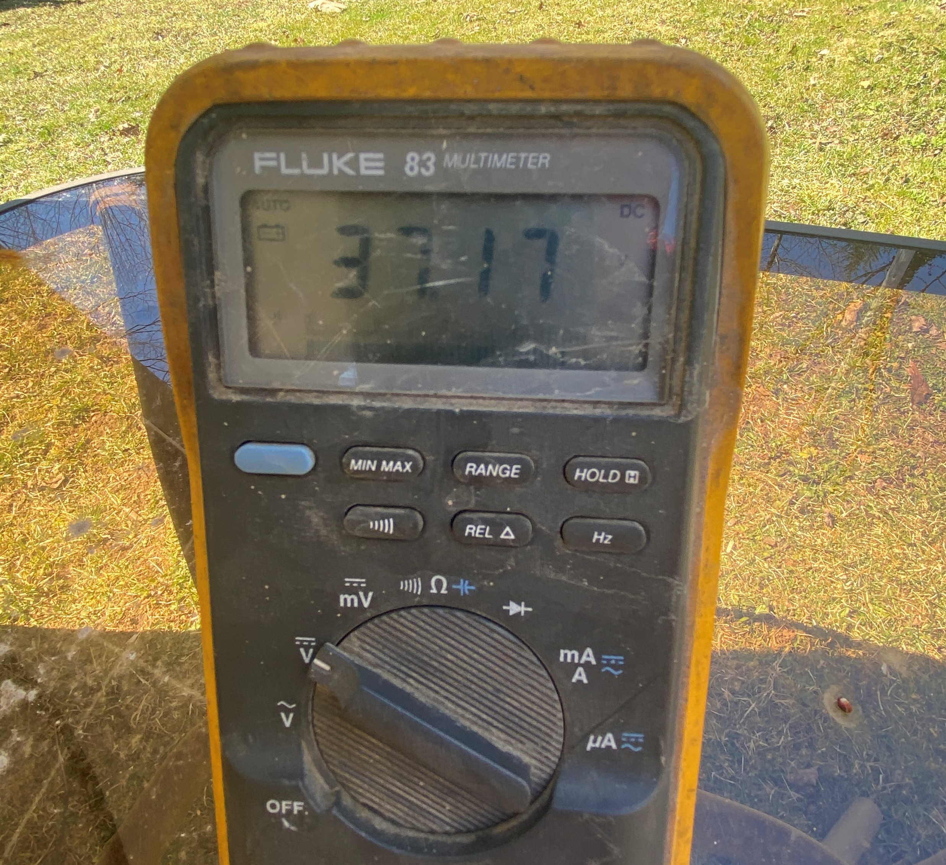
Irradiance Lab Results
The Voc is measured at
37.2 Volts
Voc rated at 37.7 V
Picture courtesy Author

Slide 10
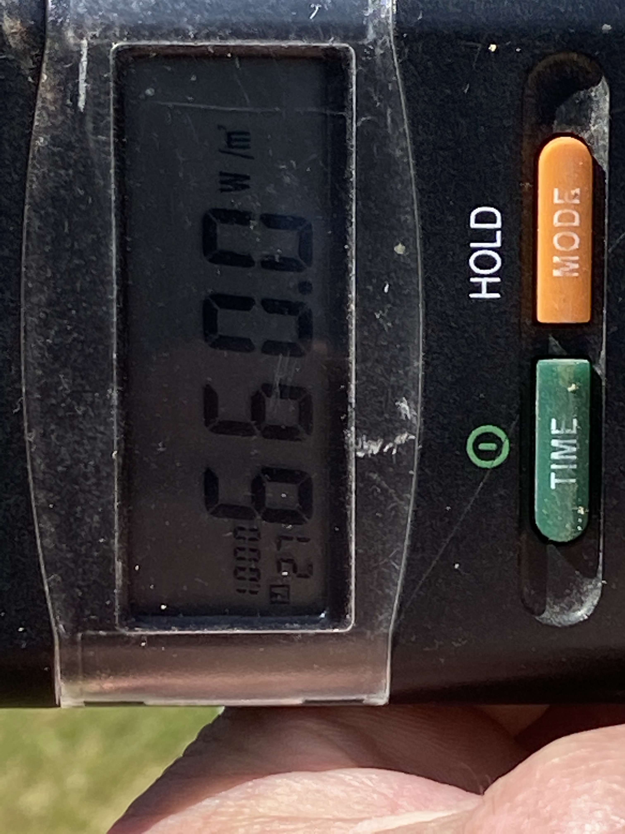
Irradiance Lab Results
The pyranometer reading 660 W/m²
Picture courtesy Author

Slide 11
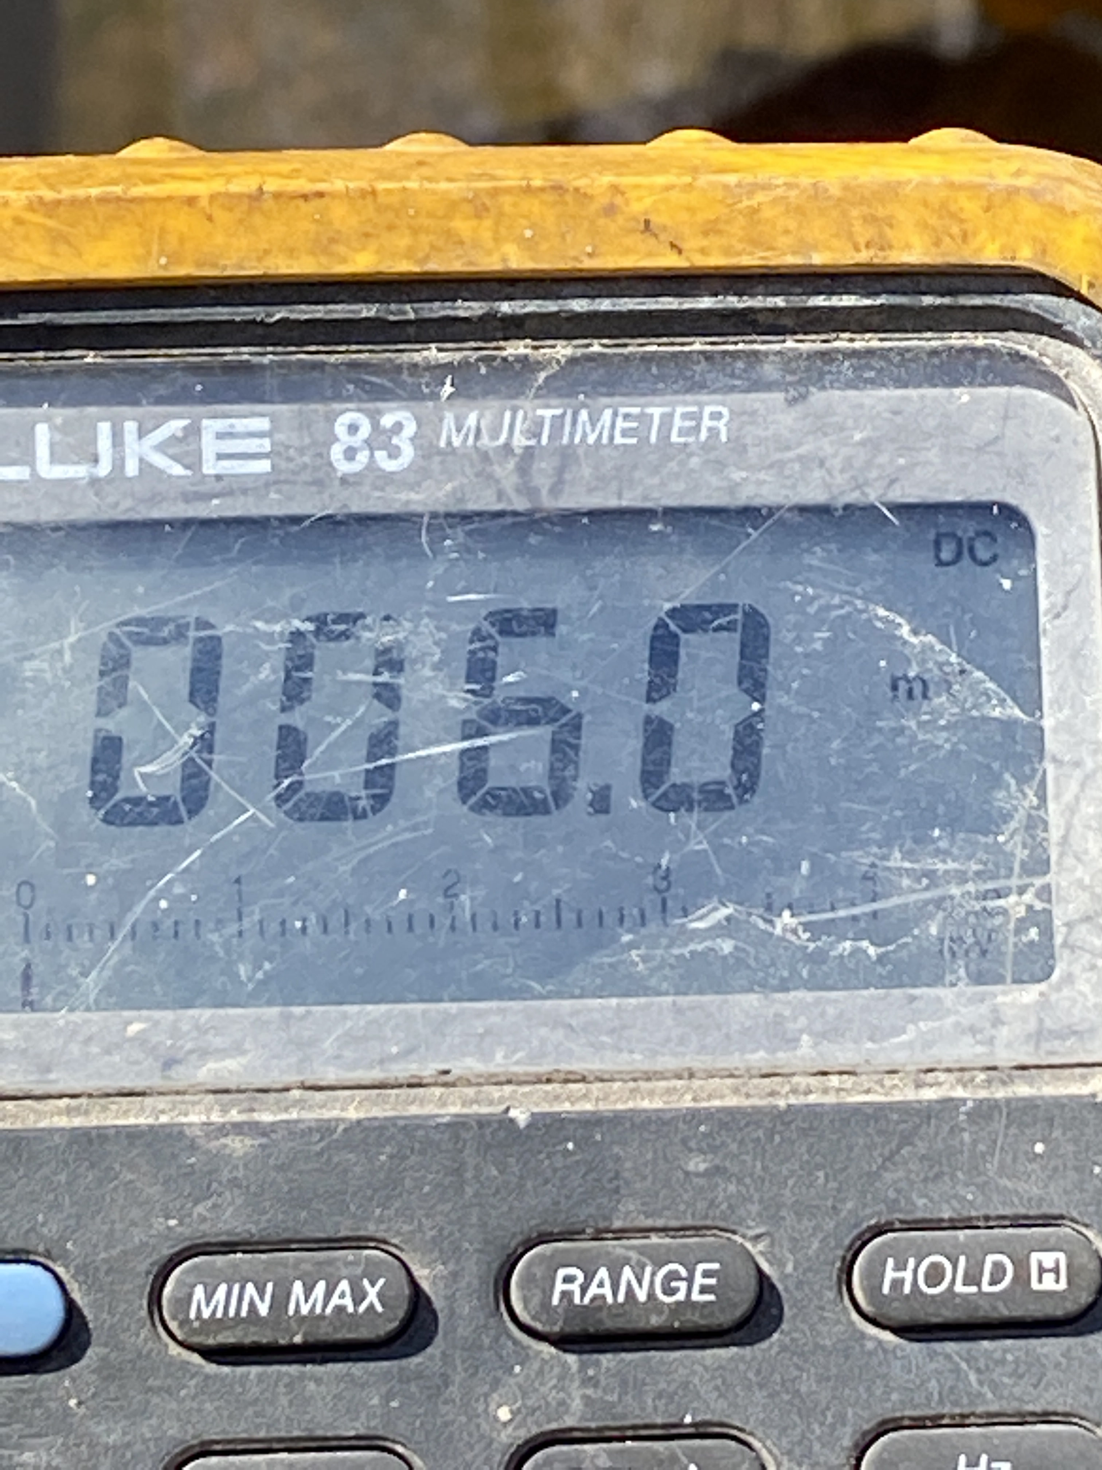
Irradiance Lab Results
The Ammeter showing 6.0A.
The irradiance is 66%
of the rated 1000W/m²
66% of the rated Isc.
0.66 x 8.79A = 5.8A
This is very close to
our reading of 6.0A.
Picture courtesy Author

Slide 12
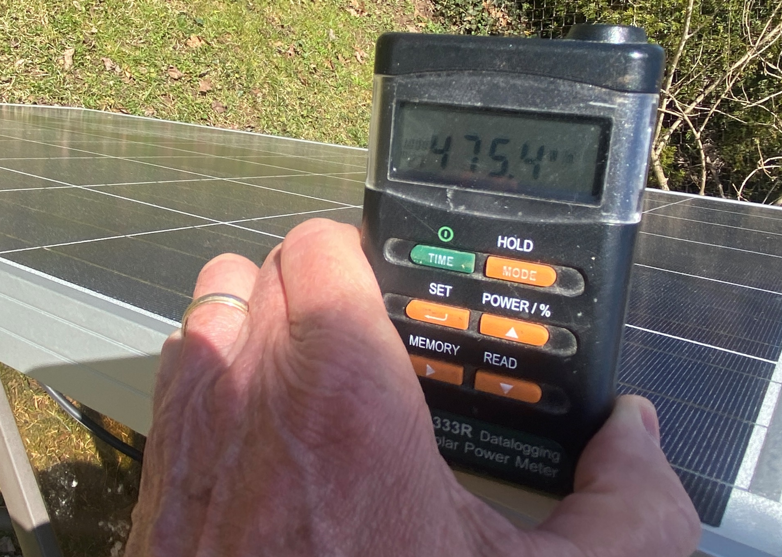
Irradiance Lab Results
The pyranometer reading 475 W/m²
Picture courtesy Author

Slide 13
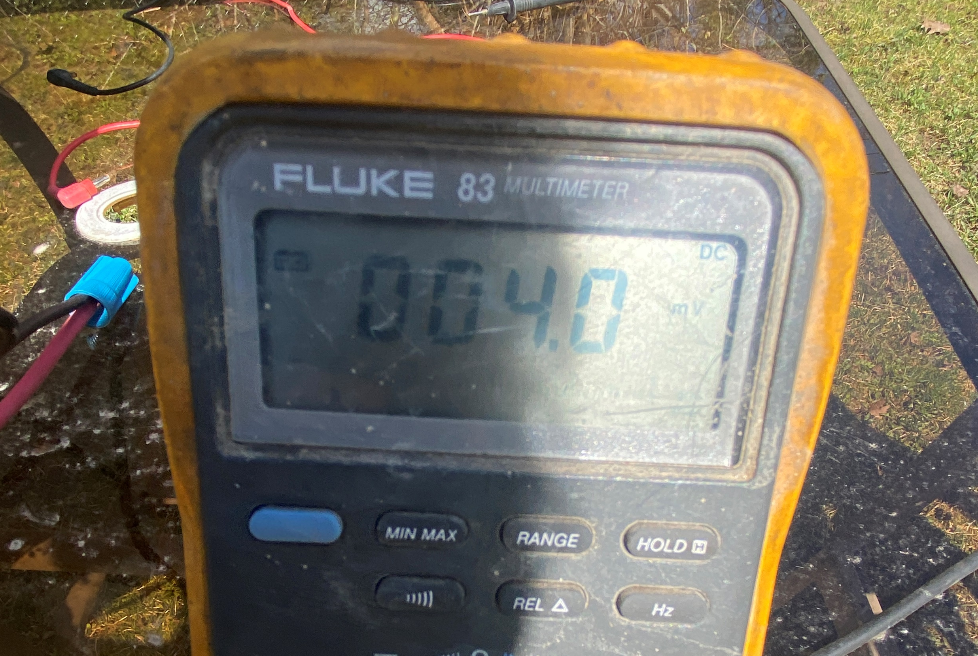
Irradiance Lab Results
The Ammeter showing 4.0A.
The irradiance is 45.7%
of the rated 100W/m²
46% of the rated Isc.
0.46 x 8.79A = 4.18A
This is very close to
our reading of 4.0A.
The readings were a
few seconds apart.
Picture courtesy Author

Slide 14
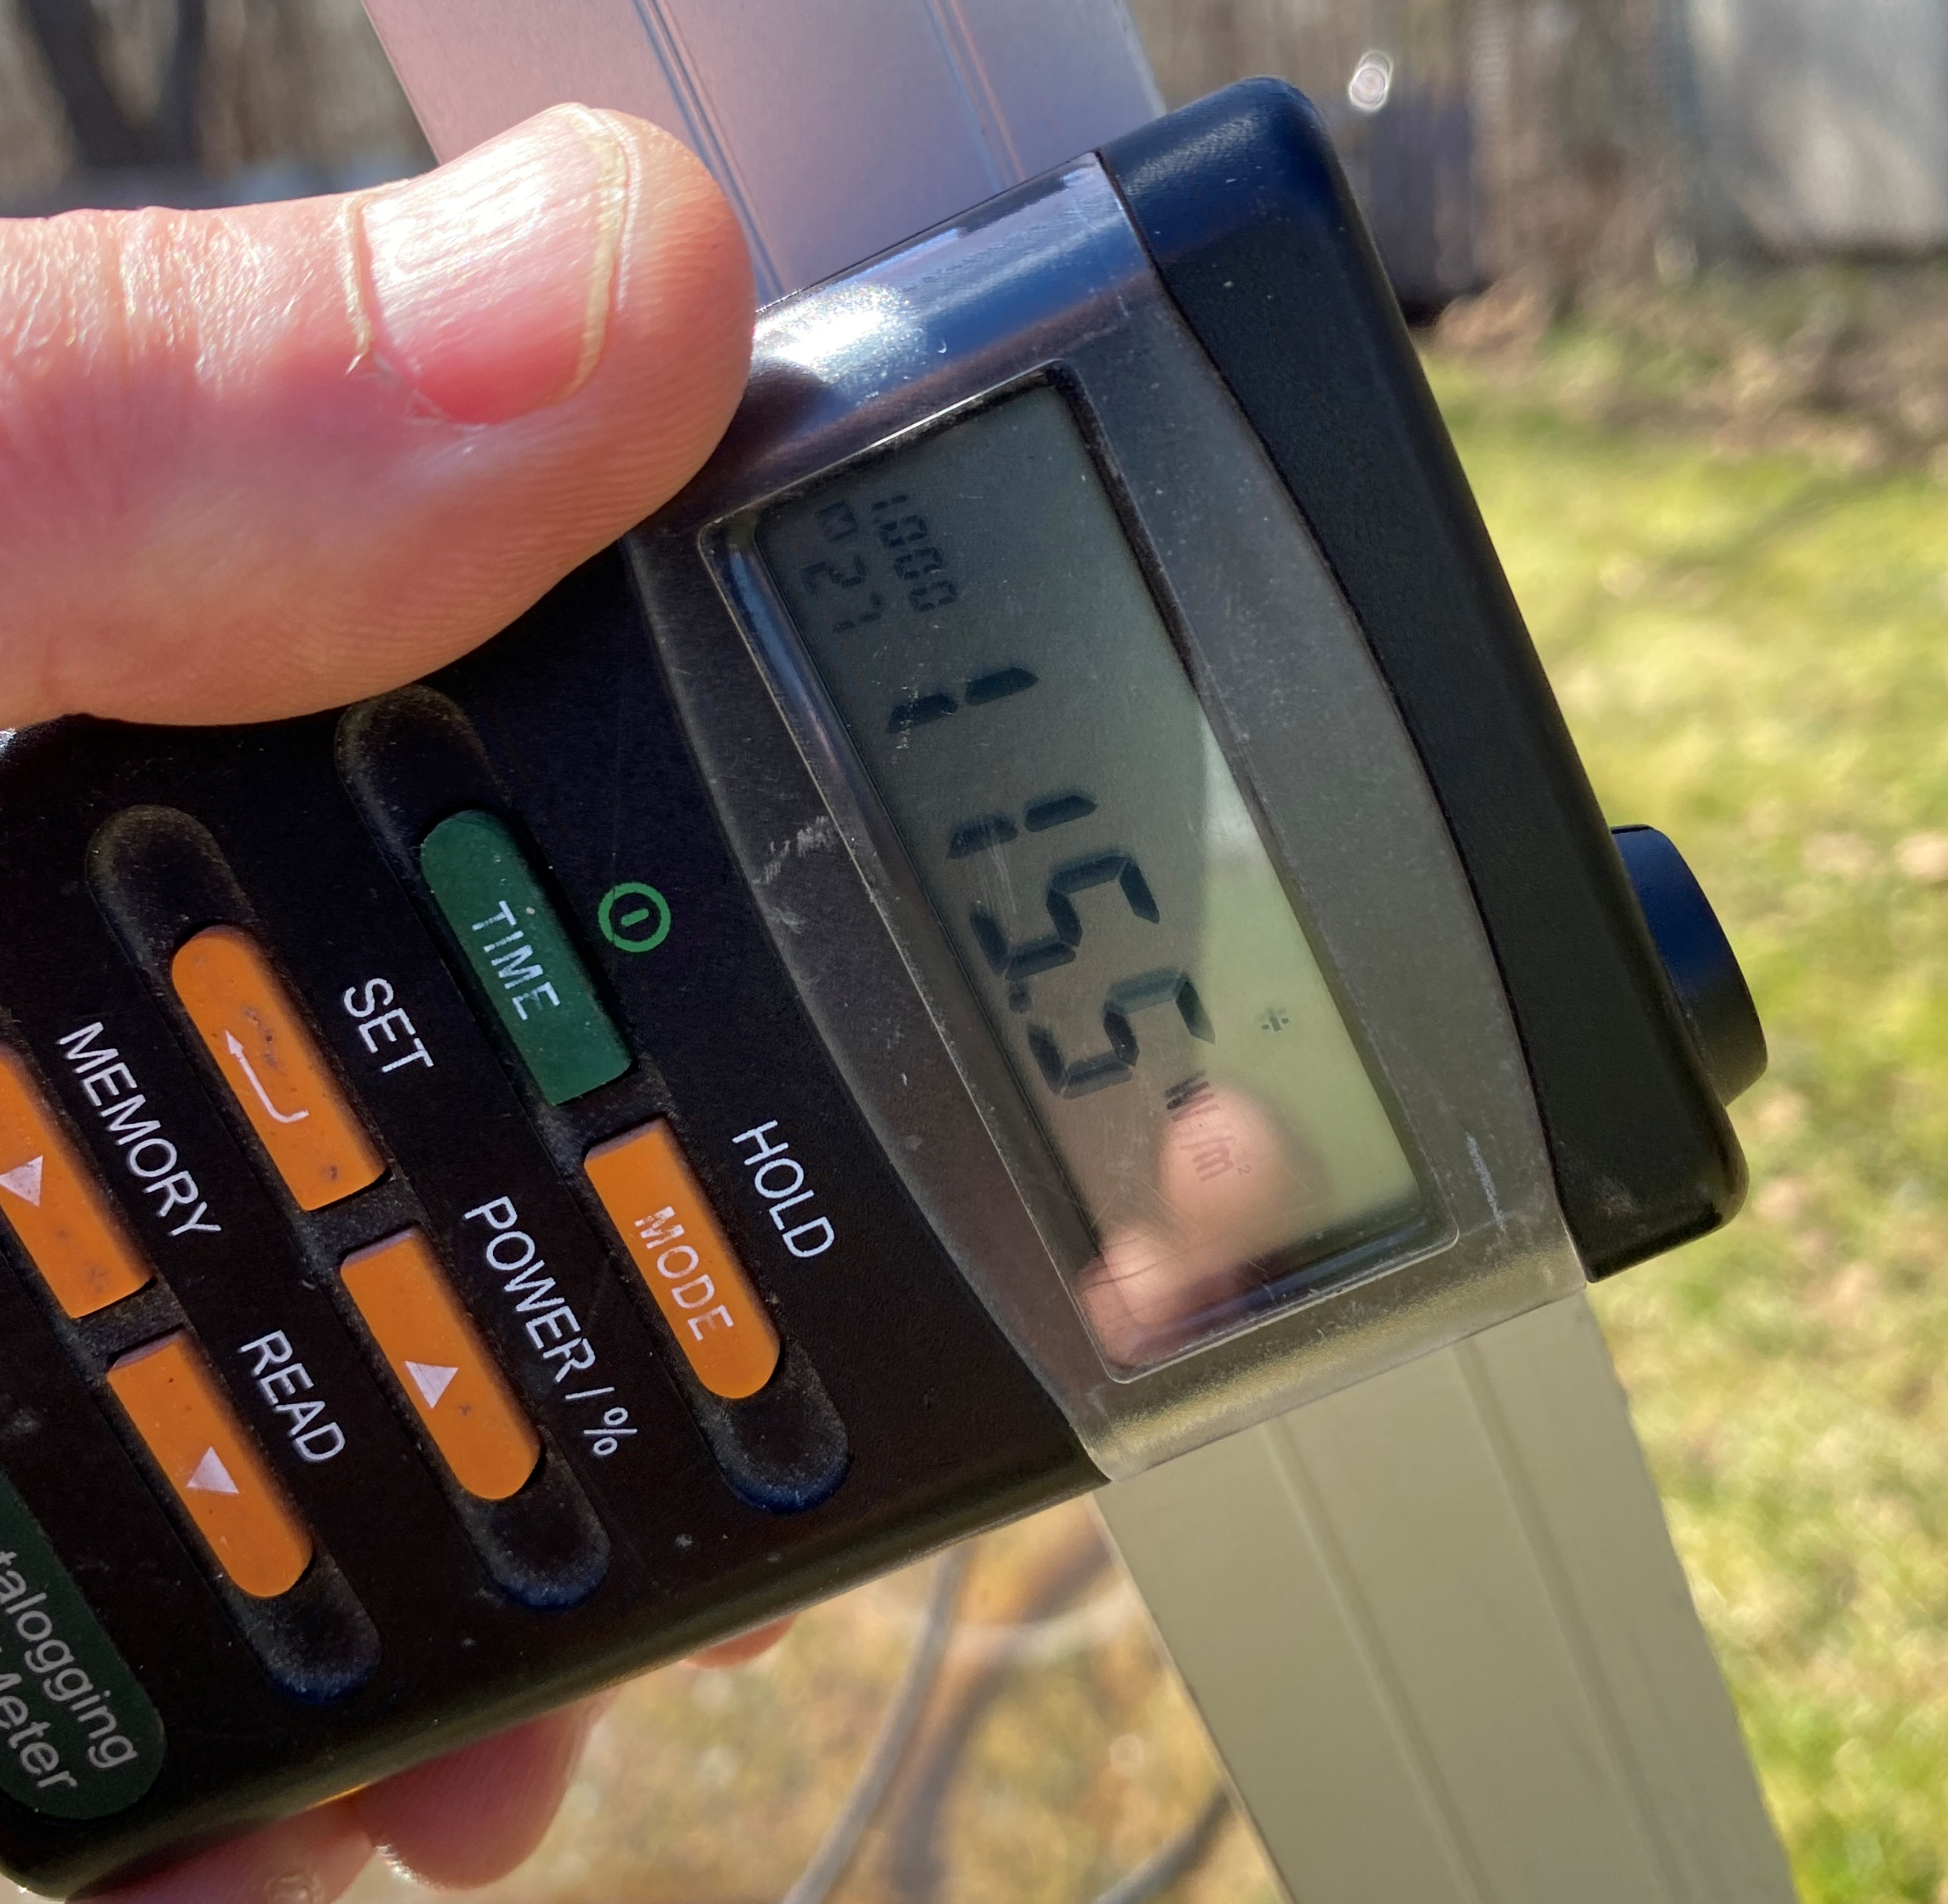
Irradiance Lab Results
The pyranometer reading 116 W/m²
Picture courtesy Author

Slide 15
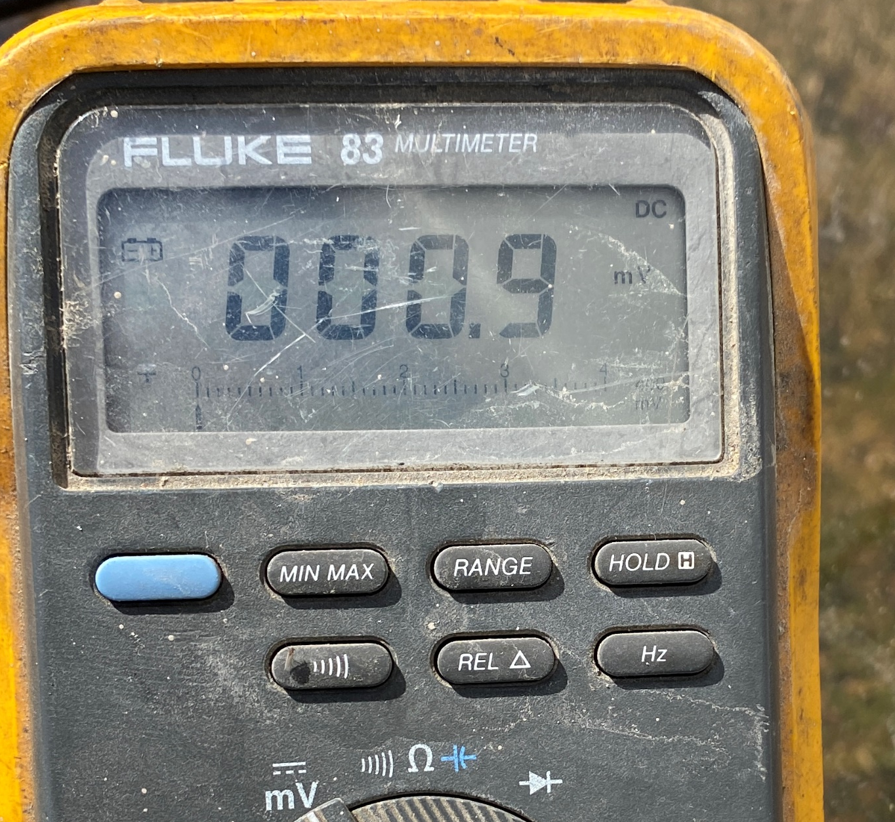
Irradiance Lab Results
The Ammeter showing 0.9A.
The irradiance is 11%
of the rated 1000W/m²
11% of the rated Isc.
0.11 x 8.79A = 0.98A
This is very close to
our reading of 0.9 A.
Picture courtesy Author

Slide 16
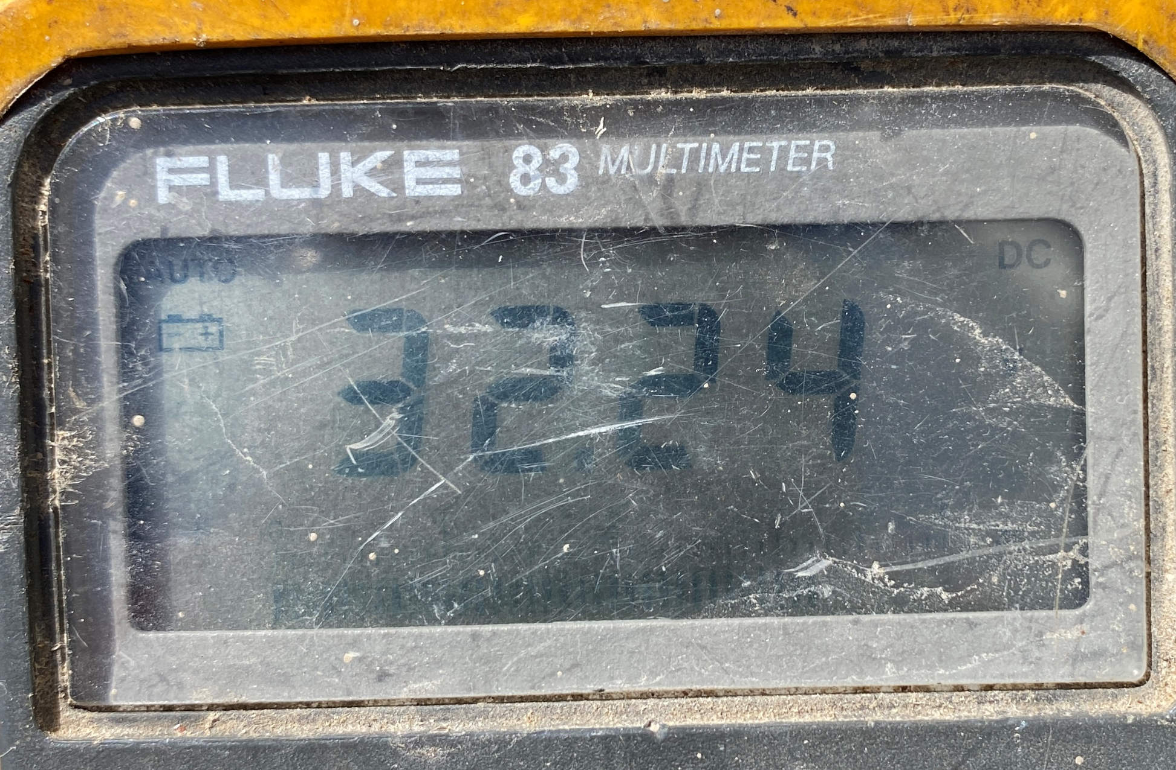
Irradiance Lab Results
The Voc is measured at only 32.2 Volts.
At this low irradiance
of 115 W/m² which is
lower than the
200 W/m² lower limit.
Voc rated at 37.7 V
Picture courtesy Author

