Slide 1




Design and Implementation of Pilot of a TVET Renewable Energy Course
DELIVERABLE #5 - TRAINING COURSES & PROFESSIONAL DEVELOPMENT

Slide 2
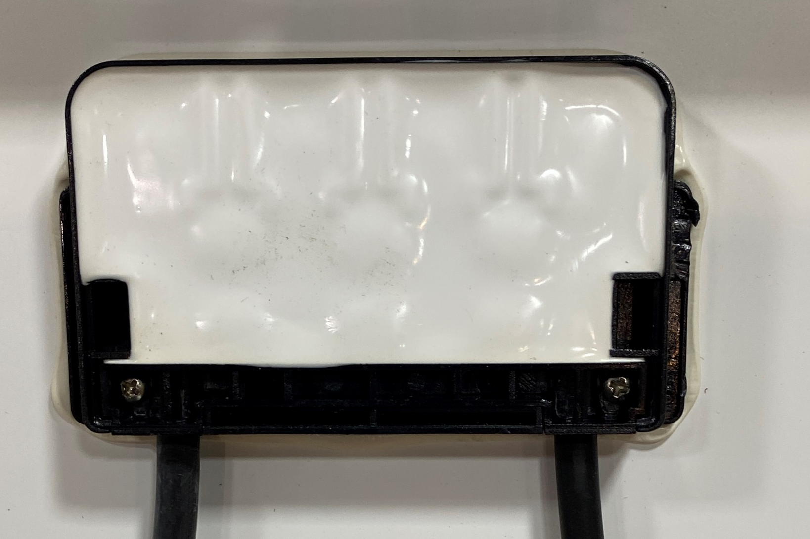
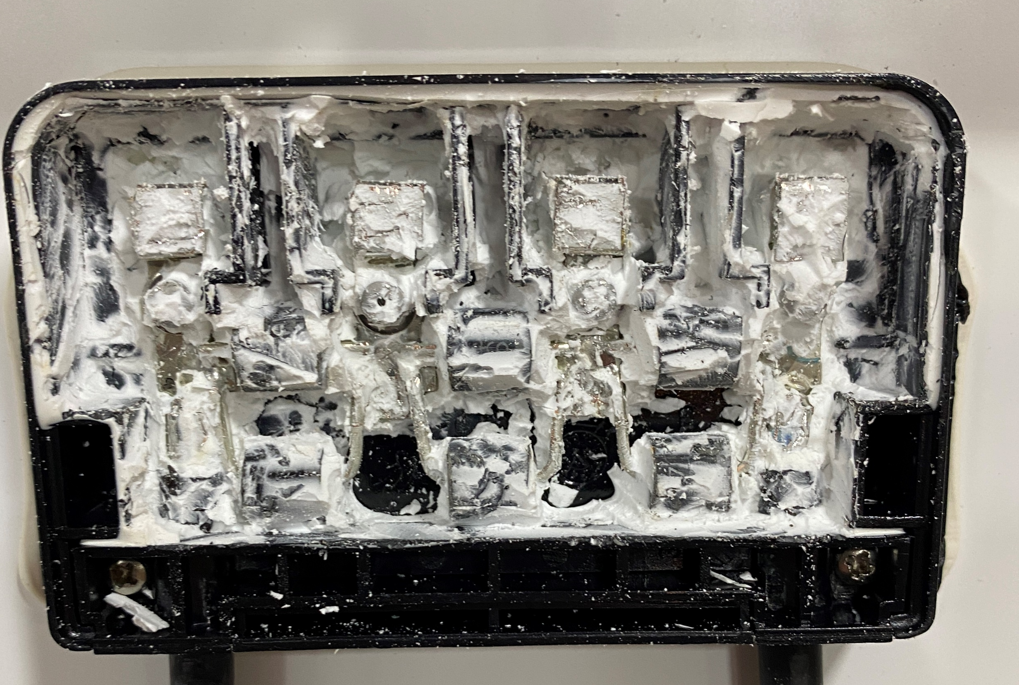

Lab 6 Shading
By-Pass Diodes
Picture courtesy author

Slide 3
Lab 6 Shading
Every PV panel should have by-pass diodes in the junction box.
The diodes are used to prevent back biasing the solar cells and having them go into reverse voltage breakdown and fail.
The diodes are placed across a group of cells.
This was covered 4 Module PV Panels in Power Point PV.

Slide 4
Lab 6 Shading
Questions?

Slide 5
Lab 6 Shading
In this lab the number of cells and diodes in the panel used must be figured out.
The panel used to demonstrate this has 60 cells and 3 by-pass diode sections.
The arrangement of the diodes needs to be figured out as well.

Slide 6
Lab 6 Shading
The junction box at the back of the panel needs to be opened and the diodes exposed.
This may take time to remove any waterproofing material.
Picture courtesy author

Slide 7
Lab 6 Shading
The by-pass diodes on this panel uses 2 for each
section.
There are 3 sections but 6 by-pass diodes.
2 in parallel for each section.
Picture courtesy author

Slide 8
Lab 6 Shading
With the demonstration panel having 60 cells and 3 sections with diodes.
Each diode section protects 20 cells that are connected in series.
The panel has 6 rows of 10 cells running vertically.
At the top and bottom of each row is a soldered jumper connecting cell rows together or diodes.

Slide 9
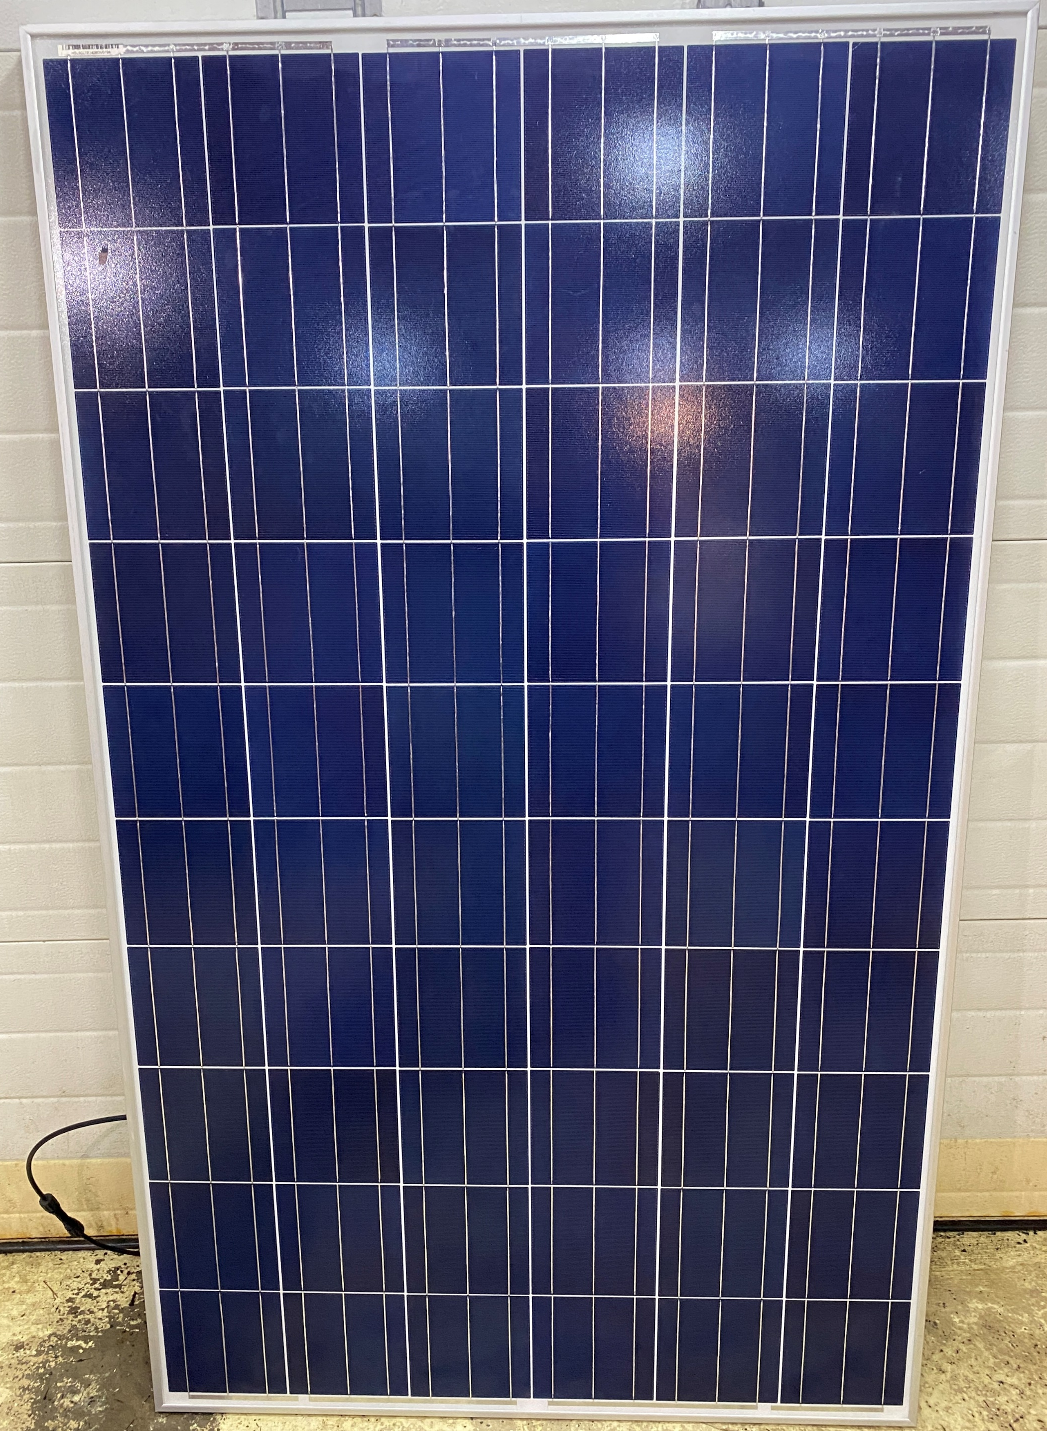
Lab 6 Shading
Picture courtesy author
6 rows
10 cells

Slide 10
Lab 6 Shading
Picture courtesy author
First row jumper only.
Connects to + lead and
to one end of a diode
section.
Bottom of first row has
jumper connecting
second row of 10 cells.
Diodes normally only
connect on top jumpers.
Connects to second row
with a jumper.

Slide 11
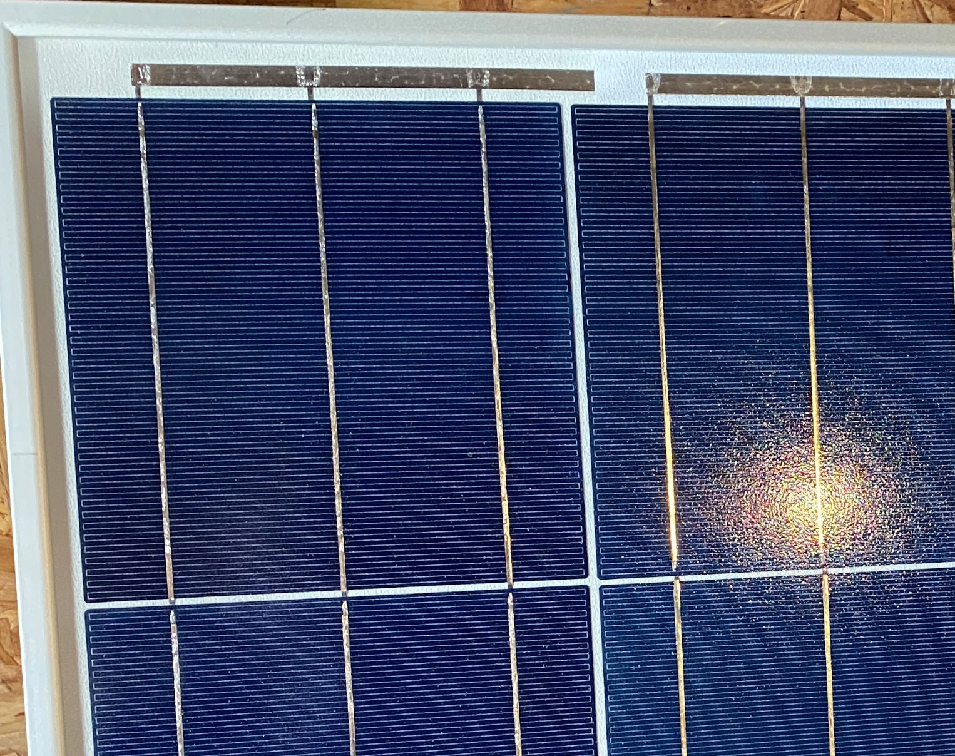
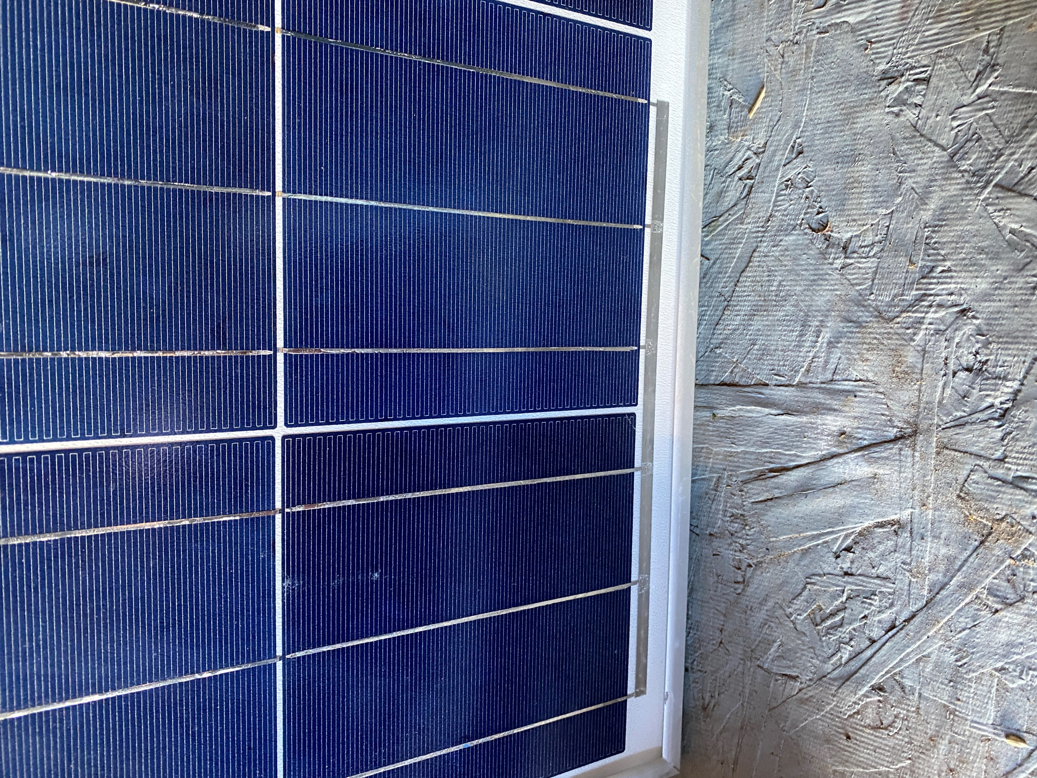
Lab 6 Shading
First row jumper only
Connects to + lead and
To one end of a diode section.
Bottom of first row has
jumper connecting
second row of 10 cells.
Diodes normally only
connect on top jumpers.
Connects to second row
with a jumper.
Picture courtesy author

Slide 12
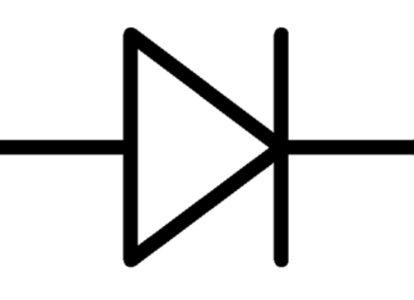
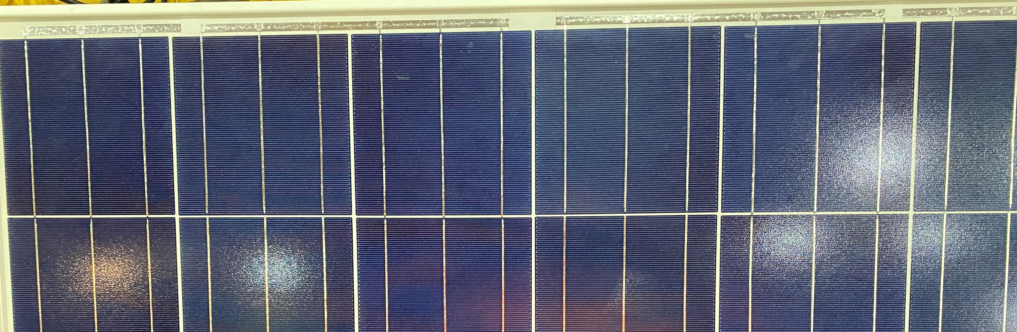
Lab 6 Shading
Top of panel view. They join the series string of cells from top to bottom of the panel. Each row of cells going up and down has 10 cells and each diode(s) are across 20 cells.
Three diodes across 10 + 10 cells each
Image courtesy author

Slide 13
Lab 6 Shading
Questions?

Slide 14
Lab 6 Shading
The first thing will be to ensure we have at least 200 W/m² so we get a full Voc.
The current will be proportional to the irradiance striking it.
In this demonstration the irradiance varied between
750 W/m² to 825 W/m²

Slide 15
Lab 6 Shading
The voltage is measured at each section
of by-pass diodes.
Section V1
Section V2
Section V3
V total
Picture courtesy author

Slide 16
Lab 6 Shading
The Voc measured was 38.4 V at first but dropped to 34.8 V when the panel warmed up and stabilized.
Voltage was measured across each diode section.
V1 = 11.7
V2 = 11.62
V3 = 11.60
Vt = 34.9 V
Which is very close to the measured Voc.

Slide 17
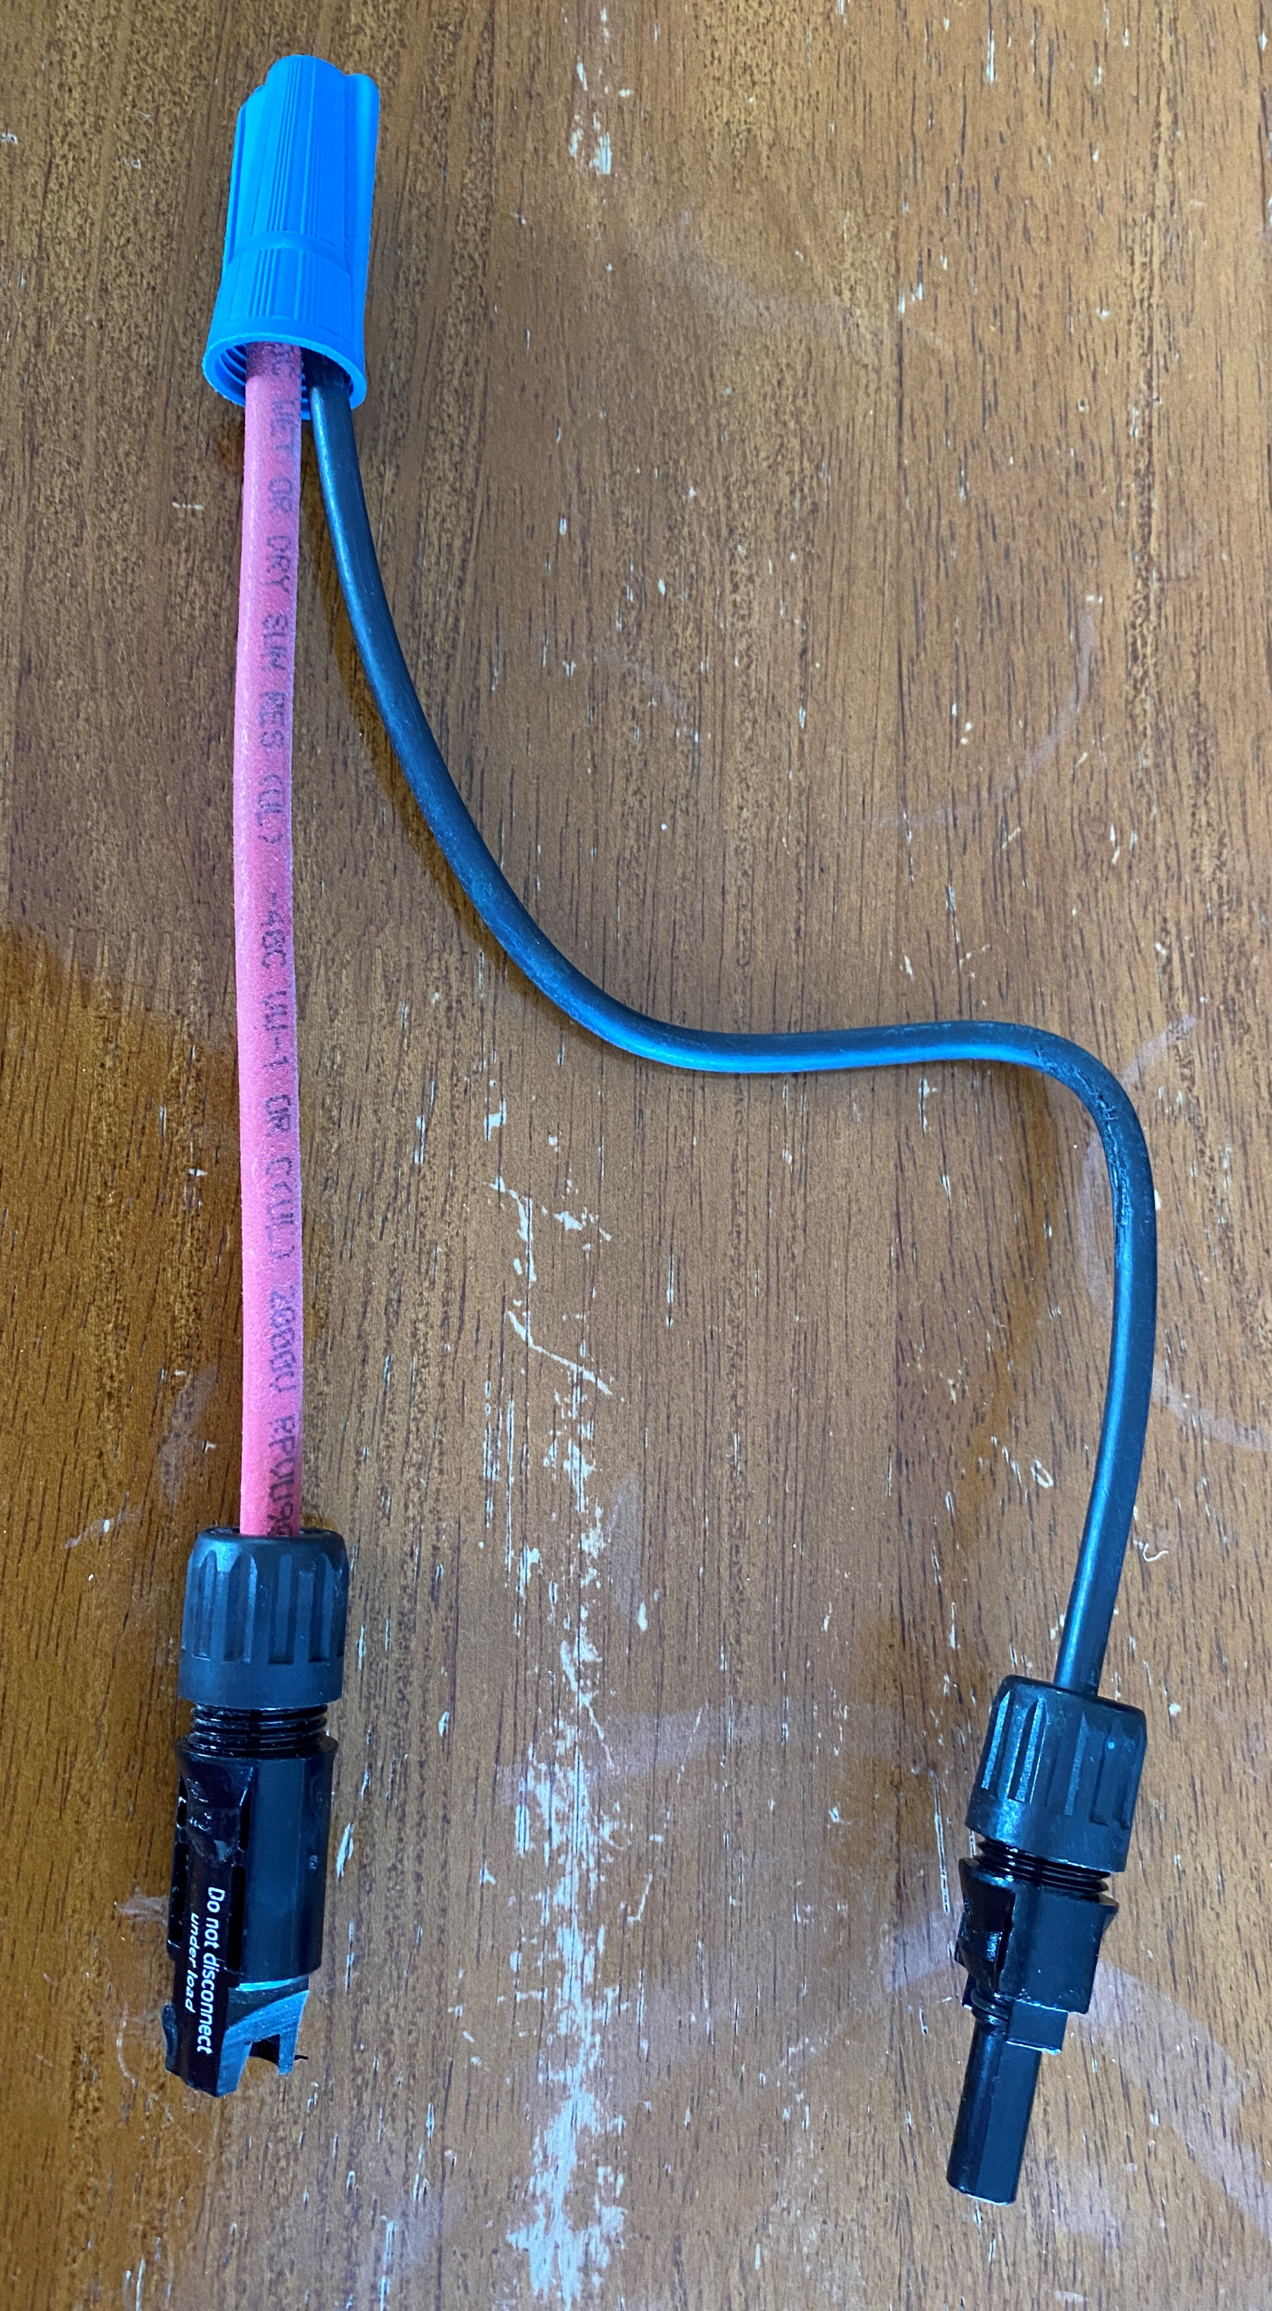
Lab 6 Shading
Picture courtesy author
The first scenario in this lab is to have the panel short circuited.
The shorting must be
accomplished by using the
shorting jumper.
Never use the MC 4 to short
the panel.

Slide 18
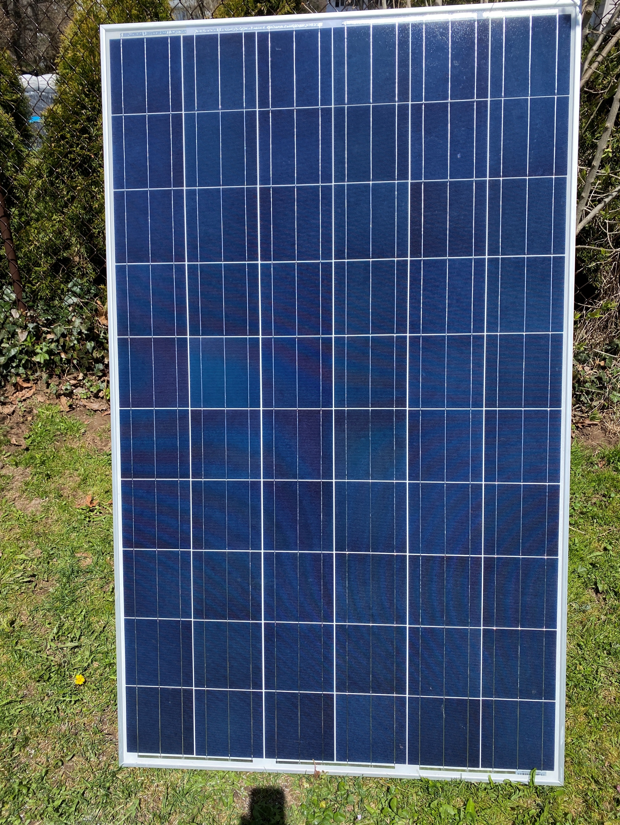
Lab 6 Shading
The panel exposed to
an irradiance between
750 W/m² and 825 W/m²
The current will be
proportional to the
irradiance striking it.
Image courtesy author

Slide 19
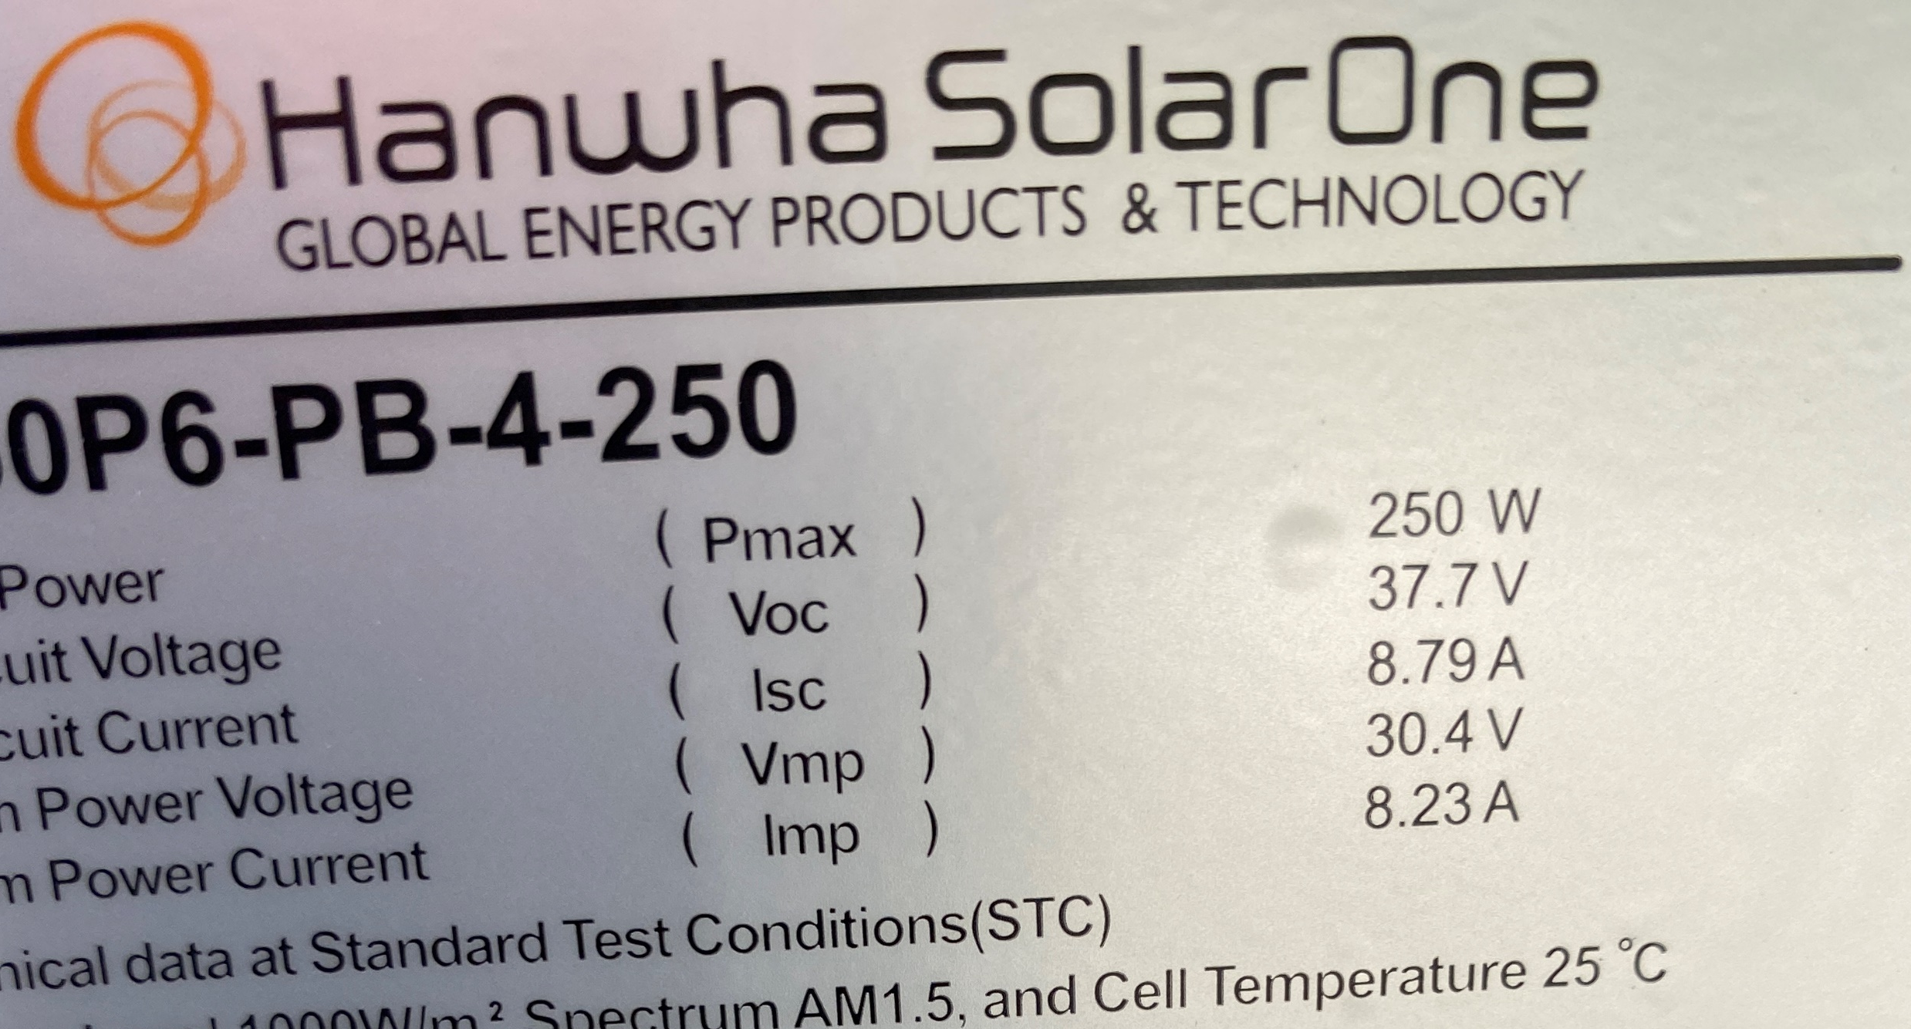
Lab 6 Shading
The STC rating of this panel is 250 watts
Voc = 37.7 V Isc = 8.79 A
Measured Isc at 7.2A close to the to 825 W/m²
825/1000 x 8.79 = 7.3 A.
Image courtesy author

Slide 20
Lab 6 Shading
The voltage across each diode section is to be measured.
Voltage was measured across each diode section.
V1 = 0.05
V2 = 0.0
V3 = 0.2
Vt = 0 V
This is the expected results.

Slide 21
Lab 6 Shading
Questions?

Slide 22
Lab 6 Shading
The next experiment is to provide the panel with a controlled shade.
EPDM rubber sheet was used.
The material used to provide shade needs to be opaque.
Thickness and being black are best to accomplish this.

Slide 23
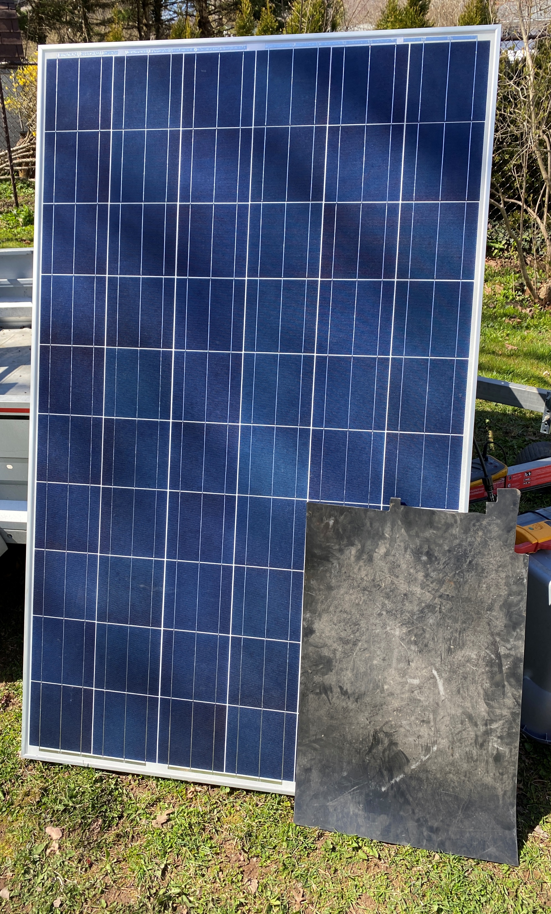
Lab 6 Shading
The controlled shading of
panel.
This panel has two rows of
10 cells per diode section.
In this lab shading will be
forced on a few cells in the
third row.
A piece of black EPDM was
used to create the shade.
Connects to second row
with a jumper.
Picture courtesy author

Slide 24
Lab 6 Shading
When a cell gets shaded it acts like a voltage drop.
The voltage reverses across the cell.
The cell is not producing power.
The current in the cell and in the rest of the cells in series with it is reduced to 0 Amps.
The by-pass diode will conduct and pass current through it and around the 20 cells.

Slide 25
Lab 6 Shading
The results were the same as unshaded.
Measured Isc was still at 7.2 A.
Voltage was measured across each diode section.
V1 = +0.60
V2 = + 0.20
V3 = - 0.62
Vt = 0 V
The sum in a closed loop must = to 0 volts.
The voltage across the diode was expected to be negative.

Slide 26
Lab 6 Shading
Questions?

Slide 27
Lab 6 Shading
The next situation is to still have the controlled shade.
This time the by-pass diodes in the third section will be removed electrically.
One side of each of the 2 diodes were opened

Slide 28
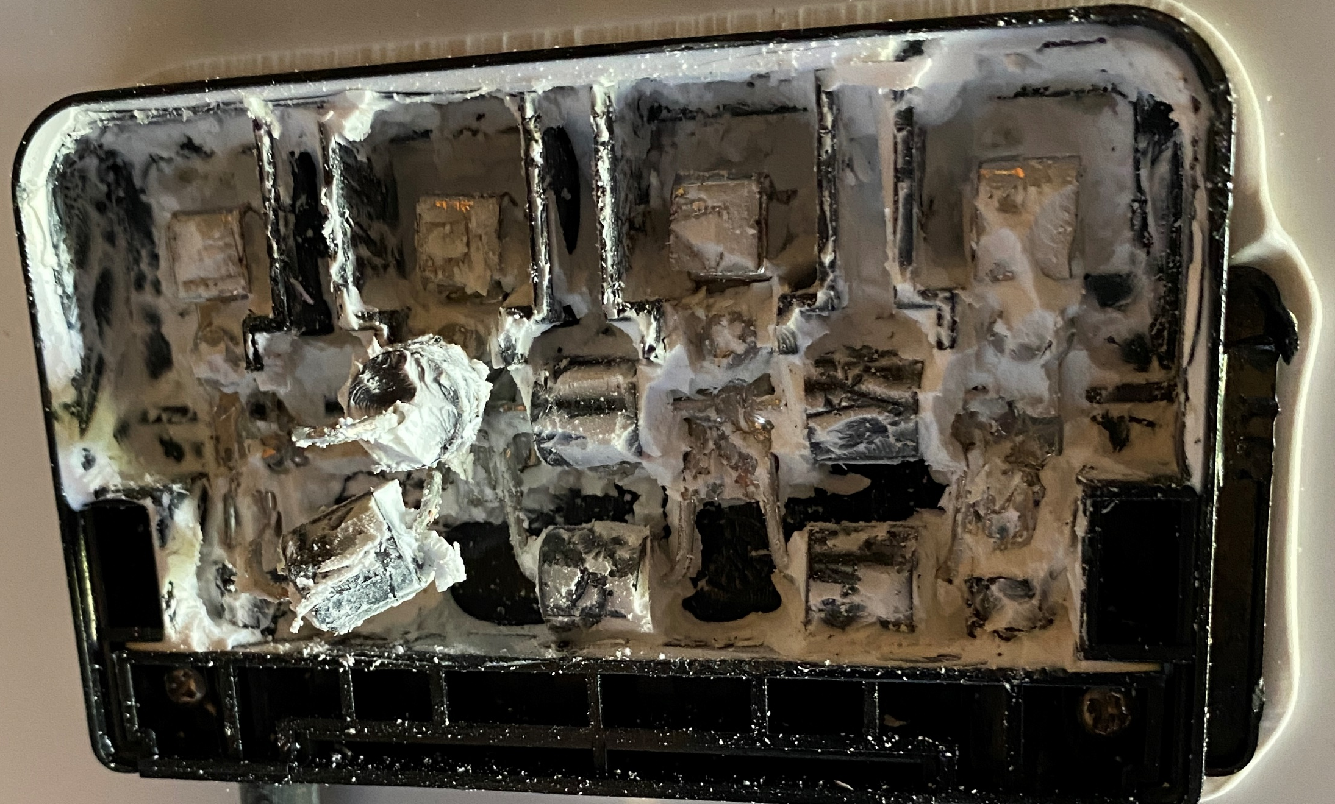
Lab 6 Shading
The by-pass diodes for the third section of cells was removed.
There are 2 diodes in parallel per group.
They were cut free.
Picture courtesy author

Slide 29
Lab 6 Shading
Put the EPDM in the same place where shade was applied.
This time the reverse biased cells are acting like a high resistive load.
The output of the panel is still shorted.
The sum of the voltages around the circuit must add to zero.

Slide 30
Lab 6 Shading
The results of shading and removal of by-pass diode protection.
V1 = +11.60
V2 = + 11.60
V3 = - 23.24
Vt = 0.04 V
The sum in a closed loop must = to 0 volts.
The voltage across the diode section was expected to be negative.

Slide 31
Lab 6 Shading
The voltage drop across the shaded 20 cells was equal to the voltage of the 40 other cells.
The voltage across the diode section was expected to be negative.
The current was reduced to 0.1 Amps

Slide 32
Lab 6 Shading
Questions?

Slide 33
Lab 6 Shading
Next is to observe how the panel reacts to shade with an electrical load put on the output.
The by-pass diodes will be both in place and removed to demonstrate how shading affects the panel output.
The circuit will act like a series circuit.

Slide 34
Lab 6 Shading
A know resistive load is placed across the panel’s output.
9.4 ohms was used.
The panel is unshaded with diodes in place.

Slide 35
Lab 6 Shading
Voltage was measured across each diode section.
V1 = 11.05
V2 = 10.95
V3 = 10.95
Vt = 32.95 V
The voltage across the sections add up to the load voltage of 32.9 V.
Measured load current is 3.0A.
Ohms law 32.9V/3.0A = 11ohms, very close to the connected load.

Slide 36
Lab 6 Shading
Questions?

Slide 37
Lab 6 Shading
Next is to shade a section of the panel.
With the load still connected to the panel.
The diodes for this section are in place.
The EPDM sheet is shading the same cells as before.

Slide 38
Lab 6 Shading
Voltage was measured across each diode section.
V1 = 11.23
V2 = 11.24
V3 = -0.3
Vt = 22.17V
Measured load current was 1.8 A.
Notice that the diodes conducted.
The current dropped by approximately 2/3 of the unshaded value.

Slide 39
Lab 6 Shading
Next is to remove the diodes for this section.
With the load still connected to the panel.
The EPDM sheet is shading the same cells as before.
Without the diodes current should drop to 0. A

Slide 40
Lab 6 Shading
Voltage was measured across each diode section.
V1 = 11.84
V2 = 11.71
V3 = -23.33
Vt = 0.22V
Measured load current was 0.1 A.
Notice that the voltage reversed on the shaded cells.
The load current was almost 0 A.

Slide 41
Lab 6 Shading
This lab was able to demonstrate how by-pass diodes operate.
The next part of this lab is to test if a panel has a failed by-pass diode.
Diodes either fail open or as a short.

Slide 42
Lab 6 Shading
Questions?

Slide 43
Lab 6 Shading
When a by-pass diode fails as a short.
It conducts around the group of cells and the Voc and load voltage will be reduced.
The Voc will be reduced as a function of how many by-pass diodes are in the panel.
1 (failed shorted) / total number of by-pass diodes in series.

Slide 44
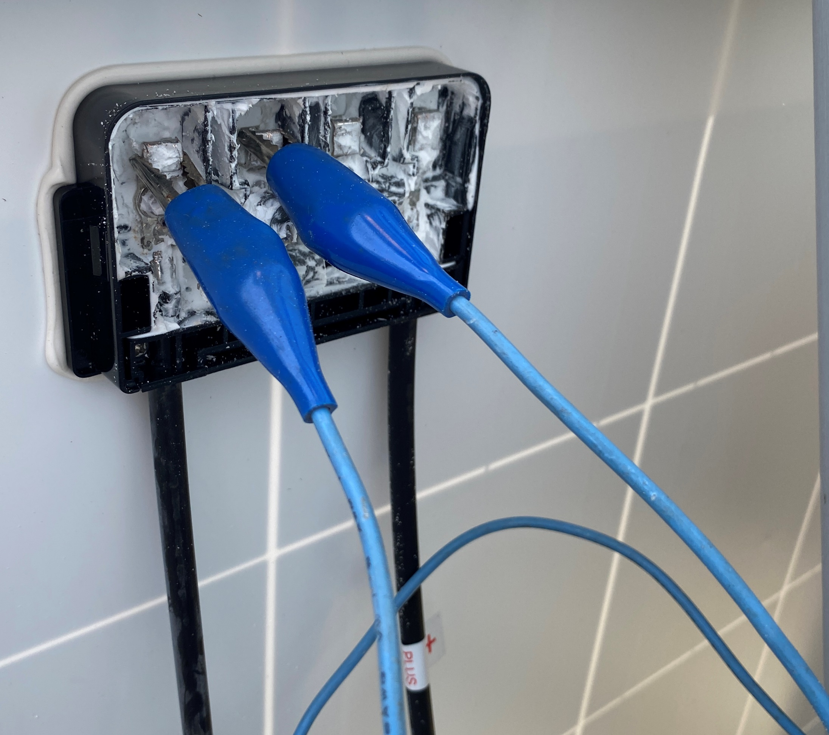
Lab 6 Shading
To demonstrate this shorted condition.
Place a jumper around
one by-pass diode.
Picture courtesy author

Slide 45
Lab 6 Shading
Measure the Voc before and after the jumper.
No jumper Jumper installed
V1 = 12.33 V1 = 12.30
V2 = 12.41 V2 = 12.30
V3 = 12.06 V3 = 0.0
Vt = 36.7 Vt = 24.6
The lower than rated Voc indicates a shorted by-pass diode.

Slide 46
Lab 6 Shading
The shorted diode acted like a short circuit.
It prevented voltage from the group of cells.
The Voc dropped from 36.7 to 24.6V
Because of only having 3 diode sections there was a 33% reduction in Voc.
The reduction will be proportional to the number of
By-pass diode sections.

Slide 47
Lab 6 Shading
To test a panel to check if a by-pass diode failed open.
First thing is to short the panel out.
Place an Ammeter in the circuit.

Slide 48
Lab 6 Shading
Put the panel is sunlight.
Place a shade on sections of the panel.
If the Isc current drops to zero, then a diode has failed open.
If there are more than one diode per section a single diode failure cannot be detected by this method.

Slide 49
Lab 6 Shading
Questions?

