Slide 1
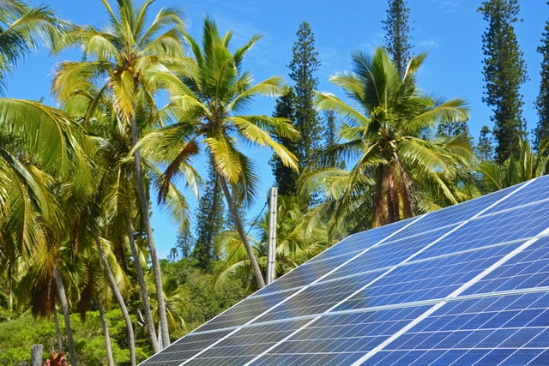



Design and Implementation of Pilot of a TVET Renewable Energy Course
DELIVERABLE #5 - TRAINING COURSES & PROFESSIONAL DEVELOPMENT

Slide 2
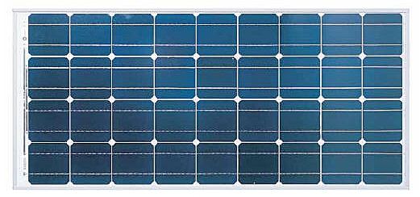
PV Panel
Basic information about PV panels.
They turn solar energy into electrical energy.
Three basic types.
Have a standard rating system.
Picture courtesy author

Slide 3
PV Panel
There are three types.
Monocrystalline.
Polycrystalline.
Amorphous.
Picture courtesy author

Slide 4
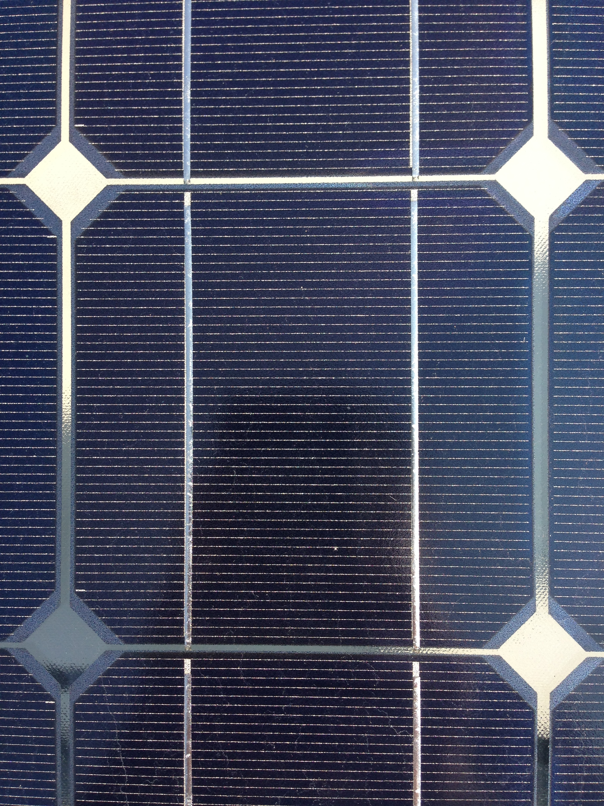
PV Panel
Monocrystalline.
Highest efficiency of the types.
Recognized by the diamond shape between the cells.
Highest cost.
Picture courtesy author

Slide 5
PV Panel
Monocrystalline.
Black Cells
Made of a single crystal.
Manufacturing process is complex.
Picture courtesy author

Slide 6
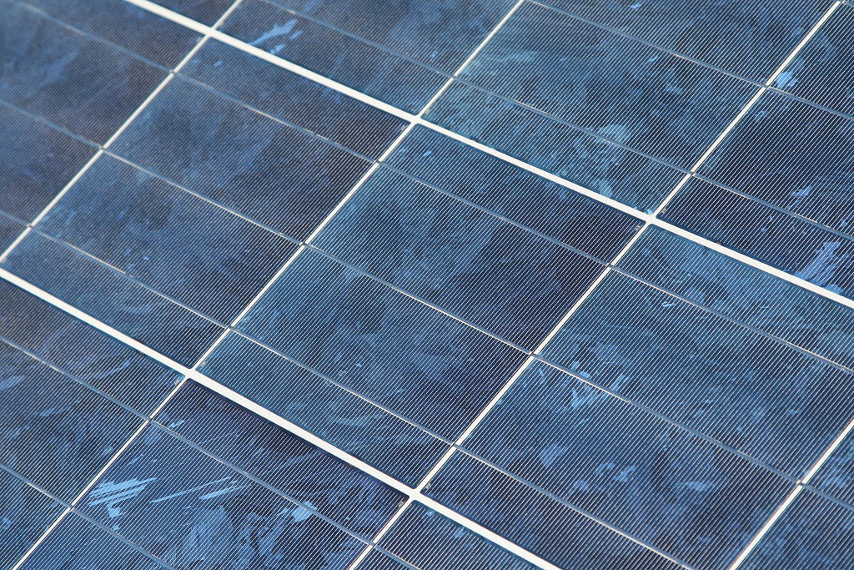
PV Panel
Polycrystalline
Slightly less efficiency by approximately 3 percent.
Recognized by square cells with a mosaic appearance.
Cost less than monocrystalline.
Picture courtesy author

Slide 7
PV Panel
Polycrystalline.
Blue Cells
Made by pouring molten silicon into square molds.
Sometimes referred as Multi-Crystalline
Picture courtesy author

Slide 8
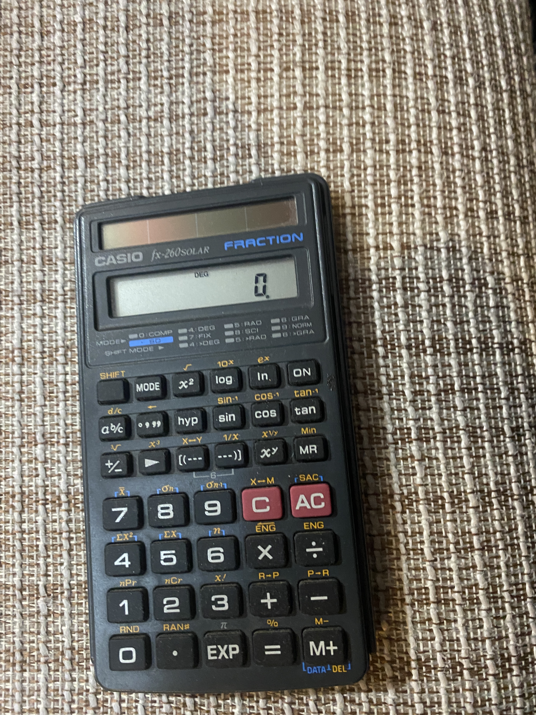
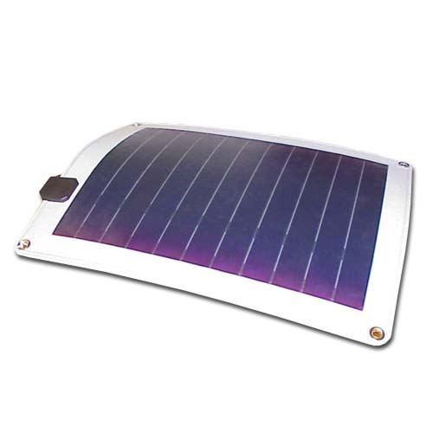
PV Panel
Amorphous.
Least efficiency. approximately 6-8 percent.
Called Thin-film panels.
Flexible
Pictures courtesy author

Slide 9
PV Panel
Questions?

Slide 10
PV Panel
Photovoltaics use semiconductor materials to convert sunlight into electricity.
The starting point for most of the world's current generation of photovoltaic devices, as well as almost all semiconductors, is pure crystal silicon.
In pure crystalline silicon, each atom forms covalent bonds with four adjacent atoms in the three-dimensional tetrahedral pattern.
In its purest form, silicon is an insulator, having no free electrons for transfer.

Slide 11
PV Panel
By adding a small amount of other elements or dopants to the surface of crystalline silicon, which changes it to allow flow of electrons to function as a semiconductor of electrons / electricity.
This gives silicon either a negative or positive charge.
5 electrons in valence shell is negative.
Pentavalent elements Phosphorus and Arsenic.
3 electrons in valence shell is positive.
Trivalent elements Boron and Gallium

Slide 12
PV Panel
The Band Gap Energy
Electrons have energies that must fit within certain allowable energy bands.
The top energy band is called the conduction band, and it is electrons within this region that contribute to current flow.
The energy that an electron must acquire to jump across the forbidden band to the conduction band is called the band-gap energy, designated Eg.

Slide 13
PV Panel
Where does this energy come from?
For photovoltaics, the energy source is photons of electromagnetic energy from the sun.
When a photon with more than 1.12 eV of energy is absorbed by a solar cell, a single electron may jump to the conduction band.
When it does so, it leaves behind a nucleus with a +4 charge that now has only three electrons attached to it.
That is, there is a net positive charge, called a hole, associated with that nucleus.

Slide 14
PV Panel
Unless there is some way to sweep the electrons away from the holes, they will eventually recombine, obliterating both the hole and electron.
When recombination occurs, the energy that had been associated with the electron in the conduction band is released as a photon, which is the basis for light-emitting diodes (LEDs).

Slide 15
PV Panel
There are formulas that allow us to measure the eV in a particular wave length coming from the sun’s radiation.
For a silicon photovoltaic cell, photons with wavelengths greater than 1.11 μm have energy hv less than the 1.12-eV band-gap energy needed to excite an electron.
None of those photons create hole-electron pairs capable of carrying current, so all of their energy is wasted.
It just heats the cell.

Slide 16
PV Panel
On the other hand, photons with wavelengths shorter than 1.11 μm have more than enough energy to excite an electron.
Since one photon can excite only one electron, any extra energy above the 1.12 eV needed is also dissipated as waste heat in the cell.

Slide 17
PV Panel
These two phenomena relating to photons with energies above and below the actual band gap establish a maximum theoretical efficiency for a solar cell.
To understand this constraint, we need to introduce the solar spectrum.
The amount of solar energy reaching the ground, as well as its spectral distribution, depends very much on how much atmosphere it has had to pass through to get there.

Slide 18
PV Panel
Recall that the length of the path taken by the sun's rays through the atmosphere to reach a spot on the ground, divided by the path length corresponding to the sun directly overhead, is called the air mass ratio, m.
Thus, an air mass ratio of 1 (designated "AM1") means that the sun is directly overhead.
By convention, AM0 means no atmosphere; that is, it is the extraterrestrial solar spectrum.

Slide 19
PV Panel
For most photovoltaic work, an air mass ratio of 1.5, corresponding to the sun being 42 degrees above the horizon, is assumed to be the standard.
For an AM 1.5 spectrum, 2% of the incoming solar energy is in the UV portion of the spectrum, 54% is in the visible, and 44% is in the infrared.

Slide 20
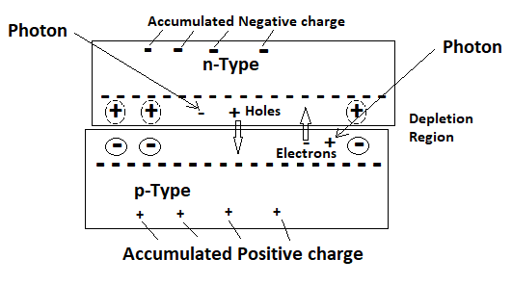
PV Panel
Photon giving energy to move electron.
Image courtesy author

Slide 21
PV Panel
Questions?

Slide 22
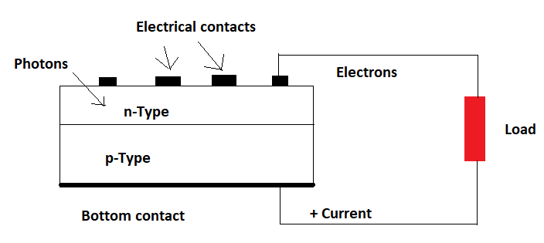
PV Panel
If electrical contacts are attached to the top and bottom of the cell, electrons will flow out of the n-side into the connecting wire, through the load and back to the p-side.
Image courtesy author

Slide 23
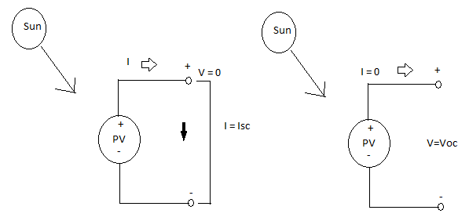
PV Panel
Two important parameters for photovoltaics are the short-circuit current Isc and the open-circuit voltage Voc.
Image courtesy author

Slide 24
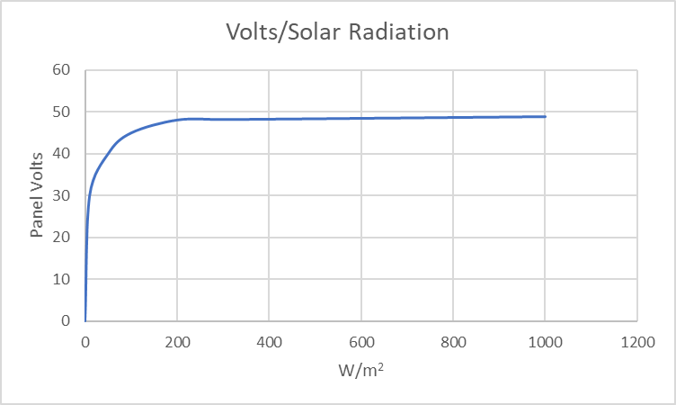
PV Panel
The open circuit voltage (Voc) will be maximum when around 200 W/m² strike the panel and it does not change with increased irradiance.
Image courtesy author

Slide 25
PV Panel
The open circuit voltage (Voc) is affected with temperature of the cell.
Silicon has a negative temperature coefficient.
As the temperature decreases the Voc increases.
As the temperature increases the Voc decreases.

Slide 26
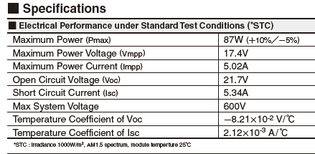
PV Panel
The temperature coefficient of this polycrystalline panel is -8.21 x 10⁻² V/C.
For every degree C of change the voltage (Voc) changes 0.0821 volts.
Image courtesy author

Slide 27
PV Panel
If the temperature of the cell is operating at 50 C what is the Voc?
The coefficient is -8.21 x 10⁻² V/C.
The STC (25C) rated Voc is 21.7V.
50C – 25C = +25C
+ 25C x -0.0821 V/C = -2.05V
The Voc at 50C is 19.65V

Slide 28
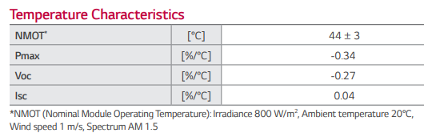
PV Panel
The temperature coefficient can also be expressed in percentage. -0.27 % / C
For every degree C of change the voltage (Voc) changes 0.0027 of the STC Voc volts.
Image courtesy HESPV.ca

Slide 29
PV Panel
The Voc at STC, 0 Celsius and at 40 Celsius. Voltage values represent a normal 36 cell panel.
Image courtesy author

Slide 30
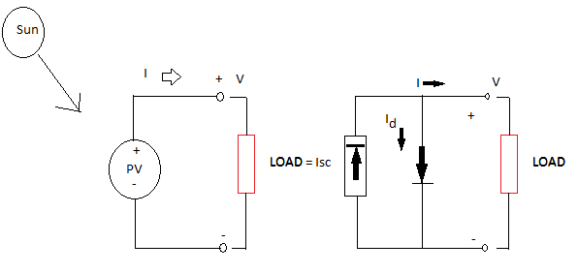
PV Panel
The equivalent circuit for a photovoltaic cell consists of a current source driven by sunlight in parallel with a real diode.
Image courtesy author

Slide 31
PV Panel
The short circuit current (Isc) is proportional to the strength of the sun. Voltage values represent a normal 36 cell panel.
Image courtesy author

Slide 32
PV Panel
The operating point at which a PV device produces its maximum power output lies between the open-circuit and short-circuit condition, when the device is electrically loaded at some finite resistance.
Maximum power transfer theorem.
Internal resistance = external load.
The maximum power point is the operating point on an I-V curve where the product of current and voltage is at maximum.

Slide 33

PV Panel
The maximum power voltage is the operating voltage on an I-V curve where the power output is at maximum.
The maximum power current is the operating current on an I-V curve where the power output is at maximum.
$Pmp =Vmp ×Imp$
Pmp = maximum power in Watts
Vmp = maximum power voltage (in Volts)
Imp = maximum power current (in Amps)

Slide 34
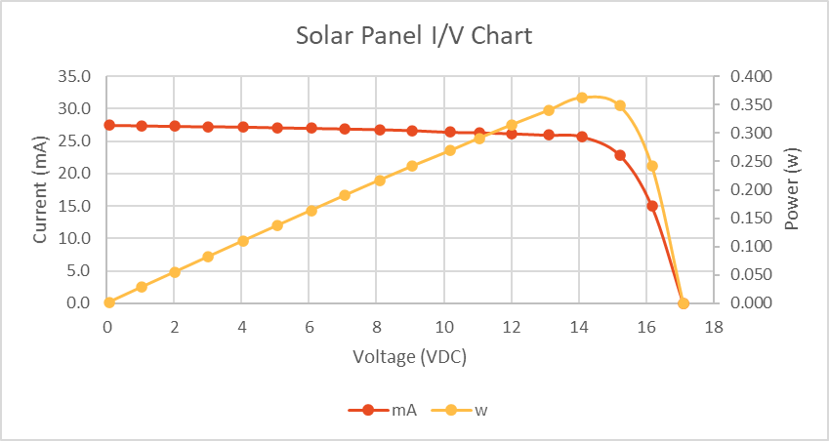
PV Panel
The orange line is the shape of the power curve.
This graph from a 1.75 Watt panel.
Image courtesy author

Slide 35
PV Panel
Maximum power happens at just one place on the curve. Voltage not highest nor is the current.
Image courtesy author

Slide 36
PV Panel
Maximum current is Isc, and it stays very close to that value until the start of the knee.
At that point it is no longer a constant current source.
The current decreases as the load resistance increases and drops to zero at open circuit.
Voltage starts at zero when shorted (Isc) and climbs as load resistance increases.
As the current starts to drop the maximum power is obtained.

Slide 37
PV Panel
Questions?

Slide 38
PV Panel
Since an individual cell produces only about 0.5 – 0.6 V, it is a rare application for which just a single cell is of any use.
Instead, the basic building block for PV applications is a module consisting of a number of pre-wired cells in series, all encased in tough, weather-resistant packages.
A typical module has 36 cells in series and is often designated as a "12-V module" even though it is capable of delivering higher voltages than that.

Slide 39
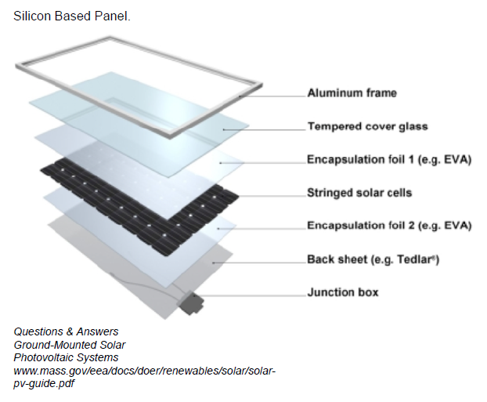
PV Panel
What are ethylene vinyl
  acetate (EVA) films?
In the solar industry,
  the most common
  encapsulation is with
  cross-linkable ethylene
  vinyl acetate (EVA).
  With the help of a lamination machine, the cells are laminated between films of EVA in a
  vacuum, which is under compression.

Slide 40
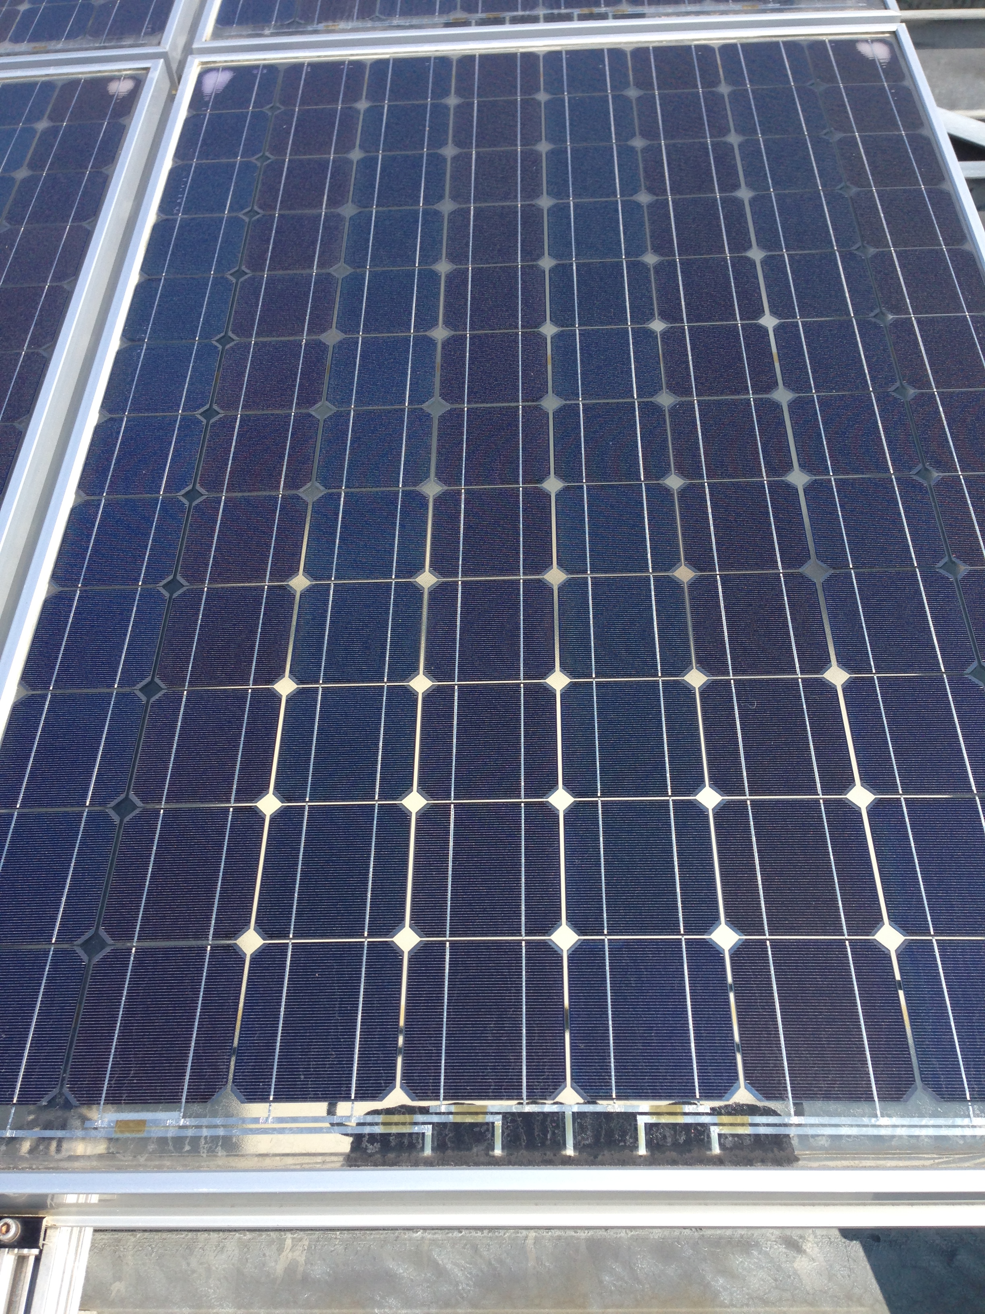
PV Panel
Modules / Panels made up from several cells.
Picture courtesy author

Slide 41
PV Panel
Multiple modules, in turn, can be wired in series to increase voltage and in parallel to increase current, the product of which is power.
An important element in PV system design is deciding how many modules should be connected in series and how many in parallel to deliver whatever energy is needed.
Such combinations of modules are referred to as an array.

Slide 42
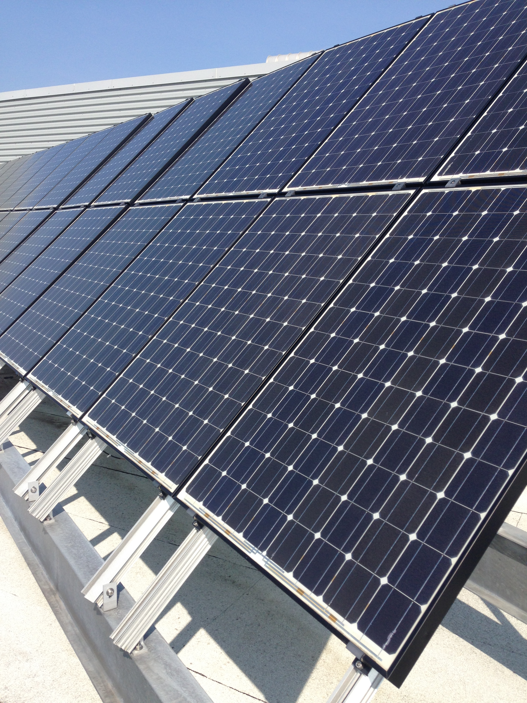
PV Panel
An array made up from several panels.
Picture courtesy author

Slide 43
PV Panel
Questions?

Slide 44
PV Panel
When cells or PV panels are wired in series, they all carry the same current, and at any given current their voltages add.
Image courtesy author

Slide 45
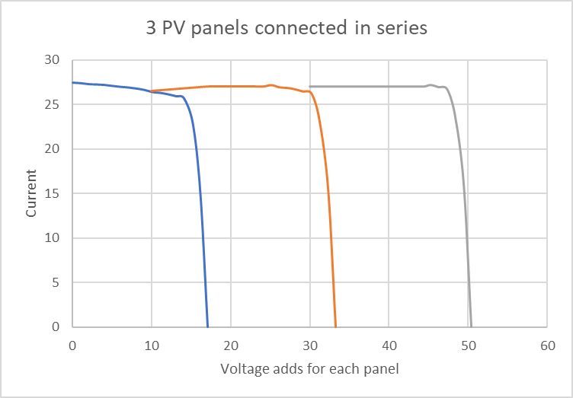
PV Panel
When cells or PV panels are wired in series it is called a string.
Three panels connected in series to obtain desired voltage.
Image courtesy author

Slide 46
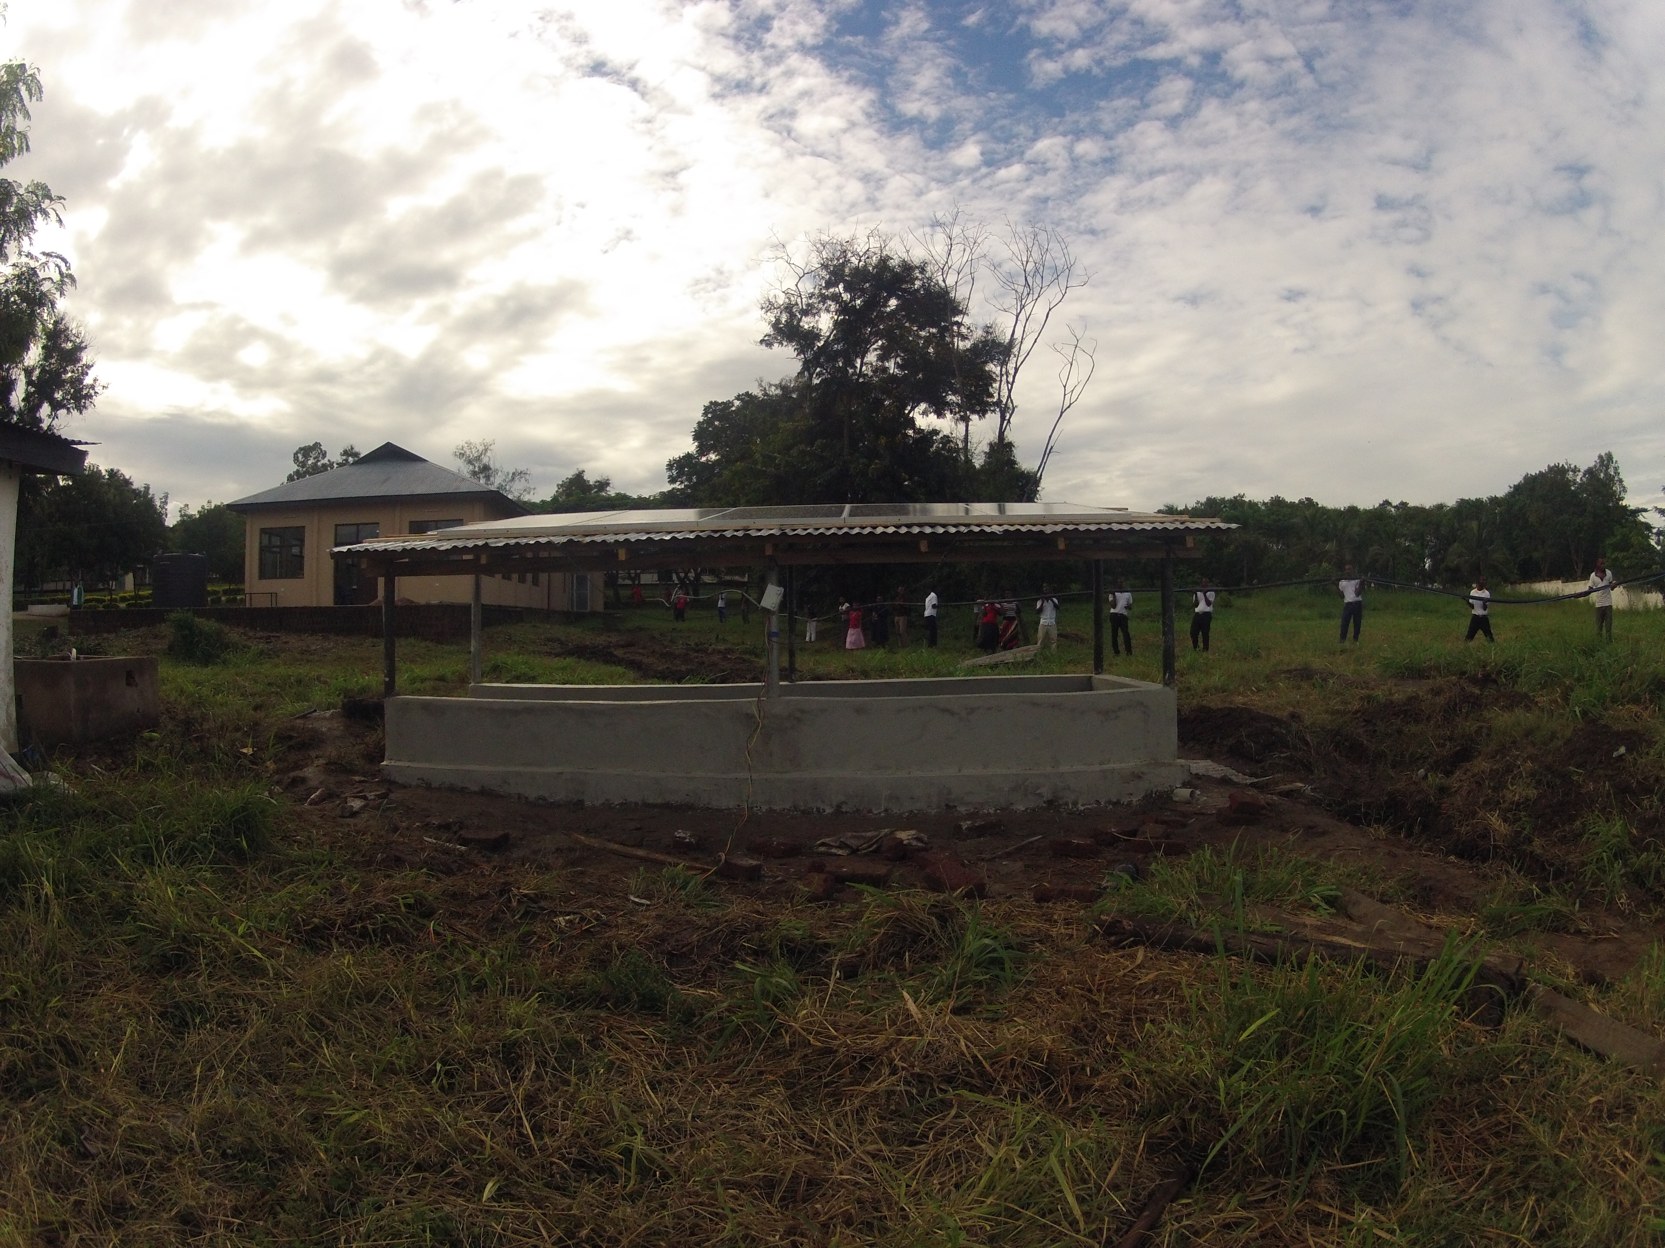
PV Panel
Four panels connected in series to obtain 150V.
Image courtesy author

Slide 47
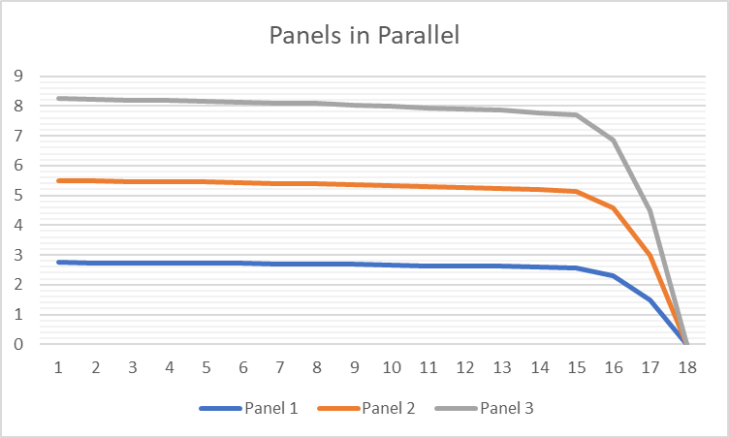
PV Panel
When photovoltaics are wired in parallel, there voltages stay the same but the current of each panel adds. Numbers on bottom are number of samples taken.
Image courtesy author

Slide 48
PV Panel
Questions?

Slide 49
PV Panel
What efficiency are PV panels?
What we know is that there are 1000 W/m² in the STC rating.
For a panel to be 100% efficient it would be producing 1000 Watts if it were 1 m² in size.
For a panel to be 50% efficient it would produce 1000 Watts and be 2 m² or produce 500 Watts and be 1 m² in size.

Slide 50
PV Panel
With only 49% of solar radiation in the visual spectrum, with silicon based PV this therefore is the maximum efficiency.
Next Slide has information from a 250 Watt panel.
Dimensions are 1636mm x 988mm
Wattage is 250Watts

Slide 51
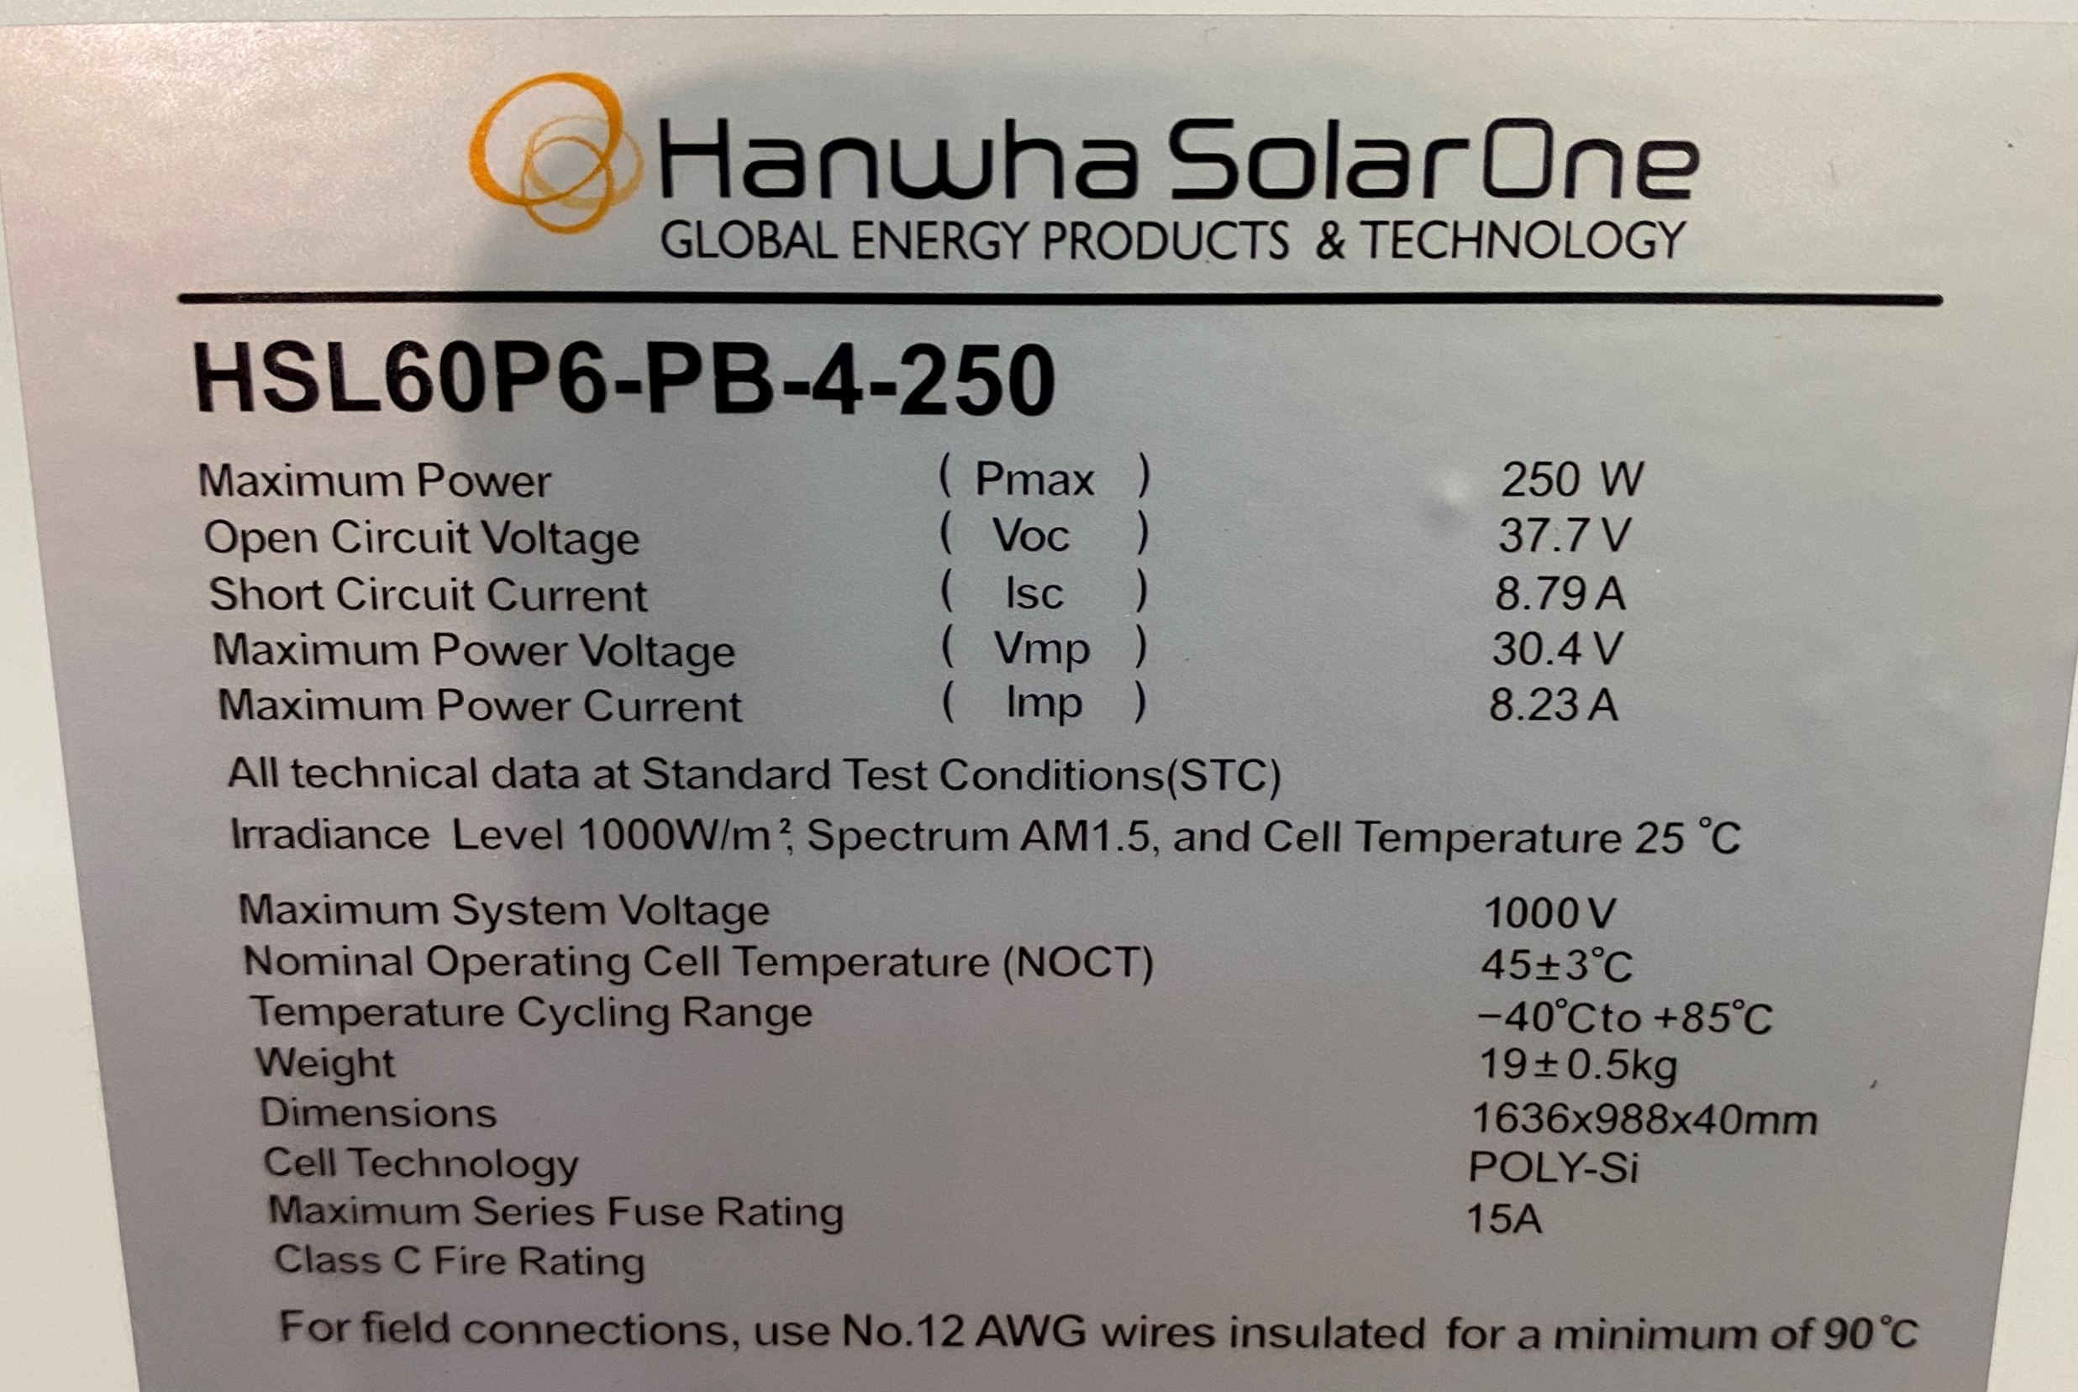
PV Panel
Only 49%
Image courtesy author

Slide 52
PV Panel
The total area the panel takes up is:
1.636m x .988m = 1.616 m² in size.
The panel is being hit with1.616 kw of irradiance and producing 250 Watts.
250 W / 1616 W = 15.47% efficient.

Slide 53
PV Panel
Questions?

Slide 54
PV Panel
What happens inside the panel?
There are a number of cells connected in series.
Sometimes there are two strings of cells connected in parallel.
The series connection of cells is like battery cells connected in series.

Slide 55
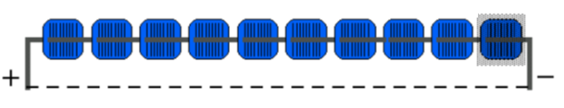
PV Panel
When there is 0 irradiance on the panel the cells have a high impedance and are like resistors.
When irradiance is striking the cells they act like battery cells, each having a positive and negative voltage.
10 cells in series = 5.5 – 6 volts
Image courtesy author

Slide 56
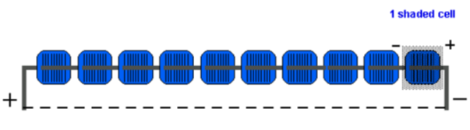
PV Panel
What happens if the irradiance drops across a cell?
It changes from a cell that produces power to a consumer of power.
Image courtesy author

Slide 57
PV Panel
How does this happen?
Something blocks the sunlight.
Hard shading localized to the cell.
A pole or object that is close to the panel.
Image courtesy author

Slide 58
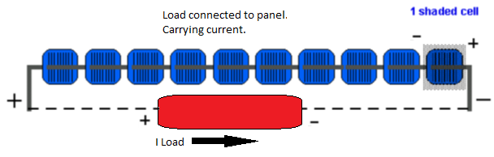
PV Panel
Electrically we can redraw the circuit to have the shaded cell passing a small amount of current through it in the same direction.
This causes the voltage across the cell to change polarity (Reversed bias).
Image courtesy author

Slide 59
PV Panel
During the shaded time the cell will generate heat as it is a load now and not a producer of energy.
The cell temperature will rise and if not corrected will have permanent damage.
Image courtesy author

Slide 60
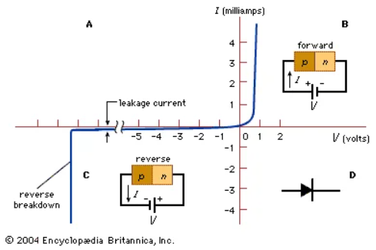
PV Panel
The PV cell is a silicon diode with a PN junction. Pictured below shows the I-V curve at both forward and revers biases.
Image courtesy Encyclopedia Britannica, Inc

Slide 61
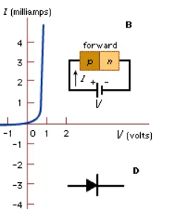
PV Panel
The cell when it is forward
  biased conducts current
  as per this diagram.
The voltage drop
  Across a silicon diode
  is around 0.7V.
The shape of the
  Curve resembles that
  of the PV cell.
Image courtesy Encyclopedia Britannica, Inc

Slide 62
PV Panel
The PV, I-V curve resembles the diode. The electrical principles are the same as a diode.
Image courtesy Encyclopedia Britannica, Inc

Slide 63
PV Panel
During shading when the PV cell is not producing forward biased current the cell is reducing the current flow from the rest of the cells in series with it.
This results in the reversal of voltage across the cell. It becomes reversed biased.
Typical silicon PN junctions like a diode and PV cell will have a reverse voltage breakdown limit, and the junction will fail and be destroyed.

Slide 64
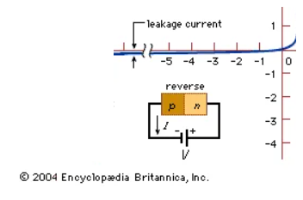
PV Panel
The silicon PN junction is designed to have current flow on the forward biased direction only.
When reversed biased, leakage current will flow.
- Voltage across the cell
- Current flow
Image courtesy Encyclopedia Britannica, Inc

Slide 65
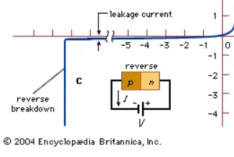
PV Panel
The PV cell is heating up when reversed biased and the breakdown voltage that damages the cell is close to 13 volts.
Image courtesy Encyclopedia Britannica, Inc

Slide 66
PV Panel
Shading is not always preventable.
How to prevent the breakdown?

Slide 67
PV Panel
How many cells in series can produce the voltage to cause breakdown?
Must be less than 13 volts of reverse bias.
Each cell in the panel produces 0.5 volts per cell.

Slide 68
PV Panel
13V divided by 0.5V/cell = 26 cells. This is the maximum number of cells, less is better.
There cannot be anymore than 26 cells in series with a shaded cell.
How to prevent 26 cells in series to cause breakdown voltage?

Slide 69
PV Panel
When building the PV panel, the cells are soldered together with traces connecting them in series.
The traces go from top of one cell to the bottom of the next cell.
Extra traces can be attached to sections of series connected cells to be brought out to a junction box at the back of the PV panel.

Slide 70

PV Panel
These extra traces can be arranged across sections of cells.
This can divide up the cells in groups.
A panel with 36 cells can be divided into two or three groups of 16 or 12 cells
A panel with 60 cells can be divided into three groups of 20 cells
A panel with 72 cells can be divided into four or six groups of 18 or 12 cells.

Slide 71
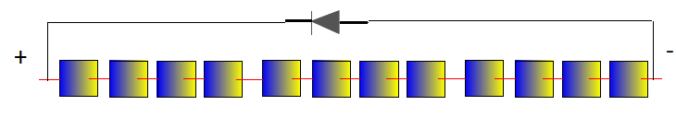
PV Panel
Breaking the panel into these groups, allows each group to have a diode placed across them.
A by-pass diode placed across each of the groups.
The by-pass diode is reversed biased during normal operation of the PV panel.
Image courtesy author

Slide 72
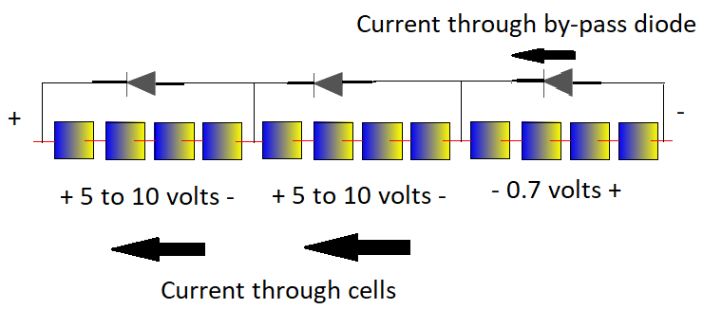
PV Panel
Currents stays the same.
Output voltage reduced by group voltage + by-pass diode voltage drop.
Image courtesy author

Slide 73
PV Panel
Questions?

Slide 74
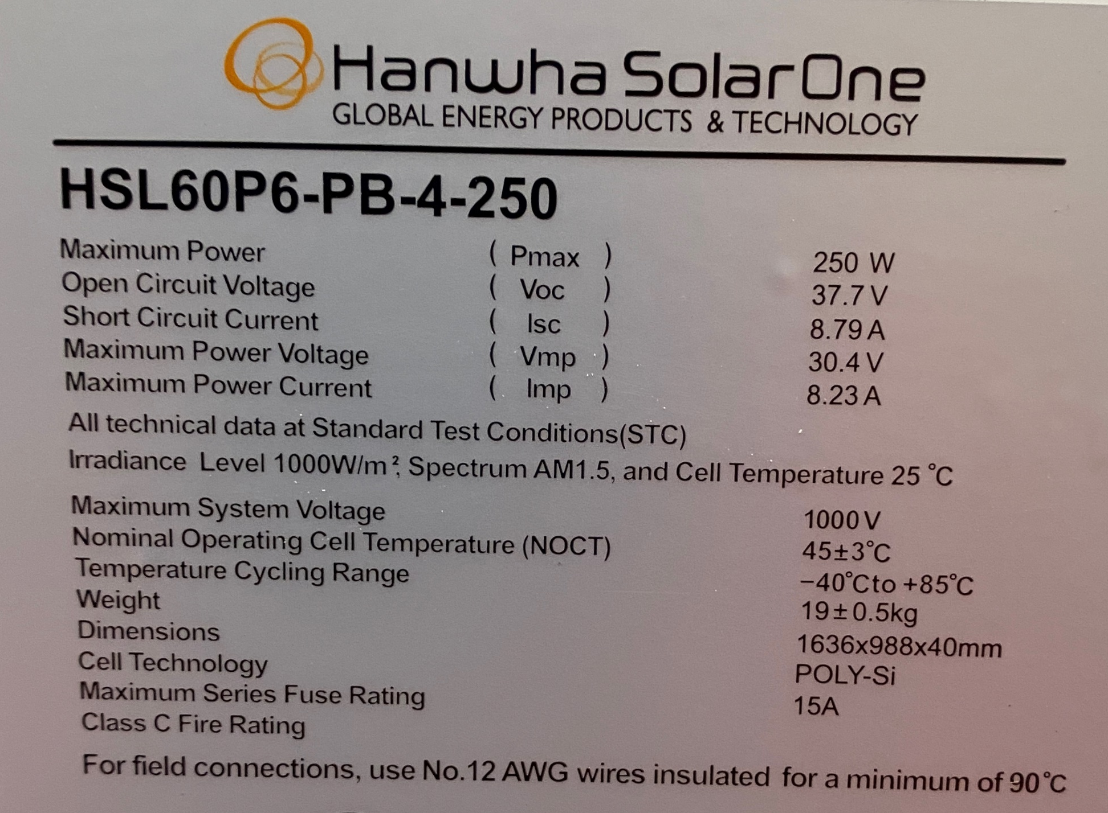

PV Panel
This panel from Hanwha.
Model HSL60P6-PB-4-250.
Has 60 cells in series to make the Voc of 37.7V
37.7V $÷$ 60 = .63V
Image courtesy author

Slide 75
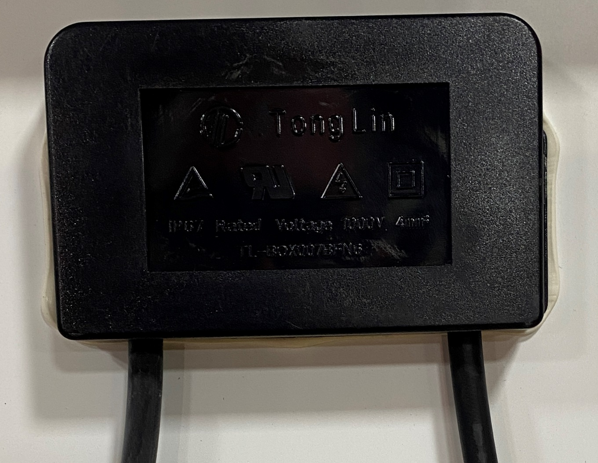
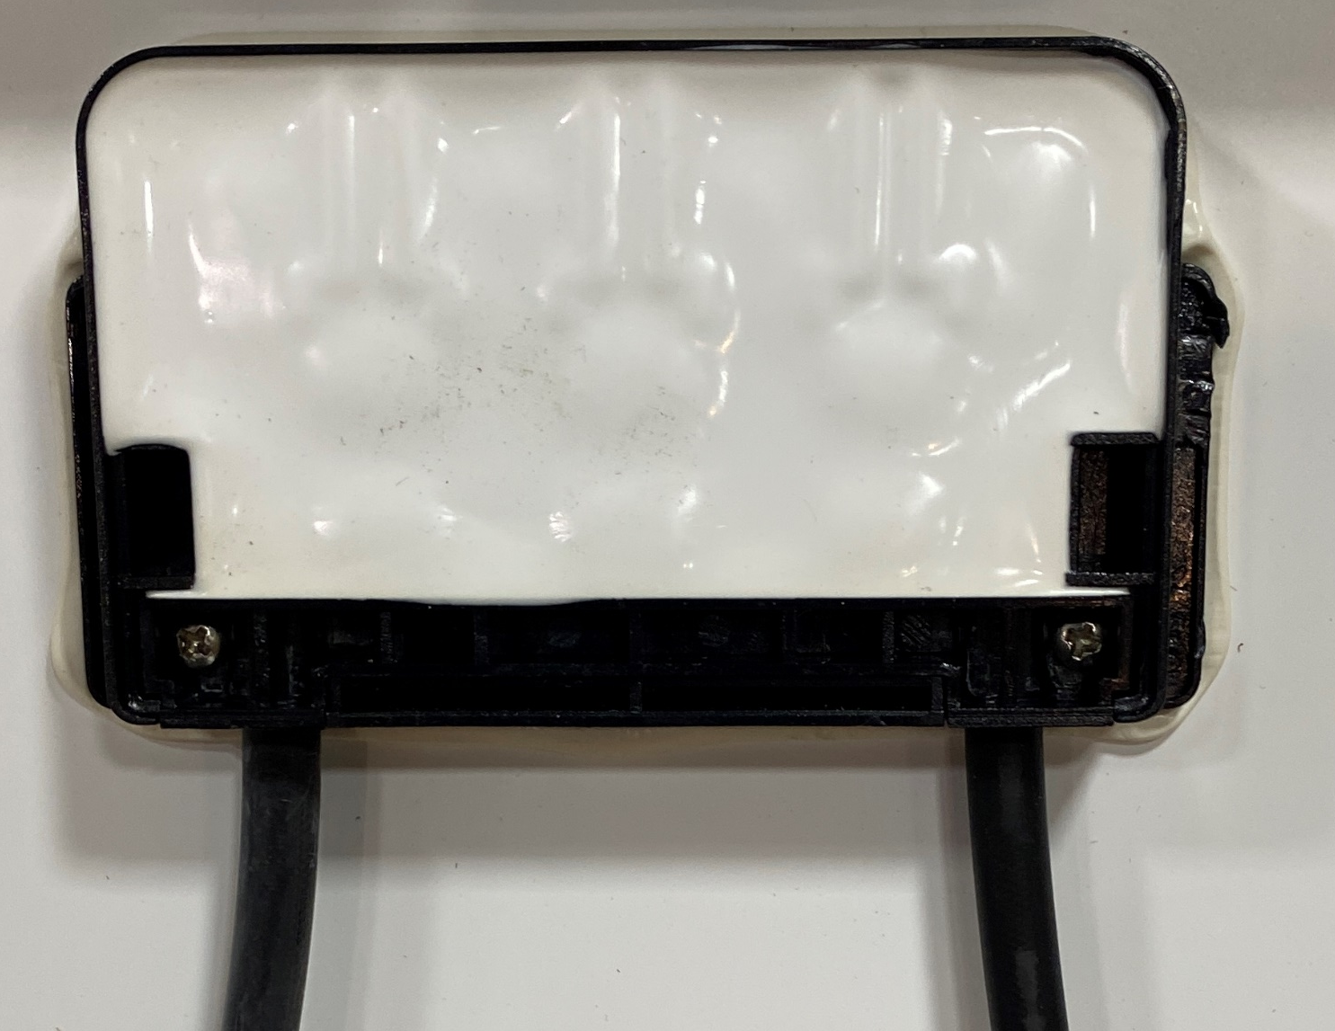
PV Panel
The junction box on the back of the panel.
The junction box houses the by-pass diodes.
Removed the cover to see that the diodes are sealed.
Images courtesy author

Slide 76
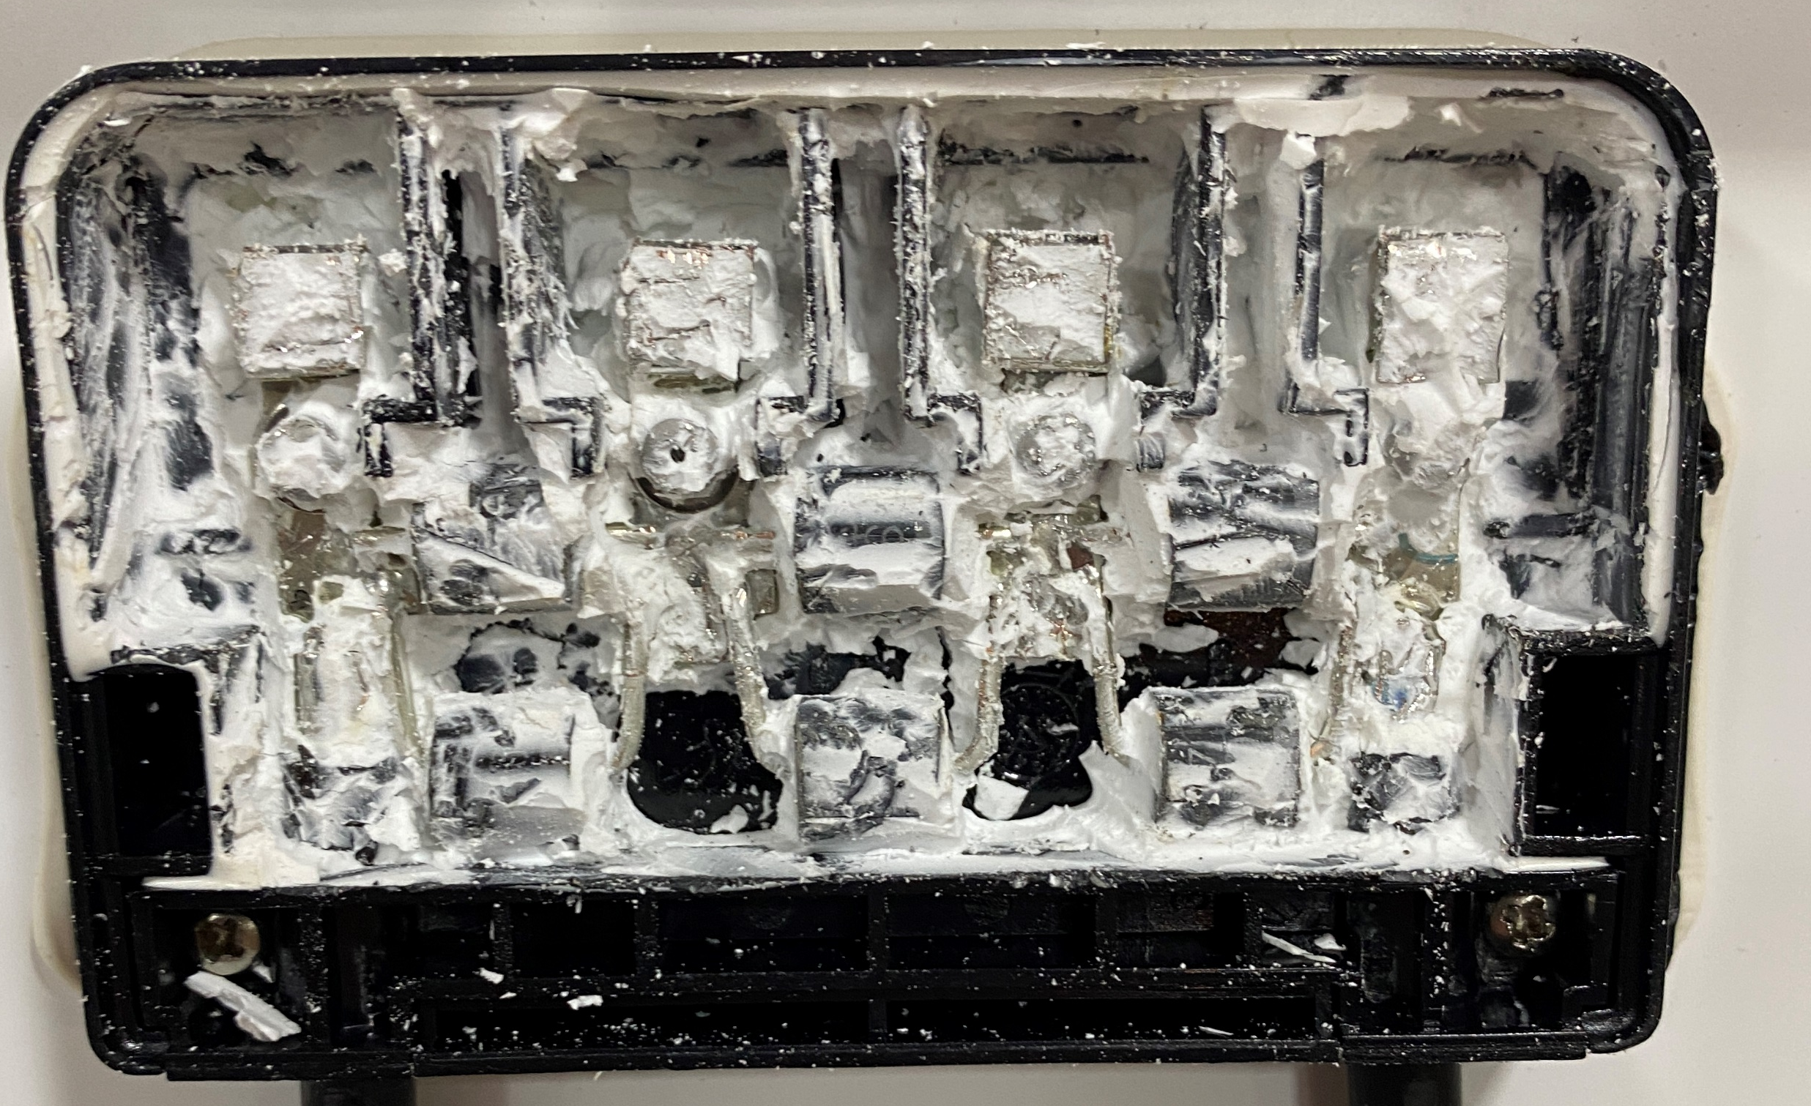
PV Panel
With the sealant removed, it reveals 6 diodes.
Three sets of two in parallel.
There are three groups of diodes. That makes each group having 20 cells each protected by a diode.
Images courtesy author

Slide 77
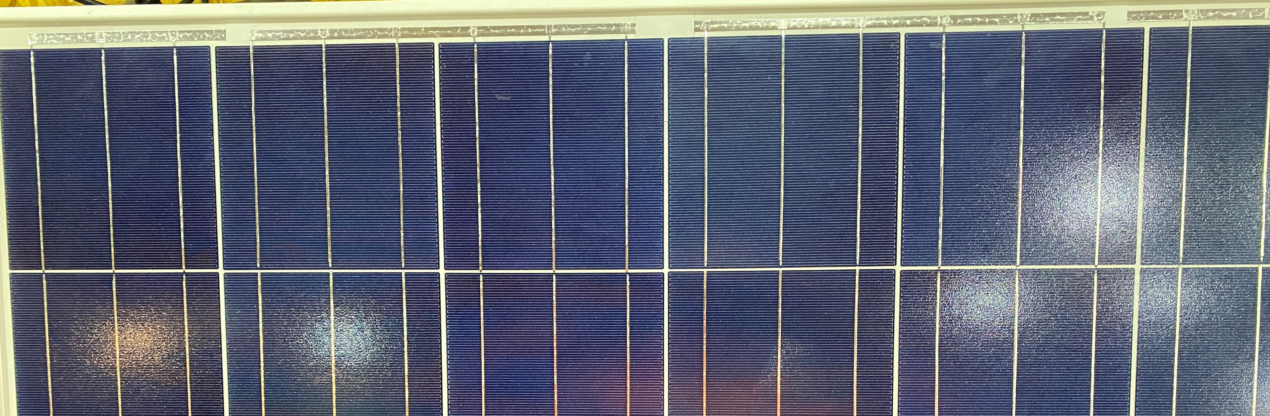
PV Panel
Top of panel view. Notice four traces on top.
They join the series string of cells from top to bottom of the panel. Each row of cells going up and down has 10 cells.
Images courtesy author

Slide 78
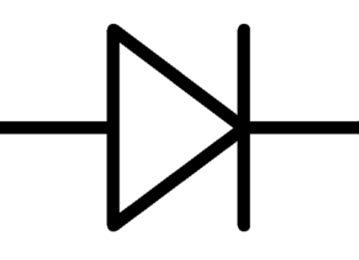
PV Panel
Top of panel view. Notice four traces on top.
They join the series string of cells from top to bottom of the panel. Each row of cells going up and down has 10 cells.
Three diodes across 10 + 10 cells each
Images courtesy author

Slide 79
PV Panel
Questions?

