Slide 1
Design and Implementation of Pilot of a TVET Renewable Energy Course
DELIVERABLE #5 - TRAINING COURSES & PROFESSIONAL DEVELOPMENT
PV Training Session

Slide 2
Racking and Mounting
This module introduces the concepts of racking and mounting of PV panels.

Slide 3
Racking and Mounting
Racking is the bonding of parts.
It is the mechanism used to hold the PV panels and all associated equipment.
There will be 5 types covered in this module.

Slide 4
Racking and Mounting
These 5 types are broken down by the equipment used to either mount or rack the PV panels together.
On roof mounting / racking
On the ground mounting / racking
On a pole mounting
Weighted (Ballast) mounting / racking
Tracking mounting / racking

Slide 5
Racking and Mounting
Questions?

Slide 6
Racking and Mounting
Before the introduction to racking and mounting.
Safety and tools need to be identified.
Fall arrest and working from heights are a prerequisite for working on the mounting and racking of PV panels.
Ladder and scaffold safety is also required.

Slide 7
Racking and Mounting
Tools:
Each manufacturer has listed the tools in the instructions manual for their products.
IRONRIDGE has given permission to use their information.
https://www.ironridge.com/
They have a YOUTUBE channel
https://www.youtube.com/c/IronRidgeSolar

Slide 8
Racking and Mounting
Common tools are:
Wrenches, Screwdrivers, Torque wrench, Rachet with sockets, tape measure, chalk line, stud finder, roofing bar, caulking gun, driver with 1/4” bit and 7/16” hex socket.

Slide 9
Racking and Mounting
The first type of racking and mounting to be explored is “on roof mounting / racking”
It can be defined as a system that is physically attached to a roof via the structural supports of the roof.
The structural supports can be made of wood, steel or concrete.

Slide 10
Racking and Mounting
The steel and wood members are the trusses or rafters that support the decking and material above the decking.
Concrete decking is supported below and the PV panel racking is attached to the concrete decking.
One other type of roof in this category is a metal roof that is made up of sheets.

Slide 11
Racking and Mounting
The idea is to use the structural support system to provide the strength to hold the PV panels in place.
The structural support system is designed to support the roof system weight and any other stresses caused by the environment.
Adding the weight of solar PV panels shall not jeopardize the integrity of the roofing system.

Slide 12
Racking and Mounting
What does cause concern is the height of the PV panels above the roof surface.
The concern is wind loading.
Wind loading is the force on solar panels that is transferred to the roof structure.
The force causes uplifting pressure on the roof.

Slide 13
Racking and Mounting
The higher they are mounted above the surface the higher the pressure from wind loading.
The location of the panels on the roof also will influence wind loading.
In particular any overhang of the panels from the roof.
Placing the panels at the top edge also causes wind loading.

Slide 14
Racking and Mounting
Questions?

Slide 15
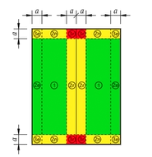
Racking and Mounting
This is a gable roof.
The red zone has the highest wind loading.
Yellow next highest.
Green lowest.
Picture courtesy IRONRIDGE

Slide 16
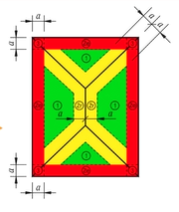
Racking and Mounting
This is a hip roof.
The red zone has the highest wind loading.
Yellow next highest.
Green lowest.
Picture courtesy IRONRIDGE

Slide 17
Racking and Mounting
As an installer the following material is good information for you.
As a designer of a racking system this information is critical.

Slide 18
Racking and Mounting
This is from the ironridge website.
ASCE/SEI 7 is a nationally adopted standard for the analysis and design of buildings and other structures.
The 2016 edition of this consensus standard (ASCE 7-16) has been adopted into the 2018 International Building Code (IBC 2018).
https://www.ironridge.com/asce716/
A lot of great information from this video.

Slide 19
Racking and Mounting
This is from the ironridge website.
Solar now has its own section of code, and is no longer tucked under “Cladding and Components.”
New wind tunnel testing results have changed wind loads across the US including Puerto Rico.
The impacts to spans and location of mounts are the key things that are needed.

Slide 20
Racking and Mounting
This is from the ironridge website.
New design considerations include Edge and Exposed Modules.
Code now discerns between Hip and Gable Roofs, low vs. high pitch, and four additional roof zones.
ASCE 7-16 does not provide design recommendations for Edge Modules, but IronRidge has developed a set for you.

Slide 21
Racking and Mounting
Questions?

Slide 22
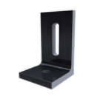
Racking and Mounting
The basic mounting device that attaches to the roof into the structural supports is an “L” bracket.
A screw or bolt attaches the “L” bracket to
the roof supporting structure.
IRONRIDGES L-Foot.
Picture courtesy IRONRIDGE

Slide 23
Racking and Mounting
The L-Foot / bracket needs to be attached to the support membrane (Truss, rafter or beam).
This means putting a hole through the roofing.
The roofing needs to be sealed from water entering.
The type of sealing will depend on the type of roof covering.
IRONRIDGE has a full range of products that can be used.

Slide 24
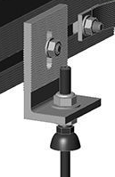
Racking and Mounting
The screw that will penetrate the roof sheathing usually has a rubber or rubber like gasket to provide water proof seal.
Every manufacturer has their own
gasket.
EJOT provides fasteners for
solar applications.
Sealing gasket.
Picture courtesy HESPV.ca

Slide 25
Racking and Mounting
The EJOT is a manufacture of fasteners and make solar products for roof types.
https://www.ejot.com/Building-Fasteners/Products/Solar-Products/Solar-Fasteners/Solar-Fastening-System-JT3-SB-3-8-0-with-FZD-sealing-washer/p/JT3-SB-8-0-FZD
https://www.youtube.com/watch?v=faGnqRJyHsU
Picture courtesy HESPV.ca

Slide 26
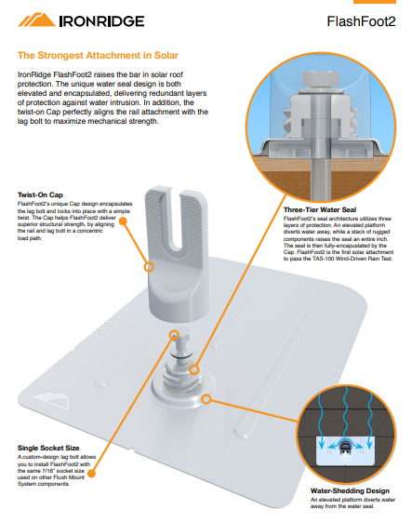
Racking and Mounting
Next few slides
show sealing.
The mount transitions
into the vertical bracket.

Slide 27
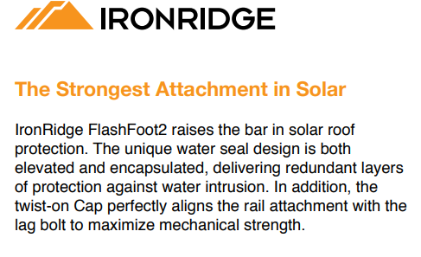
Racking and Mounting

Slide 28
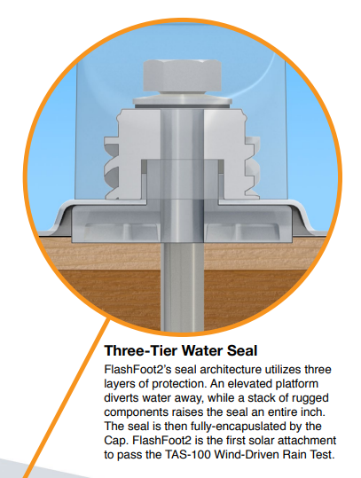
Racking and Mounting

Slide 29
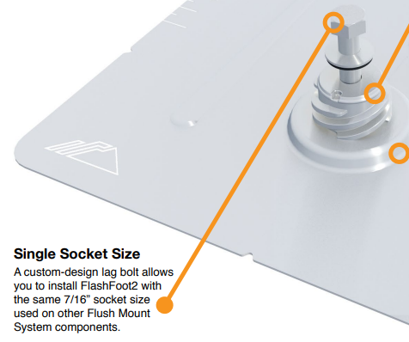
Racking and Mounting

Slide 30
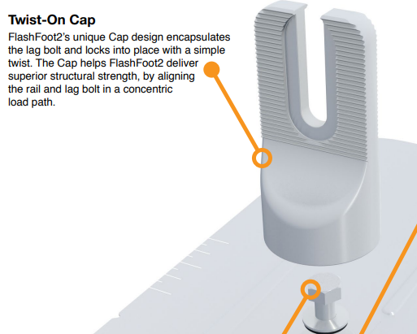
Racking and Mounting

Slide 31
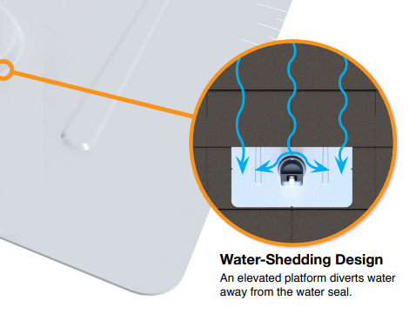
Racking and Mounting

Slide 32
Racking and Mounting
The complete brochure can be found at the ironridge link below.
https://files.ironridge.com/pitched-roof-mounting/resources/brochures/IronRidge_FlashFoot2_Tech_Brief.pdf

Slide 33
Racking and Mounting
Questions?

Slide 34
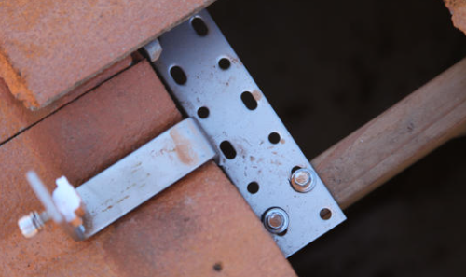
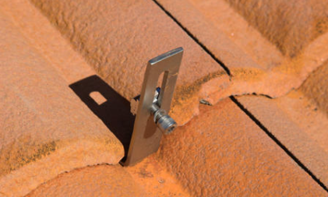
Racking and Mounting
Tiled roof uses hooks to go under the tile.
They attach to the rafter.
Come out at the end of the tile.
Pictures courtesy Author

Slide 35
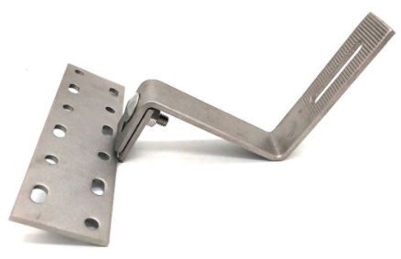
Racking and Mounting
For clay tiled roof a bracket / hook must be placed so that it clears the end of the tile.
An offset hook attaches to the rafter and lifts up higher than the tile and then bends over top of the tile going past the tile and finally turns upward to be able to attach to the rail.
Picture courtesy Author

Slide 36
Racking and Mounting
Turns upward to attach to rail.
Long enough to go past tile.
Lifts to clear tile.
Attachment to rafter.
Picture courtesy Author

Slide 37
Racking and Mounting
Ironridge has a hook for tiles.
https://files.ironridge.com/pitched-roof-mounting/resources/brochures/IronRidge_All_Tile_Hook_Installation_Manual.pdf

Slide 38
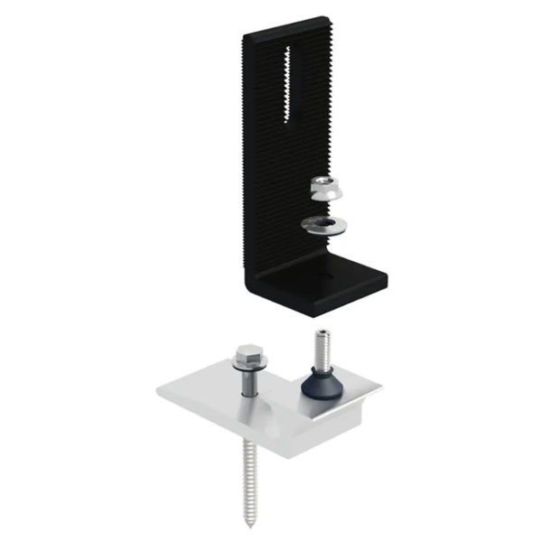
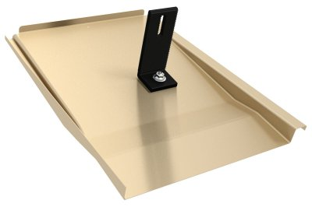
Racking and Mounting
Ironridge has a try that replaces the hook from the previous slide.
https://www.ironridge.com/mobile-landing/knockout-tile/
Pictures courtesy IRONRIDGE

Slide 39
Racking and Mounting
The complete brochure and video can be found at the ironridge links below.
https://files.ironridge.com/pitched-roof-mounting/resources/brochures/IronRidge_Knockout_Tile_Tech_Brief.pdf
https://files.ironridge.com/pitched-roof-mounting/resources/brochures/IronRidge_Knockout_Tile_Installation_Manual.pdf

Slide 40
Racking and Mounting
Questions?

Slide 41
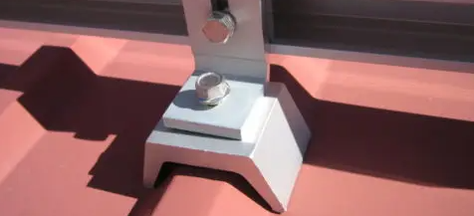
Racking and Mounting
Sheet steel roofing can be of the corrugated type or have a standing seam.
With a corrugated type of roof the idea is to drill down on top of the ridge.
Water is less likely to get in at the top of a ridge.
Picture courtesy Author

Slide 42
Racking and Mounting
With the corrugated roof, the screw must have a gasket and normally a sealant is added to seal the hole drilled in the steel.
The shape of the saddle ( straddling block) needs to be very close to the shape of the corrugated ridge.

Slide 43
Racking and Mounting
The other type of metal roof is the standing seam type.
The seam is pronounced and over laps where the two metal sheets come together.
The mounting saddle clamps to the ridge.
Depending on the clamp type, there may not be need for penetration into the metal.

Slide 44
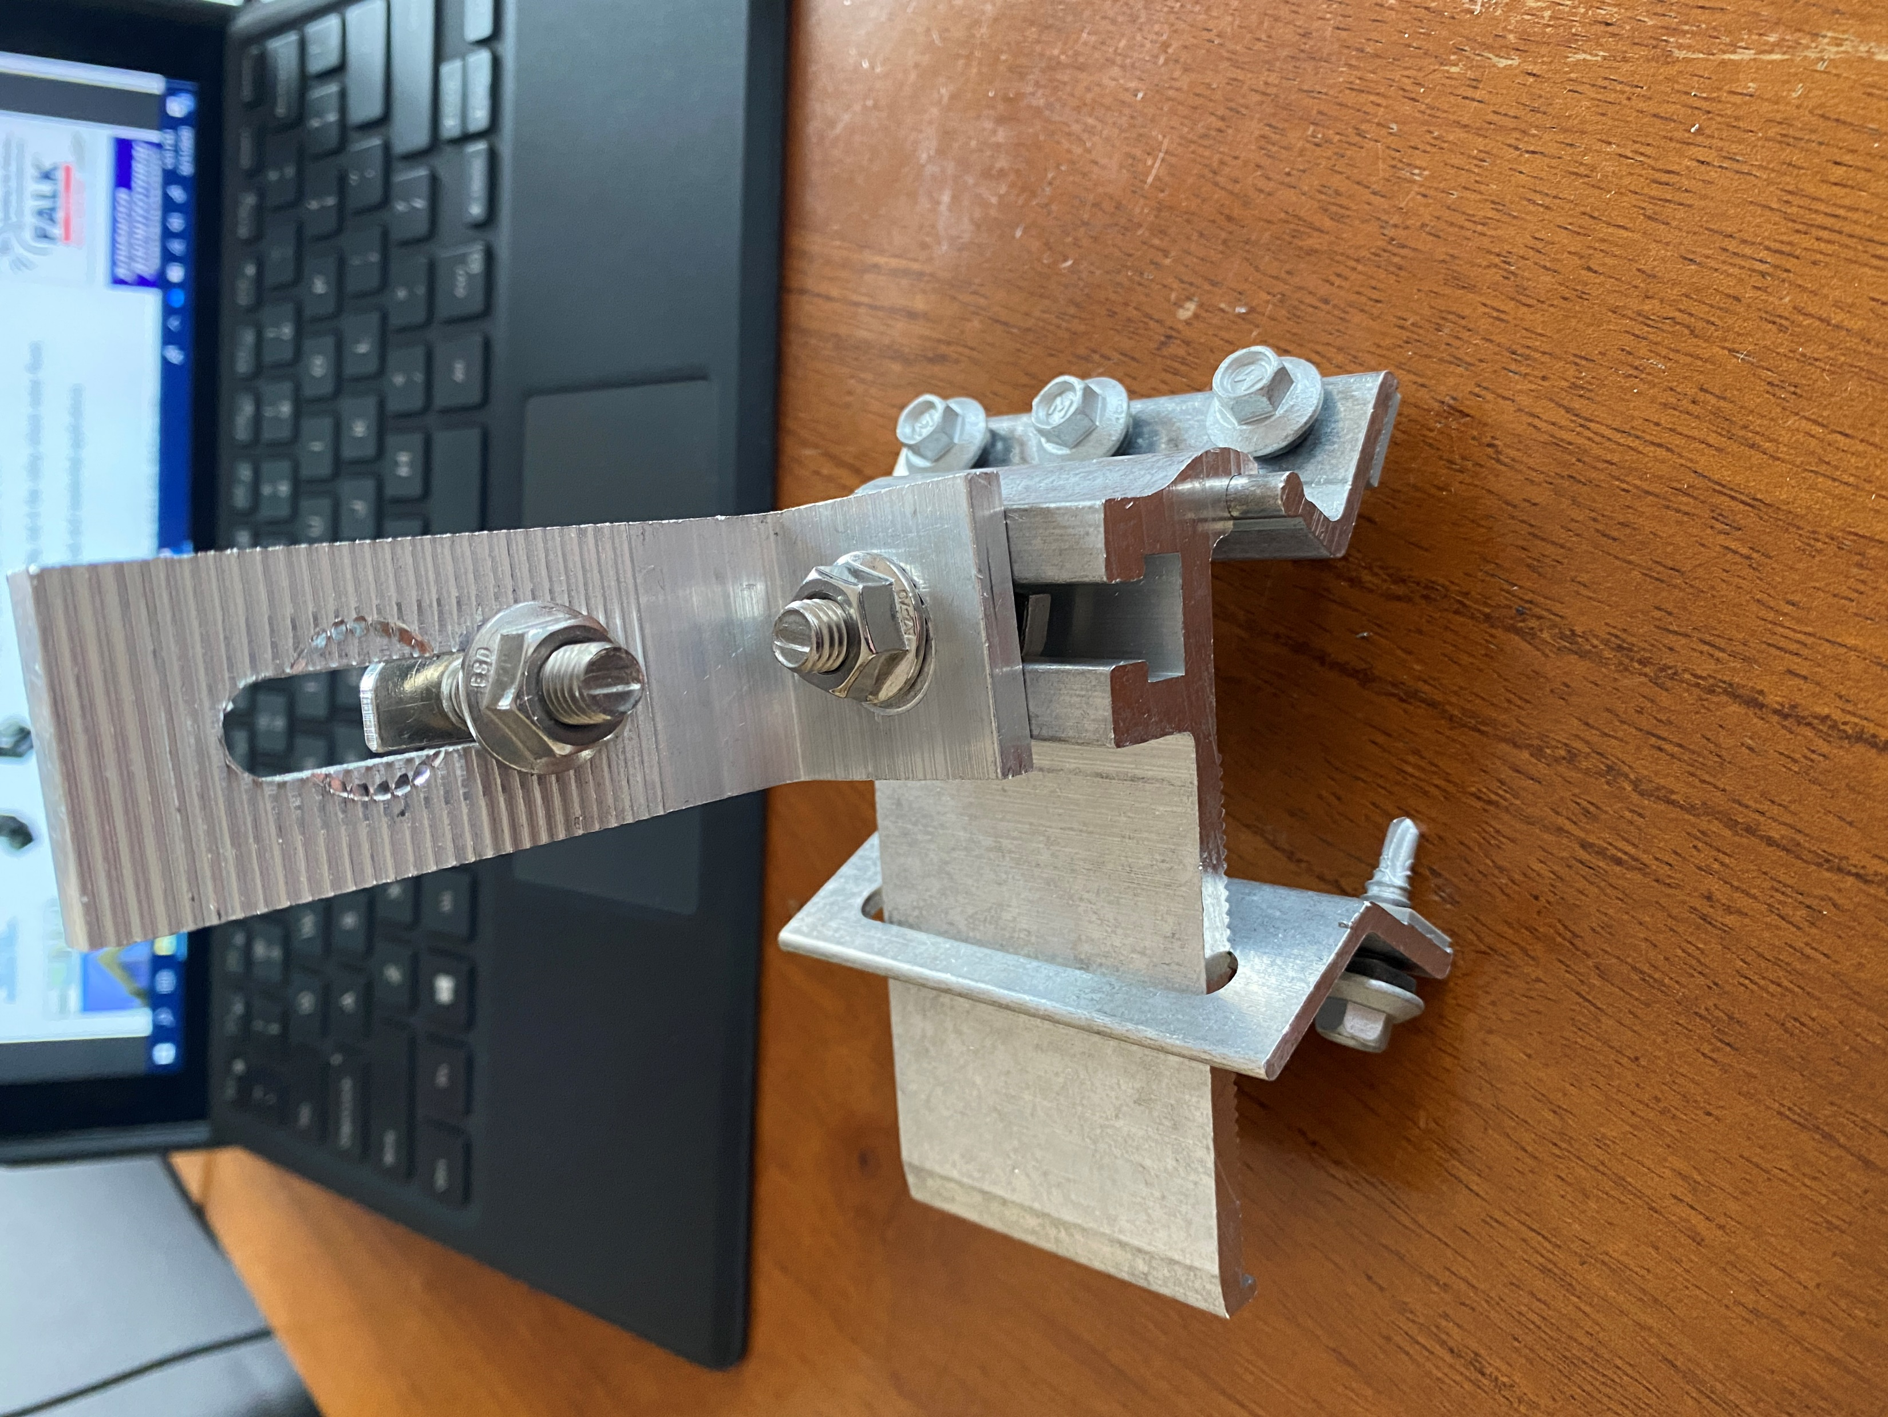
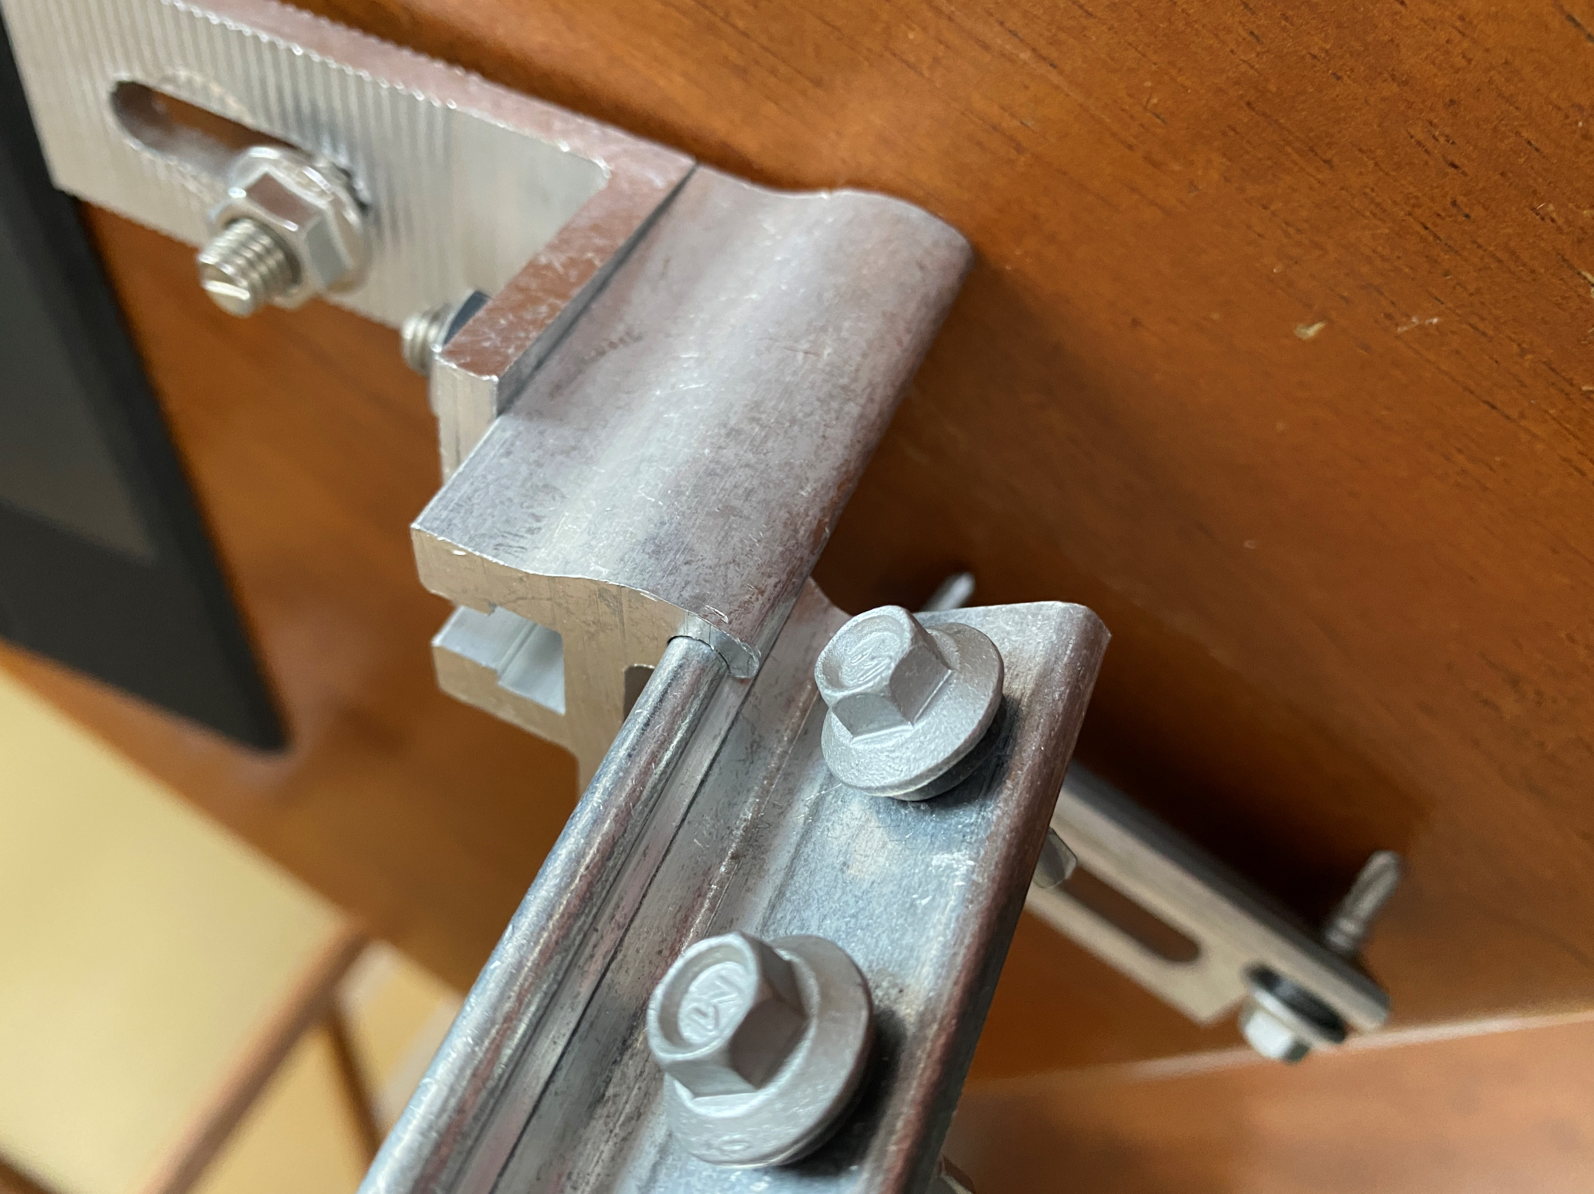
Racking and Mounting
This type screws into the metal ridge.
Pictures courtesy Author

Slide 45
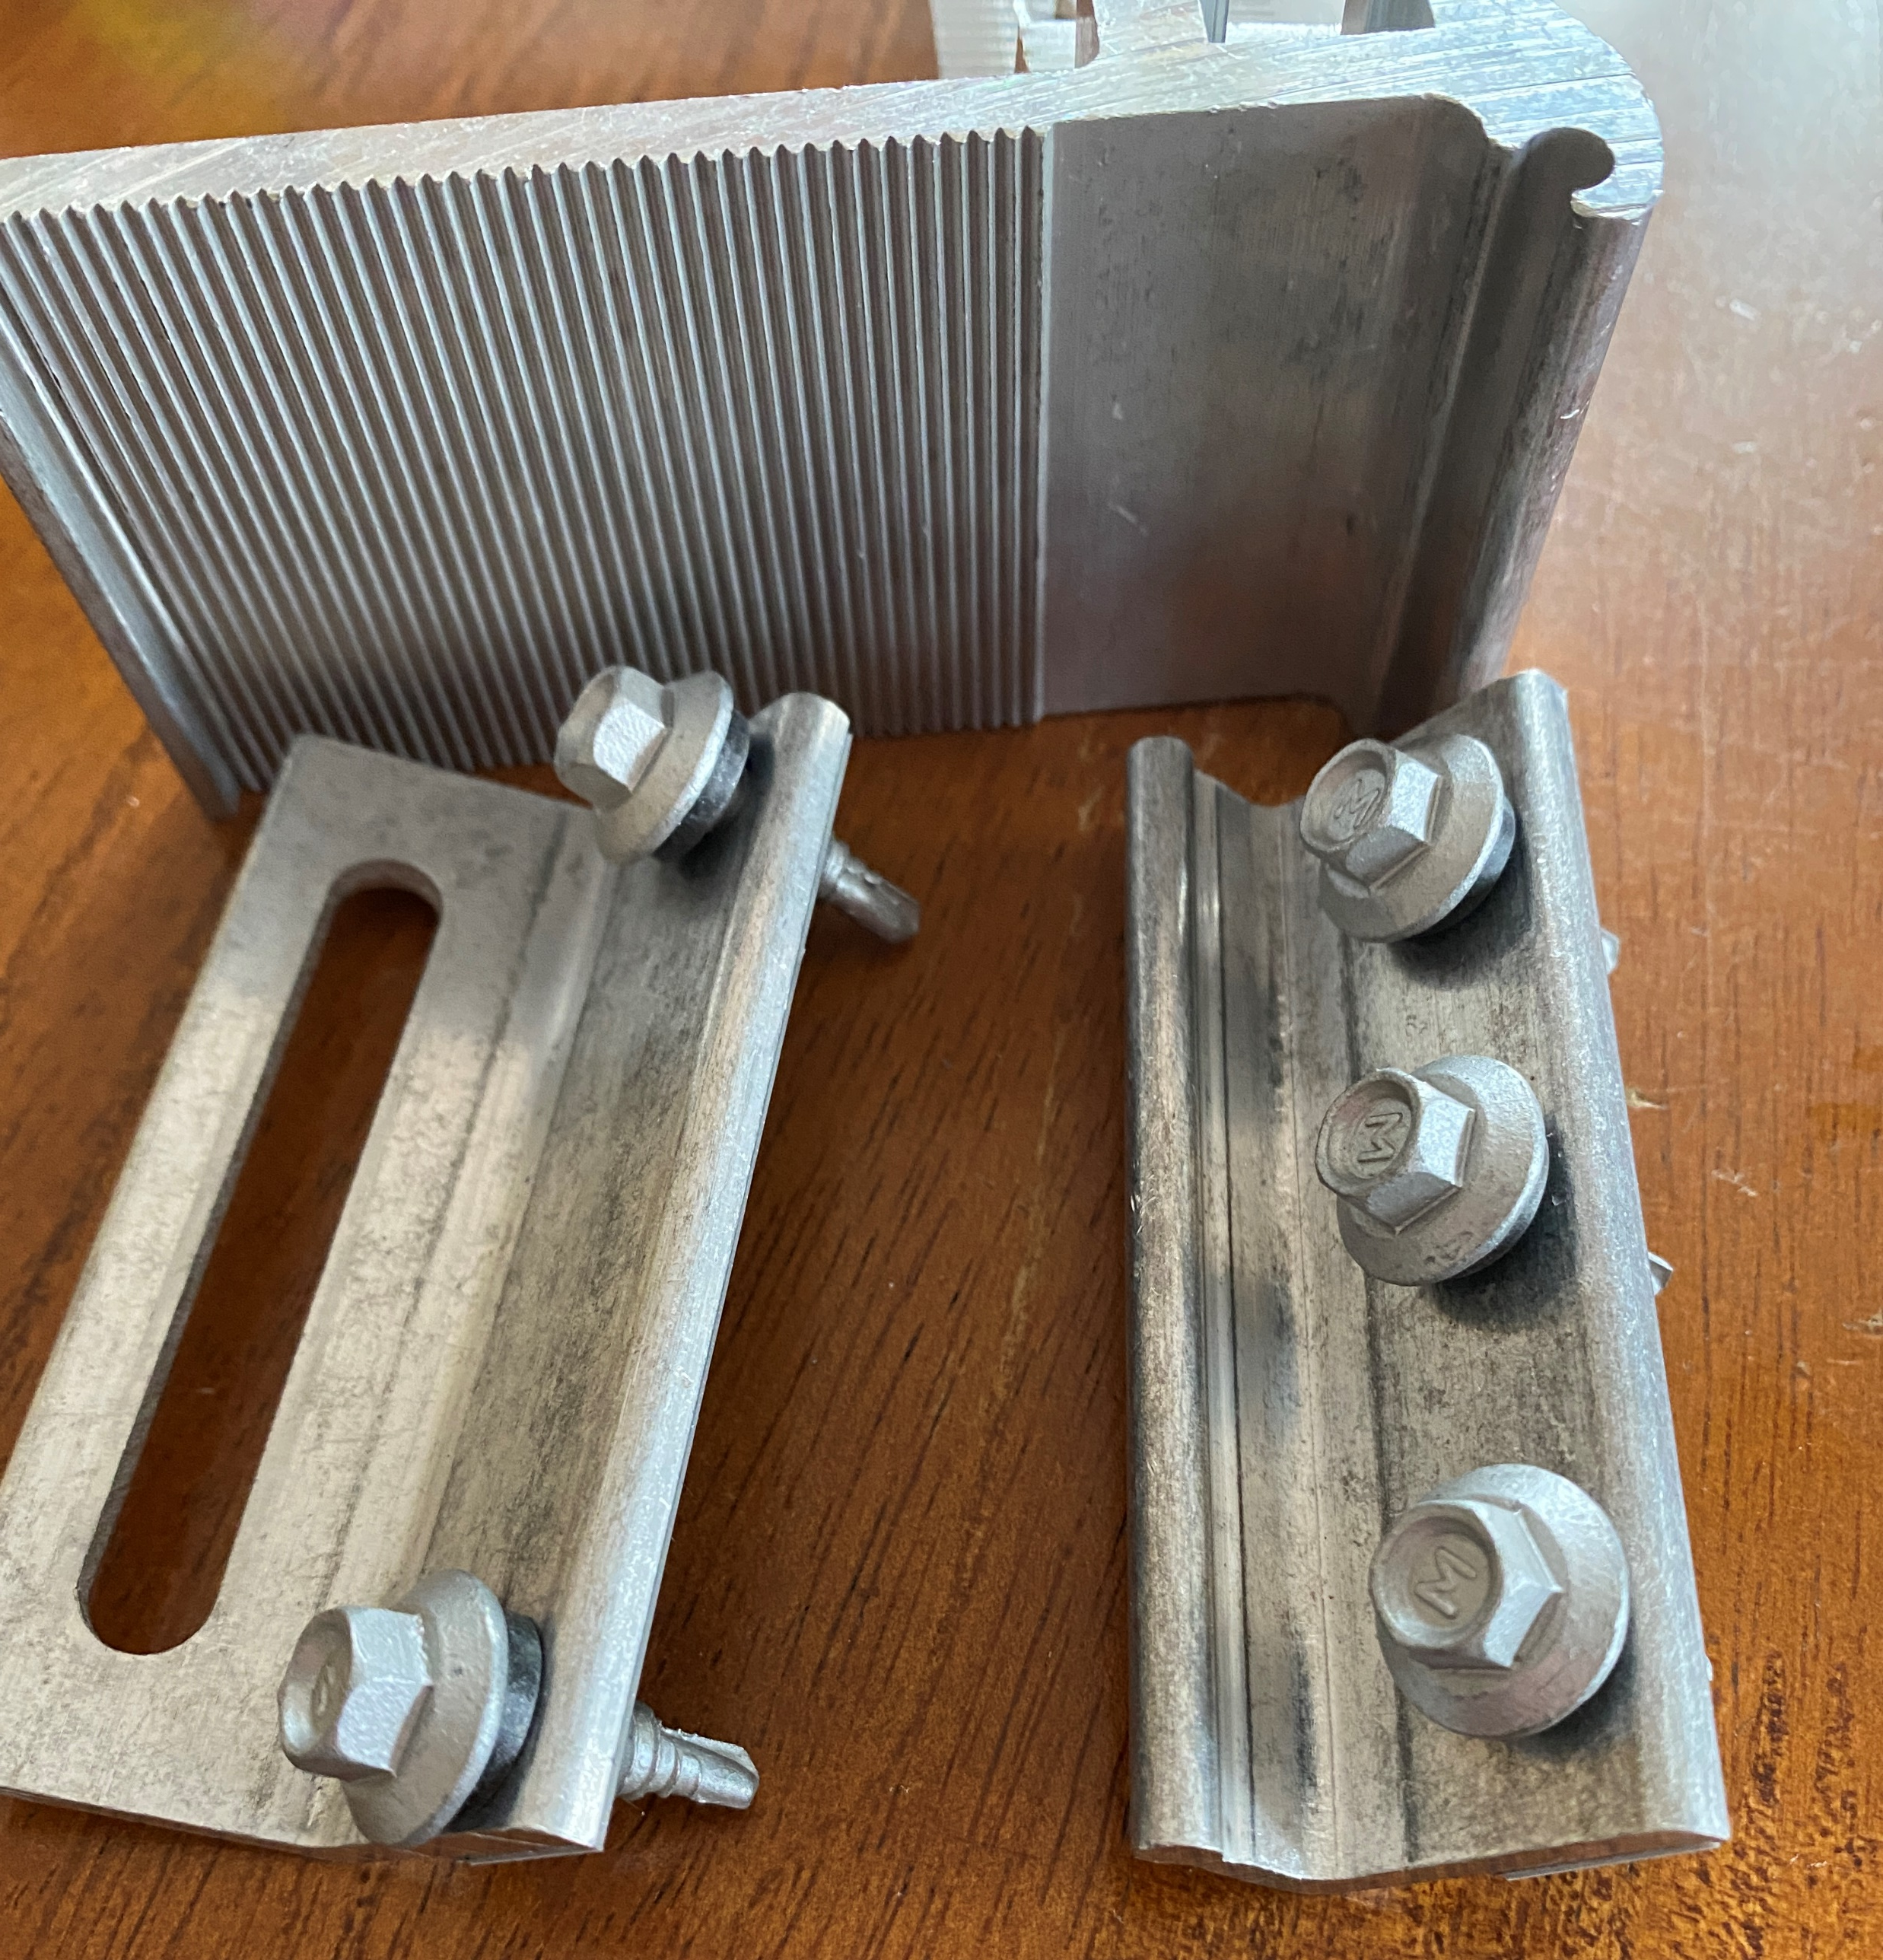
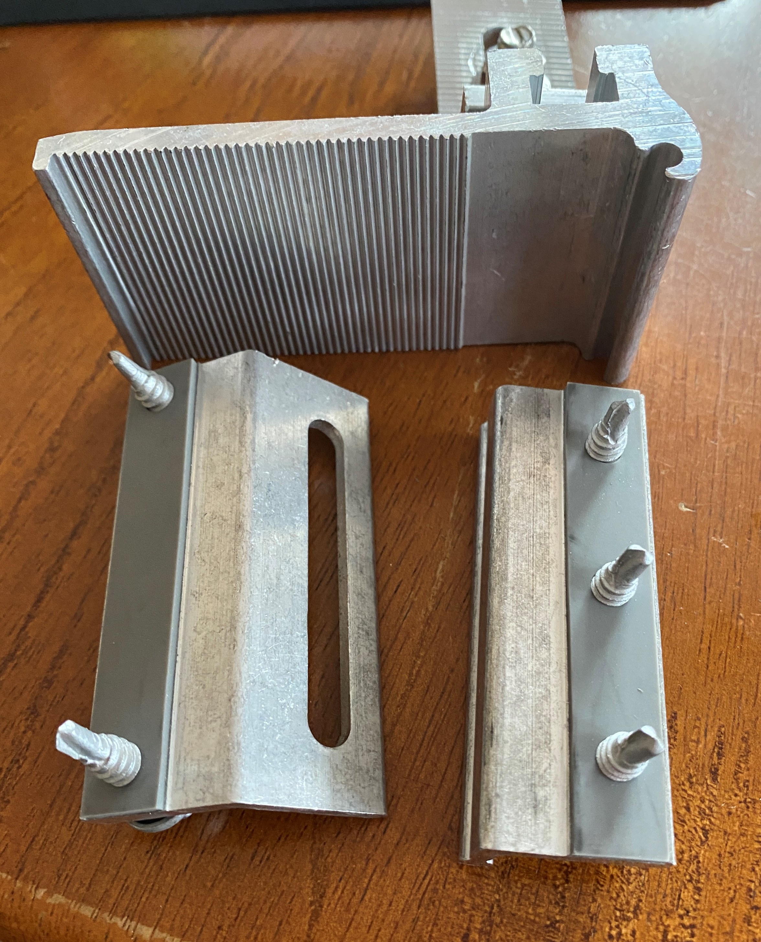
Racking and Mounting
Exploded view.
Pictures courtesy Author

Slide 46
Racking and Mounting
Ironridge has a non-penetrating standing seam clamp.
https://files.ironridge.com/pitched-roof-mounting/resources/brochures/IronRidge_QuickMount_Lynx_Tech_Brief.pdf

Slide 47
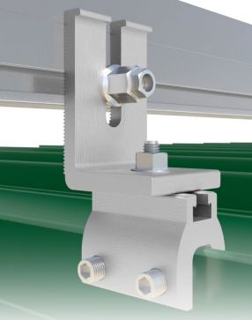
Racking and Mounting
The clamp is pressed on to the sides of the standing seam.
Picture courtesy ironridge

Slide 48
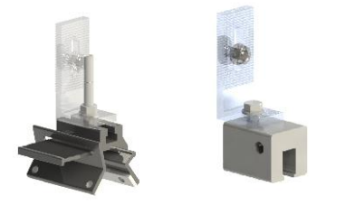
Racking and Mounting
The clamp is pressed on to the sides of the standing seam.
Picture courtesy HESPV.ca

Slide 49
Racking and Mounting
How many supporting brackets are required?
This number will be calculated by how many panels are required on the roof and also by the maximum allowable distance between the supporting brackets.
Span tables have been developed by manufacturers and are dependant on the location of the solar install.

Slide 50
Racking and Mounting
Span tables are available from the manufacturers.
Depending on the manufacturer software can be used to calculate the maximum spacing.

Slide 51
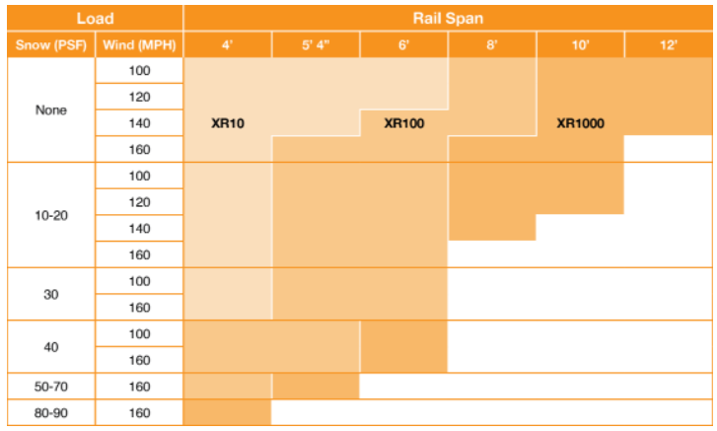
Racking and Mounting
An example of a span table.
Picture courtesy ironridge

Slide 52
Racking and Mounting
Questions?

Slide 53
Racking and Mounting
The L-bracket will be the transition device that will connect to the rails.
The rails are special aluminum extruded metal that have groves and other openings.
The groves and openings allows other accessories to connect panels and associated equipment together.
The L-bracket attaches to the rail.

Slide 54
Racking and Mounting
Rails are specific to the manufacturer and do not interchange well with other manufacturers components.
Going from the L-bracket to almost any rail is not usually a problem.
As long as the groves line up it will work.

Slide 55
Racking and Mounting
The rail manufacturer will provide rails in different lengths.
The manufacturer will also give guidelines on the maximum distance that the rail can be supported with a bracket (span table).

Slide 56
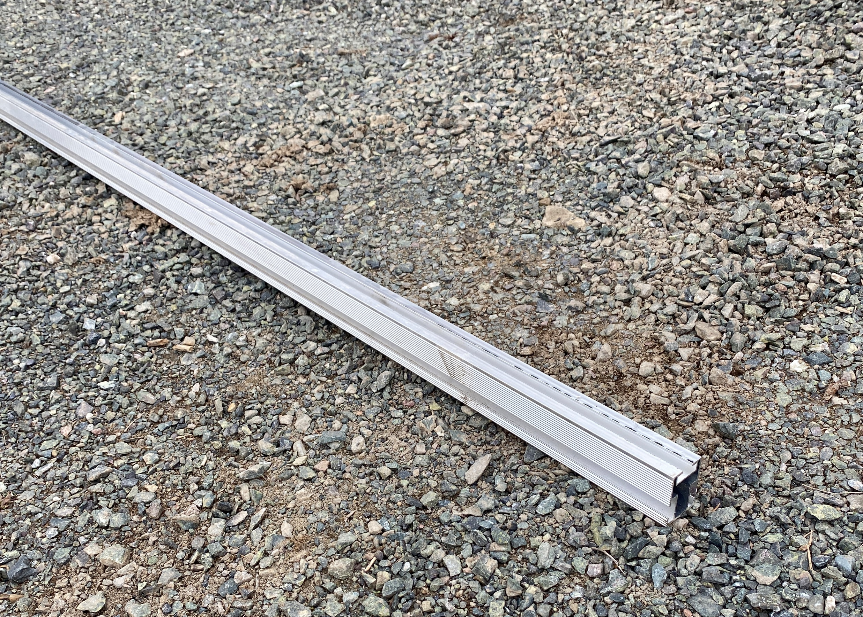
Racking and Mounting
This rail is 13 feet in length.
Pictures courtesy Author

Slide 57
Racking and Mounting
Top view.
Channel with side groves to align the height of the rail on the L-bracket.
Pictures courtesy Author

Slide 58
Racking and Mounting
Side view.
Channel with side groves.
Picture courtesy Author

Slide 59
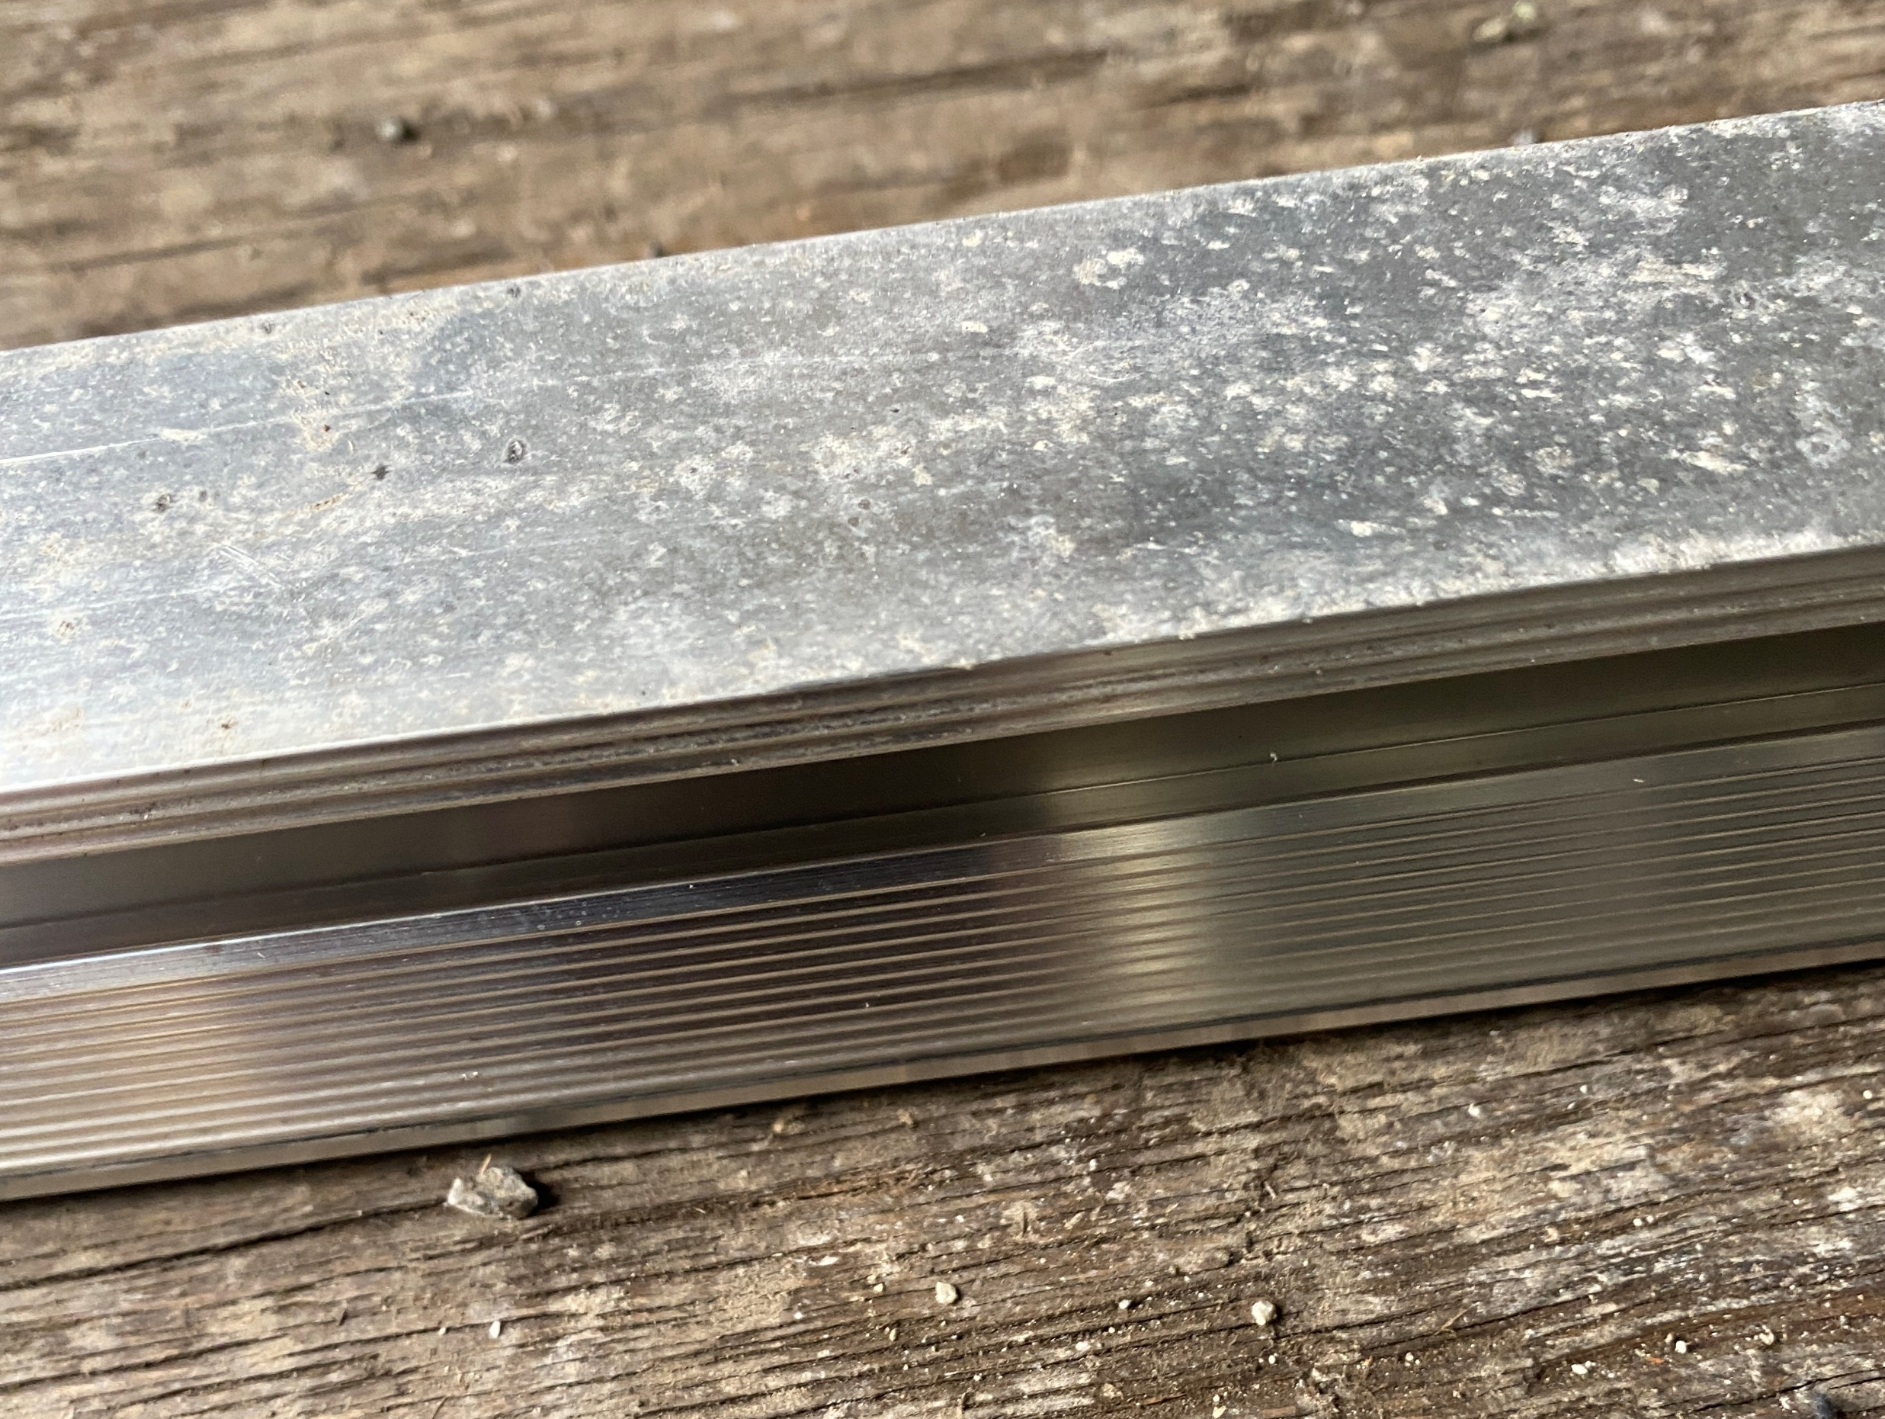
Racking and Mounting
Bottom view.
No channel.
Picture courtesy Author

Slide 60
Racking and Mounting
Profile / end view.
Multiple channels.
Picture courtesy Author

Slide 61
Racking and Mounting
Questions?

Slide 62
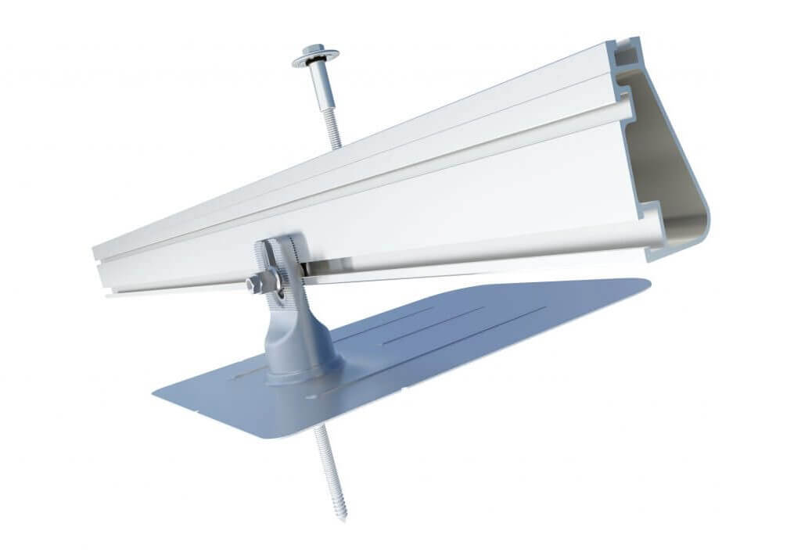
Racking and Mounting
The IRONWORKS XR RAIL system.
Picture courtesy IRONRIDGE

Slide 63
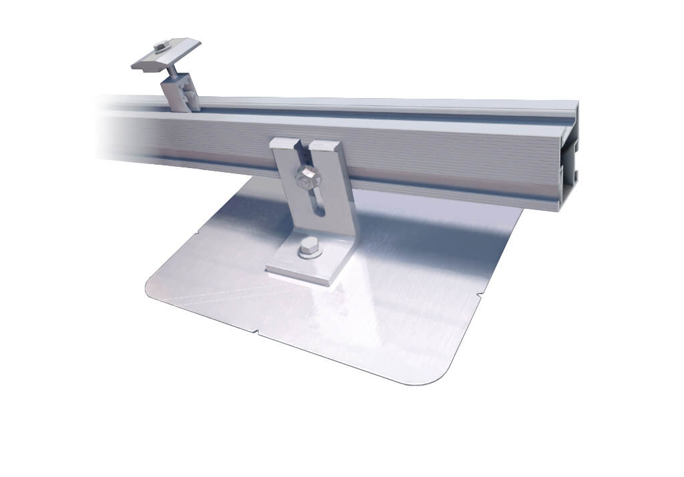
Racking and Mounting
The IRONWORKS QRAIL system.
Picture courtesy IRONRIDGE

Slide 64
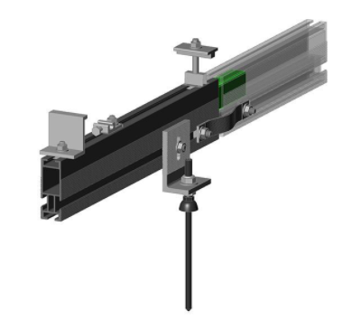
Racking and Mounting
The FAST RACK HD rail system.
Picture courtesy HESPV.ca

Slide 65
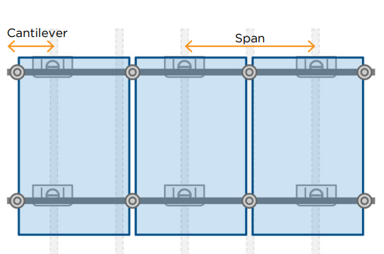
Racking and Mounting
The rail manufacturer will also specify the cantilever that a panel can go past the last support bracket.
Picture courtesy IRONRIDGE

Slide 66
Racking and Mounting
Determining spacing and rail layout.
Panels can be laid out portrait or landscape.
All depends on free space.
Rails typically go east – west direction and connect across the rafters.
Typical rafter spacing is 24 inches.

Slide 67
Racking and Mounting
The first step is to find the rafters.
A quick way to do this is to take a hammer and tap the roof listening for the solid noise when the hammer hits over top of a rafter.
If the roof sheathing is bolted to rafters then follow the line of the bolts.
Lift tiles and find the rafters.

Slide 68
Racking and Mounting
Once the rafters are found, the spacing of the rails up and down the roof (North – South) is determined.
The rail manufacturer will specify the spacing of the rails.
This link is good for laying out the rails and to adjust cantilever.
https://files.ironridge.com/education-library/Tech_Tip_Maximizing_Rail_Cantilever.pdf

Slide 69
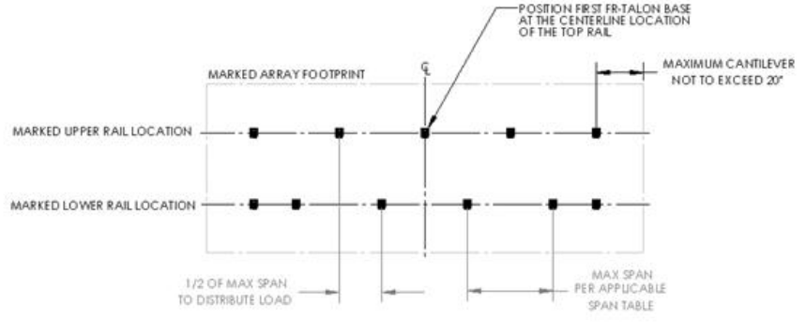
Racking and Mounting
Staggering of the supporting L brackets to different rafters makes a stronger rail system.
Picture courtesy HESPV.ca

Slide 70
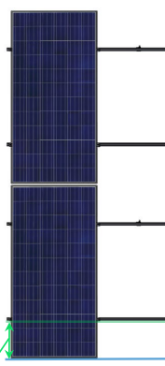
Racking and Mounting
An example is 2X spacing.
This spacing allows for 2 times
the spacing in the mid section
of the panel compared to the
cantilevered ends sections.
2X
1X
Picture courtesy Author

Slide 71
Racking and Mounting
Mark rail locations using a chalk line.
Another spacing is 20% -60% - 20%
The spacing above allows 20 percent of the panel to cantilever over the rails while 60 percent is between the rails.
Otherwise confirm the panel manufacturer’s recommendations.

Slide 72
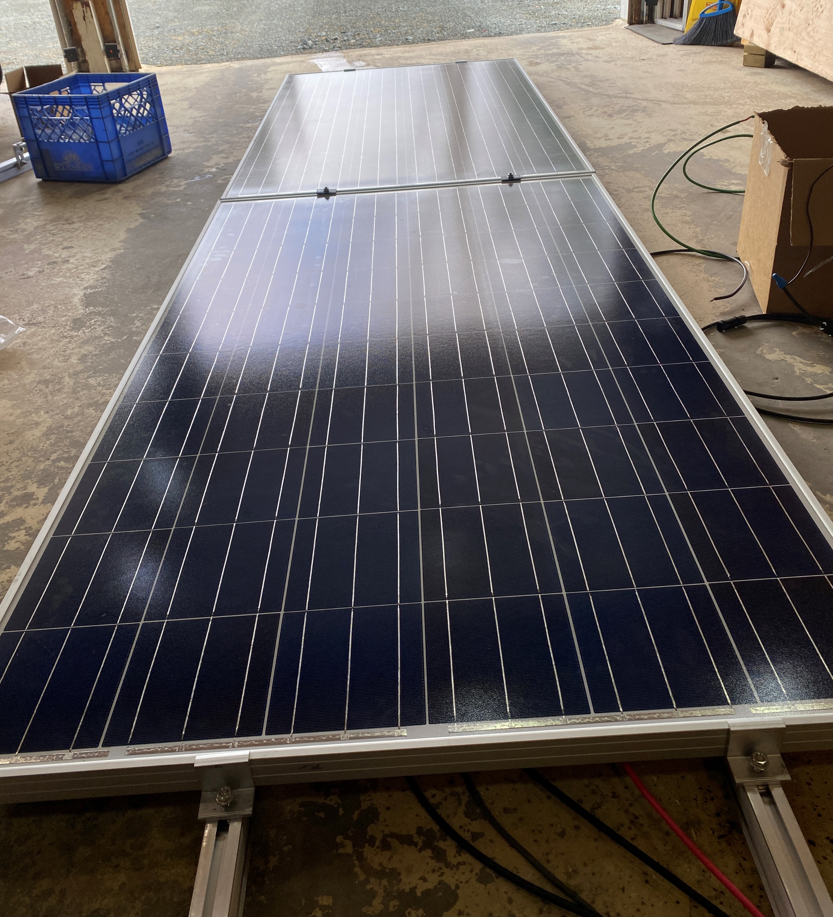
Racking and Mounting
20% spacing
Landscape
orientation
60% spacing
Picture courtesy Author

Slide 73
Racking and Mounting
Questions?

Slide 74
Racking and Mounting
Joining rails together must allow for the electrical bonding as well as the physical bonding.
Manufacturers have specific parts to accomplish this.

Slide 75
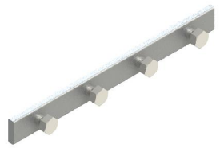
Racking and Mounting
The Fast Rack system uses this bar that slides into the rail sides.
Bolts hold it into place.
Picture courtesy HESPV.ca

Slide 76
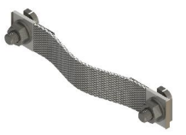
Racking and Mounting
The Fast Rack system uses this bonding jumper.
The T bolts hold it into place, between the rails.
Picture courtesy HESPV.ca

Slide 77
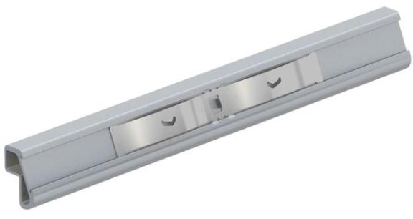
Racking and Mounting
The IronRidge system uses this splice and it acts as a bonding jumper that slides inside the rails and uses bonding teeth.
https://files.ironridge.com/pitched-roof-mounting/resources/brochures/IronRidge_BOSS_Bonded_Splice_Tech_Brief.pdf
Picture courtesy IRONRIDGE

Slide 78
Racking and Mounting
Questions?

Slide 79
Racking and Mounting
Bonding wire and connectors.
In a previous module we discussed the Lay-in lug as the preferred way to bond the rail to the grounded bonding wire.
Each rail must be
bonded together.
# 6 AWG or #16 metric.
Picture courtesy Author

Slide 80
Racking and Mounting
Wire management.
Although there are no panels mounted as of yet, the time to add wire management is now before panels go on.
Wire management includes the bonding wire and clips for the panel wiring.

Slide 81
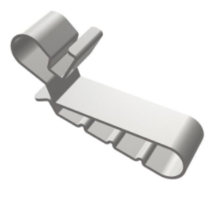
Racking and Mounting
Wire management clip.
Goes into rail track.
Holds wire.
Picture courtesy HESPV.ca

Slide 82
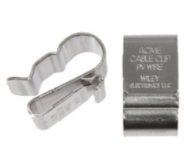
Racking and Mounting
Wire management clip.
Slides over panel edge.
Picture courtesy HESPV.ca

Slide 83
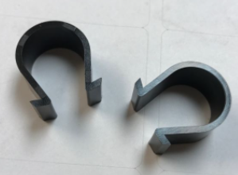
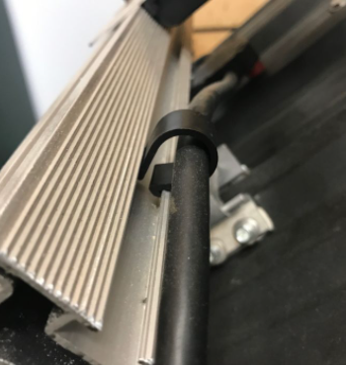
Racking and Mounting
Wire management clip.
Slides into rail.
Pictures courtesy HESPV.ca

Slide 84
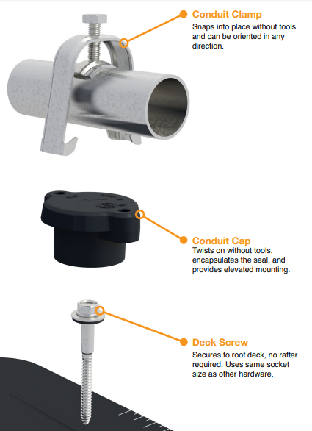
Racking and Mounting
IRONRIDGE conduit
mounting system.
Picture courtesy ironridge

Slide 85
Racking and Mounting
IRONRIDGE conduit mounting system.
https://files.ironridge.com/pitched-roof-mounting/resources/brochures/IronRidge_Conduit_Mount_Tech_Brief.pdf

Slide 86
Racking and Mounting
Questions?

Slide 87
Racking and Mounting
The next components are the clamps to hold down the panel to the rail.
There are end clamps and mid clamps.
In hurricane prone areas mid clamps
are not used.
They have two panels to hold in place.

Slide 88
Racking and Mounting
Two rails under panel and end clamps bolted to the rails.
End clamps hold panel to rail.
Locking bolt to rail
channel.
Pictures courtesy Author

Slide 89
Racking and Mounting
In hurricane areas three rails can be used to provide better attachment.
Pictures courtesy Author

Slide 90
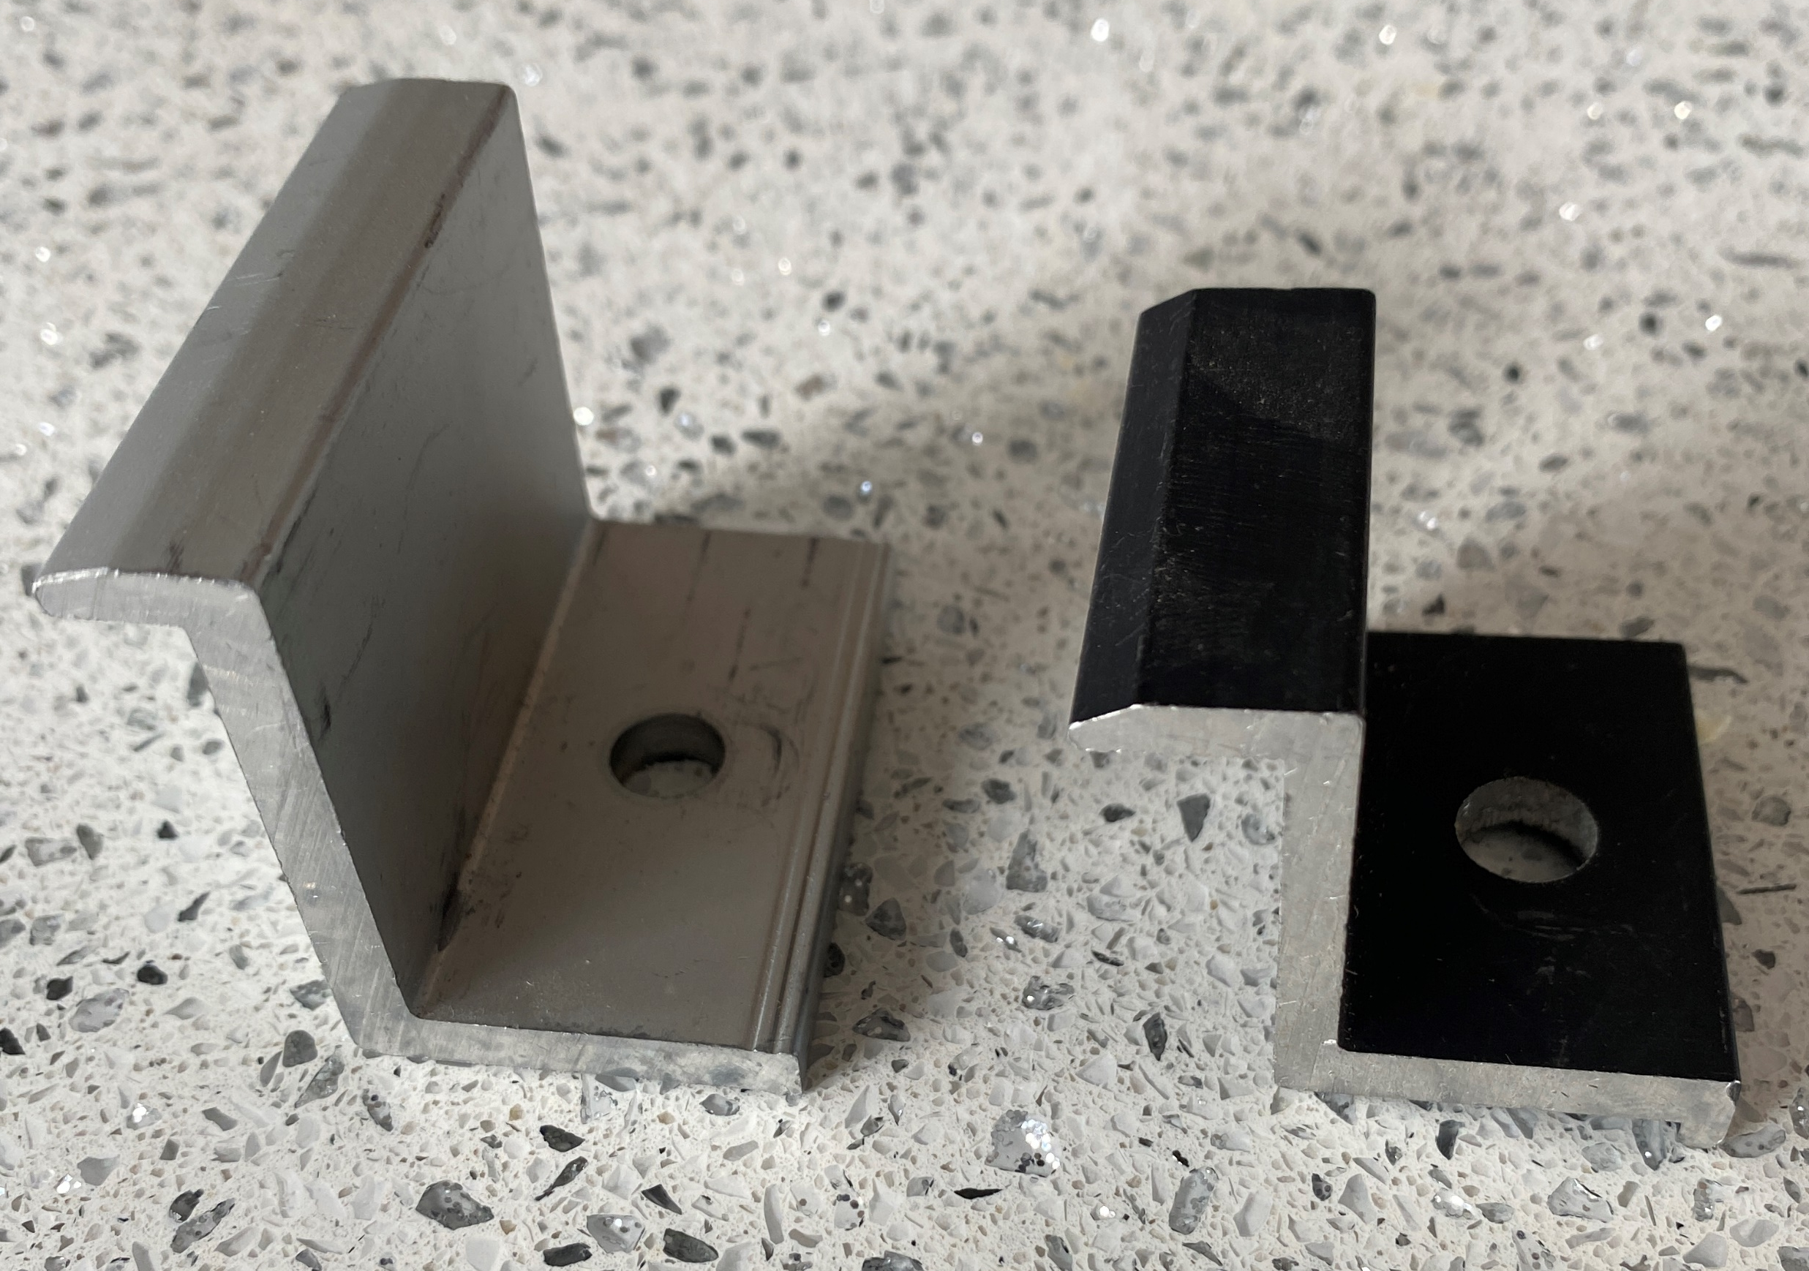
Racking and Mounting
Two examples of end clamps.
Two different heights to match up to the panel height.
Picture courtesy Author

Slide 91
Racking and Mounting
Mid clamps hold down two panels.
Not preferred practice in hurricane areas.
Picture courtesy Author

Slide 92
Racking and Mounting
Groves to provide grip to the panel.
Picture courtesy Author

Slide 93
Racking and Mounting
Fast Rack manual is found:
http://hespv.ca/hesproductspecs/HES%20Mounts/manuals/fastrack_manual.pdf
IRONRIDGE Flush Mount manual is found:
https://files.ironridge.com/pitched-roof-mounting/resources/brochures/IronRidge_Flush_Mount_Installation_Manual.pdf

Slide 94
Racking and Mounting
Questions?

