Slide 1
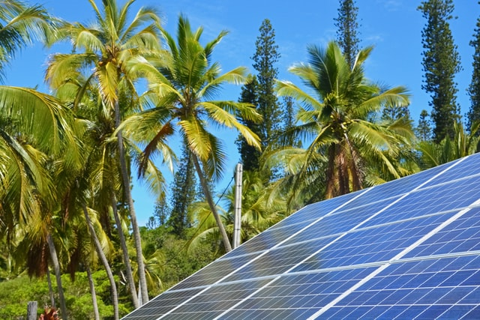
Course 05
Electrical and Circuits 1
Module 1: Introduce the concept of electric charge, insulators and conductors

Slide 2
Topics
Electric charge
Insulators
Conductors
Electrical flow through material

Slide 3
Relevancy
Understanding the basics of electricity
To promote an engineering mindset

Slide 4
Parts of an Atom
Notes:
Atoms have an equal number of electrons to protons.
The outer most electron is also called valence electrons. Free electrons are valence electrons that have been separated from the atom. The free electrons cause the “flow” of electricity
The positive particles are protons while the white neutral particles are neutrons.
The bulk of the atom’s weight is at the core, where the protons and the neutrons are. The electrons carry very little weight.
When the electrons and protons are not equal, the atom is known as an ion.
Energy needs to dislodge a single valence electron is significantly less than it is to dislodge an almost full outer shell.
(SrKellyOP, 2021)

Slide 5
Static Electricity
Electric charge that has accumulated on an object. Static electricity is often created when two objects that are not good electrical conductors are rubbed together, and electrons from one of the objects rub off onto the other. This happens, for example, when combing one's hair or taking off a sweater. Sudden releases of built-up static electricity can take the form of an electric arc.
(Dictionary.com, 2022)
Notes:
(Dictionary.com, 2022)

Slide 6
Examples of Static Charge and Uses
CRT television screen
Lightning
Clothes dryer
Electrostatic paint sprayer
Pollution management
Water ionization

Slide 7
What is an Insulator
A material or an object that does not easily allow heat, electricity, light, or sound to pass through it. Air, cloth and rubber are good electrical insulators; feathers and wool make good thermal insulators.
(Dictionary.com, 2022)

Slide 8
Insulator Analogy
When compared to water, insulators would be the obstructions that block the flow of water.
When compared to light, insulators would be similar to opaque windows or blackout curtains, where light cannot penetrate into a space

Slide 9
Insulator
(Moore, 2019)

Slide 10
Examples
Glass
Mica
Rubber
Fibreglass
Ceramic
Dry wood
Plastic
Pure water

Slide 11
Can you think of any other insulators?
Notes:
Review

Slide 12
What is a Conductor
A material or an object that conducts heat, electricity, light, or sound. Electrical conductors contain electric charges (usually electrons) that are relatively free to move through the material; a voltage applied across the conductor therefore creates an electric current. Insulators (electrical nonconductors) contain no charges that move when subject to a voltage. (Dictionary.com, 2022)
Notes:
(Dictionary.com, 2022)

Slide 13
Conductor Analogy
When compared to water, conductors would be the pipes that allow the flow of water.
When compared to light, conductors would be similar to clear glass windows or the absence of curtains. This allows light to penetrate into a space

Slide 14
Conductor
(Alistair1978, 2020)

Slide 15
Examples
Copper
Aluminum
Silver
Iron
Steel
Gold
Dirty water

Slide 16
Can you think of any other conductors?
Notes:
Review

Slide 17
How Electricity Flows
Notes:
Electrons can only flow when there is a continuous path. If there is only one (1) path to follow and it is broken, then electricity will not move, however, if there is an alternate route, then electricity may continue to flow.
(Vladimirova, 2016)

Slide 18
Wires and Cables
A cable is a multi-wire conductor
A wire is a single conductor
Wire conductors may be stranded or solid
Insulation sheathing mainly polyvinyl chloride (PVC) or polyethylene (PE)

Slide 19
Stranded vs Solid Wire
(Ehardt, 2005)
(Tester101, 2012)
Notes:
(Ehardt, 2005)

Slide 20
Conductor (Wire) Size
Conductor size is measured in both gauge number (AWG) or in mils
Diameter of a conductor can be measured in
American Wire Gauge (AWG)
Smaller numbers = larger wire size
Metric
Measurement of cross-sectional area of wire (mm²)
Circular Mils (cmil)
Measurement of cross-sectional area of wire (1/1000th of an inch)
Thousands of circular mils (MCMs)
Used for large diameter wire measurements

Slide 21
Wire size
(Powerfox, 2019)

Slide 22
Ampacity
Measurement of the maximum current a wire can allow
Depending on the current load, wire may need to be derated
Derating a wire is reducing the maximum ampacity of a wire
Notes:
When current flows through a wire, it generates heat. This is due the internal resistance of the wire. The larger the wire, the more current it can handle.

Slide 23
Derating
To lower the rated capability of (something, such as an electrical or mechanical apparatus) because of deterioration or inadequacy (Merriam-Webster, n.d.)
Notes:
(Merriam-Webster, n.d.)

Slide 24
Derating Factors
Temperature
Hotter ambient temperature means the cable can carry less current
Ground temperature derates more than air temperature
Insulation rating
The higher the insulation rating, the more current a wire can carry
Load factor (LF)
More heat is generated for a higher load factor
Notes:
(Cables Derating Factors Explained For Beginners, 2021)

Slide 25
Derating Factors
Ground terminal resistance
More thermal resistance from the environment increases heat in cable
Underground laying depth
Buried cables have a design depth; if not met, will require derating.
Cable configuration
Cables in close proximity cannot shed the temperature load
Notes:
(Cables Derating Factors Explained For Beginners, 2021)

Slide 26
Calculating Derating Factors
For each factor that must be applied, it is multiplied together
Multiply the resulting factor to the ampacity of the wire
If the adjusted value is less than the use case, a larger conductor must be used

