Slide 1
Electricity and Circuits 1
Practical Session

Slide 2
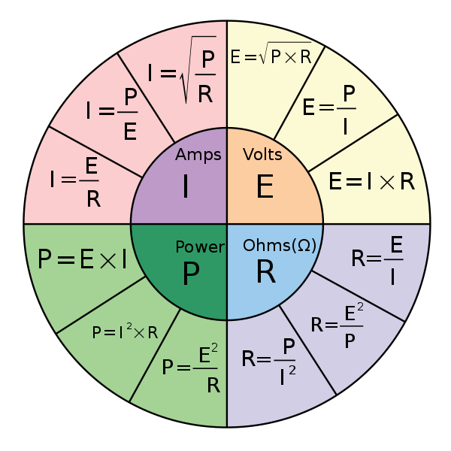
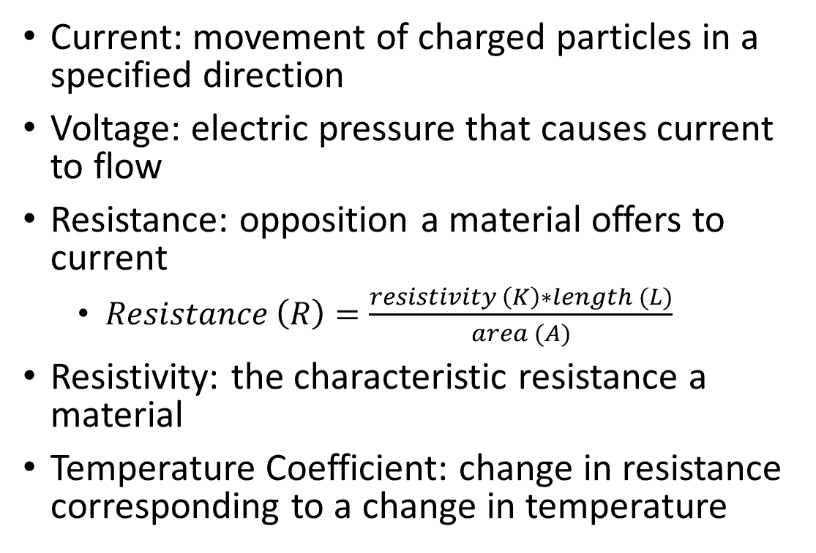
Ohm’s Law
Current: movement of charged particles in a specified direction
Voltage: electric pressure that causes current to flow
Resistance: opposition a material offers to current
  $Resistance \left(R\right)=\frac{resistivity \left(K\right)∗length (L)}{area (A)}$
Resistivity: the characteristic resistance a material
Temperature Coefficient: change in resistance corresponding to a change in temperature
(Rider, 2012)

Slide 3
Resistance
Type of material (K)
Length (L)
Cross-sectional area of material (A)
Temperature
For a specific material and temperature,
this block has a given amount of resistance.
Doubling the length of the block,
doubles the resistance.
Doubling the cross-sectional area,
halves the resistance.

Slide 4
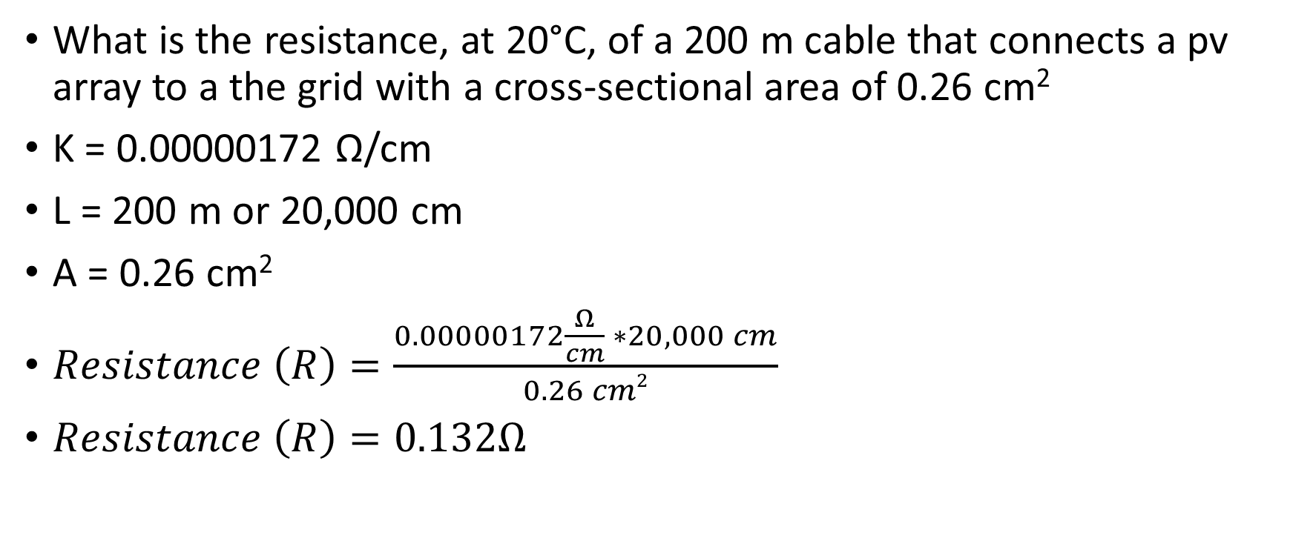

Examples
What is the resistance, at 20°C, of a 200 m cable that connects a pv array to a the grid with a cross-sectional area of 0.26 cm²
K = 0.00000172 Ω/cm
L = 200 m or 20,000 cm
A = 0.26 cm²
$Resistance \left(R\right)=\frac{0.00000172\frac{Ω}{cm} ∗20,000 cm}{0.26 cm2}$
$Resistance \left(R\right)=0.132Ω$

Slide 5
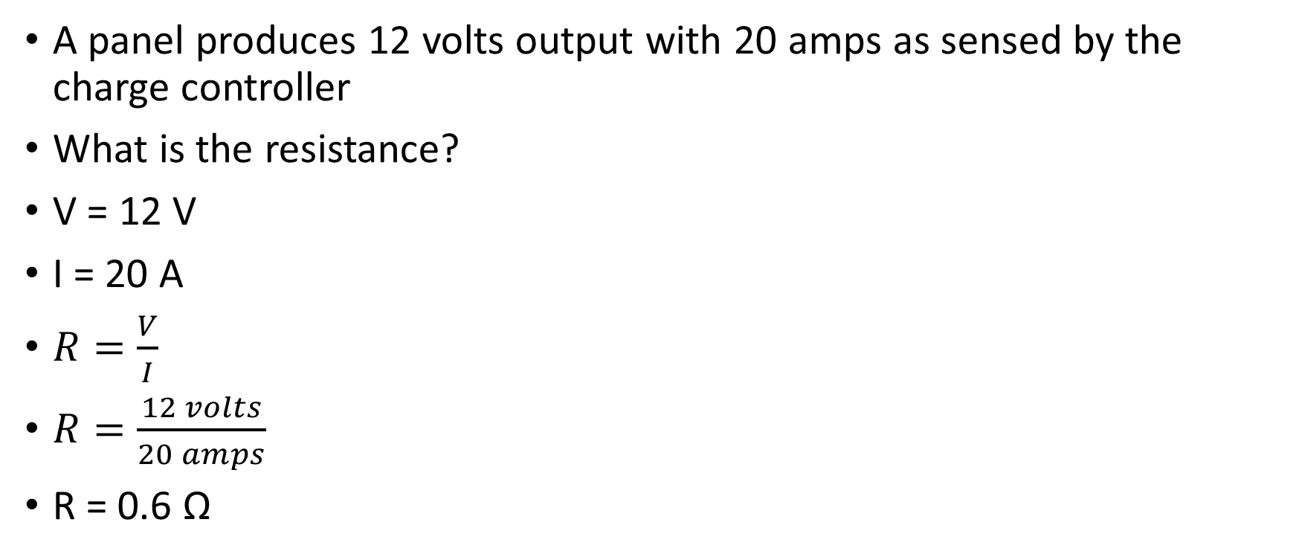
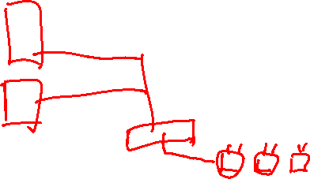
Examples
A panel produces 12 volts output with 20 amps as sensed by the charge controller
What is the resistance?
V = 12 V
I = 20 A
$R=\frac{V}{I}$
$R=\frac{12 volts}{20 amps}$
R = 0.6 Ω

Slide 6
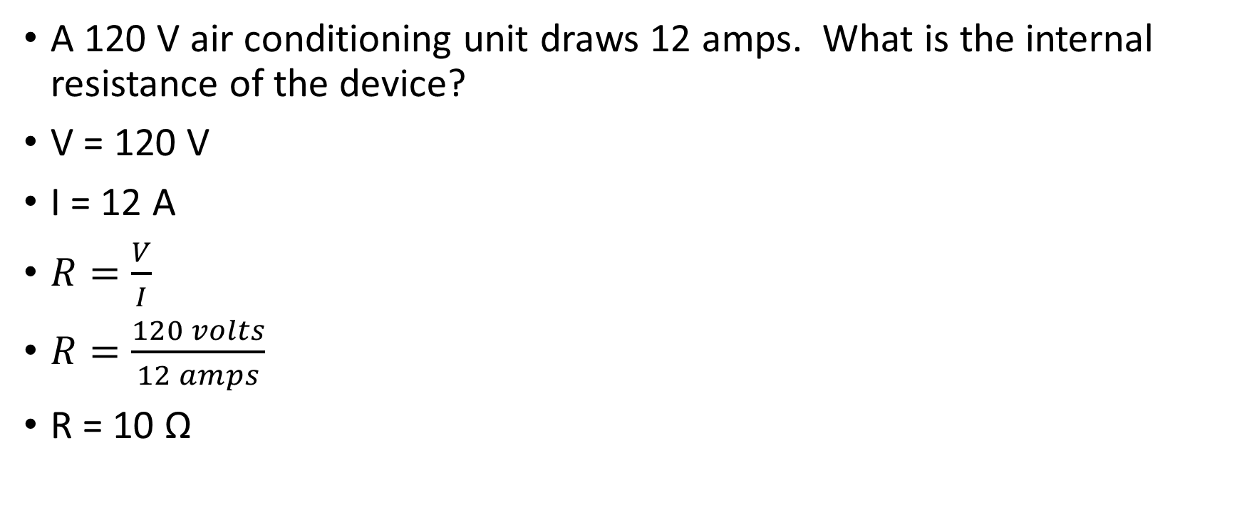
Examples
A 120 V air conditioning unit draws 12 amps. What is the internal resistance of the device?
V = 120 V
I = 12 A
$R=\frac{V}{I}$
$R=\frac{120 volts}{12 amps}$
R = 10 Ω

Slide 7


Examples
A 120 V air conditioning unit draws 12 amps. What is the power draw of the device?
V = 120 V
I = 12 A
P$=V∗I$
$P=120 V ∗12 A$
P = 1440 watts

Slide 8
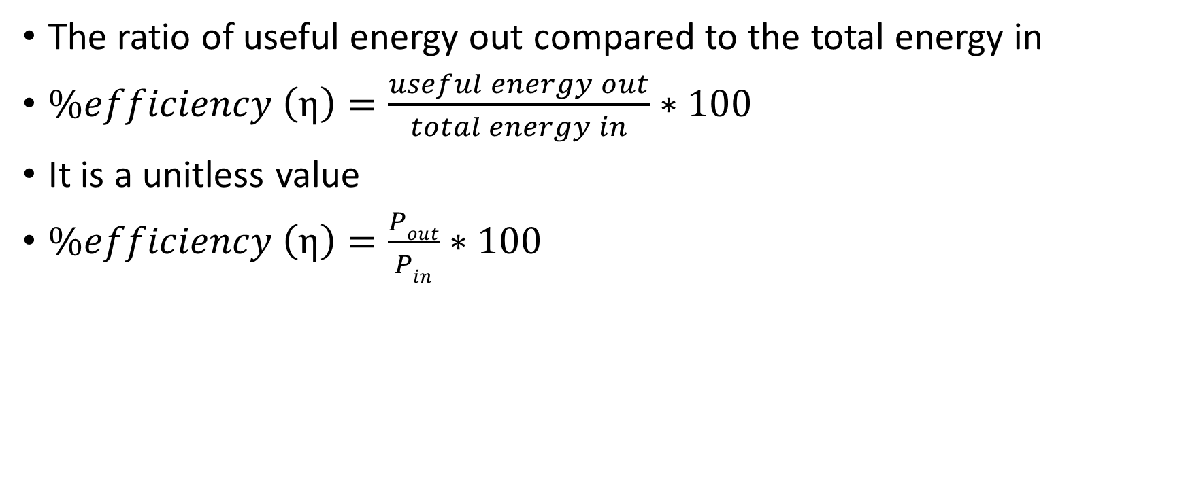
Efficiency
The ratio of useful energy out compared to the total energy in
$\%efficiency \left(η\right)=\frac{useful energy out}{total energy in}∗100$
It is a unitless value
$\%efficiency \left(η\right)=\frac{Pout}{Pin}∗100$

Slide 9
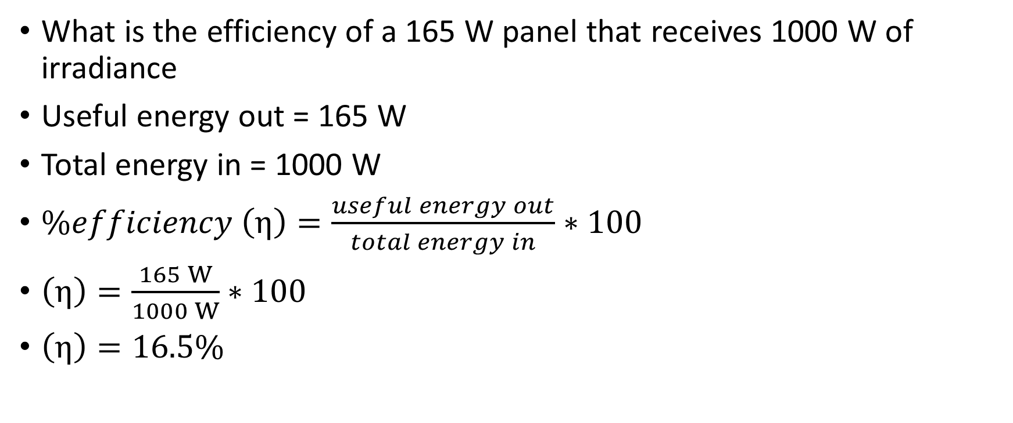
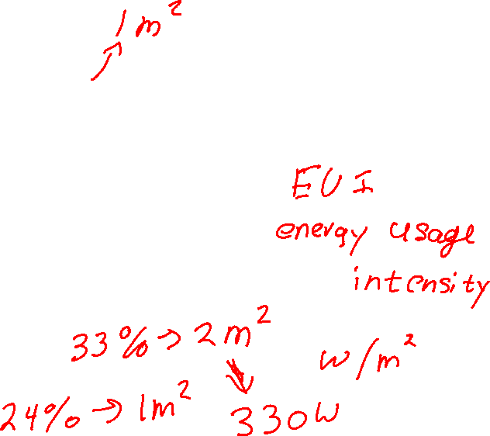
Example
What is the efficiency of a 165 W panel that receives 1000 W of irradiance
Useful energy out = 165 W
Total energy in = 1000 W
$\%efficiency \left(η\right)=\frac{useful energy out}{total energy in}∗100$
$\left(η\right)=\frac{165 W}{1000 W}∗100$
$\left(η\right)=16.5\%$

Slide 10
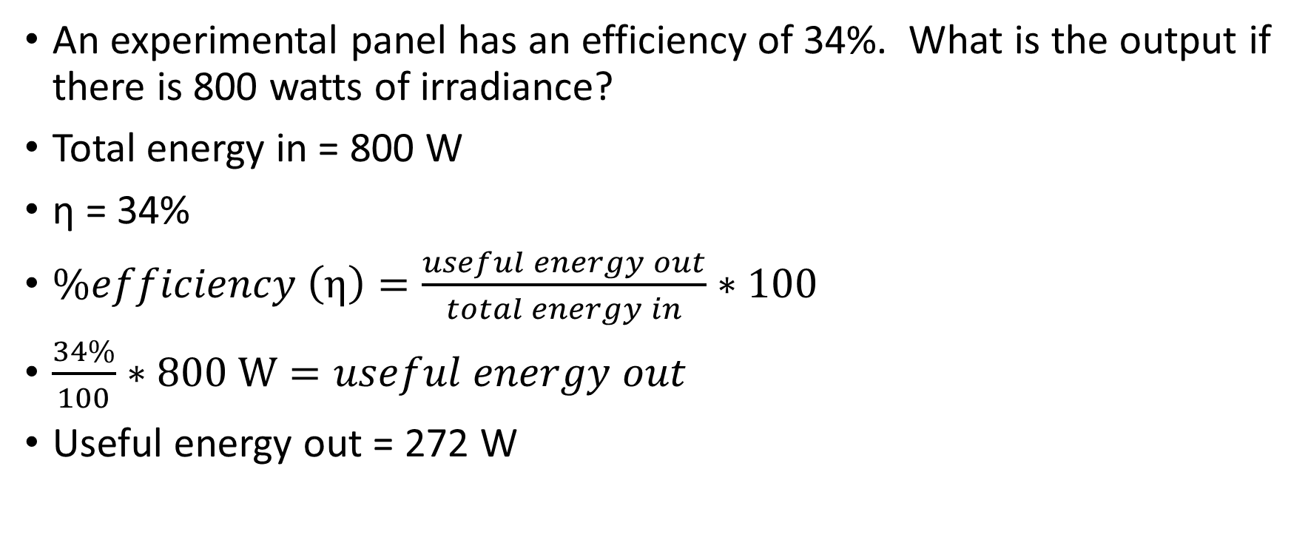
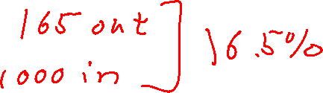
Example
An experimental panel has an efficiency of 34%. What is the output if there is 800 watts of irradiance?
Total energy in = 800 W
η = 34%
$\%efficiency \left(η\right)=\frac{useful energy out}{total energy in}∗100$
$\frac{34\%}{100}∗800 W=useful energy out$
Useful energy out = 272 W

Slide 11

Power
Rate of energy consumption/converted
$Power\left(P\right)=\frac{energy(W)}{time(t)}$
1 watt = 1 joule/second
W = power

Slide 12
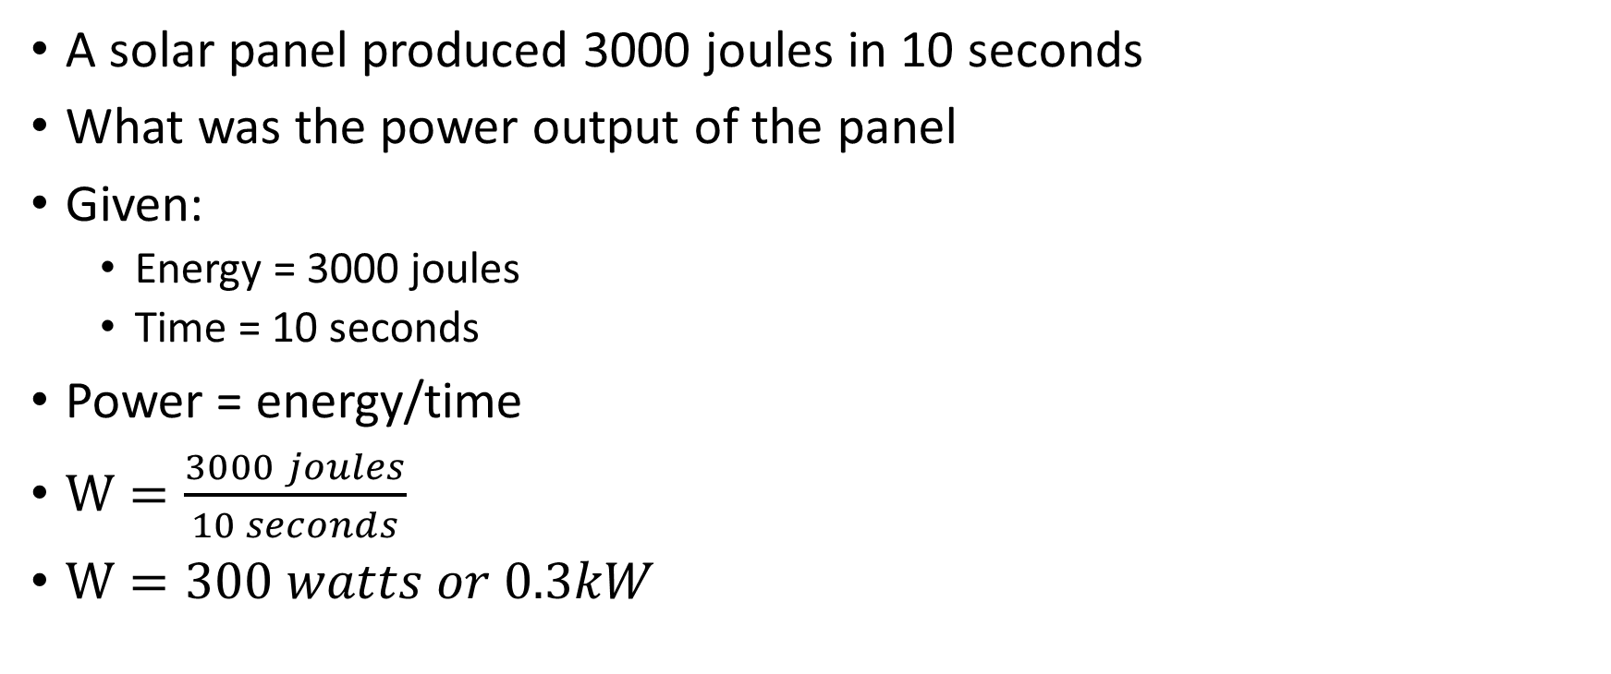
Example
A solar panel produced 3000 joules in 10 seconds
What was the power output of the panel
Given:
  Energy = 3000 joules
  Time = 10 seconds
Power = energy/time
$W=\frac{3000 joules}{10 seconds}$
$W=300 watts or 0.3kW$

Slide 13
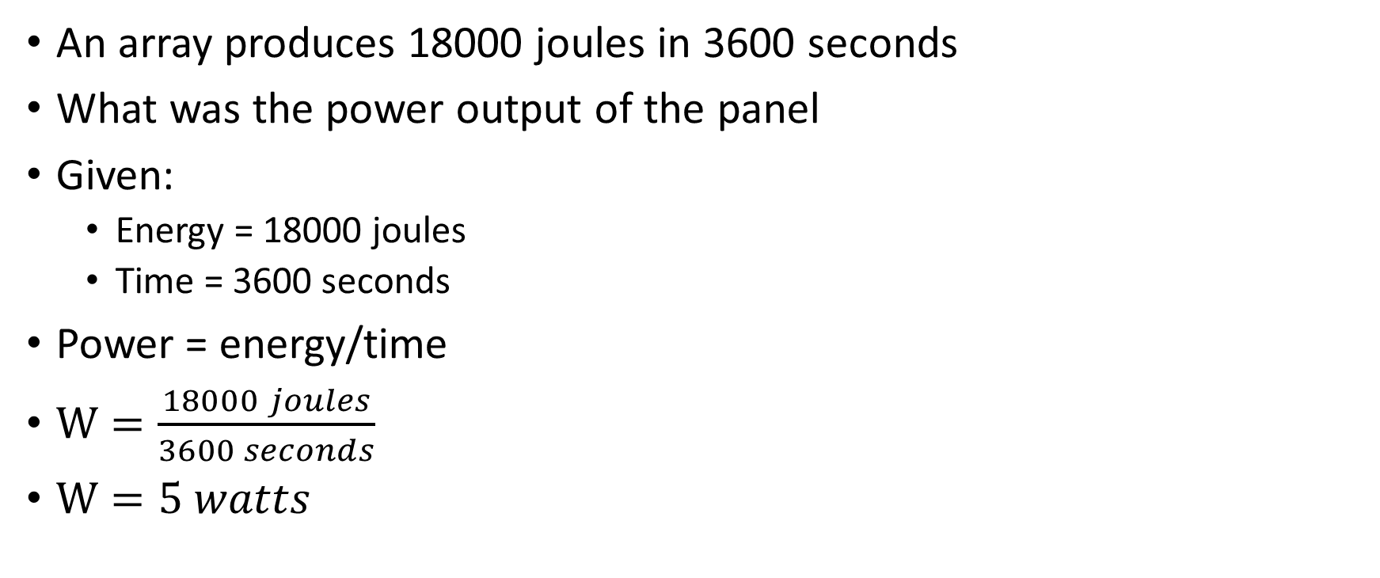
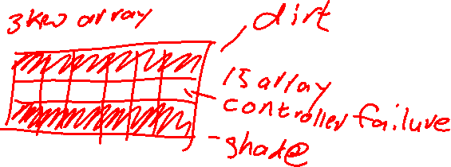
Example
An array produces 18000 joules in 3600 seconds
What was the power output of the panel
Given:
  Energy = 18000 joules
  Time = 3600 seconds
Power = energy/time
$W=\frac{18000 joules}{3600 seconds}$
$W=5 watts$

Slide 14
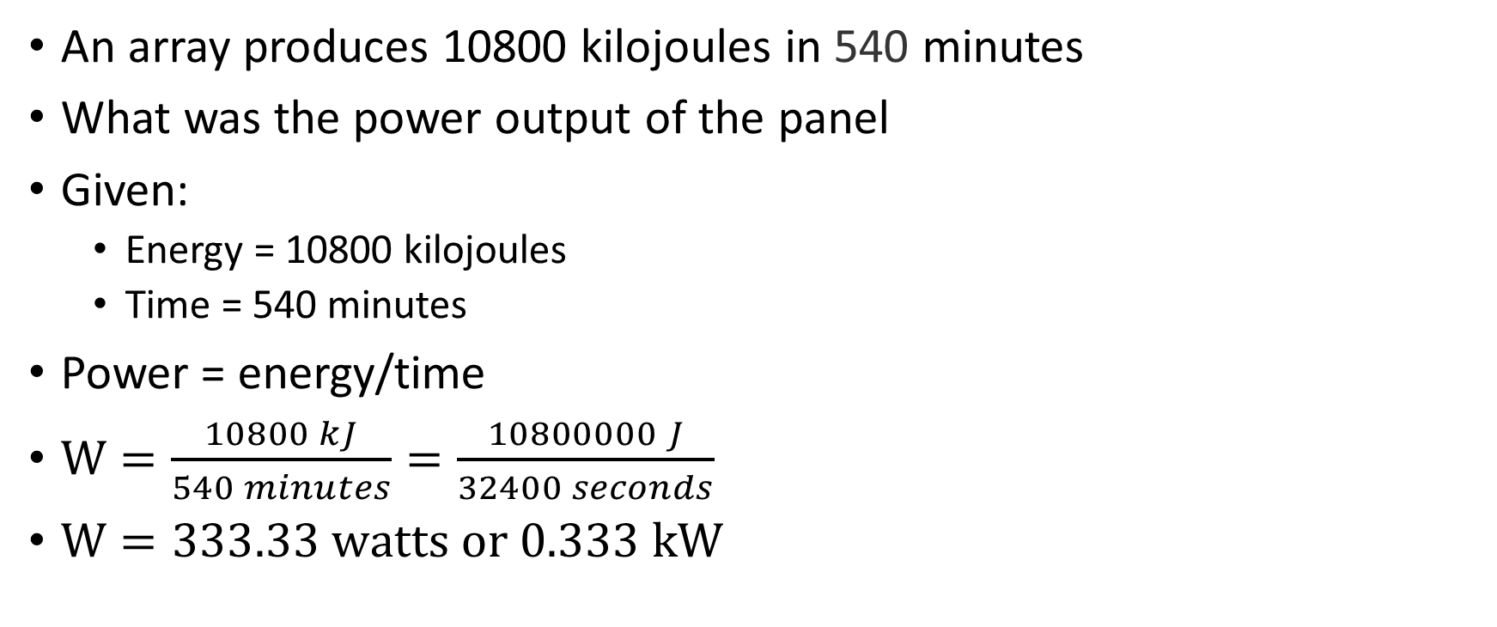

Example
An array produces 10800 kilojoules in 540 minutes
What was the power output of the panel
Given:
  Energy = 10800 kilojoules
  Time = 540 minutes
Power = energy/time
$W=\frac{10800 kJ}{540 minutes}=\frac{10800000 J}{32400 seconds}$
$W=333.33 watts or 0.333 kW$

Slide 15

Energy
Ability to do work
$energy\left(W\right)=Power\left(P\right)∗time(t)$
1 joule = 1 wattsecond
W = energy

Slide 16
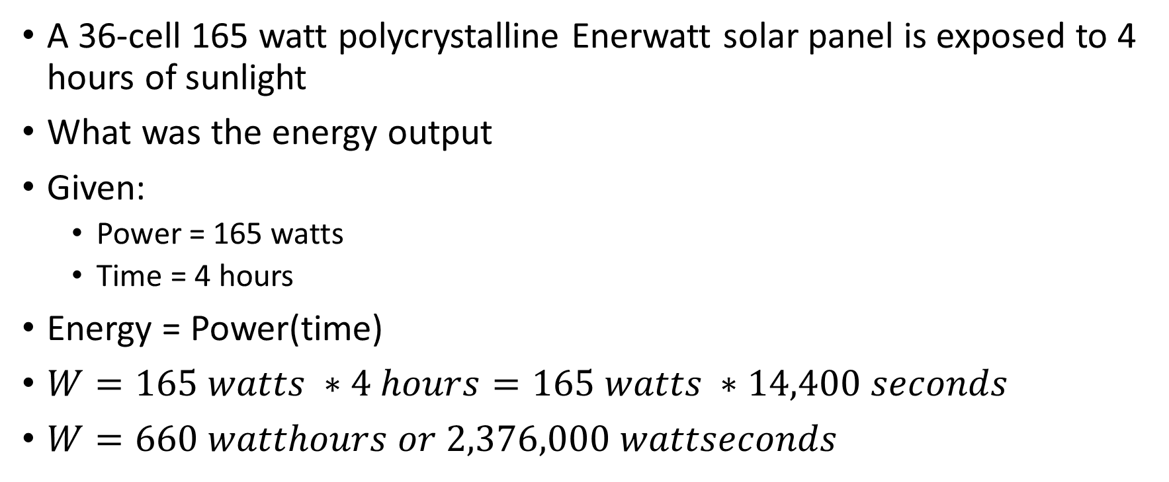
Example
A 36-cell 165 watt polycrystalline Enerwatt solar panel is exposed to 4 hours of sunlight
What was the energy output
Given:
  Power = 165 watts
  Time = 4 hours
Energy = Power(time)
$W=165 watts ∗4 hours=165 watts ∗14,400 seconds$
$W=660 watthours or 2,376,000 wattseconds$

Slide 17
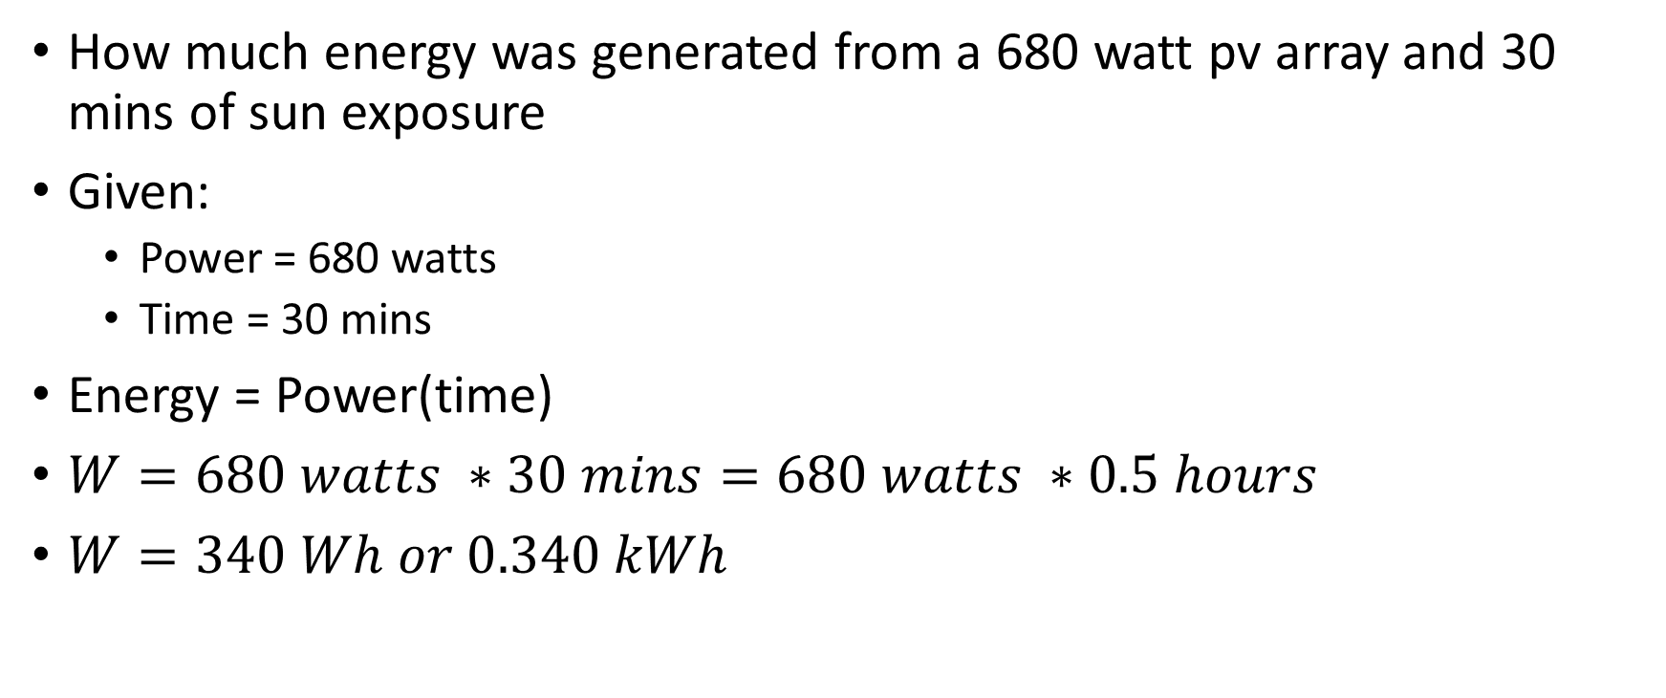
Example
How much energy was generated from a 680 watt pv array and 30 mins of sun exposure
Given:
  Power = 680 watts
  Time = 30 mins
Energy = Power(time)
$W=680 watts ∗30 mins=680 watts ∗0.5 hours$
$W=340 Wh or 0.340 kWh$

Slide 18
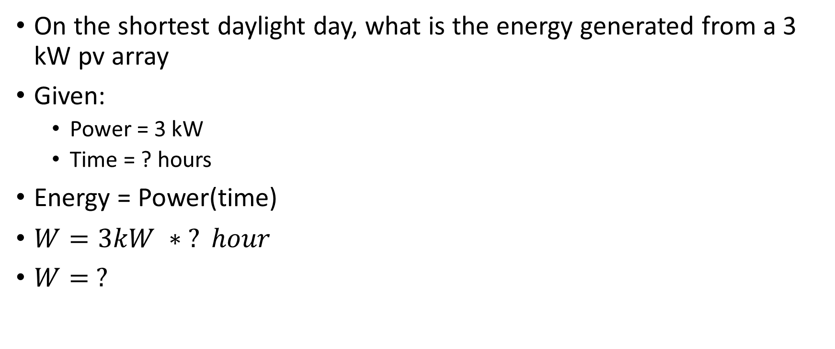
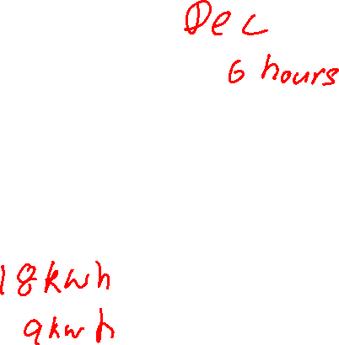
Example
On the shortest daylight day, what is the energy generated from a 3 kW pv array
Given:
  Power = 3 kW
  Time = ? hours
Energy = Power(time)
$W=3kW ∗ ? hour$
$W= ?$
Notes:
Sunrise and sunset times in Belize City (timeanddate.com)
Time = 11 hours

Slide 19
Cost
Billed for energy consumed
Normally specified in $/kWh
Cost = ($/kWh) * (kWh consumed)

Slide 20

Example
A 120 V air conditioning unit draws 12 amps and runs for 6 hours
What is the cost to run for the day
P = 1440 watts
T = 6 hours
Rate = $0.33/kWh
W = P*T
W = 1440 W * 6 hours
P = 8640 Wh or 8.640 kWh
Cost = 0.864 kWh * $0.33/kWh
Total = $2.85/day

Slide 21
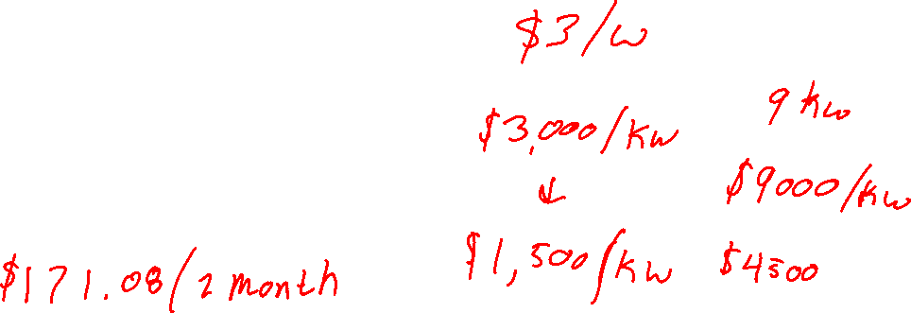
Example
A 120 V air conditioning unit draws 12 amps and runs for 6 hours
What is the cost to run for the month?
Total = $2.85/day
Time = 30 days
Total (month) = $/day * 30 days
Total = $2.85/day * 30 days
Total = $85.54/month

Slide 22

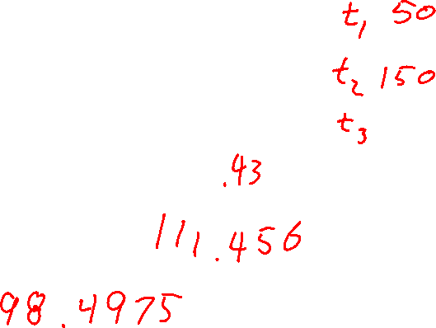
Example
A 120 V air conditioning unit draws 12 amps and runs for 6 hours
What is the cost to run for the month?
kWh used/day = 8.64 kWh
kWh used in a month = 8.64 kWh * 30 days
kWh used in a month = 259.2 kWh
Rate = $0.33/kWh
Total = 259.2 kWh * $0.33/kWh
Total = $85.54 for the month

Slide 23
Electrical Load Sizing
When sizing an off grid system, considerations need to be made for capacity (energy) and peak usage (power)
There must be enough watt-hours or kilowatt-hours to sustain the daily usage and an safety factor/buffer
The inverter must be able to provide the peak usage (power) of the site

Slide 24
Electrical Load
How much power is needed in a day?
Kitchen Loads
  (1) 60 W incandescent light, used 4 hours/day
  (1) 100 W incandescent light, used 2 hours/day
  (1) 700 W microwave, used 0.1 hours/day
Office Loads:
  (2) 15 W LED lights, used 9 hours/day
  (1) 125 W laptop computer, charged 5 hours/day
Notes:
If everything is turned on, how much power do I need?
What component is responsible for this? – Inverter

Slide 25

Electrical Load
Remember, power is the amount of instantaneous load that must be accounted for. This means we must add all the electrical loads together
Kitchen Loads
60 W + 100 W + 700 W = 860 W
Office Loads
15W + 15 W + 125 W = 155 W
Total
860 W + 155W = 1015 W

Slide 26
Electrical Load
How much energy is used in a day?
Kitchen Loads
  (1) 60 W incandescent light, used 4 hours/day
  (1) 100 W incandescent light, used 2 hours/day
  (1) 700 W microwave, used 0.1 hours/day
Office Loads:
  (2) 15 W LED lights, used 9 hours/day
  (1) 125 W laptop computer, charged 5 hours/day
Notes:
If everything is turned on, how much energy do I need?
What component is responsible for this? – Battery

Slide 27
Electrical Load
Remember, energy is the amount of total consumption that must be accounted for. This means we must calculate the energy consumption of each item then add it all together

Slide 28

Electrical Load
Kitchen Loads
60 W * 4 hr/day = 240 Wh
100 W * 2 hr/day = 200 Wh
700 W * 0.1 hr/day = 70 Wh
Office Loads
30 W * 9 hr/day = 270 Wh
125 W * 5 hr/day = 625 Wh
Total
240 Wh + 200 Wh + 70 Whr+ 270 Wh + 625 Wh = 1405 Wh or 1.405 kWh

Slide 29
Electrical Load
What is the current draw at 120V?
Kitchen Loads
  (1) 60 W incandescent light, used 4 hours/day
  (1) 100 W incandescent light, used 2 hours/day
  (1) 700 W microwave, used 0.1 hours/day
Office Loads:
  (2) 15 W LED lights, used 9 hours/day
  (1) 125 W laptop computer, charged 5 hours/day
Notes:
If everything is turned on, how much current do I need?
What component is responsible for this? – Inverter

Slide 30
Electrical Load
Remember that power is voltage * amperage
If we know the power draw, which is 1015 W or 1.015 kW, then we can calculate current
1015 watts/120 volts = 8.46 amps

Slide 31
Resources
Energy Conversion - RapidTables.com
Power Conversion - RapidTables.com
Sunrise and sunset times in Belize City (timeanddate.com)
Rate Schedule - Belize Electricity Limited

