Slide 1
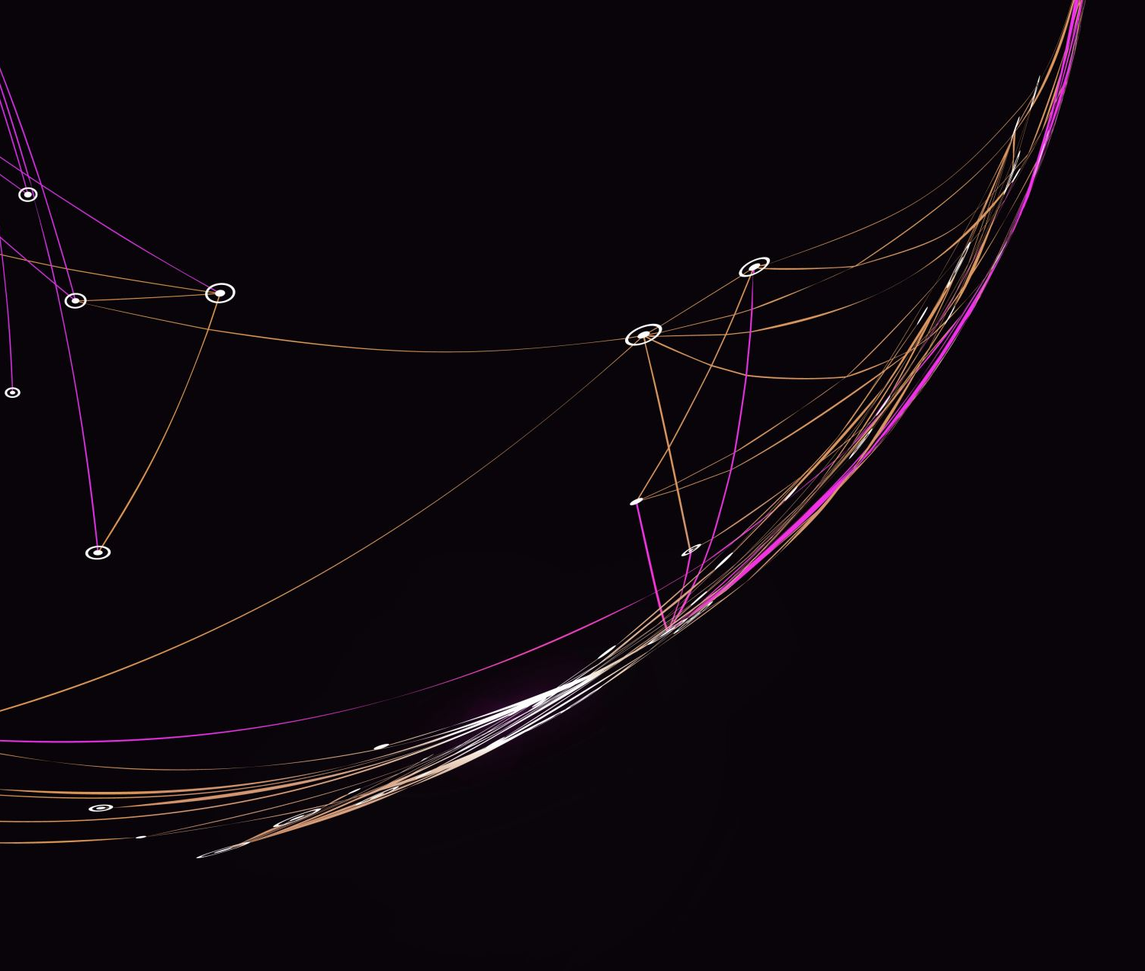
Course 5 – Electricity and Circuits

Slide 2
Objectives
Electric Charge
System Power
System Losses
Energy
Efficiency

Slide 3
Relevancy
To understand the basics of electricity
To promote an engineering mindset

Slide 4
Parts of an Atom
Protons
Electrons
Neutrons
Notes:
Atoms have an equal number of electrons to protons.​
The outer most electron is also called valence electrons. Free electrons are valence electrons that have been separated from the atom. The free electrons cause the “flow” of electricity​
The positive particles are protons while the white neutral particles are neutrons.​
The bulk of the atom’s weight is at the core, where the protons and the neutrons are. The electrons carry very little weight. ​
​
When the electrons and protons are not equal, the atom is known as an ion.​
Energy needs to dislodge a single valence electron is significantly less than it is to dislodge an almost full outer shell.​
​
(SrKellyOP, 2021)​

Slide 5
Properties of Electric Charge
Charge is quantized
Magnitude of charge is independent of type
Charge is conserved
Charge is conserved in closed systems
Notes:
This means that electric charge comes in discrete amounts, and there is a smallest possible amount of charge that an object can have. In the SI system, this smallest amount is 𝑒=1.602𝑥10^(−19) 𝐶. No free particle can have less charge than this, and, therefore, the charge on any object—the charge on all objects—must be an integer multiple of this amount. All macroscopic, charged objects have charge because electrons have either been added or taken away from them, resulting in a net charge.
Phrased another way, the smallest possible positive charge (to four significant figures) is +1.602𝑥10^(−19) 𝐶, and the smallest possible negative charge is -1.602𝑥10^(−19) 𝐶; these values are exactly equal. This is simply how the laws of physics in our universe turned out
Charge can neither be created nor destroyed; it can only be transferred from place to place, from one object to another. Frequently, we speak of two charges “canceling”; this is verbal shorthand. It means that if two objects that have equal and opposite charges are physically close to each other, then the (oppositely directed) forces they apply on some other charged object cancel, for a net force of zero. It is important that you understand that the charges on the objects by no means disappear, however. The net charge of the universe is constant
In principle, if a negative charge disappeared from your lab bench and reappeared on the Moon, conservation of charge would still hold. However, this never happens. If the total charge you have in your local system on your lab bench is changing, there will be a measurable flow of charge into or out of the system. Again, charges can and do move around, and their effects can and do cancel, but the net charge in your local environment (if closed) is conserved. The last two items are both referred to as the law of conservation of charge.

Slide 6
Static Electricity
Electric charge that has accumulated on an object. Static electricity is often created when two objects that are not good electrical conductors are rubbed together, and electrons from one of the objects rub off onto the other. This happens, for example, when combing one's hair or taking off a sweater. Sudden releases of built-up static electricity can take the form of an electric arc.​
(Dictionary.com, 2022)​

Slide 7
Examples of Static Charges and Uses
CRT television screen​
Lightning​
Clothes dryer​
Electrostatic paint sprayer​
Pollution management​
Water ionization​

Slide 8
System Power and System Losses
Also defined as work
A force moving through a distance
Generally, the limiting factor
Measured in watt, a rate of energy conversion
System loss is work that is not usefully converted

Slide 9
Examples of Systems with Losses
Incandescent lightbulb
Cordless drills
Electric stove
Electrical grid
Notes:
Can the students think of where the losses are?

Slide 10
Energy
The ability or capacity to do work
Measured in joules
Electricity producers charge consumers based on kWh used
1 kWh = 3,600,000 joules

Slide 11
Power vs Energy
Power is a snapshot in time
Energy is total power consumed over time
Energy is independent of power
Work and energy have the same base units (joules)
Work is energy used for a task

Slide 12
Power vs Energy Examples
An electricity customer gets billed for 681 kWh used
Is the customer paying for energy or power?

Slide 13
Power vs Energy Examples
An electricity customer gets billed for 681 kWh used
Is the customer paying for energy or power?
The customer is paying for energy

Slide 14
Power vs Energy Examples
A solar panel has a rated output of 330 watts
Is this power or energy?

Slide 15
Power vs Energy Examples
A solar panel has a rated output of 330 watts
Is this power or energy?
This is power
Remember that this is a rate of output

Slide 16
Conversion
Electrical energy is generally obtained from other sources
Mechanical
Chemical
Light
Energy conversion is rarely 100% efficient

Slide 17
Efficiency

Slide 18
Efficiency Examples
A solar panel converts 1300 joules of light energy into 260 joules of electrical energy
What is the efficiency of the panel?

Slide 19
Efficiency Examples

Slide 20
Efficiency Examples

Slide 21
Efficiency Examples

