Slide 1
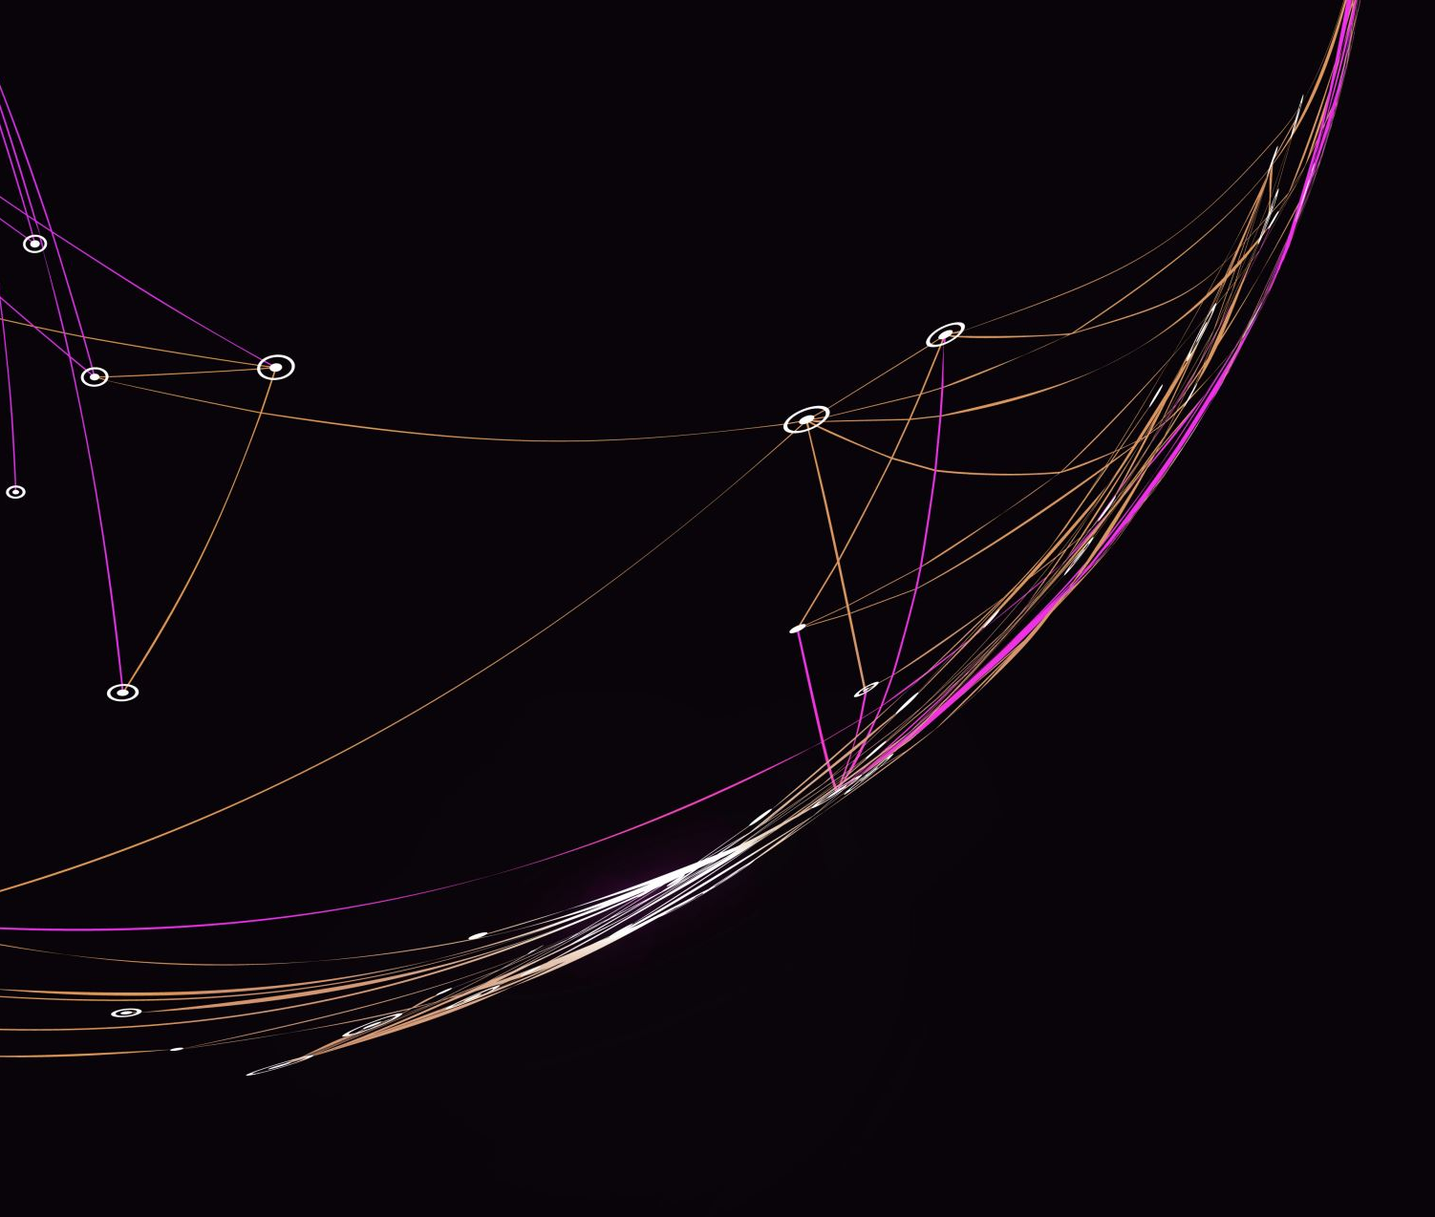
Course 5 – Electricity and Circuits

Slide 2
Objectives
Electrical Quantities
Charge
Voltage
Current
Resistance
Conductance
Power
Energy
Ohm’s Law

Slide 3
Relevancy
To understand the basics of electricity
To promote an engineering mindset

Slide 4
Charge
Electrical property of electrons and protons
Can be compared to volume of water
Base unit is coulomb
1 coulomb = $6.25∗{10}^{18} electrons$
Symbol for charge = Q
Coulomb can be written as a “C”

Slide 5
Current
The flow of electric charge
(Merriam-Webster, n.d.)
The flow of electrons in a specific direction
Electron flow can happen through all states of matter
Symbol for current is I
Measured as 1 coulomb/second or $current \left(I\right)= \frac{charge (Q)}{time(t)}$

Slide 6
Current
(Krol, 2020)

Slide 7
Conventional Flow vs Electron Flow
Conventional flow is positive to negative
Electron flow is negative to positive
Notes:
Conventional Flow vs Electron Flow Explained - Electronics-Lab.com
Conventional Versus Electron Flow | Basic Concepts Of Electricity | Electronics Textbook (allaboutcircuits.com)
Conventional flow is based on the idea of a deficiency in electrons at the negative terminal, therefore current flows from the positive to the negative side
Electron flow is based on the flow of electron charge from the negative terminal to the positive terminal.
Easy method to remember. Electron flow is about electrons, which is negative. Therefore we must be moving the negative to the positive.

Slide 8
Voltage
Electric potential or potential difference expressed in volts
(Merriam-Webster, n.d.)
Voltage is the electrical force that pushes the electrons
Also called electromotive force or potential difference

Slide 9
Voltage
Symbol is V
Base unit is volts
Can be expressed as $voltage \left(V\right)= \frac{energy (W)}{charge (Q)}$
Can has polarity, such as positive or negative

Slide 10
Voltage Analogy
(Krol, 2020)
Notes:
Voltage is the water reservoir. The higher the height, the more force there is behind the water.

Slide 11
Voltage
In your own words, describe voltage

Slide 12
Voltage
Give your own analogy for voltage

Slide 13
Voltage Generation
Voltage can be generated by converting one form of energy into electrical energy, such as:
Mechanical energy
Electric chemical
Heat
Crystals
Solar cells

Slide 14
Voltage Generation
How do you think voltage is generated from each of the following:
Mechanical energy
Electric chemical
Heat
Crystals
Solar cells

Slide 15
Resistance
The opposition a material offers to current
All materials naturally offers resistance which is converted to heat energy
Symbol is R
Base unit of ohms (Ω)
Every material has a specific resistance

Slide 16
Resistance
Conductors generally have low resistance to current
Insulators have high resistance to current
Superconductors have no resistance to current
Semiconductors have medium resistance to current

Slide 17
Resistance

Slide 18
Resistance
Resistance for materials change in relation to its temperature, known as temperature coefficient of resistance
A material’s resistance is determined by its resistivity or specific resistance, which is measurement of how much resistance is present /unit of length
Resistance for any given material can be calculated by $resistance \left(R\right)= \frac{resistivity \left(K\right)∗length (L)}{area (A)}$

Slide 19
Conductance
The ability to conduct current
Inverse of resistance
Denoted with the symbol “G”
$conductance \left(G\right)= \frac{1}{resistance (R)}$

Slide 20
Power
A rate of doing work or using energy
Base unit is $\frac{joule}{sec}$ or watt
$Power \left(P\right)= \frac{energy (W)}{time (t)}$

Slide 21
Energy
The ability to do work
Base unit is watt-second or joule
$energy \left(W\right)=power \left(P\right)∗time (t)$
1 joule is = 1 wattsecond
1kWh = 3.6 million J

Slide 22
Power and Energy Example
A solar panel array produced 3.2 kWh today
Is this power or energy?

Slide 23
Power and Energy Example
A solar panel array produced 3.2 kWh today
Is this power or energy?
This is energy
Remember that energy is total production with a time component

Slide 24
Power and Energy Example
A solar array produces 18 kWh in 3 hours
What is the power production of the array?

Slide 25
Power and Energy Example
A solar array produces 18 kWh in 3 hours
What is the power production of the array?
The power production is 6 kW

Slide 26
Electricity vs Water Comparison
Charge = Volume of water
Voltage = Pressure
Current = Pipe size
Resistance = Constriction or obstruction
Power = Reservoir (when opened = instantaneous energy, which is power)
Cell/battery = Reservoir (stored energy)

Slide 27
Electric Plumbing Analogy
Notes:
Electric Plumbing Analogy and Static Electricity - Live Sound Education
water-analogy.png (857×305) (sound.education)

Slide 28
Ohm’s Law

