Slide 1
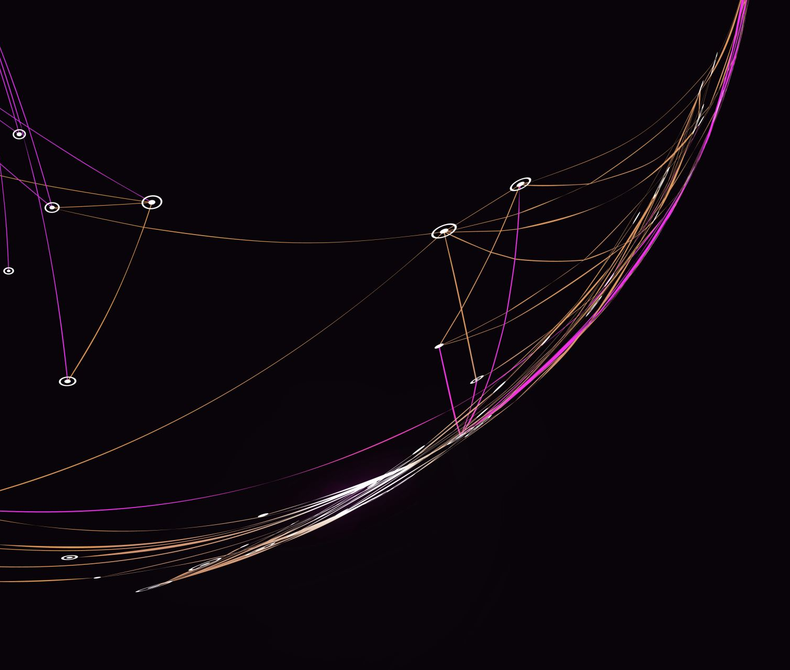
Course 5 – Electricity and Circuits

Slide 2
Objectives
Circuit symbols
Calculating electrical quantities
Measuring electrical quantities
Identifying circuits
Measuring circuits

Slide 3
Relevancy
To understand the basics of electricity
To promote an engineering mindset
NABCEP PV Associate certification
CVQ level 2

Slide 4
Circuits
Energy source – to provide voltage
Conductors – to allow current to flow
Insulators – to confine current to desired path
Load – to convert electrical energy to desired energy
Control device – to start or stop the flow of current
Protection device – to protect circuit during a malfunction

Slide 5
Circuits
Provide an example of:
Energy Source
Conductors
Insulators

Slide 6
Circuits
Provide an example of:
Load
Control device
Protection device

Slide 7
Circuits
Based on the previous list:
which components are essential
Which components are not essential

Slide 8
Schematic Diagram
Cell
Switch
Wire
Lamp

Slide 9
Lamp Circuit
This Photo by Unknown Author is licensed under CC BY-NC-ND
Notes:
Diagram of a simple circuit. Future circuits could be more complex. Knowing how to connect the real circuit and follow the schematics is paramount to success as a PV installer.

Slide 10
Discussion
Should we have protection devices?
Are there benefits to having/using protection devices?

Slide 11
Electrical Symbols
(Wikibooks, 2005)
Notes:
These are the common electrical symbols. There will be more when we have the smaller sessions.
(Wikibooks, 2005)

Slide 12
Electrical Quantities
Ohm’s law $current \left(I\right)=\frac{voltage (V)}{resistance (R)}$
Watt’s law (power law) $Power \left(P\right)=current \left(I\right)∗voltage (V)$

Slide 13
Electrical Laws
Resistance in a wire relationship
Ohm's law relationship
(Rider, 2012)
Notes:
(Rider, 2012)
Power loss (I2R)
Wire resistances
Maximum Power Transfer Theorem
Very often we come across various real time circuits that works based on maximum power transfer theorem. For effective way of connecting source to load, an impedance matching transformer is used.
In case of solar photovoltaic (PV) systems, Maximum Power Point Tracking (MPPT) is achieved with incremental conductance method (ICM) in which the load resistance must be equal to the output resistance of the PV panel and Solar Cell

Slide 14
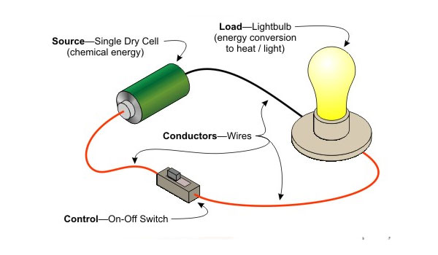
Calculating Electrical Quantities
If the circuit on the right is powered by 1.5 volt cell and has a current of 200 milliamp, what is the circuit resistance?
This Photo by Unknown Author is licensed under CC BY-NC-ND

Slide 15
Calculating Electrical Quantities
If the circuit on the right is powered by 1.5 volt cell and has a current of 200 milliamp, what is the circuit resistance?
$$R=\frac{V}{I}$$
$$R=\frac{1.5 volts}{0.2 amps}$$
$$R=7.5 Ω$$
This Photo by Unknown Author is licensed under CC BY-NC-ND

Slide 16
Calculating Electrical Quantities
An customer has a 8 watt LED light on for 24 hours of the day.
How much energy did the light use?

Slide 17
Calculating Electrical Quantities
An customer has a 8 watt LED light on for 24 hours of the day.
How much energy did the light use?
$Energy=Power∗time$

Slide 18
Calculating Electrical Quantities
An customer has a 8 watt LED light on for 24 hours of the day.
How much energy did the light use?
$Energy=Power∗time$
$Energy=8 watts ∗24 hours$

Slide 19
Calculating Electrical Quantities
An customer has a 8 watt LED light on for 24 hours of the day.
How much energy did the light use?
$Energy=Power∗time$
$Energy=8 watts ∗24 hours$
$Energy=192 watthours or 0.192 kWh$

Slide 20
Calculating Electrical Quantities
An customer has a 8 watt LED light on for 24 hours of the day.
How much did the customer pay the utility company?

Slide 21
Calculating Electrical Quantities
An customer has a 8 watt LED light on for 24 hours of the day.
How much did the customer pay the utility company?
$Cost=energy∗rate$

Slide 22
Calculating Electrical Quantities
An customer has a 8 watt LED light on for 24 hours of the day.
How much did the customer pay the utility company?
$Cost=energy∗rate$
$Cost=0.192 kWh∗\frac{\$0.33}{kWh}$

Slide 23
Calculating Electrical Quantities
An customer has a 8 watt LED light on for 24 hours of the day.
How much did the customer pay the utility company?
$Cost=energy∗rate$
$Cost=0.192 kWh∗\frac{\$0.33}{kWh}$
$Cost=\$0.06336$

Slide 24
Measuring Electrical Quantities
Voltage is measured in parallel
Current is measured in series
Resistance is measured in parallel with power off
A multimeter has the capability to do multiple functions

Slide 25
Measuring Electrical Quantities

Slide 26
Circuits
Series
Parallel
Series-Parallel

Slide 27
Series and Parallel Circuits
Notes:
Voltage dropped by each load is equivalent to the load’s resistance (Kirchoff’s voltage law)
Current is fixed throughout the whole circuit. The current is measuring the total resistance in the circuit
Resistance is added together for each load to find total resistance
Voltage is summative
Current is fixed
Resistance is summative
Power is summative
Voltage in parallel is the same for every parallel branch
Current is the sum of all individual parallel branches (Kirchoff’s current law)
Current can be estimated by using the lowest resistor
Resistance is calculated with the above formula
Total resistance will always be lower than the lowest branch resistance
Voltage is fixed
Current is summative
Resistance is calculated via reciprocal formula
Power is summative
(cnxuniphysics, n.d.)

Slide 28
Series-Parallel
A combination of a series and parallel circuit
This example is relatively simple
This Photo by Unknown Author is licensed under CC BY
Notes:
Resistors can be reduced to a single equivalent resistance by calculating equivalent resistance for each branch or series resistance
Do exercise:
Add more resistors in branch circuit and ask if Req works – kind of how micro-inverters work
Add more resistors in the bottom combined line and ask if Req works – kind of how a string inverter works
(cnxuniphysics, n.d.)

Slide 29
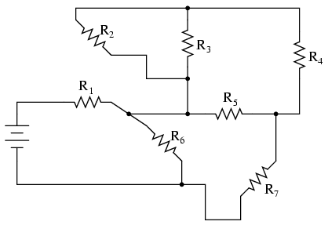
Series-Parallel
A combination of a series and parallel circuit
This example is more difficult
Notes:
Resistors can be reduced to a single equivalent resistance by calculating equivalent resistance for each branch or series resistance
Do exercise:
Add more resistors in branch circuit and ask if Req works – kind of how micro-inverters work
Add more resistors in the bottom combined line and ask if Req works – kind of how a string inverter works
(cnxuniphysics, n.d.)

Slide 30
How is it Connected?
This Photo by Unknown Author is licensed under CC BY-SA
This Photo by Unknown Author is licensed under CC BY-SA
Notes:
House can be connected one or both ways. We can’t tell, which is why we need to know
(Joshua M. Pearce, Lonny Grafman, TyMuho, Megan Moore, Felipe Schenone, Pedro Kracht, 2016)

