Slide 1
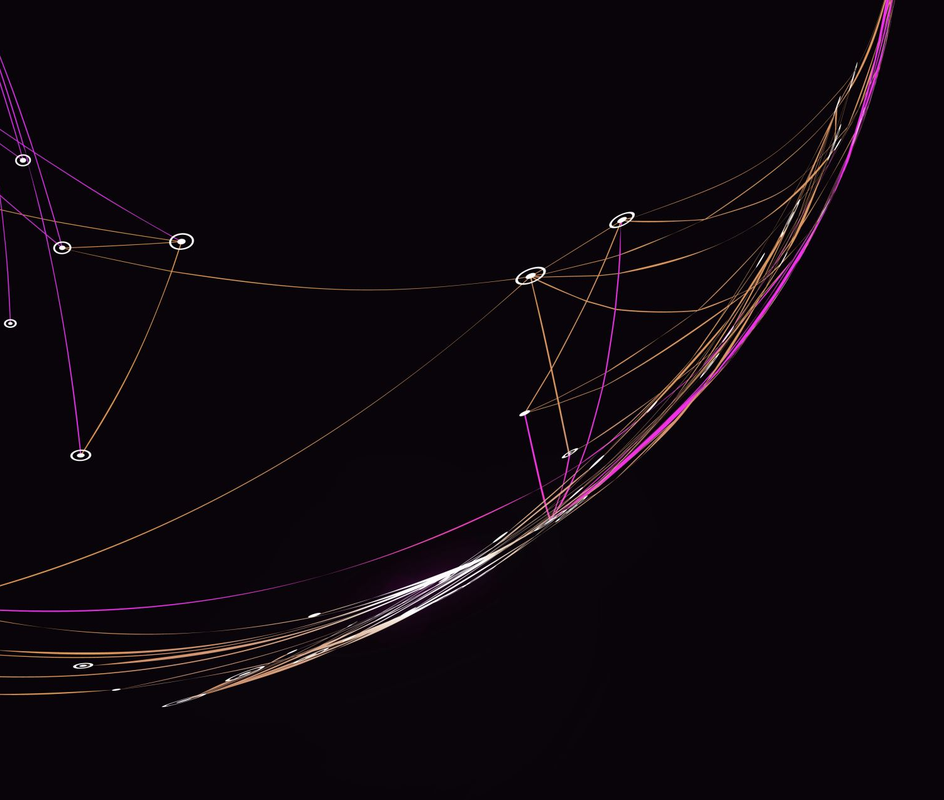
Course 5 – Electricity and Circuits

Slide 2
Objectives
Circuit components
Cells/batteries
Loads
Resistors
Switches
Wires
Overcurrent
Protection devices

Slide 3
Relevancy
To understand the basics of electricity
To promote an engineering mindset
NABCEP PV Associate certification
CVQ level 2

Slide 4
Cells
An electrochemical device consisting of two electrodes made of different materials and an electrolyte
Voltage is produced when a chemical reaction occurs between the electrodes and electrolyte

Slide 5
Battery
Consists of two or more cells electrically connected together and packaged as a single unit
Often used to refer to multi-cell or single cell

Slide 6
Types of Cells
Lead-acid
Nickel-cadmium (NiCd)
Carbon-zinc
Alkaline-manganese dioxide
Lithium

Slide 7
Cells and Batteries
Normally classified as primary or secondary
Primary types have a non-reversible reaction
Secondary types have a reversible reaction (rechargeable)
Also classified as dry and wet cell
Dry cells contain either a paste or gel electrolyte
Wet cells must be used upright
All batteries have an internal resistance

Slide 8
Primary vs Secondary
Primary cells are single use
Alkaline
Carbon-zinc
Rechargeable cells can be recharged
Lithium-ion
Lead-acid
Nickel-cadmium

Slide 9
Dry vs Wet Cells

Slide 10
Cell Comparison
These are some of the cells that you may come across in photovoltaics
(Sailors for the Sea, 2016)
Notes:
Batteries-01_0.png (560×310) (sailorsforthesea.org)
(Sailors for the Sea, 2016)

Slide 11
Ratings
Capacity of a cell/battery is rated in ampere-hours (Ah)
Capacity can change based on:
Temperature
Current drain
Discharge schedule
Final output voltage
With a specified voltage, watt-hours can be calculated

Slide 12
Lighting Loads
Incandescent
CFL
Miniature lamps
LEDs
Neon
Fluorescent

Slide 13
Types of Resistors
Carbon-composition
Wire-wound
Cermet
Deposited-film
Conductive-plastic
Surface-mount

Slide 14
Switches
SPST – single pole single throw
SPDT – single pole double throw
DPST – double pole single throw
DPDT – double pole double throw
Rotary

Slide 15
Wires and Cables
Solid
Stranded
Romex
Metallic
TC
Wire gauge

Slide 16
Overcurrent

Slide 17
Protection Devices
Fuses
Circuit breakers
Fuse resistor
Voltage sensitive/voltage dependent resistor

