Slide 1
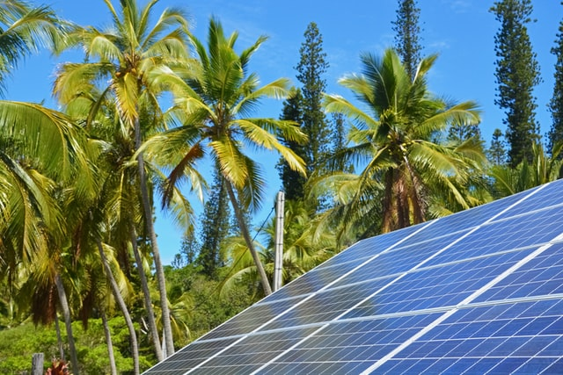
Design and Implementation of Pilot of a TVET Renewable Energy Course
DELIVERABLE #5 - TRAINING COURSES & PROFESSIONAL DEVELOPMENT
Session 31 (07 October 2022) – C09 Electricity and Circuits 2

Slide 2
Topics
Understand the battery as a source of electricity.
Understand series and parallel connections for batteries.
Describe the different types of batteries used in RE systems.
Understand magnetism, motors and generators.
Understand how the electric grid operates related to small RE systems

Slide 3
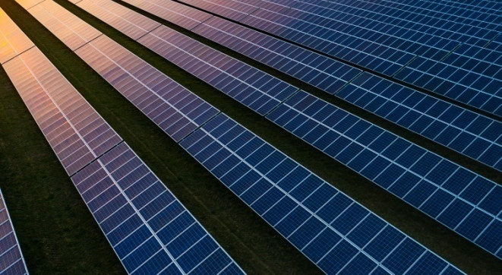
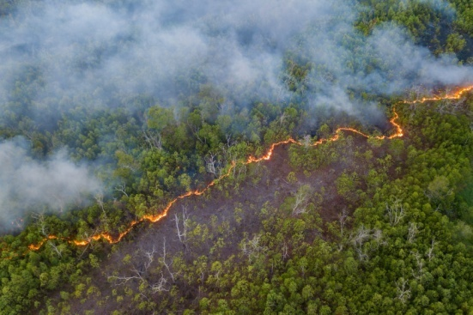
2. Term 2 Course Introductions
C 09: Electricity and Circuits 2
Elec. Cir. 2 (in Calendar Table)
Introduce the battery as a resource of stored electricity
Series & parallel connections for batteries & PV panels
List the types of batteries
Understand magnetism, motors and generators
Introduce alternating current (AC), voltage, and power
Understand types of wire and cable

Slide 4
2. Term 2 Course Introductions
C 09: Electricity and Circuits 2
Examples of anticipated outcomes after course completion
Review & identify, existing & potential, wire & cable sizes
Review & identify from drawings and at a customer’s house, the battery type(s) with connections to PV panels
Demonstrate understanding of how direct current from a PV panel source can become alternate current in a home Plan and use portable generators at customer’s home

Slide 5
2. Term 2 Course Introductions
C 09: Electricity and Circuits 2
Instructor Comments?
Instructor Discussion?
Instructor Suggestions?
“Real World” Applications?

Slide 6
Relevancy
Understanding the impact of electrical
To promote an engineering mindset

Slide 7
Why Batteries?

Slide 8
Terminology
Cycle – a complete discharge and recharge of the battery
Cycle life – the quantity of cycles the battery can endure
Capacity – amount of energy stored measured in Watt-hours
Specific gravity – ratio of density to a reference material

Slide 9
Terminology
Self-discharge - how much the battery discharges without load
Gassing – when charging is faster than absorption, which produces heat
Thermal runaway – When a battery charges too fast and generates excess heat
Sulfation – excess buildup of lead sulfate to plates
Equalization – A process to decrease sulfation on plates

Slide 10
Terminology
Peak load – the power required to start the load
Average load – the power it takes to keep a load running
Duty Cycle – also called depth of discharge
Inverter – converts DC to AC

Slide 11
What is a Battery?
An electrochemical energy storage
Converts chemical energy to electrical energy
Has a positive and negative terminal

Slide 12
Parts of a battery
This Photo by Unknown Author is licensed under CC BY

Slide 13
Types of Batteries
Lead acid
Flooded
Sealed
Lithium
Lithium-ion
Lithium-Iron-Phosphate

Slide 14
Flooded Lead Acid
Wet cell
Cheap
Requires ventilation
Low depth of discharge (DoD) @ 50%
Upright storage
Low cycle life
Requires regular maintenance

Slide 15
Absorbent Glass Mat (AGM)
More expensive the lead acid
Cheaper than lithium
Capable of 80% DOD
Maintenance free
Low cycle life

Slide 16
Lithium-Ion
Requires little maintenance
Expensive
Higher energy density (150-200 Wh/kg
High depth of discharge
Little thermal protection

Slide 17
Lithium Iron Phosphate (LiFePO₄)
Requires little maintenance
Expensive
High energy density (90-120 Wh/kg)
High depth of discharge
Safer from thermal runaway

Slide 18
Thermal Runaway

Slide 19
Questions?

Slide 20
Connections
Series
Parallel
Series-parallel

Slide 21
Rooftop Trainer
AC Disconnect
240 VAC
< 10 amp
To Lab High Voltage Trainer
Trenched conduit
PV 1: 60 cell
250 – 350 W
μ inverter
PV 2
μ inverter
PV 3
μ inverter
PV 4
μ inverter
PV 5
μ inverter
PV 6
μ inverter
Terminator

Slide 22
Rooftop Trainer
DC Disconnect/
Combiner
150 DC
Circuit Breakers
To Lab High Voltage Trainer
Trenched conduit
PV 1: 60 cell
250 – 350 W
PV 2
PV 3
PV 4
PV 5
PV 6

Slide 23
Magnets

Slide 24
Induced Voltage
•
X
Voltage is induced when conductors cut lines of flux.
Green arrow shows direction of conductor movement.
Dot and X show direction of current caused by voltage.
No voltage is induced when conductors move parallel
to the to the lines of flux.

Slide 25
Sine Wave Generation

Slide 26
Sine Wave

Slide 27
Voltage Generation

Slide 28
Questions?

Slide 29
Power Generation
A hydroelectric turbine converts the kinetic energy to electricity

Slide 30
Power Generation

Slide 31
Power Generation

Slide 32
Power Generation

Slide 33
Delta Connections
Line 1
Phase 1
Phase 2
Line 2
Phase 3
Line 3
Delta-Connected Source
Delta-Connected Load
The sum of the instantaneous
phase voltages equals zero.
Each load resistor will be
connected to one of the phases.
For the delta-to-delta connection, V_{line} = V_{phase} = V_{load}.
For the delta-to-delta connection, I_{line} = 1.732 I_{phase} = 1.732 I_{load}.

Slide 34
Wye Connections
Line 1
Line 2
Phase 1
Phase 2
Phase 3
Line 3
Wye-Connected Source
Wye-Connected Load
For the wye-to-wye connection with a balanced load:
I _{line} = I_{phase} = I_{load}.
V_{line} = 1.732 V_{phase} = 1.732 V_{load}.
There is no voltage between the source and load star-points.

Slide 35
Electric Motor
Like a generator
Uses electricity to provide drive load

Slide 36
Questions?

