Slide 1
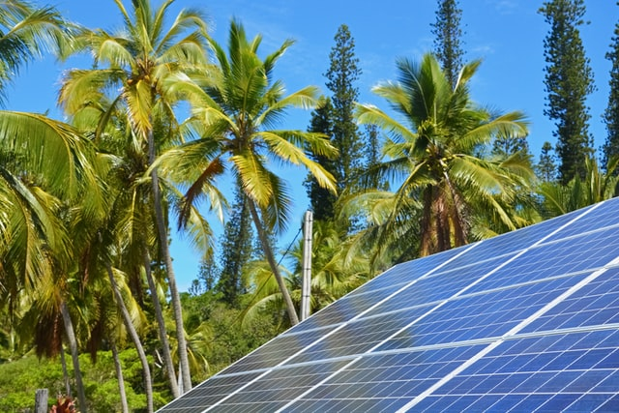
Design and Implementation of Pilot of a TVET Renewable Energy Course
DELIVERABLE #5 - TRAINING COURSES & PROFESSIONAL DEVELOPMENT
Session 33 (21 October 2022) – C09 Electricity and Circuits 2

Slide 2
Topics
Review of last topics
Understand wye connection transformers
Understand delta connection transformers
Understand grounding, bonding, and cables

Slide 3
Relevancy
Understanding the impact of electrical
To promote an engineering mindset

Slide 4
Review
Understand the battery as a source of electricity.
Understand series and parallel connections for batteries.
Describe the different types of batteries used in RE systems.
Understand magnetism, motors and generators.
Understand how the electric grid operates related to small RE systems

Slide 5
Terminology
Name some terms that would be found
Notes:
Cycle – a complete discharge and recharge of the battery
Cycle life – the quantity of cycles the battery can endure
Capacity – amount of energy stored measured in Watt-hours
Specific gravity – ratio of density to a reference material
Self-discharge - how much the battery discharges without load
Gassing – when charging is faster than absorption, which produces heat
Thermal runaway – When a battery charges too fast and generates excess heat
Sulfation – excess buildup of lead sulfate to plates
Equalization – A process to decrease sulfation on plates
Peak load – the power required to start the load
Average load – the power it takes to keep a load running
Duty Cycle – also called depth of discharge
Inverter – converts DC to AC

Slide 6
Why Batteries?

Slide 7
Questions?

Slide 8
Delta Connections
Line 1
Phase 1
Phase 2
Line 2
Phase 3
Line 3
Delta-Connected Source
Delta-Connected Load
The sum of the instantaneous
phase voltages equals zero.
Each load resistor will be
connected to one of the phases.
For the delta-to-delta connection, V_{line} = V_{phase} = V_{load}.
For the delta-to-delta connection, I_{line} = 1.732 I_{phase} = 1.732 I_{load}.

Slide 9
Wye Connections
Line 1
Line 2
Phase 1
Phase 2
Phase 3
Line 3
Wye-Connected Source
Wye-Connected Load
For the wye-to-wye connection with a balanced load:
I _{line} = I_{phase} = I_{load}.
V_{line} = 1.732 V_{phase} = 1.732 V_{load}.
There is no voltage between the source and load star-points.

Slide 10
Delta Systems
4 wire system
Typically more reliable
Requires more insulation
More expensive
Floating neutral
Can’t provide 120 volts
High amperage

Slide 11
Delta System
5 wire system
Moderate reliability
Requires more insulation
More expensive
Prone to single phase shorts
Requires more knowledge
Difficult to balance load

Slide 12
Delta System
Can deliver 120-V single-phase
Can deliver 240-V single-phase
Can deliver 240-V three-phase

Slide 13
Wye System
5 wire system
Typically less reliable
Requires less insulation
Less expensive
Can easily be adapted
Can balance loads
High voltage

Slide 14
Mixed Transformers
Notes:
Typically used as step down transformer for medium to low voltage
Normally seen in distribution substations

Slide 15
Mixed Transformers
Notes:
Step up transformer
Normally seen in generation stations

Slide 16
Questions?

Slide 17
Grounding
OSHA (Occupational Safety Health Administration)
NFPA (National Fire Protection Association)
ANSI/ISA (American National Standards Institute and Instrument Society of America)
TIA (Telecommunications Industry Association)
IEC (International Electrotechnical Commission) »
CENELEC (European Committee for Electrotechnical Standardization)
IEEE (Institute of Electrical and Electronics Engineers)

Slide 18
Grounding
A conducting connection, whether intentional or accidental between an electrical circuit or equipment and the earth, or to some conducting body that serves in place of the earth.
Notes:
Definition from the NEC Article 100

Slide 19
Equipment Grounding
May be called Earthing
Connects non-current carrying part to earth
Can have it not ungrounded
Can connect neutral as grounding to frame
Can connect ground wire to chassis

Slide 20
Earth Grounding
Connects current carrying part to earth
Typically neutral or ground wire

Slide 21
Impacts to Grounding
Ground rod
Ground clamp
Soil conductivity
Cable capacity

Slide 22
Grounding

Slide 23
Grounding

Slide 24
Question
Where would you see the grounding for a PV array

Slide 25
Questions?

Slide 26
Grounding

Slide 27
Grounding

Slide 28
Grounding

Slide 29
Bonding
The practice of connecting conductive objects to the grounding conductor
Needed when conductive metal can become energized
Needed for exposed metals to dissipate static electricity

Slide 30
Bonding

Slide 31
Bonding

Slide 32
Bonding

