Slide 1
Design and Implementation of Pilot of a TVET Renewable Energy Course
DELIVERABLE #5 - TRAINING COURSES & PROFESSIONAL DEVELOPMENT
Session 31 (07 October 2022) – C09 Electricity and Circuits 2

Slide 2
Topics
Labs for Electricity and Circuits 2

Slide 3
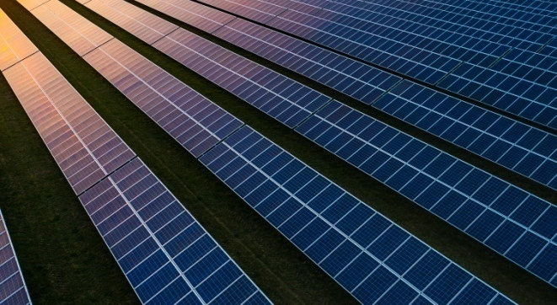
2. Term 2 Course Introductions
C 09: Electricity and Circuits 2
Elec. Cir. 2 (in Calendar Table)
Introduce the battery as a resource of stored electricity
Series & parallel connections for batteries & PV panels
List the types of batteries
Understand magnetism, motors and generators
Introduce alternating current (AC), voltage, and power
Understand types of wire and cable

Slide 4
2. Term 2 Course Introductions
C 09: Electricity and Circuits 2
Examples of anticipated outcomes after course completion
Review & identify, existing & potential, wire & cable sizes
Review & identify from drawings and at a customer’s house, the battery type(s) with connections to PV panels
Demonstrate understanding of how direct current from a PV panel source can become alternate current in a home Plan and use portable generators at customer’s home

Slide 5
12 V Trainer
Circuit Breaker
Charge Controller
30 amp
Display
Circuit Breaker
DC Loads
ATO
Fuses
PV Panel
120 to
170 W
Max Isc 10 amp
36 cell
PV Panel
120 to
170 W
Max Isc 10 amp
36 cell
Circuit Breaker
GFCI
Inverter
600 W
12 VDC
AC Loads
Circuit Breaker
Plug Load Meter
Shunt
Fuse
Battery
12 VDC
AGM
90 – 110 Ahr
Digital Multimeter

Slide 6
48V Trainer
To microinverters
Disconnect
Grid / Lab Panel
3Ph or split phase???
150 VDC Max MPPT
Charge Controller
80 Amp
Disconnect
Inverter/ Charger
2000 W
48 VDC
with
Inverter
Remote
Communication
Battery
48 VDC
AGM
90 Ahr
From small trainers
Shunt
Circuit Breaker
Circuit Breaker
Circuit Breaker
Ground Fault
150 VDC
80 A
Plug Load Meter
Digital Multimeter
AC Load
Panel
To combiner

Slide 7
Rooftop Trainer
AC Disconnect
240 VAC
< 10 amp
To Lab High Voltage Trainer
Trenched conduit
PV 1: 60 cell
250 – 350 W
μ inverter
PV 2
μ inverter
PV 3
μ inverter
PV 4
μ inverter
PV 5
μ inverter
PV 6
μ inverter
Terminator

Slide 8
Rooftop Trainer
DC Disconnect/
Combiner
150 DC
Circuit Breakers
To Lab High Voltage Trainer
Trenched conduit
PV 1: 60 cell
250 – 350 W
PV 2
PV 3
PV 4
PV 5
PV 6

Slide 9
Lab – AC Circuits
Voltage
Current
Resistance
Component testing
Notes:
To be completed on 12v trainer

Slide 10
12 V Trainer
Circuit Breaker
Charge Controller
30 amp
Display
Circuit Breaker
DC Loads
ATO
Fuses
PV Panel
120 to
170 W
Max Isc 10 amp
36 cell
PV Panel
120 to
170 W
Max Isc 10 amp
36 cell
Circuit Breaker
GFCI
Inverter
600 W
12 VDC
AC Loads
Circuit Breaker
Plug Load Meter
Shunt
Fuse
Battery
12 VDC
AGM
90 – 110 Ahr
Digital Multimeter
Notes:
Measure voltage at every circuit breaker
Measure voltage and current from every PV panel
Measure combined voltage and current from PV panels
Match measurement to charge controller
Redo above exercise twice, once with shading, and another time with different angle
Current can be measured with shunt connector
Redo complete lab with loads connected and no loads connected.
When no loads are connected, resistance/continuity should also be tested to see if components are functional.

Slide 11
Lab – PV Systems AC/DC
Familiarization with where AC is present in PV systems
Familiarization with where DC is present in PV systems
Expectations from measurements
No power when circuit breaker and disconnects engaged
MPPT Controller has no power if ground fault breaker engaged
Notes:
To be completed with 48V system

Slide 12
48V Trainer
To microinverters
Disconnect
Grid / Lab Panel
3Ph or split phase???
150 VDC Max MPPT
Charge Controller
80 Amp
Disconnect
Inverter/ Charger
2000 W
48 VDC
with
Inverter
Remote
Communication
Battery
48 VDC
AGM
90 Ahr
From small trainers
Shunt
Circuit Breaker
Circuit Breaker
Circuit Breaker
Ground Fault
150 VDC
80 A
Plug Load Meter
Digital Multimeter
AC Load
Panel
To combiner

Slide 13
Lab – Cable Sizing and Grounding
Wire sizing
String connection in parallel
Microinverters
Grounding
Wire size
How to ground
Where to ground
Notes:
To be completed with rooftop trainers
Practical exercise about the wire sizing required for different wire sizing
If a certain type of cable/wire is not available, what other options are present?

Slide 14
Rooftop Trainer
AC Disconnect
240 VAC
< 10 amp
To Lab High Voltage Trainer
Trenched conduit
PV 1: 60 cell
250 – 350 W
μ inverter
PV 2
μ inverter
PV 3
μ inverter
PV 4
μ inverter
PV 5
μ inverter
PV 6
μ inverter
Terminator

Slide 15
Rooftop Trainer
DC Disconnect/
Combiner
150 DC
Circuit Breakers
To Lab High Voltage Trainer
Trenched conduit
PV 1: 60 cell
250 – 350 W
PV 2
PV 3
PV 4
PV 5
PV 6

