Slide 1
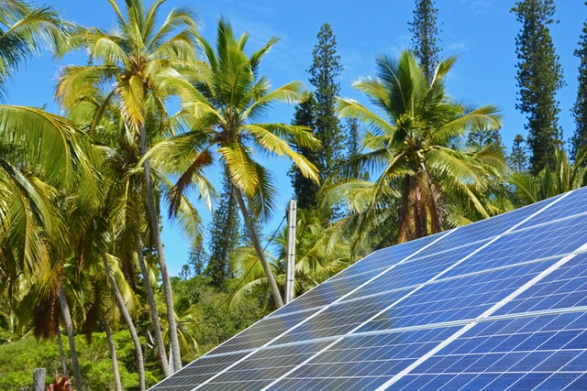



Design and Implementation of Pilot of a TVET Renewable Energy Course
DELIVERABLE #5 - TRAINING COURSES & PROFESSIONAL DEVELOPMENT

Slide 2
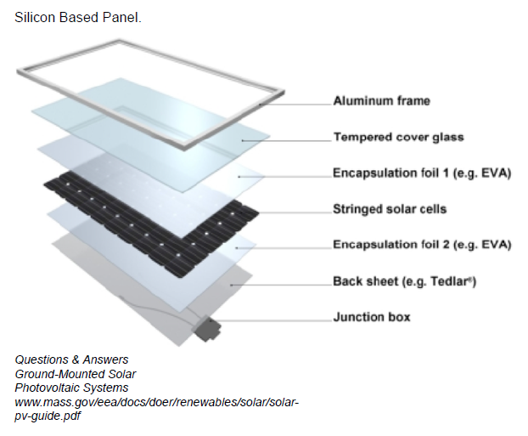

PV Panel Construction
This module will explore the layers that make up today’s PV panels.

Slide 3
PV Panel Construction
The layers are:
  Glass top,
  Cells,
  Encapsulant,
  Backing,
  Junction box,
  Aluminum frame.

Slide 4
PV Panel Construction
Questions?

Slide 5
PV Panel Construction
The glass top has the job of allowing light in the panel.
Some of the qualities of the glass to do that, are strength and a high transmissive quality.
Transmittance is the measure in percentage of how much light goes through an object. 90% is normal for solar applications.

Slide 6
PV Panel Construction
The glass needs to allow as much sunlight through as possible.
In order to do this the glass is made up of less iron than most other types of glass.
This low iron glass lets approximately 5 percent more light through.

Slide 7
PV Panel Construction
Another layer is added to the glass that keeps it from being reflective.
This anti-reflective coating can also gives the panel a blueish colour.

Slide 8
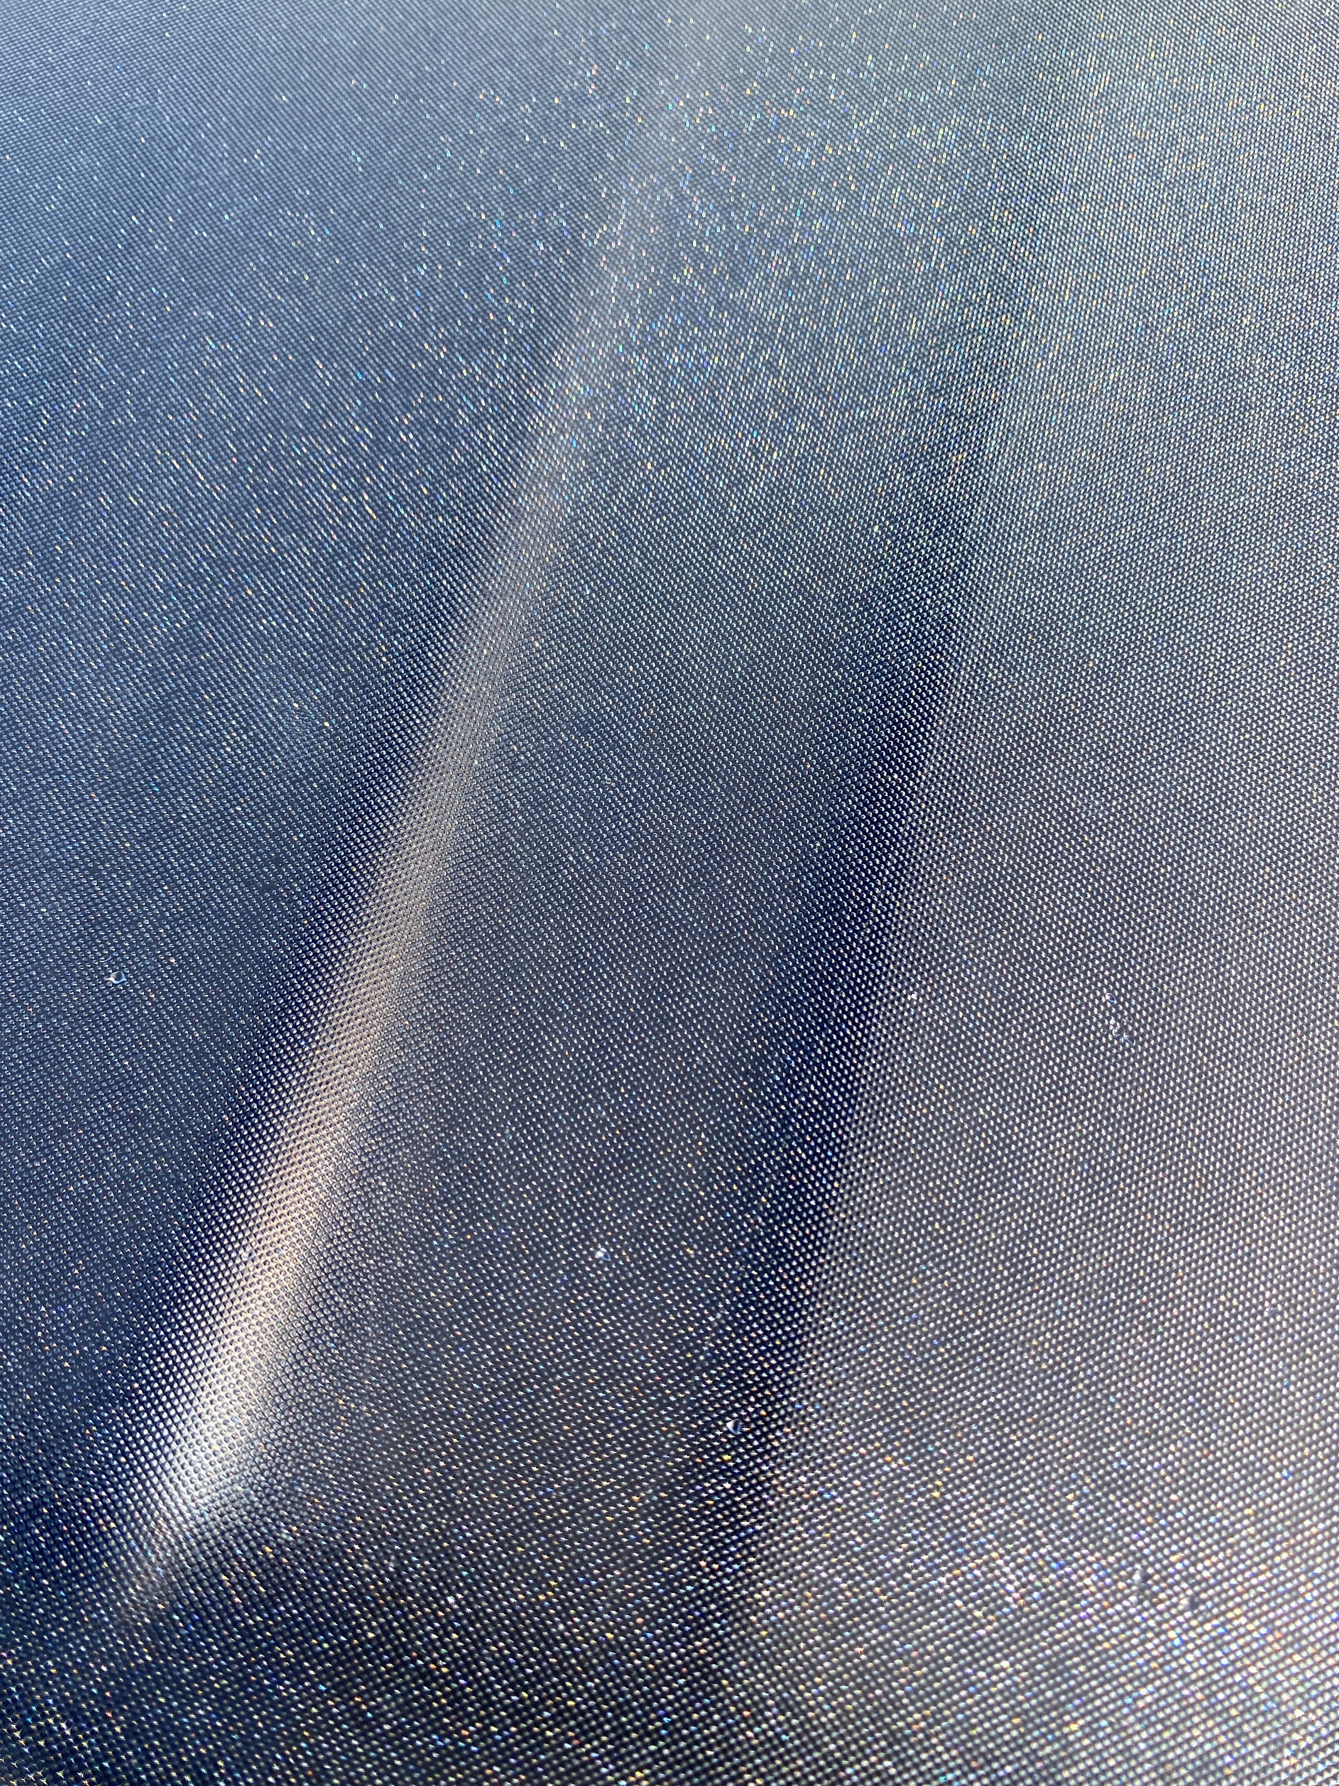
PV Panel Construction
For solar hot water collectors, one of the companies has a diffusion coating to direct the sun shine downwards to the collectors at all angles of incident.
Picture courtesy author

Slide 9
PV Panel Construction
The glass also needs to protect the cells from the outside environment.
Waterproofing is a must.
The glass is sealed to the aluminum frame with silicon caulk or silicon tape.
The silicon is pliable and waterproof.
It also adds an electrical insulation between the glass and the frame.

Slide 10
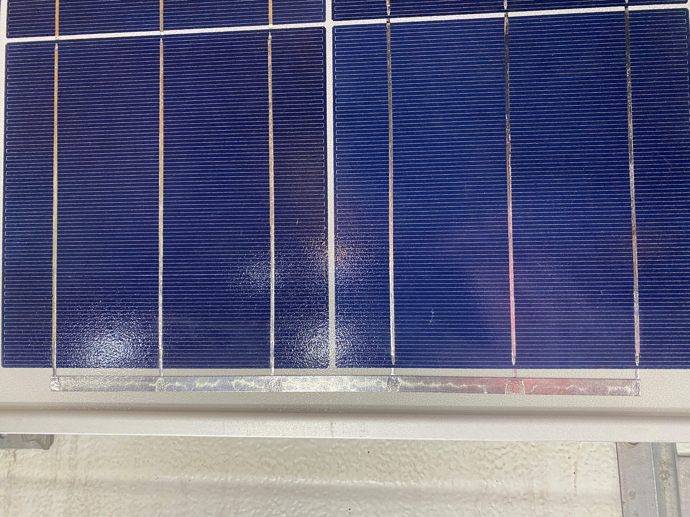
PV Panel Construction
The sealant may not be visible as in the picture below.
One could check to see if there were cracks for maintenance purposes if the sealant was visible.
Picture courtesy author

Slide 11
PV Panel Construction
The glass also needs to be strong enough to protect the cells from debris.
The glass keeps the cells from flexing too much.
They can be walked across with care.
A rock in your boot will cause the glass to shatter.

Slide 12
PV Panel Construction
To make the glass strong it needs to be tempered.
To temper glass the glass needs to be heated and allowed to cool.
This process makes the glass approximately 4 times stronger than non-tempered glass.

Slide 13
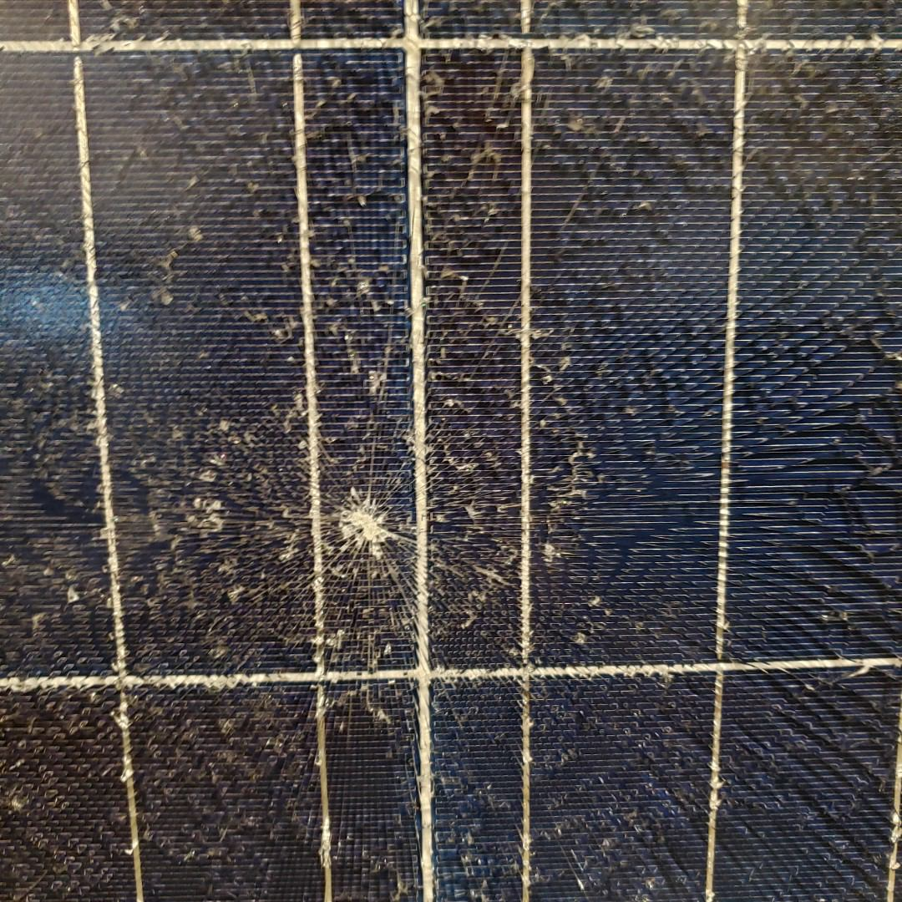
PV Panel Construction
Tempered glass when it does break will not break up into sharp pieces, but rather stay together and keeps the glass from leaving the panel.
Picture courtesy author

Slide 14
PV Panel Construction
Solar panel manufacturers can also provide the amount of force that the front and rear sides can withstand in Pascals or pounds per square foot.
It can be called the mechanical test load.
Also referred to in colder climates as the snow load (front). Also referred to wind load (back).

Slide 15
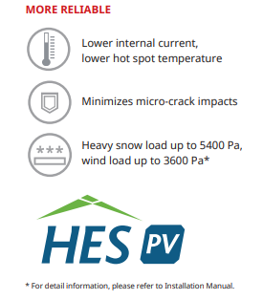
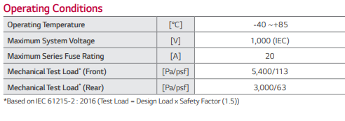
PV Panel Construction
Here are two examples of how this strength of the glass is stated.
Diagrams courtesy HESPV.CA

Slide 16
PV Panel Construction
Questions?

Slide 17
PV Panel Construction
There is a layer called encapsulant that holds the cells in place against the glass and the back sheet.
The technology is not something that as a designer or installer we need to really think about.
There have been encapsulant failures where the cells have been damaged at the edges.

Slide 18
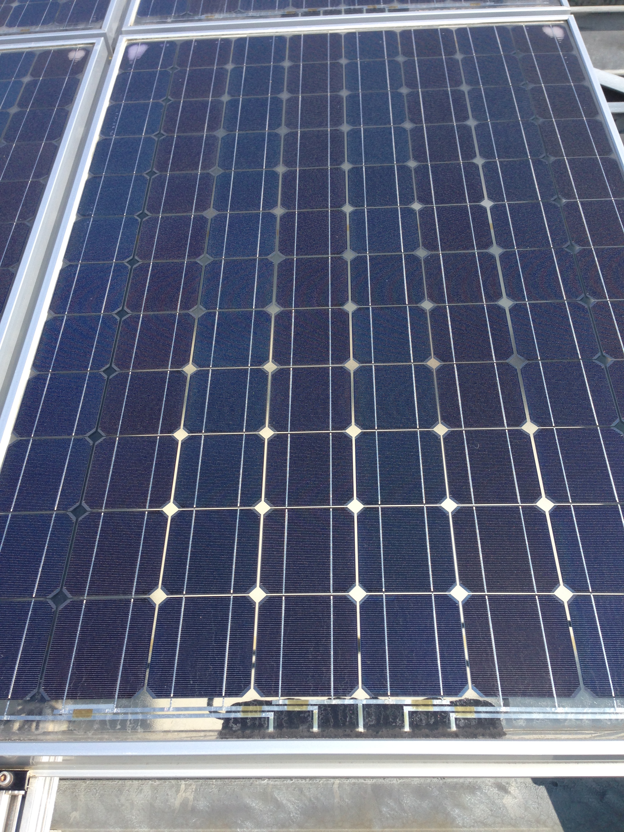
PV Panel Construction
Below is an example of how the encapsulant can fail.
White area when encapsulant failed
Picture courtesy author

Slide 19
PV Panel Construction
Benefits of the encapsulant are:
  improves damp heat and UV stability
  helps eliminate water absorption and water vapour creeping
  protects against cell corrosion
  provides high transmission of light
  adds durability to the panel.
  very thin

Slide 20
PV Panel Construction
Questions?

Slide 21
PV Panel Construction
The next major component is the backing.
It is there to provide a rigid base for the cells to be placed against.
The back panel provides another layer of moisture protection as well.

Slide 22
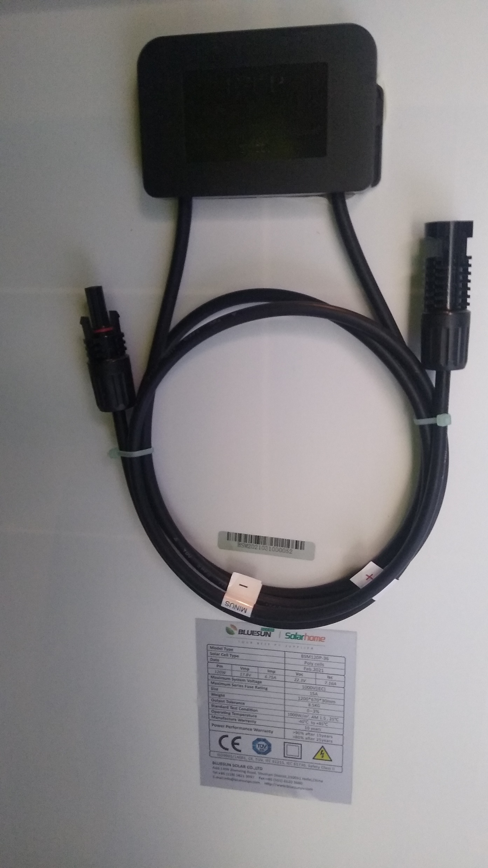
PV Panel Construction
On the back side of the
panel, the backing also
supports the junction box
and the label containing
information about the panel
is affixed to it.
Picture courtesy Mark Miller

Slide 23
PV Panel Construction
In Bi-facial (two sided PV panels) the back sheet is made of glass to allow the reflected light to add to the irradiance.
This can add up to 5 percent extra output of the PV panel.
Picture courtesy author

Slide 24
PV Panel Construction
Notice the see through back panel.
Picture courtesy author

Slide 25
PV Panel Construction
The junction box on the back of the panel is used to provide wire leads to leave the panel.
It also houses the by-pass diodes. The junction box is sometimes filled with a soft gel to keep moisture out. The soft gel can be removed (by scraping) to get access to the diodes.

Slide 26
PV Panel Construction
The junction box with wires.
The wires are UV rated and long enough to reach the next panel. The connectors at the end of the wires are of the MC4 type for the majority of panels produced. Also the polarity is marked on the wire just before the connector.
Picture courtesy Mark Miller

Slide 27
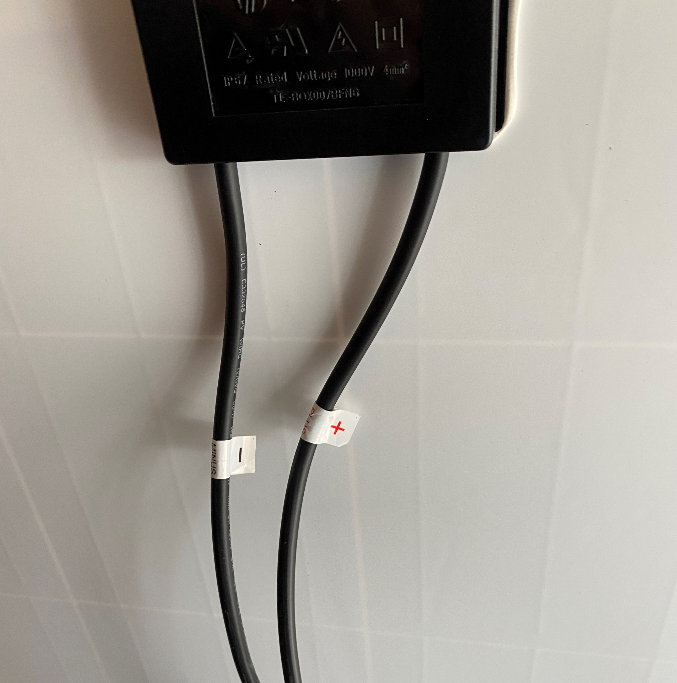
PV Panel Construction
The junction box with wires.
Polarity is indicated.
Picture courtesy Author

Slide 28
PV Panel Construction
The standard connector used is the MC4 type connector.
4 is the 4th revision.
MC stands for the manufacturer Multi-Contact.
The connector. Is water proof, lockable and unique to the solar industry.
It is not to be opened under load.
A special tool is used to unlock them.

Slide 29
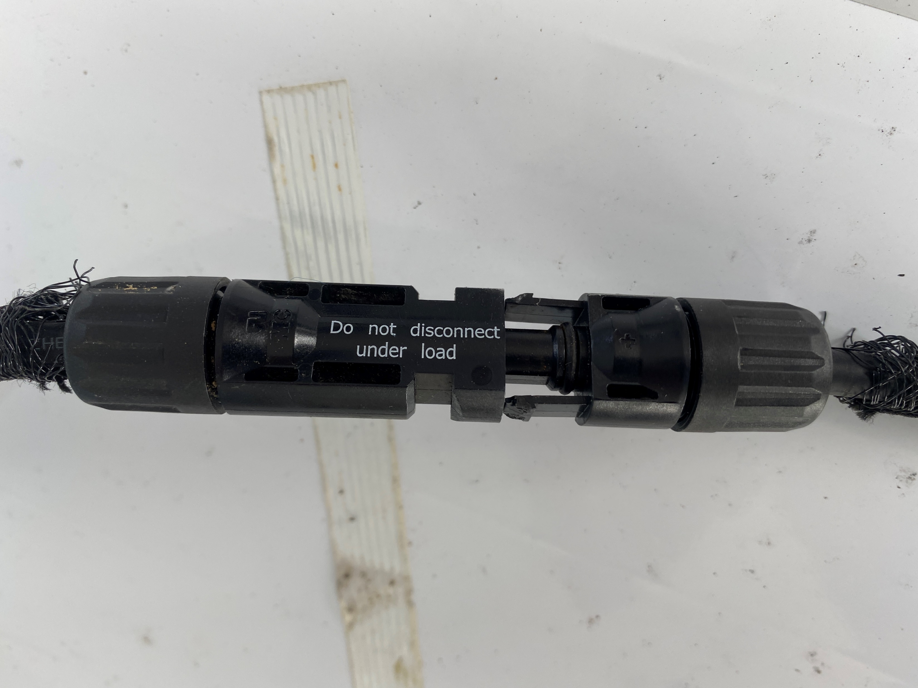
PV Panel Construction
Notice the locking tabs.
Picture courtesy Author

Slide 30
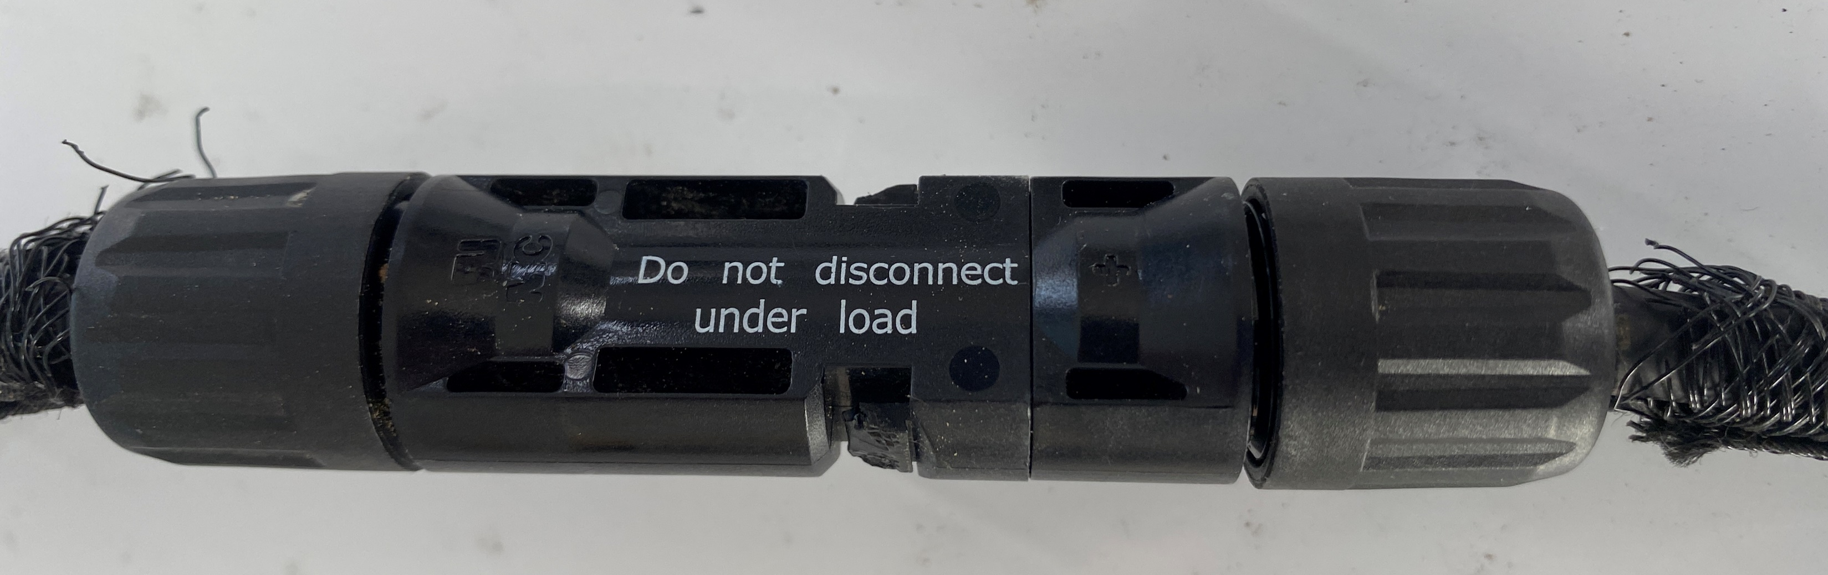
PV Panel Construction
Tabs are locked in place.
Picture courtesy Author

Slide 31
PV Panel Construction
Notice the water proofing ribs.
Picture courtesy Author

Slide 32
PV Panel Construction
Questions?

Slide 33
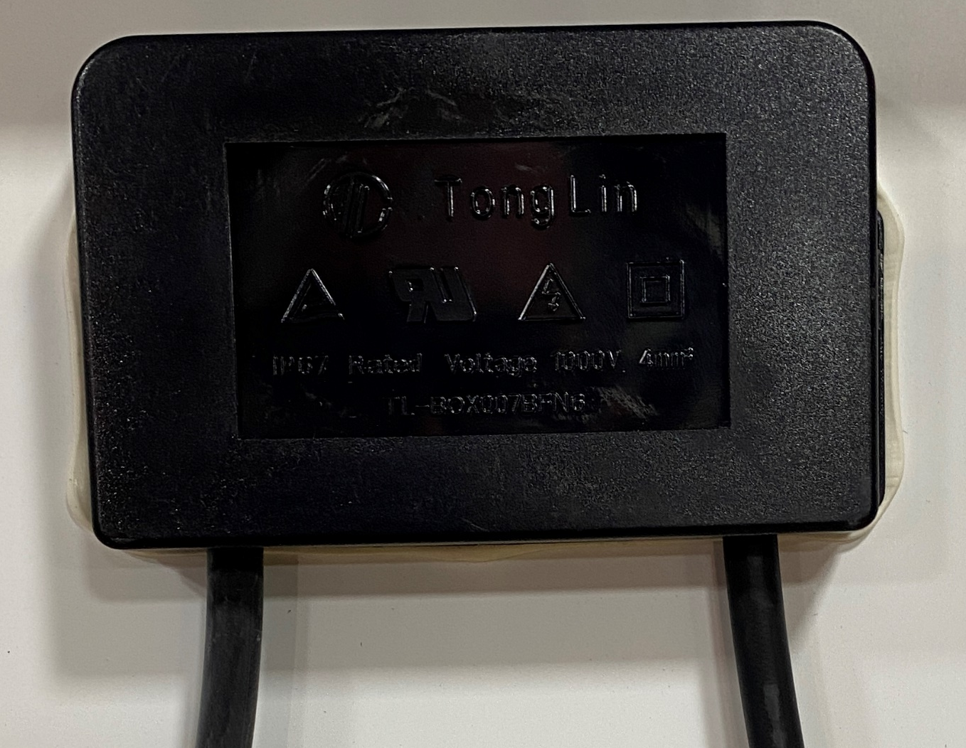
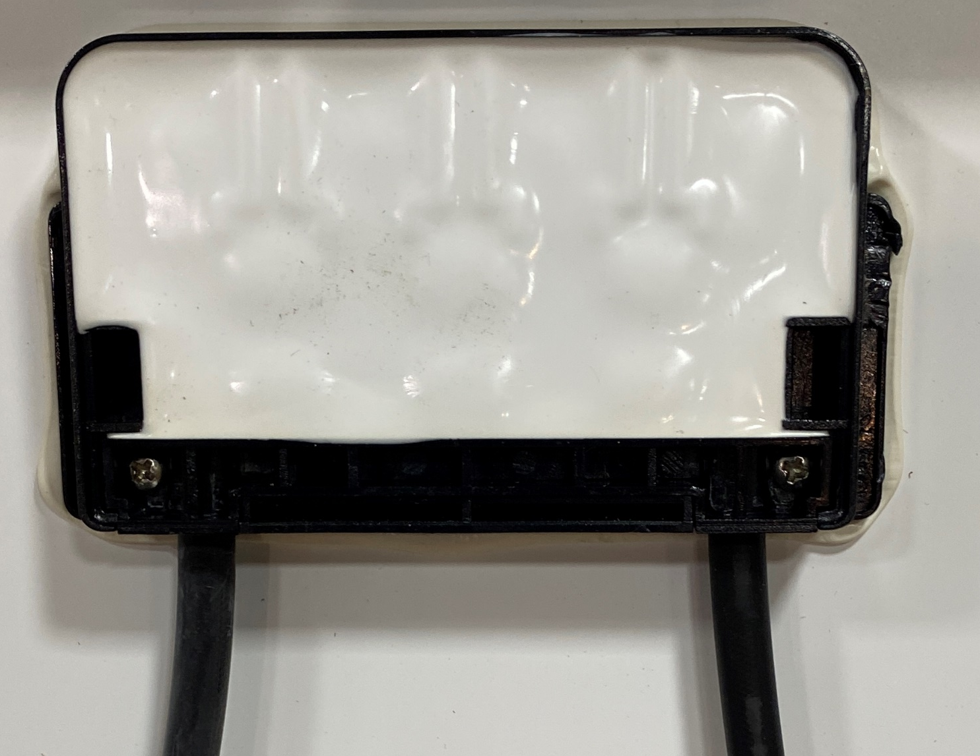
PV Panel Construction
The junction box on the back of the panel.
The junction box houses the by-pass diodes.
Removed the cover to see that the diodes are sealed.
Picture courtesy Author

Slide 34
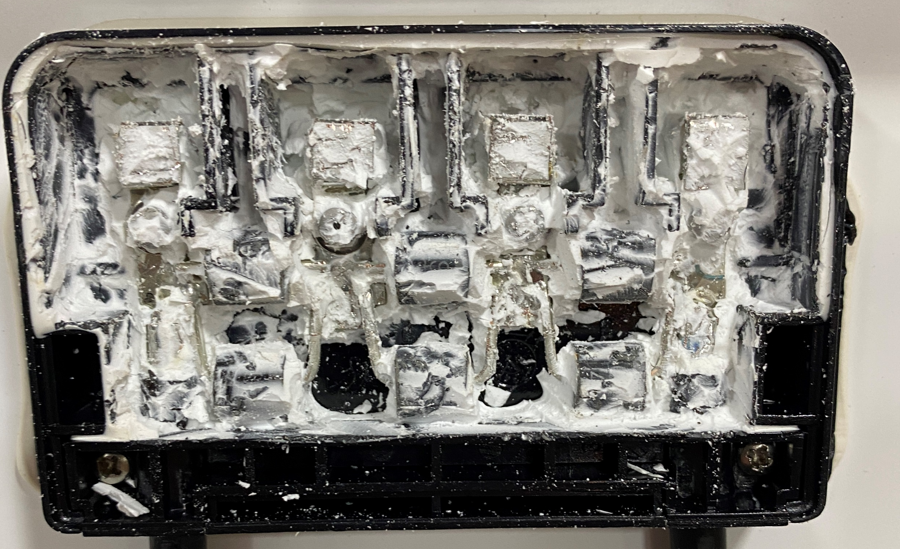
PV Panel Construction
With the sealant removed, it reveals 6 diodes.
Three sets of two in parallel.
There are three groups of diodes. That makes each group having 20 cells each protected by a diode.
Images courtesy author

Slide 35
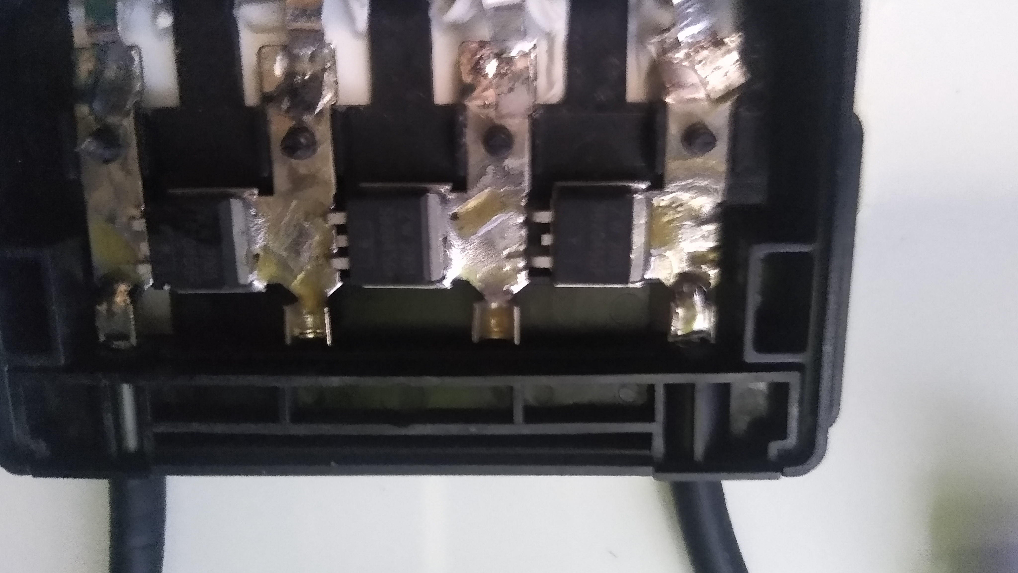
PV Panel Construction
This is the 120 Watt panel at ITVET Belize City.
There are 3 by-pass diodes, each protects 12 cells.
Image courtesy Mark Miller

Slide 36
PV Panel Construction
Questions?

Slide 37
PV Panel Construction
The next section is about the frame that holds the other components together.
Today’s panels predominately have aluminum frames.
There have been panels that were completely covered on glass. They were very rare.

Slide 38
PV Panel Construction
Handling the panels is very important.
The 60 cell panels are the largest that one person can handle safely.
385 Watt 60 cell panel weighs 19.5kg or 43lbs
The 72 cell panels are heavy for one person to handle and often requires two people to move to a roof top.
430 Watt 72 cell panel weighs 24.9kg or 54.9lbs

Slide 39
PV Panel Construction
Questions?

Slide 40
PV Panel Construction
Dropping the solar panel to a hard surface will normally break the glass top.
Any twisting of the frame will also cause the glass top to shatter.

Slide 41
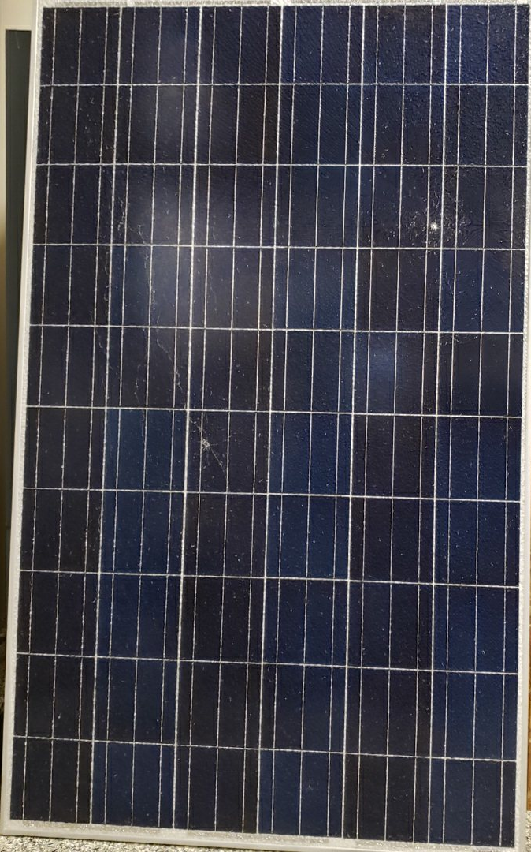
PV Panel Construction
This panel fell over on the
parking lot.
Images courtesy author

Slide 42
PV Panel Construction
Closer inspection
shows the shattered
glass face of the
panel.
Images courtesy author

Slide 43
PV Panel Construction
The panels are subjected to everyday outdoor environments from around the world.
They are meant for weather conditions for everywhere in the world.
Operating temperature range for most panels are listed between -40C and +85C
or -40F and 185F.
They do operate at colder temperatures.

Slide 44
PV Panel Construction
The frames are made of Aluminum.
Any metal that can oxidize will react to oxygen.
Aluminum reacts to oxygen and creates aluminum oxide witch is a thin and hard film.
This film further protects the aluminum from continuing to oxide ( a good thing).
Oxidization is not the same as rusting.

Slide 45
PV Panel Construction
This hard film also stops the outer surface of the frame from being conductive electrically.
The film cannot be the only barrier to corrosion if the panels are to last 25 plus years.
The aluminum frame is anodized (powder coated) to provide the longevity required to keep the aluminum strong.
This also leads to an increased in insulation electrically.

Slide 46
PV Panel Construction
Questions?

Slide 47
PV Panel Construction
There is a requirement in many jurisdictions to have the frames electrically bonded (joined) to the ground potential.
The only way to do this correctly is to puncture the Anodized coating with a material that will not corrode or have a galvanic reaction to the aluminum.
Stainless steel is the best material for this.

Slide 48
PV Panel Construction
The connection between the aluminum frame and the stain steel needs to be protected.
If aluminum oxide film forms between the stainless steel and the frame it will break the electrical contact between them.
Anti-oxidant paste must be applied between the stainless material and the aluminum frame.
There are many products on the market for this.

Slide 49
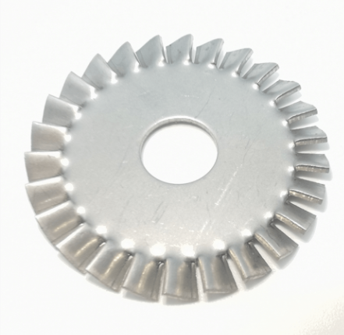
PV Panel Construction
The stainless steel device can be a star washer that penetrates into the aluminum.
Apply anti-oxidant paste between washer and the panel’s aluminum frame.
Image courtesy author

Slide 50
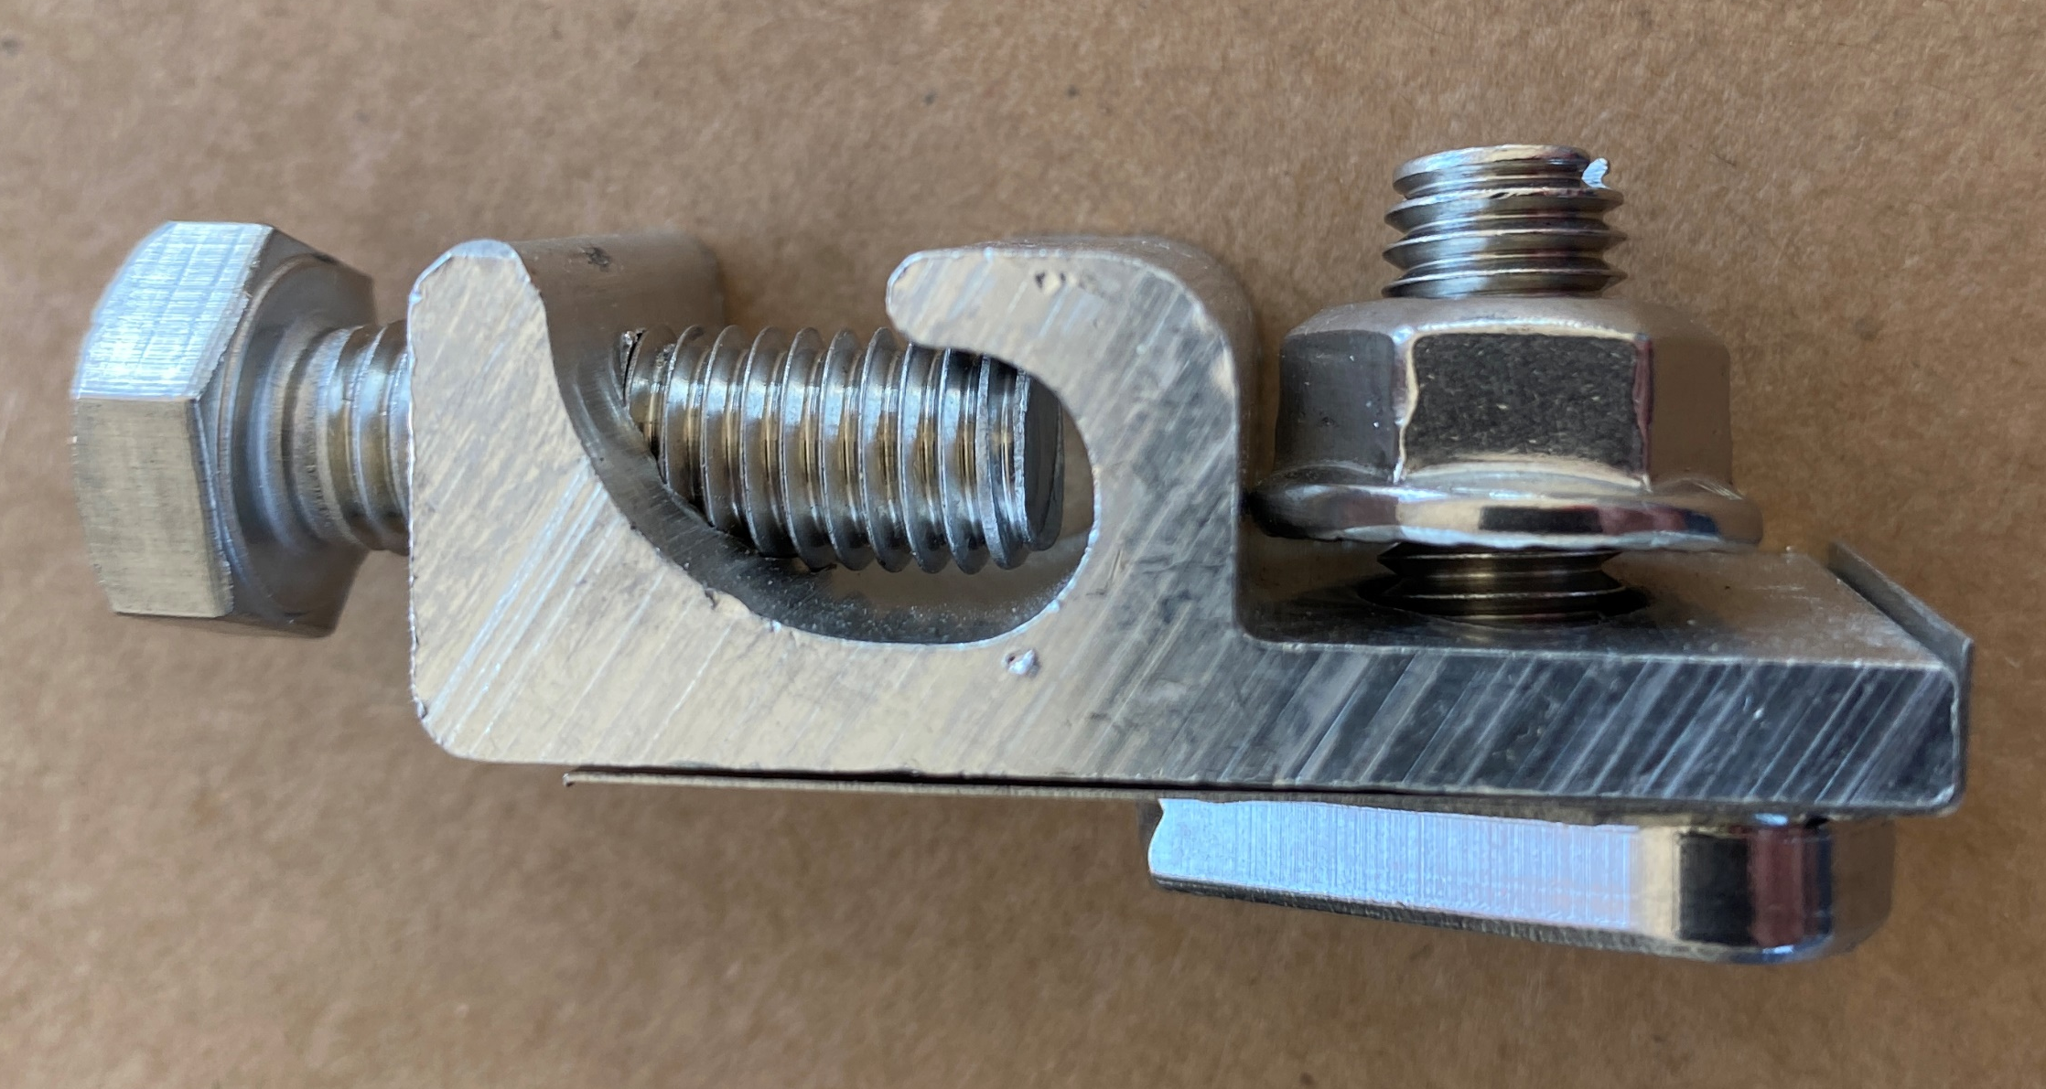
PV Panel Construction
A specialty device designed for this purpose is a WEEB (Washer Electrical Equipment Bonding).
The WEEB was designed by Wiley Electronics LLC.
Image courtesy author

Slide 51
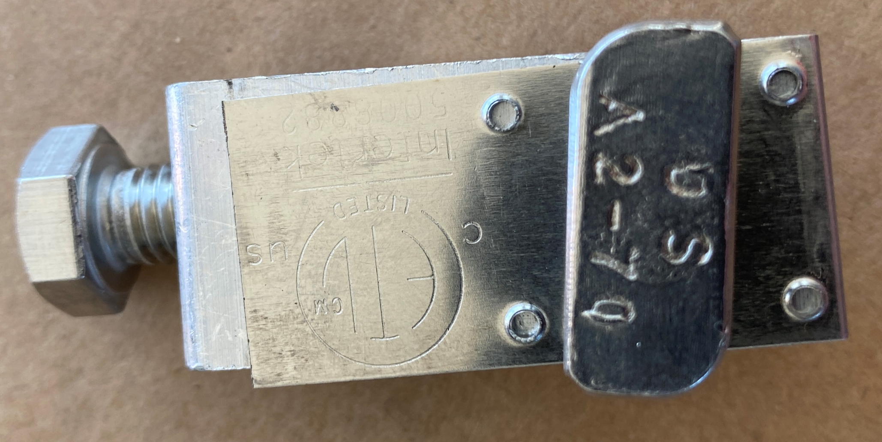
PV Panel Construction
The WEEB bottom view.
Locking bolt that holds WEEB to racking.
Sharp piercing edges.
Good for one time use.
Image courtesy author

Slide 52
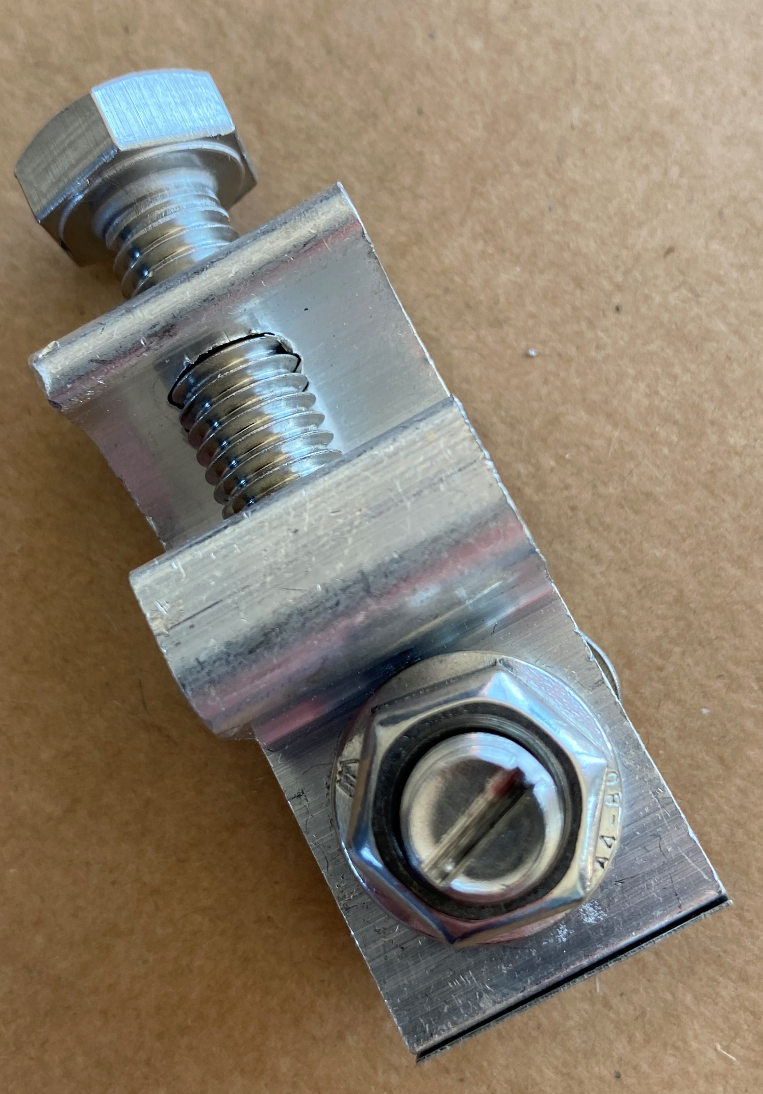
PV Panel Construction
The WEEB top view.
Locking slot to hold bolt in place.
Image courtesy author

Slide 53
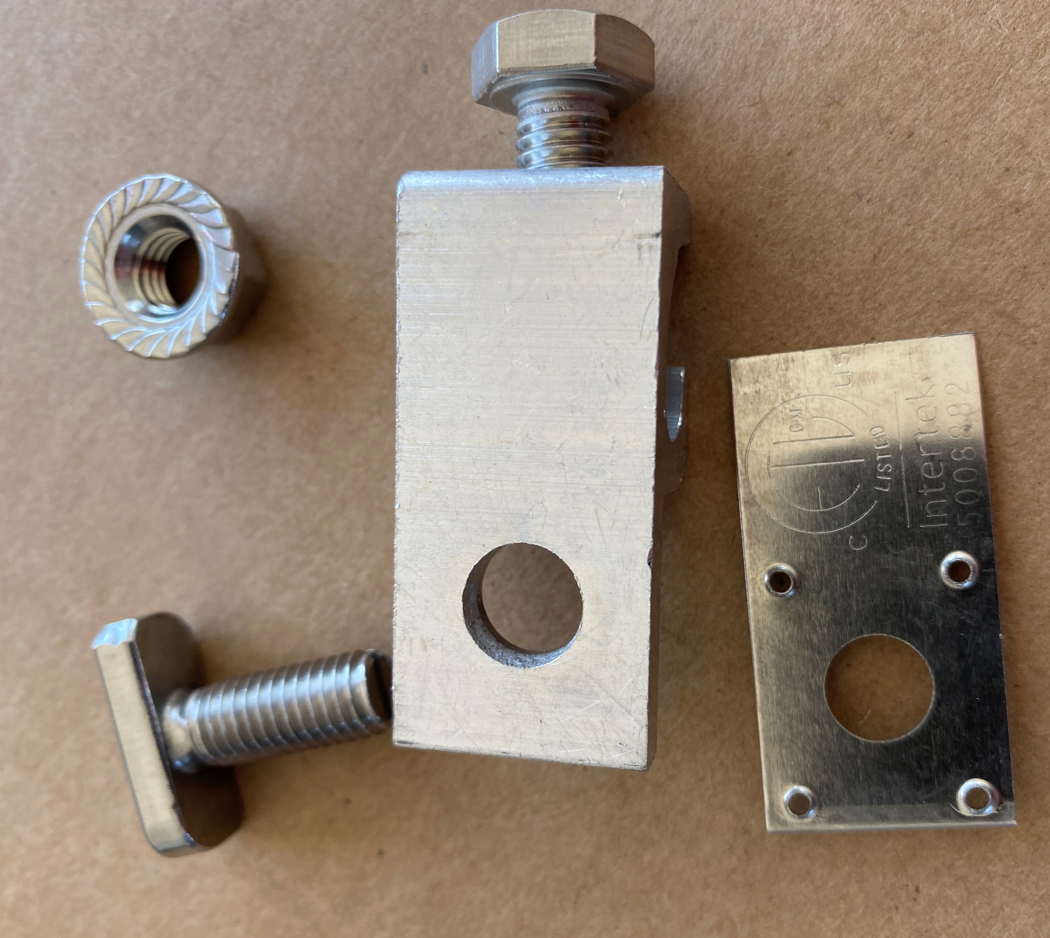
PV Panel Construction
The WEEB exploded view.
Image courtesy author

Slide 54
PV Panel Construction
The connection between the copper grounding / bonding wire must be placed in a connector that is water proof and can stand the outdoor environment.
A common connector is a lay-in lug.
This lug connector connects the copper wire to it and then transfers through the WEEB or star washer into the panel’s aluminum frame.

Slide 55
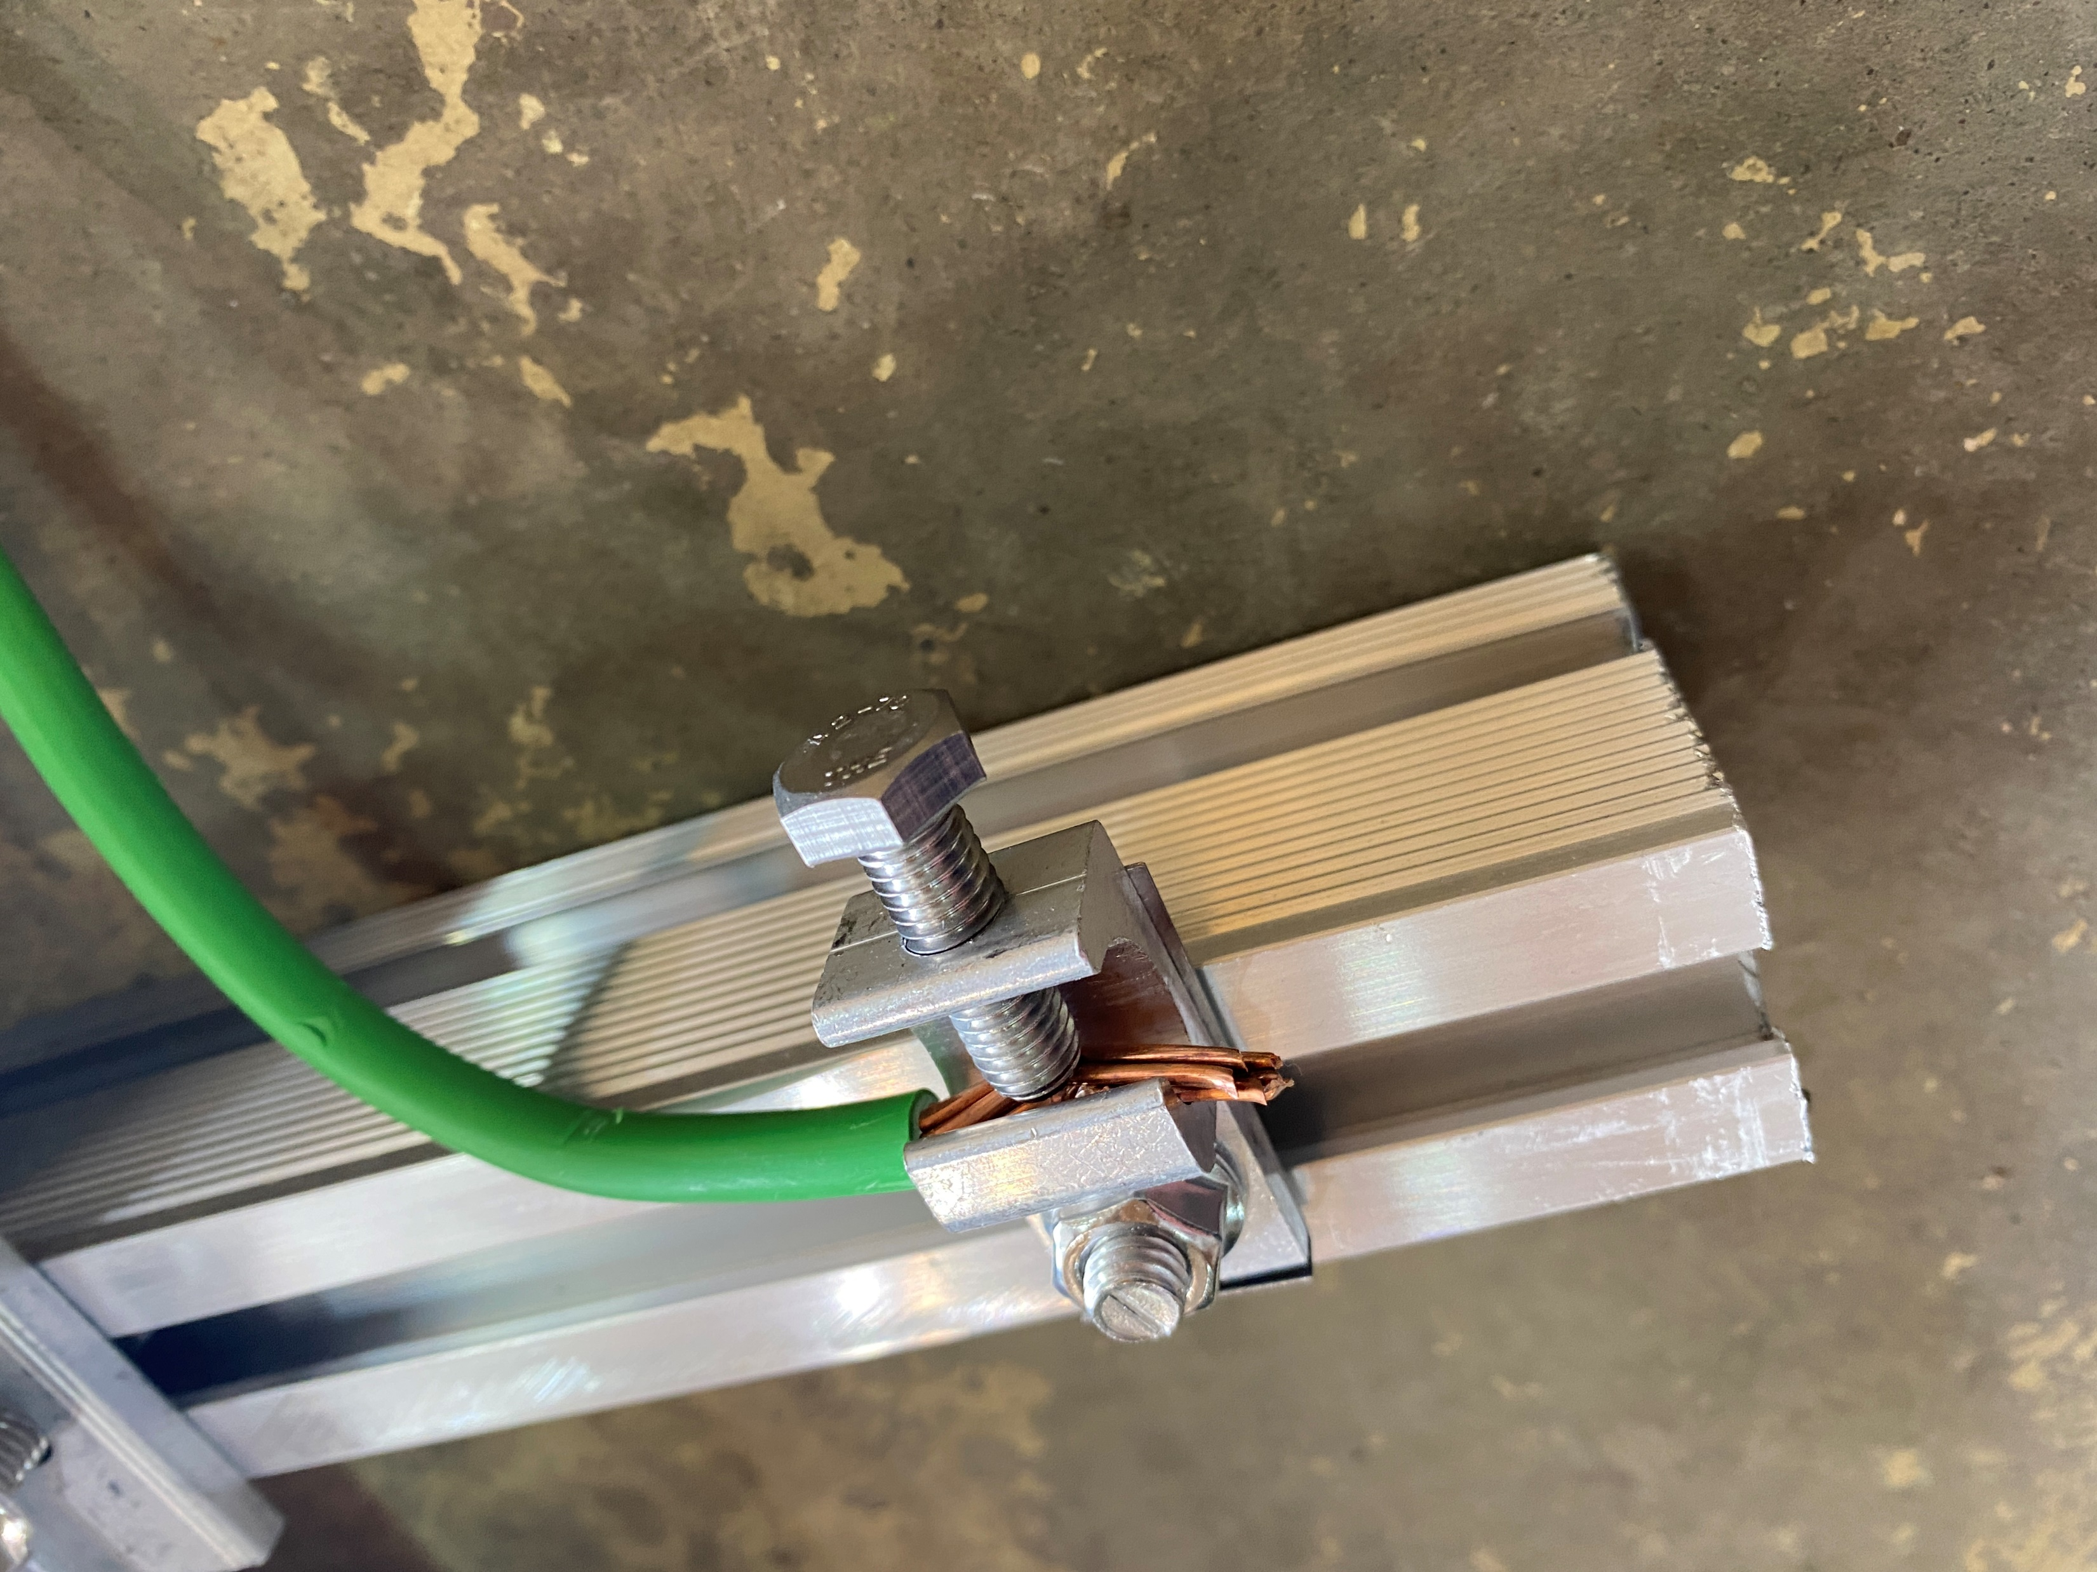
PV Panel Construction
The lay-in lug complete with bonding wire.
Electrical connection from wire to lay-in lug and then transfers through the WEEB or star washer into the panel’s
aluminum frame.
Image courtesy author

Slide 56
PV Panel Construction
Questions?

Slide 57
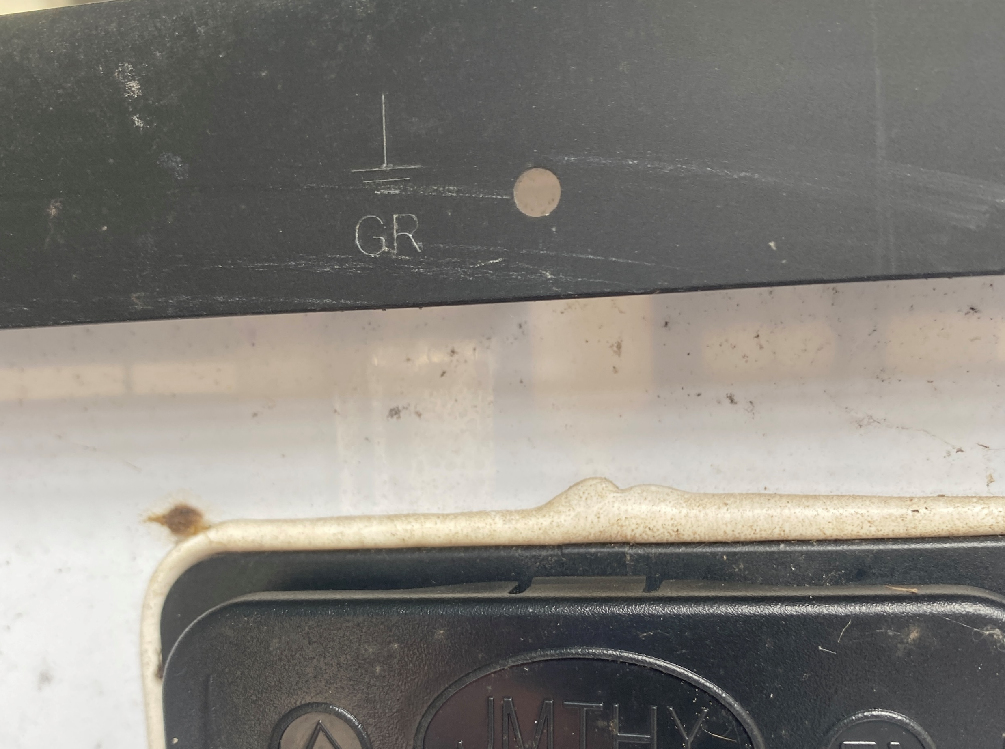
PV Panel Construction
If the panel was to be grounded directly there are dedicated holes to mount a connector on the frame. That still needs a WEEB or Star washer.
Image courtesy author

Slide 58
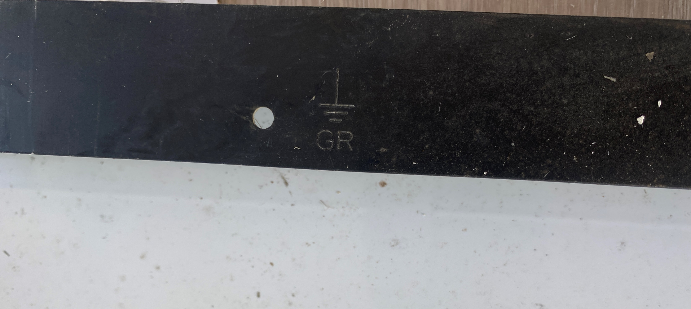
PV Panel Construction
More holes to mount a connector on the frame.
Image courtesy author

Slide 59
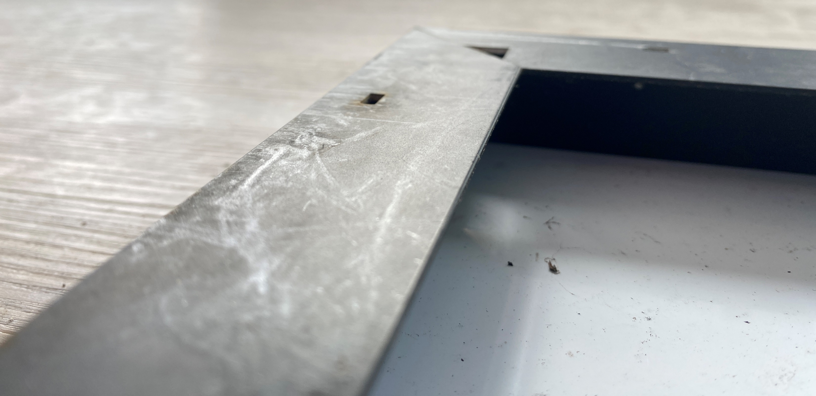
PV Panel Construction
The frame is light and moderately strong.
It will flex.
Image courtesy author

Slide 60
PV Panel Construction
Questions?

