Slide 1
Design and Implementation of Pilot of a TVET Renewable Energy Course
DELIVERABLE #5 - TRAINING COURSES & PROFESSIONAL DEVELOPMENT

Slide 2
PV Installation Labs
This presentation will put the necessary steps together for the mounting of the PV modules and microinverters for instructors to connect the microinverters to the school's electrical system.

Slide 3
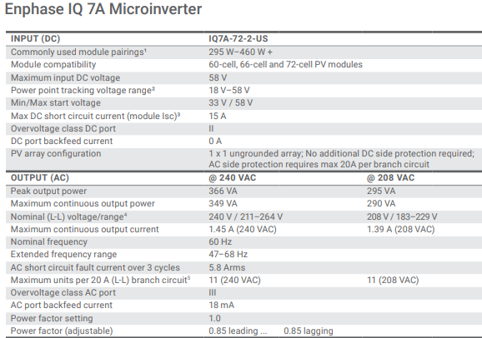
PV Installation Labs
This lab will use the Enphase IQ7A microinverter.

Slide 4
PV Installation Labs
This lab will use the Enphase IQ7A microinverter.
Maximum DC input voltage is 58V
MPPT range is 18V – 58V
Maximum Isc is 15A.

Slide 5
PV Installation Labs
The PV modules on hand are a JA Solar 325Watt module and two Blue Sun PV modules at 120 Watts.
Data sheets for each are on next two slides.
The IQ7A must be compatible with the PV modules for them to work together.

Slide 6
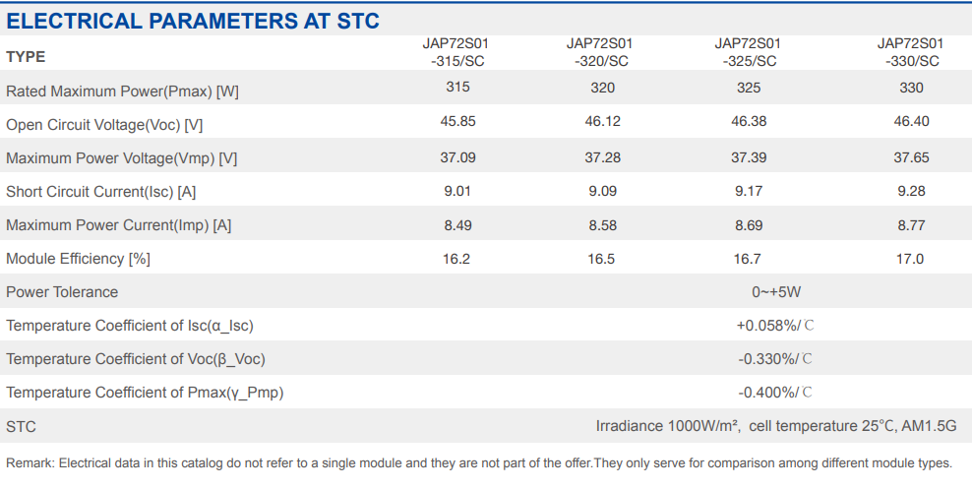
PV Installation Labs
The JA Solar 325Watt module specs.

Slide 7
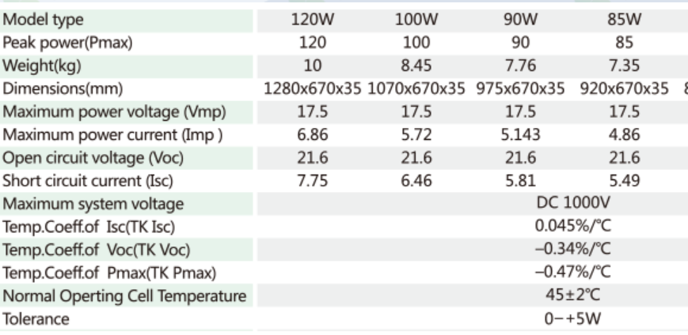
PV Installation Labs
The Blue Sun PV modules at 120 Watts specs.

Slide 8
PV Installation Labs
Starting with the JA Solar 325Watt module.
All criteria met.
(Isc is Isc x 125%)
IQ7A |  | JA Solar |  | Pass
Power Range | 295-460W | Power | 325W | √
Max DCV | 58V | Voc | 46.3V | √
MPPT Range | 18V – 58V | Vmp | 37.39V | √
Isc Max | 15A | Isc | 11.46A | √

Slide 9
PV Installation Labs
The Blue Sun 120Watt module is only a 36 cell module.
The Voc and Vmp are 22.3V and 17.8V respectively.
The Vmp is not in the range for MPPT tracking.
If two of these panels are put into series, the Voc and Vmp are satisfactory.

Slide 10
PV Installation Labs
The Blue Sun 120Watt module is only a 36 cell module.
All criteria met.
(Isc is Isc x 125%)
IQ7+ |  | JA Solar |  | Pass
Power Range | 295-460W | Power | 240W | √
Max DCV | 58V | Voc | 44.6V | √
MPPT Range | 18V – 58V | Vmp | 35.6V | √
Isc Max | 15A | Isc | 8.95A | √

Slide 11
PV Installation Labs
Next is to determine how the rails will be laid out to allow these three modules to be mounted.

Slide 12
PV Installation Labs
Point mounting system:
Is when rails are used to support the PV modules and they are placed underneath the PV modules and touch the modules at one point, not a continuous mounting under the complete underside of the PV module.
There are two different PV modules to be used in this lab.

Slide 13
PV Installation Labs
There is a JA Solar 325 Watt module and there are two Blue Sun PV modules at 120 Watts.
The JA Solar data sheet and the Blue Sun data sheets are in the following slides.
The spacing of the rails in this lab will be based on the data sheets from each manufacturer.

Slide 14
PV Installation Labs
JA Solar 325Watt module data sheet.

Slide 15
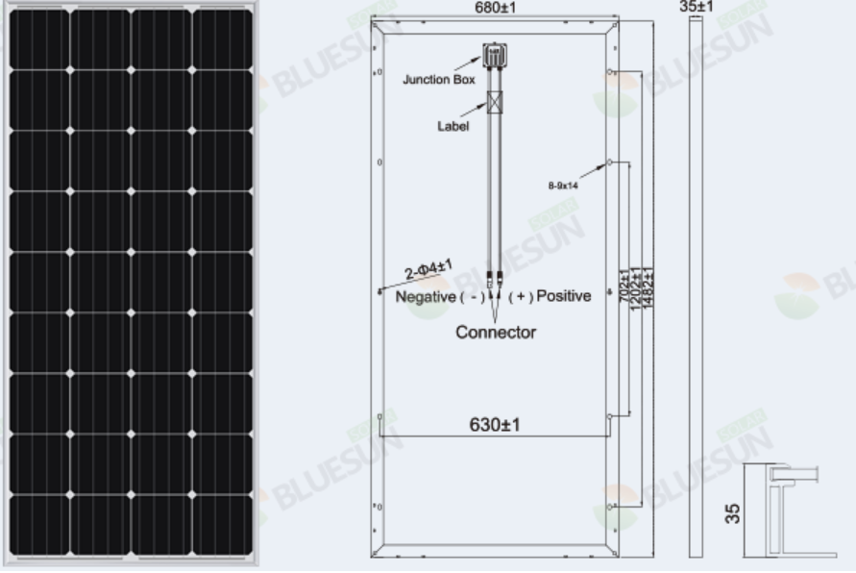
PV Installation Labs
Blue Sun 120Watt module data sheet.

Slide 16
PV Installation Labs
The JA Solar has mounting holes at two locations.
1200mm apart
1600mm apart
At 1200mm the percentage is 20 – 60 – 20
At 1600mm the percentage is 10 – 80 – 10
The better is the 1200mm apart.

Slide 17
PV Installation Labs
The Blue Sun has mounting holes at two locations.
1200mm apart
1600mm apart
At 1202mm the percentage is 10 – 80 – 10
At 702mm the percentage is 25 – 50 – 25
The better is the 702mm apart. But using the 1202mm keeps the rails in the same location as the JA Solar module.

Slide 18
PV Installation Labs
Mark is planning on using bolt through mounting of the JA Solar, and clamps for the Blue Sun modules.
Bonding will be with star washers.

Slide 19
PV Installation Labs
Make a drawing with dimensions of the rail placement that is decided on.
Before settling on the portrait layout will any of the panels work in landscape layout?

Slide 20
PV Installation Labs
After comparing and coming to an agreement, mount the L-Brackets to the rails.
Update any of your drawing to match the actual mounting plan.
Attach the rails and ensure they are level.
Tighten to manufacturers specifications.
Torque wrench is required.

Slide 21
PV Installation Labs
Lab 2 Microinverter Mounting
This is the next step in the process.
Electrical wiring and bond wiring is also included in this step.

Slide 22
PV Installation Labs
The Microinverter used is the Enphase IQ 7A.
Mounting instructions are found in the file “IQ 7 Installation Manual”
The microinverters are mounted before the PV modules.

Slide 23
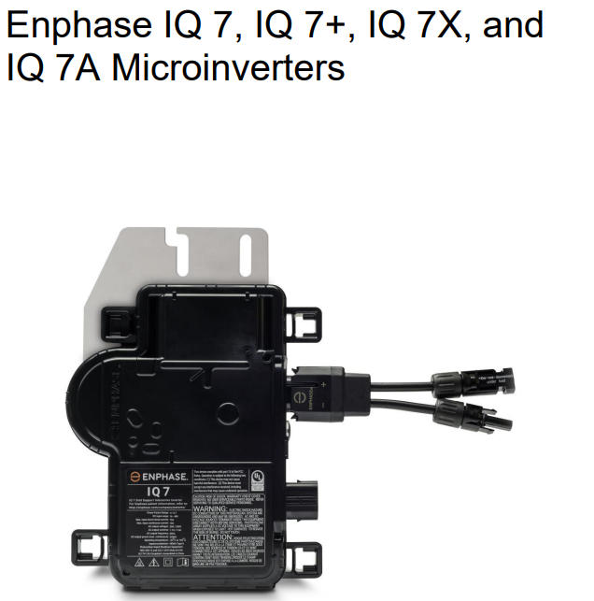
PV Installation Labs
First page of the installation manual.
Enphase Installation Manual

Slide 24
PV Installation Labs
Read and discuss the section on safety first. Pages 5-7.
Safety Symbols that are used throughout the manual are explained.
Check out the important instructions for handling of the cables.

Slide 25
PV Installation Labs
Enphase Q-12-10-240, Q Cable 1.3m (4.2ft), for portrait modules 12 each.
Enphase Q-12-17-240, Q Cable 2.0m (6.5ft), for landscape 60-cell modules 12 each.
Allows the installation for both module orientations.

Slide 26
PV Installation Labs
Grounding Considerations
The IQ Series Micros do not require grounding electrode conductors (GEC) or equipment grounding conductors (EGC).
Use star washers to bond the microinverters to the rail system.

Slide 27
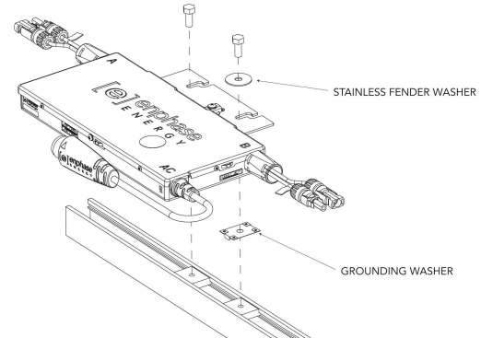
PV Installation Labs
WEEB grounding washer.
Enphase Installation Manual

Slide 28
PV Installation Labs
Branch Circuit Capacity
Plan your AC branch circuits to meet the following limits for maximum number of microinverters per branch when protected with a 20-amp over-current protection device (OCPD).
There are only two, so not an issue.
Enphase Installation Manual

Slide 29
PV Installation Labs
Wire Lengths and Voltage Rise When planning the system.
You must select the appropriate AC conductor size to minimize voltage rise.
Select the correct wire size based on the distance from the beginning of the microinverter AC branch circuit to the breaker in the load center.

Slide 30
PV Installation Labs
This exercise was part of a previous assignment.
The length of wire run from the microinverters to the school breaker will be of concern if it causes voltage drop / rise.

Slide 31
PV Installation Labs
Installing the Enphase IQ Series Micros involves several key steps.
Step 1: Position the Enphase Q Cable
Step 2: Position the Junction Box
Step 3: Mount the Microinverters
Step 4: Create an Installation Map

Slide 32
PV Installation Labs
Step 5: Manage the Cabling
Step 6: Connect the Microinverters
Step 7: Terminate the Unused End of the Cable
Step 8: Complete Installation of the Junction Box
Step 9: Connect the PV Modules
Step 10: Energize the System

Slide 33
PV Installation Labs
Enphase Installation Manual

Slide 34
PV Installation Labs
Step 1: Position the Enphase Q Cable:
A. Plan each cable segment to allow drop connectors on the Enphase Q Cable to align with each PV module. Allow extra length for slack, cable turns, and any obstructions.
(Do not bolt the microinverters yet) (Go back and read important instruction on handling the Q cables)

Slide 35
PV Installation Labs
B. Mark the approximate centers of each PV module on the PV racking.
(Align the PV module cable so as they will connect to the microinverter)

Slide 36
PV Installation Labs
C. Lay out the cabling along the installed racking for the AC branch circuit.
This needs to be thought out, which end of the array will the AC circuit wire be entering the array.

Slide 37
PV Installation Labs
D. Cut each segment of cable to meet your planned needs.
WARNING: When transitioning between rows, secure the cable to the rail to prevent cable damage or connector damage. Do not count on connector to withstand tension.

Slide 38
PV Installation Labs
Step 2: Position the Junction Box
This is the AC branch circuit junction box connecting the AC Q cables to the wire going to the AC in the lab area.
Mount to racking if possible.

Slide 39
PV Installation Labs
The bonding wire will terminate in the junction box.
It will connect to the cable ground wire and run to the grounding bus in the panel.
This bonding wire will be # 6 AWG from the rails to the junction box.
A stainless steel lay-in lug with a star washer is used per rail.

Slide 40
Racking and Mounting
Bonding wire and connectors.
In a previous module we discussed the Lay-in lug as the preferred way to bond the rail to the grounded bonding wire.
Each rail must be
bonded together.
# 6 AWG or #16 metric.
Picture courtesy Author

Slide 41
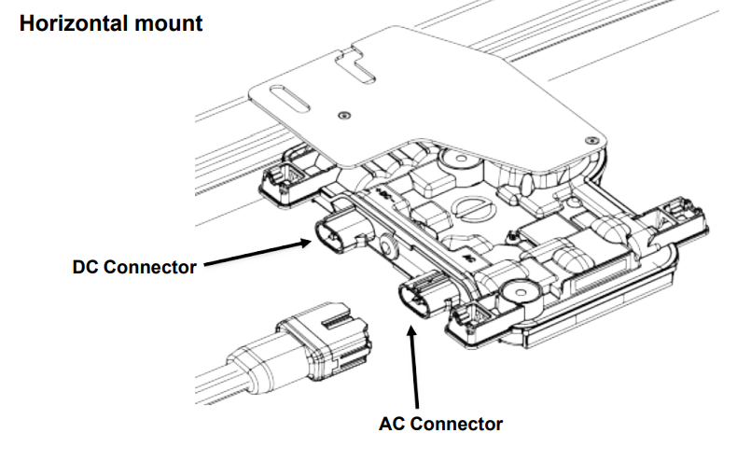
PV Installation Labs
Step 3: Mount the Microinverters
Enphase Installation Manual

Slide 42
PV Installation Labs
Step 3: Mount the Microinverters
A. If the Enphase DC bulkhead connectors are not already attached to the microinverters, attach them now. Make sure they are fully seated.
B. Mount the microinverter bracket side up (as shown) and under the PV module, away from rain and sun. Allow a minimum of 1.9 cm between the roof and the microinverter. Also allow 1.3 cm between the back of the PV module and the top of the microinverter.

Slide 43
PV Installation Labs
WARNING: Install the microinverter under the PV module to avoid direct exposure to rain, UV and other harmful weather events. Do not mount the microinverter upside down.
C. Torque the microinverter fasteners as follows. Do not over torque.
6 mm mounting hardware: 5 N m
8 mm mounting hardware: 9 N m

Slide 44
PV Installation Labs
Normally an installation map is created.
Take note of where the serial numbers are and the removable sticker containing the serial number on the Enphase IQ7+.

Slide 45
PV Installation Labs
Step 5: Manage the Cabling
A. Use cable clips or tie wraps to attach the cable to the racking. Leave no more than 1.8 m between cable clips or tie wraps.
Dress any excess cabling in loops so that it does not contact the roof.
Do not form loops smaller than 12 cm in diameter.

Slide 46
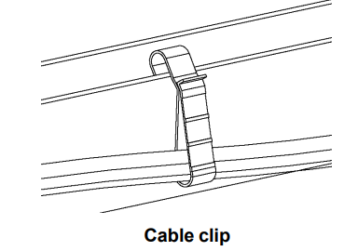
PV Installation Labs
Step 5: Manage the Cabling.
Different clips for different racking.
Enphase Installation Manual

Slide 47
PV Installation Labs
Step 6: Connect the Microinverters
A. Connect the microinverter. Listen for a click as the connectors engage.
B. Cover any unused connector with Enphase Sealing Caps.
Listen for a click as the connectors engage.

Slide 48
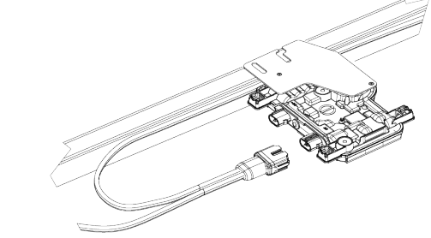
PV Installation Labs
Step 6: Connect the Microinverters
Enphase Installation Manual

Slide 49
PV Installation Labs
WARNING: Risk of electric shock. Risk of fire.
Install sealing caps on all unused AC connectors as these connectors become live when the system is energized.
Sealing caps are required for protection against moisture ingress.
Or make your own cap / termination.

Slide 50
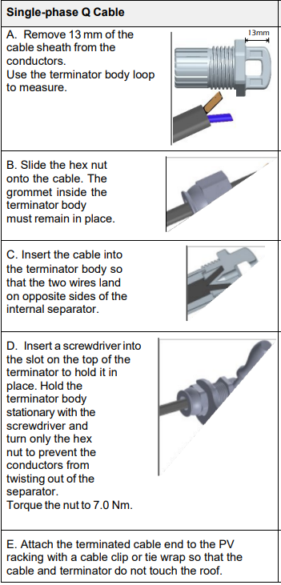
PV Installation Labs
Step 7: Terminate the
Unused end of the cable.
Terminate the unused end
of the Enphase Q Cable as
follows:
Enphase Installation Manual

Slide 51
PV Installation Labs
Step 8: Complete Installation of the Junction Box
A. Connect the Enphase Q Cable into the junction box.
Q Cable uses the following color code:
Enphase Installation Manual

Slide 52
PV Installation Labs
The following slide is a complete schematic of the install.
It does show the Envoy S which is not part of this lab.

Slide 53
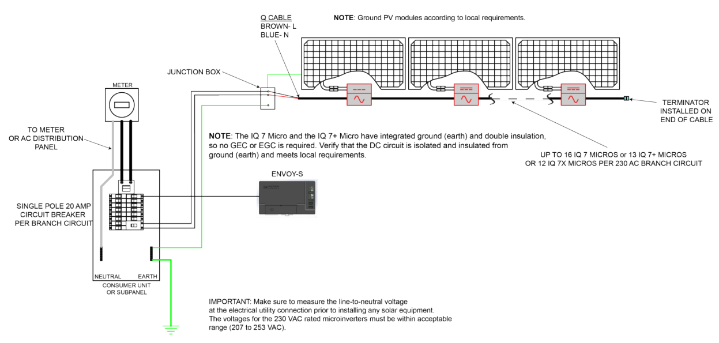
PV Installation Labs
Step 8: Complete Installation of the Junction Box
Enphase Installation Manual

Slide 54
PV Installation Labs
Step 8: Complete Installation of the Junction Box
The terminator installed at the last microinverter.
Enphase Installation Manual

Slide 55
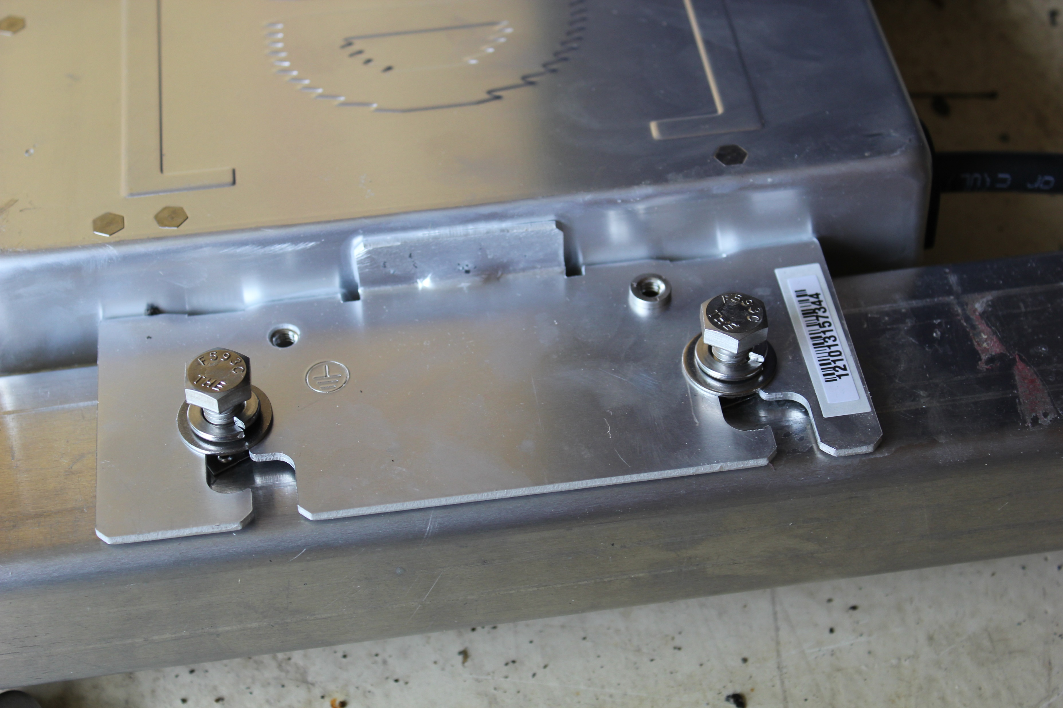
PV Installation Labs
Picture courtesy Author

Slide 56
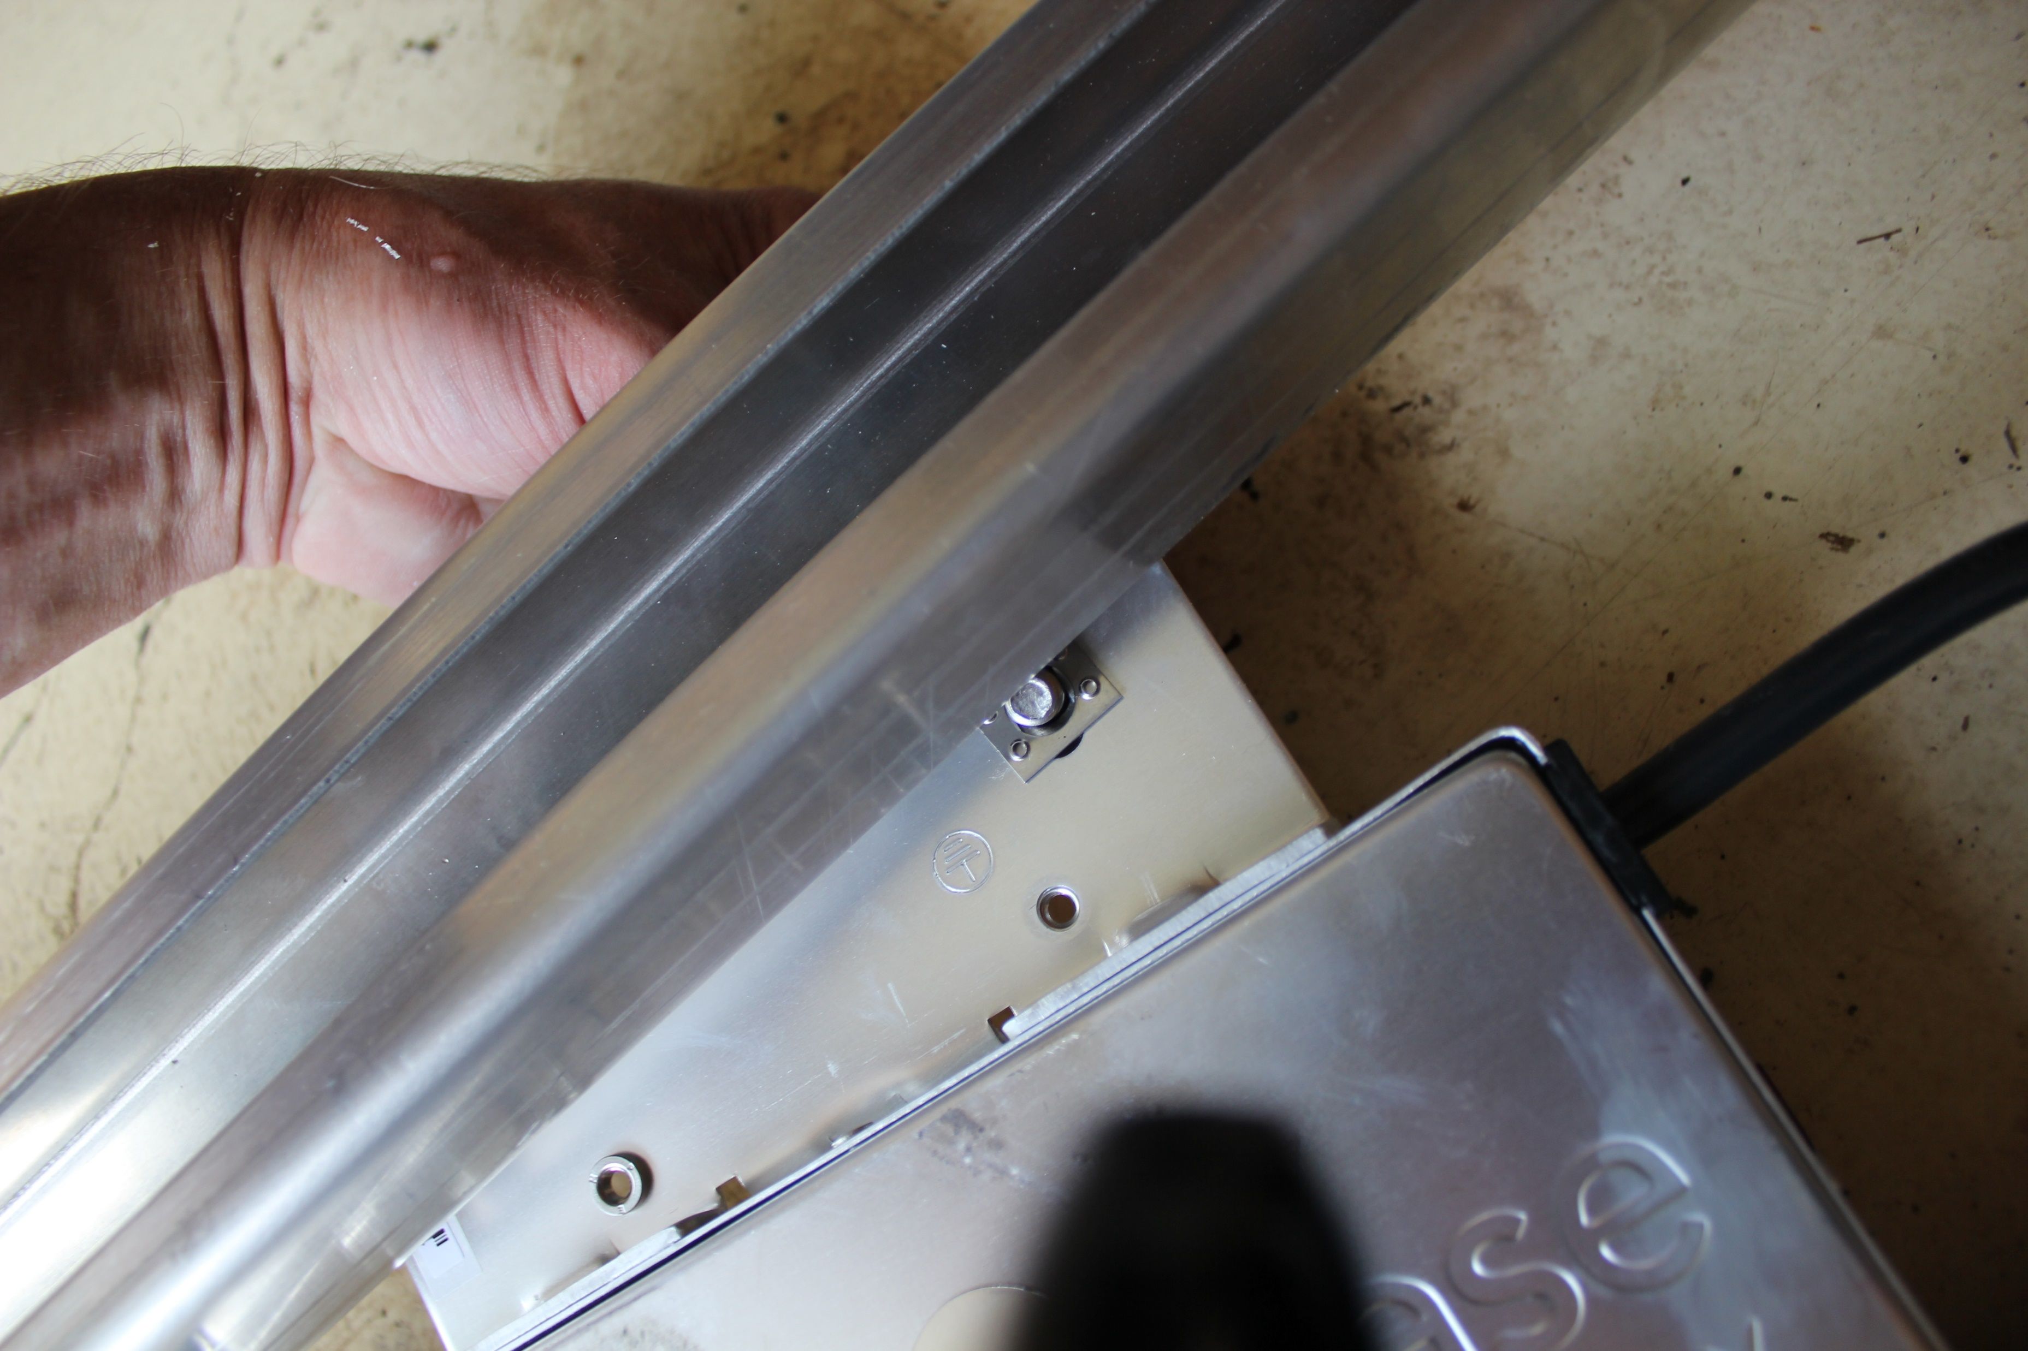
PV Installation Labs
Picture courtesy Author

Slide 57
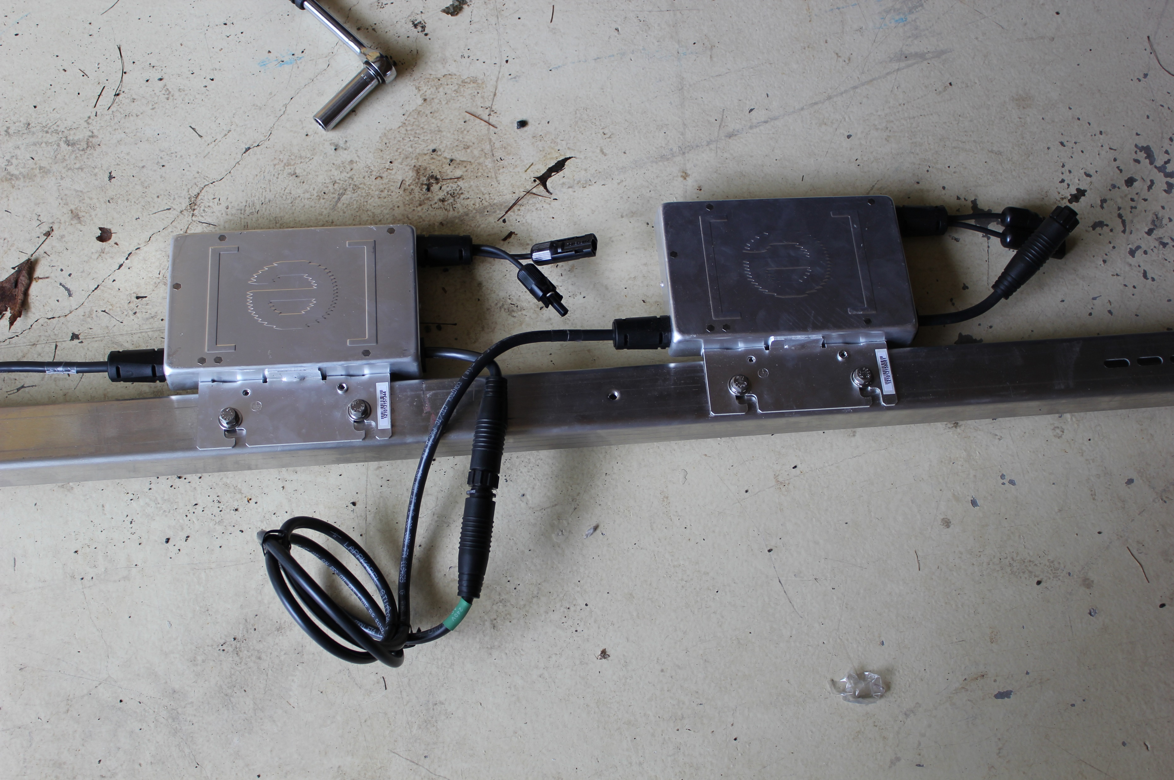
PV Installation Labs
Picture courtesy Author

Slide 58
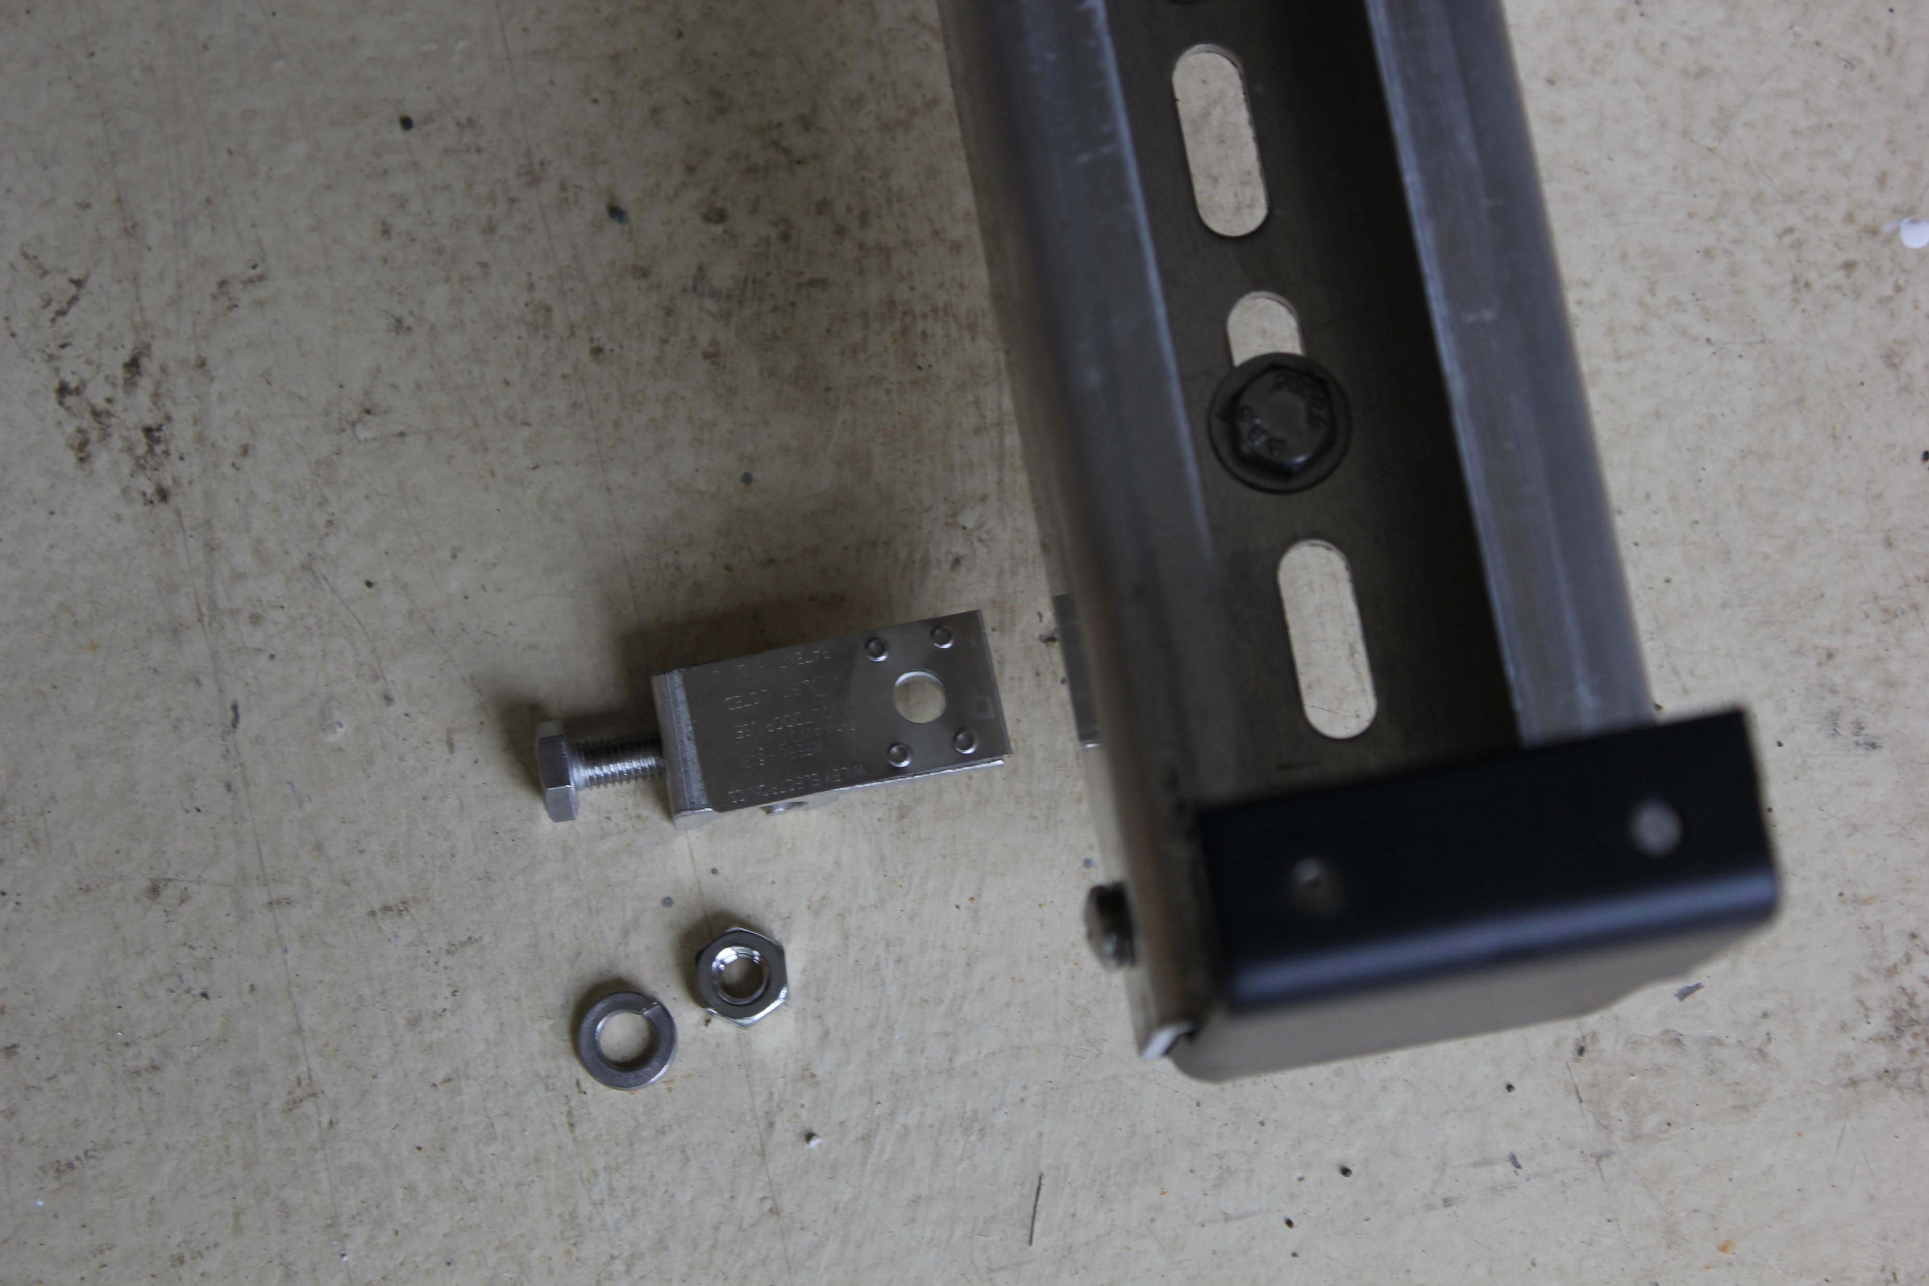
PV Installation Labs
Picture courtesy Author

Slide 59
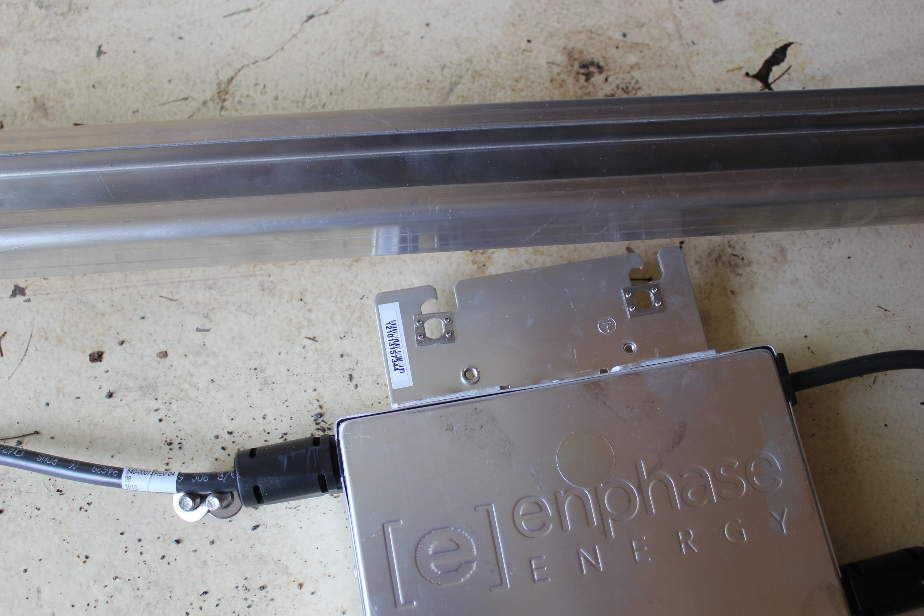
PV Installation Labs
Picture courtesy Author

Slide 60
PV Installation Labs
At this point the rails have been attached to the L-Brackets
The microinverters are attached to the rails.
The bonding wire is attached to the rails and back to the junction box.
Last steps are the PV Modules connecting to the microinverters and to the rails.

Slide 61
PV Installation Labs
Continuing from the Enphase installation manual:
Step 9: Connect the PV Modules WARNING: Electrical shock hazard. The DC conductors of this photovoltaic system are ungrounded and may be energized.
A. Connect the DC leads of each PV module to the DC input connectors of the corresponding microinverter.

Slide 62
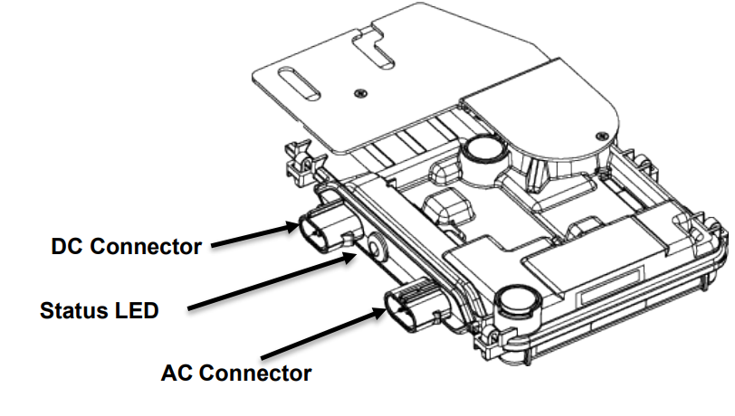
PV Installation Labs
B. Check the LED on the connector side of the microinverter. The LED flashes six times when DC power is applied.
Enphase Installation Manual

Slide 63
PV Installation Labs
Clamps will be used on the Blue Sun modules and bolt through on the JA Solar module.
Mark will guide you through this process.

Slide 64
PV Installation Labs
Clamps are not in contact with the front glass.
Clamps do not deform the frame.
Clamps that satisfy the structural requirements based on the conditions of the installation site according to the applicable regulations and technical standards.
Long-term stable clamps that securely affix the module to the mounting frame.

Slide 65
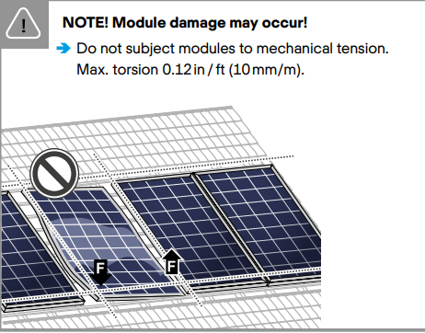
PV Installation Labs
Place modules in sequence. One at a time.
Plan the placement and set out a written plan when each module is to be
mounted.
Qcell Installation Manual

Slide 66
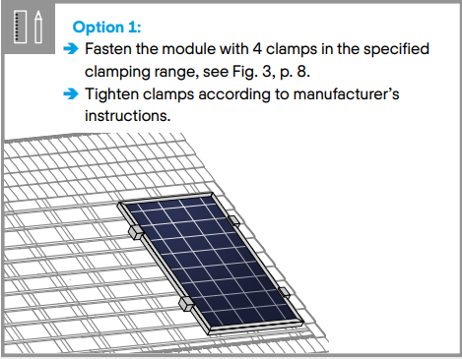
PV Installation Labs
The clamps must be tightened to their manufacturer's specifications.
The use of a
torque wrench
is mandatory.
Qcell Installation Manual

Slide 67
PV Installation Labs
Stainless steel fasteners tend to gall while being tightened.
The risk of galling or thread seizing can be reduced by:
Using lubrication
Tighten fasteners with low rpm’s, without interruptions
Apply only light pressure

Slide 68
PV Installation Labs
The clamps are designed to hold the PV module in place.
The stainless-steel bolt should not be over torqued as galling will result and the bolt may break off if it is removed.
Manufacturers suggest anywhere from 11 – 22 N-m.
For #6 (1/4”) use lower end value
For #10 (3/8”) use higher end value
This is only a suggested range

Slide 69
PV Installation Labs
Grounding / bonding through the clamp.
Proper grounding is achieved by bonding all exposed non-current carrying metal equipment to the appropriately sized equipment grounding conductor (EGC) or racking system that can be used for integrated grounding.
Mark will guide you through the methods most encountered in Belize.

Slide 70
PV Installation Labs
PV module frames are protected from corrosion with an anodized coating, which has to be penetrated in order to ensure proper bonding.
The different methods listed below are suggested methods for an appropriate bond between the frame and the EGC or racking system (that will have to be properly grounded).
The method appropriate for any individual installation will depend on multiple factors.

Slide 71
PV Installation Labs
Option A: Use of a grounding lug A listed grounding lug can be bonded to the frame using the grounding holes pre-drilled in the frame.
These holes are marked with a ground symbol, as shown below on the frame section drawing:
To install the grounding lug, follow the specified instructions of the manufacturer.
The grounding lug should be made of stainless steel or tin plated metals such as aluminum to avoid corrosion

Slide 72
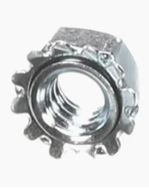
PV Installation Labs
The grounding lug should be attached to the frame grounding hole using a stainless-steel screw, toothed lock washer or KEPS nut (in order to penetrate the anodized layer) and backing nut.
Care should be taken to avoid
the use of grounding hardware
of dissimilar metals, which may
lead to corrosion.
Picture courtesy Author

Slide 73
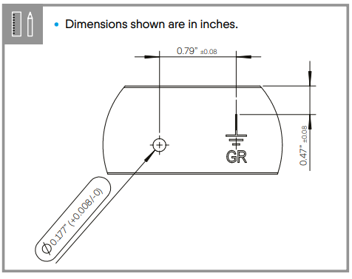
PV Installation Labs
The grounding lug should be attached to the frame grounding.
Qcell Installation Manual

Slide 74
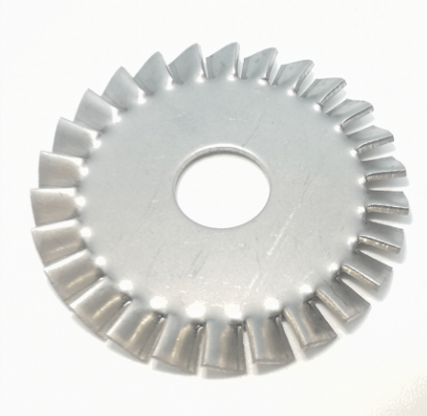
PV Panel Construction
The stainless steel device can be a star washer that penetrates into the aluminum.
Apply anti-oxidant paste between washer and the panel’s aluminum frame.
Image courtesy author

Slide 75
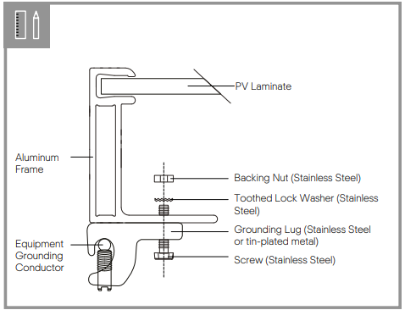
PV Installation Labs
The lay in lug with star washer to penetrate the anodized coating of the Qcell module.
Qcell Installation Manual

Slide 76
PV Installation Labs
Option B: Integrated grounding methods.
The PV modules can be bonded with the racking system using integrated grounding methods.
The racking system will then have to be grounded so that the overall system is properly grounded.
An example of such integrated grounding method is the use of a star washer between the module and the racking system, when mounting the module.

Slide 77
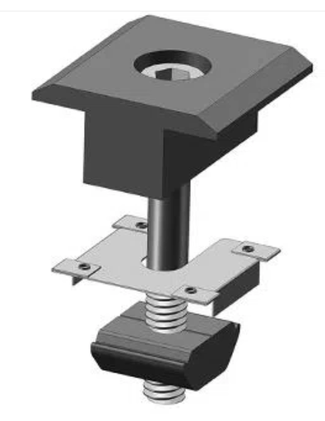
PV Installation Labs
The module frame to rail bond requires a washer.
The washer penetrates both
the rail and the module.
This method uses the mid
clamps only to bond.
WANHOS Solar Technology

Slide 78
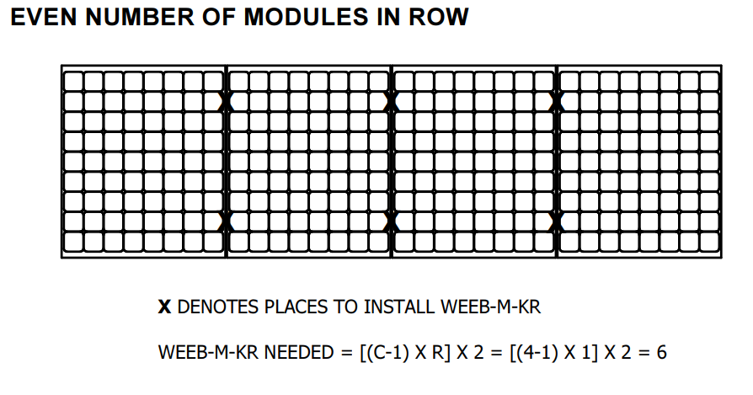
PV Installation Labs
The WEEB installation manual provides a formula for how many WEEB should be placed on the array.
Picture courtesy BURNDY

Slide 79
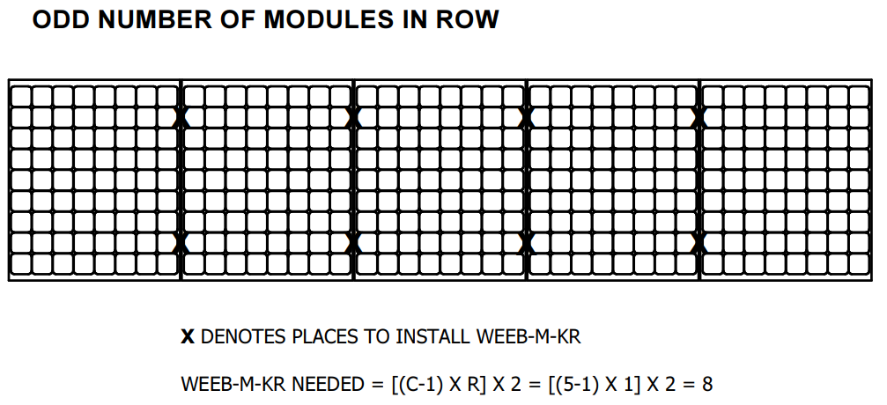
PV Installation Labs
The WEEB installation manual provides a formula for how many WEEB should be placed on the array.
Picture courtesy BURNDY

Slide 80
PV Installation Labs
Next step it to place the panels on the rails and have the bonding washers in place with the mid clamps.
Tighten the bolts of all the clamps using the torque wrench.

Slide 81
PV Installation Labs
The module “Inverter Connections and Rules”
In that module the connection of the microinverter output circuit to a branch circuit is explained in detail.
This lab is a temporary connection to the schools AC system.
A disconnection means still needs to be established.

Slide 82
PV Installation Labs
The inverter output circuit conductors are going to be run through the outside roll up doors and across the floor.
There will need to be an agreed procedure and a wiring method established before the branch circuit connection would be established.
Disconnection means can be of the plug and cord type.
This needs to be developed by the instructor.

Slide 83
PV Installation Labs
Once the wiring method between the inverter and school AC source has been established.
A procedure for connecting the inverters to the source will need to be written.
A safety review before connection is made is also required.

Slide 84
PV Installation Labs
Commissioning a solar installation like this requires proving that it is working correctly.
Enphase IQ7 status LED Indications and Error Reporting The following section describes LED indications.
Enphase Installation Manual

Slide 85
PV Installation Labs
The status LED on each microinverter lights orange about six seconds after DC power is applied.(No Envoy)
It remains lit solid for two minutes, followed by six orange blinks.
After that, red blinks indicate that no grid is present if the system is not yet energized.
Any short red blinks after DC power is first applied to the microinverter indicate a failure during microinverter startup

Slide 86
PV Installation Labs
There is the 5-minute wait before the microinverter will connect to the grid.
Flashing “Orange” is what you should see.
Flashing “RED” check to see if the branch circuit is on.
Enphase Installation Manual

Slide 87
PV Installation Labs
DC Resistance Low – Power Off Condition For all IQ Series models, a solid red status LED when DC power has been cycled indicates the microinverter has detected a DC Resistance Low – Power Off event.
The LED will remain red and the fault will continue to be reported by the Envoy until the error has been cleared.

Slide 88
PV Installation Labs
An insulation resistance (IR) sensor in the microinverter measures the resistance between the positive and negative PV inputs to ground.
If either resistance drops below a threshold, the microinverter stops power production and raises this condition.
This may indicate defective module insulation, defective wiring or connectors, moisture ingress, or a similar problem. Although the cause may be temporary, this microinverter condition persists until the sensor is manually reset.

Slide 89
PV Installation Labs
There are two DC to AC ratios in this lab:
325 Watts in DC and 295 VA in AC = 110%
240 Watts in DC and 295 VA in AC = 81%
These are not large ratios.
The microinverter output will have an efficiency applied to the input from the PV modules.

Slide 90
PV Installation Labs
With the JA Solar module will put the microinverter at 100% rated output with 91% rated solar irradiance input.
Therefore, at any higher than 909W/M² the inverter will be clipping their output to maximum.
Below that amount of irradiance, the output is linear.
For the inverter to put out 50% of its rated value, only 455W/M² of irradiance is required.

Slide 91
PV Installation Labs
With the Blue Sun modules, they will only be able to drive the microinverter at 81% rated output with 100% rated solar irradiance input.
Therefore, the inverter will not be clipping the output.
The irradiance to the microinverter output is linear.
At 1000W/M² of irradiance the microinverter will be 240VA.

Slide 92
PV Installation Labs
When a system (PV + Inverter + Grid) is energized for the first time it is normal to take reading and record them as part of a commissioning process.
Commissioning is the process of guaranteeing the performance of a system.
Reading of voltage, amperage and irradiance will be taken.

Slide 93
PV Installation Labs
Make a table with the following columns.
Time | Irradiance | Inverter Voltage | Inverter Amperage | Inverter Wattage

Slide 94
PV Installation Labs
Time intervals are every minute, starting as soon as the inverter is connected to the school AC power.
Irradiance is measured perpendicular to the PV module and measured in W/m²
Inverter voltage is measured at the junction box.
Inverter amperage is measured at the junction box.
Inverter output watts is the product of the above two readings.

Slide 95
PV Installation Labs
The inverter output circuit is now ready to be connected to the school AC.
Until the inverters turn on the voltage measured is the schools branch circuit voltage.
Once the inverters turn on the voltage measured is the voltage rise.
This is the voltage required to push the solar amperage to the schools AC.

Slide 96
PV Installation Labs
Continue to record this until the voltage stabilized or at least 10 minutes.
Analyze the readings.
The irradiance should be proportional to the output of the microinverters.
Did the voltage rise after the inverters started to produce power?

Slide 97
PV Installation Labs
The reading should correlate.
Plot the reading and be able to explain their relationships.

