Slide 1
Design and Implementation of Pilot of a TVET Renewable Energy Course
DELIVERABLE #5 - TRAINING COURSES & PROFESSIONAL DEVELOPMENT

Slide 2
PV Installation Labs
This presentation will put the necessary steps together for the mounting of the PV modules and microinverters on your simulated roof.
There will be 4 labs that will allow for the microinverters to connect to the electrical in the lab area that connects to the grid.

Slide 3
PV Installation Labs
Lab 1 Racking Placement
Lab 2 Microinverter Mounting
Lab 3 Module Mounting
Lab 4 Grid Connect

Slide 4
PV Installation Labs
Lab 1 Racking Placement
This is the mounting of the racking equipment:
Design the layout
L bracket to roof
Flashing
Rails and their placement

Slide 5
PV Installation Labs
Best practices is to draw on paper the layout and dimensions of all equipment.
This is done on more than one piece of paper.
Place on every one of your drawings the following:
A project name
Your name(s)
Date

Slide 6
PV Installation Labs
Start with the “Roof Section” drawing.
Providing dimensions of roof section / segment.
Find the rafters and mark on the drawing where they are with dimensions.
This provides a map of where the L-Bracket screws can be attached to the rafters.

Slide 7
PV Installation Labs
Record on a separate drawing the equipment that is on hand:
Include dimensions
PV Modules
Roof attachment including the L brackets
Rails

Slide 8
PV Installation Labs
Design the layout:
Roof dimensions and Module sizes need to be compatible.
There are 6 Hanwha Q.Peak 395 Watt QCells modules.
They can be placed portrait or landscape.

Slide 9
PV Installation Labs
Reference the module data sheet.
The 6 Q.PEAK Modules measure 74” x 42” (1879mm x 996mm)
They can be placed portrait or landscape.
2 x 3 or 3 x 2 either way they require 130 square feet.
This lab use portrait layout.

Slide 10
PV Installation Labs
Design the layout:
Modules should not be placed to roof edges.
18 inch is recommended setback.
IronRidge allows for twice the height of the array from the roof surface to the roof edge.
18 inches will require more roof space

Slide 11
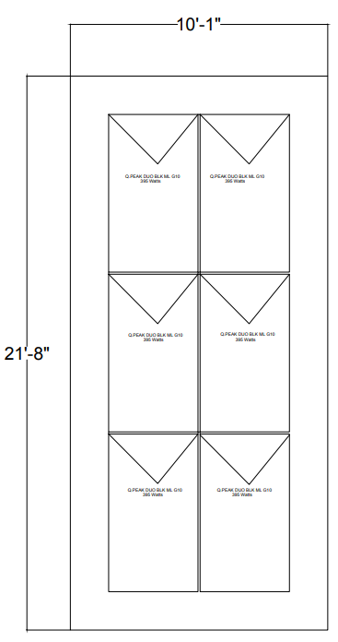
PV Installation Labs
Design the layout:
To have 18” all around for clearance and 1” between modules for clamps the roof segment needs to be 10’1” x 21’8”
Picture courtesy author

Slide 12
PV Installation Labs
1 inch between modules to
allow for the clamps.
18 inches between modules
and roof edges.
Draw the modules on a
separate layout drawing.
Include dimensions.
Picture courtesy author

Slide 13
PV Installation Labs
Now that the placement of the modules are established it is time to find where the rails and clamps will be placed.
In the Q.PEAK manufacturer installation manual.

Slide 14
PV Installation Labs
Provides the possible mounting options.
Bolt through or clamps
Rail positions
The effect of spacing and mounting options for the strength the module will have on the roof.

Slide 15
PV Installation Labs
Two methods are suggested:
Point mounting and linear mounting.
Point mounting is when the rails touch the module frame at a single connection point as in bolt through or clamp.
Linear mounting is when the rail runs along the length of the module frame.

Slide 16
PV Installation Labs
Point mounting system:
There is a code placed by each mounting method giving the strength to the roof.
In the next slide there are two options each with their own code.
From the PV module installation manual CL1a and CL1b are the provided codes.

Slide 17
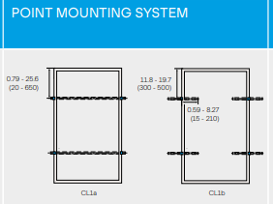
PV Installation Labs
Point mounting system:
20-550mm
Suggested
mounting
distance
from edges
Picture courtesy QPEAK

Slide 18
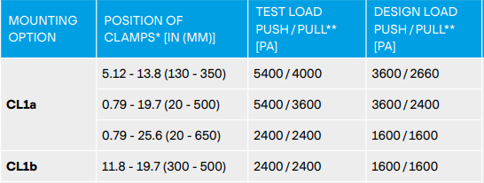
PV Installation Labs
Point mounting system:
Note the positions of clamps need to be in specific range.
Picture courtesy QPEAK

Slide 19
PV Installation Labs
Point mounting system:
CL1a uses full length contact per rail.
CL1b uses two smaller pieces of rail.
For this lab CL1a will be followed
Picture courtesy QPEAK

Slide 20
PV Installation Labs
Point mounting system:
Spacing between the clamps along the long side of the module (span) must not be larger than 1400mm
1879mm – 1400mm = 479 mm
Divide 479mm by 2 gives the closest the clamps can be to the top and bottom edge of the module frame.
239.5mm is minimum distance (slide 17 says 20mm -550mm)(slide 18 for maximum strength 130mm – 350mm)

Slide 21
PV Installation Labs
For maximum strength 130mm – 350mm is to be used.
1879mm – 350mm - 350mm = 1179mm which is less than the 1400mm maximum span between points of attachment.
At 130mm the span between points of attachment is greater than 1400mm.

Slide 22
PV Installation Labs
The minimum distance is 240mm to a maximum distance of 350mm is the range for meeting the CL1a criteria.
240mm represents a 13% - 74% - 13% spacing.
350mm represents a 19% - 62% - 19% spacing.
In a previous module the 20% - 60% -20% spacing was introduced as a general guide for clamp positions
On your roof drawing mark out the rail positions so as to meet these conditions.

Slide 23
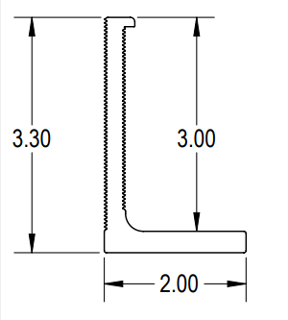
PV Installation Labs
The L-Bracket must now be positioned on the rafter to allow the rail to be at the dimensions you determined.
This is just an example.
2.00 inches at base and hole
Is very close to center of bracket.
1 inch = 25.4 mm.
Rail is mounted at top face of bracket.
Picture courtesy IronRidge

Slide 24
PV Installation Labs
Rail goes above the L-Bracket
Picture courtesy Author
Picture courtesy IronRidge

Slide 25
PV Installation Labs
On your drawing mark with dimensions where the L-brackets and rails will be placed on the roof section.
Before mounting any of the L-brackets, check all other drawings between the lab groups. To ensure they are all compatible.
All groups will be sharing the same rails.

Slide 26
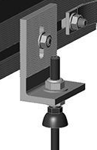
Racking and Mounting
The screw that will penetrate the roof sheathing usually has a rubber or rubber like gasket to provide water proof seal.
Every manufacturer has their own
gasket.
EJOT provides fasteners for
solar applications.
Sealing gasket.
Picture courtesy HESPV.ca

Slide 27
PV Installation Labs
After comparing and coming to an agreement, mount the L-Brackets and flashing.
Update any of your drawing to match the actual mounting plan.
Attach the rails and ensure they are level.
Tighten to manufacturers specifications.
Torque wrench is required.

Slide 28
PV Installation Labs
Questions?

Slide 29
PV Installation Labs
Lab 2 Microinverter Mounting
This lab will allow for the microinverters to be mounted on the rails.
Electrical wiring and bond wiring is also included in this lab.

Slide 30
PV Installation Labs
The Microinverter used is the Enphase IQ 7A.
Mounting instructions are found in the file “IQ 7 Installation Manual”
The microinverters are mounted before the PV modules.

Slide 31
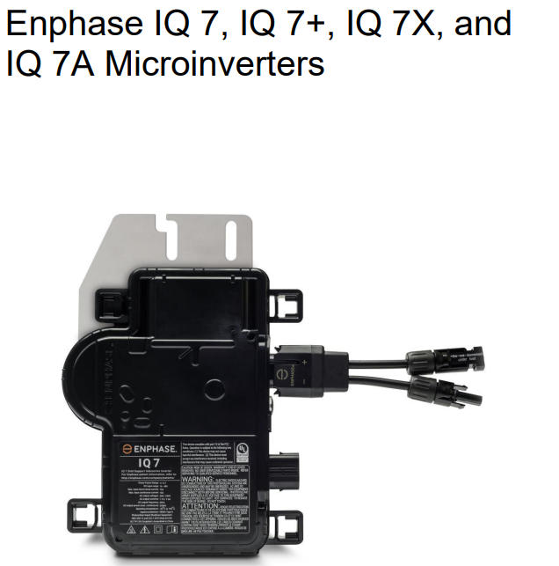
PV Installation Labs
First page of the installation manual.
Enphase Installation Manual

Slide 32
PV Installation Labs
Instructors need to read and discuss the section on safety first. Pages 5-7.
Safety Symbols that are used throughout the manual are explained.
Important instructions for handling of the cables.

Slide 33
PV Installation Labs
The Enphase IQ system is comprised of the following:
Enphase IQ 7, IQ 7+, IQ 7X and IQ 7A Microinverters. The smart grid ready IQ Series Microinverters convert the DC output of the PV module into grid-compliant AC power.
This is the microinverter itself.

Slide 34
PV Installation Labs
The Enphase IQ system is comprised of the following:
Enphase Envoy-S™. Model ENV-S-WB230-F, -G, or -I for single-phase installations. The Enphase Envoy-S is a communication device that provides network access to the PV array.
Our installation will not include this monitoring device.

Slide 35
PV Installation Labs
The Enphase IQ system is comprised of the following:
Enphase Enlighten™ web-based monitoring and management software. Installers can use Enlighten Manager to view detailed performance data, manage multiple PV systems, and remotely resolve issues that might impact system performance.
Our installation will not use this web-based tool.

Slide 36
PV Installation Labs
The Enphase IQ system is comprised of the following:
Enphase Installer Toolkit™ mobile app for iOS and Android devices. It allows installers to configure the system while onsite.
Our system will not be using this application.

Slide 37
PV Installation Labs
The Enphase IQ system is comprised of the following:
Enphase Battery(ies) offer energy storage solutions.
Our system does not include batteries.

Slide 38
PV Installation Labs
The Enphase IQ system is comprised of the following:
Enphase Field Wireable connectors (Q-CONN-R-10F and Q-CONN-R-10M) make connections from any Q Cable, or open Field Wireable connector.
Not required in our system.

Slide 39
PV Installation Labs
Cables, caps and tools included to support the installation on the roof are:
Enphase Q-12-10-240, Q Cable 1.3m (4.2ft), for portrait modules 12 each.
Enphase Q-12-17-240, Q Cable 2.0m (6.5ft), for landscape 60-cell modules 12 each.
Allows the installation for both module orientations.

Slide 40
PV Installation Labs
Cables, caps and tools included to support the installation on the roof are:
Enphase Q-TERM-10, Q Cable termination cap, one needed for each unused cable end 6 each
Enphase Q-SEAL-10, Q Cable sealing cap, one needed to cover each unused connector on the cabling 6 each
Enphase Q-DISC-10, Q Cable disconnect tool 6 each

Slide 41
PV Installation Labs
Questions?

Slide 42
PV Installation Labs
Planning for Microinverter Installation
The IQ 7+ and IQ 7A Microinverters support PV modules with 60 cells / 120-half-cells or 72 cells / 144-half-cells.
Verify that the Qcells meet this requirement.
All install quickly and easily.

Slide 43
PV Installation Labs
The microinverter housing is designed for outdoor installation and complies with the IP67 environmental enclosure rating standard:
IP67 rating definition: Indoor or outdoor use primarily to provide a degree of protection against hose-directed water, the entry of water during occasional temporary submersion at a limited depth, and damage from external ice formation

Slide 44
PV Installation Labs
The Enphase Q Cable is available in multiple connector spacing options for landscape and portrait orientations to meet varying site requirements.
This lab the portrait orientation of the modules is being used.
Refer to the “Roof Section” drawing that shows the orientation of the 6 modules.

Slide 45
PV Installation Labs
Grounding Considerations
The IQ Series Micros do not require grounding electrode conductors (GEC) or equipment grounding conductors (EGC).
Your Authority Having Jurisdiction (AHJ) may require you to bond the mounting bracket to the racking.
If so, use earthing hardware or star washers.

Slide 46
PV Installation Labs
Earthing hardware or star washers.
The WEEB washer or a star washer is the bonding device between the microinverter and the rail to which the microinverter is mounted to.

Slide 47
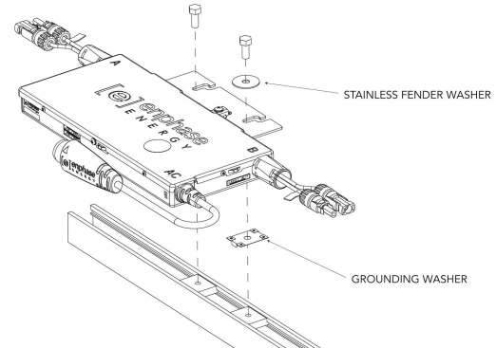
PV Installation Labs
WEEB grounding washer.
Enphase Installation Manual

Slide 48
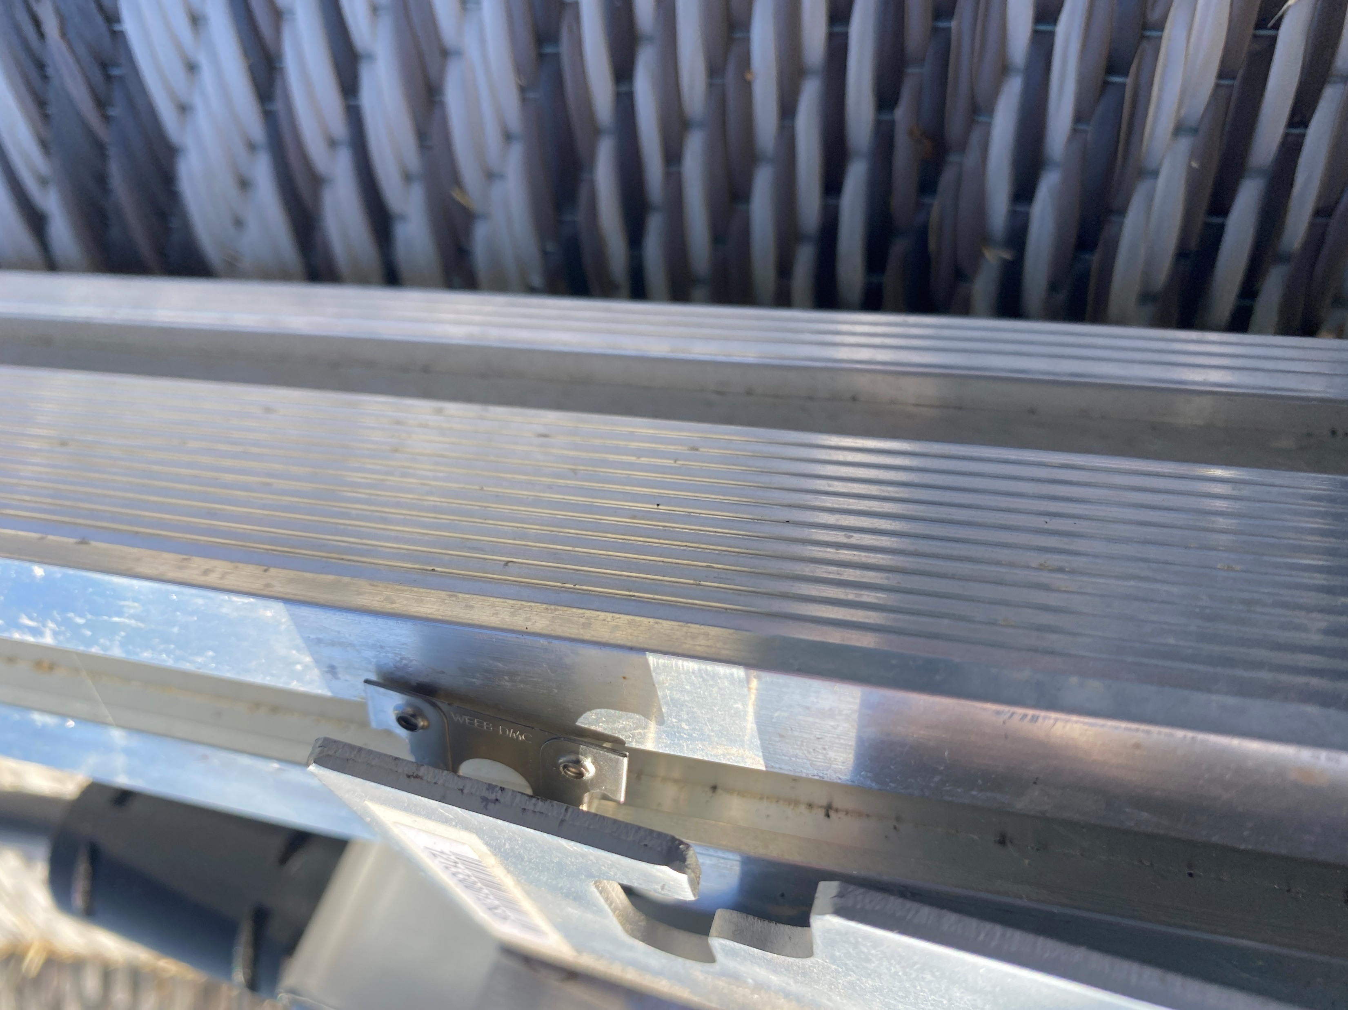
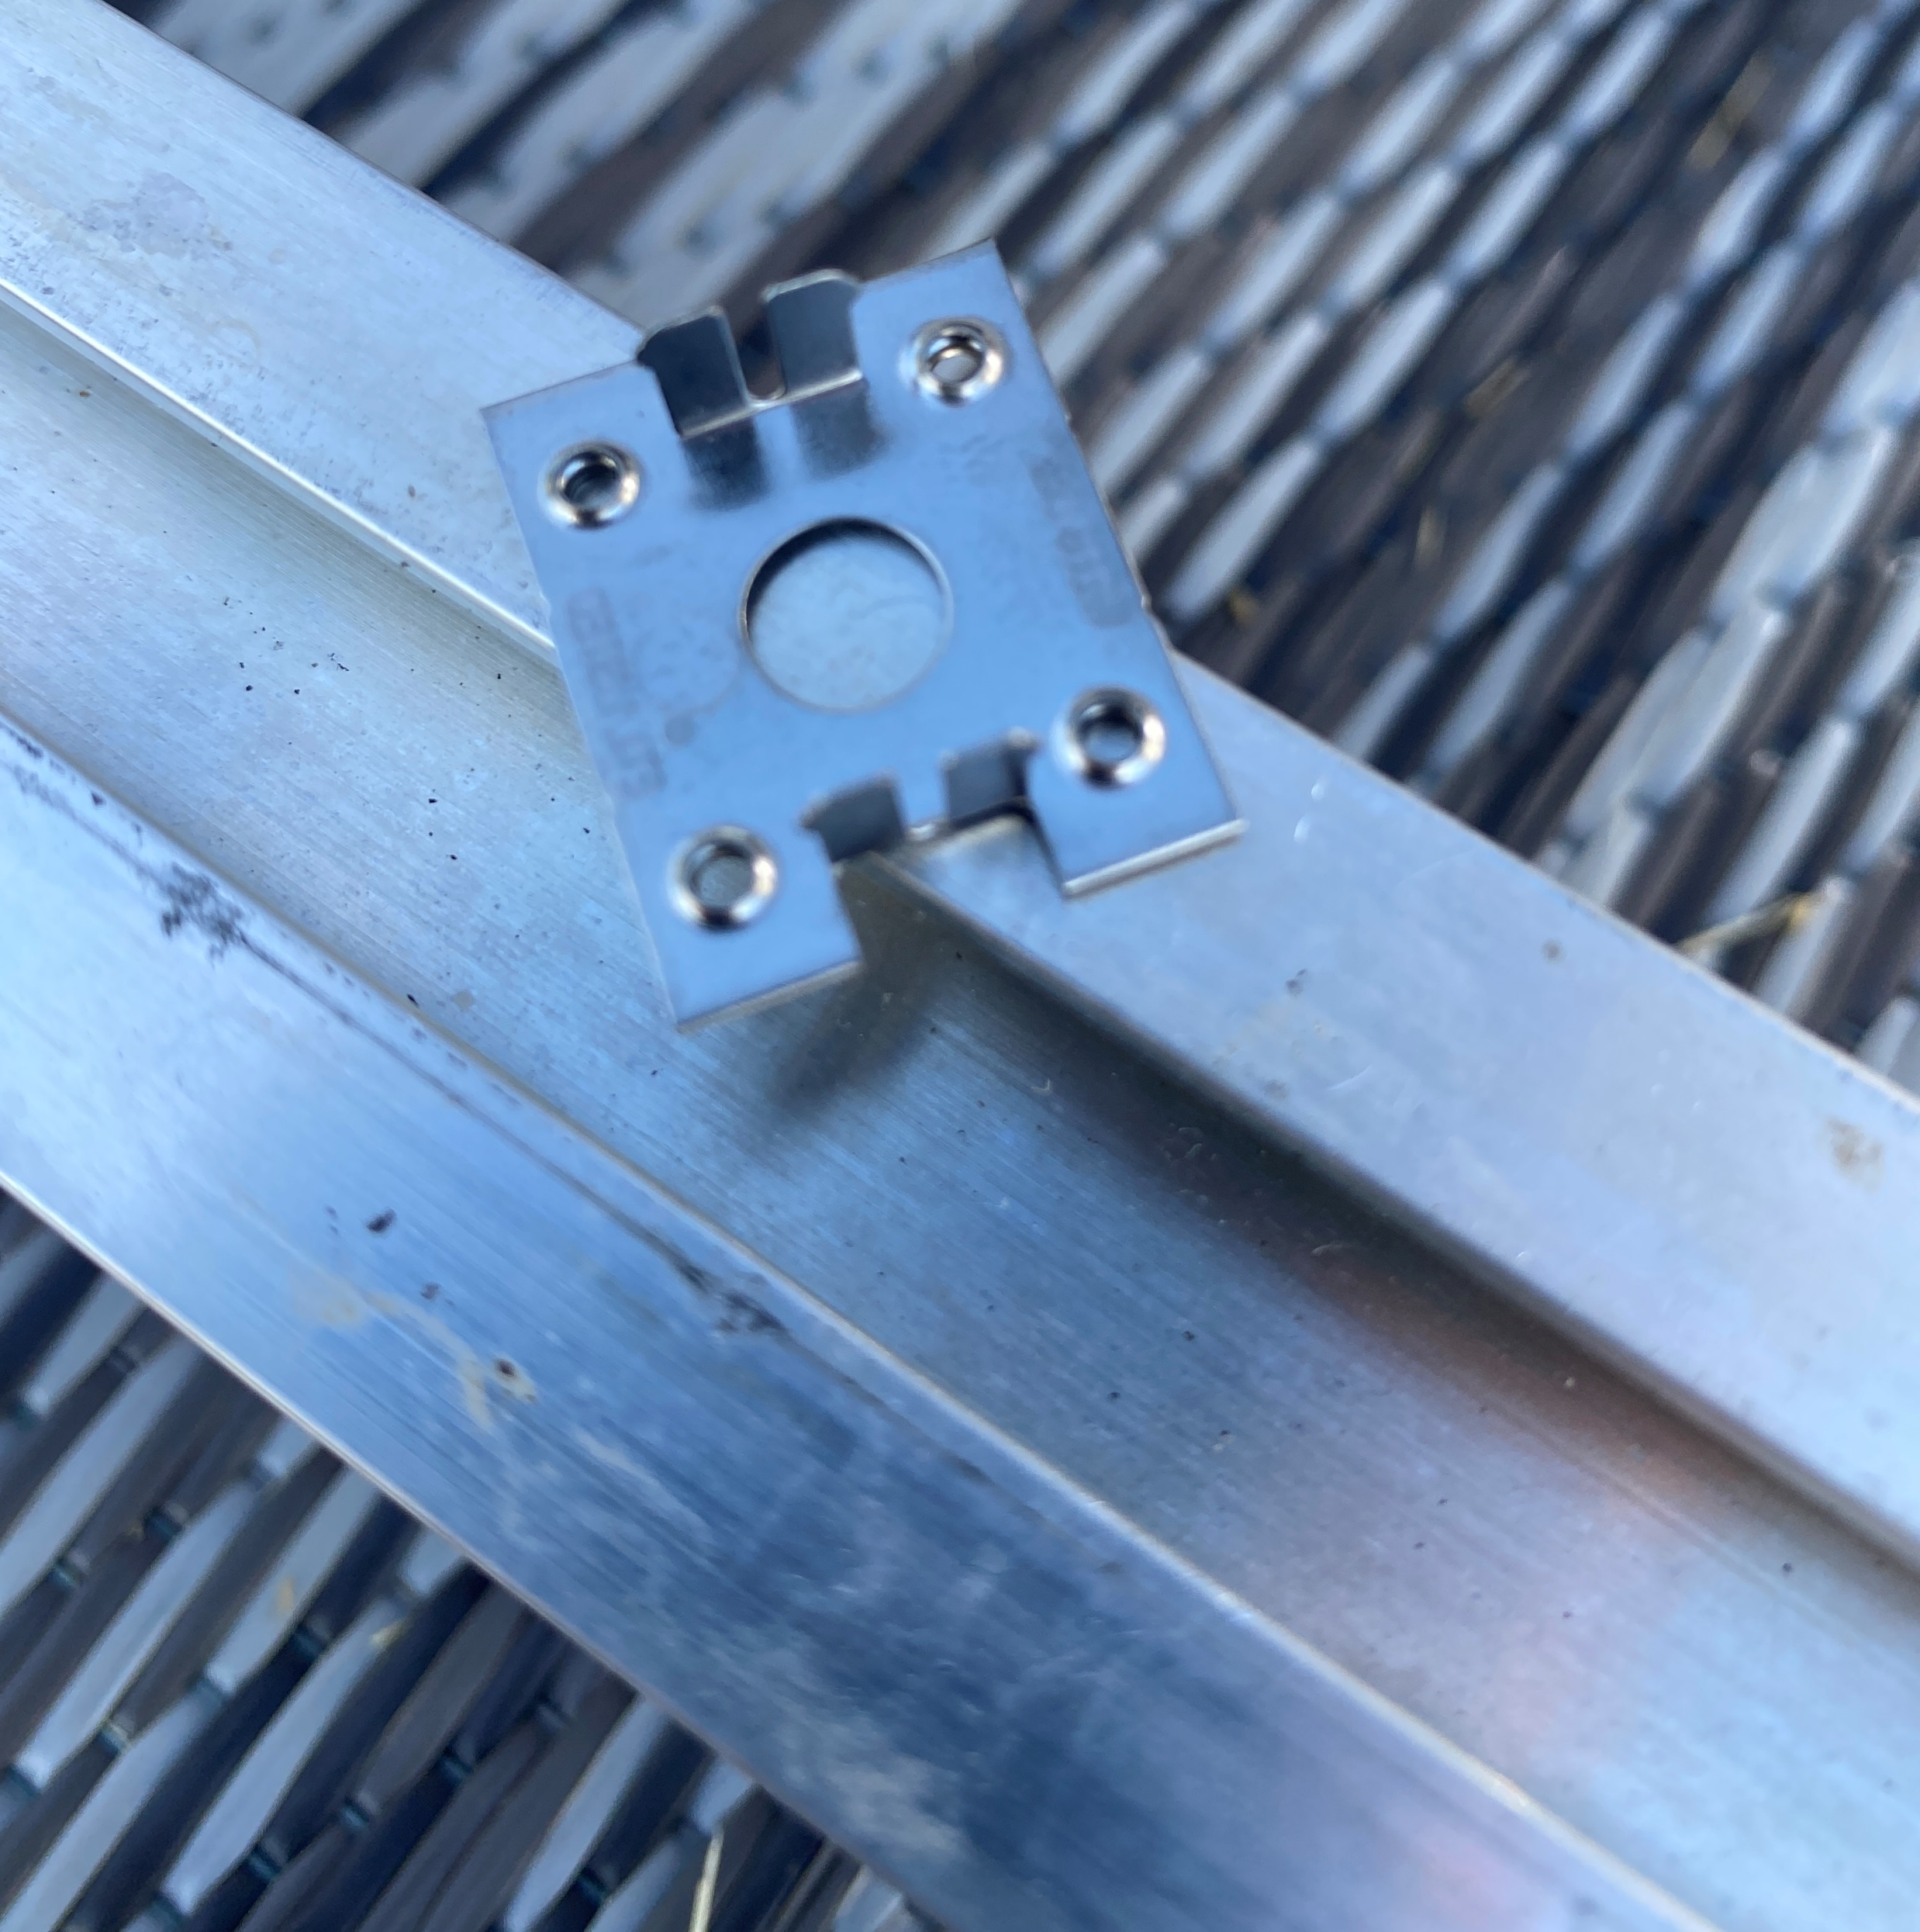
Racking Microinverters
The WEEB going under the microinverter.
Pictures courtesy author

Slide 49
PV Installation Labs
Questions?

Slide 50
PV Installation Labs
Branch Circuit Capacity
Plan your AC branch circuits to meet the following limits for maximum number of microinverters per branch when protected with a 20-amp over-current protection device (OCPD).
The lab will use 6 microinverters, under the 11 limit.
Enphase Installation Manual

Slide 51
PV Installation Labs
Wire Lengths and Voltage Rise When planning the system.
You must select the appropriate AC conductor size to minimize voltage rise.
Select the correct wire size based on the distance from the beginning of the microinverter AC branch circuit to the breaker in the load center.

Slide 52
PV Installation Labs
This exercise was part of a previous assignment.
There will be a lab where the microinverter output circuit is going to be connected to the schools AC.
In this lab the wire size calculation will be completed.

Slide 53
PV Installation Labs
Parts and Tools Required In addition to the microinverters.
Tie wraps or Cable Clips (ET-CLIP-100)
Enphase Sealing caps (Q-SEAL-10) for any unused drops on the Enphase Q Cable.
Enphase Terminator (Q-TERM-R-10 for single phase) One for each AC cable segment end; typically, two needed per branch circuit.
Enphase Disconnect Tool (Q-DISC-10)
Enphase Q Cable:

Slide 54
PV Installation Labs
Other Items:
Field Wireable Connectors (Q-CONN-R-10M and Q-CONN-R-10).
Number 2 and 3 screwdrivers.
Wire cutters, voltmeter.
Torque wrench, sockets, wrenches for mounting hardware

Slide 55
PV Installation Labs
Installing the Enphase IQ Series Micros involves several key steps.
Step 1: Position the Enphase Q Cable
Step 2: Position the Junction Box
Step 3: Mount the Microinverters
Step 4: Create an Installation Map

Slide 56
PV Installation Labs
Step 5: Manage the Cabling
Step 6: Connect the Microinverters
Step 7: Terminate the Unused End of the Cable
Step 8: Complete Installation of the Junction Box
Step 9: Connect the PV Modules
Step 10: Energize the System

Slide 57
PV Installation Labs
Enphase Installation Manual

Slide 58
PV Installation Labs
Questions?

Slide 59
PV Installation Labs
Step 1: Position the Enphase Q Cable:
A. Plan each cable segment to allow drop connectors on the Enphase Q Cable to align with each PV module. Allow extra length for slack, cable turns, and any obstructions.
(Do not bolt the microinverters yet) (Go back and read important instruction on handling the Q cables)

Slide 60
PV Installation Labs
B. Mark the approximate centers of each PV module on the PV racking.
(Align the PV module cable so as they will connect to the microinverter)

Slide 61
PV Installation Labs
C. Lay out the cabling along the installed racking for the AC branch circuit.
This needs to be thought out, which end of the array will the AC circuit wire be entering the array.

Slide 62
PV Installation Labs
D. Cut each segment of cable to meet your planned needs.
In this lab no wire segments shall be cut.
WARNING: When transitioning between rows, secure the cable to the rail to prevent cable damage or connector damage. Do not count on connector to withstand tension.

Slide 63
PV Installation Labs
Step 2: Position the Junction Box
This is the AC branch circuit junction box connecting the AC Q cables to the wire going to the AC in the lab area.
Mount to racking if possible.

Slide 64
PV Installation Labs
The bonding wire will terminate in the junction box.
It will connect to the cable ground wire and run to the grounding bus in the panel.
This bonding wire will be # 6 AWG from the rails to the junction box.
A stainless steel lay-in lug with a WEEB or star washer is used per rail.

Slide 65
Racking and Mounting
Bonding wire and connectors.
In a previous module we discussed the Lay-in lug as the preferred way to bond the rail to the grounded bonding wire.
Each rail must be
bonded together.
# 6 AWG or #16 metric.
Picture courtesy Author

Slide 66
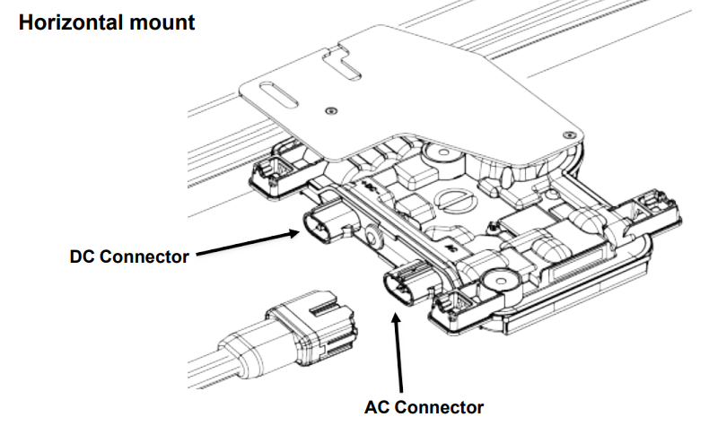
PV Installation Labs
Step 3: Mount the Microinverters
Enphase Installation Manual

Slide 67
PV Installation Labs
Step 3: Mount the Microinverters
A. If the Enphase DC bulkhead connectors are not already attached to the microinverters, attach them now. Make sure they are fully seated.
B. Mount the microinverter bracket side up (as shown) and under the PV module, away from rain and sun. Allow a minimum of 1.9 cm between the roof and the microinverter. Also allow 1.3 cm between the back of the PV module and the top of the microinverter.

Slide 68
PV Installation Labs
WARNING: Install the microinverter under the PV module to avoid direct exposure to rain, UV and other harmful weather events. Do not mount the microinverter upside down.
C. Torque the microinverter fasteners as follows. Do not over torque.
6 mm mounting hardware: 5 N m
8 mm mounting hardware: 9 N m

Slide 69
PV Installation Labs
Step 4: Create an Installation Map
The Enphase Installation Map is a diagram of the physical location of each microinverter in your PV installation.
Copy or use the blank map on page 39 (of the installation manual) to record microinverter placement for the system or provide your own layout if you require a larger or more intricate installation map.

Slide 70
PV Installation Labs
Each Enphase Microinverter have a removable serial number label.
Build the installation map by peeling the serial number labels from the microinverter mounting plates and placing the labels on the map.
(Not for this Lab)

Slide 71
PV Installation Labs
Peel the removable serial number label from each microinverter and affix it to the respective location on the paper installation map.
Always keep a copy of the installation map for your records.
For this lab, the labels will remain on the microinverters for future labs.

Slide 72
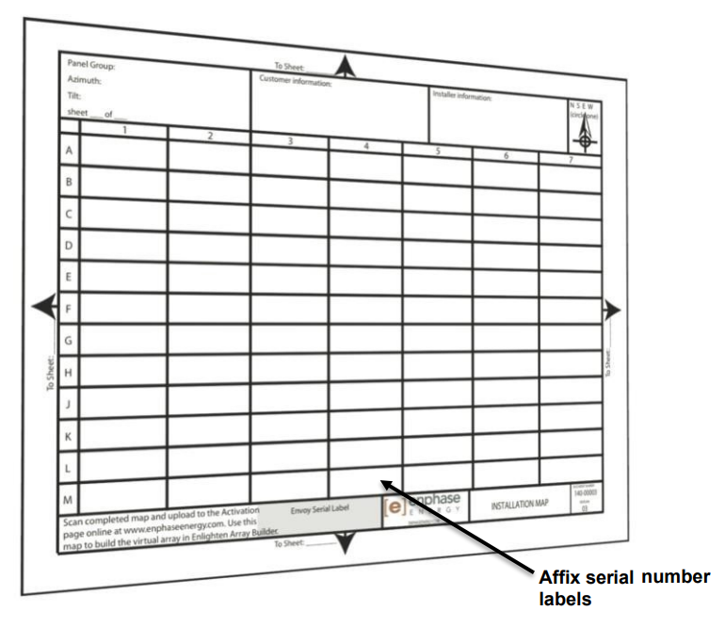
PV Installation Labs
Peel the removable serial number label from each microinverter and affix
it to the respective
location on the
paper installation
map.
For this Lab,
write down the
microinverter
serial numbers
Enphase Installation Manual

Slide 73
PV Installation Labs
Questions?

Slide 74
PV Installation Labs
Step 5: Manage the Cabling
A. Use cable clips or tie wraps to attach the cable to the racking. Leave no more than 1.8 m between cable clips or tie wraps.
Dress any excess cabling in loops so that it does not contact the roof.
Do not form loops smaller than 12 cm in diameter.

Slide 75
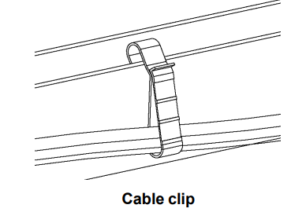
PV Installation Labs
Step 5: Manage the Cabling.
Different clips for different racking.
Enphase Installation Manual

Slide 76
PV Installation Labs
Step 6: Connect the Microinverters
A. Connect the microinverter. Listen for a click as the connectors engage.
B. Cover any unused connector with Enphase Sealing Caps.
Listen for a click as the connectors engage.

Slide 77
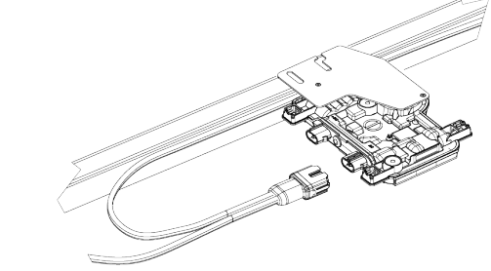
PV Installation Labs
Step 6: Connect the Microinverters
Enphase Installation Manual

Slide 78
PV Installation Labs
WARNING: Risk of electric shock. Risk of fire.
Install sealing caps on all unused AC connectors as these connectors become live when the system is energized.
Sealing caps are required for protection against moisture ingress.
NOTE: If you need to remove a sealing cap.

Slide 79
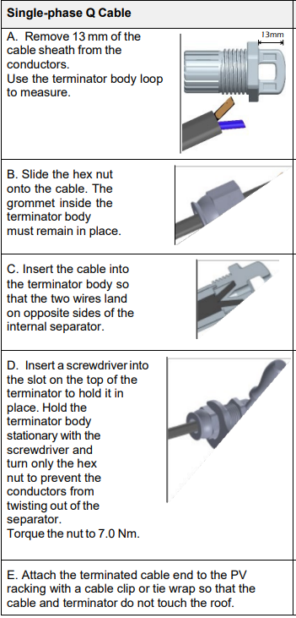
PV Installation Labs
Step 7: Terminate the
Unused end of the cable.
Terminate the unused end
of the Enphase Q Cable as
follows:
Enphase Installation Manual

Slide 80
PV Installation Labs
Step 8: Complete Installation of the Junction Box
A. Connect the Enphase Q Cable into the junction box.
Q Cable uses the following color code:
Enphase Installation Manual

Slide 81
PV Installation Labs
The following slide is a complete schematic of the install.
It does show the Envoy S which is not part of this lab.

Slide 82
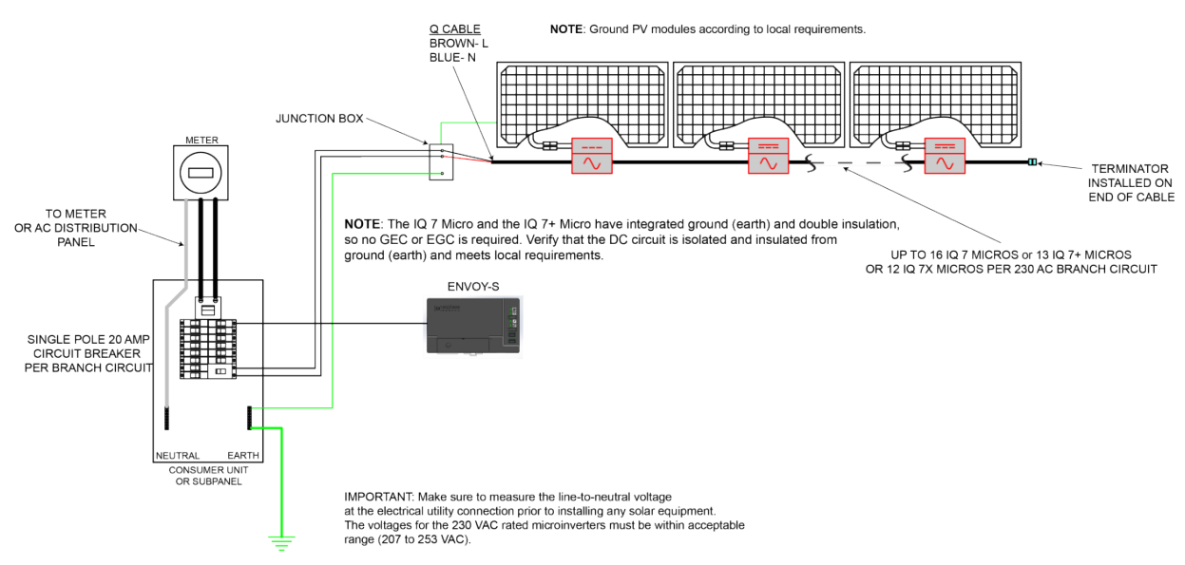
PV Installation Labs
Step 8: Complete Installation of the Junction Box
Enphase Installation Manual

Slide 83
PV Installation Labs
Step 8: Complete Installation of the Junction Box
The terminator installed at the last microinverter.
Enphase Installation Manual

Slide 84
PV Installation Labs
Questions?

Slide 85
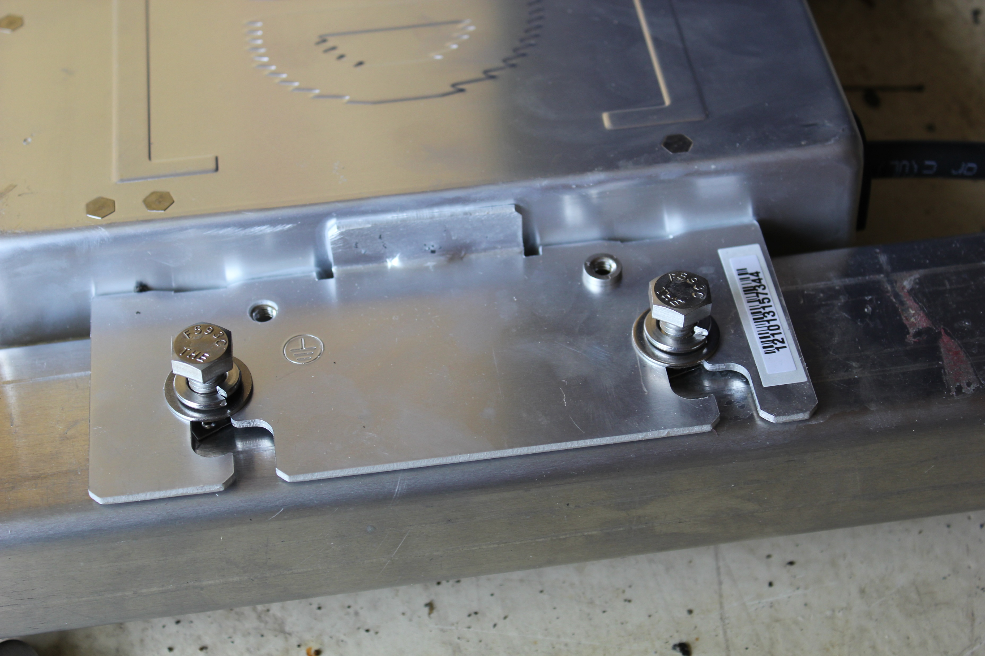
PV Installation Labs
Picture courtesy Author

Slide 86
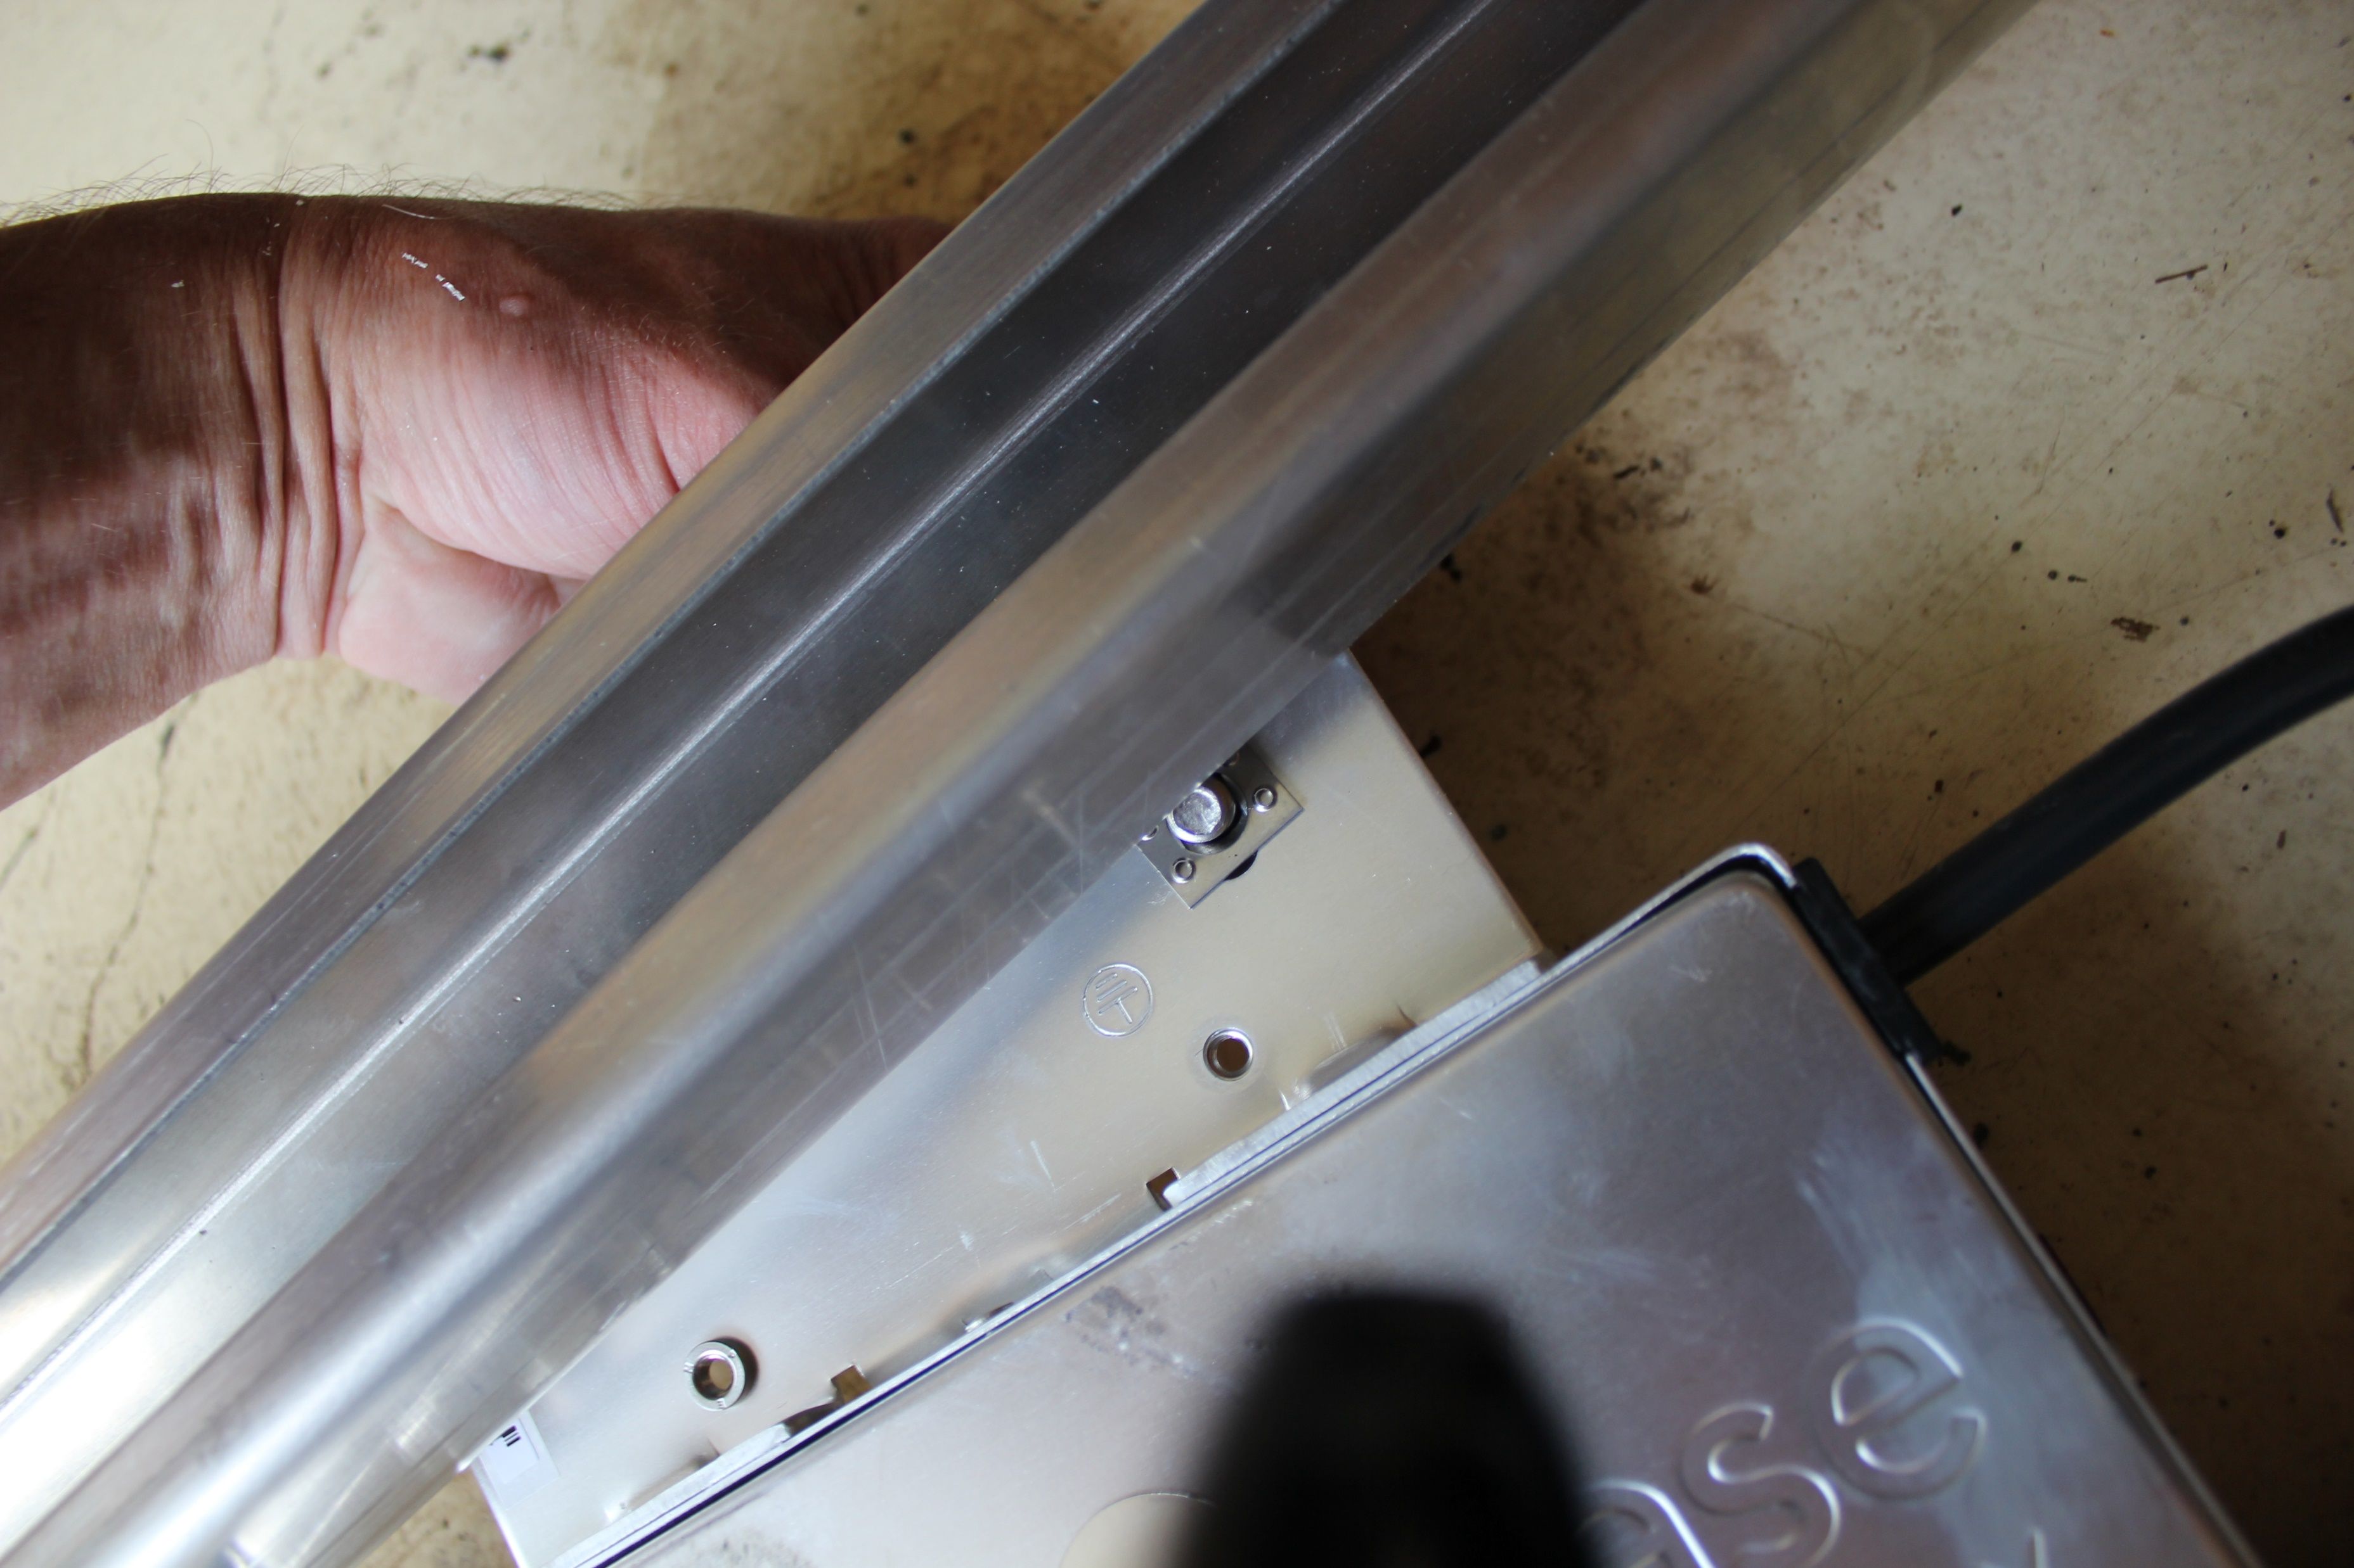
PV Installation Labs
Picture courtesy Author

Slide 87
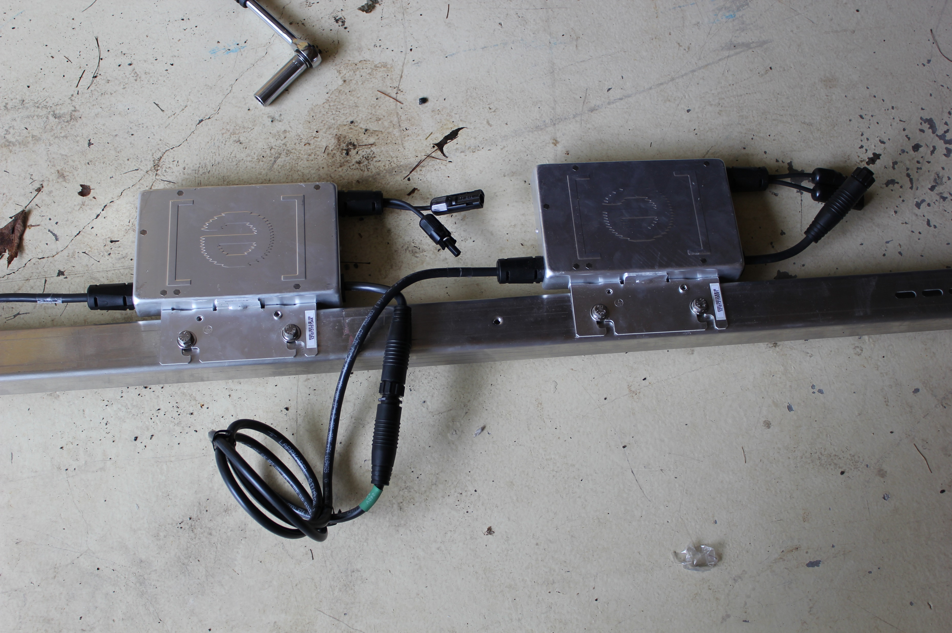
PV Installation Labs
Picture courtesy Author

Slide 88
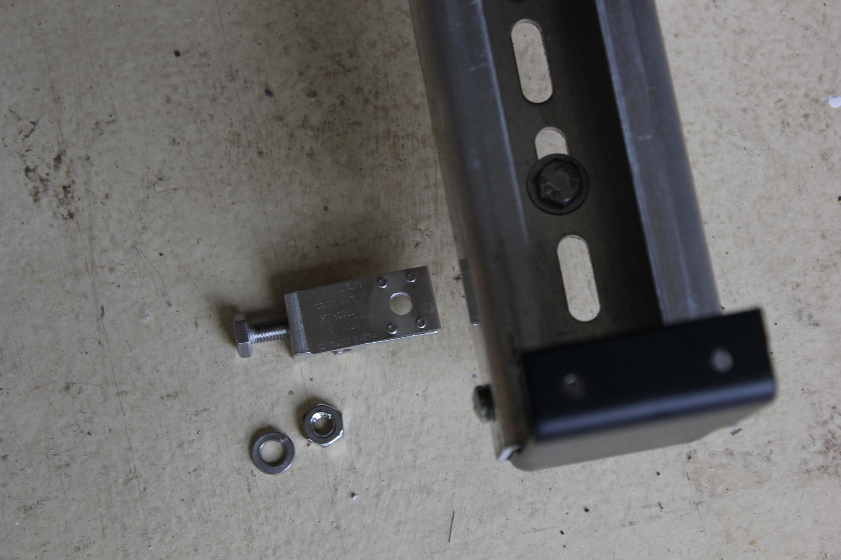
PV Installation Labs
Picture courtesy Author

Slide 89
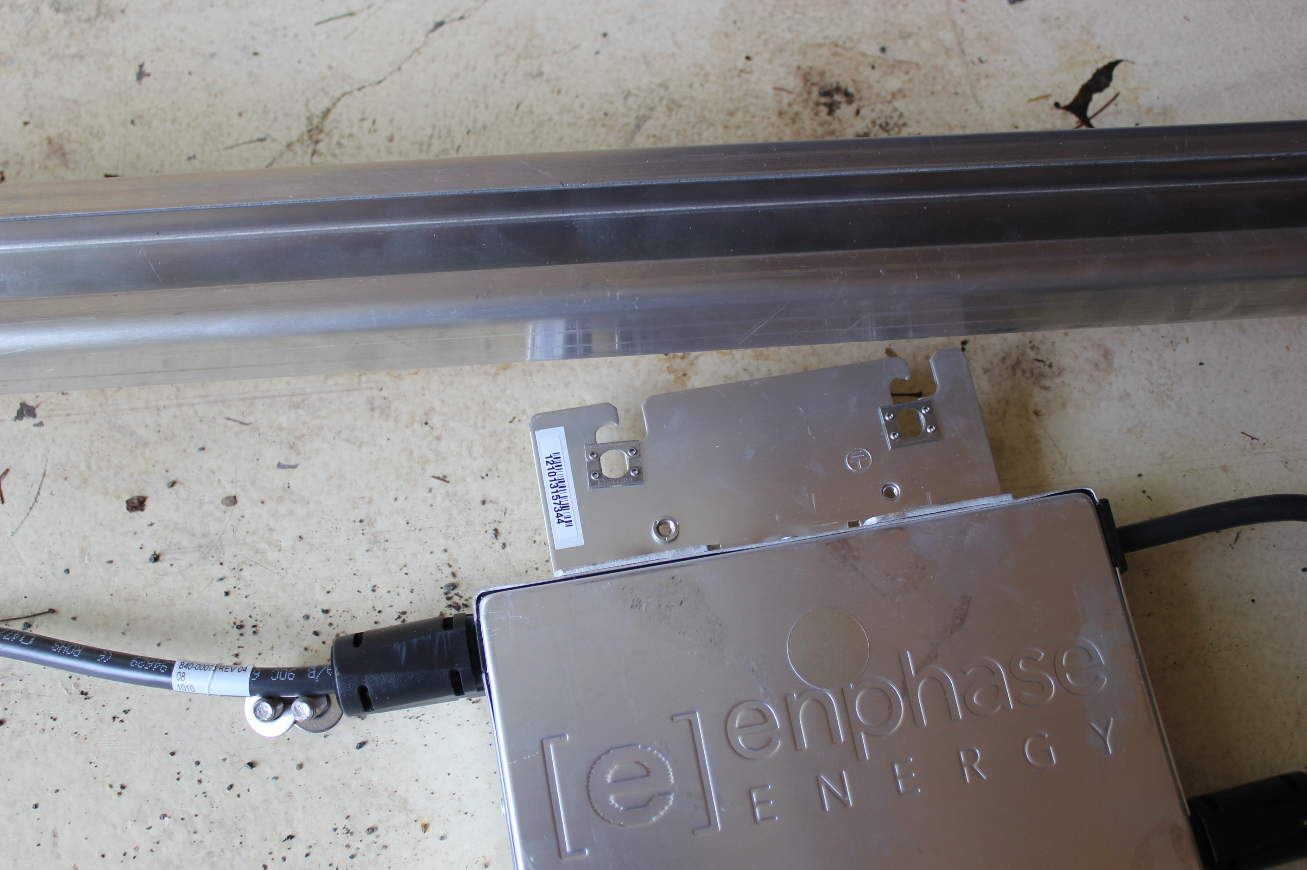
PV Installation Labs
Picture courtesy Author

Slide 90
PV Installation Labs
Lab 3 Module Mounting
This lab will demonstrate how the Qcell PV modules will connect to the microinverters and to the racking.
During the racking / rail installation the Qcell 395 Watt modules gave information on mounting options in their installation manual.

Slide 91
PV Installation Labs
At this point the rails have been attached to the L-Brackets
The microinverters are attached to the rails.
The bonding wire is attached to the rails and back to the junction box.
Last steps are the PV Modules connecting to the microinverters and to the rails.

Slide 92
PV Installation Labs
This lab will use the point mounting system using clamps to secure the modules to the rails.
The strongest method will be used for this lab.
Clamp dimensions are provided in the Qcell installation manual.

Slide 93
PV Installation Labs
Point mounting system:
Note that the minimum clamp dimensions are given.
Width at 40mm clamp depth at 10mm
Picture courtesy QPEAK

Slide 94
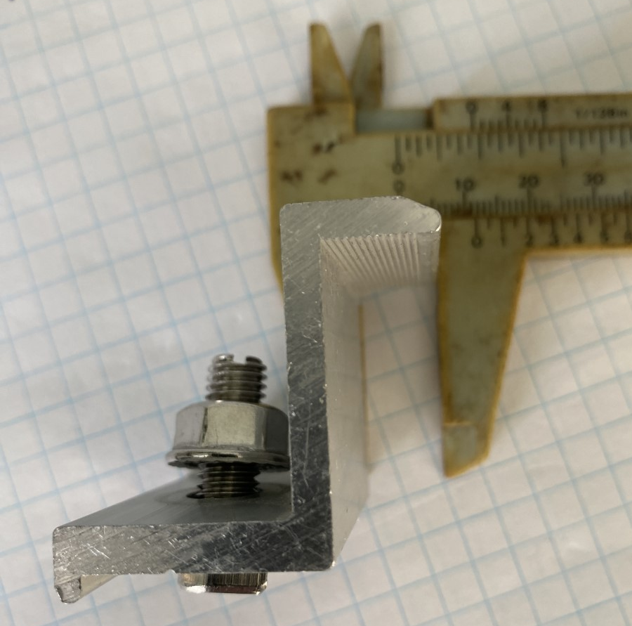
PV Installation Labs
Point mounting system:
Clamp depth at 10mm
Picture courtesy Author

Slide 95
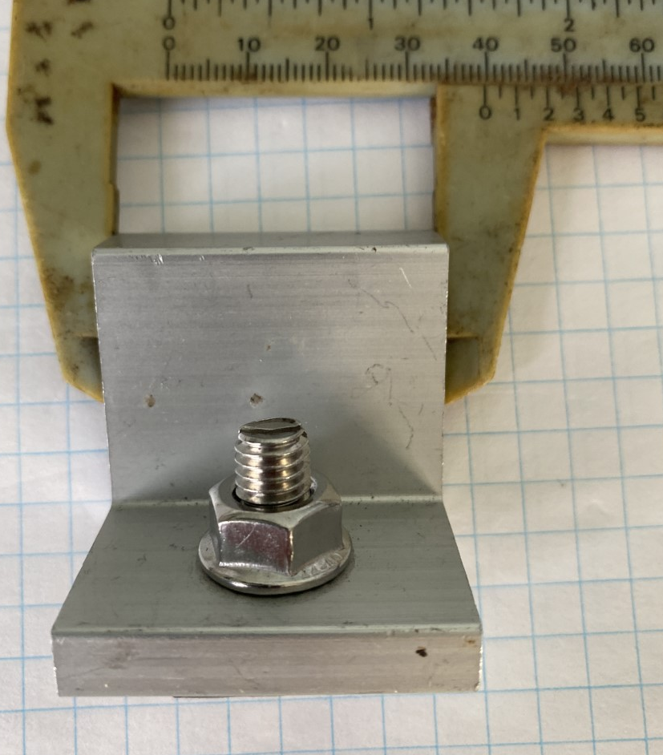
PV Installation Labs
Point mounting system:
Clamp width at 40mm
Picture courtesy Author

Slide 96
PV Installation Labs
Point mounting system:
Clamp height at 32mm
Same as module.
Picture courtesy QPEAK

Slide 97
PV Installation Labs
Point mounting system:
Clamp height at 32mm
Same as module.
Picture courtesy Author

Slide 98
PV Installation Labs
Continuing from the Enphase installation manual:
Step 9: Connect the PV Modules WARNING: Electrical shock hazard. The DC conductors of this photovoltaic system are ungrounded and may be energized.
A. Connect the DC leads of each PV module to the DC input connectors of the corresponding microinverter.

Slide 99
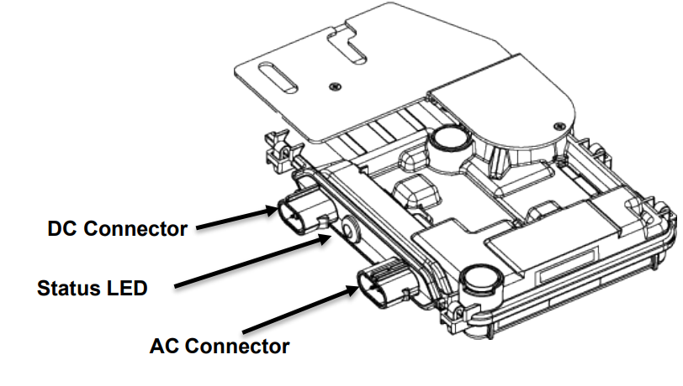
PV Installation Labs
B. Check the LED on the connector side of the microinverter. The LED flashes six times when DC power is applied.
Enphase Installation Manual

Slide 100
PV Installation Labs
C. Mount the PV modules above the microinverters
The Qcell installation manual guides this process.

Slide 101
PV Installation Labs
Use customary clamps that satisfy the following requirements:
Clamp width: ≥1.5in (38mm).
Clamp height compliant with a 1.26in (32mm) frame height.
Clamp depth: 0.28-0.47 in (7-12 mm). (“applicable for all CL clamping mounting options at section 2.3 Mounting Options“)

Slide 102
PV Installation Labs
Clamps are not in contact with the front glass.
Clamps do not deform the frame.
Clamps that satisfy the structural requirements based on the conditions of the installation site according to the applicable regulations and technical standards.
Long-term stable clamps that securely affix the module to the mounting frame.

Slide 103
PV Installation Labs
Module Orientation Requirements
Vertical or horizontal installation is permitted.
Ensure that rain and melting snow can run off freely. No water accumulation.
Ensure that the drainage holes in the frame are not covered. No sealing.

Slide 104
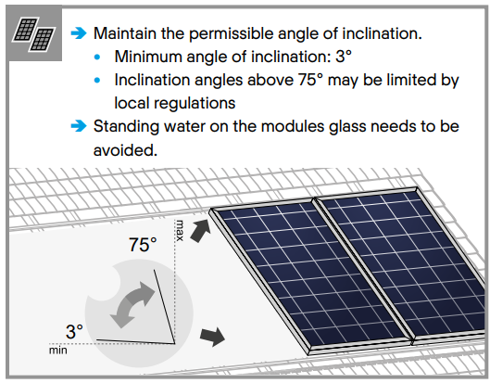
PV Installation Labs
Follow the Qcell installation manual
Qcell Installation Manual

Slide 105
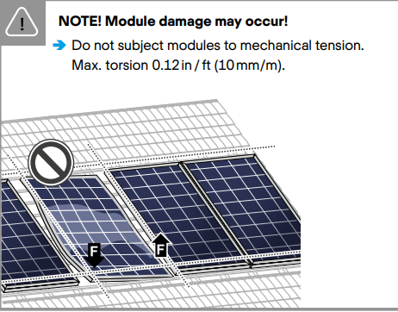
PV Installation Labs
Place modules in sequence. One at a time.
Plan the placement and set out a written plan when each module is to be
mounted.
Qcell Installation Manual

Slide 106
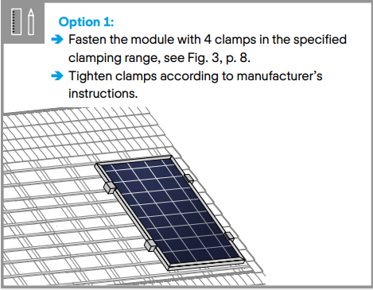
PV Installation Labs
The clamps must be tightened to their manufacturer's specifications.
The use of a
torque wrench
is mandatory.
Qcell Installation Manual

Slide 107
PV Installation Labs
Stainless steel fasteners tend to gall while being tightened.
The risk of galling or thread seizing can be reduced by:
Using lubrication
Tighten fasteners with low rpm’s, without interruptions
Apply only light pressure

Slide 108
PV Installation Labs
The clamps are designed to hold the PV module in place.
The stainless-steel bolt should not be over torqued as galling will result and the bolt may break off if it is removed.
Manufacturers suggest anywhere from 11 – 22 N-m.
For #6 (1/4”) use lower end value
For #10 (3/8”) use higher end value
This is only a suggested range

Slide 109
PV Installation Labs
Grounding / bonding through the clamp.
Proper grounding is achieved by bonding all exposed non-current carrying metal equipment to the appropriately sized equipment grounding conductor (EGC) or racking system that can be used for integrated grounding.

Slide 110
PV Installation Labs
Q CELLS frames are protected from corrosion with an anodized coating, which has to be penetrated in order to ensure proper bonding.
The different methods listed below are suggested methods for an appropriate bond between the frame and the EGC or racking system (that will have to be properly grounded).
The method appropriate for any individual installation will depend on multiple factors.

Slide 111
PV Installation Labs
Option A: Use of a grounding lug A listed grounding lug can be bonded to the frame using the grounding holes pre-drilled in the frame.
These holes are marked with a ground symbol, as shown below on the frame section drawing:
To install the grounding lug, follow the specified instructions of the manufacturer.
The grounding lug should be made of stainless steel or tin plated metals such as aluminum to avoid corrosion

Slide 112
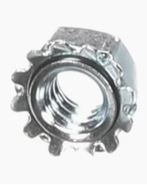
PV Installation Labs
The grounding lug should be attached to the frame grounding hole using a stainless-steel screw, toothed lock washer or KEPS nut (in order to penetrate the anodized layer) and backing nut.
Care should be taken to avoid
the use of grounding hardware
of dissimilar metals, which may
lead to corrosion.
Picture courtesy Author

Slide 113
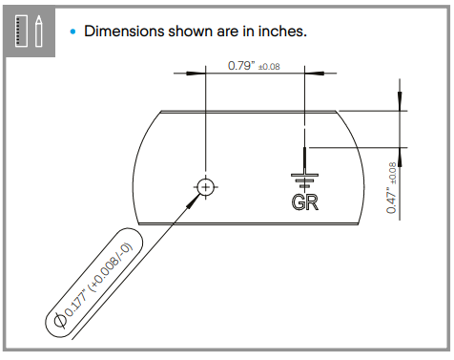
PV Installation Labs
The grounding lug should be attached to the frame grounding.
Qcell Installation Manual

Slide 114
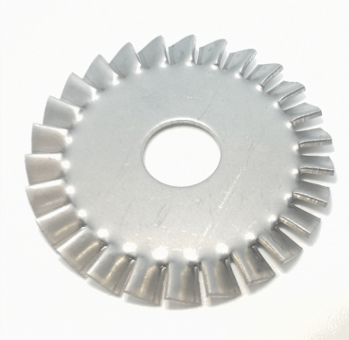
PV Panel Construction
The stainless steel device can be a star washer that penetrates into the aluminum.
Apply anti-oxidant paste between washer and the panel’s aluminum frame.
Image courtesy author

Slide 115
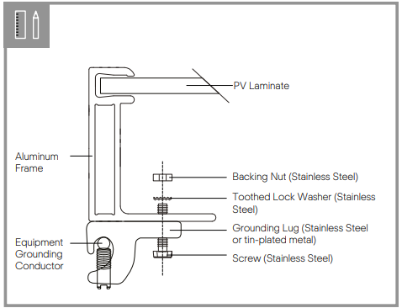
PV Installation Labs
The lay in lug with star washer to penetrate the anodized coating of the Qcell module.
Qcell Installation Manual

Slide 116
PV Installation Labs
Option B: Integrated grounding methods.
The Q CELLS modules can be bonded with the racking system using integrated grounding methods.
The racking system will then have to be grounded so that the overall system is properly grounded.
An example of such integrated grounding method is the use of a WEEB clip between the module and the racking system, when mounting the module.

Slide 117
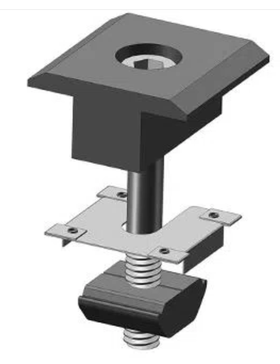
PV Installation Labs
The module frame to rail bond requires a washer.
The washer penetrates both
the rail and the module.
Single use only.
WANHOS Solar Technology

Slide 118
PV Installation Labs
The module frame to rail bond requires a washer.
The washer penetrates both
the rail and the module.
Single use only.
Picture courtesy Author

Slide 119
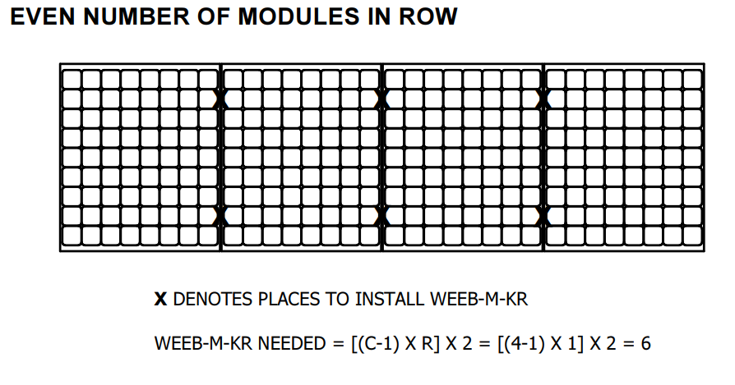
PV Installation Labs
The WEEB installation manual provides a formula for how many WEEB should be placed on the array.
Picture courtesy BURNDY

Slide 120
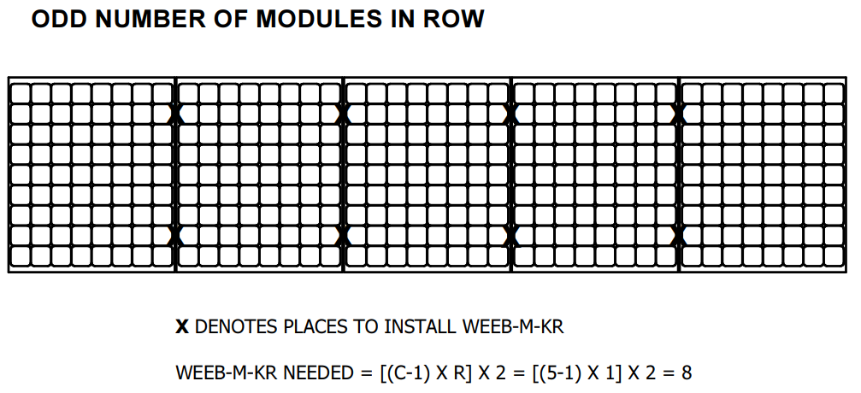
PV Installation Labs
The WEEB installation manual provides a formula for how many WEEB should be placed on the array.
Picture courtesy BURNDY

Slide 121
PV Installation Labs
Now that the drawing has the layout for the 6 panels on the rails.
Using WEEB washers or Star washers on the mid clamps to provide two bonding points per panel.
Next step it to place the panels on the rails and have the bonding washers in place with the mid clamps.
Tighten the bolts of all the clamps using the torque wrench.

Slide 122
PV Installation Labs
Questions?

Slide 123
PV Installation Labs
Lab 4 Grid Connect
This lab will demonstrate how to connect the inverter output circuit to a school AC branch circuit.

Slide 124
PV Installation Labs
The module “Inverter Connections and Rules”
In that module the connection of the microinverter output circuit to a branch circuit is explained in detail.
This lab is a temporary connection to the schools AC system.
A disconnection means still needs to be established.

Slide 125
PV Installation Labs
The inverter output circuit conductors are going to be run through the outside roll up doors and across the floor.
There will need to be procedure written up by the instructors and a wiring method established before the branch circuit connection would be established.
Disconnection means can be of the plug and cord type.
This needs to be developed by the instructor.

Slide 126
PV Installation Labs
Once the wiring method between the inverter and school AC source has been established.
A procedure for connecting the inverters to the source will need to be written.
A safety review before connection is made is also required.

Slide 127
PV Installation Labs
Commissioning a solar installation like this requires proving that it is working correctly.
Enphase IQ7 status LED Indications and Error Reporting The following section describes LED indications.
Enphase Installation Manual

Slide 128
PV Installation Labs
The status LED on each microinverter lights orange about six seconds after DC power is applied.(No Envoy)
It remains lit solid for two minutes, followed by six orange blinks.
After that, red blinks indicate that no grid is present if the system is not yet energized.
Any short red blinks after DC power is first applied to the microinverter indicate a failure during microinverter startup

Slide 129
PV Installation Labs
There is the 5-minute wait before the microinverter will connect to the grid.
Flashing “Orange” is what you should see.
Flashing “RED” check to see if the branch circuit is on.
Enphase Installation Manual

Slide 130
PV Installation Labs
DC Resistance Low – Power Off Condition For all IQ Series models, a solid red status LED when DC power has been cycled indicates the microinverter has detected a DC Resistance Low – Power Off event.
The LED will remain red and the fault will continue to be reported by the Envoy until the error has been cleared.

Slide 131
PV Installation Labs
An insulation resistance (IR) sensor in the microinverter measures the resistance between the positive and negative PV inputs to ground.
If either resistance drops below a threshold, the microinverter stops power production and raises this condition.
This may indicate defective module insulation, defective wiring or connectors, moisture ingress, or a similar problem. Although the cause may be temporary, this microinverter condition persists until the sensor is manually reset.

Slide 132
PV Installation Labs
The DC to AC ratio of this set up is:
395 Watts in DC and 349 VA of AC out
= 1.13 to 1 or 113%
This is not a large ratio.
The microinverter output will have an efficiency applied to the input from the PV modules.

Slide 133
PV Installation Labs
This means that the inverters will be at 100% rated output with 88% rated solar irradiance input.
Therefore, at any higher than 880W/M² the inverter will be clipping their output to maximum.
Below that amount of irradiance, the output is linear.
For the inverter to put out 50% of its rated value, only 440W/M² of irradiance is required.

Slide 134
PV Installation Labs
When a system (PV + Inverter + Grid) is energized for the first time it is normal to take reading and record them as part of a commissioning process.
Commissioning is the process of guaranteeing the performance of a system.
Reading of voltage, amperage and irradiance will be taken.

Slide 135
PV Installation Labs
Make a table with the following columns.
Time | Irradiance | Inverter Voltage | Inverter Amperage | Inverter Wattage

Slide 136
PV Installation Labs
Time intervals are every minute, starting as soon as the inverter is connected to the school AC power.
Irradiance is measured perpendicular to the PV module and measured in W/m²
Inverter voltage is measured at the junction box.
Inverter amperage is measured at the junction box.
Inverter output watts is the product of the above two readings.

Slide 137
PV Installation Labs
The inverter output circuit is now ready to be connected to the school AC.
Until the inverters turn on the voltage measured is the schools branch circuit voltage.
Once the inverters turn on the voltage measured is the voltage rise.
This is the voltage required to push the solar amperage to the schools AC.

Slide 138
PV Installation Labs
Continue to record this until the voltage stabilized or at least 10 minutes.
Analyze the readings.
The irradiance should be proportional to the output of the microinverters.
Did the voltage rise after the inverters started to produce power?

Slide 139
PV Installation Labs
The reading should correlate.
Plot the reading and be able to explain their relationships.

Slide 140
PV Installation Labs
Questions?

Slide 141
PV Installation Labs
There are 4 separate labs to be completed based on this presentation module.
Lab 1 Racking Placement
Lab 2 Microinverter Mounting
Lab 3 Module Mounting
Lab 4 Grid Connect

