Slide 1
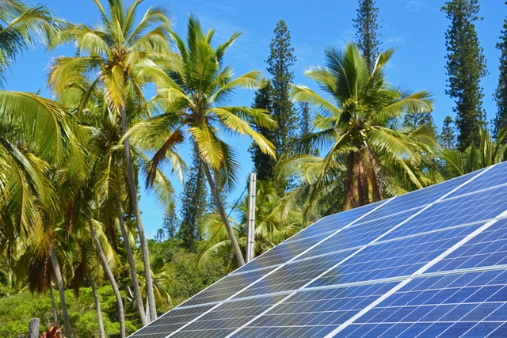



Design and Implementation of Pilot of a TVET Renewable Energy Course
DELIVERABLE #5 - TRAINING COURSES & PROFESSIONAL DEVELOPMENT
PV Training Session

Slide 2

Screws and Anchors
Ground mount anchoring systems.
5 major types:
Screws
Concrete
Helical Screws
Driven Piers
Ballast

Slide 3

Screws and Anchors
Ground (soil/earth) screws are gaining popularity.
They are versatile.
Quick to install.
Low impact on land drainage.
Picture courtesy Ironridge

Slide 4
Screws and Anchors
Ground screws are twisted into the ground.
They are put in pace manually or by a machine.
When a specified torque is measured at the correct depth the screw is then tested for pull up strength.
Picture courtesy Ironridge

Slide 5
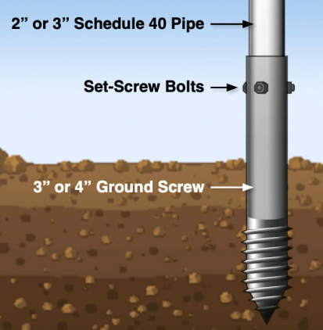
Screws and Anchors
Ground screws use bolts to
attach to the above
ground racking
system.
Picture courtesy Ironridge

Slide 6
Screws and Anchors
Ironridge provides a link to Krinner.
Krinner is a manufacturer of a ground screw.
https://www.krinner.io/fileadmin/userdaten/Downloads/Englisch/Brochures-Flyer/Product_catalog_2020_web.pdf
Picture courtesy Ironridge

Slide 7
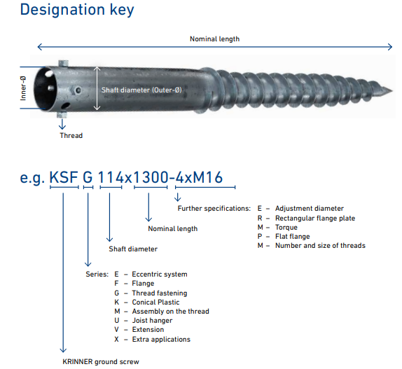
Screws and Anchors
Krinner ground screws come in different sizes.
The longer and
wider give the
screws a better
grip into the soil.
Picture courtesy Krinner

Slide 8
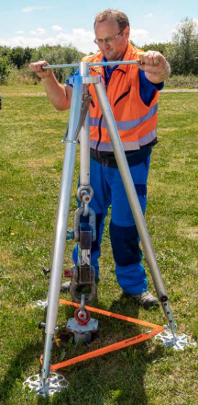
Screws and Anchors
Krinner as a system provider of ground screws offers its own range of devices for
performing tensile, compression
and horizontal tests.
Picture courtesy Krinner

Slide 9
Screws and Anchors
Questions?

Slide 10
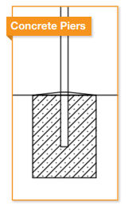
Screws and Anchors
Concrete as an anchor.
Concrete piers provide
excellent resistance to
vertical and lateral loads.
Constructed with readily
available materials.
Picture courtesy Ironridge

Slide 11
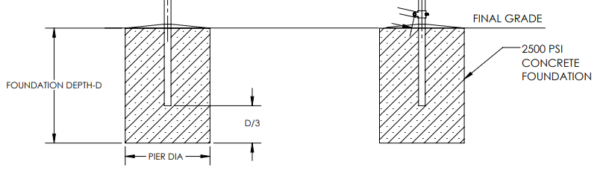
Screws and Anchors
Concrete as an anchor.
The depth and diameter of the concrete foundation will be designed based on soil type.
The spacing of the concrete piers is based on wind loading.
Picture courtesy Ironridge

Slide 12
Screws and Anchors
Questions?

Slide 13
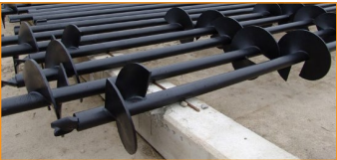
Screws and Anchors
Helical screws as an anchor.
These products provide very good resistance to
uplift, but provide minimal resistance to lateral
loads compared to concrete foundations.
Picture courtesy Ironridge

Slide 14
Screws and Anchors
Lower lateral load resistance results in:
Shorter E-W pier spans
More piers (foundations)
Additional bracing

Slide 15
Screws and Anchors
From an installation standpoint:
These anchors may be faster to install,
but increased material,
equipment and
engineering costs may outweigh any labor savings.

Slide 16
Screws and Anchors
Questions?

Slide 17
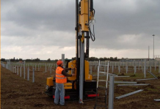
Screws and Anchors
PILE-DRIVEN OR VIBRATORY-DRIVEN PIERS as an anchor.
From an installation standpoint:
Specialized equipment and operators are required
to install these types
of foundations which
increases the overall
system costs.
Picture courtesy Ironridge

Slide 18
Screws and Anchors
This option does not utilize a helical blade or screw, which means that it will have a lower resistance to uplift forces.
This necessitates deeper foundations.
As with a helical pile,
a PE will be required to
determine the pier depth
and spacing, and
provide a letter for the
foundation design.
Picture courtesy Ironridge

Slide 19
Screws and Anchors
Questions?

Slide 20
Screws and Anchors
Ballast as an anchor.
Ballast is for this application is using weight to keep the PV system anchored.
This type of system does not penetrate anything into the ground.
It relies on the weight of the ballast to keep it secured to the ground.

Slide 21
Screws and Anchors
The ballast weight shall be designed by an engineer.
The spacing and actual weight can vary.
The weights can be made ahead of the construction.

Slide 22
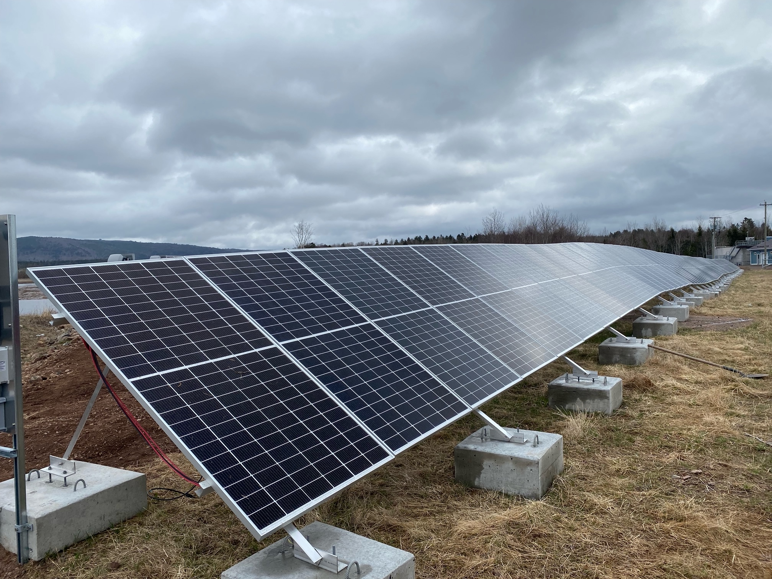
Screws and Anchors
The contour of the land does not need to be perfectly flat.
Picture courtesy Thermo Dynamics Ltd.

Slide 23
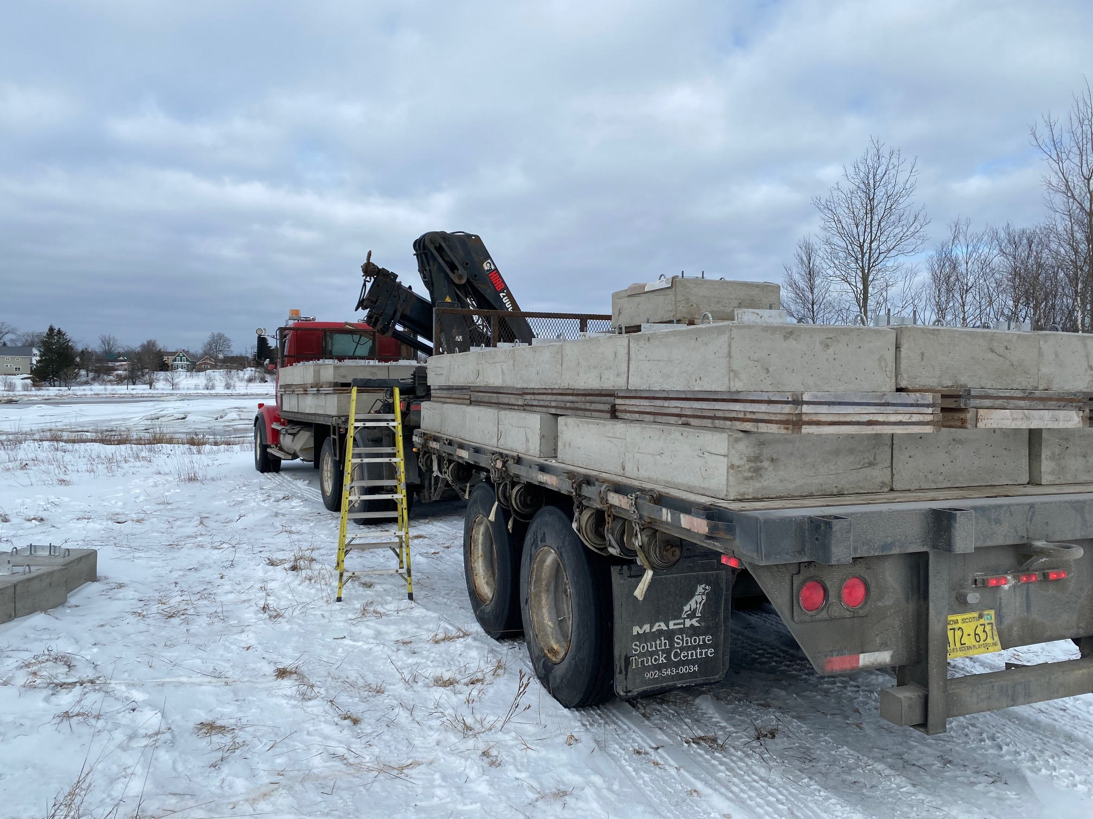
Screws and Anchors
The concrete blocks can be made ahead of time.
Put in place with machinery.
No excavation to
pour concrete
piers.
L brackets are
mounted in the
concrete.
Picture courtesy Thermo Dynamics Ltd.

Slide 24
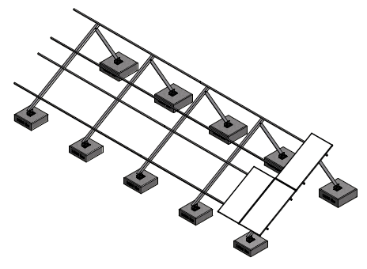
Screws and Anchors
This picture shows two panels in portrait high.
Picture courtesy Thermo Dynamics Ltd.

Slide 25
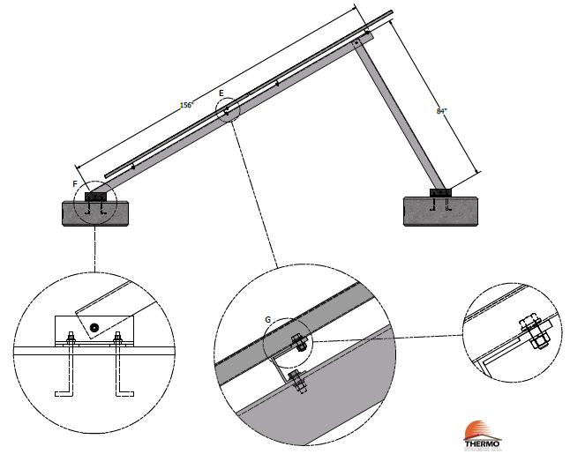
Screws and Anchors
Bolt through without clamps.
Bolt through is
the strongest
method for
attachment of
panels to
racking.
Picture courtesy Thermo Dynamics Ltd.

Slide 26
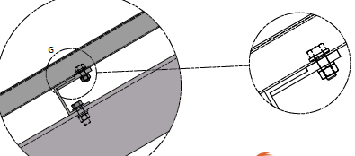
Screws and Anchors
Bolt through without standard mid and end clamps.
Panel and racking.
Picture courtesy Thermo Dynamics Ltd.

Slide 27
Screws and Anchors
Questions?

