Slide 1
Design and Implementation of Pilot of a TVET Renewable Energy Course
DELIVERABLE #5 - TRAINING COURSES & PROFESSIONAL DEVELOPMENT
PV Training Session

Slide 2
Racking and Mounting
This module introduces the concepts of racking and ground mounting of PV panels.

Slide 3
Racking and Mounting
Racking is the bonding of parts.
It is the mechanism used to hold the PV panels and all associated equipment.
There will be 5 types covered in this module.

Slide 4
Racking and Mounting
These 5 types are broken down by the equipment used to either mount or rack the PV panels together.
On roof mounting / racking
On the ground mounting / racking
On a pole mounting
Weighted (Ballast) mounting / racking
Tracking mounting / racking

Slide 5
Racking and Mounting
The second type of racking and mounting to be explored is “on the ground mounting / racking”
Often referred to as ground mount.
It can be defined as a system that is anchored to the ground.
The details of how these systems are anchored is covered in the Power Point “ Ground Mount Screws and Anchors”.

Slide 6
Racking and Mounting
Questions?

Slide 7
Racking and Mounting
Before the introduction to racking and mounting.
Safety and tools need to be identified.
Fall arrest and working from heights are a prerequisite for working on the mounting and racking of PV panels.
Ladder and scaffold safety is also required.

Slide 8
Racking and Mounting
Tools:
Each manufacturer has listed the tools in the instructions manual for their products.
IRONRIDGE has given permission to use their information.
https://www.ironridge.com/
They have a YOUTUBE channel
https://www.youtube.com/c/IronRidgeSolar

Slide 9
Racking and Mounting
Common tools are:
Wrenches, Screwdrivers, Torque wrench, Rachet with sockets, tape measure, chalk line, stud finder, roofing bar, caulking gun, driver with 1/4” bit and 7/16” hex socket.

Slide 10
Racking and Mounting
Ground mounting is when the panels are mounted to a system that is anchored to the ground.
Anchored can be an in ground system.
Anchored can be a ballasted system.

Slide 11
Racking and Mounting
Why ground mount?
No roof
Roof not able to support panels.
Roof is too small.
Solar resource availability.
Option to have array tiltable.

Slide 12
Racking and Mounting
Questions?

Slide 13
Racking and Mounting
No roof available to mount the panels.
Solar system is not part of a building or there is no building.
An example would be a water pumping system.
Decorative display of solar panels.
The panels are placed in a shape of a flower.
Lined up to provide a pathway.

Slide 14
Racking and Mounting
Pergolas to provide shade.
Another would be a temporary or mobile power consumer.
RV or other mobile accommodations
Vehicle charging station

Slide 15
Racking and Mounting
Questions?

Slide 16
Racking and Mounting
Roof not able to support panels because roof is too thin or structurally weak.
Out buildings such as sheds or barns that the roof is made from very thin corrugated metal sheets.
Thatched roof has no structure that allows the panels to be elevated enough to provide air flow.
Asbestos roofing shall not be tampered with.

Slide 17
Racking and Mounting
Green roofs are meant to have vegetation growing on them.
Panels would block the sun from the vegetation.

Slide 18
Racking and Mounting
The roof is too small.
The number of panels required take up too much space.
The design for a solar PV system is based on required energy capture.
Panels shall not be placed too close to the roof lines.

Slide 19
Racking and Mounting
Questions?

Slide 20
Racking and Mounting
It is easier to have the panels connected to one system and one roof.
Splitting them into smaller systems can be complicated.
Connecting panels from different locations requires more wire and added costs.

Slide 21
Racking and Mounting
The solar resource availability.
The roof is not suitable to capture the resource.
The pitch is not optimum.
The angle is too steep.
Beyond a certain angle energy caption is reduced.
The orientation is not optimum.
It is facing too far in one direction
East and West facing produce little energy

Slide 22
Racking and Mounting
The roof is shaded.
Early morning or late afternoon shading is not bad
Midday shading reduces resource capture.
Seasonal shading will need to be assessed.
The ground area is better suited to capture the resource.
Often the ground area will allow for various orientation and tilt options.

Slide 23
Racking and Mounting
The ground mount system can be designed to be tilted.
Why tilt an array?
In Belize and other tropical areas the sun moves past the equator during certain times of the year.
Being able to tilt the array to capture more energy when the sun moves past the south and into the north direction.

Slide 24
Racking and Mounting
In areas of the world where the sun zenith is low in the winter season.
It is desirable to tilt the array lower to capture more of the resource.
The day light is shortened as the path it takes across the sky is reduced.
The lower tilt allows snow to slide off of the panels.

Slide 25
Racking and Mounting
There are two basic anchoring systems.
The first is a ballast system which rests on the ground and does not go into the ground.
The other is a system that penetrates the ground to anchor and support the racking system.

Slide 26
Racking and Mounting
Questions?

Slide 27
Racking and Mounting
What are considerations of a ground mount system.
Panels are grouped just like on a roof.
They are tilted to what ever angle that captures the solar resource best.
That is not an option for roof mounted systems.
Wind loading is the biggest issue with ground mounts.

Slide 28
Racking and Mounting
The panels are held together with the same racking as on the roof.
The rails instead of attaching to the roof will attach to a braced metal frame.
The frame is can be made from a boxed metal shape or from schedule 40 round pipe.
Ironridge has many design options.

Slide 29
Racking and Mounting
Ironridge has documented design certifications on their website.
Just like the roof, the span between supports is the variable that changes.
The span changes based on regional winds.
The American Society of Civil Engineers (ASCE) have defined level of wind based on geographic features.

Slide 30
Racking and Mounting
Civil Engineers (ASCE) have defined level of wind based on geographic features.
Exposure B is urban and residential with buildings less than 30 feet tall.
Exposure C is open terrain with buildings less than 30 feet tall.
Exposure D is coastal areas with about a mile open to sea. It does not include hurricane prone areas.

Slide 31
Racking and Mounting
Questions?

Slide 32
Racking and Mounting
The Ironridge certificates can be found at
https://base.ironridge.com/ground-based-mounting/resources
Navigate to the “Certification” and select a state.
I picked Florida due to it being costal.

Slide 33
Racking and Mounting
The option used was 4 panels up vertically with the XR1000 rail system and concrete based pillars.
Picture courtesy IRONRIDGE

Slide 34
Racking and Mounting
The downloaded certificate can be found at
https://files.ironridge.com/groundmounting/certification/XR1000SGA4/IronRidge_XR1000SGA4_Certification_UFO_FL.pdf
Picture courtesy IRONRIDGE

Slide 35
Racking and Mounting
It has 57 pages of information.
The first page sets out guidelines.
The structure is a simple column (pier) and beam (cross pipe) system. The piers & cross pipes are schedule 40 steel pipes or Allied Mechanical Tubing. The tops of the piers are connected in the E-W direction by the cross pipes which cantilever over and extend past the end piers. The cross pipes are connected by proprietary IronRidge XR1000 Rails spanning up and down the slope which cantilever over and extend past the top and bottom cross pipes. There are typically two rails per column of modules. The modules are clamped to the rails by the IronRidge Module Mounting Clamps as shown in the attached Exhibit.

Slide 36
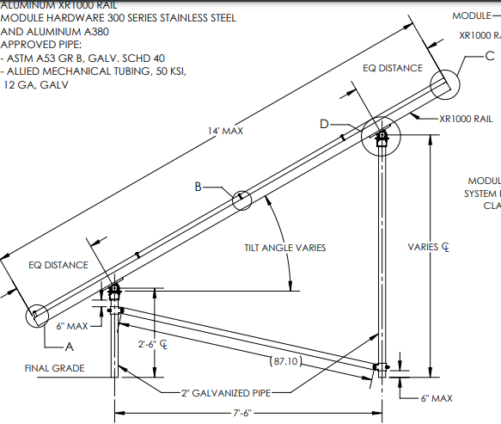
Racking and Mounting
Picture courtesy IRONRIDGE

Slide 37
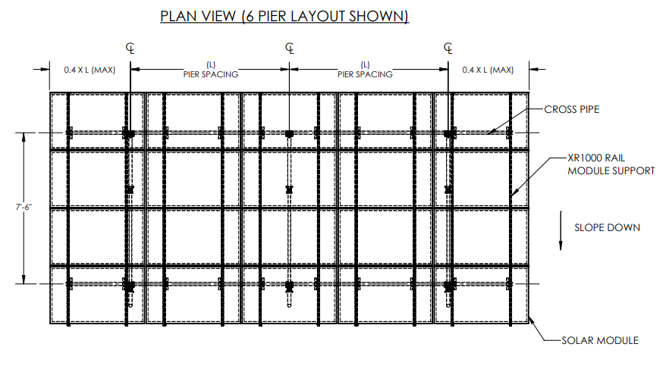
Racking and Mounting
Picture courtesy IRONRIDGE

Slide 38
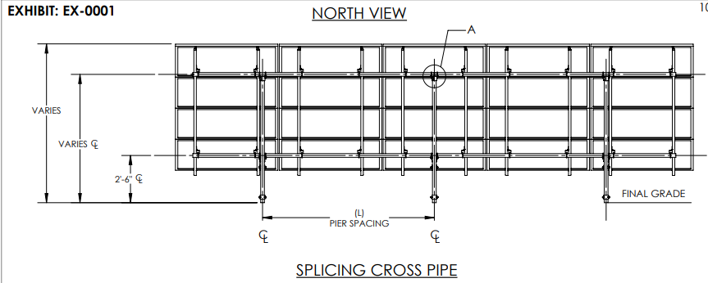
Racking and Mounting
Picture courtesy IRONRIDGE

Slide 39
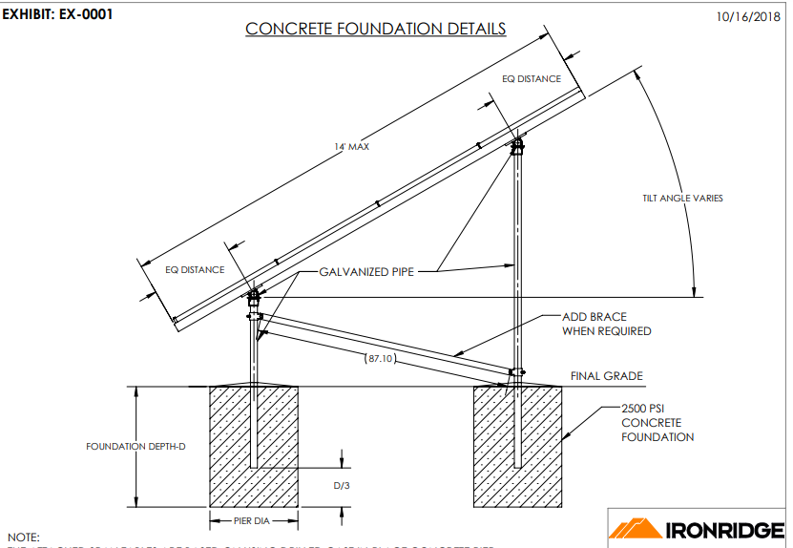
Racking and Mounting
Picture courtesy IRONRIDGE

Slide 40
Racking and Mounting
The pier spacing in the N-S direction is 7’-6”.
The pier spacing in the E-W direction is selected from load tables determined by the structural design for the specified slope, wind load, and snow load.

Slide 41
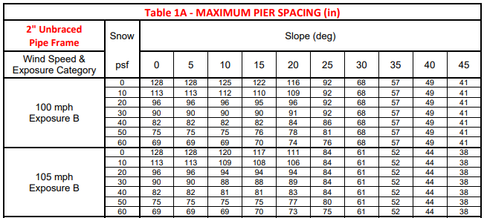
Racking and Mounting
This is the first of 12 span tables.
Exposures from B to D are included in the tables.
The maximum wind speed is 160 mph.
Picture courtesy IRONRIDGE

Slide 42
Racking and Mounting
Tables are for 2 and 3 inch piped frames that are either braced or unbraced.
Picture courtesy IRONRIDGE

Slide 43
Racking and Mounting
Spacing is 27”.
Picture courtesy IRONRIDGE

Slide 44
Racking and Mounting
Spacing is 82”.
Picture courtesy IRONRIDGE

Slide 45
Racking and Mounting
To see the results of pipe size and bracing the following conditions are looked at.
Exposure D windspeed 100 mph and 40 degree tilt.
For the 2’ pipe unbraced the maximum span is 27”
Same pipe braced the span can be increased to 82”

Slide 46
Racking and Mounting
Spacing is 83”.
Picture courtesy IRONRIDGE

Slide 47
Racking and Mounting
Spacing is 144”.
Picture courtesy IRONRIDGE

Slide 48
Racking and Mounting
To see the results of pipe size and bracing the following conditions are looked at.
Exposure D windspeed 100 mph and 40 degree tilt.
For the 3’ pipe unbraced the maximum span is 83”
Same pipe braced the span can be increased to 144”

Slide 49
Racking and Mounting
To analyze these differences one can make the conclusion that the larger the pipe the stronger it is and can take the wind forces with fewer supports.
Adding braces also significantly increased the strength of the frame.

Slide 50
Racking and Mounting
Questions?

Slide 51
Racking and Mounting
The option used was 4 panels up vertically with the XR1000 rail system and ground screw based pillars.
Picture courtesy IRONRIDGE

Slide 52
Racking and Mounting
The downloaded certificate can be found at
https://files.ironridge.com/groundmounting/certification/XR1000SGA4/IronRidge_XR1000SGA4_Certification_UFO_GS_FL.pdf
Picture courtesy IRONRIDGE

Slide 53
Racking and Mounting
It has 15 pages of information.
The first page sets out guidelines.
The structure is the same as the concrete previous sample
Gravity loads are transferred to the piers and ground screws by the rails and cross pipes acting as simple beams.
For lateral loads the system is a cantilever structure. The effect of seismic loads (for all design categories A-F) have been determined to be less than the effect due to wind loads in all load conditions and combinations.

Slide 54
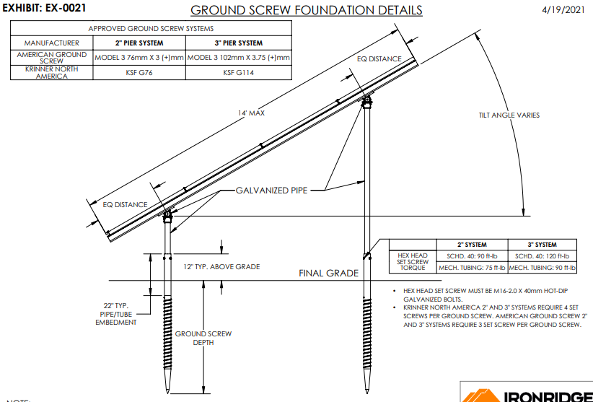
Racking and Mounting
Picture courtesy IRONRIDGE

Slide 55
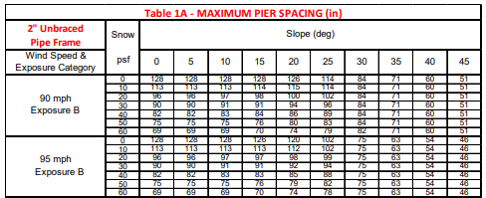
Racking and Mounting
This is the first of 6 span tables.
Exposures from B to D are included in the tables.
The maximum wind speed is 160 mph.
Picture courtesy IRONRIDGE

Slide 56
Racking and Mounting
Tables are for 2 and 3 inch piped frames that are unbraced.
Picture courtesy IRONRIDGE

Slide 57
Racking and Mounting
To see the results of pipe size the following conditions are looked at.
Exposure D windspeed 100 mph and 40 degree tilt.
For the 2’ pipe unbraced the maximum span is 27”
For the 3’ pipe unbraced the maximum span is 61”

Slide 58
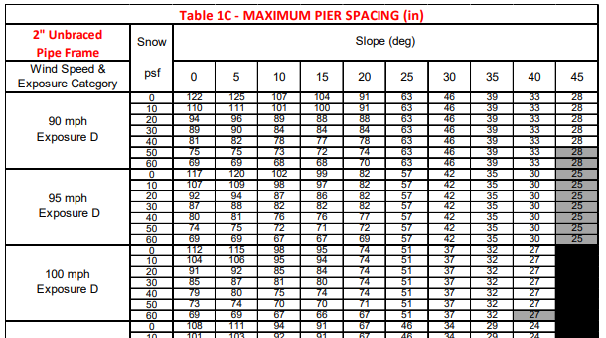
Racking and Mounting
Spacing is 27”.
Picture courtesy IRONRIDGE

Slide 59
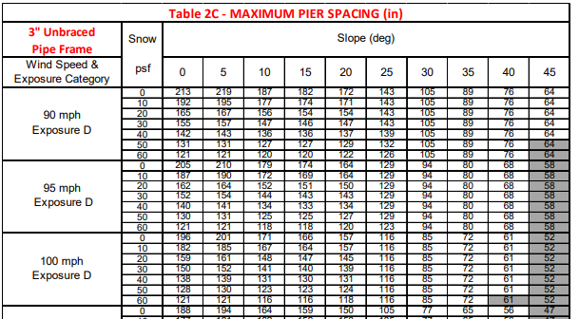
Racking and Mounting
Spacing is 61”.
Picture courtesy IRONRIDGE

Slide 60
Racking and Mounting
To analyze these differences one can make the conclusion that the larger the pipe the stronger it is and can take the wind forces with fewer supports.
Comparing the concrete to the screw piles.
For the 2 inch unbraced the two systems used the same spacing.
For the 3 inch unbraced, the screw piles required more pillars than did the concrete.

Slide 61
Racking and Mounting
Questions?

