Slide 1




Design and Implementation of Pilot of a TVET Renewable Energy Course
DELIVERABLE #5 - TRAINING COURSES & PROFESSIONAL DEVELOPMENT
PV Training Session

Slide 2
Racking and Mounting
This module introduces the concepts of racking and mounting of PV panels.

Slide 3
Racking and Mounting
Racking is the bonding of parts.
It is the mechanism used to hold the PV panels and all associated equipment.
There will be 5 types covered in this module.

Slide 4
Racking and Mounting
These 5 types are broken down by the equipment used to either mount or rack the PV panels together.
    On roof mounting / racking
    On the ground mounting / racking
    On a pole mounting
    Weighted (Ballast) mounting / racking
    Tracking mounting / racking

Slide 5
Racking and Mounting
Questions?

Slide 6
Racking and Mounting
The second type of racking and mounting to be explored is “on the ground mounting / racking”
Often referred to as ground mount.
It can be defined as a system that is anchored to the ground.
The details of how these systems are anchored is covered in the Power Point “ Ground Mount Screws and Anchors”.

Slide 7
Racking and Mounting
Questions?

Slide 8
Racking and Mounting
Advantages of ground mounting PV panels.
Easy access to panels.
Limited by amount of land and not the roof.
Able to be tilted to desired angle.

Slide 9
Racking and Mounting
Advantages of ground mounting PV panels.
Optimum azimuth angle not limited by building orientation.
Single axis tracking is an affordable option.

Slide 10
Racking and Mounting
Disadvantages of ground mounting PV panels.
Vegetation maintenance.
Ground clearance if machinery used for vegetation and or snow removal.
Snow accumulation (not everywhere).

Slide 11
Racking and Mounting
Disadvantages of ground mounting PV panels.
Dust / sand and pollen buildup.
Limited to number of panels North - South.
Need more space than roof mounted.
Requires strong racking components.

Slide 12
Racking and Mounting
Easy access to panels is good for cleaning and any maintenance that is required.
It also provides access to unqualified people.
The unqualified people need to be protected against the dangers of electricity.

Slide 13
Racking and Mounting
The MC4 connectors need protection against anyone opening them under load.
There are two standard accepted ways to provide protection:
A fence can be built around the array with a lockable gate.
A metal guard that encases the wiring.

Slide 14
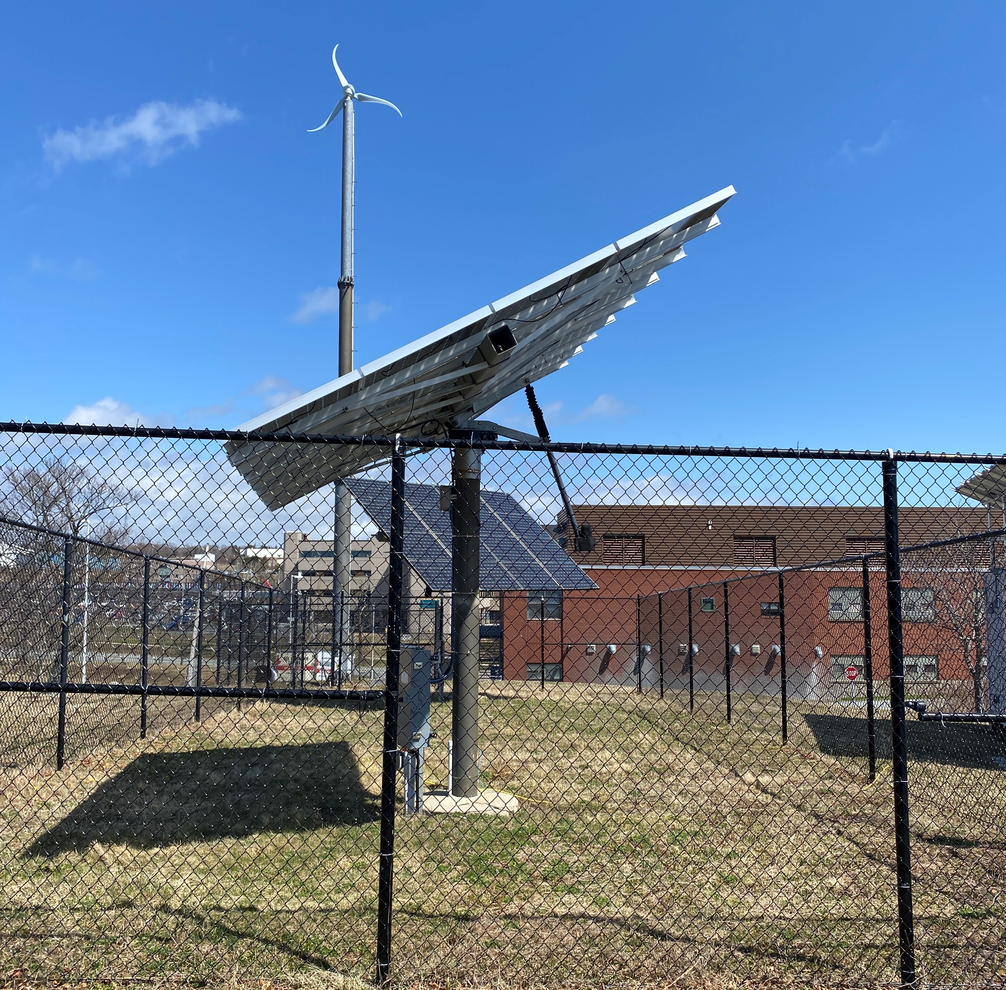
Racking and Mounting
A fence can be built around the array with a lockable gate.
Picture courtesy Author

Slide 15
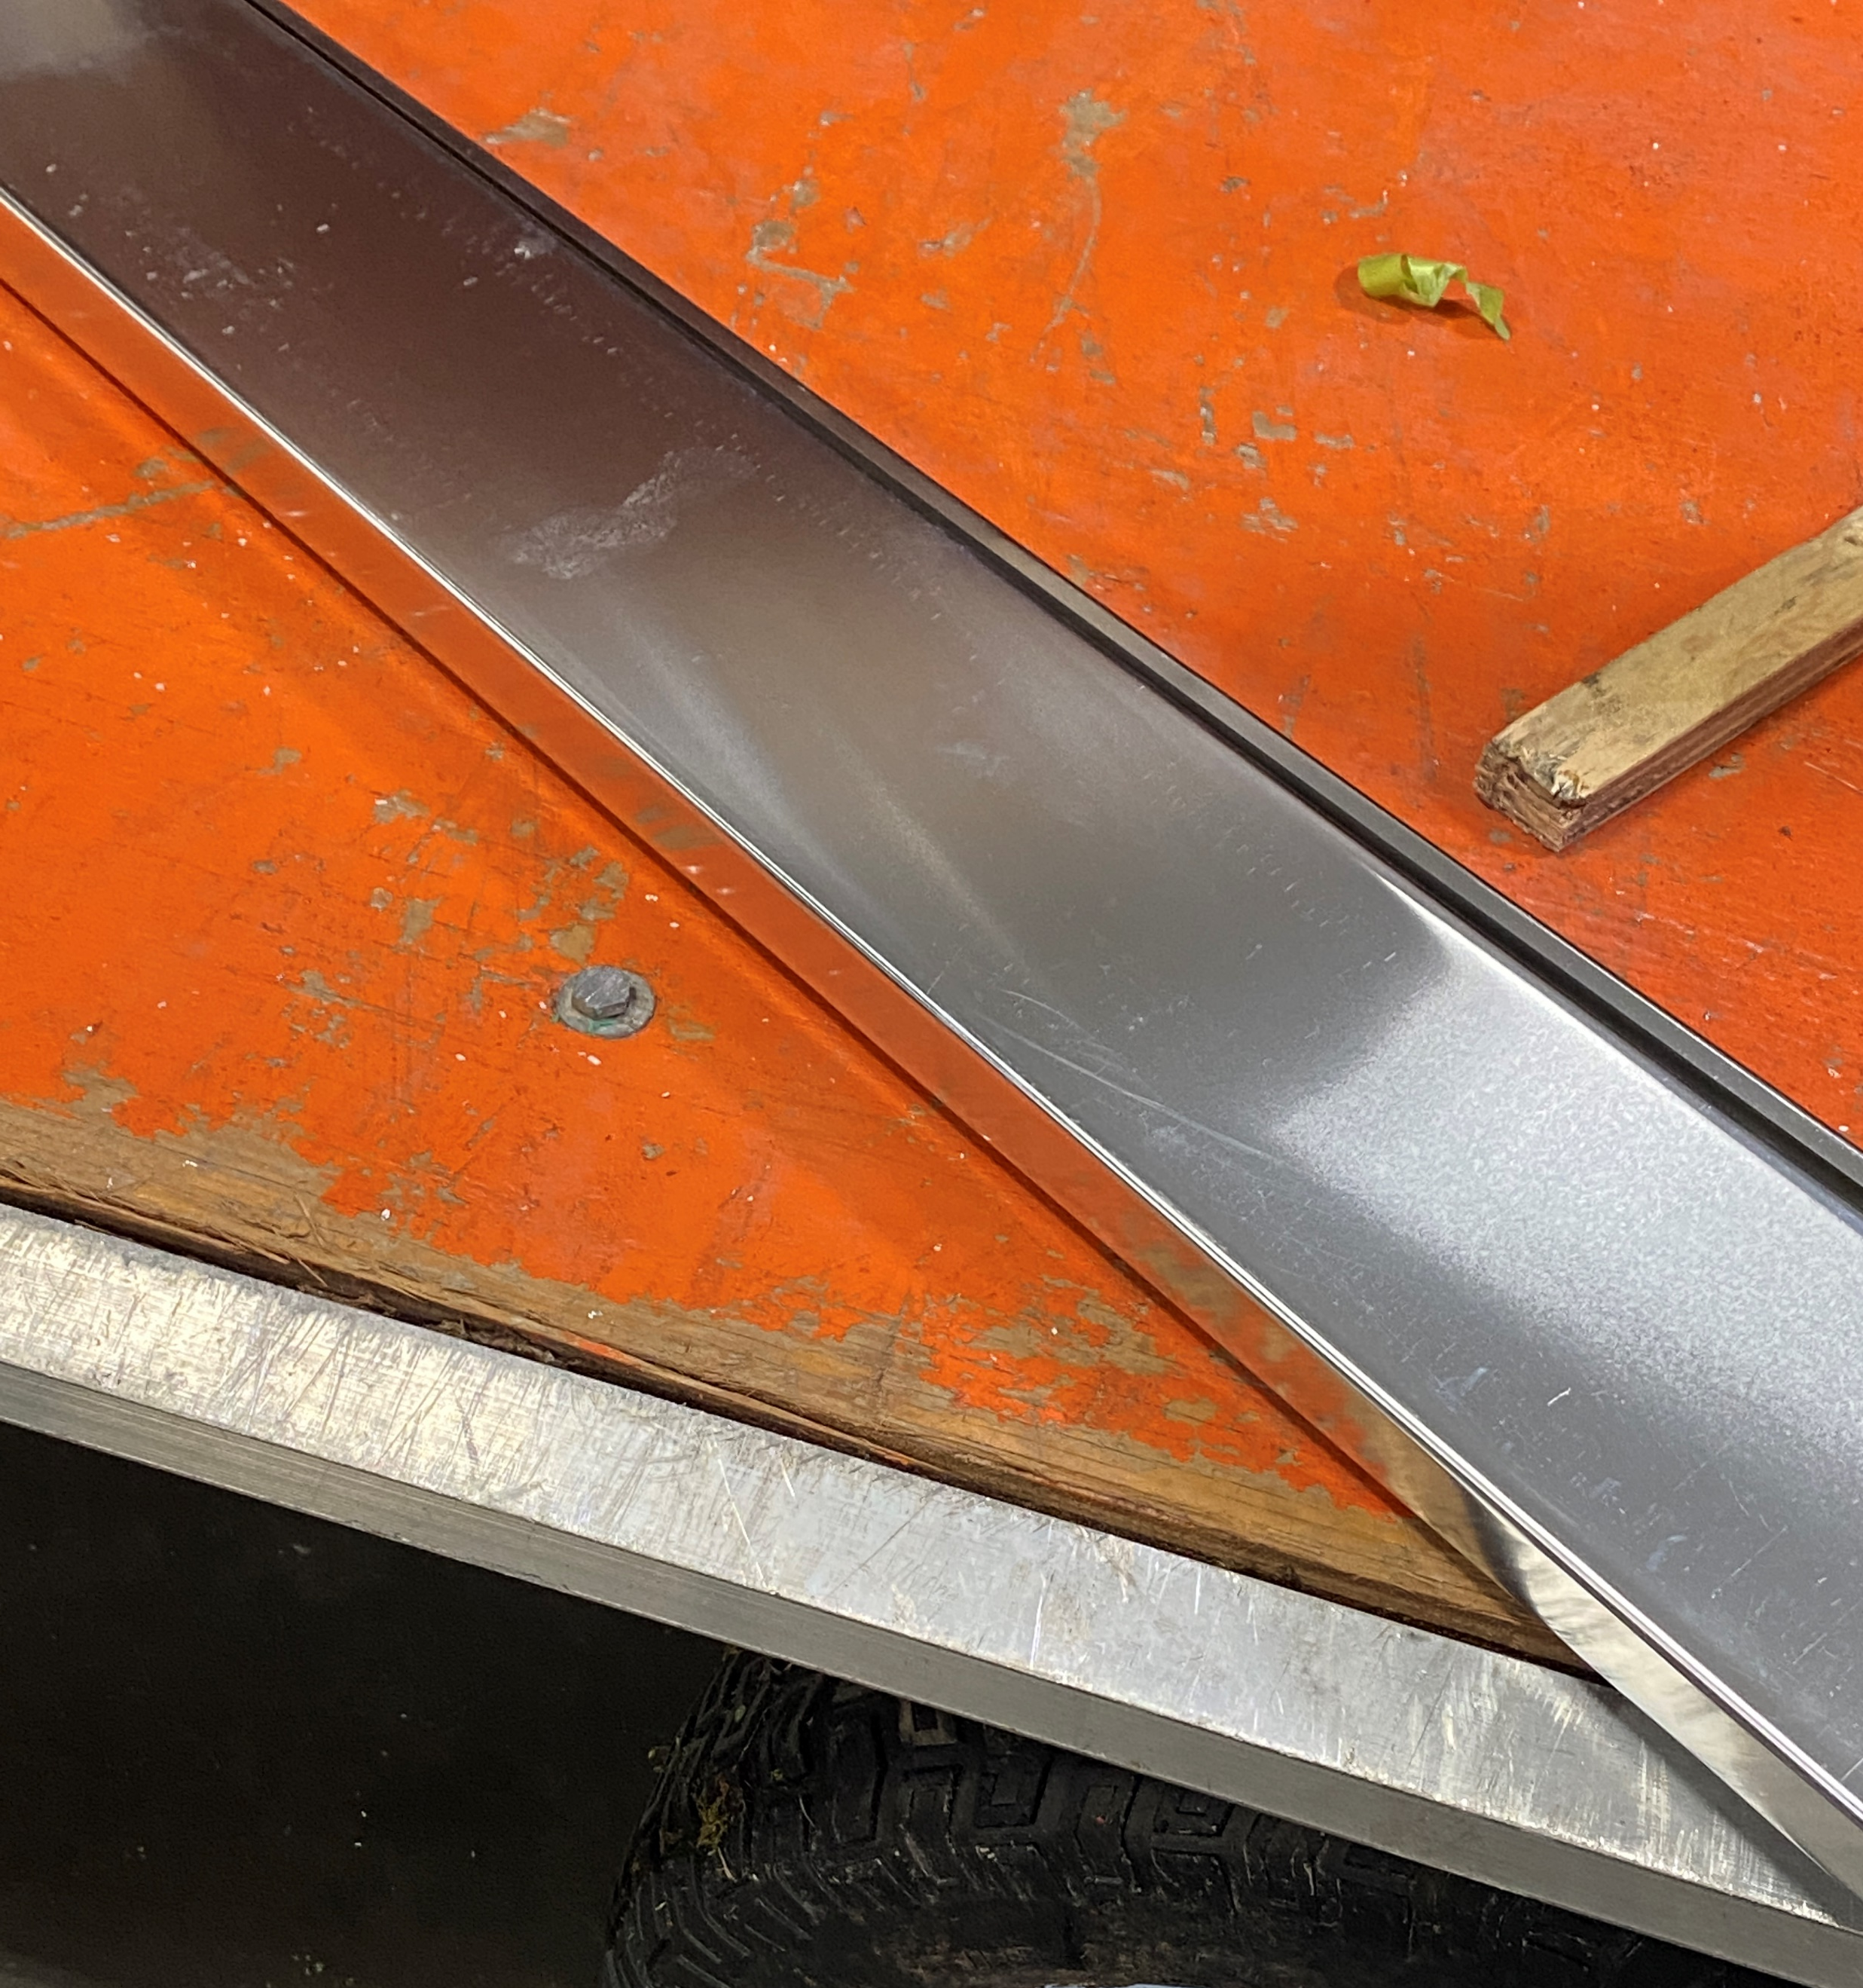
Racking and Mounting
A metal guard that encases the wiring.
Picture courtesy Author

Slide 16
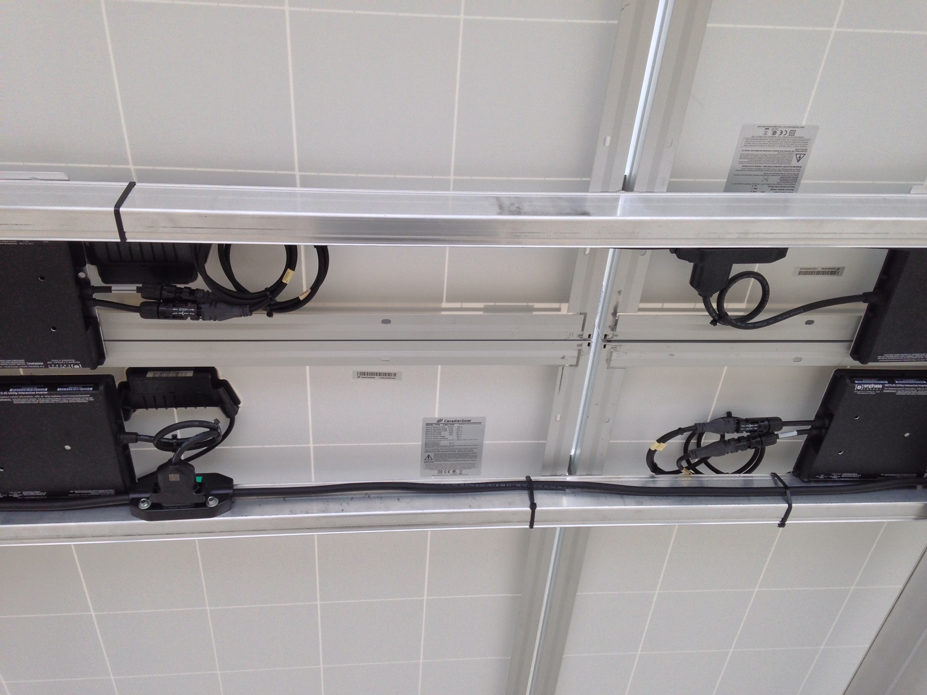
Racking and Mounting
All of the wiring kept close together.
Picture courtesy Author

Slide 17
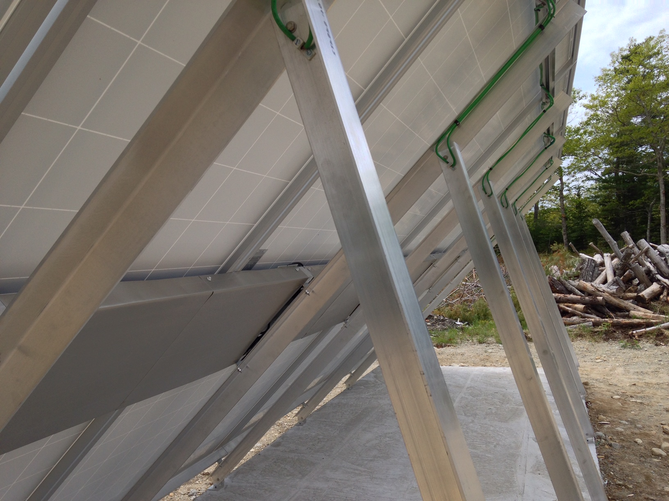
Racking and Mounting
Both rails are covered.
Picture courtesy Author

Slide 18
Racking and Mounting
After a high wind the panels are easily accessed to check for any loose fittings or wires that have came out of the wire management system.
The torque of bolts can be checked also.

Slide 19
Racking and Mounting
Pictures required here.

Slide 20
Racking and Mounting
Limited by amount of land and not the roof.
When a large array is required that has a foot print larger than available space on the roof.
The ground area can be a viable option.

Slide 21
Racking and Mounting
Multiple rows can be used as well.
Land can be cleared and the array established.
Picture courtesy Author

Slide 22
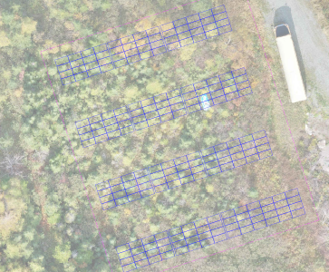
Racking and Mounting
The multiple rows can easily be placed after the vegetation is removed.
Picture courtesy Author

Slide 23
Racking and Mounting
Able to be tilted to desired angle.
On a roof typically 10 degrees off of the roof line is the largest angle allowed due to wind loading.
More than 10 degrees requires an approved drawing.
The drawing will show any extra supports required.

Slide 24
Racking and Mounting
The tilt will effect the wind loading.
The greater the angle of tilt the more wind loading.
The span tables will set the maximum distance between the ground piers East - West.
The span tables will set this maximum ground support distance.

Slide 25
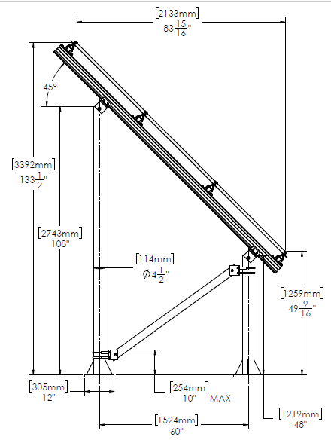
Racking and Mounting
The angle for this example
is 45 degrees.
Options for designing tilt.
Things to consider.
Pier spacing comes from
span table.
North South spacing can be
based on cantilever.

Slide 26
Racking and Mounting
This link is good for laying out the rails and to adjust cantilever.
https://files.ironridge.com/education-library/Tech_Tip_Maximizing_Rail_Cantilever.pdf

Slide 27
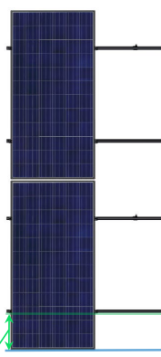
Racking and Mounting
An example is 2X spacing.
This spacing allows for 2 times
the spacing in the mid section
of the panel compared to the
cantilevered ends sections.
2X
1X
Picture courtesy Author

Slide 28
Racking and Mounting
Another spacing is 20% -60% - 20%
The spacing above allows 20 percent of the panel to cantilever over the rails while 60 percent is between the rails.
Otherwise confirm the panel manufacturer’s recommendations.

Slide 29
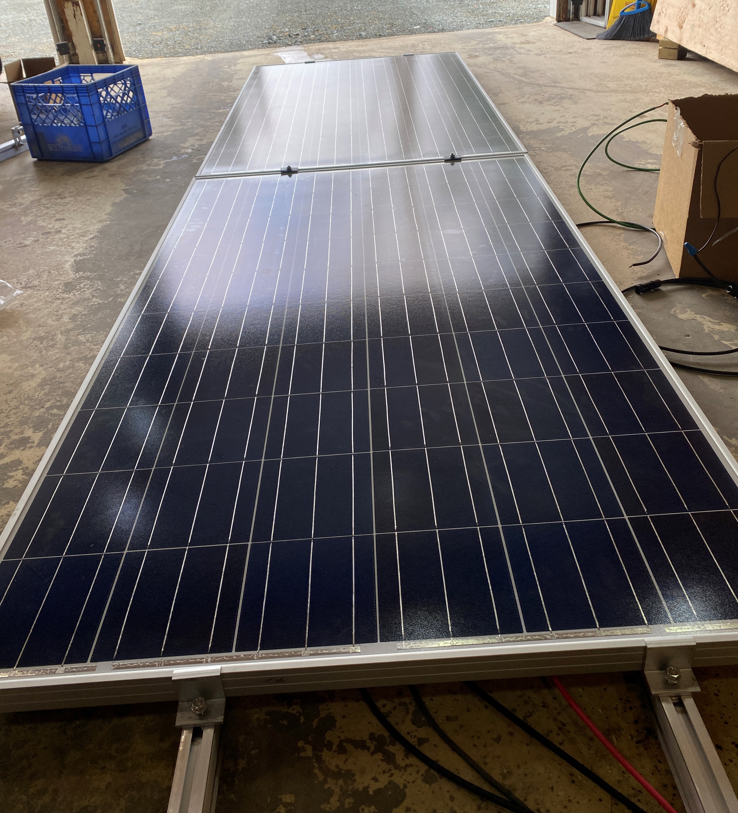
Racking and Mounting
20% spacing
Landscape
orientation
60% spacing
Picture courtesy Author

Slide 30
Racking and Mounting
To lower the angle.
The cantilever measurement
provides the minimum
spacing north – south.
Lets design for a single
row of PV panels.

Slide 31
Racking and Mounting
The desired tilt angle is 15 degrees south.
Panel to be used is the LG 445W 72 Cell.
The next slides will provide the data sheets for this panel.

Slide 32
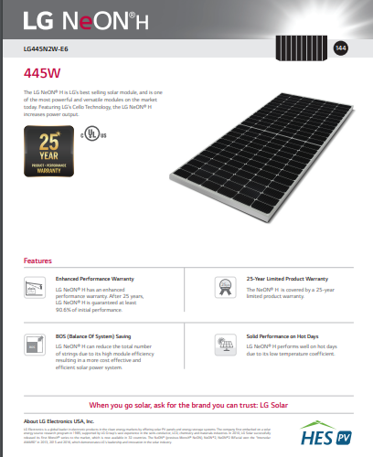
Racking and Mounting
The data sheet for
LG445W 72 Cell
Picture courtesy Charge Solar

Slide 33
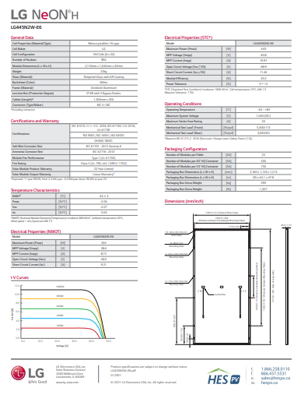
Racking and Mounting
The data sheet for
LG445W 72 Cell
Picture courtesy Charge Solar

Slide 34
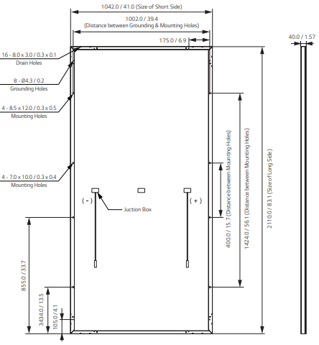
Racking and Mounting
Closer look at required information needed.
Picture courtesy Charge Solar

Slide 35
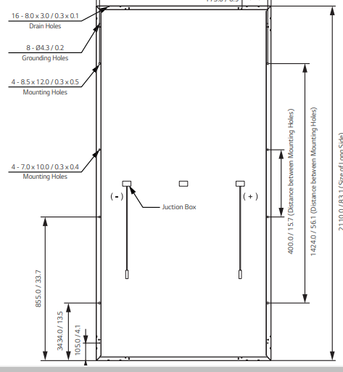
Racking and Mounting
Mounting holes are
shown.
4 holes are provided.
Distance between
mounting holes.
Picture courtesy Charge Solar

Slide 36
Racking and Mounting
The spacing to keep the cantilever within range
is the 1424 mm between the two outer mounting
holes.
1424 / 2110 (panel length) = 2/3 of panel length.
This provides only 16% (343 mm) of cantilever.
The North – South rails are now going to be 1424 mm apart.

Slide 37
Racking and Mounting
To get the height difference between the two north and south piers.
Start with the angle of the panel from the horizontal.
In this case 15 degrees.
45 º
15 º
Image courtesy Author

Slide 38
Racking and Mounting
The height difference is the length of the opposite side of a triangle.
With the same angle the height changes as the length of the north – south spacing changes.
15 º
15 º
Image courtesy Author

Slide 39
Racking and Mounting
What is the minimum spacing north – south?
It would be based on the cantilever length and the length of the panel.
This would assume that the rails are mounted directly to the piers.

Slide 40
Racking and Mounting
The spacing values for mounting.
PV Panel
2110 mm
1424mm
Piers
1375mm
Image courtesy Author

Slide 41
Racking and Mounting
The numbers:
Rail separation = 1424mm
Angle = 15 degrees
Distance North – South to provide cantilever.
Function of the Cosine of 15 degrees = .966.
1424mm x .966 = 1375mm between the piers.

Slide 42
Racking and Mounting
Calculate the height difference at this minimal north – south spacing of 1375 mm.
Using the tangent function:
  Tangent = opposite / adjacent
  Tangent (15) = .27
  Opposite = tangent x adjacent = .27 x 1375mm
  370 mm height difference.

Slide 43
Racking and Mounting
Ironridge suggests a north – south pier spacing of 7’ 6”.
In this next example we will convert the panel’s metric measurements into feet and inches.
1 inch = 25.4 mm
1 foot = 12 inches

Slide 44
Racking and Mounting
Calculate the height difference at a north – south spacing of 7’ 6” = 90 inches.
Using the tangent function:
  Tangent = opposite / adjacent
  Tangent (15) = .27
  Opposite = tangent x adjacent = .27 x 90 inches
  24 inches of height difference.

Slide 45
Racking and Mounting
The spacing values for mounting.
PV Panel
83 inches
56 inches 24 inches
Piers
90 inches
Image courtesy Author

Slide 46
Racking and Mounting
Questions?

Slide 47
Racking and Mounting
Optimum azimuth angle not limited by building orientation.
The maximum solar gain happens when the orientation is due south.
Building roofs are not normally built due south.
A ground mount system can be built due south.

Slide 48
Racking and Mounting
Some cities require that buildings be built perpendicular to the street.
Zoning by-laws and covenants cover these rules.
Most cities have the zoning information on their website.

Slide 49
Racking and Mounting
Belize City Council (Bella Vista Zoning) By-laws
  Does not specify the orientation of buildings
Another example can be found at this link.
https://belizecitycouncil.org/lib/docs/planning/Regulations.pdf

Slide 50
Racking and Mounting
Single axis tracking is an affordable option.
Being able to change the angle of the panels.
Seasonal adjustment.
Not daily adjustment.

Slide 51
Racking and Mounting
Changing the azimuth direction is not advised
More space is required between panels.
Motorized equipment is required.
Maintenance and energy is required to move the panels.

Slide 52
Racking and Mounting
Extra brackets are required to change the tilt of the panels.
These brackets must be as strong as the fixed bracket that would normally be used.
Simple is best.

Slide 53
Racking and Mounting
The changing of the tilt must be performed without losing support to hold the panels in place.
Adjusting the brackets must be able to done without the integrity of the other bracket being affected.

Slide 54
Racking and Mounting
The tilt can be change at the equinoxes.
Also at the solstices.
Image courtesy Author

Slide 55
Racking and Mounting
Image courtesy Author

Slide 56
Racking and Mounting
Image courtesy Author

Slide 57
Racking and Mounting
An arc can be used to reposition each panel or sections that have more than one panel.
Image courtesy Author

Slide 58
Racking and Mounting
Questions?

Slide 59
Racking and Mounting
Disadvantages of ground mounting PV panels.
Vegetation maintenance.
The lower the panels are mounted the wind loading is reduced.
However if vegetation is allowed to grow it may reach the panels.

Slide 60
Racking and Mounting
The vegetation can soil the panel surface.
Some vegetation have an oily secretion that requires soap and water to remove it.
Yearly cleaning maintenance may be required.
Pollen can accumulate on the surface as well.
Rain will help keep the panels clean.

Slide 61
Racking and Mounting
The other issue with vegetation is that it can grow and cause shading.
The elevation of the bottom of the panel should be high enough to get vegetation trimming equipment to operate.
Vegetation management can be applied as well.

Slide 62
Racking and Mounting
Ground clearance if machinery used for vegetation and or snow removal.
The spacing between rows of panels needs to be wide enough to not cause shading.
This spacing may need to be increased if machinery is to be used to do maintenance.

Slide 63
Racking and Mounting
Questions?

Slide 64
Racking and Mounting
Minimum row spacing calculations.
What information is required?
What is the lowest angle the sun will get to?
What is the tilt angle of the panel?
What is the height of the panel from ground top and bottom?

Slide 65
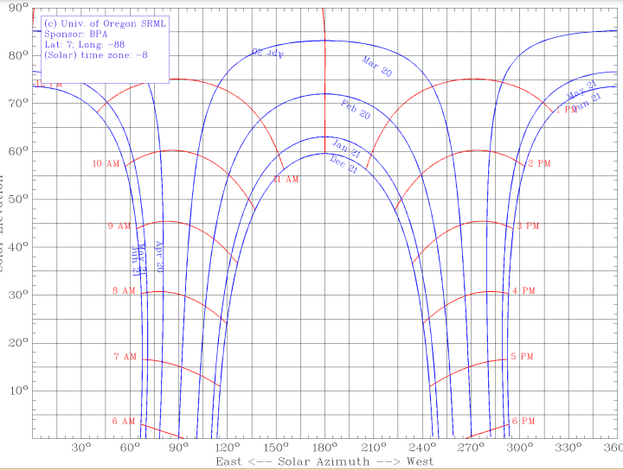
Racking and Mounting
What is the lowest midday angle the sun will get to?
Use a sun
path chart.
60 Degrees
for Belize.
Image courtesy University Oregon

Slide 66
Racking and Mounting
Before 10:00 am the irradiance is not as strong.
Using the sun path chart, look at the angle of the sun at 10:00am.
If shading in the early morning is not important this calculation can be ignored.

Slide 67
Racking and Mounting
Questions?

Slide 68
Racking and Mounting
At 10:00 am is the lowest angle to do the calculation.
Use a sun
path chart.
50 Degrees
for Belize.
Image courtesy University Oregon

Slide 69
Racking and Mounting
What is the tilt angle of the panel?
The optimum tilt angle in Belize is 15 degrees.
This was selected from the RETScreen program.

Slide 70
Racking and Mounting
What is the height of the panel from ground top and bottom?
Panel length is 83 inches (LG 445W).
Bottom edge is 24 inches from ground (for this example).
Top edge is calculated with the Sin function.
Image courtesy Author

Slide 71
Racking and Mounting
What is the height of the panel from ground, top and bottom?
Sin = opposite / hypotenuse
Sin 15 degrees = .26
Opposite side = .26 x 83 inches = 21 ½ inches.
Top edge is 45 ½ inches above the ground.
Image courtesy Author

Slide 72
Racking and Mounting
The shadow cast by the sun on the front row panel is calculated.
Image courtesy Author

Slide 73
Racking and Mounting
The top height of the panel is the opposite side of the new triangle. The distance between rows to the ground is the length of the adjacent side.
50 º
Image courtesy Author

Slide 74
Racking and Mounting
The adjacent is calculated with the tangent function.
Tan = opposite / adjacent
Tan 50 degrees = 1.19
Adjacent = opposite / 1.19
45 ½ /1.19 = 38 3/16 inches
Image courtesy Author

Slide 75
Racking and Mounting
The shadow cast by the sun on the front row panel is calculated.
The second triangle under the second panel.
Shorten the spacing by the adjacent length of this second triangle.
24 inches
50 º
Image courtesy Author

Slide 76
Racking and Mounting
The adjacent is calculated with the tangent function.
Tan = opposite / adjacent
Tan 50 degrees = 1.19
Adjacent = opposite (24inches) / 1.19
Distance under is 24 /1.19 = 20 3/16 inches
Image courtesy Author

Slide 77
Racking and Mounting
The adjacent is calculated with the tangent function.
The row spacing is now 38 3/16 – 20 3/16 inches
18 inches between rows.
Is this practical?
Most likely not as it is very tight to pass through.
Image courtesy Author

Slide 78
Racking and Mounting
Questions?

Slide 79
Racking and Mounting
Snow accumulation (not everywhere).
Although not everywhere this is a concern.
If panels are mounted too low snow can cause shading.
The accumulation of snow is available at weather related websites.
https://www.currentresults.com/Weather/Canada/Nova-Scotia/Places/halifax-snowfall-totals-snow-accumulation-averages.php

Slide 80
Racking and Mounting
If snow clearing equipment is to be used.
Space between the rows needs to be wide enough.

Slide 81
Racking and Mounting
Dust / sand and pollen buildup.
In extreme cases dust / sand and pollen will need to be removed.
Dust / sand is abrasive which will require water.
Scrubbing the dust / sand will damage the surface of the panels.

Slide 82
Racking and Mounting
To measure the effects of the contaminates on the surface of the panel use a hand held pyranometer.
The shading can be measured by comparing the pyranometer reading to the current produced by the panel.

Slide 83
Racking and Mounting
Limited to number of panels North - South.
A consideration is the number of panels that can be mounted in the north – south direction.
Structurally the more panels the stronger the racking system needs to be.

Slide 84
Racking and Mounting
Need more space than roof mounted.
The foot print for a ground mounted system is larger than one that is mounted on a roof.

Slide 85
Racking and Mounting
Requires strong racking components.
The racking components of a ground mount system will be subjected to greater wind forces than a roof top system.
This may add extra costs and make a roof mount system a better choice financially.

Slide 86
Racking and Mounting
Questions?

Slide 87
Racking and Mounting
The mounting of ground mount systems.
There are two basic types.
Pipe
Channel

Slide 88
Racking and Mounting
Ironridge has this manual for ground mount rails and frame.
https://files.ironridge.com/groundmounting/brochures/IronRidge_Ground_Mount_Installation_Manual.pdf

Slide 89
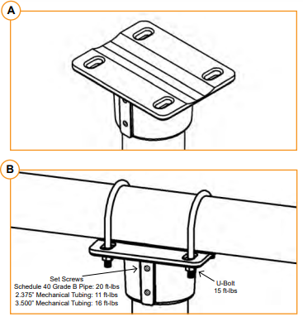
Racking and Mounting
Ironridge uses this bracket to transition from vertical pier to
pipe.
From manual page 5.
Image courtesy ironridge

Slide 90
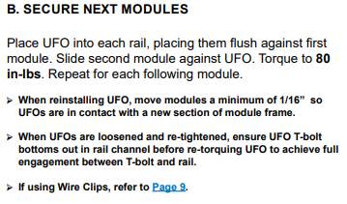
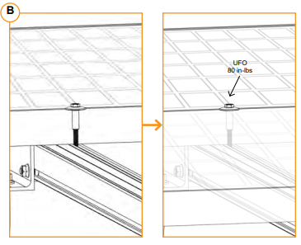
Racking and Mounting
Ironridge uses their own clamps to mate the panels to the rails.
Image courtesy ironridge

Slide 91
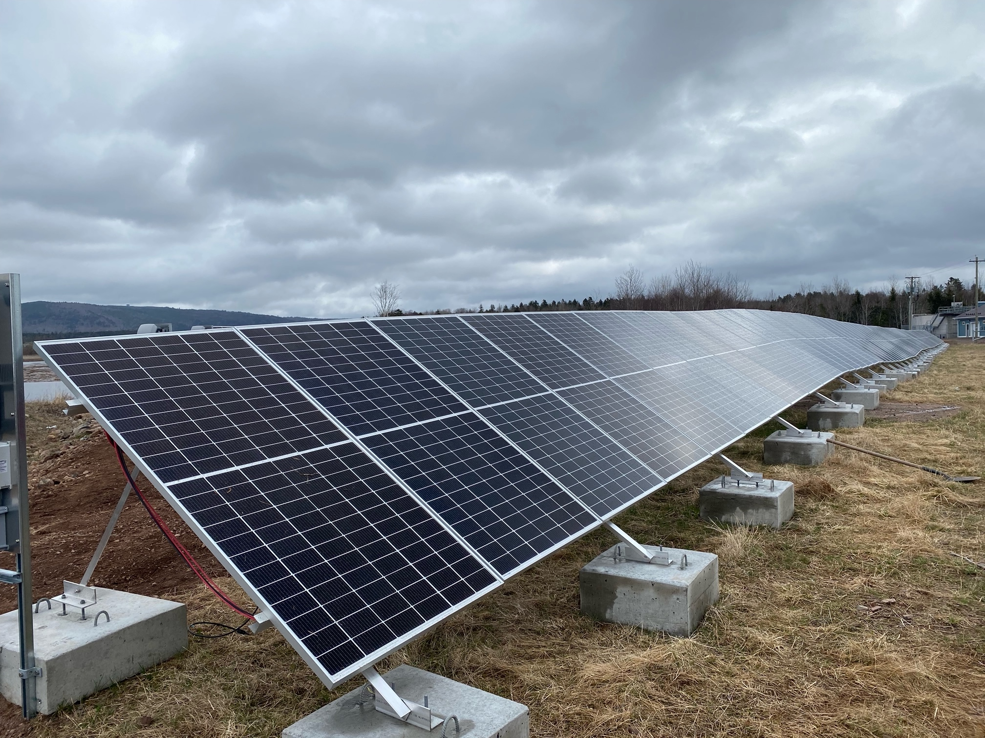
Racking and Mounting
Channel can come in a number of shapes.
The one below is angled Aluminum
Image courtesy Author

Slide 92
Racking and Mounting
Channel is not racking.
Racking is attached to the channel.
Best practice does have the panel attached to the racking by bolts and not clamps.

Slide 93
Racking and Mounting
The racking is attached to the channel in next slide.
Picture courtesy Author

Slide 94
Racking and Mounting
The channel is boxed Aluminum in this system.
Picture courtesy Author

Slide 95
Racking and Mounting
Questions?

