Slide 1




Design and Implementation of Pilot of a TVET Renewable Energy Course
DELIVERABLE #5 - TRAINING COURSES & PROFESSIONAL DEVELOPMENT

Slide 2
Racking and Mounting
This module introduces the concepts of racking and mounting of PV panels.

Slide 3

Racking and Mounting
Span tables are used to set the maximum distance between the rail support brackets.
Tables for these exercises are from IronRidge.
The span tables in this example are for a sloped roof.

Slide 4
Racking and Mounting
Questions?

Slide 5
Racking and Mounting
The reason for span tables.
The concern is wind loading.
Wind loading is the force on solar panels that is transferred to the roof structure.
The force causes uplifting pressure on the roof.

Slide 6
Racking and Mounting
The higher they are mounted above the surface the higher the pressure from wind loading.
The location of the panels on the roof also will influence wind loading.
In particular any overhang of the panels from the roof.
Placing the panels at the top edge also causes wind loading.

Slide 7
Racking and Mounting
Questions?

Slide 8
Racking and Mounting
The ASCE ( American Society of Civil Engineers) have set the categories for wind exposures.
IronRidge have taken those categories and made certificates for their span tables.
Picture courtesy IRONRIDGE

Slide 9
Racking and Mounting
IronRidge has documented design certifications on their website.
Just like the roof, the span between supports is the variable that changes.
The span changes are based on regional winds.

Slide 10
Racking and Mounting
Civil Engineers (ASCE) have defined level of wind based on geographic features.
Exposure B is urban and residential with buildings less than 30 feet tall.
Exposure C is open terrain with buildings less than 30 feet tall.
Exposure D is coastal areas with about a mile open to sea. It does not include hurricane prone areas.

Slide 11
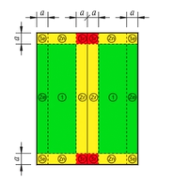
Racking and Mounting
This is a gable roof.
The red zone has the highest wind loading.
Yellow next highest.
Green lowest.
ASCE developed
the pressure areas
and Ironridge matched
them to spans.
Picture courtesy IRONRIDGE

Slide 12
Racking and Mounting
This is from the IronRidge website.
ASCE/SEI 7 is a nationally adopted standard for the analysis and design of buildings and other structures.
The 2016 edition of this consensus standard (ASCE 7-16) has been adopted into the 2018 International Building Code (IBC 2018).
https://www.ironridge.com/asce716/
A lot of great information from this video.

Slide 13
Racking and Mounting
This is from the IronRidge website.
Solar now has its own section of code, and is no longer tucked under “Cladding and Components.”
New wind tunnel testing results have changed wind loads across the US including Puerto Rico.
The impacts to spans and location of mounts are the key things that are needed.

Slide 14
Racking and Mounting
This is from the IronRidge website.
New design considerations include Edge and Exposed Modules.
Code now discerns between Hip and Gable Roofs, low vs. high pitch, and four additional roof zones.
ASCE 7-16 does not provide design recommendations for Edge Modules, but IronRidge has developed a set for you.

Slide 15
Racking and Mounting
The IronRidge certificates can be found at
https://base.ironridge.com/pitched-roof-mounting/resources
Navigate to the “Certification” and select a state.
Florida selected due to it being costal.

Slide 16
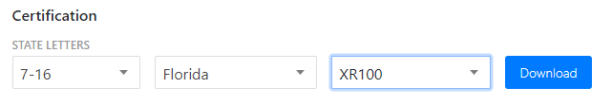
Racking and Mounting
The ASCE option used was 7-16 and the rails selected are the XR100.
Picture courtesy IRONRIDGE

Slide 17
Racking and Mounting
The downloaded certificate can be found at
https://files.ironridge.com/pitched-roof-mounting/resources/certification/XR100/IronRidge_XR100Flush_Certification_UFO_FL-716.pdf
Picture courtesy IRONRIDGE

Slide 18
Racking and Mounting
The tables included in this letter provide the maximum allowable spans of XR Rails in the Flush Mount System for the respective loads and configurations listed, covering wind exposure categories B, C, & D, roof zones provided in ASCE 7-16 for gable & hip roof profiles, and roof slopes of 8° to 45°.

Slide 19
Racking and Mounting
It has 30 pages of information.
The first few pages set out guidelines.
The Flush Mount System is a proprietary rooftop mounting system used to support photovoltaic (PV) modules installed in portrait or landscape orientation and set parallel to the underlying roof surface.
PV modules are supported by extruded aluminum XR Rails and secured to the rails with IronRidge mounting clamps.

Slide 20
Racking and Mounting
The XR Rails are side mounted to a selected roof attachment with 3/8” stainless steel bonding hardware and then attached directly to the roof structure or to a stanchion that is fastened to the underlying roof structure.

Slide 21
Racking and Mounting
Questions?

Slide 22
Racking and Mounting
The tabulated spans are applicable when the following conditions are met:
1. Span is the distance between two adjacent roof attachment points (measured at the center of the attachment fastener).
2. Each module shall be supported by 2 rails (2 rail system) or 3 rails (3 rail system). Spans are calculated based on 2 rail systems, and conservatively deemed acceptable for 3 rail systems.

Slide 23
Racking and Mounting
3. The underlying roof slope, measured between the roof surface and horizontal plane, is 8º to 45º.
4. The mean roof height, defined as the average of the roof eave height and the roof ridge height measured from grade, does not exceed 30 feet.

Slide 24
Racking and Mounting
5. A clearance from the underside of the array to the roof surface of 2” minimum shall be provided and the height of the array, the distance from the module top surface to the roof surface (defined as h2), shall not exceed 10”.
6. Module length and area shall not exceed the maximum values listed on the respective span tables.

Slide 25
Racking and Mounting
7. All Flush Mount components shall be installed in a professional workmanlike manner per IronRidge’s Flush Mount Installation Manual and other applicable standards for the general roof construction practice.

Slide 26
Racking and Mounting
The maximum rail cantilever length, measured from the rail end to the nearest attachment point, shall be the lesser of the following two conditions:
40% of the allowable span provided for the respective load & configuration condition from the span tables, or 36”.
Allowable span length in the charts may be multiplied by a factor of 1.08 if the rails are continuous over a minimum of three spans.

Slide 27
Racking and Mounting
No splices are allowed in the rail cantilever.
For each XR splice type install per the following requirements:
a) XR Bonded Splice cannot be installed in the center 1/3 of interior spans, or the outer 2/3 of end spans.
b) BOSS Splice can be installed at any location within a span.

Slide 28
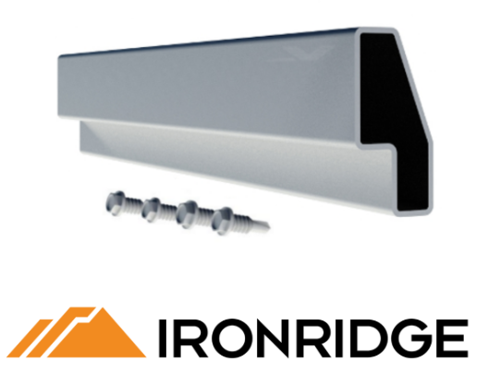
Racking and Mounting
XR Bonded Splice cannot be installed in the center 1/3 of interior spans, or the outer 2/3 of end spans.
Picture courtesy IRONRIDGE

Slide 29
Racking and Mounting
BOSS Splice documentation at IronRidge
https://files.ironridge.com/pitched-roof-mounting/resources/brochures/IronRidge_BOSS_Bonded_Splice_Tech_Brief.pdf

Slide 30
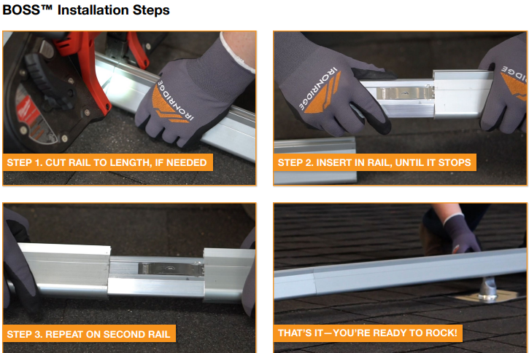
Racking and Mounting
Picture courtesy IRONRIDGE

Slide 31
Racking and Mounting
There are 24 tables that give span distances for:
Maximum module length.
Maximum area of module.
Wind exposure category.
Picture courtesy IRONRIDGE

Slide 32

Racking and Mounting
This is from the first page of tables.
The spans are in inches apart.
Maximum module length is specified.
Maximum area of module is specified.
Wind exposure area is specified.
Picture courtesy IRONRIDGE

Slide 33
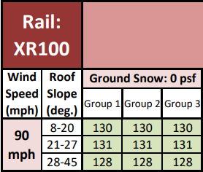
Racking and Mounting
This is from the first page of tables.
Wind Speed 90 mph
Roof Slope in ranges
No snow load
Roof broken into
three Groups
Picture courtesy IRONRIDGE

Slide 34
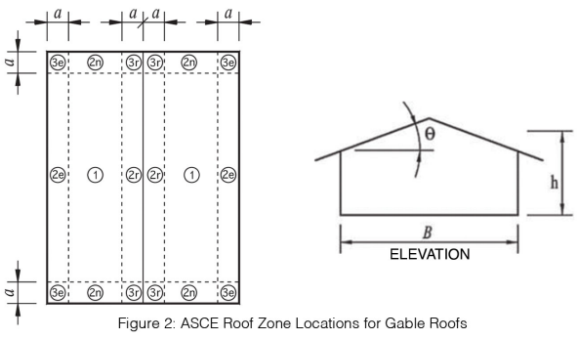
Racking and Mounting
Roof line sectioned off into 6 areas.
1, 2n, 2e, 2r, 3e, and 3r
Picture courtesy IRONRIDGE

Slide 35
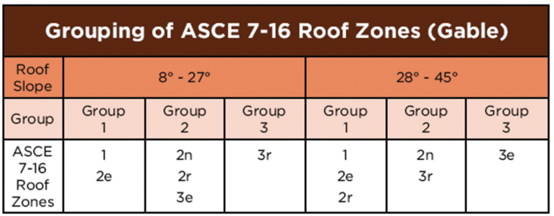
Racking and Mounting
For a roof line with a slope of 20 º.
Group 1 = (sections 1 and 2e) spacing is 130 inches between brackets
Picture courtesy IRONRIDGE

Slide 36
Racking and Mounting
For a roof line with a slope of 20 º.
Group 2 = (sections 2n and 2r and 3e) spacing is 130 inches between brackets
Picture courtesy IRONRIDGE

Slide 37
Racking and Mounting
For a roof line with a slope of 20 º.
Group 3 = (section 3r) spacing is 130 inches between brackets
Picture courtesy IRONRIDGE

Slide 38
Racking and Mounting
Questions?

Slide 39
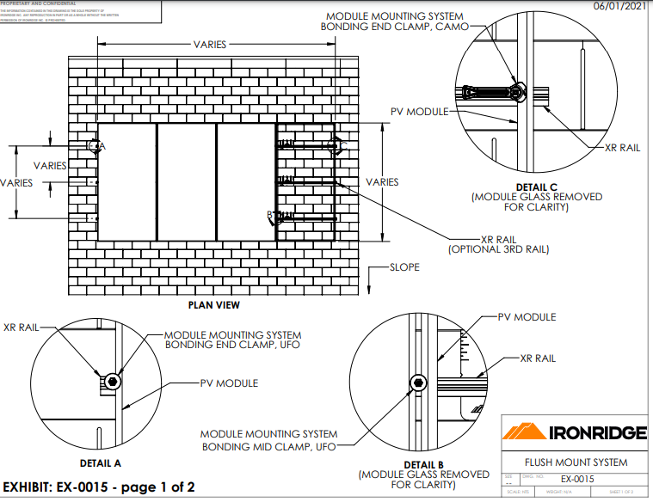
Racking and Mounting
Page 28 Details.
Picture courtesy IRONRIDGE

Slide 40
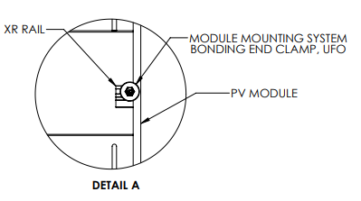
Racking and Mounting
IronRidge UFO bonding and end clamp holding panel to XR rail.
Picture courtesy IRONRIDGE

Slide 41
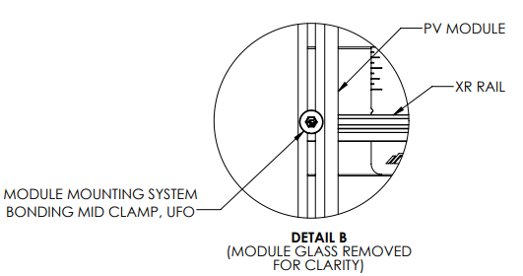
Racking and Mounting
IronRidge UFO bonding and mid clamp holding panel to XR rail.
Picture courtesy IRONRIDGE

Slide 42
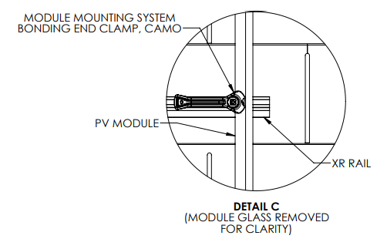
Racking and Mounting
IronRidge CAMO bonding and end clamp holding panel to XR rail.
Picture courtesy IRONRIDGE

Slide 43
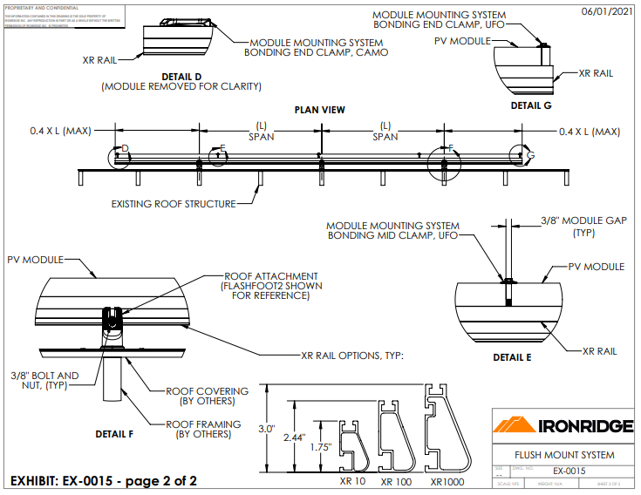
Racking and Mounting
Page 29 Details.
Picture courtesy IRONRIDGE

Slide 44
Racking and Mounting
Questions?

