Slide 1




Design and Implementation of Pilot of a TVET Renewable Energy Course
DELIVERABLE #5 - TRAINING COURSES & PROFESSIONAL DEVELOPMENT

Slide 2

Racking and Mounting
This module introduces the concepts of racking and mounting of PV panels.

Slide 3
Racking and Mounting
Racking is the bonding of parts.
It is the mechanism used to hold the PV panels and all associated equipment.
There will be 5 types covered in this module.

Slide 4
Racking and Mounting
These 5 types are broken down by the equipment used to either mount or rack the PV panels together.
    On roof mounting / racking
    On the ground mounting / racking
    On a pole mounting
    Weighted (Ballast) mounting / racking
    Tracking mounting / racking

Slide 5
Racking and Mounting
The third type of racking and mounting to be explored is “on a pole mounting”.

Slide 6
Racking and Mounting
The most common set up is a single panel installation.
There are options for multiple panel pole mounts.

Slide 7
Racking and Mounting
Examples of pole mount PV systems:
Lighting
Security
Traffic signal / signage
Communications / SCADA (supervisory control and data acquisition)
Weather station
Water pumping

Slide 8
Racking and Mounting
Questions?

Slide 9
Racking and Mounting
The reasons for pole mounting:
Small foot print
A pole already exists
Out of reach
Need height
Adjustable tilt option

Slide 10
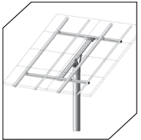
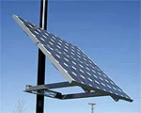
Racking and Mounting
There are two mounting options.
Top of pole mount.
Side of pole mount.
Pictures courtesy altestore.com

Slide 11
Racking and Mounting
Questions?

Slide 12
Racking and Mounting
The mount will have the ability to fasten to a round object.
https://hespv.ca/media/wysiwyg/infortis/ultimo/mounts/TPM-FOUNDATION-GUIDELINES.pdf
This link has information that underlines the need to know soil conditions.
The base needs to be able to support the wind conditions.

Slide 13
Racking and Mounting
As in ground mounted systems a wind loading profile needs to be conducted.
This example will follow the AltEstore design tool.
https://www.altestore.com/store/solar-panel-mounts/top-of-pole-mounts-for-solar-panels-c514/

Slide 14
Racking and Mounting
The first step is to know the PV panel size.
This will help determine the area exposed to the wind.

Slide 15
Racking and Mounting
Find the following site conditions:
Wind / snow load (Belize = no snow load)
Soil conditions
Options for the mount

Slide 16
Racking and Mounting
Max wind speed - standard mounts can withstand 90-100 mph winds.
High wind version mounts available for higher zones.
Desired tilt angle - with most mounts able to be seasonally adjusted, what is the best angle it should be set at for most of year

Slide 17
Racking and Mounting
Soil type - is the soil crystalline bedrock, sedimentary rock, sandy gravel, silty sand, sandy clay.
Exposure category - is the site sheltered with buildings or forests, or open/flat, or on the coastline/severe conditions (B-C-D).
Foundation shape and size - what is the diameter of the hole that will hold the mount, that concrete will be poured into.

Slide 18
Racking and Mounting
Pole mount installs easily over standard Schedule 40 or 80 rigid steel pipe.
This is not included with the mounts normally.

Slide 19
Racking and Mounting
Dig hole according to recommended depth and diameter.
Once pole is in ground, use level to make sure it's vertical to the ground.
Brace pipe to prevent it from moving during the concrete pouring.
Allow concrete to cure.
Backfill around pole.

Slide 20
Racking and Mounting
From the altestore, this link opens a calculator to entre the data required.
https://www.mtsolar.us/top-of-pole-mount-calculator/

Slide 21
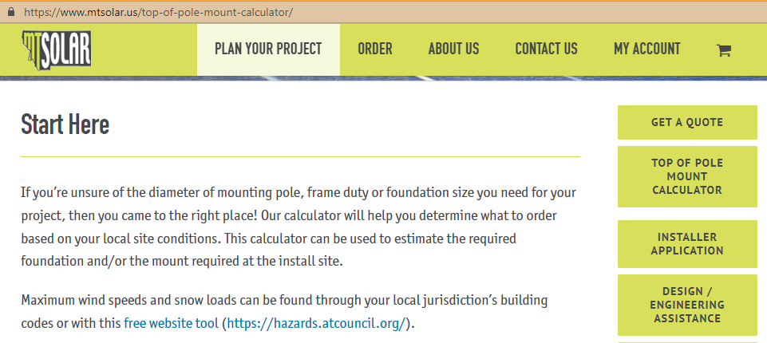
Racking and Mounting
This is the pop-up screen (ensure pop-ups are not blocked in your browser).
Scroll down the page.

Slide 22
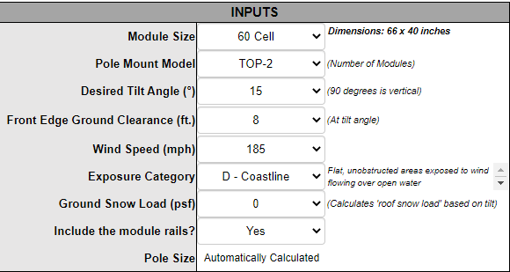
Racking and Mounting
Start to add information.
Check the “Dimensions” for accuracy.
There was no option for 1 panel.

Slide 23
Racking and Mounting
15 degrees is optimal for Belize.
8 feet was selected to keep out of reach.
Any height is acceptable.

Slide 24
Racking and Mounting
Worst case scenario is 185 mph wind speed.
Exposure D ( Covered in previous modules)
Belize snow?

Slide 25
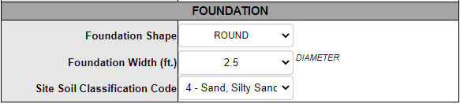
Racking and Mounting
The choice for shape is either round or square.
There are a number of widths to pick from.
5 types of soil conditions are available to be selected.

Slide 26
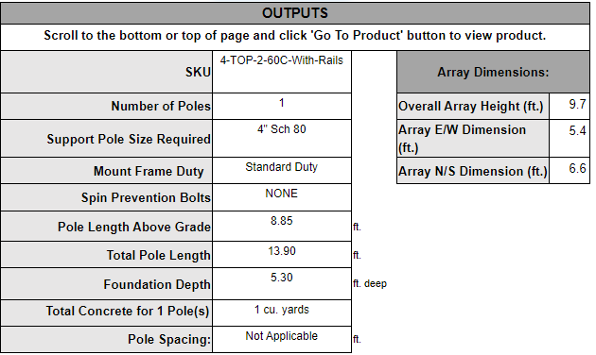
Racking and Mounting
The calculator provided the following information.

Slide 27
Racking and Mounting
The calculator is a good tool for students to input various conditions.
Students can explain the designed differences.

Slide 28
Racking and Mounting
Questions?

Slide 29
Racking and Mounting
Side of pole mounts are easy to install.
Typically used for small numbers of solar modules (usually no more than 4 modules).

Slide 30
Racking and Mounting
Sunwize has many side of pole mounts.
This link is to just one of their many mounts.
https://www.altestore.com/static/datafiles/Others/SW-SOP-mounts-10-12.pdf

Slide 31
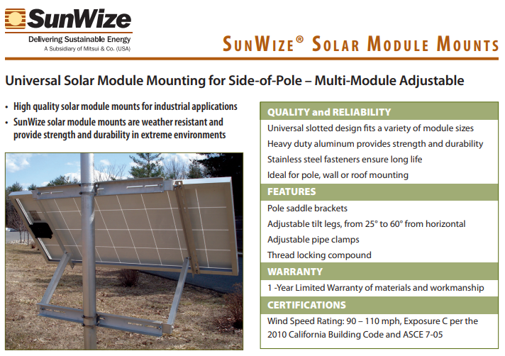
Racking and Mounting
Note the wind speed rating.
Pictures courtesy Sunwize and altestore.com

Slide 32
Racking and Mounting
Questions?

Slide 33
Racking and Mounting
Pole mounted solar panels are usually part of a stand alone system.
They have all of the components to provide energy.
Basic system components are:
PV panel
Battery
Charge controller

Slide 34
Racking and Mounting
The complete pole mounting system normally has an enclosure to house the accessary equipment.
The enclosure can be mounted to the pole or a nearby structure.
The enclosure needs to be weather proof.

Slide 35
Racking and Mounting
NEMA (the National Electrical Manufacturers Association) has a rating system for outdoor equipment like enclosures.
Type 3R
Type 4
Type 4x
Each of these are acceptable but there are differences.

Slide 36
Racking and Mounting
Type 3R: Intended for outdoor use.
Provides a degree of protection against falling rain and ice formation.
Constructed with knockouts on the sides and bottom.

Slide 37
Racking and Mounting
These are not rain-tight, which means exposure to beating rain could result in water entering.
Nor are they water-tight, which means moisture could enter when subjected to a stream of water under certain conditions.
This style of enclosure does not have a gasketed sealing surface.

Slide 38
Racking and Mounting
Type 4: Weather tight (weatherproof) enclosures.
Constructed for either indoor or outdoor use.
Provide a degree of protection against falling dirt, rain, sleet, snow, windblown dust, splashing water, and hose-directed water.

Slide 39
Racking and Mounting
Type 4X: Same as Type 4 except constructed from corrosion-resistant material.
Corrosion-resistant as defined by industry standards.
Constructed to provide a degree of protection against exposure to corrosive agents such as salt spray.

Slide 40
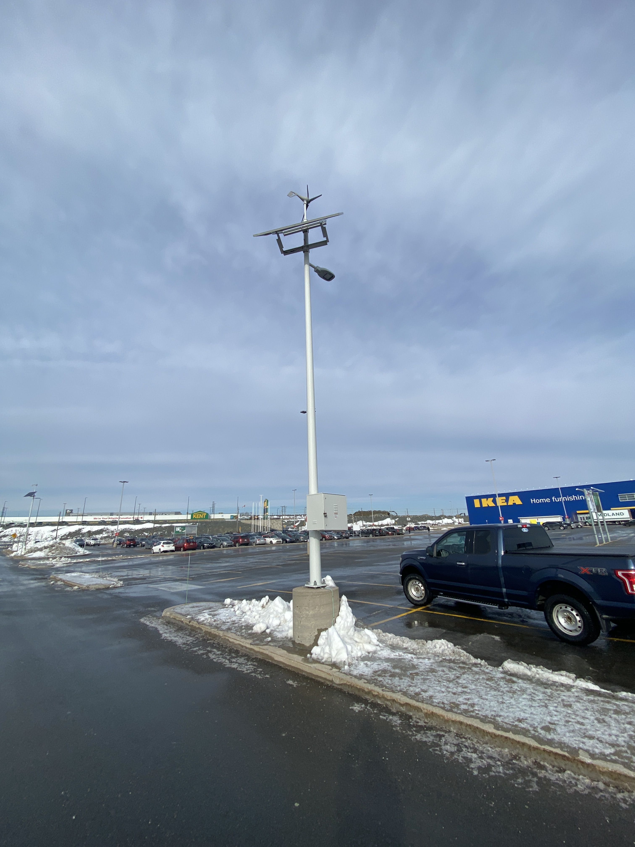
Racking and Mounting
The complete pole mount
and the associated
equipment including the
enclosure.
Picture courtesy author

Slide 41
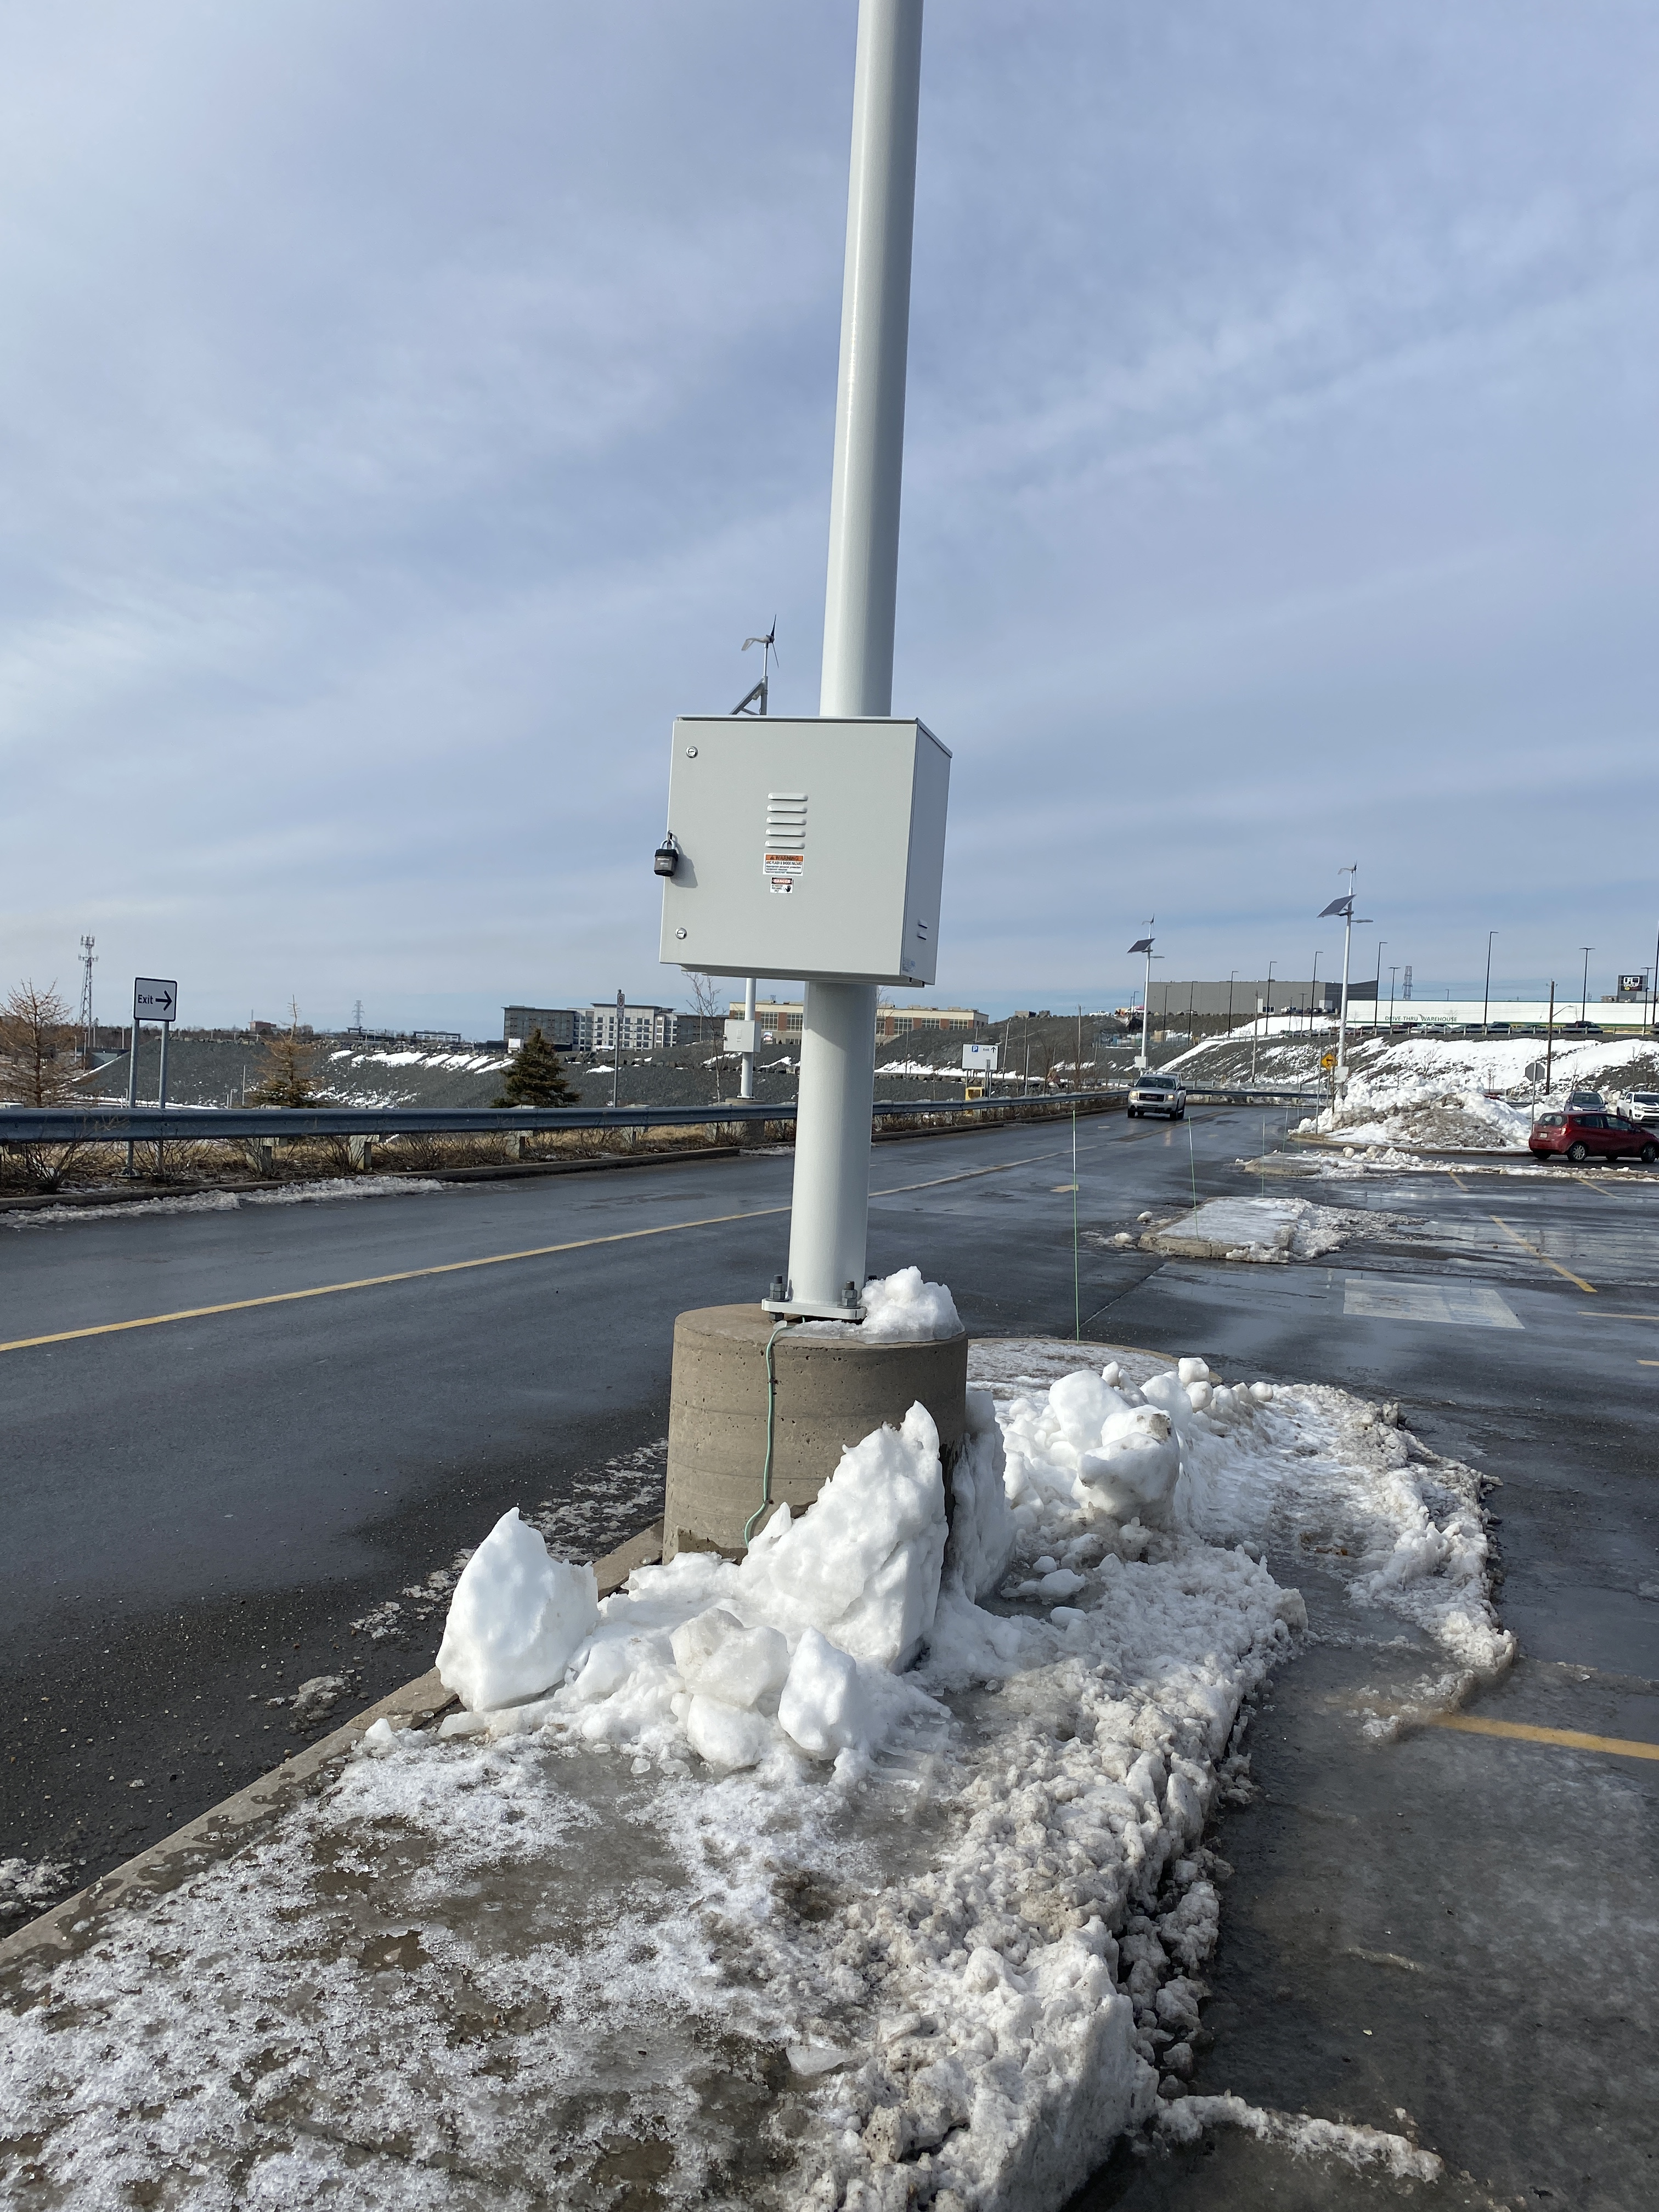
Racking and Mounting
Close up look at the locked
enclosure.
Picture courtesy author

Slide 42
Racking and Mounting
Questions?

