Slide 1




Design and Implementation of Pilot of a TVET Renewable Energy Course
DELIVERABLE #5 - TRAINING COURSES & PROFESSIONAL DEVELOPMENT

Slide 2
Racking and Mounting
This module introduces the concepts of racking and mounting of PV panels.

Slide 3
Racking and Mounting
Racking is the bonding of parts.
It is the mechanism used to hold the PV panels and all associated equipment.
There will be 5 types covered in this module.

Slide 4
Racking and Mounting
These 5 types are broken down by the equipment used to either mount or rack the PV panels together.
    On roof mounting / racking
    On the ground mounting / racking
    On a pole mounting
    Weighted (Ballast) mounting / racking
    Tracking mounting / racking

Slide 5

Racking and Mounting
The fifth type of racking and mounting to be explored is “Tracking mounting / racking”.

Slide 6
Racking and Mounting
These types of mounts have the ability to change the angle that the PV panel is facing.
Moves about an axis.
Can be motorized or manually moved.

Slide 7
Racking and Mounting
Used to capture more energy than fixed tilt panels.
More expensive than fixed tilt setup.
Requires maintenance.

Slide 8
Racking and Mounting
Questions?

Slide 9
Racking and Mounting
Reference for tracking the sun.
Azimuth and Zenith.
South Azimuth = either 0 or 180 degrees depending on the source.
North Azimuth = either 0 or 180 degrees depending on the source.

Slide 10
Racking and Mounting
Either is correct.
South Azimuth = 0 degrees
East Azimuth = 90 degrees
West Azimuth = -90 degrees
South Azimuth = 180 degrees
East Azimuth = 90 degrees
West Azimuth = 270 degrees

Slide 11
Racking and Mounting
Reference for tracking the sun.
Azimuth and Zenith.
Zenith = angle from 90 degrees overhead.
Changes seasonally.
Facing the sun is the angle from overhead.

Slide 12
Racking and Mounting
Reference for tracking the sun.
In morning and dusk the sun zenith is at greatest angle.
In Belize the sun travels across overhead to the north.
During this time the zenith is still a positive angle.

Slide 13
Racking and Mounting
Reference for tracking the sun.
Fixed tilt angle is the angle from flat horizontal position downwards to perpendicular at 90 degrees from horizontal looking due south.
Azimuth tracking is from east – west and follows the sun from morning to dusk at a fixed tilt angle.

Slide 14
Racking and Mounting
Reference for tracking the sun.
Fixed tilt angle is the angle from flat horizontal position downwards to perpendicular at 90 degrees from horizontal looking due south.
Zenith tracking is from south - north and follows the sun from morning to dusk changing the tilt angle.

Slide 15
Racking and Mounting
Reference for tracking the sun.
Sun position calculator:
https://www.pveducation.org/pvcdrom/properties-of-sunlight/sun-position-calculator
This site uses south as 180 degrees.
C.B.Honsberg and S.G.Bowden, “Photovoltaics Education Website,” www.pveducation.org, 2019.

Slide 16
Racking and Mounting
There are two basic types of tracking systems.
Single axis and dual axis.
Axis is a reference point or line that something rotates around.
Earth rotates around an axis that goes from the north pole to the south pole.

Slide 17
Racking and Mounting
Earth rotates around an axis that goes from the north pole to the south pole.
This rotates the earth east – west.
When a PV panel tracks east – west, it captures more of the morning and evening sun.

Slide 18
Racking and Mounting
On fixed mounted panels the most energy is captured from the mid-day sun (10am – 4pm).
The angle of incidence follows the Cosine rule.
When fixed angle panels are pointing this way, the early morning angle of incidence is very high and only captures a small percentage of the early morning energy.

Slide 19
Racking and Mounting
When using a tracking system to move east – west it will capture more of the early morning and evening energy.
The following slides demonstrate the extra amount of energy that can be harvested by an east – west tracker.
RETScreen is used to generate the difference in the daily radiation.

Slide 20
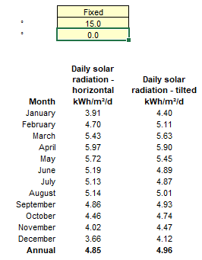
Racking and Mounting
This first example is with the PV panels tilted at the optimum angle for Belize at 15 degrees.
Annual daily is 4.96 kWh/m²/d.
Picture courtesy author

Slide 21
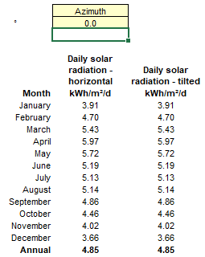
Racking and Mounting
This example is with the PV panels at 0 degrees or laying flat. The Azimuth tracking is east – west. There should be no difference in this example because there is no starting tilt.
Picture courtesy author

Slide 22
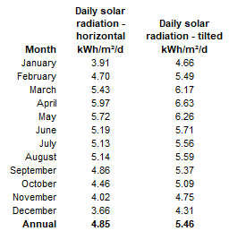
Racking and Mounting
This example is with the PV panels at 15 degrees. The Azimuth tracking is east – west. There is a difference of 0.5kWh/m²/d compared to the 15 degree tilt.
This is a gain of 10 percent.
Not a big increase.
Picture courtesy author

Slide 23
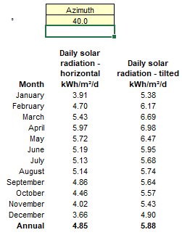
Racking and Mounting
Increasing the tilt to 40 degrees and using the Azimuth tracking is east – west. There is a difference of 0.92kWh/m²/d compared to the 15 degree tilt.
This is a gain of 18 percent.
More than leaving the panels
at 15 degrees and Azimuth
tracking.
Picture courtesy author

Slide 24
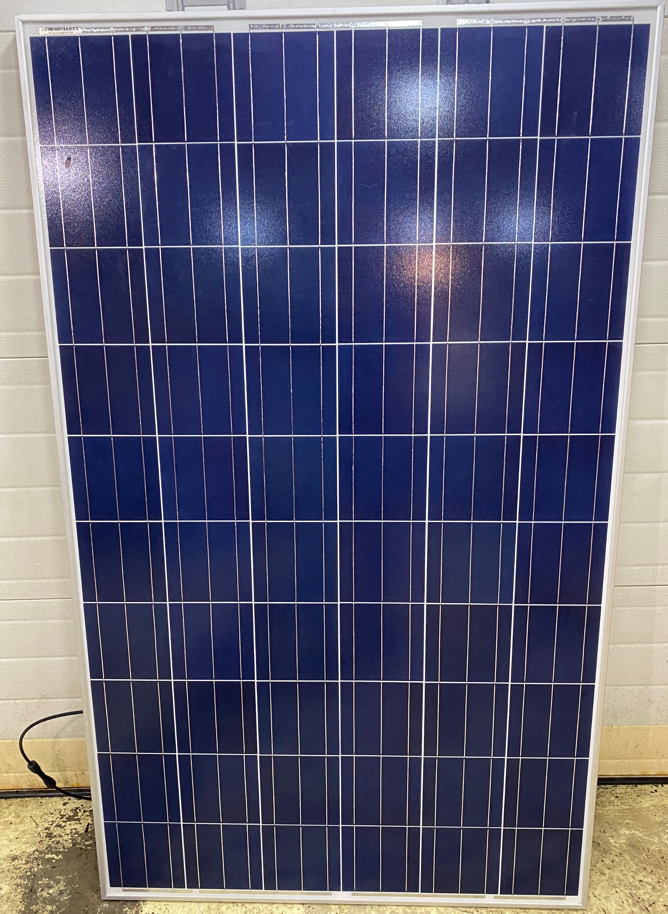
Racking and Mounting
The panel moves around a single
axis.
Vertical axis of the panel.
Turning the panel around
this axis allows the panel to
track the sun east – west.
Picture courtesy author

Slide 25
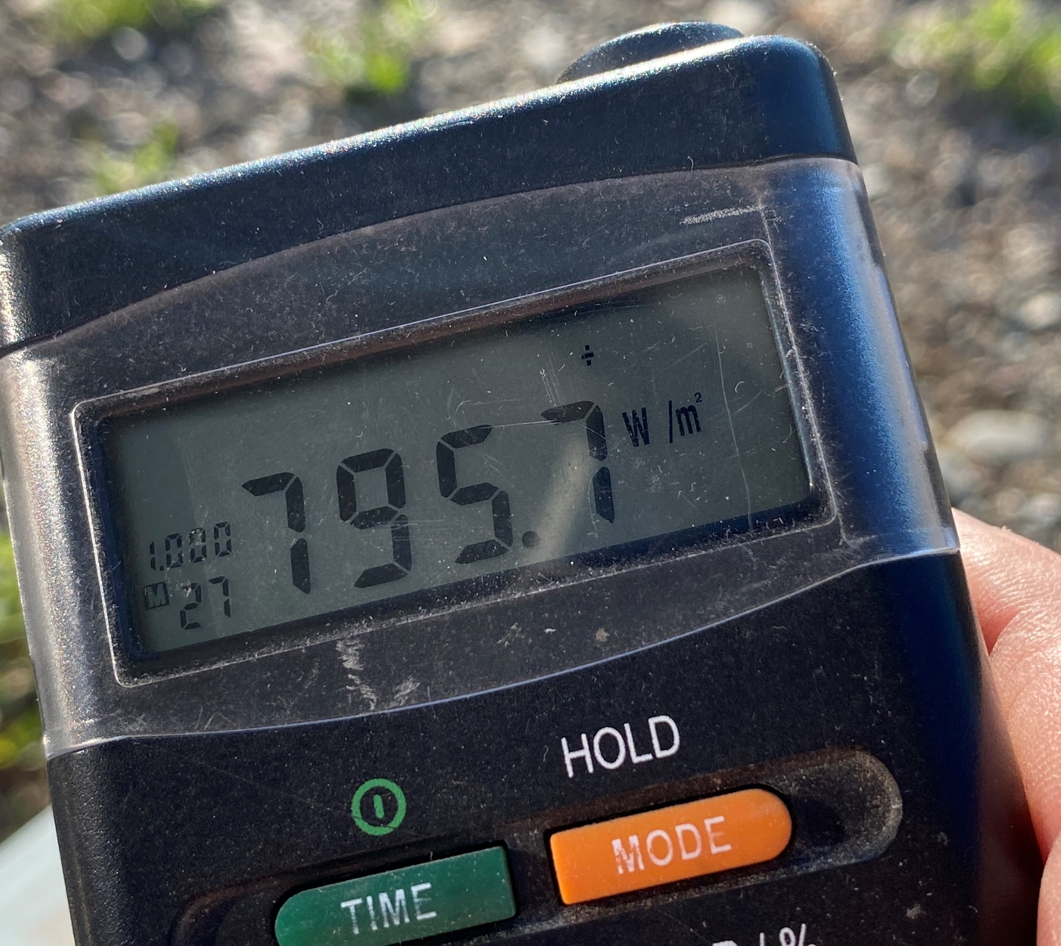
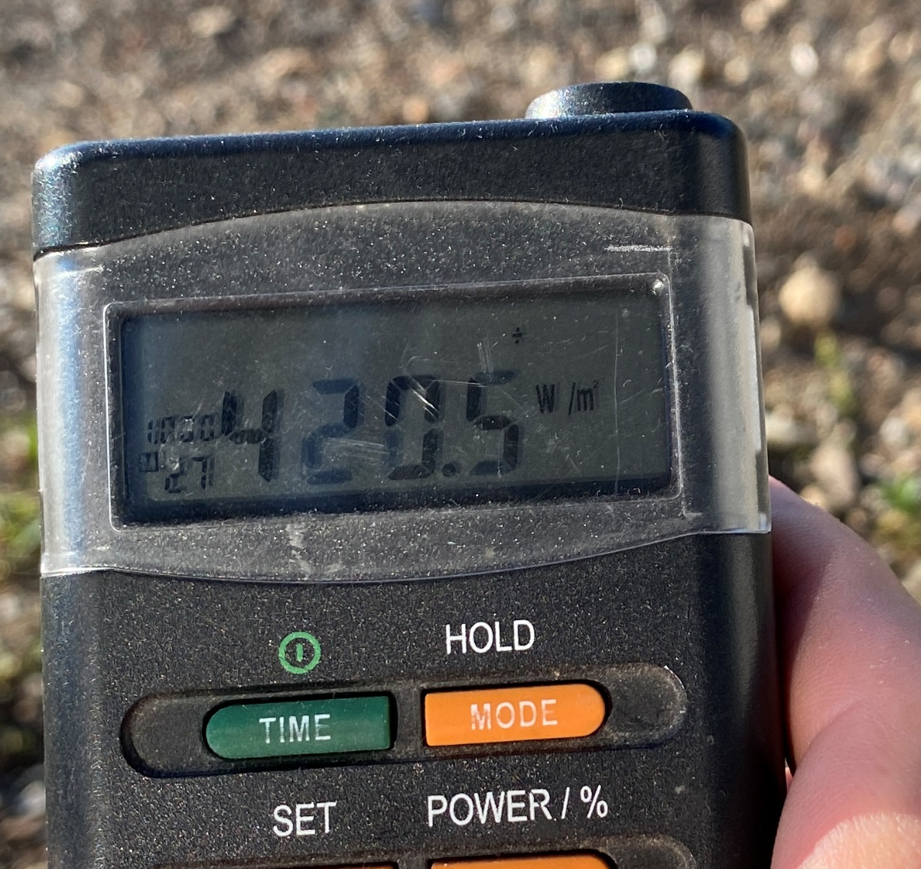
Racking and Mounting
The difference early morning tracking versus the fixed tilt irradiance reading.
Left reading pointing at morning sun.
Left reading at optimum fixed tilt angle.
Picture courtesy author

Slide 26
Racking and Mounting
Need pictures of east west trackers.
Picture courtesy author

Slide 27
Racking and Mounting
Moving the panels everyday usually requires a motorized system.
They require maintenance.
Consumes power.

Slide 28
Racking and Mounting
There is another single axis system that moves the panels.
This system can follow the seasonal north – south movement of the sun.
The movement can be motor driven or manually moved.

Slide 29
Racking and Mounting
These track the zenith angle of the sun.
They move the panels up and down as the sun changes seasonally.
Three common manually moved positions are:
  Winter solstice
  Summer solstice
  Equinox

Slide 30
Racking and Mounting
This is example of a single axis movement.
Horizontal axis of the panel.
Turning the panel around
this axis allows the
panel to track the sun
north - south.
Picture courtesy author

Slide 31
Racking and Mounting
When using a tracking system to move north – south it will capture more energy as the earth tilts to and from the sun.
It keeps the panels closer to a perpendicular angle of incidence during the mid-day when the irradiance is the strongest.
Most effective at higher latitudes, where the sun has a large north – south seasonal movement.

Slide 32
Racking and Mounting
The following slides demonstrate the extra amount of energy that can be harvested by a north - south tracker.
RETScreen is used to generate the difference in the daily radiation.

Slide 33
Racking and Mounting
This example is with the PV panels tilted at the optimum angle for Belize at 15 degrees.
Annual daily is 4.96 kWh/m²/d.
Picture courtesy author

Slide 34
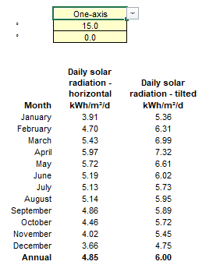
Racking and Mounting
This example is with the PV panels pointing due south. The Zenith tracking is north – south. There is a difference of 1.04kWh/m²/d
compared to the 15 degree tilt.
This is a gain of 21 percent.
A larger increase over
east-west tracking.
Picture courtesy author

Slide 35
Racking and Mounting
Picture of single axis tracker.
Picture courtesy author

Slide 36
Racking and Mounting
When these two types of tracking are combined the tracker is now called dual axis tracking.
It combines the best of the east – west and the north – south tracking.
This system requires energy and a system to move the panel during the daylight hours.

Slide 37
Racking and Mounting
To move the panels in both directions requires a mechanism that will operate independently of each other.
The most common type of gearing system used to do this is a worm gear assembly.
Worm gears are used to increase torque and reduce speed from the driven source.

Slide 38
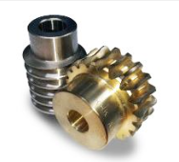
Racking and Mounting
The rotational direction of the driven shaft is changed by 90 degrees.
Speed and torque can be
changed.
Picture courtesy author

Slide 39
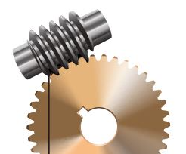
Racking and Mounting
The worm in a worm gear may have a single start or multiple starts.
For a single-start worm, each full turn
(360 degrees) of the worm advances
the gear by one tooth.
When they are the same,
there is no speed change.
40 teeth in the worm gear and single-start on the worm
Picture courtesy author

Slide 40
Racking and Mounting
The speed ratio of a worm and worm gear set is the number of teeth of the worm gear divided by the number of threads (starts)
of the worm.
This example has 40 teeth and a
single start.
40 teeth divided by the 1 (single start) = 40:1 ratio.
Picture courtesy author

Slide 41
Racking and Mounting
The higher the speed reduction ratio the torque is increased.
The dual axis tracker follows the sun and there for needs to be slow moving.
The extra torque keeps the wind from moving the tracker.

Slide 42
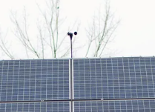
Racking and Mounting
Dual trackers can have a wind function that drops the panel(s) to a flat horizontal position.
This removes the torque placed on the tracker components in high winds.
Typically a wind vane is mounted somewhere on the frame / racking.
Picture courtesy author

Slide 43
Racking and Mounting
Dual trackers can track the sun position or monitor the irradiance of the sun to move its position.
GPS sensors, programming for location will move the tracker to be perpendicular to the sun.
This works for direct radiation.
It reduces the PV panel production on overcast or foggy conditions.

Slide 44
Racking and Mounting
Pictures from handheld pyranometer showing diffused versus direct radiation.
Picture courtesy author

Slide 45
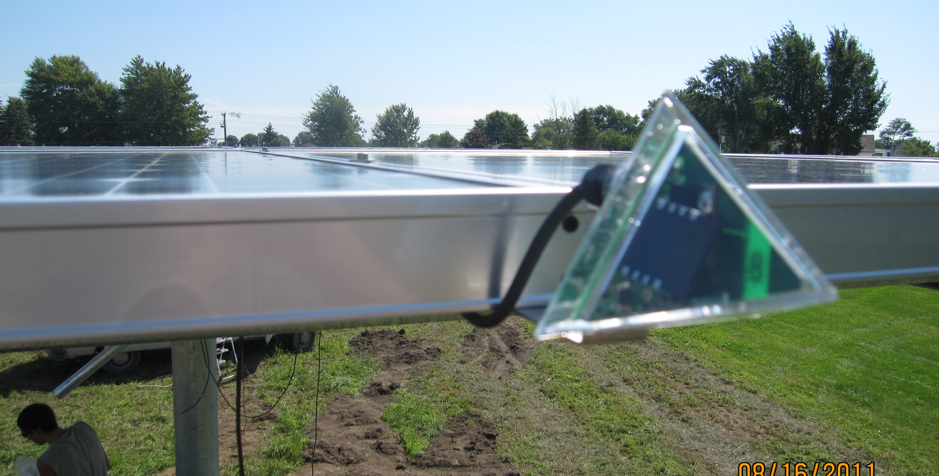
Racking and Mounting
Pyranometer used to measure the irradiance.
It is mounted to the racking at the top of the tracker and at 90 degrees to the panel face.
Picture courtesy author

Slide 46
Racking and Mounting
This example is with the PV panels tilted at the optimum angle for Belize at 15 degrees.
Annual daily is 4.96 kWh/m²/d.
Picture courtesy author

Slide 47
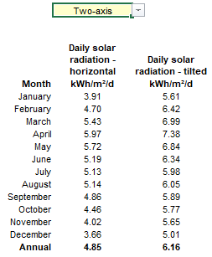
Racking and Mounting
This is the daily radiance from a duel axis tracker in Belize. There is a difference of
1.2kWh/m²/d compared to
the 15 degree tilt.
This is a gain of 24 percent.
Annual daily is 6.16 kWh/m²/d.
Picture courtesy author

Slide 48
Racking and Mounting
Trackers require maintenance.
Manufacturers will supply a list and timeline for a maintenance schedule.
Maintenance of the bearings usually require adding grease via a grease fitting.
Maintenance of the gears is doing a visual / physical check of the free play of the tracking mechanism.

Slide 49
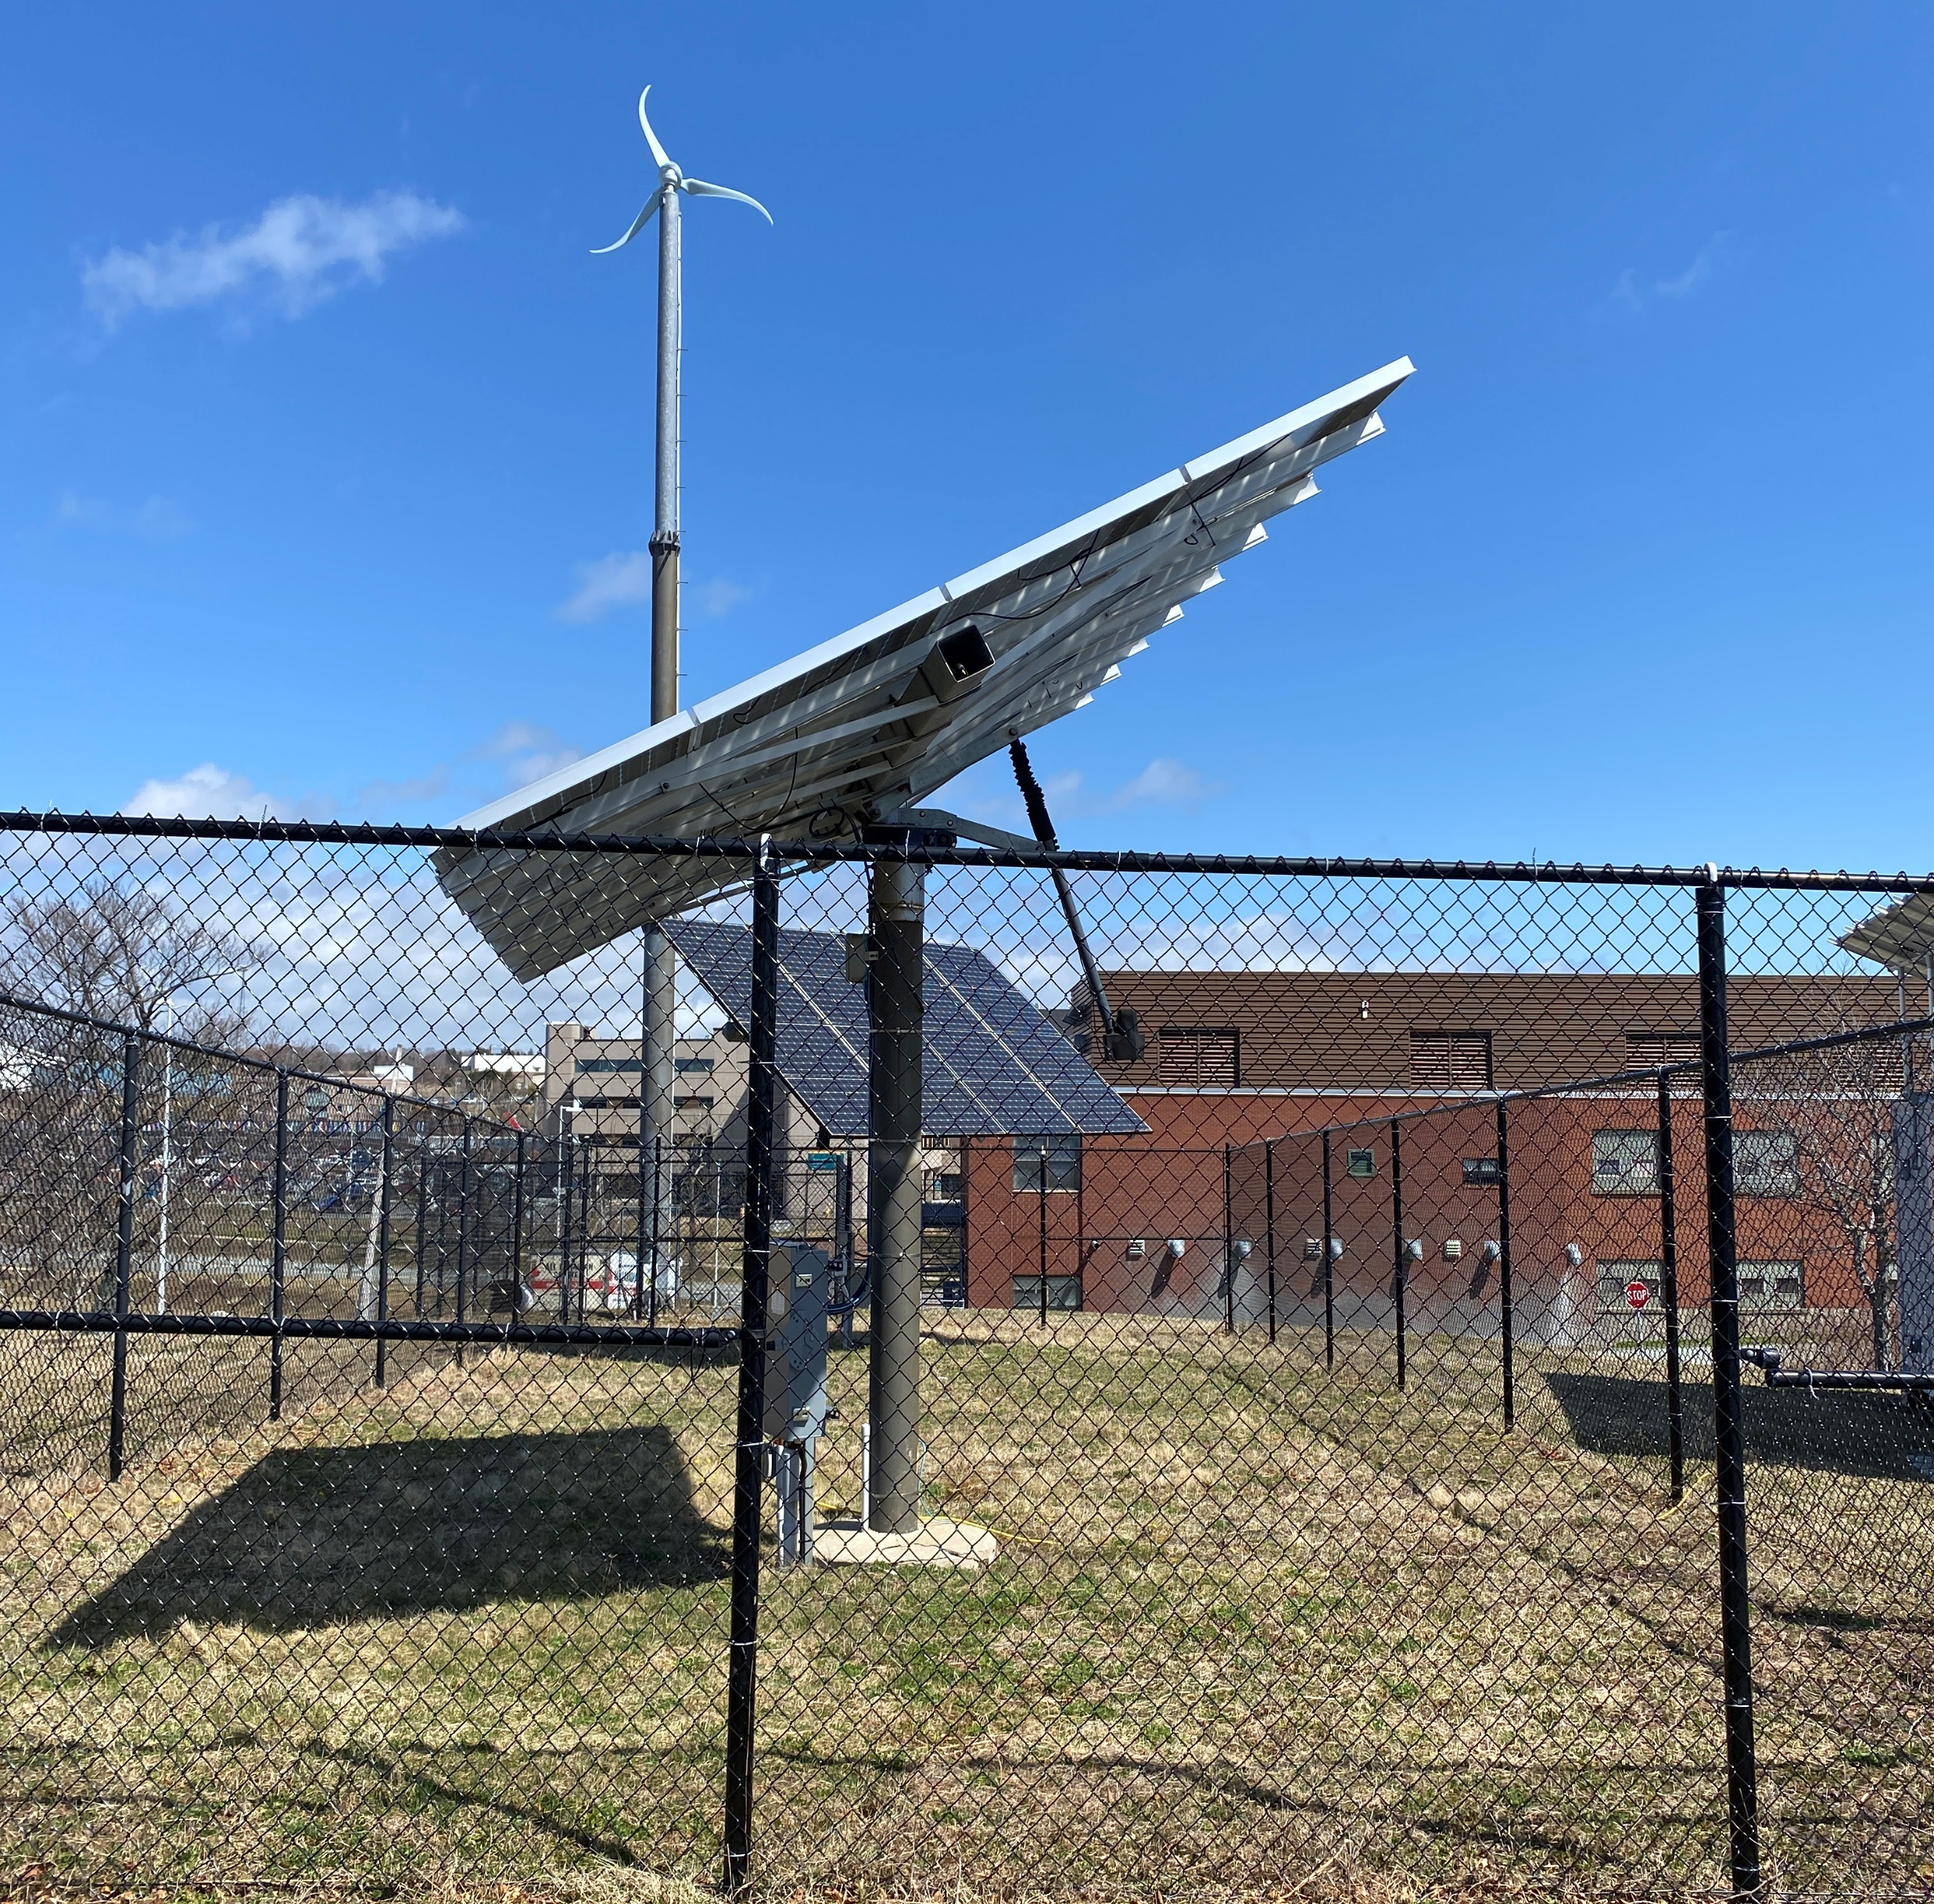
Racking and Mounting
Lack of maintenance allowed the wind to push panels out of sun.
Picture courtesy author

Slide 50
Racking and Mounting
Questions?

Slide 51
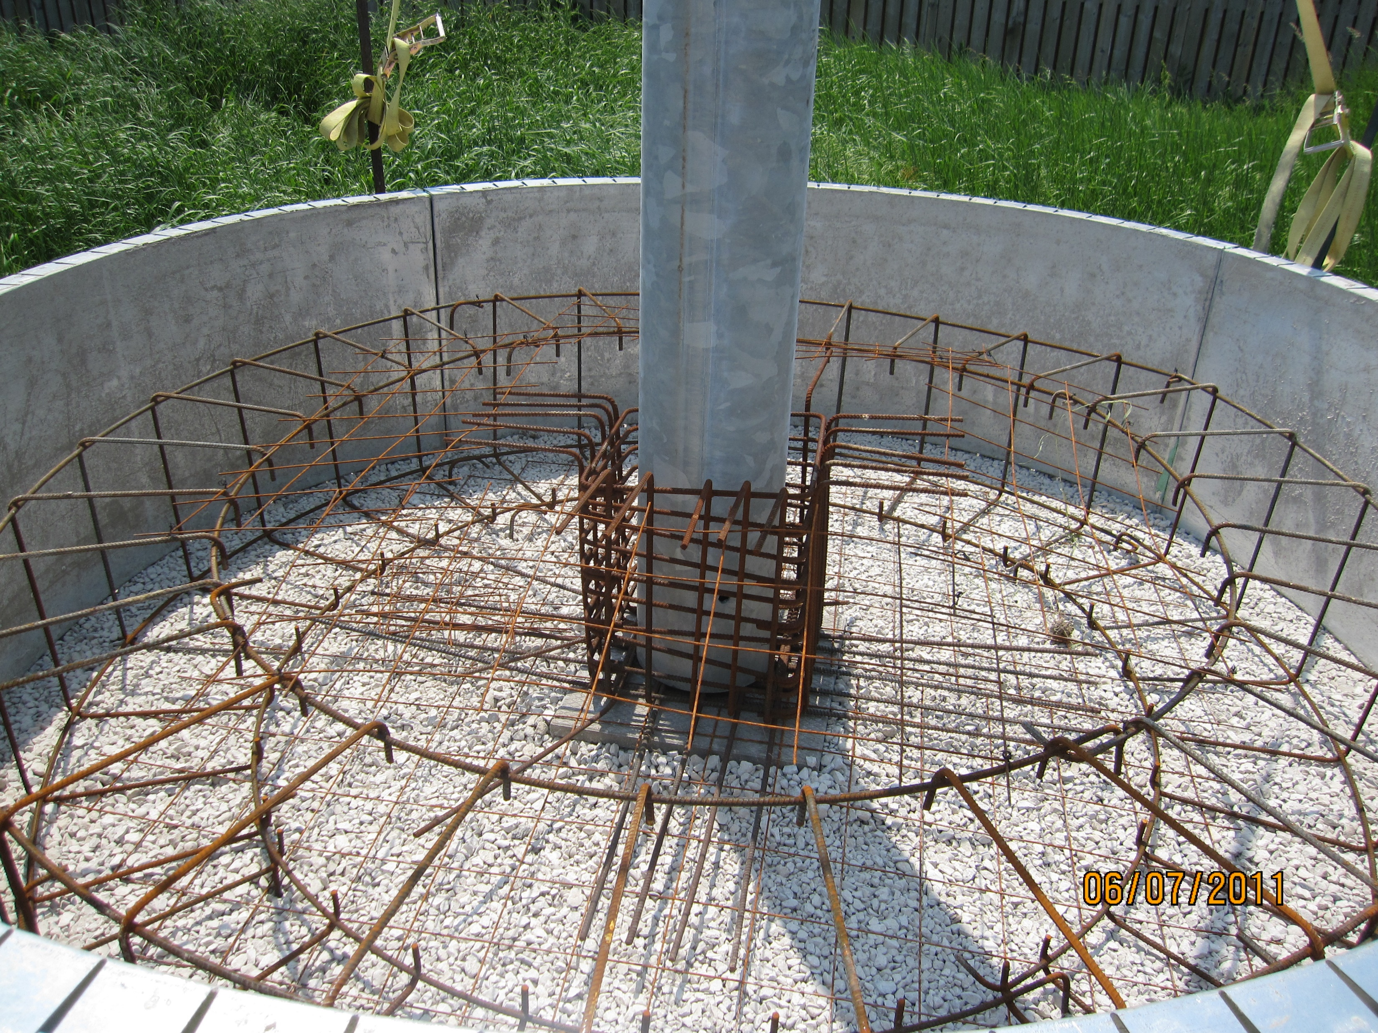
Racking and Mounting
Concrete base of dual axis tracker.
Picture courtesy author

Slide 52
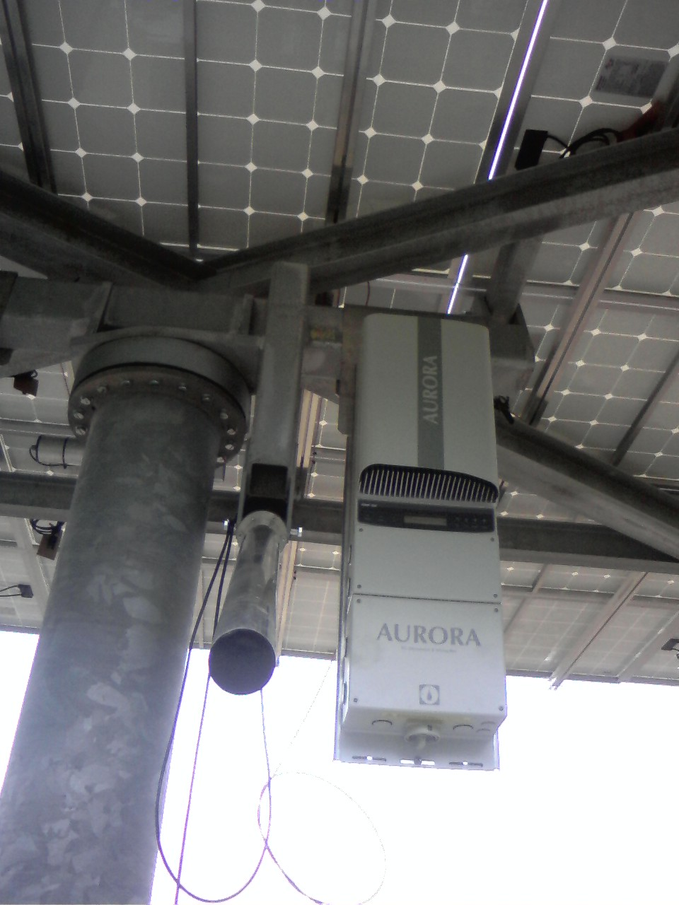
Racking and Mounting
Dual axis tracker system.
Picture courtesy author

Slide 53
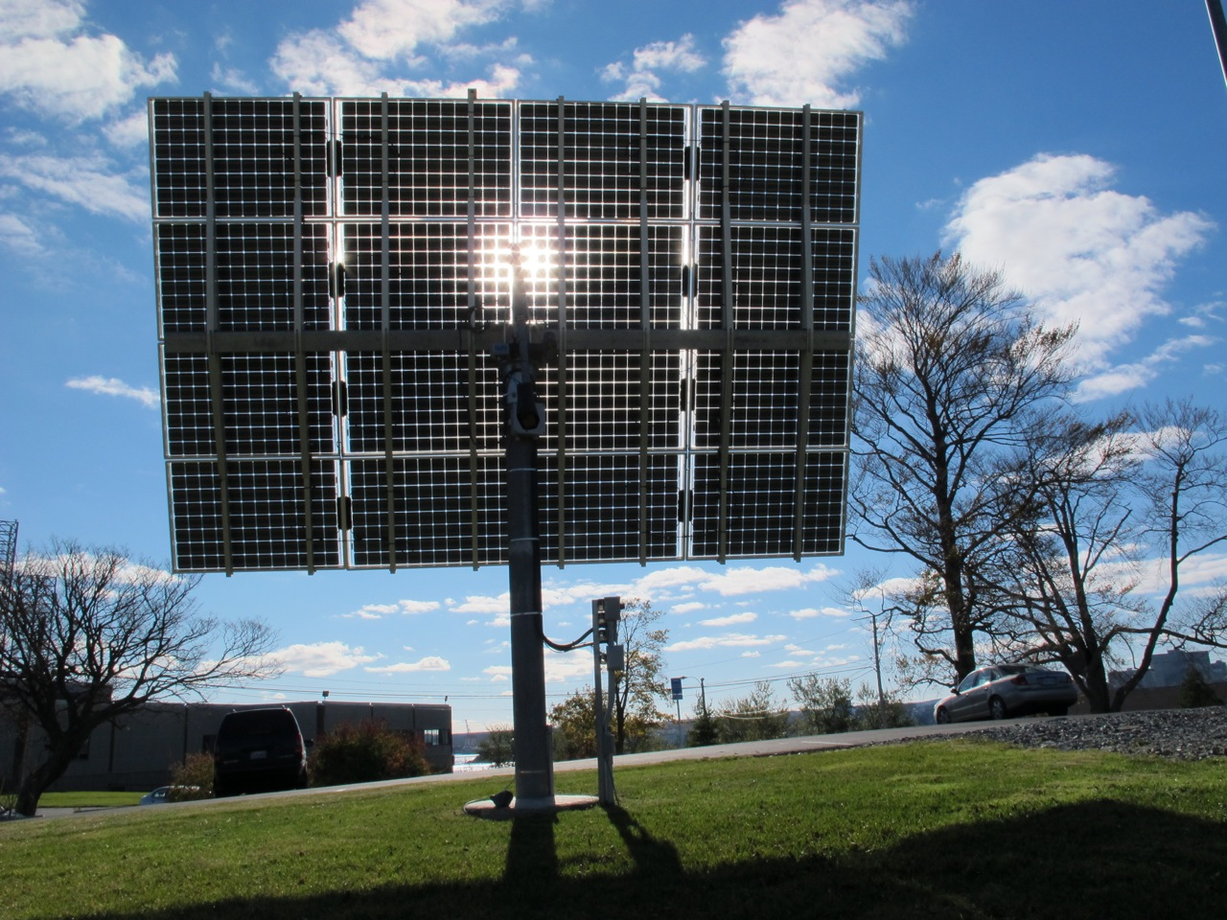
Racking and Mounting
Dual axis tracker system.
Picture courtesy author

