Slide 1




Design and Implementation of Pilot of a TVET Renewable Energy Course
DELIVERABLE #5 - TRAINING COURSES & PROFESSIONAL DEVELOPMENT

Slide 2

Racking Combiner Box
This module introduces the combiner box as an accessory to the racking system.
Mounting the combiner box.
Wire management.
Grounding and bonding.

Slide 3
Racking Combiner Box
Questions?

Slide 4
Racking Combiner Box
What is a Combiner box?
An electrical enclosure that is outdoor rated.
NEMA Rated (National Electrical Manufacturers Association).
NEMA 3 minimum.

Slide 5
Racking Combiner Box
What is a Combiner box?
It is a box that combines strings of PV panels.
A string is a connection of PV panels in series.
A single panel is still a string.
The strings are combined (paralleled) into a single string.

Slide 6
Racking Combiner Box
The combiner box takes the output from PV panels and brings them together for a single output pair of wires.
The combiner box will indicate how many strings it can accommodate.
Also voltage and amperage limits.
Provides overcurrent protection.

Slide 7
Racking Combiner Box
The wire coming from the PV string is sized to handle the short circuit current (Isc).
The wire is also rated for the maximum voltage of the string.

Slide 8
Racking Combiner Box
A combiner box is normally only required if there are more than two strings of PV panels.
With one string only the combiner can act as a disconnection means if required.
An over current device is not required unless it is used as the disconnection means on a single string input.

Slide 9
Racking Combiner Box
With a two string array if one string faults, the current generated is not great enough to damage either string’s wire.
Therefore a combiner box is not required.
The two strings can be combined in a junction box or brought to the charge controller or inverter.
A disconnecting means will be required.

Slide 10
Racking Combiner Box
When three or more strings are used, a fault on one string will cause the other two strings to feed the fault.
This will have a current more than the faulted string’s wire can support .
The combiner box will have either breakers or fuses that will protect the faulted string.

Slide 11
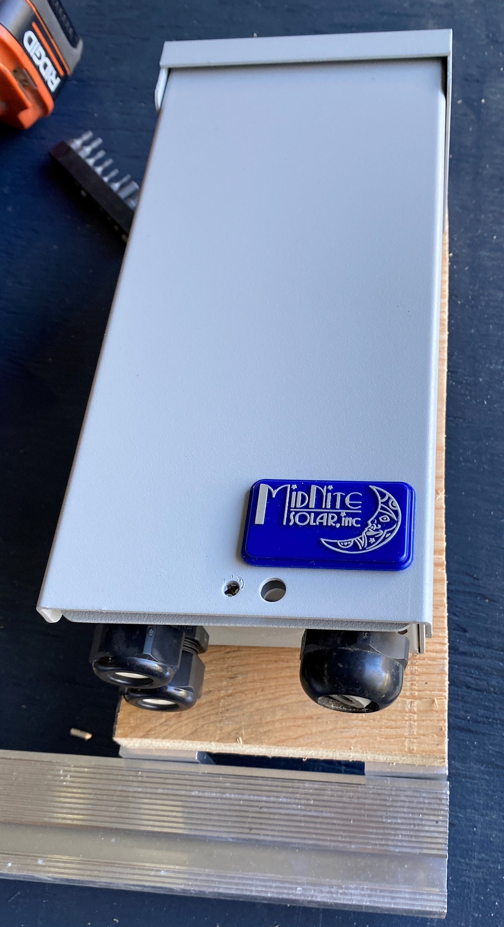
Racking Combiner Box
The combiner box with
hinged cover with screw
lockable.
Picture courtesy author

Slide 12
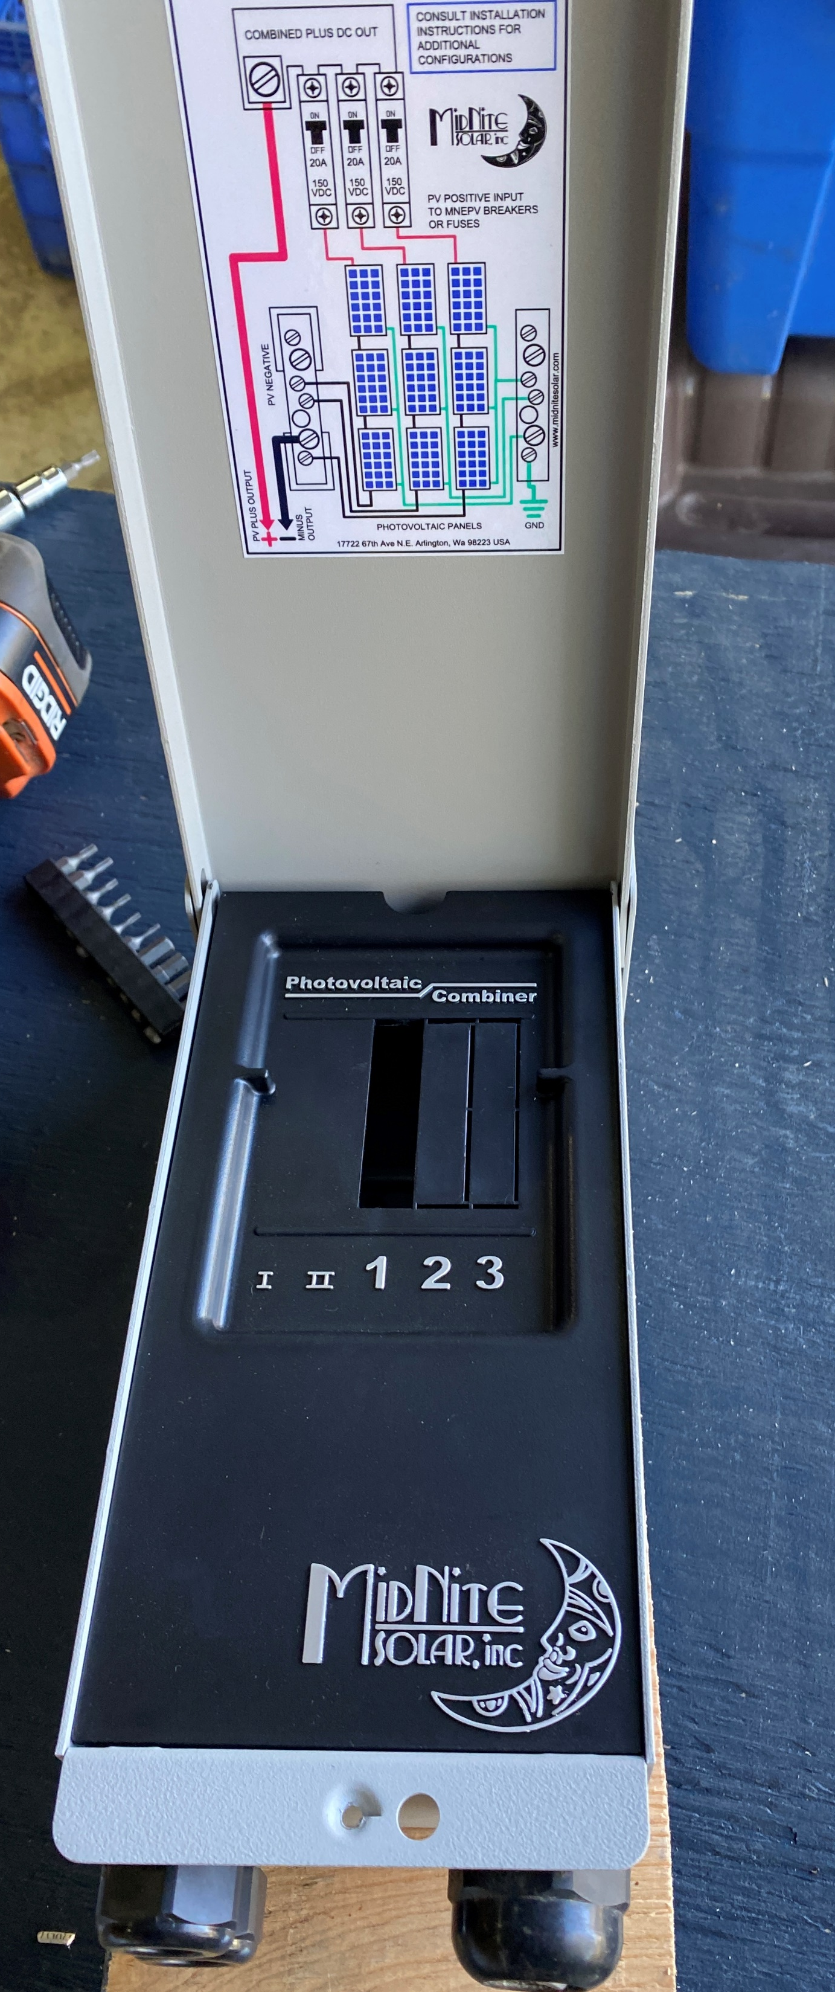
Racking Combiner Box
The MidNite Solar combiners
come with a suggested schematic.
Picture courtesy author

Slide 13
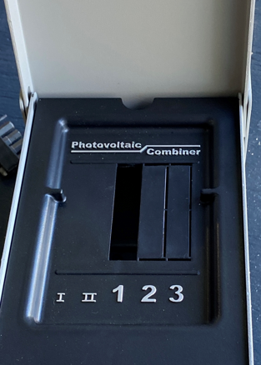
Racking Combiner Box
This combiner box has
room for three strings.
The openings are used to
access the finger pull fuses
or DC rated breakers.
Picture courtesy author

Slide 14
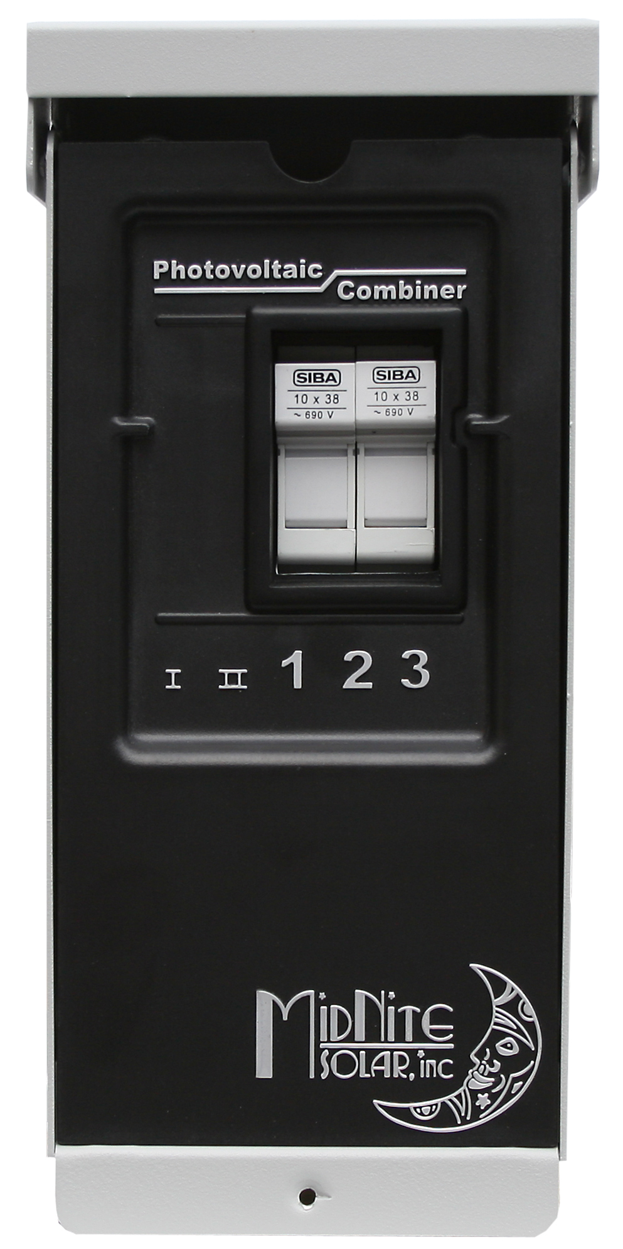
Racking Combiner Box
MidNite Solar manufacturers and
sells combiner boxes and
accessories.
Accessories include:
  Fuses or Breakers
  Surge protector
  Strain relief connectors
Picture courtesy MidNite Solar

Slide 15
Racking Combiner Box
MidNite Solar has documentation on their combiner boxes.
The link below is
“ Combiners explained with diagrams”.
https://www.midnitesolar.com/pdfs/MidNite%20PV%20Combiners%20explained%20w%20diagrams.pdf

Slide 16
Racking Combiner Box
MidNite Solar has documentation on their combiner boxes.
The link below has the previous link plus others about combiner boxes.
https://www.midnitesolar.com/productPhoto.php?product_ID=78&productCatName=Combiners&productCat_ID=9&sortOrder=4&act=p

Slide 17
Racking Combiner Box
MidNite Solar can be found on the internet at:
https://www.midnitesolar.com/
MidNite Solar has many products and great documentation on their products.

Slide 18
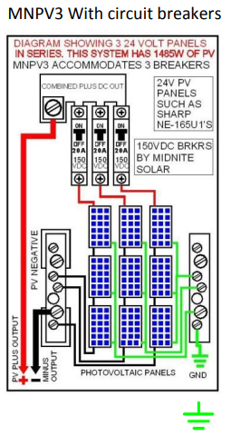
Racking Combiner Box
Schematic diagram of the
MNPV3.
3 breakers.
3 strings of 3 PV panels.
Symbol for an inverter.
Picture courtesy MidNite Solar

Slide 19
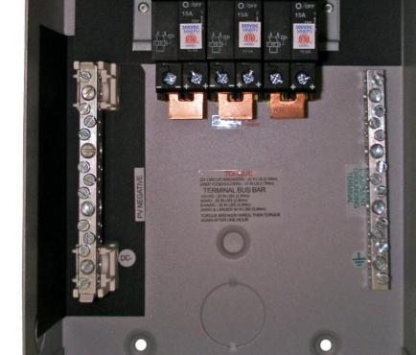
Racking Combiner Box
Inside combiner box. Notice the two busbars.
Isolated from housing
busbar for the
negative of PV’s
Grounding busbar
connected to metal
housing.
Symbol for an inverter.
Picture courtesy MidNite Solar

Slide 20
Racking Combiner Box
The busbar that is connected to the metal housing is the where the bonding ground wire is connected to.
The bonding wire is connected to each rail and comes to this busbar.
All of the racking and PV panel bonding is at same potential.
Symbol for an inverter.

Slide 21
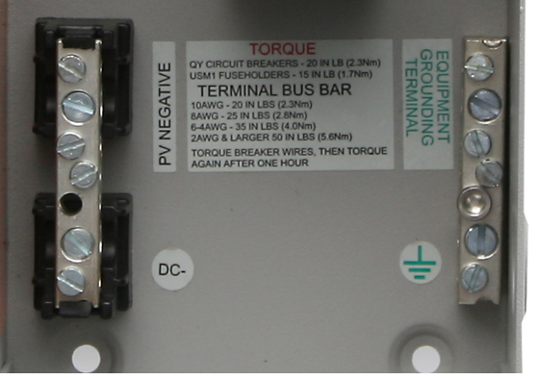
Racking Combiner Box
The busbar that is isolated from the metal housing is the where the negative of the PV panels connect to.
Insulating material
is placed under the
busbar.
Picture courtesy MidNite Solar

Slide 22
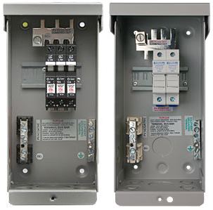
Racking Combiner Box
Positive leads from PV strings are combined into this connector.
Positive leads from PV
strings go to the
breaker / fuse holders.
Breaker + is input.
Picture courtesy MidNite Solar

Slide 23
Racking Combiner Box
Negative leads from PV strings are combined into this busbar.
Picture courtesy MidNite Solar

Slide 24
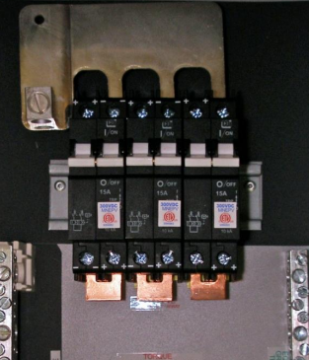
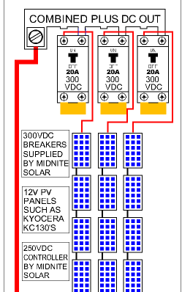
Racking Combiner Box
Positive leads in this setup come in at the top of the breakers.
Picture courtesy MidNite Solar

Slide 25
Racking Combiner Box
The installation of a PV combiner can have Code rules that apply.
The location to install the combiner may be required to be in site of and / or a maximum distance from the PV panels.
Some systems have the PV modules located close to the inverters and or battery system.

Slide 26
Racking Combiner Box
If this is the case, you can elect to mount the combiner box inside and run each PV string down to the combiner box inside the house.
This is convenient for trouble shooting and upgrading.
For longer runs the combiner will be mounted outdoors on the pole for pole mounted PV arrays or similar mounting for rack mounted arrays.

Slide 27
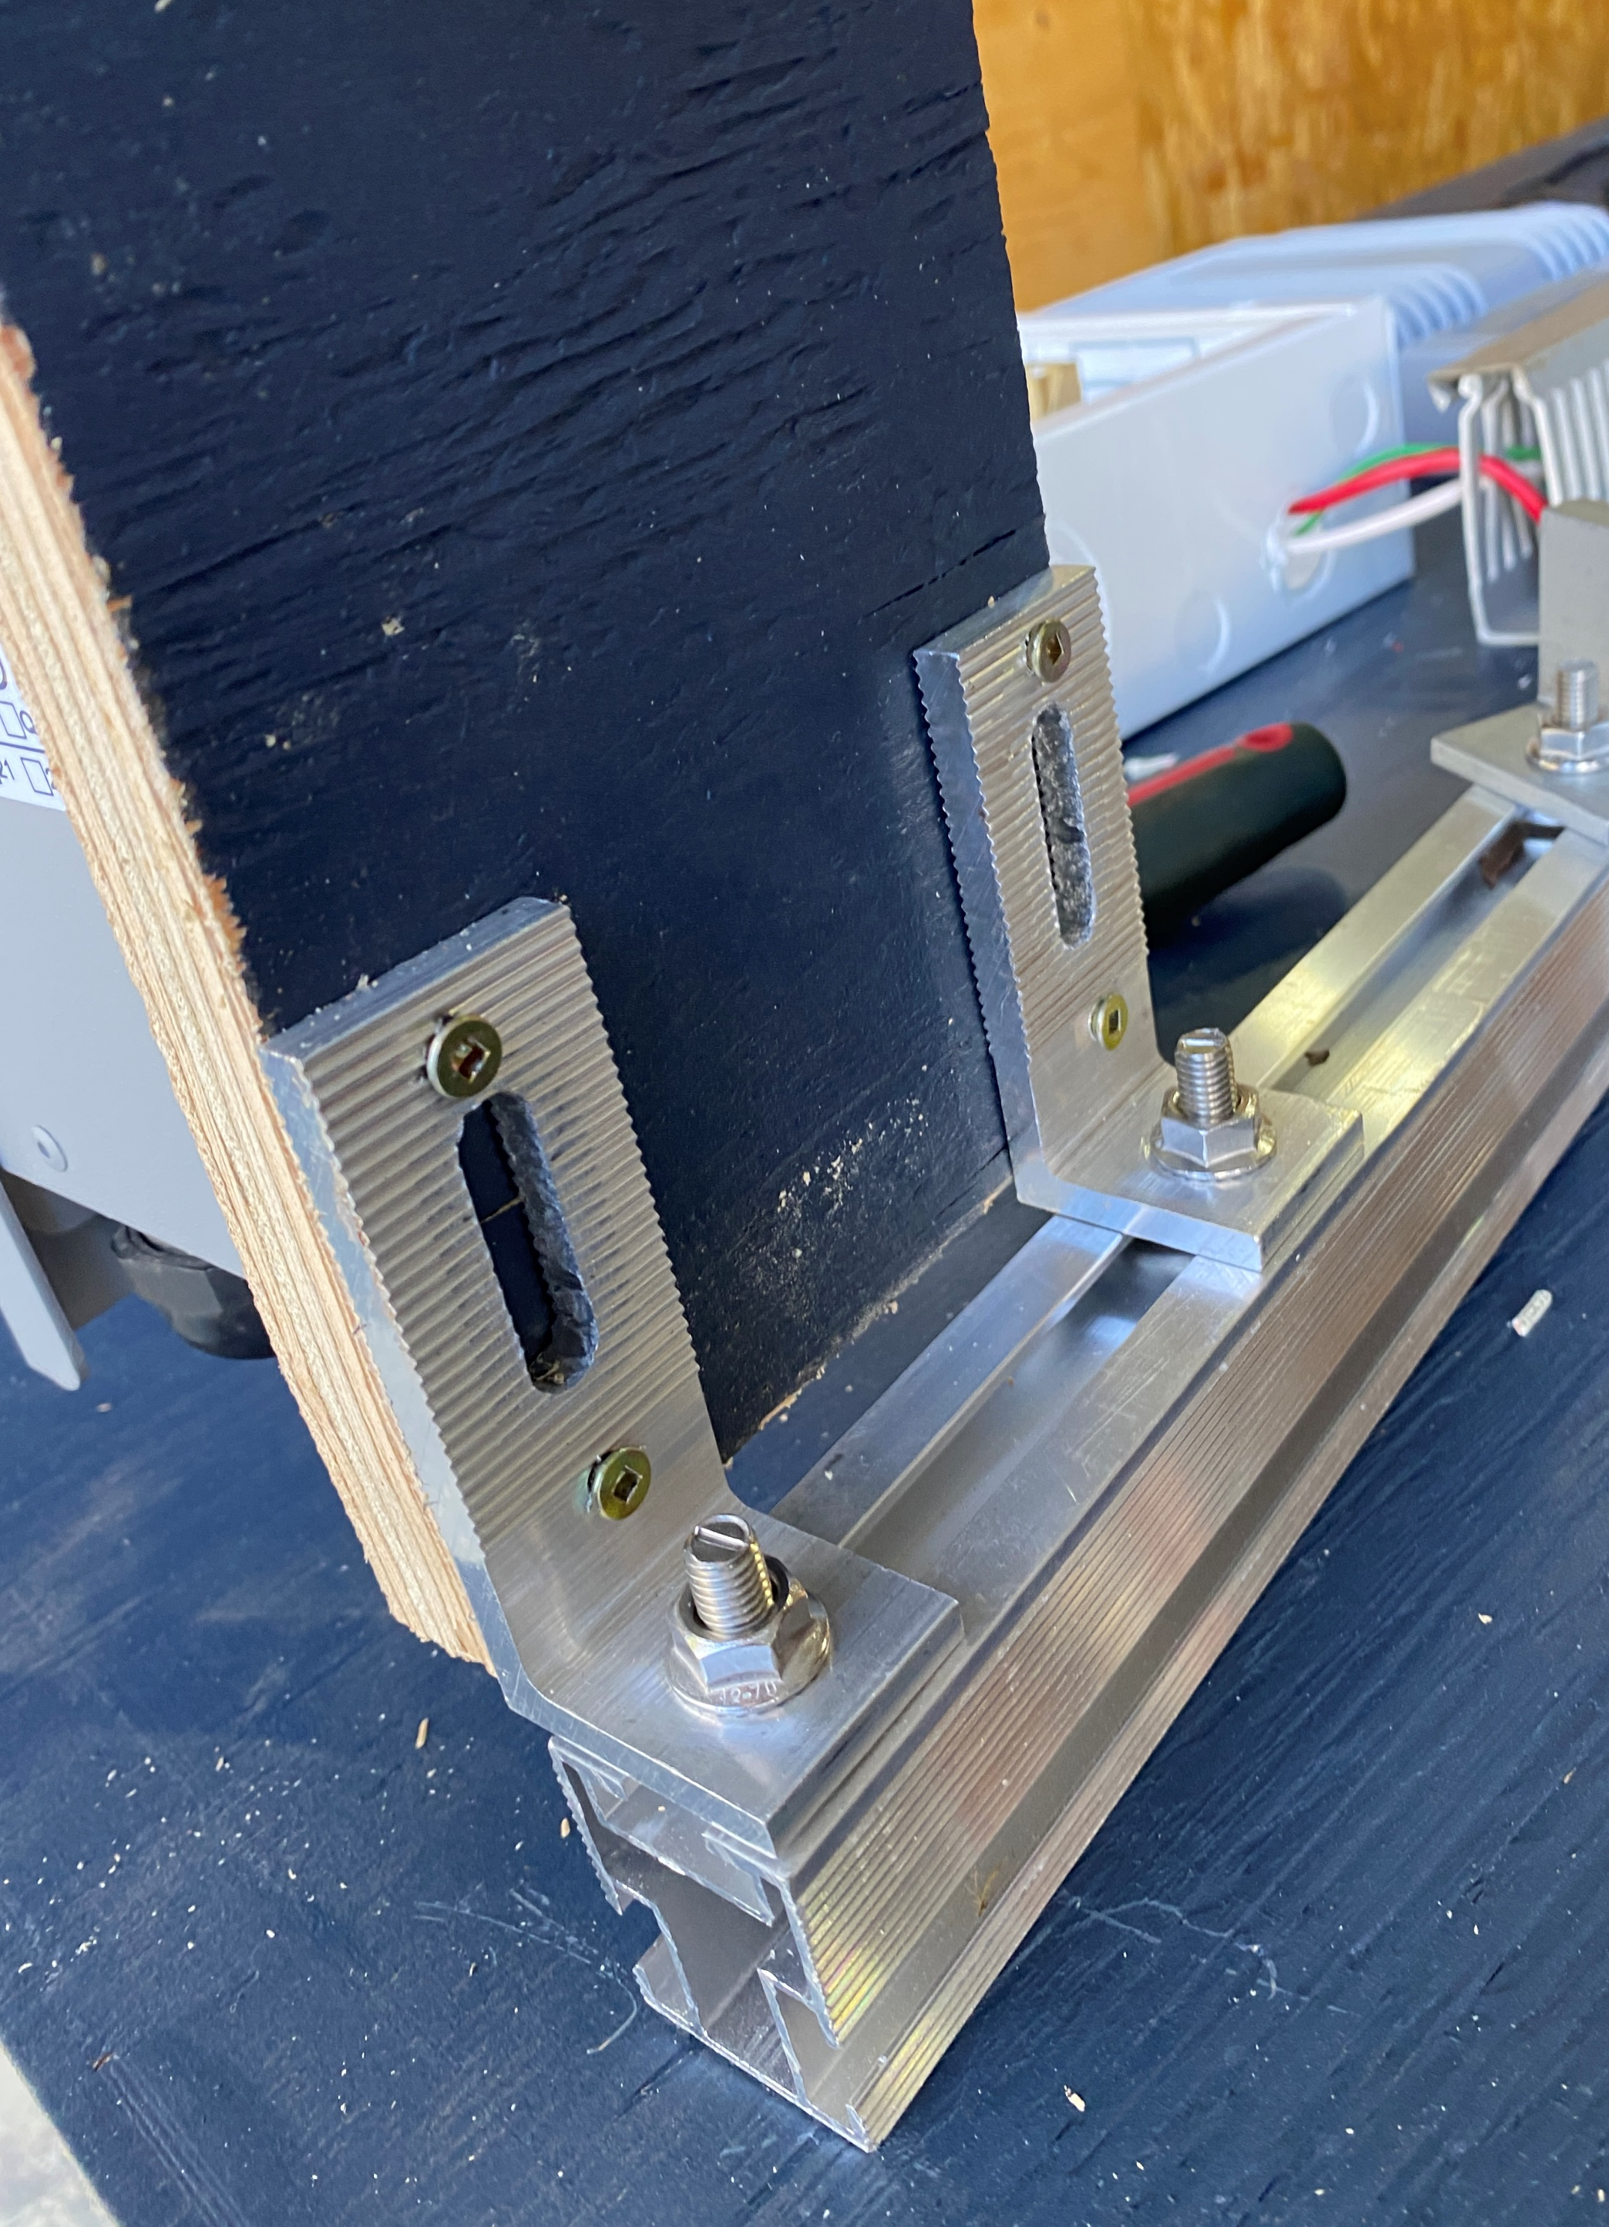
Racking Combiner Box
The combiner box can be
attached to a wooden surface.
L brackets attach to the rails.
Picture courtesy author

Slide 28
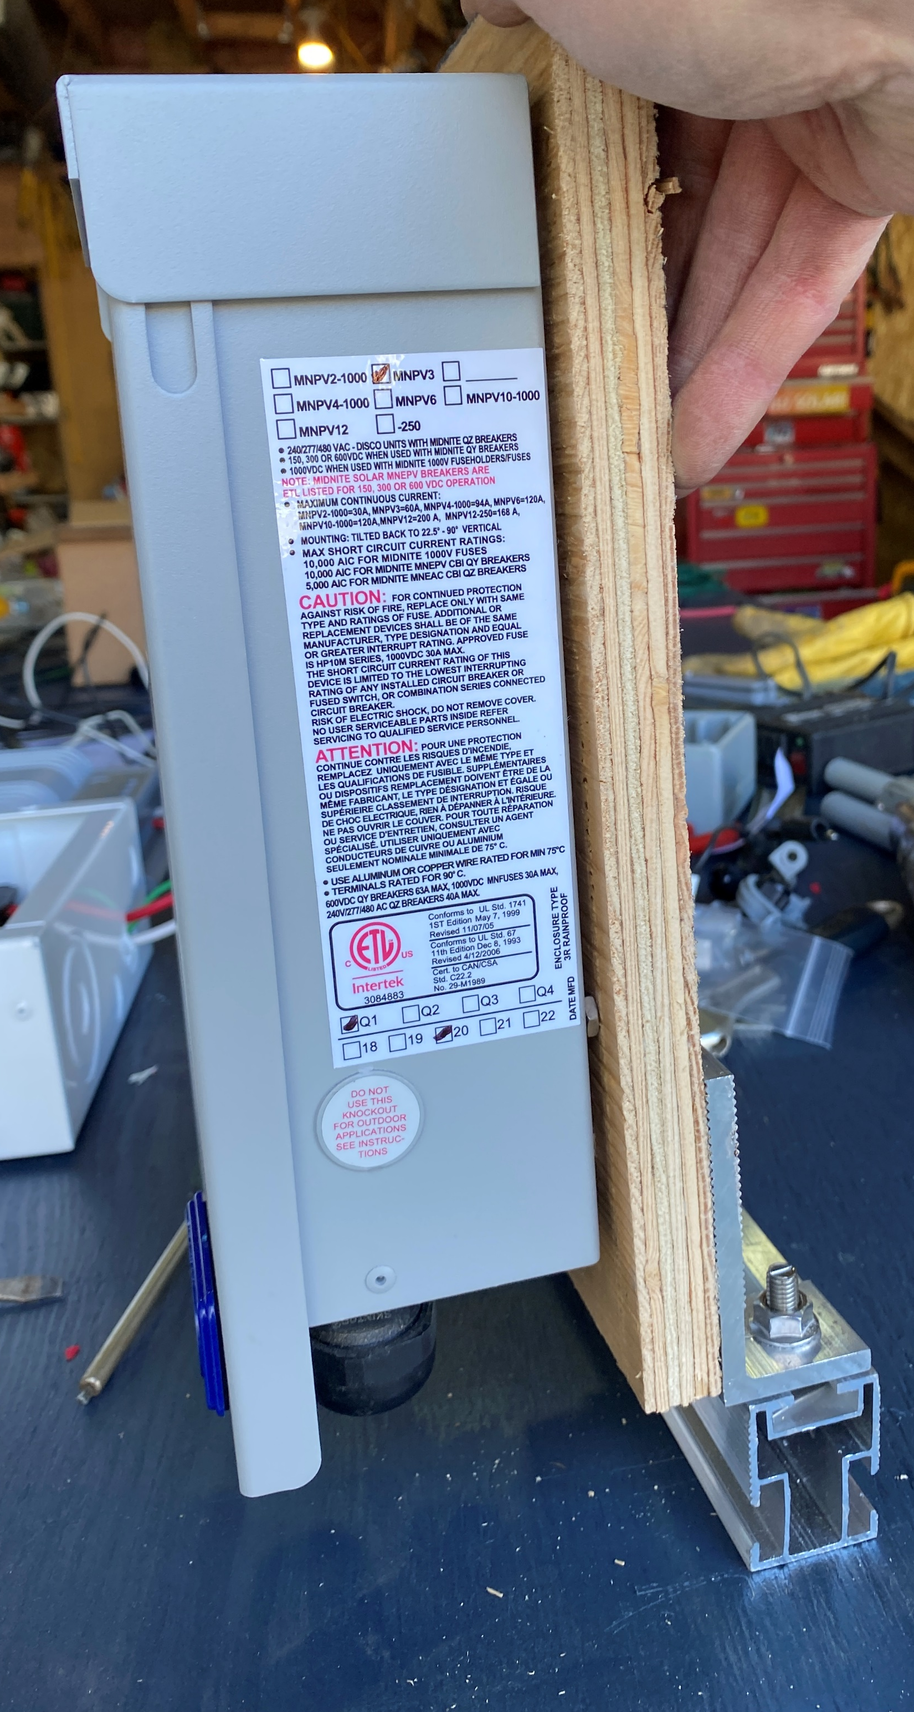
Racking Combiner Box
The combiner box can be
attached to a wooden surface.
L brackets attach to the rails.
Picture courtesy author

Slide 29
Racking Combiner Box
The combiner can be mounted in the vertical position or slanted backwards to accommodate up to a 3/12 (14°) roof pitch.
All unused holes should be blocked using RTV sealant or some similar goop in order to keep rain and insects out of the enclosure.
Care must be taken to insure that no water will get on terminal busbars when mounted less than vertical.

Slide 30
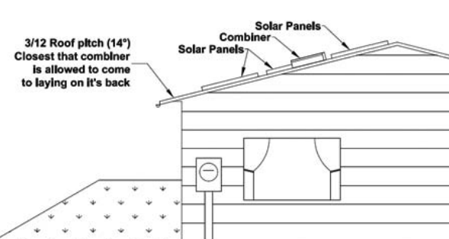
Racking Combiner Box
The mounting of the combiner box on a roof.
Minimum slope to keep rain from entering side knockouts.
Picture courtesy MidNite Solar

Slide 31
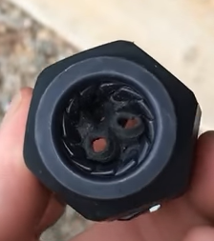
Racking Combiner Box
The wire coming in to the combiner box are put into a strain relief connector.
This strain relief connector
has two holes.
One for the positive wire.
One for the negative wire.
Picture courtesy author

Slide 32
Racking Combiner Box
Typical wires at the combiner box are:
The output wires from the PV panels.
The grounding / bonding wires.
The positive combined wire.
The negative combined wire.

Slide 33
Racking Combiner Box
Wire management is the running of the PV panel wires along the rail.
Clips made for the racking.
Cable ties designed to provide UV protection.
These are the preferred methods of supporting the PV wire.

Slide 34
Racking Combiner Box
Wire management is also the running of the output wires from the combiner box.
Typical cable management is used as per normal electrical practices.

Slide 35
Racking Combiner Box
In the combiner box the wire that electrically bonds the rails will enter and attach to the
EQUIPMENT
GROUNDING
TERMINAL.
Another grounding
wire will leave and
connect to the system
ground.
Picture courtesy MidNite Solar

Slide 36
Racking Combiner Box
Questions?

