Slide 1
Design and Implementation of Pilot of a TVET Renewable Energy Course
DELIVERABLE #5 - TRAINING COURSES & PROFESSIONAL DEVELOPMENT

Slide 2
Racking Microinverters
This module introduces the microinverter as an accessory to the racking system.
Mounting the microinverter.
Wire management.
Grounding and bonding.
Interconnections.

Slide 3
Racking Microinverters
Questions?

Slide 4
Racking Microinverters
What is a microinverter?
Definition of an inverter first:
An inverter is an electronic device that takes
DC (Direct Current) and changes it into
AC (Alternating Current).

Slide 5
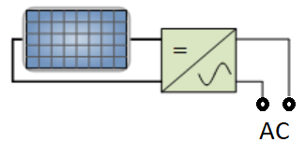
Racking Microinverters
In this case the DC comes from the PV panel.
Symbol for an inverter.
Picture courtesy author

Slide 6
Racking Microinverters
DC input.
AC output.
Picture courtesy author

Slide 7
Racking Microinverters
Questions?

Slide 8
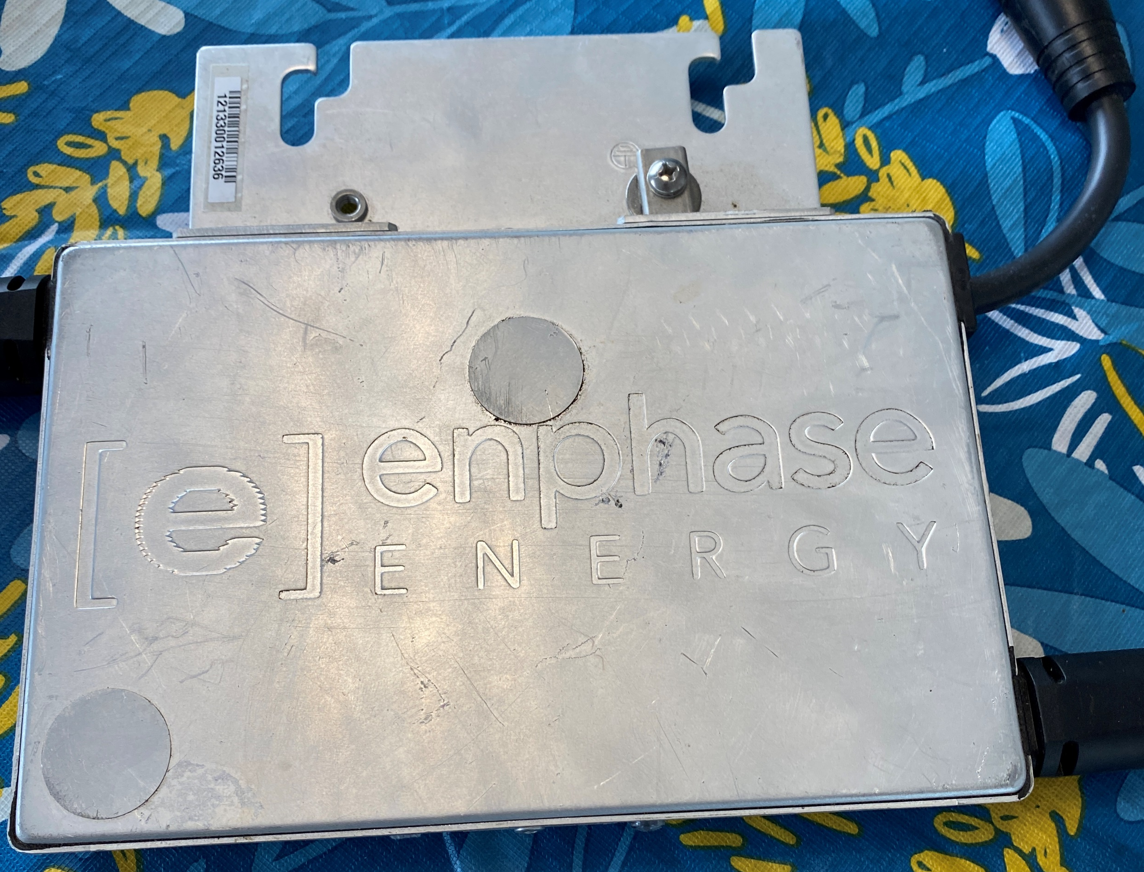
Racking Microinverters
A microinverter is an inverter that mounts to the racking.
It goes behind a
PV panel.
Picture courtesy author

Slide 9
Racking Microinverters
Why use a microinverter?
No DC wiring.
DC wiring have separate rules from AC wiring.
AC wiring right from source with standardized voltages.
These are just a few advantages of a microinverter

Slide 10
Racking Microinverters
These can be seen as a disadvantage of microinverters.
They can only produce AC power.
They will not operate without a stable AC connection to use / take their power.

Slide 11
Racking Microinverters
The AC output is taken off of the racking to be used elsewhere.
Some microinverters can take the energy from up to 4 PV panels.
The DC wiring is just to the microinverter.

Slide 12
Racking Microinverters
Questions?

Slide 13
Racking Microinverters
Why use an inverter?
The DC energy that is produced by the PV system is not used as DC energy.
The energy is consumed as AC.

Slide 14
Racking Microinverters
The inverter needs to produce a standard voltage at a standard frequency.
The AC output must meet an expected quality.
It can do this in one of two ways:
Use a battery based system to provide a firm base.
Use a stable grid of AC that it can connect to.

Slide 15
Racking Microinverters
Use a battery based system to provide a firm base.
The energy from the PV system varies during the day and is not available at times of no irradiance.
Feeding this varying energy into a battery stores it for use when it is required.

Slide 16
Racking Microinverters
Firm power is guaranteed power by a power plant or transmitting system.
It comes with guaranteed range of voltage and frequency.
Voltage range must be limited to +/- 10 percent of nominal voltage.
If frequency is 60Hz, Range is 58.5 to 60.5 Hz.

Slide 17
Racking Microinverters
For these reasons microinverters are normally connected to a stable AC grid.
The grid can be a microgrid or a utility.
The microinverters will have these limits programmed into them.
If grid or microinverter go outside of any of the limits it will disconnect from the grid.

Slide 18
Racking Microinverters
Questions?

Slide 19
Racking Microinverters
The following material is from ENPHASE which manufacture microinverters.

Slide 20
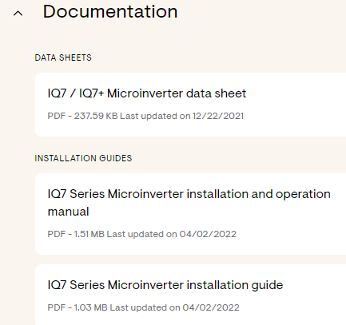
Racking Microinverters
Documentation for installation IQ7:
https://enphase.com/store/microinverters/iq7-series/iq7-microinverter

Slide 21
Racking Microinverters
Data Sheet for IQ7 microinverter.
https://enphase.com/sites/default/files/2021-04/IQ7A-DS-EN-US.pdf

Slide 22
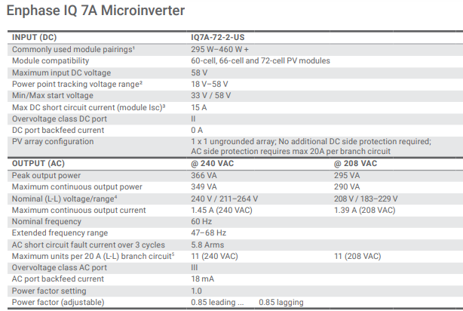
Racking Microinverters
Data Sheet for IQ7A microinverter.
Important information
How many cell panel
Output power
Over current protection

Slide 23
Racking Microinverters
Data Sheet for IQ7A microinverter.
60 or 72 cell compatible.
Panel power range.

Slide 24
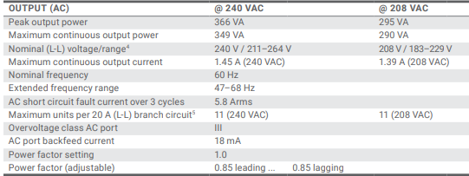
Racking Microinverters
Data Sheet for IQ7A microinverter.
Power output.
Voltage range output (AC).
Over current protection.

Slide 25
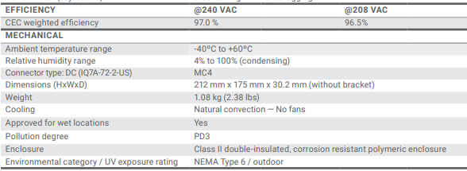
Racking Microinverters
Data Sheet for IQ7A microinverter.
Efficiency (peak).
Mechanical and environmental information.

Slide 26
Racking Microinverters
The following material is from ENPHASE which manufacture microinverters.
Compatible racking for Enphase microinverters.
https://enphase.com/download/compatible-racking-systems-enphase-microinverters-tech-brief

Slide 27
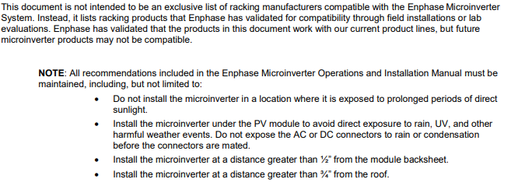
Racking Microinverters
Compatible racking for Enphase microinverters.
Installation location conditions.

Slide 28
Racking Microinverters
Compatible racking for Enphase microinverters.
Grounding requirements.

Slide 29
Racking Microinverters
Compatible racking for Enphase microinverters.
Grounding Options for the M215 Original and Previous Generation Microinverters.
The ground clamp provided on the mounting flange of the M215 Original Enphase Microinverters.
Accepts #8 through #6 AWG grounding electrode conductors.

Slide 30
Racking Microinverters
Compatible racking for Enphase microinverters.
This document also details alternative grounding clip solutions for each rail type, if available.
Compatible Racking 2 © 2017 Enphase Energy Inc. All rights reserved. September 2017 CS.
Has evaluated and approved the Burndy / Wiley Electronics WEEB grounding washers for use with the Enphase Microinverter.

Slide 31
Racking Microinverters
Compatible racking for Enphase microinverters.
Where the compatible racking models have listed grounding washers available,
we list the Burndy / Wiley Electronics part numbers in sections 2 and 3 of this document.

Slide 32
Racking Microinverters
Compatible racking for Enphase microinverters.
Installing Enphase Microinverters with UL2703 Racking Partners Enphase has partnered with:
Unirac, SnapNrack, Ironridge, and ProSolar to validate that the grounding and bonding of the modules, racking, and microinverters can be provided through the Enphase Engage Cabling system.

Slide 33
Racking Microinverters
Compatible racking for Enphase microinverters.
These certifications do not apply to the IQ Microinverter system, since the Q Cable does not include a ground conductor

Slide 34
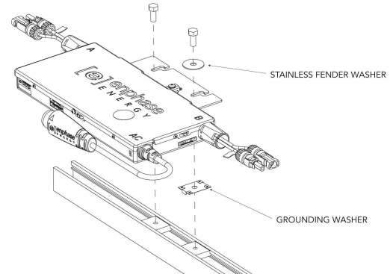
Racking Microinverters
Using the WEEB as bonding washer.

Slide 35
Racking Microinverters
WEEB Installation Procedure If using WEEBs or star washers in your installation, follow these steps:
1. Install a minimum of one grounding washer per microinverter.
2. For each microinverter, install stainless steel 1-1/2” fender washers on the topside of the mounting bracket for the bolt that passes through the grounding washer.

Slide 36
Racking Microinverters
3. Torque the microinverter fasteners to the values listed (minimum torque requirements). Wiley Electronics and the racking manufacturers will have specific torque specifications in their installation documents.
We recommend using the highest of these values:
• 0.25 inch mounting hardware – 45 in-lbs minimum
• 5/16” mounting hardware – 80 in-lbs minimum

Slide 37
Racking Microinverters
Questions?

Slide 38
Racking Microinverters
Installation guide for IQ7 microinverter.
https://enphase.com/download/iq7-series-microinverter-integrated-mc4-connectors-installation-guide

Slide 39
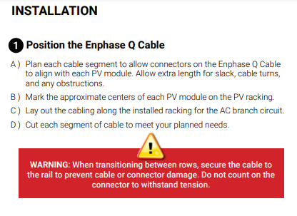
Racking Microinverters
Draw a layout plan for the microinverters.
The AC cable will connect the microinverters.
Plan on where
the AC home run
will end.

Slide 40
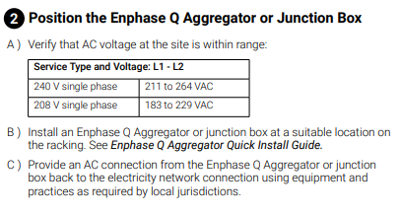
Racking Microinverters
The junction box will be the place the AC from the location will join to the AC microinverter cable.

Slide 41
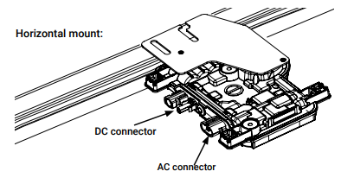
Racking Microinverters
The microinverter will mount horizontally on the top side of the racking rail.
Two bolts will attach the microinverter to the rail.

Slide 42
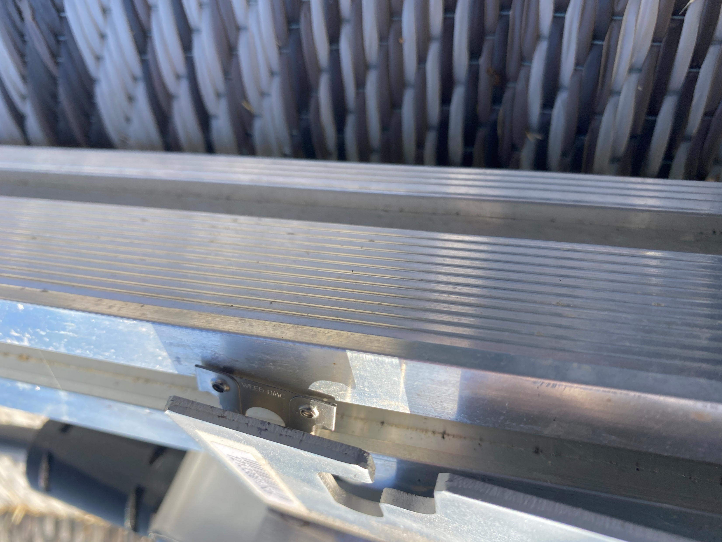
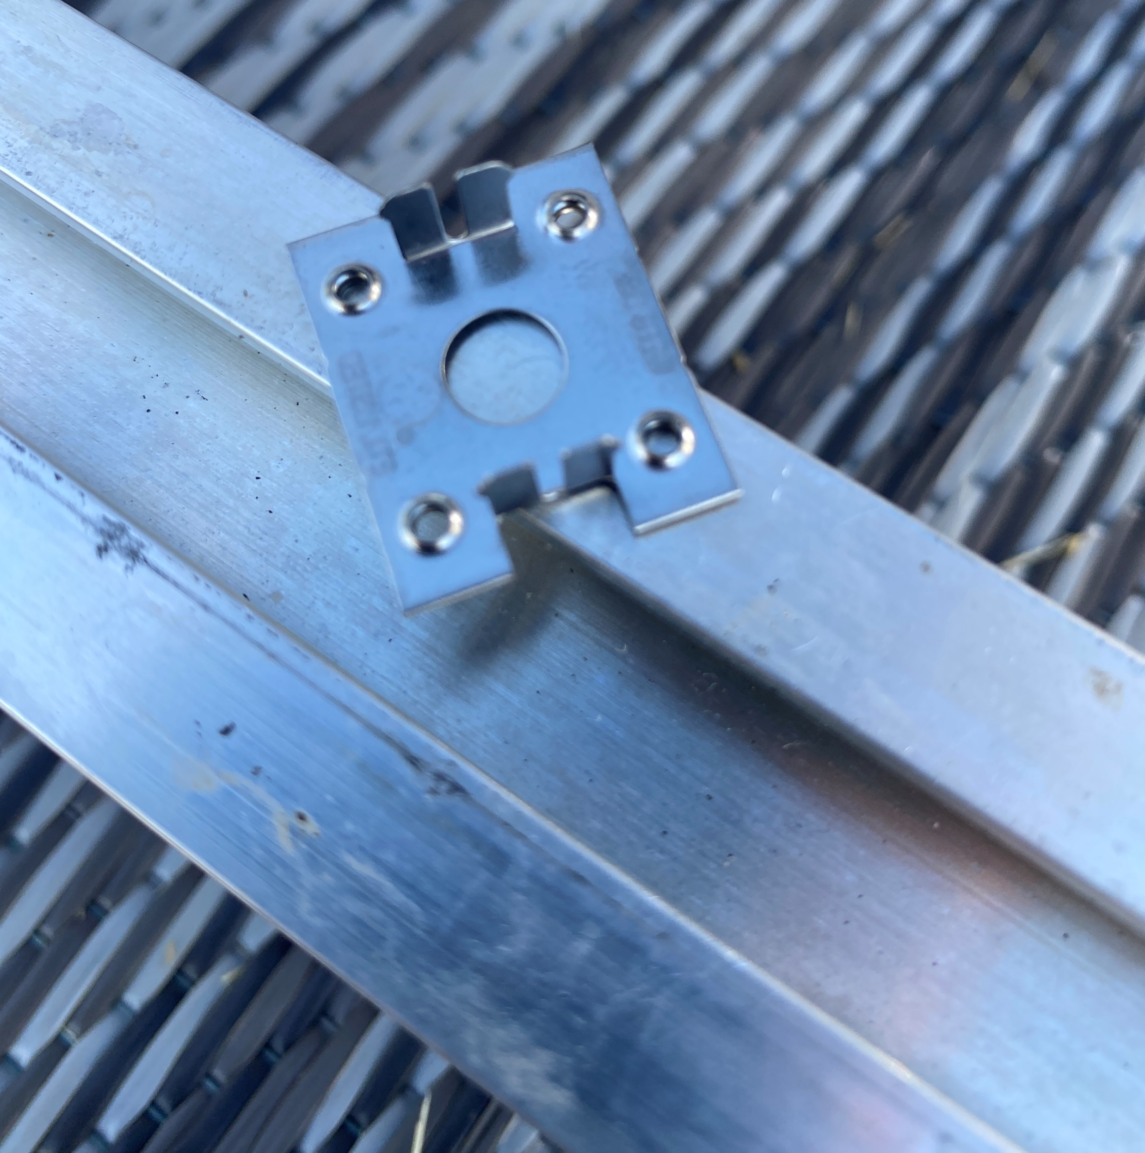
Racking Microinverters
The WEEB going under the microinverter.
Pictures courtesy author

Slide 43
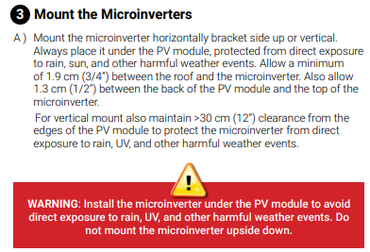
Racking Microinverters
The microinverter needs to be under the PV panel.

Slide 44
Racking Microinverters
Torquing is very important.

Slide 45
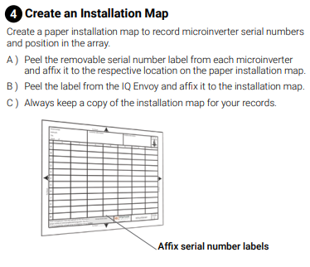
Racking Microinverters
Mapping is for remote monitoring purposes.

Slide 46
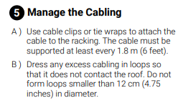
Racking Microinverters
The insulation on the wire will be removed if allowed to touch the roof.
The installation is expected to last 25 years.

Slide 47
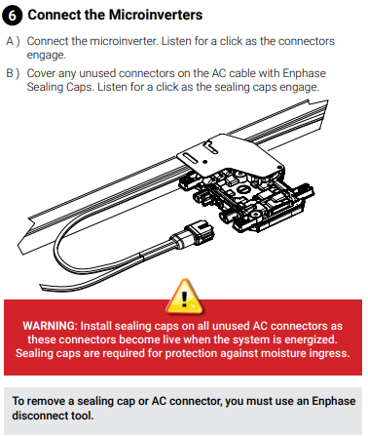
Racking Microinverters
The connector needs
a firm push to engage
the microinverter.

Slide 48
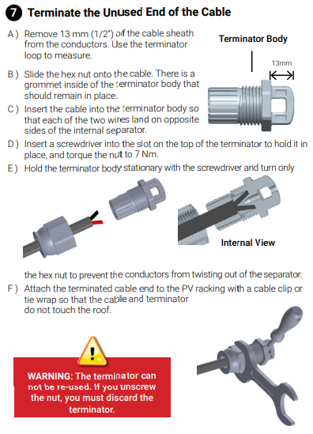
Racking Microinverters
This can also be done
without their connector.

Slide 49
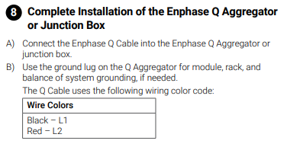
Racking Microinverters
The Black and Red represent that the two wires are not at ground potential.

Slide 50
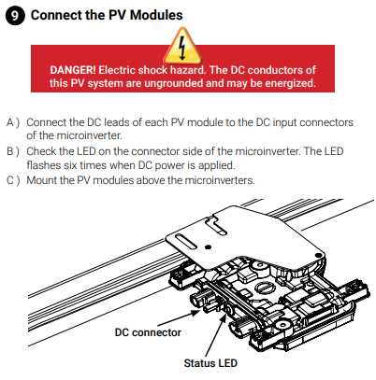
Racking Microinverters
Check that the LED flashes.

Slide 51
Racking Microinverters
Questions?

Slide 52
Racking Microinverters
Check that the LED flashes.
6 times to indicate DC is
applied.
Video courtesy author

Slide 53
Racking Microinverters
Check that the LED flashes.
To indicate no AC is present.
The rate is every second.
Video courtesy author

Slide 54
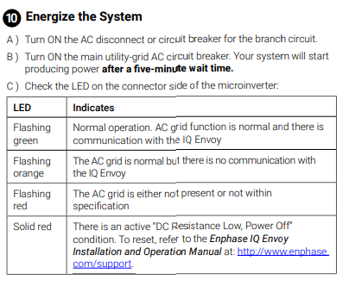
Racking Microinverters
Check that the LED flashes.

Slide 55
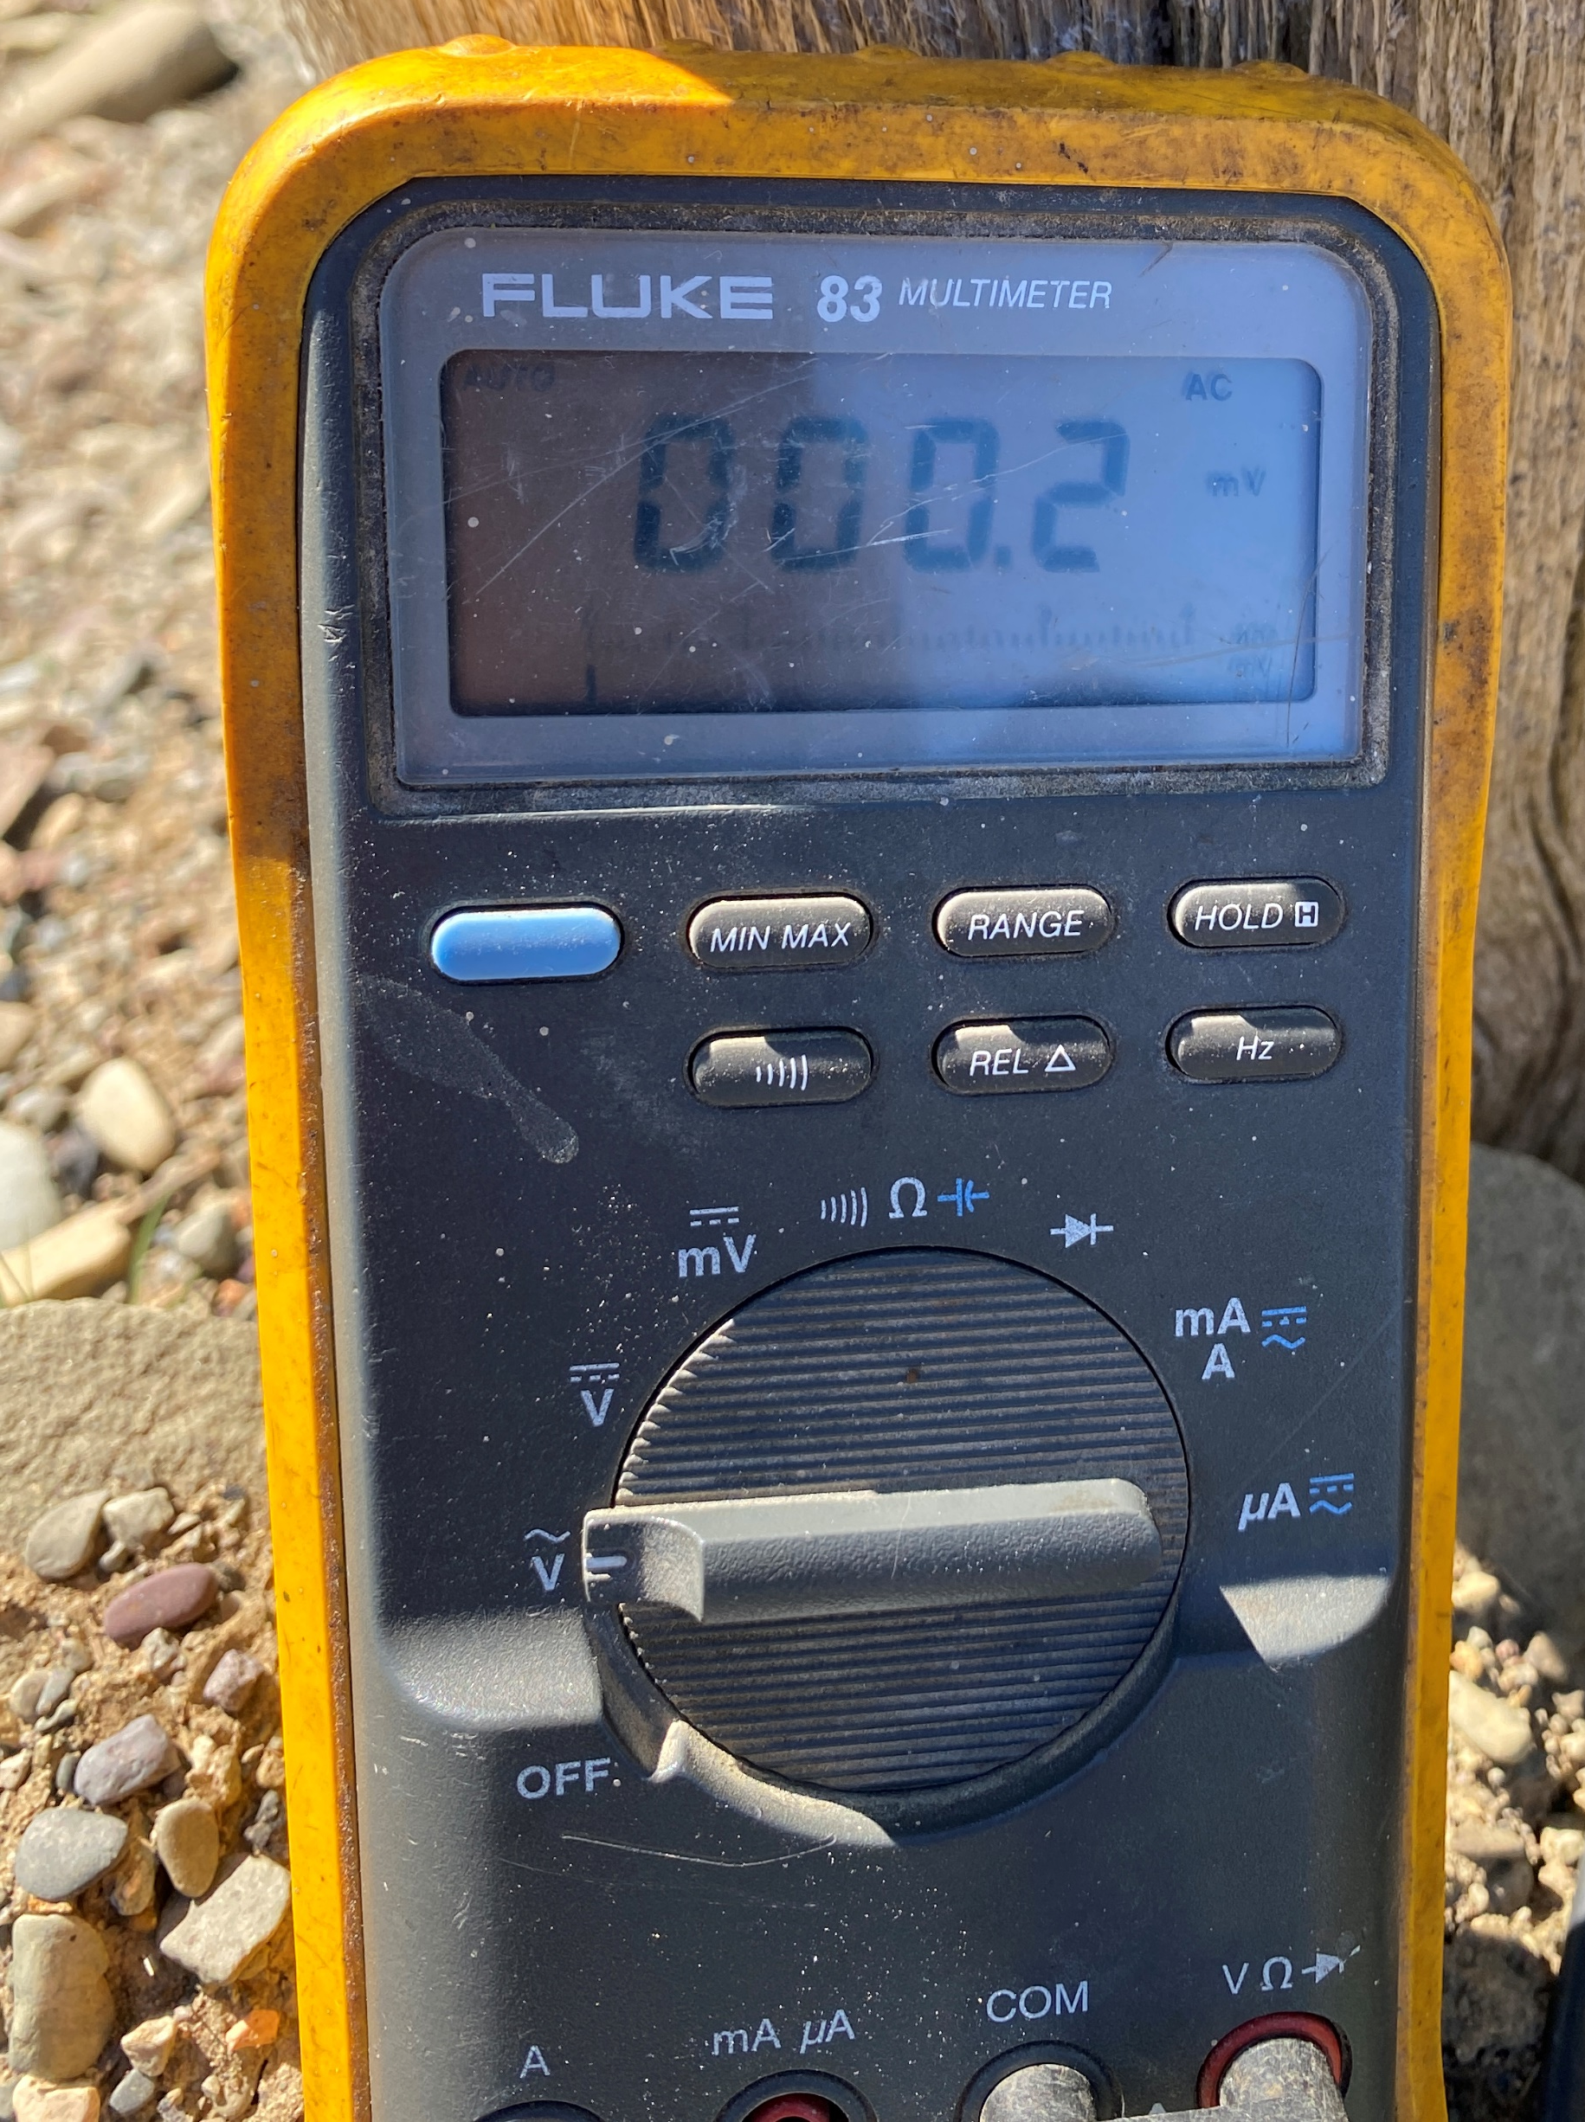
Racking Microinverters
Voltmeter as an Ammeter.
Clip on measure output current from the microinverter.
Pictures courtesy author

Slide 56
Racking Microinverters
After the AC voltage was applied, the unit waited five minutes to connect and deliver power to the grid.
This is part of the regulations (UL 1741).

Slide 57
Racking Microinverters
This microinverter is rated at 190 Watts.
Connected to it is a 300 Watt 60 cell PV panel.
The panel was laying flat on the ground.
After the 5 minute wait period the light flashed orange to indicate it was not communicating with the remote computer system.

Slide 58
Racking Microinverters
The hand held pyranometer reads 641 W/m².
641 W/m² / 1000 W/m² x 300 Watts = 192.3 Watts.
Picture courtesy author

Slide 59
Racking Microinverters
192.3 Watts / 240 Volts = 0.8 Amps.
Picture courtesy author

Slide 60
Racking Microinverters
Questions?

