Slide 1
Design and Implementation of Pilot of a TVET Renewable Energy Course
DELIVERABLE #5 - TRAINING COURSES & PROFESSIONAL DEVELOPMENT
Session 13 (13 May 2022) - Course C 01: Communications

Slide 2
For Today:
Communications Courses in 2 year RE EE Program
What does “success” look like at course completion?
Content within context of other ITVET Belize Courses
Description of Course 1 in Term 1 of Year 1
Development of Course 1

Slide 3
1. Communications Courses in 2 Year Program
2 Year (32 Course) RE EE Program Overview
1st Year | Term 1 | Communi- cations 1 (“Comms”) | Applied Math 1 | Electricity and Circuits 1 | Intro to Energy Science |  |  | PV Applications | Integrated Lab 1
 | Term 2 | Customer Relations and Audits 1 | Energy, Buildings and Equipment | Electricity and Circuits 2 |  | PV System Installation |  |  | Integrated Lab 2
 | Term 3 | English Comms 2 | Applied Math 2 | Photovoltaic System Installation |  | Solar Hot Water Systems |  |  | Integrated Lab 3
2nd Year | Term 4 | English Comms 3 | Energy Efficiency Measurement and Verification | Energy Use Modeling & Analysis | Advanced Energy System Design |  |  | Small Wind Design and Operation | Integrated Lab 4
 | Term 5 | Projects and Comms 1 | Technical Drawing | Economic Analysis of Energy Systems |  | Solar PV System Design | Solar PV System Design |  | Integrated Lab 5
 | Term 6 | Projects and Comm 2 | Electricity Codes and Regulations | Business Operations and Entrepreneurship |  | PV System Maintenance & Operation | PV System Maintenance & Operation |  | Integrated Lab 6

Slide 4
Course 01: Communications 1
12 Week Term 1, Year 1 40 Classroom hours 0 New Lab hours 12 weeks x 5 periods/wk 2 periods Wed pm 3 periods Thurs am
Marking Breakdown 20% Individual Tests 30% Individual Projects 40% Group Projects 10% Employability Skills

Slide 5
Course 12: Communications 2
10 Week Term 3, Year 1 40 Classroom hours 0 New Lab hours 10 weeks x 6 periods/wk 3 periods Mon & Wed am Same Marking Breakdown
Marking Breakdown 20% Individual Tests 30% Individual Projects 40% Group Projects 10% Employability Skills

Slide 6
Course 17: Communications 3
12 Week Term 4, Year 2 40 Classroom hours 0 New Lab hours 12 weeks x 5 periods/wk 2 periods Mon pm 3 periods Tue am
Marking Breakdown 20% Individual Tests 30% Individual Projects 40% Group Projects 10% Employability Skills

Slide 7
Courses 23 & 28: Proj. Comms. 1 & 2
10 Week Term 5 & 6, Yr. 2 40 Classroom hours 0 New Lab hours 10 weeks x 6 periods/wk 3 periods Mon am 3 periods Wed am
Marking Breakdown 20% Individual Tests 30% Individual Projects 40% Group Projects 10% Employability Skills

Slide 8
2. What does “success” look like?
Students completing Year 1 (Installer) or 2 Year (Designer) RE EE Program Requirements at their own time and pace
Students and Industry Qualifications NABCEP, CVQ, etc.
Instructors with resources, achieving their desired results
ITVET with resources for scalable, sustainable program
Skills competently applied to a changing Green Economy
Belize Employers – competent, adaptable team members

Slide 9
2. What does “success” look like?
For Employers and the “Communications” part of Program:
Understand options and communicate recommendations
Prepare project descriptions, drawings, and reports
Plan and prepare maintenance and monitoring reports
Prepare project proposals, estimates, quotes, invoices
Verbal, written, & digital communications skills – clients, residents, suppliers, partners, regulators, team members

Slide 10
2. What does “success” look like?
Successful use of skill sets with forms of communications:
Verbal – in-person, telephone Understand options and communicate recommendations
Written – drawings, letters, reports and descriptions of projects, travel directions, sites, equipment, materials
Digital – some verbal and written communications in a different format (e.g. text, email, video clip, presentation)

Slide 11
2. What does “success” look like?
Program completion prepares for work place circumstances:
Personal – Job application letter, CV’s, LinkedIn profile
Technical descriptions – How to do it, or How it was done
Technical specifications, drawings, regulations, suppliers
Contracts, proposals, quotes, change orders, invoices
Customer – site assessments, audits, complaints
Formal – meeting agenda, minutes, decision making

Slide 12
2. What does “success” look like?
Projects completed using mixed team language skills:
Teams members’ various backgrounds and experiences
English, Spanish (mixed), Mayan, Creole, . . . Ukrainian?
English as lead for Technical, Regulatory, and Legal
Potential language mix with field work and customers
Sometimes “close enough” is okay and sometimes not
Language skills within the team, not of each member

Slide 13
2. What does “success” look like?
For “communications” skill sets, what does program completion or work place “success” look like:
For an experienced electrical technician in the field?
For a project manager, or regulator representative?
For an ITVET Belize Instructor?
For someone with mixed language skills?
For potential new program students?

Slide 14
3. Content within context of ITVET
Vision of “communications” skill sets, experiences, and potential of people completing the new RE EE Program
Uncertainty of skill sets for those starting New Program
Introductory communications courses may be similar in theory for multiple technical programs but differ with
Applications presented through assignments and projects
Scenarios based on expected potential work place conditions

Slide 15
3. Content within context of ITVET
2021 – 2022
Diana Ireland
ITVET Belize
Typical at ITVET?
Training Delivery and Assessment Plan
Profile of the Trainee / Portfolio of the Trainee
Program Policies & Regulations / Technology Requirements
Instructional Methods / Modes (Face to Face and Online)
Resources (Technical; Underpinning Knowledge and Skills)
Delivery Schedule (week / Instructional Methods (IM)
Practical Grading Criteria and Theoretical Grading Criteria

Slide 16
3. Content within context of ITVET
2021 – 2022
Diana Ireland
ITVET Belize
Typical at ITVET?
Delivery Schedule (Is it equivalent to a Lesson Plan?)
For each Week or 2 week period, the Course Outline Topic (e.g. Parts of Speech) and Tasks (e.g. Define, Identify, Use)
Instructional Methods (IM) (e.g. Collaborative Discussions)
Promotional Action (PA) (e.g. Practice work sheets, games)
Assessment Method (e.g. Test 1, Assignment 1, Project 1)
Resources (e.g. Textbook, Videos, Worksheet, Powerpoint)

Slide 17
3. Content within context of ITVET
English Diagnostic Assessment
ITVET Belize
75 minutes
40% Multiple Choice
30% Reading Comprehension
30% Paragraph Writing
Communications skills when starting at ITVET Belize
For currently offered programs?
For new 2 year, 32 course RE EE Program?
Where needed, process to successfully start in Programs?

Slide 18
3. Content within context of ITVET
Language and Communication
Skills (Level One Introduction)
Belize National Council on
TVET (NCTVET)
Belize Min. of Education
approval in 2006
Program Module and Title
M1-1 Understanding grammar, mechanics and usage
M2-1 The communication process
M3-1 Developing writing skills
M4-1 Developing reading skills

Slide 19
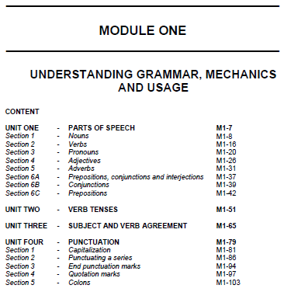
3. Content within context of ITVET
M1-1 Understanding grammar,
mechanics and usage
107 sheets in PDF
Four (4) Units
Parts of Speech
Verb Tenses
Subject and Verb Agreement
Punctuation
For each Unit:
Objectives, Requirements (Knowledge, Performance, Attitudinal), Instructional Strategies, Socio-Interpersonal Skills, Assessment, and References

Slide 20
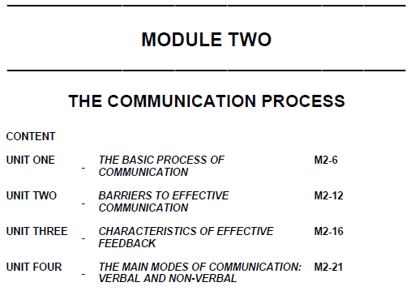
3. Content within context of ITVET
M2-1 The Communication
Process
29 sheets in PDF
Four (4) Units
The Basic Process of Communication
Barriers to Effective Communication
Characteristics of Effective Feedback
The Main Modes of Communication
For each Unit:
Objectives, Requirements (Knowledge, Performance, Attitudinal), Instructional Strategies, Socio-Interpersonal Skills, Assessment, and References

Slide 21
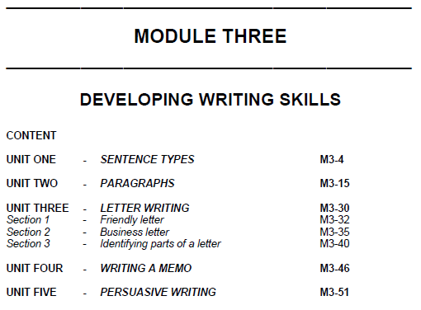
3. Content within context of ITVET
M3-1 Developing Writing Skills
61 sheets in PDF
Five (5) Units
Sentence Types
Paragraphs
Letter Writing
Writing a Memo
Persuasive Writing
For each Unit:
Objectives, Requirements (Knowledge, Performance, Attitudinal), Instructional Strategies, Socio-Interpersonal Skills, Assessment, and References

Slide 22
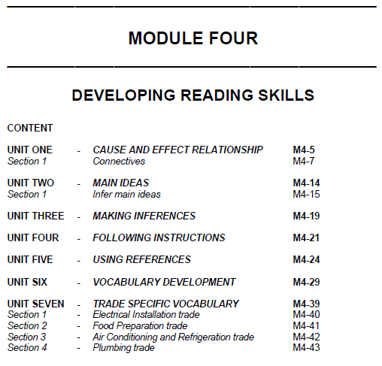
3. Content within context of ITVET
M4-1 Developing Reading Skills
44 sheets in PDF
Seven (7) Units
Cause and Effect Relationship
Main Ideas
Making Inferences
Following Instructions
Using References
Vocabulary Development
Trade Specific Vocabulary
Start with “Electrical Installation” & “Air Conditioning” terms
Similar text structure for units, as in Modules 1, 2, & 3

Slide 23
3. Content within context of ITVET
ITVET Belize English Language Diagnostic Assessment
Belize Language and Communication Skills (Modules)
Uncertainty of skill sets for those starting New Program
Existing ITVET Communications introduction courses
For New Program Course C 01: Communications 1
Provide “Trade” specific assignment examples and scenarios
Share & compare with NSCC’s “Eng. Lang. Diag. Assessment”

Slide 24
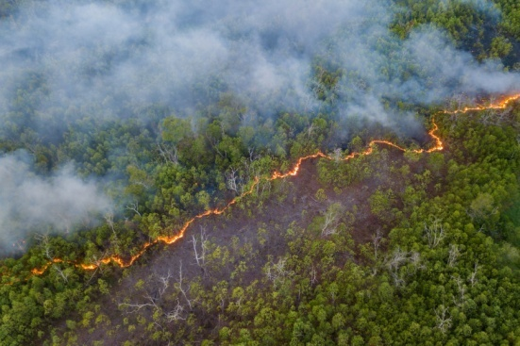
4. Description of Course 01
Communications 1 (Term 1, Year 1)
40 Classroom Hours as 12 weeks x 5 periods / week
2 periods Wed. pm and 3 Periods Thurs. am
Marking Breakdown
20% Individual Tests 30% Individual Projects
40% Group Projects 10% Employability Skills

Slide 25
4. Description of Course 01
Learning Outcomes and Tasks
(from Course 01 Description Outline and Work Plan)
Introduce Technical Writing
Introduce oral presentations and critical thinking
Identify interpersonal and other communications skills including business and email writing required if technical professional in the work place

Slide 26
4. Description of Course 01
Learning Outcomes and Tasks
(from Course 01 Description Outline and Work Plan)
Introduce personal characteristics which impact working and professional success
Identify elements of English grammar
Describe technical terms clearly and concisely in grammatically correct sentences
Comprehend written technical content

Slide 27
4. Description of Course 01
From Learning Outcomes and Tasks
Task 01
Introduce Technical Writing
Review Trade Related Examples provided
What “success” looks like to different people
Applicable elements from ITVET Belize courses

Slide 28
4. Description of Course 01
From Learning Outcomes and Tasks
Task 02
Introduce oral presentations and critical thinking
Unplanned, 1 - 2 min., in-person, telephone, video clip
Planned, 3 - 5 min., in-person, telephone, video clip
Evaluation (critical thinking) of presentations by others

Slide 29
4. Description of Course 01
From Learning Outcomes and Tasks
Task 03
Identify interpersonal and other communications skills including business and email writing required of technical professional in the work place
What “success” looks like to different people
Applicable elements from ITVET Belize courses
Review Trade Related Examples provided

Slide 30
4. Description of Course 01
From Learning Outcomes and Tasks
Task 04
Introduce personal characteristics which impact working and professional success
Anticipated to be a relatively small amount of time
Review general characteristics within population
Self identification and assessment exercise

Slide 31
4. Description of Course 01
From Learning Outcomes and Tasks
Task 05
Identify elements of English grammar
What “success” looks like to different people
Applicable elements from ITVET Belize courses
Review or include Trade Related Examples provided (e.g. nouns, verbs, adverbs, adjectives)

Slide 32
4. Description of Course 01
From Learning Outcomes and Tasks
Task 06
Describe technical terms clearly and concisely in grammatically correct sentences
What “success” looks like to different people
Applicable elements from ITVET Belize courses
Review or include Trade Related Examples provided (e.g. terms, phrases, acronyms such as NSBCEP)

Slide 33
4. Description of Course 01
From Learning Outcomes and Tasks
Task 07
Comprehend written technical content
Anticipated to be a major part of the course
What “success” looks like to different people
Review Trade Related Examples provided (e.g. drawings, specifications, safety data sheets, safety plans, equipment and material supplier sheets)

Slide 34
4. Description of Course 01
Marking Breakdown
20% Individual Tests
30% Individual Projects
40% Group Projects
10% Employability Skills

Slide 35
4. Description of Course 01
Marking Breakdown
20% Individual Tests (Examples)
Task 3 Personal Skills
Task 4 Personal Characteristics
Task 5 English Grammar
Task 6 Describe Technical Terms

Slide 36
4. Description of Course 01
Marking Breakdown
30% Individual Projects (Examples)
Task 1 email, text, letter, CV preparation exercises
Task 2 unplanned oral presentations
Task 2 evaluations and critical thinking

Slide 37
4. Description of Course 01
Marking Breakdown
40% Group Projects (Examples)
Task 1 Technical Writing (adapt safety document template to a different specific scenario)
Task 2 Planned Video Presentation
Task 7 Comprehend Technical Content

Slide 38
4. Description of Course 01
Marking Breakdown
10% Employability Skills (Examples)
Those used in ITVET Belize communications courses
Attendance
Timeliness
Attention to detail

Slide 39
5. Development of Course 01
Development of Course
From Theory to Practical Application
Build on 2022 ITVET Belize communications courses
Provide “Trade” content to fill the theoretical gaps
Provide Course 01 Instructor with “Trade” related examples for assignments, projects, and tests
June 2022 “small group” session on Course 01
Share “Trade” related examples beforehand

Slide 40
5. Development of Course 01
Providing Instructor with “Trade”
related Course Material Examples
Terms, Definitions, Phrases, Acronyms
Health and Safety Plan and Safety Data Sheet
Technical Specification and Drawings
Emails, Letters, maintenance and monitoring reports
Project proposals, estimates, quotes, invoices

Slide 41
Summary
Course 01: Communications 1
40 Classroom hours
12 Week Term 1, Year 1
Build on ITVET courses
Add “Trade” related examples
Communications Courses in 2 year RE EE Program
What does “success” look like at course completion?
Content within context of other ITVET Belize Courses
Description of Course 01 in Term 1 of Year 1
Development of Course 01
Share “Trade” related examples for June 2022 Session
00,000,000,000,000 kg
100,000 kg per person
38 m x 38 m x 38 m
Also a very small part of the
atmosphere
Belize is a “net carbon sink” due to FOLU
Sink = drain, removal; FOLU = Forestry and Other Land Use
Energy is your dominant emission
Forests absorb and sequester much larger amounts of carbon
They always did, so the emissions remain a problem
Look after forests!
http://www.grisanik.com/blog/how-much-carbon-is-in-the-atmosphere/#:~:text=Furthermore%2C%20multiplying%20Earth's%20atmosphere%205.137,atmosphere%20is%20~3%2C208%20Gt%20CO2.

