Slide 1
Design and Implementation of Pilot of a TVET Renewable Energy Course
DELIVERABLE #5 - TRAINING COURSES & PROFESSIONAL DEVELOPMENT
Session 19 (24 June 2022) - Course C 06: Integrated Laboratory (Health and Safety)

Slide 2
For Today:
Integrated Lab Courses in 2 year RE EE Program
What does “success” look like at course completion?
Content within context of other ITVET Belize Courses
Description of Course 6 in Term 1 of Year 1
Development of Course 6

Slide 3
1. Integrated Lab Courses in 2 Year Program
2 Year (32 Course) RE EE Program Overview
1st Year | Term 1 | Communi- cations 1 (“Comms”) | Applied Math 1 | Intro to Energy Science | PV Applications |  |  |  |  | Electricity and Circuits 1 | Integrated Lab 1
 | Term 2 | Customer Relations and Audits 1 | Energy, Buildings and Equipment | Electricity and Circuits 2 |  |  | PV System Installation |  |  |  | Integrated Lab 2
 | Term 3 | English Comms 2 | Applied Math 2 | Solar Hot Water Systems |  |  | Energy Efficiency Measurement and Verification |  |  |  | Integrated Lab 3
2nd Year | Term 4 | English Comms 3 | Small Wind Design and Operation | Energy Use Modeling & Analysis |  | Advanced Energy System Design |  |  | Battery Based PV Installation |  | Integrated Lab 4
 | Term 5 | Projects and Comms 1 | Technical Drawing | Economic Analysis of Energy Systems |  |  | Solar PV System Design | Solar PV System Design |  |  | Integrated Lab 5
 | Term 6 | Projects and Comm 2 | Electricity Codes and Regulations | Business Operations and Entrepreneurship |  |  | PV System Maintenance & Operation | PV System Maintenance & Operation |  |  | Integrated Lab 6

Slide 4
Course 06: Integrated Lab 1
12 Week Term 1, Year 1 0 Classroom hours 16 New Lab hours 4 + 4 periods/week Mon. & Tue. pm, 160 min. Weeks 1, 2, and 12
Marking Breakdown 00% Individual Tests 15% Individual Projects 75% Group Projects 10% Employability Skills

Slide 5
Course 11: Integrated Lab 2
10 Week Term 2, Year 1 13 1/3 Classroom hours 10 weeks x 2 periods/wk 10 2/3 New Lab hours Wk. 1&10 x 8 periods/wk
Marking Breakdown 15% Individual Tests 15% Individual Projects 60% Group Projects 10% Employability Skills

Slide 6
Course 16: Integrated Lab 3
10 Week Term 3, Year 1 13 1/3 Classroom hours 10 weeks x 2 periods/wk 18 2/3 New Lab hours 7 labs x 4 period / lab
Marking Breakdown 15% Individual Tests 15% Individual Projects 60% Group Projects 10% Employability Skills

Slide 7
2. What does “success” look like?
Students completing Year 1 (Installer) or 2 Year (Designer) RE EE Program Requirements at their own time and pace
Students and Industry Qualifications NABCEP, CVQ, etc.
Instructors with resources, achieving their desired results
ITVET with resources for scalable, sustainable program
Skills competently applied to a changing Green Economy
Belize Employers – competent, adaptable team members

Slide 8
2. What does “success” look like?
For Employers and the “Integrated Lab” part of Program:
Health and Safety – Legal, Insurance, NABCEP, and CVQ
Field and Shop use of Equipment and Materials
Health and Safety – Hazard Assessment and Reduction
Health and Safety – Do it, Demonstrate it. Test for it.
Assemble and operate, measure, record, and analyze results from laboratory assignments

Slide 9
2. What does “success” look like?
For “integrated lab” skill sets, what does program completion or work place “success” look like:
For an experienced electrical technician in the field?
For a project manager, or regulator representative?
For an ITVET Belize Instructor?
For someone completing the new RE EE Program?
For potential new students to the RE EE Program?

Slide 10
3. Content within context of ITVET
Vision of “integrated lab” and health and safety skill sets, experiences, and potential of people completing the new RE EE Program
Health and safety in ITVET lab and in field for work, may be similar in scope to other ITVET Belize programs (e.g. air conditioning, plumbing, electrical technician)

Slide 11
3. Content within context of ITVET
Typical at ITVET
New REP C 01 – 32
Partially complete
Course Instructors
to complete TDAP
Training Delivery and Assessment Plan
Profile of the Trainee / Portfolio of the Trainee
Program Policies & Regulations / Technology Requirements
Instructional Methods / Modes (Face to Face and Online)
Resources (Technical; Underpinning Knowledge and Skills)
Delivery Schedule (week / Instructional Methods (IM)
Practical Grading Criteria and Theoretical Grading Criteria

Slide 12
3. Content within context of ITVET
Typical at ITVET
New REP C 01 – 32
Partially complete
Course Instructors
to complete TDAP
Delivery Schedule (Tool in preparing Lesson Plans)
For each Week or 4 period lab, the Course Outline Topic (e.g. REP Lab Equipment) and Tasks (e.g. Identify and Use)
Instructional Methods (IM) (e.g. Collaborative Discussions)
Promotional Action (PA) (e.g. Practice work sheets, games)
Assessment Method (e.g. Test 1, Assignment 1, Project 1)
Resources (e.g. New Lab, Manuals, Videos, Powerpoint)

Slide 13
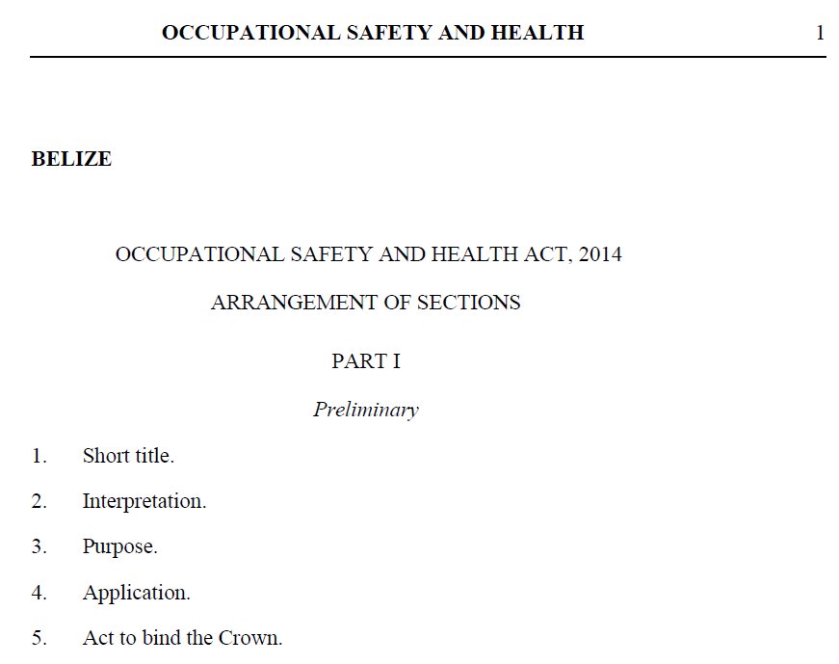
3. Content within context of ITVET
Health and Safety
On ITVET Belize campus
After program completion
Legal responsibilities
ITVET Performance Goals
Social responsibilities
Similar to other ITVET Belize programs
Air Conditioning
Electrical
Plumbing
Building Construction

Slide 14
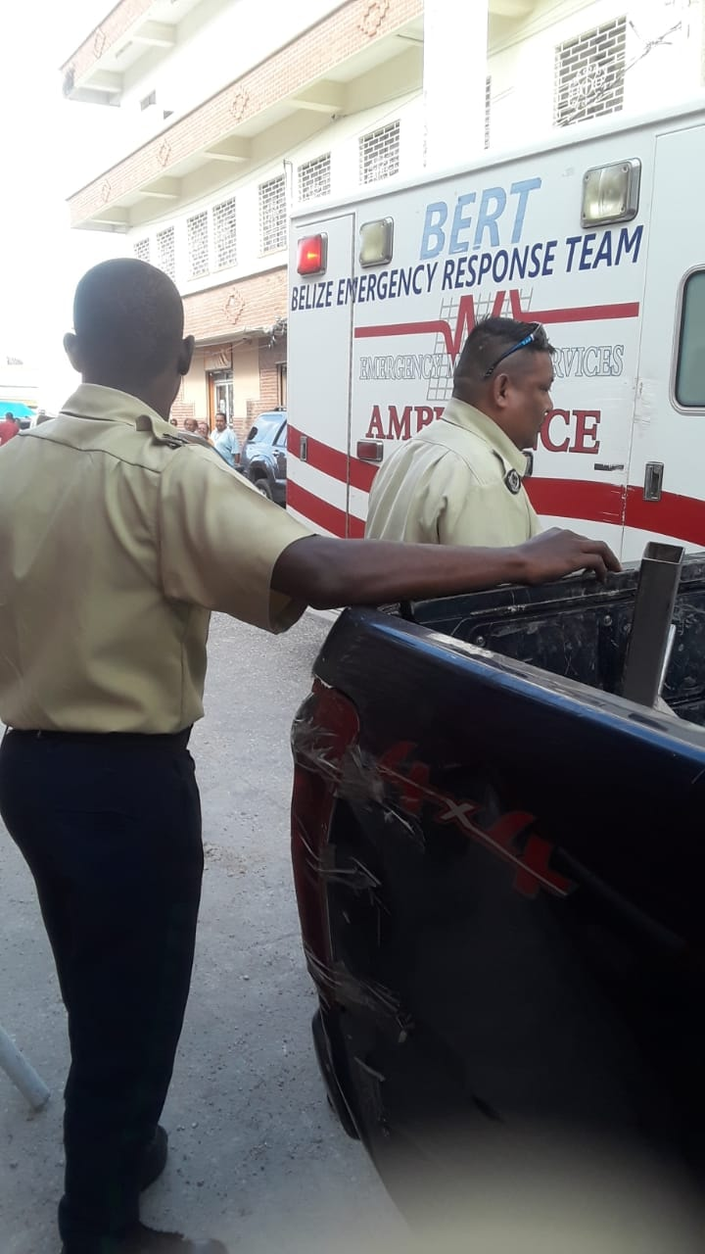
3. Content within context of Belize
Health and Safety
Belize Emergency Response Team
Within the Belize community
Social
Business
Legal and Regulatory
Financial (Direct / Indirect)

Slide 15
3. Content within context of ITVET
Health and Safety (content is not just for one course)
Equipment and Tools (e.g. Power Drill in the New Lab)
Materials and Methods (e.g. fall arrest in the field)
Personal Protective Equipment (e.g. Harness)
Documentation habits (e.g. future employers)

Slide 16
3. Content within context of ITVET
Lab activities within larger project
Assemble and operate, measure, record, and analyze results from laboratory assignments
Individual lab or assignment may be one activity within a larger more comprehensive project at work
Appreciation of the big picture

Slide 17
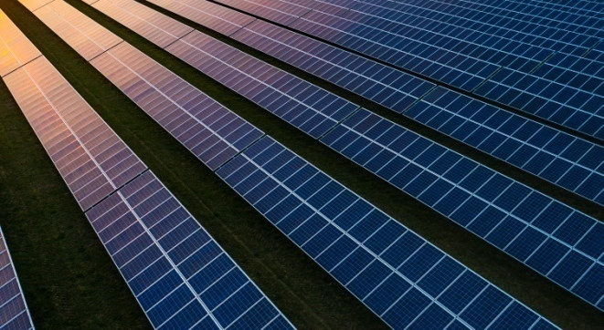
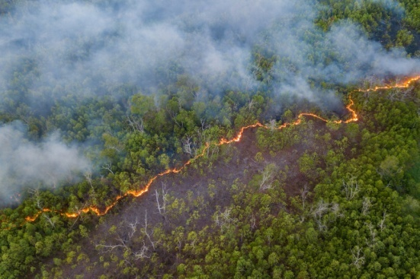
4. Description of Course 06
Integrated Laboratory 1 (Term 1, Year 1)
16 New Lab Hours (24 periods) as 4+4 periods / wk.
Mon. and Tue. pm, 160 minutes. Weeks 1, 2, and 12
Marking Breakdown
00% Individual Tests 15% Individual Projects
75% Group Projects 10% Employability Skills

Slide 18
4. Description of Course 06
Learning Tasks
(from Course 06 Technical Delivery & Assessment Plan)
Identify appropriate hand tools and power tools
Safe tool, equipment & material handling procedures
Identify, minimize, and report workplace hazards
Appropriate personal protective equipment (PPE) is considered, stored, selected, checked, and used in accordance with proper procedures

Slide 19
4. Description of Course 06
Learning Tasks
(from Course 06 Technical Delivery & Assessment Plan)
Manual handling techniques
Follow Accident and Emergency Procedures
Occupational Health and Safety requirements
Worksite environment and safety
Physical, mental, emotional condition of people

Slide 20
4. Description of Course 06
Learning Tasks
(from Course 06 Technical Delivery & Assessment Plan)
Assemble and operate, measure, record, and analyze results from laboratory assignments

Slide 21
4. Description of Course 06
Technical Delivery and Assessment Plan
Task 01
Identify appropriate hand tools and power tools
All hand tools and power tools in the New Lab
Images of other tools that may be used in the field
Wrenches, Screwdrivers, meters, wire cutters, hack saw, and pliers
Electric and battery operated tools (e.g. power drills)

Slide 22
4. Description of Course 06
Technical Delivery and Assessment Plan
Task 02
Safe tool, equipment & material handling procedures
From Manuals if necessary, but not always Manuals
Develop a group of “Safe Work Procedures” for course

Slide 23
4. Description of Course 06

Slide 24
4. Description of Course 06
Technical Delivery and Assessment Plan
Task 03
Identify, minimize, and report workplace hazards
Consider potential workplace hazards
Hazard Assessment – characterize and analyze
Hazard Assessment – minimize and reduce hazards
Student Exercise: Manual and Power Tool Manuals

Slide 25
4. Description of Course 06

Slide 26
4. Description of Course 06
Technical Delivery and Assessment Plan
Task 04
Appropriate personal protective equipment (PPE) is considered, stored, selected, checked, and used in accordance with proper procedures
PPE considerations for New Lab and other activities
PPE storage, selection, training, checking, readiness
PPE use, replacement, cleaning, storage, disposal

Slide 27
4. Description of Course 06

Slide 28
4. Description of Course 06
Technical Delivery and Assessment Plan
Task 05
Manual handling techniques
Lifting and lowering of heavy loads
Pushing and pulling objects and loads
Carrying and moving objects and loads
Holding and restraining objects

Slide 29
4. Description of Course 06
Technical Delivery and Assessment Plan
Task 06
Follow Accident and Emergency Procedures
Safety Program for organization (e.g. training, admin.)
Safety Plan for workplace (e.g. New Lab, or project site)
Documents (e.g. auditing procedure compliance test)
Reviews and revisions to procedures
Holding and restraining objects

Slide 30
4. Description of Course 06
Technical Delivery and Assessment Plan
Task 07
Occupational Health and Safety requirements
ITVET Belize
Legal and Insurance reasons
Business and social reasons
Safety meetings (e.g. Project start & end; daily onsite)

Slide 31
4. Description of Course 06
Technical Delivery and Assessment Plan
Task 08
Worksite environment and safety
Limited space and confined space entry
Fall arrest and working from heights
Traffic control, wet surfaces, and weather conditions
Excavation, construction, fire, electrical & emergencies

Slide 32
4. Description of Course 06
Technical Delivery and Assessment Plan
Task 09
Physical, mental, emotional condition of people
Safety Checklist type Approach

Slide 33
4. Description of Course 06
Technical Delivery and Assessment Plan
Task 10
Assemble and operate, measure, record, and analyze results from laboratory assignments
Week 12 - Last week of course
Group project exercise
Scenario or influenced by Course 04 and 05 Lab work

Slide 34
4. Description of Course 06
Marking Breakdown
00% Individual Tests
15% Individual Projects
75% Group Projects
10% Employability Skills

Slide 35
4. Description of Course 06
Marking Breakdown
00% Individual Tests (Examples)
0 x 5% - Individual Tests
Anticipate and suggest no individual tests
No exam anticipated

Slide 36
4. Description of Course 06
Marking Breakdown
15% Individual Projects (Examples)
1 x 15% - Individual Project or Assignment
Tasks 1 and 2 (New Lab Tool Manual Safety Review)
Tasks 4 and 5 (Personal Protective Equipment Scenario)
Task 6 (Accident and Emergency Procedures)

Slide 37
4. Description of Course 06
Marking Breakdown
75% Group Projects (Examples)
3 x 25% - Group Projects or Assignments
Site Safety Plan Scenario Exercise
Hazard Assessment Scenario Exercise
Integrated Lab Exercise

Slide 38
4. Description of Course 02
Marking Breakdown
5% Employability Skills (Examples)
Similar to those used in some ITVET Belize courses
Attendance
Timeliness
Attention to detail

Slide 39
5. Development of Course 06
Development of Course
From Theory to Practical Application
Build on 2022 ITVET Belize health and safety courses
Provide “Trade” content to fill the theoretical gaps
Provide Course 06 Instructor with “Trade” related examples for assignments and projects
June 24, 2022 “tool safety manual” exercise
Share “Trade” related examples

Slide 40
5. Development of Course 06
Providing Instructor with “Trade”
related Course Material Examples
From New Lab Equipment and Tool List
Safety and Operations Manuals
Find, Review, and Understand
Potential hazard identification and assessment
Contribute to class course information resources

Slide 41
5. Development of Course 06

Slide 42
Summary
Course 06: Integrated Lab 1
16 New Lab hours
3 of 12 Week Term 1, Year 1
Health and Safety
Integrated Lab example
Integrated Lab Courses in 2 year RE EE Program
What does “success” look like at course completion?
Content within context of other ITVET Belize Courses
Description of Course 06 in Term 1 of Year 1
Development of Course 06
Share “Trade” related examples
00,000,000,000,000 kg
100,000 kg per person
38 m x 38 m x 38 m
Also a very small part of the
atmosphere
Belize is a “net carbon sink” due to FOLU
Sink = drain, removal; FOLU = Forestry and Other Land Use
Energy is your dominant emission
Forests absorb and sequester much larger amounts of carbon
They always did, so the emissions remain a problem
Look after forests!
http://www.grisanik.com/blog/how-much-carbon-is-in-the-atmosphere/#:~:text=Furthermore%2C%20multiplying%20Earth's%20atmosphere%205.137,atmosphere%20is%20~3%2C208%20Gt%20CO2.

Slide 43
Questions?
Comments?
Suggestions?
Thank you

