Slide 1
Design and Implementation of Pilot of a TVET Renewable Energy Course
DELIVERABLE #5 - TRAINING COURSES & PROFESSIONAL DEVELOPMENT
Session 33 (14 October 2022) – Term 2 C 07 – Communications 02

Slide 2
For Today:
Communications Courses in 2 year RE EE Program
What “success” looks like at program completion
Content within context of other ITVET Belize Courses
Description of Course 7 in Term 2 of Year 1
Development of Course 7

Slide 3
1. Communications Courses in 2 Year Program
2 Year (~32 Course) RE EE Program Overview
1st Year | Term 1 | Communi- cations 1 Comm 1 | Applied Math 1 Math 1 | Intro to Ener. Sci. Ener Sci | PV Applications PV Appl |  | Elec. and Circuits 1 Elec. Cir. 1 | Integrated Lab 1 Int Lab 1
 | Term 2 | Communi-cations 2 Comm 2 | Energy Model. and Analysis Ener M A | Electricity and Circuits 2 Elec. Cir. 2 |  | PV Grid Tied Design PV GT De |  | Integrated Lab 2 Int Lab 2
 | Term 3 | Communi- cations 3 Comm 3 | Applied Math 2 Math 2 | Solar Hot Water Systems Sol H W S |  | PV Solar Panel Installations PV Instal |  | Technical Drawing Tec Dwg
2nd Year | Term 4 | Audits 1 – Customer Relations Audits 1 | Energy Eff. Measure. & Verification E E M V | PV Stand Alone System Design PV SASD | PV Stand Alone Syst. Design PV SASD | PV Battery Based Installations PV Bat In |  | Sm. Wind Design & Operation Sm Wind
 | Term 5 | Projects and Comms 1 Pro Comm | Audits 2 – Load Analysis Audits 2 | Econ Analysis of Energy Systems Econ A E S |  | Elec. Codes and Regulations Elec C A R |  | Project Planning Proj Plan
 | Term 6 | Adv. Energy System Design AES Des | Final Project (Classroom) Fin Proj | Bus. Operations & Entrepreneurs. Bus O & E |  | PV Sys. Maint. & Operation PV M & O |  | Final Proj. (Lab) Fin Pro

Slide 4
1. Program Overview
Term 02:Course Calendar Year 1 Short Term (Jan – Mar) (5 Courses x 10 Weeks)
240 Hours | Day 1 (Mon) | Day 2 (Tue) | Day 3 (Wed) | Day 4 (Thur)
8:10 – 8:50 | C 07: Comm 2 | C 08: Ener M A | C 07: Comm 2 | C 08: Ener M A
8:50 – 9:30 | C 07: Comm 2 | C 08: Ener M A | C 07: Comm 2 | C 08: Ener M A
9:30 – 10:10 | C 07: Comm 2 | C 08: Ener M A | C 07: Comm 2 | C 08: Ener M A
10:10 – 10:25 | 15 minutes | 15 minutes | 15 minutes | 15 minutes
10:25 – 11:05 | C 09: Elec Cir 2 | C 10: PV GT De | C 09: Elec Cir 2 | C 10: PV GT De
11:05 – 11:45 | C 09: Elec Cir 2 | C 10: PV GT De | C 09: Elec Cir 2 | C 10: PV GT De
11:45 – 13:00 | Lunch & HR | Lunch & HR | Lunch & HR | Lunch & HR
13:00 – 13:40 | Lab (2:40) | Lab 1 (2:40) | C 10: PV GT De | C 09: Elec Cir 2
13:40-14:20 | C 09: Elec Cir 2 | C 10: PV GT De | C 10: PV GT De | C 09: Elec Cir 2
14:20 - 15:00 | C09 = 6 Labs | C10 = 10 Labs | C 10: PV GT De | C 09: Elec Cir 2
15:00 - 15:40 | C11 = 4 Labs | C11 = 0 Labs | C 10: PV GT De | C 08: Ener M A
C 07: Comm 2 | 40 hours | 10 x 6 CP x 2/3 | C 07: Communications 2 (LC 2)
C 08: Ener M A | 46.7 hours | 10 x 7 CP x 2/3 | C 08: Energy Modelling and Analysis (EE 3)
C 09: Elec Cir 2 | 62.7 hours | ((10 x 7 CP) + (6 x 4 LP)) x 2/3 | C 09: Electricity and Circuits 2 (AS 2) Labs (6 x 4 periods) on Weeks 3, 4, 5, 7, 8, 9
C 10: PV GT De | 80 hours | ((10 x 8 CP) + (10 x 4 LP)) x 2/3 | C 10: Grid tied PV Design (PV2) Labs (10 x 4 periods) on Weeks 1 – 10
C 11: Int Lab 2 | 10.7 hours | (4 x 4 LP) x 2/3 | C 11: Integrated Laboratory 2 (NL 2) Labs (4 x 4 periods) on Weeks 1, 2, 6, 10)

Slide 5
2. Term 2 Course Introductions
Jan – March (10 Weeks)
Communications 2
Energy Use, Modelling and Analysis
Electricity and Circuits 2
Grid Tied Solar Photovoltaic Design
Integrated Laboratory

Slide 6
Course 07: Communications 2
10 Week Term 2, Year 1 40 Classroom hours 0 New Lab hours 10 weeks x 6 periods/wk 3 periods Mon am 3 periods Wed am
Marking Breakdown 20% Individual Tests 30% Individual Projects 40% Group Projects 10% Employability Skills

Slide 7
Course 12: Communications 3
10 Week Term 3, Year 1 33.3 Classroom hours 0 New Lab hours 10 weeks x 5 periods/wk 3 periods Mon am 2 periods Wed pm
Marking Breakdown 20% Individual Tests 30% Individual Projects 40% Group Projects 10% Employability Skills

Slide 8
C 18: Audits 01 – Customer Relations
12 Week Term 4, Year 2 32 Classroom hours 0 New Lab hours 12 weeks x 4 periods/wk 2 periods Mon pm 2 periods Wed pm
Marking Breakdown 20% Individual Tests 30% Individual Projects 40% Group Projects 10% Employability Skills

Slide 9
C 23: Projects and Communications
10 Week Term 5, Year 2 53.3 Classroom hours 0 New Lab hours 10 weeks x 8 periods/wk 5 periods Mon am & pm 3 periods Wed am
Marking Breakdown 20% Individual Tests 30% Individual Projects 40% Group Projects 10% Employability Skills

Slide 10
2. What does “success” look like?
Students completing Year 1 (Installer) or 2 Year (Designer) RE EE Program Requirements at their own time and pace
Students and Industry Qualifications NABCEP, CVQ, etc.
Instructors with resources, achieving their desired results
ITVET with resources for scalable, sustainable program
Skills competently applied to a changing Green Economy
Belize Employers – competent, adaptable team members

Slide 11
2. What does “success” look like?
For Employers and the “Communications” part of Program:
Understand options and communicate recommendations
Prepare project descriptions, drawings, and reports
Plan and prepare maintenance and monitoring reports
Prepare project proposals, estimates, quotes, invoices
Verbal, written, & digital communications skills – clients, residents, suppliers, partners, regulators, team members

Slide 12
2. What does “success” look like?
Successful use of skill sets with forms of communications:
Verbal – in-person, telephone Understand options and communicate recommendations
Written – drawings, letters, reports and descriptions of projects, travel directions, sites, equipment, materials
Digital – some verbal and written communications in a different format (e.g. text, email, video clip, presentation)

Slide 13
2. What does “success” look like?
Program completion prepares for work place circumstances:
Personal – Job application letter, CV’s, LinkedIn profile
Technical descriptions – How to do it, or How it was done
Technical specifications, drawings, regulations, suppliers
Contracts, proposals, quotes, change orders, invoices
Customer – site assessments, audits, complaints
Formal – meeting agenda, minutes, decision making

Slide 14
2. What does “success” look like?
Projects completed using mixed team language skills:
Teams members’ various backgrounds and experiences
English, Spanish (mixed), Mayan, Creole, . . . Ukrainian?
English as lead for Technical, Regulatory, and Legal
Potential language mix with field work and customers
Sometimes “close enough” is okay and sometimes not
Language skills within the team, not of each member

Slide 15
2. What does “success” look like?
For “communications” skill sets, what does program completion or work place “success” look like:
For an experienced electrical technician in the field?
For a project manager, or regulator representative?
For an ITVET Belize Instructor?
For someone with mixed language skills?
For potential new program students?

Slide 16
3. Content within context of ITVET
Vision of “communications” skill sets, experiences, and potential of people completing the new RE EE Program
Uncertainty of skill sets for those starting New Program
Introductory communications courses may be similar in theory for multiple technical programs but differ with
Applications presented through assignments and projects
Scenarios based on expected potential work place conditions

Slide 17
3. Content within context of ITVET
2021 – 2022
Diana Ireland
ITVET Belize
Typical at ITVET?
Training Delivery and Assessment Plan
Profile of the Trainee / Portfolio of the Trainee
Program Policies & Regulations / Technology Requirements
Instructional Methods / Modes (Face to Face and Online)
Resources (Technical; Underpinning Knowledge and Skills)
Delivery Schedule (week / Instructional Methods (IM)
Practical Grading Criteria and Theoretical Grading Criteria

Slide 18
3. Content within context of ITVET
2021 – 2022
Diana Ireland
ITVET Belize
Typical at ITVET?
Delivery Schedule (Is it equivalent to a Lesson Plan?)
For each Week or 2 week period, the Course Outline Topic (e.g. Parts of Speech) and Tasks (e.g. Define, Identify, Use)
Instructional Methods (IM) (e.g. Collaborative Discussions)
Promotional Action (PA) (e.g. Practice work sheets, games)
Assessment Method (e.g. Test 1, Assignment 1, Project 1)
Resources (e.g. Textbook, Videos, Worksheet, Powerpoint)

Slide 19
3. Content within context of ITVET
Language and Communication
Skills (Level One Introduction)
Belize National Council on
TVET (NCTVET)
Belize Min. of Education
approval in 2006
Program Module and Title
M1-1 Understanding grammar, mechanics and usage
M2-1 The communication process
M3-1 Developing writing skills
M4-1 Developing reading skills

Slide 20
3. Content within context of ITVET
ITVET Belize English Language Diagnostic Assessment
Belize Language and Communication Skills (Modules)
Uncertainty of skill sets for those starting New Program
Existing ITVET Communications introduction courses
For New Program Course C 07: Communications 2
Provide “Trade” specific assignment examples and scenarios
Build on New Program Course C 01: Communications 1

Slide 21
4. Description of Course 07
Term 02:Course Calendar Year 1 Short Term (Jan – Mar) (5 Courses x 10 Weeks)
240 Hours | Day 1 (Mon) | Day 2 (Tue) | Day 3 (Wed) | Day 4 (Thur)
8:10 – 8:50 | C 07: Comm 2 | C 08: Ener M A | C 07: Comm 2 | C 08: Ener M A
8:50 – 9:30 | C 07: Comm 2 | C 08: Ener M A | C 07: Comm 2 | C 08: Ener M A
9:30 – 10:10 | C 07: Comm 2 | C 08: Ener M A | C 07: Comm 2 | C 08: Ener M A
10:10 – 10:25 | 15 minutes | 15 minutes | 15 minutes | 15 minutes
10:25 – 11:05 | C 09: Elec Cir 2 | C 10: PV GT De | C 09: Elec Cir 2 | C 10: PV GT De
11:05 – 11:45 | C 09: Elec Cir 2 | C 10: PV GT De | C 09: Elec Cir 2 | C 10: PV GT De
11:45 – 13:00 | Lunch & HR | Lunch & HR | Lunch & HR | Lunch & HR
13:00 – 13:40 | Lab 1 (2:40) | Lab 1 (2:40) | C 10: PV GT De | C 09: Elec Cir 2
13:40-14:20 | C 09: Elec Cir 2 | C 10: PV GT De | C 10: PV GT De | C 09: Elec Cir 2
14:20 - 15:00 | C09 = 6 Labs | C10 = 10 Labs | C 10: PV GT De | C 09: Elec Cir 2
15:00 - 15:40 | C11 = 4 Labs | C11 = 0 Labs | C 10: PV GT De | C 08: Ener M A
C 07: Comm 2 | 40 hours | 10 x 6 CP x 2/3 | C 07: Communications 2 (LC 2)
C 08: Ener M A | 46.7 hours | 10 x 7 CP x 2/3 | C 08: Energy Modelling and Analysis (EE 3)
C 09: Elec Cir 2 | 62.7 hours | ((10 x 7 CP) + (6 x 4 LP)) x 2/3 | C 09: Electricity and Circuits 2 (AS 2) Labs (6 x 4 periods) on Weeks 3, 4, 5, 7, 8, 9
C 10: PV GT De | 80 hours | ((10 x 8 CP) + (10 x 4 LP)) x 2/3 | C 10: Grid tied PV Design (PV2) Labs (10 x 4 periods) on Weeks 1 – 10
C 11: Int Lab 2 | 10.7 hours | (4 x 4 LP) x 2/3 | C 11: Integrated Laboratory 2 (NL 2) Labs (4 x 4 periods) on Weeks 1, 2, 6, 10)

Slide 22
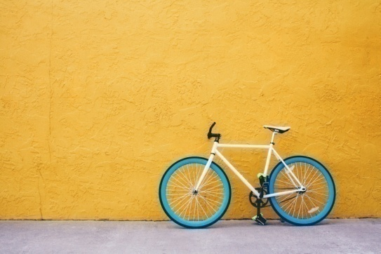
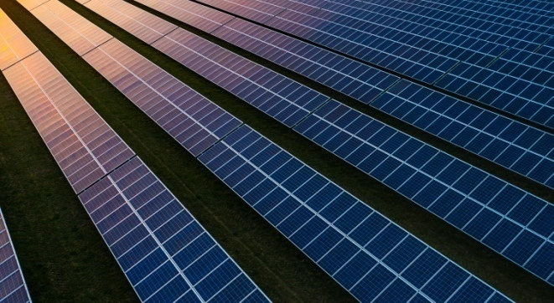
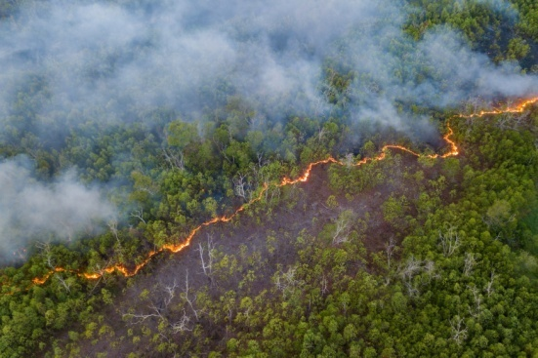
4. Description of Course 07
Communications 2 (Term 2, Year 1)
40 Classroom Hours as 10 weeks x 6 periods / week
3 periods Mon. am and 3 Periods Wed. am
Marking Breakdown
20% Individual Tests 30% Individual Projects
40% Group Projects 10% Employability Skills

Slide 23
4. Description of Course 07
C 07; Communications 2
Comm 2 (in Calendar Table)
Introduce business correspondence and writing skills including email writing required of technical professionals in the workplace
Review & refine fundamentals of clear, concise writing
Review & refine fundamentals of presentations
Create job search documents

Slide 24
4. Description of Course 07
C 07: Communications 2
Examples of anticipated outcomes after course completion
Preparing more effective job applications documents
A new employee communicating with customers, suppliers, technical team members, and regulators
Make reasonable technical demonstrations for others (e. g. “How to ... “ or “What is different for this project ... “)

Slide 25
4. Description of Course 07
From Learning Outcomes and Tasks
Task 01
Introduce Business Correspondance and Writing Skills
Review Trade Related Examples provided
Consider email, texting, smart phones & other options
Consider typical local workplace conditions and habits
Applicable elements from ITVET Belize courses

Slide 26
4. Description of Course 07
From Learning Outcomes and Tasks
Task 02
Fundamentals of Clear Concise Communications
Build on unfinished Tasks in C 01 Communications 01
Written, verbal, digital, in-person, technical, financial
Consider typical local workplace conditions and habits
Applicable elements from ITVET Belize courses

Slide 27
4. Description of Course 07
From Learning Outcomes and Tasks
Task 03
Fundamentals of Presentations
Unplanned, 1 - 2 min., in-person, telephone, video clip
Planned, 3 - 5 min., in-person, telephone, video clip
Build on Task 2 of C 01 Communications 01
Consider typical local workplace conditions and habits
Applicable elements from ITVET Belize courses

Slide 28
4. Description of Course 07
From Learning Outcomes and Tasks
Task 04
Create Job Search Documents
Cover letter and CV as potential employee
LinkedIn and other locally applicable digital platforms
Preparation of an Employer’s “Installer” Job Posting
Useful critical review of examples by others

Slide 29
4. Description of Course 07
Marking Breakdown
20% Individual Tests
30% Individual Projects
40% Group Projects
10% Employability Skills

Slide 30
4. Description of Course 07
Marking Breakdown
20% Individual Tests (Examples)
Task 1 Business Correspondence & Communications
Task 2 Clear Concise Communications

Slide 31
4. Description of Course 07
Marking Breakdown
30% Individual Projects (Examples)
Task 1 Business Correspondence & Communications
Task 2 Clear Concise Communications
Task 4 Create Job Search Documents

Slide 32
4. Description of Course 07
Marking Breakdown
40% Group Projects (Examples)
Task 3 Fundamentals of Presentations
Task 4 Create Job Search Documents

Slide 33
4. Description of Course 07
Marking Breakdown
10% Employability Skills (Examples)
Those used in ITVET Belize communications courses
Attendance
Timeliness
Attention to detail

Slide 34
5. Development of Course 07
Development of Course
From Theory to Practical Application
Build on 2022 ITVET Belize communications courses
Build on Course C 01: Communications 01
Provide “Trade” content to fill the theoretical gaps
Provide Course 07 Instructor with “Trade” related examples for assignments, projects, and tests
Fall 2022 “small group” session on Course 07

Slide 35
5. Development of Course 07
Providing Instructor with “Trade”
related Course Material Examples
Terms, Definitions, Phrases, Acronyms
Locally inspired business correspondence examples
Locally inspired job posting examples

Slide 36
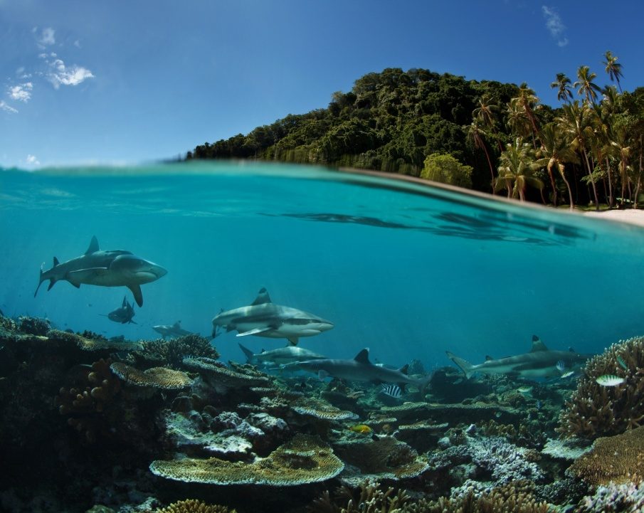
Summary
Course 07: Communications 2
40 Classroom hours
10 Week Term 2, Year 1
Build on Communications 01
Add “Trade” related examples
Communications Courses in 2 year RE EE Program
What does “success” look like at course completion?
Content within context of other ITVET Belize Courses
Description of Course 07 in Term 2 of Year 1
Development of Course 07
Share “Trade” related examples in Fall 2022 Sessions
00,000,000,000,000 kg
100,000 kg per person
38 m x 38 m x 38 m
Also a very small part of the
atmosphere
Belize is a “net carbon sink” due to FOLU
Sink = drain, removal; FOLU = Forestry and Other Land Use
Energy is your dominant emission
Forests absorb and sequester much larger amounts of carbon
They always did, so the emissions remain a problem
Look after forests!
http://www.grisanik.com/blog/how-much-carbon-is-in-the-atmosphere/#:~:text=Furthermore%2C%20multiplying%20Earth's%20atmosphere%205.137,atmosphere%20is%20~3%2C208%20Gt%20CO2.

Slide 37
For Today:
C 07: Communications 2
Instructor Comments?
Instructor Discussion?
Instructor Suggestions?
“Real World” Applications?

Slide 38
Questions?
Comments?
Suggestions?
Thank you

