Slide 1
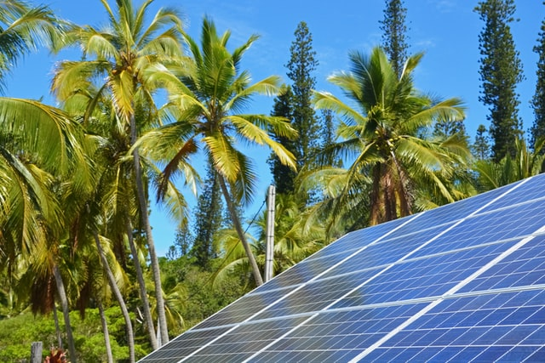
Design and Implementation of Pilot of a TVET Renewable Energy Course
DELIVERABLE #5 - TRAINING COURSES & PROFESSIONAL DEVELOPMENT
Session 42 (25 November 2022) – Term 3 C32 – Applied Math 2

Slide 2
For Today:
Math Courses in 2 year RE EE Program
What does “success” look like at course completion?
Content within context of other ITVET Belize Courses
Description of Course 32 in Term 3 of Year 1
Developing Course 32

Slide 3
1. Program Overview (Courses)
2 Year (~32 Course) RE EE Program Overview
1st Year | Term 1 | Communi- cations 1 Comm 1 | Applied Math 1 Math 1 | Intro to Ener. Sci. Ener Sci | PV Applications PV Appl |  | Elec. and Circuits 1 Elec. Cir. 1 | Integrated Lab 1 Int Lab 1
 | Term 2 | Communi-cations 2 Comm 2 | Energy Model. and Analysis Ener M A | Electricity and Circuits 2 Elec. Cir. 2 |  | PV Grid Tied Design PV GT De |  | Integrated Lab 2 Int Lab 2
 | Term 3 | Communi- cations 3 Comm 3 | Applied Math 2 Math 2 | Solar Hot Water Systems Sol H W S |  | PV Solar Panel Installations PV Instal |  | Technical Drawing Tec Dwg
2nd Year | Term 4 | Audits 1 – Customer Relations Audits 1 | Energy Eff. Measure. & Verification E E M V | PV Stand Alone System Design PV SASD | PV Stand Alone Syst. Design PV SASD | PV Battery Based Installations PV Bat In |  | Sm. Wind Design & Operation Sm Wind
 | Term 5 | Projects and Comms 1 Pro Comm | Audits 2 – Load Analysis Audits 2 | Econ Analysis of Energy Systems Econ A E S |  | Elec. Codes and Regulations Elec C A R |  | Project Planning Proj Plan
 | Term 6 | Adv. Energy System Design AES Des | Final Project (Classroom) Fin Proj | Bus. Operations & Entrepreneurs. Bus O & E |  | PV Sys. Maint. & Operation PV M & O |  | Final Proj. (Lab) Fin Pro

Slide 4
1. Program Overview (Term 3)

Slide 5
Course 32: Applied Math 2
10 Week Term 3, Year 1 33.3 Classroom hours 0 New Lab hours 10 weeks x 5 periods/wk 3 periods Tue am 2 periods Thur pm
Marking Breakdown 35% Individual Tests 35% Individual Projects 25% Group Projects 05% Employability Skills

Slide 6
Course 12: Applied Math 1
12 Week Term 1, Year 1 32 Classroom hours 0 New Lab hours 12 weeks x 4 periods/wk 2 periods Tue & Thurs am Same Marking Breakdown
Marking Breakdown 35% Individual Tests 35% Individual Projects 25% Group Projects 05% Employability Skills

Slide 7
2. What does “success” look like?
Students completing Year 1 (Installer) or 2 Year (Designer) RE EE Program Requirements at their own time and pace
Students and Industry Qualifications NABCEP, CVQ, etc.
Instructors with resources, achieving their desired results
ITVET with resources for scalable, sustainable program
Skills competently applied to a changing Green Economy
Belize Employers – competent, adaptable team members

Slide 8
2. What does “success” look like?
For Employers and the “Applied Math” part of Program:
Belize High School Form 4 Math and much more
Estimating, Calculations, Unit Conversions, and Geometry
Use of calculators and spreadsheets as tools of the trade
Prepare for technical calculations in other RE EE Courses
Verbal, written, & digital math skills – (e.g. estimating and ordering project materials, supplies, business math)

Slide 9
2. What does “success” look like?
Successful use of skill sets with applied math skills:
Technical – calculating energy use, losses, production
Field Activities – construction and installation materials, supplies, tools, equipment for projects
Business – financial quotes, invoices, financial summaries

Slide 10
2. What does “success” look like?
For “applied math” skill sets, what does program completion or work place “success” look like:
For an experienced electrical technician in the field?
For a project manager, or regulator representative?
For an ITVET Belize Instructor?
For someone completing the new RE EE Program?
For potential new students to the RE EE Program?

Slide 11
3. Content within context of ITVET
Vision of “applied math” skill sets, experiences, and potential of people completing the new RE EE Program
Uncertainty of skill sets for those starting New Program
Introductory math courses may be similar in theory for multiple ITVET Belize technical programs but differ with
Applications presented through assignments and projects
Scenarios based on expected potential work place conditions

Slide 12
3. Content within context of ITVET
Belize High School Form 4 Math Skills
The two applied math courses (32 hours for Course 12 in Term 1 and 33.3 hours for Course 32 in Term 3) Applied Math 1 builds on High School Form 4 Skills.
Applied Math 2 reinforces problem solving skills for examples involving other Year 1 courses

Slide 13
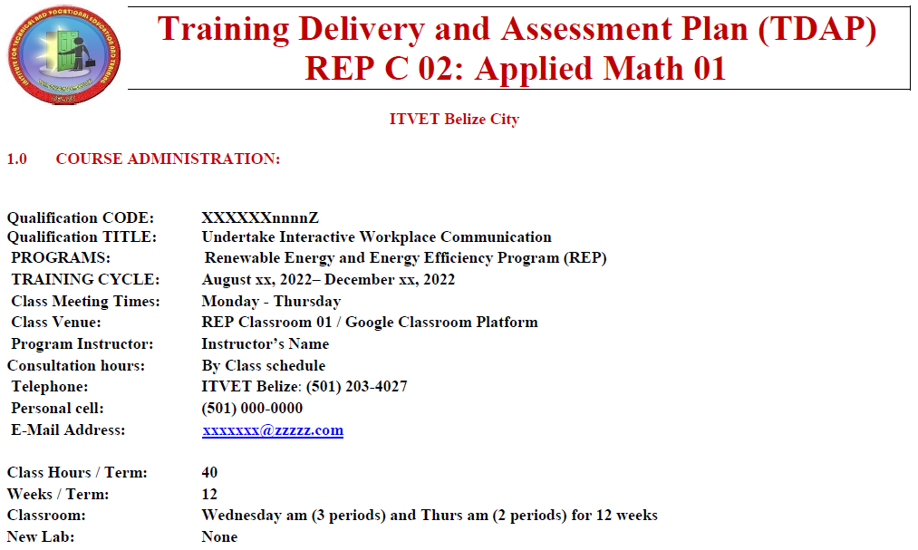
3. Content within context of ITVET
Typical at ITVET
New REP C 11 – 65
Partially complete
Course Instructors
to complete TDAP
Training Delivery and Assessment Plan
Profile of the Trainee / Portfolio of the Trainee
Program Policies & Regulations / Technology Requirements
Instructional Methods / Modes (Face to Face and Online)
Resources (Technical; Underpinning Knowledge and Skills)
Delivery Schedule (week / Instructional Methods (IM)
Practical Grading Criteria and Theoretical Grading Criteria

Slide 14
3. Content within context of ITVET
Typical at ITVET
New REP C 11 – 65
Partially complete
Course Instructors
to complete TDAP
Delivery Schedule (Is it equivalent to a Lesson Plan?)
For each Week or 2 week period, the Course Outline Topic (e.g. Parts of Speech) and Tasks (e.g. Define, Identify, Use)
Instructional Methods (IM) (e.g. Collaborative Discussions)
Promotional Action (PA) (e.g. Practice work sheets, games)
Assessment Method (e.g. Test 1, Assignment 1, Project 1)
Resources (e.g. Textbook, Videos, Worksheet, Powerpoint)

Slide 15
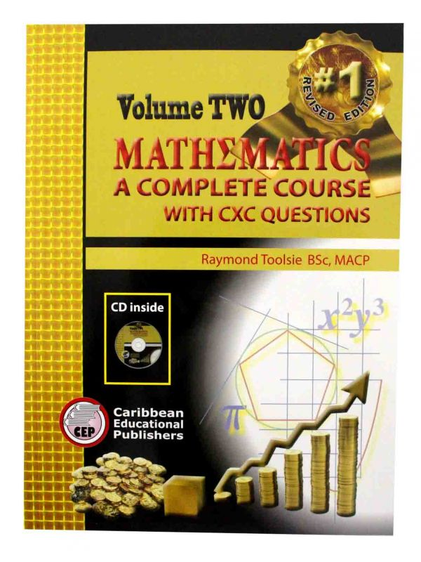
3. Content within context of ITVET
Math at High School Form 4
(before?) ITVET Belize
Vol 1 and 2 from 1990’s
Revised and updated
Source for some review material
Used at a Belize High School
Mathematics A complete Course with CXC Questions
CXC = Caribbean Examinations Council
Exit Assessment
RE EE Program assumes Form 4 Math already completed

Slide 16
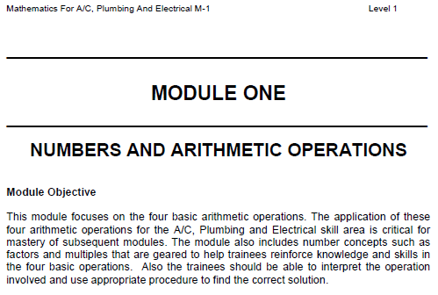
3. Content within context of ITVET
Math Modules M1 to M10
ITVET Belize for
A/C, Plumbing, Elec.
240 pages
10 Modules (1 – 10)
Form 4 Math Content
Modules 11 + ?
Math (M1 – M10) skills when starting at ITVET Belize
For those who did not complete High School Form 4 Math?
Not required if High School Form 4 Math completed?
RE EE Program assumes Form 4 Math already completed

Slide 17
3. Content within context of ITVET
Math Modules M1 to M10 (132 hours in total)
M - 1 (6 hours) Numbers and Arithmetic Operations
M - 2 (15) Calculations and Fractions and Decimals
M - 3 (15) Computing with Scientific Notation: Powers, Symbols / Terms and Signed Numbers
M - 4 (10) Estimations and Measurements
M - 5 (20) Percentages
M - 6 (12) Ratio and Proportion
M - 7 (15) Basic Statistics
M - 8 (12) Exploring Algebra
M - 9 (12) Calculating Perimeters and Areas
M - 10 (15) Geometry

Slide 18
3. Content within context of ITVET
New RE EE Program and Applied Math Skills
Belize High School Form 4 Math Skills before starting
Course 12 Applied Math (32 hours) reviews and builds on some existing Form 4 Math skills and topics
With 132 hours as Modules M – 1 to M – 10, Course 12 (32 hours) builds on Modules M - 1 to M - 10
Course 12 Math reviews, not teaches M 1– 10 content

Slide 19
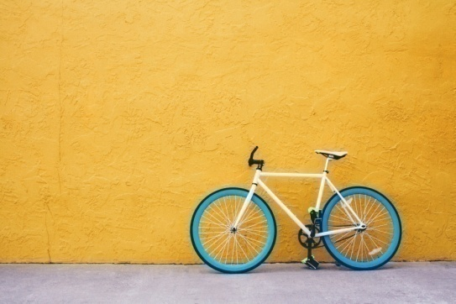
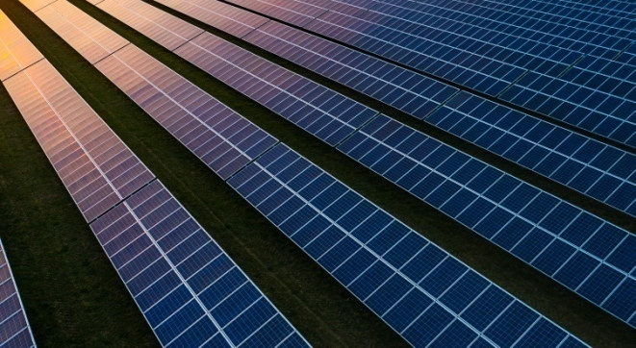
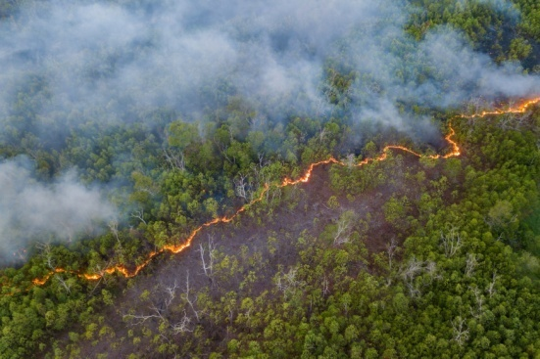
4. Description of Course 32
Applied Math 2 (Term 3, Year 1)
33.3 Classroom Hours as 10 weeks x 5 periods / week
3 periods Tue. am and 2 Periods Thurs. pm
Marking Breakdown
35% Individual Tests 35% Individual Projects
25% Group Projects 05% Employability Skills

Slide 20
C 32: Applied Mathematics 2
10 Week Term 3, Year 1 33.3 Classroom hours as 5 periods/wk. x 10 weeks (Tue. am and Thurs. pm) 0 New Lab hours as 0 periods x 10 weeks
Marking Breakdown 35% Individual Tests 35% Individual Assign. 20% Group Projects 10% Employability Skills

Slide 21
4. Description of Course 32
C 32: Applied Mathemantic 2
Math 02 (in Calendar Table)
Review of basic algebra and geometry
Introduce functional notation
Introduce linear equations and quadratic equations
Introduce trigonometric functions and exponents
Applied renewable energy / energy efficiency problems
Spreadsheet and math tool journal and use for design

Slide 22
4. Description of Course 32
C 32: Applied Mathematics 2
Examples of anticipated outcomes after course completion
Equation solving involving angles and trigonometry (e.g. sloped roof materials)
Hand calculator solving of typical applied renewable energy and energy efficiency mathematical problems
Awareness of spreadsheet and math tools used for design

Slide 23
4. Description of Course 32
From Learning Outcomes and Tasks
Task 01
Review of basic algebra and geometry
Module M-8 Algebra
E.g. Simplify the following: 2p x 3q x (-q) x 4p
Module M-9 Perimeters and Areas
Find inside area of a 100 mm pipe, 6 mm thick

Slide 24
4. Description of Course 32
From Learning Outcomes and Tasks
Task 01
Review of basic algebra and geometry
Module M-10 Geometry
Find the size of the angles marked w, x, y and z.

Slide 25
4. Description of Course 32
From Learning Outcomes and Tasks
Task 02
Introduce functional notation
Review Trade Related Examples provided
What “success” looks like to different people
Applicable elements from ITVET Belize courses

Slide 26
4. Description of Course 32
From Learning Outcomes and Tasks
Task 02
Introduce functional notation (Module M-3)
-1.5(0.8) – 0.2(4) = -1.2 – 0.8 = -2
20 + 2(-5) 20 -10 10
Write the following as ordinary numbers:
8.2 x 10² 5 x 10³ 1.87 x 10⁶ 12. 2 x l0⁻³

Slide 27
4. Description of Course 32
From Learning Outcomes and Tasks
Task 03
Introduce linear equations and quadratic equations
Review Trade Related Examples provided
What “success” looks like to different people
Applicable elements from ITVET Belize courses

Slide 28
4. Description of Course 32
From Learning Outcomes and Tasks
Task 03
Introduce linear equations and quadratic equations
Factor Label Method, multiple units, solve for unknown
Exercise in net metering calculations
Exercise with thermodynamics and solar hot water

Slide 29
4. Description of Course 32
From Learning Outcomes and Tasks
Task 04
Introduce trigonometric functions and exponents
Review Trade Related Examples provided
What “success” looks like to different people
Applicable elements from ITVET Belize courses

Slide 30
4. Description of Course 32
From Learning Outcomes and Tasks
Task 04
Introduce trigonometric functions and exponents
Angles, estimates and using sine, cosine, and tangents
Exercises with exponents and unit conversions
Varying angle of the sun and solar energy production

Slide 31
4. Description of Course 32
From Learning Outcomes and Tasks
Task 05
Applied renewable energy / energy efficiency problems
Review Trade Related Examples provided
What “success” looks like to different people
Applicable elements from ITVET Belize courses

Slide 32
4. Description of Course 32
From Learning Outcomes and Tasks
Task 05
Applied renewable energy / energy efficiency problems
Net solar and wind energy project production and use
Battery based energy storage and end use efficiency
Vehicle engine idling time impact on fuel use efficiency

Slide 33
4. Description of Course 32
From Learning Outcomes and Tasks
Task 06
Spreadsheet and math tool journal and use for design
Review Trade Related Examples provided
Technical, Material, Financial
What “success” looks like to different people
Applicable elements from ITVET Belize courses

Slide 34
4. Description of Course 32
From Learning Outcomes and Tasks
Task 06
Spreadsheet and math tool journal and use for design
Technical – calculation of net energy flow
Material – calculate project materials and equipment
Financial – calculate cumulative project financial costs

Slide 35
4. Description of Course 32
Marking Breakdown
35% Individual Tests
35% Individual Projects
25% Group Projects
05% Employability Skills

Slide 36
4. Description of Course 32
Marking Breakdown
35% Individual Tests (Examples)
4 x 5% - Individual Tests
Tasks 1, 2, and 3 (Operations)
Tasks 4, 5, and 6 (Notation, Percentages, Conversions)
Task 7 and 8 (Geometry)
Task 9 (Algebra)
15% “Exam” – Individual Test

Slide 37
4. Description of Course 32
Marking Breakdown
35% Individual Projects (Examples)
4 x 5% - Small Individual Projects or Assignments
Tasks 1, 2, and 3 (Completing Project Materials List)
Tasks 4, 5, and 6 (Focus on Unit Conversions)
Task 7 and 8 (Focus on Geometry)
Task 9 (Focus on Algebra style problem solving)
15% Major Project – Technical estimate of Power

Slide 38
4. Description of Course 32
Marking Breakdown
20% Group Projects (Examples)
2 x 10% - Group Projects or Assignments
Material – Material Estimate for a Solar Panel Project
Financial - Cost Estimate for a Solar Panel Project

Slide 39
4. Description of Course 32
Marking Breakdown
5% Employability Skills (Examples)
Those used in ITVET Belize communications courses
Attendance
Timeliness
Attention to detail

Slide 40
5. Development of Course 32
Development of Course
From Theory to Practical Application
Build on 2022 ITVET Belize Applied Math 01 course
Provide “Trade” content to fill the theoretical gaps
Provide Course 32 Instructor with “Trade” related examples for assignments, projects, and tests
Winter 2023 “small group” session on Course 32
Share “Trade” related examples

Slide 41
5. Development of Course 32
Providing Instructor with “Trade”
related Course Material Examples
Technical, Material, and Financial
Energy Losses (Equipment, Wiring, Transitions)
Equipment sizing sheet
Technical Specification and Drawings
Project financial estimates, quotes, invoices

Slide 42
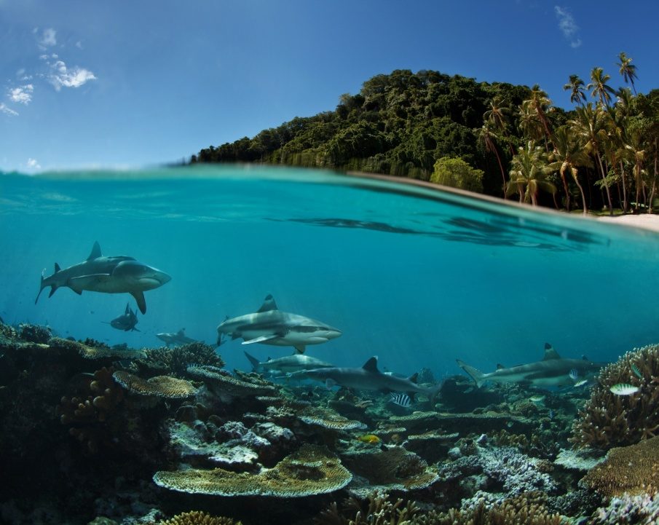
Summary
Course 32: Applied Math 2
33.3 Classroom hours
10 Week Term 3, Year 1
Build on Applied Math 1
Add “Trade” related examples
Applied Math Courses in 2 year RE EE Program
What does “success” look like at course completion?
Content within context of other ITVET Belize Courses
Description of Course 32 in Term 3 of Year 1
Development of Course 32
Share “Trade” related examples
00,000,000,000,000 kg
100,000 kg per person
38 m x 38 m x 38 m
Also a very small part of the
atmosphere
Belize is a “net carbon sink” due to FOLU
Sink = drain, removal; FOLU = Forestry and Other Land Use
Energy is your dominant emission
Forests absorb and sequester much larger amounts of carbon
They always did, so the emissions remain a problem
Look after forests!
http://www.grisanik.com/blog/how-much-carbon-is-in-the-atmosphere/#:~:text=Furthermore%2C%20multiplying%20Earth's%20atmosphere%205.137,atmosphere%20is%20~3%2C208%20Gt%20CO2.

Slide 43
Questions?
Comments?
Suggestions?
Thank you

