Slide 1
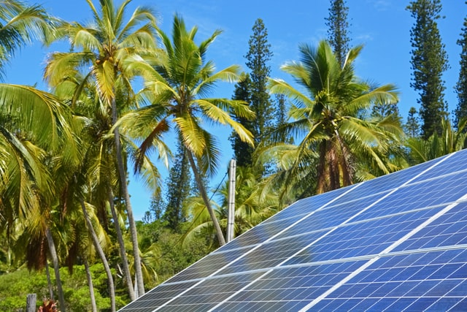
Design and Implementation of Pilot of a TVET Renewable Energy Course
DELIVERABLE #5 - TRAINING COURSES & PROFESSIONAL DEVELOPMENT
Session 64 (24 February 2023) – Term 4 C 45 – Small Wind Design and Operation

Slide 2
For Today:
Applied Science Courses in 2 year RE EE Program
What “success” looks like
Master Plan Learning Outcomes and TDAPS
Description of Course 45 in Term 4 of Year 2
Developing Course 45

Slide 3
C45 – Small Wind Design & Operation
Overview and Description
This course will introduce the learner to the basic components of small wind turbine systems. The course will model the performance of small wind turbines in various locations. The learner will identify operation, maintenance, and troubleshooting procedures. The learner will be able to identify considerations for towers, foundations, and system installations.

Slide 4
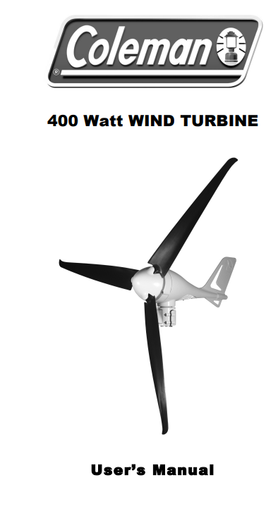
C45 – Small Wind Lab Equipment
Wind turbine for Lab use
Coleman 400 Watt
~ $US 600 (or $BZ 1200?)
Example of “Small Wind”
5 – 7 amp for > 5.5 m/s
average annual wind speed
(building code = local wind m/s)
From wind to battery storage

Slide 5
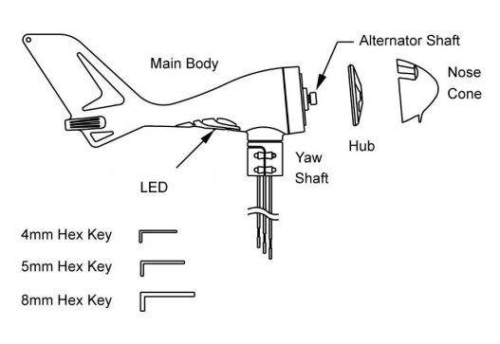
C45 – Small Wind Lab Equipment

Slide 6
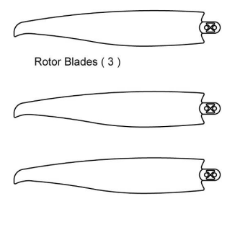
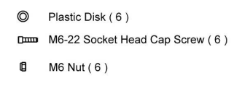
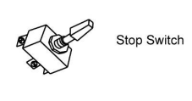
C45 – Small Wind Lab Equipment

Slide 7
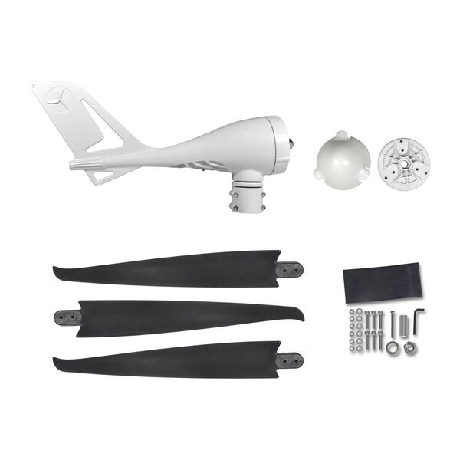
C45 – Small Wind Lab Equipment

Slide 8
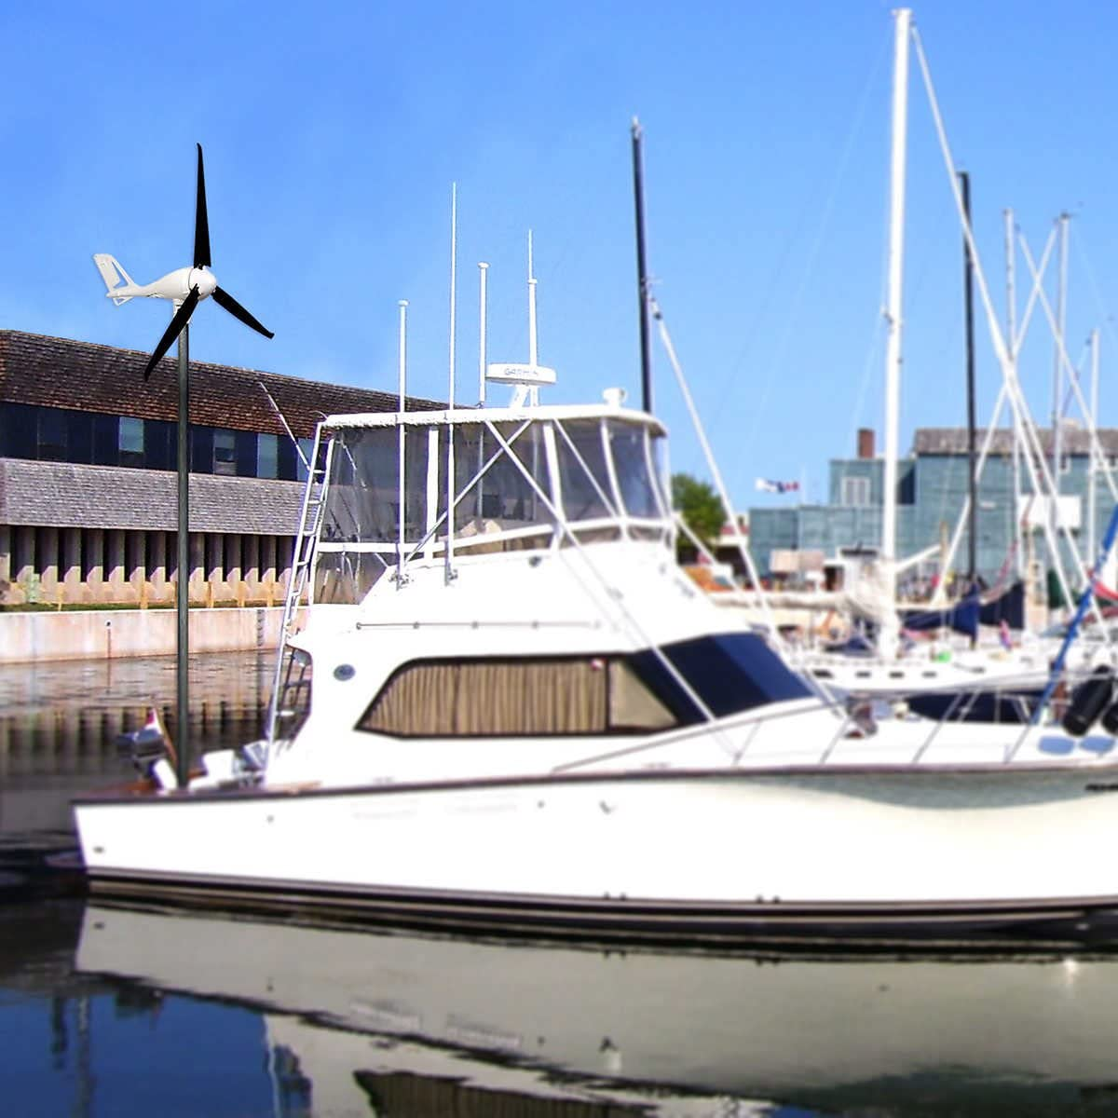
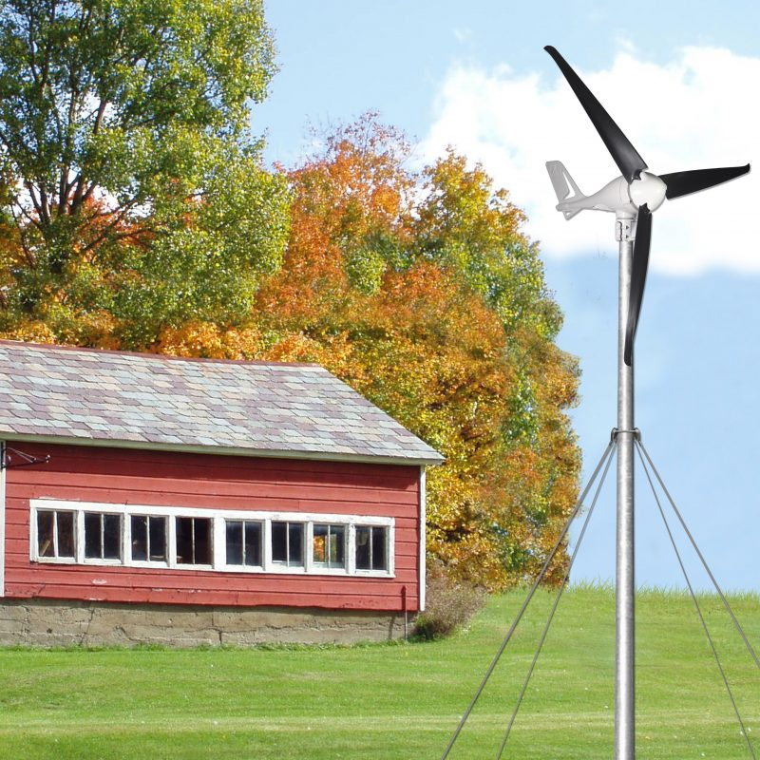
C45 – Small Wind Lab Equipment

Slide 9
C45 – Small Wind Design & Operation
Tasks for Course C 45
T1 - Understand fundamentals of wind systems
T2 - Indentify Small Wind (SW) system applications and uses
T3 - Understand the fundamentals of Small Wind Turbines (incl. science, theory, and system components)
T4 – List considerations for towers, foundations, and system installation
T5 – Prepare site assessment of available wind resource

Slide 10
C45 – Small Wind Design & Operation
Tasks for Course C 45
T6 – Prepare site assessment of potential for a Small Wind project
T7 – Size the small wind components
T8 – Identify operation, maintenance, and trouble shooting procedures
T9 – Apply safety methods and best practices
T10 – Understand the impacts and challenges of small wind systems

Slide 11
1. Applied Science Courses in 2 Year Program
2 Year (~32 Course) RE EE Program Overview
1st Year | Term 1 | Communi- cations 1 Comm 1 | Applied Math 1 Math 1 | Intro to Ener. Sci. Ener Sci | PV Applications PV Appl |  | Elec. and Circuits 1 Elec. Cir. 1 | Integrated Lab 1 Int Lab 1
 | Term 2 | Communi-cations 2 Comm 2 | Energy Model. and Analysis Ener M A | Electricity and Circuits 2 Elec. Cir. 2 |  | PV Grid Tied Design PV GT De |  | Integrated Lab 2 Int Lab 2
 | Term 3 | Communi- cations 3 Comm 3 | Applied Math 2 Math 2 | Solar Hot Water Systems Sol H W S |  | PV Solar Panel Installations PV Instal |  | Technical Drawing Tec Dwg
2nd Year | Term 4 | Audits 1 – Customer Relations Audits 1 | Energy Eff. Measure. & Verification E E M V | PV Stand Alone System Design PV SASD | PV Stand Alone Syst. Design PV SASD | PV Battery Based Installations PV Bat In |  | Sm. Wind Design & Operation Sm Wind
 | Term 5 | Projects and Comms 1 Pro Comm | Audits 2 – Load Analysis Audits 2 | Econ Analysis of Energy Systems Econ A E S |  | Elec. Codes and Regulations Elec C A R |  | Project Planning Proj Plan
 | Term 6 | Adv. Energy System Design AES Des | Final Project (Classroom) Fin Proj | Bus. Operations & Entrepreneurs. Bus O & E |  | PV Sys. Maint. & Operation PV M & O |  | Final Proj. (Lab) Fin Pro

Slide 12
1. Program Overview (Term 4)

Slide 13
1. Term 4 Course Introductions
Aug – Dec (12 Weeks)
Audits 01 Customer Rel.
Energy Efficiency, Measurement and Verification
Solar Stand Alone PV System Design
Battery Based PV Instal.
Small Wind Design and Operation

Slide 14
C 45: Small Wind Design & Operation
12 Week Term 4, Year 2 48 Classroom hours + 16 New Lab hours 12 weeks x 6 periods/wk 3 periods Mon & Wed am 3 Labs Wed & Thurs pm
Marking Breakdown 20% Individual Tests 30% Individual Projects 40% Group Projects 10% Employability Skills

Slide 15
2. What does “success” look like?
Students completing Year 1 (Installer) or 2 Year (Designer) RE EE Program Requirements at their own time and pace
Students and Industry Qualifications NABCEP, CVQ, etc.
Instructors with resources, achieving their desired results
ITVET with resources for scalable, sustainable program
Skills competently applied to a changing Green Economy
Belize Employers – competent, adaptable team members

Slide 16
2. What does “success” look like?
For Employers and the “Small Wind” part of Program:
Identification, selection, installation, operation, maintenance, of equipment and instruments
Interpretation, analysis, conclusions, and recommendations from wind resource & site assessments
Sizing equipment for load analysis and site conditions
Accounting for uncertainties, data gaps, and assumptions
Verbal, written, & digital communications skills

Slide 17
3. Master Plan and TDAP Use
Typical at ITVET
For all courses
By all Instructors
For each term
Training Delivery and Assessment Plan
Profile of the Trainee / Portfolio of the Trainee
Program Policies & Regulations / Technology Requirements
Instructional Methods / Modes (Face to Face and Online)
Resources (Technical; Underpinning Knowledge and Skills)
Delivery Schedule (week / Instructional Methods (IM)
Practical Grading Criteria and Theoretical Grading Criteria

Slide 18
3. Master Plan and TDAP Use
Typical at ITVET
For all courses
By all Instructors
For each term
Delivery Schedule (Is it equivalent to a Lesson Plan?)
For each Week or 2 week period, the Course Outline Topic (e.g. Parts of Speech) and Tasks (e.g. Define, Identify, Use)
Instructional Methods (IM) (e.g. Collaborative Discussions)
Promotional Action (PA) (e.g. Practice work sheets, games)
Assessment Method (e.g. Test 1, Assignment 1, Project 1)
Resources (e.g. Textbook, Videos, Worksheet, Powerpoint)

Slide 19
3. Master Plan Learning Outcomes
From Master Plan, Learning Outcomes 3, 5, 8, 9. and 10
3 – Design
5 – Individual and Teamwork
8 – Impact of renewable energy on society and the environment
9 – Ethics and equity
10 – Economics and project management

Slide 20
3. Master Plan Learning Outcomes
Master Plan Learning Outcome 3 – Design
An ability to design solutions for complex, open-ended engineering problems and to design systems, components, or processes that meet specified needs with appropriate attention to health and safety risks, applicable standards, and economic, environmental, cultural and societal considerations.

Slide 21
3. Master Plan Learning Outcomes
Master Plan Learning Outcome 5 – Individual and Teamwork
An ability to work effectively as a member and leader in teams, preferably in a multi-disciplinary setting.

Slide 22
3. Master Plan Learning Outcomes
Master Plan Learning Outcome 8 – Impact of Renewable Energy (RE) on society and the environment
An ability to analyze aspects of RE activities. This includes an understanding of the interactions that RE projects have with the economic, societal, health, safety, legal, and cultural aspects of society; the uncertainties in the prediction of such interactions; and sustainable design and development, and environmental stewardship.

Slide 23
3. Master Plan Learning Outcomes
Master Plan Learning Outcome 9 – Ethics and equity
An ability to apply ethics, accountability, and equity.

Slide 24
3. Master Plan Learning Outcomes
Master Plan Learning Outcome 10 – Economics and project management
An ability to appropriately incorporate economics and business practices including project, risk, and change management into the practice of renewable energy, and to understand limitations.

Slide 25
4. C 45 in Term 4 of Program

Slide 26
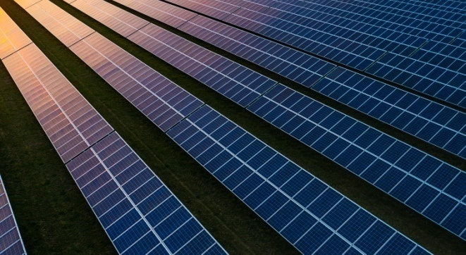
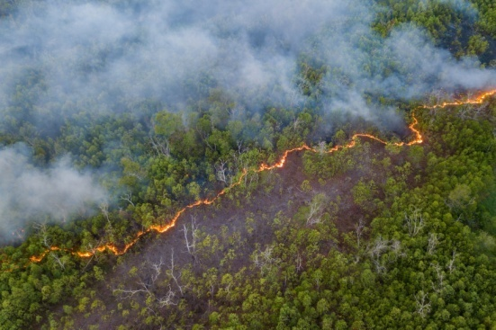
4. Description of Course 45
Small Wind Design and Operations (Term 4, Year 2)
48 Classroom Hours as 12 weeks x 6 periods / week
3 periods Tue. am and 3 Periods Thursday am
16 Lab hours as 6 Labs (Weeks 2, 3, 6, 7, 10, 11)
Marking Breakdown
20% Individual Tests 30% Individual Projects
40% Group Projects 10% Employability Skills

Slide 27
4. Description of Course 45
C 45; Small Wind Design and Operation
Examples of anticipated outcomes after course completion
Propose equipment in response to site assessment of potential demand, avail. wind resource, & site limitations
Design, layout, construction, and connections for project
Installation, testing, commission, operations and troubleshooting of project equipment at customer site

Slide 28
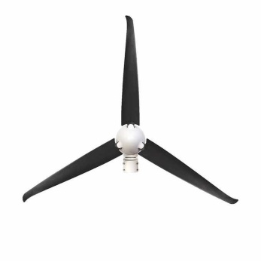
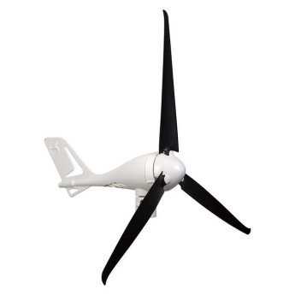
4. Description of Course 45
C 45; Small Wind Design & Operations
Sm Wind (in Calendar Table)
(T1) Understand fundamentals of wind systems
(T2) Indentify Small Wind (SW) system applications and uses
(T3) Understand the fundamentals of SM Turbines (incl. science, theory, and system components)

Slide 29
4. Description of Course 45
C 45; Small Wind Design & Operations
(T4) List considerations for towers,
foundations, and system installation
(T5) Prepare site assessment of available wind resource
(T6) Prepare site assessment of potential for a SW project
(T7) Size the small wind components

Slide 30
4. Description of Course 45
C 45; Small Wind Design & Operations
(T8) Identify operation, maintenance,
and trouble shooting procedures
(T9) Apply safety methods and best practices
(T10) Understand the impacts and challenges of small wind systems

Slide 31
4. Description of Course 45
From Learning Outcomes and Tasks
Task 01
Understand fundamentals of wind systems
Load & elec. bill analysis for sizing off grid systems
Relative efficiencies with larger sizes and scale
Wind speed / voltage / amps / kW-hr (e.g. for the 400W Wind Turbine used as lab equipment)
Off-grid applications / describe an On-grid system

Slide 32
4. Description of Course 45
From Learning Outcomes and Tasks
Task 02
Indentify Small Wind (SW) system applications & uses
End uses (e.g. electrical load reduction, remote or stand alone loads, telecommunications, water pumping, heating, transportation)
Market (e.g. residential, agricultural, commercial, industrial, educational, scale = 1 site or 2+ sites)
Q
Q

Slide 33
4. Description of Course 45
From Learning Outcomes and Tasks
Task 03
Understand the fundamentals of Small Wind Turbines (incl. science, theory, and system components)
Converting wind to electrical energy by turbines
Component descriptions and functions (e.g. Rotor, generator, and rotor over-speed protection devices)
Pros and cons of various wind turbine designs

Slide 34
4. Description of Course 45
From Learning Outcomes and Tasks
Task 03
Understand the fundamentals of Small Wind Turbines (incl. science, theory, and system components)
Converting wind to electrical energy by turbines
Component descriptions and functions (e.g. Rotor, generator, and rotor over-speed protection devices)
Pros and cons of various wind turbine designs

Slide 35
4. C45 Task 3 – Wind Turbines
Understand fundamentals of wind systems.
What is a wind system?
In this module a wind system is a complete wind generator and the balance of system components.

Slide 36
4. C45 Task 3 – Wind Turbines
First let’s take a look at a wind generator.
Instead of electricity turning blades like a fan to make wind, the wind turning the blades of a turbine, spins a generator, which creates electricity.

Slide 37
4. C45 Task 3 – Wind Turbines
What is wind?
It is a form of solar energy:
Sun heats the earth unevenly
Variations in the surface of the earth
Rotation of the earth

Slide 38
4. C45 Task 3 – Wind Turbines
Temperature differences cause wind currents.
Atmospheric pressure differences builds wind.
Hot air rising, cold air falling.

Slide 39
4. C45 Task 3 – Wind Turbines
Wind can provide torque through blades.
Torque can be used to rotate a mechanical shaft.
Shaft can drive pumps, gristmill, sawmill etc.
The word mill is used to describe the breaking of solid materials into smaller pieces by grinding, crushing, or cutting.

Slide 40
4. C45 Task 3 – Wind Turbines
A turbine is a machine for producing power in which a rotor is fitted with vanes or blades.
It is made to revolve by a fast-moving flow of water, steam, gas, air, or other fluid.
A rotor is the part of the generator that rotates.
Usually has magnets spinning past a stator.
Stator is stationary having wire wound into coils.

Slide 41
4. C45 Task 3 – Wind Turbines
A wind turbine uses blades exposed to the wind and allows a shaft with magnets to spin past coils of wire to produce electricity.
This is a basic description of a wind turbine.

Slide 42
4. C45 Task 3 – Wind Turbines
The wind turbine used in this course is the “Coleman 400-Watt Wind Turbine”
The manual is found in the drive containing other files for this course.
This turbine is made by Sunforce model 44444.
It is made to connect to and charge a 12-volt battery system.

Slide 43
4. Description of Course 45
From Learning Outcomes and Tasks
Task 04
List considerations for towers, foundations, and system installation
Pros and cons of 5 types of Towers
Foundation design (e.g. height, wind loading, soil type, turbine, connections to buildings / structures)
Site conditions affecting installation and methods

Slide 44
4. Description of Course 45
From Learning Outcomes and Tasks
Task 05
Prepare site assessment of available wind resource
Average annual wind speed, variability, and peak
General mapping (e.g. Belize) & local building code
Influences from site and micro-conditions
Peak loads and (automatic) equipment shut off

Slide 45
4. C45 Task 5 – Wind Resource
Wind is the movement of air current.
Wind has energy.
Wind has power.
Wind is used for sailing, drying clothes, etc.

Slide 46
4. C45 Task 5 – Wind Resource
How much wind does an area have?
A wind resource map will provide this information.
Wind maps have an average wind speed for a given period of time and at various elevations.
These resources are found at various websites.

Slide 47
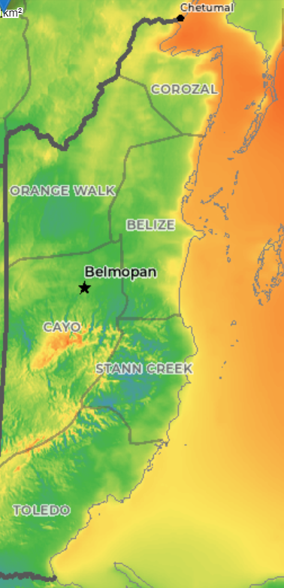
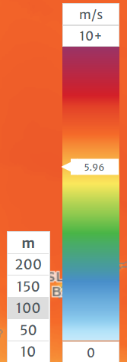
4. C45 Task 5 – Wind Resource
This map shows Belize from
1998 – 2017.
Measured at
100 meters.
https://globalwindatlas.info/en

Slide 48
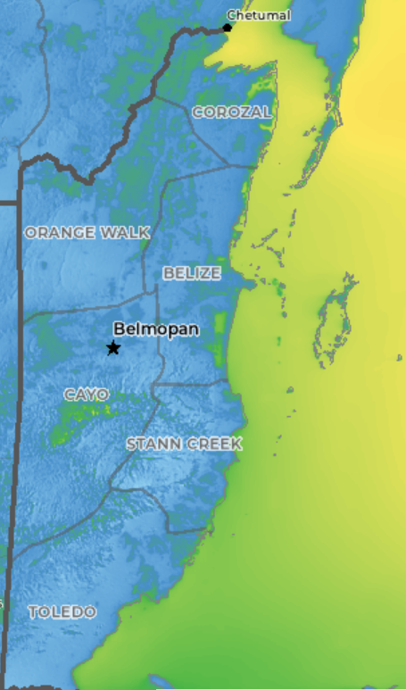
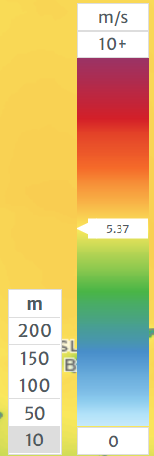
4. C45 Task 5 – Wind Resource
This map shows Belize from
1998 – 2017.
Measured at
10 meters.
https://globalwindatlas.info/en

Slide 49
4. C45 Task 5 – Wind Resource
Note that the higher the measurement is taken the greater the wind energy potential.
RETScreen has wind speeds in its database and can model the potential.
Just like the solar site assessment, wind site assessments need to be made.

Slide 50
4. C45 Task 5 – Wind Resource
Looking at a wind resource map it shows that the wind speed on average varies due to different geographic conditions such as:
Terrain differences
Bodies of water
Vegetation

Slide 51
4. Description of Course 45
From Learning Outcomes and Tasks
Task 06
Prepare site assessment of potential for a SW project
Setbacks (property line, right of ways, power and communications line routes and heights)
On site buildings, structures, trees, connections to battery or other energy storage
Building vs. ground mounted vs. mobile (e.g. ship)

Slide 52
4. Description of Course 45
From Learning Outcomes and Tasks
Task 07
Size the small wind components
Consider situations where small wind is not viable
Monthly wind speed for sizing off-grid systems
Characterize electrical demand load to be supported by stored Small Wind system output
Sizing SW system components for elec. demand

Slide 53
4. Description of Course 45
From Learning Outcomes and Tasks
Task 08
Identify operation, maintenance, and trouble shooting procedures
Trouble shooting (problem recognition, symptom observation, cause diagnosis, corrective action)
Inspection and maintenance activities and intervals
Testing equipment, meters, QA/QC, documentation

Slide 54
4. Description of Course 45
From Learning Outcomes and Tasks
Task 09
Apply safety methods and best practices
Electrical safety hazards (e.g. lock out / tag out)
Fall protection equipment and practices
Sequence and tasks for maintenance & inspection

Slide 55
4. C45 Small Wind Task 9 - Safety
Mechanical Hazard
Rotating blades present the most serious mechanical hazard.
The rotor blades are made of very strong thermoplastic.
At the tip, the blades may be moving at velocities over 15m/s.
At this speed, the tip of a blade is nearly invisible and can cause serious injury.
Under no circumstances should you install the turbine where a person could come in contact with moving rotor blades.

Slide 56
4. C45 Small Wind Task 9 - Safety
Electrical Hazard
The Coleman Wind Turbine is equipped with sophisticated electronics designed to provide protection from electrical dangers.
Please note that the inherent personal dangers from electrical current still exist, therefore caution should always be used when connecting this and other electrical devices.
Heat in a wiring system is often a result of too much current flowing through an undersized wire or through a bad connection

Slide 57
4. C45 Small Wind Task 9 - Safety
Important Safety Instructions
Read through this manual prior to assembly.
1) Place this instruction manual in a safe place for reference.
2) Wait until a calm day to install or perform maintenance on your Turbine.
3) Listen to your Turbine should you hear any mechanical noise, maintenance may be required, please contact Sunforce Products Customer Service.

Slide 58
4. C45 Small Wind Task 9 - Safety
4) After installation re-adjust and tighten the screws and bolts.
5) Adhere to proper grounding techniques as established by the NEC.
6) Your Coleman Wind Turbine must be installed in accordance with this manual and local and national building code. Incorrect installation may void your warranty.
7) Wind turbine blades spin at a potentially dangerous speed. Installation instructions must therefore be followed carefully and respected. Never approach a turbine in motion

Slide 59
4. Description of Course 45
From Learning Outcomes and Tasks
Task 10
Understand the impacts and challenges of small wind systems
Influence of local permitting and zoning regulations
Economic pay back period vs. evolving solar options
Adapting off-the-shelf units to site specific conditions (e.g. elec. demand and battery storage)

Slide 60
4. Description of Course 45
Marking Breakdown
20% Individual Tests
30% Individual Projects
40% Group Projects
10% Employability Skills

Slide 61
4. Description of Course 45
Marking Breakdown
20% Individual Tests (Examples)
Task 1 Understand fundamentals of wind systems
Task 2 Identify Small Wind (SW) system applications and uses
Task 4 List considerations for towers, foundations, and system installation

Slide 62
4. Description of Course 45
Marking Breakdown
30% Individual Projects (Examples)
Task 3 Understand fundamentals of Small Wind Turbines (incl. system components, science & theory)
Task 5 Prepare site assessment of available wind resource
Task 6 Prepare site assessment of the potential viability for a Small Wind project

Slide 63
4. Description of Course 45
Marking Breakdown
40% Group Projects (Examples)
Task 7 Size the small wind system components
Task 8 Identify operation, maintenance, and troubleshooting procedures
Task 9 Apply safety methods and best practices
Task 10 Understand the impacts and challenges of small wind systems

Slide 64
4. Description of Course 45
Marking Breakdown
10% Employability Skills (Examples)
Those used in ITVET Belize communications courses
Attendance
Timeliness
Attention to detail

Slide 65
5. Development of Course 45
Development of Course
From Theory to Practical Application
Elaborate on NABCEP Small Wind documentation
Elaborate on Coleman 400 W Manual
“Small group sessions” in 2023 on Course 45

Slide 66
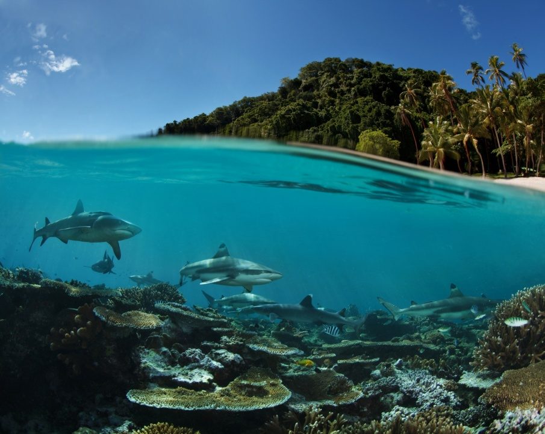
Summary
C45 Small Wind Design
And Operation
48 Classroom hours
16 Lab hours
12 Week Term 4, Year 2
Applied Science Courses in 2 year RE EE Program
What does “success” look like?
Master Plan Learning Outcomes and TDAPS
Description of Course 45 in Term 4 of Year 2
Development of Course 45
Elaborate on NABCEP and Coleman Turbine documents in other 2023 Sessions

Slide 67
For Today:
C45 Small Wind Design
and Operation
Instructor Comments?
Instructor Discussion?
Instructor Suggestions?
“Real World” Applications?

Slide 68
Questions?
Comments?
Suggestions?
Thank you

