Slide 1
Design and Implementation of Pilot of a TVET Renewable Energy Course
DELIVERABLE #5 - TRAINING COURSES & PROFESSIONAL DEVELOPMENT
Session 75 (31 March 2023) – Term 5 C53 – Economic Analysis of Energy Systems

Slide 2
For Today:
Renewable Energy and Energy Efficiency (RE EE) Program Overview
Description of Course 53 in Term 5 of Year 2
From TDAPS to Lesson Plans (incl. Master Plan, Pedagogical Materials)
Developing Course 53

Slide 3
C 53: Econ. Analysis of Ener. Syst.
Overview and Description
An introduction to the economic analysis of system scenarios and options having technical descriptions through the energy efficiency modeling, analysis, measurement and verification topics of earlier courses. Calculate and compare relative financial performance (e.g. “rate of return” and “payback period”) of reasonably developed and competing potential energy system options or scenarios.

Slide 4
C 53: Econ. Analysis of Ener. Syst.
C53 Course among other Energy Efficiency courses:
C13 Introduction to Energy Science
C23 Energy Modeling and Analysis
C42 Energy Efficiency Measurement and Verification
C53 Economic Analysis of Energy Systems
C62 Advanced Energy System Design

Slide 5
What does “success” look like?
For Employers and the “Energy Efficiency” part of Program:
Identification, selection, installation, operation, maintenance, of equipment and instruments
Interpretation, analysis, conclusions, and recommendations from measurement data results
Accounting for uncertainties, data gaps, and assumptions
Verbal, written, & digital communications skills – clients, residents, suppliers, partners, regulators, team members

Slide 6
C53 uses C42 Tech. Descriptions
C 42; Energy Efficiency Measurement and Verification
Examples of anticipated outcomes after course completion
Propose equipment, instruments, methods, and procedures for target data in an energy efficiency project
Calculate and compare relative financial performance (e.g. “rate of return” and “payback period”) of reasonably developed and competing potential energy system options or scenarios.

Slide 7
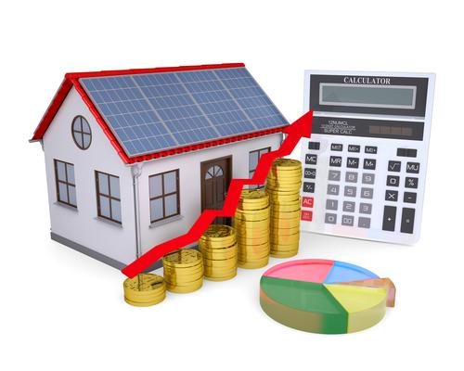
C 53: Econ. Analysis of Ener. Syst.
C 53: Econ. Analysis of Energy Systems
At a glance
For Energy System Scenarios A, B, C, and D (e.g. PV, Hot Water, Wind, and Efficiency), there is a net change in desired Energy (e.g. additionally produced or saved Watts) and a corresponding net change in costs (e.g. $$$ value of net change in Watts less scenario costs from design, construction, operations, & maintenance)
Which scenario has the best ratio of net $$$ / Watts?

Slide 8
1. Program Overview (Partners)
Belize National Energy Policy Goals
Inter-American Development Bank (ADB)
Belize Ministry of Education (MOE)
ITVET – Belize
Nova Scotia Community College (NSCC) Project Team

Slide 9
1. Program Overview (Project)
New Program Course Descriptions & Materials
Instructor Preparations & Professional Development
New Program Marketing and Promotion Support
Some New Lab Equipment
Implementation Plan
Capacity to “scale up” from Pilot Course

Slide 10
1. Program Overview (Courses)
2 Year (~32 Course) RE EE Program Overview
1st Year | Term 1 | Communi- cations 1 Comm 1 | Applied Math 1 Math 1 | Intro to Ener. Sci. Ener Sci | PV Applications PV Appl |  | Elec. and Circuits 1 Elec. Cir. 1 | Integrated Lab 1 Int Lab 1
 | Term 2 | Communi-cations 2 Comm 2 | Energy Model. and Analysis Ener M A | Electricity and Circuits 2 Elec. Cir. 2 |  | PV Grid Tied Design PV GT De |  | Integrated Lab 2 Int Lab 2
 | Term 3 | Communi- cations 3 Comm 3 | Applied Math 2 Math 2 | Solar Hot Water Systems Sol H W S |  | PV Solar Panel Installations PV Instal |  | Technical Drawing Tec Dwg
2nd Year | Term 4 | Audits 1 – Customer Relations Audits 1 | Energy Eff. Measure. & Verification E E M V | PV Stand Alone System Design PV SASD | PV Stand Alone Syst. Design PV SASD | PV Battery Based Installations PV Bat In |  | Sm. Wind Design & Operation Sm Wind
 | Term 5 | Projects and Comms 1 Pro Comm | Audits 2 – Load Analysis Audits 2 | Econ Analysis of Energy Systems Econ A E S |  | Elec. Codes and Regulations Elec C A R |  | Project Planning Proj Plan
 | Term 6 | Adv. Energy System Design AES Des | Final Project (Classroom) Fin Proj | Bus. Operations & Entrepreneurs. Bus O & E |  | PV Sys. Maint. & Operation PV M & O |  | Final Proj. (Lab) Fin Pro

Slide 11
1. Program Overview

Slide 12
1. Program Overview (Term 5 Courses)
January – March (10 Weeks)
Projects and Communications
Audits 02 – Load Analysis
Economic Analysis of Energy Systems
Electrical Codes and Regulations
Project Plan (for C 63)

Slide 13
C 53: Econ Analysis of Energy Systems
10 Week Term 5, Year 2 40 Classroom hours as 6 periods/wk. x 10 weeks (2 x Tue. am) + (2 x Tue. pm) + (2 x Wed. am) 0 New Lab hours
Marking Breakdown 25% Individual Tests 35% Individual Assign. 30% Group Projects 10% Employability Skills

Slide 14
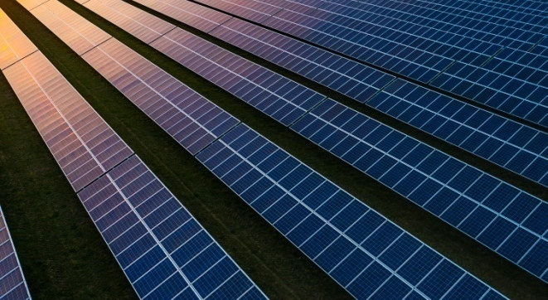
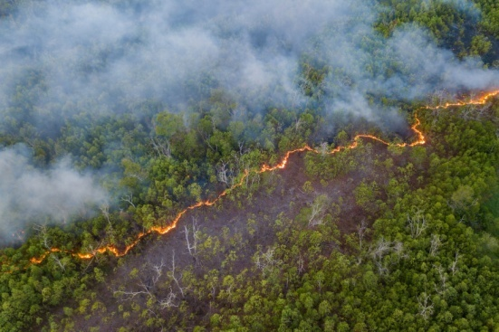
C 53: Econ. Analysis of Ener. Syst.
C 53: Econ. Analysis of Energy Systems
Econ AES (in Calendar Table)
(T1) Introduce concept of interest, investment, & loans
(T 2) Introduce the concept of the time value of money
(T 3) Identify the present and future value of single and repeated payments for different interest rates

Slide 15
C 53: Econ. Analysis of Ener. Syst.
C 53: Econ. Analysis of Energy Systems
Econ AES (in Calendar Table)
(T 4) Identify the rate of return for energy systems and energy efficiency measures
(T 5) Prepare and rank the relative benefit of potential energy system or efficient improvement decisions

Slide 16
C 53: Econ. Analysis of Ener. Syst.
C 53: Econ. Analysis of Energy Systems
Examples of anticipated outcomes after course completion
Develop reasonable financial project scenarios for potential energy systems (e.g. PV, small wind, solar hot water, energy efficiencies)
Calculate scenario “rate of return” & “payback period”
Calculate & compare relative financial performance of competing potential energy system options / scenarios

Slide 17
C 53: Econ. Analysis of Ener. Syst.
From Learning Outcomes and Tasks
Task 01
Introduce concept of interest, investment, & loans
Interest – the “rent” on borrowed use of others’ $$
Investment – scenario option with risks to spend $$ and receive $$$ or $ or zero or less ... over time
Loans – principal, interest, time, payments, security

Slide 18
C 53: Econ. Analysis of Ener. Syst.
From Learning Outcomes and Tasks
Task 02
Introduce the concept of the time value of money
Present Worth (e.g. in 2023 of sum of annual $1000 payments over 5 years from 2024 - 2028)
Future Worth (e.g. in 2028 of sum of annual $1000 payments over 5 years from 2024 - 2028)
Account for varying interest and inflation rates

Slide 19
C 53: Econ. Analysis of Ener. Syst.
From Learning Outcomes and Tasks
Task 03
Identify the present and future value of single and repeated payments for different interest rates
Present & Future Worth - single & series payments
Account for fixed and for varying interest rates
Account for stable and for varying inflation rates

Slide 20
C 53: Econ. Analysis of Ener. Syst.
From Learning Outcomes and Tasks
Task 04
Identify the rate of return for energy systems and energy efficiency measures
For scenario options (e.g. A, B, C, D) calculate ratios of net $$$ per net change in Watts due to scenario
Calculate when net $$ revenue pays Investment $$
Compare to option of $$ staying in a bank account

Slide 21
C 53: Econ. Analysis of Ener. Syst.
From Learning Outcomes and Tasks
Task 05
Prepare and rank the relative benefit of potential energy system or efficient improvement decisions
For scenario options (e.g. A, B, C, D) compare and rank based on ratios of net $$ per change in Watts
Rank by lifecycle net $ revenue to Investment $
Account for risks of varying interest & inflation rates

Slide 22
2. Description of Course 53
Marking Breakdown
25% Individual Tests
35% Individual Projects
30% Group Projects
10% Employability Skills

Slide 23
2. Description of Course 51
Marking Breakdown
25% Individual Tests (Examples)
9% Task 1 Introduce ... interest, investment, & loans
8% Task 2 Introduce concept ... time value of money
8 % Task 3 ... present & future value of … payments for different interest rates
0% Task 4 Identify the rate of return . . . for scenarios
0% Task 5 ... rank the relative benefit ... of (options)

Slide 24
2. Description of Course 53
Marking Breakdown
35% Individual Projects (Examples)
0% Task 1 Introduce . . . interest, investment, & loans
5% Task 2 Introduce concept ... time value of money
15% Task 3 ... present & future value of … payments for different interest rates
10% Task 4 Identify the rate of return ... for scenarios
5% Task 5 ... rank the relative benefit ... of (options)

Slide 25
2. Description of Course 51
Marking Breakdown
30% Group Projects (Examples)
0% Task 1 Introduce . . . interest, investment, & loans
0% Task 2 Introduce concept ... time value of money
0% Task 3 ... present & future value of … payments for different interest rates
10% Task 4 Identify the rate of return ... for scenarios
20% Task 5 ... rank the relative benefit ... of (options)

Slide 26
2. Description of Course 53
Marking Breakdown
10% Employability Skills (Examples)
Instructor selected (e.g. other ITVET Belize courses)
Attendance
Timeliness
Attention to detail

Slide 27
2. Description of Course C53
C 51: Projects & Communications
Instructor Comments?
Instructor Discussion?
Instructor Suggestions?
“Real World” Applications?

Slide 28
3. From TDAPs to Lesson Plans
Technical Delivery and Assessment Plan (TDAP) for each ITVET course includes a Delivery Schedule section
Delivery Schedule includes places for Instructor to note the intended Teaching Method and Promotional Action
Master Plan (Learning Outcomes)
Pedagogical Materials Document includes
Teaching Methods (TM) and Promotional Actions (PA)

Slide 29
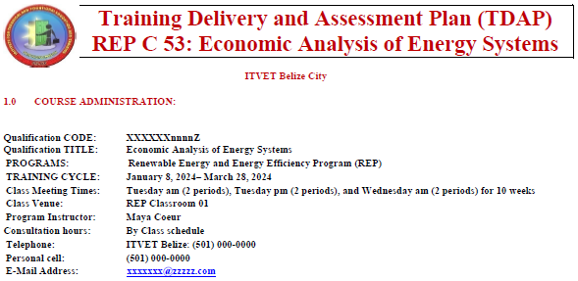
3. From TDAPs to Lesson Plans
Typical at ITVET
For all courses
By all Instructors
For each term
Training Delivery and Assessment Plan
Profile of the Trainee / Portfolio of the Trainee
Program Policies & Regulations / Technology Requirements
Instructional Methods / Modes (Face to Face and Online)
Resources (Technical; Underpinning Knowledge and Skills)
Delivery Schedule (week / Instructional Methods (IM)
Practical Grading Criteria and Theoretical Grading Criteria

Slide 30
3. From TDAPs to Lesson Plans
Typical at ITVET
For all courses
By all Instructors
For each term
Delivery Schedule (The basis for the Lesson Plans!?)
For each Week or ?? week period, the Course Outline Topic (e.g. Present worth of series of payments) and Tasks
Instructional Methods (IM) (e.g. Collaborative Discussions)
Promotional Action (PA) (e.g. Practice work sheets, games)
Assessment Method (e.g. Test 1, Assignment 1, Project 1)
Resources (e.g. Textbook, Videos, Worksheet, Powerpoint)

Slide 31
3. From TDAPs to Lesson Plans
From Master Plan, Learning Outcomes 8, 9. and 10
8 – Impact of renewable energy on society and the environment
9 – Ethics and equity
10 – Economics and project management

Slide 32
3. From TDAPs to Lesson Plans
Master Plan Learning Outcome 8 – Impact of Renewable Energy (RE) on society and the environment
An ability to analyze aspects of RE activities. This includes an understanding of the interactions that RE projects have with the economic, societal, health, safety, legal, and cultural aspects of society; the uncertainties in the prediction of such interactions; and sustainable design and development, and environmental stewardship.

Slide 33
3. From TDAPs to Lesson Plans
Master Plan Learning Outcome 9 – Ethics and equity
An ability to apply ethics, accountability, and equity.

Slide 34
3. From TDAPs to Lesson Plans
Master Plan Learning Outcome 10 – Economics and project management
An ability to appropriately incorporate economics and business practices including project, risk, and change management into the practice of renewable energy, and to understand limitations.

Slide 35
3. From TDAPs to Lesson Plans
Performance Goals of a Pedagogical Materials Document
Identify materials that support new course delivery
Have course content based on evidence based approaches that emphasize Competence Based Education and Training (CBET) principles
Have course content based on current labour market needs and necessary skill sets

Slide 36
3. From TDAPs to Lesson Plans
Pedagogical Materials Document content includes:
Instruction Methods = Pedagogical Approaches (PA):
Constructivist
Collaborative
Integrative
Reflective
Inquiry
Other

Slide 37
3. From TDAPs to Lesson Plans
Promotional Activities (PA) of Instruction Methods:
Contact between students and instructors
Reciprocity and cooperation among students
Active learning
Prompt feedback
Emphasis on time on task
High expectations
Respect for diverse talents and ways of learning

Slide 38
3. From TDAPs to Lesson Plans
Competency Based Assessment Tool of Participants:
Development for ITVET Belize RE / EE Program
Description
Application
Assessment
Use of applicable Caribbean Vocational Qualifications (CVQ)
Use of applicable NABCEP materials (North American Based Certified Energy Practitioners)

Slide 39
3. From TDAPs to Lesson Plans
Community Performance Goals:
Development closes skills gap in renewable energies in BZ
Be responsive to current labour market needs
Provide learners with the necessary skills set
Practical and hands on learning using equipment and other tools
A continuous industry attachment component

Slide 40
3. From TDAPs to Lesson Plans
Documents
Technical Delivery and
Assessment Plan (TDAP)
Master Plan (Outcomes)
Pedagogical Materials
Lesson Plans
Comments? Discussions? Suggestions? “Real World”?
What would be most helpful, for an Instructor new to preparing Lesson Plans at ITVET Belize?
Experienced ITVET Belize Instructor recommendations . . . ?
Please contact Cameron.Ells@NSCC.ca

Slide 41
4. Development of Course 53
Development of Course
From Theory to Practical Application
Next time in Session 76 (2023.04.21) – Example text for potential Tests, Assignments, and Projects
Examples of digital references and templates
Review suggested DRAFT TDAP for C53
“Small group sessions” in 2023 on Course 53

Slide 42
Summary
C53 Projects & Communications
40 Classroom hours
0 Lab hours
10 Week Term 5, Year 2
Renew. Energy / Energy Efficiency Program Overview
Description of Course 53 in Term 5 of Year 2
From TDAPS to Lesson Plans (incl. Master Plan, Pedagogical Materials)
Development of Course 53
Session 76 examples of Test, Assignment and Project text
Examples of digital references (PDF, Excel, Word) & TDAP

Slide 43
For Today:
C53 Projects & Communications
Instructor Comments?
Instructor Discussion?
Instructor Suggestions?
“Real World” Applications?

Slide 44
Questions?
Comments?
Suggestions?
Thank you

