Slide 1
Design and Implementation of Pilot of a TVET Renewable Energy Course
DELIVERABLE #5 - TRAINING COURSES & PROFESSIONAL DEVELOPMENT
Session 78 (28 April 2023) – Term 5 C51 – Projects and Communications

Slide 2
For Today:
Course C51 within RE Program, and Description, from 2023.03.17 session.
Draft TDAP for Course 51 in Term 5 of Year 2
Example text for Tests, Assignments and Projects
Course Materials and 3rd session on 2024.05.26

Slide 3
From 2023.03.17 for C51:
Renewable Energy and Energy Efficiency (RE EE) Program Overview
Description of Course 51 in Term 5 of Year 2
From TDAPS to Lesson Plans (incl. Master Plan, Pedagogical Materials)
Developing Course 51

Slide 4
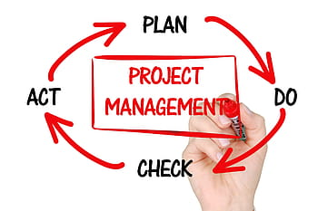
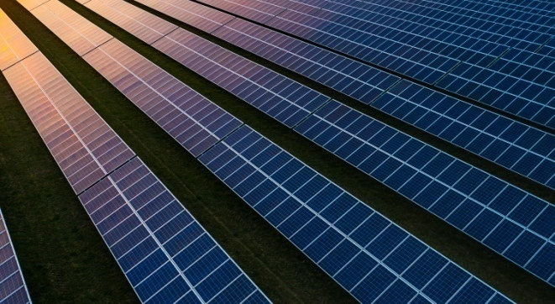
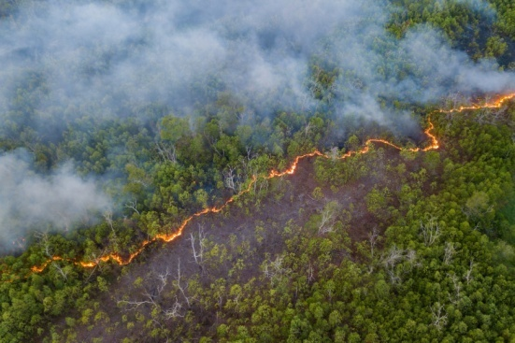
1. From 2023.03.17 for C51
Development of Course
From Theory to Practical Application
Next week’s Session 73 (2023.03.24) – Example text for potential Tests, Assignments, and Projects
Examples of digital references and templates
Review suggested DRAFT TDAP for C51
“Small group sessions” in 2023 on Course 51

Slide 5
C 51: Projects & Communications
Overview and Description
An introduction to project management is combined with applied communications documents (e.g. proposal, schedule, plan, and budget). Practical methods are applied to track effectiveness at meeting project performance goals (e.g. quality, time, budget, safety) and to manage changes in the use of available resources (e.g. people, equipment, time, $$$) to achieve desired performance goals.

Slide 6
1. Program Overview (Courses)
2 Year (~32 Course) RE EE Program Overview
1st Year | Term 1 | Communi- cations 1 Comm 1 | Applied Math 1 Math 1 | Intro to Ener. Sci. Ener Sci | PV Applications PV Appl |  | Elec. and Circuits 1 Elec. Cir. 1 | Integrated Lab 1 Int Lab 1
 | Term 2 | Communi-cations 2 Comm 2 | Energy Model. and Analysis Ener M A | Electricity and Circuits 2 Elec. Cir. 2 |  | PV Grid Tied Design PV GT De |  | Integrated Lab 2 Int Lab 2
 | Term 3 | Communi- cations 3 Comm 3 | Applied Math 2 Math 2 | Solar Hot Water Systems Sol H W S |  | PV Solar Panel Installations PV Instal |  | Technical Drawing Tec Dwg
2nd Year | Term 4 | Audits 1 – Customer Relations Audits 1 | Energy Eff. Measure. & Verification E E M V | PV Stand Alone System Design PV SASD | PV Stand Alone Syst. Design PV SASD | PV Battery Based Installations PV Bat In |  | Sm. Wind Design & Operation Sm Wind
 | Term 5 | Projects and Comms 1 Pro Comm | Audits 2 – Load Analysis Audits 2 | Econ Analysis of Energy Systems Econ A E S |  | Elec. Codes and Regulations Elec C A R |  | Project Planning Proj Plan
 | Term 6 | Adv. Energy System Design AES Des | Final Project (Classroom) Fin Proj | Bus. Operations & Entrepreneurs. Bus O & E |  | PV Sys. Maint. & Operation PV M & O |  | Final Proj. (Lab) Fin Pro

Slide 7
1. Program Overview

Slide 8
1. Program Overview (Term 5 Courses)
January – March (10 Weeks)
Projects and Communications
Audits 02 – Load Analysis
Economic Analysis of Energy Systems
Electrical Codes and Regulations
Project Plan (for C 63)

Slide 9
Course 51: Projects and Comm.
10 Week Term 5, Year 2 53.3 Classroom hours as 8 periods/wk x 10 weeks (3 x Mon. am) + (2 x Mon. pm) + (3 x Wed. am) 0 New Lab hours
Marking Breakdown 25% Individual Tests 35% Individual Assign. 30% Group Projects 10% Employability Skills

Slide 10
1. Description of Course C51
C 51; Projects and Communications
Pro Com 3 (in Calendar Table)
Introduce project management tools for achieving desired project performance goals (e.g. safety, budget, time, and quality)
Communicate project management messages to clients (e.g. proposal, plan, revision, budget, schedule, estimate, quote, change order, invoice)
Apply to Course C 55 Project Plan (for C63) documents

Slide 11
1. Description of Course C51
C 51; Projects and Communications
Tasks
(T 1) Identify project planning steps and documentation
(T 2) Identify the tasks required for effective project development and management
(T 3) Identify methods project managers and their teams use to effectively track and control projects (e.g. quality, time, budget, safety)

Slide 12
1. Description of Course C51
C 51; Projects and Communications
Tasks
(T 4) Identify available techniques and tools employed in industry (e.g. potential Belize RE project employers) to provide good project planning and management
(T 5) Apply logic to sequence the individual tasks that define and constrain a successful project
(T 6) Prepare and produce project planning documents (e.g. proposal, schedule, plan, and budget)

Slide 13
1. Description of Course C51
C 51; Projects and Communications
Tasks
(T 7) Employ standard estimating and scheduling procedures
(T 8) Effectively communicate project status and goals to supervisors and to clients or customers

Slide 14
1. Description of Course C51
C 51: Projects and Communications
Examples of anticipated outcomes after course completion
Apply project planning procedures into the course C 55 Project Plan documents (for C 63 Final Project)
Track effectiveness at meeting project performance goals (e.g. quality, time, budget, safety) and manage changes in the use of available resources (e.g. people, equipment, time, $$$) to achieve desired performance goals
Evaluate and review technical demonstrations by others (e. g. “How to ... “ or “What is different for this project ... “)

Slide 15
1. Description of Course C51
From Learning Outcomes and Tasks
Task 01
Identify Project Planning Steps and Documentation
Plan – Go – Check – Act
Initiation; Planning; Execution; Monitoring / controlling; and Closing
Customers; Competitors; Capabilities; Cost; Channels; Communication; and Coordination

Slide 16
1. Description of Course C51
From Learning Outcomes and Tasks
Task 02
Identify the tasks required for effective project development and management
Project team – direction, management, motivation
Project Plan – overall and at detailed stages
Risk management – safety, business, technical
Appropriate knowledge for realistic circumstances

Slide 17
1. Description of Course C51
From Learning Outcomes and Tasks
Task 03
Identify methods project managers and their teams use to effectively track and control projects
Performance goals - quality, time, budget, & safety
Physical, functional, service, financial, legal, social
Tracking – performance; hours; $$$; incidents
Variances from plan, schedule, budget

Slide 18
1. Description of Course C51
From Learning Outcomes and Tasks
Task 04
Identify available techniques and tools employed in industry (e.g. potential Belize RE project employers) to provide good project planning and management
Inspired by potential Belize based, RE projects
Techniques that do not rely on digital tools
Using digital tools that are expected to be available

Slide 19
1. Description of Course C51
From Learning Outcomes and Tasks
Task 05
Apply logic to sequence the individual tasks that define and constrain a successful project
Logic, logical ways, and logistics
Exercises on an “best order” for scenario of tasks
Proposing appropriate sequencing of tasks (e.g. technical project; safety; major family meal)

Slide 20
1. Description of Course C51
From Learning Outcomes and Tasks
Task 06
Prepare and produce project planning documents (e.g. proposal, schedule, plan, and budget)
Components for Belize inspired project scenarios
Individual and Group course projects
Exercises that are technical and otherwise

Slide 21
1. Description of Course C51
From Learning Outcomes and Tasks
Task 07
Employ standard estimating & scheduling procedures
Inspired by potential Belize based, RE projects
Scheduling (e.g. Critical Path and bar charts)
Estimating (e.g. spreadsheet style) quantities and dollars, as planned and as regularly revised

Slide 22
1. Description of Course C51
From Learning Outcomes and Tasks
Task 08
Effectively communicate project status and goals to supervisors and to clients or customers
Project Documents – plan, schedule, budget
Project Updates – documented, verbal, and digital
Questions and Answers; Changes; Uncertainties

Slide 23
2. Description of Course 51
Marking Breakdown
25% Individual Tests
35% Individual Projects
30% Group Projects
10% Employability Skills

Slide 24
1. Description of Course 51
Marking Breakdown
25% Individual Tests (Examples)
4% Task 1 Identify project planning steps & doc.’s
4% Task 2 Identify tasks required for effective project development and management
12 % Task 3 Identify methods … to effectively track and control projects (e.g. quality, time, budget, safety)
5% Task 4 Identify available techniques and tools …

Slide 25
1. Description of Course 51
Marking Breakdown
35% Individual Projects (Examples)
3% Task 5 Apply logic to sequence … individual tasks
20% Task 6 Prepare and produce planning documents (e.g. proposal, schedule, plan, budget)
4% Task 7 Employ standard estimating and scheduling procedures
8% Task 8 Effectively communicate status & goals ...

Slide 26
1. Description of Course 51
Marking Breakdown
30% Group Projects (Examples)
4% Task 5 Apply logic to sequence … individual tasks
16% Task 6 Prepare and produce planning documents (e.g. proposal, schedule, plan, budget)
4% Task 7 … Estimating & scheduling procedures
6% Task 8 Effectively communicate status & goals ...

Slide 27
1. Description of Course 51
Marking Breakdown
10% Employability Skills (Examples)
Those used in ITVET Belize communications courses
Attendance
Timeliness
Attention to detail

Slide 28
1. Description of Course C51
C 51: Projects & Communications
Instructor Comments?
Instructor Discussion?
Instructor Suggestions?
“Real World” Applications?

Slide 29
2. Draft C51 TDAP Review
Technical Delivery and Assessment Plan (TDAP) for each ITVET course includes a Delivery Schedule section
Delivery Schedule includes places for Instructor to note the intended Teaching Method and Promotional Action
Master Plan (Learning Outcomes)
Pedagogical Materials Document includes
Teaching Methods (TM) and Promotional Actions (PA)

Slide 30
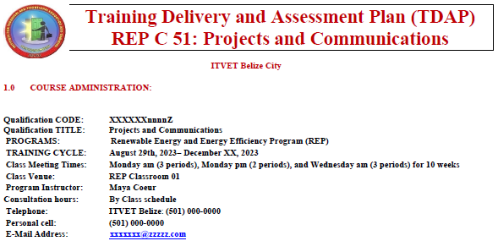
2. Draft C51 TDAP Review
Typical at ITVET
For all courses
By all Instructors
For each term
Training Delivery and Assessment Plan
Profile of the Trainee / Portfolio of the Trainee
Program Policies & Regulations / Technology Requirements
Instructional Methods / Modes (Face to Face and Online)
Resources (Technical; Underpinning Knowledge and Skills)
Delivery Schedule (week / Instructional Methods (IM)
Practical Grading Criteria and Theoretical Grading Criteria

Slide 31
2. Draft C51 TDAP Review
Typical at ITVET
For all courses
By all Instructors
For each term
Delivery Schedule (The basis for the Lesson Plans!?)
For each Week or 7 week period, the Course Outline Topic (e.g. Planning Documents) and Tasks (e.g. Budget)
Instructional Methods (IM) (e.g. Collaborative Discussions)
Promotional Action (PA) (e.g. Practice work sheets, games)
Assessment Method (e.g. Test 1, Assignment 1, Project 1)
Resources (e.g. Textbook, Videos, Worksheet, Powerpoint)

Slide 32
3. Example Text for Student Work
From C51 Student Work Examples, draft example text for:
4 – Individual Tests
5 – Individual Assignments / Projects
4 – Group Projects
(Refer to 14 page, Version 1, PDF, 2023.04.28)

Slide 33
4. Course Materials for 2024.05.26
Documents
Technical Delivery and
Assessment Plan (TDAP)
Master Plan (Outcomes)
Pedagogical Materials
Lesson Plans
Comments? Discussions? Suggestions? “Real World”?
What would be most helpful, for an Instructor new to preparing Lesson Plans at ITVET Belize?
Experienced ITVET Belize Instructor recommendations . . . ?
Please contact Cameron.Ells@NSCC.ca

Slide 34
4. Course Materials for 2024.05.26
Development of Course
From Theory to Practical Application
Next C51 Session 88 (2023.05.26) – Examples of Plans, Schedules, Budgets, and other documents
Examples of digital references and templates
“Small group sessions” in 2023 on Course 51

Slide 35
Summary
C51 Projects & Communications
53.3 Classroom hours
0 Lab hours
10 Week Term 5, Year 2
Course C51 Description, Marking and place within Renew. Energy / Energy Efficiency Program Overview
Draft Version 1 TDAP for Course C51
Example text for Tests, Assignments and Projects
Development of Course 51
Session 71 2023.03.17 Intro., Description and Marking
Session 78 examples of Test, Assignment and Project text
Session 88 2023.05.26 plus “Small Group” sessions

Slide 36
Questions?
Comments?
Suggestions?
Thank you

