Slide 1
Design and Implementation of Pilot of a TVET Renewable Energy Course
DELIVERABLE #5 - TRAINING COURSES & PROFESSIONAL DEVELOPMENT

Slide 2
Battery Based PV
This module introduces Battery Based Installations
The outcomes will be the following:
Battery handling / Safety
Receiving New Batteries from Vender
Connections
Racking / Boxes
ESS (Energy Storage System)
Maintenance

Slide 3
Battery Based PV
An assumption for this course is that the Renewable lab on campus will be available for teaching as well as a classroom.
This course is hands on intense.
The learners will build a living lab to monitor how the flooded lead acid batteries perform on a daily basis.

Slide 4
Battery Based PV
First thing to know about batteries is they are an energy source.
Depending on their size they can produce lethal energy.
Treat them as if they are an explosive.

Slide 5
Battery Based PV
Batteries have a very low internal resistance.
If short circuited across the terminals typically, within the first few microseconds no current flow is measured.
After a few milliseconds the current starts to flow and will rapidly increase to a peak before falling back and eventually reducing to zero.

Slide 6
Battery Based PV
This short circuit current can reach a few thousand amps.
The current will continue to fall and in some cases, may flow for several hours before reaching zero.
The most common event that causes this short circuit is the handling of tools and equipment.

Slide 7
Battery Based PV
The handling of wrenches is very important when working on the terminals.
Insulated wrenches that are tied to the workers arm help reduce accidental contact across terminals or to ground.
Making sure that the voltmeter is on volts and not on amps or ohms is a common mistake.

Slide 8
Battery Based PV
Installing jumpers or bars between batteries can also lead to the shorting of the battery.
Careful attention to the placement of theses will reduce the potential for an accidental short of the battery.

Slide 9
Battery Based PV
Battery chemistry must be understood from a safe handling point of view.
Manufacturers provide the necessary information in the form of safety data sheets (SDS).
The next few slides are an example of one and the information relevant for the safe handling of the battery.

Slide 10
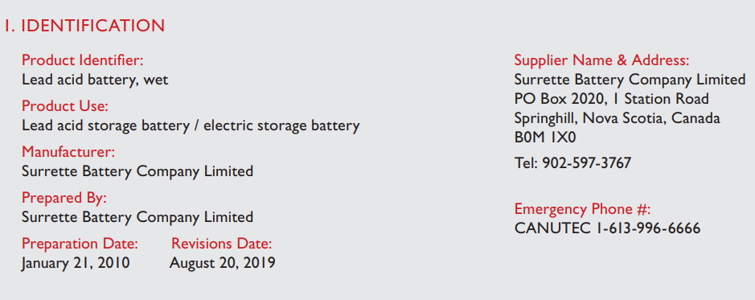
Battery Based PV
A Safety Data Sheet (SDS) contains information about the battery and precautions that need to be taken to handle the battery.
Rolls provides one for their flooded batteries.
Rolls Battery

Slide 11
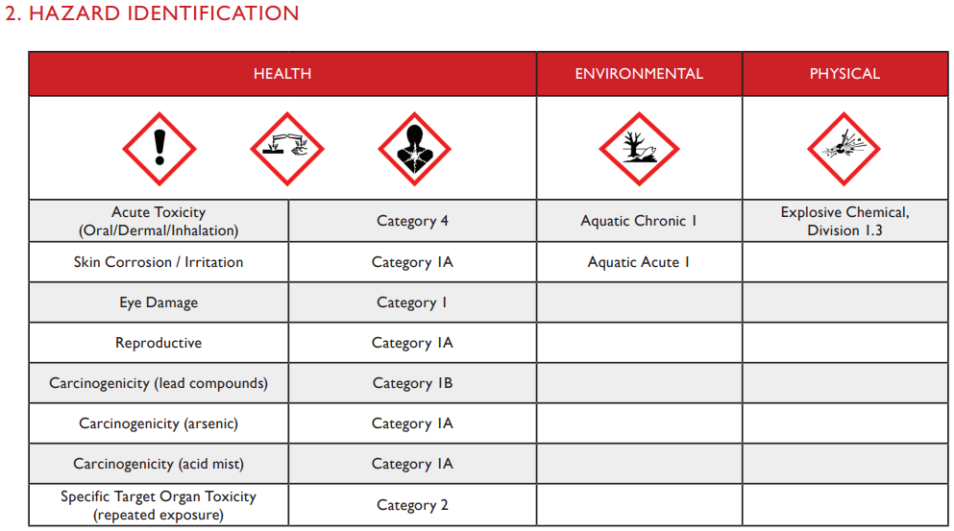
Battery Based PV
Category numbers:
Rolls Battery

Slide 12
Battery Based PV
The Category is usually a number (1-4)
Or letter (A, B, C)
1 indicates a greater hazard category than 2,
A is a greater hazard than B.
Some of the numeric categories have subcategories, so Class 2A is more hazardous than Class 2B, for example.

Slide 13
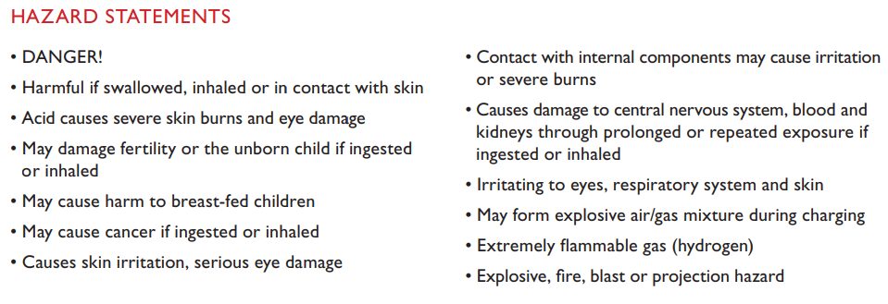
Battery Based PV
SAFETY DATA SHEET – FLOODED LEAD-ACID BATTERY
Rolls Battery

Slide 14
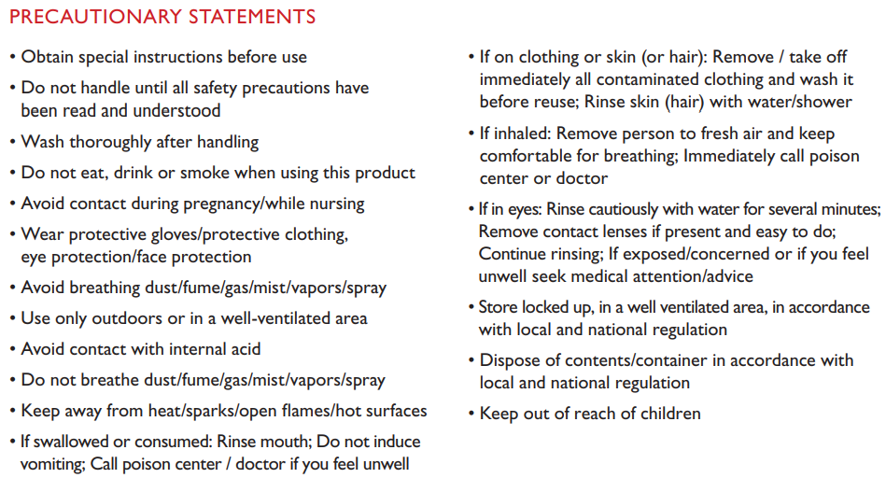
Battery Based PV
SIGNAL WORD: DANGER!
Rolls Battery

Slide 15
Battery Based PV
COMPOSITION / INFORMATION ON INGREDIENTS
A CAS number stands for Chemical Abstract Services.
CAS numbers are assigned to a chemical substance.
Rolls Battery

Slide 16
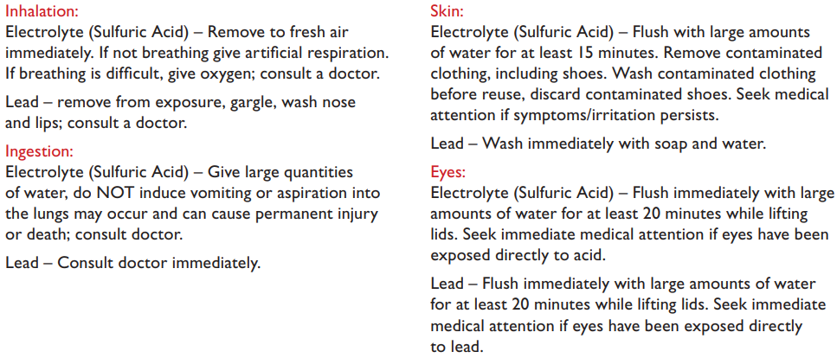
Battery Based PV
FIRST-AID MEASURES
Rolls Battery

Slide 17
Battery Based PV
Other headings in the SDS are:
FIRE-FIGHTING MEASURES
ACCIDENTAL RELEASE MEASURES
HANDLING AND STORAGE
EXPOSURE CONTROLS / PERSONAL PROTECTION
PHYSICAL AND CHEMICAL PROPERTIES
STABILITY AND REACTIVITY
TOXICOLOGICAL INFORMATION
Rolls Battery

Slide 18
Battery Based PV
Other headings in the SDS are:
ECOLOGICAL INFORMATION
DISPOSAL CONSIDERATIONS
TRANSPORT INFORMATION
REGULATORY INFORMATION
OTHER INFORMATION
Rolls Battery

Slide 19
Battery Based PV
If there is a SDS for a product it must be read and understood before using.
Normally the SDS are put in a binder and left with the client / system.
A copy is kept at the workplace for when service work needs to be done on the equipment in the field.

Slide 20
Battery Based PV
PPE (Personal Protective Equipment) is mandatory when working on batteries.
Depending on the type of battery, other PPE is required.
Manufacturers provide an installation manual for the safe handling of their batteries.

Slide 21
Battery Based PV
The FULLRIVER and Rolls manuals provide the following handling guidelines.
The following slides are taken from the manufacturer's installation guides.

Slide 22
Battery Based PV
Before installing your Fullriver battery, please adhere to the following safety guidelines and make sure that you have the proper equipment for installation, operation, and diagnostic testing.
SAFETY PROTECT YOURSELF AND PROTECT YOUR BATTERY
Wear protective gear, including gloves, when handling a battery.
Install and remove a battery using the lifting handles provided.

Slide 23
Battery Based PV
When working on or near flooded batteries the minimum PPE is:
Face shield / goggles
Gloves
Apron
An eyewash station is mandatory in some jurisdictions.

Slide 24
Battery Based PV
Rolls battery company has a YouTube channel.
Watch this video and get a feel for how to maintain a flooded battery.
It is also good source of basic battery terminalogy.
Rolls Maintenance Video
https://www.youtube.com/watch?v=O2dg4v-5--A

Slide 25
Battery Based PV
Use a wrench / socket with a rubber coated handle for installing, tightening, or removing battery connections.
Do not place any objects on top of a battery.
Do not smoke near a battery.

Slide 26
Battery Based PV
Keep flames, sparks and metal objects away from a battery.
Charge batteries in a ventilated area - although AGM and Gel batteries typically do not release gas.
The safety valve may open to alleviate excess pressure if the battery is over-charged.

Slide 27
Battery Based PV
Sealed Cell or Battery.
A cell or battery that has no provision for the routine addition of water or electrolyte or for external measurement of electrolyte specific gravity.
Some cells that are considered to be sealed under conditions of normal use, such as valve-regulated lead acid or some lithium cells, contain pressure relief valves.

Slide 28
Battery Based PV
From Rolls:
EQUIPMENT & SAFE HANDLING PROCEDURE
Goggles, rubber gloves & rubber boots
Distilled water
Baking soda, soda ash (to neutralize battery acid)

Slide 29
Battery Based PV
To prevent injury, always wear acid-resistant clothing, PVC gloves, goggles and rubber boots.
Flooded batteries must be maintained in an upright position at all times.
Always have plenty of water and baking soda on hand in the event of an acid spill during transport.

Slide 30
Battery Based PV
INSPECTION (Rolls):
When receiving shipment of your batteries, it is important to thoroughly inspect each pallet, battery and packaging.
Before signing acceptance of the shipment, remove the shrink-wrap from the pallet and inspect each battery for damage (i.e. cracks, dents, punctures, deformations, acid leaks or other visible abnormalities).

Slide 31
Battery Based PV
In the event of a suspected leak or damage, do not accept the shipment.
Contact your battery retailer or Rolls Battery to determine whether the batter(ies) require replacement.
Battery shipments which are known to be damaged, but accepted, will not be replaced under the terms of Rolls Battery manufacturer warranty.

Slide 32
Battery Based PV
QUICK CHECK LIST (Rolls)
SHIPPING/RECEIVING (MUST INSPECT PRIOR TO DRIVER RELEASE!)
All parts are included
No acid spill
No visual damage to the batteries
Verify electrolyte levels (Flooded)

Slide 33
Battery Based PV
INSTALLATION (Rolls)
Protective equipment should be worn
All electrical components should be turned off
Acid spill cleanup material should be readily available

Slide 34
Battery Based PV
PROVISIONS AGAINST ELECTROLYTE HAZARD
ELECTROLYTE AND WATER
Electrolyte used in lead-acid batteries is an aqueous solution of sulfuric acid.
Electrolyte used in NiCd and NiMH batteries is an aqueous solution of potassium hydroxide.
Distilled or demineralized water is used when topping up the cells.

Slide 35
Battery Based PV
PROTECTIVE CLOTHING (Rolls)
In order to avoid personal injury from electrolyte splashes when handling electrolyte and/or vented cells or batteries, protective clothing shall be worn, such as
− protective glasses or face shields,
− protective gloves and aprons.
In the case of valve-regulated or gastight sealed batteries, at least protective glasses and gloves shall be worn.

Slide 36
Battery Based PV
ACCIDENTAL CONTACT, "FIRST AID“ (Rolls)
GENERAL
Acid and alkaline electrolytes create burns in eyes and on the skin.
A source of clean water, from tap or a dedicated sterile reservoir, shall be provided in the vicinity of the battery under charging or maintenance for removing electrolyte splashed onto body parts.

Slide 37
Battery Based PV
ACCIDENTAL CONTACT, "FIRST AID“ (Rolls)
EYE CONTACT
In the event of accidental contact with electrolyte, the eyes shall be immediately flooded with large quantities of water for an extended period of time.
In all cases immediate medical attention shall be obtained.

Slide 38
Battery Based PV
ACCIDENTAL CONTACT, "FIRST AID“ (Rolls)
SKIN CONTACT
In the event of accidental skin contact with electrolyte, the affected parts shall be washed with large quantities of water or with adequate neutralizing solutions.
If irritation of skin persists medical attention shall be obtained.

Slide 39
Battery Based PV
BATTERY ACCESSORIES AND MAINTENANCE TOOLS (Rolls)
Materials used for battery accessories, battery stands or enclosures, and components inside battery rooms shall be resistant to or protected from the chemical effects of the electrolyte.
In the event of electrolyte spillage, the liquids shall be removed promptly from all surfaces with absorbing and neutralizing material.

Slide 40
Battery Based PV
BATTERY ACCESSORIES AND MAINTENANCE TOOLS (Rolls)
Maintenance tools such as funnels, hydrometers, thermometers which come in contact with electrolyte shall be dedicated either to the lead-acid or NiCd-batteries and shall not be used for any other purpose.

Slide 41
Battery Based PV
BATTERY ORIENTATION (Rolls)
Flooded lead-acid batteries must be kept in an upright position at all times as electrolyte may spill if tilted more than 20 degrees.
Rolls VRLA AGM batteries should be installed upright for best performance and may not be mounted upside down or horizontally on the end (shortest side) of the case.

Slide 42
Battery Based PV
BATTERY ORIENTATION (Rolls)
Models installed horizontally should not rest on the cover or case/cover seam and must be supported fully on the long side of the case.

Slide 43
Battery Based PV
BATTERY ORIENTATION (Rolls)
Special order models compatible with horizontal installation, as well as racking systems, are available upon request.
Use caution not to cover or apply pressure to valves located on the top of the batteries when using strapping to install or secure cells as damage may occur.

Slide 44
Battery Based PV
BATTERY ORIENTATION (FULLRIVER)
The ideal placement of batteries is upright.
AGM and Gel batteries can be placed on their side if necessary.
It is preferred that all the batteries within a pack be placed in the same orientation.
NEVER place batteries in an inverted orientation (terminals pointed towards ground).

Slide 45
Battery Based PV
INSPECTION & INITIAL CHARGE OF FLOODED
LEAD-ACID BATTERIES WARNING (Rolls)
ALWAYS WEAR THE PROPER PERSONAL PROTECTIVE EQUIPMENT (GOGGLES, GLOVES, CLOTHING) WHEN HANDLING FLOODED BATTERIES AND ELECTROLYTE.
WET BATTERIES MUST BE FULLY CHARGED BEFORE BEING DELIVERED TO THE END USER.

Slide 46
Battery Based PV
UNLESS INSTRUCTED BY TECHNICAL SUPPORT, NEVER ADD ACID TO THE BATTERIES AT ANY TIME. (Rolls)
USE DISTILLED WATER ONLY
A battery may not be fully charged when received.
An initial charge brings the battery to an operational state.
Before charging, inspect for physical damage, check polarity and electrolyte levels in each cell.

Slide 47
Battery Based PV
Ensure the electrolyte (liquid) covers the plates completely.
It is normal for electrolyte levels to lower as the battery case will relax (bulge) slightly after filling.
If the plates are exposed, add distilled water until all are just submerged.
It is important not to overfill each cell as the electrolyte level will rise during the charging process

Slide 48
Battery Based PV
INITIAL INSPECTION & CHARGING FLOODED (Rolls)
1. Inspect the batteries for damage.
Important: read all warning labels on batteries before proceeding.
2. Flooded batteries are fully charged and tested before shipping.
However, deep cycle batteries will self-discharge when not in use during transportation and storage.

Slide 49
Battery Based PV
Upon installation, the initial charge brings the battery to an operational state.
Before this charging process, electrolyte levels should be checked, making sure the plates are covered in each cell.
If required, add distilled water until the plates are fully submerged.
It is important not to overfill as the electrolyte level will rise slightly during charge.

Slide 50
Battery Based PV
3. Check for correct polarity.
Attaching the positive and negative voltmeter lead to the positive and negative battery terminal should provide a positive voltage reading.
If it is negative, a reverse polarity condition exists, and you should contact your dealer or their Technical Support to advise.

Slide 51
Battery Based PV
Specific Gravity:
It is the ratio of the density of a substance to the density of a standard, usually water for a liquid.
For flooded Lead acid batteries, it is the density of sulfuric acid in water (the electrolyte).

Slide 52
Battery Based PV
Specific Gravity:
The electrolyte in a fully charged battery is usually 1.26 times as heavy as an equal volume of pure water when both liquids are at the same temperature.
The battery electrolyte would therefore be described as having a “Specific Gravity” of 1.260 meaning that its weight is 1.260 times the weight of pure water.

Slide 53
Battery Based PV
Measuring specific gravity:
A hydrometer that measures between 1.3 and 1 is acceptable.
Trojan Batteries provides this YouTube video showing how to measure the specific battery.
https://www.youtube.com/watch?v=DgiII0OnAZg

Slide 54
Battery Based PV
Place batteries on charge.
Do not let the cell temperature exceed 52°C (125°F).
If the temperature becomes excessive or the cells begin to gas vigorously, reduce the rate of charge.
Continue charging until all cells reach the specific gravity of the filling acid.
All cell specific gravities should be even (1.260-1.280) when resting at full charge.

Slide 55
Battery Based PV
SPECIFIC GRAVITY (Rolls)
The specific gravity of electrolyte in a battery is the most accurate measurement of actual state of charge.
To determine if the batteries have reached full SOC, testing should be done when the charge cycle has been completed and the battery bank is resting at Float voltage.
The specific gravity (SG) reading should remain constant for 3+ hours for an accurate 100% SOC reading.

Slide 56
Battery Based PV
*Test and record specific gravity readings regularly to confirm charging parameters are properly programmed and to avoid possible over/undercharge, cell damage and/or battery failure.
Rolls Battery provides a Flooded Deep Cycle Battery Maintenance logbook to track these readings and includes reminders to perform regular system inspections.

Slide 57
Battery Based PV
*
NOTE: Failure to adhere to ongoing maintenance requirements, including routine testing and logging of specific gravity and voltage readings, may result in denial of a filed warranty claim where the performance history and cause of cell/battery failure cannot be determined.

Slide 58
Battery Based PV
(Rolls) Recommended testing: every 45-60 days
Minimum: every 90 days
Routine testing of specific gravity in flooded models provides an opportunity to quickly identify any notable changes in battery performance caused by charge-related issues such as over/undercharging, sulfation buildup, capacity loss or cell/battery performance or failures.

Slide 59
Battery Based PV
Regular testing and tracking offers peace of mind and is expected as part of the normal maintenance procedures.
When monitored, necessary system adjustments may be made to quickly correct & prevent any further issue or damage.

Slide 60
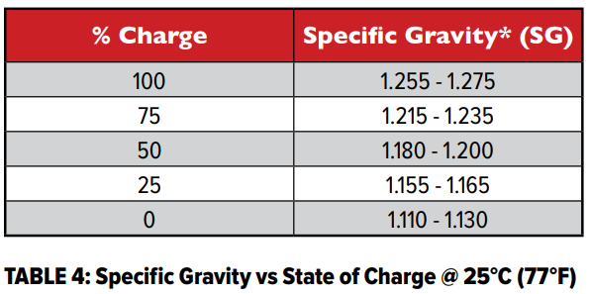
Battery Based PV
Specific Gravity vs State of Charge.
Rolls Battery

Slide 61
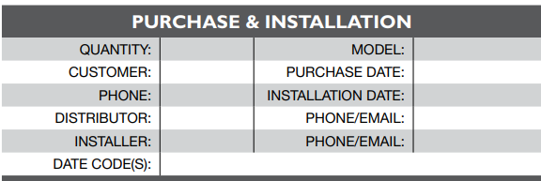
Battery Based PV
Rolls has a maintenance logbook that keeps track of maintenance and basic system information.
Keeping records makes the document legal and accountable.
Rolls Battery

Slide 62
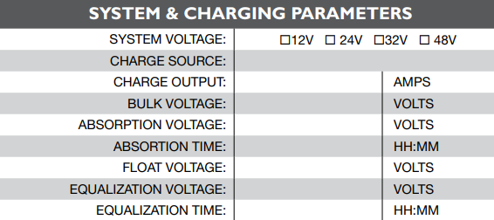
Battery Based PV
Filling out a logbook for every battery in the campus lab is a great activity.
Rolls Battery

Slide 63
Battery Based PV
The class can be divided into groups to perform these checks for each battery.
Students can start the logbook as if the batteries just arrived.
Specific Gravity check is for Flooded only.
Rolls Battery

Slide 64
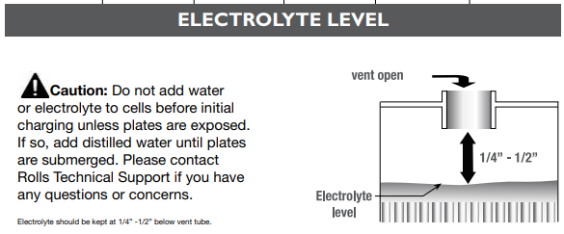
Battery Based PV
This check is for flooded only batteries.
Rolls Battery

Slide 65
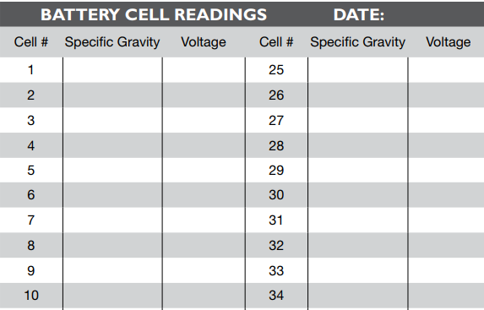
Battery Based PV
The voltages can be recorded for any type of battery.
The sheet has more cell #s.
Rolls Battery

Slide 66
Battery Based PV
It is encouraged to include comments as well as the check placed in the box.
Such as corrosion, dirt on the battery itself.
Litter or things stored that shouldn’t be.
Rolls Battery

Slide 67
Battery Based PV
BATTERY MAINTENANCE & STORAGE
Batteries should be kept clean at all times.
If installed or stored in a dirty location, regular cleaning should be performed.
Before doing so, assure that all the vent caps are tightly fastened (Flooded).
Rolls Battery

Slide 68
Battery Based PV
Using a solution of water and baking soda (100g per liter), gently wipe the battery and terminals with a damp sponge, then rinse with water and wipe dry.
Rolls Battery

Slide 69
Battery Based PV
A common cause of failure with Flooded battery banks is poor maintenance.
Rolls Battery

Slide 70
Battery Based PV
Systems are often professionally installed, and maintenance left to homeowners / clients who are unaware of the requirements or simply choose not to complete the proper maintenance procedures.
To maintain cycle life and protect your investment, Flooded batteries should be inspected regularly and, if required, cells should be topped up with distilled water as they near full state-of-charge.
Rolls Battery

Slide 71
Battery Based PV
Customers will often neglect this for extended periods of time, and when doing so, over-water the cells resulting in loss of electrolyte, overflow during charging and/or corrosion issues.
Failing to top up cells may result in plate exposure, overheating and possible explosion.
Rolls Battery

Slide 72
Battery Based PV
ELECTROLYTE - ADDING DISTILLED WATER (Flooded)
Only distilled (preferred), deionized or reverse osmosis water should be used in Flooded battery cells.
As required, water should be added to each cell as the batteries near full state-of-charge.
Improper watering may cause internal cell damage. Test water to confirm a PH reading of 7 or less and no Total Dissolved Solids (TDS < 5 PPM).
Rolls Battery

Slide 73
Battery Based PV
A Total Dissolved Meter and a PH meter are worth having for doing maintenance.
NOTE: Do not add sulfuric acid to Flooded battery cells during normal top up.
In the case of accidental spill, premixed electrolyte may be used to refill cells. 1.265 S.G. for Series 4000, 4500 & 5000 models. 1.280 S.G. for FS models. (Check with manufacturer)
Rolls Battery

Slide 74
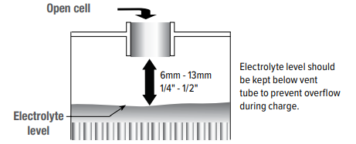
Battery Based PV
CAUTION: Do not add water or electrolyte to cells before initial charging unless plates are exposed.
If so, add distilled water until plates are submerged.
Rolls Battery

Slide 75
Battery Based PV
NOTE: If the battery cells require watering more than once every two (2) months the programmed charging voltages may be too high.
Adjust and monitor accordingly (Charge Controller).
If a particular cell requires significantly more water than others this may be a sign of charge imbalance in the battery bank caused by resistance (Terminal connection) and / or cell failure.
Rolls Battery

Slide 76
Battery Based PV
Typically, Series 4000 & 4500 models will require watering every 30-60 days.
Series 5000 batteries generally require watering every 60-90 days as these models are designed with a higher electrolyte reserve allowing longer watering intervals.
However, watering frequency may vary considerably due to operating temperature, depth of discharge, cycle frequency and humidity.
Rolls Battery

Slide 77
Battery Based PV
Rolls Battery
Rolls YouTube Channel
https://www.youtube.com/RollsBatteryEngineering
Rolls Battery Plant
https://www.youtube.com/watch?v=69O8H9diTvw
General Rolls Battery Information
https://www.youtube.com/watch?v=Zfw64KKGs6M

Slide 78
Battery Based PV
From Rolls Battery, the most common causes of battery failure.
Rolls Battery

Slide 79
Battery Based PV
Installation of batteries:
For all Rolls models it is recommended that the batteries are separated 2.5cm-7.5cm (1"-3”) inches apart to allow proper airflow, cooling and ease of maintenance.
Spacing allows for air flow and cooling.
Rolls Battery

Slide 80
Battery Based PV
CABLE SIZING:
Cabling should be proportionate to the amperage of your system.
The following table notes the maximum current carrying capacity based on cable gauge (Copper).
Rolls Battery

Slide 81
Battery Based PV
Battery cables should be selected allowing a maximum voltage drop of 2% or less across the entire length of the cable.
Interconnection cables (battery to battery) should also be sized at the same gauge and of equal length between connections.
When choosing interconnect cables or custom bus bars, size to allow adequate spacing between batteries for airflow as outlined above.
Rolls Battery

Slide 82
Battery Based PV
TERMINALS & CABLE CONNECTIONS:
All cable connections should be adequately sized, insulated and free of damage.
The cable connectors should be clean and properly mated with the battery terminals to ensure a snug connection.
Electrolyte spills and corrosion buildup will damage cable connectors and terminals.
Rolls Battery

Slide 83
Battery Based PV
It is recommended that terminal connections are disconnected, cleaned and re-torqued periodically as part of the regular maintenance routine.
This also applies to connections using bus bars.
Check and recalibrate the torque wrench for accuracy before use.
Rolls Battery

Slide 84
Battery Based PV
Visual inspections may not always detect poor connections.
The use of an Infrared (IR temperature) sensor may assist in identifying poor connections when testing under load or during charge.
Connections which have overheated and / or developed problems will often be welded to the terminal.
Rolls Battery

Slide 85
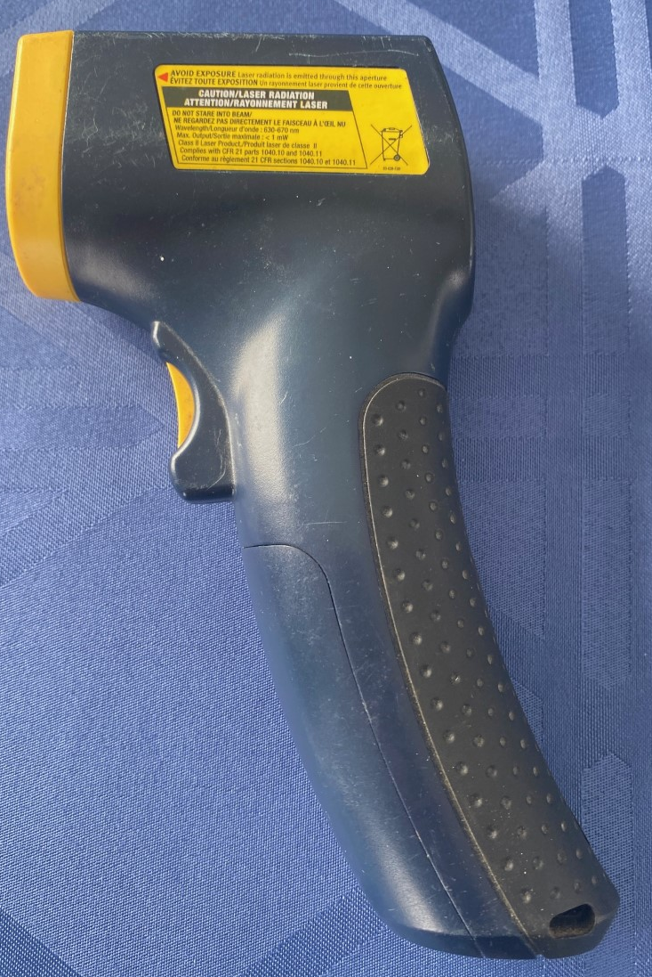
Battery Based PV
The Infrared (IR temperature) sensor / gun.
Author

Slide 86
Battery Based PV
Loose connections may result in ignition of hydrogen gas during charging or cause a short, melting the terminals.
Loose or overtightened connections may also cause high resistance.
The result is an unwanted voltage drop as well as excessive terminal heating which causes the terminal to melt or even catch fire.
Rolls Battery

Slide 87
Battery Based PV
To limit the possibility of damage or fire, use a torque wrench to properly adjust terminal connections during your regular maintenance schedule.
As batteries are cycled and heat up during charge, under-torqued connections may become loose over time as the terminals heat & cool, causing possible arching and a risk of spark.
Over-torqued connections may indent, crack or bend the terminal and/or washers or terminal connectors.
Rolls Battery

Slide 88
Battery Based PV
Damage to terminals and/or batteries caused by under/over-torque is often unrepairable and is not covered under manufacturer warranty.
Follow the recommended torque settings for each terminal type.
Battery distributors or dealers may offer replacement or repair, where possible, at the customer's expense.
Rolls Battery

Slide 89
Battery Based PV
TERMINAL TORQUE SETTINGS:
Refer to the chart below for the recommended torque setting for the battery terminal (see battery specifications).
Calibrate the torque wrench before use to ensure accuracy.
Always move torque wrench setting to zero after use.
Rolls Battery

Slide 90
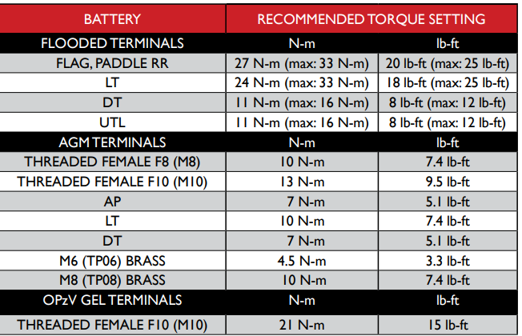
Battery Based PV
TERMINAL TORQUE SETTINGS:
Rolls Battery

Slide 91
Battery Based PV
PARALLEL & SERIES CONNECTIONS:
Applications often demand more voltage or more ampere capacity than the capacity of one battery.
By connecting multiple batteries of the same make / model / capacity in series, parallel or series parallel configurations, output voltage or battery bank amperage may be increased as needed.
Rolls Battery

Slide 92
Battery Based PV
SERIES CONNECTIONS:
Depending on the manufacture and type, some batteries cannot be connected in series.
This tends to be with lithium batteries when a BMS is used.
Always check with manufacture before connecting in series.
Rolls Battery

Slide 93
Battery Based PV
CONNECTING IN SERIES LITHIUM (Next 5 Slides)
Rolls 12V and 24V LFP batteries can be combined in series strings (maximum four (4) 12V batteries and two (2) 24V for 48-volts) to achieve higher operating voltages by connecting the positive terminal of one battery to the negative terminal of the next battery.
Initial set up requires balancing of the batteries to the same SOC (State of Charge).
Rolls Battery

Slide 94
Battery Based PV
For initial balancing prior to connecting batteries in series, each battery should be connected in parallel and fully charged (or charged individually) using a 2-stage charger.
Leaving the battery at the absorption / Constant Voltage voltage for at least 24 hours.
This will minimize the severity of a charge imbalance between batteries which results in reduced bank capacity.
Rolls Battery

Slide 95
Battery Based PV
Although the BMS provides over-voltage protection to each cell, developing a charge imbalance between batteries is still possible.
Rolls recommends disconnecting and fully charging each battery individually once per year, at minimum.
If the batteries are cycled frequently at high charge/discharge currents this may be done more often. (Check monthly and set pattern for charging)
Rolls Battery

Slide 96
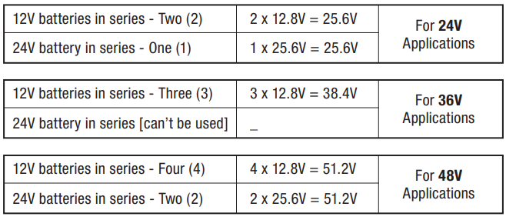
Battery Based PV
EXAMPLE SERIES CONFIGURATIONS
NOTE: Do not connect batteries in strings above 48V nominal as this will exceed the voltage limit of the BMS.
Rolls Battery

Slide 97
Battery Based PV
LFP batteries, even those with similar open circuit voltages may be at drastically different SOC, due to the flat relationship between open circuit voltage and SOC for LFP cells.
Always refer to the manufacturer manuals.
A BMS manages the lithium battery.
Rolls Battery

Slide 98
Battery Based PV
PARALLEL & SERIES CONNECTIONS:
To increase voltage, batteries are connected in series.
Capacity of the battery bank remains the same as voltage increases.
To increase the available amount of current and capacity, batteries are connected in parallel.
Rolls Battery

Slide 99
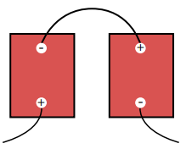
Battery Based PV
In this situation it is best to use lower voltage, higher capacity cells to minimize the number of parallel strings.
To increase voltage, connect the batteries in series.
Rolls Battery

Slide 100
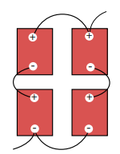
Battery Based PV
To increase capacity and voltage, connect the batteries in series parallel.
Note that the exiting negative and positive wires are from opposite batteries.
This encourages even current taken from both parallel strings.
Rolls Battery

Slide 101
Battery Based PV
EXAMPLE:
Battery = 6-volt (S6 L16-HC)
Battery Voltage = 6V each
Battery Capacity = 445 AH each
System Voltage = 12V System
Capacity = 890 AH total
Rolls Battery

Slide 102
Battery Based PV
EXAMPLE:
Twenty-four (24) 2-volt batteries at 2527 AH each = 2527 AH at 48 Volts.
Rolls Battery

Slide 103
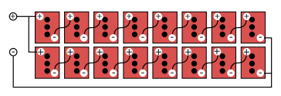
Battery Based PV
EXAMPLE:
Two (2) strings of eight (8) 6-volt batteries at 445 AH each = 2 x 445 AH at 48 Volts = 890 AH at 48 Volts.
Two parallel strings. Series / Parallel.
Rolls Battery

Slide 104
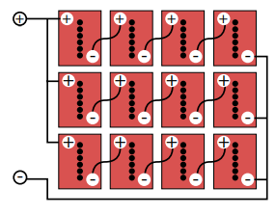
Battery Based PV
EXAMPLE:
Three (3) strings of four (4) 12-volt batteries at 371 AH each = 3 x 371 AH at 48 Volts = 1113 AH at 48 Volts.
Three Parallel Strings.
Series / Parallel
Rolls Battery

Slide 105
Battery Based PV
Connecting more than three (3) series strings in parallel is not recommended.
Multiple parallel connections increase resistance between batteries and strings, causing an imbalance of charge and discharge currents.
This may result in cell damage or premature failure which is not covered under manufacturer warranty.
Rolls Battery

Slide 106
Battery Based PV
It is important that the battery is installed securely, free of contaminants and that all connections are in good contact with the terminals.
It is recommended that the batteries are separated 2.5cm-7.5cm (1"-3”) inches apart to allow proper airflow, cooling and ease of maintenance.
Flooded batteries should be installed in a temperature-controlled room or enclosure with adequate battery spacing to allow cooling.
Rolls Battery

Slide 107
Battery Based PV
Excessive heat will reduce cycle life due to cell degradation.
Batteries should never be installed in a completely sealed enclosure.
Enclosures for Valve Regulated batteries (VRLA) such as sealed AGM & GEL models, should, at minimum, be passively ventilated.
Rolls Battery

Slide 108
Battery Based PV
Enclosures for Flooded models should be actively ventilated with both positive and negative airflow installed to remove and replace any hydrogen gas generated during charging (produced as cell voltage reaches 2.25 VPC or above.
Every effort should be made to avoid hydrogen accumulation as concentrations in excess of 2-4% may ignite with electrical spark and are explosive.
Rolls Battery

Slide 109
Battery Based PV
BATTERY ENCLOSURES FOR RESIDENTIAL
BATTERY-BASED PV SYSTEMS:
Residential battery-based PV systems have been installed by certified PV Professionals for decades.
With rising utility costs and system components becoming more readily available and affordable, stand-alone and grid-connected backup systems have become more popular than ever.
Rolls Battery

Slide 110
Battery Based PV
A battery bank that is properly sized, maintained and installed in a well-designed enclosure will provide many years of service.
Following guidelines and the manufacturer’s recommendations for proper design and placement of the battery enclosure, while adhering to all code requirements and necessary precautions, will ensure the system operates efficiently and safely.
Rolls Battery

Slide 111
Battery Based PV
Lead-acid batteries, like other battery technologies, will offer the best performance when operating temperatures are maintained at 20°C (68°F).
Higher operating temperatures cause cell degradation which shortens the cycle life of the battery. (In Belize this can be an issue)
Lower operating temperatures will reduce capacity.
Rolls Battery

Slide 112
Battery Based PV
Flooded lead-acid batteries off-gas hydrogen while charging.
This includes the Bulk and Absorption phase of a 3-phase charge profile and any routine corrective equalizations.
Hydrogen is explosive and may ignite if exposed to open flame or spark and is also corrosive to electronics.
Rolls Battery

Slide 113
Battery Based PV
For this reason, active ventilation must be installed in the battery enclosure to prevent the buildup of hydrogen gas.
When operating at 20°C (68°F) ambient temperature, sealed (VRLA) batteries such as AGM or GEL models do not require active ventilation as hydrogen off-gassing during charge is minimal.
Rolls Battery

Slide 114
Battery Based PV
However, passive airflow in the enclosure is required, at a minimum, as these batteries will off-gas small amounts of hydrogen during heavy charging.
At higher ambient temperatures, ventilation also prevents overheating which accelerates cell degradation and shortens battery life.
Rolls Battery

Slide 115
Battery Based PV
CONSIDERATIONS:
Location:
Review and follow all local code requirements.
(Article 110 of the NEC)
Flooded lead-acid batteries required active ventilation to remove hydrogen off-gassing.
Sealed VRLA batteries require passive airflow at a minimum. In an installation where ambient temperatures are greater than 25°C (77°F) active ventilation should also be installed.
Rolls Battery

Slide 116
Battery Based PV
The location of a battery enclosure should always be the first consideration.
The battery bank should not be installed in a living space.
If the battery enclosure is located inside a storage room or garage, the active ventilation system must exhaust outside, away from windows, doors or fresh air intake.
Rolls Battery

Slide 117
Battery Based PV
480.10 Battery Locations
Battery locations shall conform to 480.10(A) through (G).
(A) Ventilation.
Provisions appropriate to the battery technology shall be made for sufficient diffusion and ventilation of gases from the battery, if present, to prevent the accumulation of an explosive mixture.
Rolls Battery

Slide 118
Battery Based PV
(B) Live Parts
Guarding of live parts shall comply with 110.27.
(A) Live Parts Guarded Against Accidental Contact
Except as elsewhere required or permitted by this Code, live parts of electrical equipment operating at 50 to 1000 volts, nominal shall be guarded against accidental contact by approved enclosures or by any of the following means:
By location in a room, vault, or similar enclosure that is accessible only to qualified persons.
Rolls Battery

Slide 119
Battery Based PV
(B) Prevent Physical Damage
In locations where electrical equipment is likely to be exposed to physical damage, enclosures or guards shall be so arranged and of such strength as to prevent such damage.
(C) Warning Signs
Entrances to rooms and other guarded locations that contain exposed live parts shall be marked with conspicuous warning signs forbidding unqualified persons to enter. The marking shall meet the requirements in 110.21(B).
Rolls Battery

Slide 120
Battery Based PV
(C) Spaces About Battery Systems
Spaces about battery systems shall comply with 110.26 and 110.34. Working space shall be measured from the edge of the battery cabinet, racks, or trays.
For battery racks, there shall be a minimum clearance of 25 mm (1 in.) between a cell container and any wall or structure on the side not requiring access for maintenance. Battery stands shall be permitted to contact adjacent walls or structures, provided that the battery shelf has a free air space for not less than 90 percent of its length.
Rolls Battery

Slide 121
Battery Based PV
(D) Top Terminal Batteries
Where top terminal batteries are installed on tiered racks or on shelves of battery cabinets, working space in accordance with the battery manufacturer's instructions shall be provided between the highest point on a cell and the row, shelf, or ceiling above that point.
Rolls Battery

Slide 122
Battery Based PV
(E) Egress
Personnel doors intended for entrance to, and egress from, rooms designated as battery rooms shall open in the direction of egress and shall be equipped with listed panic or listed fire exit hardware.
(F) Piping in Battery Rooms
Gas piping shall not be permitted in dedicated battery rooms.
Rolls Battery

Slide 123
Battery Based PV
Egress. A personnel door(s) intended for entrance to and egress from rooms designated as ESS (Energy Storage System) or battery rooms shall open in the direction of egress and shall be equipped with listed panic hardware.
Panic hardware, also known as an exit device, is designed to provide building occupants fast and easy egress in an emergency.
A push bar to open the door is an example.

Slide 124
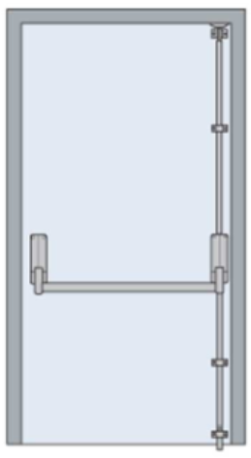
Battery Based PV
A push bar, or panic bar is mounted for easy egress.

Slide 125
Battery Based PV
Please consult your local codes and standards for specific requirements as you are exhausting gasses that are potentially explosive.
Ventilation systems must exhaust outside and may exit via a ceiling or wall-mounted vent.
Wall-mounted exhaust should be as close to the ceiling height as possible.
Rolls Battery

Slide 126
Battery Based PV
Fire code requires that flooded lead-acid batteries are not installed in the same room as the inverter or any other electrical device, appliance, pilot light or heating system which may pose a risk of spark or fire.
This is a fire code regulation and not an electrical code regulation.
Check local or international codes.
Rolls Battery

Slide 127
Battery Based PV
Although an active ventilation system will be installed, do not install the battery enclosure directly below a wall-mounted charger or inverter as hydrogen is corrosive and may damage this equipment.
Rolls Battery

Slide 128
Battery Based PV
The ventilation system shall be designed to limit the maximum concentration of hydrogen to 1% of the total volume of the room during the worst-case event of simultaneous “boost” charging of all the batteries in accordance with nationally recognized standards.
Continuous ventilation shall be provided at a rate of not less than 1 cfm/sq ft or 0.305 m³/min / square meter of floor area of the room or cabinet.

Slide 129
Battery Based PV
As an example, the volume of hydrogen gas generated daily by a 24 cell, 105Ah lead calcium battery charging at 2.2 V per cell is calculated as follows:
Total m³/min of hydrogen gas = number of cells x gas generation rate of battery type in m³/min x float current in amps x minutes / day.
The gas generation rate needs to be determined, in this example it is 7.6 x 10⁻⁶ m³/min

Slide 130
Battery Based PV
Volume of gas production = 24 cells x 7.6 x 10⁻⁶ m³/min x (.006A / 100Ah) x 105Ah x 60min/h x 24h/day = 1.65m³ of hydrogen gas/day
For a room (8’x4’x8’) of 7.25m³ volume.
Total gas allowed is 1%.
7.25m³ x .01 = 0.725m³ of hydrogen gas.
To meet the 1% maximum level, one air change for each 0.725m³ / 1.65m³ gas/day = 4.4 days.

Slide 131
Battery Based PV
A minimum of 4 air changes per hour is recommended.
Therefore, a forced ventilation fan is required.

Slide 132
Battery Based PV
Rolls has an example of this same calculation at their Rolls Technical Support web page
https://support.rollsbattery.com/en/support/solutions/articles/228198-calculating-hydrogen-concentration-for-proper-ventilation
Source used by Rolls for their calculation.
http://giantbatteryco.com/GLOSSARY/Calculate.Industrial.Battery.Hydrogen.Gas.Emission.html

Slide 133
Battery Based PV
If the battery enclosure is on the exterior wall of a home or other structure it must not be positioned in direct sunlight to prevent overheating.
Zephyr Industries offers a variety of 12V, 24V & 48V power vent fans specifically designed for battery enclosures.
These fans may be operated from the auxiliary relay on high-end charge controllers or by a voltage-controlled switch.
Rolls Battery

Slide 134
Battery Based PV
When connected to a voltage-controlled relay, the fan operates only when the batteries are being charged and blows gas vapors out.
These units also include a built-in damper when not in use to minimize back drafting.
Rolls Battery

Slide 135
Battery Based PV
Battery Box:
1. SIZE: When building a custom battery enclosure or purchasing a pre-built cabinet it is essential that the enclosure allows sufficient spacing around and between the batteries.
Most lead-acid battery manufacturers recommend a minimum of 1”-3” spacing on each side of the battery to allow adequate cooling as the batteries heat up during charge, to allow proper airflow for removal of hydrogen off-gassing, and ease of maintenance.
Rolls Battery

Slide 136
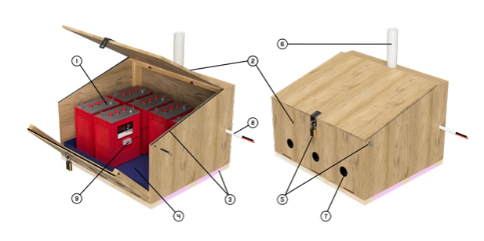
Battery Based PV
The height of the enclosure should also allow adequate space for easy installation/removal, routine inspection, watering and space for battery cabling.
Rolls Battery

Slide 137
Battery Based PV
2. DESIGN & ACCESS:
Easy access to the battery bank is important as routine maintenance such as watering (flooded models) and cleaning & re-torquing terminal connections will be required.
The enclosure should have a hinged slanted lid to ensure easy access and discourage placing or storing items on top of the lid.
Rolls Battery

Slide 138
Battery Based PV
When working with larger, heavier batteries, a removable or hinged front entry is also preferred as this will allow easier access for installation & future battery replacement.
3. INSULATION: foam or rubber weather stripping should be used around all openings at the top to seal and prevent hydrogen gas from escaping the enclosure as well as preventing rodents from getting inside.
Rolls Battery

Slide 139
Battery Based PV
Batteries will self-discharge when not in use which poses a risk of damage due to freezing in cold temperatures.
If the enclosure will not be in a climatized space and the system operates in very cold temperatures, rigid foam insulation may be installed under the bottom of the enclosure and/or around the interior, as well as the space between the batteries to reduce the risk of freezing.
Insulation should be removed in warmer months to prevent overheating.
Rolls Battery

Slide 140
Battery Based PV
4. SPILL CONTAINMENT:
A spill-proof liner should be installed in the enclosure.
This will contain any electrolyte overflows due to leaks from the batteries in the case of overfilling, puncture or cracked cases from freezing.
Rolls Battery

Slide 141
Battery Based PV
Rolls Battery

Slide 142
Battery Based PV
5. SAFETY:
For safety, the enclosure must include a latch and/or lock.
Removable pin(s) may be used to secure the hinged front wall in place when unlocked and the lid is open.
Rolls Battery

Slide 143
Battery Based PV
6. VENTILATION:
When using flooded lead-acid batteries the enclosure must have active ventilation.
If the battery enclosure is located inside a storage room or garage, the active ventilation system must exhaust outside via a ceiling or wall-mounted vent, a minimum 2m (6.5 ft) from any opening (doors or windows) or fresh air intake.
Wall mounted exhaust should be as close to the ceiling height as possible.
Rolls Battery

Slide 144
Battery Based PV
7. AIR INTAKE:
Intake vents should be installed along the bottom 1/3 of the enclosure to allow proper airflow when the fan is active.
Installing screen or vent inserts is recommended to keep rodents out of the enclosure.
Rolls Battery

Slide 145
Battery Based PV
Rolls Battery

Slide 146
Battery Based PV
8. WIRING:
Use conduit to run wiring in/out of the enclosure, including battery connections and the battery temperature sensor, to protect wiring.
Rolls Battery

Slide 147
Battery Based PV
9. TEMPERATURE SENSOR:
Most charge controllers and inverters use a battery temperature sensor to regulate charge voltage.
This sensor should be mounted on the side of a battery case in the middle of battery bank.
Rolls Battery

Slide 148
Battery Based PV
9. TEMPERATURE SENSOR:
Rolls Battery

Slide 149
Battery Based PV
A battery box design can be found in the PDF from Home Power Magazine located in the electronic media folder.
Rolls Battery

Slide 150
Battery Based PV
TEMPERATURE COMPENSATION
& SENSOR INSTALLATION:
For charge accuracy and safety, many systems use a sensor mounted to the battery to measure cell temperature and adjust charge voltage accordingly.
Temperature sensors should be installed directly on the side of a cell or battery in the center of the bank and must be securely mounted below the electrolyte level to determine accurate cell temperature.
Rolls Battery

Slide 151
Battery Based PV
When using chargers that do not feature temperature compensation, voltage settings should be monitored and adjusted based on actual cell temperature.
Failure to use or properly install the provided sensor may cause damage due to over/undercharge which is not covered under manufacturer warranty.
Rolls Battery

Slide 152
Battery Based PV
As a precaution, this sensor may also trigger a programmed safety charge cut-off as the battery bank should not exceed an operating temperature of 52ºC (125ºF).
NOTE: FOR ACCURACY, THE TEMPERATURE SENSOR SHOULD NOT BE MOUNTED TO THE BATTERY TERMINAL OR TOP OF THE BATTERY CASE.
Rolls Battery

Slide 153
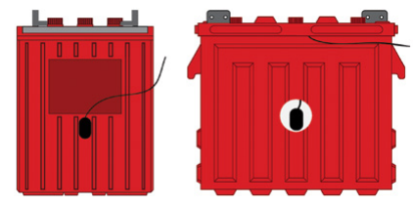
Battery Based PV
Location of the temperature sensor.
Rolls Battery

Slide 154
Battery Based PV
Lithium Battery Installation from Rolls.
Rolls Battery

Slide 155
Battery Based PV
This section is to allow students to understand that manufacturers provide manuals for specific equipment.
General assumptions should not be made until after reading these manuals.
This section is for a particular lithium battery.
The system falls under the definition of an ESS (Energy Storage System).
Rolls Battery

Slide 156
Battery Based PV
Lithium batteries are a chemical risk if mis-operated, mishandled or abused.
Do protect terminals from short circuit before, during, and after installation.
Do wear electrically insulated gloves.
Do use electrically insulated tools.
Rolls Battery

Slide 157
Battery Based PV
Do wear safety toe boots / shoes
Do handle battery carefully
Do secure battery safely
Do always assume battery terminals are energized
Do wear eye protection
Rolls Battery

Slide 158
Battery Based PV
Do not immerse battery in water
Do not lift or carry the battery during usage or operation
Do not operate or store battery outside of operating limits
Do not short circuit battery
Rolls Battery

Slide 159
Battery Based PV
Do not expose battery to flames, or incinerate
Do not open battery case or disassemble battery
Do not wear rings, watches, bracelets or necklaces when handling or working near battery
Do not puncture battery
Rolls Battery

Slide 160
Battery Based PV
Do not drop or crush battery
Do not lift battery by the terminal cables
Do not vibrate battery
Do not expose battery to water or other fluids
Do not expose battery to direct sunlight
Rolls Battery

Slide 161
Battery Based PV
Do not dispose of battery
Do not connect with other types of batteries
Do not expose battery to high temperatures
Do not install with other battery types or brands
Rolls Battery

Slide 162
Battery Based PV
Recommended Battery Operating Limits
Nominal Interruption Time - Peak Current Characteristic of Rolls LFP BMS
The battery should not be operated outside the Maximum Operating Limits, the BMS (Battery Management System) will open its internal relay and disconnect the battery if any of the following limits are exceeded.
Rolls Battery

Slide 163
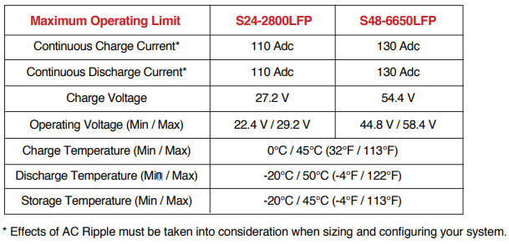
Battery Based PV
Recommended Battery Operating Limits
Rolls Battery

Slide 164
Battery Based PV
Recommended Battery Operating Limits
Nominal Interruption Time - Peak Current Characteristic of Rolls LFP BMS.
Although the battery is capable of performing up to the Maximum Battery Operating Limits noted, the following settings are recommended to maximize battery health and account for unforeseen external conditions.
Rolls Battery

Slide 165
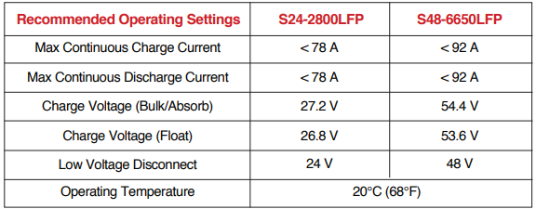
Battery Based PV
Recommended Battery Operating Limits, supplied to allow for maximum life of battery.
Rolls Battery

Slide 166
Battery Based PV
Battery Location:
Locate the batteries close to the inverter in order to minimize the length of the battery cables.
Care should be taken to ensure adequate clearance above the batteries is maintained for access to both battery and inverter connections and disconnects.
A Battery Wall-Mount Bracket (specific for these batteries) is available for use with this ESS model.
Rolls Battery

Slide 167
Battery Based PV
Rolls LFP ESS performance and service life will be optimized when they are operated in an ambient temperature of 15°C to 25°C.
Care should be taken to ensure that the battery’s temperature is > 0°C during charging.
This cold temperature should not be realized in Belize, unless in a refrigerated space.
Rolls Battery

Slide 168
Battery Based PV
Securing Battery:
Battery can be strapped in place with non-conductive nylon straps.
Battery may have hold down brackets at the base of the battery.
A Rolls Battery LFP Wall-Mount Bracket specific to the model.
Rolls Battery

Slide 169
Battery Based PV
Installation:
Battery cables must be sized to the specifications required by the inverter charger, and Copper must compression be installed lug in accordance with the M8” bolt (supplied with battery) standards set by the authority having local jurisdiction.
Do not use or install a battery temperature sensor.
BMS takes care of temperature compensation.
Rolls Battery

Slide 170
Battery Based PV
Confirm that battery is set to OFF
If the battery circuit has a disconnect - open the disconnect to isolate battery.
Cable connection points should also be kept clean.
Broken, frayed, brittle, kinked or cut cables should never be used.
Rolls Battery

Slide 171
Battery Based PV
Secure the new battery - be careful not to ground the terminals to any metal mounting, fixture, or body part.
Connect battery cables - connect the ground cable last to avoid sparking.
Terminals are button-type, M8 female recommended torque is 9.0 Nm (6.64 ft-lb)
Rolls Battery

Slide 172
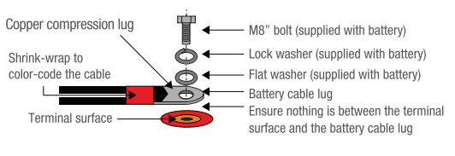
Battery Based PV
Copper compression lugs required.
Rolls Battery

Slide 173
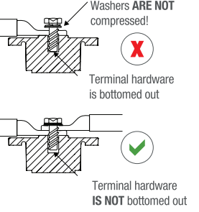
Battery Based PV
Proper compression of the washer is extremely important.
Rolls Battery

Slide 174
Battery Based PV
If the battery circuit has a disconnect - close disconnect to reconnect the battery.
Set the battery to ON
Rolls Battery

Slide 175
Battery Based PV
Terminal burnout is caused by:
Discharge currents exceeding allowable limits
Improper cable installation
Improper cable sizing
Improper terminal torque
Warrantee is not valid for any of these reasons.
Rolls Battery

Slide 176
Battery Based PV
Parallel Battery Wiring:
To ensure proper balancing and load sharing between parallel batteries refer to the wiring diagram on next slide.
Lithium batteries are very sensitive to voltage and undersized battery cables will impede battery and system performance.
Rolls Battery

Slide 177
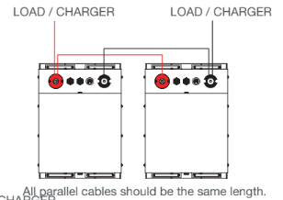
Battery Based PV
Parallel Battery Wiring:
Rolls Battery

Slide 178
Battery Based PV
The thickness (cross section) of cable used should exceed the recommended minimum for the inverter charger installation whenever possible.
Five or more batteries in parallel should be installed using a busbar configuration.
In a busbar configuration all battery cable sets should be the same length regardless of the battery’s proximity to the busbar (or combiner box).
Rolls Battery

Slide 179
Battery Based PV
Rolls LFP Network:
The BMS communicates with the other same batteries in the system.
The AEBus is utilized by all networked Rolls LFP to coordinate all voltage, temperature, and current data.
Rolls Battery

Slide 180
Battery Based PV
LFP cells do not need maintenance charges like
Equalization
Pulse charge
Overcharge
Or any others typically recommended or required for lead acid batteries.
Rolls Battery

Slide 181
Battery Based PV
CHARGING TEMPERATURE:
Best if kept between 10ºC and 35ºC.
C denotes the 20hour rate.
Rolls Battery

Slide 182
Battery Based PV
Racking for any type of battery.
Can be cabinet style with doors that open.
Can be open racking in a controlled room.
Any metal needs to be grounded.
Bolted / fastened to floor is often required by manufacturer.

Slide 183
Battery Based PV
Rack or Cabinet?
Cabinets look better than the open racks.
Rack can accommodate more batteries.
Cabinets offer better protection from electrocution.
Cabinets keep batteries and terminals away from users.

Slide 184
Battery Based PV
Rack or Cabinet?
Flooded batteries are best in racks to vent fumes.
Maintenance is easier in racks.
Temperature is better controlled in rack.
Visual inspection is easier in rack.
Cabinets offer breaker space.

Slide 185
Battery Based PV
There are packaged battery-based storage systems.
Called ESS (Energy Storage System) are pre-configured.
Can be all in one housing.
Lithium or lead acid for residential applications.
A few applications are found in the next slides.

Slide 186
Battery Based PV
Peak Shaving (Time of Day Rates)
ESS allows a user to shift where their electricity comes from by drawing power from the batteries during the higher-cost daytime hours then recharging during the lower-cost nighttime hours.
This practice is referred to as peak shaving.
ESS Fact Sheet NFPA

Slide 187
Battery Based PV
Time of Day Rates vary from utility to utility.
Some utilities do not offer time of day rates.
Time of day rate means that the customer will pay different amount for each kWhr depending on the time of the day.
Also, seasonal adjustments can also be applied.

Slide 188
Battery Based PV
Time of Use can be a way to save money on your energy bill and contribute to cleaner energy production.
Time-of-Use (ToU) tariffs are a new way for homes with Smart Meters to pay for electricity.
You pay different rates at different times of day.
This differs from a traditional ‘flat’ tariff, which charges the same rate at all times of day.

Slide 189
Battery Based PV
ToU tariffs reflect the amount of electricity used at different times.
Usage is low at night and highest in the late afternoon, when people return from work and many businesses are still open.
It costs more to provide electricity during these peak hours.

Slide 190
Battery Based PV
An example of how the rate varies:
NSPI Time of Day Rate

Slide 191
Battery Based PV
An example of how the rate varies:
NSPI Time of Day Rate

Slide 192
Battery Based PV
The ESS can provide the energy used in the house during the time when the rate is the highest.
When the rate is lowest it can use the grid to charge the batteries back up.
Solar can also be used to power the loads or charge the batteries.

Slide 193
Battery Based PV
Load Leveling (Microgrid application):
When power generation facilities ramp up and ramp down to keep up with the changing demand for electricity, it puts stress on the system.
ESS can help flatten out the demand curve by charging when electrical demand is low and discharging when it is high.
ESS Fact Sheet NFPA

Slide 194
Battery Based PV
Uninterruptible Power Supply:
ESS can provide near instantaneous protection from power interruptions and are often used in hospitals, data centers, and homes.
ESS Fact Sheet NFPA

Slide 195
Battery Based PV
What Are the Advantages?
Supplement Renewables, renewable energies such as solar panels or wind turbines only produce electricity when the sun is out, or the wind is blowing.
Supplementing these with ESS allows users to take advantage of the electricity that is generated when the renewable energy technologies are not producing electricity.
ESS Fact Sheet NFPA

Slide 196
Battery Based PV
An ESS is normally used to provide power during the day for load management (Peak demand)
Or as a backup incase the main power source goes down.
The ESS can have a utility interactive hybrid inverter.
The ESS can be part of a microgrid as an energy storage and source.

Slide 197
Battery Based PV
The definition of an energy storage system as per the NEC:
An ESS is one or more components assembled together capable of storing energy for use at a future time.
It can include (but is not limited to) batteries, capacitors, and kinetic energy devices (e.g., flywheels and compressed air).

Slide 198
Battery Based PV
There are three types of storage systems described within the definitions found at NEC 706.2. These systems are:
Energy Storage System, Self-Contained;
Energy Storage System, Pre-Engineered of Matched Components; and
Energy Storage System, Other.

Slide 199
Battery Based PV
Energy Storage System, Self-Contained;
Purchased as a single unit.
Single manufacturer designed and all components are part of the package.
Can be stand – alone in a container.

Slide 200
Battery Based PV
Energy Storage System, Pre-Engineered of Matched Components;
Single manufacture and components are connected together, not necessary to be in same cabinet or room.

Slide 201
Battery Based PV
Energy Storage System, Other.
Put together from separate pieces of equipment that do not need to be from same manufacturer.
All pieces of equipment need to be listed.

Slide 202
Battery Based PV
Energy storage systems can be (and typically are) connected to other energy sources, such as the local utility distribution system.
There may be one or more sources connected to an ESS. (Generator)
These systems can have AC or DC output for utilization.

Slide 203
Battery Based PV
The ESS can be used as a back up to the grid when it goes down.
It has a battery inverter that is AC coupled to the utility and allows for energy to flow in both directions from the battery.
AC coupled is when the inverter is connected to an AC source.

Slide 204
Battery Based PV
DC coupling is when two or more DC inputs or outputs are connected together:
PV to charge controller
Charge controller to batteries
Charge controller to DC loads
Battery to DC input of inverter

Slide 205
Battery Based PV
AC coupling is when two or more AC inputs or outputs are connected together:
Inverter to AC panel (loads)
Inverter to generator
Inverter to Utility or grid

Slide 206
Battery Based PV
When the ESS is connected to solar PV the DC energy from the PV can go to charge the batteries or be put through the PV inverter to the battery inverter to supply AC loads.
The PV is DC coupled to the DC input to the charge controller function of the PV inverter.
Other designs us a charge controller to feed a hybrid inverter that is DC coupled to the batteries and PV while also being AC coupled to the AC loads.

Slide 207
Battery Based PV
Monthly and quarterly maintenance for flooded lead acid batteries.
The renewable industry needs people trained to do maintenance on flooded batteries as well as Lithium and other batteries.
The next section will be on the monthly and quarterly maintenance of the flooded lead acid battery.

Slide 208
Battery Based PV
The presentation Battery Based PV Installations Lab Activities outlines the maintenance required for flooded lead acid batteries.
It also makes reference to the four lab activities for the learners in this course.
The first lab is designed to have learners simulate receiving a shipment of flooded batteries; then have them shipped out to a customer including conditioning the batteries for the shipment.

Slide 209
Battery Based PV
During this lab activity safety requirements are followed.
Documentation is prepared and completed for each of these steps.
This simulates a real-world job activity.

Slide 210
Battery Based PV
The second lab is to install a working battery back of flooded batteries.
The batteries (4 x 12 Volt) will be installed in the campus lab area.
Racks will be used, and the OutBack FXR charger inverter will be setup to charge the batteries.
This lab will take a number of weeks to complete.

Slide 211
Battery Based PV
It has many objectives that overlap with the Stand-Alone Course.
When the lab is completed, it provides a living lab for the learners to measure how the battery back reacts to charging and discharging.
The battery bank can take over some loads from the campus grid.
The campus grid can provide charging for the batteries.

Slide 212
Battery Based PV
Having a controlled discharge and charge the learners can learn to predict the way the batteries will react to various loads and charging rates.
Logging these measurements will provide a history for other years of classes.

Slide 213
Battery Based PV
The next two labs are maintenance-based labs.
Monthly maintenance, that is an industry standard for flooded batteries.
The other is a quarterly timed maintenance procedure. It is an add on to the monthly maintenance.
It looks at other areas of concern beside monthly readings.

Slide 214
Battery Based PV
Equalization of the flooded batteries is covered in depth in that presentation.
Equalization can happen at any monthly maintenance inspection.
These labs represent the majority of preventative maintenance exercises used in the industry.

