Slide 1
Design and Implementation of TVET Renewable Energy Course Pilot
DELIVERABLE #5 - TRAINING COURSES & PROFESSIONAL DEVELOPMENT
Session 62 (17 February 2023) – Term 4 C 42 – Energy Efficiency Measurement and Verification

Slide 2
Anticipated Outcomes
Examples of anticipated outcomes for each task after course
completion are as follows:
(T1) Understand how to capture and interpret critical data:
Propose equipment, instruments, methods, and procedures for collecting data in an energy efficiency project
Capture energy consumption from equipment and schedules
Assess for accuracy and identify any gaps in dates or missing data
Interpret data

Slide 3
Anticipated Outcomes (T1) Continued:
Calculate baseline energy use with the collected data
Interpret baseline results and recommend upgrades for energy reduction and cost savings
State unknowns, uncertainties, and assumptions
Present findings in a technical report with conclusions

Slide 4
Anticipated Outcomes Continued
(T2)
Identify common types of sensors and processors
used in the following building types in Belize and North
America:
Residential
Commercial
Industrial

Slide 5
Collecting Consumption Data Onsite
Emporia YouTube Promo

Slide 6
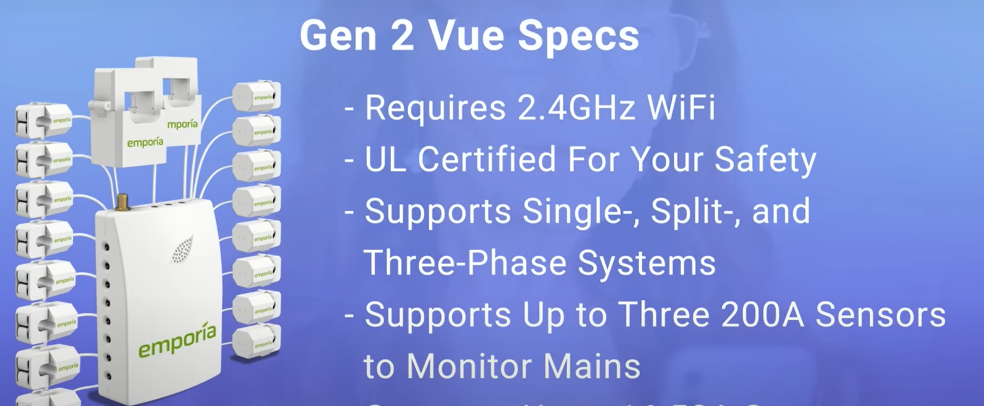
Collecting Consumption Data Onsite
The Emporia Gen Vue Energy Monitor:
Includes 18 current transformers (CTs)
Each CT can monitor up to 50 Amps
Emporia YouTube Promo

Slide 7
Collecting Consumption Data Onsite
Emporia YouTube Promo

Slide 8
Collecting Consumption Data Onsite
Emporia YouTube Promo

Slide 9
Collecting Consumption Data Onsite
Emporia YouTube Promo

Slide 10
Collecting Consumption Data Onsite
Emporia YouTube Promo

Slide 11
Collecting Consumption Data Onsite
Emporia Gen Vue installed in a Siemens 200 A residential panel.
Two CTs on the main.
Sixteen CTs on various loads are listed below:
Washer and Dryer
Dishwasher
Fridge
Water heater
HVAC systems (3)
Attached garage
Plug loads in entertainment areas

Slide 12
Anticipated Outcomes Continued
(T3)
Assess the design and performance of integrated
control and monitoring systems using the available resources with the
following:
Case study examples
Performance goals
Example applications in Belize and North America

Slide 13
Anticipated Outcomes Continued
(T4)
Understand methods for remote monitoring of energy
systems using the following:
North American examples
Belize examples
Project: Proposal of a remote system for a building in Belize
Example: Install an Emporia Gen 2 Vue Energy Monitor or similar monitoring system in a residential home.

Slide 14
Collecting Consumption Data Onsite
Larger commercial, institutional and industrial buildings with
complex systems require a larger monitoring capacity and
features for tracking and managing loads and consumption.
Selecting a monitoring system:
Assess the system’s size and complexity to determine the number
of loads that require monitoring
Research the data collection capabilities and capacity of the
Monitoring system to ensure it meets your needs and budget.
Schneider Electric Ecostruxure Demo

Slide 15
Heating and Cooling Degree Days
Heating Degree Days (HDDs) have a linear relationship with energy consumption related to mechanical heating systems.
Cooling Degree Days (CDDs) have a linear relationship with energy consumption related to mechanical cooling.
Degree Days are independent values and are always modelled on the x-axis.
Energy consumption is a dependent value and is always modelled on the
y-axis.
When mechanical heating or cooling equipment is used in a building, the daily energy consumed in the building depends on the degree days.

Slide 16
Heating Degree Days (HDD)
Heating Degree Days (HDDs) are used to calculate heating loads in cooler climates where mechanical heating systems are necessary in order to maintain interior building temperature setpoints for human comfort.
HDDs are calculated by using the outdoor baseline temperature of 18 degrees Celsius (C) or 65 degrees Fahrenheit (F) as the temperature at which a building will require mechanical heating to maintain a comfortable interior temperature setpoint of 21 degrees Celsius or 69.8 degrees Fahrenheit.
The assumption is made that internal gains from body heat, electrical equipment, cooking, bathing and washing will generate enough heat to keep the building at 21 C or 69.8 F until the outdoor temperature drops to 18 C (65 F) or lower, at which time a mechanical heating system will be required to heat the building.

Slide 17
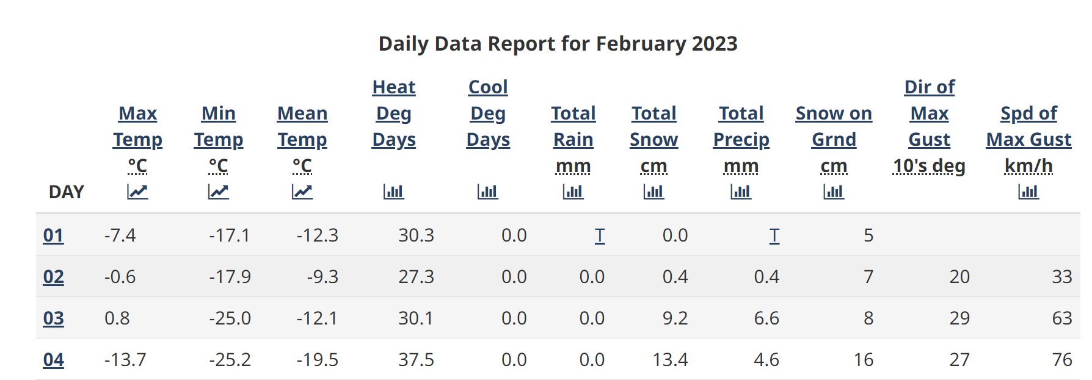
Heating Degree Days (HDD)
Example calculation of HDD:
HDD values are calculated by the daily mean temperature (highest daily temperature+ the
lowest daily temperature)/2, subtracted from the baseline temperature of 18 C.
Mean temperature data and HDD example for Greenwood Nova Scotia, Canada:
https://climate.weather.gc.ca/climate_data/daily_data_e.html?StationID=6354

Slide 18
Heating Degree Days (HDD)
Example calculation of HDD:
HDD values are calculated by subtracting the daily mean temperature (highest daily temperature + the lowest daily temperature)/2, from the baseline temperature of 18 C. A mean temperature calculation example is below:
The highest daily temperature on February 4th, 2023 in Nova Scotia is -13.7 C
The lowest daily temperature on February 4th, 2023 in Nova Scotia is -25.2 C
-13.7 C + (-25.2 C) = - 38.9 C/2 = -19.45 C
-19.45 C is the mean temperature for the day.
HDD = 18 C – (-19.45 C) = 37.45 Heating Degree Days

Slide 19
Cooling Degree Days (CDD)
Cooling Degree Days (CDDs) are used to calculate cooling loads in warm climates where mechanical cooling systems are used to maintain interior building temperature setpoints for human comfort.
CDDs are calculated by using the outdoor baseline temperature of 18 degrees Celsius or 65 degrees Fahrenheit.
An exterior temperatures rise above 18 C (65 F) will require the use of a mechanical cooling system to maintain a comfortable interior setpoint.

Slide 20
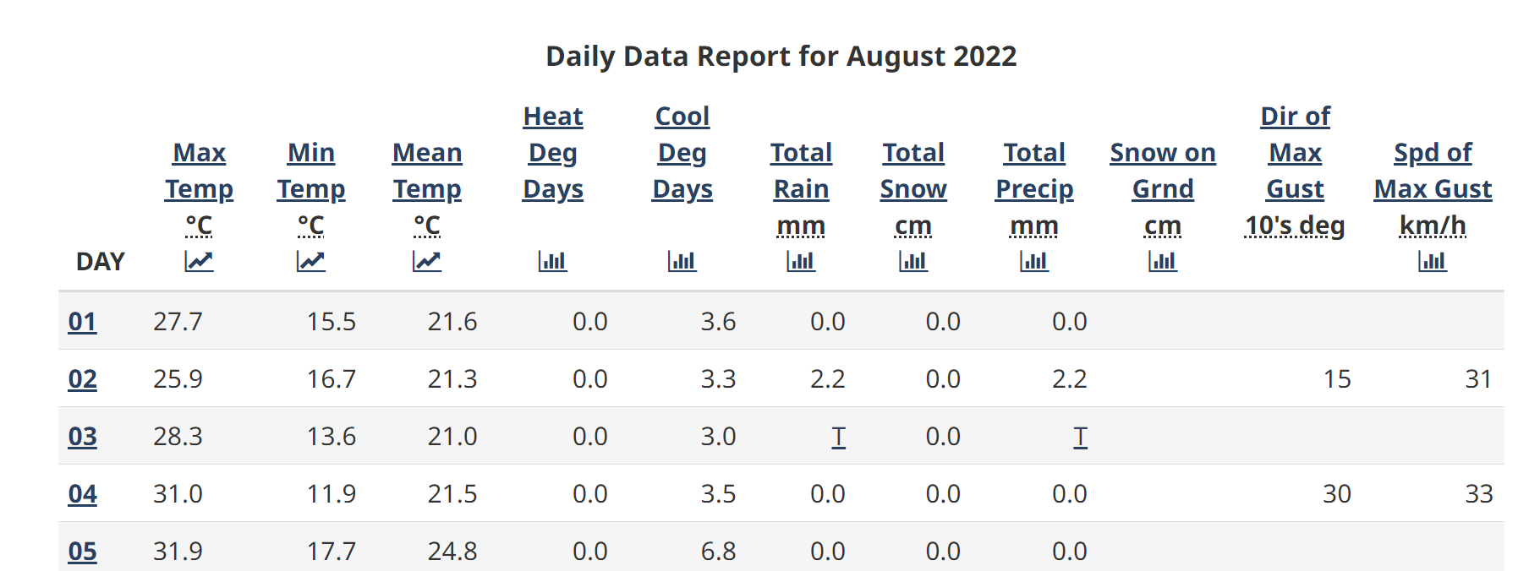
Cooling Degree Days (CDD)
CDD values can be calculated when the daily mean temperature is above 18 C or 65 F. If the mean value is higher, subtract the baseline temperature of 18 C from the mean to calculate the CDD. A CDD calculation example follows for
August 1, 2022: (Mean Temp.) 21.6 C -18 C (baseline temp) = 3.6 CDD
Weather.gc.ca/climate_data_cooling

Slide 21
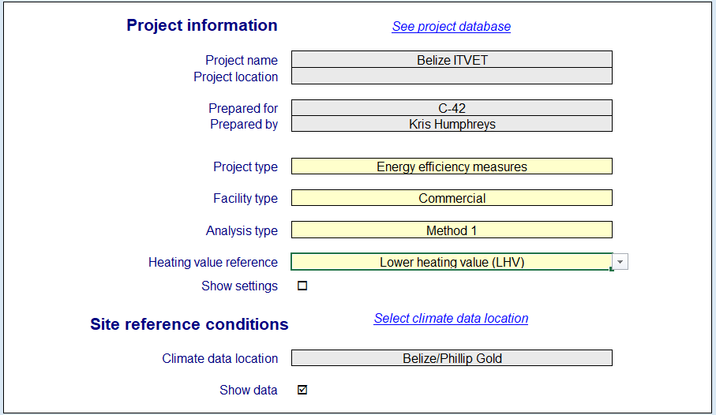
RETScreen Cooling Degree Days (CDD)
Notes:
Time permitting, introduce the building types and componenets

Slide 22
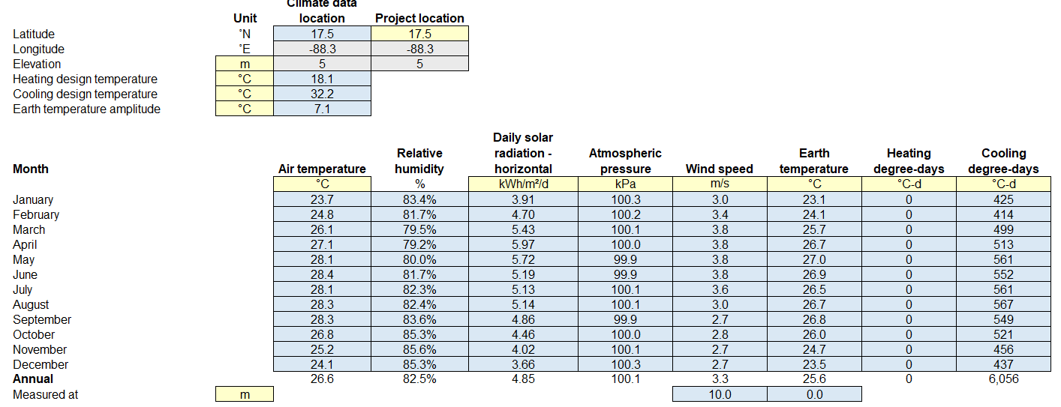
RETScreen Cooling Degree Days (CDD)
Notes:
Open RETScreen and walk through the steps to populate CDD for a specific region in Belize.

Slide 23
Data Analysis
Now that we have the tools to collect energy consumption data, and recognize monitoring systems to help track consumption, we can:
Analyze the data for accuracy
Determine approaches to increase efficiency
Reduce consumption
Benefit from lower energy costs and emissions!

Slide 24
Anticipated Outcomes Continued
(T5)
Identify baseline energy use with the following applications:
Residential, commercial, and industrial buildings in Belize, The USA, and Canada
Measured scenarios and working assumptions
Analyzed interpretations of significant data gaps
Conclusions, recommendations, and limitations

Slide 25
Energy Monitoring, Targeting and Reporting
Energy monitoring, targeting and reporting (EMTR) is used to manage energy consumption related to a building and the processes within.
It can be used to:
Analyze the historical performance of buildings
Set targets for future reduction of energy consumption
Control existing energy performance
Project consumption in order to budget for future energy-related costs
Capehart, B. L., et al. “Guide to Energy Management: International Version. Eighth Edition". Fairmont Press, 2016,.

Slide 26
Energy Monitoring, Targeting and Reporting
Energy monitoring is the regular collection and analysis of information related to energy use. It can be used to:
Determine a baseline
Identify energy use anomalies
Verify energy efficiency measures (EEMs)
Track cost savings
Project consumption and budget requirements
Capehart, B. L., et al. “Guide to Energy Management: International Version. Eighth Edition". Fairmont Press, 2016,.

Slide 27
Targeting
Targeting is related to energy efficiency goals.
Setting a target to reduce energy consumption by 10% within a specified timeframe provides an objective with clear parameters for building managers and users to follow.
Have you set a goal and achieved it?
Capehart, B. L., et al. “Guide to Energy Management: International Version. Eighth Edition". Fairmont Press, 2016,.

Slide 28
Reporting
Reporting is necessary to present the information in an easy-to-understand format. It enables:
Ongoing control of energy used
Timely achievement of energy efficiency goals
Regular verification of efficiency upgrades and savings
Capehart, B. L., et al. “Guide to Energy Management: International Version. Eighth Edition". Fairmont Press, 2016,.

Slide 29
Developing An Energy Modelling Performance Model
Energy monitoring involves the development of an energy performance model (EPM) that identifies the relationship between consumption and the applicable independent variable.
The comparison of a predicted performance identified by the cumulative sum of differences (CUSUM) to the actual performance is achieved with a data sample and modelled linear regression.
Capehart, B. L., et al. “Guide to Energy Management: International Version. Eighth Edition". Fairmont Press, 2016,.

Slide 30
Analyzing Data With Linear Regression
Capehart, B. L., Turner, Wayne C., Kennedy, William J.
Date:
2016
Analyzing data captured through energy monitoring can include an energy performance model (EPM) that demonstrates the linear relationship between the consumption of energy and an independent variable.
Independent variables can be:
Heating or cooling degrees days
Production of goods measured in units, tonnes or another appropriate unit of measure.
Capehart, B. L., et al. “Guide to Energy Management: International Version. Eighth Edition". Fairmont Press, 2016,.

Slide 31
Sample of a School’s Energy Data : HDD
Capehart, B. L., et al. “Guide to Energy Management: International Version. Fairmont Press, 2008,.

Slide 32
Analyzing Data With Linear Regression
Capehart, B. L., Turner, Wayne C., Kennedy, William J.
Date:
2016
The equation is y = mx + b
Where:
y = total energy consumption
m = energy in kWh used per HDD
x = HDD value
b = non-heating energy use
Capehart, B. L., et al. “Guide to Energy Management: International Version. Eighth Edition". Fairmont Press, 2016,.
Notes:
Share Excel calculation

Slide 33
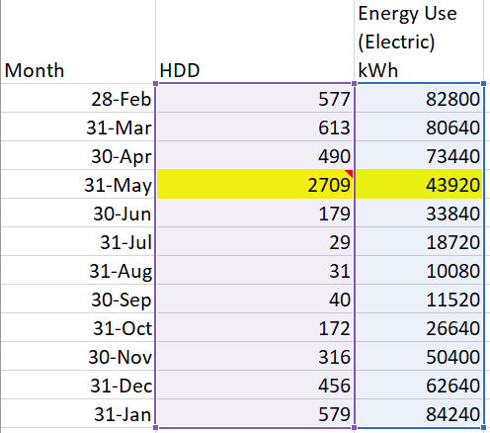
Analyzing Data With Linear Regression
Capehart, B. L., Turner, Wayne C., Kennedy, William J.
Date:
2016
This highlighted row of data is shown as an outlier on the scatter plot. The R2 value is 0.06, which tells us the data has a very poor fit. Removing this line of data will return a favourable R2 and realistic regression equation. This line is an anomaly and should be removed.
Capehart, B. L., et al. “Guide to Energy Management: International Version. Eighth Edition". Fairmont Press, 2016,.

Slide 34
Analyzing Data With Linear Regression
Capehart, B. L., Turner, Wayne C., Kennedy, William J.
Date:
2016
Anomalies can arise from:
Failing infrastructure such as a broken water main and the pump running nonstop for two days until discovered
Building envelope failures such as a breach in the building envelope in the event of a hurricane during mechanical cooling or heating
Human error such as a door or window left open during mechanical heating or cooling
Keystroke errors.
Capehart, B. L., et al. “Guide to Energy Management: International Version. Eighth Edition". Fairmont Press, 2016,.
Notes:
Always confirm the anomaly with the technician or facilities staff.

Slide 35
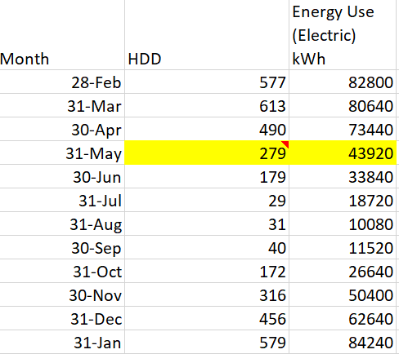
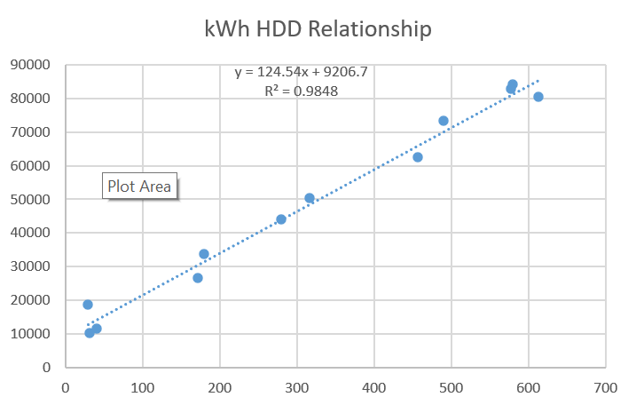
Analyzing Data With Linear Regression
Upon a check of the original data set, the anomaly was determined to be a keystroke error.
Data set is corrected from 2709 to 279
Goodness of fit is improved to R2 = 0.9848 from 0.0679
Linear regression equation is accurate

Slide 36
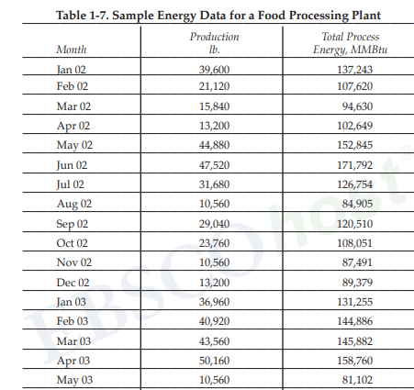
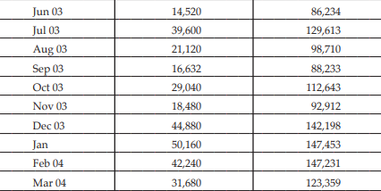
Food Production Facility: Regression and CUSUM

Slide 37
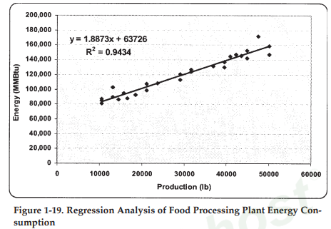
Food Production Facility: Regression and CUSUM
Linear regression for the entire 27 month
dataset.
*Note the MMBtu per pound is 1.8873

Slide 38
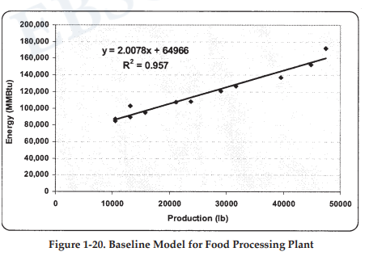
Food Production Facility: Regression and CUSUM
Baseline regression for consistent consumption/lb. in the 12-month period before upgrades.
*Note the MMBtu consumption is double the entire dataset m value of 1.8873

Slide 39
Food Production Facility: Regression and CUSUM
Comparison of Energy Consumption
First Year
Comparison of Energy Consumption
Second Year

Slide 40
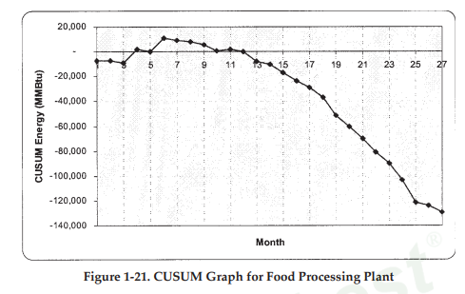
Food Production Facility: Regression and CUSUM
Cumulative Sum of Differences (CUSUM)

Slide 41
Food Production Facility: Regression and CUSUM
Cumulative Sum of Differences (CUSUM)
Determine predicted consumption from the linear regression equation.
Actual Consumption – Predicted = Variance
CUSUM is the cumulative sum of the variation for each month in
the period.
Notes:
Demonstrate variance and CUSUM calculations

Slide 42
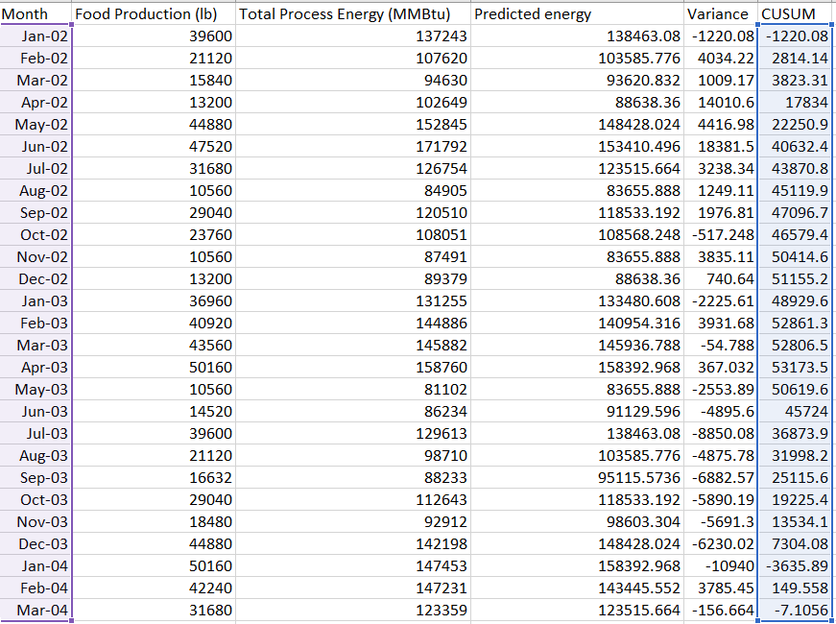
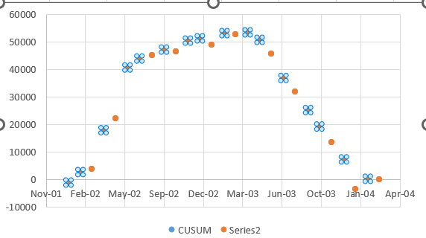
Food Production Facility: Regression and CUSUM

Slide 43
Questions and Comments?

