Slide 1
Design and Implementation of TVET Renewable Energy Course Pilot
DELIVERABLE #5 - TRAINING COURSES & PROFESSIONAL DEVELOPMENT
Session (24 February 2023) – Term 4 C 42 – Energy Efficiency Measurement and Verification

Slide 2
Energy Efficiency Recommendations
Once a baseline energy consumption has been determined, energy efficiency upgrades can be recommended.
Energy efficiency upgrades may include:
R-value of building assemblies and installation of insulation
Space heating or cooling systems
Process heating or cooling systems
Lighting systems
Pumping systems
Domestic or process hot water heating systems
Air exchange systems
Large cooling systems such as chillers

Slide 3
Energy Efficiency Monitoring and Verification Model
RETScreen Expert is an Internationally accepted industry
standard for modelling the following:
Residential buildings
Industrial buildings
Commercial buildings
Solar generation projects
Wind generation projects
Agriculture projects

Slide 4
RETScreen 4 Start Screen (Older Unsupported Version of RETScreen)
You have RETScreen 4, and the following slides will look at the functionality of the software. Since it is no longer
supported, using the free RETScreen Expert, or purchasing the Expert is recommended. The Free version has full
functionality, however the files cannot be saved. Screenshots of the calculations copied into a word document or
transcription of data from the free version to an Excel is recommended if the full version is not affordable.

Slide 5
RETScreen 4 Start Screen: Climate Data
*Be sure to check the show data box to display the climate data.

Slide 6
RETScreen Energy Model Fuels and Schedules
Various fuels are embedded in the drop-down menu under the Fuels and
Schedules section of the RETScreen Energy Model tab.
Select the fuel (s) that is applicable to the building’s consumption.
Which website do you use to determine current fuel prices for gasoline, diesel,
kerosene and liquid petroleum gas (LPG)?
Prices fluctuate, so check the latest price and update the cost when creating
a new file!

Slide 7
RETScreen: Setting a Schedule
Schedule 1 is a baseline considering 24-hour/day occupation and setpoint temperature.
Schedule 2 may be modelled to fit the building’s unique occupation.
Space heating and cooling temperature are set to the preference of building occupants.
Unoccupied setting reflects the temperature rise or fall below the preferred setpoint
that is acceptable during unoccupied building hours.

Slide 8
RETScreen Building North
A building that is oriented 10
degrees northeast is entered
as + 10 degrees North in
RETScreen.
A building that is oriented 10
degrees northwest is entered
as -10 degrees North in
RETScreen.
Building orientation is used for
solar gain and thermal loss
calculations.

Slide 9
RETScreen 4 Facility Characteristics
Facility Characteristics include:
Heating Systems
Cooling Systems
Building Envelope
Ventilation
Lights
Electrical Equipment
Hot Water
Heat Recovery

Slide 10
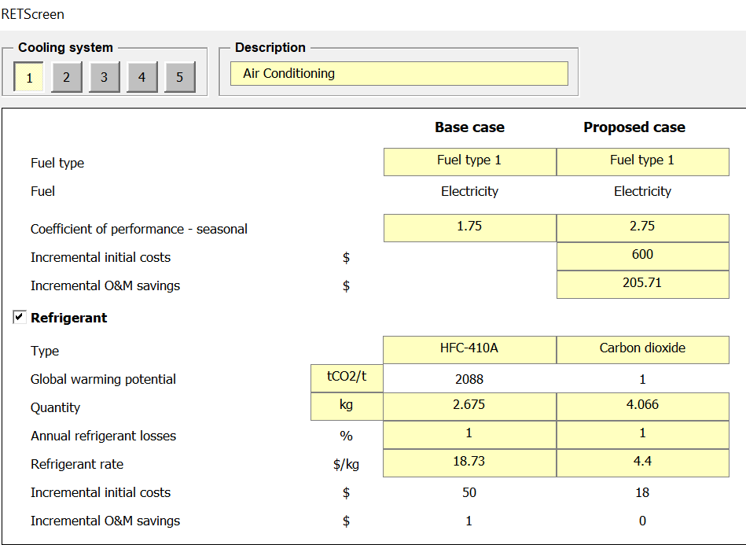
RETScreen 4 Heating System
To create a Heating System:
Add a description.
Select fuel type.
Enter SEER.
Enter incremental costs when an upgrade has been identified and the cost of the upgrade is known.
Enter the Operations and Maintenance (O&M) savings.

Slide 11
RETScreen 4 Cooling System
To create a Cooling System:
Add a description.
Select fuel type.
Enter COP.
Enter incremental costs when an upgrade has been identified and the cost of the upgrade is known.
Enter the Operations and Maintenance (O&M)savings.
See the simple payback example on the following slide for savings calculations.

Slide 12
Simple Payback Cost Savings
Simple Payback is:
Cost of upgrade/projected savings/year
=$600/$205.71 /year
=2.91 years
Projected savings:
Base cost (3000kWh/COP 1.75)*$0.33/kWh
=1714.29 kWh*$0.33/kWh
=$565.71
Projected Cost (3000kWh/COP 2.75)*$0.33/kWh
=$360
Annual Savings = $565.71-$360
= $205.71
Example:
A home has a cooling load of 3000 kWh/year @ $0.33/kWh.
Cost is $565.71/year
The current air conditioning unit has a COP (co-efficient of performance) of 1.75
The replacement AC unit has a COP of 2.75, and costs $600.00.
What are the cost savings associated with the new upgrade?

Slide 13
Energy Upgrades Estimated Payback
A simple payback of
less than three
years is desirable for
energy efficiency
upgrades, however in
some cases a longer
payback period is
acceptable.
Automated Buildings.com

Slide 14
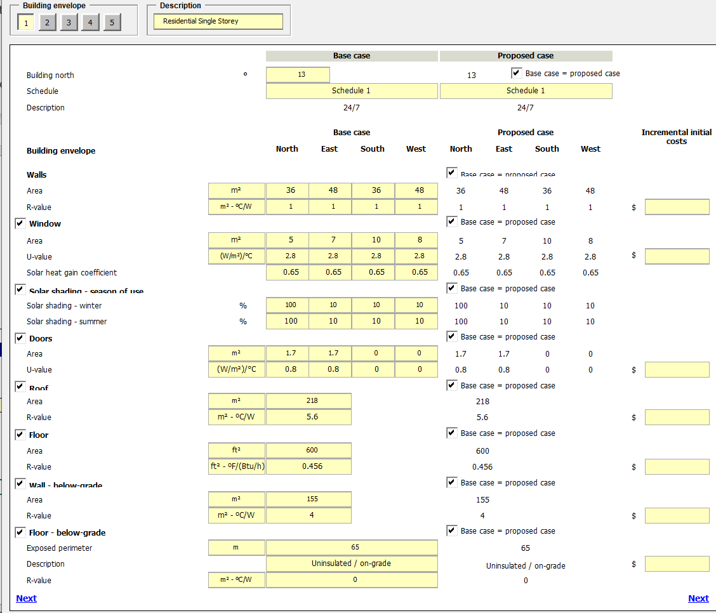
RETScreen Building Components

Slide 15
RETScreen Summer Shading Factors
RETScreen 4 Help Index ”Solar Shading”
Notes:
Belize is 17 degrees north, select the closest at 35 degrees latitude.

Slide 16
RETScreen Summer Shading Factors
Notes:
Belize is 17 degrees north, select the closest at 35 degrees latitude.

Slide 17
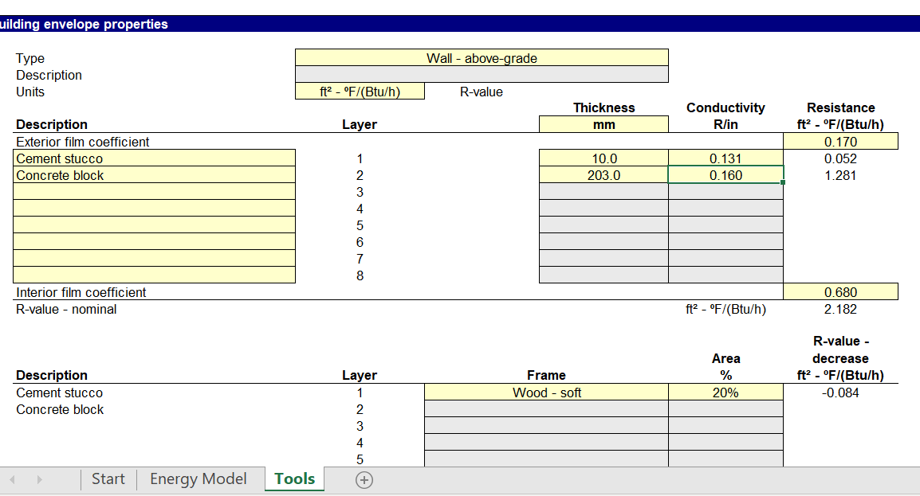
RETScreen Tools Tab: Calculate RSI
The tools tab is used to calculate the effective RSI value of building components.

Slide 18
R-Value (R) and R-value Système International (RSI)
R-value (ft² *°F / Btu/hr) is the imperial measurement of a material’s resistance to heat flow.
R-value Système International (RSI) (m² *°C / W) is the metric measurement
of a material’s resistance to heat flow.
The conversion of R-Imperial to RSI is:
R 5 / 5.678= 0.88059 RSI
The conversion of RSI to R Imperials is:
0.88059 RSI*5.678 = R5

Slide 19
U value and RSI Relationship
There is an inverse relationship between RSI (m2 °C/W) and U( W/m2 °C) values:
1/RSI (m2 °C/W) = U (W/m2 °C)
Building envelope upgrades that increase R-values and lower U-values will reduce energy consumption related to the heating or cooling loads.

Slide 20
RETScreen Expert
Let’s look at how RETScreen Expert can help determine a baseline and calculate the cost savings of upgrades.
*RETScreen Expert is recommended for calculations. The RETScreen 4 version is no longer supported and has macro issues when running calculations. Use caution when modelling and always compare the model with historical energy consumption from billing information or benchmark building for comparison.
A free version is available here: NRcan RETScreen Expert Free Download Read Only
RETScreen Video Introduction

Slide 21
Example Test Questions

Slide 22
Example Individual Project

Slide 23
Example Group Project

Slide 24
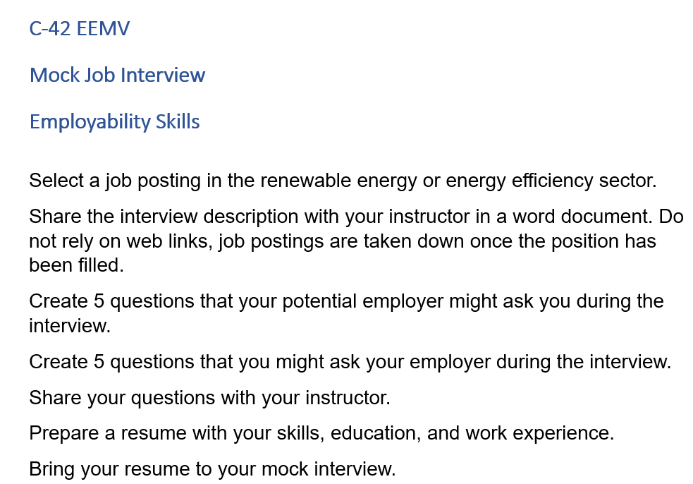
Example Employability Skills Exercise

Slide 25
That is the end of C-42! Questions?

