Slide 1
Design and Implementation of TVET Renewable Energy Course Pilot
DELIVERABLE #5 - TRAINING COURSES & PROFESSIONAL DEVELOPMENT
Session (June 16, 2023) – Term 4
C 62 – Advanced Energy System Design

Slide 2
Course 62 Advanced Energy System Design
Year Two April to June Term 6
10 Weeks with:
58.7 Classroom hours 10 weeks x 9 periods/week
Three periods Tuesday AM
Two periods Tuesday PM
One period lab Wednesday PM X 2
Three periods Thursday AM
Marking Breakdown
20% Individual Tests 30% Individual Projects
40% Group Projects
10% Employability Skills

Slide 3
What does “success” look like for students?
Students completing Year 1 (Installer) or Year 2 (Designer) Renewable Energy (RE) and Energy Efficiency (EE) program requirements
Students are Industry Qualified under NABCEP and others
Instructors are achieving the desired course outcomes and student understanding with the required resources
ITVET is equipped with resources for a scalable and sustainable program
Skills are competently applied to a changing Green Economy
Belize Employers are hiring competent and adaptable team members from the program

Slide 4
Development of Course 62
From Theory to Practical Application through:
Development of hands-on experiments and assessments of energy systems in Belize to act as a basis for assignments and projects within C-62 Advanced Energy System Design tasks and outcomes.

Slide 5
What does “success” look like for employers?
Advanced Energy System Design Practice:
Identification of the opportunity for advanced energy system design in client buildings or processes
Analysis of loads and identification of advanced energy system components to reduce energy consumption
Communication with clients to promote energy efficiency through advanced energy system design recommendations

Slide 6
Course Connections:
C62 Advanced Energy System Design course completion is delivered in
Term six with:
C61 Business Operations and Entrepreneurship
C63 Final Project

Slide 7
Program Overview (Term 6)

Slide 8
Master Plan and TDAP Use
Typical of ITVET:
For all courses
By all Instructors
For each term
Training Delivery and Assessment Plan
Profile of the Trainer / Portfolio of the Trainee
Program Policies & Regulations / Technology Requirements
Instructional Methods / Modes (Face to Face and Online)
Resources (Technical Underpinning Knowledge and Skills)
Delivery Schedule by week and Instructional Methods (IM)
Practical Grading Criteria and Theoretical Grading Criteria

Slide 9
Master Plan Learning Outcomes
Master Plan Learning Outcome 1 – Knowledge-Base
Through reading, listening and understanding classroom lectures, students will gain knowledge that will enable the application of their skills within the class, lab, and industry.
Master Plan Learning Outcome 2 – Investigation
An ability to conduct investigations of a complex problem by methods that include appropriate experiments, analysis and interpretation of data, and synthesis of information in order to reach valid conclusions.

Slide 10
Master Plan Learning Outcomes
Master Plan Learning Outcome 3 – Design
An ability to design solutions for complex, open-ended engineering problems and to design systems, components or processes that meet specified needs with appropriate attention to health and safety risks, applicable standards, and economic, environmental, cultural and societal considerations.
An ability to assess the requirements of an energy system by collecting data and making conclusions much like a detective solving a case.
Your case is how to create the most advanced energy system.
You will identify the best building envelope properties, system properties, and loads to recommend an advanced system that will meet the demand without curtailment!

Slide 11
Master Plan Learning Outcomes
Master Plan Learning Outcome 4 – Use of technical tools
An ability to create, select, apply, adapt, and extend appropriate techniques, resources, and modern technical tools to a range of renewable energy activities, from simple to complex, with an understanding of the associated limitations.
Master Plan Learning Outcome 5 – Individual work and teamwork
An ability to work effectively as a member and leader in teams, preferably in a multi-disciplinary setting.

Slide 12
Master Plan Learning Outcomes
Master Plan Learning Outcome 6 – Communication skills
An ability to communicate complex renewable energy concepts within the technical community, and with society at large.
An ability to read, write, speak and listen, and comprehend information.
An ability to write effective reports and design documentation
An ability to effectively give and respond to clear instructions.
Master Plan Learning Outcome 7 – Professionalism
An understanding of the roles and responsibilities of a renewable energy practitioner in society, especially the protection of the public and the public interest.

Slide 13
Master Plan Learning Outcomes
Master Plan Learning Outcome 8 – Impact of renewable energy on society and the environment:
An ability to analyze social and environmental aspects of renewable energy activities.
An understanding of the interactions that renewable energy projects have with the economic, social, health, safety, legal, and cultural aspects of society.
A prediction of the concepts of sustainable design, development and environmental stewardship.

Slide 14
Master Plan Tasks
Task 01: Identify energy systems in the built environment
Task 02: Identify design concepts and components to implement an advanced energy system in a building or process
Task 03: Identify relevant codes and requirements that impact advanced energy system design and installation
Task 04: Identify factors that influence advanced energy system design and performance
Task 05: Identify equipment specification data
Task 06: Explain energy storage and advanced energy system sizing considerations

Slide 15
Marking Breakdown
Individual Tests 20%
Individual Assignments 30%
Group Projects 40%
Employability Skills 10%

Slide 16
Advanced Energy System Design
The Objectives of an Advanced Energy System:
Advanced Energy Systems use the most efficient and low-impact systems to
achieve the desired result and build in redundancy to prevent system
downtime, brownouts or blackouts.
Downtime is the period in which a system is unavailable, offline or not
operational.
A brownout occurs when the line voltage from the electricity supply is
temporarily reduced. Voltage reduction may impede system functions and
damage electronic controls.
A blackout occurs when the electricity supply is interrupted and electrical
systems are inoperable. This may affect cooking, heating, and cooling
appliances and critical controls such as safety and communication systems.
Notes:
https://www.esfi.org/brownouts/

Slide 17
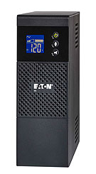
Advanced Energy System Design
The Components of an Advanced Energy System:
Uninterruptible Power Supplies (UPS)
Battery backup systems can protect critical electronic systems by preventing sudden shut-downs due to interruption of power supply.
A UPS is an electrical device that provides emergency power to a load when the
usual main power source fails.
Consider a hurricane that topples power lines, and restoration of the main electricity supply could take days, weeks or months in some remote areas.
Protecting networking equipment and data storage centers (DSCs) is insured when UPS systems are installed
Eaton UPS and Filmwerks Application Video
Notes:
Watch Video on UPS application for power and carbon footprint

Slide 18
Uninterruptible Power Supplies (UPS)
The Components of an Advanced Energy System:
How to size your UPS:
UPS are given a power rating in volt-amperes (VA)
UPS range in size from 300 VA to 5,000 kilovolt amperes (kVA)
Choose a UPS that is 1.2 times the size of your VA capacity to account for the high
power demand during the startup of devices
Remember:
If there is anticipated growth of the system capacity (newer server hardware typically
has higher demand requirements) a higher multiplier than the 1.2 X should be used.
Video VA vs Watts
Notes:
Watch Video VA VS Watts See Excel Sheet “Sizing UPS and Inverters” in C-62 Resources>Exercises

Slide 19
Uninterruptible Power Supplies (UPS)
The Components of an Advanced Energy System:
Uninterruptible Power Supplies (UPS)
Function:
A UPS system supplies power to devices from its internal battery to keep devices
operable during blackouts for a specific period of time.
When the UPS energy storage has been depleted supplying power to the devices, the
UPS assists in system shutdown to prevent damage to the devices or data loss in
computers.
https://www.eaton.com/5SC UPS
Notes:
https://www.eaton.com/us/en-us/products/backup-power-ups-surge-it-power-distribution/backup-power-ups/uninterruptible-power-supply-faq.html

Slide 20
Uninterruptible Power Supplies (UPS)
How to size your UPS:
Add the load of each device that is intended to be supported by the UPS.
Nameplate information will provide the voltage and amperes or watts:
UPS are given a power rating in volt-amperes (VA)
UPS range in size from 300 VA to 5,000 kilovolt amperes (kVA)
Choose a UPS that is 1.2 times the size of your VA capacity to account for the high
power demand during the startup of devices
When calculating demand, remember P = I*V
Where (P)ower = Watts (demand) Energy = P*t (time in hours) = Watt hours
I = Amperes
V= Volts

Slide 21
Advanced Energy systems
How to size your Inverter:
Add the load (W) of each device that is intended to be supported by the
inverter.
Nameplate information will provide the voltage and amperes (P=IV) or Watts
Inverters are given a power rating in volts and watts depending on battery size and load serviced
Inverters range in size from 75 to 10,000 W for residential applications, and up to 50,000 watts for larger systems
Choose an inverter that matches the battery size, load intended and surge rating on overload

Slide 22
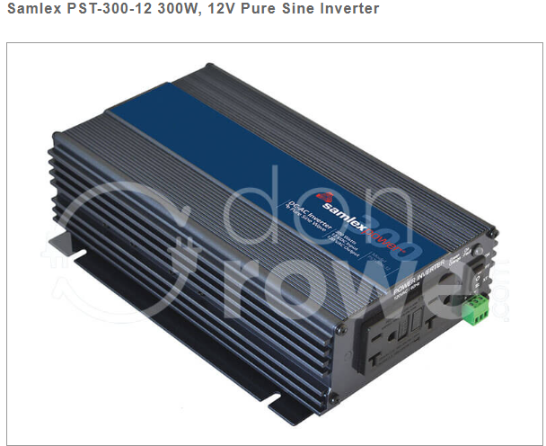
Advanced Energy systems
Inverters and their role:
Remember: A 12V pure sine inverter can accommodate a DC power conversion to
300 W AC power
Therefore:
Plug loads cannot exceed the power supported.
There are two plugs in this example, so:
Two plugs with a maximum combined 300 W
demand can operate two devices
Two plugs, each 150 W max

Slide 23
Advanced Energy systems
Inverter Types:
The most common inverters today are:
Sine wave inverters that are the most efficient and work well with all equipment
Modified Sine Wave Inverters that work with some equipment but with reduced efficiency
Square wave inverters that are the cheapest and will run equipment with universal motors but not much else and are seldom seen in today’s technology
Solar Electric Inverter Types

Slide 24
Advanced Energy System Design
Energy Storage Systems
Battery storage systems provide a backup power supply for buildings, systems and
transportation infrastructure to bridge demand during power outages.
Battery storage systems can be paired with renewable energy (RE) generation
systems such as solar, wind and hydro to support energy independence and
reduction of grid dependency.

Slide 25
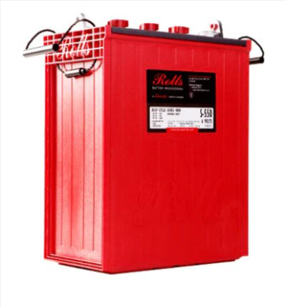
Energy Storage Systems
Battery storage of renewable energy provides energy security in remote locations and during grid failure.
Battery size must be matched to the building or system load!
If it is oversized, curtailment will be required unless the system is grid-tied
If it is undersized, the equipment load will not be met, and occupant needs, or production rates will be adversely impacted
Surrette Battery S6_L16_HC

Slide 26
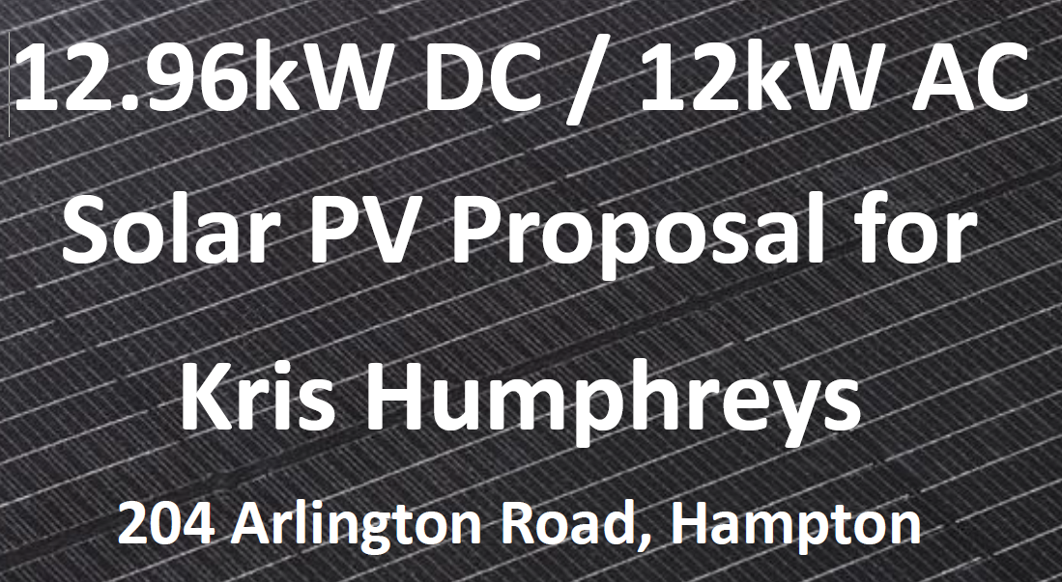
Energy Storage Systems

Slide 27
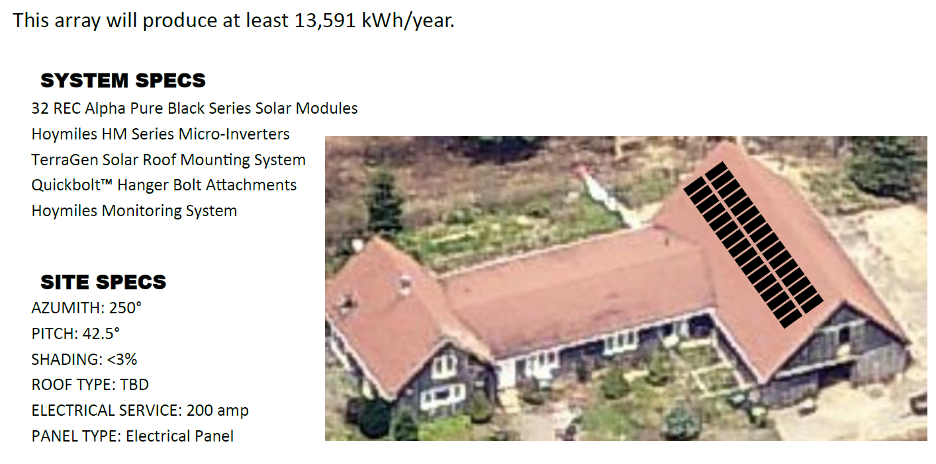
Energy Storage Systems
Notes:
What might impact the installation of this solar array? At a glance it looks good, but what critical factors might influence the project?

Slide 28
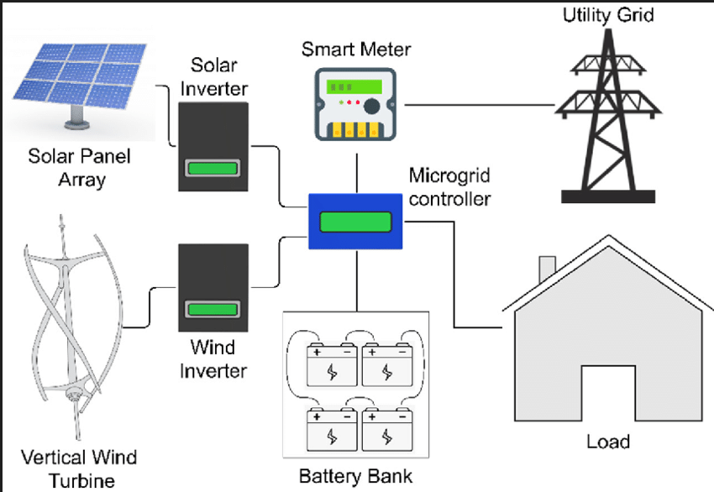
Advanced Energy System Example: What else could be added?
Notes:
See C-62 Resources PDF Multi-Objective_Sizing_Optimization_of_a_Grid-Connected System, what else could we add to this system t make it more resilient and efficient?

Slide 29
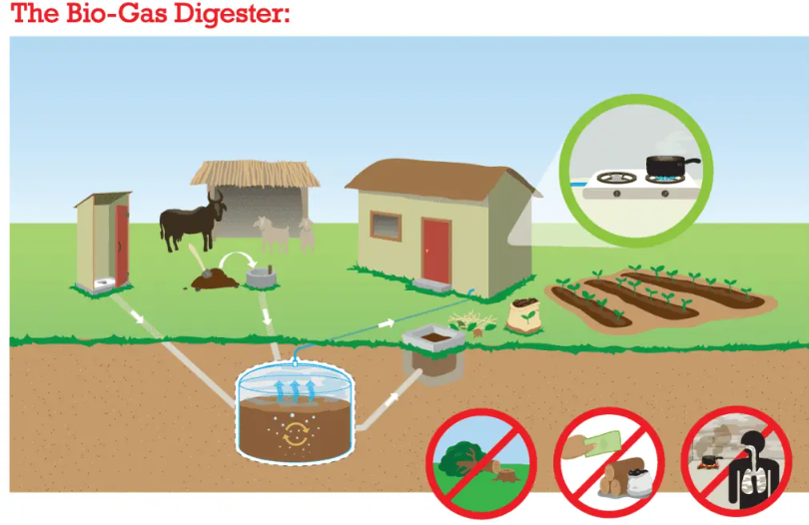
Energy Storage System Components
https://www.build-a-biogas-plant.com/methane-and-biogas/
Notes:
https://www.build-a-biogas-plant.com//biogas-case-studies

Slide 30
Biogas Terms
Anaerobic: An environment or condition that lacks oxygen.
Biogas: A gas mixture, produced during anaerobic digestion that contains methane and carbon dioxide. Biogas can be burned as an energy source.
Bioreactor: An artificial environment in which organisms are encouraged to accomplish a particular task, essentially microbes’ workplace.
Organic Material: All living, or once-living things or items produced by living things. These carbon-based items include food waste, yard scraps, plant material, sugar, animals and people. Also just called "organics."
Notes:
Review Lab Biogas Digester Experiment

Slide 31
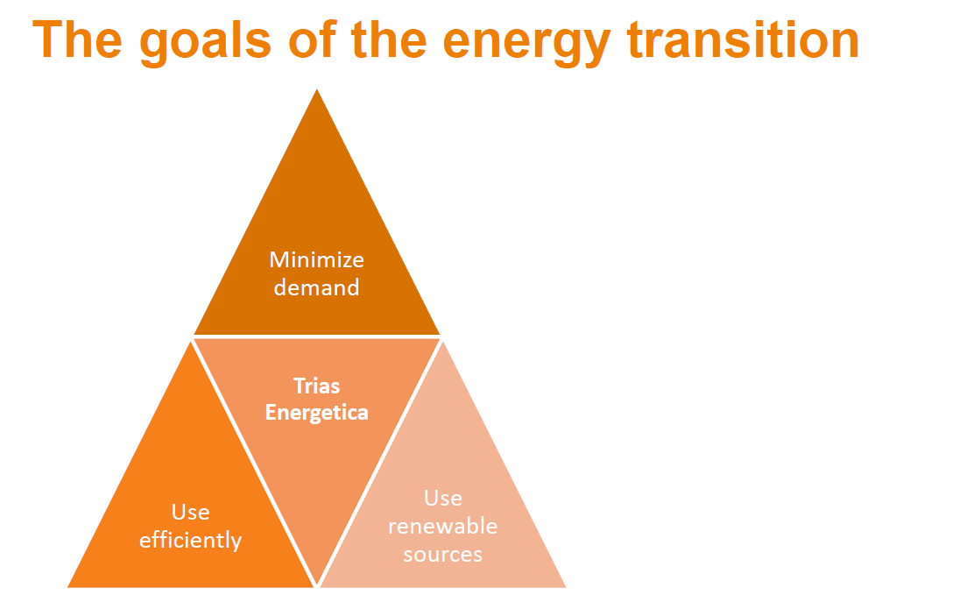
Advanced Energy and The Trias Energetic
Why is the implementation of Advanced Energy Systems critical?
Notes:
Ask how the advanced design minimizes demand, improves efficient use, and promotes renewable resources

Slide 32
The Trias Energetic
A global energy transition away from fossil fuel use and eCO2 emissions is critical to reducing our environmental impact and slowing climate change related to global warming.

Slide 33
Advanced Energy System Design Incorporates The Trias Energetic
Minimize Demand
Deadband technology integration to prevent the operation of heating and cooling systems at the same time
In some climates there is a high-temperature variation, and it may be necessary on the same day to turn on the heating in certain hours and the cooling system in others.
The same situation can occur in buildings with rooms with different exposures (e.g., north/south).
Notes:
The term shoulder seasons is used in cliamtes with a seasonal change in weather, such as spring and fall.

Slide 34
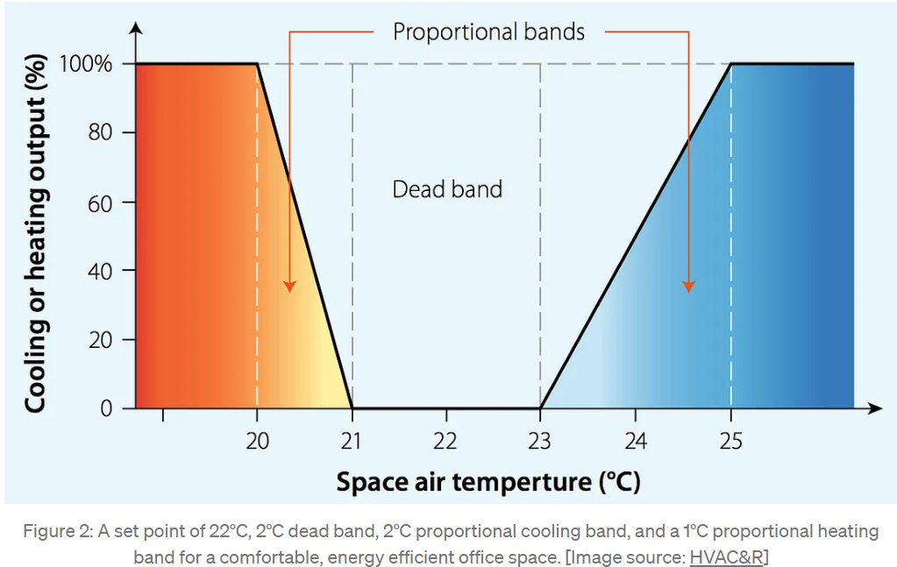
Advanced Energy System Design Incorporates
Notes:
The term shoulder seasons is used in cliamtes with a seasonal change in weather, such as spring and fall.

Slide 35
Advanced Energy System Design Incorporates
Efficient Use With:
Variable frequency drives (VFDs) in motors
A VFD is a type of motor controller that drives an electric motor by varying the frequency and voltage supplied
Applicable to AC induction electric motors or synchronous motors
Other names for a VFD are variable speed drive (VSD), adjustable speed drive, adjustable frequency drive, AC drive, microdrive, and inverter

Slide 36
Advanced Energy System Design
Efficient Use With:
Variable frequency drives (VFDs) in motors
Frequency (or hertz) is directly related to the motor’s speed measured in revolutions per minute (RPMs)
The faster the frequency, the faster the RPMs go
As the system’s motor speed requirements change, the VFD can simply turn up or down the motor speed to meet the speed requirement
This is a better energy-use approach than full-speed ON or OFF!

Slide 37
Advanced Energy System Design
Efficient Use With:
Variable frequency drives (VFDs) in motors
There are many reasons why we may want to adjust motor speed.
For example, to:
Save energy and improve system efficiency
Match the speed of the drive to the process requirements
Match the torque or power of a drive to the process requirements
Improve the working environment
Lower noise levels, for example from fans and pumps
Reduce mechanical stress on machines to extend their lifetime
Shave peak consumption to avoid peak-demand prices and reduce the motor size required
Danfoss: What is a variable frequency drive?

Slide 38
Advanced Energy System Design
Efficient Use With:
VRF heat pump technology for heating and cooling
Heat pumps are the most efficient mechanical system for space heating and cooling.
Heat pumps incorporate VFD technology to increase the efficiency of the refrigeration cycle which operates on a refrigerant gas.
Heat pump efficiency is rated by the formula W out/ W in and is referred to as the coefficient of performance (COP).
Air-to-air heat pumps, air-to-water heat pumps and geothermal heat pumps may have COPs ranging from 2.5-5.55.
The higher the COP, the more efficient the system is with less energy consumption.

Slide 39
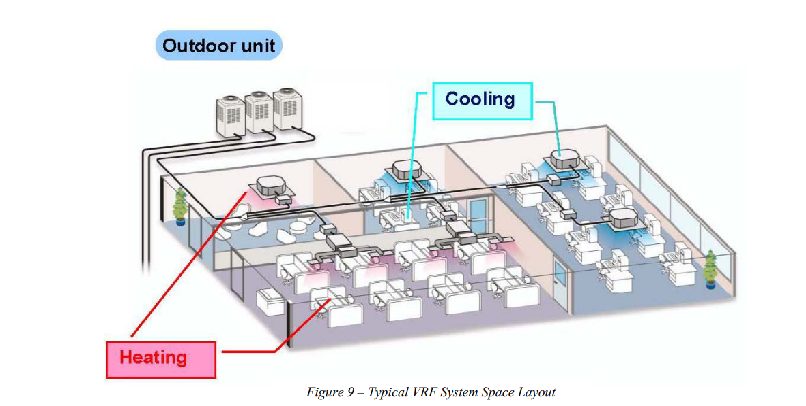
Advanced Energy System Design
Efficient Use With:
Variable refrigerant flow (VRF) heat pump technology for heating and cooling
Notes:
See Variable Refrigerant Flow Systems Flexible Solutions for Comfort by Carrier in Resources Folder C-62

Slide 40
Advanced Energy System Design
Efficient Use With:
VRF heat pump technology for heating and cooling
Heat pumps are the most efficient mechanical system for space heating and cooling.
Heat pumps incorporate VFD technology to increase the efficiency of the refrigeration cycle which operates on a refrigerant gas.
Heat pump efficiency is rated by the formula W out/ W in and is referred to as the coefficient of performance (COP).
Air-to-air heat pumps, air-to-water heat pumps and geothermal heat pumps may have COPs ranging from 2.5-5.55.
The higher the COP, the more efficient the system is with less energy consumption.

Slide 41
Advanced Energy System Design
Efficient Use With:
VRF heat pump technology for heating and cooling
Hydrochlorofluorocarbon (HCFC) refrigerant gases are being phased out due to their high global warming potential (GWP) and ozone-depleting properties (ODP).
New refrigerant gases such as carbon dioxide (CO2) and propane (C3H8) have a much lower GWP and no ODP compared to the hydrofluorocarbons (HFCs) that have been used historically.

Slide 42
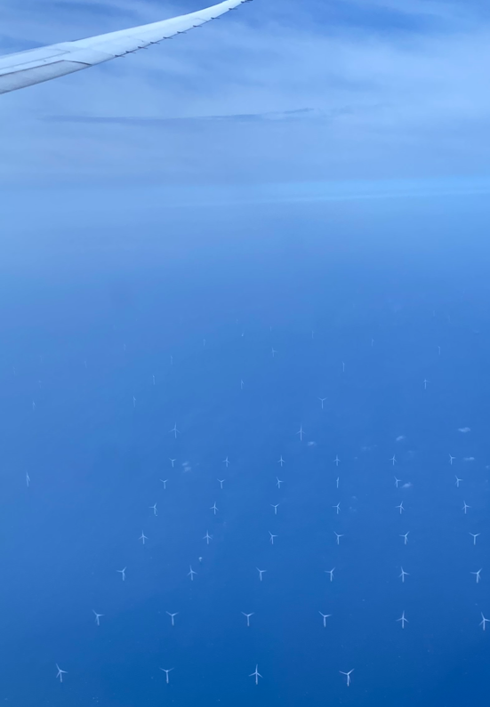
Advanced Energy System Design Incorporates
Renewable resource integration
Solar, wind, tidal and green biogas
generation, coupled with energy
storage and controls to maximize efficiency
We need them all working together!

Slide 43
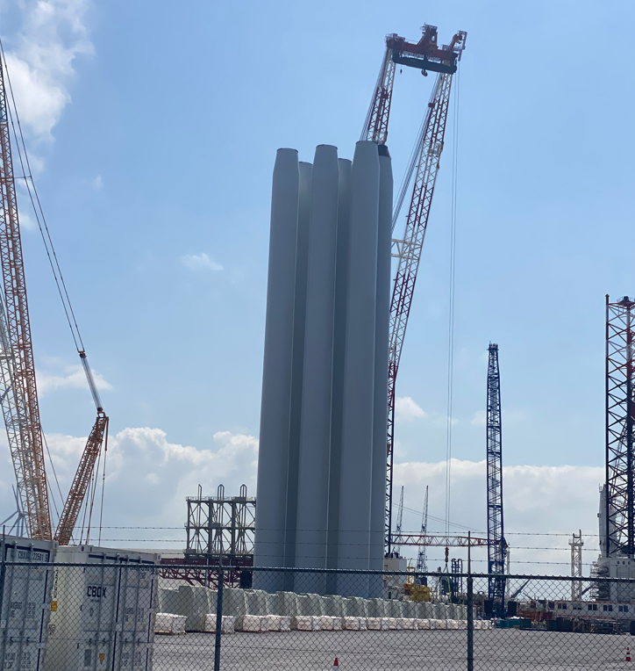
Advanced Energy System Design Incorporates
Renewable resource integration
Offshore wind technology is rapidly
Advancing as a leading source of clean
wind energy in the EU.

Slide 44
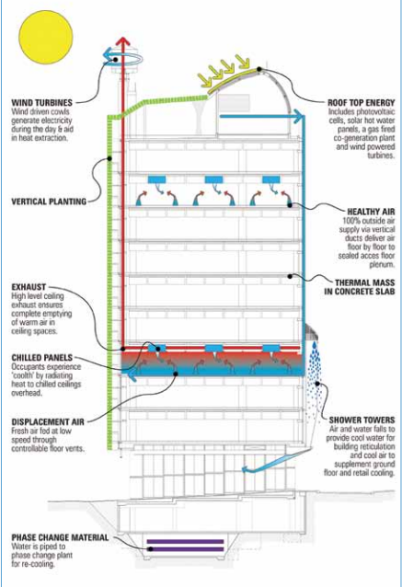
Master Plan Tasks
Task 01: Identify energy systems in thebuilt environment
Building as a system:
Approximately 22% higher construction cost due in part to backup mechanical systems
Conservative 11-year payback on capital
Forecast is a more realistic 8-year return based on initial performance
Cairns Regional Council. (2021).Sustainable Tropical Building Design.
https://www.cairns.qld.gov.au/__data/assets/pdf_file/0003/45642/BuildingDesign.pdf
Notes:
*For more information, please refer to the PDF cited below in the C-62 Resource folder..

Slide 45
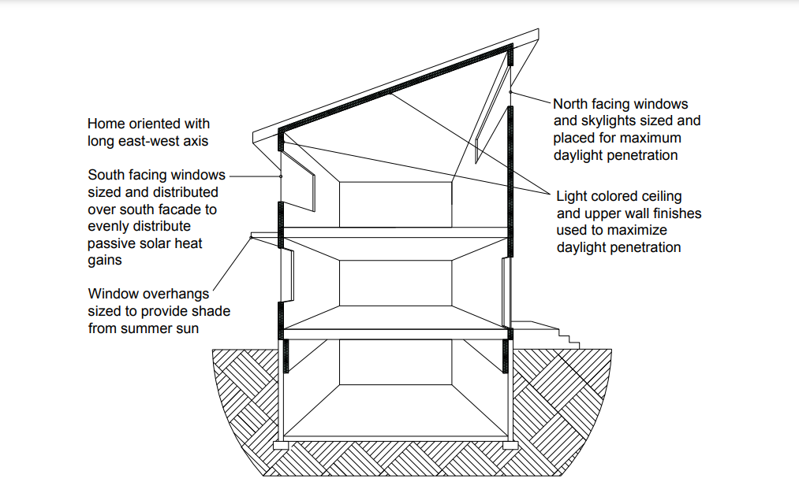
Master Plan Tasks
Task 01: Identify energy systems in the built environment
Ideal design for seasonal climate zones with heating and cooling requirements
FP Innovations. (2014). High-Performance Housing in British Columbia. https://www.bchousing.org/publications/High-Performance-Housing-BC.pdf
Notes:
*For more information, please refer to the PDF cited below in the C-62 Resource folder..

Slide 46
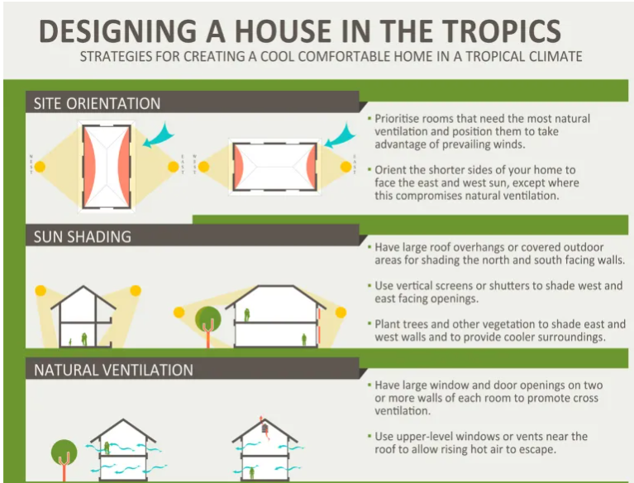
Master Plan Tasks
Task 01: Identify energy systems in the built environment
Ideal design for tropical climate zones with cooling loads
Cairns Regional Council. (2021). Sustainable Tropical Building Design Guidelines for Commercial Buildings.
https://www.cairns.qld.gov.au/__data/assets/pdf_file/0003/45642/BuildingDesign.pdf
Notes:
*For more information, please refer to the PDF cited below in the C-62 Resource folder..

Slide 47
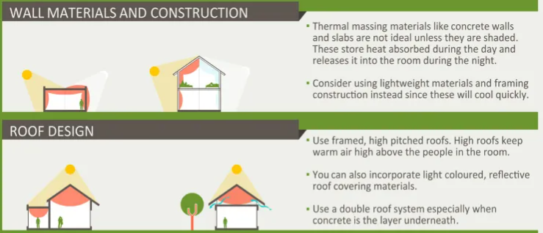
Master Plan Tasks
Task 01: Identify energy systems in the built environment
Ideal design for tropical climate zones with cooling loads
Cairns Regional Council. (2021). Sustainable Tropical Building Design Guidelines for Commercial Buildings.
https://www.cairns.qld.gov.au/__data/assets/pdf_file/0003/45642/BuildingDesign.pdf
Notes:
*For more information, please refer to the PDF cited below in the C-62 Resource folder..

Slide 48
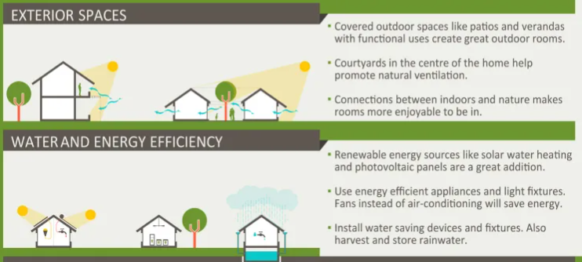
Master Plan Tasks
Task 01: Identify energy systems in the built environment
Ideal design for tropical climate zones with cooling loads
Architropics. (2021). Designing a House for the Tropics. https://architropics.com/designing-a-house-for-the-tropics/
Notes:
*For more information, please refer to the PDF cited below in the C-62 Resource folder..

Slide 49
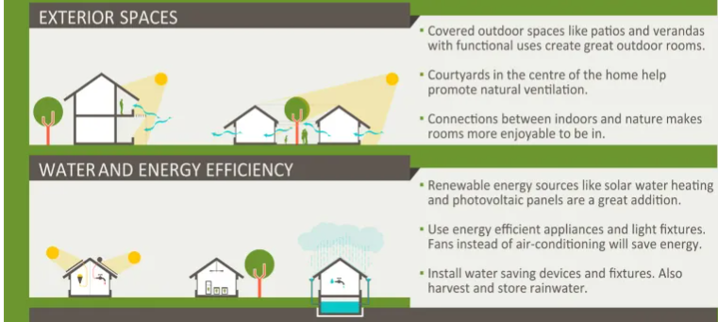
Master Plan Tasks
Task 01: Identify energy systems in the built environment
Ideal design for tropical climate zones with cooling loads
Architropics. (2021). Designing a House for the Tropics. https://architropics.com/designing-a-house-for-the-tropics/
Notes:
*For more information, please refer to the PDF cited below in the C-62 Resource folder..

Slide 50
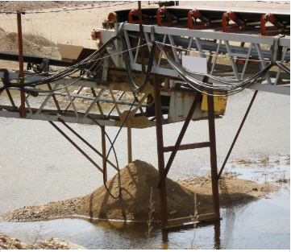
Master Plan Tasks
Task 01: Identify energy systems in the built environment
Identify losses:
Implement solutions:
Architropics. (2021). Designing a House for the Tropics. https://architropics.com/designing-a-house-for-the-tropics/
Notes:
*For more information, please refer to the PDF cited below in the C-62 Resource folder..

Slide 51
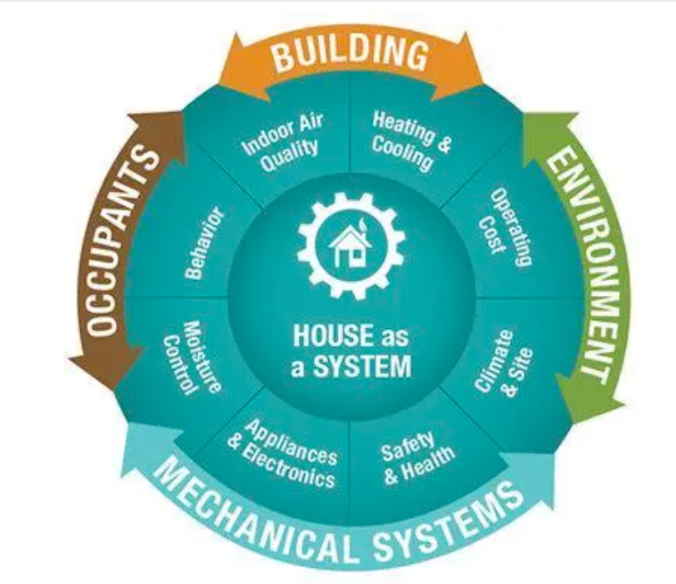
Master Plan Tasks
Task 02: Identify design concepts, mechanical equipment and renewable energy systems used in advanced energy system design
Photo Credit Conservation Services Group. (2014, March 21). Build with Rise. https://www.buildwithrise.com/stories/house-as-a-system-concept
Notes:
*For more information, please refer to the PDF cited below in the C-62 Resource folder..

Slide 52
Master Plan Tasks
Task 03: Identify relevant codes and requirements that impact advanced energy system design and installation
https://www.en-tran-ce.org/en/projects/we-energy-game/
Notes:
*For more information, please refer to the PDF cited below in the C-62 Resource folder..

Slide 53
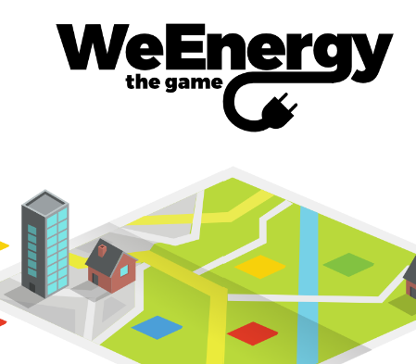
Master Plan Tasks
Task 03: Identify relevant codes and requirements that impact advanced energy system design and installation
https://game.wegosustainable.nl
Notes:
*For more information, please refer to the PDF cited below in the C-62 Resource folder..

Slide 54
Questions or Comments?
Thank you!
Notes:
*For more information, please refer to the PDF cited below in the C-62 Resource folder..

