Slide 1
Design and Implementation of Pilot of a TVET Renewable Energy Course
DELIVERABLE #5 - TRAINING COURSES & PROFESSIONAL DEVELOPMENT

Slide 2
Codes and Regulations
This course introduces the NEC (National Electrical Code (United States))
Code rules will be explored and explained as they relate to Renewable Energy (RE) systems.
The 2023 Version of the NEC will be used.
The assumption is that Belize will adopt the NEC as the official electrical code for RE.

Slide 3
Codes and Regulations
Course out comes include:
Understand the layout of the NEC
Identify the Articles that govern the RE systems.
Explain the process of applying code rules to RE systems.
Apply code rules to the installation of RE systems

Slide 4
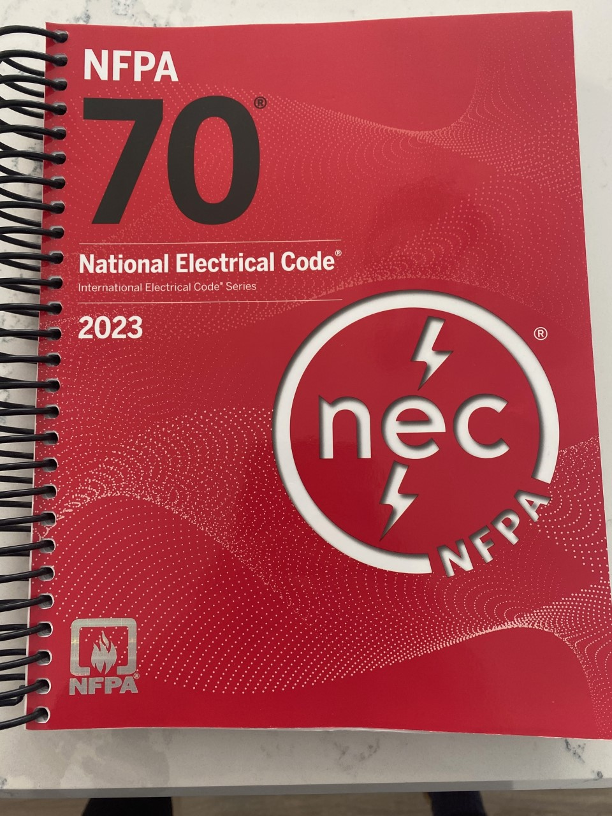
Codes and Regulations
2023 NEC
Picture courtesy author

Slide 5
Codes and Regulations
NEC and other governing bodies that produce electrical standards.
Other examples are:
Canadian Electrical Code by CSA (Canadian Standards Council)
BS 7671 is the British requirements for Electrical Installations
IEC60364 is Europe's version

Slide 6
Codes and Regulations
The role of the NEC is to reduce electrical hazards and fires.
Printed copies date back to 1897.
Each new version supersedes all previous versions.
The NEC is adopted by many Caribbean countries.

Slide 7
Codes and Regulations
The “Contents” identify the Chapters.
Each Chapter is broken into Articles starting with the number of the chapter
NEC Code is coded as follows:
### is Article Number (First # is Chapter Number)

Slide 8
Codes and Regulations
Example: 690.41(B)(2)(1)
6 means Chapter# 6 - 690 means Article # 690
- 41 means section or code rule #41
- B means subsection #B
- 2 means sub-sub section #2
- 1 means point #1

Slide 9
Codes and Regulations
# Roman-numerals which are the Part Number
Part I.; Part II.; Part III.; Part IV.; Part V. etc
Example: In Article 690 Solar Photovoltaic (PV) Systems
Part I. General
Part II. Circuit Requirements
Part III. Disconnecting Means
Part IV. Wiring Methods and Materials
Part V. Grounding and Bonding
Part VI. Source Connections

Slide 10
Codes and Regulations
There are Chapters in the NEC that deal with RE systems directly.
Some Chapters are specific and are required to explain rues used for the RE systems.

Slide 11
Codes and Regulations
Article 90 is the introduction to the code and its layout.
90.1 is the Scope of the NEC
It introduces the Code, its use and application.
It describes installations that it covers and does not cover.
Plus other explanations of the use and organization of the Code.

Slide 12
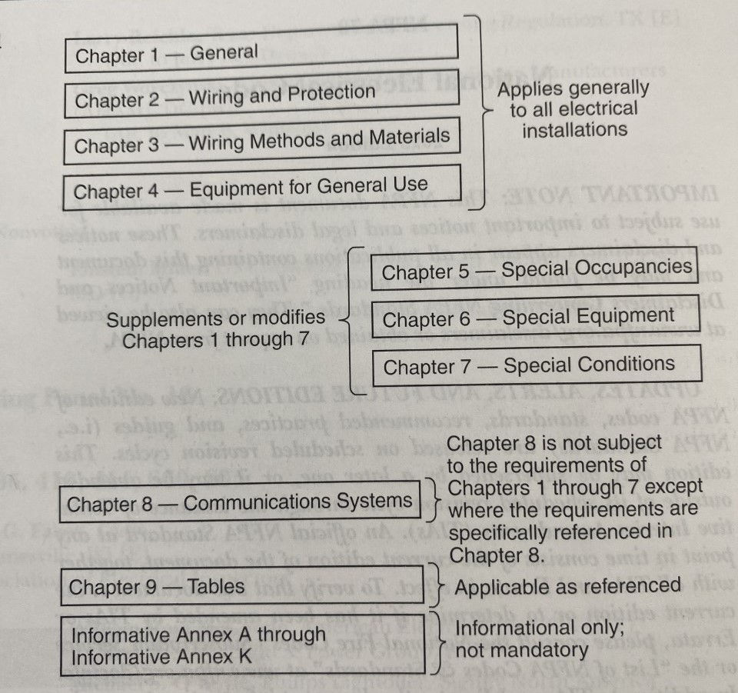
Codes and Regulations
Figure 90.3 shows the Code Arrangement.
NEC 2023

Slide 13
Codes and Regulations
Chapters 1 – 4 applies generally to all electrical installations.
Chapters 5 – 6 – 7 are for special installations.
These chapters supplements or modifies
chapters 1 – 4.
Chapter 9 has tables for referencing.
NEC 2023

Slide 14
Codes and Regulations
The (9) NEC chapters are divided into Chapters and Articles.
Articles such as:
Article 100 - General Requirements
Article 200 – Wiring and Protection
Article 300 - Wiring Methods and Materials
Article 400 – Equipment for General Use
2023 NEC

Slide 15
Codes and Regulations
Article 500 – Special Occupancies
Article 600 – Special Equipment
Article 700 – Special Conditions
Article 800 - Communication Systems
Article 900 - Tables
2023 NEC

Slide 16
Codes and Regulations
Article 100 – Definitions placed in alphabetical order.
Figures are also included to help explain the definition.
Reference to the CMP - # (Code Making Panel) is provided as well (Folks who worked on the code).
2023 NEC

Slide 17
Codes and Regulations
Article 110 – General Requirements for Electrical Installations.
Article 110.1 – Scope. Most articles have a Scope defining what the Article covers.
Article 110.2 – Approval. States that conductors and equipment permitted by this Code shall be approved.
2023 NEC

Slide 18
Codes and Regulations
Definitions of Approved, Identified, Labeled and Listed.
These words describe the validity of the equipment used.
APPROVED = Acceptable to the authority having jurisdiction (AHJ). Belize Electricity Limited (BEL)
2023 NEC

Slide 19
Codes and Regulations
IDENTIFIED = Recognized as suitable for the specific purpose, function, use, environment, application and so forth, where described in a particular Code requirement.
Suitability of equipment for a specific purpose, environment, or application may be determined by a qualified testing laboratory, inspection agency, or other organization concerned with product evaluation. Such identification may include labeling or listing.
Mike Holt + 2023 NEC

Slide 20
Codes and Regulations
LABELED = Equipment or materials to which has been attached a label, symbol or other identifying mark of an organization that is acceptable to the AHJ. (BEL)
Manufacturer indicates compliance with appropriate standards or performance in a specific manner.
2023 NEC

Slide 21
Codes and Regulations
It means that a label, symbol, or some identifying mark has been attached to the equipment or materials to indicate compliance with appropriate standards, like UL or CSA or ETL.
UL = Underwriters Laboratories
CSA = Canadian Standards Association
ETL = Intertek Electrical Testing Labs (ETL)
2023 NEC

Slide 22
Codes and Regulations
LISTED = Equipment, materials, or services included in a list published by an organization that is acceptable to the AHJ and concerned with evaluation of products or services, that maintains periodic inspection of production of listed equipment or materials or periodic evaluation of services, and whose listing states that either the equipment or material, or services meets appropriate designated standard or has been tested and found suitable for a specific purpose.
2023 NEC

Slide 23
Codes and Regulations
Underwriters Laboratories (UL) are most widely known for standards in electrical products.
IEEE-SA – IEEE Standards Association
NEMA – National Electrical Manufacturers Association
CE (as the logo CЄ) mean that the manufacturer or importer affirms the good's conformity with European health, safety, and environmental protection standards.

Slide 24
Codes and Regulations
The equipment, materials or services are included in a list published by a Nationally Recognized Testing Laboratory (NRTL) are considered as listed.

Slide 25
Codes and Regulations
The next group of slides introduce Section 690 including terms / definitions used in the section.

Slide 26
Codes and Regulations
Chapter 6 Special Equipment.
Article 690 – Solar Photovoltaic (PV) Systems.
Part I. General.
Article 690.1 Scope. This article applies to solar PV systems, including the array circuit(s), inverter(s), and controller(s) for such systems.
The systems covered by this article include those interactive with other electric power production sources or stand-alone, or both.
2023 NEC

Slide 27
Codes and Regulations
These PV systems may have ac or dc output for utilization.
2023 NEC

Slide 28
Codes and Regulations
Throughout the code there are “Information Notes” that explain some details of a particular code.
Informational Note No. 2: Article 691 covers the installation of large-scale PV electric supply stations.
Not covered in this course.
2023 NEC

Slide 29
Codes and Regulations
The definitions in section 690 shall apply only within this article. (These are only found in this section.)
AC Module System. An assembly of ac modules, wiring methods, materials, and subassemblies that are evaluated, identified, and defined as a system.
Alternating-Current (ac) Module (Alternating-Current Photovoltaic Module). A complete, environmentally protected unit consisting of solar cells, inverter, and other components, designed to produce ac power.
2023 NEC

Slide 30
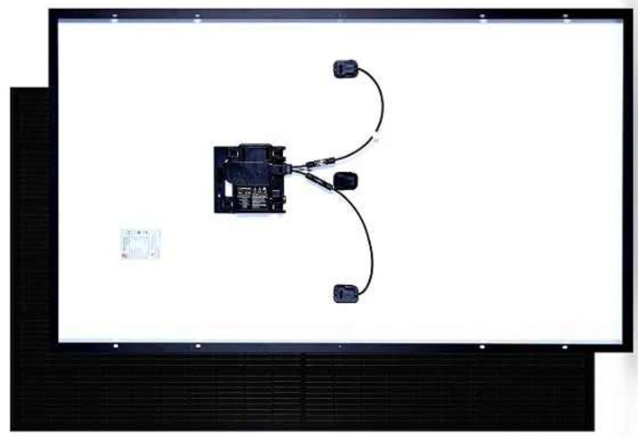
Codes and Regulations
AC Module.
Enphase microinverter mounted directly to the PV panel.
Enphase

Slide 31
Codes and Regulations
In a conventional solar system, solar panels send direct current (DC) to an inverter that changes the power to alternating current (AC) to match the electricity in our homes.
With AC Solar Modulars the solar panel has microinverter technology on the back side that is directly integrated by the manufacturer at the factory.
Enphase

Slide 32
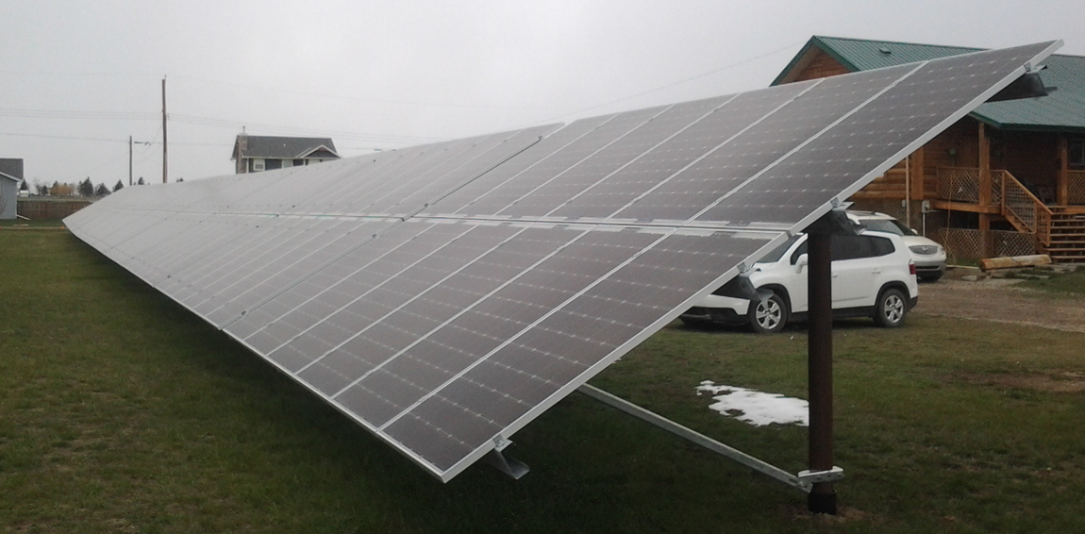
Codes and Regulations
Array. A mechanically and electrically integrated grouping of modules with support structure, including any attached system components such as inverter(s) or dc-to-dc converter(s) and attached associated wiring.
Cory Manual + 2023 NEC

Slide 33
Codes and Regulations
Bipolar Circuit. A dc circuit that is comprised of two monopole circuits, each having an opposite polarity connected to a common reference point.(Not covered in this course)
More information on the monopole circuit that comprises a bipolar circuit in later slide.
2023 NEC

Slide 34
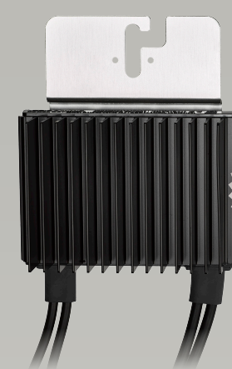
Codes and Regulations
DC-to-DC Converter. A device installed in the PV source circuit or PV output circuit that can provide an output dc voltage and current at a
higher or lower value than the input
dc voltage and current.
An example of a DC-to-DC
Converter is an optimizer.
A device that provides MPPT at the
module level.
2023 NEC

Slide 35
Codes and Regulations
DC-to-DC Converter Output Circuit. Circuit conductors between the dc-to-dc converter source circuit(s) and the inverter or dc utilization equipment.
See next slide.
2023 NEC

Slide 36
Codes and Regulations
DC to DC Converter Output Circuit
DC to DC
Converters
Inverter
Combiner
Box
Author

Slide 37
Codes and Regulations
DC-to-DC Converter Source Circuit. Circuits between dc-to-dc converters and from dc-to-dc converters to the common connection point(s) of the dc system.
See next slide.
2023 NEC

Slide 38
Codes and Regulations
DC to DC Converter Source Circuits
DC to DC
Converters
Combiner
Box
Author

Slide 39
Codes and Regulations
Direct-Current (dc) Combiner. An enclosure that includes devices used to connect two or more PV system dc circuits in parallel (pictured next slide).
Can be a combiner box or a junction box.
If with a junction box, only two strings because with more than two strings an overcurrent device is required.
2023 NEC

Slide 40
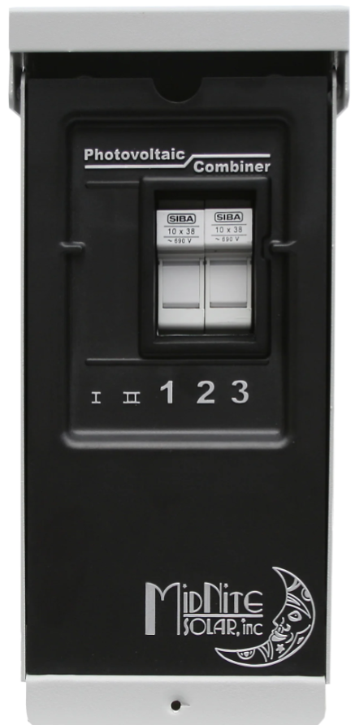
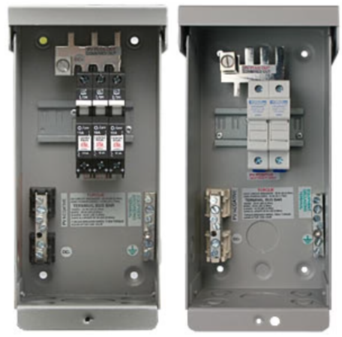
Codes and Regulations
Direct-Current (dc) Combiner. (Combiner Box)
MidNite Solar

Slide 41
Codes and Regulations
Electronic Power Converter.
A device that uses power electronics to convert one form of electrical power into another form of electrical power.
Informational Note: Examples of electronic power converters include, but are not limited to, inverters, dc-to-dc converters, and electronic charge controllers. These devices have limited current capabilities based on the device ratings at continuous rated power.
2023 NEC

Slide 42
Codes and Regulations
Grounded, Functionally. A system that has an electrical ground reference for operational purposes that is not solidly grounded.
Informational Note: A functionally grounded system is often connected to ground through an electronic means internal to an inverter or charge controller that provides ground-fault protection. Examples of operational purposes for functionally grounded systems include ground-fault detection.
2023 NEC

Slide 43
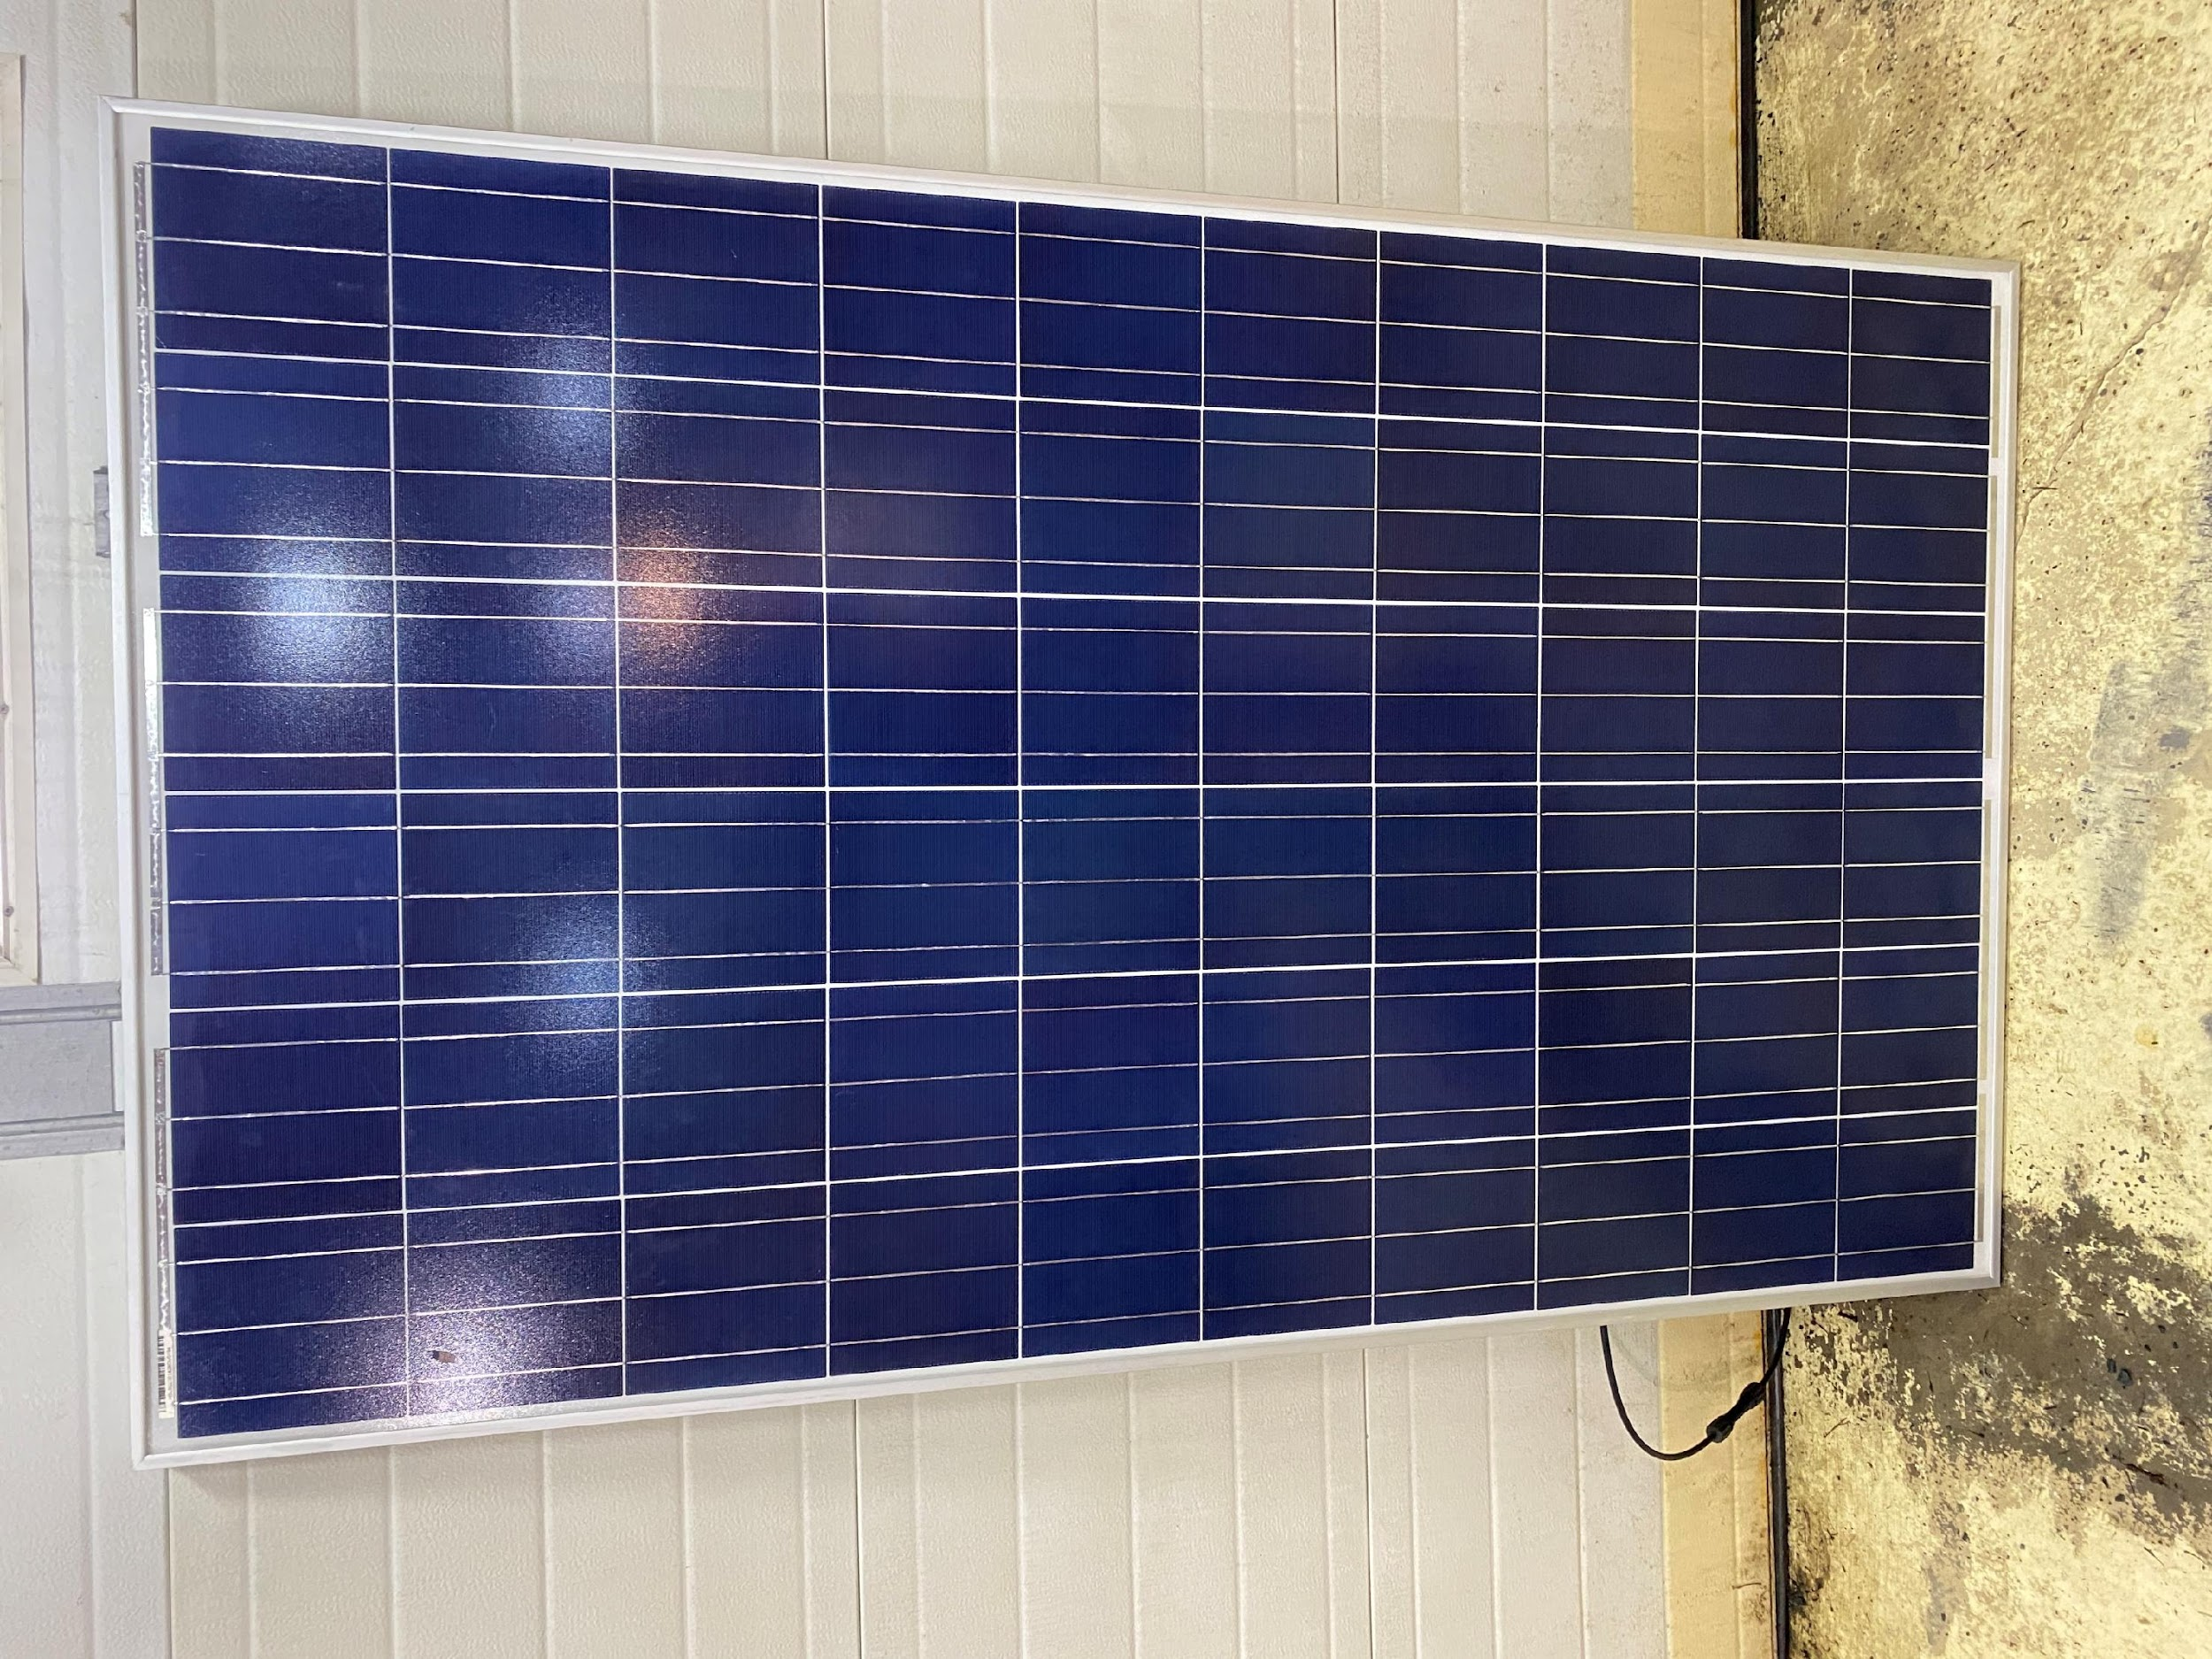
Codes and Regulations
Module. A complete, environmentally protected unit consisting of solar cells and other components designed to produce dc power.
2023 NEC

Slide 44
Codes and Regulations
Monopole Circuit. An electrical subset of a PV system that has two conductors in the output circuit, one positive (+) and one negative (—).
Each monopole circuit is connected to form the bipolar array. (Rarely used array)
2023 NEC

Slide 45
Codes and Regulations
Monopole Circuit. An electrical subset of a PV system that has two conductors in the output circuit, one positive (+) and one negative (—).
Two monopole circuits making a bipolar array.
2023 NEC

Slide 46
Codes and Regulations
PV Source Circuit. The dc circuit conductors between modules and from modules to dc combiners, electronic power converters, or a dc PV system disconnecting means.
See next slide.
2023 NEC

Slide 47
Codes and Regulations
PV Source Circuit or PV String Circuit.
DC to DC
Converters
Combiner
Box
Author

Slide 48
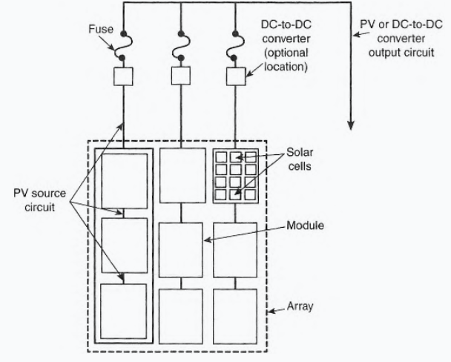
Codes and Regulations
PV Output Circuit. The dc circuit conductors from two or more connected PV source circuits to their point of termination.
2023 NEC

Slide 49
Codes and Regulations
PV Output Circuit / Source Circuit.
Combiner
Box
Author

Slide 50
Codes and Regulations
PV System DC Circuit.
Any dc conductor in PV source circuits, PV output circuits, dc-to-dc converter source circuits, and dc-to-dc converter output circuits.
Not an ac circuit, just dc wiring anywhere in the PV circuit(s).
2023 NEC

Slide 51
Codes and Regulations
Article 690 refers / references to other articles / chapters.
These are for general conditions that are also referenced in section 690.
The next slides are the basic article references used.
2023 NEC

Slide 52
Codes and Regulations
Article 110.7 – Wiring Integrity. Completed wiring installations shall be free of short circuits, ground faults, or any connections to ground other than as required or permitted elsewhere in this Code.
Good Workmanship, professionally done.
2023 NEC

Slide 53
Codes and Regulations
Article 110.8 – Wiring Methods. Only methods recognized as suitable are included in this Code.
Wiring methods is the identification of electrical conductors or wires by their general type.
An example would be voltage limitations (under 1000 volts).
2023 NEC

Slide 54
Codes and Regulations
Article 110.12 – Mechanical Execution of Work.
Electrical equipment shall be installed in a professional and skillful manner.
Safety and cleanliness are included in this definition.
2023 NEC

Slide 55
Codes and Regulations
110.12(A) Unused Openings. Unused openings, shall be closed to afford protection substantially equivalent to the wall of the equipment.
If knockout is not used, but
is opened, it must be
resealed.
Author + 2023 NEC

Slide 56
Codes and Regulations
110.12(B) Integrity of Electrical Equipment and Connections. There shall be no damaged parts that may adversely affect the safe operation or mechanical strength of the equipment.
Repairs must be made to make equipment safe and reliable.
2023 NEC

Slide 57
Codes and Regulations
110.12(C) Cables and Conductors.
Cables and Conductors shall be supported and protected against damage. (Shortened Version)
Wiring methods will explain the supports and or securing of cables and conductors.
2023 NEC

Slide 58
Codes and Regulations
Article 110.14 - Electrical Connections. Terminals and connectors shall be identified for the material of the conductor and shall be properly installed and used.
Depending on the number of strands and size of the wire, different types of connectors / connections are required.
Crimped versus terminal versus mechanical fasteners versus soldered.
2023 NEC

Slide 59
Codes and Regulations
110.14 Connections and terminals for conductors more finely stranded than Class B and Class C stranding as shown in Chapter 9, Table 10, (next slide) shall be identified for the specific conductor class or classes.
Battery cables are an example of fine stranded.
Ground connections are another example.
2023 NEC

Slide 60
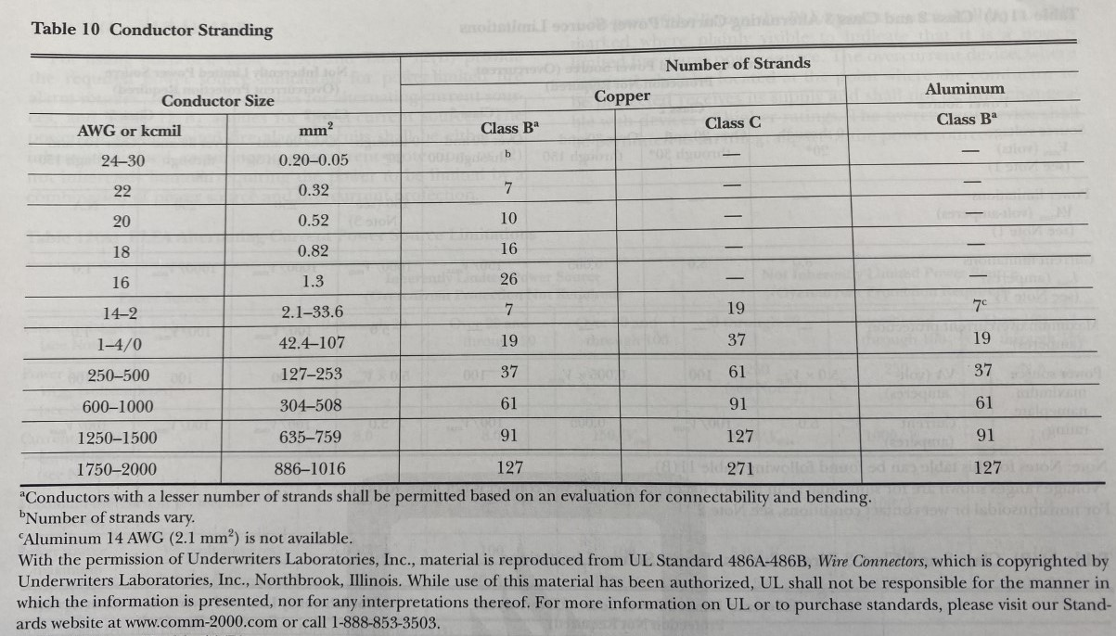
Codes and Regulations
Conductor Stranding Classes (2023 NEC Table 10)

Slide 61
Codes and Regulations
Class B: General power cables, like THHN and XHHW, among other standard 600v control cables.
XHHW which stands for "XLPE (cross-linked polyethylene) High Heat-resistant Water-resistant.
THHN is a thermoplastic high-heat-resistant, nylon-coated wire
Web Search

Slide 62
Codes and Regulations
Class C: These are just more flexible versions of Class B cables.
Class D: Power cables with extra flexible stranding.
Web Search

Slide 63
Codes and Regulations
Article 110.14 - (A) Terminals. Connections of conductors to terminal parts shall ensure a mechanical secure electrical connection without damaging the conductors and be made by means of pressure connectors (including screw type).
Article 110.14 - (B) Splices. Conductors shall be spliced or joined with splicing devices identified for the use or by brazing, welding, or soldering with a fusible metal or alloy.
2023 NEC

Slide 64
Codes and Regulations
Article 110.21 - Marking.
(A) Equipment Markings.
(1) General. The manufacturer’s name, trademark, or other descriptive marking by which the organization responsible for the product can be identified or affixed onto all electrical equipment.
Other markings for safety that indicate voltage, current, wattage, or other ratings shall be provided as specified elsewhere in this Code. (Lots in 690).
2023 NEC

Slide 65
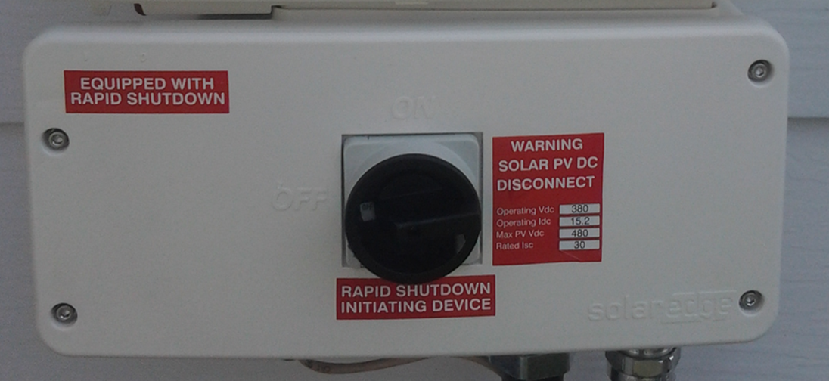
Codes and Regulations
Article 110.21 - Marking.
Cory Manuel

Slide 66
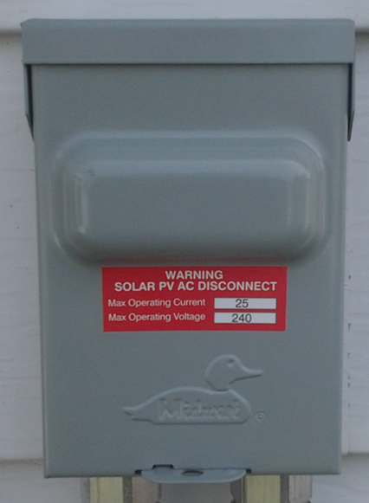
Codes and Regulations
Article 110.22 - Identification of Disconnecting Means.
(A) General. Each disconnecting
means shall be legibly marked to
indicate its purpose unless
located and arranged so the
purpose is evident.
SOLAR PV AC DISCONNECT
Cory Manuel
2023 NEC

Slide 67
Codes and Regulations
Article 110.25 - Lockable Disconnecting Means.
If a disconnecting means is required to be lockable open elsewhere in this Code, it shall be capable of being locked in the open position.
The provision for locking shall
remain in place with or
without the lock installed.
2023 NEC

Slide 68
Codes and Regulations
Part II. 1000 Volts, Nominal or Less
110.26 Spaces About Electrical Equipment.
Working space, and access to and egress from working space, shall be provided and maintained about all electrical equipment to permit ready and safe operation and maintenance of such equipment. 610mm (24”) wide and 2.0m (6 ½ ‘) high.
Keeping 1 m (3ft) clearance in front is required.
2023 NEC

Slide 69
Codes and Regulations
110.26(6) Grade, Floor, Working Platform.
The grade, floor, or platform in the required working space shall be kept clear, and the floor, grade, or platform in the working space shall be as level as practical for the entire required depth and width of the working space.
110.26(6)(B) Clear Spaces. Working space required by this section shall not be used for storage.
Closets are not allowed to house electrical equipment.
2023 NEC

Slide 70
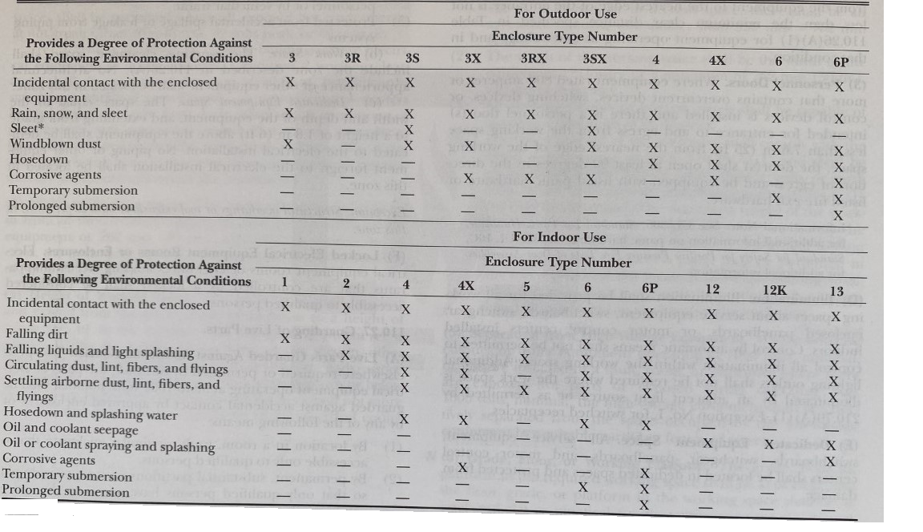
Codes and Regulations
Table 110.28 - Enclosure Selection. These are the NEMA (National Electrical Manufactures Association) rated numbers.
NEC Table 110.28

Slide 71
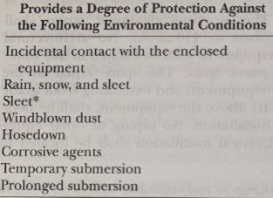
Codes and Regulations
NEMA 4X Disconnect Switch.
Picture Courtesy Author

Slide 72
Codes and Regulations
Article 110.29 - In Sight From (Within Sight From, Within Sight).
Where this Code specifies that one equipment shall be “in sight from,” “within sight of” another equipment, the specified equipment shall be visible and not more than 15 m (50ft) distance from the other.
The distance does vary for specific code references.
2023 NEC

Slide 73
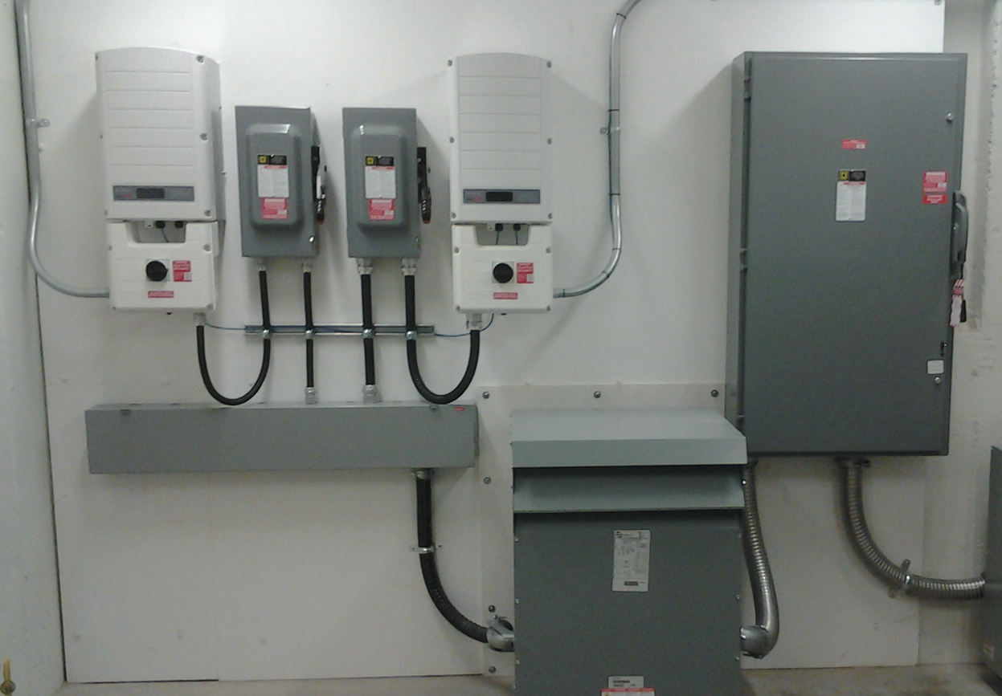
Codes and Regulations
Article 110.29 - In Sight From (Within Sight From, Within Sight). All equipment is within sight of each other.
Cory Manuel

Slide 74
Codes and Regulations
Article 690.15(C) Equipment Disconnecting Means specifies 3m or 10 feet.
Cory Manuel

Slide 75
Codes and Regulations
Chapter 2 is Wiring and Protection. All articles in this chapter pertain to codes around wiring and their protection.
Article 200 Use and Identification of Grounded Conductors.
2023 NEC

Slide 76
Codes and Regulations
Article 200.1 - Scope. This article provides requirements for the following:
(1) Identification of terminals
(2) Grounded conductors in premises wiring systems
(3) Identification of grounded conductors.
(Grounded conductors carry current, Grounding conductors do not)
2023 NEC

Slide 77
Codes and Regulations
Article 200.2 – General. Grounded conductors shall comply with 200.2(A) and (B).
Definition of grounded conductors and grounding conductors.
“Grounding Conductor”, Equipment (EGC). A conductive path(s) that is part of an effective ground-fault current path and connects normally non—current-carrying metal parts of equipment together and to the system grounded conductor or to the grounding electrode conductor, or both.
2023 NEC

Slide 78
Codes and Regulations
Definition of grounded conductors and grounding conductors.
“Grounded Conductor”.
A system or circuit conductor that is intentionally grounded. This is the neutral conductor when connected to a split or multiphase system and carries current.
Informational Note:
Although an equipment grounding conductor is grounded, it is not considered a grounded conductor.
2023 NEC

Slide 79
Codes and Regulations
Article 200.2 – General. Grounded conductors shall comply with 200.2(A) and (B).
200.2(A) Insulation. The grounded conductor, if insulated, shall have insulation that complies with either one of the following:
(1) Is suitably rated, other than color, for any ungrounded conductor of the same circuit for systems 1000 volts or less.(Same or greater voltage rating)
2023 NEC

Slide 80
Codes and Regulations
200.2(A)(2) Refers to circuits over 1000 volts.(N/A)
200.2(B) Continuity. The continuity of a grounded conductor shall not depend on a connection to a metal enclosure, raceway, or cable armor.
The ground must be continuous and the removal of any of these will break the continuity to ground and the applied voltage may be present.
2023 NEC

Slide 81
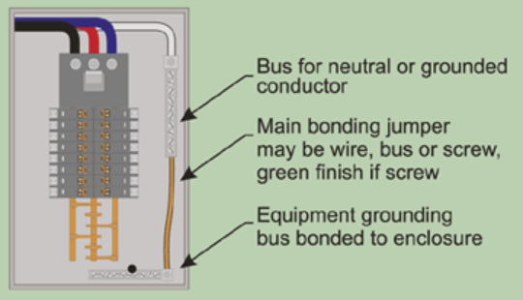
Codes and Regulations
Article 200.3 – Connection to a Grounded System. Grounded conductors of premises wiring system shall be electrical connected to the supply system grounded conductor to ensure a common, continuous grounded system. (Neutral bonding jumper)
2023 NEC

Slide 82
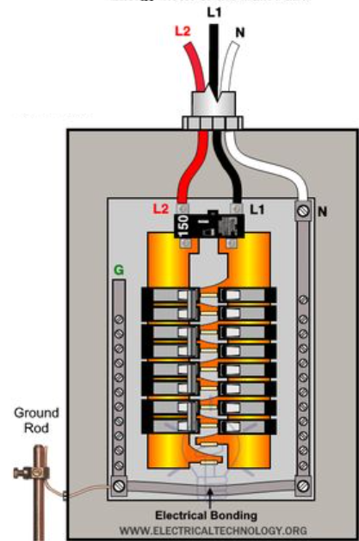
Codes and Regulations
Main supply from utility.
Grounded Conductor Bus
(Neutral Bar)
Grounding Conductor Bus
Bonding Jumper

Slide 83
Codes and Regulations
In stand-alone systems there may not be a supply system ground.
A separately derived ground system is used. (Definition in a later slide)
2023 NEC

Slide 84
Codes and Regulations
Article 200.6 – Means of Identifying Grounded Conductors. (How to tell if it is the Grounded Conductor)
(A) Sizes 6 AWG or Smaller. The insulation of grounded conductors of 6 AWG or smaller shall be identified by one of the following means:
(1) A continuous white outer finish.
(2) A continuous grey outer finish.
(3) Three continuous white or grey stripes along the conductor’s entire length on other than green insulation.
2023 NEC

Slide 85
Codes and Regulations
(3) Three continuous white or grey stripes along the conductor’s entire length on other than green insulation.
White tape placed at every end and at junction boxes is not permitted for the grounded conductor in this application (#6 AWG or Smaller).
2023 NEC

Slide 86
Codes and Regulations
(4) Conductors with white or grey insulation and colored tracer threads in the braid identifying the source of manufacturer.
This is not a common wire type used.
2023 NEC

Slide 87
Codes and Regulations
(5) A single – conductor, sunlight – resistant, outdoor – rated cable used as a solidly grounded conductor in photovoltaic power systems, as permitted by 690.31(C) (1)[Single-Conductor Cable], shall be identified at the time of installation by markings at terminations in accordance with 200.6 (A) (1) through (A) (4).
White tape placed at every end at terminations is permitted for the grounded conductor in this scenario.
2023 NEC

Slide 88
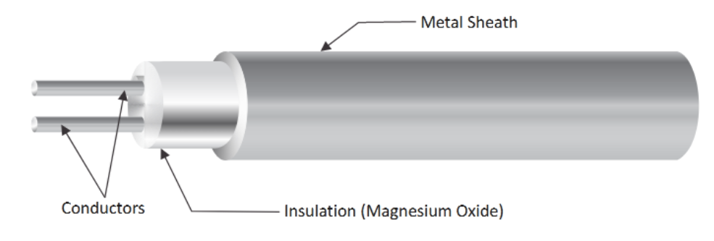
Codes and Regulations
(6) The grounded conductor of a mineral insulated (Type MI) shall be identified at the time if installation by a distinctive white or grey marking at its terminations. The marking shall encircle the conductor insulation. See next slide.
Temsen.com and 2023 NEC

Slide 89
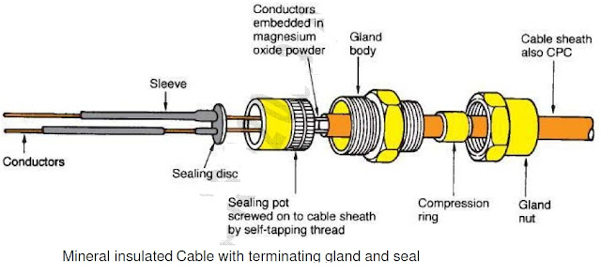
Codes and Regulations
(6) The grounded conductor of a mineral insulated (Type MI) shall be identified at the time if installation by a distinctive white or grey marking at its terminations. The marking shall encircle the conductor insulation.
2023 NEC

Slide 90
Codes and Regulations
Article 200.6 – Means of Identifying Grounded Conductors. This is for 4 AWG and larger wire; limited colors are available for these conductors.
(B) Sizes 4 AWG or Larger. An insulated grounded conductor 4 AWG or larger shall be identified by one of the following means:
(1) A continuous white outer finish.
(2) A continuous grey outer finish.
Not a common size in normal PV systems except if a battery is utilized.
2023 NEC

Slide 91
Codes and Regulations
200.6(3) Three continuous white or grey stripes along the entire length on other than green insulation.
200.6(4) At the time of installation, be identified by a distinctive white or grey marking at its terminations. This marking shall encircle the conductor insulation.
2023 NEC

Slide 92
Codes and Regulations
200.6(C) Flexible Cords. An insulated conductor that is intended for use as a grounded conductor, where contained within a flexible cord, shall be identified by a white or grey outer finish or by methods permitted by 400.22.( not common to PV installations)
2023 NEC

Slide 93
Codes and Regulations
Article 200.11 Polarity of Connections. No grounded conductor shall be attached to any terminal or lead so as to reverse the designated polarity.
2023 NEC

Slide 94
Codes and Regulations
Article 210 - Branch Circuits Not Over 1000 Volts ac, 1500 Volts dc.
Article 210.5 – Identification for Branch Circuits.
(A) Grounded conductor. The grounded conductor of a branch circuit shall be identified in accordance with 200.6 (previous slides, current carrying).
2023 NEC

Slide 95
Codes and Regulations
210.5(B) Equipment Grounding Conductor. The equipment grounding conductor shall be identified in accordance with 250.119 (Not current carrying).
Article 250.119:
Equipment grounding conductors shall be permitted to be bare, covered, or insulated.
Individually covered or insulated equipment grounding conductors shall have a continuous outer finish that is either green or green with one or more yellow stripes except as permitted in this section.
2023 NEC

Slide 96
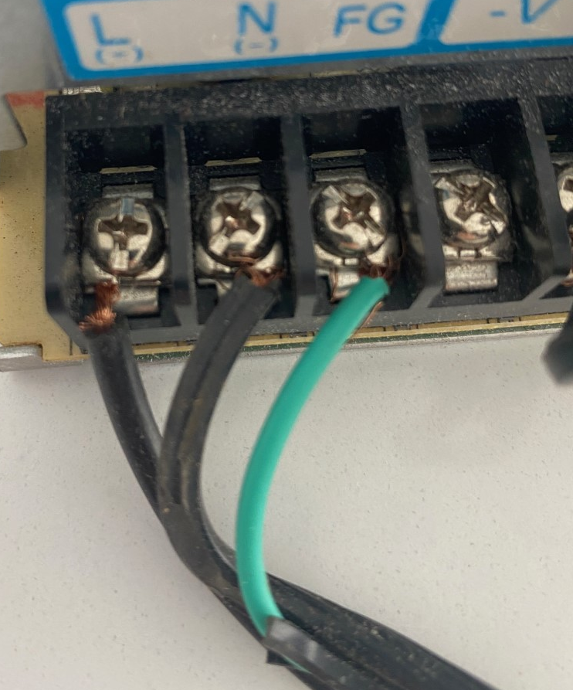
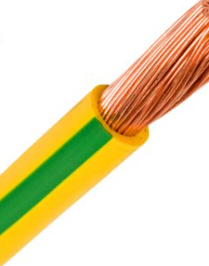
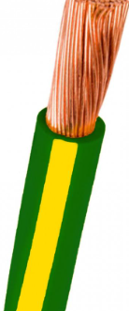
Codes and Regulations
Conductors with insulation or individual covering that is green, green with one or more yellow stripes, or otherwise identified as permitted by this section shall not be used for ungrounded or grounded (current carrying) circuit conductors.
Author + 2023 NEC

Slide 97
Codes and Regulations
210.5(C) Identification of Ungrounded Conductors(Hot or live). Ungrounded conductors shall be identified in accordance with 210.5(C)(1) or (2), as applicable.
(C)(1) Branch Circuits Supplied from More Than One Nominal Voltage System.(the intent is ac circuits)
Each phase requires color coding, marking tape, tagging or other approved means.
AC circuits normally use red, black and blue.
2023 NEC

Slide 98
Codes and Regulations
210.5(C)(2) Branch Circuits Supplied by Direct – Current Systems.
Where a branch circuit is supplied from a dc system operating at more than 60 volts.
This is not part of this course.
48 volts dc is highest voltage used in this course.
2023 NEC

Slide 99
Codes and Regulations
210.5(C)(2)(a) Even though the voltage is less than 60, this is a good practice.
Positive Polarity, Sizes 6 AWG or Smaller. Where the positive polarity of a dc system does not serve as the connection point for the grounded conductor, each positive (hot) ungrounded conductor shall be identified by one of the following means:
(1) A continuous red outer finish
(2) A continuous red stripe durably marked along the conductor's entire length on insulation of a color other than green, white, gray, or black
2023 NEC

Slide 100
Codes and Regulations
(3) Imprinted plus signs (+) or the word POSITIVE or POS durably marked on insulation of a color other than green, white, gray, or black and repeated at intervals not exceeding 610 mm (24 in.) in accordance with 310.8(B)
(4) An approved permanent marking means such as sleeving or shrink-tubing that is suitable for the conductor size, at all termination, connection, and splice points, with imprinted plus signs (+) or the word POSITIVE or POS durably marked on insulation of a color other than green, white, gray, or black
2023 NEC

Slide 101
Codes and Regulations
210.5(C)(2)(b) Even though the voltage is less than 60, this is a good practice.
Negative Polarity, Sizes 6 AWG or Smaller. Where the negative polarity of a dc system does not serve as the connection point for the grounded conductor, each negative ungrounded (hot) conductor shall be identified by one of the following means:
(1) A continuous black outer finish.
(2) A continuous black stripe durably marked along the conductor's entire length on insulation of a color other than green, white, gray, or red.
2023 NEC

Slide 102
Codes and Regulations
(3) Imprinted minus signs (—) or the word NEGATIVE or NEG durably marked on insulation of a color other than green, white, gray, or red and repeated at intervals not exceeding 610 mm (24 in.) in accordance with 310.8(B)
(4) An approved permanent marking means such as sleeving or shrink-tubing that is suitable for the conductor size, at all termination, connection, and splice points, with imprinted minus signs (—) or the word NEGATIVE or NEG durably marked on insulation of a color other than green, white, gray, or red
2023 NEC

Slide 103
Codes and Regulations
Article 225 – Outside Branch Circuits and Feeders.
Article 225.1 - Scope.
This article covers requirements for outside branch circuits and feeders run on or between buildings, structures, or poles on the premises; and electrical equipment and wiring for the supply of utilization equipment that is located on or attached to the outside of buildings, structures, or poles.
2023 NEC

Slide 104
Codes and Regulations
Article 225.4 – Conductor Insulation.
Where within 3.0 m (10 ft) of any building or structure other than supporting poles or towers, open individual (aerial) overhead conductors shall be insulated for the nominal voltage. The insulation of conductors in cables or raceways, shall be of thermoset or thermoplastic type and, in wet locations, shall comply with 310.10(C) (Next slide).
2023 NEC

Slide 105
Codes and Regulations
Article 310.10(C) is for Wet Locations.
Definition of Wet Location:
Installations underground or in concrete slabs or masonry in direct contact with the earth; in locations subject to saturation with water or other liquids, such as vehicle washing areas; and in unprotected locations exposed to weather.
2023 NEC

Slide 106
Codes and Regulations
Article 225.4 – Conductor Insulation.
Exception: Equipment grounding conductors and grounded circuit conductors shall be permitted to be bare or covered as specifically permitted elsewhere in this Code.
See previous slides pertaining to 210.5(B).
2023 NEC

Slide 107
Codes and Regulations
Article 225.31 Disconnecting Means (Outside Branch Circuits and Feeders).
(A) General. Means shall be provided for disconnecting all ungrounded conductors that supply or pass through the building or structure.
See next slide.
2023 NEC

Slide 108
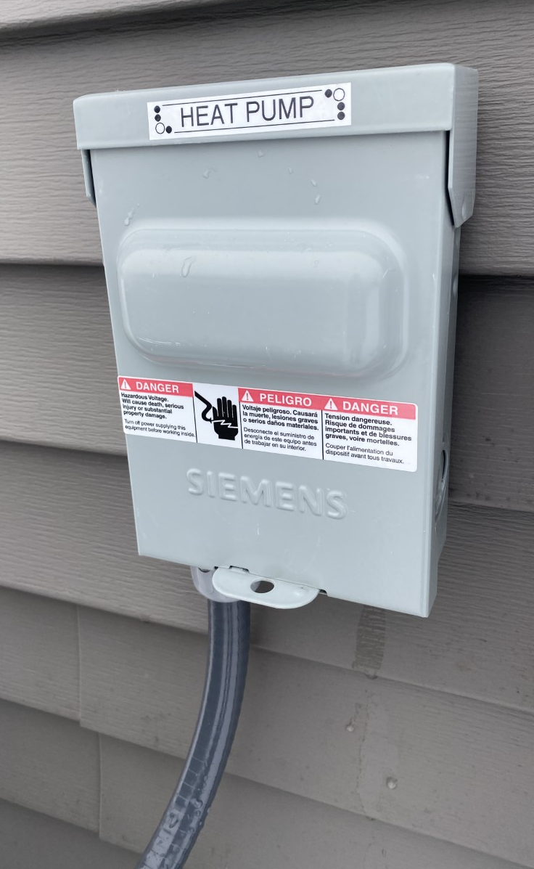
Codes and Regulations
(A) General. Means shall be
provided for disconnecting all
ungrounded conductors that
supply or pass through the
building or structure.
Author

Slide 109
Codes and Regulations
225.31(B) Location. The disconnecting means shall be installed either inside or outside of the building or structure served or where the conductors pass through the building or structure.
The disconnecting means shall be at a readily accessible location nearest the point of entrance of the conductors.
(Keeps the conductor length as short as possible)
2023 NEC

Slide 110
Codes and Regulations
Article 240 – Overcurrent Protection:
240.1 Scope
Parts I through VII of this article provide the general requirements for overcurrent protection and overcurrent protective devices not more than 1000 volts, nominal.
2023 NEC

Slide 111
Codes and Regulations
240.4 Protection of Conductors
Conductors, other than flexible cords, flexible cables, and fixture wires, shall be protected against overcurrent in accordance with their ampacities specified in article 310.14 [ Ampacities for Conductors Rated 0 Volts – 2000 Volts], which are tables found in 310.15 and 310.16.
Unless otherwise permitted or required in 240.4(A) through (G). (Next slide is 240.4(D))
2023 NEC

Slide 112
Codes and Regulations
240.4 (D): Common wire sizes and their overcurrent requirements:
(D)(3) 14 AWG Copper at 15 amperes.
(D)(4) 12 AWG Aluminum and Copper-Clad Aluminum at 15 amperes.
(D)(5) 12 AWG Copper at 20 amperes.
(D)(6) 10 AWG Aluminum and Copper-Clad Aluminum at 25 amperes.
(D)(7) 10 AWG Copper at 30 amperes
2023 NEC

Slide 113
Codes and Regulations
240.6 Standard Ampere Ratings.
Table 240.6(A) has the standard sizes normally found.
Next slide.
2023 NEC

Slide 114
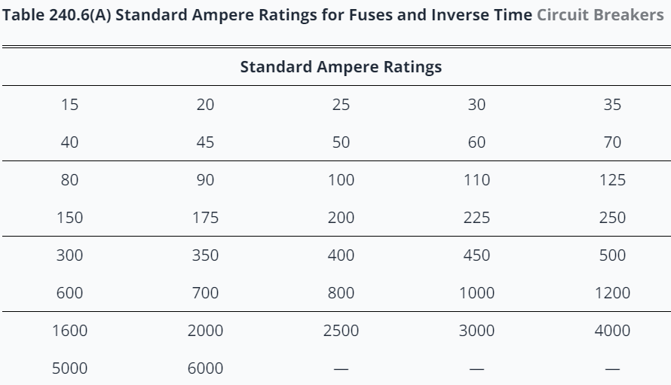
Codes and Regulations
Table 240.6(A) Overcurrent
2023 NEC

Slide 115
Codes and Regulations
Article 240.7 – Listing Requirements. The following shall be listed: (Refer to definition of listed)
(1) Branch – circuit overcurrent protective devices.
(2) Relays and circuit breakers providing ground – fault protection of equipment.
(3) Ground – fault circuit interrupter devices.
This keeps the integrity of these devices.
2023 NEC

Slide 116
Codes and Regulations
Article 240.15 – Ungrounded Conductors (Hot or live).
(A) A fuse or an overcurrent trip unit of a circuit breaker shall be connected in series with each ungrounded conductor.
(B) Circuit Breaker as Overcurrent Device.
As long as the circuit breaker opens all of the ungrounded conductors both manually and automatically it can be used.
2023 NEC

Slide 117
Codes and Regulations
Article 240.24 – Location in or on Premises (Overcurrent protection).
240.24(A) Accessibility. Circuit breakers and switches containing fuses shall be readily accessible and installed so that the center of the grip of the operating handle of the switch or circuit breaker, when in its highest position, is not more than 2.0 m (6 ft 7 in.) above the floor or working platform.
2023 NEC

Slide 118
Codes and Regulations
240.24(E) Not Located in Bathrooms
In dwelling units, dormitory units, and guest rooms or guest suites, overcurrent devices, other than supplementary overcurrent protection, shall not be located in bathrooms.
240.24(F) Not Located over steps.
Overcurrent devices shall not be located over steps of a stairway.
2023 NEC

Slide 119
Codes and Regulations
Article 300 – General Requirements for Wiring Methods and Materials.
Article 300.1 Scope.
(A) All Wiring Installations.
This article covers general requirements for wiring methods and materials for all wiring installations unless modified by other articles in Chapter 3.
This covers methods and materials for the various wiring conditions found in wiring applications.
2023 NEC

Slide 120
Codes and Regulations
300.1(B) Integral Parts of Equipment.
The requirements of this article are not intended to apply to the conductors that form an integral part of equipment, such as microinverters, controllers, dc-dc converters, or factory-assembled control equipment or listed utilization equipment.
300.1(C) Metric Designators and Trade Sizes
Metric designators and trade sizes for conduit, tubing, and associated fittings and accessories shall be as designated in Table 300.1(C).
2023 NEC

Slide 121
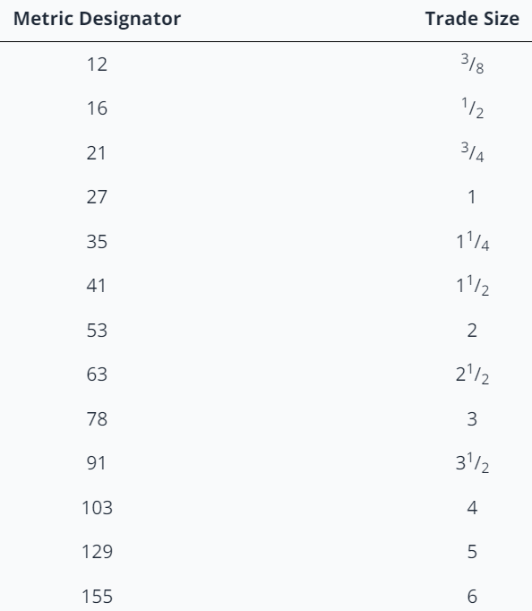
Codes and Regulations
Table 300.1(C) Metric Designators and Trade Sizes.
2023 NEC

Slide 122
Codes and Regulations
Article 310 – Conductors for General Wiring
310.1 Scope
This article covers general requirements for conductors rated up to and including 2000 volts and their type designations, insulations, markings, mechanical strengths, ampacity ratings, and uses. These requirements do not apply to conductors that form an integral part of equipment, such as motors, motor controllers, and similar equipment, or to conductors specifically provided for elsewhere in this Code.
2023 NEC

Slide 123
Codes and Regulations
Article 310.15 (B) – Ambient Temperature Correction Factors.
310.15(B)(2) Rooftop. For raceways or cables exposed to direct sunlight on or above rooftops where the distance above the roof to the bottom of the raceway or cable is less than 19 mm (3/4 in.), a temperature adder of 33°C (60°F) shall be added to the outdoor temperature to determine the applicable ambient temperature for application of the correction factors in Table 310.15(B)(1)(1) or Table 310.15(B)(2)(2).(Belize is 35C ambient)
Exception: Type XHHW-2 insulated conductors shall not be subject to this ampacity adjustment.
2023 NEC

Slide 124
Codes and Regulations
Article 310.15 (B) – Ambient Temperature Correction Factors.
In older versions of this Code other distances have extra adder temperatures.
The intent is to have the raceways mounted at least ¾ of an inch above the rooftop.

Slide 125
Codes and Regulations
Table 310.16 Ampacities of Insulated Conductors for Not More Than Three Current – Carrying Conductors in Raceway, Cable, or Earth (Directly Buried)
Refer to the 2023 NEC for this table.
This table is used for many applications.
2023 NEC

Slide 126
Codes and Regulations
Article 690 Solar Photovoltaic (PV) Systems.
The next group of slides deal with this article.
Previous articles will be referenced within this 690 article.
2023 NEC

Slide 127
Codes and Regulations
Article 690.1 – Scope was covered earlier. Along with definitions.
Article 690.4 - General Requirements
(A) Photovoltaic Systems.
Photovoltaic systems shall be permitted to supply a building or other structure in addition to any other electrical supply system(s).
2023 NEC

Slide 128
Codes and Regulations
690.4(B) Equipment.
Inverters, PV modules, ac modules and ac module systems, dc combiners, dc-to-dc converters, rapid shutdown equipment, dc circuit controllers, and charge controllers intended for use in PV systems shall be listed or be evaluated for the application and have a field label applied.
The definition of listed has been covered.
2023 NEC

Slide 129
Codes and Regulations
690.4(C) Qualified Personnel.
The installation of equipment and all associated wiring and interconnections shall be performed only by qualified persons. (NABCEP, ITVET or CVQ)
The qualifications are subject to the AHJ.
An AHJ or Authority Having Jurisdiction is the organization, office, or individual having statutory responsibility for enforcing the requirements of a standard. (BEL and or ITVET).
2023 NEC

Slide 130
Codes and Regulations
690.4(D) Multiple PV Systems. Multiple systems are permitted to be installed in or on a building or structure.
690.4(E) Locations Not Permitted. No parts in bathrooms.
2023 NEC

Slide 131
Codes and Regulations
690.4(F) Electronic Power Converters Mounted in Not Readily Accessible Locations.
Electronic power converters and their associated devices shall be permitted to be mounted on roofs or other exterior areas that are not readily accessible. Disconnecting means shall be installed in accordance with 690.15.
Behind panels is an example or on roofs, out of reach. Pole top mounting.
2023 NEC

Slide 132
Codes and Regulations
690.4(G) PV Equipment Floating on Bodies of Water.
PV equipment floating on or attached structures floating on bodies of water shall be identified as being suitable for the purpose and use wiring methods that allow for any expected movement of the equipment.
The equipment is subject to increased levels of humidity, corrosion, and mechanical and structural stress must be included in the structural design.
2023 NEC

Slide 133
Codes and Regulations
690.6 Alternating-Current (ac) Modules and Systems.
(A) Photovoltaic Source Circuits
The requirements of Article 690 pertaining to PV source circuits shall not apply to ac modules or ac module systems. The PV source circuit, conductors, and inverters shall be considered as internal components of an ac module or ac module system.
(B) Output Circuit
The output of an ac module or ac module system shall be considered an inverter output circuit.
2023 NEC

Slide 134
Codes and Regulations
Part II Circuit Requirements
690.7 Maximum Voltage
The maximum voltage of PV system dc circuits shall be the highest voltage between any two conductors of a circuit or any conductor and ground.
The maximum voltage shall be used to determine the voltage and voltage to ground of circuits in the application of this Code.
2023 NEC

Slide 135
Codes and Regulations
690.7(1)On a building or dc circuits inside shall not exceed 1000 volts.
690.7(2) Not to exceed 600 volts on or in one- and two-family dwellings.
690.7(3) PV System dc circuits exceeding 1000 volts need to comply with 690.31(G), not covered in this course.
2023 NEC

Slide 136
Codes and Regulations
690.7(A) Photovoltaic Source Circuits.
In a dc PV source circuit, the maximum dc voltage shall be calculated in accordance with one of the following three methods:
690.7(A)(1) The sum of the PV module-rated open-circuit voltage of the series-connected modules corrected for the lowest expected ambient temperature using the open-circuit voltage temperature coefficients in accordance with the instructions included in the listing or labeling of the module.
2023 NEC

Slide 137
Codes and Regulations
PV Source Circuit or PV String Circuit.
DC to DC
Converters
Combiner
Box
Author

Slide 138
Codes and Regulations
PV Output Circuit. The dc circuit conductors from two or more connected PV source circuits to their point of termination.
2023 NEC

Slide 139
Codes and Regulations
PV Output Circuit / Source Circuit.
Combiner
Box
Author

Slide 140
Codes and Regulations
Example: The name plate data of the PV module gives the temperature coefficients. Use the Voc at -0.28%/C.
STC Voc = 44.3V
Belize cold temp = 10C
Voc at 10C = (((10C-25C) x -0.0028) x 44.3V) + 44.3V
Voc at 10C = 46.2 per module
Charge Solar.ca

Slide 141
Codes and Regulations
Use the STC (Standard Test Condition) rated values.
690.7(A)(2) For crystalline and multicrystalline silicon modules, the sum of the PV module-rated open-circuit voltage of the series-connected modules corrected for the lowest expected ambient temperature using the correction factors provided in Table 690.7(A)(Next slide)
In Belize, the lowest temperature used in other courses in this program was 10 Celsius.
2023 NEC

Slide 142
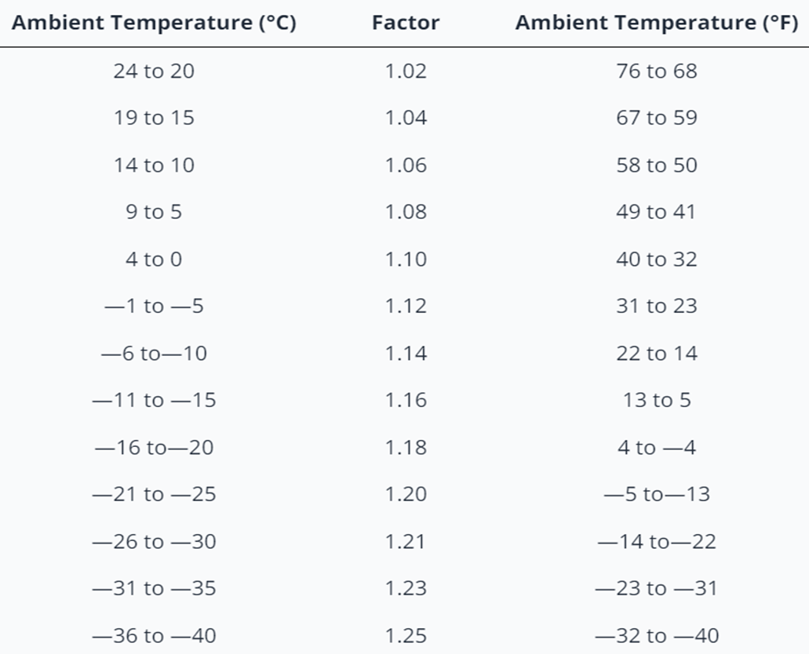
Codes and Regulations
Table 690.7(A) Following the table this would increase the Voc by a
factor of 1.06.

Slide 143
Codes and Regulations
Using table 690.7(A) for the same STC data from the previous example:
Voc = 44.3
Voc at 10C = Voc x 1.06 = 46.9V
Very close to the previous calculation.
690.7(A)(3) is for systems over 100kW and therefore not used in this course.

Slide 144
Codes and Regulations
690.7(B) DC – to – DC Converter circuits.
DC-to-DC Converter. A device that can provide an output dc voltage and current at a higher or lower value than the input dc voltage and current.
A DC – DC Converter can be an optimizer that has an MPPT function.
2023 NEC

Slide 145
Codes and Regulations
690.7(B) In a dc-to-dc converter circuits, the maximum voltage shall be calculated in accordance with 690.7(B)(1) or (B)(2).
690.7(B)(1) Single DC-to-DC Converter
For circuits connected to the output of a single dc-to-dc converter, the maximum voltage shall be determined in accordance with the instructions included in the listing or labeling of the dc-to-dc converter.
2023 NEC

Slide 146
Codes and Regulations
690.7(B) dc-to-dc converter circuits
2023 NEC

Slide 147
Codes and Regulations
690.7(B)(2) Two or More Series-Connected DC-to-DC Converters
For circuits connected to the output of two or more series-connected dc-to-dc converters, the maximum voltage shall be determined in accordance with the instructions included in the listing or labeling of the dc-to-dc converter multiplied by the number of the dc-dc converters.
2023 NEC

Slide 148
Codes and Regulations
690.7(C) Bipolar PV Source Circuits.
Not covered in this course.
2023 NEC

Slide 149
Codes and Regulations
690.7(D) Marking DC PV Circuits.
After calculating the highest DC PV voltage as per 690.7, have it permanently located in one of the following locations:
(1) DC PV system disconnecting means.
(2) PV system electronic power conversion equipment (Inverter or charge controller).
(3) Distribution equipment associated with the PV system (Disconnect or Combiner box).
2023 NEC

Slide 150
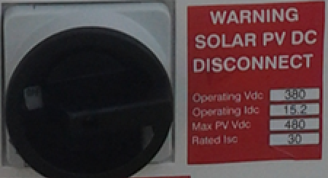
Codes and Regulations
690.7(D) Marking DC PV Circuits.
Cory Manuel

Slide 151
Codes and Regulations
Article 690.8 – Circuit Sizing and Current.
(A) Calculation of Maximum Circuit Current (not conductor size).
Calculated by one of the methods of 690.8(A)(1) or (A)(2).
690.8(A)(1) PV System Circuits.
2023 NEC

Slide 152
Codes and Regulations
Article 690.8 – Circuit Sizing and Current.
(Quick overview)
Calculated by either 690.8(A)(1) or (A)(2).
690.8(A)(1) PV System Circuits(all).use (A)(1)(a-c)
(A)(1)(a) use (1) or (2)
(A)(1)(a)(1)use 125% Isc x strings
(A)(1)(a)(2)N/A over 100kW
(A)(1)(b) PV DC to DC Converter Circuit
(A)(1)(c) Inverter Output Circuit
2023 NEC

Slide 153
Codes and Regulations
Article 690.8 – Circuit Sizing and Current.
(Quick overview)
Calculated by either 690.8(A)(1) or (A)(2).
690.8(A)(2) Circuits Connected to Input of Electronic Power Converters
2023 NEC

Slide 154
Codes and Regulations
690.8(A)(1)(a) Photovoltaic Source Circuit Currents, The maximum current shall be calculated in either of the following:
690.8(A)(1)(a)(1) Maximum Isc of the PV modules connected in parallel multiplied by 125% (extra irradiance).
Use the STC values for the modules.
Multiply by the number of strings of the same modules.
Finally allow for extra irradiance by multiplying by a 125%.
2023 NEC

Slide 155
Codes and Regulations
690.8(A)(1)(a)(2) PV Systems 100kW or greater. N/A for this course.
2023 NEC

Slide 156
Codes and Regulations
690.8(A)(1)(b) If DC – DC converters are used, add the continuous rated current output of how many are connected in parallel.
Simple calculation and found on data sheet or label.
Solar Edge Optimizer + 2023 NEC

Slide 157
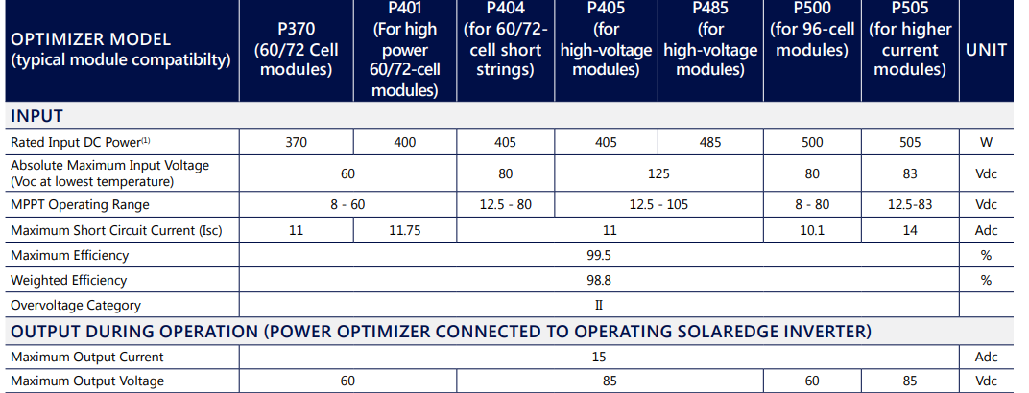
Codes and Regulations
690.8(A)(1)(b) This Solar Edge Optimizer has a 15A maximum dc current output per string.
Solar Edge Optimizer + 2023 NEC

Slide 158
Codes and Regulations
690.8(A)(1)(c) Inverter Output Circuit Current is the inverter continuous maximum output current rating.
Found on data sheet or label.
Fronius PRIMO 3.8-1 continuous output ac current.
2023 NEC

Slide 159
Codes and Regulations
690.8(A)(2) Circuits Connected to the Input of Electronic Power Converters. (Inverter, charge controller, optimizer)
If the circuit is protected with an overcurrent device that does not exceed the conductor ampacity, the maximum current is the equal to the electronic power converter rated input.
(The overcurrent device is equal to or less than the conductor capacity)
(There is an overcurrent device in the PV circuit)
2023 NEC

Slide 160
Codes and Regulations
690.8(A)(2) Circuits Connected to the Input of Electronic Power Converters. (Inverter, charge controller, optimizer)
DC Source Circuit
Electronic Power Converter
Author

Slide 161
Codes and Regulations
A review of common wire sizes and their overcurrent requirements.
240.4 (D): Common wire sizes and their overcurrent requirements:
(D)(3) 14 AWG Copper at 15 amperes.
(D)(5) 12 AWG Copper at 20 amperes.
(D)(7) 10 AWG Copper at 30 amperes
2023 NEC

Slide 162
Codes and Regulations
690.8(A)(2) Circuits Connected to the Input of Electronic Power Converters.
Example: Fronius PRIMO 3.8-1 Inverter has two input strings of 18A each (using one of them).
The 18A continuous requires a minimum conductor size of 18 x 125% = 22.5 with an over current of 30A. The minimum conductor is 30A as well.
Fronius + 2023 NEC

Slide 163
Codes and Regulations
690.8(A)(2) Circuits Connected to the Input of Electronic Power Converters. (Inverter, charge controller, optimizer).
18A continuous = 22.5A = 30A conductor.
Overcurrent = 30A
DC Source Circuit can be greater than 18.
DC Source Circuit
18A Continuous Input
Author

Slide 164
Codes and Regulations
If the installed PV can generate current greater than 18 Amps, the circuit current can be based on the 18A input to the inverter.
Before this rule, the ampacity of the circuit would have been 125% of the Isc.
It is common to increase the DC – AC ratio of PV to inverter capacity to gain low light level energy.
This also increases the available DC current beyond the capacity of the inverter. The inverter limits the current to its rated amount.
2023 NEC

Slide 165
Codes and Regulations
690.8(B) Conductor Ampacity. Circuit conductors will have an ampacity equal to or greater than the currents calculated in 690.8 (B)(1) or (B)(2).
Conductor ampacity is not maximum current calculations. It is the conductor's size to carry the maximum current calculated.
Normally the conductor ampacity is 125% of the continuous current.
Exception to this is for equipment listed for 100% rating.
2023 NEC

Slide 166
Codes and Regulations
690.8(B)(1) Without Adjustment and Correction Factors. The minimum conductor ampacity size is 125% of the current calculated in 690.8(A).
Example 690.8(A) plus 125% from 690.8(B)(1).
The extra 125% is not to have 100% current carried by the conductor.
Example is a wire carries 80% of its capacity.
80% = 1/125%.
2023 NEC

Slide 167
Codes and Regulations
690.8(B)(2) With Adjustment and Correction Factors. Using the correction factors with the current calculated in 690.8(A).
Correction factors are voltage drop, ambient temperature and number of conductors.
Example: If 58% derated for temperature plus Isc x 125% the conductor is greater than 690.8(B)(1).
2023 NEC

Slide 168
Codes and Regulations
690.8(C) Systems with Multiple Direct – Current Voltages. The common-return conductor is sized by adding the ampere ratings of individual overcurrent devices.
Bi-Polar systems, not covered in this course.
2023 NEC

Slide 169
Codes and Regulations
690.8(D) This next code is for using more than two strings and only one overcurrent device.
This is not a standard practice and therefore this rule will not be presented here.

Slide 170
Codes and Regulations
690.8(D) Multiple PV String Circuits.
Where an overcurrent device is used to protect more than one set of parallel-connected PV string circuits, the ampacity of each of each conductor protected by the device shall not be less than the sum of the following:
(1) The rating of the overcurrent device
(2) The sum of the maximum currents as calculated in 690.8(A)(1)(a) for the other parallel-connected PV string circuits protected by the overcurrent device.
2023 NEC

Slide 171
Codes and Regulations
Sizing of Module Interconnection Conductors. Where a single overcurrent device is used (this is not a common procedure) to protect a set of two or more parallel-connected module circuits, the ampacity of each of the module interconnection conductors (wires between modules will be replaced) shall not be less than the sum of the rating of the single overcurrent device plus 125 percent of the short-circuit current from the other parallel- connected modules.
In example next slide both the pos+ and neg- are protected.
2023 NEC

Slide 172
Codes and Regulations
(D) Multiple PV String Circuits.
40A fuse
Module name plate specifies overcurrent device at 15A.
STC Isc = 8.50A
Combiner
Box
690.8(D)Each Conductor
Author

Slide 173
Codes and Regulations
690.8(D) Multiple PV String Circuits.
The ampacity of each conductor = the sum of:
The over current device (15A) plus the 690.8(A)(1)(a) (125% Isc) for the other conductors.
Three strings, the other conductors = (8.50 x 125%) (10.6A) each of two.
15A + 10.6 + 10.6 = 36.2A or 40A each conductor.
Main overcurrent = 8.5 x 1.25 x 3 x 1.25 = 40A
Author

Slide 174
Codes and Regulations
Article 690.9 – Overcurrent Protection.
(A) Circuits and Equipment.
Information Note: Photovoltaic system dc circuit are current limited circuits that generally only need overcurrent protection when connected in parallel to higher current sources.
The Isc x 125% is highest current with one string.
2023 NEC

Slide 175
Codes and Regulations
Article 690.9 – Overcurrent Protection.
(A) Circuits and Equipment.
PV system dc circuit and inverter output conductors and equipment shall be protected against overcurrent. Circuits sized in accordance with 690.8(A)(2) [ Circuits Connected to Input of Electronic Power Converters] are required to be protected with overcurrent devices. Each circuit shall be protected from overcurrent in accordance with 690.9(A)(1), (A)(2), or (A)(3).
2023 NEC

Slide 176
Codes and Regulations
690.9(A)(1) Circuits Where Overcurrent Protection Not Required.
Overcurrent protective devices are not required if both of the following conditions are met:
(1) The conductors have ampacity for the maximum circuit current.
(2) The currents from all sources is not greater than the overcurrent protective device rating specified for the PV module or electronic power converter (manufacturer manual).
2023 NEC

Slide 177
Codes and Regulations
(1) The conductors have ampacity for the maximum circuit current.
In a two string PV connection, the conductor for each string is Isc x 125% x 125%.
If one string is shorted the maximum current either conductor sees is the same Isc x 125% x 125%.
2023 NEC

Slide 178
Codes and Regulations
(2) The currents from all sources is not greater than the overcurrent protective device rating specified for the PV module or electronic power converter (manufacturer manual).
Maximum two strings of the same overcurrent rated modules.
2023 NEC

Slide 179
Codes and Regulations
690.9(A)(2) Circuits Where Overcurrent Protection Is Required on One End.
A circuit conductor fed from a current limited supply (PV module or dc-dc converters for example), with the conductor rated for the maximum current from this supply, and also connected to sources that can impress currents greater than the conductor's ampacity, an overcurrent device shall be installed at the point of connection to the higher current source(s).
2023 NEC

Slide 180
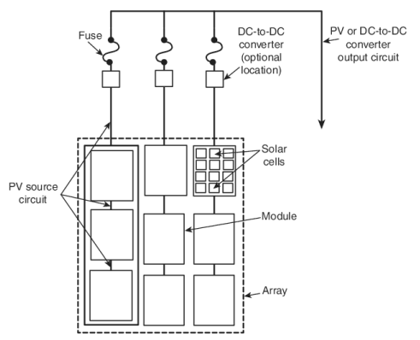
Codes and Regulations
690.9(A)(2) Circuits Where Overcurrent Protection Is Required on One End. Any two strings can backfeed and overload the other string.
Overcurrent device
on end with higher
current source(s).

Slide 181
Codes and Regulations
690.9(A)(3) Other Circuits.
This section 690.9(A)(3) addresses installations where conductor overcurrent protection can be provided at either the supply end or the load end of the circuit.
The provisions provide length limitations to be complied with, and where installed in a building, physical protection must be provided by metal raceways or cable armor.
2023 NEC

Slide 182
Codes and Regulations
For example: A ground mounted array with the PV output circuit entering a building, the overcurrent device for this circuit can be located within the disconnecting means (disconnect switch) located at the load end inside the building.
Instead of having the disconnect outside near the array, it can be inside the building.
Note limitations 690.9(3)(4)a, b, c, and d.
2023 NEC

Slide 183
Codes and Regulations
690.9(A)(3) Other Circuits. Circuits that do not comply with 690.9(A)(1) or (A)(2) [ This is the reason for A(3) ] are protected with one of the following methods ( these are special circumstances and most likely handled by an electrician).
690.9.(A)(3)(1) and (2) Conductors less than 3 m (10ft) protected with overcurrent device on one end, if in building also requires to be in a raceway or metal clad cable.
2023 NEC

Slide 184
Codes and Regulations
690.9.(A)(3)(3) Have overcurrent devices on both ends.
2023 NEC

Slide 185
Codes and Regulations
690.9(A)(3)(4) Conductors not installed in or on a building. These conductors can be protected on one end of the conductor provided all of the following conditions are met:
(a) Conductors installed in metal raceways, or underground, or directly entering a pad mount enclosure.
(b) Conductors of each circuit terminate at an overcurrent device that limits the current to the ampacity of the conductors.
2023 NEC

Slide 186
Codes and Regulations
690.9(A)(3)(4)(c) The disconnecting means has overcurrent protection, or the overcurrent device is located within 3 m (10ft) of the disconnecting means.
690.9(A)(3)(4)(d) The disconnecting means is installed outside of a building, or at a readily accessible location near where the conductors enter the building including installations complying with 230.6.
230.6 Keeps the conductors protected because they are unfused from the source. (Next slide)
2023 NEC

Slide 187
Codes and Regulations
Article 230.6 – Conductors Considered Outside the Building. Conductors are considered outside a building by the following:
(1) Installed under concrete not less than 50 mm (2 inches) underneath the building or structure.
(2) Installed inside a building and encased in concrete or brick not less than 50 mm (2 inches).
(3) N/A
(4) Installed in conduit buried at least 450 mm ( 18 inches) in earth underneath a building or structure.
2023 NEC

Slide 188
Codes and Regulations
230.6(5) Installed in rigid or intermediate metal conduit and has the clearance requirements in 230.24 and placed directly through the eve, but not a wall of a building.
230.24 refers to clearances of overhead service conductors.
2023 NEC

Slide 189
Codes and Regulations
690.9(B) Device Ratings.
Overcurrent devices used in PV source circuits need to be listed for use in PV systems. Electronic devices that are listed to prevent backfeed current in PV system dc circuits shall be permitted to prevent overcurrent of conductors on the PV array side of the device.
Optimizers can be used as backfeed protection and depending on manufacturer installation instructions can eliminate the overcurrent device.
2023 NEC

Slide 190
Codes and Regulations
690.9(B) Device Ratings.
Overcurrent devices when required, shall be rated with one of the following and allowed to be sized rounded up as per 240.4(B).[ Next standard size above].
2023 NEC

Slide 191
Codes and Regulations
690.9(B)(1) Overcurrent devices rated not less than 125% of the current calculated in 690.8(A)[Calculation of Maximum Circuit Current].
690.9(B)(2) An assembly (can be a combiner box) together with overcurrent device(s) listed for continuous operation 100% of its rating can be used at the 100% rating.
Check the manufacturer data sheet for lug temperature and bus bar continuous amperage.
2023 NEC

Slide 192
Codes and Regulations
690.9 (C) PV System DC Circuits. A single overcurrent protective device, where required, shall be permitted to protect the PV modules, dc-dc converters, and conductors of each circuit. Where single overcurrent protection devices are used to protect PV source or output circuits, all overcurrent devices shall be placed in the same polarity for all circuits within a PV system.
2023 NEC

Slide 193
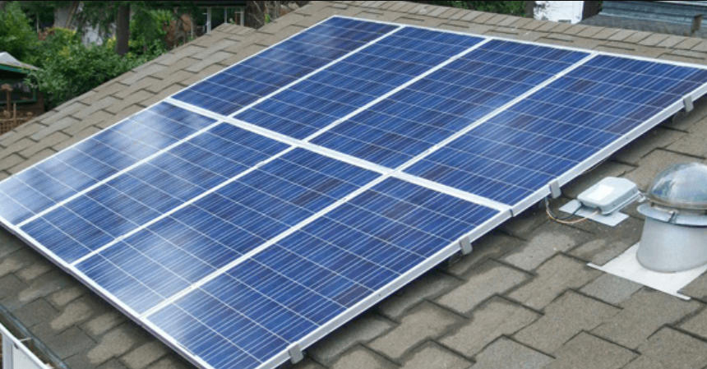
Codes and Regulations
Same polarity for overcurrent devices.
Be accessible but shall not be required to be readily accessible.
Combiner
Box
SolaDeck + Author

Slide 194
Codes and Regulations
The overcurrent devices shall be accessible but shall not be required to be readily accessible.
They can be accessible but not necessarily required to be readily accessible (as on a roof).
2023 NEC

Slide 195
Codes and Regulations
Blocking Diodes.
Blocking Diodes are not Listed as overcurrent devices but can be used to prevent backfeed.
They must be on the array side of the overcurrent device.
Combiner
Box
Author

Slide 196
Codes and Regulations
690.9(D) Transformers N/A for this course.
2023 NEC

Slide 197
Codes and Regulations
Article 690.11 Arc-Fault Circuit Protection (dc).
Arc-Fault protection is designed to detect a flow of current out from a conductor or module that is not intentional.
It can happen between a conductor to ground or to other conductors or between connections.
These arcs happen in a range of frequencies that can be monitored by a detector and will break the circuit to prevent the arc from causing a fire.
2023 NEC

Slide 198
Codes and Regulations
ARC Faults Types
Series Arc
Parallel Arc
Ground Arc
Combiner
Box
Inverter
Author

Slide 199
Codes and Regulations
Article 690.11 Arc-Fault Circuit Protection (dc).
PV system dc conductors with 80 volts or greater between them, need to be protected by a listed PV arc-fault circuit interrupter or other system components listed to the same protection. The system needs to detect and interrupt arcing faults caused by a failure in the continuity of a conductor, connection, module, or other system component in the PV system dc circuits.
2023 NEC

Slide 200
Codes and Regulations
Fronius Inverter with Arc-Fault Circuit Protection
Fronius Inverter

Slide 201
Codes and Regulations
There is an exception to this rule:
For PV systems not installed on or in buildings, PV output circuits and dc-to-dc converter output circuits that are installed in metallic raceways or metal-clad cables, or installed in enclosed metallic cable trays, or are underground shall be permitted without arc-fault circuit protection.
2023 NEC

Slide 202
Codes and Regulations
Examples for exception are:
Detached structures whose sole purpose is to house PV system equipment shall not be considered buildings according to this exception.
A ground mount is another example of this.
2023 NEC

Slide 203
Codes and Regulations
Article 690.12 – Rapid Shutdown of PV Systems on Buildings.
Main purpose is for fire fighter safety.
Firefighters that go on a roof to fight a fire.
Rapid shut down is used to control the conductors leaving the array (Source Circuit).
It prevents the conductors from being energized to not more than 30 volts within 30 seconds.
2023 NEC

Slide 204
Codes and Regulations
Article 690.12 – Rapid Shutdown of PV Systems on Buildings.
PV system circuits installed on or in buildings shall include a rapid shutdown function to reduce shock hazard for firefighters in accordance with 690.12(A) through (D).
Exception 1: Ground-mounted PV system circuits that enter buildings, of which the sole purpose is to house PV system equipment, shall not be required to comply with 690.12.
2023 NEC

Slide 205
Codes and Regulations
Exception 2: PV equipment and circuits installed on nonenclosed detached structures that a firefighter would not go up on the roof doesn’t require rapid shutdown.
2023 NEC

Slide 206
Codes and Regulations
690.12(A) Controlled Conductors. These are the conductors that require the rapid shutdown.
(1) PV system dc circuits
(2) Inverter output circuits that are located under the modules and part of the array area (microinverters).
690.12(B) Controlled Limits. Array Area (boundary) is 305 mm (1 ft) from the array in all directions.
If these controlled conductors are outside this area need to meet 690.12(B)(1).
2023 NEC

Slide 207
Codes and Regulations
If these controlled conductors are inside this area need to meet 690.12(B)(2).
690.12(B)(1) Outside the Array Boundary.
Controlled conductors located outside the array boundary or more than 1m (3 feet) from the point of entry inside the building shall be required to be less than 30 volts within 30 seconds.
The 30 volts is between any two conductors and any conductor to ground.
2023 NEC

Slide 208
Codes and Regulations
If these controlled conductors are inside this area need to meet 690.12(B)(2).
690.12(B)(2) Inside the Array Boundary. One of the following
(1) The PV array needs to provide shock hazard control for fire fighters. It needs to be initiated with a device as per 690.12(C).[Next slide]
(2) A rapid shutdown system needs to bring the voltage between conductors to 80 volts or less within 30 seconds.
2023 NEC

Slide 209
Codes and Regulations
690.12(C) Initiation Device. To operate the rapid shutdown, an initiation device is required. The device’s “OFF” position shall indicate that the rapid shutdown has been initiated for the PV system that it is associated with.
Devices shall be one of the following:
(1) Service disconnection means
(2) PV system disconnection means
(3) Readily accessible switch that plainly indicates whether it is in the “off” or “on” position
A maximum of 6 initiation devices per location.
2023 NEC

Slide 210
Codes and Regulations
Devices shall be one of the following:
(1) Service disconnection means when microinverters or dc-dc converters are used.
(2) PV system disconnection means when microinverters or dc-dc converters are used.
(3) Readily accessible switch that plainly indicates whether it is in the “off” or “on” position
A rapid shut shutdown system device is being used.
2023 NEC

Slide 211
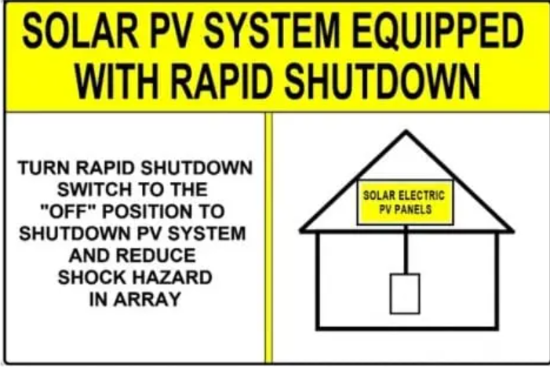
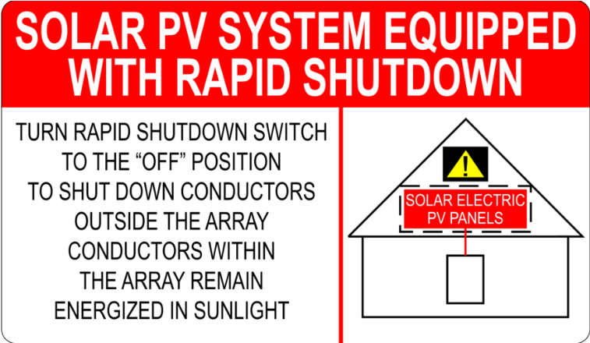
Codes and Regulations
690.12(D) Buildings with Rapid Shutdown. Labelling for each system shall have signage.
Web Search

Slide 212
Codes and Regulations
Part III. Disconnecting Means.
A disconnecting means is defined as a device, or group of devices, or other means by which the conductors of a circuit can be disconnected from their source of supply.
2023 NEC

Slide 213
Codes and Regulations
Part III. Disconnecting Means.
Article 690.13 Photovoltaic System Disconnecting Means. A disconnecting means is required to disconnect the PV system from all wiring systems, including power systems, energy storage, and utilization equipment and premises wiring.
The PV system is the total components, circuits, and equipment up to and including the PV system disconnecting means that, in combination, convert solar energy into electrical energy.
2023 NEC

Slide 214
Codes and Regulations
The PV system disconnecting means shall simultaneously disconnect the PV system conductors that are not solidly grounded from all conductors of other wiring systems.
With Transformerless inverters this requires a disconnect to open both DC wires.
2023 NEC

Slide 215
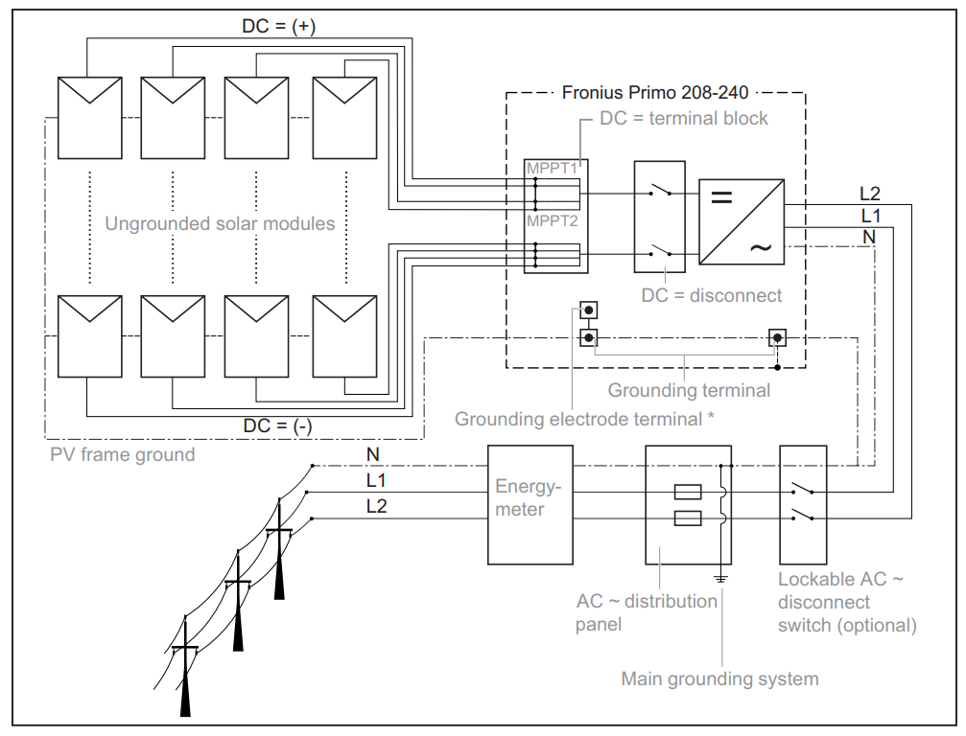
Codes and Regulations
Disconnect opens both DC wires.
Fronius Inverter

Slide 216
Codes and Regulations
Article 690.13 Photovoltaic System Disconnecting Means.
Question to ask if the disconnect in questions is the PV system disconnecting means is:
Is it disconnecting all the equipment required to convert solar energy into electric energy?
If straight from PV to dc-dc converter to inverter to main panel, then this disconnecting means is on the ac side of the inverter, if there is a dedicated breaker in the panel it is it, if there is a utility disconnect it is it, if there is a disconnect before the panel it is it also.
2023 NEC

Slide 217
Codes and Regulations
Photovoltaic System Disconnecting Means
Allowed PV System Disconnect
Utility Power
Main Panel Disconnect Breaker
Inverter
PV DC Source Disconnect
Inverter AC Disconnect
Utility
Disconnect
PV Breaker
Author

Slide 218
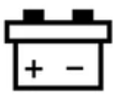
Codes and Regulations
Photovoltaic System Disconnecting Means
Allowed PV System Disconnect
Utility Power
Main Panel Disconnect Breaker
Hybrid Inverter
PV DC Source Disconnect
Inverter AC Disconnect
ESS Source Disconnect
Energy Storage System
Utility
Disconnect
PV Breaker
Author

Slide 219
Codes and Regulations
690.13(A) Location.
(1) Readily Accessible. Needs to be installed at a readily accessible location.
(2) Enclosure Doors and Covers. Being readily accessible indicates that unqualified persons have access, and therefore the cover or hinged door need to be locked or require a tool to open it.
2023 NEC

Slide 220
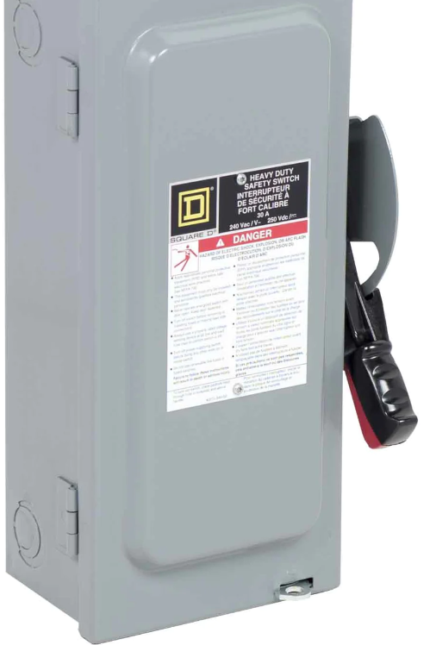
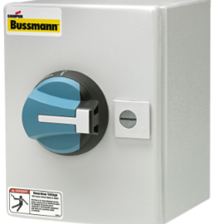
Codes and Regulations
Lockable and a tool required to open.
2023 NEC

Slide 221
Codes and Regulations
690.13(B) Marking.
The PV disconnecting means needs to plainly indicate if it is closed “on” or open “off”.
The permanent label needs to say “PV SYSTEM DISCONNECT” or equivalent.
2023 NEC

Slide 222
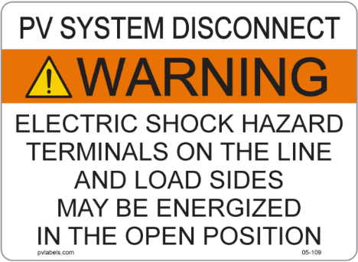
Codes and Regulations
If the “Line” or “Load” sides can be energized another label “WARNING ELECTRICAL SHOCK HAZORD TERMINALS ON THE LINE AND LOAD SIDES MAY BE ENERGIZED IN THE OPEN POSITION
2023 NEC

Slide 223
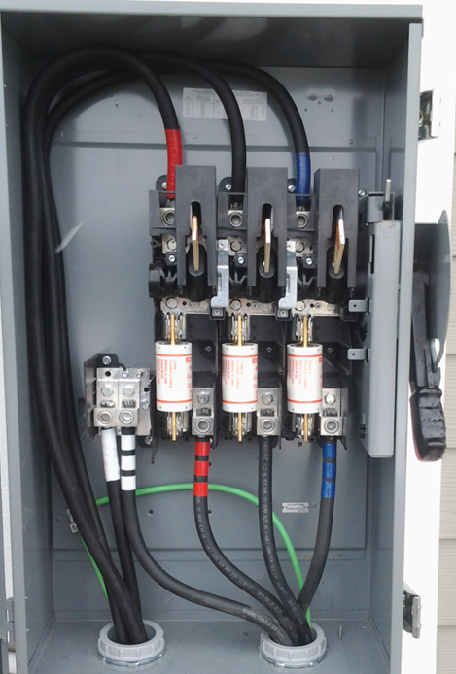
Codes and Regulations
Depending on the disconnect,
the bare open parts / fingers
can be energized.
The best practice is to keep
these parts / fingers connected
to the de-energized
conductors if possible.
The fingers are the load side.
Cory Manual

Slide 224
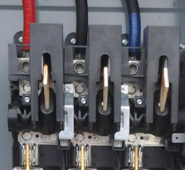
Codes and Regulations
Bare open parts / fingers
Cory Manual

Slide 225
Codes and Regulations
690.13(C) Maximum Number of Disconnects.
Each PV system disconnecting means shall consist of not more than six switches or sets of circuit breakers or a combination of either.
A single PV system disconnecting means shall be permitted for the combined ac output of one or more inverters.
2023 NEC

Slide 226
Codes and Regulations
690.13(D) Ratings.
The disconnect need to be rated to handle the maximum circuit current and available fault current.
690.13(E) Type of Disconnect. Must be able to open the ungrounded conductors at the same time (simultaneously) from all conductors of other wiring systems. Be able to be locked as in 110.25.
Article 110.25 – Lockable Disconnecting Means.
2023 NEC

Slide 227
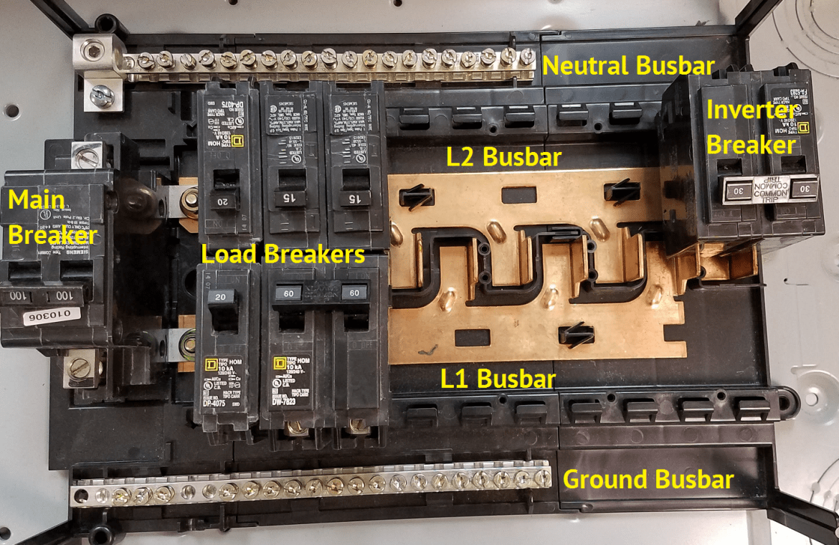
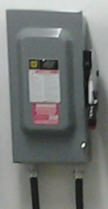
Codes and Regulations
Also, the PV system disconnecting means needs to be one of the following:
(1) A manually operated switch or breaker.
Altestore.com

Slide 228
Codes and Regulations
(2) A connector meeting the requirements of 690.33(D)(1) or (D)(3).
690.33(D)Interruption of Circuit. Mating connectors shall be one of the following:
690.33(D)(1) Rated for the interrupting current without hazard to the operator.
690.33(D)(3) Supplied as part of listed equipment and used in accordance with instructions provided.
2023 NEC

Slide 229
Codes and Regulations
690.13(E)(2)
690.33(D)(3) Supplied as part of listed equipment and used in accordance with instructions provided.
From Enphase IQ microinverter:
The inverter ac connector if only a single series branch circuit. (Must be readily accessible)
Enphase

Slide 230
Codes and Regulations
690.33(D)(3) Supplied as part of listed equipment and used in accordance with instructions provided.
From Enphase IQ microinverter: The last connector would disconnect the PV equipment from the rest of the system. (Needs to be readily accessible)
Enphase

Slide 231
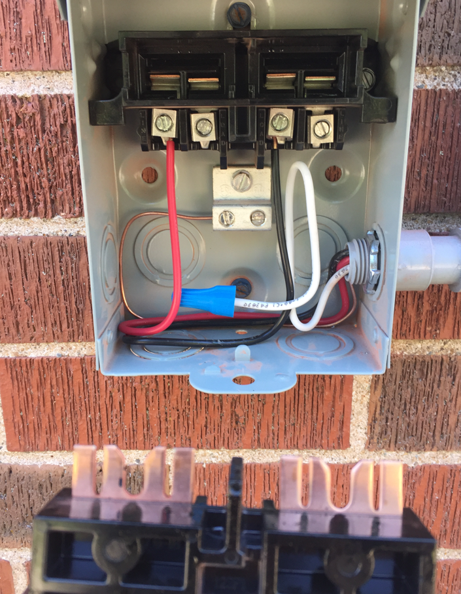
Codes and Regulations
690.13(E)(3) A pull-out switch that has sufficient interrupting rating.
Cory Manuel

Slide 232
Codes and Regulations
690.13(E)(4) A remote-controlled switch or breaker operated locally and opens automatically when its control power is removed.
(Not common)
690.13(E)(5) A device listed or approved for the intended use.
2023 NEC

Slide 233
Codes and Regulations
Article 690.15 – Disconnecting Means for Isolating Photovoltaic Equipment.
A disconnecting means so far has the ability to disconnect a circuit underload.
An isolating device does not necessarily need to break load current.
An example can be a mating connector.
2023 NEC

Slide 234
Codes and Regulations
Article 690.15 – Disconnecting Means for Isolating Photovoltaic Equipment.
(A) Type of Disconnecting Means. Where required shall be one of the following.
(1) In accordance with 690.15(C).
(2) As part of a listed equipment where an interlock or similar means prevents it from being operated under load.
(3) Circuits with a maximum current of 30A or less, an isolating device as per 690.15(B).
2023 NEC

Slide 235
Codes and Regulations
690.15(B) Isolating Device. An isolating device does not need to be required to have an interrupting rating if it is marked “Do Not Disconnect Under Load” or Not for Current Interrupting” and is not required to open all conductors simultaneously.
The isolating device can be one of the following:
(1) A mating connector as per 690.33 and listed and identified for use with specific equipment.
Article 690.33 Mating Connectors shall comply with 690.33(A) through (D). (Up coming slides)
2023 NEC

Slide 236
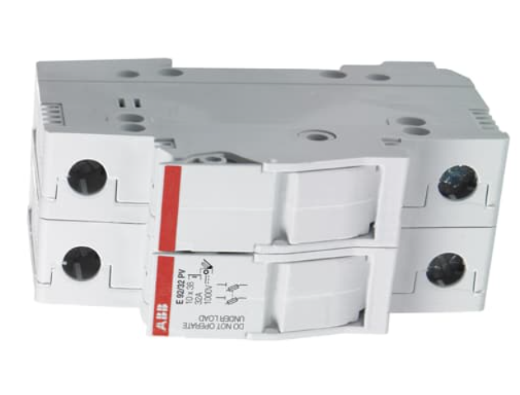
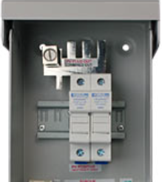
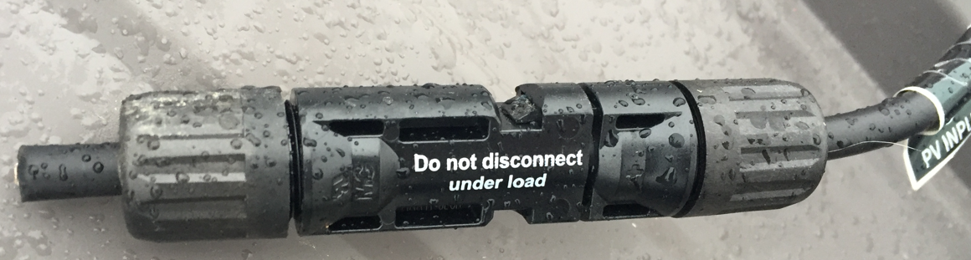
Codes and Regulations
690.15(2) A finger safe fuse holder (Often in combiner boxes).
690.15(3) An isolating device that requires a tool to open the connection (MC4 Connector).
Author + 2023 NEC

Slide 237
Codes and Regulations
690.15(C) Equipment Disconnecting Means. Shall comply with the following:
(1) Sufficient rating for fault current and maximum voltage.
(2) Simultaneously disconnect all current-carrying conductors that are not solidly grounded.
(solidly grounded is the key)
Grounded, Solidly. Connected to ground without inserting any resistor or impedance device (GFCI).
2023 NEC

Slide 238
Codes and Regulations
690.15(3) Be externally operated (arm pull for example) and indicates when open “off” or closed “on” position. When this disconnect is located out of sight or more than 3m (10ft) it must be lockable as in 110.25.
690.15(4) Any of the types in 690.13(E)(1) through (E)(5).
2023 NEC

Slide 239
Codes and Regulations
Equipment disconnecting means, other than those complying with 690.33, shall be marked in accordance with the warning in 690.13(B) if the line and load terminals can be energized in the open position.
2023 NEC

Slide 240
Codes and Regulations
A common installation practice is to terminate PV source-side dc conductors in the same manner that utility source-side ac conductors are generally connected on the line side of a disconnecting means.
This practice is more likely to de-energize load-side terminals, blades, and fuses when the disconnect is in the open position and no energized sources are connected to the load side of the disconnect.
2023 NEC

Slide 241
Codes and Regulations
690.15(D) Location and Control. Isolating devices or equipment disconnecting means shall follow:
(1) Located within the equipment.
(2) Located in sight and readily accessible.
(3) Lockable in accordance with 110.25
(4) Provided with remote controls to activate:
(a) located within the same equipment.
(b) Is lockable in accordance with 110.25, and the location of the controls are marked on the disconnection means.
2023 NEC

Slide 242
Codes and Regulations
Part IV. Wiring Methods and Materials.
Article 690.31 Wiring Methods.
(A) Wiring Systems.
(1) Serviceability. If a device that is mounted (ie microinverter, or combiner box) needs to have enough slack in the wires to allow the device to be replaced.
2023 NEC

Slide 243
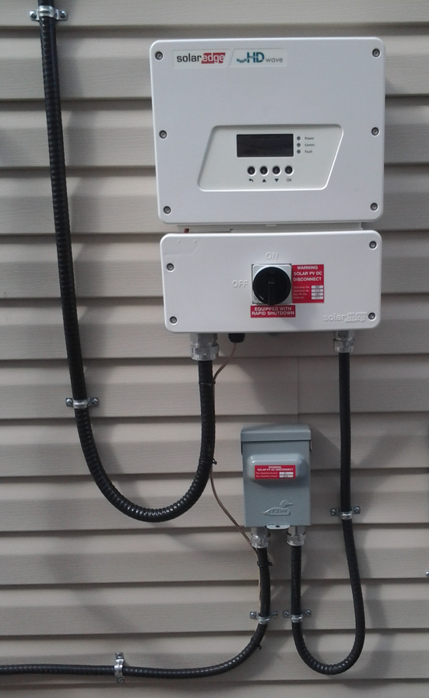
Codes and Regulations
690.31(2) Where readily accessible. When over 30 volts, the wiring needs to be protected, and metal clad wiring is acceptable (Type MC cable).
Cory Manuel + 2023 NEC

Slide 244
Codes and Regulations
690.31(3) Conductor Ampacity.
Tables in this section for higher temperature wire.
690.31(4) Special Equipment.
Besides wiring methods listed elsewhere in the Code, wiring systems listed for PV system is allowed.
(Conductor temperature limitations at terminations needs to be considered.)
2023 NEC

Slide 245
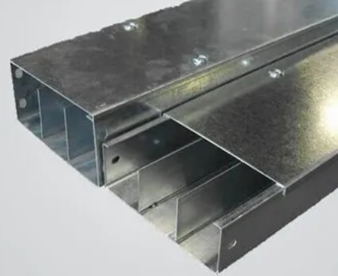
Codes and Regulations
690.31(B) Identification and Grouping.
(1) Conductors of Different Systems. If the voltage rating of any conductor is less than the circuit voltage of any other and
occupies the same raceway
a barrier shall be used to
separate them.
Author + 2023 NEC

Slide 246
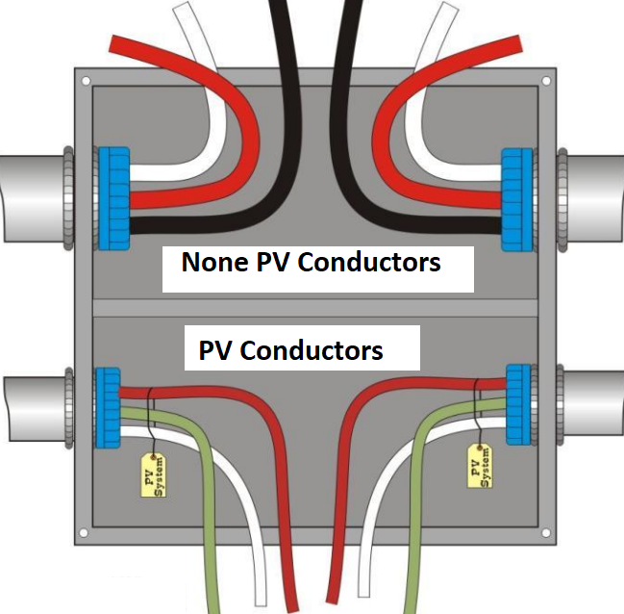
Codes and Regulations
690.31(B) Identification and Grouping.
(1) Conductors of Different Systems.
Author + 2023 NEC

Slide 247
Codes and Regulations
690.31(B)(1) Conductors of Different Systems.
If the voltage rating of the conductors are the same exceptions can be made to this rule.
(1) Remote control, signaling, and power-limited circuits (Jacketed cables) are permitted to be run with the same PV system dc wiring.
(2) Inverter output circuits can be in same junction boxes, pull box and raceways as PV dc circuits that are identified and grouped as 690.31(B)(2) and (B)(3).
2023 NEC

Slide 248
Codes and Regulations
690.31(B)(2) Identification. PV dc conductors at all terminations shall be identified as per 690.31(B)(2)(a) and (B)(2)(b).
690.31(B)(2)(a) Conductors that do not rely on color coding need to be identified by approved permanent marking means.
2023 NEC

Slide 249
Codes and Regulations
690.31(B)(2)(b) For nonsolidly grounded conductors positive or negative, need to have (+) POSITIVE or POS and (-) NEGATIVE or NEG securely marked on the insulation.
Colors for positive conductors can not be green, white or grey.
Negative conductors can not be green, white, grey or red.
2023 NEC

Slide 250
Codes and Regulations
690.31(B)(3) Grouping.
When ac and dc wires are in the same junction box, pull box or raceway they need to be grouped by cable ties or other means and when run together, they need to be grouped at intervals of not more than 1.8m (6ft).
Cable tie ac wires together.
Cable tie dc wires together.
2023 NEC

Slide 251
Codes and Regulations
690.31(C) Cables. Type PV wire or cable and Type distributed generation (DG) cables be listed.
Distributed Generation (DG) cable. This cable is intended for use with specific distributed generation equipment/devices such as photovoltaic modules, inverters, solar trackers, etc. DG cable is suitable for use between cable trays and utilization equipment.
PV and DG wire have nonstandard insulation outer diameter (thicker).
2023 NEC

Slide 252
Codes and Regulations
690.31(C) Cables. Type PV wire or cable and Type distributed generation (DG) cables be listed.
690.31(C)(1)Single-Conductor Cable. Shall comply with 690.31(C)(1)(a) through (C)(1)(c).
(a) In exposed outdoor locations in PV dc circuits within the array use one of the following:
(1) PV wire or cable
(2) Marked sunlight resistance and Type USE-2 and Type RHW-2.
2023 NEC

Slide 253
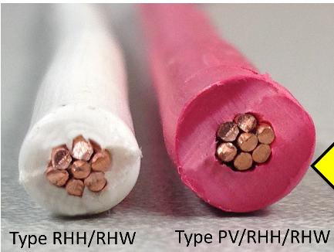
Codes and Regulations
(1) PV wire or cable.
The PV wire on the right
has thicker insulation.
Author

Slide 254
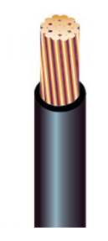
Codes and Regulations
690.31(C)(1)(a)(2) Marked sunlight resistance and Type USE-2 and Type RHW-2.
Underground Service Entrance (90C)
Rubber Heat (90C)Waterproof
Author

Slide 255
Codes and Regulations
DG Type Cable
Author

Slide 256
Codes and Regulations
690.31(C)(1)(b) Exposed cables sized 8 AWG or smaller need to be supported at intervals no further than 600mm (24 in) by cable ties, straps or other similar fitting.
690.31(C)(1)(c) Conductors bigger than # 8 AWG needs to be supported not exceeding 1400mm (54in), with cable ties, straps or similar supports.
2023 NEC

Slide 257
Codes and Regulations
690.31(C)(2) Cable Tray.
PV wire or cable of any size, with or without a cable tray rating installed in outdoor locations be supported intervals not to exceed 300mm (12in) and secured not to exceed 1400mm (54in).
Definition of supported and secured next slide.
2023 NEC

Slide 258
Codes and Regulations
The NEC doesn't have a formal definition, so it means what you think it means, when you use these terms in ordinary use.
Support means constrain against its weight.
Secure means constrain against any force in any direction.
For instance, a cable is supported by the rungs of a cable tray, but it is free to move upwards if someone picked them up. And it is free to shift along its length or position within the tray width, and sag between rungs.
Mike Holt

Slide 259
Codes and Regulations
Where PV wire smaller than 1/0 AWG is installed in ladder ventilated trough cable trays the following:
(1) All single conductors be installed in a single layer.
(2) If a circuit pair of wires are bundled together, then they can be in other than a single layer.
(3) The sum of the diameters of all conductors can not exceed the cable tray width.
2023 NEC

Slide 260
Codes and Regulations
Ladder ventilated trough cable tray.
Author

Slide 261
Codes and Regulations
690.31(C)(3) Multiconductor Jacketed Cables.
Where not listed for PV assembly.
Be installed as follows:
Author

Slide 262
Codes and Regulations
690.31(C)(3)(1) In raceways, where on or in buildings (not on roof).
(2) Where not in raceways:
a. Marked sunlight resistance in exposed outdoor locations
b. Protected or guarded, in presence of physical damage
c. Closely follow the surface of support structures
d. Secured at intervals not exceeding 1.8 m (6ft)
e. Secured within 600mm (24in) of mating connectors.
2023 NEC

Slide 263
Codes and Regulations
690.31(C)(3)f. Marked for direct burial when buried in the earth.
690.31(C)(4) Flexible Cords and Cables Connected to Tracking PV Arrays.
These are part of the moving array. They need to conform to Article 400 and Types hard service cord or portable power cord. Extra-hard use, outdoor, water resistance and sunlight resistant.
Amperage as per Table 400.5. (Ampacity for Flexible Cords and Flexible Cables)
2023 NEC

Slide 264
Codes and Regulations
690.31(C)(5) Flexible, Fine Stranded Cables. These cables shall be terminated only with terminals, lugs, devices or connectors as per 110.14.(Specific for the application)
Table 690.31(C)(4) Minimum PV Wire Strands is used due to the amount of movement these wires are subjected to.
2023 NEC

Slide 265
Codes and Regulations
690.31(C)(6) Small-Conductor Cables.
Sizes AWG 16 – 18 are allowed for module interconnection as long as the ampacity is met as per 400.5 (Ampacity for Flexible Cords and Flexible Cables) and applied adjustments and correction factors of 310.14 (Ampacities for Conductors Rated 0 Volts – 2000 Volts).
2023 NEC

Slide 266
Codes and Regulations
690.31(D) Direct-Current Circuits on or in Buildings. Need to comply with 690.31(D)(1) and (2).
690.31(D)(1) Metal Raceways and Enclosures. Where inside a building and the dc voltage is greater than 30 volts or 8 Amps, the conductors will be contained in metal raceways or Type MC metal-clad cable that meets 250.118(A)(10)(b) or (A)(10)(c) [Listed and identified for being an equipment grounding conductor (next slides)], or in a metal enclosure.
2023 NEC

Slide 267
Codes and Regulations
Article 250.11(10)Type MC cable that provides an effective ground-fault current path in accordance with one or more of the following:
(a) It contains an insulated or uninsulated equipment grounding conductor in compliance with 250.118(1)( A copper, aluminum, or copper-clad aluminum conductor. This conductor shall be solid or stranded; insulated, covered, or bare; and in the form of a wire or a busbar of any shape.)
2023 NEC

Slide 268
Codes and Regulations
Article 250.11(10)(c) The metallic sheath or the combined metallic sheath and equipment grounding conductors of the smooth or corrugated tube-type MC cable that is listed and identified as an equipment grounding conductor.
This is the only type that can be used for the equipment grounding conductor.
2023 NEC

Slide 269
Codes and Regulations
690.31(D)(2) Marking and Labeling. Enclosures containing PV system dc circuit conductors are required to be labeled with “ PHOTOVOLTAIC POWER SOURCE or SOLAR PV DC CIRCUIT”
(1) Exposed raceways, cable trays, and other wiring methods.
(2) Covers or enclosures of boxes.
(3) Conduit bodies that have unused openings.
2023 NEC

Slide 270
Codes and Regulations
690.31(E) Bipolar PV Systems.(Not covered in this course)
690.31(F) Wiring Methods and Mounting Systems.
Roof-mounted systems are permitted with an approved means. (racking systems)
690.31(G) Over 1000 Volts DC. N/A
2023 NEC

Slide 271
Codes and Regulations
Article 690.32 Component Interconnections.
Fittings and connectors if concealed will meet requirements for wiring methods of insulation (voltage), temperature rise, and short-circuit current ratings and be capable of resisting the effects of environment they are located in.
Basically, make these as if they are never to be accessed and last for any conditions that they could be exposed to.
2023 NEC

Slide 272
Codes and Regulations
Article 690.33 Mating Connectors. Other than ones above, shall comply with 690.33(A) through (D).
690.33(A) Configuration. The mating connectors shall be polarized and be of a configuration that is different than any other on the premise. (MC-4 for example)
690.33(B) Guarding. Constructed and installed to guard against accidental contact of live parts with people.
(MC-4 for example)
2023 NEC

Slide 273
Codes and Regulations
690.33(C) Type. Be of a latching or locking type. If over 30 volts dc or 15 volts ac will require a tool for opening. (MC-4 for example)
2023 NEC

Slide 274
Codes and Regulations
690.33(D) Interruption of Circuit. Be one of the following:
(1) Rated for interrupting current without hazard to the operator.
(2) Require a tool to operate and marked “Do Not Disconnect Under Load” or “Not for Current Interrupting”
(3) Supplied as part of listed equipment and with instructions provided with the equipment. ( Microinverter is an example of this)
2023 NEC

Slide 275
Codes and Regulations
Article 690.34 Access to Boxes. Junction, pull and outlet boxes mounted behind modules need to be installed to allow access to the wiring inside them directly or by removal of a module with a removable fasteners and connected with flexible wire system.
Access is normally for troubleshooting and repair, not regular maintenance.
2023 NEC

Slide 276
Codes and Regulations
Part V. Grounding and Bonding
Article 690.41 PV System DC Circuit Grounding and Protection.
690.41(A) PV System DC Circuit Grounding Configurations. One or more of the following configurations can be used:
(1) 2-wire circuits with one functionally ground conductor. (Ground Fault Protection see Fig 1.)
(2) Bipolar circuits with center tap.
(3) Circuits not isolated from the inverter output circuit.
2023 NEC

Slide 277
Codes and Regulations
(4) Ungrounded circuits
(5) Solidly grounded circuits permitted in 690.41(B) ( one or two strings where there is no building or system ground. See Fig 2.)
(6) Circuits protected by equipment listed or identified for the use.
Next slides explain these 6 options.
2023 NEC

Slide 278
Codes and Regulations
690.41(A)(1) Fig 1. Functionally grounded through GFCI fuse.
Grounded through circuitry at inverter or charge controller.
Pacific Gas and Electric Company

Slide 279
Codes and Regulations
690.41(A)(2) Bipolar is not covered in this course / program.

Slide 280
Codes and Regulations
690.41(A)(3) Circuits not isolated from the inverter output circuit. (Transformerless Inverter)
With a Transformerless inverter the grounded dc conductor from the PV array is directly coupled to the inverter’s grounded ac conductor. (neutral).
An external GFPD (Ground Fault Protection Device) is added to the combiner box or separately.

Slide 281
Codes and Regulations
690.41(A)(3) Circuits not isolated from the inverter output circuit. (Transformerless Inverter)
Some manufacturers include the GFPD on board.
On a fault it will disconnect the neutral form the DC side of the inverter under the first fault condition.
All Fronius Transformerless inverters switch off and break the neutral connection if an earth fault occurs

Slide 282
Codes and Regulations
690.41(A)(4) Ungrounded circuits.
Inverters with transformers that do not provide GFPD through a functional grounding system, it is important to provide ground-fault protection.
The equipment grounding conductor stays isolated from the grounded conductor.

Slide 283
Codes and Regulations
690.41(A)(5) Fig 2. Solidily grounded.
Pacific Gas and Electric Company

Slide 284
Codes and Regulations
690.41(A)(6) Circuits protected by equipment listed and identified for the use.
Microinverters are an example of this.

Slide 285
Codes and Regulations
690.41(B) DC Ground-Fault Detector-Interrupter (GFDI) Protection.
PV dc circuits at more than 30 volts or 8 amperes must be provided with dc ground-fault protection meeting the requirements of 690.41(B)(1) and (B)(2) to reduce fire hazards.
Solidly grounded PV source circuits with not more than two modules in parallel and not on or in buildings shall be permitted without ground-fault protection.
2023 NEC

Slide 286
Codes and Regulations
690.41(B)(1) Ground-Fault Detection. The GFDI needs to detect ground-fault(s) in the PV dc circuits, including in a functionally grounded system, and be listed.
Some dc-dc converters are not listed as having GFDI and would require one being added.
2023 NEC

Slide 287
Codes and Regulations
690.41(B)(2) Faulted Circuits. The faulted circuits needs to be controlled by:
(1) The current-carrying conductors be automatically disconnected.
(2) In a functionally grounded system, the GFDI needs to stop the power to the output circuits.
690.41(B)(3) Indication of Faults. The GFDI equipment needs to provide indication of ground-faults at a readily accessible location.
2023 NEC

Slide 288
Codes and Regulations
Article 690.42 Point of PV System DC Circuit Grounding Connection.
(A) Circuits with GFDI Protection. Circuits as per 690.41(B) can have either the positive or negative wire connection to ground through the GFDI.
(B) Solidly Grounded Circuits. For these systems the grounding connection shall be made from any single point on the PV dc system to a point in the grounding electrode system as per 690.47(A).
2023 NEC

Slide 289
Codes and Regulations
Ground Fault Detection Protection Circuit.
DC Positive Bus Isolated from Ground
Main DC Breaker (30A)
Double Pole Ground Detection Breakers, Main 63A and 1A Ground Breaker.
DC Negative Bus Isolated from Ground
DC + to loads
DC – to loads
DC Enclosure
Author

Slide 290
Codes and Regulations
The ground fault system in the previous slide keeps both the DC + and DC – isolated from ground with isolated buses.
The DC – is connected to ground through the 1 A breaker.
The 1A breaker is ganged with the 63A breaker.
If the 1A breaker sees more than 1A it operates, and trips open the 63A breaker removing the DC – from ground and stopping the fault current.
This is one type of ground fault detection system.

Slide 291
Codes and Regulations
Article 690.43 Equipment Bonding and Grounding.
Exposed non-current-carrying metal parts of the PV modules, racking, electrical equipment, and enclosures of the PV system are required to be connected to an equipment grounding conductor as per 250.134 or 250.136.
250.134 Equipment Fastened in Place or connected Permanent Wiring Methods (Fixed)
250.136 Equipment Secured to a Metal Rack or Structure.
2023 NEC

Slide 292
Codes and Regulations
Equipment grounding conductors and devices are required to be as per 690.43(A) through (D).
690.43(A) Photovoltaic Module Mounting Systems and Devices. These devices and systems for mounting PV modules and used to bond the modules are required to be listed, labeled and identified for bonding PV modules. These pieces of equipment are listed under UL 2703.
2023 NEC

Slide 293
Codes and Regulations
690.43(A) Photovoltaic Module Mounting Systems and Devices.
Mike Holt

Slide 294
Codes and Regulations
The Scope of UL 2703 is the following:
1.1 These requirements cover rack mounting systems and clamping devices for flat-plate photovoltaic modules and panels that comply with the Standard for Flat-Plate Photovoltaic Modules and Panels, UL 1703, intended for installation on or integral with buildings, or to be freestanding (i.e., not attached to buildings), in accordance with the National Electrical Code, ANSI/NFPA 70 and Model Building Codes.
Web Search

Slide 295
Codes and Regulations
1.2 These requirements cover rack mounting systems and clamping devices intended for use with photovoltaic module systems with a maximum system voltage of 1000 V.
1.3 These requirements cover rack mounting systems and clamping devices pertaining to ground/bonding paths, mechanical strength, and suitability of materials only.
Web Search

Slide 296
Codes and Regulations
690.43(B) Equipment Secured to Grounded Metal Supports. This are the racking components.
The devices in 690.43.(A) are permitted to bond the equipment to the grounded metal supports. The rails need to use an identified bonding jumpers connected between the separate metal sections or be identified for equipment bonding and is required to be connected to the equipment grounding conductor.
2023 NEC

Slide 297
Codes and Regulations
690.43(B) Equipment Secured to Grounded Metal Supports. (Bonding Jumper)
Charge Solar

Slide 298
Codes and Regulations
690.43(C) Location. The equipment grounding conductor is allowed to be separated from the PV dc wiring but must follow the rules for 250.134.
Article 250.134 is equipment that is fastened in place (PV panels, and racking).
2023 NEC

Slide 299
Codes and Regulations
Article 250.118 identifies the types of equipment grounding conductors.
A copper, aluminum, or copper-clad aluminum conductor. This conductor shall be solid or stranded; insulated, covered, or bare; and in the form of a wire or a busbar of any shape. This is the most common method.
Armor of type AC cable or MC Cable if it has a grounding conductor included.
2023 NEC

Slide 300
Codes and Regulations
AC (Armor Clad) uses the armor jacket and the bare wire. MC (Metal Clad) does not use the jacket.
Web Search

Slide 301
Codes and Regulations
AC or MC cable!
The main difference between the AC wire and the MC wire is that the metal-clad cable has a standard ground wire, whereas the AC cable relies on a jacket in combination with a wire or thin strip to secure the grounding. The metal armor can also act as a part of the earth grounding in combination with the bonding wire. In type MC cables, the armor is not part of the grounding.
AC cables need to connect to metal boxes.
Author

Slide 302
Codes and Regulations
690.43(D) Bonding over 250 Volts. Beyond the scope of this program.
2023 NEC

Slide 303
Codes and Regulations
Article 689.45 Size of Equipment Grounding Conductors. These conductors will be sized as per 250.122 (Check table 250.122 next slide).
If the PV dc wires do not have overcurrent protection, the size of the equipment grounding conductor will be sized based on 690.9(B) (Device Ratings previously described) and Table 250.122 (next slide).
2023 NEC

Slide 304
Codes and Regulations
Equipment Grounding Conductors Table 250.122
2023 NEC

Slide 305
Codes and Regulations
Article 690.47 Grounding Electrode System.
690.47(A) Buildings or Structures Supporting a PV System. A grounding electrode system is required to be installed as per 690.47(B) if supported by a building or structure(s).
The PV array equipment grounding conductors need to be connected to grounding electrode system as per Part VII of article 250.
2023 NEC

Slide 306
Codes and Regulations
690.47(B) Grounding Electrodes and Grounding Electrode Conductors.
An additional grounding electrode can be installed, the electrode must be one of the types as in article 250.52.
These are not required.
2023 NEC

Slide 307
Codes and Regulations
690.47(A) Continued.
In not solidly grounded (functionally grounded) PV systems, a single connection to the already established AC distribution equipment (main panel) grounding electrode system.
2023 NEC

Slide 308
Codes and Regulations
690.47(A) Continued.
For solidly grounded systems, the grounded conductor is connected to the grounding electrode system with a conductor sized as per 250.166 (Size of the Direct-Current Grounding Electrode Conductor).
Not smaller than # 8 AWG copper
Not smaller than the neutral
Not larger than 3 / 0 copper
2023 NEC

Slide 309
Codes and Regulations
Part VI. Source Connections.
690.56 Identification of Power Sources. Marking / labelling as per 705.10 (Article 705 Interconnected Electric Power Production Sources). More on this in article 705 slides.
690.59 Connection to Other Sources. Parts I and II of article 705 shall be followed.
2023 NEC

Slide 310
Codes and Regulations
690.72 Self-Regulated PV Charge Control.
The PV source circuit when charging a battery shall not require extra equipment to charge the battery system.
The charge control shall be part of the PV source circuit.
(1) The charge control must meet the voltage and charge requirements of the battery system.
(2) The maximum charging current shall be as recommended by the battery manufacturer.
2023 NEC

Slide 311
Codes and Regulations
This concludes the article 690 Solar Photovoltaic PV Systems code rules.
The next article is 705.10 Article 705 Interconnected Electric Power Production Sources.
This article is about the parallel operation of two or more electric power systems connected together.

Slide 312
Codes and Regulations
705 Interconnected Electric Power Production Sources.
705.1 Scope
This Article covers installation of one or more electric power production sources operating in parallel with a primary source(s) of electricity.
Primary source is normally the utility grid.
It can be an onsite power source, generator, ESS, micro-grid or any combination of.
Information Note Figure 705.1 shows common configurations.
2023 NEC

Slide 313
Codes and Regulations
705.05 Parallel Operation.
(A) Output Compatibility. Must have compatible wave shape, voltage and frequency.
This was introduced in the course “Grid Tied PV Design”.
(B) Synchronous Generators. When interconnected to other systems, synchronizing equipment shall be installed.
This was introduced in the course “Grid Tied PV Design”.
2023 NEC

Slide 314
Codes and Regulations
705.06 Equipment Approval. Equipment for interconnected electric systems shall be listed or be field evaluated and be labelled.
Home made equipment is allowed if it is tested and then labelled.
2023 NEC

Slide 315
Codes and Regulations
Information Note Figure 705.1 shows common configurations. (Note the Numbers 1 - 6)
3
1
6
2
4
5
2023 NEC

Slide 316
Codes and Regulations
From the previous slide the numbers 1 – 6 explained.
(1) The primary source is the source that will be available the most often. Typically, it is the utility grid power source.
(2) The AC loads are the ones that are connected for daily use and are fed from the main panel.

Slide 317
Codes and Regulations
(3) Multimode Inverter is a device that has more than one operating mode.
Mode 1 it can route the primary source energy directly to the AC loads.
Mode 2 it can supply the AC loads when the primary source is not available (power outage) via the ESS (Energy Storage System).
Mode 3 it can put power back to the primary source under selected conditions.
Mode 4 it can charge the ESS.

Slide 318
Codes and Regulations
Information Note Figure 705.1 shows common configurations. DC interconnected(Note the Numbers 1 - 6)
3
1
6
2
4
5
2023 NEC

Slide 319
Codes and Regulations
(4) Microgrid Interconnect Device (MID). A device that enables a microgrid system to separate from and reconnect to operate in parallel with a primary power source.
This allows the inverter to be in an island mode when not connected to the primary source.
It also allows the primary source to connect to the loads and the inverter for other functions.
(Charge ESS or sell PV power for an example).

Slide 320
Codes and Regulations
(5) The ESS is an energy source that can receive energy from the primary source and or the PV source.
It can also supply energy to the AC loads and or the primary source.

Slide 321
Codes and Regulations
(6) This power source will be a dc source.
It can come from any renewable source, but for this course it will be PV powered.

Slide 322
Codes and Regulations
Information Note Figure 705.1 shows common configurations. AC interconnected
2023 NEC

Slide 323
Codes and Regulations
705.08 System Installation. Any installation in the article is to be completed by a qualified person.
Definition of a qualified person is in the definition section.
2023 NEC

Slide 324
Codes and Regulations
705.10 Identification of Power Sources (690.56)
Permanent markings will be installed at each service equipment location, or at an approved readily visible location as per:
(1) Indicate the location of each power source disconnecting means for a building or structure.
(2) The phone number of off-site entities servicing the power source systems. (just like you find on an elevator)
(3) The words “CAUTION: MULTIPLE SOURCES OF POWER” as per 110.21(B) [Size and color]
2023 NEC

Slide 325
Codes and Regulations
705.11 Source Connections to a Service.
These are the conductors on the side of the power source, not the Load-Side or user load side.
These conductors can be DC or AC.
If DC they most likely connect to an inverter.
If AC they most likely are from an inverter.

Slide 326
Codes and Regulations
705.11 Source Connections to a Service.
Definition of “Service” is:
The conductors and
equipment connecting the
servicing utility (power source)
to the wiring system of the
premises served.
2023 NEC

Slide 327
Codes and Regulations
Service Conductors are the conductors from the service point to the service disconnecting means.
Picture courtesy EC&M

Slide 328
Codes and Regulations
Service Equipment are the necessary equipment, consisting a circuit breaker(s) or switch(es) and fuses and their accessories, connected to the servicing utility (power source) which is intended to be the control and disconnect of the servicing utility (power source).
See next slide for the Service Equipment.
2023 NEC

Slide 329
Codes and Regulations
Service Equipment
This has separate disconnecting means outside of main panel.
Author

Slide 330
Codes and Regulations
705.11 Source Connections to a Service.
705.11(A) Service Connections. An electric power production source shall be permitted to be connected to a service by one of the following methods.
230.2(A) Interconnected electric power production sources.
2023 NEC

Slide 331
Codes and Regulations
230.82(6) Solar PV systems, fuel cell systems, wind electric systems, energy storage systems, or interconnected electric power production systems (Inverter), as long as they have disconnection means suitable for use as service equipment and have appropriate overcurrent protection.
2023 NEC

Slide 332
Codes and Regulations
705.11(B) Conductors. Service conductors shall comply with the following:
(1) Ampacity of the conductor as calculated in 705.28(A).(Circuit Sizing and Current)
(2) Not be smaller than # 6 AWG copper.
(3) Any ampacity of any other service conductors that the power production sources shall not be smaller than required in 705.11(B).
2023 NEC

Slide 333
Codes and Regulations
705.11(C) Connections. Connections shall comply with 705.11(C)(1) through (C)(3).
(1) Splices or Taps. Service conductor splices and taps shall comply with 230.33 or 230.46 including enclosure fill requirements (how much volume (fill) may be occupied by conductors, taps or splices).
2023 NEC

Slide 334
Codes and Regulations
A tap does not cut the main wire, it pierces it and allows another wire to tap into the piercing device.
BUCHANAN Tap Connector

Slide 335
Codes and Regulations
A splitter can provide taps for conductors.
Cory Manuel

Slide 336
Codes and Regulations
A splitter can provide taps for conductors.
Cory Manuel

Slide 337
Codes and Regulations
A splice joins two wires to
make them extend further.
Compression tool required.
Splice for service conductors
Author

Slide 338
Codes and Regulations
230.33 + 230.46 include the following:
Be marked suitable for use on the line side of service equipment.
Follow underground installation if applicable.
Not allowed in a raceway.
110.14 Electrical Connections (B) Splices.
2023 NEC

Slide 339
Codes and Regulations
705.11(C)(2) Existing Equipment. Any modifications to existing equipment must be made as per manufacturers instructions or be field evaluated.
705.11(C)(3) Utility-Controlled Equipment. Metering equipment shall only be used with permission of the utility owning them.
2023 NEC

Slide 340
Codes and Regulations
705.11(D) Service Disconnecting Means.
As per Parts VI through VII of Article 230 shall be followed for the disconnecting means between power production source and other conductors of other systems.
230 Part VI Service Disconnecting Means.
Disconnect all ungrounded conductors.
230 Part VII Service Equipment – Overcurrent Protection. Each ungrounded conductor requires overcurrent protection.
2023 NEC

Slide 341
Codes and Regulations
705.11(E) Bonding and Grounding. As per Article 250 all metal parts shall be bonded. This includes boxes, enclosures metal conduit.
705.11(F) Overcurrent Protection. As per Article 230. This is the same as any service, it is required to have an overcurrent protection.
2023 NEC

Slide 342
Codes and Regulations
705.12 Load-Side Source Connections.
Load - side connections allows interconnecting an alternate power source to the load side of the service disconnecting means of another source at any distribution equipment (short version).
The output of an inverter (interconnected power source) is allowed to connect to the load-side of the service disconnecting means of other power sources.
Next slide.
2023 NEC

Slide 343
Codes and Regulations
Load-Side Source Connections
2023 NEC

Slide 344
Codes and Regulations
705.12 (A) Feeders and Feeder Taps.
Definition of a Feeder. It is the circuit conductors between the service equipment, other power source and the final branch-circuit overcurrent device. Conductors past the final the overcurrent device protecting the circuit and the outlet are branch-circuit conductors.
When there is a separation between the service disconnect and the main panel those conductors are feeder conductors.

Slide 345
Codes and Regulations
The conductors between the utility meter and the service disconnect are not feeder conductors, they are service conductors.

Slide 346
Codes and Regulations
705.12 (A) Feeders and Feeder Taps.
When a power source output connection is made to a feeder:
(1) The feeder ampacity is at least 125 percent of the power source output circuit current.
(2) If the power source output connection is not made at the opposite end of the feeder (in other words sharing the feeder with another source). The feeder shall be protected by either of the following:
(a) The feeder ampacity is not less than the sum of the primary source overcurrent device plus 125% of the power source output circuit current.
2023 NEC

Slide 347
Codes and Regulations
705.12 (A)(2)(b) An overcurrent device at the load side of the power source at not greater than feeder ampacity.
Next three slides show variations.
2023 NEC

Slide 348
Codes and Regulations
Ampacity Feeder Conductors
Inverter
Power Source Disconnect 80A x 125% = 100A
Utility Power
100A Capacity
Requires conductor change
300A Capacity
200A Breaker
200A Capacity
Author

Slide 349
Codes and Regulations
Load Side Overcurrent
Utility Power
Inverter
Power Source Disconnect 80A x 125% = 100A
100A Capacity
Load Side Overcurrent
200A Capacity
200A Capacity
200A Breaker
Author

Slide 350
Codes and Regulations
Load Side Overcurrent
Inverter
Power Source Disconnect 80A x 125% = 100A
Utility Power
200A Breaker no conductor change
100A Capacity
200A Capacity
200A Breaker
200A Capacity
Author

Slide 351
Codes and Regulations
705.12 (A)(3) For taps that do not extend outside of the disconnection means then the tap conductor ampacity is equal to the over current of the overcurrent device, or if they do, then the tap conductors ampacity is not less than 1 / 10th of the overcurrent device protecting the feeder.
The last condition leaves the tap conductors protected by their own overcurrent device.
2023 NEC

Slide 352
Codes and Regulations
705.12 Load-Side Source Connections.
(B) Busbars
The NEC definition for this example of a busbar is: A non-insulated conductor electrically connected to the source of supply and physically supported on an insulator providing a power rail for connection to utilization equipment.
2023 NEC

Slide 353
Codes and Regulations
Ungrounded busbars
Grounded busbar
Located in the tub of the
panel.
Picture courtesy author

Slide 354
Codes and Regulations
705.12 (B) Busbars
(2) Where two sources, one a primary power source (Utility), and the other power source (PV), are located at opposite ends of a busbar that contains loads, the sum of 125 percent of the power-sources output circuit current and the rating of the overcurrent device protecting the busbar shall not exceed 120 percent of the busbar rating.
2023 NEC

Slide 355
Codes and Regulations
705.12 Busbars.
This will limit the amount of solar energy that can be put into the main panel of the residence when the solar overcurrent device is at the opposite end of the busbar..
120% of the total panel main breaker size can be connected. (Assuming busbar = main breaker size)
100A panel can have 100A main + 20A solar breaker

Slide 356
Codes and Regulations
125% of the solar current plus the main overcurrent device can be 120% of busbar rating.
Solar breaker amperage is calculated as the continuous inverter output x 125%.
16A solar x 125% = 20A breaker plus 100A main breaker = 120A of breakers.

Slide 357
Codes and Regulations
A way to increase the capacity of the main panel is to get a higher amperage one.
60A box with a 50A main breaker, max breaker current allowed is 72A, so can handle 20A breaker from solar.
50A + 20A solar breaker = 16A output current x 125% = 3840W inverter rating.

Slide 358
Codes and Regulations
125A box / tub with a 100A main breaker, max breaker current allowed is 150A, so can handle 50A breaker from solar.
125A x 120% = 150A in breakers
150A – 100A main = 50A solar breaker
50A x 80% = 40A solar inverter continuous output current. (9600 Watt inverter rating)

Slide 359
Codes and Regulations
240 volts x 16A solar = 3840 Watts at output of inverter.
If the inverter output is too high for the main panel, there are other ways to have the output go into the utility.
A splitter can be added on the load side of the utility meter.

Slide 360
Codes and Regulations
The splitter is rated by voltage and current.
It will take the solar and main panel connections to the meter when the meter is connected into the splitter.
Picture courtesy author

Slide 361
Codes and Regulations
Another method is to have a double lug meter base.
The second lug will allow the inverter output to be connected before the meter and bypass the main panel.

Slide 362
Codes and Regulations
Double lug
meter base.
Utility connection
Two lugs for loads
Main Panel
Inverter output
Picture courtesy author

Slide 363
Codes and Regulations
705.13 Energy Management Systems (EMS).
Article 750 Energy Management Systems defines the role of these systems for load control in a building.
750.20 Alternate Power Sources. EMS shall not override any controls for the following:
(1) Fire Pumps
(2) Health care facilities
(3) Emergency systems
(4) Legally required standby systems
(5) Critical operations systems
2023 NEC

Slide 364
Codes and Regulations
750.30 Load Management.
(A) Load Shedding Controls. Shall not override the load shedding controls for
(1) Fire pumps
(2) Emergency systems
(3) Legally required standby systems
(4) Critical operations power systems
2023 NEC

Slide 365
Codes and Regulations
750.30 Load Management.
(B) Disconnection of Power. EMS shall not disconnect power to the following:
(1) Elevators, escalators, moving walks, or stairway lift chairs
(2) Positive mechanical ventilation for hazardous (classified) locations
(3) Ventilation used to exhaust hazardous gas
(4) Circuits suppling emergency lighting
(5) Essential electrical systems in health care facilities.
2023 NEC

Slide 366
Codes and Regulations
The EMS is used to manage electrical loads and manage the various power sources.
From previous slides, the EMS must be managed to provide enough power for systems deemed essential.
The EMS must also be managed to control the amperage (current) supplying feeders and busbars from overloading.

Slide 367
Codes and Regulations
705.20 Source Disconnecting Means. Means for disconnecting power source output conductors shall be made. A single disconnect can be used to disconnect multiple power sources from conductors of other systems.
2023 NEC

Slide 368
Codes and Regulations
705.20 Source Disconnecting Multiple Sources.
2023 NEC

Slide 369
Codes and Regulations
705.20 The disconnecting means shall comply with the following:
(1) Be one of the following types:
(a) A manually operable switch or circuit breaker
(b) A load-break-rated pull-out switch
(c) A power-operated or remote-controlled switch or circuit breaker that is manually operable locally and opens automatically when control power is interrupted
(d) A device listed or approved for the intended application
2023 NEC

Slide 370
Codes and Regulations
705.20 (2) Simultaneously disconnect all ungrounded conductors of the circuit
(3) Located where readily accessible
(4) Externally operable without exposed live parts
(5) Plainly indicate whether in the open (off) or closed (on) position
(6) Have ratings sufficient for the maximum circuit current, available fault current, and voltage that is available at the terminals
2023 NEC

Slide 371
Codes and Regulations
705.20 (7) Where the line and load terminals are capable of being energized in the open position, be marked with the following or equivalent.
WARNING
ELECTRICAL SHOCK HAZARD TERMINALS ON THE LINE AND LOAD SIDES MAY BE ENERGIZED IN THE OPEN POSITION
2023 NEC

Slide 372
Codes and Regulations
705.25 Wiring Methods. Power source output conductors must comply with 705.25(A) through (C)
(A) General. Equipment listed and methods for power production systems as well as general wiring methods found elsewhere in this Code.
(B) Flexible Cords and Cables. Only for moving parts, or for ready removal for maintenance and repair shall be listed and identified as DG cable, or extra hard use, and water resistant. When exposed to sun, it shall be sunlight resistant.
2023 NEC

Slide 373
Codes and Regulations
705.25 (C) Multiconductor Cable Assemblies. Are permitted if listed and used according to this.
An ac module harness is an example of this.
2023 NEC

Slide 374
Codes and Regulations
705.28 Circuit Sizing and Current.
(A) Power Source Output Maximum Current.
Where not elsewhere required or permitted in this Code, the maximum current for power sources need to be calculated by one of the following:
(1) The sum of the continuous rated output of each equipment.
(2) N/A
(3) N/A
2023 NEC

Slide 375
Codes and Regulations
705.28 (B) Conductor Ampacity. Not less than the following, including temperature correction of conductors.
(1) Maximum current calculated in 705.28(A) multiplied by 125%.
(2) N/A
(3) Where connected to feeders, if smaller than the feeder conductors, ampacity calculated as in 240.21(B). (Based on the length of the tap conductors)
2023 NEC

Slide 376
Codes and Regulations
705.30 Overcurrent Protection.
(A) Circuit and Equipment. Power source output circuit conductors and equipment shall be provided with overcurrent protection. Circuits connected to more than one electrical source shall have overcurrent devices located to provide overcurrent protection from all sources.
2023 NEC

Slide 377
Codes and Regulations
705.30 Overcurrent Protection.
(B) The overcurrent devices in other than generator systems shall be sized to carry not less than 125 percent of the maximum currents as calculated in 705.28(A). The rating or setting of overcurrent devices shall be permitted in accordance with 240.4(B) [800A or less] and (C) [800A or more]
2023 NEC

Slide 378
Codes and Regulations
705.30 Overcurrent Protection.
(C) Marking. Equipment containing overcurrent protection supplied from interconnected power sources shall be marked to indicate this and the presence of all sources.
(D) Suitable for Backfeed. Fuses unless otherwise stated, are considered suitable for backfeed. Circuit breakers that are not marked Line and Load are considered suitable for backfeed. If marked Line and Load, are not are considered suitable for backfeed unless specifically rated. (Next slide)
2023 NEC

Slide 379
Codes and Regulations
Load and Line Marked Breaker.
Author

Slide 380
Codes and Regulations
Load and Line Not Marked on Breaker.
Good for Backfeed.
Author

Slide 381
Codes and Regulations
705.30 Overcurrent Protection.
(E) Fastening. The backfeed breaker in past codes was required to be fastened to the panel busbars.
The additional fastening device was for push on breakers.
Author + 2023 NEC

Slide 382
Codes and Regulations
705.30 Overcurrent Protection.
(F) Transformers.
(1) Overcurrent placed on side of transformer with largest source.
(2) Secondary conductors protected as per 240.21(C).
240.21(C)(1) Protected on primary side
240.21(C)(2) Secondary conductors not longer than 3m or 10 feet.
2023 NEC

Slide 383
Codes and Regulations
705.32 Ground Fault Protection. The output of interconnected power production equipment requires the connection to GFCI, it shall be on the supply side of the ground-fault protection equipment.
Explanation of GFP Devices on next slide.
2023 NEC

Slide 384
Codes and Regulations
Circuit breakers with fault-powered ground-fault protection power circuit breakers, or smaller thermal-magnetic circuit breakers with add-on ground-fault modules, that are not marked “line” and “load” and therefore are suitable for backfeeding.
Normal GF breakers line power fed circuitry, and will not work when backfed. They also have terminals marked line and load.

Slide 385
Codes and Regulations
705.40 Loss of Primary Source. As per UL1741, when the primary power source is lost, the output of interactive electric power production equipment shall automatically disconnect from the ungrounded conductors.
This does not apply to interactive electric power production equipment providing power to emergency required standby systems.
2023 NEC

Slide 386
Codes and Regulations
705.45 Unbalanced Interconnections.
(A) Single Phase. Single-phase power sources in interactive systems shall be connected to 3-phase power systems in order to limit unbalanced voltages at the point of interconnection to not more than 3 percent.
(B) Three Phase. Three-phase power sources in interactive systems shall have all phases automatically de-energized upon loss of, or unbalanced, voltage in one or more phases unless the interconnected system is designed so that significant unbalanced voltages will not result.
2023 NEC

Slide 387
Codes and Regulations
Part II Microgrid Systems.
705.50 System Operation. Microgrid systems shall be capable of operating in interactive mode with a primary source of power or other interconnected electric power production sources. They can also disconnect from other sources and operate as an isolated microgrid system operating in island mode.
2023 NEC

Slide 388
Codes and Regulations
Part II Microgrid Systems.
705.60 Primary Power Source Connection.
Connections to primary power sources that are external to the microgrid system shall comply with the requirements of 705.11, 705.12, or 705.13. Power source conductors connecting to a microgrid system, including conductors supplying distribution equipment, shall be considered as power source output conductors.
2023 NEC

Slide 389
Codes and Regulations
Part II Microgrid Systems.
705.65 Reconnection to Primary Power Sources.
Microgrid systems that reconnect to primary power sources shall be provided with the necessary equipment to establish a synchronous transition.
( Inverters have this built in)
2023 NEC

Slide 390
Codes and Regulations
Part II Microgrid Systems.
705.70 Microgrid Interconnect Devices (MID).
Microgrid interconnect devices shall comply with the following:
(1) Be required for any connection between a microgrid system and a primary power source
(2) Be evaluated for the application and have a field label applied or be listed for the application
(3) Have sufficient number of overcurrent devices located to provide overcurrent protection from all sources
2023 NEC

Slide 391
Codes and Regulations
Part II Microgrid Systems.
705.76 Microgrid Control System (MCS).
MCS is beyond the scope of this course.
2023 NEC

Slide 392
Codes and Regulations
Part III Interconnected Systems Operation in Island Mode.
705.80 Power Source Capacity.
705.81 Voltage and Frequency Control.
705.82 Single 120-Volt Supply.
The first two articles ensure the there is enough capacity to power the loads and keep the voltage and frequency at the proper levels.
The system can be operated with a single 120 volts supply.
2023 NEC

