Slide 1
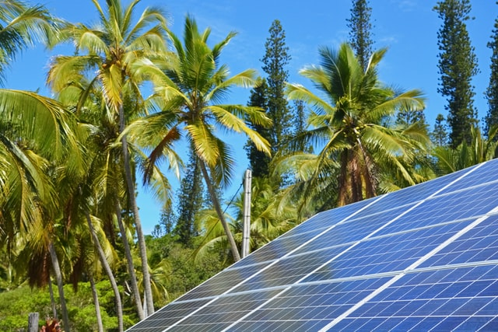
Design and Implementation of Pilot of a TVET Renewable Energy Course
DELIVERABLE #5 - TRAINING COURSES & PROFESSIONAL DEVELOPMENT

Slide 2
Grid Tied Inverters
This module will introduce grid tied inverters.
After this module, the learner will be able to:
Describe the basic operation of an inverter.
Identify the various types of grid interactive inverters.
Match PV panels to inverter inputs

Slide 3
Grid Tied Inverters
Calculate PV voltages for MPPT, based on temperatures.
Select PV panels for microinverters.

Slide 4
Grid Tied Inverters
At this point we know how a grid is established.
Generators have been the focus.
Inverters can also supply electrical energy to a grid.

Slide 5
Grid Tied Inverters
The group IEEE (Institute of Electrical and Electronics Engineers) have established the rules for grids and connecting power sources to the grid.
Then UL (Underwriters Laboratories) 1741which sets out the parameters for equipment connecting to a grid.

Slide 6
Grid Tied Inverters
These inverters are called grid interactive.
What makes them grid interactive is that they are designed with firmware (software built into the brains of the inverter) that follows the UL1741 rules.
They also produce a pure sinewave output with less than 5 % distortion.
They will synchronize to a grid and provide electrical power.

Slide 7
Grid Tied Inverters
Questions?

Slide 8
Grid Tied Inverters
A few of the rules that are part of the UL1741 are:
Anti-Islanding
This prevents the inverter from sending out power to a grid that is down.
It keeps the line from being energized.
It makes the inverter not stand alone.
Utility workers will not be exposed to live wires when the grid is down.

Slide 9
Grid Tied Inverters
Delay connecting to a grid
This keeps the grid from being exposed to power before the utility stabilizes it.
The inverter needs to see a stable grid for 5 minutes before it will connect to it.
This does not affect the inverter when it sees the sun in the morning as long as the grid was live all night.

Slide 10
Grid Tied Inverters
Must not stay connected if the voltage is out of range
This keeps the inverter from staying connected or to connect to a grid where the voltage is too high or too low.
The voltage range is + - 10% of the nominal value.

Slide 11
Grid Tied Inverters
Must not stay connected if the frequency is out of range
This keeps the inverter from staying connected or to connect to a grid where the frequency is too high or too low.
The frequency range is + - 2.5% of the nominal value.
60Hz systems can only operate between 58.5Hz and 61.5 Hz

Slide 12
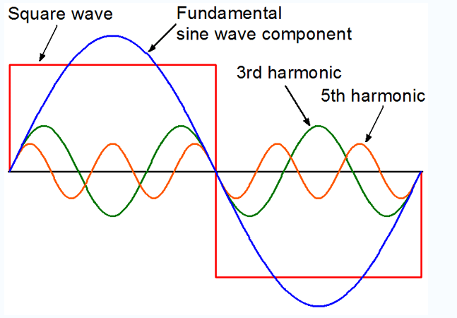
Grid Tied Inverters
Must have a pure sinewave output that the harmonic distortion is less than 3-5 percent,
This keeps noise from entering the grid from a poor-quality device.
Picture courtesy author

Slide 13
Grid Tied Inverters
Must have a ground fault protection scheme,
This prevents the inverter from operating if there is a ground fault on the DC side.

Slide 14
Grid Tied Inverters
Questions?

Slide 15
Grid Tied Inverters
There three types of grid interactive inverters.
String inverter
Microinverter
Hybrid inverter
The next few slides provide a very basic explanation of each type.

Slide 16
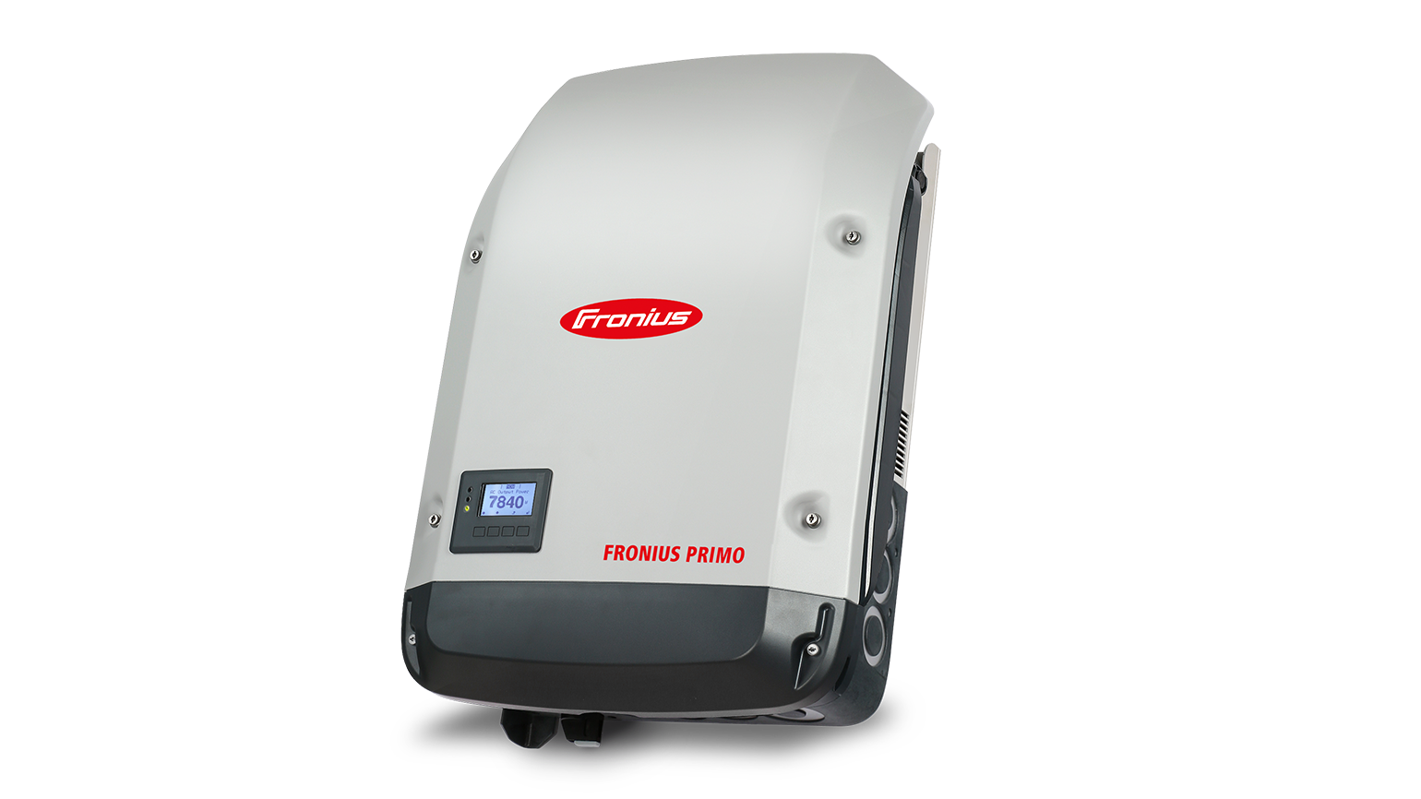
Grid Tied Inverters
String Inverter
Picture courtesy Fronius

Slide 17
Grid Tied Inverters
String inverters are the original type of inverters.
String refers to solar PV panels connected in series in a string.
By placing the panels in series, the amperage is lower than if connected in parallel.
Voltage is increased.
Power = Volts x Amps

Slide 18
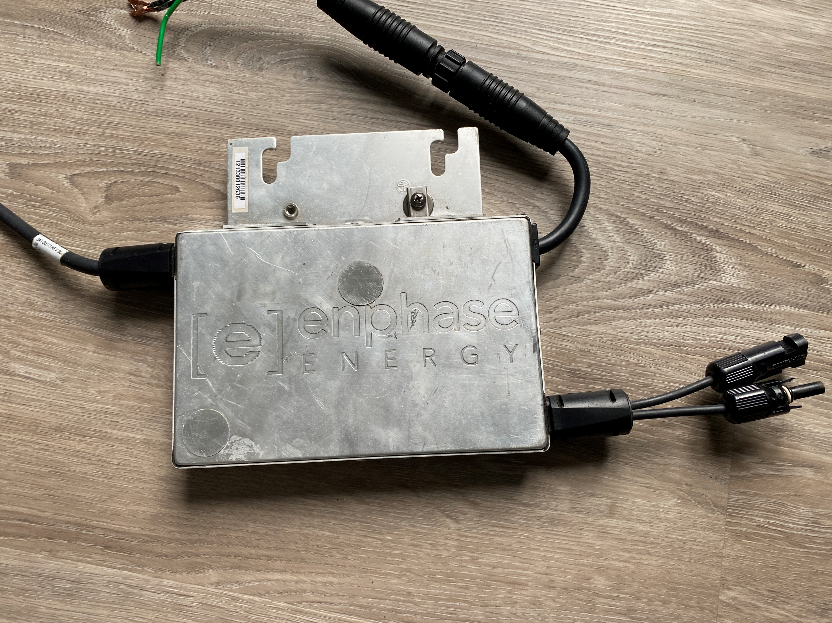
Grid Tied Inverters
Microinverter
Picture courtesy author

Slide 19
Grid Tied Inverters
Microinverters are an example of MLPE (Module Level Power Electronics) that go under the PV panel.
These types of “inverter to panel” connections keeps the DC from leaving the roof or structure.
Can be one panel per microinverter or multiple panels per microinverter.
As of this time 4 panels per microinverter is available.
They are mounted behind a panel.

Slide 20
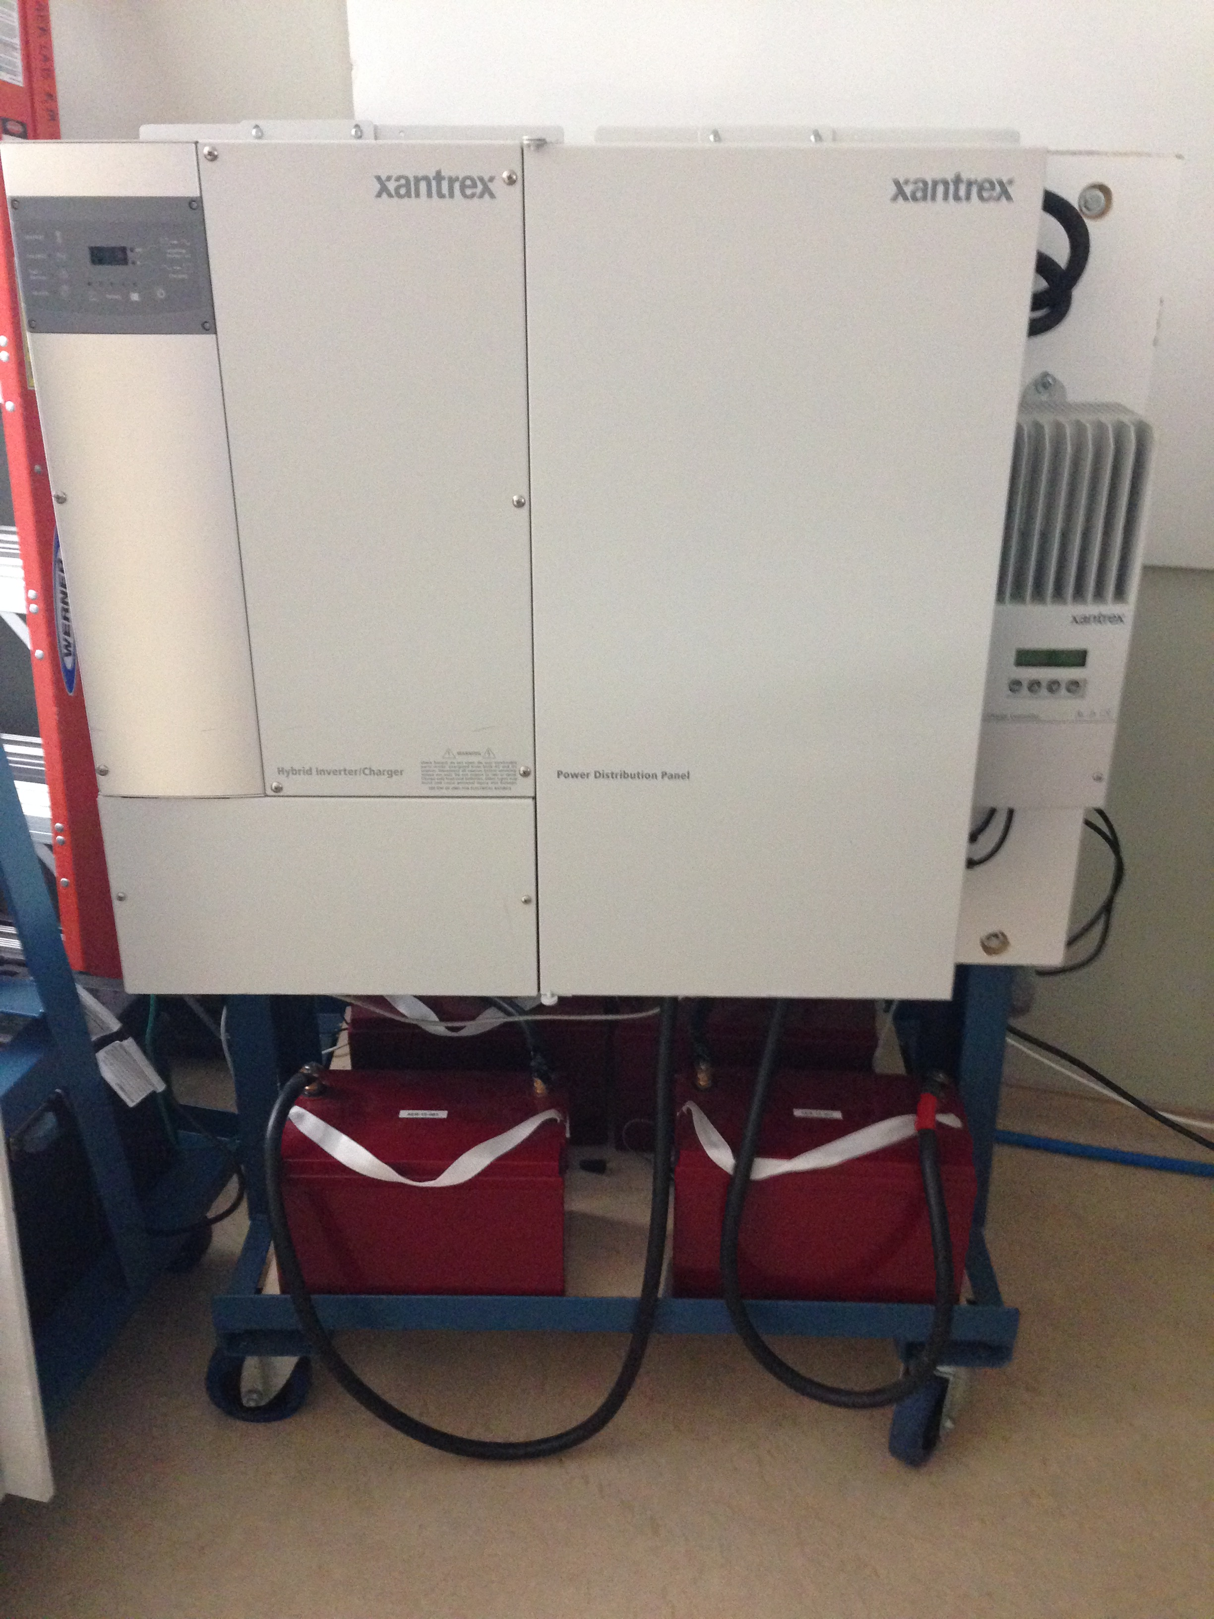
Grid Tied Inverters
Hybrid inverters
Picture courtesy author

Slide 21
Grid Tied Inverters
Hybrid inverters are a type of inverter that can be grid interactive or stand –alone.
Battery based
PV connects to a charge controller
Usually supports a generator connection

Slide 22
Grid Tied Inverters
Hybrid inverters will be discussed in detail in their own module.
They have a number of systems that interconnect.

Slide 23
Grid Tied Inverters
Questions?

Slide 24
Grid Tied Inverters
Grid interactive inverters can be either transformer coupled or transformer less coupled to the AC power source.
The transformer inverters have an extra 2-4% loss because of the transformer.
The transformer inverters are heavier as well.

Slide 25
Grid Tied Inverters
Transformer less inverters are very popular in Europe.
These inverters do not have electrical isolation between the PV negative and the neutral connection on the AC side.
Electrical isolation is provided in a “transformer inverter” through the transformer.

Slide 26
Grid Tied Inverters
Transformer inverters:
Pros
Due to the transformer, they have electrical isolation between the DC and AC which lowers the risk of shock and surges.
Rugged and dependable.

Slide 27
Grid Tied Inverters
Transformer inverters:
Cons
Require extra components which costs more.
Bulky and take up larger footprint.

Slide 28
Grid Tied Inverters
Transformer less inverters:
Pros
Lighter than transformer types.
More efficient.

Slide 29
Grid Tied Inverters
Transformer less inverters:
Cons
More prone to surges and shocks because the PV DC negative is tied to the AC neutral.
Look for models with built in surge protection.

Slide 30
Grid Tied Inverters
Fronius manufacturers both transformer and transformer less inverters.
Their IG series has a transformer.
Their Primo series is transformer less.
The next few slides shows the difference in the connection between the two.

Slide 31
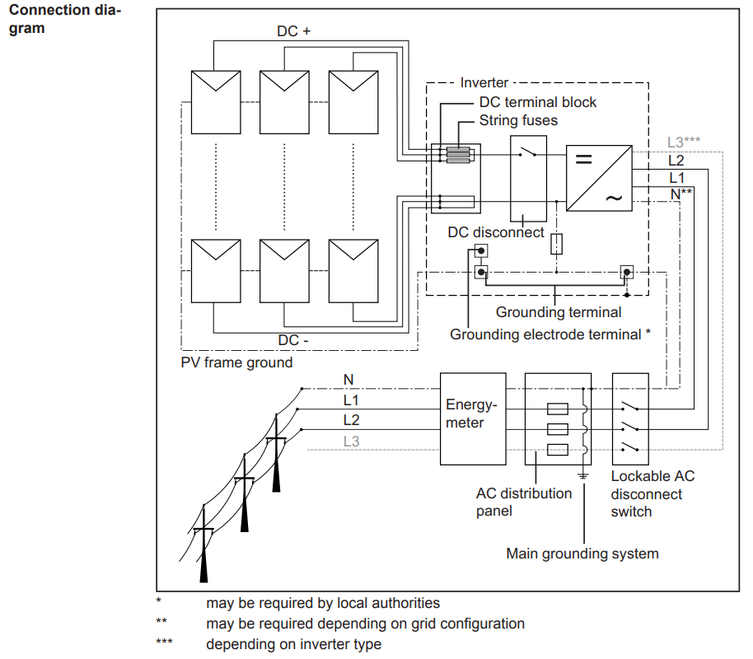
Grid Tied Inverters
The IG series has a transformer.
Picture courtesy Fronius

Slide 32
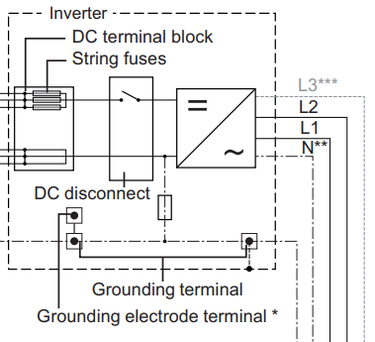
Grid Tied Inverters
The connection of the Negative PV DC to ground before the DC to
AC.
Transformer is
before the AC
connection to the
L1-L2-L3 and N.
Picture courtesy Fronius

Slide 33
Grid Tied Inverters
Questions?

Slide 34
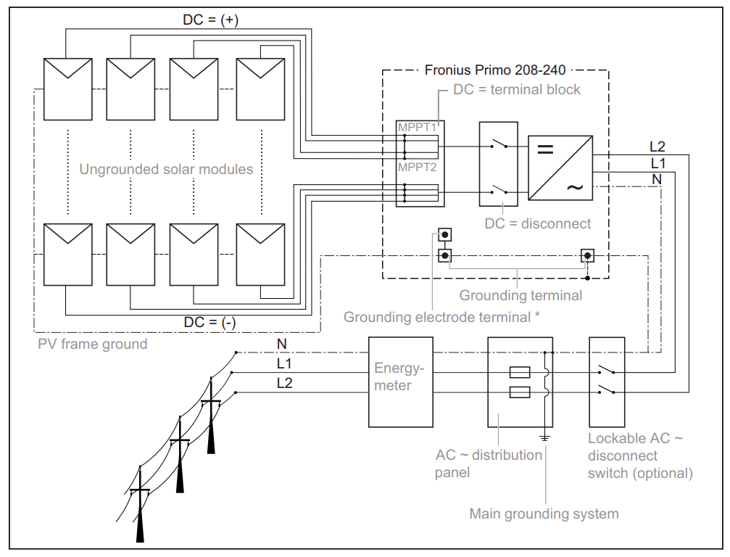
Grid Tied Inverters
The Primo series has no transformer.
Picture courtesy Fronius

Slide 35
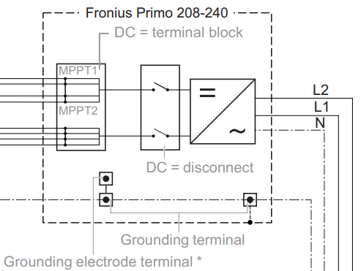
Grid Tied Inverters
The PV DC negative is already tied to the neutral AC.
Note more than
one PV inputs.
Picture courtesy Fronius

Slide 36
Grid Tied Inverters
Note the subtle wiring changes in the grounding connection between the two inverter types.
The installation manual is very important to follow.

Slide 37
Grid Tied Inverters
Questions?

Slide 38
Grid Tied Inverters
How do inverters capture the DC power from PV panels?
One of two ways.
They can connect directly to the panel / panels.
They can have a charge controller pass the DC energy on to a battery and the inverter can take the battery energy and use it.

Slide 39
Grid Tied Inverters
If they connect directly to the panel they produce what the PV panels are producing.
If they use the battery energy, the inverter will start and stop based on the battery voltage.
Stop producing at low battery voltage.
Hybrid inverters use the battery method.

Slide 40
Grid Tied Inverters
Both string and microinverters use MPPT technology to capture the DC power.
MPPT stands for Maximum Power Point Tracking.
To transfer power from one device to another it follows the “Maximum Power Transfer Theorem”

Slide 41
Grid Tied Inverters
“Maximum Power Transfer Theorem”
States the output resistance / impedance must equal the input resistance / impedance to transfer the most power between devices.
An example is an audio amplifier matched to the correct speaker ohms.
4Ω to 4Ω or 8Ω to 8Ω

Slide 42
Grid Tied Inverters
“Maximum Power Transfer Theorem”
As the sun radiation varies so does the internal resistance of the PV panel.
The load would need to match to get maximum power from PV panel

Slide 43
Grid Tied Inverters
To continually change the load would not be practical.
MPPT is a circuit that shorts the PV panel.
The short circuit current is put through an inductor.
The inductor stores the energy in the air as magnetic energy.

Slide 44
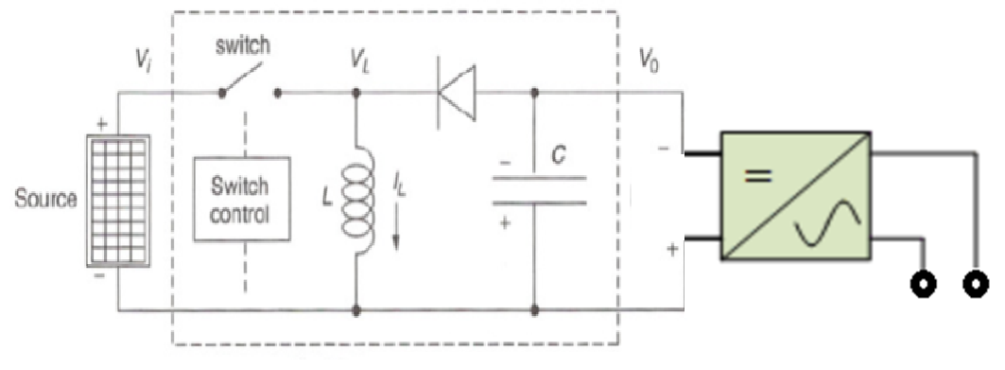
Grid Tied Inverters
The inductor will release this stored energy back into the circuit when the switch is opened.
Picture courtesy author

Slide 45
Grid Tied Inverters
The capacitor stores the energy.
The inverter takes the stored energy and makes AC.
Picture courtesy author

Slide 46
Grid Tied Inverters
The rate at which the switch opens and closes is matched to the irradiance.
To capture the most energy available.
Picture courtesy author

Slide 47
Grid Tied Inverters
The higher the radiation the faster the switching.
The lower the radiation the slower the switching.
Picture courtesy author

Slide 48
Grid Tied Inverters
The maximum power that is available makes it way to the inverter input.
Efficiencies can reach the high 90’s percent.
This was a simplified explanation of MPPT circuits.

Slide 49
Grid Tied Inverters
Questions?

Slide 50
Grid Tied Inverters
Microinverter basics.
A microinverter will connect directly to a PV panel and produce AC power from the DC power produced by the PV panel.
Uses MPPT technology to capture the DC power.

Slide 51
Grid Tied Inverters
The microinverter manufacturer will provide specifications.
These are required before a PV panel can be connected to it.
The output wattage and voltage.
The input wattage and voltage.
Start with these two specifications.

Slide 52
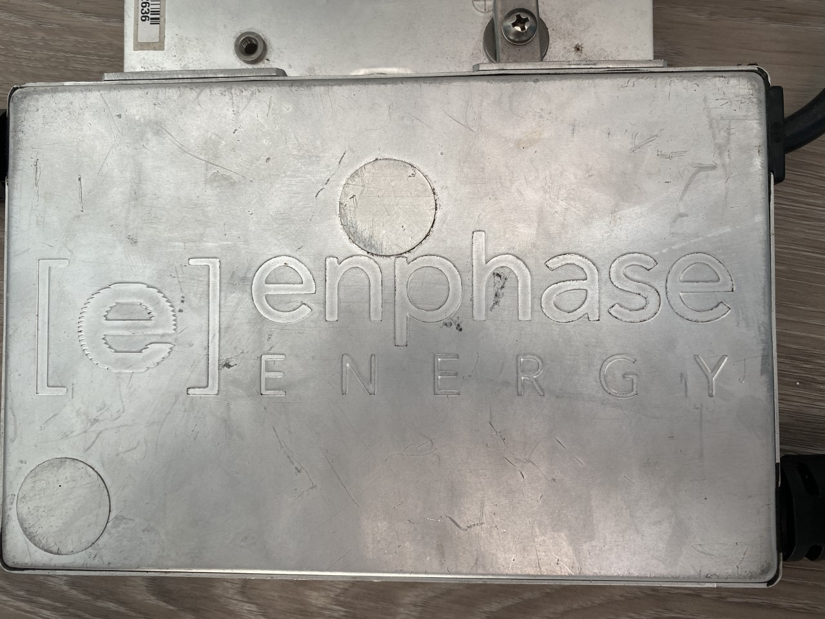
Grid Tied Inverters
The following is from an Enphase M190 microinverter.
Picture courtesy author

Slide 53
Grid Tied Inverters
The following is from an Enphase M190 microinverter.
This shows the MPPT operating range DC
Max DC current
AC output voltage
Picture courtesy author

Slide 54
Grid Tied Inverters
To have the microinverter MPPT circuit to work.
The PV panel must operate in this range.
It is between 22 and 40VDC.
Picture courtesy author

Slide 55
Grid Tied Inverters
A 36 cell panel’s Vmp will be in the range of 16V – 18V which is too low.
60 - 72 cell panels will operate in the 34V – 40V at Vmp.
Picture courtesy author

Slide 56
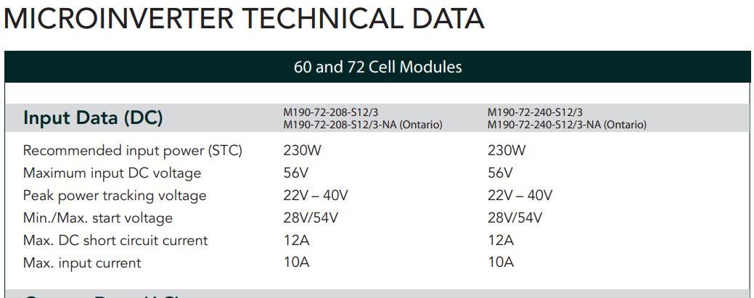
Grid Tied Inverters
This microinverter can work with 60 or 72 cell panels for the operating input voltage.
Picture courtesy Enphase

Slide 57
Grid Tied Inverters
Questions?

Slide 58
Grid Tied Inverters
This is information from a 250 Watt 60 cell panel.
The Vmp is between the 22V and 40V range.
Picture courtesy author

Slide 59
Grid Tied Inverters
Next is the Max. DC current at 10A.
The 250 Watt panel produces Isc of 8.79A
The Imp is 8.23A
Picture courtesy author

Slide 60
Grid Tied Inverters
Multiplying each value by 1.25 for extra irradiance due to environmental conditions gives:
Isc of 11A
Imp of 10.3A
Which one is relative to the 10A max. DC input?
Go to the manufacturers manual.

Slide 61
Grid Tied Inverters
Under the column for 208 or 240 the Isc is 12A this is a pass.
Max. input current is 10A this is a fail (10.3A).
Picture courtesy Enphase

Slide 62
Grid Tied Inverters
The 250W panel exceeds the recommended Wattage of this microinverter.
The recommended (STC) power is 230W.
Picture courtesy Enphase

Slide 63
Grid Tied Inverters
The DC to AC ratio for a 230W to 190W output (AC) is 1.21.
Higher ratios can be used as long as the Input voltage range falls into the MPPT range and the input current is at or lower than the maximum (10A for the M190) for the microinverter.

Slide 64
Grid Tied Inverters
Questions?

Slide 65
Grid Tied Inverters
As the manufacturers data sheet indicates a microinverters can connect PV panels of greater wattage than the output rating of the inverter.
This allows more energy to be captured during low light levels.
They will clip their output power at high light levels.

Slide 66
Grid Tied Inverters
Pros and cons to this.
The pros are that in areas where direct sun doesn’t strike the sun for much of the day.
Overcast days it will produce more energy.
The larger sized panel will capture more energy than one matched in wattage to the inverter output.

Slide 67
Grid Tied Inverters
Cons to this.
If there is a high irradiance for much of the time.
The microinverter will be maxed out in production and the extra energy available from the higher wattage panel is not utilized.

Slide 68
Grid Tied Inverters
The document:
“Enphase-Tech-Brief-Why-Larger-EN_0.pdf”
Explains the DC – AC ratio.
Ratios of up to 1.7 – 1 are used.

Slide 69
Grid Tied Inverters
Questions?

Slide 70
Grid Tied Inverters
Notice the AC max. continuous output current of 0.80A.
Max. units per branch circuit is 15.
Picture courtesy author

Slide 71
Grid Tied Inverters
Branch circuit loading is always 80% of the overcurrent protection device.
15 unit x 0.80A = 12A and a 15A breaker can be loaded to 80% = 12A.
Picture courtesy author

Slide 72
Grid Tied Inverters
Questions?

Slide 73
Grid Tied Inverters
A selling point for microinverters is the claim they operate on individually on a single panel (even multiple input microinverters).
And when this single panel gets shaded it does not reduce power to the other panels in series as does the string inverter.
Another selling point is that the system can have more microinverters added to the system.

Slide 74
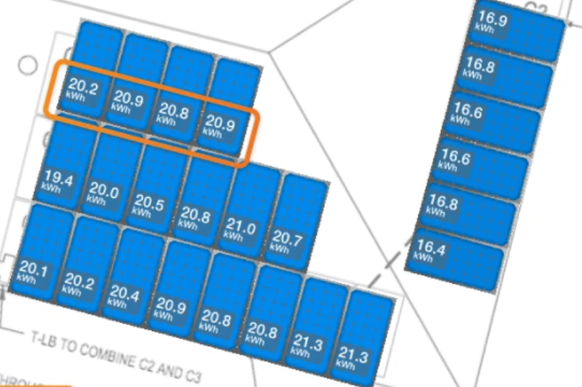
Grid Tied Inverters
During the installation course, the procedure to map the location of microinverters is covered.
Mapping allows for remote monitoring.
Picture courtesy author

Slide 75
Grid Tied Inverters
Questions?

Slide 76
Grid Tied Inverters
String Inverter
Picture courtesy Fronius

Slide 77
Grid Tied Inverters
String inverters involve more design to have them work correctly.
A string inverter uses PV panels connected in series.
The next few slides will be taken from the Fronius
Cutsheet for the 3.8 – 8.2 kW models.

Slide 78
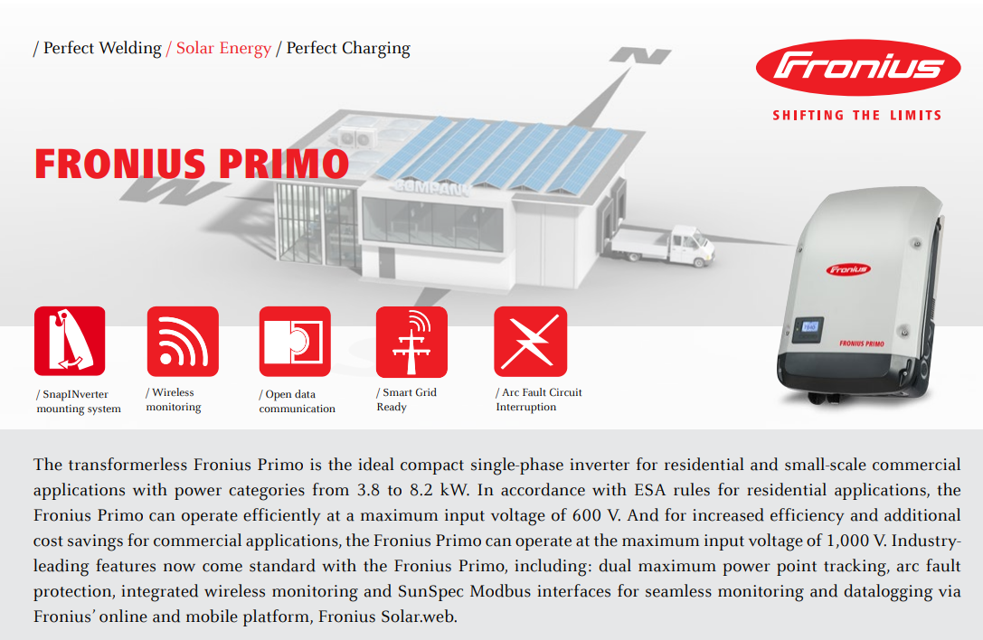
Grid Tied Inverters
Picture courtesy Fronius

Slide 79
Grid Tied Inverters
Although it says it can operate at 1000 VDC
Utility rules will dictate the maximum string voltage.
This exercise will use a 600 VDC input from the PV panel string.
NEC (National Electrical Code) USA code 690.7 states that 600VDC maximum for single and two family homes.

Slide 80
Grid Tied Inverters
Questions?

Slide 81
Grid Tied Inverters
The cell temperature of the PV panel will influence the voltage produced by the cell.
Belize temperatures low and high are 10C and 65C for cells.
The temperature coefficient for the PV panel is given by the manufacturer in the data sheet.
The LONGi 430W will be used for this example.

Slide 82
Grid Tied Inverters
STC Voc 48.5V at 25C
The only coefficient required to use is Voc.
Calculate the two extremes for the MPPT range
Then calculate the maximum voltage input to the inverter.
Picture courtesy HESPV.ca

Slide 83
Grid Tied Inverters
The temperature coefficient is negative.
As the temperature goes down the voltage goes up.
-.270% / C For every + or - of 1 degree C the voltage will change .270% from STC values.

Slide 84
Grid Tied Inverters
10C is (10C – 25C) = -15C change from STC
-15 x (-.270%) -.0027 = 4.05% change from STC (48.5V).
= 1.96V greater than 48.5V = 50.5V
50.5V is the new Voc at 10C.

Slide 85
Grid Tied Inverters
Good design will have the PV panel’s Vmp operate in the MPPT range of the inverter.
The temperature range is from 10C to 65C.
Same calculation as before using both 10C and 65C
This time use Vmp at STC.
LONGi 430W Vmp = 40.7V

Slide 86
Grid Tied Inverters
This is an Excel sheet to calculate voltages based on cell temperature for the Longi 430W panel.
The Vmp voltage range for the MPPT range is between 42.3V (10C) to 36.3V (65C).
Voc at 10C is 50.5V
Voc Calculator | STC Vmp | STC Voc | Lowest Temperature | Highest Temperature | Voc Low | Voc High | Vmp Low | Vmp High
Panel Info
Longi 430 | 40.7 | 48.5 | 10 | 65 | 50.5 | 43.3 | 42.3 | 36.3
Coefficient
"-0.270%/C"
Picture courtesy author

Slide 87
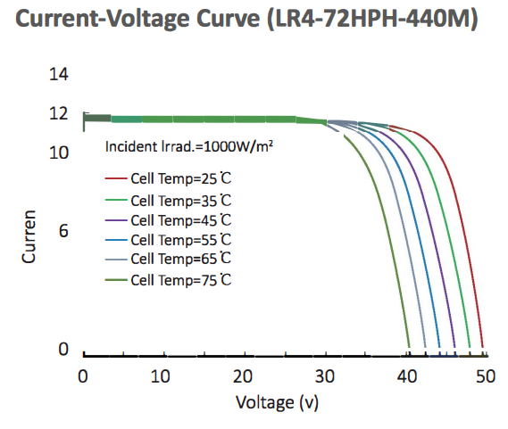
Grid Tied Inverters
Longi 430W panel temperature curves match the calculation in the Excel sheet.
65C = 43.3V
Picture courtesy HESPV.ca

Slide 88
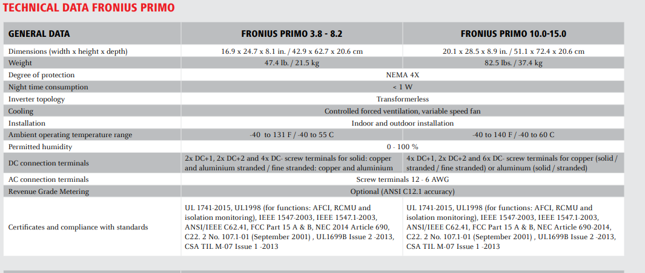
Grid Tied Inverters
Nema 4X housing, good for outdoor.
Transformerless.
Picture courtesy Fronius

Slide 89
Grid Tied Inverters
Ambient temperature stated.
Humidity.
Screw terminal size for wires in and out.
Picture courtesy Fronius

Slide 90
Grid Tied Inverters
Notice the UL1741 and other compliance Certificates.
Picture courtesy Fronius

Slide 91
Grid Tied Inverters
AFCI (arc fault protection)
GFCI
DC disconnects built in
Reverse polarity protection for incorrect installation
Picture courtesy Fronius

Slide 92
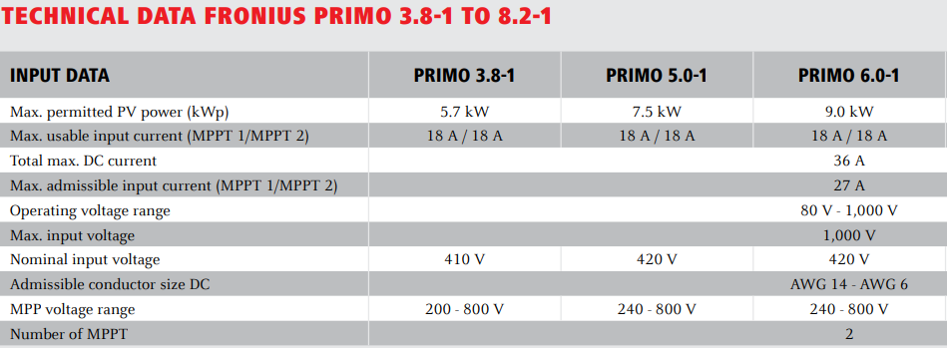
Grid Tied Inverters
The Input Data:
5.7kW for 3.8kW = 150% over capacity on the PV DC wattage. Gather extra low light energy.
Picture courtesy Fronius

Slide 93
Grid Tied Inverters
AC output is 3.8kW
DC input from PV is 5.7kW

Slide 94
Grid Tied Inverters
Questions?

Slide 95
Grid Tied Inverters
The Input Data:
MPPT1 and MPPT 2 (two string inputs)
18A each if both are used.
Picture courtesy Fronius

Slide 96
Grid Tied Inverters
The Input Data:
18A each for each string if both are used for a total of 36A.
27A if just one string is used.
Max wattage is 5,700 for both inputs combined.

Slide 97
Grid Tied Inverters
The Input Data:
Operating range is 80V – 1000V
Nominal is normally between the two extremes
Picture courtesy Fronius

Slide 98
Grid Tied Inverters
The Input Data:
Conductor size DC is the range the connector can safely pass the current without over heating.
Picture courtesy Fronius

Slide 99
Grid Tied Inverters
The Input Data:
MPPT voltage range is the string voltage that the inverter will operate in the MPPT voltage window.
Picture courtesy Fronius

Slide 100
Grid Tied Inverters
The Input Data:
The string size (number of PV panels in series) needs to be determined so that Vmp of all the panels add up between the MPPT range.
Cell temperature needs to used to calculate the actual operating voltage.

Slide 101
Grid Tied Inverters
Exercise in designing the string / strings.
Use the Fronius 3.8kW inverter.
Use the Longi 72/144 cell 430 Watt panel.
Next slide has some cutsheet data for it.

Slide 102
Grid Tied Inverters
Data sheet / cutsheet:
Use the 430Watt model
Picture courtesy HESPV.ca

Slide 103
Grid Tied Inverters
Voc 48.5V
Isc 11.31A
Vmp 40.7V
Imp 10.57A
Picture courtesy HESPV.ca

Slide 104
Grid Tied Inverters
This is an Excel sheet to calculate voltages based on cell temperature for the Longi 430W panel.
The Vmp voltage range for the MPPT range is between 42.3V (10C) to 36.3V (65C).
Voc at 10C is 50.5V
Voc Calculator | STC Vmp | STC Voc | Lowest Temperature | Highest Temperature | Voc Low | Voc High | Vmp Low | Vmp High
Panel Info
Longi 430 | 40.7 | 48.5 | 10 | 65 | 50.5 | 43.3 | 42.3 | 36.3
Coefficient
"-0.270%/C"
Picture courtesy author

Slide 105
Grid Tied Inverters
The next steps to design the possible combinations of strings for the Fronius 3.8Kw inverter.
Maximum input voltage used will be 600VDC.
Maximum DC solar power can be 5.7kW.
If two string each have maximum 18A each.
If one string used have maximum of 27A.

Slide 106
Grid Tied Inverters
To have the MPPT operate, the string Vmp needs to be between 200V – 800V.
At temperatures experienced in Belize the Vmp range per panel is 42.3V(10C) – 36.3V(65C).

Slide 107
Grid Tied Inverters
To make an array of 5.7kW from the 430W panels.
5700 / 430 = 13.3 panels.
Always round down never up as the extra panel creates more total power.
This number is a guide only.
Using the Isc and Voc will be the guide for the maximum number of panels in the array.

Slide 108
Grid Tied Inverters
Data Sheet from the LONGi 430:
Picture courtesy HESPV.ca

Slide 109
Grid Tied Inverters
Worst case scenario is the inverter is connected to the Isc of the panel / string at the 125% extra irradiance.
Isc = 11.31A = 11.31 x 1.25 = 14.1A
The maximum input per MPPT input (2 of them) is 18A, so one string per input is under the 18A limit.
If two strings were combined into one MPPT input it is more than the 27A limit.

Slide 110
Grid Tied Inverters
If one string of 430W panels is connected in series, they need to keep the MPPT in the operational (200V – 800V) range.
Vmp (as per the Excel calculation) at 65C is worse case at 36.3V. (Lowest voltage temperature)
The minimum number of panels in series to attain 200V is (200 / 36.3) = 5.5 panels.
Rounding up ensures that the minimum is always attained.

Slide 111
Grid Tied Inverters
6 panels gives a low of 218V to the MPPT input.
6 panels at 10C (50.5V) will give a Voc of 303V.
This is below the target Voc of 600V.
This string arrangement on both of the MPPT inputs is an array size of 12 x 430W panels.
12 x 430 = 5160W adding extra irradiance of 125% gives a maximum input to the inverter of 6450W

Slide 112
Grid Tied Inverters
The 3.8kW rating is for the AC output.
More DC input up to 5.7kW is allowed.
The design should not exceed the 5700W limit.
Two stings of 6 will exceed this limit.
Back to the design.

Slide 113
Grid Tied Inverters
Questions?

Slide 114
Grid Tied Inverters
The first design met the minimum MPPT input voltage and did not exceed the Voc limit.
Adding more panels in series will increase the voltage and wattage.
The second MPPT input does not need to be the same as the first.
Can’t use less panels in series (MPPT lower limit).

Slide 115
Grid Tied Inverters
Questions?

Slide 116
Grid Tied Inverters
Quick math 430W x 125% = 538W
5700W / 538 = 10.6 and round down.
10 panels total
Need 6 in series to meet the minimum MPPT voltage.
Try 10 in series for single MPPT input.

Slide 117
Grid Tied Inverters
Voc with 10 in series at 10C = 50.5V x 10 = 505V.
This is under the 600VDC limit we set.
MPPT range between 10C and 65C is 423V – 363V
At both of these temperatures, the MPPT voltage is within range.

Slide 118
Grid Tied Inverters
With the 10 panel setup:
The current is the same as the single MMPT input we calculated for 6 panels.
Voltage is under 600VDC
Nominal input power is 4300W
Burst power (125%) = 5375W (under 5700W)

Slide 119
Grid Tied Inverters
Questions?

Slide 120
Grid Tied Inverters
String inverters assume that all of the panels in a string will be producing the same power.
If one panel or a group of panels are subjected to shading.
The current in the string will be reduced to the lowest panel’s output.

Slide 121
Grid Tied Inverters
The location of panels in the string need to be subjected to the same irradiance if possible.
Grouping the panels may be necessary.
Inverters with more than one string input allow two groups of panels to help keep them balanced.
Two roof tops / areas are an example of this.

Slide 122
Grid Tied Inverters
When this partial shading of a string can’t be avoided an electronic device called an optimizer is used.
This is another MLPE Module Level Power Electronics) device.
Optimizers connect across the PV panel and use an electronic circuit to match the strings amperage.
The voltage produced is lower, but the rest of the string does not see any reduction in current.

Slide 123
Grid Tied Inverters
Depending on the manufacturer of the optimizer, they may be required to connect to a specific panel or inverter.
Discrete optimizers work on each panel without communicating to the central inverter.
They can be connected to just the panels that will be experiencing the shading.

Slide 124
Grid Tied Inverters
Questions?

