Slide 1
Design and Implementation of Pilot of a TVET Renewable Energy Course
DELIVERABLE #5 - TRAINING COURSES & PROFESSIONAL DEVELOPMENT

Slide 2
Service and the NEC
This module will introduce rules and configurations for the Point of Interconnection.
Connecting the grid interactive inverters to the service entrance.
The 2023 NEC rules around this.

Slide 3
Service and the NEC
After this module, the learner will be able to:
Describe the connection to a service entrance.
Identify the NEC rules to install and connect to the service entrance.
Describe the procedure to connect a microinverter
Describe the procedure to connect a string inverter

Slide 4
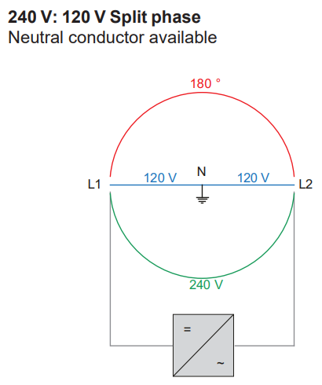
Service and the NEC
This is the most common residential connection.
One inverter across the
240 Volt split phase.
Picture courtesy Fronius

Slide 5
Service and the NEC
Questions?

Slide 6
Service and the NEC
The role of the NEC or other governing bodies that produce electrical standards.
Other examples are:
Canadian Electrical Code by CSA (Canadian Standards Council)
BS 7671 is the British requirements for Electrical Installations
IEC60364 is Europe's version

Slide 7
Service and the NEC
The role of the NEC is to reduce electrical hazards and fires.
The NEC is adopted by many Caribbean countries.
For this program, the NEC rules will be used in the teaching of materials.

Slide 8
Service and the NEC
The section in the NEC that deals with solar PV is:
Article 690 “Solar Photovoltaic (PV) Systems”
It has Parts and subsections.
Roman Numeral System used.
When the word “listed” is used, it is referencing that the item has been UL certified.

Slide 9
Service and the NEC
Questions?

Slide 10
Service and the NEC
690 Part I General
Definitions (Found in Article 100)
Previous Modules studied have referred to the PV as panels.
The NEC refers to them as PV modules
Scope
General Requirements

Slide 11
Service and the NEC
690 Part II Circuit Requirements
Circuit Sizing and Current
Overcurrent Protection
Arc Fault Circuit Protection (Direct Current)
Rapid Shutdown of PV Systems on Buildings

Slide 12
Service and the NEC
690 Part III Disconnection Means
Photovoltaic System Disconnection Means
Disconnecting Means for Isolating Photovoltaic Equipment

Slide 13
Service and the NEC
690 Part IV Wiring Methods and Materials
Wiring Methods
Component Interconnections
Mating Connectors
Access to Boxes

Slide 14
Service and the NEC
690 Part V Grounding and Bonding
PV System DC Circuit Grounding and Protection
Point of PV System DC Circuit Grounding Connections
Equipment Grounding and Bonding
Size of Equipment Grounding Conductors
Grounding Electrode System

Slide 15
Service and the NEC
690 Part VI Source Connections
Identification of Power Sources
Connection to Other Sources
Self-Regulated PV Charge Control

Slide 16
Service and the NEC
Questions?

Slide 17
Service and the NEC
One of the assignments for this course was to match a microinverter to a PV panel.
The next slides will take an example of that assignment and match the NEC rules to the design.
The example will use Enphase IQ7 microinverter and the Heliene 60M G1 305W module.

Slide 18
Service and the NEC
The Enphase IQ7 microinverter has the following specifications:
Input DC specifications:
Panel input wattage 235W-350W
60 cell modules
Maximum VDC input 48V
MPPT range 27V – 37V
Min-Max start stop V 16V – 48V
Isc max 15A

Slide 19
Service and the NEC
The Enphase IQ7 microinverter has the following specifications:
Output AC specifications at 240VAC:
Peak output 250VA
Continuous output 240VA
Maximum continuous output current 1.0A
Maximum unit per branch circuit 16

Slide 20
Service and the NEC
Heliene 60M G1 305W module has the following specification STC:
Pmp(W) 305
Voc(V) 39.98
Vmp(V) 33.6
Imp(A) 9.07
Isc(A) 9.67

Slide 21
Service and the NEC
The DC to AC ratio is 305W to 240W = 1.27
This will gather more energy than a 1 to 1 ratio at lower irradiance levels.

Slide 22
Service and the NEC
Next is to apply the temperature corrections for the module.
10C and 65C as per Belize temperatures.
Voc at 10C = 41.6
Vmp at 10C = 35.0
Vmp at 65 = 30.0
IQ7 max VDC = 48 ok
IQ7 MPPT range 27V – 37V ok

Slide 23
Service and the NEC
Applying the 125% increase of irradiance
Isc 9.67A x 1.25 = 12.1A under the IQ7 15A max.

Slide 24
Service and the NEC
The maximum number of the IQ7 on a 240VAC branch circuit is 16.
16 x 1.0A = 16.0A
20 A breaker good for 20A x 80% = 16A
Therefore, maximum for branch circuit.

Slide 25
Service and the NEC
Questions?

Slide 26
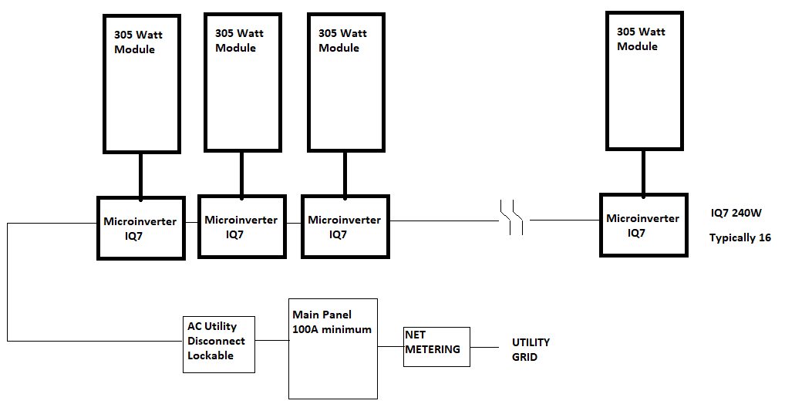
Service and the NEC
Schematic microinverters for a single 240VAC branch circuit. Required by the Utility.
Picture courtesy author

Slide 27
Service and the NEC
Schematic showing connection to modules, inverter, utility disconnect, main panel, NET metering and finally the connection to the utility grid.
Picture courtesy author

Slide 28
Service and the NEC
The NEC 690.4 General Requirements spell out some basic assumptions:
(A) PV Systems can supply a building or structure in addition to other electrical systems.
(B) Equipment UL listed (see next slide)

Slide 29
Service and the NEC
(B) Requires equipment in the system must be evaluated for the application and have a field label applied.
Picture courtesy author

Slide 30
Service and the NEC
(C) Qualified Personnel. The installation shall be performed only by qualified personnel.
(E) Locations not permitted. PV system equipment and disconnection means not to be installed in washrooms.
(F) Not Readily Accessible Locations. Roofs are an example of this and are permitted for mounting.

Slide 31
Service and the NEC
690.11 Arc-Fault Circuit Protection (dc). Not required with microinverters.
690.12 Rapid Shutdown of PV Systems on Buildings.
Rapid Shutdown is built into microinverters, as they cannot produce electric power when the connected source goes down. The AC utility disconnect can be used to de-energize their output.

Slide 32
Service and the NEC
Questions?

Slide 33
Service and the NEC
690.31 Wiring Methods
Picture courtesy author

Slide 34
Service and the NEC
690.31 Wiring Methods:
These are the sections for 690.31
(A) Wiring Systems
(B) Identification and Grouping (NA microinverter)
(C) Cables (NA microinverter)
(D) Direct Current Circuits on or in Buildings (NA microinverter)
(E) Wiring Methods and Mounting Systems

Slide 35
Service and the NEC
(A) Wiring Systems
(1) Serviceability. Wiring devices with integral enclosures like the PV panel and microinverter, shall have sufficient length of cable be provided to facilitate replacement.

Slide 36
Service and the NEC
(F) Wiring Methods and Mounting Systems
Permitted to be held in place with an approved means. (Racking system)

Slide 37
Service and the NEC
690.43 Equipment Grounding and Bonding
250.120 Bonding Conductor Size
Picture courtesy author

Slide 38
Service and the NEC
690.43 Equipment Grounding and Bonding:
Exposed Non-Current-Carrying Metal Parts Connected to Equipment Grounding Conductor
(A) PV Module Mounting Systems and Devices
(B) Equipment Secured to Grounded Metal Supports
(C) Location

Slide 39
Service and the NEC
690.45 refers to 250.120 Bonding Conductor Size
Equipment Grounding Conductor Installation.
Aluminum and Copper-Clad Aluminum Conductors.
Equipment Grounding Conductors Smaller Than 6 AWG.

Slide 40
Service and the NEC
Questions?

Slide 41
Service and the NEC
690.13 PV System Disconnection Means
Picture courtesy author

Slide 42
Service and the NEC
690.13 PV System Disconnection Means
Disconnect the PV System From All Wiring Systems.
(A) Location
Readily Accessible
Enclosure Doors and Covers
(B) Marking
(C) Maximum Number of Disconnects
(D) Ratings
(E) Type of Disconnect (1) through (5)

Slide 43
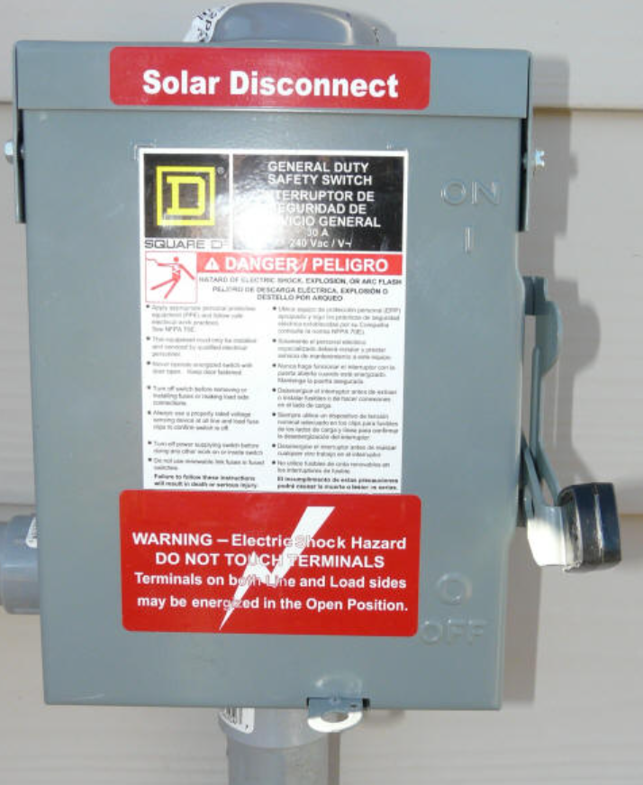
Service and the NEC
690.13 PV System Disconnection Means
Mounted near the utility meter.
Picture courtesy author

Slide 44
Service and the NEC
Questions?

Slide 45
Service and the NEC
690.15 Disconnecting Means for Isolating Photovoltaic Equipment.
Picture courtesy author

Slide 46
Service and the NEC
690.15 Disconnecting Means for Isolating Photovoltaic Equipment.
(A) Type of Disconnecting Means.
In accordance with (C)
(B) Isolating Devices.
(C) Equipment Disconnecting Means.
690.13 (E) (1) through (5)
(D) Location and Control.
Lockable (Utility disconnect)

Slide 47
Service and the NEC
Questions?

Slide 48
Service and the NEC
705 Interconnected Electric Power Production Sources.
Picture courtesy author

Slide 49
Service and the NEC
705 Interconnected Electric Power Production Sources.
705.1 Scope
This Article covers installation of one or more electric power production sources operating in parallel with a primary source(s) of electricity.

Slide 50
Service and the NEC
705.20 Disconnection Means
Picture courtesy author

Slide 51
Service and the NEC
705.20 Source Disconnection Means
Means shall be provided to disconnect power source output conductors of electric power production equipment from conductors of other systems.

Slide 52
Service and the NEC
705.12 Load-Side Source Connections.
Picture courtesy author

Slide 53
Service and the NEC
705.12 Load-Side Source Connections.
Where distribution equipment or feeders are fed simultaneously by a primary source of electricity and one or more other power source(s), must comply with 705.12 (A) and (B).
(A) Feeders and Taps (NA microinverter)
(B) Busbars

Slide 54
Service and the NEC
705.12 Load-Side Source Connections.
(B) Busbars
The NEC definition for this example of a busbar is: A non-insulated conductor electrically connected to the source of supply and physically supported on an insulator providing a power rail for connection to utilization equipment.

Slide 55
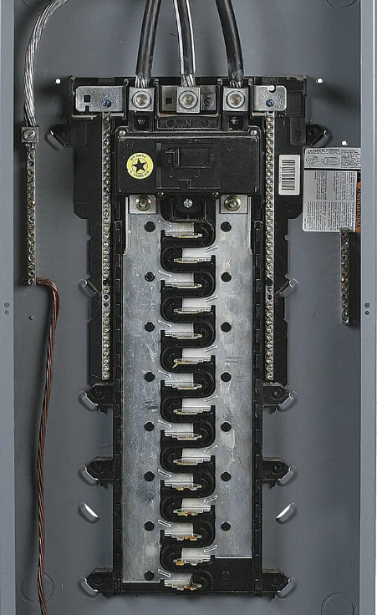
Service and the NEC
Ungrounded busbars
Grounded busbar
Located in the tub of the
panel.
Picture courtesy author

Slide 56
Service and the NEC
705.12 (B) Busbars
(2) Where two sources, one a primary power source (Utility), and the other power source (PV), are located at opposite ends of a busbar that contains loads, the sum of 125 percent of the power-sources output circuit current and the rating of the overcurrent device protecting the busbar shall not exceed 120 percent of the busbar rating.

Slide 57
Service and the NEC
705.12 Busbars.
This will limit the amount of solar energy that can be put into the main panel of the residence when the solar overcurrent device is at the opposite end of the busbar..
120% of the total panel main breaker size can be connected. (Assuming busbar = main breaker size)
100A panel can have 100A main + 20A solar breaker

Slide 58
Service and the NEC
125% of the solar current plus the main overcurrent device can be 120% of busbar rating.
Solar breaker amperage is calculated as the continuous inverter output x 125%.
16A solar x 125% = 20A breaker plus 100A main breaker = 120A of breakers.

Slide 59
Service and the NEC
A way to increase the capacity of the main panel is to get a higher amperage one.
60A box with a 50A main breaker, max breaker current allowed is 72A, so can handle 20A breaker from solar.
50A + 20A solar breaker = 16A output current x 125% = 3840W inverter rating.

Slide 60
Service and the NEC
125A box / tub with a 100A main breaker, max breaker current allowed is 150A, so can handle 50A breaker from solar.
125A x 120% = 150A in breakers
150A – 100A main = 50A solar breaker
50A x 80% = 40A solar inverter continuous output current. (9600 Watt inverter rating)

Slide 61
Service and the NEC
240 volts x 16A solar = 3840 Watts at output of inverter.
If the inverter output is too high for the main panel, there are other ways to have the output go into the utility.
A splitter can be added on the load side of the utility meter.

Slide 62
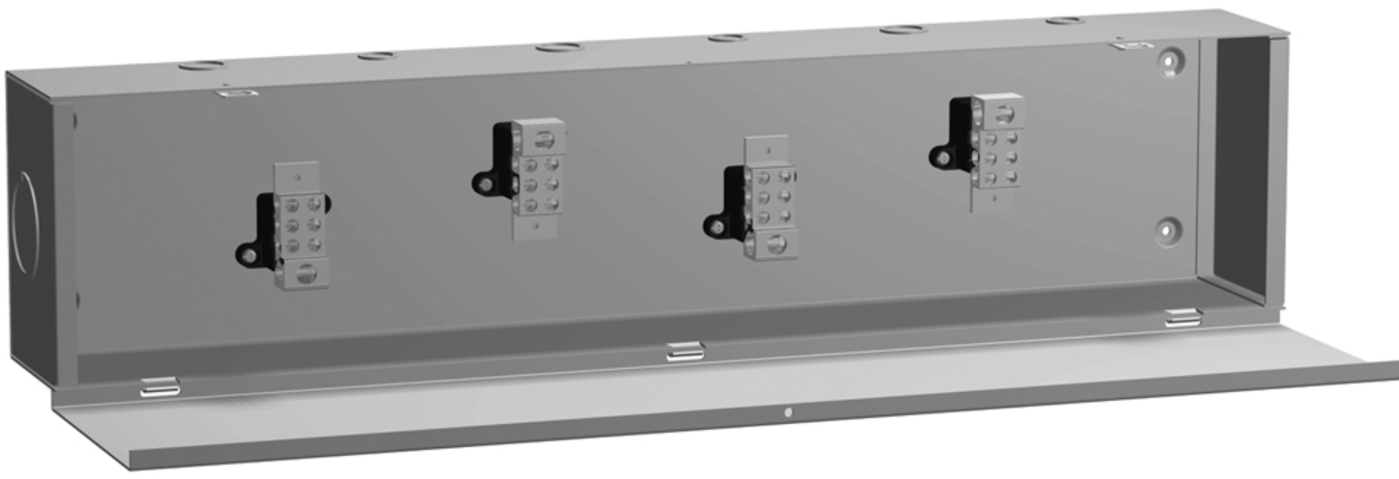
Service and the NEC
The splitter is rated by voltage and current.
It will take the solar and main panel connections to the meter when the meter is connected into the splitter.
Picture courtesy author

Slide 63
Service and the NEC
Another method is to have a double lug meter base.
The second lug will allow the inverter output to be connected before the meter and bypass the main panel.

Slide 64
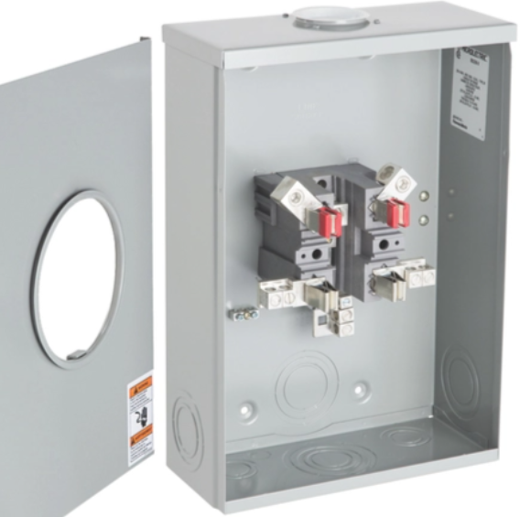
Service and the NEC
Double lug
meter base.
Utility connection
Two lugs for loads
Main Panel
Inverter output
Picture courtesy author

Slide 65
Service and the NEC
Questions?

Slide 66
Service and the NEC
Other Articles need to be followed as well:
200 is Wiring and Protection
300 Wiring Methods and Materials
700 Special Conditions

Slide 67
Service and the NEC
If there is wire coming from the microinverter and going to the utility disconnect that is on the roof.
That wire will be assessed for:
Amperage
Voltage drop
Temperature

Slide 68
Service and the NEC
In this example make some assumptions:
Length of last inverter to utility disconnect is 10 meters or 33 feet with a short run into main panel of 3 meters or 10 feet.
16 inverters each adding 1.0 Amps = 16A on wire.
This roof conductor will be less than ¾ of an inch above the roof.

Slide 69
Service and the NEC
Questions?

Slide 70
Service and the NEC
310.15 Ampacity Tables
(B)(2) Rooftop
For raceways or cables exposed to direct sunlight on or above rooftops where the distance above the roof to the bottom of the raceway or cable is less than ¾ of an inch, a temperature adder of 33C shall be added to the outdoor temperature to determine the ambient temperature for Table 310.15(B)(1)(1)

Slide 71
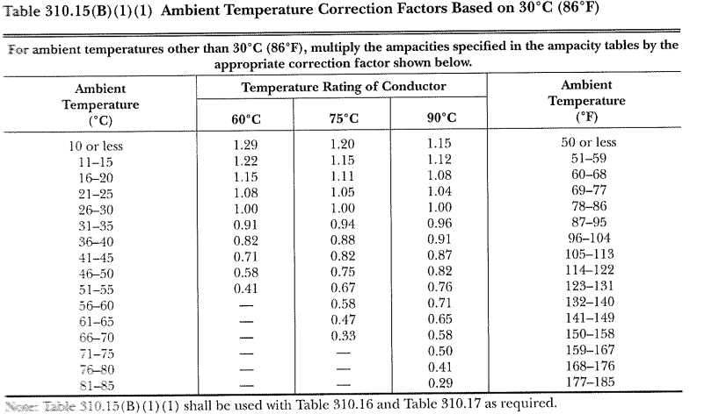
Service and the NEC
310.15 Ampacity Tables
Picture courtesy 2023 NEC

Slide 72
Service and the NEC
The conductors will reach a temperature of approximately 35C (High Ambient in Belize)
+ 33C (adder) = 68C
The further they are away from the roof the lower the temperature they will be exposed to.
Table 310.15 (B)(1)(1) Ambient Temperature Correction Factors Based on 30C.
For 90C wire in ambient of 68 is 0.58

Slide 73
Service and the NEC
The wire ampacity is 0.58 of its capacity at 30C
This is using 90C wire.
690.8 states that because this deration is greater than the normal 80%, then the 58% will be the only one required.
Table 310.16 Ampacity of Insulated Conductors

Slide 74
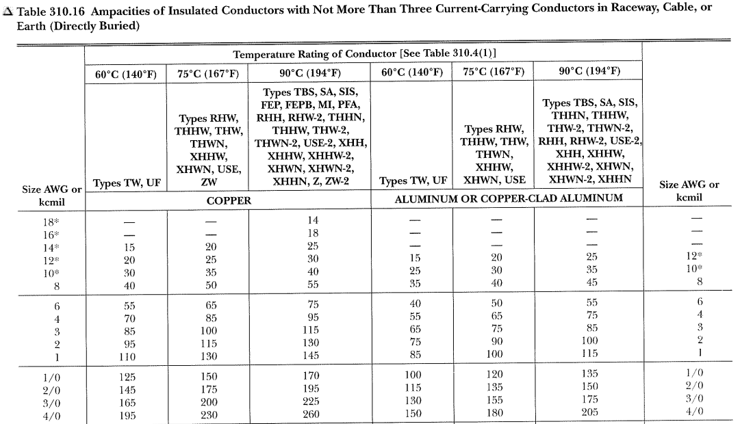
Service and the NEC
Table 310.16 Ampacity of Insulated Conductors
Picture courtesy 2023 NEC

Slide 75
Service and the NEC
0.58 x 30A (#12AWG) = 17.4A which is more than the 16A required.
16A x 1/0.58 = ampacity required of the conductor to handle the inverter output.
16A x 1/0.58 = 27.6A round up to 30A
Need 30A wire = #12 AWG with an overcurrent device rated at 16A x 125% = 20A breaker.

Slide 76
Service and the NEC
Last example was with conductors rated at 90C
This time use 75C conductors.
The conductors will reach a temperature of approximately 35C (High Ambient in Belize)
+ 33C (adder) = 68C
Table 310.15 (B)(1)(1) Ambient Temperature Correction Factors Based on 30C.
For 75C wire in ambient of 68 is 0.33

Slide 77
Service and the NEC
The wire ampacity is 0.33 of its capacity at 30C
This is using 75C wire.
690.8 states that because this deration is greater than the normal 80%, then the 33% will be the only one required.
Table 310.16 Ampacity of Insulated Conductors

Slide 78
Service and the NEC
0.33 x 30A (#12AWG) = 9.9A which is less than the 16A required. (Too small of a wire)
16A x 1/0.33 = ampacity required of the conductor to handle the inverter output.
16A x 1/0.33 = 48.5A round up to 50A
Need 50A wire = #8 AWG with an overcurrent device rated at 16A x 125% = 20A breaker.

Slide 79
Service and the NEC
The last 3 meters of 90C wire will be #12 AWG from the utility disconnect to the main panel.
The last 3 meters of the 75C wire will be a #12 AWG from the utility disconnect to the main panel.
Rule 240.4(D)(6) states that the overcurrent protection shall not exceed ( 12 AWG Copper 20 amperes) after any correction factors for ambient temperature and number of conductors have been applied.

Slide 80
Service and the NEC
Questions?

Slide 81
Service and the NEC
Next calculate Voltage Drop.
647.4(D) The voltage drop on any branch circuit shall not exceed 1.5 percent.
Most manufacturers will suggest a maximum value for this.

Slide 82
Service and the NEC
Enphase calls this voltage rise.
The inverter works as per UL1741 output voltage limits.
The resistance of the inverter output circuit can be high enough to reduce the voltage at the point where it delivers to the utility.
The inverter will raise its output voltage to push current to the utility.

Slide 83
Service and the NEC
If the voltage at the inverter gets raised to the limit of the UL1741 upper limit the inverter will shutdown.
To prevent this from happening the voltage rise (voltage drop on consuming circuits) is calculated the same way as voltage drop.

Slide 84
Service and the NEC
Questions?

Slide 85
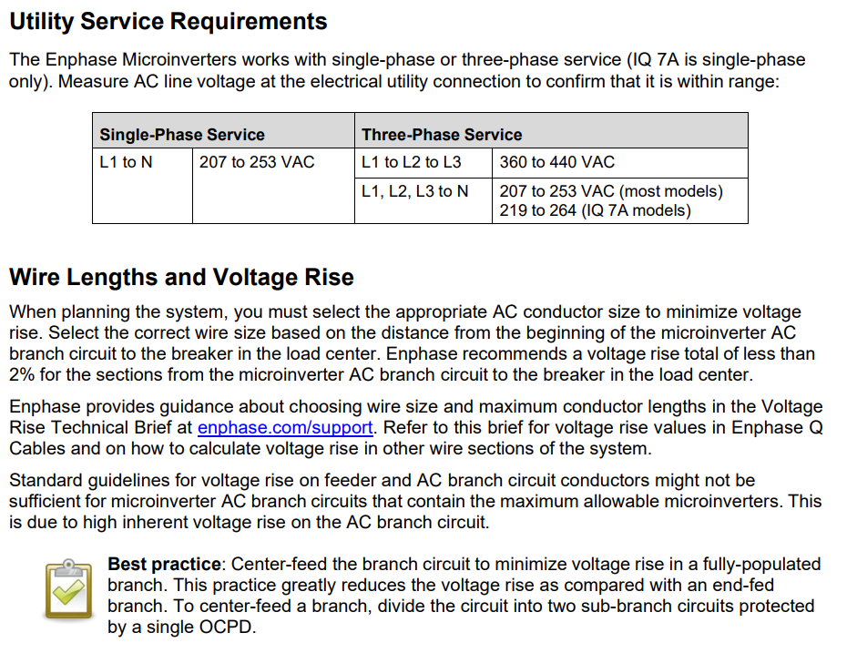
Service and the NEC
Enphase provides this in their installation manual.
Picture courtesy author

Slide 86
Service and the NEC
This is the same calculation only instead of dropping voltage the voltage will rise over the inverter output circuit.
Enphase recommends less than 2 percent.
Therefore, use the NEC 1.5%
Some manufacturers recommend 1%.

Slide 87
Service and the NEC
To calculate the voltage drop or rise, the resistance of the wire needs to be known and the total length of wire.
Find the resistance of the wire size, usually in ohms per 1000 feet or meters.
Use meters (convert from feet to meters by multiplying by 3.28)

Slide 88
Service and the NEC
Find the length of the wire run.
Double this length to allow for both the wires in the cable.
10 meter length has 20 meters of wire.
The 240 volt cable has a black and a red wire 10 meters long each.

Slide 89
Service and the NEC
Questions?

Slide 90
Service and the NEC
Common copper wire resistances from NEC Chapter 9 Table 8. Direct-Current Resistance at 75C. Conductors have 7 strands and insulated.
#6 AWG Copper has 1.67 ohms / 1000 meters
#8 AWG Copper has 2.65 ohms / 1000 meters
#10 AWG Copper has 4.23 ohms / 1000 meters
#12 AWG Copper has 6.73 ohms / 1000 meters
#14 AWG Copper has 10.2 ohms / 1000 meters

Slide 91
Service and the NEC
Multiply the length of the wire by the ohms per meter to get total resistance of the wire.
1000 x ohms / 1000 meters = ohms per meter.
For this example the wires used were #12 AWG and #8 AWG

Slide 92
Service and the NEC
#12 AWG has 6.73 Ohms / 1000 meters, for the 10 meter + 3 meter length of wire it would have 0.175 Ohms.
To calculate the voltage across this circuit multiply the current by the resistance (Ohm’s Law).
16A x 0.175 Ohms = 2.80 Volts.
This is the actual worst-case voltage drop for the circuit.

Slide 93
Service and the NEC
Voltage drop is expressed in percentage of the source voltage.
The calculation for this is:
(2.80 V / 240V ) x 100% = 1.17%
This is below the 1.5% limit of the NEC.

Slide 94
Service and the NEC
#8 AWG has 2.65 Ohms / 1000 meters, for the 10 meter length of wire it would have 0.053 Ohms.
To calculate the voltage across this circuit multiply the current by the resistance (Ohm’s Law).
16A x 0.053 Ohms = 0.85 Volts.
This is the voltage drop for this section of the circuit.

Slide 95
Service and the NEC
Voltage drop is expressed in percentage of the source voltage.
The calculation for this is:
(0.85 V / 240V ) x 100% = 0.35%
Now the last section of wire at #12 AWG is added.

Slide 96
Service and the NEC
#12 AWG has 6.73 Ohms / 1000 meters, for the 3 meter length of wire it would have 0.04 Ohms.
To calculate the voltage across this circuit multiply the current by the resistance (Ohm’s Law).
16A x 0.04 Ohms = 0.65 Volts.

Slide 97
Service and the NEC
Total voltage drop for the inverter output circuit is the drop of 0.85V + 0.65V from both the #8 and #12 conductors.
(1.5V / 240V) x 100% = 0.63%
This is below the NEC of 1.5%.

Slide 98
Service and the NEC
Questions?

Slide 99
Service and the NEC
The rest of the inverter output circuit from the utility disconnect to the main panel does not require temperature correction.
16A on a 12AWG wire must be protected with an overcurrent device of 20A.
Applying the 80% rule (16A x 125%) = 20A breaker.

Slide 100
Service and the NEC
Those are the major NEC codes that must be met on a microinverter installation.

Slide 101
Service and the NEC
Questions?

Slide 102
Service and the NEC
The next option will be as per the “String Inverters and PV Panels assignment #2” using a string inverter.
Slides with the header “Grid Tied Inverters” are from the Module Grid Interactive Inverters”
The same exercise was used before, but now with different PV modules.

Slide 103
Service and the NEC
The String inverter selected is the Fronius PRIMO rated at 3.8kW at 240 Volts.
Use the same PV module in the microinverter example.
The Heliene 60M G1 305W module

Slide 104
Service and the NEC
Heliene 60M G1 305W module has the following specification STC:
Pmp(W) 305
Voc(V) 39.98
Vmp(V) 33.6
Imp(A) 9.07
Isc(A) 9.67

Slide 105
Service and the NEC
Apply the temperature corrections for the module.
10C and 65C as per Belize temperatures.
Voc at 10C = 41.6
Vmp at 10C = 35.0
Vmp at 65 = 30.0

Slide 106
Service and the NEC
Applying the 125% increase of irradiance
Isc 9.67A x 1.25 = 12.1A

Slide 107
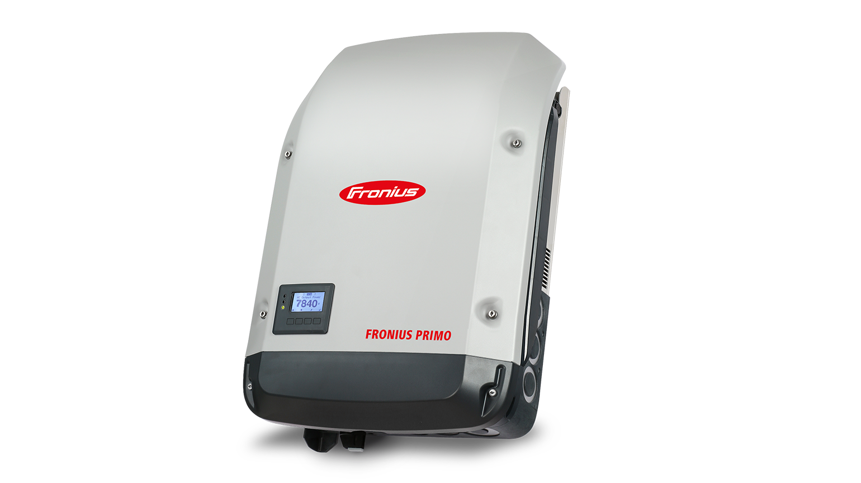
Grid Tied Inverters
PRIMO String Inverter
Picture courtesy Fronius

Slide 108
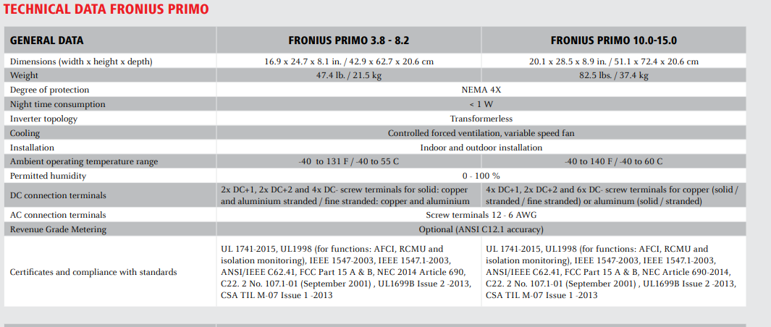
Grid Tied Inverters
Data Sheet For Inverter
Picture courtesy Fronius

Slide 109
Grid Tied Inverters
Data Sheet For Inverter
Picture courtesy Fronius

Slide 110
Grid Tied Inverters
AFCI (arc fault protection)
GFCI
DC disconnects built in
Reverse polarity protection for incorrect installation
Picture courtesy Fronius

Slide 111
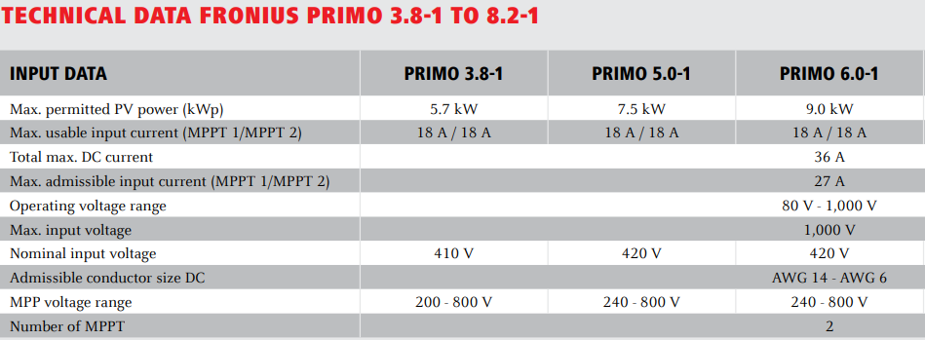
Grid Tied Inverters
The Input Data:
5.7kW for 3.8kW = 150% over capacity on the PV DC wattage. Gather extra low light energy.
Picture courtesy Fronius

Slide 112
Service and the NEC
Inverter Data:
AC output is 3.8kW
DC input from PV is 5.7kW
MPPT range 80V – 1000V
18A per MPPT input
27A maximum with one MPPT input used

Slide 113
Service and the NEC
Although it says it can operate at 1000 VDC
Utility rules will dictate the maximum string voltage.
NEC (National Electrical Code) USA code 690.7 states that 600VDC maximum for single and two family homes.
This exercise will use a 600 VDC input from the PV panel string.

Slide 114
Service and the NEC
Questions?

Slide 115
Service and the NEC
First step is to calculate how many modules would it take to get close to the 600VDC limit.
Temperature adjusted Voc is 41.6V
600 / 41.6 = 14.4 modules round down to 14 modules.
14 modules x 41.6V = 582VDC

Slide 116
Service and the NEC
Vmp range from 30V – 35V
14 modules x Vmp 30V = 420VDC
14 modules x Vmp 35V = 490VDC
These are both within the MPPT voltage range of the inverter.

Slide 117
Service and the NEC
Quick math to calculate the Wattage from 14 modules.
305W x 14 = 4256W
Add 125% for extra irradiance = 5320W
This meets the requirements for the inverter.
This is with just one MPPT input being used.

Slide 118
Service and the NEC
The maximum current from one string will be Isc at 9.67A x 125% = 12.1A which is less than the 27A limit for just one MPPT being used.
Another approach is to use both of the MPPT inputs to see if more modules can be connected to the inverter without exceeding the Wattage input limit of 5.7kW.

Slide 119
Service and the NEC
Working backwards:
5.7kW / 1.25 = maximum wattage of the STC rating for the modules.
4560 Watts / 305 Watts / module = 14.95 modules
15 modules very close to the maximum input at 5719 Watts.

Slide 120
Service and the NEC
If the extra module was to be used.
Two strings are required.
7 modules on one and 8 on the other.
Checking for MPPT voltage within range:
7 x 30V and 7x 35V = 210VDC and 245VDC
This also works.

Slide 121
Service and the NEC
Questions?

Slide 122
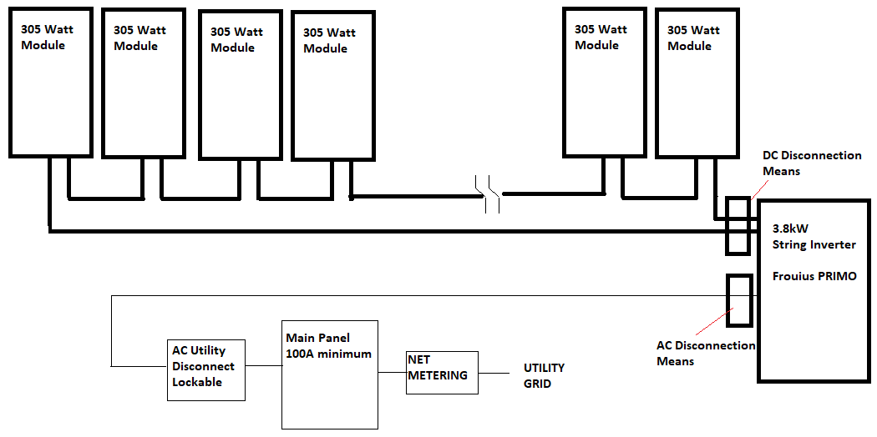
Service and the NEC
Schematic string inverter one MPPT input.
Picture courtesy author

Slide 123
Service and the NEC
690.31 Wiring Methods
Picture courtesy author

Slide 124
Service and the NEC
690.31 Wiring Methods:
These are the sections for 690.31
(A) Wiring Systems
(B) Identification and Grouping
(C) Cables
(D) Direct Current Circuits on or in Buildings
(E) Wiring Methods and Mounting Systems

Slide 125
Service and the NEC
(A) Wiring Systems
(1) Serviceability. Wiring devices with integral enclosures like the PV panel, shall have sufficient length of cable be provided to facilitate replacement.

Slide 126
Service and the NEC
(2) Where Readily Accessible
PV DC circuit conductors greater than 30 volts that are readily accessible to unqualified persons shall be installed in MC cable, in multiconductor jacketed cable, or in a raceway.
Behind the module the raceway is the rail channel with clips to hold the PV wire in place.

Slide 127
Service and the NEC
(2) Where Readily Accessible
Leaving the module array the wire needs to be protected.
Transition the wire from PV wire to other high temperature wire in a junction box as close to the array as possible.
Conduit mounted a short distance behind the array to the junction box provides this protection.

Slide 128
Service and the NEC
(3) Conductor Ampacity
If using 105C or 125C wire, follow the ampacity and temperature corrections in Table 690.31(A)(1) and 690.31(A)(3)(2).
Otherwise follow Table 310.15 and 310.16

Slide 129
Service and the NEC
(B) Identification and Grouping.
(2) Identification
PV system dc circuits conductors shall be identified at all termination, connection, and splice points by color coding, marking tape, tagging or other approved means.
(b) For nonsolidly grounded positive conductors shall include imprinted plus signs (+) or word POSITIVE or POS on insulation of a color other than green, white, or grey

Slide 130
Service and the NEC
(B) Identification and Grouping.
(b) For nonsolidly grounded negative conductors shall include imprinted plus signs (-) or word NEGATIVE or NEG on insulation of a color other than green, white, grey, or red. Only solidly grounded PV system dc circuit conductors shall be marked in accordance with 200.6
200.6 be colored white or grey

Slide 131
Service and the NEC
(C) Cables Type PV wire or cable and Type distributed generation (DG) cable shall be listed.
Single – Conductor Cable.
(a) Single-conductor cable in exposed outdoor locations in PV system dc circuits within the PV array to be one of the following:
PV wire or cable
Single-conductor cable marked with sunlight resistant and Type USE-2 and Type RHW-2
(b) Exposed cables sized 8 AWG or smaller
(c) Exposed cables sized larger than 8 AWG

Slide 132
Service and the NEC
(3) Multiconductor Jacketed Cables.
Have special instructions for installation. Details found in 690.31(C)(3)
(4) Flexible Cords. Shall comply with Article 400 as hard service cord or portable power cable.
(5) Flexible, Fine-Stranded Cables. To be terminated in accordance with 110.14.

Slide 133
Service and the NEC
(D) Direct – Current Circuits on or in Buildings.
(1) Metal Raceways and Enclosures. Where inside buildings, PV system dc circuits that exceed 30 volts or 8 amperes shall be in contained metal raceways, in Type MC metal-clad cable that complies with 250.118(A)(10)(b) or (A)(10)(c), or in metal enclosure.

Slide 134
Service and the NEC
(D) Direct – Current Circuits on or in Buildings.
(2) Marking and Labelling. Unless located and arranged so the purpose is evident, the following wiring methods and enclosures that contain PV system dc circuit conductors shall be marked with the wording PHOTOVOLTAIC POWER SOURCE or SOLAR PV DC CIRCUIT.
(1) Exposed raceways
(2) Covers
(3) Conduit bodies

Slide 135
Service and the NEC
(F) Wiring Methods and Mounting Systems.
Roof-mounted PV array mounting systems shall be permitted to be held in place with an approved means other than those required by 110.13.
Racking system that are approved. Same as Microinverter systems

Slide 136
Service and the NEC
Questions?

Slide 137
Service and the NEC
690.3 Mating Connectors
Picture courtesy author

Slide 138
Service and the NEC
690.33 Mating Connectors. Shall comply with 690.33(A) through (D).
(A) Configuration. The mating connectors shall be polarized and shall have a configuration that is noninterchangeable with receptacles in other electrical systems on the premises.
The MC 4 connector is most common type used

Slide 139
Service and the NEC
690.33 Mating Connectors. Shall comply with 690.33(A) through (D).
(B) Guarding. Constructed and installed so as to guard against inadvertent contact with live parts by persons.
(C) Type. Latching or locking, operating at over 30 volts dc shall require a tool for opening.

Slide 140
Service and the NEC
690.33 Mating Connectors. Shall comply with 690.33(A) through (D).
(D) Interruption of Circuit. Be one of the following:
(1) Rated for interrupting current without hazard to the operator.
(2) Requires the use of a tool to open and marked “Do Not Disconnect Under Load” or “Not for Current Interrupting”
(3) Supplied as part of listed equipment provided with instructions

Slide 141
Service and the NEC
Questions?

Slide 142
Service and the NEC
690.41 PV System DC Circuit Grounding and Protection.
Picture courtesy author

Slide 143
Service and the NEC
(A) PV System DC Circuit Grounding Configurations.
One or more of the following configurations.
2-wire circuits with one functionally grounded conductor
Circuits not isolated from the grounded inverter output circuit (transformerless this example)
Ungrounded circuits
Solidly grounded circuits as permitted in 690.41(B)
Circuits protected by equipment listed and identified for the use

Slide 144
Service and the NEC
(B) DC Ground-Fault Detector-Interrupter (GFDI) Protection. (Built into the inverter)
PV system dc circuits that exceed 30 volts shall be provided with GFDI protection meeting 690.41 (B)(1) and (B)(2) to reduce fire hazards.
Ground-Fault Detection. The GFDI device or system shall detect fault(s) in the PV system dc circuits, including any functionally grounded conductors, and be listed.
Faulted Circuits.

Slide 145
Service and the NEC
(2) Faulted Circuits. The faulted circuits shall be controlled by one of the following methods:
the current-carrying conductors of the faulted circuit shall be automatically disconnected.
The device (GFDI) fed by the faulted circuit shall automatically cease to supply power to output circuits from the ground reference in a functionally grounded system.
Indication of Faults. Provide indication at a readily accessible location.

Slide 146
Service and the NEC
690.42 Point of PV System DC Circuit Grounding Connection.
(A) Circuits with GFDI Protection. Shall have any circuit-to-ground connection made by the GFDI equipment.
(B) Solidly Grounded Circuits. The grounding connection shall be made from any single point on the PV dc system to a point in the grounding electrode system in 690.47 (A).

Slide 147
Service and the NEC
Questions?

Slide 148
Service and the NEC
Disconnection Means for Inverter. Both DC and AC required.
Picture courtesy author

Slide 149
Service and the NEC
It is convenient to have the string inverter mounted near the utility energy meter.
It makes the disconnection and operation of the inverter accessible.

Slide 150
Service and the NEC
Inverter input and output circuit wiring is the same as the microinverter.
That wire will be assessed for:
Amperage
Voltage drop
Temperature

Slide 151
Service and the NEC
Inverter DC input wiring is calculated the same way as the microinverter output conductors.
One difference is 690.7 (A) Photovoltaic Source Circuits. Calculated in accordance in one of the following:
(1) The sum of the module Voc in the PV string and corrected for the lowest ambient temperature with module labeling.
(2) For silicon modules the same as (1) but using Table 690.7(A)

Slide 152
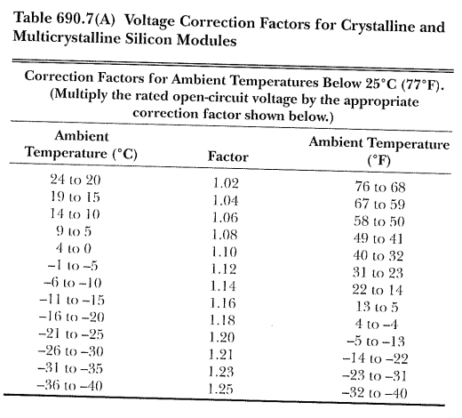
Service and the NEC
Table 690.7(A)
Picture courtesy 2023 NEC

Slide 153
Service and the NEC
Table 690.7(A)
Belize 10C lowest ambient temperature.
Use 1.06 x Voc
1.06 x 39.98V = 42.4V
From the manufacturers corrected Voc coefficient the Voc at 10C is 41.6V
Both are close enough.

Slide 154
Service and the NEC
Temperature adjusted Voc is 41.6V
600V / 41.6V = 14.4 modules round down to 14 modules.
14 modules x 41.6V = 582VDC
This is the 690.7 Maximum Voltage of the source circuit.

Slide 155
Service and the NEC
690.8 Calculation of Maximum Circuit Current.
(A) The maximum current shall be calculated in accordance with one of the methods 690.8(A)(1) or 690.8(A)(2).
The maximum current shall be the sum Isc rating of the PV module connected in parallel multiplied by 125 percent.
(2) NA

Slide 156
Service and the NEC
The maximum current from the one string will be Isc at 9.67A x 125% = 12.1A
This is the assumed highest current that the source circuit conductors will carry.

Slide 157
Service and the NEC
690.9 Overcurrent Protection.
690.9(A)(1) Circuits Where Overcurrent Protection Not Required.
Overcurrent protective devices shall not be required where both of the following are met:
(1) The conductors have sufficient ampacity for the maximum circuit current.
(2) The current from all sources do not exceed the maximum overcurrent protective device rating specified for the PV module or electronic power converter.

Slide 158
Service and the NEC
(1) Only has one source the single string.
(2) No other strings that can back feed the string.
When more than two strings are combined overcurrent protection is required.

Slide 159
Service and the NEC
In this example make some assumptions:
Length of the source conductors from the array to the input of the string inverter is 10 meters or 33 feet.
The maximum current calculated as per 690.8 is 12.1A
This roof conductor will be less than ¾ of an inch above the roof.

Slide 160
Service and the NEC
Questions?

Slide 161
Service and the NEC
310.15 Ampacity Tables (same as microinverters(
(B)(2) Rooftop
For raceways or cables exposed to direct sunlight on or above rooftops where the distance above the roof to the bottom of the raceway or cable is less than ¾ of an inch, a temperature adder of 33C shall be added to the outdoor temperature to determine the ambient temperature for Table 310.15(B)(1)(1)

Slide 162
Service and the NEC
310.15 Ampacity Tables
Picture courtesy 2023 NEC

Slide 163
Service and the NEC
The conductors will reach a temperature of approximately 35C (High Ambient in Belize)
+ 33C (adder) = 68C
The further they are away from the roof the lower the temperature they will be exposed to.
Table 310.15 (B)(1)(1) Ambient Temperature Correction Factors Based on 30C.
For 90C wire in ambient of 68 is 0.58

Slide 164
Service and the NEC
The wire ampacity is 0.58 of its capacity at 30C
This is using 90C wire.
690.8 states that because this deration is greater than the normal 80%, then the 58% will be the only one required.
Table 310.16 Ampacity of Insulated Conductors

Slide 165
Service and the NEC
Table 310.16 Ampacity of Insulated Conductors
Picture courtesy 2023 NEC

Slide 166
Service and the NEC
0.58 x 25A (#14AWG) = 14.5A which is more than the 12.1 required.
12.1A x 1/0.58 = ampacity required of the conductor to handle the inverter output.
12.1 A x 1/0.58 = 20.9A round up to 25A

Slide 167
Service and the NEC
Need 25A wire = #14 AWG with an overcurrent device rated at 12.1A x 125% = 15.1A breaker.
There is no requirements for an overcurrent device in this application.
However if there were then:
Rule 240.4(D)(4) states that the overcurrent protection shall not exceed ( 14 AWG Copper 15 amperes) after any correction factors for ambient temperature and number of conductors have been applied.

Slide 168
Service and the NEC
Next calculate Voltage Drop.
647.4(D) The voltage drop on any branch circuit shall not exceed 1.5 percent.
Most manufacturers will suggest a maximum value for this.
Looking at the installation manual for the Fronius inverter and there is no suggested voltage drop percentage.

Slide 169
Service and the NEC
The conductor is #14 copper.
Source voltage that is most impacted by the voltage drop is the highest temperature Vmp at 420V.
The corrected Isc is also the highest current to ever be placed on the conductors.
Using the Excel calculator located in the Google Drive folder the highest Voltage drop is 0.62%.
Well below the 1.5% required by the NEC.

Slide 170
Service and the NEC
Those are the major NEC codes that must be met on a string inverter installation.

Slide 171
Service and the NEC
Questions?

Slide 172
Service and the NEC
(B) Conductor Ampacity.
Circuit conductors shall have an ampacity not less than the larger of 690.8(B)(1) or (B)(2).
(1) Without Adjustment and Correction Factors.
The minimum conductor size with an ampacity not less than the maximum currents calculated in 690.8(A) multiplied by 125 percent.
Exception: Circuits containing an assembly, together with its overcurrent device(s), that is listed for continuous operation at 100 percent of its rating shall be permitted to be used at 100 percent of its rating.
(2) With Adjustment and Correction Factors.
The maximum currents calculated in 690.8(A) with adjustment and correction factors.

