Slide 1
Design and Implementation of Pilot of a TVET Renewable Energy Course
DELIVERABLE #5 - TRAINING COURSES & PROFESSIONAL DEVELOPMENT

Slide 2
Maintenance
PV System Operation and Maintenance Course Outcomes.
Determine the performance of each component in a PV system.
Read and interpret manufactures data sheets for scheduled maintenance.
Demonstrate trouble shooting techniques on PV systems.
Demonstrate how to take readings safely from PV systems.

Slide 3
Maintenance
What is maintenance?
There are three basic types of maintenance.
Corrective
Preventative
Predictive

Slide 4
Maintenance
Corrective maintenance is what you need to do when something fails.
Call it repairing or troubleshooting.
When a part of the system has either stopped working properly or has failed, it is necessary to do corrective maintenance.

Slide 5
Maintenance
Preventative Maintenance attempts to spread out the maintenance activities by planning on a regular basis.
Equipment is regularly inspected, cleaned and have adjustments made to them by maintenance workers.
Since the maintenance is done on a schedule, equipment will be addressed at a specific time, not when some type of event occurs.

Slide 6
Maintenance
Predictive maintenance attempts to forecast when a piece of equipment is going to fail or stop performing as expected.
This is done by monitoring the equipment and then using the data that is collected (during maintenance or online) to prevent the failure before it occurs.
Instead of working on a schedule, maintenance is driven by indications given by the equipment.

Slide 7
Maintenance
Safety Requirements
The first thing this course will examine are safety related topics.
Whether the work is performed alone or as a team some basic rules need to be established.
The scope of the work needs to be identified.

Slide 8
Maintenance
Safety begins with adequate planning and preparation.
Safety requirements during PV servicing include the proper use of lockout / tagout procedures.
Utilizing personal protective equipment (PPE).
Safe work procedures for safely disconnecting live circuits.

Slide 9
Maintenance
When performing work around these systems there normally is a work order.
It is a document that provides all the information about a maintenance / troubleshooting task and outlines a process for completing that task.
It may include details on who authorized the job, the scope, who it's assigned to, and what is expected.
A written document that has this shall be used.

Slide 10
Maintenance
Lockout / tagout is required when energized equipment is serviced or maintained.
Required if safety guards are removed or bypassed.
If a worker has to place any part of their body in the equipment’s point of operation, or if hazardous energy sources are present.
It is assumed that lockout / tagout was covered in previous safety courses.

Slide 11
Maintenance
Selecting the PPE and having it on site will help minimize exposure to site conditions and equipment hazards.
Site assessment to identify potential hazards is part of the process to selecting the appropriate PPE for the maintenance task at hand.
Competency in the classroom must be observed before maintenance can be performed on PV direct current (dc) circuits.

Slide 12
Maintenance
The competency will be developed through performing lab exercises during this course.
Taking live dc readings (voltage and current) can be dangerous.
Competency must be demonstrated on this work.
The operation of disconnection means and work around combiner boxes and junction boxes will be part of lab work during the course.

Slide 13
Maintenance
DC voltages up to 1000 V will become common.
This course will not prepare learners to work on voltages above 4 modules connected in series.
Arc flash requirements will be a concern and it will be more common to see arc flash warning labels on combiner boxes and disconnects.
Another competency is the ability to understand how to calculate the DC voltages present before performing maintenance.

Slide 14
Maintenance
Missing signage is very possible on systems.
When preparing for a maintenance operation at a jobsite besides PPE an appropriate fire extinguisher and first aid kit shall be on hand.
Personnel must have proper training in their use.

Slide 15
Maintenance
Isolating live DC circuits is a dangerous operation.
One can not assume that disconnect switches are grounded and operate correctly.
The minimum PPE to operate the disconnect is safety glasses and gloves.

Slide 16
Maintenance
There is a Left Hand Rule for operating disconnects.
Hold the disconnect with your LEFT hand Turn your body to face away from the switch.
Close your eyes. Take a deep breathe and hold it.
Then "throw" the disconnect lever.
Using this method reduces the risk of injury if an arc flash does occur.

Slide 17
Maintenance
Afterwards use a properly rated voltmeter to confirm that no voltage is present on the disconnected circuit.
If possible, visually inspect that the operating blades have moved to the open position.
A common failure, is one of the blades are welded shut or the linkage fails to open a blade.

Slide 18
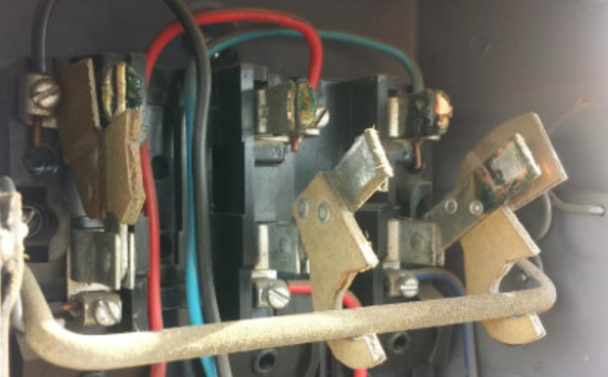
Maintenance
One blade stays shut because the linkage failed.
Weak linkage or welded shut blade.
Courtesy Linked In

Slide 19
Maintenance
Routine Scheduled Preventive Maintenance
When a person arrives at the jobsite, a site assessment to the physical surroundings is observed.
What are the site hazards?
They can include physical hazards and energy hazards.
These hazards need to be identified and documented.

Slide 20
Maintenance
Physical hazards can include:
Clutter, garbage, or other material.
Working from heights.
Machinery
Hot surfaces
Animals

Slide 21
Maintenance
Energy hazards can include:
Battery / chemical.
Sufficient current to burn or arc.
Voltage sources to electrocute or arc flash.
Rotational machinery.
Wind, solar, hydro or pressures stored in a device.

Slide 22
Maintenance
First is step being to identify what and where are the sources of energy?
Can you determine those dangers without a system drawing?
Does there need to be a written procedure developed to deal with them?

Slide 23
Maintenance
To prevent and safeguard against these hazards the preferred order of action based on overall effectiveness would be:
Elimination
Substitution
Engineering controls
Administrative controls
Personal protective equipment (PPE)

Slide 24
Maintenance
Elimination
Can those dangers be removed?
By releasing any stored energy.
By isolating the energy.
Solar PV panels can be covered with opaque material.

Slide 25
Maintenance
Substitution
Can the work be performed at night?
Can the energy be replaced with a safer source?
Power Supply as an example.

Slide 26
Maintenance
Engineering controls reduce and try to prevent hazards from coming into contact with workers.
Engineering controls can include modifying equipment or the workspace, using protective barriers, ventilation, and more.
Prevent users from modifying or interfering with the control.

Slide 27
Maintenance
Administrative controls use work practices to reduce the duration, frequency, or intensity of exposure to hazards.
This may include:
Lockout tagout procedures.
Work process training.
Ensuring adequate rest breaks.
Limiting access to hazardous areas.

Slide 28
Maintenance
Personal protective equipment (PPE)
PPE is equipment worn to minimize exposure to hazards.
Examples of PPE include:
Gloves, safety glasses, hearing protection, footwear, hard hats, and aprons.

Slide 29
Maintenance
Knowledge is the most important component of safety.
Developing safety procedures is required on PV systems.
Operating, troubleshooting and maintenance procedures are part of this safety procedure.
Consult manufacturers manuals for equipment level procedures.

Slide 30
Maintenance
Before performing any work, this procedure must be documented and designed.
Safe work practices
Written methods outlining how to perform a task with minimum risk to people, equipment, materials, environment, and processes.
Safe work procedures
A series of specific steps that guide a worker through a task from start to finish in chronological order.

Slide 31
Maintenance
This topic should have been introduced in previous courses.
Safe Work Procedures include:
Description of work
Scope
Authorizations and/or pre-requisites

Slide 32
Maintenance
Potential hazards
Safety controls
Personal Protective Equipment (PPE) requirements
Responsibilities of each employee/contractor involved
Instructions or a fixed sequence of steps to follow

Slide 33
Maintenance
Clean up / shut down procedures
Emergency / evacuation procedures
Any additional information that needs noting

Slide 34
Maintenance
The basic types of PV maintenance for this course will be the following:
General Site Inspection
Grounding and Racking Inspection
Wiring and Combiner and Junction Box Inspection
Utilization Equipment Inspection

Slide 35
Maintenance
Personnel responsible for system maintenance should always review the system manuals prior to deploying to the site if possible.
They should ensure that all maintenance parts and required tools are available for any on-site visits.
Various spare parts should be on hand.

Slide 36
Maintenance
General Site Inspection
Upon arrival conduct a general inspection of the PV installation site.
Is working from heights a consideration?
If previous knowledge of site required scaffolding and ladders, they should be either on site or arranged to be there.
Fall arrest PPE needs to be used.

Slide 37
Maintenance
Upon arrival conduct a general inspection of the PV installation site.
Look for obvious shading.
Is this shading part of the maintenance procedure?
New growth or was it always there?

Slide 38
Maintenance
Check the tilt and orientation of the array.
Is it part of the maintenance procedure?
Has the tilt or orientation changed?

Slide 39
Maintenance
Check to ensure roof penetrations are watertight, if applicable.
Check and ensure roof drainage.
Are the roof drains clogged?
Could they now be part of the maintenance.
Check for signs of water pooling in the vicinity of the array.

Slide 40
Maintenance
Check for vegetation growth or other shade items that will affect the performance of the array.
Is ground erosion near the base / footings of a ground mount array evident.
Is there signs of animal / bird infestation under or on the array.
Check for debris from under or around the array, can it be removed?

Slide 41
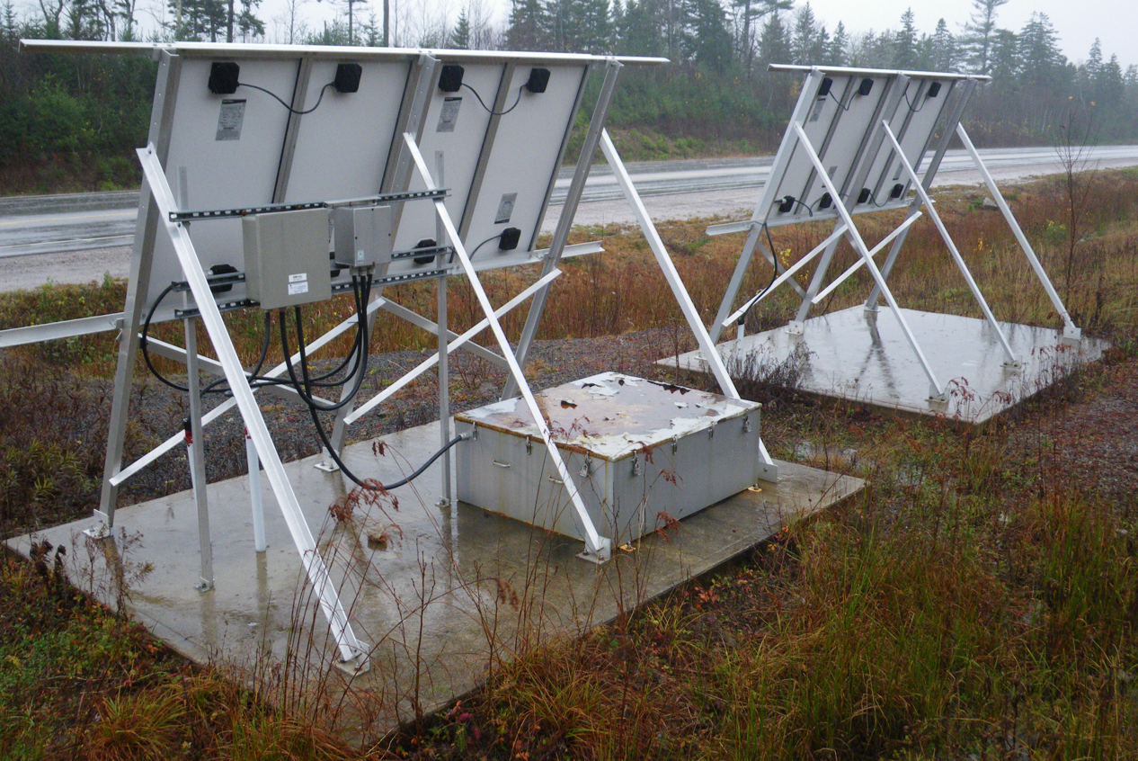
Maintenance
Although not an issue yet, take the time to remove the growing vegetation.
Cory Manuel

Slide 42
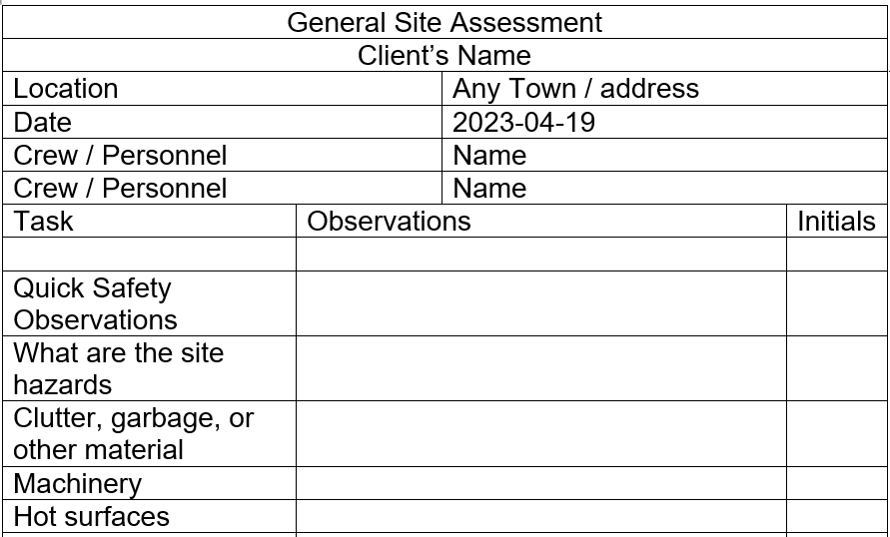
Maintenance
The “General Site Assessment” form can be the following.

Slide 43
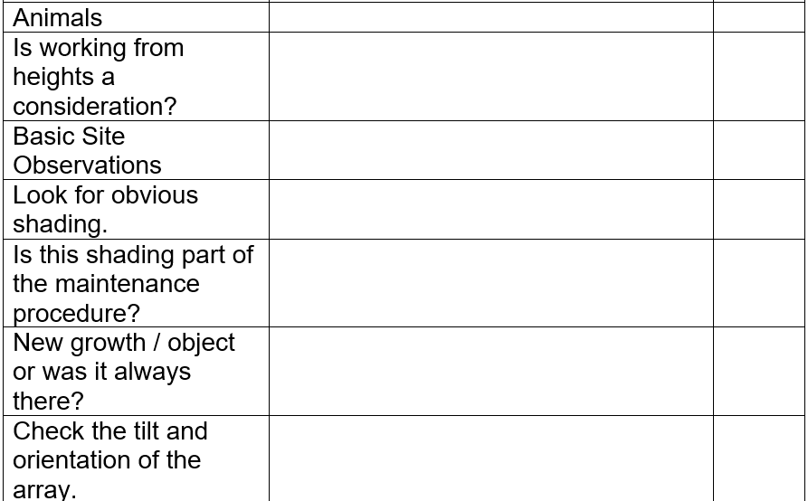
Maintenance

Slide 44
Maintenance

Slide 45
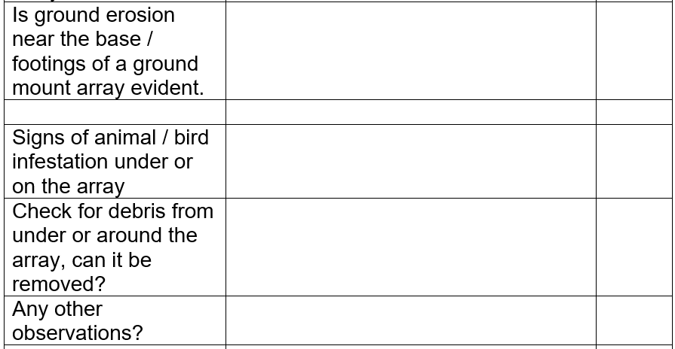
Maintenance
The electronic version of this form is part of the documentation for the course.

Slide 46
Maintenance
Array Maintenance
The next section involves maintenance for the PV array and associated racking, cabling and equipment that pertains to the PV system.

Slide 47
Maintenance
These next slides describe the procedure before working with the array.
There is no assumption that it is safe to touch the array.
The metal components need to be checked for bonding to earth.

Slide 48
Maintenance
Before going to the worksite are there any drawings / sketches for the system?
Upon entering the worksite and completing the General Site Assessment, the PV array is noted for its type of mounting and location.
A visual check is made and take notes.
Are safety signs and labels in place?

Slide 49
Maintenance
Do not touch any metal parts until after the equipment grounding is inspected.
Is the array ( can be just one panel) in a readily accessible location?
Working from heights consideration?
Disconnection means accessible?
Racking issues that are visible?

Slide 50
Maintenance
Does the racking need to be repaired when first looked at?
Take notes on accessibility, and any physical damage that is visible.
Ladder or scaffolding required?
Is the mounting structure safe to access?

Slide 51
Maintenance
If the racking is easy to visually inspect check for corrosion or other defects.
Loose racking components / brackets.
Take notes and record your findings.

Slide 52
Maintenance
Some questions to ask yourself:
Are any of the wires visible and need to be secured?
If and where do the wires enter a building / structure?
Do they look damaged?
Is there a disconnecting means?

Slide 53
Maintenance
If the array needs to be physically worked on, as in securing the racking, torquing of bolts, or cleaning of the panels what needs to be done first?
Get a wiring diagram of the array and know what the voltage and current are available.
This should be marked / labelled somewhere near the disconnecting means.

Slide 54
Maintenance
When working on an array, never assume it is safe to touch.
Remove any load from the array.
Isolate array.
Test for bonding and equipment grounding.
Visual check first.
Lockout tagout, as necessary.

Slide 55
Maintenance
Before touching any of the metal parts including the modules, look for the equipment grounding conductor.
Is it securely fastened to the racking?
Can you follow it back to where it is grounded?
With a voltmeter check the voltage of the module frame and the grounding conductor, use both dc and ac scales.

Slide 56
Maintenance
It is not uncommon in small low voltage systems to find that there is no ground electrode.
The safe limit to work on a system is 30 volts.
PV panels can have leakage current from cell(s) to the frame.
The practice of checking the frame voltage to ground is very important.

Slide 57
Maintenance
The voltmeter should read 0 volts dc and ac.
If there is voltage measured then the grounding connection needs to be repaired, and the dc wiring inspected for damage.
Before any repairs are made the disconnecting means needs to be opened.
If the disconnecting means is not meant to be opened under load, then the load needs to be disconnected.

Slide 58
Maintenance
The next step is to find where the voltage is coming from.
All sources of voltage need to be isolated from each other.
Then the source that is at fault can be repaired or if ungrounded, an equipment ground wire is required.

Slide 59
Maintenance
This may require an equipment grounding conductor be attached to the utility ground electrode.
It may also require that a grounding electrode to be installed.
A self derived grounded system is one where the ground electrode is not connected to the utility.

Slide 60
Maintenance
If there are no disconnecting means (which is not normal) then a procedure to remove all loads needs to be established.
If there is a charge controller in this scenario, all of the loads need to be disconnected first.
The battery may still be drawing current from the array, and it will need to be disconnected as well.
Using a clip-on dc ammeter is good for determining when the current has stopped.

Slide 61
Maintenance
Use a clamp-on dc current meter to confirm that the load / wire does not have any current passing through it.
Then disconnect the string by opening the string wire positive and negative connectors and putting caps (if bare use insulated mechanical fastening device) on the source circuit connectors.
Go back to the combiner box / charge controller and use a voltmeter to confirm that each string has been successfully disconnected.

Slide 62
Maintenance
The terminals on the charge controller are also not meant to be used as a disconnecting means under load conditions.
Placing an opaque covering over the array may be the best option to stop the current flow.
Waiting until dark is another option.
The PV mating connectors (MC-4) or the finger safe fuses are not meant to be opened under load, doing so can cause arcing and do damage.

Slide 63
Maintenance
Once the array is isolated from the rest of any utilization equipment, a lockout tagout procedure shall be used.
This is the first step when working on an array.
It needs to be isolated and ensure the bonding to ground is working.
A continuity check from the modules to the grounding conductor shall be performed.

Slide 64
Maintenance
It is important to verify that the equipment ground is properly installed on all exposed non-current carrying metal parts.
That way, the removal of a single piece of equipment during module replacement, for example does not impact the integrity of the bonding of the remaining equipment.
If removal of any component results in a break in the bond connection, a jumper of suitable ampacity must be used as a temporary connection.

Slide 65
Maintenance
Procedure:
Set ohmmeter to the continuity setting.
Touch one lead to a metal surface or ground wire.
Touch the other lead to a nearby metal surface or ground wire.

Slide 66
Maintenance
To confirm continuity between the two surfaces by listening for the beep when the leads touch the surfaces at the same time.
Repeat this process randomly throughout the array and at every combiner box, disconnect, and inverter.

Slide 67
Maintenance
Repair the grounding connection before performing other maintenance work.
The PV leads need to be checked for insulation failure.
If damaged, a procedure to isolate them before they are repaired.
A maintenance upgrade is to replace regular plastic wire ties with ones rated for supporting flexible conduit and cables. (next slide)

Slide 68
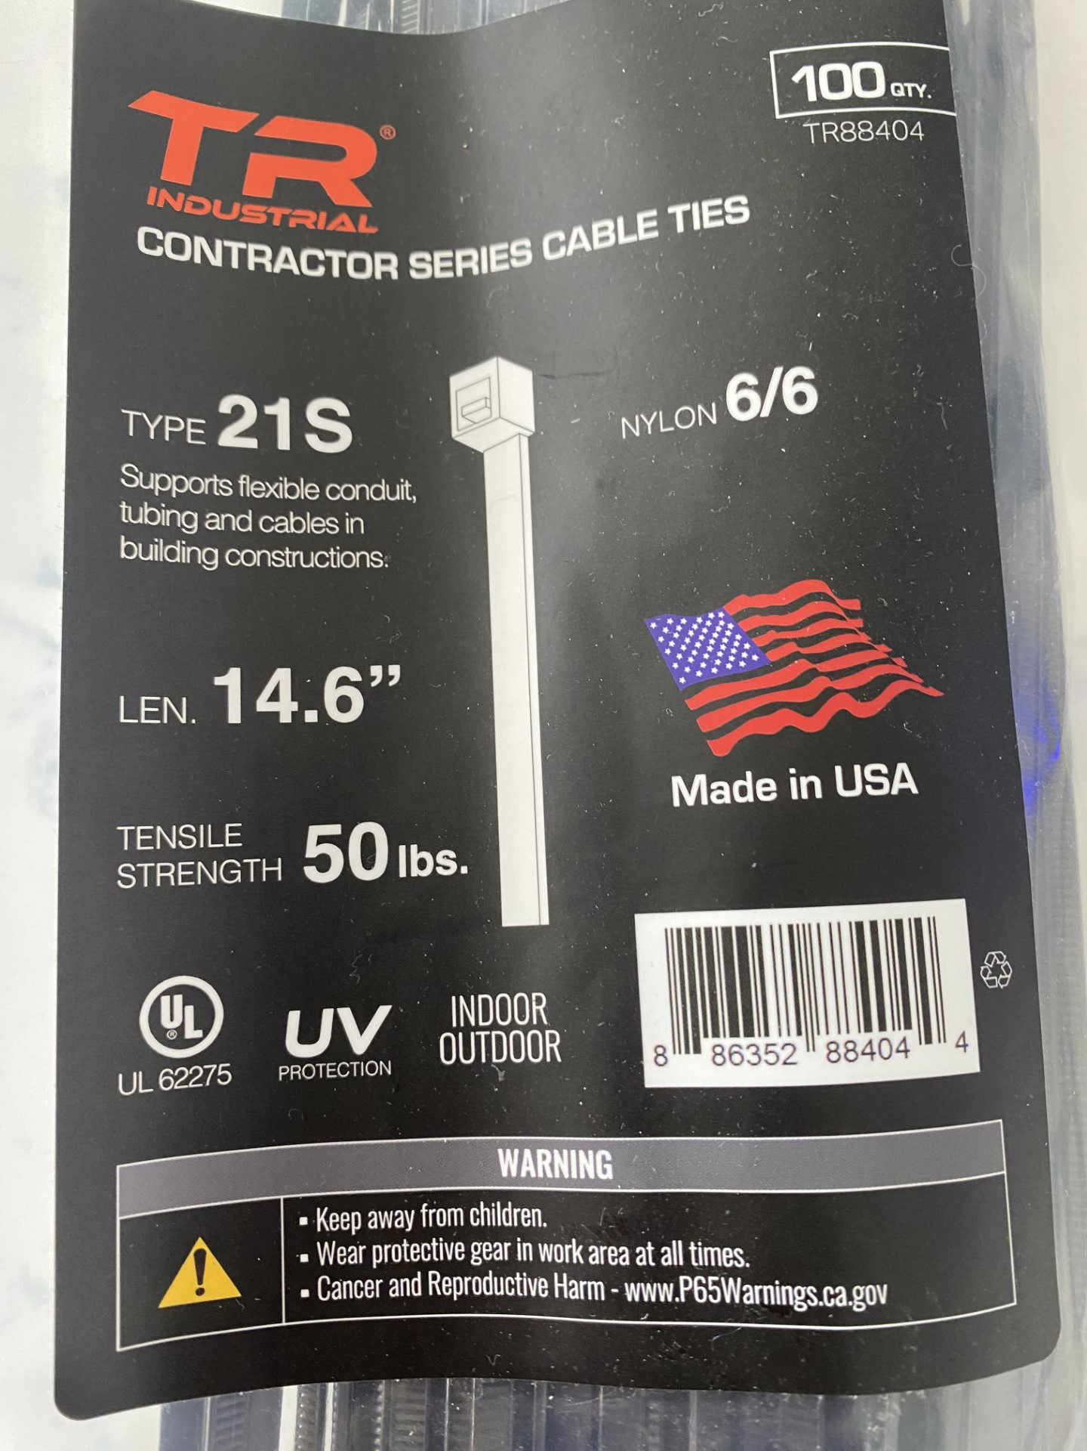
Maintenance
Type 21S for the supporting of flexible conduit, tubing and cables in buildings. UV protection outdoor rated.
Author

Slide 69
Maintenance
Once the array has been assessed for wiring and racking integrity the next option is to do physical maintenance.
Re-torquing of the bolts to manufacturer specs is a maintenance item.
Make up a diagram of the array with each bolt identified on the diagram.

Slide 70
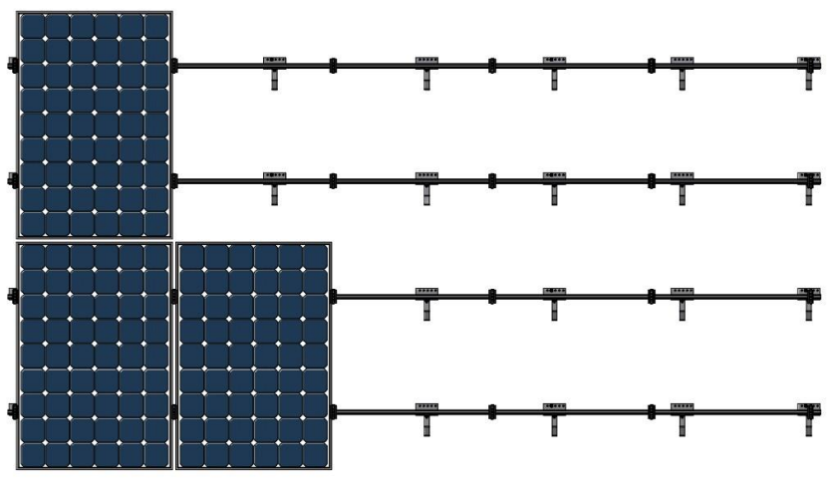
Maintenance
Allow for a cut away view showing where the bolts to be retorqued are located (Highlighted in yellow).

Slide 71
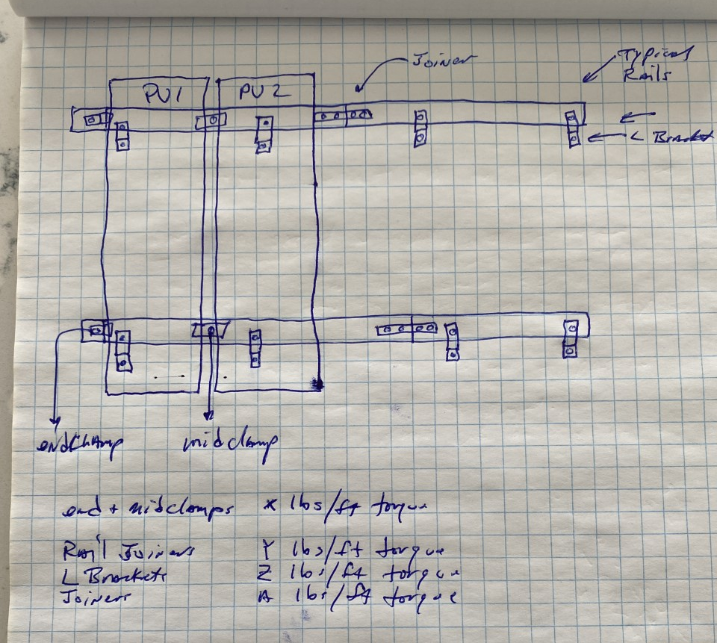
Maintenance
A hand sketch to identify where the bolts are and their torque settings. A checklist should be attached, and it needs to be
initialized after
torquing by the
person who did it.
Author

Slide 72
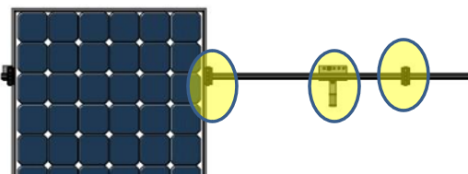
Maintenance
Panel Clamps, L Bracket, Rail Joiner
Author

Slide 73
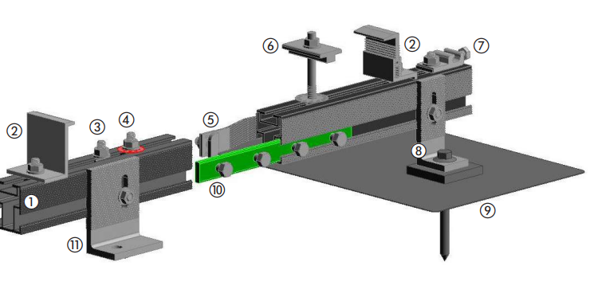
Maintenance
Panel Clamps, L bracket, Rail Joiner
Author
Charge Solar

Slide 74
Codes and Regulations
Array Bolt Torquing
Author

Slide 75
Maintenance
Each bolt will need to be identified for the racking system.
A torque value assigned for each bolt.
An initial placed by each bolt on the sheet indicating it was torqued.
A permanent marker line drawn on the bolt head and the mating surface indicating where the bolt head position is after being retorqued.

Slide 76
Maintenance
Torque marks are made when lugs have been tightened to the proper torque value.
Ideally, they are applied during initial installation, but if not, they can be marked on the lug after torquing during a maintenance visit.
The mark is a straight line through the lug and the housing.

Slide 77
Maintenance
Over time, if the line separates between the lug and the housing, it shows that the lug has moved and needs to be re-torqued.
Record with your initial on the maintenance sheet.

Slide 78
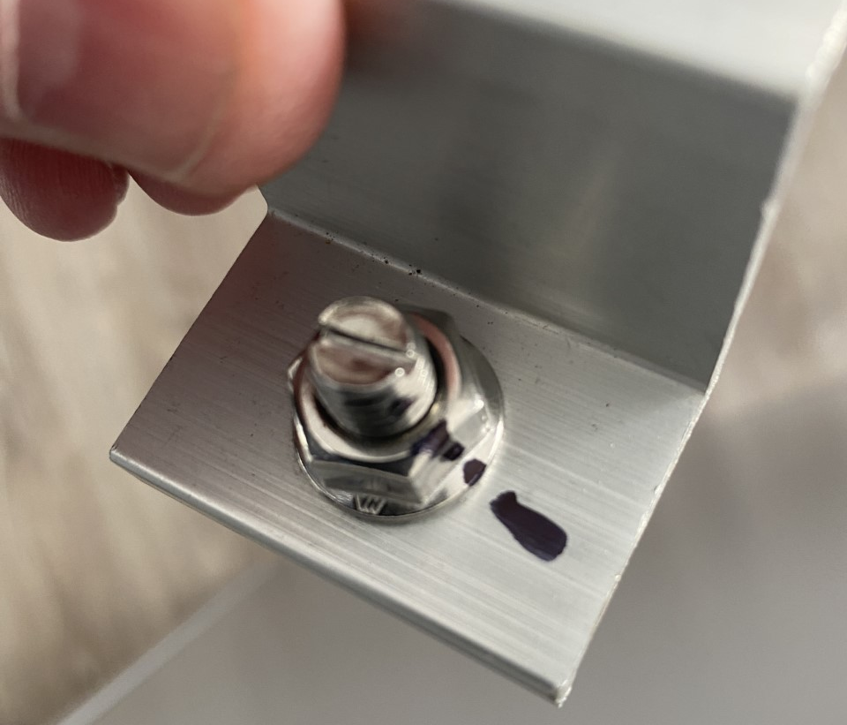
Maintenance
Bolt with permanent marker line.
Author

Slide 79
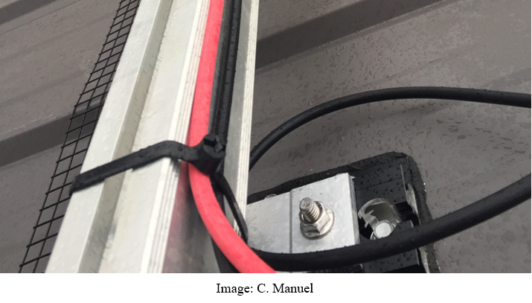
Maintenance
When torquing the bolts, a visual check of the wire management is also performed. Have wire ties handy.

Slide 80
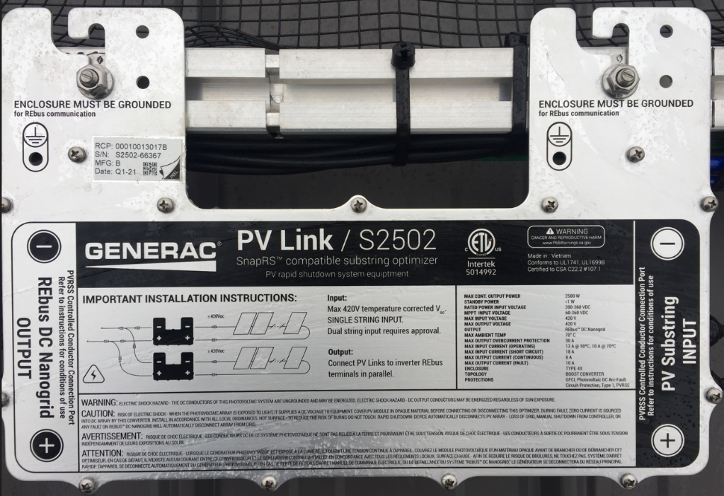
Maintenance
Any other electronic equipment under the panel must also be torqued and checked that the grounding connection is still intact.
Cory Manuel

Slide 81
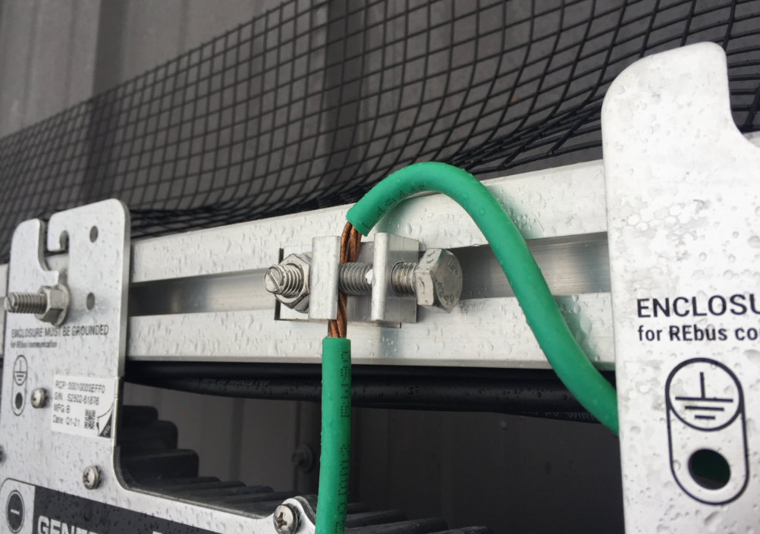
Maintenance
Check the tightness of the lay-in lug.
Cory Manuel

Slide 82
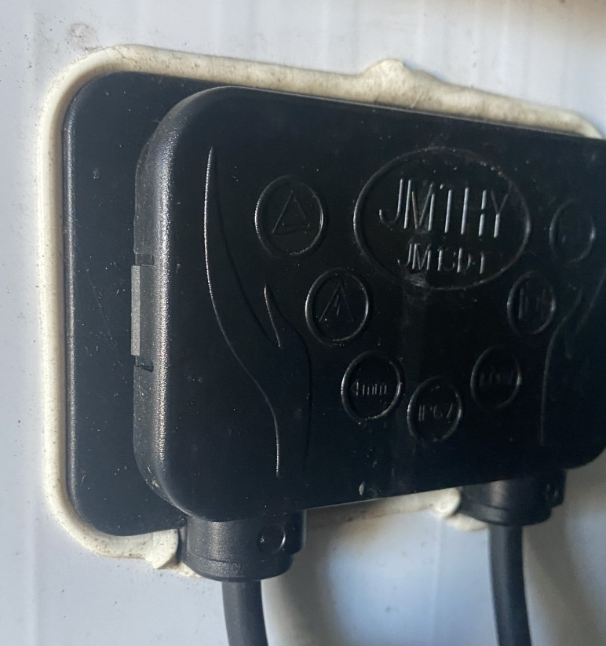
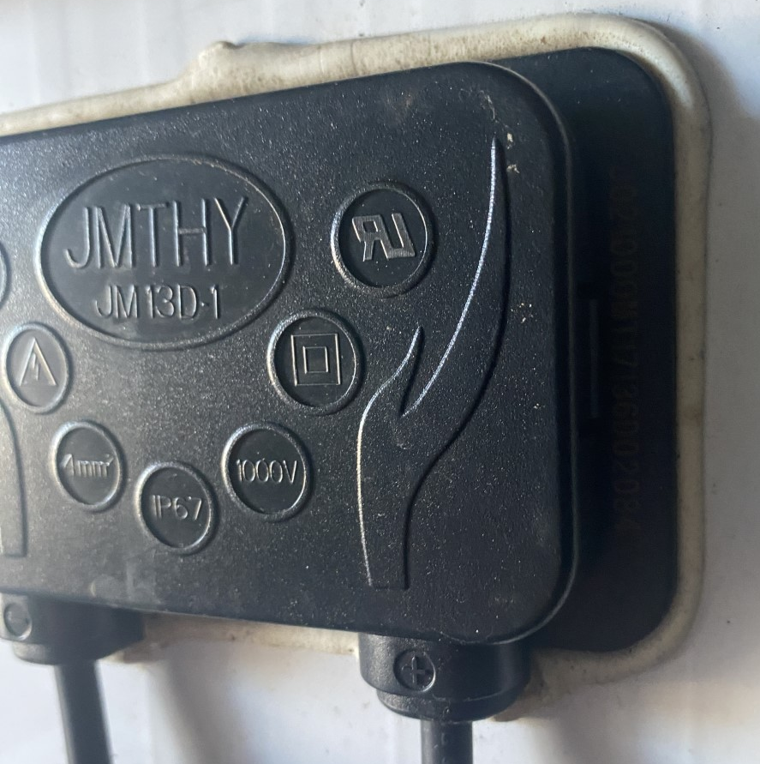
Maintenance
Check the junction box at the back of the panel.
Author

Slide 83
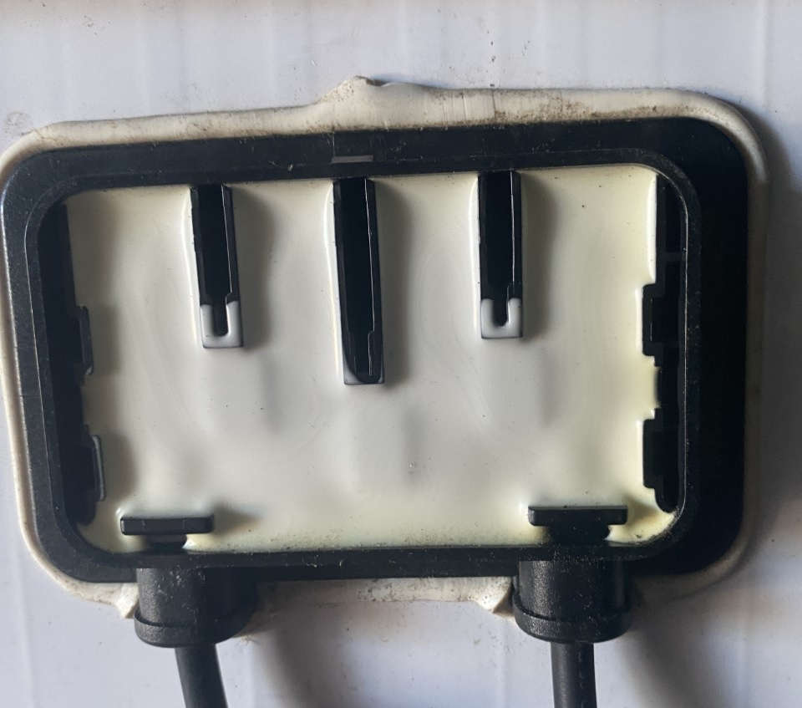
Maintenance
Check the junction box at the back of the panel.
Author

Slide 84
Maintenance
Another maintenance activity is cleaning debris from the surface of the panels.
Adapt cleaning schedule to rain, pollen season, bird season if possible.
A cloth or soft bristled brush are the only tools that should touch the surface of the panels.
If clean fresh water is available, it can be sprayed at low pressure onto the surface with a hose.

Slide 85
Maintenance
This will remove the larger dirt with the least amount of contact with the surface.
Pressurized power washers should never be used directly on the surface.
Never spray broken modules with water.
Do not spray water directly on any junction box or wires.
Abrasive soaps or solvents should never be used.

Slide 86
Maintenance
Follow the PV module manufacturer’s recommendations with any array cleaning.
Clean PV modules with plain demineralized water and mild detergent recommended by the manufacturer.
A strip cleaner, and squeegee (often on opposite sides of the same tool), using overlapping vertical strokes in the same way window glass is cleaned on commercial buildings

Slide 87
Maintenance
If the dirt is still on the surface, warm soapy dish detergent can be used with either a soft bristled brush, sponge or with a soft cloth and gentle motion action.
Rince often.
Bird droppings have sharp and abrasive matter.
Soaking the droppings before applying any cleaning method is best. Leave 10 minutes before rinsing.

Slide 88
Maintenance
If this does not remove the dropping, then rub gently with mild detergent and warm water.
Mold from water laying on low slope installations can be removed with warm water with a mild detergent and either the soft bristled brush, cloth or a sponge.
Rain usually will keep the panels clean.

Slide 89
Maintenance
If the array was cleaned or determined that cleaning was not required, a visual inspection of the surface of each panel is made.
Any irregularities shall be noted.
These can include color blemishes that would indicate local hot spots from shading. (Mold, bird dropping or vegetation)

Slide 90
Maintenance
Delamination between the cell and attached layers can cause them to separate.
There are a few causes for this.
The only one that can be addressed is if water / moisture has migrated inside the panel.
Sealing is an option and should only be attempted after consultation with the client. There are products for this.

Slide 91
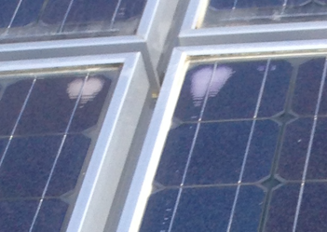
Maintenance
Delamination between the cell and attached layers.
Author

Slide 92
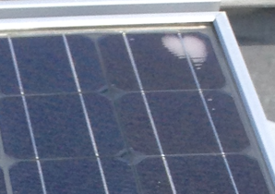
Maintenance
Delamination between the cell and attached layers.
Author

Slide 93
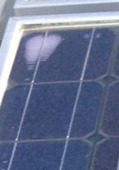
Maintenance
Delamination between the cell and attached layers.
Author

Slide 94
Maintenance
If this phenomenon is observed mark the frame of the panel with a permanent marker and record the delamination in a sketch or picture.
The next time maintenance is performed the delamination can be checked for change.
The performance of the panel will be affected.
Planning to replace the panel can be made for a future date.

Slide 95
Maintenance
Leaks in the edge between the glass and the frame can be repaired with silicon caulking.
Scratches in the surface can be filled with epoxy.
Broken or shattered surfaces are not repairable, and the panel should be replaced.

Slide 96
Maintenance
Once the visual inspection and cleaning maintenance has been completed a performance test is performed.
A performance test is a measure of the Voc and Isc at a given irradiance.
The irradiance meter / pyranometer is used for measuring the W/m² from the sun to the panel surface.

Slide 97
Maintenance
Combiner / junction boxes shall be opened and checked.
Be prepared for anything that may have moved into the combiner / junction box.
The fuses and or breakers need to be checked.
Fuses and breakers can be checked for continuity.
Breakers should be operated manually and checked for circuit open.

Slide 98
Maintenance
The STC values for Voc and Isc are required for the array modules.
Readings for irradiance shall be taken and the minimum is 200w/m² as this is the low end where the Voc will be close to maximum values.
Before attempting to take Voc and Isc readings ensure it is safe to take the readings.

Slide 99
Maintenance
Voc reading should be made at a terminal preferably.
If the Voc is above 30Vdc it is considered dangerous.
If the terminals from a combiner box or disconnect are not available, then an adapter shall be made.
The adapter is made of two MC4 connected wires that are fed into a finger safe terminal strip.

Slide 100
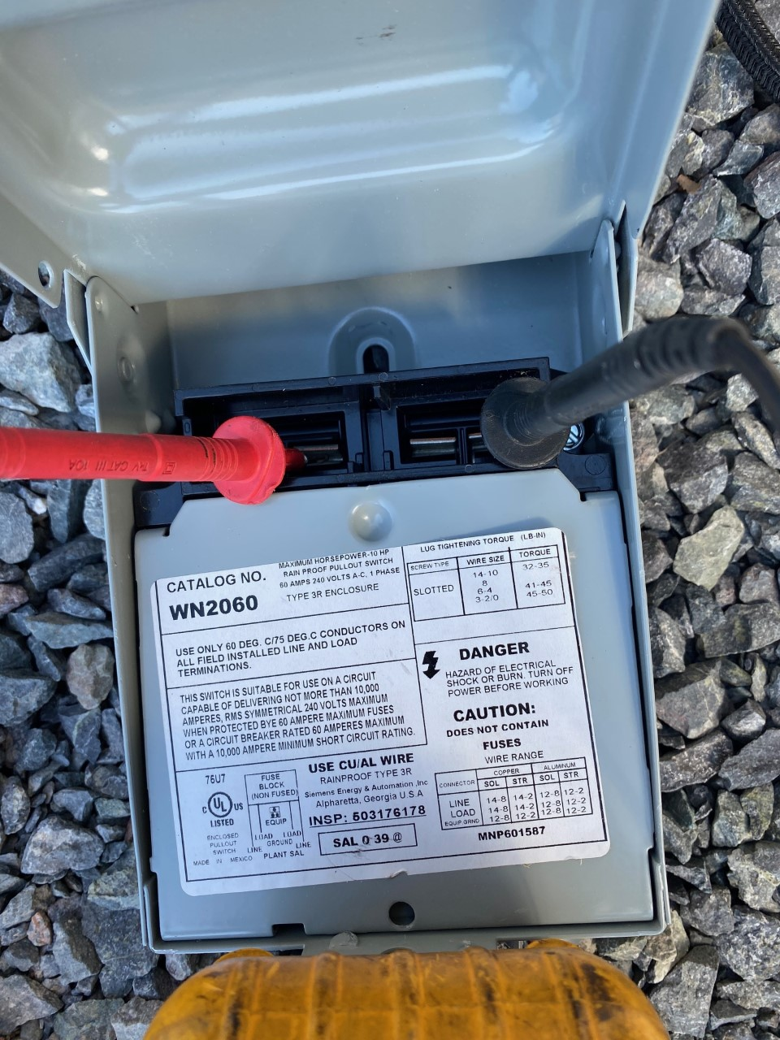
Maintenance
A safe temporary connection to make Voc measurements.
Ensure disconnect (pictured)
is rated for the Voc at dc.
Author

Slide 101
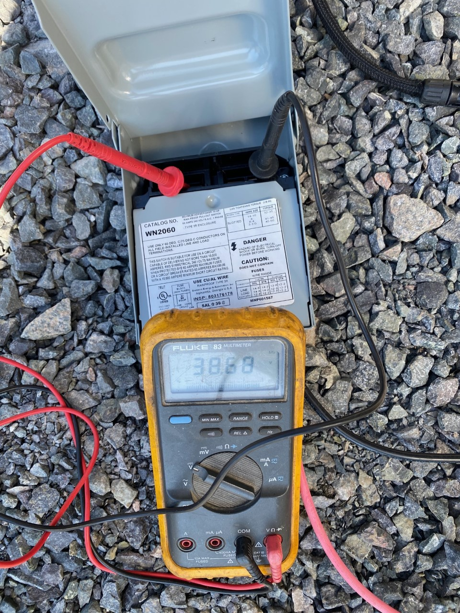
Maintenance
No finger touching wires.
Author

Slide 102
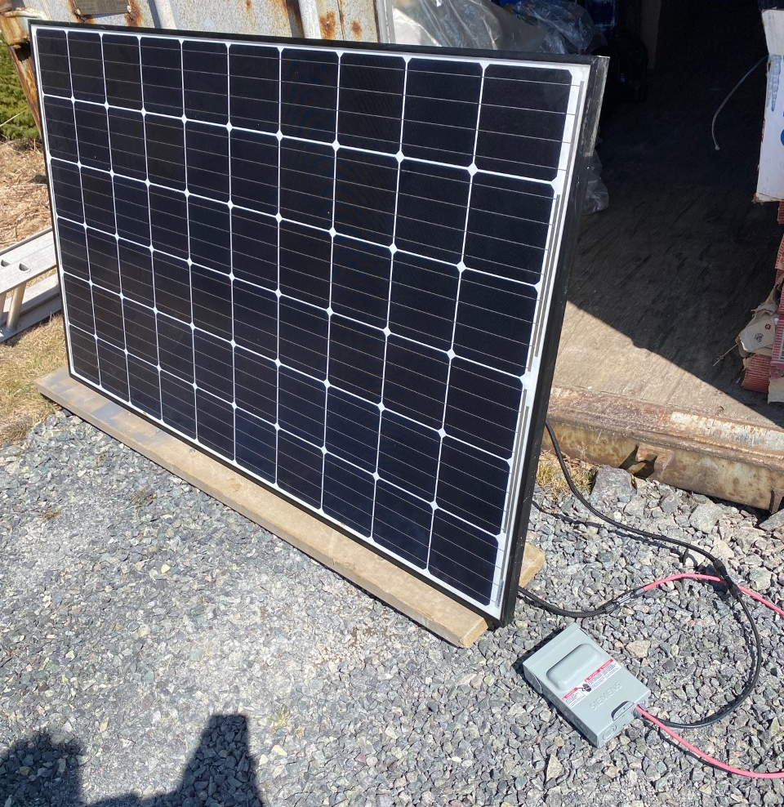
Maintenance
Setup with only one
panel, but will work
with array.
Author

Slide 103
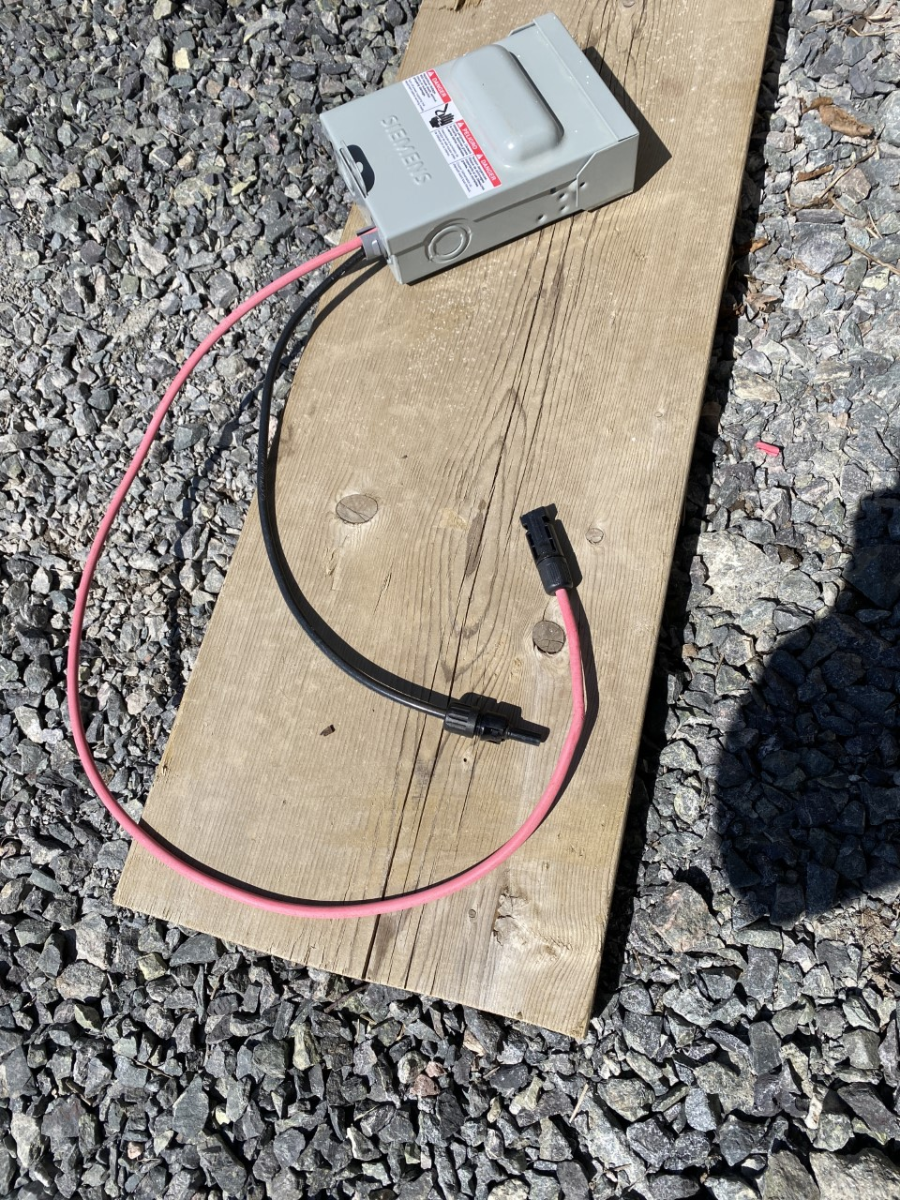
Maintenance
Insulated box connector.
MC-4 connectors at
disconnect have locks
removed.
Author

Slide 104
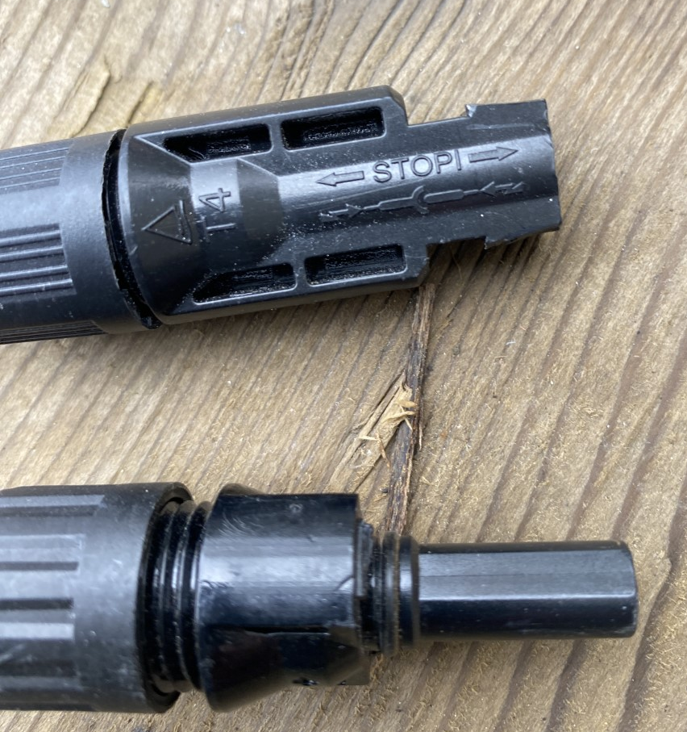
Maintenance
MC-4 connectors at
disconnect have locks
removed.
Makes it easy to work
connecting to the array
connectors.
Author

Slide 105
Maintenance
The Voc measured is compared to the STV values and apply the temperature correction factor (Temperature coefficient from the panel manufacturer) found on the data sheet.
If the value is more than 5% different, then each panel is checked for Voc, and the mating connectors shall be examined for tightness and any arcing or corrosion.
If there is a panel that is not meeting the Voc expected, then it should be replaced if it also does not meet the expected Isc.

Slide 106
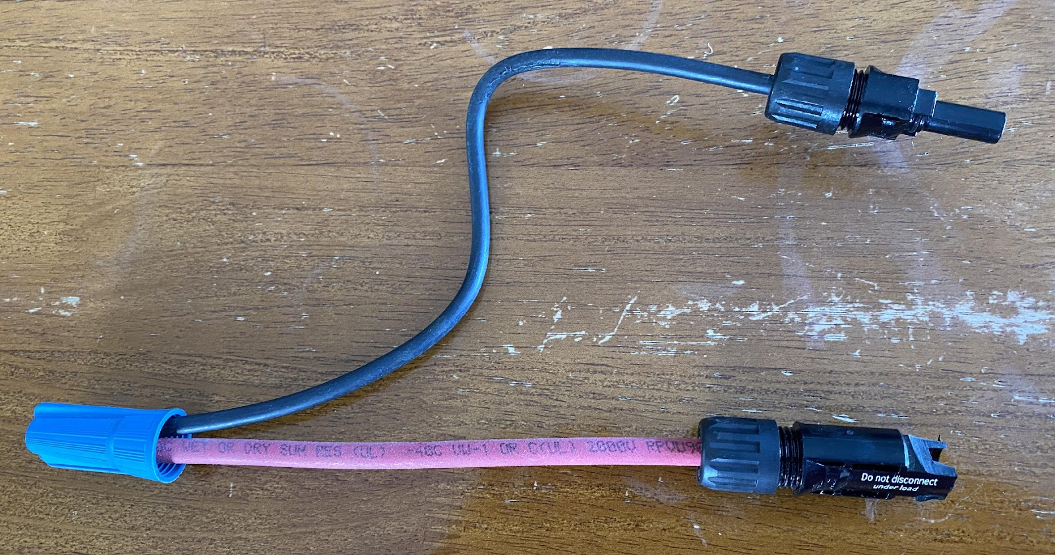
Maintenance
The Voc is recorded for maintenance records.
The Isc is checked next using the specially made jumper.
MC-4 connectors have locks removed.
Author

Slide 107
Maintenance
The jumper is used to prevent the shorting the panel with the MC4 connectors, instead the shorting happens when the mechanical fastening device is installed. (Marrette, a twist-on wire connector)
Author

Slide 108
Maintenance
The Isc measured is compared to the STC values found on the data sheet.
A clip-on ammeter is a good choice of instrument to use for this application.
Cut zip ties if needed and make sure the conductors are tight in their terminals and will not come out when the current clamp is placed around them.

Slide 109
Maintenance
If the value is more than 15% different, then each panel is checked for Isc, and the mating connectors shall be examined for tightness and any arcing or corrosion damage.

Slide 110
Maintenance
If there is a panel that is not meeting the Voc expected, then it should be replaced if it also does not meet the expected Isc.
By using the handheld pyranometer to measure the irradiance, these calculations will be very close to the expected / calculated values.
These maintenance steps will provide a valuable record of the performance and condition of the PV modules, racking and wiring.

Slide 111
Maintenance
The maintenance of the utilizing equipment is the next step.
Identify all of, these pieces of equipment.
Draw a sketch of the connected equipment if there is not one on site.
Identify any signage that is installed.

Slide 112
Maintenance
Record any signage missing or illegible.
Record values of overcurrent devices.
To provide proper maintenance, understanding of how the system was intended to work is required.
Manuals and operational notes are very helpful as is prior maintenance records.

Slide 113
Maintenance
From the sketch or diagram, identify the first piece of equipment that leaves the array area.
If it is conduit, wireways or a disconnecting means then it needs to be visually inspected.
Disconnecting means are meant to be operated.
Verify that it does work and opens the required number of conductors.

Slide 114
Maintenance
As each of these are inspected, visually inspect the grounding conductors for continuity.
A continuity check will verify that the bonds are performing.
Record any findings and that it was checked.

Slide 115
Maintenance
Combiner and Junction Box Maintenance
Once the panels / racking have been checked and in good working order, the combiner and / or junction boxes can be checked.
On some systems a lightening / surge protector may be present.
Look for visual signs that it has failed.

Slide 116
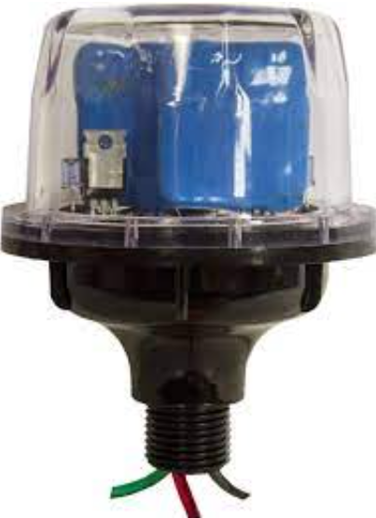
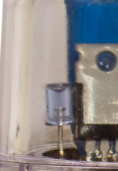
Maintenance
This is the MidNite Solar surge protector.
The Led is the status indicator.
MidNite Solar

Slide 117
Maintenance
With the MidNite Solar surge protector, when it is in proper working order, a blue light should be visible.
Replace if visibly damaged, or if light is not operational.
Visually check for signs of stress.
You will see burned or blackened somewhere inside the dome.

Slide 118
Maintenance
The maintenance is on the combiner and any dc junction boxes which requires this inspection.
Look for signage that details the Voc and Isc.
If this signage is found record the information.
All sources of voltage must be removed from the combiner or junction box.

Slide 119
Maintenance
This may require a lockout / tagout permit.
After these sources have been removed it is safe to perform the maintenance.
Now the combiner or junction box can be opened.
Be prepared for finding moisture, rodents, insects, or vegetation.

Slide 120
Maintenance
Clean any of these from the box.
If there is moisture find the source or opening and apply silicon caulk or equivalent to seal.
The maintenance is to ensure that the wiring is free of nicks, chew marks or deformation of the insulation.
Look for areas where the wire may be against sharp surfaces and free them from this.

Slide 121
Maintenance
Check the strain relief connectors that they are tight but not too tight to deform the insulation.
Any connectors that are used need to be checked for tightness and corrosion. Replace if necessary.
If there is overcurrent protection it needs to be checked.
Breakers need to be operated and verify the resistance of the connection in both the open and closed state.

Slide 122
Maintenance
Fuses need to be removed and checked.
The terminals of the fuse holder(s) need to be checked for resistance.
After these steps have been performed then the sealing gasket needs to be checked and replaced if necessary.
An electronic file in the course package has the check list for these steps.

Slide 123
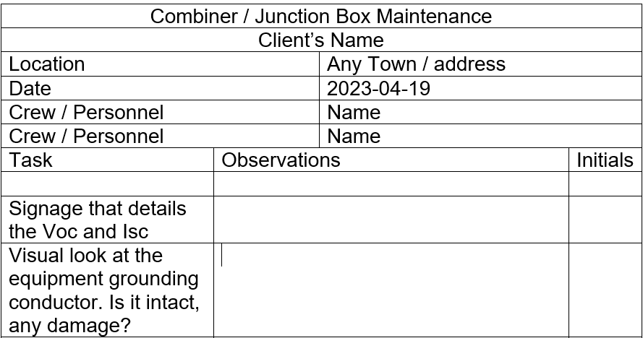
Maintenance

Slide 124
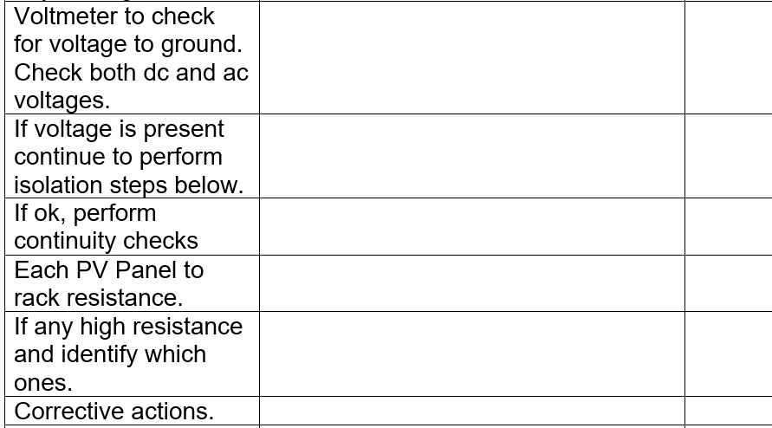
Maintenance

Slide 125
Maintenance

Slide 126
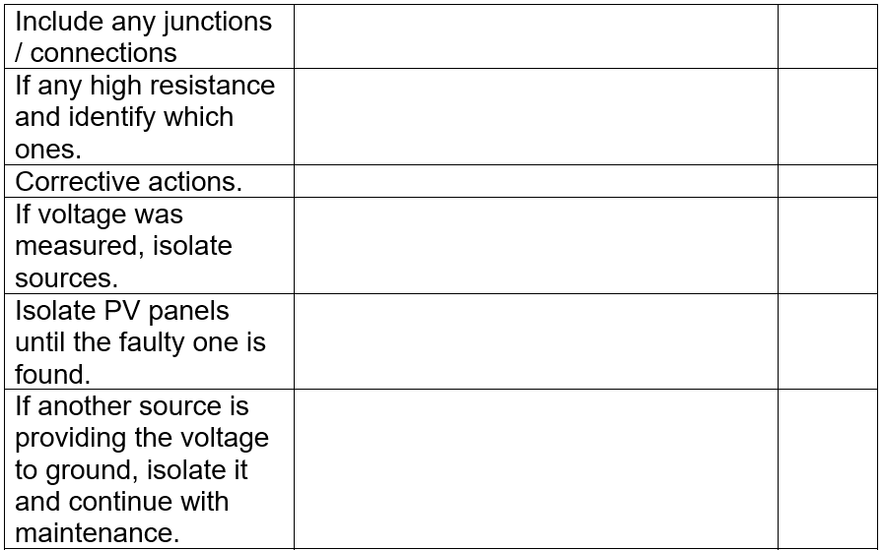
Maintenance

Slide 127
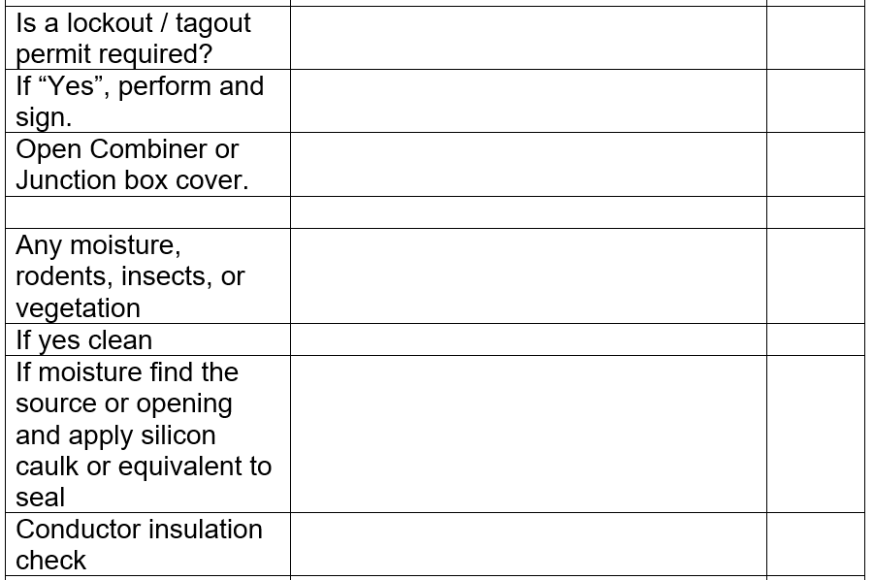
Maintenance

Slide 128
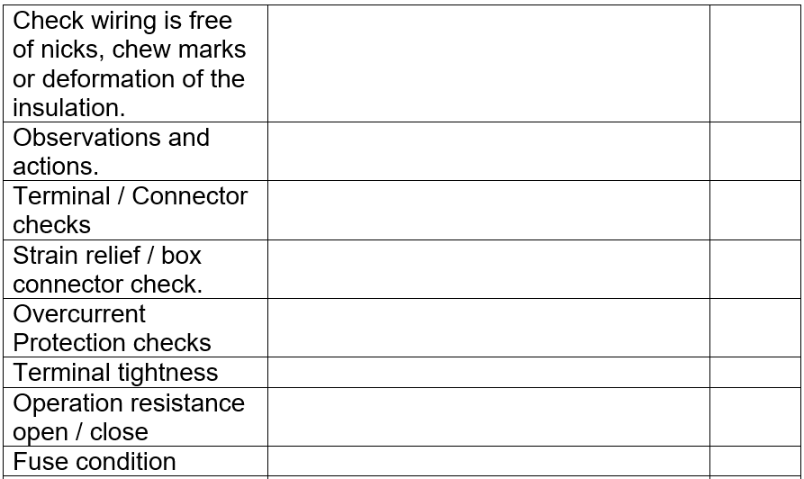
Maintenance

Slide 129
Maintenance
Modifications to this form is encouraged.

Slide 130
Maintenance
Charge Controller Maintenance.
If there is a charge controller in the system then it needs to be checked for proper settings, and operation.
Having the manual is beneficial.
There are two basic types of charge controllers that have been covered in this program, a PWM and the MPPT type.

Slide 131
Maintenance
Maintenance for the charge controller is to check if it is working properly.
Visual check (connections, alarms, screen, cleanliness)
Take measurements
Check settings
Is it performing as expected.
These are the four steps to be performed.

Slide 132
Maintenance
The following slides are a guide to performing these four checks.
Depending on the first observations, it will guide the maintenance person as to what will be performed as a first maintenance activity.
The charge controller must be clean enough to take readings and observe any indicators / screen readings it may have.

Slide 133
Maintenance
Determining how the charge controller is connected to the other equipment will allow the maintenance person to understand how it serves the system.
This will show how the charge controller can be isolated and made safe to work on.
A plan to isolate the charge controller needs to be documented.
A wiring diagram is required.

Slide 134
Maintenance
The wiring diagram will allow for a safe work procedure.
The maximum voltages in and out of the charge controller will be identified.
The maximum amperage available at the terminals will be identified.
These values will determine how the wiring will be handled.

Slide 135
Maintenance
At this point, the maintenance person will be able to assess what procedures will be required to safely work on the charge controller.
Overcurrent devices can be used to isolate the charge controller from the other system components.
If there are no overcurrent devices, then a safe disconnection means needs to be established.
Having a second person on site with knowledge of electrical safe handling of equipment is important.

Slide 136
Maintenance
A visual inspection of the wiring to and from the charge controller needs to be completed.
Determine the battery type (chemistry) and configuration is recorded.
The total Ahr of the battery bank is also recorded.

Slide 137
Maintenance
At this point, the PV input voltage and current is known.
The battery voltage and Ahr capacity is known.
Now the maintenance person can gather the charge controller make and model to determine if it is compatible for the system.
The Soc will help determine what the charge controller should be providing to the battery / loads.

Slide 138
Maintenance
The irradiance should be measured to help calculate the current available from the PV array.
Charge controllers typically when they first see PV energy, start to charge battery at the bulk stage.
This can be forced by cycling the PV power.
Prior knowledge of the charge controller is very helpful at this stage of maintenance.

Slide 139
Maintenance
If the charge controller can be used to charge a number of battery chemistries and types.
Does the battery type and voltage match the settings in the charge controller.
Are there any visible alarms / lights / codes being indicated by the charge controller?

Slide 140
Maintenance
Depending on the battery Soc, time the PV has been on that day and the irradiance will indicate what the charge controller is doing in the circuit.
Does it have multiple stage charging?
Can you tell what stage is it in by an indicator or message?
Are there any loads on the battery or connected directly to the charge controller?

Slide 141
Maintenance
A clip-on ammeter is a useful tool for checking the operation of the charge controller.
Remove any loads connected to the battery and or charge controller.
This leaves the charge controller, PV and battery in the circuit.

Slide 142
Maintenance
Disconnect the PV source to the charge controller.
Disconnect the battery to the charge controller.
The charge controller if it has indicators or a screen should be off after a short period of time.
Record the battery voltage before reapplying the battery to the charge controller.
Do not apply PV source power at this point.

Slide 143
Maintenance
What indications are showing from the charge controller?
Record what is observed.
The voltage of the batteries should not change and if the charge controller displays the battery voltage it is to be recorded.
Measure and record the battery voltage.

Slide 144
Maintenance
Is the battery voltage within range of expected values?
Expected range is fully charged to 50% Soc for normal operation.
If it is below 20 Soc, there may be a normal reason.

Slide 145
Maintenance
A normal reason would be if there has been a load that has drained the battery to this point.
The reason could be a lack of sunlight.
Also, the battery capacity has deteriorated.
Older batteries lose capacity.

Slide 146
Maintenance
An abnormal reason would be:
If an over current supplying PV power or charge controller power to the batteries has operated.
Bad connections in the charging system or failed cell in the battery.
A wrong setting in the charge controller.
Incorrect design criteria.

Slide 147
Maintenance
Not all of these conditions can be assessed at the same time.
An overall component maintenance check will piece together the operation of the complete system.
Most electronic charge controllers with menu screens will be accessible when the battery is reconnected to the charge controller.
Record the settings available in the maintenance report and any changes made to them.

Slide 148
Maintenance
If there is a battery sensor, is it connected?
Check the connections to the charge controller for tightness / connection.
Make sure the battery sensor is placed on the side of the battery.
Reattach if it is not adhered to the battery side.

Slide 149
Maintenance
Some charge controllers use a pair of sensing wires to measure battery voltage.
If the battery sensing wires are present measure the voltage and compare it to the battery terminal voltage.
If there is a difference, check both sets of wires for connections and damage.

Slide 150
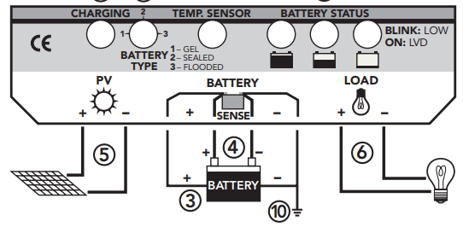
Maintenance
Some charge controllers use a pair of sensing wires to measure battery voltage.
Morning Star

Slide 151
Maintenance
The sense wires are used normally only when there is a long wire run between the controller and the battery.
If there is a voltage drop between the charge controller and the battery, it will raise the controller output slightly to compensate.

Slide 152
Maintenance
After these procedures have been completed the PV source can be put onto the charge controller.
Normally the charge controller thinks that this is the start of the morning sun.
If the charge controller is set up for bulk stage charging, then it will send all of the available current to the battery.
The amount will be what the parameters are set to if this option is available within the charge controller.

Slide 153
Maintenance
Be ready to measure and record this value.
The bulk voltage is also set within the charge controller.
The time that the charge controller is in bulk is determined by the settings or the charge controller.
These settings are usually found in the manual.
See next slide.

Slide 154
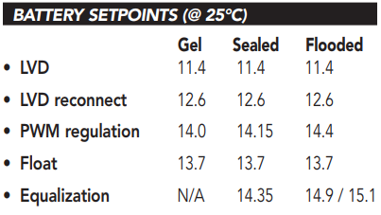
Maintenance
This manual states that in bulk stage 100% of solar is used, therefore not using the PWM function.
Absorb starts
at PWM
regulation.
Float starts
at some time
not always
listed in the manual.
Morning Star

Slide 155
Maintenance
Leave the charge controller in to charge the batteries.
Take voltage and current reading along with pyranometer irradiance numbers.
There should be a correlation between the current and the irradiance.
The voltage will continue to rise until it reaches the next stage of charging.

Slide 156
Maintenance
Battery Maintenance.
The battery bank requires maintenance.
There are monthly and quarterly maintenance procedures that were covered in the course “Battery Based PV Installations”.
Review the battery records and determine what maintenance procedures the batteries require.

Slide 157
Maintenance
Go back to the “Battery Based PV Installations” and review the monthly and quarterly maintenance requirements for the various types of batteries.
Flooded batteries will require the most maintenance.

Slide 158
Maintenance
The necessary safety PPE and procedures are required for performing this maintenance.
After completing the maintenance procedure, record the measurements and observed conditions of the batteries.
If the batteries are of the type to have an equalization charge, then check records for the last time it was performed.

Slide 159
Maintenance
An equalization charge will be performed based on the manufacturer's recommendations.
Distilled or demineralized water must be used if water is to be added to the flooded battery.
Many of the basic inspections are part of the battery maintenance procedures introduced already.

Slide 160
Maintenance
Inverter Maintenance.
Inverter maintenance is usually required annually.
Each inverter manufacturer will have specific requirements for inspection, testing, services, and documentation.
They do this to meet its warranty obligations.

Slide 161
Maintenance
A one-line diagram that includes the inverter is very helpful when performing maintenance.
Find or acquire the inverter manual. (installation and / or operational)
Perform visual checks for disconnection means (DC and AC) and signage.

Slide 162
Maintenance
Inverter maintenance starts with a visual inspection of the cabinet that houses the inverter if present.
Check any air filters in the cabinet or on the inverter housing.
Clean or replace, as necessary if readily accessible, otherwise wait to remove energy from the inverter.
Isolation cannot be established by controls (on-off).

Slide 163
Maintenance
Typical inverters have indication lights or display.
Verify the status of any and all indicators and record.
If an error code or fault is present, it shall be investigated before continuing with maintenance.
If the fault or error code is resolved, then isolate the inverter from the DC and AC side disconnection means.

Slide 164
Maintenance
As a safety precaution:
Do not remove cover.
These devices normally do not contain any user-serviceable parts.
Maintenance work must be carried out by a trained service technician.
Both AC and DC voltage sources may terminate inside the device.
Each circuit must be turned off before carrying out maintenance work.

Slide 165
Maintenance
Walk over to the OutBack inverter and see that both the AC and DC connections are inside the inverter.
To isolate from AC and DC, separate disconnection means must be established.

Slide 166
Maintenance
All persons involved in start-up operation, maintenance and servicing of the device must:
Be suitably qualified,
Have knowledge of and experience in dealing with electrical installations and
Have fully read and precisely followed the Operating Instructions.

Slide 167
Maintenance
Open both the DC and AC disconnection means if present.
Otherwise remove both DC and AC sources.
The DC terminals may have stored energy from the capacitor bank.
Use DC voltmeter to verify the DC terminals are at a safe level before proceeding (below 30V).
Check the torque of the terminals (AC and DC).

Slide 168
Maintenance
The maintenance includes checking the torque of the mounting bolts.
If there are cooling fins they shall be examined and cleaned, as necessary.
Record the condition of the cooling fins.
Dirt / dust and airborne contaminants are site specific and a record of these is required.

Slide 169
Maintenance
If there is a cooling fan look for dirt and clean as required.
Turn fan with finger to check for stiffness.

Slide 170
Maintenance
If the inverter is part of a stand-alone system, restore DC power source.
Turn on the inverter unloaded and measure the output and input voltage.
Record these values.
Apply AC loads and record input and output voltages, record these values along with load.

Slide 171
Maintenance
Unloaded the DC voltage should not drop.
If it does check connections on the DC side of the inverter.
Loading the AC side with a known load will help determine how the batteries are performing.
If the AC voltage drops more than anticipated check the AC terminals for connection.

Slide 172
Maintenance
For grid connected inverters apply the AC side power source.
Apply the DC side source.
The inverter is designed to wait 5 minutes for a stable AC source before it will export AC power to the grid.
Measure this time and record.

Slide 173
Maintenance
Next is to measure the performance of the grid connected inverter.
This requires having a knowledge of the incoming DC power.
Depending on the inverter the input and output power is may be displayed.
To validate the readings or if they are not available, a calculated guess can be made.

Slide 174
Maintenance
Gather the PV source array information.
Total installed Watts of the array.
The DC voltage output of the array as per module data.
Sting voltage from number of panels in series.
If safe, measure the DC voltage to inverter input.

Slide 175
Maintenance
Using a handheld pyranometer measure the irradiance at the angle of incidence to the panels.
Calculate the expected DC power going into the inverter from this reading.
Measure the AC output amperage with clip-on ammeter.

Slide 176
Maintenance
Calculate the inverter’s output.
Use the rated output volts or measure it.
Multiply the voltage with the AC amperage.
What is the expected efficiency?
Power out / Power in

Slide 177
Maintenance
Is the inverter performing as expected?
Is the incoming DC power as expected?
Record these observations.
If the DC input power is lower than expected perform the maintenance set out for the PV modules described earlier in the presentation.

Slide 178
Maintenance
Was the efficiency close to the expected value?
If it was lower, is it due to low irradiance or fluctuating irradiance?
A consistent irradiance is best for doing this test and should be greater than 200 W/m².
Inverters will derate if their temperature is above the manufacturer’s specifications.
Check graph if available in manual.

Slide 179
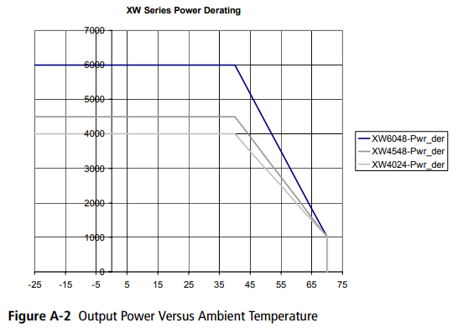
Maintenance
Check graph if available in manual.
Xantrex Manual

Slide 180
Maintenance
If the inverter has MPPT input, a ringing sound from the inductors maybe heard.
If there is variable cloud cover the frequency of the inductors will produce an audible pitch sound.
As the clouds cover the irradiance the pitch will be lower in frequency.
As the irradiance gets stronger the pitch increases and might be heard.

Slide 181
Codes and Regulations
Array Bolt Torquing
Author

