Slide 1
Design and Implementation of Pilot of a TVET Renewable Energy Course
DELIVERABLE #5 - TRAINING COURSES & PROFESSIONAL DEVELOPMENT

Slide 2
The Grid
This module will introduce the concept of an electrical grid.
After this module the learner will be able to:
Describe an electrical grid
Identify power sources that feed an electrical grid
Identify loads that are energized by electrical grid
Describe typical grid parameters
Describe single and 3-pase services
Identify voltage configurations

Slide 3
The Grid
An electrical grid for this application is defined as:
Is an interconnection of common objects.
It is a framework that is physically connected.
For this module the common objects are electrical.

Slide 4
The Grid
An electrical object is something that:
Produces electricity
Transmits electricity
Consumes electricity

Slide 5
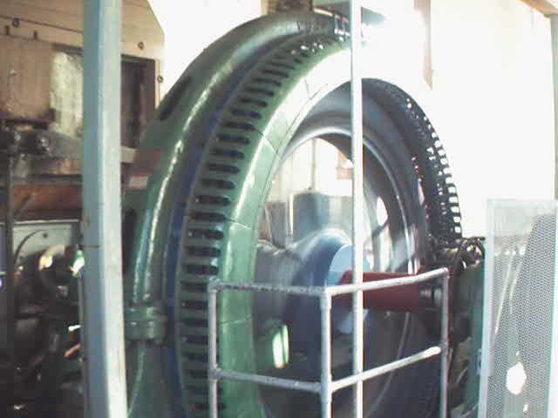
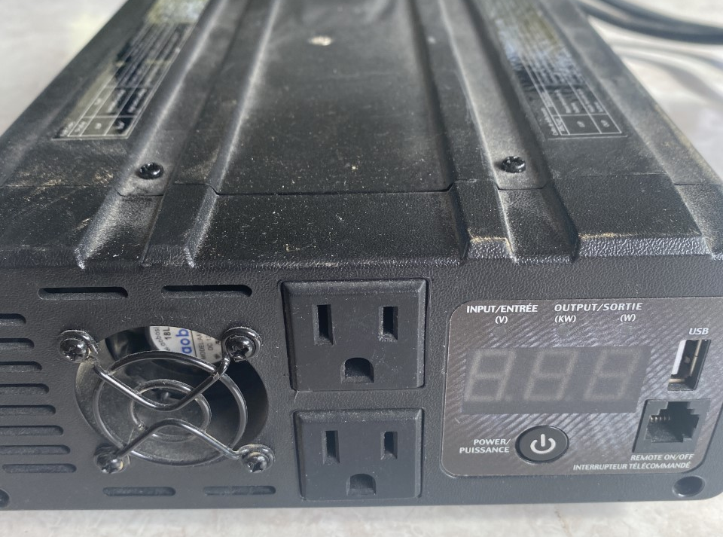
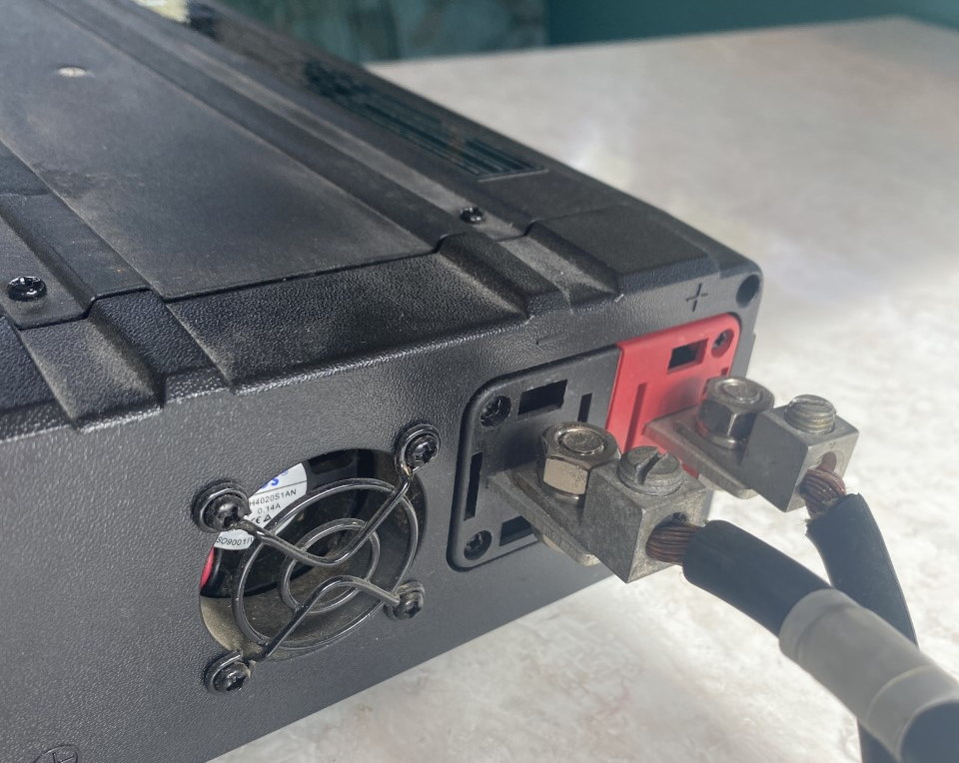
The Grid
Objects that produce electricity are:
Alternators / Generators
Magnets that move past windings
Induce a voltage in the windings
Inverters
Electronic
Different types
Picture courtesy author

Slide 6
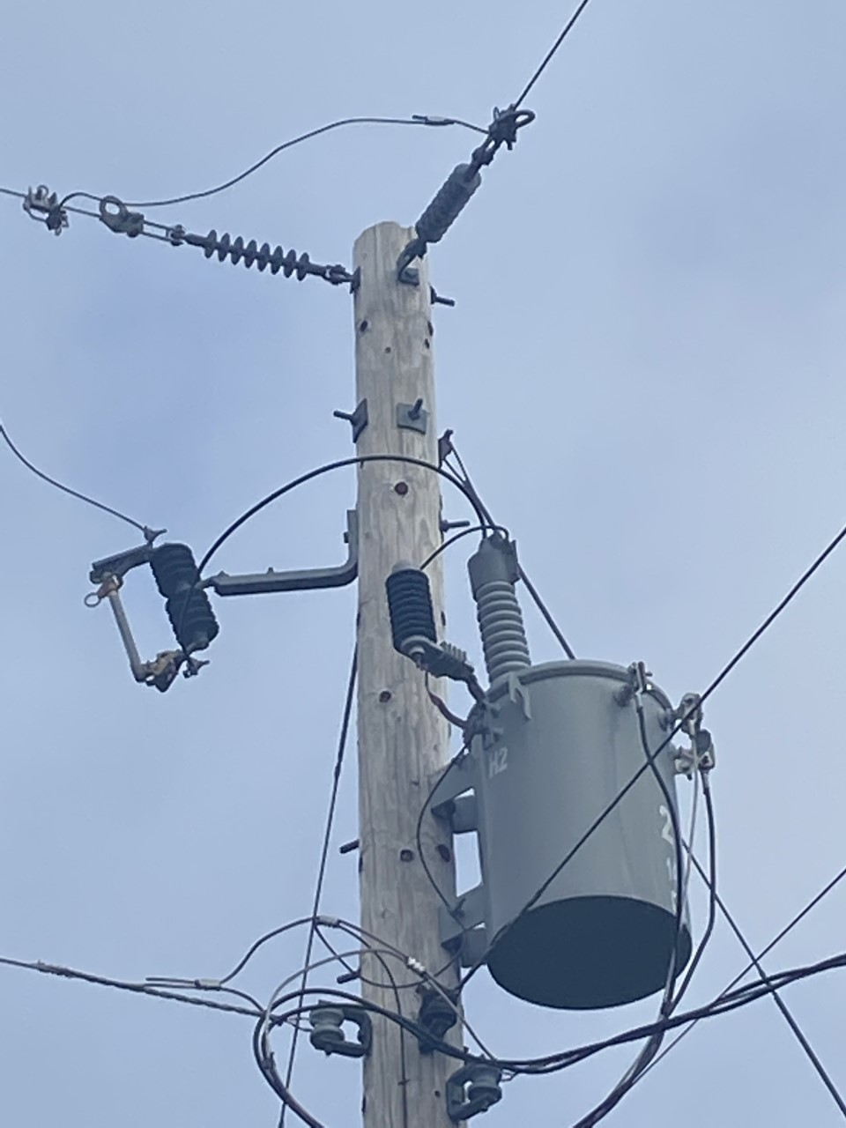
The Grid
Objects that transmit electricity are:
Wires
Wires connect the electricity producing machine to transmit electricity.
Wire can be underground or overhead.
Transformers
Increase or decrease the generated voltage from the generator(s) / alternator(s).
Strategically located.
Picture courtesy author

Slide 7
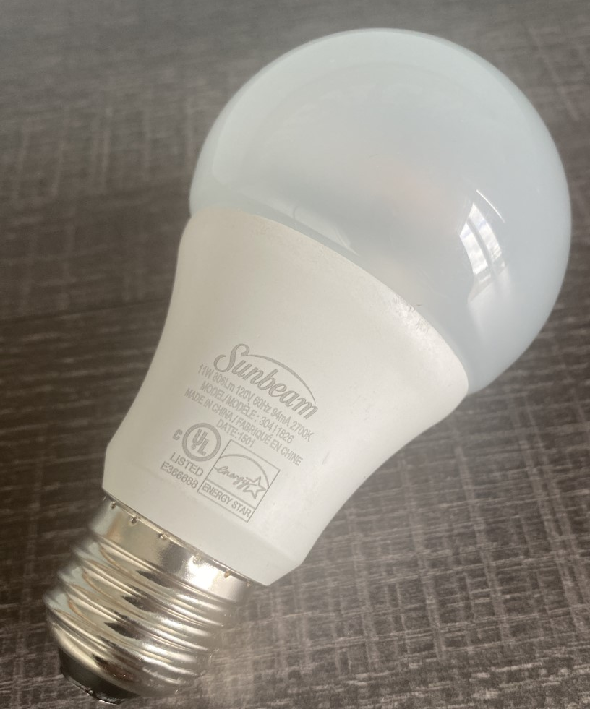
The Grid
An object that consumes electricity is called a load.
An example of a load is a light bulb.
Loads can be large or small electrically.
Loads are typically measured in Watts
Ranging from milliwatts – Megawatts.
Picture courtesy author

Slide 8
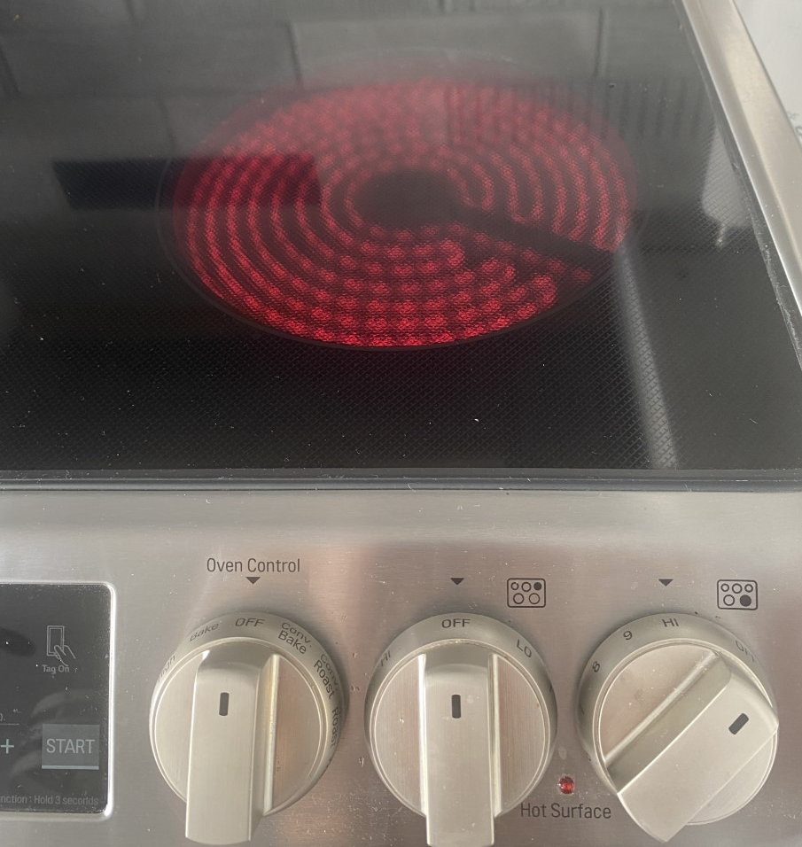
The Grid
Loads are meant to do work.
Sometimes the work they do generates heat.
Heat is not always wanted.
All electrical devices produce heat.
Wires produce heat.
Picture courtesy author

Slide 9
The Grid
Questions?

Slide 10
The Grid
Generally, the interconnection between generation (Power producing equipment) and the consumers is made up of transmission and distribution lines.
Transmission lines (wires) are of the highest voltage and transmit electricity the greatest distance.
Distribution lines transmit electricity from substations to consumers at a lower voltage than the transmission system.

Slide 11
The Grid
Electrical transmission system
The transmission system is made up of wires and transformers that connect all of the generating equipment.
Make up backbone of grid and connects complete country.

Slide 12
The Grid
Transmission system voltage in Belize is 230kV that connects to Mexico.
The transmission voltage can also be lower in rural areas.
Substations transition the electricity from the transmission system to the distribution system.

Slide 13
The Grid
Electrical distribution system
The transmission system feeds into substations that distribute the electricity through the distribution system to consumers.
Substations operate at a lower voltage for safety, and it doesn’t move the electricity as far as the transmission system.

Slide 14
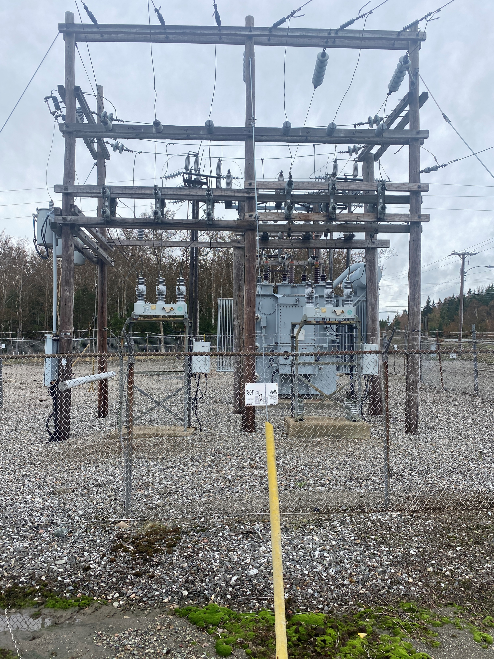
The Grid
Along the transmission system
there are substations.
They drop the transmission
voltage to safer levels.
They send out 3-phase lines
that go to streets.
Picture courtesy author

Slide 15
The Grid
Transformers drop the voltage from transmission levels to the distribution levels.
Typical distribution voltage
In Belize is 22kV.
Picture courtesy author

Slide 16
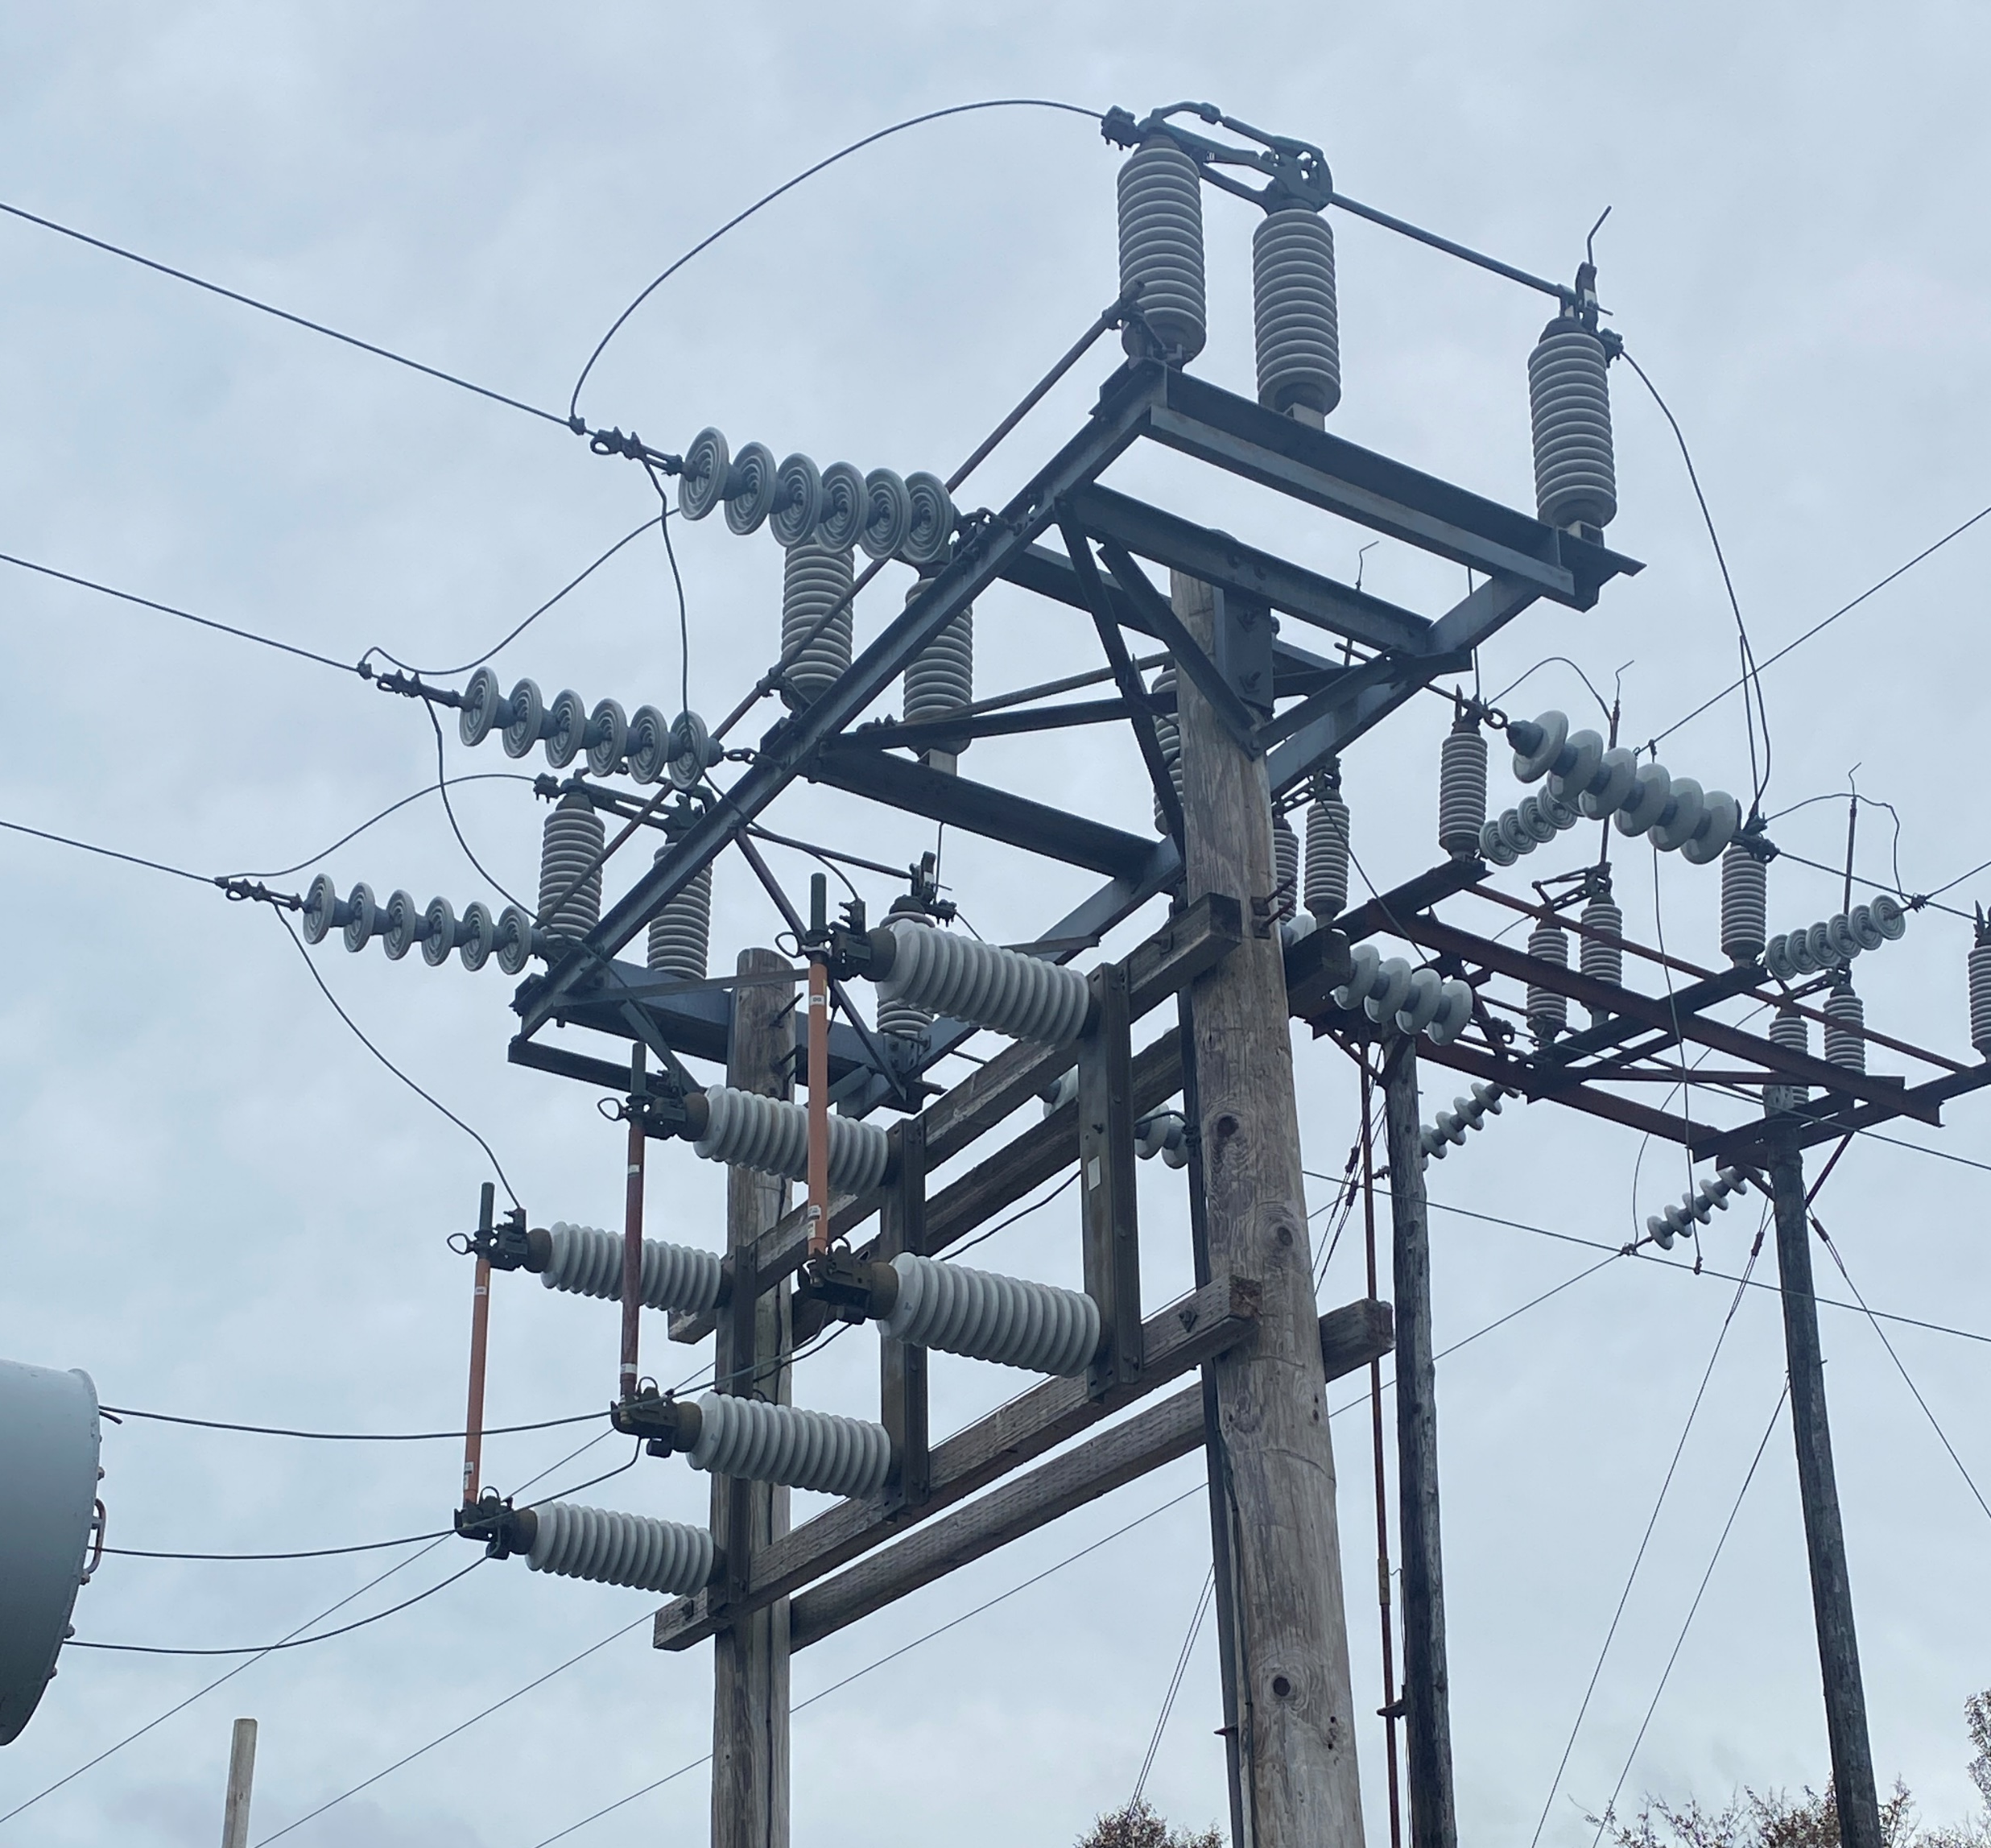
The Grid
The transformer is protected by fuses.
Cutout Fuses

Slide 17
The Grid
The substation serves the purpose to distribute the electricity out to customers.
A reclosure is used to feed
the individual lines out
from the substation to
customers.
Pictured are two reclosures.
Picture courtesy author

Slide 18
The Grid
A reclosure is a high voltage automatic switch that senses faults and opens the distribution line.
It will normally open and reclose the line to see if the fault has cleared.
A maximum of 4 times will the reclosure try to clear the fault.
After the set number of tries, the reclosure will stay open until closed after the fault was repaired or removed.

Slide 19
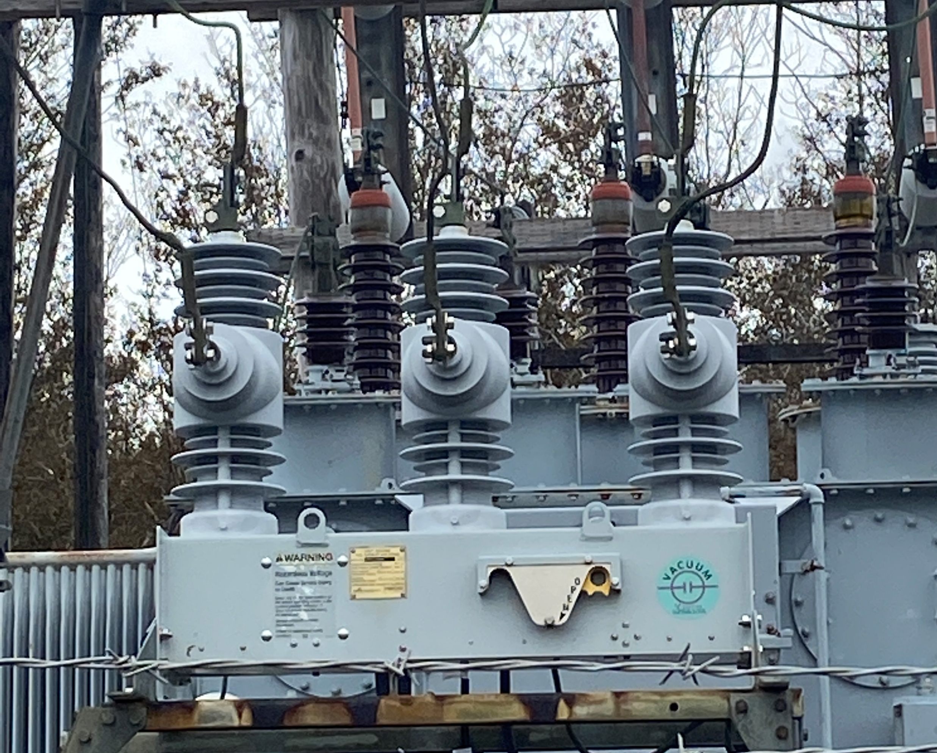
The Grid
This reclosure has the 3-phase distribution voltage enter it at the top and go out at the bottom.
From transformer
To distribution

Slide 20
The Grid
A fuse feeding a transformer
is another example.
Fuse cutout
Picture courtesy author

Slide 21
The Grid
Questions?

Slide 22
The Grid
How would you size a grid?
Geographically it can span many thousands of miles or as small as just between households.
Great variances in grid sizes.
Belize Electricity Limited (BEL) national grid has approximately 1900 miles of transmission and distribution lines. (bel.com.bz/Company_information.aspx)

Slide 23
The Grid
Grids that are between households and those that run small communities are called micro-grids.
Typically made up of PV, wind turbine, batteries and inverters.
A generator may also be part of the mix of power generation.

Slide 24
The Grid
Who owns a grid?
Generally, worldwide the vast majority of grids are owned and operated by electric utilities.(BEL for instance)
The utility is a company that controls electricity generation and distribution of electricity for sale generally in a regulated market.
However, small grids can be operated by private individuals.

Slide 25
The Grid
Questions?

Slide 26
The Grid
Consumer loads
The next section will focus on customer services / entrance.
The loads that are consumed by residential, commercial and industrial customers.

Slide 27
The Grid
The load type will determine the service / entrance provided.
Voltages delivered from the substation to point of connection.
Voltage varies depending on the customer.
The voltages and configurations that are in Belize.

Slide 28
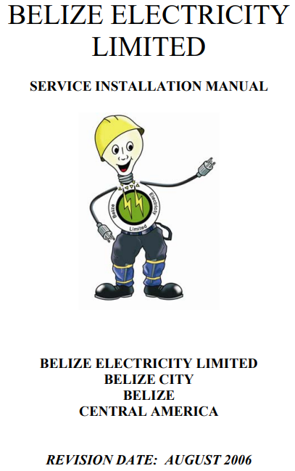
The Grid
The images for the next few
slides are taken from the
Belize Electricity Limited
Service Installation Manual.

Slide 29
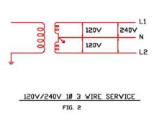
The Grid
This configuration is the most common type for residential services.
It is a single split
phase supply.

Slide 30
The Grid
Called the Edison 3 wire service.
Transformer drops distribution voltage to 120 / 240 volts.
The secondary is
centre tapped.
Tap is grounded.
Tap is the neutral.

Slide 31
The Grid
There are three connections leaving the transformer that are going to the residence.
The neutral is often made of Aluminum and has a steel core to support it and make it stronger.
There are two other wires that are 120 volts between neutral.
They are 240 volts between them.

Slide 32
The Grid
Each of the two hot legs are at 120 volts to the neutral.
One is at 120VL0 degrees and the other at 120VL180 degrees from the neutral (Centre tap).
The difference between them is the subtraction.
This subtraction will be explained in later slides.

Slide 33
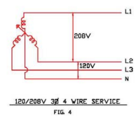
The Grid
Business and small commercial establishments that have higher power requirements can utilize a 3-phase supply.
The voltage is 120 / 208
4 wire neutral included.

Slide 34
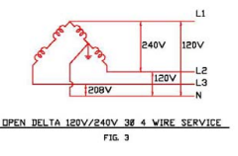
The Grid
An older way to supply 3-phase power with just two transformers in a delta configuration.
The centre tap provides two legs of 120 Volts.
Between all three phases
is 240 Volts.
One leg to neutral has
208 Volts (Red Leg).

Slide 35
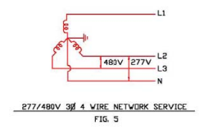
The Grid
For customers using higher powered motors and loads.
This option provides the highest voltage.
Another transformer
within the building is
required to supply
120 Volt loads.

Slide 36
The Grid
Questions?

Slide 37
The Grid
All grids have some basic things in common.
Because of this, rules have been established.
The rules protect all the components of the grid.
These rules and protections were developed over time.

Slide 38
The Grid
Over time other sources of generation were added to the grids.
The group IEEE ( Institute of Electrical and Electronics Engineers) have established the rules for grids and connecting power sources to the grid.
Then UL (Underwriters Laboratories) 1741which sets out the parameters for equipment connecting to a grid.

Slide 39
The Grid
Grid assumptions / rules:
The grid is all points from generation to consumer.
Grid must be of a voltage at the load, that the loads can operate at.
Must be at an AC frequency that the loads are designed to operate at.
Have enough capacity in generation to supply the loads.

Slide 40
The Grid
The grid is designed to operate within certain parameters.
The parameters are around voltage and frequency.
The voltage will be maintained between a minimum and maximum value.
The frequency of the grid will be maintained between a lower and upper limit with a sinusoidal voltage shape.

Slide 41
The Grid
Nominal voltage is the voltage that is set to a standard value.
Just some of the nominal voltages in AC (RMS) are:
120,240,120,208,4160,13.8kV and 69kV
The voltage on the grid is normally between 90% and 110% of the nominal voltage.

Slide 42
The Grid
Nominal frequency is either 50Hz or 60Hz.
Hz stands for hertz.
Hertz is the unit of measurement for the rate per second that the AC sine wave operates at.
60Hz happens 60 times per second or every 16.7mSeconds

Slide 43
The Grid
Grid frequency is held to within 2.5% of nominal frequency.
At 60Hz the variance is between 58.5Hz and 61.5Hz.
The shape of the sinusoidal voltage is kept to within 3-5% distortion of a pure sinewave.

Slide 44
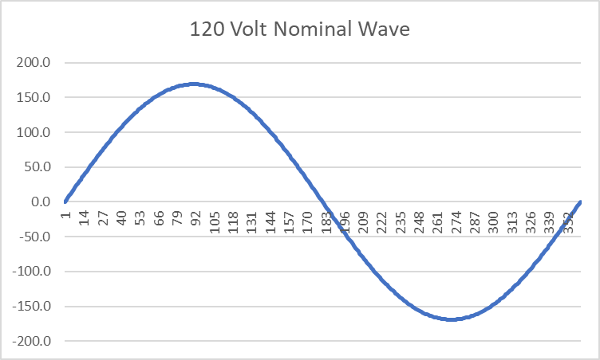
The Grid
An example of a Nominal 120 Volt Sine Wave.
Picture courtesy Author

Slide 45
The Grid
Grid protection is required to ensure the quality of the voltage on the grid going to the consumer.
Protection equipment operates devices that remove power to consumers.
Controlling equipment interact with grid producing machines to adjust their parameters.

Slide 46
The Grid
Questions?

Slide 47
The Grid
Grids originally were comprised of generators that had moving magnet coils on a rotating machine.
They were powered by water, diesel, coal, bunker C oil or wind.
Pictured is a
hydro generator.
Picture courtesy Author

Slide 48
The Grid
Let's start at the grid with the 3-phase power generated by the major power plants.
These generators have spinning magnets.
They induce a voltage in coils placed 120 physical degrees away from each other on the stator (stationary part of the generator).

Slide 49
The Grid
Sinewave produced by the magnet moving past a coil of wire in a generator.
http://www.ece.umn.edu/users/riaz/animations/alternator.html

Slide 50
The Grid
Sinewave produced by the magnet moving past a coil of wire in a generator.

Slide 51
The Grid
Questions?

Slide 52
The Grid
There are three sections of these coils called “A”, “B”, and “C” phase.
The voltage produced in each of these phases are peaking 120 degrees apart.
Potential difference between these is just that, potential difference, which is a subtraction between each voltage, at the angular distance between them.

Slide 53
The Grid
Voltages at their nominal values are referenced as RMS voltage.
Root Mean Square:
Used to come up with a nominal voltage or the DC equivalent for an AC voltage.

Slide 54
The Grid
The next few slides show how the nominal AC voltage is determined.
The sinewave shape of the AC voltage wave if averaged is zero.
Half of the time positive and half negative.
It still does work!

Slide 55
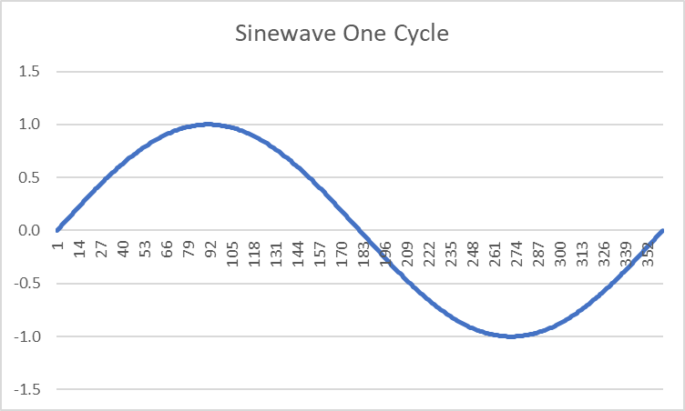
The Grid
Sin wave for one cycle looks like this:
Sin(0) = 0
Sin(45) = .707
Sin(90) = 1
Sin(135)= .707
Sin(180)= 0
Sin(225)= -.707
Sin(270)= -1
Sin(315)= -.707
Sin(360)= 0
Average for full cycle is zero!
Image courtesy Author

Slide 56
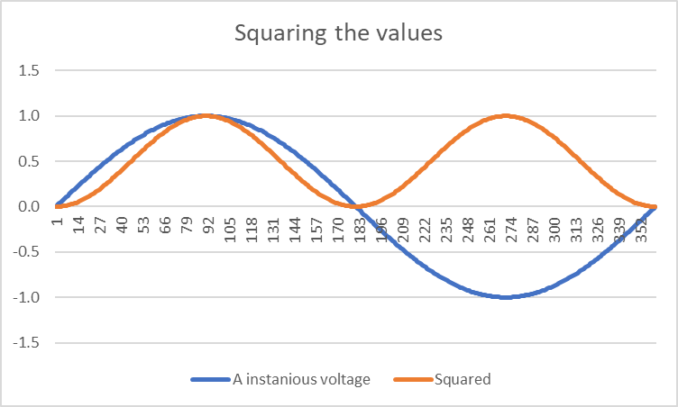
The Grid
To get the nominal or DC equivalent of the AC wave we use RMS.
Square each value of the cycle.
Makes negative values positive.
Image courtesy Author

Slide 57
The Grid
Next take the average of these values (Mean)
For all of the values of the squared values, the average is 0.5.
Image courtesy Author

Slide 58
The Grid
Next take this average value of 0.5 and take it’s square root.
This provides a value of 0.707.
This makes the nominal
voltage 0.707 of the
peak value.
Image courtesy Author

Slide 59
The Grid
At the receptacle in a residence the nominal voltage is 120 volts, but it peaks at +- 169 volts.
Image courtesy Author

Slide 60
The Grid
Questions?

Slide 61
The Grid
Why do all of this?
When an electrical power source synchronizes to another voltage it needs to match the shape and size of the AC wave.
The power source will have a range of voltages that it can synchronize to.
These nominal voltage values are based on region and if the voltage is single phase, 3-phase or split phase.

Slide 62
The Grid
In Belize the nominal consumer voltages are:
120-240 (Split Phase)
120 / 208 (Single / 3-Phase)
277 / 480 ( 3-Phase)

Slide 63
The Grid
Single phase is one phase of a 3-phase system.
Most commercial, industrial and school buildings have 3-phase entering the building.
When you plug into a receptacle it is just one of the phases, or a single phase.
Next slides will show how the voltages are measured.

Slide 64
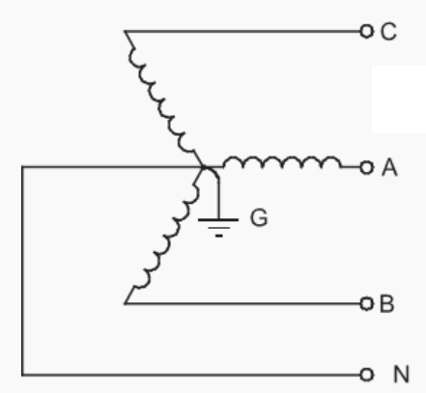
The Grid
The 120 / 208 is the single phase and 3-phase voltages.
Terminal or Line voltage is measured between any two terminals
A-B
B-C
C-A
and will measure 190V
Image courtesy Author

Slide 65
The Grid
The 120 / 208 is the single phase and 3-phase voltages.
Phase voltage is measured between any terminal and the N (Neutral / Star Point)
A-n
B-n
C-n
and will measure 120V
Image courtesy Author

Slide 66
The Grid
The potential difference (subtracting the voltages) is
VAB = VAn – VBn
120L0 degrees – 120L-120 degrees
= 1.73 (√3)Van L+30 degrees
= 1.73 x 120V
= 208L+30 degrees
Image courtesy Author

Slide 67
The Grid
The potential difference (subtracting the voltages) is
VAB = VAn – VBn
120L0 degrees – 120L-120 degrees
Subtracting take the rectangular form of each voltage.
Cosine Sine
120 +j0
- -60 -j103.9
= +180 +j103.9
Image courtesy Author

Slide 68
The Grid
Cosine Sine
120 +j0 208V +j103.9
- -60 -j103.9
= +180 +j103.9 +180
Going back to polar form: $\sqrt{{180}^{2}+{103.9}^{2}}=208V$
208 Volts at an angle +30 degrees
InvCos (Adjacent / Hypotenuse)
InvCos (+103.9/+180) = +30 degrees
Image courtesy Author

Slide 69
The Grid
Questions?

