Slide 1
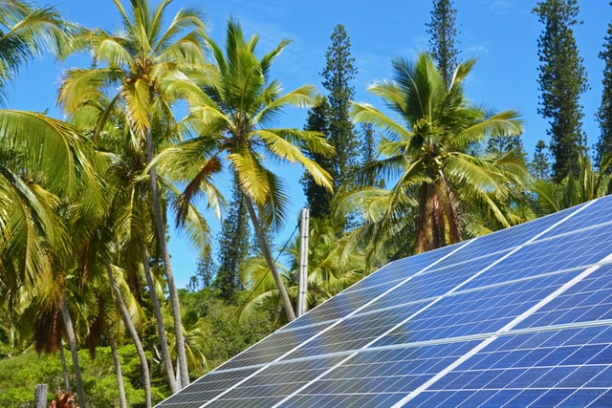



Design and Implementation of Pilot of a TVET Renewable Energy Course
DELIVERABLE #5 - TRAINING COURSES & PROFESSIONAL DEVELOPMENT

Slide 2
Stand Alone Design
The outcomes will be the following:
Identify equipment associated with a stand-alone energy system design.
Determine specifications for stand-alone equipment.
Demonstrate software modelling for PV systems.
Size battery capacity for various systems.

Slide 3
Stand Alone Design
Stand Alone Solar PV System.
The term stand alone comes from the independence of connecting to a utility grid.
Stand alone systems can have various sources of energy to make the system deliver the required amount of energy required.

Slide 4
Stand Alone Design
These systems require a form of energy storage.
For this course, the storage will be battery based.
The course labs will be based on the equipment that is on hand at the campus.
The lab system will consist of PV panels, lead acid batteries, charge controllers and stand-alone inverters.

Slide 5
Stand Alone Design
This course will start with the battery.
Then add equipment to the battery system.
Charge controllers
PV panels
Inverters

Slide 6
Stand Alone Design
There are 3 primary reasons why a battery storage source is used:
Autonomy.
A battery provides flexibility as stored energy can be drawn on demand.
Energy can be supplied during periods of low or no sunlight, such as on cloudy days or at night when the PV modules are producing little or insufficient power to supply the electrical load or demand.

Slide 7
Stand Alone Design
2. Stable Voltage.
The voltage produced by a PV panel alone changes depending on the load.
The energy from a battery, on the other hand, is produced over a reasonably stable voltage range.
Most electrical devices, such as motor, radio or computer, need a reasonable stable voltage source in order to operate properly.

Slide 8
Stand Alone Design
3. Surge Current.
A PV array cannot respond to some devices, including most motors that require an inrush or high current to start.
The output current of a PV array is dependent on irradiance only (which varies constantly) and therefore cannot respond to the steady and or variable current requirements of a motor.
A battery, however, can provide a current many times higher than a PV array. The ability to supply high current allows these devices like motors, fridges, and electronics to be powered PV.

Slide 9
Stand Alone Design
These batteries need to be rechargeable.
Secondary batteries will recharge when the discharge current is reversed.
Primary batteries are one use only and can’t be recharged.
There are two “Primary” battery types:
  Alkaline with Zinc and Manganese dioxide.
  Coin Cell with lithium and silver oxides.

Slide 10
Stand Alone Design
Examples of Secondary batteries.
Lead-acid batteries contain lead with an acid and are cheap. These are heavy.
Ni-Cd batteries are made of Nickel and Cadmium. They have a lower discharge rate.

Slide 11
Stand Alone Design
Ni-MH batteries are made of Nickel and metal hydride mixture. They have low power density.
NiFe Nickel Iron batteries are made of Nickel and Iron. Long lasting battery.
Li-ion batteries are made of Lithium metal. They have a high-power density.

Slide 12
Stand Alone Design
There are three main common battery types for stand-alone applications in Belize.
Lead Acid, Lithium Ion and Nickel Iron
Lead Acid has been around since 1859.
Lithium Ion has been around since the 1990’s.
Nickel Iron has been around since 1903.

Slide 13
Stand Alone Design
Power density is a common reference given to secondary batteries.
Power density is defined as how much energy a battery contains in proportion to how much it weighs.
Unit is Wh/kg, Watt hours / kilogram
Wh is one watt consumed per hour

Slide 14
Stand Alone Design
Within the lead acid family of batteries are three main types.
  Flooded
  Gel
  AGM (Absorb Glass Mat)

Slide 15
Stand Alone Design
Flooded or (Wet) Cell is the original Lead acid battery and the oldest type of secondary battery.
They have a lower energy to weight ratio compared to the AGM and Gel types.
Their ability to supply high surge currents and their low cost, make them attractive for use in the inverter applications.

Slide 16
Stand Alone Design
Showing chemical states from charge to discharge.
Pb = Lead S = Sulphur H2O = Water
Picture courtesy Rolls

Slide 17
Stand Alone Design
VRLA stands for valve regulated lead-acid and is the designation for low maintenance lead-acid batteries, also called recombinant batteries.
VRLA batteries are commonly further classified as: Absorbent glass mat (AGM) and Gel battery.
These batteries are called sealed lead-acid batteries, but this term is misleading: a sealed battery would be a safety hazard due to overpressure risks.

Slide 18
Stand Alone Design
A safety valve is present, hence the name valve-regulated.
Sealed is opposed to vented (also called flooded).
Because VRLA batteries use much less electrolyte (battery acid) than traditional lead-acid batteries, they are also occasionally referred to as an "acid-starved" design.

Slide 19
Stand Alone Design
Gel is a class of a VRLA battery with a gel like electrolyte; the sulfuric acid is mixed with a silica fume (also used in concrete), which makes the resulting mass gel-like and immobile.
Unlike a traditional wet-cell lead-acid battery, these batteries do not need to be kept upright (though they cannot be charged in an inverted position).

Slide 20
Stand Alone Design
In addition, Gel batteries virtually eliminate electrolyte evaporation, spillage common to wet-cell batteries, and boast greater resistance to extreme temperatures, shock, and vibration.
Chemically they are the same as wet (non-sealed) batteries except that the lead plates are of calcium and not antimony.

Slide 21
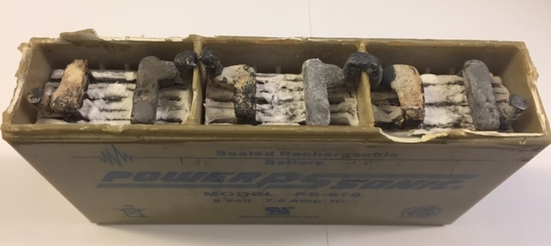
Stand Alone Design
Gel battery cut away.
Picture courtesy Author

Slide 22
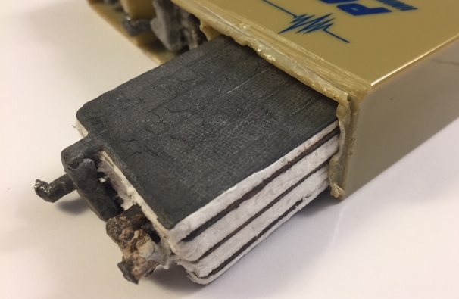
Stand Alone Design
Gel battery cut away.
Picture courtesy Author

Slide 23
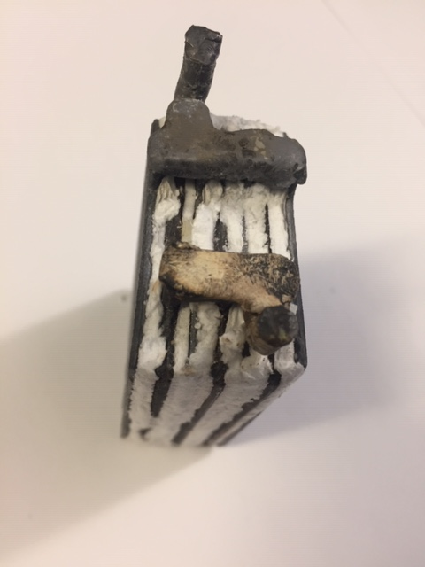
Stand Alone Design
Gel, one 2-volt cell
Picture courtesy Author

Slide 24
Stand Alone Design
Absorbed Glass Mat (AGM) It is a class of a VRLA (Valve regulated Lead Acid) battery in which the electrolyte is absorbed into a mat of glass fibers.
The plates in an AGM battery may be flat in a rectangular case, or cylindrical they are also sometimes referred to as spiral wound.
Their unique (for lead acid chemistries) construction also allows for the lead in their plates to be purer as they no longer need to support their own weight as in traditional cells.

Slide 25
Stand Alone Design
Common to all Lead acid batteries are cells of nominal 2 volts.
Cells connected in series define the battery.
Common battery voltages are 6, 12, and 24.
Cells can be incased like a battery to make a battery bank for various voltages.

Slide 26
Stand Alone Design
The 100% SoC (State of Charge) for lead acid batteries is when the cell voltage reaches 2.11Volts.
For 12volt battery the fully charged voltage is 12.65V
For 0% SoC for lead acid batteries is when the cell voltage reaches 1.75 Volts.
For 12volt battery the fully discharged voltage is 10.50Volts.

Slide 27
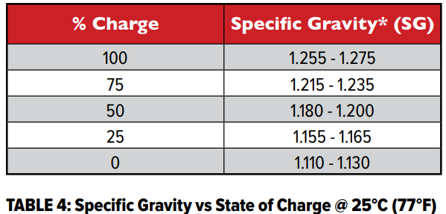
Stand Alone Design
This is a linear scale and on non-flooded batteries it is the best way to check the SoC of the battery.
Flooded batteries can also have their specific gravity tested.
Picture courtesy Rolls Battery

Slide 28

Stand Alone Design
Nickel Iron Battery.
Nickel Iron battery is rated for at least 11,000 cycles with daily use.
That’s 30 years of service.
Daily deep discharging has no impact on battery cycle life, allowing for more usable capacity.
Never have to worry about accidental over-discharge damaging the battery bank.

Slide 29
Stand Alone Design
Nickel Iron Battery.
Nickel Iron is tolerant of over-charge, over-discharge, and below freezing temperatures.
The alkaline electrolyte acts as a metal preservative, leading to years of uninterruptible performance.

Slide 30
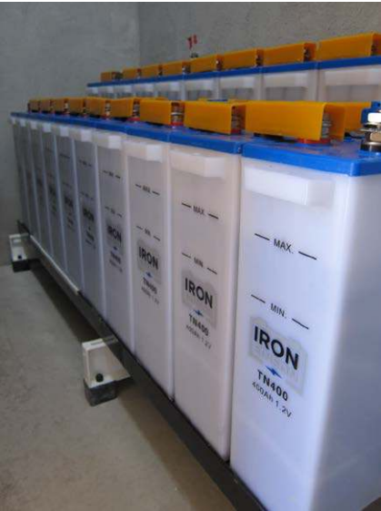
Stand Alone Design
Nickel Iron Battery.
Picture courtesy Iron Edison

Slide 31
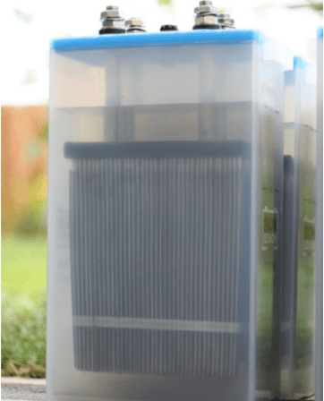
Stand Alone Design
Nickel Iron Battery.
Picture courtesy Iron Edison

Slide 32
Stand Alone Design
The voltage of a fully charged cell is 1.4 V which decreases to 1.3 V rapidly.
The average voltage of a cell is 1.2 V and reduces to 1.0 V when fully discharged.

Slide 33
Stand Alone Design
Lithium-ion Battery.
Lithium is very light metal and has the best electrochemical potential with the largest energy density compared to weight.
Lithium-ion batteries have a high cell voltage of 3.6 volts.
Four cells make a battery of 14.4 volts.

Slide 34
Stand Alone Design
The voltage of a fully charged cell is 4.0 V.
The average voltage of a cell is 3.6 V and reduces to 3.1 V when fully discharged.

Slide 35
Stand Alone Design
Lithium Solar Battery Chemistry
Under the umbrella of "lithium batteries", there are both lithium metal batteries and lithium-ion batteries.
Lithium metal batteries are not rechargeable, so they’re not relevant for solar power systems.
Under the umbrella of "lithium-ion batteries", there are a few types - each with its own set of pros, cons, and specific use cases.
Courtesy AltEstore.com

Slide 36
Stand Alone Design
Today, three types are by far the most common, and they have different specialties:
Lithium iron phosphate (or LiFePO4 or LFP) - built for long cycle life, tolerance of deep discharging, and thermal and chemical stability for safety.
LiFePO4 cells make the best batteries for solar and other renewable energy systems.
Courtesy AltEstore.com

Slide 37
Stand Alone Design
Lithium nickel manganese cobalt (NMC) - built for improved energy density(Watt-hours / weight) and low self-discharging.
NMC cells can handle higher charging rates than LiFePO4 cells, but at the risk of thermal runaway.
They are commonly used in electric vehicles and battery-powered tools.
Courtesy AltEstore.com

Slide 38
Stand Alone Design
Lithium cobalt oxide (or LiCoO2 or LCO) - built for extreme energy density, but relatively short-lived and also prone to thermal runaway - sometimes to dangerous levels.
LCO cells’ best and most common application is in portable devices like phones and laptops.
Courtesy AltEstore.com

Slide 39
Stand Alone Design
Common battery terms no matter which type.
Deep Discharge Batteries:
Are designed for the prolonged, repeated, and deep charging/discharging cycles needed to store and distribute energy generated by intermittent renewable sources like solar panels.

Slide 40
Stand Alone Design
DEPTH OF DISCHARGE
Depth of Discharge (DOD), is used to describe how deeply the battery has been discharged.
A battery which is 100% fully charged would have a DOD of 0%.
A battery which has been discharged by 20% of its capacity, maintaining 80% of its capacity, would have a DOD of 20%.
If a battery has been completely discharged with no
remaining capacity, the DOD is 100%
Courtesy Rolls Battery

Slide 41
Stand Alone Design
CYCLE LIFE
Battery manufacturers rate the cycle life of their batteries by comparing the level of discharge on the battery and the frequency of cycling.
Higher battery discharge will result in shorter cycle life.
In reverse, a smaller discharge percentage will extend the expected cycle life of the battery as the battery will provide more charge/discharges
Courtesy Rolls Battery

Slide 42
Stand Alone Design
Ampere Hour Capacity
A unit measure for the rated capacity of the storage batteries.
Typical manufacture ratings found on the battery sheet are in 1, 6, 20, and 100 Hour intervals.
An amp-hour is one amp for one hour, or 10 amps for 1/10 of an hour and so forth.

Slide 43
Stand Alone Design
It is amps X hours.
If you have something that pulls 20 amps, and you use it for 20 minutes, then the amp-hours used would be 20 (amps) X .333 (hours), or 6.67 AH.
The accepted AH rating time period for batteries used in solar electric and backup power systems (and for nearly all deep cycle batteries) is the "20 hour rate".

Slide 44
Stand Alone Design
This means that it is discharged down to 10.50 volts over a 20 hour period while the total actual amp-hours it supplies is measured.
Sometimes ratings at the 6 hour rate and 100 hour rate are also given for comparison and for different applications.
The 6-hour rate is often used for industrial batteries, as that is a typical daily duty cycle.

Slide 45
Stand Alone Design
The 100hour rate is useful for figuring battery capacity for long-term backup amp-hour requirements.
Four days of discharging is approximately 100 hours.

Slide 46
Stand Alone Design
LOW VOLTAGE DISCONNECT (LVD OR LVCO)
Many charging systems offer the ability to program a Low Voltage Disconnect (LVD) or Cut Off (LVCO) which can remove the load from the battery or start a backup generator.
By default, this may be set by the charger manufacturer at 1.75 volts per cell (VPC)(Lead acid).
Always verify the default settings and adjust as required.

Slide 47
Stand Alone Design
Charge Rate:
Current applied to a cell to restore its capacity.
Charge rate is usually expressed in terms of the cell's C Rate.
This rate is also commonly expressed as a fraction of the capacity of the battery.

Slide 48
Stand Alone Design
C-Rate (C):
Discharge or charge current, in amperes, expressed in multiples of the rated capacity.
For example, C/10 discharge current for a battery rated at 150 Ah is: 150 AH/10 = 15.0 A

Slide 49
Stand Alone Design
Self Discharge:
Discharge that takes place while the battery is in an open-circuit condition.

Slide 50
Stand Alone Design
State of Charge (SOC):
The amount of deliverable low-rate electrical energy stored in a battery at a given time expressed as a percentage of the energy when fully charged and measured under the same discharge conditions.
If the battery is fully charged, the state of charge is said to be 100 percent.

Slide 51
Stand Alone Design
BCI Group:
The Battery Council International (BCI) Group Number "fingerprints" a battery with the following characteristics:
(a) dimensions (L x W x H),
(b) voltage (6V or 12V),
(c) polarity (right-hand front positive, left-hand front positive, etc.),
(d) type terminals (top, side, "L", etc.). The BCI Group Number does not designate a battery’s capacity; it merely defines the above-listed physical characteristics.

Slide 52
Stand Alone Design
Battery capacity required for the stand-alone system.
Determining how many Ah are required.
How many hours are required.
What voltage to use.

Slide 53
Stand Alone Design
Determining how many Ah are required.
The assumption for this first example is that the system will supply DC only to the loads.
First is to make a list of every electrical load that will be used.
All of the electrical equipment will need to be at the same voltage.

Slide 54
Stand Alone Design
Let the system nominal voltage be 12V DC.
Make a list of each appliance / load with the Wattage of each.
Assign a length of time per day they will be used.
DC only loads | Watts | Hours per day
Light | 10 | 5
TV | 75 | 2
Radio | 5 | 6
Router | 10 | 16
Computer | 75 | 1
Fridge | 100 | 1
Water Pump | 250 | 1

Slide 55
Stand Alone Design
The Amps required is calculated by dividing the wattage by the nominal system voltage for each load.
Then multiplying the length of time in hours used each day.
DC only loads | Watts | Hours per day | Ahrs=AxHrs
 |  |  | A=Watts / Volts
Light | 10 | 5 | 4.17
TV | 75 | 2 | 12.50
Radio | 5 | 6 | 2.50
Router | 10 | 16 | 13.33
Computer | 75 | 1 | 6.25
Fridge | 100 | 1 | 8.33
Water Pump | 250 | 1 | 20.83

Slide 56
Stand Alone Design
Add the total Ahr for each device per day.
This will give the total Ahr for a 24-hour period.
The Amps required over the
24 hours is 2.8A.
67.9Ah for the day.
Daily Ahr
67.92
Ahrs=AxHrs
A=Watts / Volts
4.17
12.50
2.50
13.33
6.25
8.33
20.83

Slide 57
Stand Alone Design
It is normal to not have enough solar energy everyday to fully cover these loads or charge the batteries.
The number of days in a row that needs to be held in the battery is selected.
For this example, three days of autonomy is used.
The battery Ahrs required for three days are now 3 x 67.92 = 203.8 Ahr

Slide 58
Stand Alone Design
It is normal to not have enough solar energy everyday to fully cover these loads.
Daily Ahr | Amps continuous | Days of Autonomy
67.92 | 2.8 | 3
 |  | Ahr for Autonomy
 |  | 203.8

Slide 59
Stand Alone Design
This is the required amount of capacity that the battery bank requires.
The actual amount of battery capacity will need to be increased for Dept of Discharge (DOD).
The life and number of cycles that the battery will use depend greatly on the amount of energy pulled from the battery each day.

Slide 60
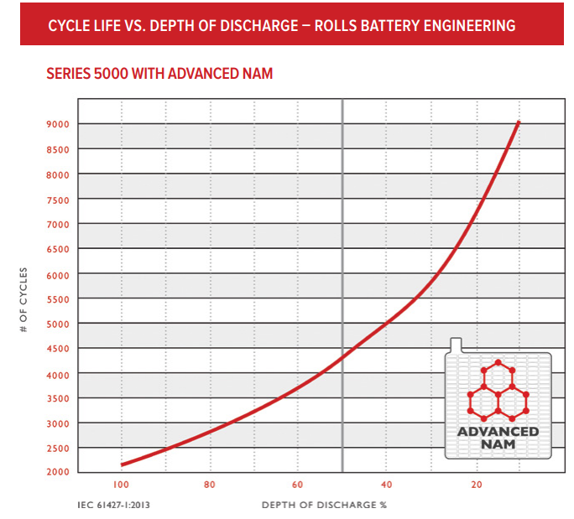
Stand Alone Design
Battery manufacturers will give a chart that shows the number of cycles a battery can live through versus the depth of discharge (DOD).
This is Lead acid battery.
Picture courtesy Rolls Battery

Slide 61
Stand Alone Design
The DOD will depend on the battery type.
Lithium ion will be around 80%.
Nickel Iron 80%.
Lead acid sized to operate between 20% and 50%.

Slide 62
Stand Alone Design
The three day 203.8Ah for an 80% DOD requires a battery capacity of 255Ah.
Lithium-ion and Nickel Iron batteries would need this capacity.
Lead acid sized to operate between 20% and 50%.
At 20% requires 1019Ahr.
At 50% requires 407.4Ahr.

Slide 63
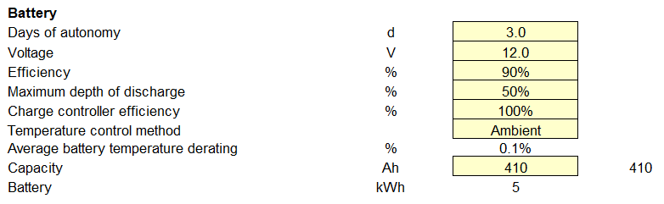
Stand Alone Design
RETScreen calculated the same size capacity.
RETScreen calculated 0.1% derating for temperature.

Slide 64
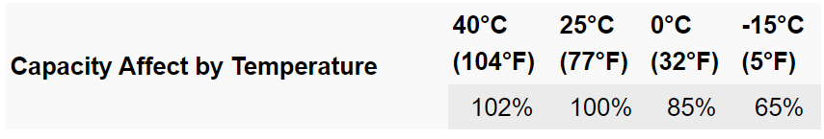
Stand Alone Design
Rolls provide the temperature affected capacity in a table.
RETScreen ambient temperature for Belize.
Air temperature
°C
23.7
24.8
26.1
27.1
28.1
28.4
28.1
28.3
28.3
26.8
25.2
24.1
26.6
Picture courtesy Rolls Battery

Slide 65
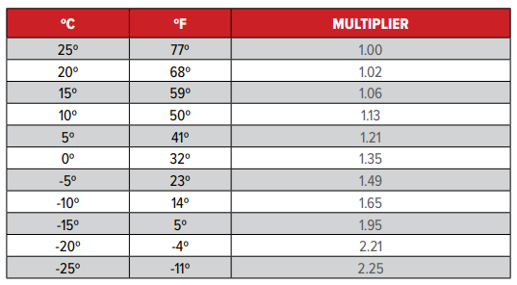
Stand Alone Design
Lead acid temperature multiplier.
Courtesy Rolls Battery

Slide 66
Stand Alone Design
BATTERY CAPACITY & TEMPERATURE
Ideal operating temperature for deep cycle lead-acid batteries is 25°C (77°F).
Battery capacity and cycle life is affected by operating temperature.
Operating at higher temperatures will reduce cycle life due to cell degradation.
Courtesy Rolls Battery

Slide 67

Stand Alone Design
A cycle life reduction of ~50% for every 10°C over 25°C (77°F) is expected.
Loss of cycle life is not recoverable.
Continuous operation at 35°C (95°F) will typically reduce battery cycle life by 50%.
Courtesy Rolls Battery

Slide 68
Stand Alone Design
Lead acid deep cycle batteries should be used to a maximum 50% DOD as this offers a balance between capacity vs. cycle life, also taking into consideration the cost of replacement.
Courtesy Rolls Battery

Slide 69
Stand Alone Design
Rolls Battery
20% 7300
cycles.
50% 4300
cycles.
Picture courtesy Rolls Battery

Slide 70
Stand Alone Design
For this example, a lead acid battery is to be used.
The Ahr for this example is 407.4Ahr and a battery needs to be chosen.
The battery bank will not see this discharge on a regular basis.
First look at lead acid AGM from Rolls Battery.

Slide 71
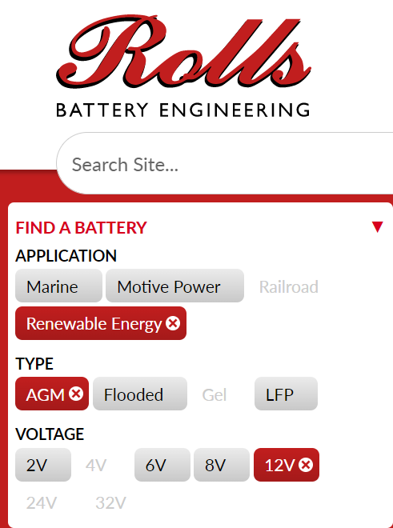
Stand Alone Design
https://www.rollsbattery.com/
Select Renewable Energy,
AGM Type,
12V Volts
Picture courtesy Rolls Battery

Slide 72
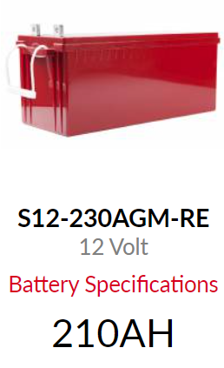
Stand Alone Design
This is the 12 Volt AGM battery.
The Specifications are on the next
slides.
210AH
Picture courtesy Rolls Battery

Slide 73
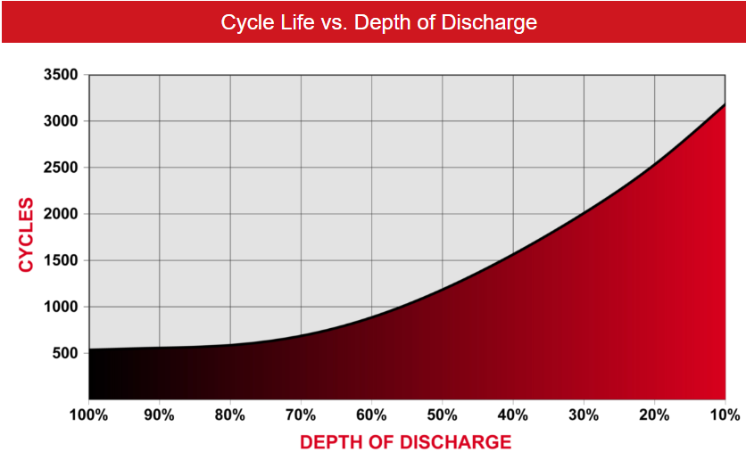
Stand Alone Design
Daily Ahr required is 68.
Picture courtesy Rolls Battery

Slide 74
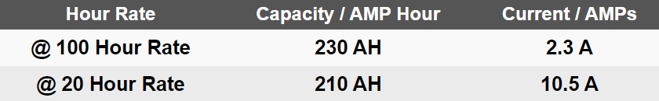
Stand Alone Design
The battery bank size is 407.4Ahr, required for three days without charging.
The 100-hour rate is 230Ah.
It would take two of these batteries in parallel to obtain 460h.
Picture courtesy Rolls Battery

Slide 75
Stand Alone Design
Two batteries connected in parallel provides 420Ah at the 20-hour rate.
The daily draw is 68Ah.
This is a DOD of 16% per day for normal operation.
If the sun did not shine for three days,
the DOD is 408 / 460 = 90%.
Picture courtesy Rolls Battery

Slide 76
Stand Alone Design
Because the three days without sun is not a normal occurrence then the few times with a DOD of 90% is not going to hurt the batteries.
Looking at the cycle of life versus DOD chart shows that the cycle life for the normal day to day is 2700 cycles.

Slide 77
Stand Alone Design
Daily Ahr required is 68Ahr with 2700 cycles.
Picture courtesy Rolls Battery

Slide 78
Stand Alone Design
Three day, Ahr required is 408Ahr with 500 cycles.
Picture courtesy Rolls Battery

Slide 79
Stand Alone Design
The next example is to have AC only loads.
The same equipment will be used with the same wattage rating.
The inverter will be included as a DC load.
For this example, we will say it is 5Watts.
The inverter will be on for 16 hours per day.

Slide 80
Stand Alone Design
The AC loads are at 120VAC.
For example, the computer draws 75Watts at 120V.
The Amperage is W / V = 75W / 120V = .625AAC.
We want the amperage at the battery to deliver this amperage to the computer.
Watts = 75W / 12V = 6.25A

Slide 81
Stand Alone Design
At the battery level the wattage of the load is the same.
Adding the inverter adds more DC load.
The operating load and the inefficiency of the inverter need to be added to the battery capacity.

Slide 82
Stand Alone Design
The inverter does have a parasitic load.
The inverter will always have some power consumed to keep it turned on.
Use 5 Watts for this continuous load as long as the inverter is turned on.
The inverter is also not 100% efficient.

Slide 83
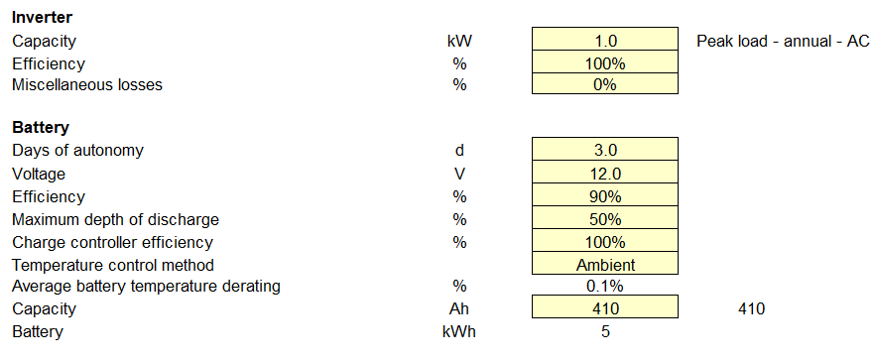
Stand Alone Design
Adding the inverter without any of its losses shows the same battery capacity as the DC example.

Slide 84
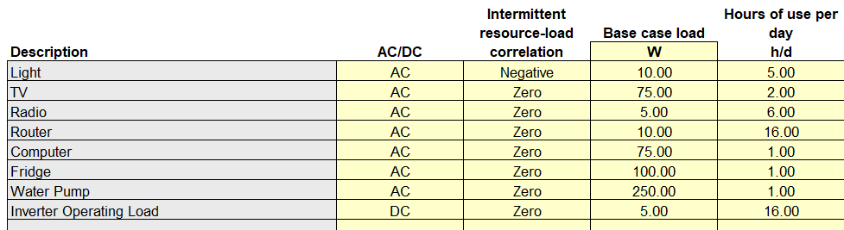
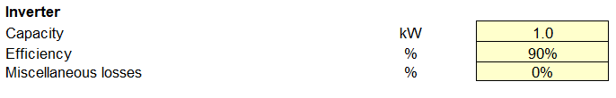
Stand Alone Design
Using the operating loss of 5Watts for 16 hours a day, and an inverter efficiency of 90%.

Slide 85
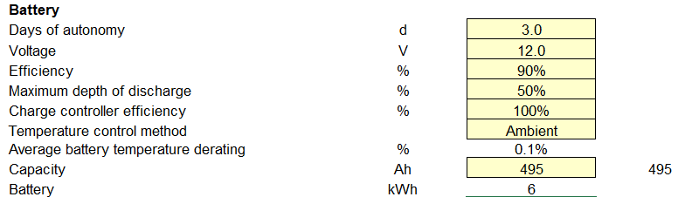
Stand Alone Design
These extra operating losses cause the battery capacity to be increased to 495Ah.

Slide 86
Stand Alone Design
The 5-Watt operating loss requires an extra battery capacity to be increased by 30Ah.
AC only loads | Watts | Hours per day | Ahrs=AxHrs
 |  |  | A=Watts / Volts
Light | 10 | 5 | 4.17 | DOD
TV | 75 | 2 | 12.50 | 50.00%
Radio | 5 | 6 | 2.50 | Ahr for DOD
Router | 10 | 16 | 13.33 | 448
Computer | 75 | 1 | 6.25
Fridge | 100 | 1 | 8.33
Water Pump | 250 | 1 | 20.83
Inverter | 5 | 16 | 6.67

Slide 87
Stand Alone Design
With the inverter average efficiency at 90% the new total required battery capacity is 497Ah.
AC only loads | Watts | Hours per day | Ahrs=AxHrs
 |  |  | A=Watts / Volts
Light | 10 | 5 | 4.17 | DOD
TV | 75 | 2 | 12.50 | 50.00%
Radio | 5 | 6 | 2.50 | Ahr for DOD | Inverter Ah
Router | 10 | 16 | 13.33 | 448 | 497
Computer | 75 | 1 | 6.25
Fridge | 100 | 1 | 8.33
Water Pump | 250 | 1 | 20.83
Inverter | 5 | 16 | 6.67

Slide 88
Stand Alone Design
The RETScreen and this calculation are very close to each other at less than 1% difference.
The inverter allows for AC loads to be used on the battery-based system.
The inverter requires additional battery capacity.

Slide 89
Stand Alone Design
One method to reduce the impact of the inverter is to have separate DC loads and AC loads.
It allows DC equipment to run more efficiently and enables the inverter to be shut off if no AC loads are required.

Slide 90
Stand Alone Design
This next example will select some of the AC loads to be DC.
Purchase DC lighting, radio and water pump.
Removes the inefficiency of the inverter and also allows these devices to operate without the need for inverter.

Slide 91
Stand Alone Design
The end result is that there is a saving of 23Ahr by having some of the loads being DC.
Days of Autonomy
3
Ahr for Autonomy
237.2
DC Load Ahr
34.17
AC Inverter Ahr
44.91
Total Ahr
79.07
DOD
50.00%
Ahr for DOD
474

Slide 92
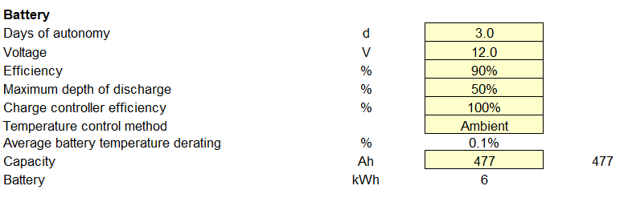
Stand Alone Design
RETScreen also produced similar Ahr reduction.

Slide 93
Stand Alone Design
Solar PV provides energy to the battery for approximately 10 hours per day on average in Belize.
The batteries depending on the type require a special interface between the PV and the battery.
This device is called a charge controller.
Lithium-ion can also use a BMS (Battery management system). (More on this later)

Slide 94
Stand Alone Design
The first type of charging that will be explored is the most common, lead acid.
Flooded
Gel
AGM
The three types of lead acid require different charge requirements.

Slide 95
Stand Alone Design
Most deep cycle batteries used in the Renewable Energy Industry were originally designed and manufactured for use in commercial and industrial applications where consistent charge cycles are carried out from six to twelve hours until the batteries reach a full state of charge.
In Renewable Energy (RE) applications, a lengthy
charge time is not typical and in most instances a maximum of 4-6 hours of peak charge is achieved each day due to limited daylight and varying weather conditions.

Slide 96
Stand Alone Design
To ensure the batteries received sufficient charge, charging systems must be adequately sized or additional charge sources added to prevent undercharge, deficit cycling and premature battery failure.

Slide 97
Stand Alone Design
Flooded lead acid batteries have a liquid electrolyte.
The charging of them causes hydrogen gas to be created.
Multistage chargers are recommended for the charging of these batteries.

Slide 98
Stand Alone Design
MULTI-PHASE CHARGING
The most common charge method for Flooded deep cycle batteries is a three-phase charge cycle with periodic equalizations.
Always be sure to follow the recommended charging parameters as these will vary.
Often, pre-programmed (charge controller) default settings are not in line with the battery manufacturer's recommended voltage settings.
Courtesy Rolls Battery

Slide 99
Stand Alone Design
Using these may result in damage or battery failure which is not covered under the manufacturer warranty.
Refer to the charger manufacturer for specific programming instructions.
Courtesy Rolls Battery

Slide 100
Stand Alone Design
BULK CHARGE
The first of the three-phase charging process is the Bulk charge.
During this stage the maximum amount of current flows into the battery bank until a desired programmed voltage is reached.
Courtesy Rolls Battery

Slide 101
Stand Alone Design
For Flooded models, the recommended Bulk charge current is 10% of the AH capacity of the battery bank, based on the 20 Hr AH rate (C/20) (min 5%, max 20%).
Higher charge current may cause the battery bank to overheat or damage the cells.
A lower charge current may be used, however, this will prolong the required charge time and increase the potential for sulfation buildup.
Courtesy Rolls Battery

Slide 102
Stand Alone Design
Bulk charge voltage set points are outlined in Table 2 (a) & 2 (b) Flooded Charging Parameters.
2 (b) refers to solar applications.
Courtesy Rolls Battery

Slide 103
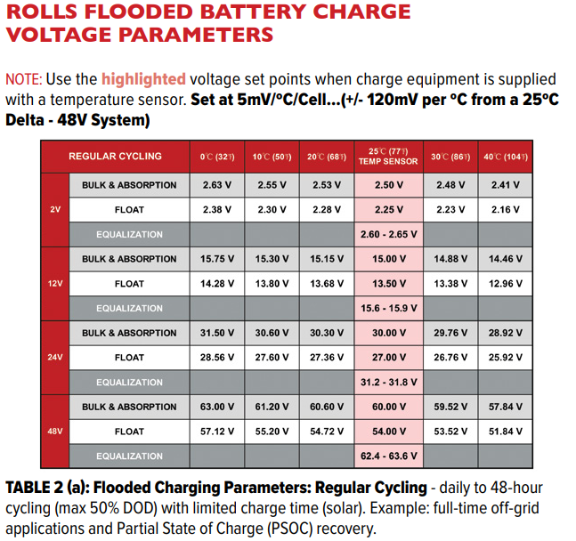
Stand Alone Design
Courtesy Rolls Battery

Slide 104
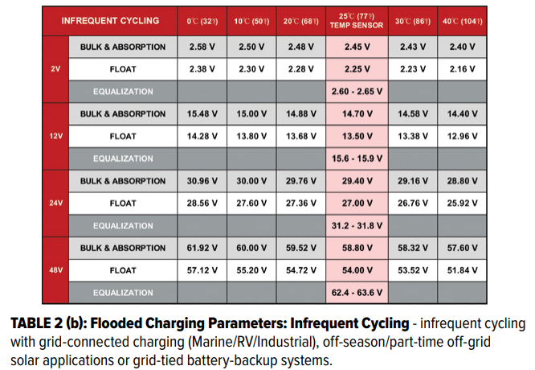
Stand Alone Design
Courtesy Rolls Battery

Slide 105
Stand Alone Design
Bulk charge voltage set points for various 12 volt flooded battery temperatures.
Courtesy Rolls Battery

Slide 106
Stand Alone Design
ABSORPTION CHARGE
The second and most important phase of the charge cycle is the Absorption charge.
The Bulk charge typically brings the battery bank to approximately 80% SOC.
Once reached, the charger will then switch to the programmed Absorption voltage to complete the charging cycle.
Courtesy Rolls Battery

Slide 107
Stand Alone Design
Most three-phase chargers include an Absorption charge time setting allowing the user to program the duration of time needed to reach a full state of charge (100% SOC).
To set the Absorption charge time, a calculation is done using the 20 Hr AH rating of the battery bank (C/20) and the actual measured charge current and/or max charger output.
Courtesy Rolls Battery

Slide 108
Stand Alone Design
As the battery bank nears 100% SOC, internal resistance in the battery increases and charge current begins to decrease.
It is assumed that over the time of the Absorption charge that 50% of your maximum charge current will be available.
Courtesy Rolls Battery

Slide 109
Stand Alone Design
The Absorption Charge Time calculation uses a multiplier of 0.42 for Flooded models which factors in assumed loss of current during the Absorption charge phase.
Courtesy Rolls Battery

Slide 110
Stand Alone Design
ABSORPTION CHARGE TIME – FLOODED
Where: T = 0.42 x C /I T = ABSORPTION CHARGE TIME
C = 20 hr RATED CAPACITY (total AH capacity of battery bank)
I = Charging Current (Amps) (*see Note: CHARGING CURRENT below)
0.42 = (factors in assumed current loss during Absorption charge phase)
Courtesy Rolls Battery

Slide 111
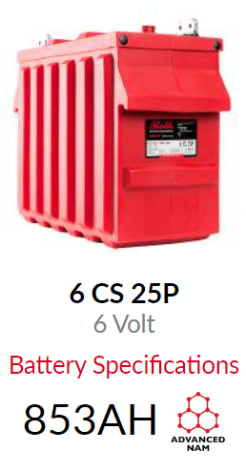
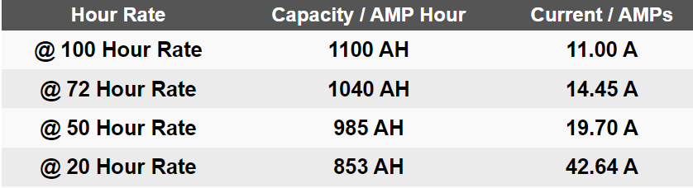
Stand Alone Design
EXAMPLE:
2 strings of 6 Volt 6 CS 25P models.
C20 853Ah 19.70A
Courtesy Rolls Battery

Slide 112
Stand Alone Design
EXAMPLE:
Where: T = 0.42 x C /I T = ABSORPTION CHARGE TIME
2 strings of 6 Volt 6 CS 25P models.
C = 20 hr AH rate = 853 AH x (2 strings) = 1706 AH
I = 10% (recommended) of 1706 AH = 170 Amps
T = 0.42 x 1706/170 = 4.2 hrs
Courtesy Rolls Battery

Slide 113
Stand Alone Design
However, if actual measured current is less (~160 Amps), or maximum charger output is limited to 160 Amps, 160 is used. (Ex. 2 x 80 Amp controllers)
Substituting the actual maximum charge controller output back into the formula give new time.
T = 0.42 x 1706/160 = 4.48 hrs
Courtesy Rolls Battery

Slide 114
Stand Alone Design
NOTE: CHARGING CURRENT - Actual measured current output (Amps) to the battery bank should be used in this calculation.
Recommended charge current for Flooded models is 10% of the 20 Hr AH rating of the battery bank (C/20) (min 5%, max 20%).
Charge source(s) and chargers should be properly sized, based on the rated capacity of the battery bank, to ensure adequate charge output.
Courtesy Rolls Battery

Slide 115
Stand Alone Design
Maximum charger output applies when the generated output meets or exceeds this threshold.
Courtesy Rolls Battery

Slide 116
Stand Alone Design
FLOAT CHARGE
When the Absorption charge phase has completed and the batteries have reached 100% SOC, the charger will continue to output at a lower voltage setting known as Float.
Float voltage maintains the battery bank at a constant 100% SOC until the charge output diminishes (Ex: solar) and/or a load is applied which begins to discharge the battery bank.
Courtesy Rolls Battery

Slide 117
Stand Alone Design
To prolong battery life, the Float settings on the power supply should be adjusted to the voltage indicated in Table 2 (a) & 2 (b) Flooded Charging Parameters.
Higher or lower voltage settings may result in unnecessary overcharge or sulfation buildup.
Courtesy Rolls Battery

Slide 118
Stand Alone Design
Table 2 (a) & 2 (b) Flooded Charging Parameters.
Courtesy Rolls Battery

Slide 119
Stand Alone Design
Sulfation is the formation of lead sulfate crystals on the surface of the (lead) plates within the battery.
If not repaired (maintenance) the crystals will grow and cover more surface area.
This reduces the surface area and reduces capacity of the battery.

Slide 120
Stand Alone Design
FLOODED LEAD-ACID BATTERY - CHARGE EFFICIENCY / CHARGE FACTOR
Charge efficiency is a measure of the energy you may take out of a charged battery divided by the energy required to charge it.
Charge efficiency will depend on a number of factors including the rate of charging or discharging.
Courtesy Rolls Battery

Slide 121
Stand Alone Design
Charge efficiency for traditional Flooded deep cycle models is typically 80%.
This should be reduced 1% per year after the third (3) year of operation
Courtesy Rolls Battery

Slide 122
Stand Alone Design
EQUALIZATION
Over time, individual cell readings may vary slightly in specific gravity due to charge imbalance or sulfation buildup.
Individual cell readings will vary slightly in specific
gravity after a charging cycle.
Equalization, or a “controlled overcharge", is required to bring each battery plate to a fully charged condition.
Courtesy Rolls Battery

Slide 123
Stand Alone Design
This reduces stratification and buildup of sulfation on the plates; two circumstances that shorten battery life.
One of the most commonly asked questions is “When is it time to equalize my battery bank?
“ As usage is unique for each system, this will depend on several factors including depth of discharge, cycle frequency, operating temperature, charging voltage and current.
Courtesy Rolls Battery

Slide 124
Stand Alone Design
Stratification is when the acid solution and water separate.
The acid is heavier than the water, it moves to the bottom portion of the battery.
This allows the water to sulfate the plates on the upper half.
Voltage readings may look ok, but capacity is reduced.

Slide 125
Stand Alone Design
Monitor specific gravity and voltage regularly as these readings will indicate when an Equalization may be necessary.
NOTE: Running frequent equalizations on batteries that do not require balancing or desulfation will overcharge and deteriorate the cells prematurely, shortening the life of the battery.
Courtesy Rolls Battery

Slide 126
Stand Alone Design
An Equalization should be completed when the specific gravity of individual cells within the battery bank are varied by more than .025 -.030.(Ex. 1.265, 1.235, 1.260, 1.210...)
Do not attempt to equalize a battery bank with failed cells or missing batteries as this will force an overcharge on the remaining cells which may cause
permanent damage.
Courtesy Rolls Battery

Slide 127
Stand Alone Design
When resting in Float charge, if specific gravity readings are consistently lower than recommended it may be necessary to adjust Bulk/Absorption voltages slightly and/or Absorption time to increase charge time.
To properly equalize the battery bank, follow the Correction Equalization procedure using the recommended Equalization set point in Table 2 (a) & 2 (b) Flooded Charging Parameters starting at the lower end of the provided voltage range.
Courtesy Rolls Battery

Slide 128
Stand Alone Design
Equalization voltage range for 12V battery bank.
Equalization is only done on Flooded Lead acid batteries.
Courtesy Rolls Battery

Slide 129
Stand Alone Design
The next battery that will be used to learn about charging is a Lead acid AGM battery.
ROLLS VRLA AGM BATTERY

Slide 130
Stand Alone Design
CHARGING INSTRUCTIONS
To maximize the life of your Rolls VRLA AGM battery, it is important that it is properly charged.
Over or undercharging a VRLA AGM battery will result in shortened cycle life.
The best protection from improper charging is to use a quality charger and routinely checking that the charge current and manufacturer-recommended voltage settings are properly maintained.
Courtesy Rolls Battery

Slide 131
Stand Alone Design
VRLA AGM CHARGING GUIDELINES
To maintain good health, VRLA AGM batteries should be brought to a full charge on each cycle or, at minimum, once every 6-7 days.
Charge should be completed in a ventilated area as hydrogen gas may still be released through the pressure relief valve if the batteries are excessively overcharged.
Courtesy Rolls Battery

Slide 132
Stand Alone Design
Never charge a frozen battery.
Ideal charging temperatures: 0°C-40°C (32°F-104°F)
Courtesy Rolls Battery

Slide 133
Stand Alone Design
VRLA AGM CHARGING CHARACTERISTICS
To maximize your battery life, a voltage regulated charger with temperature compensation is strongly recommended.
Refer to Table 6 VRLA AGM Charge Voltage for the recommended charging parameters.
Courtesy Rolls Battery

Slide 134
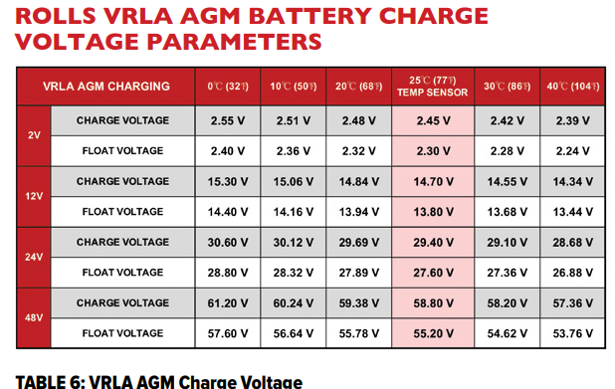
Stand Alone Design
Table 6 VRLA AGM Charge Voltage for the recommended charging parameters.
Courtesy Rolls Battery

Slide 135
Stand Alone Design
NOTE: Use the highlighted voltage set points when charge equipment is supplied with a temperature sensor.
Set at 4mV/ºC/Cell...(+/- 96mV per ºC from a 25ºC
Delta - 48V System) Higher or lower settings may cause incorrect adjustments in charge voltage.
Without a temperature sensor, charge settings must be adjusted manually based on the battery temperature when in use, not just ambient temperatures.
Courtesy Rolls Battery

Slide 136
Stand Alone Design
Charge voltage should be set to 2.45vpc @ 25°C (77°F) to allow the charger to properly adjust voltage with temperature compensation.
Temperature compensation should be programmed as specified in Table 6 with adjustment in increments of 4mv/ºC/Cell. Without temperature compensation, voltage settings should be manually adjusted for temperatures varying from 25°C (77°F).
As temperature decreases, the voltage should increase and vice versa.
Courtesy Rolls Battery

Slide 137
Stand Alone Design
If the charger has a preset charge profile for VRLA AGM type batteries, verify that these voltage settings follow the battery manufacturer's specific charging parameters.
Courtesy Rolls Battery

Slide 138
Stand Alone Design
VRLA AGM BULK & ABSORPTION CHARGE
VRLA AGM batteries have a lower internal resistance than Flooded models, allowing them to accept current more efficiently.
It is recommended that the initial charge current is set at 20% of C/20 of the battery bank (min 10% / max 30% of C/20) in order to fully charge the batteries within a reasonable amount of time.
Courtesy Rolls Battery

Slide 139
Stand Alone Design
It may be set lower however, this will increase the required charge time.
Refer to the recommended & maximum charge current noted on the product label as these may be lower than 20% of C/20 / max 30% on larger 2-volt AGM models.
It is very important that VRLA AGM batteries are brought to a full charge frequently to prevent capacity loss.
Courtesy Rolls Battery

Slide 140
Stand Alone Design
It should also be noted that, unlike Flooded models, these batteries should NOT be equalized to recover capacity loss.
This program setting (Equalize) should be disabled in the charge controller to prevent accidental overcharge.
Courtesy Rolls Battery

Slide 141
Stand Alone Design
The charger should deliver the initial max current at the programmed Bulk voltage until the voltage limit is reached, then switching to the Absorption charge phase.
The charger should maintain the Absorption voltage until current tapers to the programmed End Amps/Return Amps/Tail Current set point (3% is recommended for VRLA AGM models).
Courtesy Rolls Battery

Slide 142
Stand Alone Design
To set the Absorption charge time, a calculation is done using the 20hr Ah rating of the battery bank (C/20) and the actual measured charge current and/or max charger output.
Courtesy Rolls Battery

Slide 143
Stand Alone Design
VRLA AGM ABSORPTION CHARGE TIME
Where: T = 0.38 x C /I T = ABSORPTION CHARGE TIME
C = 20 hr RATED CAPACITY (total AH capacity of battery bank)
I = Charging Current (Amps) (*see Note: CHARGING CURRENT on pg 11 for details)
0.38 = (factors in assumed current loss during Absorption charge phase)
Courtesy Rolls Battery

Slide 144
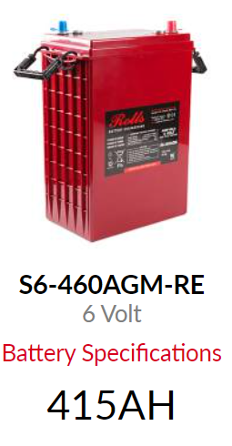
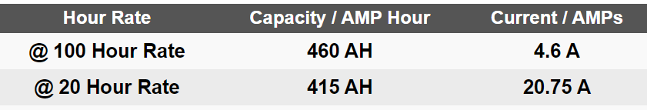
Stand Alone Design
EXAMPLE:
2 strings of 6 Volt S6-460AGM-RE.
Courtesy Rolls Battery

Slide 145
Stand Alone Design
EXAMPLE:
2 strings of 6 Volt S6-460AGM-RE models.
C = 20 hr AH rate = 415 AH x (2 strings) = 830 AH
I = 20% (recommended) of 830 AH = 166 Amps
T = 0.38 x 830/166 = 1.9 hrs
Courtesy Rolls Battery

Slide 146
Stand Alone Design
NOTE:
If actual measured current is 120 Amps, or the maximum charger output is limited to 120 Amps, 120 is used.
Go back and recalculate the actual time based on available charging current.
(Ex. 2 x 60 Amp controllers)
T = 0.38 x 830/120 = 2.6 hrs
Courtesy Rolls Battery

Slide 147
Stand Alone Design
VRLA AGM FLOAT STAGE AND TERMINATION
To maintain 100% SOC, the charger continues output to the battery bank at the programmed Float voltage and End Amps/Return Amps/Tail Current indefinitely or until the charger is shut off or unplugged.
The profile in Table 6: VRLA AGM Charge Voltage may be used with or without the Float stage.
Courtesy Rolls Battery

Slide 148
Stand Alone Design
Without the Float stage, recharge may be terminated based on time.
This will vary by depth of discharge and charge current, or percentage recharge (105-110%).
Courtesy Rolls Battery

Slide 149
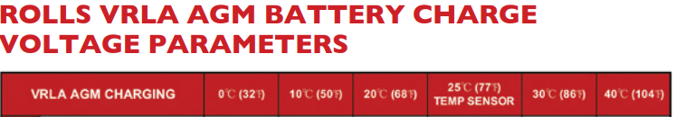

Stand Alone Design
Without the Float stage, recharge may be terminated based on time.
Courtesy Rolls Battery

Slide 150
Stand Alone Design
VRLA AGM CHARGE EFFICIENCY/CHARGE FACTOR
Charge efficiency is a measure of the energy you may take out of a charged battery divided by the energy required to charge it.
Charge efficiency will depend on a number of factors including the rate of charging or discharging.
Courtesy Rolls Battery

Slide 151
Stand Alone Design
VRLA AGM batteries have an average charge efficiency of ~80%.
This should be reduced 1% per year after the third (3) year of operation.
Courtesy Rolls Battery

Slide 152
Stand Alone Design
STORAGE
NOTE: When not in use, it is normal to expect 2% self-discharge per month (at 25ºC (77ºF) for sealed VRLA AGM models.
This rate slows as ambient temperatures decrease and increases at higher temperatures.
Stored batteries should be recharged every 3-4 months until the battery is put in service to avoid sulfation buildup and possible freezing in cold temperatures.
Courtesy Rolls Battery

Slide 153
Stand Alone Design
What Is a Solar Charge Controller?
An essential part of nearly all battery-based renewable energy systems, charge controllers serve as a current and/or voltage regulator to protect batteries from overcharging.
Their purpose is to keep your deep cycle batteries properly fed and safe for the long term.
Courtesy Altestore

Slide 154
Stand Alone Design
Solar charge controllers are a necessity for the safe and efficient charging of solar batteries.
Think of the charge controller as a strict regulator between your solar panels and solar battery.
Courtesy Altestore

Slide 155
Stand Alone Design
Without a charge controller, solar panels can continue to deliver power to a battery past the point of a full charge, resulting in damage to the battery and a potentially dangerous situation.
The basic functions of a controller are quite simple.
Charge controllers block reverse current and prevent battery overcharge.
Courtesy Altestore

Slide 156
Stand Alone Design
Some controllers also prevent battery over-discharge, protect from electrical overload, and/or display battery status and the flow of power.
Modern solar charge controllers work by detecting and monitoring the battery’s voltage level and closely regulating the flow of current from the panels to the battery.
Courtesy Altestore

Slide 157
Stand Alone Design
Generally, the three primary charge controller types are 1- or 2-stage solar charge controllers, 3-stage and/or PWM solar charge controllers, and maximum power point tracking (MPPT).
These 1- or 2-stage charge controllers use shunt transistors or relays to control voltage in either one or two steps (hence the names 1-stage or 2-stage controller). These are the oldest types and are extremely basic – and sometimes inefficient – in their components. However, their reliability and affordability do still attract some people.
Courtesy Altestore

Slide 158
Stand Alone Design
PWM charge controllers are inexpensive and reliable.
Their drawback is that they should only be used when the nominal voltage of the solar panels matches the battery voltage – and even then, they have inefficiencies in larger systems.
PWM is pulse width modulation.
Courtesy Altestore

Slide 159
Stand Alone Design
HOW DOES A PWM CHARGE CONTROLLER WORK?
A PWM (Pulse Width Modulation) charge controller features a battery that is connected to the solar energy source via an electronic switch.
When the battery reaches a full charge, the electrical current is gradually reduced until it arrives at a low-maintenance state (where it will then stay).
Courtesy Altestore

Slide 160
Stand Alone Design
PWM charge controllers are for small-scale applications where the nominal voltage of the solar array matches the battery bank voltage.
The following explains a PWM charge controller.
https://www.altestore.com/store/charge-controllers/solar-charge-controllers/pwm-solar-charge-controllers-c477/#more
Courtesy Altestore

Slide 161
Stand Alone Design
From the video a PWM is a good fit financially for a small system if the voltage of the PV matched the battery voltage.
The MPPT advantage is utilized on larger systems and where higher PV voltages are used.

Slide 162
Stand Alone Design
Maximum Power Point Tracking (MPPT) Controllers
MPPT charge controllers are the highest-quality, most advanced option available, but they come with the high prices to match.
MPPT controllers provide an impressive 94-98% efficiency level, delivering about 10-30% more power to the solar battery than other types.
Courtesy Altestore

Slide 163
Stand Alone Design
Unless your solar system is small (cabin-sized or smaller) and its battery voltage is no more than 24V, an MPPT controller is usually worth the extra initial investment.
With larger, more advanced systems and 48V battery banks becoming much more common over the years, MPPT charge controllers are the new standard.
Courtesy Altestore

Slide 164
Stand Alone Design
When looking for a charge controller to charge these batteries the 3-stage charge controller is the best option.
Now that the basics of charge controllers have been introduced.
Time to look at charge controllers.

Slide 165
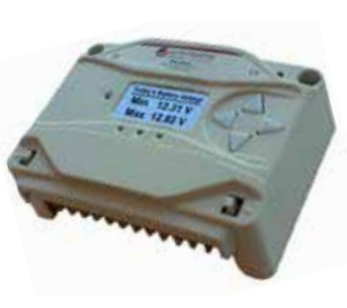
Stand Alone Design
The lab has both PWM and MPPT charge controllers.
The Morningstar ProStar PS-30M is the PWM charge controller.
Courtesy Morning Star

Slide 166
Stand Alone Design
The ProStar PS-30M.
PS = ProStar
30 is the amperage
M means there is a visual meter to read values.
Courtesy Morning Star

Slide 167
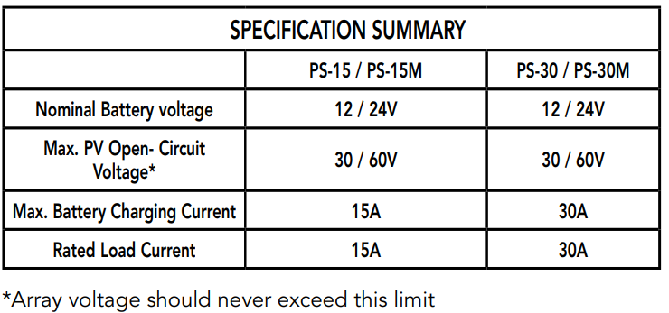
Stand Alone Design
It can be used to charge 12 or 24 volt batteries.
Courtesy Morning Star

Slide 168
Stand Alone Design
The Installation, operation, and maintenance manual must be read and is provided.
The manual guides you through the installation, set-up and operation for the charge controller.
The controller features eight (8) adjustable settings switches, a communication port, and terminals for remote battery temperature and voltage measurement.
Courtesy Morning Star

Slide 169
Stand Alone Design
Rated for 12 or 24 Volt systems, and 15 or 30 Amps of charging current.
Fully protected with automatic and manual recovery.
Seven standard charging programs selectable with DIP switches,
Continuous self-testing with fault notification.
LED indications and optional meter monitoring.
Terminals sized for #6 AWG /16 mm² wire
Includes battery voltage sense terminals.
Optional remote battery temperature sensor.
Courtesy Morning Star

Slide 170
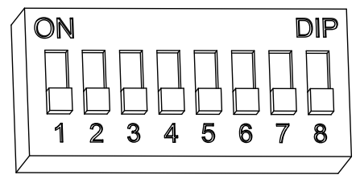
Stand Alone Design
The DIP switch block shown in Figure 3.1 below is used to set the operating parameters for the ProStar.
Courtesy Morning Star

Slide 171
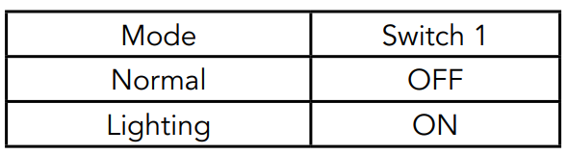
Stand Alone Design
Switch 1 is for Load / Lighting
Courtesy Morning Star

Slide 172
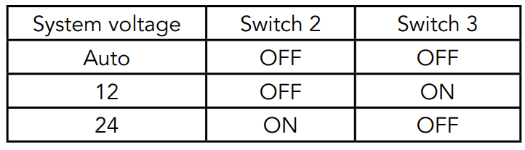
Stand Alone Design
Switches 2, 3: System Voltage
Three (3) system voltage configurations are available as shown in the table below:
Courtesy Morning Star

Slide 173
Stand Alone Design
Switches 4, 5, 6: Battery Type Selection.
Preset ProStar battery charging options are shown in the next slide.
All voltage settings listed are for nominal 12 Volt batteries. Multiply the voltage settings by two (2) for 24 Volt systems.
Courtesy Morning Star

Slide 174
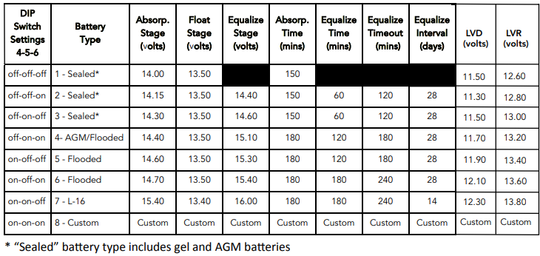
Stand Alone Design
Switches 4, 5, 6: Battery Type Selection.
Courtesy Morning Star

Slide 175
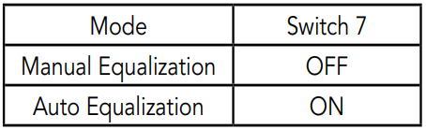
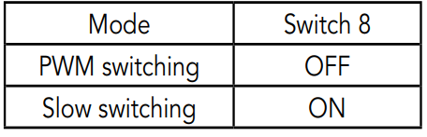
Stand Alone Design
Switch 7: Battery Equalization.
Switch 8: Current Switching.
Courtesy Morning Star

Slide 176
Stand Alone Design
The default (PWM) switching setting (OFF / down) operates at 300Hz.
If load or system noise is an issue, DIP 8 can be set (ON-up) for slow switching at 1Hz. Standard PWM switching is recommended when system noise is not a problem.
Courtesy Morning Star

Slide 177
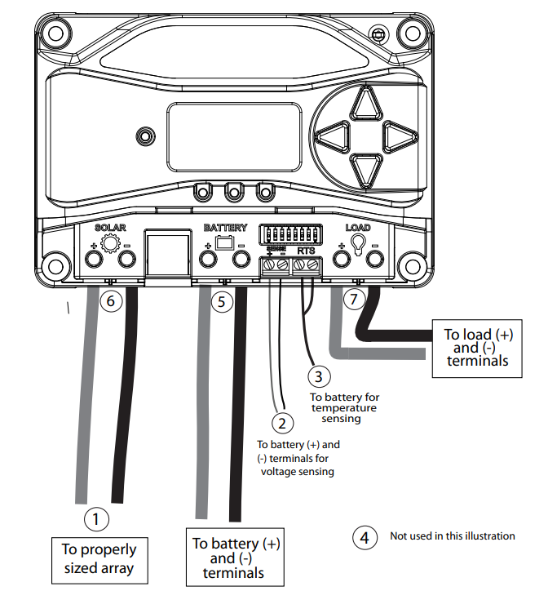
Stand Alone Design
Wiring terminals for the charge controller.
Courtesy Morning Star

Slide 178
Stand Alone Design
Multiple controllers can be installed in parallel on the same battery bank to achieve greater total charging current.
In this type of system, each ProStar must have its own solar array.
The load terminals of multiple controllers can only be wired together if the total load draw does not exceed the nameplate current of the LOWEST rated controller.
Courtesy Morning Star

Slide 179
Stand Alone Design
Battery Voltage Sense Wires
Due to connection and cable resistance, voltage drops are unavoidable in power cables that carry current, including the ProStar battery cables.
If Battery Sense wires are not used, the controller must use the voltage reading at the battery power terminals for regulation.
This voltage will be higher than the actual battery bank voltage while charging the battery.
Courtesy Morning Star

Slide 180
Stand Alone Design
Battery voltage Sense connection enables the ProStar to measure the battery terminal voltage precisely with small gauge wires that carry very little current, and thus have no voltage drop.
The sense wires, when connected directly to the battery, will improve battery charging accuracy.
Battery voltage sense wires are recommended if the controller is more than five meters from the battery.
Courtesy Morning Star

Slide 181
Stand Alone Design
Remote Temperature Sensor:
All charging settings are based on 25°C (77°F).
If the battery temperature varies by 5°C, the charging setting will change by 0.15 Volts for a 12 Volt battery.
This is a substantial change in the charging of the battery, and the use of the optional Remote Temperature Sensor (RTS) is recommended to adjust charging to the actual battery temperature.
Courtesy Morning Star

Slide 182
Stand Alone Design
Power-Up and Verify System Operation.
Close the battery disconnect to start the processor, and activate the controller’s protections.
Watch the charging status, and then the three battery state of charge (SOC) LEDs blink in sequence (G-Y-R), confirming proper start-up.
If they do not light, check the battery polarity (+/–) and battery voltage.
Courtesy Morning Star

Slide 183
Stand Alone Design
The green, yellow or red LED will light depending on the battery state-of-charge (SOC).
Confirm that one of these LEDs is on before going to the next step.
Close solar disconnect.
If the solar input is connected while in sunlight, the charging LED indicator will light.
Confirm proper connection by observing the charging LED.
Courtesy Morning Star

Slide 184
Stand Alone Design
Insert the load fuse, or close the breaker, and turn the load on to confirm a proper connection.
If the load does not turn on, it could be for various reasons:
The ProStar is in LVD (red LED on); there is a short circuit in the load (LEDs blinking R/G – Y); there is an overload condition (LEDs blinking R/Y - G); the load is not connected, not working, or turned off.
Courtesy Morning Star

Slide 185
Stand Alone Design
After all connections have been completed, observe the LEDs to make sure the controller is operating normally for system conditions.
If the optional digital meter is used, observe that the display is scrolling with proper voltage and current values.
Also, a self- test can be performed with digital meter units.
Courtesy Morning Star

Slide 186
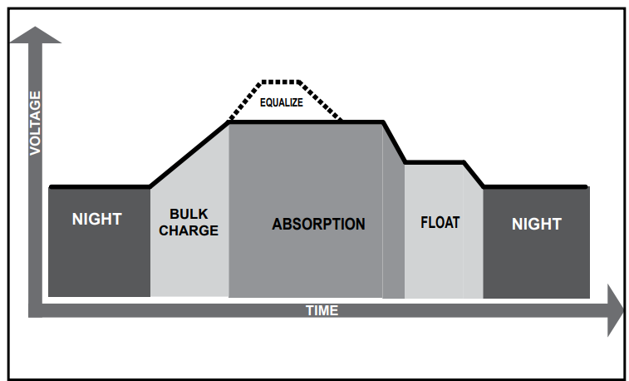
Stand Alone Design
The ProStar has a 4-stage battery charging algorithm.
Courtesy Morning Star

Slide 187
Stand Alone Design
Bulk Charge Stage
During Bulk charging, the battery is not at 100% state of charge and battery voltage has not yet charged to the Absorption voltage set-point.
The controller will deliver 100% of available solar power to recharge the battery.
Courtesy Morning Star

Slide 188
Stand Alone Design
Absorption Stage
When the battery has recharged to the Absorption voltage set-point, constant voltage regulation is used to maintain battery voltage at the Absorption set-point.
This prevents heating and excessive battery
gasing.
The battery is allowed to come to full state of charge at the Absorption voltage set-point.
Courtesy Morning Star

Slide 189
Stand Alone Design
The green SOC LED will blink once per second during Absorption charging.
The battery must remain in the Absorption charging stage for a cumulative 150 - 180 minutes, depending on battery type, before transition to the Float stage will occur.
However, Absorption time will be extended by thirty minutes if the battery discharges below 12.50 Volts (12V system) the previous night.
Courtesy Morning Star

Slide 190
Stand Alone Design
The Absorption set-point is temperature compensated through either the on-board local temperature sensor, or an optional Remote Temperature Sensor (RTS).
Courtesy Morning Star

Slide 191
Stand Alone Design
Float Stage
After the battery is fully charged in the Absorption stage, the ProStar reduces the battery voltage to the Float voltage set-point.
When the battery is fully recharged, there can be no more chemical reactions and all the charging current is turned into heat and gassing.
Courtesy Morning Star

Slide 192
Stand Alone Design
The float stage provides a very low rate of maintenance charging while reducing the heating and gasing of a fully charged battery.
The purpose of float is to protect the battery from long-term overcharge.
The green SOC LED will blink once every two (2) seconds during Float charging.
Courtesy Morning Star

Slide 193
Stand Alone Design
Once in Float stage, loads can continue to draw power from the battery.
In the event that the system load(s) exceed the solar charge current, the controller will no longer be able to maintain the battery at the Float set-point.
Should the battery voltage remain below the Float set-point for a cumulative sixty minute period, the controller will exit Float stage and return to Bulk
charging.
Courtesy Morning Star

Slide 194
Stand Alone Design
The Float set-point is temperature compensated through either the on-board local temperature sensor, or an optional Remote Temperature Sensor (RTS).
Courtesy Morning Star

Slide 195
Stand Alone Design
Equalization Stage
WARNING: Risk of Explosion Equalizing vented batteries produces explosive gases.
The battery bank must be properly ventilated.
CAUTION: Equipment Damage Equalization increases the battery voltage to levels that may damage sensitive DC loads.
Verify all system loads are rated for the temperature
compensated Equalize voltage before beginning an
Equalization charge
Courtesy Morning Star

Slide 196
Stand Alone Design
CAUTION: Equipment Damage
Excessive over-charging and gassing too vigorously can damage the battery plates and cause shedding of active material from the plates.
An equalization that is too high, or too long, can be damaging.
Review the requirements for the particular battery being used in your system.
Courtesy Morning Star

Slide 197
Stand Alone Design
Certain battery types benefit from a periodic boost charge to stir the electrolyte, level the cell Voltages, and complete the chemical reactions.
Equalization (EQ) charging raises the battery voltage above the standard absorption voltage so that the electrolyte gases.
The green SOC LED will blink rapidly two (2) times per second during equalization charging.
Courtesy Morning Star

Slide 198
Stand Alone Design
The duration of the equalize charge is determined by the selected battery type.
See table 4-1 in this section for more details.
The Equalization Time is defined as time spent at the equalize set-point.
If there is insufficient charge current to reach the equalization voltage, the equalization will terminate after an additional sixty minutes to avoid over-gassing or heating of the battery.
Courtesy Morning Star

Slide 199
Stand Alone Design
If the battery requires more time in equalization, with non-metered versions, manual EQ can be activated using the push-button (see Section 4.4) to continue for one or more additional EQ cycles.
The Prostar meter, or MSView software, can also be used to program EQ timing and duration.
Courtesy Morning Star

Slide 200
Stand Alone Design
The Equalization set-point is temperature compensated through either the on-board local temperature sensor, or an optional Remote Temperature Sensor (RTS).
Why Equalize?
Routine equalization cycles are often vital to the performance and life of a battery - particularly in a solar system.
Courtesy Morning Star

Slide 201
Stand Alone Design
During battery discharge, sulfuric acid is consumed, and soft lead sulfate crystals form on the plates.
If the battery remains in a partially discharged condition, the soft crystals will turn into hard crystals over time.
This process, called “lead sulfation”, causes the crystals to become harder over time and more difficult to convert back to soft active materials.
Courtesy Morning Star

Slide 202
Stand Alone Design
Sulfation from chronic undercharging of the battery is the leading cause of battery failures in solar systems.
In addition to reducing the battery capacity, sulfate build-up is the most common cause of buckling plates and cracked grids.
Deep cycle batteries are particularly susceptible to lead sulfation.
Courtesy Morning Star

Slide 203
Stand Alone Design
Normal charging of the battery can convert the sulfate back to the soft active material if the battery is fully recharged.
However, a solar battery is seldom completely recharged, so the soft lead sulfate crystals harden over a period of time.
Only a long controlled overcharge, or equalization, at a higher voltage can reverse the hardening of sulfate crystals.
Courtesy Morning Star

Slide 204
Stand Alone Design
When to Equalize?
The ideal frequency of equalizations depends on the battery type (lead-calcium, lead-antimony, etc.), the depth of discharging, battery age, temperature, and other factors.
One very broad guide is to equalize flooded batteries every one to three months or every five to ten deep discharges.
Courtesy Morning Star

Slide 205
Stand Alone Design
Some batteries, such as the L-16 group, will need more frequent equalizations.
The difference between the highest cell and lowest cell in a battery can also indicate the need for an equalization.
Either the specific gravity or the cell voltage can be measured.
Courtesy Morning Star

Slide 206
Stand Alone Design
The battery manufacturer can recommend the specific gravity or voltage values for your particular battery.
Preparation for Equalization: First, confirm that all of the system loads are rated for the equalization voltage.
Consider that at 0°C (32°F) the Equalization voltage will reach 16.75 Volts for L-16 batteries with a temperature sensor installed.
Courtesy Morning Star

Slide 207
Stand Alone Design
Disconnect any loads at risk of damage due to the high input voltage.
If Hydrocaps are used, be sure to remove them before starting an equalization.
Replace the Hydrocaps with standard battery cell caps.
The Hydrocaps can get very hot during an equalization.
Courtesy Morning Star

Slide 208
Stand Alone Design
After the equalization is finished, add distilled water to each cell to replace gassing losses.
Confirm that the battery plates are submerged.
Equalize a Sealed Battery?
The Battery Charging Settings table (see table 4-1 in
this section) shows two sealed battery settings with an Equalization cycles.
Courtesy Morning Star

Slide 209
Stand Alone Design
These are minimal "boost” cycles to level individual cells.
This is not an equalization and will not vent gas from sealed batteries that require up to 14.4V charging (12V battery).
Many VRLA batteries, including AGM and gel, have
charging requirements up to 14.4V (12V battery).
Courtesy Morning Star

Slide 210
Stand Alone Design
Depending on the battery manufacturer’s recommendation, the “boost” cycle for sealed cells can be disabled by setting the equalize setting switch to manual, if required.
Battery Charge Settings:
The ProStar provides seven (7) standard battery charging settings that are selected with the settings switches.
Courtesy Morning Star

Slide 211
Stand Alone Design
These standard charging settings are suitable for lead-acid batteries ranging from sealed (gel, AGM, maintenance-free) to Flooded and L-16 cells.
In addition, an eighth charging setting provides for custom set-points using MSViewTM PC software.
Courtesy Morning Star

Slide 212
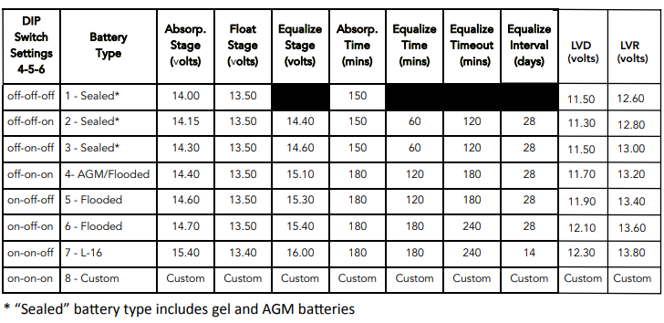
Stand Alone Design
These settings are general guidelines for use at the operator’s discretion. Consult the battery
manufacturer for optimal battery charge settings.
Courtesy Morning Star

Slide 213
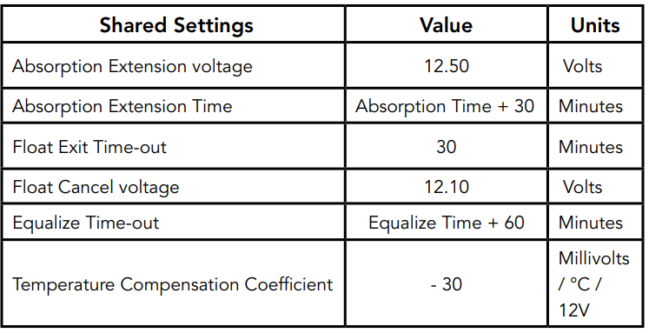
Stand Alone Design
Battery settings that are shared between all battery types.
Courtesy Morning Star

Slide 214
Stand Alone Design
Load Control Information:
The primary purpose of the load control function is to disconnect system loads when the battery has discharged to a low state of charge, and reconnect system loads when the battery is sufficiently recharged.
The total current draw of all loads must not exceed the ProStar 15 or 30 Amp maximum load rating.
Courtesy Morning Star

Slide 215
Stand Alone Design
Current Compensation:
All LVD and LVR set-points are current compensated.
Under load, the battery voltage will sag in proportion to the current draw of the load.
A short-term large load could cause a premature LVD without the current compensation feature.
Courtesy Morning Star

Slide 216
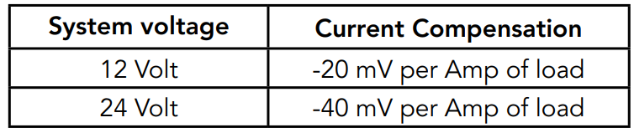
Stand Alone Design
Current compensation begins at three Amps of load draw.
LVD and LVR set-points are adjusted lower per the following table:
Courtesy Morning Star

Slide 217
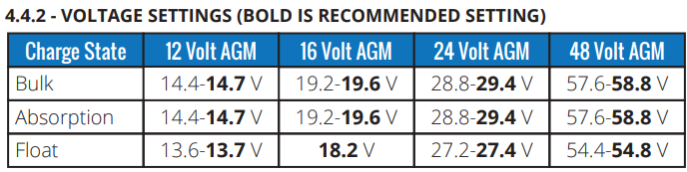
Stand Alone Design
Connecting the charge controller to the FULLRIVER DC105 AGM 12volt battery.
Courtesy FULLRIVER Battery

Slide 218
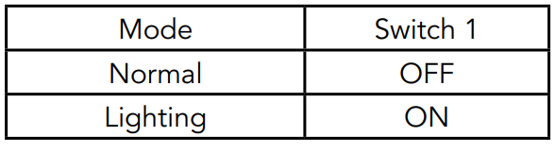
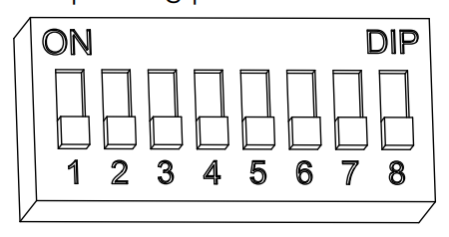
Stand Alone Design
DIP switch selection:
Switch 1 should be OFF.
Courtesy Morning Star

Slide 219
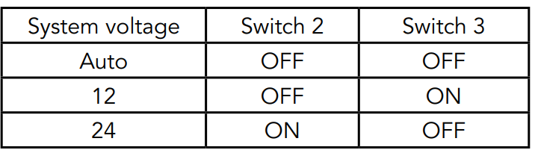
Stand Alone Design
DIP switch selection:
Switch 2 and 3 should be OFF or 12 2 OFF 3 ONN
Courtesy Morning Star

Slide 220
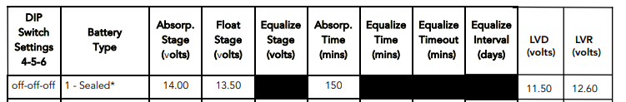
Stand Alone Design
This arrangement keeps equalization from happening. The Bulk stage starts in the morning when charge controller sees PV input.
Courtesy Morning Star

Slide 221
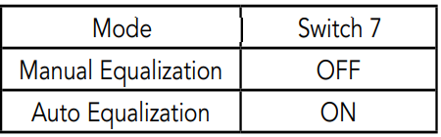
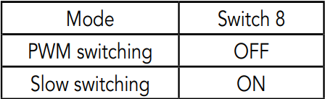
Stand Alone Design
Switch 7: Battery Equalization, switch 7 set to OFF
Switch 8: Current Switching, switch set to OFF.
Default is OFF.
Courtesy Morning Star

Slide 222
Stand Alone Design
Bulk and Absorb get to 14.40V, Battery wants 14.4-14.7V.
Float is 13.5 and battery wants 13.6-13.7V.
As long as the PV can supply the correct amount of amps, the battery will charge fully.
Courtesy FULLRIVER Battery

Slide 223
Stand Alone Design
DC105-12 is rated at 105AH @ 20 Hrs.
The recommended bulk current is 0.20 x 105 = 21 Amps.
The maximum bulk current is 0.35 x 105 = 37 Amps.
The charge controller is able to handle 30A maximum.
With a PWM charge controller, the charge current will be the wattage of the PV array / battery voltage.
Courtesy FULLRIVER Battery

Slide 224
Stand Alone Design
For the DC105-12 a minimum of 20A is required to properly charge the battery.
At 14.4V x 20A = an array of 288A minimum.
The PV panel on the solar trainer is 395W that can deliver a calculated 27.4 amps.
The PV panel will be operating outside of the maximum power voltage of 36.88V
Courtesy FULLRIVER Battery

Slide 225
Stand Alone Design
The PV Imp is 10.71A and at 14.4 volts it will produce approximately only 154W.
The charging current will be 10.7.
Two of these panels will need to be put into parallel to achieve the proper charging current.
Courtesy FULLRIVER Battery

Slide 226
Stand Alone Design
For PWN charge controllers to be most efficient they need to be connected to a PV panel with close to the battery voltage as possible.
For 12 batteries a 36-cell panel is optimum using a PWM charge controller.
Courtesy FULLRIVER Battery

Slide 227
Stand Alone Design
The lab has both PWM and MPPT charge controllers.
The MPPT (Maximum Power Point Tracker) charge controller uses an electronic chopping circuit to harvest the PV energy.
This type of charge controller turns off and on an electronic switch just like the PWM.
EPEVER

Slide 228
Stand Alone Design
Instead of a switch placing the PV across the battery, it places the short-circuiting current into an inductor.
The inductor stores the energy in a magnetic field around the windings (wire) of the inductor.
When the switch opens the stored magnetic field collapses and induces current into the coil, which is now connected to a capacitor to form a DC bus.
EPEVER

Slide 229
Stand Alone Design
The rate at which the switch depends on the amount of current that can be captured in the magnetic field.
Slower on cloudy times and faster on sunny times.
Next is to look at the MPPT charge controller in the lab.
EPEVER

Slide 230
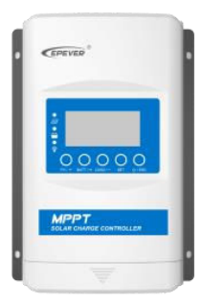
Stand Alone Design
The EPEVER model XTRA3215N-XDS2 is the MPPT type.
EPEVER

Slide 231
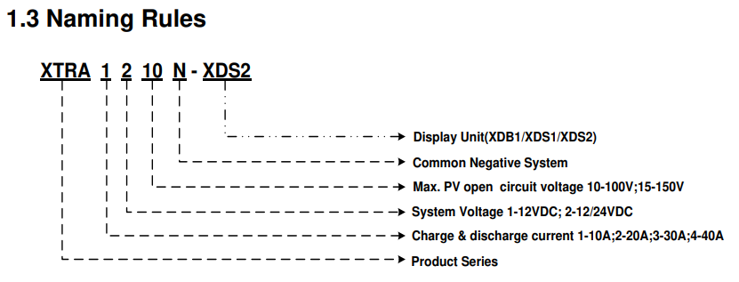
Stand Alone Design
The EPEVER MPPT charge controller model that is in the lab is the XTRA3215N-XDS2
EPEVER

Slide 232
Stand Alone Design
The EPEVER MPPT charge controller model that is in the lab is the XTRA3215N-XDS2
30A
12-24Vdc
150 V PV
Negative ground

Slide 233

Stand Alone Design
The EPEVER MPPT charge controller model that is in the lab is the XTRA3215N-XDS2
XDS2
EPEVER

Slide 234

Stand Alone Design
The EPEVER MPPT charge controller model that is in the lab is the XTRA3215N-XDS2
XDS2
EPEVER

Slide 235

Stand Alone Design
The rated current in and out of the battery is 30A
EPEVER

Slide 236

Stand Alone Design
The two options for sensing battery temperature.
EPEVER

Slide 237
Stand Alone Design
The battery parameters can be entered into the charge controller manually.
Select the battery type first.
The three choices are:
Lead acid
Lithium
User which allows for modified options

Slide 238

Stand Alone Design
The three major options for selecting battery type.
Lead acid
Lithium
User
EPEVER

Slide 239
Stand Alone Design
When type 1 Battery (Lead Acid) or 2 Lithium Battery is selected the charge controller assumes default battery parameters.
When type 3 (USE) is selected, the battery parameters need to be set manually.
EPEVER

Slide 240

Stand Alone Design
The Lead acid options for selecting battery type.
Sealed (AGM)
Gel
Flooded
Some manufacturers call AGM Sealed.
EPEVER

Slide 241

Stand Alone Design
The Lithium Iron Phosphate (LFP)options for selecting battery type.
EPEVER

Slide 242

Stand Alone Design
The Lithium nickel cobalt manganese oxide (LNCM) options for selecting battery type.
EPEVER

Slide 243

Stand Alone Design
The USER option for selecting battery type.
EPEVER

Slide 244
Stand Alone Design
The battery capacity is entered. (Ahr)
The temperature units either C or F.
The LCD screen will jump from screen to screen and the time between can be set between 2 – 20 seconds. 2 seconds is the default setting.
Load type is set next (see later).
EPEVER

Slide 245

Stand Alone Design
If the battery manufacturer sets the values for better operation, then the default values provided for the battery type can be modified.
The USE (USER) option is selected to over-ride the default values.
EPEVER

Slide 246
Stand Alone Design
Under the "USE" interface, the battery parameters that can be local set are shown in the table below:
Parameters | Default | Range
System Voltage Level | 12 VDC | 12,24,36,48 VDC
Boost charging voltage (BCV) | 14.4V | 9 – 17V
Float charging voltage (FCV) | 13.8V | 9 – 17V
Low voltage reconnect voltage (LVR) | 12.6V | 9 – 17V
Low voltage disconnect voltage (LVD) | 11.1V | 9 – 17V
Lithium battery protection enable (LEN) | NO | YES / NO
EPEVER

Slide 247

Stand Alone Design
Only those battery parameters in previous slide can be set on the local controller.
The remaining battery parameters follow the following logic.
EPEVER

Slide 248
Stand Alone Design
The charge controller can have parameters remotely set with a PC, via WiFi, Bluetooth, or a remote meter.
Battery voltage parameters:
Measure the parameters in the condition of 12V/25ºC. Please double the values in the 24V system and multiplies the values by 4 in the 48V system.
EPEVER

Slide 249

Stand Alone Design
Battery voltage parameters:
Battery Type | Sealed | Gel | FLOODED | USER
Parameters
EPEVER

Slide 250

Stand Alone Design
Battery voltage parameters:
Battery Type | Sealed | Gel | FLOODED | USER
Parameters
EPEVER

Slide 251
Stand Alone Design
When the battery type is "USE," the battery voltage parameters follow the following logic: (Check table)
A． Over Voltage Disconnect Voltage > Charging Limit Voltage ≥ Equalize Charging Voltage ≥
Boost Charging Voltage ≥ Float Charging Voltage > Boost Reconnect Charging Voltage.
B． Over Voltage Disconnect Voltage > Over Voltage Reconnect Voltage.
EPEVER

Slide 252
Stand Alone Design
C． Low Voltage Reconnect Voltage > Low Voltage Disconnect Voltage ≥ Discharging Limit Voltage.
D． Under Voltage Warning Reconnect Voltage>Under Voltage Warning Voltage≥ Discharging Limit Voltage;
E． Boost Reconnect Charging voltage >Low Voltage Reconnect Voltage.
EPEVER

Slide 253

Stand Alone Design
The Load Control function can have many options.
It sets how or when the load is connected to the battery.
The Light ON / OFF is the load is either turned “on” or “off”.
EPEVER

Slide 254

Stand Alone Design
The Load Control options.
EPEVER

Slide 255

Stand Alone Design
Control the load ON/OFF time by setting the real-time clock
EPEVER

Slide 256
Stand Alone Design
The charge controller manual give these two efficiencies.
Rated Charge Power at 12V is 390 Watts at 97.6%
Full Load efficiency is 95.1%
The charge power efficiency is used when calculating input power to charge the batteries.
Full load efficiency is maximum, a lower value is used in calculations (85-90%).
EPEVER

Slide 257

Stand Alone Design
Setting the charge controller to a specific battery.
The Rolls S12-116AGM-RE to the
EPEVER XTRA3215N-XDS2.
Look at the specifications from Rolls.
Courtesy Rolls Battery

Slide 258

Stand Alone Design
The charge controller 30A charge is good for this battery.
The battery type needs to be selected to Sealed on the charge controller.
Courtesy Rolls Battery

Slide 259
Stand Alone Design
To enter the battery parameter functions:
Press the “Enter” button and hold 5s under the battery interface.
Buttons are:
EPEVER

Slide 260

Stand Alone Design
Switch the battery type.
Step 1: Press the BATT button to browse the battery parameters on the initial interface.
Then press the SET button to enter the battery parameters setting interface.
Step 2: Long-press the BATT button to enter the battery-type interface.
EPEVER

Slide 261
Stand Alone Design
Switch the battery type.
Step 3: Press the PV or LOAD button to select the battery type.
Step 4: Press the SET button to confirm.
Step 5: Continue to press the SET button twice or wait for 10S of no-operation to automatically go back to the battery parameters setting interface.
EPEVER

Slide 262
Stand Alone Design
Select the battery Ahr capacity for the 20 hour rate.
Operation:
Step 1: Press the BATT button to browse the battery parameters on the initial interface.
Then press the SET button to enter the battery parameters setting interface.
Step 2: Long-press the BATT button to enter the battery-type interface.
EPEVER

Slide 263
Stand Alone Design
Step 3: Press the SET button to jump to the battery capacity interface.
Step 4: Press the PV or LOAD button to set the battery capacity.
Step 5: Press the SET button to confirm.
EPEVER

Slide 264

Stand Alone Design
Set the temperature units:
Step 1: Press the BATT button to browse the battery parameters on the initial interface.
Then, press the SET button to enter the battery parameters setting interface.
EPEVER

Slide 265
Stand Alone Design
Step 2: Long-press the BATT button to enter the battery-type interface.
Step 3: Press the SET button twice to jump to the temperature unit's interface.
Step 4: Press the PV or LOAD button to set the temperature units.
Step 5: Press the SET button to confirm.
EPEVER

Slide 266

Stand Alone Design
Set the LCD screen delay time between changing the screen.
NOTE: The LCD cycle default time is 2s, and the setting time range is 0～20s.
Operation:
Step 1: Press the PV button to browse the PV parameters on the initial interface. Then, press the
button to SET enter the PV parameters setting interface.
EPEVER

Slide 267
Stand Alone Design
Step 2: Long-press the PV button to enter the LCD cycle time interface.
Step 3: Press the PV or LOAD button to set the LCD cycle time.
Step 4: Press the SET button to confirm.
EPEVER

Slide 268
Stand Alone Design
Next is to select the Load type.
For this the 117 Manual mode(Default load ON) will be used.
Operation:
Step 1: Press the LOAD button to browse the load parameters on the initial interface.
Then, press the SET button to enter the load parameters setting interface.
EPEVER

Slide 269
Stand Alone Design
Step 2: Long-press the LOAD button to enter the load type interface.
Step 3: Press the PV or LOAD button to change the load type.
Step 4: Press the SET button to confirm.
EPEVER

Slide 270
Stand Alone Design
The default Boost (Bulk - Absorb) charging voltage is 14.4V.
The Float voltage is 13.8V.
Rolls charge values.
Boost charging voltage (BCV) | 14.4V
Float charging voltage (FCV) | 13.8V

Slide 271
Stand Alone Design
The default Boost (Bulk and Absorb) charging voltage is 14.4V the Rolls suggested charge voltage is 14.7.
The USE battery type could be used to change the boost voltage to 14.7V.
The Float voltage is 13.8V which matched Rolls suggested voltage.

Slide 272
Stand Alone Design
Rolls suggests that the charging current be 20% of the C/20 of the battery bank Ahr.
This battery model has a C/20 of 105 Ah.
20% is 21A which 20A is the stated as the recommended charging current.
Maximum is 30% of 105Ah = 31.5A

Slide 273

Stand Alone Design
Rolls information from the data sheet.
Courtesy Rolls Battery

Slide 274
Stand Alone Design
The EPEVER charge controller is rated to charge and discharge at 30A.
The next process is to match PV panels to the system.
The charge controller can connect to PV panels up to a certain voltage and amperage.
The battery needs to be charged between 10 – 30A.

Slide 275



Stand Alone Design
The charge controller PV Voc input voltage can not exceed 138V.
EPEVER

Slide 276

Stand Alone Design
The Q.Peak Duo ML-G10+ 395 Watt PV Module.
Voc = 45.27V. (Range in Belize 39.5 – 46.1V)
Isc = 11.07A (125% = 13.8A)
The Voc spread sheet was used for Voc calculations.

Slide 277
Stand Alone Design
When in MPPT mode the Battery charge voltage is being maintained and the maximum current is being delivered.
395W input and charging voltage = 14.4V
  (395W/14.4V=27.4A)
Therefore, the amperage will be 27.4 x 97.6% efficiency in and x 95.1% efficiency out to battery.
The charge current will be 25.5A at 1000W/m²

Slide 278
Stand Alone Design
One 395Watt panel will be enough to charge and maintain the battery requirements.
At float voltage, the battery is not taking any current.
The PV wattage is going to the load.
395W / 13.8V = 28.6A available to run loads.

Slide 279
Stand Alone Design
The maximum load that the charge controller can handle during Float charge is 13.8V x 30A = 414W.
If the loads are greater than this there are two choices.
Increase battery voltage to a higher level, but the loads also need to change to the new level.
Add another charge controller in parallel to increase available amperage.

Slide 280
Stand Alone Design
If those choices are not available loads can be connected directly to the battery and not through the controller.
The disadvantage of this is that the battery can be overly discharged, and damage can occur to the battery.
An inverter can be connected across the battery, if it has low voltage protection.

Slide 281

Stand Alone Design
An inverter with low voltage disconnect to shed itself from the battery.
EPEVER

Slide 282
Stand Alone Design
Some charge controllers can also charge Lithium batteries.
Lithium batteries have a very small change in voltage from 100% to 0% SoC.
Battery managements system are included in better quality charger / charging schemes.

Slide 283
Stand Alone Design
The BMS can control the charging of the battery or cells.
They can monitor individual or multicell within the battery.
The BMS can send alarms and or control the charging.

Slide 284
Stand Alone Design
These are examples of the BMS taking control.
Taken from Rolls manual for their Lithium battery.
BATTERY MANAGEMENT SYSTEM (BMS)
PROTECTION SUMMARY
Rolls R-Series batteries include a built-in battery management system (BMS) which offers protection in conditions where the battery voltage, current or operating/cell temperature may be unsafe or damaging.

Slide 285
Stand Alone Design
The switch architecture of the BMS allows charge and discharge to be stopped independently.
Under these undesirable operating conditions, the internal BMS will interrupt the current into or out of the battery, or disconnect it fully, as required.

Slide 286
Stand Alone Design
BATTERY CHARGING
Although a lithium-specific charger is recommended, Rolls 12V R-Series models are compatible with most common lead-acid battery chargers for nominal voltage of the pack.
The recommended and maximum continuous charge currents are specified on the product label.

Slide 287
Stand Alone Design
Rolls R-Series batteries may cycle or be stored in a partial state-of-charge (PSOC).
Rolls R-Series batteries should be cycled from 0% depth of discharge (DoD) or 100% state of charge (SOC), to 80% DOD or 20% SOC for optimal cycle life.
To prevent over-discharge, the BMS will disconnect the battery when the low voltage cut-off is reached, protecting the battery from over discharge.

Slide 288
Stand Alone Design
Inverters used for solar applications and stand-alone.
An inverter inverts DC into AC, simple.
The steps involved are:
  DC capture,
  transposing DC into DC bus,
  making an AC wave,
  delivering an AC wave
Capturing DC is the interface to accept a DC voltage into the inverter.

Slide 289
Stand Alone Design
A power inverter is a device that is usually used to convert electrical power from DC form to AC using electronic / electrical components.
In solar applications the inverter/charger will transform the DC from the PV array via the charge controller or directly to AC, or charge batteries if present.
The inverter may also be used to supply AC to loads in the residence or sell any excess AC power to the grid.

Slide 290

Stand Alone Design
AC (Alternating Current) is generally produced by a rotating magnetic field that has its magnetic lines of flux cut across stationary turns of wire.
The lines of flux induce a sinusoidal shaped voltage in the wire. For Belize it is at a rate of 60 Hz. The standard for residential voltage is 120 Volts RMS. It is in this shape.
Picture courtesy Author

Slide 291
Stand Alone Design
Utility grid systems supply pure sine wave voltages and require when inverters tie into their systems that the quality meet UL1741(SA) standards.
Inverters, like most devices come in varying qualities. The basic output difference for most is divided into square wave, modified sine wave, and pure sine wave.

Slide 292
Stand Alone Design
The square wave is the simplest and the least expensive type, its use is limited to noncritical loads with some loads or equipment not able to work with this type of AC.
Like the name suggests the output shape is square, where the voltage is on and off between +169 and – 169 (sometimes less) volts (120 RMS).

Slide 293
Stand Alone Design
The modified sine wave topologies (which are actually modified square waves) produce square waves with some dead spots between positive and negative half-cycles they are suitable for many electronic loads, although their THD( Total harmonic Distortion) is about 25%.
THD is the square root of the sum of the squares of the harmonic voltages divided by the fundamental voltage:

Slide 294


Stand Alone Design
The modified sine wave topologies (which are actually modified square waves) produce square.
Most loads can be operated from a modified sine wave; they are the most popular low-cost inverters on the consumer market today. Their THD can be reduced to about 6.5%.
Picture courtesy Author

Slide 295

Stand Alone Design
THD is the square root of the sum of the squares of the harmonic voltages divided by the fundamental voltage:
Picture courtesy Author

Slide 296
Stand Alone Design
The next type is a pure sine wave inverter which will reproduce a sine wave with a THD of less than 3 percent.
These inverters have waveforms that very closely resemble sine waves.
All loads will work with these inverters, even with power factors less than 1.
It is these types of inverters that are used in grid tie applications.

Slide 297
Stand Alone Design
Inverters are required in systems which supply power to AC loads.
Inverters convert the DC output of the array and/ or battery to standard AC power similar to that supplied by utilities.
Inverters which supply power of the same quality as utilities (in terms of frequency stability, voltage level, current and voltage wave shapes) are available, but depending upon the requirements of the load.

Slide 298
Stand Alone Design
Inverters which supply lower quality power may be more economical to use in autonomous systems such as stand-alone photovoltaic power systems.
In a system with battery storage, the inverter is normally wired so as to draw directly from the batteries or the battery charger.
The battery charging function may also be integrated within the inverter.
As with other types of power conditioners, many or all system control functions may be integrated into the inverter.

Slide 299
Stand Alone Design
The inverter that is used at the campus lab is a pure sinewave type.
It gets its energy from the battery and supplies 120V AC at 60 hz.
The rated continuous output is 600Watts at a power factor (PF) of 1.

Slide 300
Stand Alone Design
Power Factor, (PF): It is denoted by “PF” and is equal to the ratio of the Active Power (P) in Watts to the Apparent Power (S) in VA.
The maximum value is 1 for resistive types of loads where the Active Power (P) in Watts = the Apparent Power (S) in VA.
It is 0 for purely inductive or purely capacitive loads.

Slide 301
Stand Alone Design
Practically, the loads will be a combination of resistive, inductive and capacitive elements and hence, its value will be > 0 <1.
Normally it ranges from 0.5 to 0.8 e.g.
(i) AC motors (0.4 to 0.8),
(ii) Transformers (0.8)
(iii) AC to DC Switch Mode Power Supplies (0.5 to 0.6) etc

Slide 302
Stand Alone Design
In other courses, this phase angle difference between current and voltage is assumed to have been covered.
Active Power (P), Watts: It is denoted as “P” and the unit is “Watt”.
It is the power that is consumed in the resistive elements of the load.

Slide 303
Stand Alone Design
A load will require additional Reactive Power for powering the inductive and capacitive elements.
The effective power required would be the Apparent Power that is a vectorial sum of the Active and Reactive Powers.

Slide 304
Stand Alone Design
Maximum Continuous Running AC Power Rating: This rating may be specified as “Active Power” in Watts (W) or “Apparent Power” in Volt Amps (VA).
It is normally specified in “Active Power (P)” in Watts for Resistive type of loads that have Power Factor =1.

Slide 305
Stand Alone Design
Reactive types of loads will draw higher value of “Apparent Power” that is the sum of “Active and Reactive Powers”.
Thus, AC power source should be sized based on the higher “Apparent Power” Rating in (VA) for all Reactive Types of AC loads.
If the AC power source is sized based on the lower “Active Power” Rating in Watts (W), the AC power source may be subjected to overload conditions when powering Reactive Type of loads.

Slide 306

Stand Alone Design
An example is an LED bulb that has a 8Watt rating.
Looking at the information on the bulb provides the voltage, Wattage and the current draw.
Courtesy Author

Slide 307
Stand Alone Design
Voltage is 120VAC, Wattage is 8W and current draw is 85mA.
The VA = 120V x .085A = 10.2 VA
PF = (True power)/(Apparent power) PF = W/VA
The current on the AC side is 85mA and 10.2VA with a PF of .78 capacitive (Switching power supply).

Slide 308
Stand Alone Design
The current on the DC side is 8W / Battery voltage.
The inverter will supply the VARs on the AC side.
Inverter capacity x Power Factor = Active Power

Slide 309

Stand Alone Design
With this in mind, the sizing of an inverter is dependent on what type of loads are connected to them.
Courtesy Samlex

Slide 310
Stand Alone Design
Note 1. Multiply the Maximum Continuous Running Power Rating (Active Power Rating in Watts) of the appliance / device by the recommended Sizing Factor to arrive at the Maximum Continuous Running Power Rating of the inverter.
Note 2. For photographic strobe / flash unit, the Surge Power Rating of the inverter should be > 4 times the Watt Sec rating of photographic strobe / flash unit.
Courtesy Samlex

Slide 311

Stand Alone Design
Specifications for the 12V Samlex 600W pure sinewave inverter.
85% peak efficiency.
600mA operating load and no load.
Courtesy Samlex

Slide 312
Stand Alone Design
Operates from 10.7V to 16.5V.
An alarm sounds at 10.5V and shuts the load off at 10V.
The DC voltage on the terminals will depend on the amount of current drawn from the battery and temperature.
The State of Discharge of a battery under load cannot be estimated accurately.

Slide 313
Stand Alone Design
If a 300Watt load is on the AC side of the inverter the wattage from the battery will be 300Watts + 600mA (7.2W) + efficiency of the inverter.
Inverters tend to be most efficient at full load.
The inverter is said to be 85% peak.
Safe to use 80%.

Slide 314
Stand Alone Design
When the losses are added into the load the DC side will see 300W X 1.25 + 7.2W = 382.2Watts.
The greatest current draw on the battery happens at the lowest DC operating voltage.
Use 10.5V for this low voltage input to the inverter.
Current draw of the battery is 36.4ADC.

Slide 315
Stand Alone Design
If the battery is kept at full charge the current required to keep the load will be less.
Use 13.5V for this full charge voltage input to the inverter.
Current draw of the battery is 28.3ADC.

Slide 316
Stand Alone Design
Wire size will be based on the low voltage and full load on the inverter.
For this inverter it has a continuous load of 600W.
The input will see 7.2W + 600W + 85% efficiency.
713Watts of DC are required to achieve this AC output.
At 10.5V at the terminals the current will be 67.9A.

Slide 317
Stand Alone Design
The wire will be sized for this continuous current.
Wire amperage is 125% of 67.9A = 85A.
From NEC table 310.16: AWG Copper
60C = #3
75C = #4
90C = #4

Slide 318
Stand Alone Design
The upper limit for a 12volt DC system is using a
4 / 0 copper wire.
The inverter wattage of around 1500W would require approximately 1500W + efficiency (85%) = 1765 DC watts input from the battery.
1765W / 10.5V = 168A
Wire size add 125% = 210A requiring 4/0 75C or 3/0 90C conductor.

Slide 319
Stand Alone Design
This size of inverter (600W) is intended for small loads.
There can be a number of loads that when added together add up to greater than 600W.
This is ok, as long as they are not all on at the same time.
Also, the chart provided by Samlex suggested the amount of VA required by certain loads (Table2.1)

Slide 320
Stand Alone Design
Any motor loads have an inrush of 5-10 times their running amperage.
Also, motors are reactive, and the apparent power must be factored into the 600Watts of this inverter.

Slide 321
Stand Alone Design
The four solar trainers each have the 12volt FULLRIVER DC105 AH AGM battery.
This allows for 48volts of battery power to be utilized.
The campus lab has the Outback inverter and charge controller.
By connecting these batteries in series, a 48volt battery bank can be made.

Slide 322
Stand Alone Design
The inverter is model FXR3048.
FXR series model numbers use the following naming conventions.
  The model number includes “FXR” as the inverter series.
  “R” indicates that the FXR was designed for renewable applications.
  Off-grid and grid-interactive functions are integrated in the same inverter

Slide 323
Stand Alone Design
Read the manuals for both the charge controller and the inverter.
The 30 indicates it is a 3000Watt inverter.
The 48 indicates it is rated for a 48volt battery bank.
The model number is followed by “A”. This designates the inverter’s output as nominally 120 Vac (used in North America, Latin America, Asia, and other regions).

Slide 324

Stand Alone Design
OutBack FXR3048
Courtesy OutBack

Slide 325
Stand Alone Design
As part of an OutBack Power Grid/Hybrid™ system, it can provide off-grid power, grid backup power, or grid-interactive service which sells excess renewable energy back to the utility.
Battery-to-AC inverting which delivers power to run backup loads and other functions
• Provides single-phase output
• Adjustable range of output voltage
• Settable nominal output frequency

Slide 326
Stand Alone Design
AC-to-battery charging (OutBack Power systems are battery-based)
Accepts a wide variety of single-phase AC sources.
Uses battery energy stored from renewable resources
Can utilize stored energy from many sources (PV arrays, wind turbines, etc.)
FLEXmax charge controllers will optimize PV power production as part of a Grid/Hybrid system

Slide 327
Stand Alone Design
Inverter Functionality:
The FXR inverter can be used for many applications. Some of the inverter’s operations occur automatically.
Others are conditional or must be enabled manually before they will operate.
Most of the inverter’s individual operations and functions can be programmed using the system display.
This allows customization or fine tuning of the inverter’s performance.

Slide 328

Stand Alone Design
The FXR inverter can be used for many applications.
Courtesy OutBack

Slide 329
Stand Alone Design
Before operating the inverter:
The operator needs to define the application and decide which functions will be needed.
The FXR inverter is programmed with seven AC input modes.

Slide 330




Stand Alone Design
Possible modes for stand-alone applications:
Courtesy OutBack

Slide 331
Stand Alone Design
The FXR inverter requires batteries to operate.
Other sources may not maintain DC voltages that are consistent enough for the inverter to operate reliably.
Courtesy OutBack

Slide 332
Stand Alone Design
Low Battery Cut-Out:
This function prevents the inverter from draining the batteries completely.
When the DC voltage drops below the Cut-Out Voltage for the Cut-Out Delay period, the inverter will stop functioning.
The system display will give a Low Battery V error. These items are adjustable.
Courtesy OutBack

Slide 333
Stand Alone Design
Low Battery Cut-In:
The recovery point from Low Battery Cut-Out.
When the DC voltage rises above this point for 1 minute, the error will clear, and the inverter will resume functioning. This item is adjustable.
  Connecting an AC source for the inverter to charge the batteries will also clear a low battery error.
Courtesy OutBack

Slide 334
Stand Alone Design
Output Voltage:
The AC output voltage can be adjusted.
Along with small changes, this allows the inverter to be used for different nominal voltages such as 100 Vac and 127 Vac
Courtesy OutBack

Slide 335
Stand Alone Design
An automated search circuit is available to minimize the power draw when no loads are present.
When enabled, the inverter does not always deliver full output. The output is reduced to brief pulses with a delay between them.
These pulses are sent down the output lines to see if a resistance is present.
Courtesy OutBack

Slide 336
Stand Alone Design
Basically, the pulses “search” for a load.
If a load is detected on the output, the inverter’s output increases to full voltage so that it can power the load.
When the load is turned off, the inverter “goes to sleep” and begins searching again.
Courtesy OutBack

Slide 337
Stand Alone Design
Search is inoperative if the UPS input mode is in use.
Search mode is ideal for use in small systems where it is critical to conserve battery capacity and avoid idle draw or “ghost” loads.
Ghost or Phantom is used to describe any appliance or electronic that still uses electricity or “standby power” when turned off.
Courtesy OutBack

Slide 338
Stand Alone Design
Common examples of appliances and devices that have phantom / ghost loads include televisions, DVD players, cable boxes, stereos, coffee makers, microwave ovens, toasters, laptop chargers, hair dryers, and cell phone chargers.
Courtesy OutBack

Slide 339
Stand Alone Design
The inverter has a single AC input.
However, it has two sets of AC source settings.
With an external transfer switch, the inverter can be used on more than one AC source.
It is common to use utility grid power and a gas or diesel generator. Other combinations of AC sources are possible.
Courtesy OutBack

Slide 340
Stand Alone Design
Severe conditions cause the inverter to limit its output or shut down for protection.
The most common conditions are high voltage, low voltage, and temperature.
The limits for these conditions are summarized in Table 20 on the next slide.
Courtesy OutBack

Slide 341

Stand Alone Design
Severe conditions cause the inverter to limit its output or shut down for protection.
Courtesy OutBack

Slide 342

Stand Alone Design
High temperatures derates the output Wattage.
Courtesy OutBack

Slide 343
Stand Alone Design
The FXR inverter cannot connect directly to PV (solar power), wind turbines, or other unregulated DC sources.
The batteries are the inverter’s primary source of power.
A renewable energy source is always treated as a battery charger, even if all of its power is used
immediately by the inverter.
Courtesy OutBack

Slide 344
Stand Alone Design
The renewable source must have a charge controller, or some other regulation method, to prevent overcharging.
OutBack Power’s FLEXmax family of charge controllers can be used for this purpose, as can other products.
OutBack FM80-150 is used at the campus.
Courtesy OutBack

Slide 345
Stand Alone Design
Battery Type:
The FXR inverter/charger uses a three-stage charge cycle.
The default inverter/charger settings assume a deep-cycle stationary lead-acid battery.
The inverter’s settings can be adjusted for other advanced battery technologies
Courtesy OutBack

Slide 346
Stand Alone Design
Battery Type:
The FXR inverter/charger uses a three-stage charge cycle.
The default inverter/charger settings assume a deep-cycle stationary lead-acid battery.
The inverter’s settings can be adjusted for other advanced battery technologies
Courtesy OutBack

Slide 347
Stand Alone Design
The following tools may be required for this installation:
Wrench and socket sets; should include torque and ratchet wrenches.
Wire cutters/strippers
Insulated screwdriver set (flat and Phillips)
Long-nose pliers
High-resolution voltmeter
Courtesy OutBack

Slide 348
Stand Alone Design
Mounting
One person can install the FXR inverter, but installation may be easier with two people.
The unit has four mounting holes, one in each corner. (See Figure 4.) Use fasteners in all corners.
Due to the variance in other mounting methods, OutBack Power only endorses the use of FLEXware mounting products.
Courtesy OutBack

Slide 349
Stand Alone Design
Use M6 × 20 mm machine screws, one per corner, to attach the inverter to the mounting plate.
Follow the instructions with each mounting system.
Mount the plate on a flat, solid mounting surface.
Ensure the surface is strong enough to handle three times the total weight of all the components.
Courtesy OutBack

Slide 350
Stand Alone Design
If using a FLEXware Mounting Plate, avoid large air gaps behind the plate.
These can result in louder mechanical noise during heavy inverting or charging.
Mount and secure each component before attaching any wiring.
Courtesy OutBack

Slide 351
Stand Alone Design
When the inverter is used with other metal chassis, make sure that all chassis are grounded appropriately. (See the grounding instructions on page 20.)
Grounding other chassis may involve metal-to-metal contact, or separate ground wires.
Courtesy OutBack

Slide 352
Stand Alone Design
IMPORTANT:
Use correct fasteners to secure the inverter to the mounting surface, regardless of the type of surface.
OutBack Power cannot be responsible for damage to the product if it is attached with inadequate fasteners.
Courtesy OutBack

Slide 353

Stand Alone Design
IMPORTANT:
Courtesy OutBack

Slide 354
Stand Alone Design
Wiring
It will be necessary to remove knockouts from the AC Plate to run wires.
The AC Plate has one knockout of ½” size and two knockouts of ¾” size.
Install appropriate bushings to protect the wires.
Use copper wire only.
Wire must be rated at 75°C or higher.
Courtesy OutBack

Slide 355
Stand Alone Design
Grounding:
For safety, the neutral and ground conductors should be mechanically bonded.
OutBack Power does not bond these conductors within the inverter.
Some codes require the bond to be made at the main panel only.
Make sure that no more than one bond is present in the AC system at any time.
Courtesy OutBack

Slide 356
Stand Alone Design
Grounding:
For all installations, the negative battery conductor should be bonded to the grounding system at only one point.
If the OutBack Power GFDI is present, it provides the bond.
Courtesy OutBack

Slide 357

Stand Alone Design
Grounding:
Courtesy OutBack

Slide 358
Stand Alone Design
The inverter’s DC ground is a box lug located next to the negative DC battery terminal.
This lug accepts up to 1/0 AWG (70 mm² or 0.109 in²) wire.
Local codes or regulations may require the DC ground to be run separately from the AC ground.
Also, if present, it will be necessary to remove the DC Cover or Turbo Fan before making the ground connection.
Courtesy OutBack

Slide 359

Stand Alone Design
The inverter’s DC ground is a box lug located next to the negative DC battery terminal.
Courtesy OutBack

Slide 360

Stand Alone Design
The DC battery wire size.
Courtesy OutBack

Slide 361
Stand Alone Design
When installing DC cables:
Battery positive (+) and negative (–) cables should be no longer than 10 feet (3 meters) each.
This helps to minimize voltage loss and other possible effects.
Turn off DC circuit breakers before proceeding.
Tie, tape, or twist cables together to reduce self-inductance.
Courtesy OutBack

Slide 362
Stand Alone Design
1. Install all DC cables.
Do not install hardware in a different order from Figure 8.
The battery cable lug should be the first item installed on the stud.
It should make solid contact with the mounting surface.
Courtesy OutBack

Slide 363

Stand Alone Design
Do not close the main DC disconnect until wiring is complete and the inverter system is prepared for commissioning.
Courtesy OutBack

Slide 364

Stand Alone Design
2. Install the battery terminal covers.
These are made of stiff plastic with a snap-on design.
Courtesy OutBack

Slide 365

Stand Alone Design
2. Install the cover.
Courtesy OutBack

Slide 366
Stand Alone Design
AC wiring.
This wiring is from the inverter to the loads.
A load centre complete with breakers is required for each branch circuit.
The neutral and ground conductors should be mechanically bonded.
Ensure there is no more than one AC neutral-ground bond at any time.
Courtesy OutBack

Slide 367
Stand Alone Design
AC wiring.
Local or national codes may require the bond to be made at the main panel only.
The installer is responsible for providing overcurrent protection.
The AC input and output may need to be protected with branch-rated circuit breakers of maximum 60AAC size to meet applicable code requirements.
Courtesy OutBack

Slide 368
Stand Alone Design
AC wiring.
Local or national codes may require the bond to be made at the main panel only.
The installer is responsible for providing overcurrent protection.
The AC input and output may need to be protected with branch-rated circuit breakers of maximum 60AAC size to meet applicable code requirements.
Courtesy OutBack

Slide 369
Stand Alone Design
AC wiring.
Do not install these inverters using a load center that has multiwire branch circuits.
The inverter is single phase 120V.
The FXR inverter’s AC terminal block has six positions for AC wires.
The terminals will accept conductor sizes up to #6 AWG (16 mm²) or 0.021 in².
Courtesy OutBack

Slide 370
Stand Alone Design
AC wiring.
The AC HOT OUT terminal connects to the output load panel.
The terminal can carry up to 60 amps using the inverter’s transfer relay.
Size the output wiring and protective devices according to the size of the loads and the applicable code.
Courtesy OutBack

Slide 371

Stand Alone Design
AC wiring.
The AC HOT OUT
The two NEUTRAL
terminals are
electrically common.
Courtesy OutBack

Slide 372
Stand Alone Design
AC wiring.
The two NEUTRAL terminals are electrically common.
If connecting to an external neutral bus, only one terminal needs to be used.
An external neutral bus is often located in the main electrical panel.
Use the other terminal if connecting to a device that
has its own neutral wire, such as a generator.
Courtesy OutBack

Slide 373
Stand Alone Design
The INVERTER ON/OFF jumper bridges two pins.
This jumper parallels the two INVERTER ON/OFF terminals on the Control Wiring Terminal Block.
If either connection is closed, this sets the inverter to On as long as the internal programming has not been set to Off with the system display.
(The inverter is given an external OFF command in the factory. Its initial state will be Off.)
Courtesy OutBack

Slide 374


Stand Alone Design
The INVERTER ON/OFF jumper bridges two pins.
Courtesy OutBack

Slide 375
Stand Alone Design
Pre-startup Procedures
1. Ensure all DC and AC overcurrent devices are opened, disconnected, or turned off.
2. Double-check all wiring connections.
3. Confirm that the total load does not exceed the inverter’s rated power.
Courtesy OutBack

Slide 376
Stand Alone Design
Pre-startup Procedures
4. Inspect the work area to ensure tools or debris have not been left inside.
5. Using a high-resolution digital voltmeter (DVM), verify battery voltage.
  Confirm the voltage is correct for the inverter model. Confirm the polarity.
6. Connect the system display, if present.
Courtesy OutBack

Slide 377
Stand Alone Design
To start a single-inverter system:
1. Close the main DC circuit breakers from the battery bank to the inverter.
Confirm that the system display is operational, if present.
2. If a system display is present, perform all programming for all functions.
These functions may include AC input modes, AC output voltage, input current limits, battery charging, generator starting, and others.
Courtesy OutBack

Slide 378
Stand Alone Design
3. Turn on the inverter using the system display (or external switch, if installed).
The inverter’s default condition is Off.
Do not turn on any AC circuit breakers at this time.
4. Using a high-resolution , verify 120 Vac (or appropriate voltage) between the AC HOT OUT and AC NEUTRAL OUT terminals. (See Figure 35.)
Courtesy OutBack

Slide 379
Stand Alone Design
The inverter is working correctly if the AC output reads within 10% of 120 Vac or the programmed output voltage.
5. Proceed past the items below to Step 6 on the next page.
Courtesy OutBack

Slide 380
Stand Alone Design
Close the AC output circuit breakers.
Do not connect an AC input source or close any AC input circuits.
7. Use a high-resolution voltmeter to verify correct voltage at the AC load panel.
8. Connect a small AC load and test for proper functionality
Courtesy OutBack

Slide 381
Stand Alone Design
9. Compare the voltmeter’s readings with the system display meter readings.
If necessary, the system display’s readings can be calibrated to match the voltmeter more accurately.
Calibrated settings include AC input voltage, AC output voltage, and battery voltage
Courtesy OutBack

Slide 382
Stand Alone Design
Powering Down
These steps will completely isolate the inverter.
To remove power from the system:
1. Turn off all load circuits and AC input sources.
2. Turn off all renewable energy circuits.
3. Turn each inverter Off using the system display or external switch.
4. Turn off the main DC overcurrent devices for each inverter
Courtesy OutBack

Slide 383
Stand Alone Design
The FXR inverter requires almost no regular maintenance. However, OutBack Power recommends the following items on a periodic basis:
Check all electrical connections periodically for tightness using the torque values from pages 20
through 22 of the installation manual.
Check the batteries according to the recommendations and schedule provided by the battery manufacturer.
Courtesy OutBack

Slide 384
Stand Alone Design
Using the available equipment in the campus lab the stand-alone example first used will be applied to this equipment.
The batteries are the DC105 AGM 12Volt.
The batteries need to be charged properly to have them last.

Slide 385
Stand Alone Design
The first step is to calculate the required PV modules to charge the batteries.
By calculating this the assumption is that the loads will be supplied with enough energy to keep them working year-round.
The example for the AC – DC mixed loads will be used for this.

Slide 386

Stand Alone Design
PV module on the solar trainer:
The Q.PEAK 395W panel has the following specifications.
395W at 1000W/M²
10.71A at Imp per panel at 1000W/M²

Slide 387
Stand Alone Design
The two choices for charge controllers on the solar trainers are:
EPEVER MPPT XTRA3215N that can charge at 30A.
ProStart PWM PS 30M that can charge at 30A.

Slide 388
Stand Alone Design
The MPPT charge controller can take all of the Wattage of the PV module at approximately 95% efficiency.
The PWM can only take the Imp current at the charging voltage at approximately 75-80% efficiency.

Slide 389
Stand Alone Design
The MPPT charge controller will deliver:
Bulk Voltage is 14.5V
Efficiency of charge controller is 95% maximum.
.95 x 395W / 14.5V = 25.9A charging current.

Slide 390
Stand Alone Design
The PWM charge controller will deliver:
Bulk Voltage is 14.5V
Efficiency of charge controller is 80% maximum.
Imp = 10.71A
.8 x 10.71A = 8.6A charging current.

Slide 391

Stand Alone Design
The battery at the campus is the FULLRIVER DC105 AGM 12Volt Lead acid.
The Ah or C-rate for 100 hours is 115Ah from the supplied cutsheet for the battery.
Charged based on the C-20 rate.

Slide 392



Stand Alone Design
The inverter on the solar trainer is the Samlex 600W at 12Vdc input.
85% efficient.
600mA no-load input.

Slide 393
Stand Alone Design
The loads are divided into AC and DC loads.
Same loads used in earlier example.
Inverter Wattage is 7.2W from the 600mA no-load draw.
AC only loads | Watts | Hours per day | Ahrs=AxHrs
 |  |  | A=Watts / Volts
Light | 0 | 0 | 0.00
TV | 75 | 2 | 12.50
Radio | 0 | 0 | 0.00
Router | 10 | 16 | 13.33
Computer | 75 | 1 | 6.25
Fridge | 100 | 1 | 8.33
Water Pump | 0 | 0 | 0.00
Inverter | 0 | 0 | 0
DC only loads | Watts | Hours per day | Ahrs=AxHrs
 |  |  | A=Watts / Volts
Light | 10 | 5 | 4.17
TV | 0 | 0 | 0.00
Radio | 5 | 6 | 2.50
Router | 0 | 0 | 0.00
Computer | 0 | 0 | 0.00
Fridge | 0 | 0 | 0.00
Water Pump | 250 | 1 | 20.83
Inverter | 7.2 | 16 | 9.6

Slide 394
Stand Alone Design
The daily Ahr for DC is = 37.10
The daily Ahr for AC is = 40.42
The daily total Ahr combined is = 84.65
This Ahr has 85% efficiency of the inverter added (7.1Ahr extra).
Wanting 3 days of autonomy = 253.9Ahr
Using a DOD of 50% = 508Ahr battery size.

Slide 395
Stand Alone Design
The C100 for our batteries is 115Ah.
To get the 508Ah there needs to be:
4 batteries x 115Ah = 460Ah or
5 batteries x 115Ah = 575Ah
This requires that 5 batteries are put into parallel at 12Vdc.

Slide 396
Stand Alone Design
The C20 rate for the batteries is 105Ah.
The charging requirements for the battery bank is based on this C20 rate, 5 x 105Ah = 525Ah
From FULLRIVER the recommended bulk current is 20-25% of the 20 Hr AH capacity or 0.20 x C20.
To a maximum of 35% at 184A.
20% of 525Ah = 105A

Slide 397
Stand Alone Design
Using the PWM charge controller in this example is not practical.
To get the 105A at 8.6A each would require 12 charge controllers connected to 12 of the 395W modules.

Slide 398
Stand Alone Design
Using the MPPT charge controller in this example is not practical.
To get the 105A at 25.9 each would require 4 charge controllers connected to 4 of the 395W modules.
A system of 12Vdc with either charge controller can only reasonably be connected to a smaller system.

Slide 399
Stand Alone Design
Working backwards from the equipment that is available the maximum connected loads can be calculated as follows.
If the PWM is used it can charge at 8.6A with the 395W module.
For a C20 rate charge of 8.6A the battery size would be 8.6A / .20 = 43Ah
Use 3 days of autonomy = 14.3Ah / day.

Slide 400
Stand Alone Design
For three days of autonomy with no AC loads the C100 rate at 50% DOD = a daily load of 7.2Ah.
The realistic load will be a radio and some lights.
The full utilization of the 395W module is not attainable.
PWM charge controllers work best when the Vmp is close to the bulk charge voltage.

Slide 401
Stand Alone Design
Working backwards using the MPPT charge controller.
The charging current from the EPEVER is 30A.
For a C20 rate charge of 25.9A the battery size would be 25.9A / .20 = 130Ah.
This is a great match for the 105Ah battery in the campus lab.

Slide 402
Stand Alone Design
For three days of autonomy with no AC loads the C100 rate at 50% DOD = a daily load of 17.5Ah.
The realistic load will be a radio, lights and a fridge.
The full utilization of the 395W module is now attainable.
This assumption also requires enough irradiance to sustain this charging requirement.

Slide 403
Stand Alone Design
These examples were based on the available equipment on each trainer.
Options to increase load is to increase the battery bank voltage.
For the same loads the current is reduced.
Both the ProStart and EPEVER charge controllers can operate at 24 volts.

Slide 404
Stand Alone Design
By being able to double the voltage two batteries can supply twice the Whrs (Watt hours).
Whr = Ahr x Volts.
Keeping the Ahr the same allows for the charge controllers to keep the same current output.
The disadvantage is that the DC loads also need to be able to operated at the 24 volts.

Slide 405
Stand Alone Design
If two trainers were utilized.
One bank of 24 volts can be charged by one MPPT charge controller.
The EPEVER can be connected to 780 Watts of PV when operated at 24Vdc.
The MPPT charge controller is still the best choice for this application.

Slide 406

Stand Alone Design
This is the efficiency curves for the lab charge controller.
The 395W module operates at 36.88 at Vmp.

Slide 407
Stand Alone Design
The highest efficiency of the charge controller when charging a 24volt battery bank is at a PV input of 34 volts.
The question to parallel the PV modules or place them in series?
Putting them in parallel (two of them) does not require a combiner box.
It does increase the minimum size of the wire.

Slide 408
Stand Alone Design
The minimum size of the wire is the Isc x 2 (modules parallel) x 1.25 (extra irradiance) x 1.25 (continuous duty).
Isc = 11.10A
Minimum parallel current for wire sizing = 34.6A
The minimum series connected size of the wire is the Isc x 1 ( 2 module series) x 1.25 (extra irradiance) x 1.25 (continuous duty).
Minimum current for wire sizing = 17.3A

Slide 409
Stand Alone Design
Two 105Ah batteries connected in series.
The Ahr remain the same, but the voltage doubles and provides more Whrs.
Going back to the loads used in the first example
The Wattage of the loads will be the same, but the Ahrs will be reduced by 50%.
A = W / V and Ahr = A x hours

Slide 410
Stand Alone Design
Using 24 volts for the power supply, the Ahr required is 50% less.
The same Watts for each loads remains the same.
DC only loads | Watts | Hours per day | Ahrs=AxHrs
 |  |  | A=Watts / Volts
Light | 10 | 5 | 2.08
TV | 75 | 2 | 6.25
Radio | 5 | 6 | 1.25
Router | 10 | 16 | 6.67
Computer | 75 | 1 | 3.13
Fridge | 100 | 1 | 4.17
Water Pump | 250 | 1 | 10.42

Slide 411
Stand Alone Design
The new Ahr battery bank is 204Ahr for the 3 days of autonomy with a DOD of 50%.
When this example was using 12Vdc for battery bank the required Ahr was 408Ahr.
System Voltage | Daily Ahr
24 | 33.96
Days of Autonomy
3
Ahr for Autonomy
101.9
DOD
50.00%
Ahr for DOD
204

Slide 412
Stand Alone Design
The batteries are now in series and the charging current is the same as if they were alone in the circuit.
These batteries are being charged at 24volts now and require double the wattage in PV to charge.
The two of the DC 105 AGM 12volt batteries in series have a combined C100 of 115Ahr.
204Ahr is required for these loads to operate.

Slide 413
Stand Alone Design
If another 24volt bank was utilized (other two trainers) then the capacity will be doubled to 230Ahr.
This is slightly more than the required Ahr for these 24volt loads.
This is exercise was meant for calculating limits and expectations for a simple stand-alone AC – DC based system.

Slide 414
Stand Alone Design
If these loads cannot be sourced at 24Vdc, the only other option is to provide 120Vac through an inverter to them.
At the campus lab there is the FX series inverter by OutBack.
It is rated at 3000Watts and with an input voltage of 48Vdc.

Slide 415
Stand Alone Design
This inverter is another pure sinewave output type.
It has many modes of operation that were described in previous slides.
The inverter can also be used as a battery charger in some of those modes.
To have it act as a battery charger it must be AC coupled to a 120VAC source to provide the charging energy.

Slide 416
Stand Alone Design
To use this inverter as a stand-alone device it will require an external battery charger.
The campus lab has an OutBack charge controller.
The 4 solar trainers will need to provide the 4 x 12V batteries to supply the 48volts for the inverter.
The 4 Q.Peak 395Watt modules along with the combiner box is required.

Slide 417
Stand Alone Design
First calculate the energy required to maintain the batteries at optimum charge.
The batteries are in series so the charging current will be approximately 20% of the C-20 rate up to a maximum 35% of the C-20 rate.
This range is 20-35% of 105Ah = 21A – 36.8A

Slide 418

Stand Alone Design
The charge controller has a maximum PV Wattage input range.
There are four 395W
modules totaling
1580Watts.
Courtesy OutBack

Slide 419
Stand Alone Design
Models:
FLEXmax 80: 80 amps maximum continuous
output current (up to 40°C without thermal derating)
FLEXmax 60: 60 amps maximum continuous
output current (up to 40°C without thermal derating)
The rated current is for charging and input from the PV modules.
Courtesy OutBack

Slide 420
Stand Alone Design
The maximum input PV voltage is 150Vdc (140 working).
The Voc for the PV panel is 45.27V.
Temperature compensated (46.6 – 43.3).
If the designer does not take the temperature into account, PV panels can fall below the MPPT operating range of the inverter or charge controller.
Connecting four of these in series would make the input voltage (non-temperature compensated) at 181.08V, which is more than the limit of 150V.

Slide 421
Stand Alone Design
For the OutBack MPPT charge controller, the operating range for this MPPT compared to the battery voltage is 12 – 24 volts higher.
The battery voltage is 48, add 12 to 24 to this gives 60 – 70v for PV input.
Two of the 395W panels in series gives Vmp of 90.54v (temperature compensated 93.2-86.6V).

Slide 422
Stand Alone Design
Maximum-power voltage (Vmp) is the operating voltage for the PV array at which the array generates the most wattage.
When designing the PV array, it is recommended for the Vmp to higher than the absorbance voltage of the battery bank.
Confirm with the manufacturer for actual MPPT operating range.
Courtesy OutBack

Slide 423
Stand Alone Design
This will ensure that the Vmp is always above the battery voltage, which is required for charging.
When operating within the MPPT range the FLEXmax is 97.5% efficient.
Courtesy OutBack

Slide 424
Stand Alone Design
The amount of current at bulk needs to be calculated.
Bulk voltage for the 48V battery bank is 58.8V (4 x 14.7).
395W x 4 = 1580W
Charge current available = 1580W / 58.8V = 26.9A
At 97.5% efficient 26.2A are delivered to the batteries.
This is 25% of the C-20 rate.

Slide 425
Stand Alone Design
The batteries can supply 115Ah for three days or 105Ah for 1 day.
This Ahrs are at 100% DOD.
50% DOD is recommended.
Power Consumption (idle) – Invert mode, no load 34 watts
Power Consumption (idle) – Search mode 9 watts

Slide 426
Stand Alone Design
Inverter efficiency: FXR specifications list “Typical Efficiency” to help estimate operating loss.
Inverter efficiency: 93% (0.93)
Inverter efficiency: 92% (0.9)
CEC Weighted Efficiency 91%
The efficiency is higher when the inverter is running near its rated output.
Courtesy OutBack

Slide 427
Stand Alone Design
The amount of Ahr required to run the inverter is the losses associated with the efficiency and the 34 Watts to run the inverter.
The percentage of efficiency can be applied to the known load.
The 34Watts is = a per day (16 hours) loss of approximately 11Ahr that would get added as a load.

Slide 428
Stand Alone Design
When this inverter is turned off it consumes 3 Watts.
The inverter in this example is off for 8 hours per day.
The 600Watt inverter used in other examples used 7.2Watts continuously as long as there is power connected to it.

Slide 429
Stand Alone Design
What is the total daily load that this system could handle?
The battery bank is 19.2Ahr for 3 days at 50% DOD or 19.2Ah x 48V = 920Whr.
At 120V this is still at 920Whr / day if 3 days of autonomy is required.

Slide 430


Stand Alone Design
What is the total daily load that this system could handle?
Courtesy Author

Slide 431
Stand Alone Design
Designing a stand-alone system around the batteries ensures that the battery health is maintained from over discharging.
The assumption is that there is enough monthly insolation during the month of the lowest daily solar radiation in kWh/m²/day.
RETScreen is a good tool for this.

Slide 432
Stand Alone Design
RETScreen model for this example shows that there is more than enough irradiance to keep the batteries charge with the four 395W panels.
The month with the lowest irradiance is December with 4.12kWh/m²/day.
The 34 Watts consumed by the inverter is also included in the model.
Running the model for December only (lowest irradiance month).

Slide 433


Stand Alone Design
RETScreen model loads.

Slide 434


Stand Alone Design
RETScreen only calculating December.

Slide 435

Stand Alone Design
RETScreen using the same parameters.

Slide 436

Stand Alone Design
RETScreen PV selection. 395W x 4 = 1580W
Efficiency = 20.8% as per manufacturers specification.

Slide 437
Stand Alone Design
Calculations for December by RETScreen.
December has Daily Solar Radiation Tilted in kWh/m²/d at 4.121.
For the 31 days in December the total radiation 127.752 kWh/m²/month.
= 31d x 4.121 kWh/m²/d = 127.752 kWh/m² for the month of December.

Slide 438
Stand Alone Design
The PV panels have an efficiency of 20.8%.
That means it will convert 20.8% of this irradiance for the month.
The efficiency is calculated by taking the area the panels take up compared to the amount of power it actually generates referenced to the STC standard at 1000 W/m²

Slide 439
Stand Alone Design
127.752 kWh/m² x .208 (20.8%) = 26.57kWh/m²
26.57kWh/m² x 7.6m² = 202kWh is the energy delivered from the PV panels to the system.
A 1% wiring loss for wire will be included in other calculations.

Slide 440
Stand Alone Design
The charge controller is weighted at 93% efficient a one percent loss (wire) is now added for an effective 92% efficiency.
This now leaving 186kWhs for the batteries.
The Whr per day has included the 90% efficiency of the inverter already.

Slide 441
Stand Alone Design
The batteries have an approximate 85% efficiency in round trip charging.
This depletes the available energy to 158kWhr at the battery.
The required kWhr for the month is 26.22 (845.8x31).
There is 6 times the available energy for this system.

Slide 442
Stand Alone Design
Using just one of the 395Watt panels provides the required energy for the loads.
The single panels produces 1.27kWh per day when only .851kWh are required.
One panel cannot produce the required current to charge the batteries.

Slide 443
Stand Alone Design
One 395W panel on a MPPT charge controller can yield approximately 6.5A.
Not enough to charge the batteries as per manufacturers recommended charge rate.

Slide 444
Stand Alone Design
Another design consideration is to look at how many of the loads can be operated at the same time.
This is not a normal occurrence.
The maximum load that can be put on the inverter needs to be calculated.
For short durations the rated output of the inverter can be exceeded. The amount is in the manufacturers manual.

Slide 445
Stand Alone Design
If the sum of the breaker amperages were added up in the AC panel in the home, they would exceed the main breaker rating most of the time.
The assumption is that not every load is on at the same time and those devices with thermostats will cycle on and off.

Slide 446
Stand Alone Design
Surge is the maximum power that the inverter can supply, usually for only a short time (usually no longer than a second unless specified in the inverter’s specifications).
Some appliances, particularly those with electric motors, need a much higher start up surge than they do when running.
Pumps, freezers and refrigerators (compressors) are common examples of these.

Slide 447
Stand Alone Design
You want to select an inverter with a continuous rating that will handle the surge rating of your appliance, so you don’t prematurely burn out the inverter.
Don’t rely on the inverter’s surge to start your equipment because inverters don’t like to operate in their surge mode unless the manufacturer claims to have a longer surge time than normal.

Slide 448
Stand Alone Design
Typical is what the inverter needs to supply on a steady / regular basis.
This is the continuous rating.
This is usually much lower than the surge.
For example, this would be what a refrigerator pulls after the first few seconds it takes for the motor to start up, or what it takes to run the microwave – or what all loads combined will total up to.

Slide 449
Stand Alone Design
The proper size of inverter will be a measurement based on the typical power and surge power necessary.
If your equipment has a startup requirement, you’ll need to supply additional surge power in order to not burn out your inverter.

Slide 450
Stand Alone Design
First, you need to determine what items you need to power and for how long. Here is an example (watt requirements vary):
Lights – maximum 50 watts
Refrigerator – About 1000 VA
Radio – maximum 10 watts
Induction cook top – 1000 watts
Fans – 66 watts
Total wattage needed is 2126 watts.

Slide 451
Stand Alone Design
The fridge and the fans also have a VA rating, not a Wattage rating.
The VA includes the power factor.
The VA will be greater than the wattage.
Use the VA rating when sizing the inverter.
If the power factor is not included (most do not), use the VA rating.

Slide 452
Stand Alone Design
The fridge has a startup power requirement so allow 2 times the continuous wattage for startup requirements. 1000W x 2 = 2000W plus the other loads = 3126W.
Chances are that not everything will be on and running at the same time.
A 3000W inverter will work for this example.
If more loads are expected in future, may consider a 4000W inverter.

Slide 453
Stand Alone Design
Recap of the fundamentals for designing a stand-alone battery based electrical system.
Identify the daily electrical devices that can / will be used.
Anticipate the length of time these will be used on a daily basis.
Find the wattage / VA of each of these devices.

Slide 454
Stand Alone Design
Based on the wattage / VA and the number of hours or portion of hours calculate the Watt x hours for each device (Whr).
If using an inverter add 10% to each AC load.
(assuming 90% efficient inverter)
If less than 90% add appropriate percent to AC loads.

Slide 455
Stand Alone Design
Decide on a battery bank nominal voltage.
Common values are 12V, 24V and 48V.
Calculate Ahr from your Whr.

Slide 456
Stand Alone Design
Take the Whr and divide it by the nominal voltage selected.
Example 1000Whr of energy required per day.
(This includes inverter usage)
Ahr = Whr / Volts:
83.3Ahr = 1000Whr / 12V
41.6Ahr = 1000Whr / 24V
20.8Aht = 1000Whr / 48V

Slide 457
Stand Alone Design
Next step is to decide on how many days of autonomy is required (days without charging the battery bank).
Three is a normal choice.
The Ahr now required are 3 times the one-day Ahr calculated.

Slide 458
Stand Alone Design
12V system = 250Ahr
24V system = 125Ahr
48V system = 62.5Ahr
Let's pick the 12V system for the rest of this example.

Slide 459
Stand Alone Design
12V system = 250Ahr
The next step is to decide on the depth of discharge (DoD) for the battery bank.
20% - 50% - 80% are all normal options.
The DoD will depend on the battery technology that is being used.

Slide 460
Stand Alone Design
If Lithium is used an 80% DoD is normal.
If Nickel Iron is used 80% DoD is normal.
If Lead acid is used 20% – 50% is normal.
For this example: 50% using AGM Lead acid battery.

Slide 461
Stand Alone Design
12Volt 250Ahr is now doubled using 50% DoD from 250Ahr to 500Ahr.
Next step is to find a battery to be used for this example.
The Rolls battery company has a great website for choosing a battery.
https://www.rollsbattery.com

Slide 462

Stand Alone Design
Click on their Battery icon.
Then select:
Renewable Energy
AGM
12V
Rolls Battery

Slide 463


Stand Alone Design
At first look two of these should provide the 500Ahr.
Click on the Battery Specifications.
Rolls Battery

Slide 464
Stand Alone Design
At the 100 Hour Rate (4 days) there are 290Ah available. Slightly less for 3 days.
To have the 500Ahr required, two of these batteries need to be placed in parallel.

Slide 465

Stand Alone Design
Rolls provides a recommended charge rate of 50A per battery.
For two in parallel this requires 100A of charging capacity.
Rolls Battery

Slide 466
Stand Alone Design
To provide 100A of current will take more than one MPPT charge controllers.
This is an expensive option.
A battery bank voltage change to a higher value is an option to reduce this high charge current.

Slide 467
Stand Alone Design
24Volt 125Ahr is now doubled using 50% DoD from 125Ahr to 250Ahr.
Next step is to find batteries to be used for this 24Volt setup.
Use Rolls battery company again.
https://www.rollsbattery.com

Slide 468
Stand Alone Design
The same battery can be used.
Instead of being in parallel, two can be put into series.
The recommended charging current is 50A.
A charge controller that can handle 60A is recommended.

Slide 469
Stand Alone Design
Another option is to go to 48Volt for the battery bank.
Where 4 batteries of 125Ahr each in series will also work.
These have a recommended charge current of 30A.
A 30A MPPT charge controller is easy to find.

Slide 470

Stand Alone Design
EPEVER has a 60A MPPT charge controller.
EPEVER

Slide 471
Stand Alone Design
Either choice will work.
The lower amperage system will use cheaper wire (smaller AWG).
The input voltage of the charge controllers is normally 150Vdc.
The next step is to determine the month with the lowest irradiance per day.

Slide 472
Stand Alone Design
In Belize City that month is December with a Daily Solar Radiation Tilted in kWh/m²/d at 4.121.
In San Pedro that month is also December with a Daily Solar Radiation Tilted in kWh/m²/d at 4.61.

Slide 473
Stand Alone Design
Calculations for December by RETScreen.
December has Daily Solar Radiation Tilted in kWh/m²/d at 4.121.
For the 31 days in December the total radiation 127.752 kWh/m²/month.
= 31d x 4.121 kWh/m²/d = 127.752 kWh/m² for the month of December.

Slide 474
Stand Alone Design
This example requires 1000Whr/day delivered into the battery bank.
Panels over 400Watts typically have an efficiency of at least 20%.
Applying this efficiency harvest is:
4.121 kWh/m²/day x .20 (20.0%) = 0.82kWh/m²/day
0.82kWh/m² x the area of the array is the energy delivered from the PV panels to the system.

Slide 475
Stand Alone Design
The charge controller is weighted at 93% efficient a one percent loss (wire) is now added for an effective 92% efficiency.
The battery is 85% efficient.
This means the kWhr/day needs to be 1000Whr x 129% more or 1290kWhr/day.

Slide 476
Stand Alone Design
A PV module / array can produce 0.82kWh/m²/day
To calculate the required area of PV we divide the total required energy (1.29kWhr/day) by the available PV module production/m² /day to get the area of the array = 1.57 square meters of PV panel with 20% efficiency.

Slide 477
Stand Alone Design
100% efficiency = 1m² at 1000W
50% = 2m² at 1000W
20% = 5m² at 1000W
20% = 1m² at 200W
20% = 1.57m² at 315W

Slide 478
Stand Alone Design
The current that can be extracted by an MPPT charge controller from a 315Watt PV module to a 48Volt battery bank is around 6A.
The array must be sized to charge the batteries.
30A x 58V = 1740W (48V battery bank)
50A x 28V = 1400W (24V battery bank)
Array of 1400W with a battery bank of 24V will work.

Slide 479
Stand Alone Design
Continuing with the same 1000Whr requirements.
This time using a lithium battery.
Same three days of autonomy.
Ahr = Whr / Volts x 3 days:
83.3Ahr = 1000Whr / 12V (x 3) = 250Ahr

Slide 480
Stand Alone Design
12Volt 250Ahr is increased using 80% DoD from 250Ahr to 312Ahr. (lithium)
Next step is to find a battery to be used for this example.
The Rolls battery company has a great website for choosing a battery.
https://www.rollsbattery.com

Slide 481

Stand Alone Design
Click on their Battery icon.
Then select:
Renewable Energy
LFP
12V
Rolls Battery

Slide 482

Stand Alone Design
At first look two of these should provide the 300Ahr.
Click on the Battery Specifications.
Note: Lithium battery is 95% efficient,
unlike the 80 - 85% of the lead acid.
Rolls Battery

Slide 483

Stand Alone Design
Charge rates depend on temperature.
For Belize the maximum charge current is:
300Ahr at 0.5C = 150A or 0.2C = 60A
Rolls Battery

Slide 484

Stand Alone Design
Time to charge from 20% SoC to 100% SoC =
At 0.5C =
100 minutes
(120 – 20)
At 0.2C =
240 minutes
(300 - 60)
Rolls Battery

Slide 485
Stand Alone Design
Using 60A for charging will only take approximately 2 hours to charge the battery to 100%.
The round trio efficiency is close to 95%.
60A x 4 hours = 240Ahr, very close to the 3 day of autonomy at 250Ahr.
Realistically with good sun the battery will only discharge 83.3Ahr or 30%.
Rolls Battery

Slide 486
Stand Alone Design
Realistically with good sun the battery will only discharge 83.3Ahr or 30% per day.
Charge at 0.2C
~100 minutes
Rolls Battery

Slide 487
Stand Alone Design
The 60A charge controller can be readily found.
The charge voltage is 14.4V
PV size = 14.4 x 60A = ~ 860 Watts
With 395W panels, three are more than enough to make this work.

