Slide 1
Design and Implementation of Pilot of a TVET Renewable Energy Course
DELIVERABLE #5 - TRAINING COURSES & PROFESSIONAL DEVELOPMENT

Slide 2
Stand Alone Labs
The OutBack products at the campus are:
The Mate3s System Display and Controller
The Flexmax 80 Charge Controller
The FXR Inverter 3048
In the course folder there are manuals for them.

Slide 3
Stand Alone Labs
This document / presentation is for the instructor to familiarize themselves with the equipment before getting the student to work on these labs.
The mounting of the equipment (charge controller and inverter could be permanent or on a rolling rack.
The first lab is using the inverter and getting to know how it is programmed and wired.
The second lab is to add the charge controller and PV to complete the stand-alone system.

Slide 4
Stand Alone Labs
These labs are the backbone for students to troubleshoot, commission and build a stand-alone system for higher wattage consumption.
They are encouraged to write a procedure for each lab as if they were interacting with a customer.
Tables of settings should also be developed.

Slide 5
Stand Alone Labs
The Mate3s System Display and Controller.
It is the graphical interface that allows the inverter and charge controller to be monitored and programmed.
It connects via an ethernet wire / RJ45.

Slide 6
Stand Alone Labs
MATE3 Programming home screen.
https://www.youtube.com/watch?v=LEXrtPpmplI&list=PL47voUmKCsCeV5K8r5mu97B4uk7w7GZJk&index=20
https://www.youtube.com/watch?v=q1DiWBQ63N8

Slide 7
Stand Alone Labs
The first lab uses the FXR Inverter.
48V DC battery input.
3000Watts output AC pure sinewave.
Two manuals, one for installation the other for operations.
The Mate3s is used to program the parameters.

Slide 8
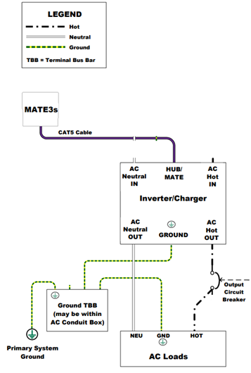
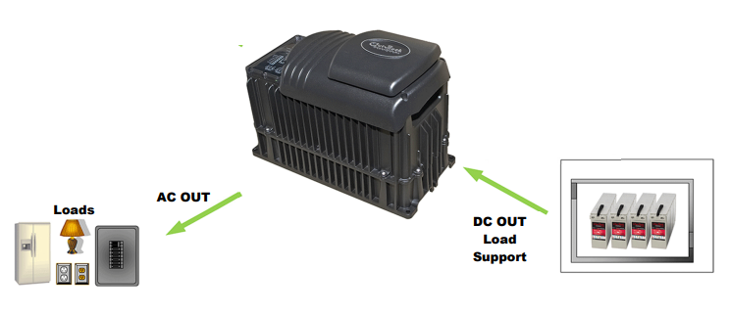
Stand Alone Labs
AC schematic wiring for FXR Inverter.
System overview.

Slide 9
Stand Alone Labs
The FXR Inverter has many operating modes compared to other inverters of this quality.
The Stand-Alone option that we will use in the labs is the “Generator” mode.
It allows for a generator to be used to charge the battery bank.
It allows AC power into it to act like a battery charger.
It sends out (inverts) AC 120V from the battery.

Slide 10
Stand Alone Labs
The labs will need the students to have the inverter mounted and wired before they can do the lab.
They will also need time to read the manuals and what parameters need to be set and to what values first.
The DC will be applied to the inverter before the AC is turned on.
With the DC on, the Mate3s can set the mode and parameters.

Slide 11
Stand Alone Labs
Once the DC power is on and the mate is powered up, the mate manual can be used to step through the process.
You are going to need to have time before the labs to be able to teach the students about the mate3.

Slide 12
Stand Alone Labs
The first lab is to get the students to wire up the inverter to the batteries.
There needs to be DC and AC breakers, a ground to the campus ground.
An AC panel or a power bar is an option to connect loads to the inverter.
The students will be able to torque the connections, the torque values are in the manual.
You will need a resistive load and an inductive load, small motor.

Slide 13
Stand Alone Labs
A big part of the learning using these pieces of equipment is knowing how parameters work.
Having them understand those parameters before the lab is important.
The complete list of the parameters are in table 25 of the operation manual.
Having the students select them for this lab is important.

Slide 14
Stand Alone Labs
Where there is only one inverter, having each student program at least one parameter is important.
Maybe divide the class into 4 groups to work on selecting the values for each parameter.
Then have them come together to explain their choices.
Make them draw up a list of the parameters that need to be set and have them in an order that they will perform sequentially.

Slide 15
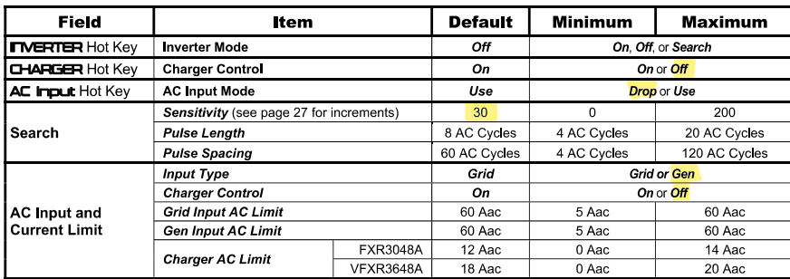
Stand Alone Labs
The Hot Key are turn off or on settings. Where there is no AC grid the charger function is turned off. (Yellow Highlighted is recommended)
AC input mode needs to be “Drop” turned off.
The Search feature is explained as the inverter turns off but checks to see if a load is present. If there is a load the inverter starts.

Slide 16
Stand Alone Labs
The Search options can be explored by the students, and they can decide on the settings.
Input type is not Grid, so only other option is Gen.
We are not using any AC source, so Charge Control is turned Off.

Slide 17
Stand Alone Labs
The Mode is set here by selecting Generator.
None of the other parameters are important as we are not connecting a generator to the inverter.

Slide 18
Stand Alone Labs
The X indicates that this is the default setting of 120Vac.
It can be adjusted within the range of 100 and 130. Might be a good exercise during the lab.
The other settings can be researched by the students and let them explain their choices for them.
The FULLRIVER manual suggests values based on DoD.

Slide 19
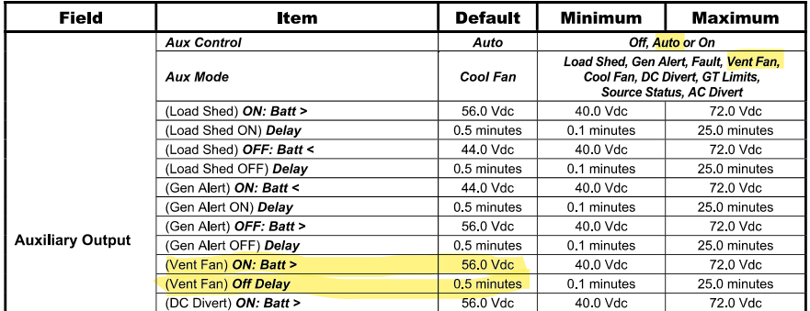
Stand Alone Labs
The Auxiliary relay output contact can be set and the Vent Fan option can be set to a value that the students can make it turn it on and off by adjusting the voltage range. A multimeter on ohms can test the state of the relay contacts. No fan is required for this.

Slide 20
Stand Alone Labs
Master Power Save Level appears on an inverter which is set as master (the default setting). The range of rank numbers is 0 to 10. The default value is 0. The master is normally left at this value.
The Master Power Save Level function is used for the master inverter on Port 1.
Slave Power Save Level appears on an inverter which is set as slave. The range of rank numbers is 1 to 10. (The default value for all ports is 1.

Slide 21
Stand Alone Labs
Master Power Save Level appears on an inverter which is set as master (the default setting). The range of rank numbers is 0 to 10. The default value is 0. The master is normally left at this value.

Slide 22
Stand Alone Labs
If the model begins with a V it is vented.

Slide 23
Stand Alone Labs
Before the students get ready to use the inverter, calculate the resistive load to have it fall into the C-20 rate.
The 105Ahr at 20 hours will have 5.3A being pulled from the battery.
There are 34 watts being used by the inverter.
34 Watts at 50volts = .7Amps
An AC load needs to draw 5.3 - .7A = 4.6A from the battery.

Slide 24
Stand Alone Labs
4.6A x 50Volts = 230W.
A 200Watt resistive load ( 2 100Watt incandescent light bulbs) or equivalent will work.
The batteries should drain at the C-20 Rate and the students should see this.
They need to measure the time the load is on the inverter.
The batteries will seem lower under this draw, but will be more accurate after they are removed from the load.

Slide 25
Stand Alone Labs
Once the students understand the parameters and have the table made with the settings they want to use.
They can turn on the inverter with the toggle switch mentioned in the lab writeup.
Once the inverter is on and inverting, the students can make current and voltage measurements at the battery.
They can also measure the AC voltage out and if the output needs to be calibrated, they can do that now.

Slide 26
Stand Alone Labs
The SoC of the battery bank can be calculated at this point.
Apply a resistive load and measure the same reading before the load was applied.
After 5 minutes take another measurement.
Continue to do so until the DoD can be calculated.
Are the batteries performing as expected?

Slide 27
Stand Alone Labs
Remove the resistive load and allow the batteries to level out.
The SoC of the battery bank can be calculated at this point.
Apply an inductive load to the inverter. Measure the VA and the battery reading of current and voltage. The battery Wattage should be less than the VA of the load.
The inverter is supplying the VARs required for the motor or inductive load.

Slide 28
Stand Alone Labs
After everyone is satisfied with the readings.
Remove the inductive load and allow the batteries to level out.
The SoC of the battery bank can be calculated at this point.
The students will have the inverter running load, various battery measurements.
They should be able to measure the SoC as the resistive load was operated.

Slide 29
Stand Alone Labs
Comparing the SoC and the rate of discharge the batteries experienced.
The students can compare against the C-Rates provided by the battery manufacturer.
The batteries under load will be lower than they actually are when the load is removed.

Slide 30
Stand Alone Labs
The second lab involves connecting the FLEXmax charge controller to charge the batteries.
The calculation for the string size has been completed in the Stand-Alone presentation.
The array will consist of the four 395Watt PV modules.
2 strings of two modules series.

Slide 31
Stand Alone Labs
A combiner box will be used, and the four trainers will be taken outside and connected in this configuration.
The charge controller shall be mounted next to the inverter and batteries.
The PV output circuit can use wires long enough to go from outside to inside to where the inverter and charge controller are located.
The last lab can stay connected as it was.

Slide 32
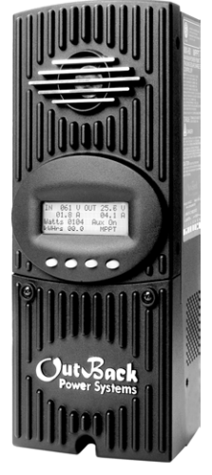
Stand Alone Labs
The FLEXmax 80 charge controller is rated for an input of 150Volts (140Volts working) from a PV array at 80 Amps.
Has the following features:
Supports 12, 24, 36, 48, and 60 Vdc battery voltages.
Backlit LCD display screen with 80 characters
(4 lines, 20 characters per line).
Last 128 days of operational data are
logged for review.
Voltage step-down capability allowing a
higher PV array voltage configuration.

Slide 33
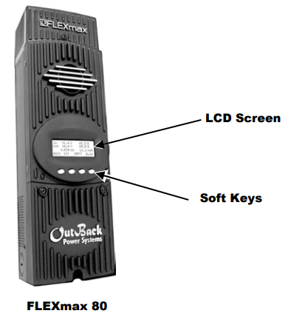
Stand Alone Labs
Built in screen, no need for the Mate3s.
Some soft keys will be used for navigation.
Some soft keys will be used
for programming.

Slide 34
Stand Alone Labs
Soft key functions are identified by text in the LCD screen directly above the key (e.g., EXIT).
In this manual, soft keys will be identified by brackets (for example, <EXIT>). Not every soft key may be used in some screens.

Slide 35
Stand Alone Labs
The FLEXmax is intended to be bonded to ground, like the inverter is.
DC / Battery-Related Installation Requirements
Shut off all DC circuit breakers before connecting any wiring.
Torque all the FLEXmax wire lugs and ground terminals to 4 Nm (35 in-lb).
Copper wiring must be rated at 75°C or higher.
Use up to 35 mm2 (2 AWG) to reduce losses and ensure highest performance of the FLEXmax.

Slide 36
Stand Alone Labs
Smaller cables can reduce performance and possibly damage the unit.
Run positive and negative cables side by side.
Keep cables together as much as possible to allow the inductive currents to cancel.
Ensure paired cables pass through the same knockout and conduit fittings.
DC battery overcurrent protection must be used as part of the installation. OutBack offers both circuit breakers and fuses for overcurrent protection.

Slide 37
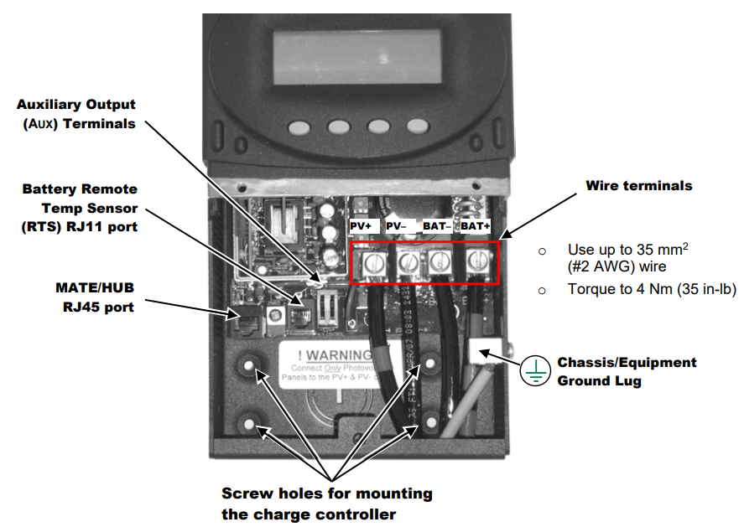
Stand Alone Labs
Wiring compartment of the FLEXmax.

Slide 38
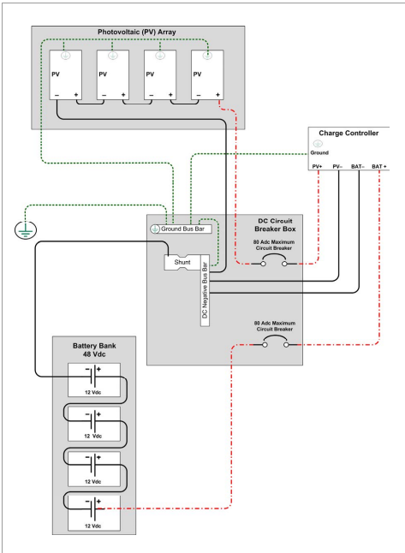
Stand Alone Labs
Wiring of the charge controller to battery
and PV including shunt if available.
The inverter is not shown here, but can
be connected as the arrows indicate.
Negative of inverter to negative bus.
Positive of inverter to breaker (same as
It was. A common connection at battery.

Slide 39
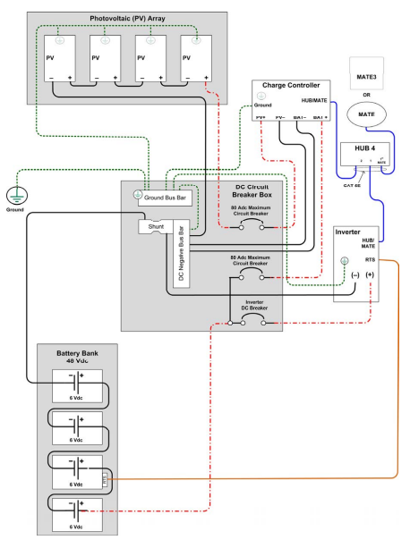
Stand Alone Labs
Wiring of the charge controller to battery
and PV including shunt if available.
Please note that the connection of the
PV array is not the same as used for
this lab.
A HUB 4 is required if the Mate3 is used
by both the inverter and charge controller.

Slide 40
Stand Alone Labs
Operation of this unit consists of monitoring screens and programming screens.
The majority of programming screens are accessed using the main menu.
The FLEXmax uses power from the battery bank to operate.
The battery voltage must be at least 10.5 volts or higher to power up the FLEXmax.
When battery power is detected, the FLEXmax will go through a series of power-up screens.

Slide 41
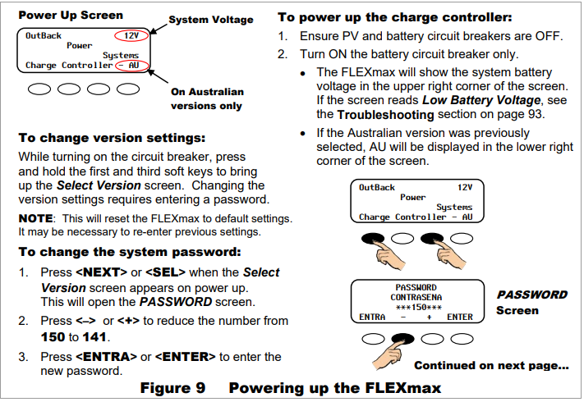
Stand Alone Labs
When the FLEXmax first powers up these instruction must be completed.
The digital manual is part of the course pack.

Slide 42
Stand Alone Labs
The FLEXmax uses three stage charging.
The bulk starts as soon as the sun powers up the PV array.
The MPPT should start and put as much into the battery as possible.
These are the 48volt settings from FULLRIVER.

Slide 43
Stand Alone Labs
The recommended bulk current is 20-25% of the 20 Hr AH
capacity or 0.20 x C20 (20 Hr. capacity in AH).
The maximum allowable bulk current is 35% of the 20 Hr. AH capacity or 0.35 x C20 (20Hr. capacity in AH), unless specified.
DC115-12 is rated at 105AH @ 20 Hrs.
The recommended bulk current is 0.20 x 105 = 21 Amps
The maximum bulk current is 0.35 x 105 = 36.8 Amps.

Slide 44
Stand Alone Labs
The array consists of four 395W modules.
With MPPT, the total wattage is 1580Watts.
Bulk amperage will depend on the voltage of the battery bank.
Worst case is the bank is at 42 Volts (0% SoC).
The available PV amperage is 1580W / 42V = 37.6A

Slide 45
Stand Alone Labs
This is very close to the maximum of 40A that the battery should be charged with.
This scenario can happen if the PV is turned on during the day and the charge controller goes into Bulk stage charging.
The charge controller should be programmed to limit the Bulk charge to a lower value.
The recommended bulk current is 21Amps.
This is a good exercise for the students to do.

Slide 46
Stand Alone Labs
If there is a load applied to the inverter, it will require amperage as well.
This extra amperage will take away from the bulk available current to charge the batteries.
If the load is known and repeated everyday, then the Bulk current can be increased.
The maximum available from the array is close to 40A.

Slide 47
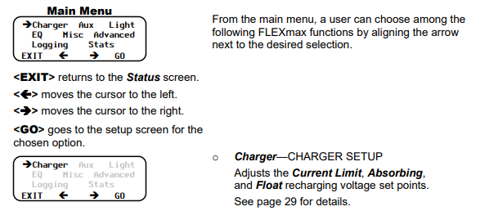
Stand Alone Labs
This is the Main Menu screen.

Slide 48
Stand Alone Labs
Charger Screen:
Charging settings should follow the battery manufacturer’s recommendations.
This screen allows changes to the recharging voltage set points if the default settings do not match the battery manufacturer's recommendations.

Slide 49
Stand Alone Labs
(For an explanation of battery charging, see pages 98 and 99).
Current Limit
Absorbing
Float
The default charger output current limit setting is:
80 amps for the FM80.
This setting is adjustable from 5 to 80 amps

Slide 50
Stand Alone Labs
Absorb Time Limits (Advanced Menu)
The amount of time the charge controller stays in the Absorbing stage of charging can be adjusted in the Absorb Time Limits screen.
An Absorbing charge stage normally ends when the battery voltage is maintained at the Absorbing set point for the time period set in the Absorb Time Limits screen.
Absorb Time is adjustable from 0 to 24 hours (consult the battery manufacturer’s recommendations). See upcoming slides for this calculation.

Slide 51
Stand Alone Labs
When the Absorb Time Limit is reached, the charge controller goes into Float stage and may briefly display Charged, then Float.
When the battery voltage drops below the Float voltage set point, the charge controller recharges to maintain this set point, employing the MPPT function in MPPT Float mode.

Slide 52
Stand Alone Labs
FULLRIVER suggests:
Absorption time varies per installation according to total bank size and total PV kW.
Our maximum absorption time is 4 hours; however, most installations need 2-3 hours on average.

Slide 53
Stand Alone Labs
To estimate your rough absorption time, use the following formula:
[(AH * DOD) / CHARGE AMPS * 0.85]
105 x .50 / 35 x .85 = 1.76 hours
If your charge controller offers a setting such as Absorb End Amps (Outback) or similar that automatically transfers to float charge based on amps accepted, absorption time should be set to 4 hours and this setting should be set to approximately 1.75% of total bank capacity in Ah.
1.75% of 105Ah = 1.84A

Slide 54
Stand Alone Labs
1.75% of 105Ah = 1.84A is End Amps.
Absorb End Amps (Advanced Menu)
While the battery voltage is at or above the Absorbing voltage target (see page 22) and the Absorb End Amps value is reached for a time delay of 15 seconds, the charge controller will switch to the Float stage.
This happens regardless of the charger time minutes as shown in the
Misc menu under ChgT (see page 47).
The charger timer will be reset to zero.

Slide 55
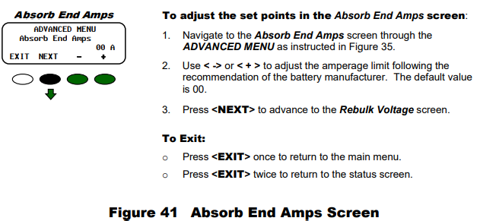
Stand Alone Labs
Setting the Absorb End Amps.

Slide 56
Stand Alone Labs
This should be the settings that will get the charge controller up and running.
The students need access to a paper copy of these manuals.
The students can make a table with the settings that need to be set and the values also recorded.

Slide 57
Stand Alone Labs
At this point, the lab is ready to begin.
The object of this lab is to make a complete stand-alone system and for the students to be able to trouble shoot and commission a system.
First is to power up the DC to the inverter and ensure it is operating correctly.
Measure the SoC of the battery bank.

Slide 58
Stand Alone Labs
Turn on the DC to the charge controller.
Ensure it is operating correctly by checking the screens showing battery voltage.
Turn on the PV disconnect to the charge controller.
Wait and watch for the charge controller find the MPPT range.
Verify that the charge controller goes into Bulk stage charging.

Slide 59
Stand Alone Labs
Record the PV and battery voltages and currents from the charge controller.
Compare with the handheld pyranometer that the MPPT is working.
This exercise has been completed in previous labs.
Measure the current draw by the inverter, is it approximately 34 Watts?
The battery bank voltage should be increasing.

Slide 60
Stand Alone Labs
Each battery should have the same voltage across their terminals.
If they are out more than 10%, check connections for voltage drop.
If there is no measurable voltage drop, a battery with lower voltage could be faulty.
If one battery is lower, wait until end of Bulk and remeasure.

Slide 61
Stand Alone Labs
Apply a load to the inverter and measure the currents from the PV, charge controller and the battery and inverter input.
The highest current should be from the charge controller to the batteries.
If it is not, then the batteries are not being charged.
The load is greater than what is being harvested from the PV modules.

Slide 62
Stand Alone Labs
This is a complete and functioning stand-alone system.
Students should write a procedure for how they would install and commission this or a system like this.
Referencing manual are part of the process.

Slide 63
Stand Alone Labs
AC and DC Wiring Diagram / Schematic.
Breaker AC
AC Out
Load Center
FXR 3048
48Vdc
AC Out
Outlet
Breaker DC
Neutral
Grnd
Grnd
System
Ground

Slide 64
Stand Alone Labs
PV, Charge Controller and Inverter Wiring Diagram / Schematic.
395W PV x 4
Combiner
Breaker AC
AC Out
Load Center
FXR 3048
Inverter
48Vdc
AC Out
Outlet
Breakers DC
FLEXmax 80
Charge Controller
Neutral
Grd
Grd
System
Ground

