Slide 1
Design and Implementation of Pilot of a TVET Renewable Energy Course
DELIVERABLE #5 - TRAINING COURSES & PROFESSIONAL DEVELOPMENT

Slide 2
Synchronizing
This module will introduce the concept of synchronizing of AC power producing equipment.
After this module learners will be able to:
Describe the process of synchronizing of power sources to the grid.
Describe the basic differences between synchronous and induction generators.
Calculate the frequency of generators and their speed.

Slide 3
Synchronizing
After this module learners will be able to:
Describe the operation of a synchroscope.
Describe the operation of the three light bulb method of synchronizing of generators.
Describe the phase and speed relationship to synchronizing power sources.

Slide 4
Synchronizing
AC power producing equipment can be defined as:
Generator / Alternator
Inverter

Slide 5
Synchronizing
Many times, we hear folks talking about a machine that takes a rotating force to produce electricity.
Often, they call it a generator…..or an alternator.
In modern vehicles we use the term alternator to describe the device that produces DC from the rotating engine.

Slide 6
Synchronizing
An Alternator as the name implies make alternating voltage (AC).
Your modern vehicle has an alternator.
It makes 3-phase power and has a rectification circuit that changes the AC into DC.

Slide 7
Synchronizing
A generator can make AC or DC
Vehicles made pre 1960s had a generator to charge the battery.
They had a commutator and brushes that required maintenance.

Slide 8
Synchronizing
Questions?

Slide 9
Synchronizing
Generators that produce 3-phase power are the most common machine used today.
They have rotating magnets and a stationary set of windings.
The induced voltage depends on the magnetic field's strength, speed of the magnets and the length and number of turns of the wire in the magnetic field.

Slide 10
Synchronizing
The minimum number of magnets the generator can have is two.
A north pole and a south pole.
The speed at which these spin will dictate the frequency of the generated voltage.

Slide 11
Synchronizing
The frequency in Belize is 60hz.
The generator frequency is equal to the speed of the generator in revolutions per minute times the number of magnetic poles then divided by 120
For example, if a generator has just 1 north and 1 south pole rotating in the stator and does so at a speed of 3600rpm
The frequency is 60hz

Slide 12
Synchronizing
Frequency f = (rpm x number of poles)/120
The 120 comes from 2 x 60
The 2 represents the pairs of poles because there needs to be a south pole for every north pole.
The 60 represents the rpm in seconds.

Slide 13
Synchronizing
Generators that produce 50hz voltage will spin slower than the 60hz ones.
Rearranging the formula to get speed:
Rpm = (120 x f)/poles
3000rpm = 120x50/2

Slide 14
Synchronizing
Questions?

Slide 15
Synchronizing
This formula only works for synchronous generators.
There are 2 basic types of generators:
Synchronous
Induction

Slide 16
Synchronizing
Synchronous generators have a separate system to create the magnetic field that spins on the rotor.
This system is named separate DC excitation.
When connected to a grid this type of generator will stay in sync with the grid and keep its speed / frequency locked to the grid.
This is the most popular type of generator for utilities.

Slide 17
Synchronizing
Induction generators rely on the magnetic field in the stator to create the magnetism in the rotor.
When connected to a grid this type of generator will have a slip frequency.
When it is suppling power to the grid it will spin slightly faster.
This is popular for small scale generators.

Slide 18
Synchronizing
Questions?

Slide 19
Synchronizing
All power generating devices that connect to the utility grid or another power generating device, must be able to synchronize their voltage to that of the source supply.
Synchronizing involves the incoming power source to match that of the running source (grid).
Incoming is the source connecting to an already running unit or grid.

Slide 20
Synchronizing
An incoming unit if a generator type will physically come up to almost the running frequency.
The voltage will then be established and adjusted to that of the running source.
Then the speed will be adjusted to align with that of the running source.

Slide 21
Synchronizing
If this process is done manually there will be a means of seeing the relationship between the incoming and the running voltages.
One method is using a synchroscope.
It is a spinning dial that indicates the frequency difference between the two sources.

Slide 22
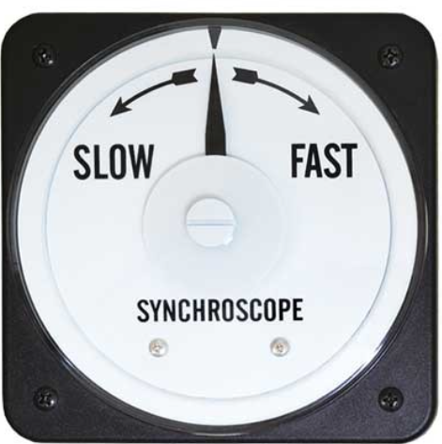
Synchronizing
The direction of spin indicates weather the incoming unit is spinning fast or slow.
If the needle stops the
incoming and the running
are at the same frequency.
The needle when stopped
also indicates the phase
angle between the two.
Image courtesy Author

Slide 23
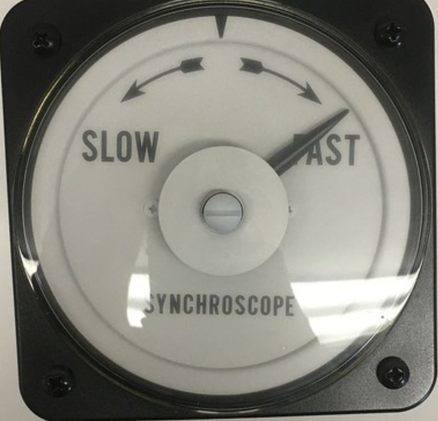
Synchronizing
In this picture the needle is stopped.
This means the two are at same speed.
The needle is stopped on the
right or fast side, this indicates
the incoming voltage is not in
phase and ahead of the
running source.
Image courtesy Author

Slide 24
Synchronizing
The angle of the needle represents the angular distance between the two units.
0 degrees
This picture indicates that the
voltage of the incoming is
approximately 50-60 degrees
ahead. -90 +90
180 degrees out
Image courtesy Author

Slide 25
Synchronizing
If the incoming connected to the running at this point, there would be a large inrush of current between the two sources and could trip any overcurrent protection.
The incoming unit would also
abruptly change its rotor to
match that of the running.
This can be felt and heard.
Image courtesy Author

Slide 26
Synchronizing
Questions?

Slide 27
Synchronizing
Another manual indication used to synchronize is three light bulbs.
Each are connected to a voltage representing the same phase between the incoming and running phase.
A to A, B to B, and C to C.
The voltage between each phase (incoming and running) will light up the bulb.

Slide 28
Synchronizing
If a bulb is bright, it means that the incoming and running voltages are not the same.
Either because of being out of sync or just a difference in voltage between them.
The time to synchronize the two is when all three bulbs are out.
During the starting of the incoming unit, the lights will go bright and dim as the units get closer to being in sync.

Slide 29
Synchronizing
The rate at which the bulbs go bright and dark is relative to the frequency difference between them.
Closing the breaker when the lights go out and the time interval between bight and dark is around 3-5 seconds is safe.
If the bulbs do not all go bright and dark at same time it indicates the phase is wrong or the unit is turning in the wrong direction.

Slide 30
Synchronizing
Questions?

Slide 31
Synchronizing
As we know all incoming power devices need to be able to synchronize.
Which involves the incoming power source to match that of the running source (grid).
Match means:
Same voltage level (RMS and peak)
In same phase sequence if multiphase unit
In phase with running voltage

Slide 32
Synchronizing
Same voltage level means that the incoming power source voltage (RMS or peak) is within the specified tolerance of the grid. Normally less than 10% difference.
Synchronizing at a higher or lower voltage produces reactive energy.
Which will either try to raise or lower the running voltage.

Slide 33
Synchronizing
In same phase sequence if multiphase (Poly) unit.
Three phase systems have an A-B-C sequence.
Meaning that the A phase is referenced to a zero-degree reference.
The B phase is 120 electrical degrees lagging the A phase.
The C phase is 120 electrical degrees ahead of the A phase.

Slide 34
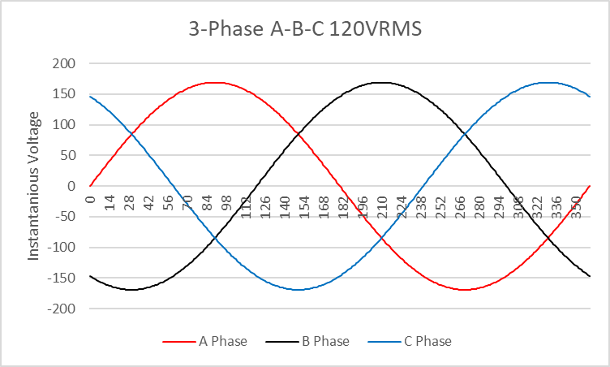
Synchronizing
In same phase sequence if multiphase (Poly) unit.
All three phases (A,B,C) must be in this sequence.
Image courtesy Author

Slide 35
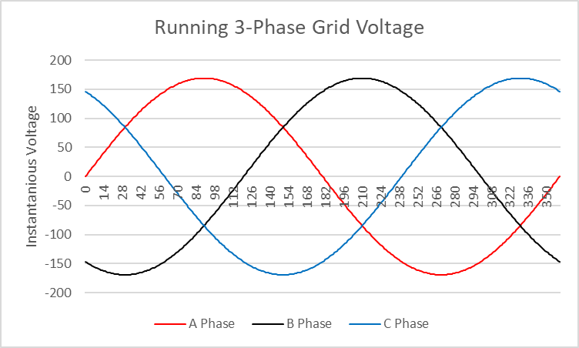
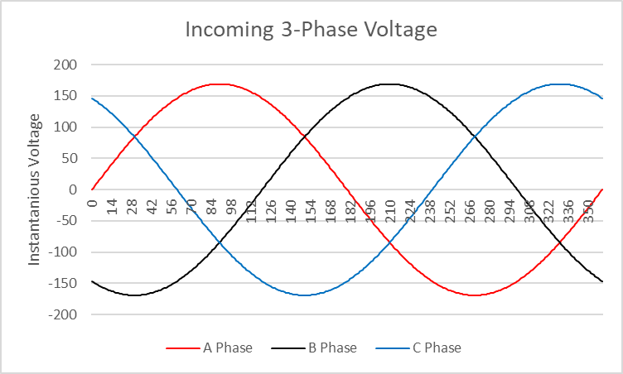
Synchronizing
Running Grid and Incoming power same sequence.
Image courtesy Author

Slide 36
Synchronizing
In-phase at same instant. Both at same angle.
.
Image courtesy Author

Slide 37
Synchronizing
Inverters that are grid interactive can also be used as a power producing device.
They must meet the same conditions as generators to sync to the running source.
The inverters can be single phase units.
3-phase unit.
Or 3 single phase units communicating with each other.

Slide 38
Synchronizing
Questions?

